Slide 1
EP
EDEXCEL IAL MATHS
P4.8 Vectors in two and three dimensions
The full notes page in 12 sections · practice questions with answers · simulations
ExaminerPrep is an independent tutoring service. It has been developed independently from and is not endorsed by the International Baccalaureate Organization. "International Baccalaureate", "IB" and "IB Diploma Programme" are registered trademarks of the IBO, used here for descriptive purposes only.
Pearson Edexcel and Cambridge are trademarks of their owners; ExaminerPrep is not affiliated with any exam board.
Notes:
P4.8 Vectors in two and three dimensions. Notes for this topic: https://examinerprep.com/notes/edexcel-ial-maths/vectors-in-two-and-three-dimensions/

Slide 2
What this page covers
Overview
Vectors in two and three dimensions in i,j,k and column form; magnitude and unit vectors
Adding vectors, multiplying by scalars, parallel vectors and collinear points
Position vectors, AB⃗=b-a, dividing a line segment in a ratio, and the distance between two points
The vector equation of a line, r=a+td, and testing whether a point lies on it
Parallel, intersecting and skew lines, and the point of intersection
The scalar product: angles between vectors and between lines, perpendicular vectors
The foot of the perpendicular from a point to a line, the shortest distance to a line, and areas of triangles
Notes:
What this page covers. Full notes: https://examinerprep.com/notes/edexcel-ial-maths/vectors-in-two-and-three-dimensions/

Slide 3
In one minute
Key points
1. Almost every vector question reduces to three moves: subtract position vectors to get a direction, set components equal to find where things meet, and use the scalar product to test for right angles and find angles.
2. Magnitude: |xi+yj+zk|=√(x²+y²+z²). A unit vector is the vector divided by its magnitude.
3. Position vectors: AB⃗=b-a; the distance AB=|b-a|. Parallel vectors are scalar multiples of each other.
4. Line: r=a+td, through the point with position vector a in the direction d. Through A and B: use d=b-a.
5. Two lines: parallel if the directions are multiples; otherwise solve two component equations for the two parameters and test the third: it works, they intersect; it fails, they are skew.
6. Scalar product: a·b=a₁b₁+a₂b₂+a₃b₃=|a||b|cos θ. Perpendicular ⇔a·b=0. Foot of the perpendicular: PF⃗·d=0.
Notes:
In one minute. Full notes: https://examinerprep.com/notes/edexcel-ial-maths/vectors-in-two-and-three-dimensions/

Slide 4
How do you describe a vector and find its magnitude?
Section 1 of 12
A vector has a size (magnitude) and a direction. In three dimensions we use three perpendicular unit vectors: i along the x-axis, j along the y-axis and k along the z-axis. The same vector can be written in either of two forms: 2i+3j+6k=(2, 3, 6). In two dimensions there is no k: 5i-12j=(5, -12).
The magnitude comes from Pythagoras, used twice in 3D: once across the floor, once up the vertical edge. A unit vector has magnitude 1; the unit vector in the direction of a is â=a/|a|, and a vector of magnitude k in the direction of a is kâ. In 2D the direction can also be given as an angle: 5i-12j makes tan⁻¹(12/5)=67.4° with i, measured below it.
|xi+yj+zk|=√(x²+y²+z²) â=a/|a|
Not in the formulae booklet: learn them.
Notes:
How do you describe a vector and find its magnitude?. Full notes: https://examinerprep.com/notes/edexcel-ial-maths/vectors-in-two-and-three-dimensions/

Slide 5
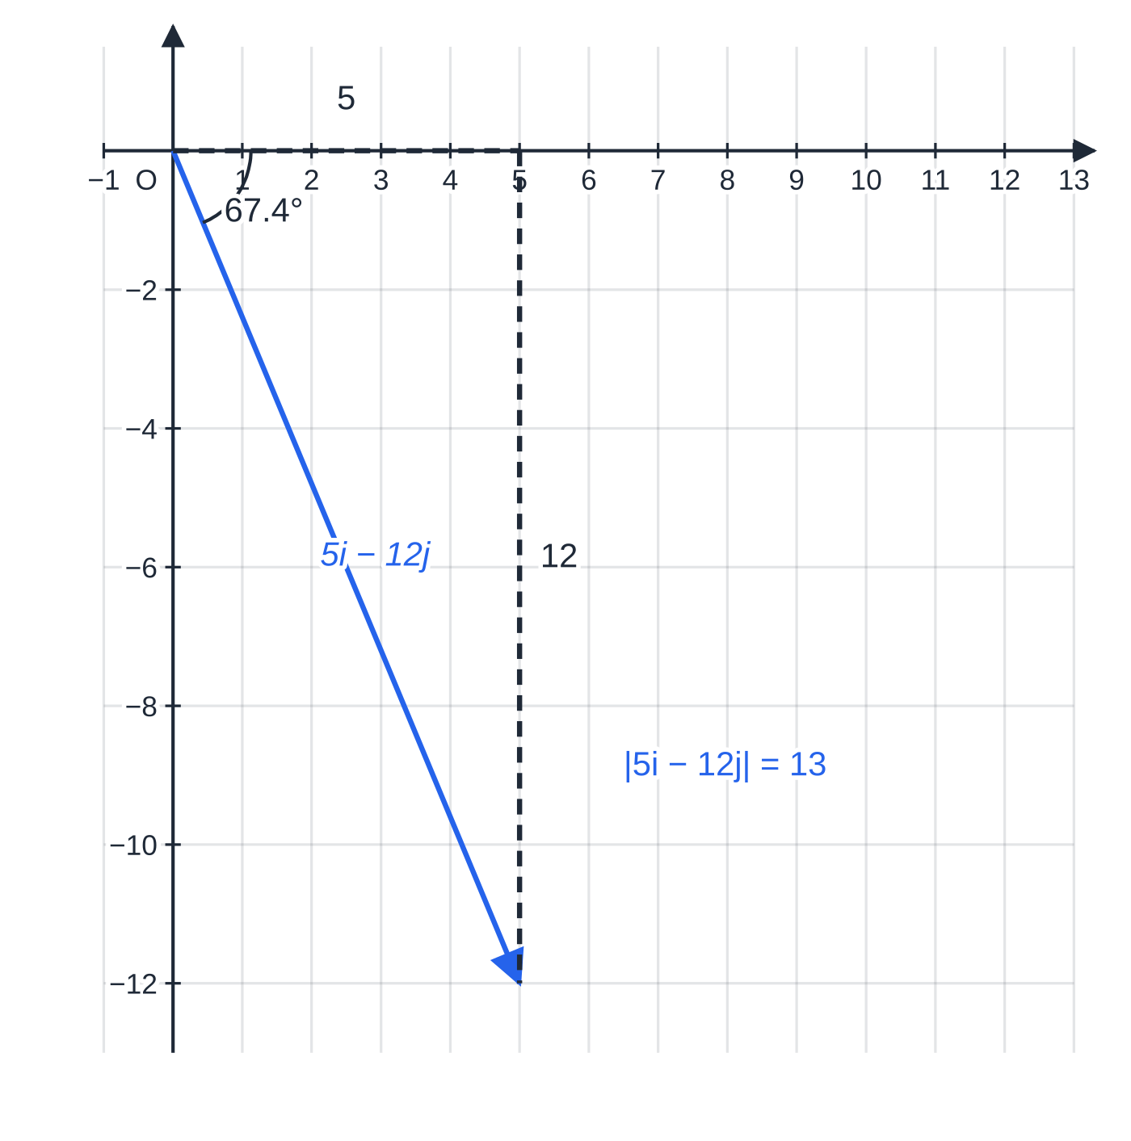
How do you describe a vector and find its magnitude? (continued)
Section 1 of 12
In two dimensions: 5i-12j has magnitude √(25+144)=13 and makes tan⁻¹(12/5)=67.4° with i, below it.
Notes:
How do you describe a vector and find its magnitude?. Full notes: https://examinerprep.com/notes/edexcel-ial-maths/vectors-in-two-and-three-dimensions/

Slide 6
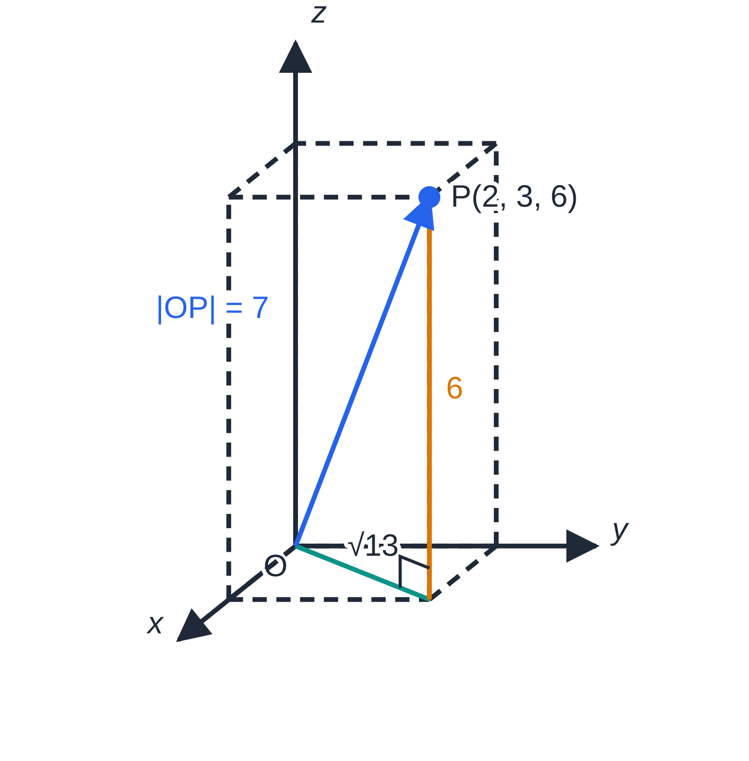
How do you describe a vector and find its magnitude? (continued)
Section 1 of 12
Worked example 1 in 3D: the floor diagonal from O to (2,3,0) has length √(2²+3²)=√13; the vertical edge is 6, so |OP⃗|²=13+36=49.
Notes:
How do you describe a vector and find its magnitude?. Full notes: https://examinerprep.com/notes/edexcel-ial-maths/vectors-in-two-and-three-dimensions/

Slide 7
How do you describe a vector and find its magnitude? (continued)
Section 1 of 12 · Worked example 1 · Easy · Find
WORKED EXAMPLE · QUESTION
The point P has coordinates (2,3,6) and O is the origin. (a) Find |OP⃗|. (b) Find a unit vector in the direction of OP⃗. (c) Find the vector of magnitude 21 in the same direction as OP⃗. (d) Given that |pi+4j-4k|=9, find the possible values of the constant p.
SOLUTION
(a) |OP⃗|=√(2²+3²+6²)=√49= 7.
(b) Divide by the magnitude: (1/7)(2i+3j+6k) (check: (4+9+36)/49=1 ✓).
(c) 21× the unit vector =3OP⃗= 6i+9j+18k.
(d) Square both sides: p²+16+16=81⇒p²=49⇒ p=7 or p=-7.
Notes:
How do you describe a vector and find its magnitude?: Worked example 1. Full notes: https://examinerprep.com/notes/edexcel-ial-maths/vectors-in-two-and-three-dimensions/

Slide 8
How do you describe a vector and find its magnitude? (continued)
Section 1 of 12
Common error
Squaring a negative component as a negative: |3i-4j|=√(9-16) is wrong. Every component is squared, so the magnitude is √(9+16)=5. Use brackets on the calculator: (-4)².
Notes:
How do you describe a vector and find its magnitude?. Full notes: https://examinerprep.com/notes/edexcel-ial-maths/vectors-in-two-and-three-dimensions/

Slide 9
How do position vectors give directions, distances and ratios?
Section 2 of 12
The position vector of a point A is OA⃗=a, the vector from the origin to A; its components are the coordinates of A. To go from A to B, go back to O and out to B: AB⃗=-a+b=b-a ("end minus start"). The distance between the points is AB=|b-a|=√((x₂-x₁)²+(y₂-y₁)²+(z₂-z₁)²); for example, (1,2,-2) to (4,6,10) is √(9+16+144)=13.
Vectors are added and multiplied by scalars component by component. Parallel vectors are scalar multiples: 6i-3j and -2i+j are parallel (-3 times). Points A, B, C are collinear if AC⃗ is a multiple of AB⃗; the shared point A rules out two separate parallel lines. The point P on AB with AP:PB=λ:μ has OP⃗=a+λ/(λ+μ)(b-a); the midpoint is ½(a+b).
Notes:
How do position vectors give directions, distances and ratios?. Full notes: https://examinerprep.com/notes/edexcel-ial-maths/vectors-in-two-and-three-dimensions/

Slide 10
How do position vectors give directions, distances and ratios? (continued)
Section 2 of 12 · Worked example 2 · Medium · Find / Show that
WORKED EXAMPLE · QUESTION
Relative to a fixed origin O, the points A and B have position vectors i+4j and 7i+j respectively. (a) Find AB⃗ and the exact distance AB. (b) The point P lies on AB with AP:PB=2:1. Find the position vector of P. (c) The point C has position vector 9i. Show that A, B and C are collinear and find the ratio AB:BC. (d) Find the angle between AB⃗ and i.
SOLUTION
(a) End minus start: AB⃗=(7i+j)-(i+4j)= 6i-3j, and AB=√(36+9)=√45= 3√5.
(b) Two thirds of the way from A: OP⃗=(i+4j)+⅔(6i-3j)= 5i+2j.
(c) BC⃗=9i-(7i+j)=2i-j, and AB⃗=3(2i-j)=3BC⃗. AB⃗ and BC⃗ are parallel and share the point B, so A, B, C are collinear, with AB:BC=3:1.
(d) Right-angled triangle with sides 6 and 3: tan⁻¹(3/6)= 26.6°, measured below i.
Notes:
How do position vectors give directions, distances and ratios?: Worked example 2. Full notes: https://examinerprep.com/notes/edexcel-ial-maths/vectors-in-two-and-three-dimensions/

Slide 11
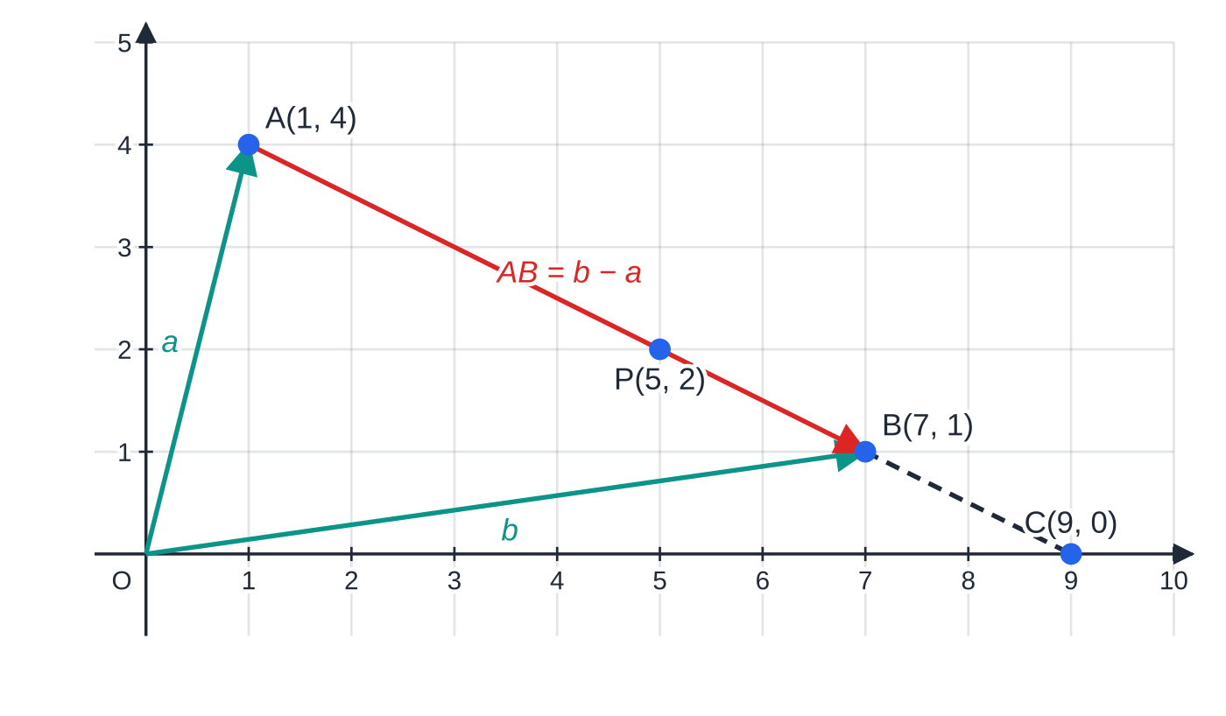
How do position vectors give directions, distances and ratios? (continued)
Section 2 of 12
Exam tip
For collinearity, write the multiple explicitly (AB⃗=3BC⃗) and name the common point. "The vectors are parallel" on its own only shows that the lines are parallel.
Worked example 2: going from A to B is -a then +b, so AB⃗=b-a. P is two thirds of the way along, and C lies on the same line further on, with AB=3BC.
Notes:
How do position vectors give directions, distances and ratios?. Full notes: https://examinerprep.com/notes/edexcel-ial-maths/vectors-in-two-and-three-dimensions/

Slide 12
What is the vector equation of a line?
Section 3 of 12
Start at a known point on the line (position vector a) and move any multiple of a direction vector d. Every point on the line has position vector
r=a+td
a: position vector of a point on the line; d: a direction vector; t: a scalar parameter (any real number). Through two points A and B: r=a+t(b-a). Not in the formulae booklet: learn it.
The equation is not unique: any point on the line can replace a, and any non-zero multiple of d is still a direction vector. To test whether a point is on the line, set a+td equal to its position vector, find t from one component, then check that the same t works in the other two. Each value of t gives one point; if |d|=3, consecutive integer values of t are 3 units apart. Where the line crosses a coordinate plane, one component is zero: z=0 on the xy-plane.
Notes:
What is the vector equation of a line?. Full notes: https://examinerprep.com/notes/edexcel-ial-maths/vectors-in-two-and-three-dimensions/

Slide 13
What is the vector equation of a line? (continued)
Section 3 of 12 · Worked example 3 · Medium · Find / Show that
WORKED EXAMPLE · QUESTION
The points A and B have coordinates (4,1,5) and (3,3,3). The line l passes through A and B. (a) Find a vector equation of l. (b) Show that the point C(2,5,1) lies on l, and find the distance AC. (c) Determine whether the point D(5,-1,6) lies on l. (d) Find the coordinates of the point where l meets the xy-plane.
SOLUTION
(a) Direction =AB⃗=(3-4)i+(3-1)j+(3-5)k=-i+2j-2k. So r=(4i+j+5k)+t(-i+2j-2k).
(b) x: 4-t=2⇒t=2. y: 1+2(2)=5 ✓. z: 5-2(2)=1 ✓. So C lies on l. AC=|2d|=2×√(1+4+4)= 6.
(c) x: 4-t=5⇒t=-1. y: 1-2=-1 ✓. z: 5+2=7≠6. So D is not on l.
(d) On the xy-plane z=0: 5-2t=0⇒t=(5/2), giving (1.5,6,0).
Notes:
What is the vector equation of a line?: Worked example 3. Full notes: https://examinerprep.com/notes/edexcel-ial-maths/vectors-in-two-and-three-dimensions/

Slide 14
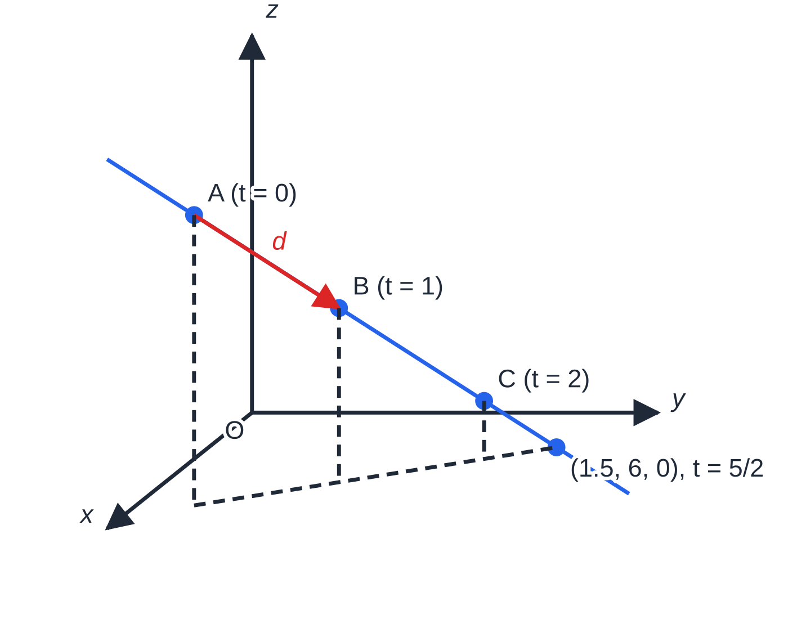
What is the vector equation of a line? (continued)
Section 3 of 12
Common error
Using the position vector of B as the direction: r=a+tb is a line through A parallel to OB⃗, not the line AB. The direction is always a difference of two position vectors.
Worked example 3: starting from A (t=0), each step of the direction vector d moves |d|=3 units along the line; the line reaches the xy-plane at t=(5/2). Dashed verticals drop each point to the xy-plane.
Notes:
What is the vector equation of a line?. Full notes: https://examinerprep.com/notes/edexcel-ial-maths/vectors-in-two-and-three-dimensions/

Slide 15
Are two lines parallel, intersecting or skew?
Section 4 of 12
Test | Result | Conclusion
Are the direction vectors multiples of each other? | yes, and a point of one line lies on the other | the same line
 | yes, but no shared point | parallel (distinct)
If not parallel: equate components, solve two equations for λ and μ | the third equation is satisfied | intersecting: substitute λ (or μ) for the point
 | the third equation fails | skew: not parallel and never meet
Use different parameters for the two lines (λ and μ): the lines meet when the same point is reached, not at the same parameter value. Skew lines exist only in three dimensions; in a plane, two non-parallel lines always meet. After finding a point of intersection, substitute μ into the second line as a check: both lines must give the same coordinates.
Notes:
Are two lines parallel, intersecting or skew?. Full notes: https://examinerprep.com/notes/edexcel-ial-maths/vectors-in-two-and-three-dimensions/

Slide 16
Are two lines parallel, intersecting or skew? (continued)
Section 4 of 12 · Worked example 4 · Hard · Show that
WORKED EXAMPLE · QUESTION
The lines l₁, l₂, l₃ and l₄ have equations l₁: r=(i+2j-k)+λ(2i-j+3k), l₂: r=(2i+6j+2k)+μ(i-2j+k), l₃: r=(j+2k)+s(4i-2j+6k), l₄: r=(3i+j)+v(i+j+k). (a) Show that l₁ and l₂ intersect, and find the coordinates of their point of intersection. (b) Show that l₁ and l₃ are parallel but are not the same line. (c) Show that l₂ and l₄ are skew.
SOLUTION
(a) Equate components. i: 1+2λ=2+μ. j: 2-λ=6-2μ. k: -1+3λ=2+μ. From i: μ=2λ-1. Into j: 2-λ=6-4λ+2⇒3λ=6⇒λ=2, μ=3. Check k: -1+3(2)=5 and 2+3=5 ✓, so the lines intersect at (5,0,5).
(b) 4i-2j+6k=2(2i-j+3k), so l₃∥l₁. Is (0,1,2) on l₁? x: 1+2λ=0⇒λ=-½; then y=2+½=2.5≠1. So the lines are parallel but distinct.
(c) Not parallel (i+j+k is not a multiple of i-2j+k). Equate components. i: 2+μ=3+v. j: 6-2μ=1+v. Subtracting: 3μ-4=2, so μ=2, v=1. k: 2+μ=4 but v=1; 4≠1, so the lines do not meet.
Notes:
Are two lines parallel, intersecting or skew?: Worked example 4. Full notes: https://examinerprep.com/notes/edexcel-ial-maths/vectors-in-two-and-three-dimensions/

Slide 17
Are two lines parallel, intersecting or skew? (continued)
Section 4 of 12 · Worked example 4 · Hard · Show that (continued)
Not parallel and not meeting: skew.
Notes:
Are two lines parallel, intersecting or skew?: Worked example 4. Full notes: https://examinerprep.com/notes/edexcel-ial-maths/vectors-in-two-and-three-dimensions/

Slide 18
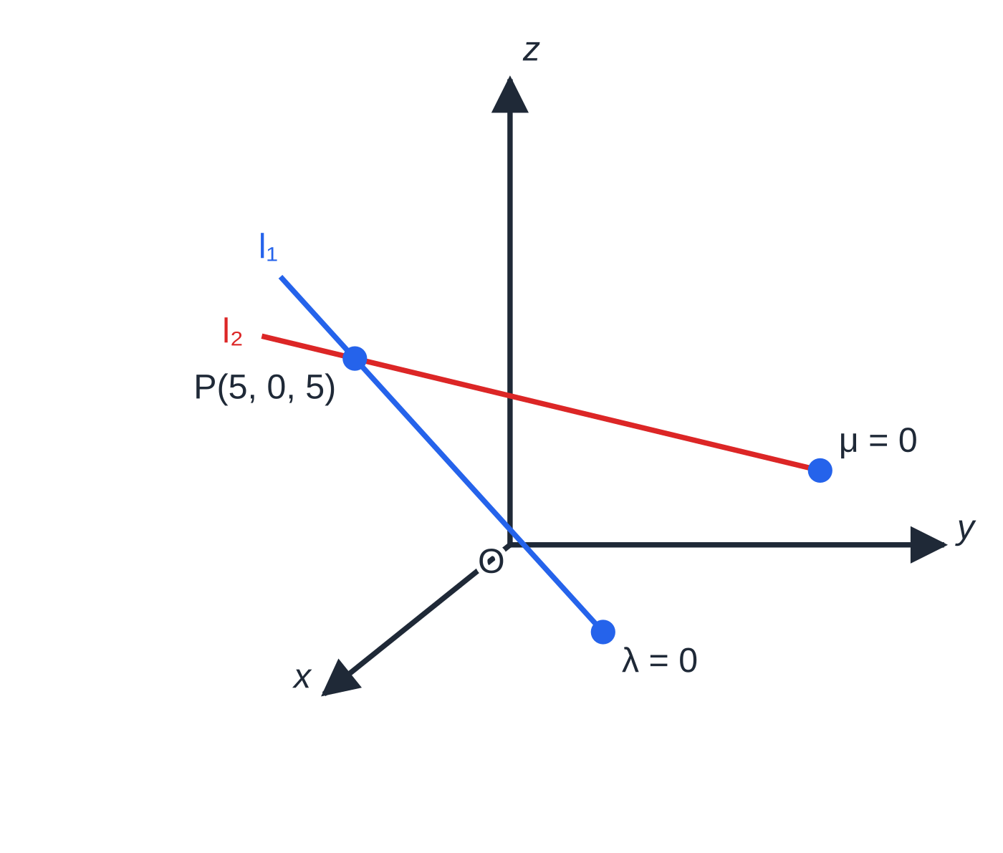
Are two lines parallel, intersecting or skew? (continued)
Section 4 of 12
Exam tip
A conclusion about skew lines needs both halves in writing: "the direction vectors are not parallel" and "the third equation is not satisfied, so the lines do not intersect". Either half alone is incomplete.
Worked example 4(a): the lines l₁ and l₂ meet at P(5,0,5), reached at λ=2 on one line and μ=3 on the other. The parameters differ; the point is the same.
Notes:
Are two lines parallel, intersecting or skew?. Full notes: https://examinerprep.com/notes/edexcel-ial-maths/vectors-in-two-and-three-dimensions/

Slide 19
What is the scalar product, and how does it give angles?
Section 5 of 12
The scalar (dot) product.
a·b=a₁b₁+a₂b₂+a₃b₃=|a||b|cos θ
θ is the angle between a and b when both point away from (or both towards) the same point, 0°≤θ≤180°; cos θ=(a·b)/|a||b|. The result is a number (a scalar), not a vector. Not in the formulae booklet: learn it.
For non-zero vectors, perpendicular means a·b=0 (cos 90°=0), the 3D version of m₁m₂=-1. Also a·a=|a|²; i·i=j·j=k·k=1 and i·j=j·k=k·i=0.
For the angle between two lines, use their direction vectors only. If the scalar product is negative, θ is obtuse and the acute angle between the lines is 180°-θ. For the angle at a vertex of a triangle, ∠BAC, use AB⃗ and AC⃗, both starting at A; using BA⃗ with AC⃗ gives 180°-∠BAC.
Notes:
What is the scalar product, and how does it give angles?. Full notes: https://examinerprep.com/notes/edexcel-ial-maths/vectors-in-two-and-three-dimensions/

Slide 20
What is the scalar product, and how does it give angles? (continued)
Section 5 of 12
Finally, |b|cos θ is the length of the projection of b onto the direction of a, the idea behind the foot of a perpendicular in the next section.
Notes:
What is the scalar product, and how does it give angles?. Full notes: https://examinerprep.com/notes/edexcel-ial-maths/vectors-in-two-and-three-dimensions/

Slide 21
What is the scalar product, and how does it give angles? (continued)
Section 5 of 12 · Worked example 5 · Medium · Find
WORKED EXAMPLE · QUESTION
(a) Find the angle between the vectors 6i+2j and 2i+4j. (b) Find the value of the constant p for which pi+2j-k and 3i+pj+4k are perpendicular. (c) Find the acute angle between the lines l₁ and l₂ of worked example 4. (d) Find the acute angle between two lines with direction vectors i+2j-2k and 3i+4k.
SOLUTION
(a) 12+8=20; √40×√20=√800=20√2. So cos θ=1/√2 and θ=45°.
(b) Perpendicular ⇔ scalar product zero: 3p+2p-4=0⇒ p=(4/5).
(c) Use the directions 2i-j+3k and i-2j+k: 2+2+3=7; √14×√6=√84. cos θ=7/√84=0.7638, so θ=40.2°.
(d) 3+0-8=-5; |i+2j-2k|=3, |3i+4k|=5. cos θ=-⅓⇒θ=109.5°. Acute angle between the lines =180°-109.5°= 70.5°.
Notes:
What is the scalar product, and how does it give angles?: Worked example 5. Full notes: https://examinerprep.com/notes/edexcel-ial-maths/vectors-in-two-and-three-dimensions/

Slide 22
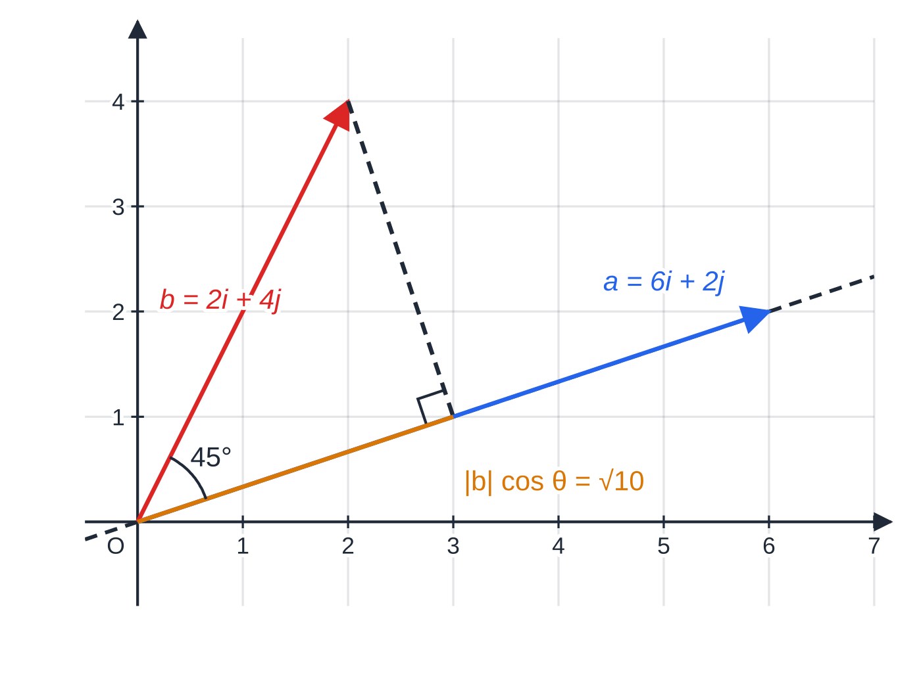
What is the scalar product, and how does it give angles? (continued)
Section 5 of 12
Worked example 5(a): a·b=20 and |a||b|=20√2, so θ=45°. The amber segment, |b|cos θ=√10≈3.16, is the projection of b on the line of a.
Notes:
What is the scalar product, and how does it give angles?. Full notes: https://examinerprep.com/notes/edexcel-ial-maths/vectors-in-two-and-three-dimensions/

Slide 23
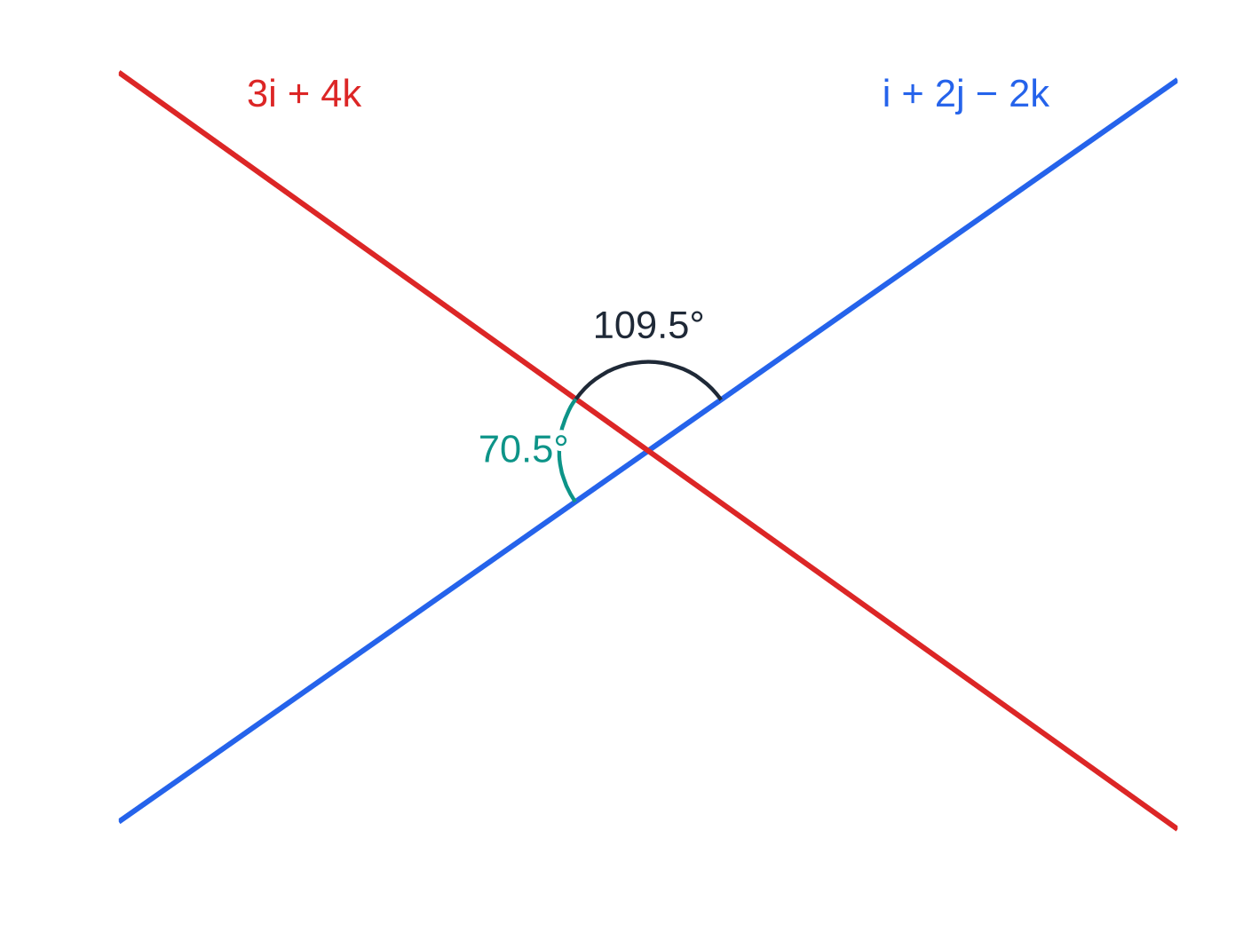
What is the scalar product, and how does it give angles? (continued)
Section 5 of 12
Common error
Using the position vectors of points on the lines (such as i+2j-k) instead of the direction vectors when finding the angle between two lines. The angle depends only on the directions.
Worked example 5(d), drawn in the plane of the two lines: the scalar product gives the obtuse angle 109.5°, but two crossing lines make a pair of angles adding to 180°, and the angle between the lines is the acute one, 70.5°.
Notes:
What is the scalar product, and how does it give angles?. Full notes: https://examinerprep.com/notes/edexcel-ial-maths/vectors-in-two-and-three-dimensions/

Slide 24
How do you find the foot of the perpendicular from a point to a line?
Section 6 of 12
The foot F is the point on the line nearest to P; there, PF⃗ is perpendicular to the line. Method: (1) write the general point of the line, F=a+td, in components; (2) form PF⃗=OF⃗-OP⃗ in terms of t; (3) solve PF⃗·d=0 for t; (4) substitute back for F. The shortest distance from P to the line is |PF⃗|. The image (reflection) of P in the line is P′, with F as the midpoint of PP′: OP′⃗=2OF⃗-OP⃗.
Notes:
How do you find the foot of the perpendicular from a point to a line?. Full notes: https://examinerprep.com/notes/edexcel-ial-maths/vectors-in-two-and-three-dimensions/

Slide 25
How do you find the foot of the perpendicular from a point to a line? (continued)
Section 6 of 12 · Worked example 6 · Hard · Find
WORKED EXAMPLE · QUESTION
The line l has equation r=(2i+j-k)+t(i+2j+2k). The point P has coordinates (0,9,1). (a) Find the coordinates of the foot of the perpendicular from P to l. (b) Find the shortest distance from P to l. (c) Find the coordinates of the image of P in the line l.
SOLUTION
(a) General point F=(2+t,1+2t,-1+2t), so PF⃗=(2+t)i+(-8+2t)j+(-2+2t)k. Perpendicular to i+2j+2k: (2+t)+2(-8+2t)+2(-2+2t)=9t-18=0⇒t=2, so F(4,5,3).
(b) PF⃗=4i-4j+2k, so |PF⃗|=√(16+16+4)= 6.
(c) F is the midpoint of PP′: OP′⃗=2(4,5,3)-(0,9,1), so P′(8,1,5).
Check with Pythagoras: the point (2,1,-1) on l is √72 from P and 2×3=6 from F along the line; 6²+6²=72 ✓.
Notes:
How do you find the foot of the perpendicular from a point to a line?: Worked example 6. Full notes: https://examinerprep.com/notes/edexcel-ial-maths/vectors-in-two-and-three-dimensions/

Slide 26
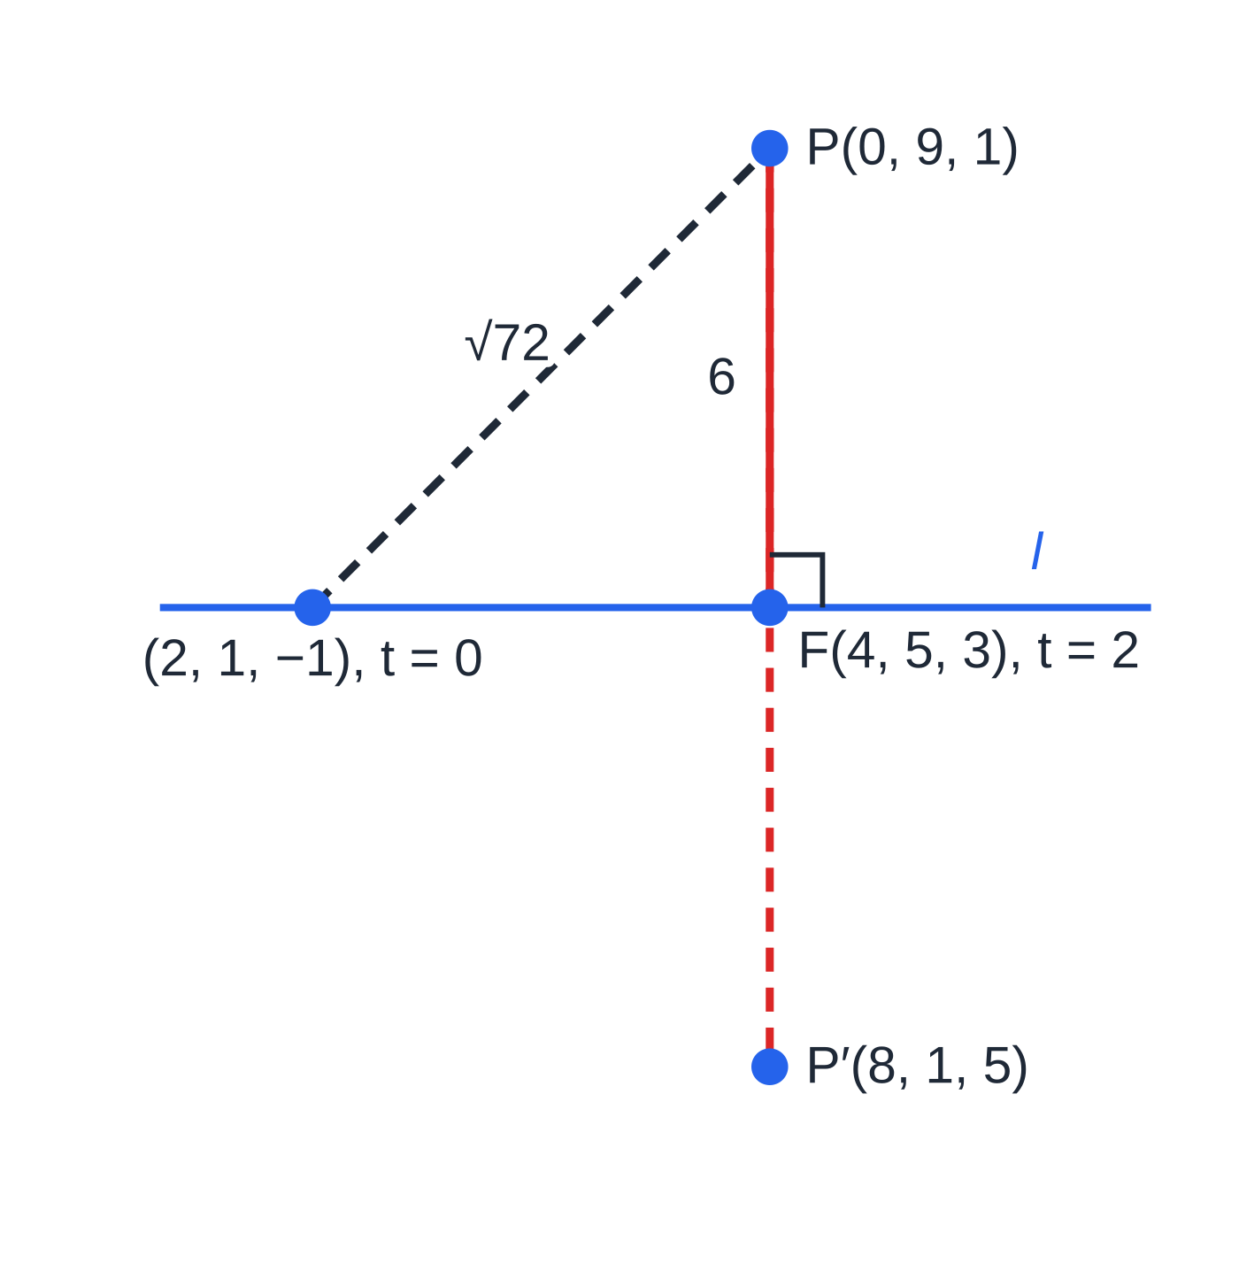
How do you find the foot of the perpendicular from a point to a line? (continued)
Section 6 of 12
Exam tip
Set PF⃗·d=0 with the direction vector of the line, never with the position vector a. Write PF⃗ in full, in terms of t, before taking the scalar product; a sign slip in that subtraction carries through to every later answer.
Worked example 6, drawn in the plane containing P and l: solving PF⃗·d=0 gives the foot F(4,5,3); the perpendicular has length 6, and the image P′ is the same distance beyond the line.
Notes:
How do you find the foot of the perpendicular from a point to a line?. Full notes: https://examinerprep.com/notes/edexcel-ial-maths/vectors-in-two-and-three-dimensions/

Slide 27
How do you find the area of a triangle with vectors?
Section 7 of 12
Find two sides from the same vertex, AB⃗ and AC⃗, and the angle θ=∠BAC from the scalar product. Then area =½|AB⃗||AC⃗|sin θ; for an exact answer, get sin θ from cos θ with sin²θ=1-cos²θ. Alternatively, area =½× base × perpendicular height, with the height from the foot of the perpendicular from C to the line AB. A parallelogram with adjacent sides AB and AC has twice the area of the triangle; its fourth vertex is D with OD⃗=b+c-a.
Notes:
How do you find the area of a triangle with vectors?. Full notes: https://examinerprep.com/notes/edexcel-ial-maths/vectors-in-two-and-three-dimensions/

Slide 28
How do you find the area of a triangle with vectors? (continued)
Section 7 of 12 · Worked example 7 · Hard · Show that / Find
WORKED EXAMPLE · QUESTION
The points A, B and C have coordinates (1,0,2), (3,4,6) and (4,1,4). (a) Show that triangle ABC is isosceles. (b) Find the size of angle BAC, in degrees to 1 decimal place. (c) Find a vector equation of the line AB, and the coordinates of the foot F of the perpendicular from C to AB. (d) Find the exact area of triangle ABC. (e) The point D is such that ABDC is a parallelogram. Find the coordinates of D and the area of the parallelogram, to 3 significant figures.
SOLUTION
(a) AB⃗=2i+4j+4k, AC⃗=3i+j+2k, BC⃗=i-3j-2k. AB=√36=6, AC=√14, BC=√(1+9+4)=√14. So AC=BC: isosceles.
(b) AB⃗·AC⃗=6+4+8=18, so cos θ=18/6√14=3/√14 and θ=36.7°.
(c) Use the direction ½AB⃗=i+2j+2k: r=(i+2k)+t(i+2j+2k). Then CF⃗=(t-3)i+(2t-1)j+(2t-2)k, and (t-3)+2(2t-1)+2(2t-2)=9t-9=0⇒t=1: F(2,2,4), the midpoint of AB.
Notes:
How do you find the area of a triangle with vectors?: Worked example 7. Full notes: https://examinerprep.com/notes/edexcel-ial-maths/vectors-in-two-and-three-dimensions/

Slide 29
How do you find the area of a triangle with vectors? (continued)
Section 7 of 12 · Worked example 7 · Hard · Show that / Find (continued)
(d) Height CF=|-2i+j|=√5, so area =½×6×√5= 3√5. Check: sin θ=√(1-(9/14))=√(5/14), and ½×6×√14×√(5/14)=3√5 ✓.
(e) AB and AC are adjacent sides, so BD⃗=AC⃗: OD⃗=(3,4,6)+(3,1,2), giving D(6,5,8); area =2×3√5=6√5= 13.4.
Notes:
How do you find the area of a triangle with vectors?: Worked example 7. Full notes: https://examinerprep.com/notes/edexcel-ial-maths/vectors-in-two-and-three-dimensions/

Slide 30
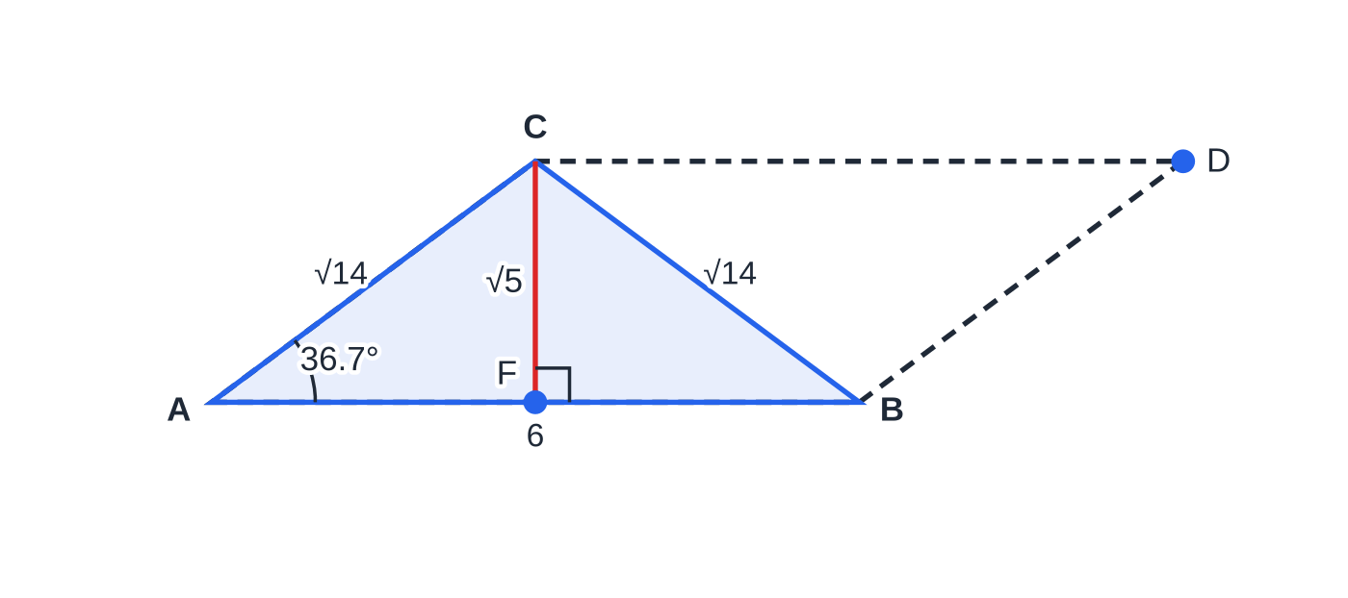
How do you find the area of a triangle with vectors? (continued)
Section 7 of 12
Common error
Using ½|AB⃗||AC⃗|cos θ for the area, or the angle between BA⃗ and AC⃗. The area formula uses sine, and the two vectors must both start at the vertex whose angle you want.
Worked example 7, the true shape of the triangle: the foot of the perpendicular from C is the midpoint F of AB (the triangle is isosceles), so the area is ½×6×√5=3√5. The dashed parallelogram ABDC has twice this area.
Notes:
How do you find the area of a triangle with vectors?. Full notes: https://examinerprep.com/notes/edexcel-ial-maths/vectors-in-two-and-three-dimensions/

Slide 31
Exam tips for P4.8
Section 8 of 12
Exam tip 1 — write the general point
For any question about a point on a line (intersection, foot of a perpendicular, a point at a given distance), start by writing the general point in components, such as (2+t,1+2t,-1+2t). Everything else is substitution.
Exam tip 2 — three equations, two unknowns
When two lines are tested, two of the component equations find λ and μ; the third decides the answer. Always show the third substitution with both values, even when the question says the lines meet.
Exam tip 3 — exact or rounded?
"Exact" means surds such as 3√5 and fractions such as (4/5). Angles are usually asked for in degrees to 1 decimal place; keep the full calculator value of cos θ until the last step.
Notes:
Exam tips for P4.8. Full notes: https://examinerprep.com/notes/edexcel-ial-maths/vectors-in-two-and-three-dimensions/

Slide 32
Exam tips for P4.8 (continued)
Section 8 of 12
Exam tip 4 — simplify the direction
A direction vector can be divided by a common factor: 2i+4j+4k can be replaced by i+2j+2k. Smaller numbers mean fewer slips, and the angle and the line are unchanged.
Exam tip 5 — check with a second method
Vector answers are easy to check: substitute an intersection point into both lines, confirm PF⃗·d=0 with your final F, or compare an area found with sin θ against ½× base × height.
Notes:
Exam tips for P4.8. Full notes: https://examinerprep.com/notes/edexcel-ial-maths/vectors-in-two-and-three-dimensions/

Slide 33
Common misconceptions
Section 9 of 12
Misconception | Why it is wrong | Correct idea
AB⃗=a-b. | From A to B you go back along a and out along b. | AB⃗=b-a: end minus start.
Two lines that do not meet must be parallel. | In three dimensions, non-parallel lines can pass each other at different heights. | Lines that are not parallel and do not meet are skew.
Two lines meet if λ=μ at some point. | The parameters belong to different lines and need not be equal. | Lines meet if some pair of values gives the same point in all three components.
The scalar product of two vectors is a vector. | Multiplying matching components and adding gives a single number. | a·b is a scalar; it is zero exactly when non-zero vectors are perpendicular.
The angle between two lines can be obtuse. | Two crossing lines make two angles that add to 180°; the convention is the smaller one. | If cos θ<0, the angle between the lines is 180°-θ.
A vector equation of a line is unique. | Any point on the line and any multiple of the direction describe the same line. | Check equivalence: parallel directions and a shared point.
Notes:
Common misconceptions. Full notes: https://examinerprep.com/notes/edexcel-ial-maths/vectors-in-two-and-three-dimensions/

Slide 34
How this topic connects
Section 10 of 12
P1 straight lines and trigonometry
The distance formula and midpoint extend to three dimensions with a z term; m₁m₂=-1 becomes a·b=0; and the cosine rule gives the same angles as the scalar product when all three sides are known.
Mechanics
Displacement, velocity and force are vectors in i and j; position = initial position + time × velocity, r=r₀+tv, is exactly the vector equation of a line with time as the parameter. Work done by a constant force is a scalar product, and closest-approach problems use the same perpendicular condition as the foot of a perpendicular.
IAL Physics
Resolving forces, work =F·s and the components of velocity in projectile motion all use the vector ideas on this page.
Notes:
How this topic connects. Full notes: https://examinerprep.com/notes/edexcel-ial-maths/vectors-in-two-and-three-dimensions/

Slide 35
Key formulae
Section 11 of 12
Formula | Use | In the formulae list?
|xi+yj+zk|=√(x²+y²+z²) | magnitude of a vector | No — learn it
â=a÷|a| | unit vector in the direction of a | No — learn it
AB⃗=b-a; AB=|b-a| | vector and distance between two points | No — learn it
OP⃗=a+λ/(λ+μ)(b-a) | point dividing AB in the ratio λ:μ | No — derive it
r=a+td | vector equation of a line | No — learn it
a·b=a₁b₁+a₂b₂+a₃b₃=|a||b|cos θ | angle between vectors or lines; a·b=0 for perpendicular vectors | No — learn it
Area =½|AB⃗||AC⃗|sin θ | area of a triangle from two sides and the included angle | No — learn it
Notes:
Key formulae. Full notes: https://examinerprep.com/notes/edexcel-ial-maths/vectors-in-two-and-three-dimensions/

Slide 36
Check your understanding
Section 12 of 12
1. Find the magnitude of 2i-3j+6k.
2. Show that i+2j+3k and 4i-5j+2k are perpendicular.
3. Does the point (5,1,9) lie on the line r=(i-j+3k)+t(2i+j+3k)?
4. Explain why lines with direction vectors 2i-4j+6k and -i+2j-3k are parallel.
5. Find the distance between the points (2,4,7) and (5,0,7).
Notes:
Check your understanding: questions. Full notes: https://examinerprep.com/notes/edexcel-ial-maths/vectors-in-two-and-three-dimensions/

Slide 37
Check your understanding · answers
Section 12 of 12
1. √(4+9+36)=√49=7.
2. Scalar product: 4-10+6=0, and neither vector is zero, so they are perpendicular.
3. x: 1+2t=5 gives t=2; then y=-1+2=1 ✓ and z=3+6=9 ✓. Yes, at t=2.
4. 2i-4j+6k=-2(-i+2j-3k): one direction is a scalar multiple of the other. (They could still be the same line; test a point.)
5. The difference is 3i-4j+0k, so the distance is √(9+16+0)=5.
Notes:
Check your understanding: answers. Full notes: https://examinerprep.com/notes/edexcel-ial-maths/vectors-in-two-and-three-dimensions/

Slide 38
Practice questions
2 original exam-style questions. Answers at the end of the deck.

Slide 39
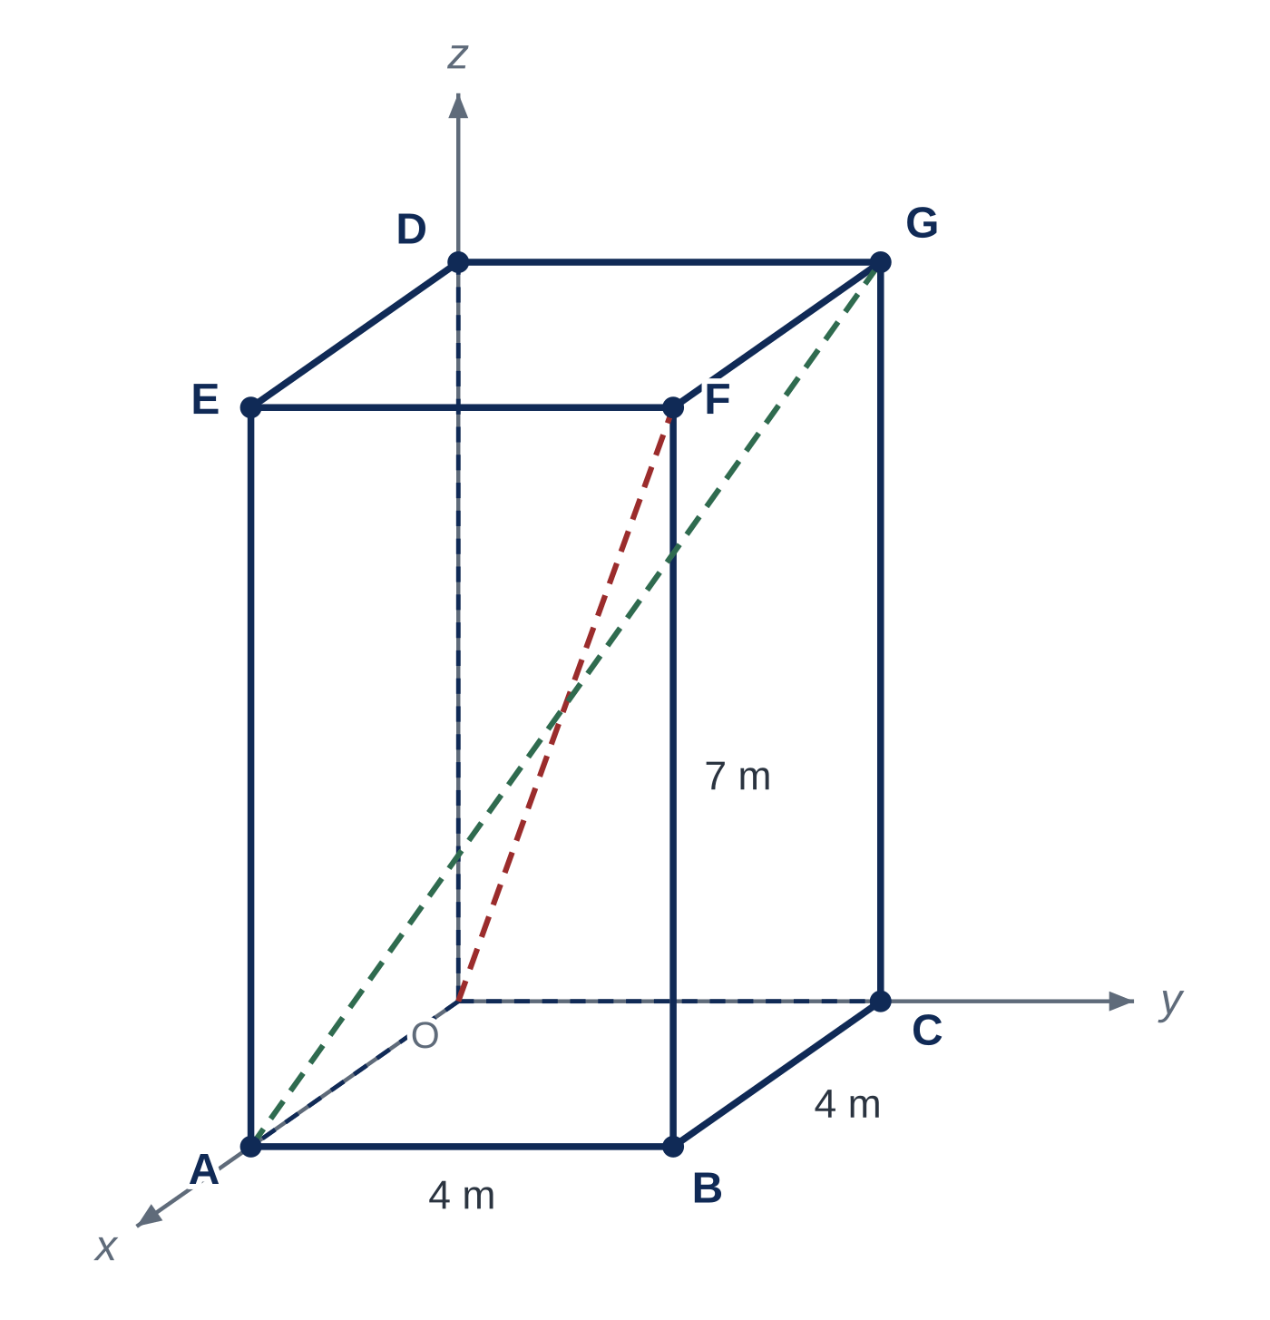
Question 1
7 marks
Figure 1 shows a storage locker modelled as a cuboid OABCDEFG. Relative to the origin O, the edges OA, OC and OD lie along the positive x-, y- and z-axes, and the vertices E, F and G are directly above A, B and C. The dimensions, in metres, are shown in Figure 1.
(a) Write down the position vectors of B and F. [2]
(b) Find the length of the diagonal OF. [2]
(c) Find the acute angle between the diagonals OF and AG, giving your answer in degrees to 1 decimal place. [3]
Notes:
Online with the full mark scheme: https://examinerprep.com/ial-maths-p4-8-vectors-in-two-and-three-dimensions-questions#IALM-P4-8-FB-02

Slide 40
Question 2
6 marks
The vectors a and b are given by a = 4i − 2j + 4k and b = i + 3j − k.
(a) Find |a|. [2]
(b) Find the unit vector in the direction of a. [1]
(c) Find 2a − 3b and show that |2a − 3b| = 3√35. [3]
Notes:
Online with the full mark scheme: https://examinerprep.com/ial-maths-p4-8-vectors-in-two-and-three-dimensions-questions#IALM-P4-8-B-01

Slide 41
Answers

Slide 42
Question 1 · answer
Mark scheme
OB = 4i + 4j
OF = 4i + 4j + 7k
√(4² + 4² + 7²) = √81
= 9 m
AG = −4i + 4j + 7k
OF·AG = −16 + 16 + 49 = 49 and cos θ = 49/(9 × 9)
θ = 52.8°
Notes:
Full mark scheme: https://examinerprep.com/ial-maths-p4-8-vectors-in-two-and-three-dimensions-questions#IALM-P4-8-FB-02

Slide 43
Question 2 · answer
Mark scheme
√(4² + (−2)² + 4²)
= 6
⅙(4i − 2j + 4k) = ⅔i − ⅓j + ⅔k (ft their |a|)
2a − 3b = 5i − 13j + 11k
√(25 + 169 + 121) = √315
√315 = √(9 × 35) = 3√35 (given answer, no errors seen)
Notes:
Full mark scheme: https://examinerprep.com/ial-maths-p4-8-vectors-in-two-and-three-dimensions-questions#IALM-P4-8-B-01

Slide 44
Keep practising
Notes for this topic
Questions on this topic
Build a printable test
ExaminerPrep is an independent tutoring service. It has been developed independently from and is not endorsed by the International Baccalaureate Organization. "International Baccalaureate", "IB" and "IB Diploma Programme" are registered trademarks of the IBO, used here for descriptive purposes only.
Pearson Edexcel and Cambridge are trademarks of their owners; ExaminerPrep is not affiliated with any exam board.

