Slide 1
EP
EDEXCEL IAL MATHS
P4.6 Volumes of revolution
The full notes page in 11 sections · practice questions with answers · simulations
ExaminerPrep is an independent tutoring service. It has been developed independently from and is not endorsed by the International Baccalaureate Organization. "International Baccalaureate", "IB" and "IB Diploma Programme" are registered trademarks of the IBO, used here for descriptive purposes only.
Pearson Edexcel and Cambridge are trademarks of their owners; ExaminerPrep is not affiliated with any exam board.
Notes:
P4.6 Volumes of revolution. Notes for this topic: https://examinerprep.com/notes/edexcel-ial-maths/volumes-of-revolution/

Slide 2
What this page covers
Overview
Where the formula V=π∫y² dx comes from, and how it reproduces the cone and sphere formulae
The volume formed when a region is rotated through 2π radians (360°) about the x-axis
Evaluating the integral with trigonometric identities, integration by parts, partial fractions and substitution
Regions between a curve and a line, or between two curves (outer solid minus inner solid)
Composite solids built from a curved piece and a cone
Curves given parametrically: V=π∫y²dx/dt dt
Using volumes of revolution to model real objects, with units and comments on the model
Notes:
What this page covers. Full notes: https://examinerprep.com/notes/edexcel-ial-maths/volumes-of-revolution/

Slide 3
In one minute
Key points
1
Rotating the region under y=f(x) from x=a to x=b through 360° about the x-axis gives a solid of volume V=π∫ₐᵇ y² dx: square first, then integrate.
4
Parametric curves: V=π∫_(t₁)^(t₂)y²dx/dt dt, with the limits changed to values of t.
2
Make y² integrable: expand brackets, use sin²x=½(1-cos 2x) or sec²x=1+tan²x, split into partial fractions, or integrate by parts.
5
Exact answers keep π (and e, ln, surds); decimals only when asked. Volumes are never negative, even for parts of the curve below the axis.
3
Between two graphs: outer solid minus inner solid, V=π∫ₐᵇ(yₒᵤₜₑᵣ²-yᵢₙₙₑᵣ²)dx. Never square the difference.
Notes:
In one minute: the key points of this topic.

Slide 4
Where does V = π∫y² dx come from?
Section 1 of 11
Volume of revolution. The volume of the solid swept out when a plane region is rotated through 2π radians about a straight line; in this unit the line is always the x-axis.
Cut the solid into thin slices perpendicular to the x-axis. The slice at x is (almost) a disc of radius y and thickness δx, so its volume is about πy² δx. Adding the discs and letting δx→0 turns the sum into an integral, exactly as the sum of thin rectangles became ∫y dx for an area. The radius is the distance from the axis to the curve, so it is y (or |y|); squaring removes any sign.
V=π∫ₐᵇ y² dx
y=f(x) is the curve; a, b are the x-limits of the region; the rotation is a full turn (2π radians). Not in the formulae booklet: learn it.
Two checks you can do yourself.
Notes:
Where does V = π∫y² dx come from?. Full notes: https://examinerprep.com/notes/edexcel-ial-maths/volumes-of-revolution/

Slide 5
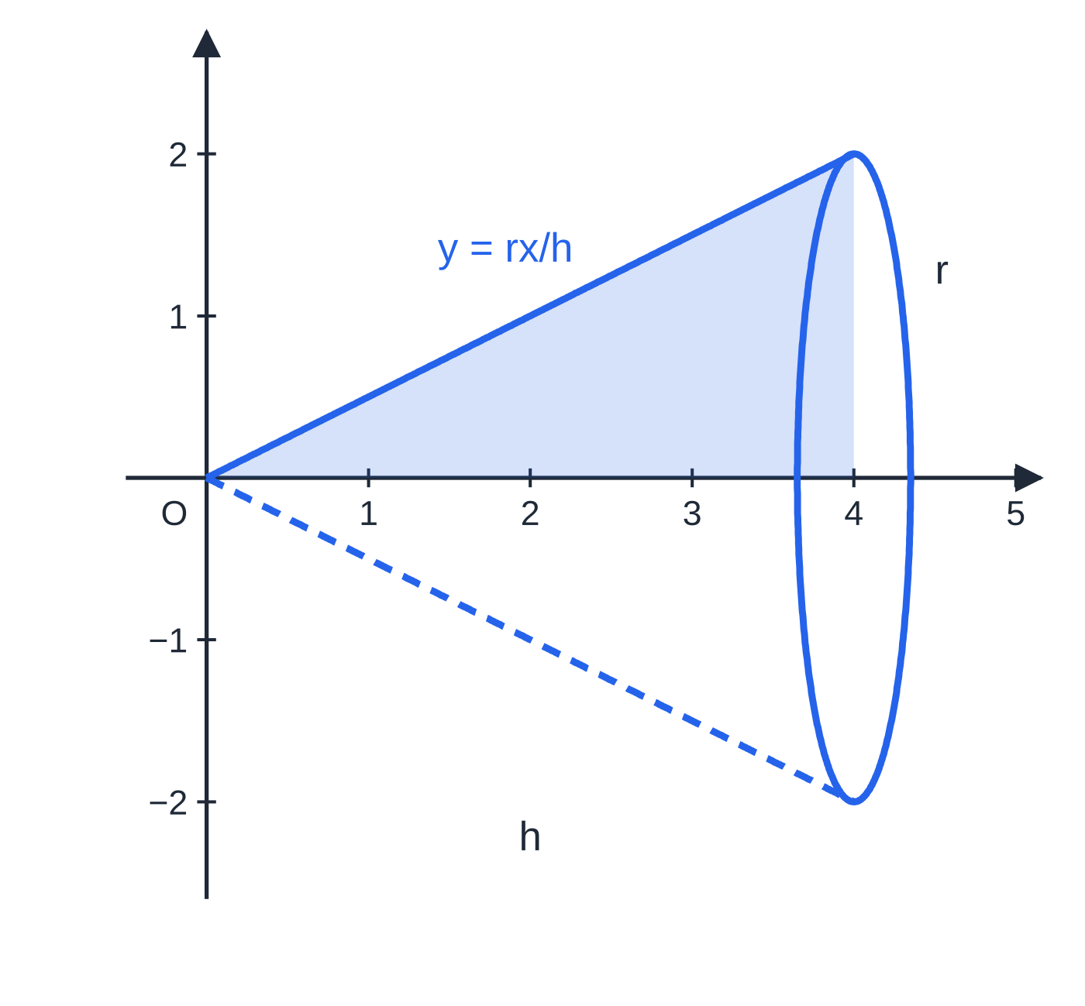
Where does V = π∫y² dx come from? (continued)
Section 1 of 11
Rotating the line y=rx/h for 0≤x≤h gives a cone: π∫₀ʰr²x²/h² dx=πr²/h²·h³/3=⅓πr²h. Rotating the semicircle y=√(r²-x²) for -r≤x≤r gives a sphere: π∫₋ᵣʳ(r²-x²) dx=π(2r³-⅔r³)=(4/3)πr³.
Rotating the triangle under y=rx/h (here r=2, h=4) about the x-axis sweeps out a cone; the disc formula gives ⅓πr²h, the familiar result.
Notes:
Where does V = π∫y² dx come from?. Full notes: https://examinerprep.com/notes/edexcel-ial-maths/volumes-of-revolution/

Slide 6
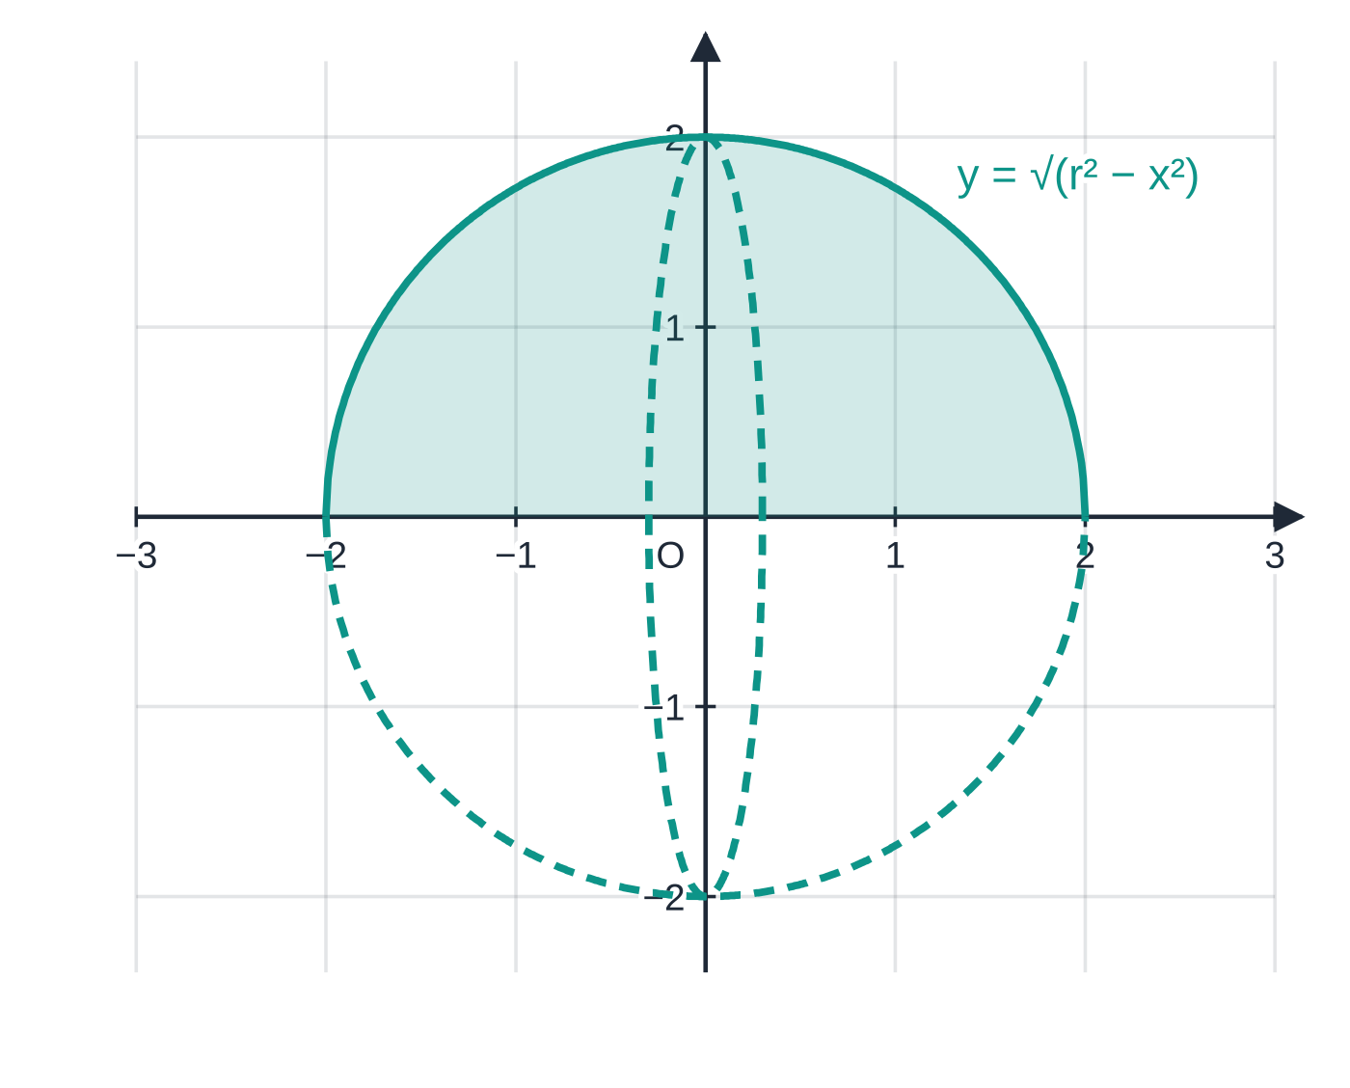
Where does V = π∫y² dx come from? (continued)
Section 1 of 11
Rotating the semicircular region (r=2) about the x-axis gives a sphere; π∫₋ᵣʳ(r²-x²) dx=(4/3)πr³. The dashed ellipse is the largest disc, at x=0.
Notes:
Where does V = π∫y² dx come from?. Full notes: https://examinerprep.com/notes/edexcel-ial-maths/volumes-of-revolution/

Slide 7
Where does V = π∫y² dx come from? (continued)
Section 1 of 11 · Worked example 1 · Medium · Find
WORKED EXAMPLE · QUESTION
The region R is bounded by the curve y=x+1/x, the x-axis and the lines x=1 and x=2. Find the exact volume of the solid formed when R is rotated through 360° about the x-axis.
SOLUTION
Square and expand: y²=(x+1/x)²=x²+2+x⁻².
Integrate: V=π∫₁²(x²+2+x⁻²)dx=π[x³/3+2x-1/x]₁².
Limits: π[((8/3)+4-½)-(⅓+2-1)]=π((37/6)-(4/3))= 29π/6 (≈15.2).
Squaring a sum gives a middle term: (x+1/x)² is not x²+1/x². Here the cross term is 2.
Notes:
Where does V = π∫y² dx come from?: Worked example 1. Full notes: https://examinerprep.com/notes/edexcel-ial-maths/volumes-of-revolution/

Slide 8
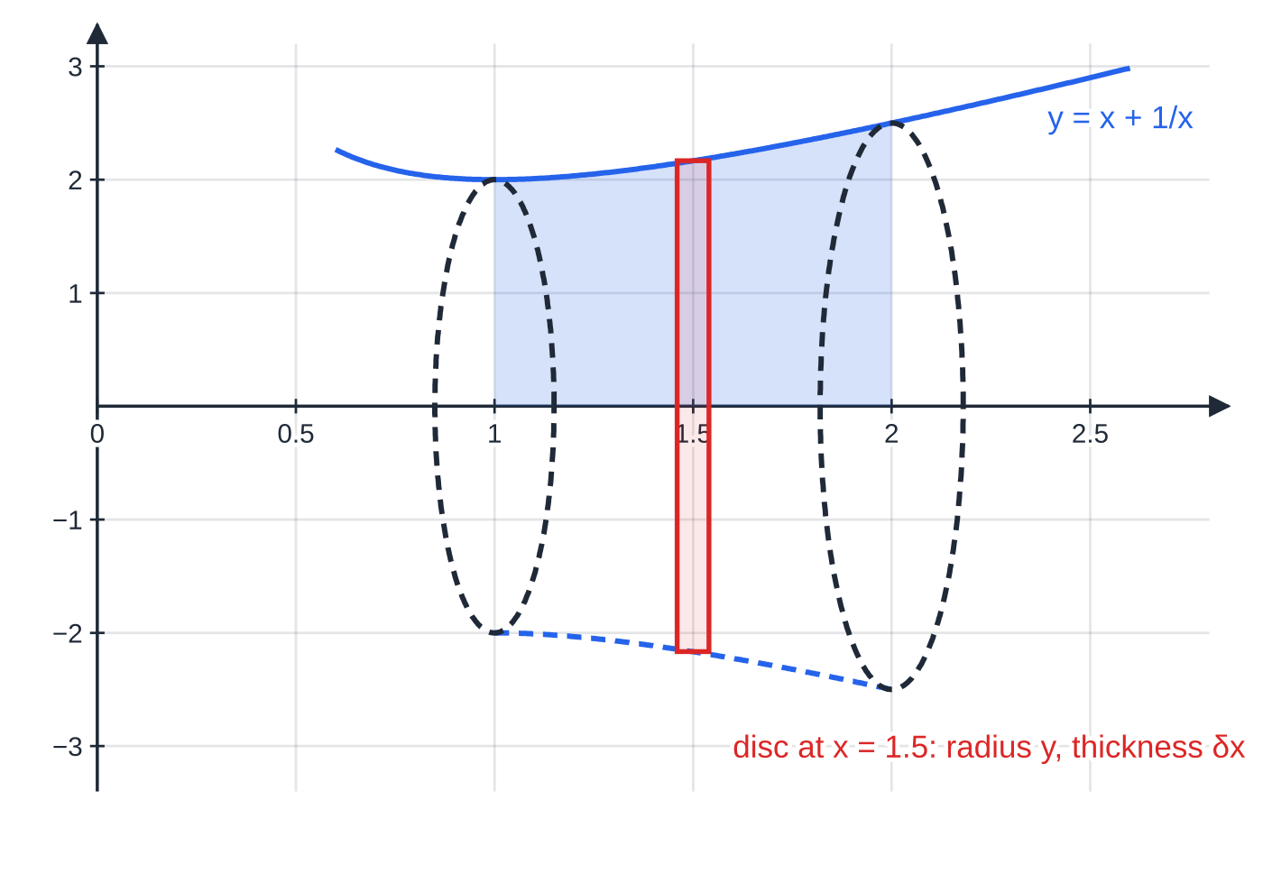
Where does V = π∫y² dx come from? (continued)
Section 1 of 11
Common error
Writing π(∫y dx)², integrating first and squaring the answer. The squaring happens to y inside the integral, before anything is integrated.
Worked example 1: the region under y=x+1/x from x=1 to 2 and the solid it sweeps out. The disc at x=1.5 has radius y≈2.17 and thickness δx; adding discs from radius 2 at x=1 to radius 2.5 at x=2 gives 29π/6≈15.2.
Notes:
Where does V = π∫y² dx come from?. Full notes: https://examinerprep.com/notes/edexcel-ial-maths/volumes-of-revolution/

Slide 9
Which integration methods might y² need?
Section 2 of 11
Squaring y usually changes the kind of integral you face: a root disappears, a sum gains a cross term, a trigonometric function becomes a square that needs an identity. Recognise the form of y² and choose the method.
Form of y² | Method | Example
powers, roots, a squared bracket | expand, then integrate term by term | (x+1/x)²=x²+2+x⁻²
sin², cos², tan², sin xcos x | double-angle identities or sec²=1+tan² | tan²x=sec²x-1
a product such as xe²ˣ or xcos x | integration by parts | ∫xe²ˣ dx
a rational function | partial fractions, giving logarithms | 4/((x+1)(x+3))
f′(x)×g(f(x)) | substitution (or recognition) | sin²xcos x with u=sin x
Notes:
Which integration methods might y² need?. Full notes: https://examinerprep.com/notes/edexcel-ial-maths/volumes-of-revolution/

Slide 10
Which integration methods might y² need? (continued)
Section 2 of 11 · Worked example 2 · Medium · Show that
WORKED EXAMPLE · QUESTION
The region bounded by y=sin x+cos x, the coordinate axes and the line x=π/2 is rotated through 2π radians about the x-axis. Show that the volume of the solid is π/2(π+2).
SOLUTION
Square and simplify with sin²x+cos²x=1 and 2sin xcos x=sin 2x: y²=sin²x+2sin xcos x+cos²x=1+sin 2x.
Integrate: V=π∫₀^(π/2)(1+sin 2x) dx=π[x-½cos 2x]₀^(π/2).
Limits, with cos π=-1 and cos 0=1: π[(π/2+½)-(0-½)]=π(π/2+1)= π/2(π+2) as required.
Notes:
Which integration methods might y² need?: Worked example 2. Full notes: https://examinerprep.com/notes/edexcel-ial-maths/volumes-of-revolution/

Slide 11
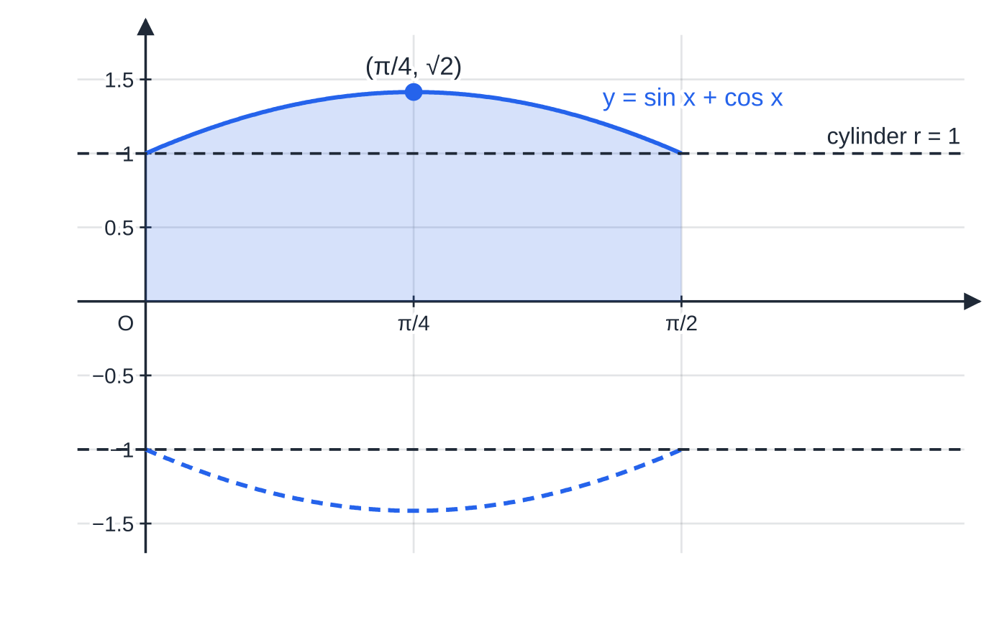
Which integration methods might y² need? (continued)
Section 2 of 11
Worked example 2: the curve rises from 1 to √2 at x=π/4 and falls back to 1, so the solid is barrel-shaped. Its volume π/2(π+2)≈8.08 is clearly more than the cylinder of radius 1 and length π/2 (volume π²/2≈4.93).
Notes:
Which integration methods might y² need?. Full notes: https://examinerprep.com/notes/edexcel-ial-maths/volumes-of-revolution/

Slide 12
Which integration methods might y² need? (continued)
Section 2 of 11 · Worked example 3 · Medium · Find
WORKED EXAMPLE · QUESTION
The curve C has equation y=√x eˣ, x≥0. The region bounded by C, the x-axis and the line x=1 is rotated through 360° about the x-axis. Find the exact volume of the solid.
SOLUTION
Square; the root disappears: y²=xe²ˣ, so V=π∫₀¹xe²ˣ dx.
By parts with u=x, dv/dx=e²ˣ, v=½e²ˣ: ∫xe²ˣ dx=½xe²ˣ-∫½e²ˣ dx=½xe²ˣ-¼e²ˣ.
Limits: π[(½e²-¼e²)-(0-¼)]= π/4(e²+1)≈6.59.
The lower limit matters: at x=0 the bracket is -¼, not 0, because e⁰=1.
Notes:
Which integration methods might y² need?: Worked example 3. Full notes: https://examinerprep.com/notes/edexcel-ial-maths/volumes-of-revolution/

Slide 13
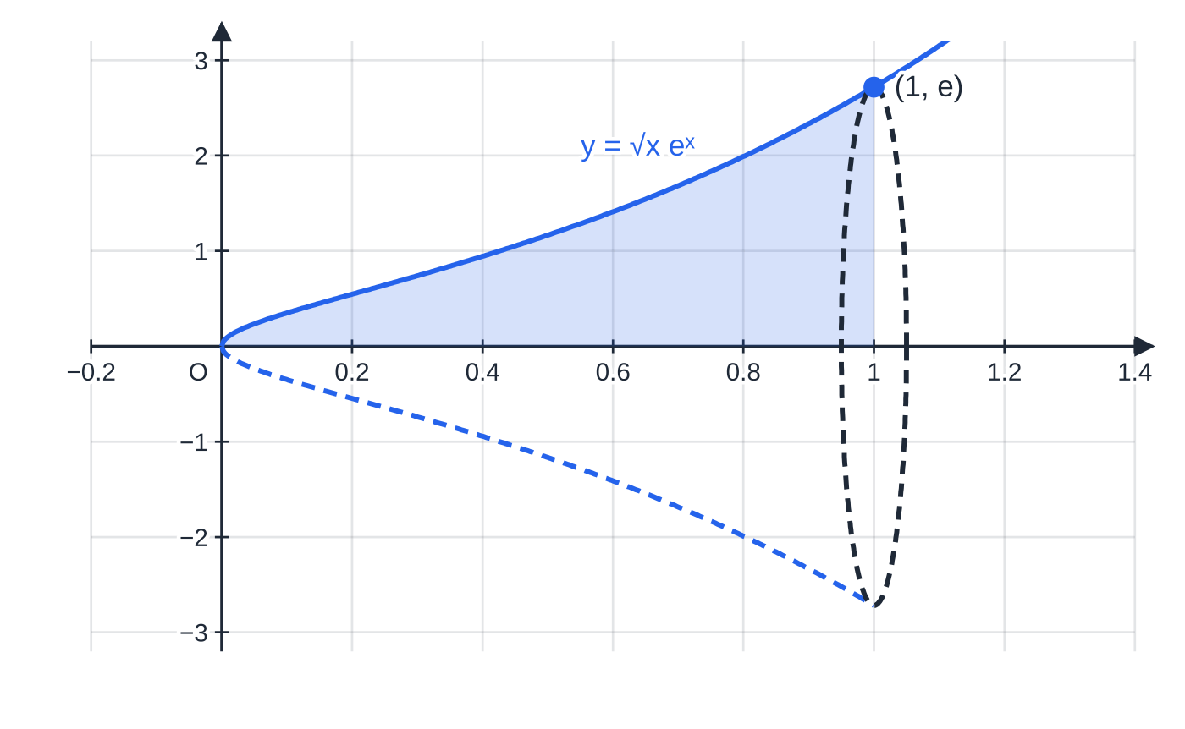
Which integration methods might y² need? (continued)
Section 2 of 11
Worked example 3: the region under y=√x eˣ from 0 to 1 and its mirror image, outlining a solid shaped like a horn whose end disc has radius e. Volume π/4(e²+1)≈6.59.
Notes:
Which integration methods might y² need?. Full notes: https://examinerprep.com/notes/edexcel-ial-maths/volumes-of-revolution/

Slide 14
Which integration methods might y² need? (continued)
Section 2 of 11 · Worked example 4 · Hard · Show that
WORKED EXAMPLE · QUESTION
The region bounded by y=2/(√((x+1)(x+3))), the axes and the line x=1 is rotated through 360° about the x-axis. Show that the volume of the solid is πln k, stating the value of k.
SOLUTION
Square and split: y²=4/((x+1)(x+3))=A/(x+1)+B/(x+3); 4=A(x+3)+B(x+1)⇒A=2, B=-2.
Integrate: V=π∫₀¹(2/(x+1)-2/(x+3))dx=π[2ln(x+1)-2ln(x+3)]₀¹.
Limits, then the laws of logarithms: π[(2ln 2-2ln 4)-(0-2ln 3)]=2πln(2×3)/4=2πln(3/2)=πln(9/4), so k=(9/4).
The form "πln k" forces the coefficient 2 inside the logarithm: 2ln(3/2)=ln(9/4). As a decimal, V≈2.55.
Notes:
Which integration methods might y² need?: Worked example 4. Full notes: https://examinerprep.com/notes/edexcel-ial-maths/volumes-of-revolution/

Slide 15
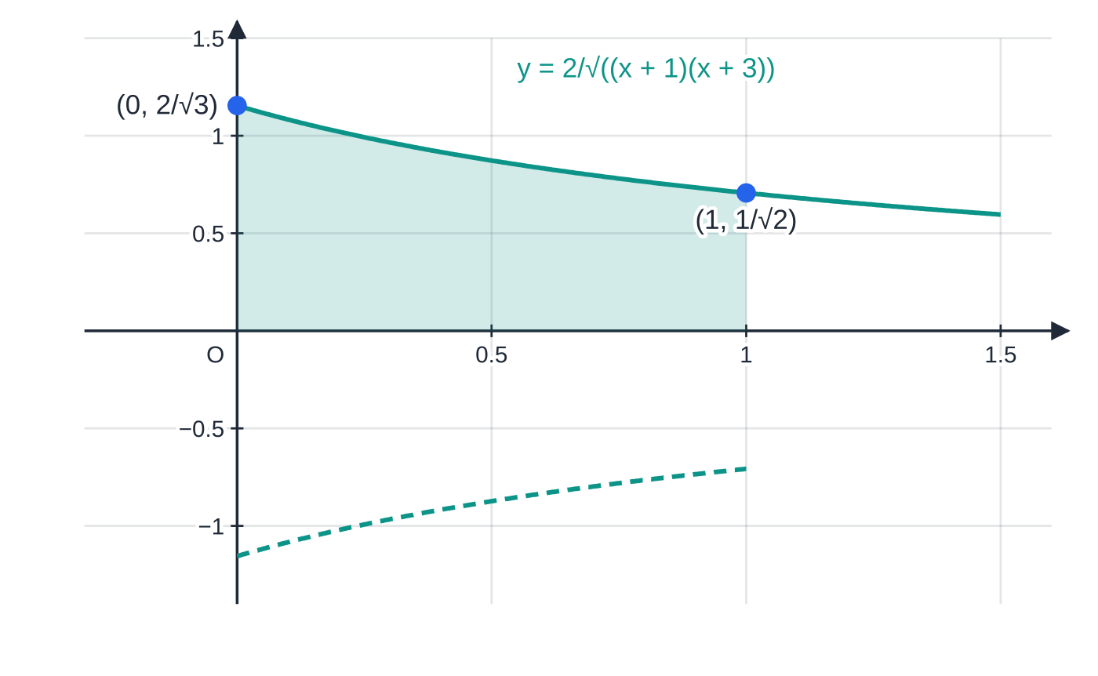
Which integration methods might y² need? (continued)
Section 2 of 11
Exam tip
Write y² on its own line, fully simplified, before the integral sign appears. Most of the difficulty in this topic is the algebra of y²; once it is in a recognisable form, the integration is routine.
Worked example 4: the radius falls from 2/√3≈1.15 to 1/√2≈0.71, so the solid tapers. Its volume is πln(9/4)≈2.55.
Notes:
Which integration methods might y² need?. Full notes: https://examinerprep.com/notes/edexcel-ial-maths/volumes-of-revolution/

Slide 16
What if the region lies between two graphs?
Section 3 of 11
Rotating a region between an upper graph y₁ and a lower graph y₂ (both above the x-axis) gives a solid with a hole along the axis. Each slice is a washer: a disc of radius y₁ with a disc of radius y₂ removed. So the volume is (outer solid) − (inner solid): π∫y₁² dx-π∫y₂² dx.
π∫(y₁-y₂)² dx is wrong: it would be the volume of a solid whose radius is the gap between the graphs, which is a different solid. The washer picture below shows the difference in one slice.
V=π∫ₐᵇ(yₒᵤₜₑᵣ²-yᵢₙₙₑᵣ²)dx
yₒᵤₜₑᵣ≥yᵢₙₙₑᵣ≥0 on a≤x≤b; a, b are usually where the graphs meet. Not in the formulae booklet: derive it from the disc formula.
Notes:
What if the region lies between two graphs?. Full notes: https://examinerprep.com/notes/edexcel-ial-maths/volumes-of-revolution/

Slide 17
What if the region lies between two graphs? (continued)
Section 3 of 11 · Worked example 5 · Hard · Find
WORKED EXAMPLE · QUESTION
The line y=7-x meets the curve y=6/x, x>0, at the points A and B. The finite region R between them is rotated through 360° about the x-axis. (a) Find the coordinates of A and B. (b) Find the exact volume of the solid generated.
SOLUTION
(a) 7-x=6/x⇒x²-7x+6=0⇒(x-1)(x-6)=0, so A(1,6), B(6,1).
(b) Decide which is outer: at x=3 the line gives 4, the curve gives 2. So the outer radius is 7-x and the inner radius 6/x.
Outer solid: π∫₁⁶(7-x)² dx=π[-⅓(7-x)³]₁⁶=π(-⅓+72)=215π/3.
Inner solid: π∫₁⁶36/x² dx=π[-36/x]₁⁶=π(-6+36)=30π.
Subtract: V=215π/3-30π= 125π/3≈131.
Notes:
What if the region lies between two graphs?: Worked example 5. Full notes: https://examinerprep.com/notes/edexcel-ial-maths/volumes-of-revolution/

Slide 18
What if the region lies between two graphs? (continued)
Section 3 of 11 · Worked example 5 · Hard · Find (continued)
The outer solid is a frustum of a cone, so 215π/3 can be checked: the line meets the x-axis at x=7, giving cones of radius 6 (height 6) and radius 1 (height 1): ⅓π(216-1)=215π/3.
Notes:
What if the region lies between two graphs?: Worked example 5. Full notes: https://examinerprep.com/notes/edexcel-ial-maths/volumes-of-revolution/

Slide 19
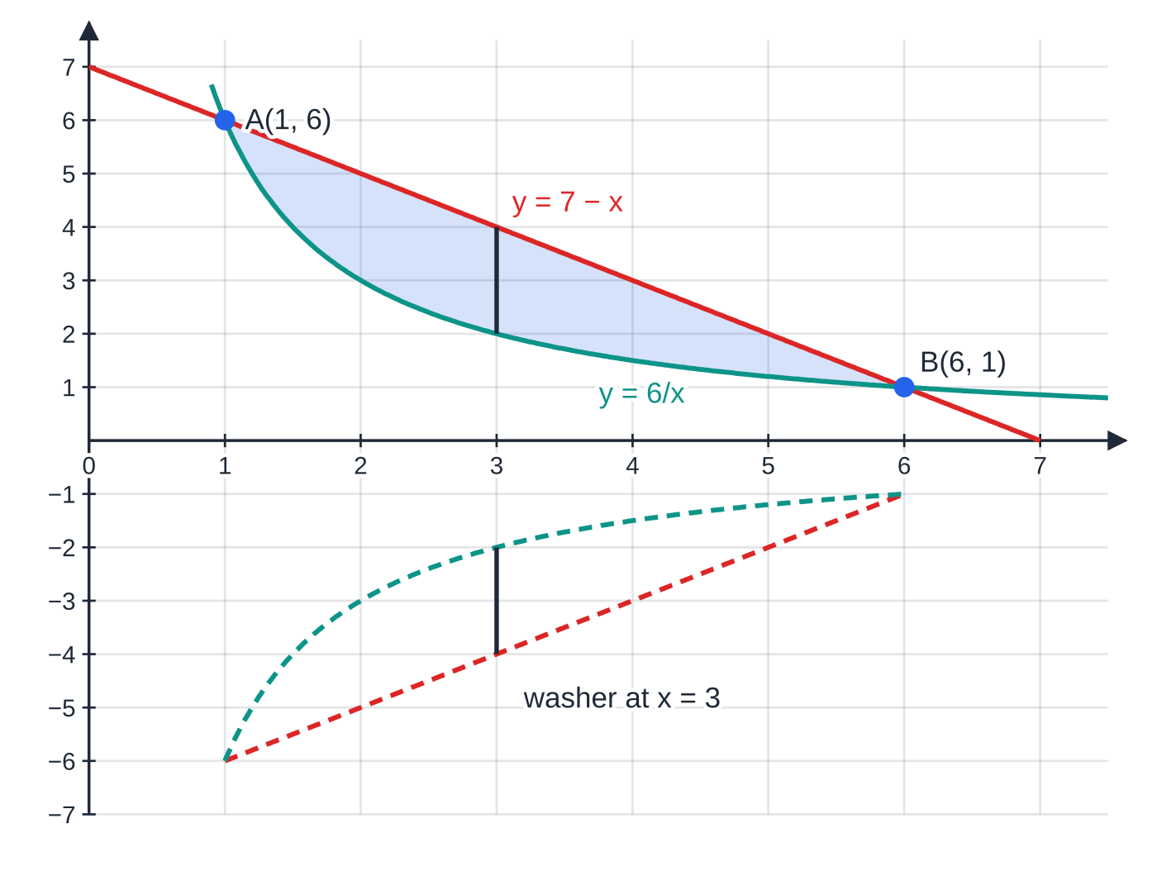
What if the region lies between two graphs? (continued)
Section 3 of 11
Worked example 5: rotating the shaded region between y=7-x and y=6/x gives a solid with a hollow core. The slice at x=3 is a washer with outer radius 4 and inner radius 2.
Notes:
What if the region lies between two graphs?. Full notes: https://examinerprep.com/notes/edexcel-ial-maths/volumes-of-revolution/

Slide 20
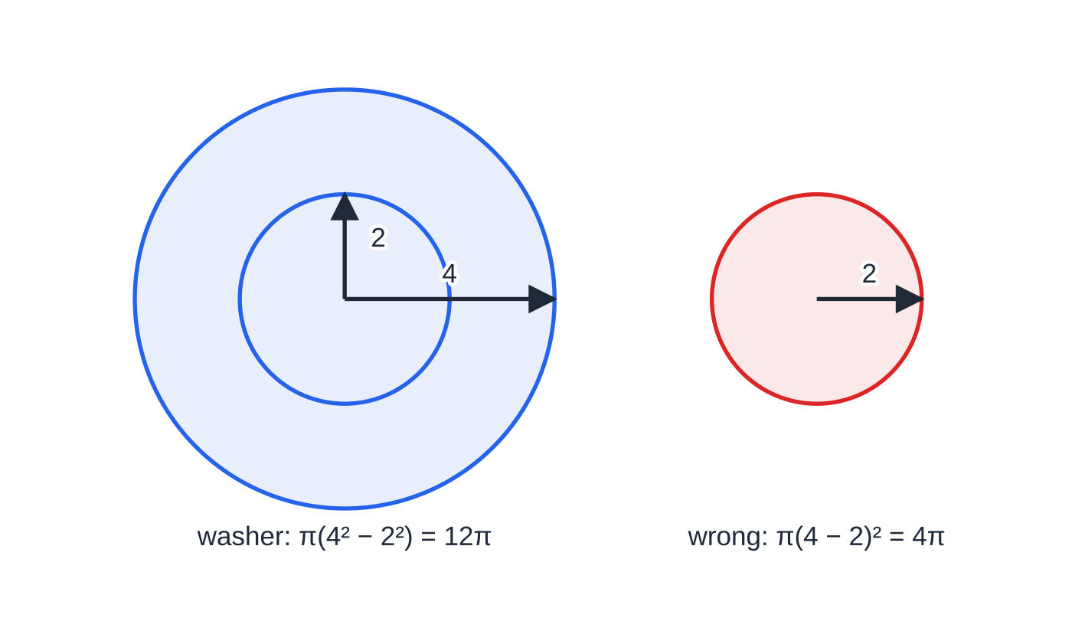
What if the region lies between two graphs? (continued)
Section 3 of 11
Common error
Using π∫(y₁-y₂)² dx. For worked example 5 it gives 35.1 instead of 131. Square each radius separately, then subtract.
One slice at x=3. The true cross-section is the shaded ring of area 12π; squaring the gap gives a small disc of area 4π, a different shape entirely.
Notes:
What if the region lies between two graphs?. Full notes: https://examinerprep.com/notes/edexcel-ial-maths/volumes-of-revolution/

Slide 21
How do you find a volume from parametric equations?
Section 4 of 11
When x=f(t) and y=g(t), change the variable in π∫y² dx: replace dx by dx/dt dt. The limits must become values of t: solve f(t)=a and f(t)=b (or use the t-values given). If x decreases as t increases, keep the t-limits in the order that matches x=a to x=b; the negative dx/dt then makes the answer come out positive.
V=π∫_(t₁)^(t₂)y² dx/dt dt
t₁, t₂ are the parameter values at x=a and x=b. Not in the formulae booklet: derive it; it is the disc formula with dx=dx/dt dt.
Quick check: the ellipse x=acos t, y=bsin t rotated about the x-axis gives (4/3)πab², which is a sphere when a=b.
Notes:
How do you find a volume from parametric equations?. Full notes: https://examinerprep.com/notes/edexcel-ial-maths/volumes-of-revolution/

Slide 22
How do you find a volume from parametric equations? (continued)
Section 4 of 11 · Worked example 6 · Hard · Show that / Find
WORKED EXAMPLE · QUESTION
The curve C has parametric equations x=sin t, y=sin 2t, 0≤t≤π/2. The region bounded by C and the x-axis is rotated through 2π radians about the x-axis. (a) Show that the volume is 4π∫₀^(π/2)sin²tcos³t dt. (b) Use the substitution u=sin t to find the exact volume.
SOLUTION
(a) x=0 at t=0 and x=1 at t=π/2; dx/dt=cos t. With sin 2t=2sin tcos t: V=π∫₀^(π/2)(2sin tcos t)²cos t dt=4π∫₀^(π/2)sin²tcos³t dt as required.
(b) u=sin t, du=cos t dt, cos²t=1-u²; limits u=0 to 1. 4π∫₀¹u²(1-u²) du=4π[u³/3-u⁵/5]₀¹=4π·(2/15)= 8π/15≈1.68.
Check in Cartesian form: y²=4x²(1-x²), and π∫₀¹4x²(1-x²) dx=8π/15 as well.
Notes:
How do you find a volume from parametric equations?: Worked example 6. Full notes: https://examinerprep.com/notes/edexcel-ial-maths/volumes-of-revolution/

Slide 23
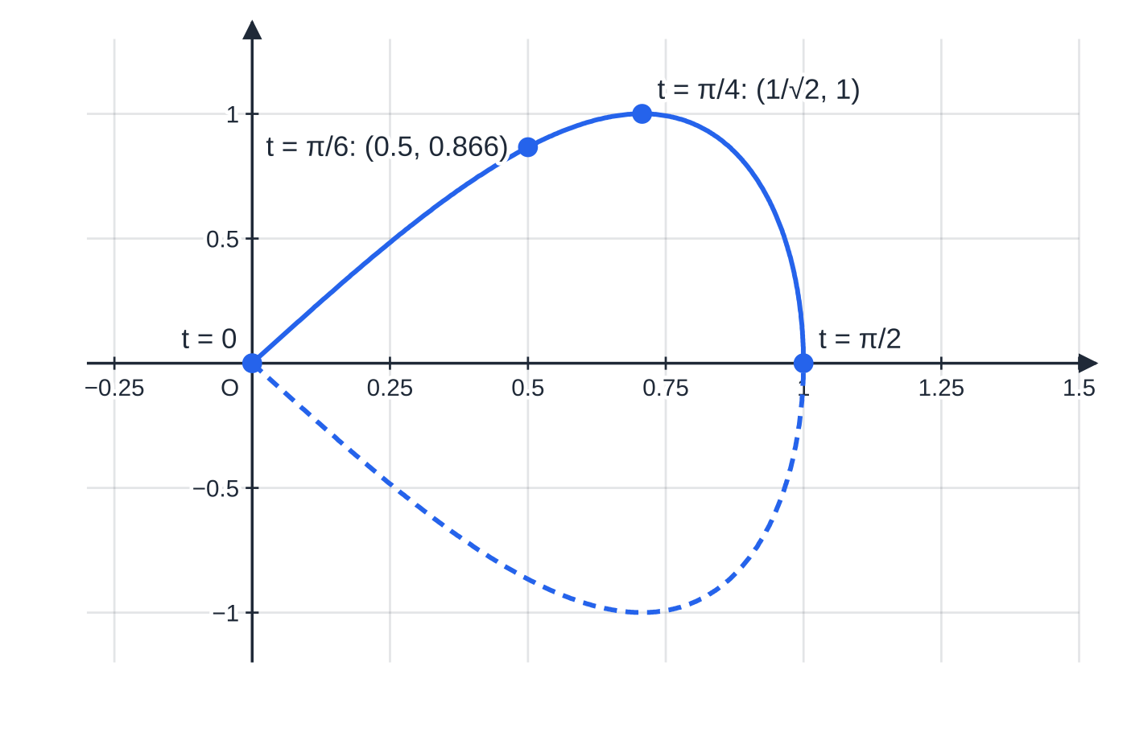
How do you find a volume from parametric equations? (continued)
Section 4 of 11
Common error
Keeping the x-limits after changing to t, or leaving out dx/dt. Every part of the integral must be in terms of t: the integrand, the "dt" and both limits.
Worked example 6: as t increases from 0 to π/2, x increases from 0 to 1, so the t-limits run in that order. The highest point (1/√2,1) is at t=π/4. The solid has volume 8π/15≈1.68.
Notes:
How do you find a volume from parametric equations?. Full notes: https://examinerprep.com/notes/edexcel-ial-maths/volumes-of-revolution/

Slide 24
How are volumes of revolution used to model real objects?
Section 5 of 11
Many objects (bowls, vases, bottles, lampshades, buoys) have a circular cross-section, so their shape can be described by a profile curve rotated about the axis of symmetry. Put that axis along the x-axis. Keep the units: lengths in cm give volumes in cm³ (1 litre = 1000 cm³), and mass = density × volume. "Filled to a depth d" means integrate from the base to x=d, so a volume condition often leads to an equation for d. Be ready to criticise the model: real walls have thickness, bases are flat or have a foot, the profile is only an approximation, and the material may not be uniform.
Notes:
How are volumes of revolution used to model real objects?. Full notes: https://examinerprep.com/notes/edexcel-ial-maths/volumes-of-revolution/

Slide 25
How are volumes of revolution used to model real objects? (continued)
Section 5 of 11 · Worked example 7 · Hard · Show that / Find
WORKED EXAMPLE · QUESTION
The inside of a vase is modelled by rotating the curve y=6-2cos(πx/15), 0≤x≤30, through 360° about the x-axis, where x cm is the distance along the axis from the base. (a) Show that y²=38-24cos(πx/15)+2cos(2πx/15). (b) Find the capacity of the vase in litres, to 3 significant figures. (c) Show that the vase is exactly half full when the water is 15 cm deep, and give one limitation of the model.
SOLUTION
(a) With θ=πx/15 and cos²θ=½(1+cos 2θ): y²=36-24cos θ+4cos²θ=36-24cos θ+2+2cos 2θ=38-24cos(πx/15)+2cos(2πx/15).
(b) V=π[38x-360/πsin(πx/15)+15/πsin(2πx/15)]₀³⁰. Since sin 2π=sin 4π=0, only the first term survives: V=1140π cm³ ≈3581 cm³ = 3.58 litres.
Notes:
How are volumes of revolution used to model real objects?: Worked example 7. Full notes: https://examinerprep.com/notes/edexcel-ial-maths/volumes-of-revolution/

Slide 26
How are volumes of revolution used to model real objects? (continued)
Section 5 of 11 · Worked example 7 · Hard · Show that / Find (continued)
(c) The same integral from 0 to 15, with sin π=sin 2π=0, gives π(38×15)=570π=½×1140π, so the vase is half full at a depth of 15 cm. This also follows from symmetry: the profile is symmetrical about x=15.
Limitations: the model ignores the thickness of the glass in the walls and the base, assumes the profile is exactly a cosine curve, and assumes the base is a perfectly flat disc of radius 4 cm. Any one, stated in context, is enough.
Notes:
How are volumes of revolution used to model real objects?: Worked example 7. Full notes: https://examinerprep.com/notes/edexcel-ial-maths/volumes-of-revolution/

Slide 27
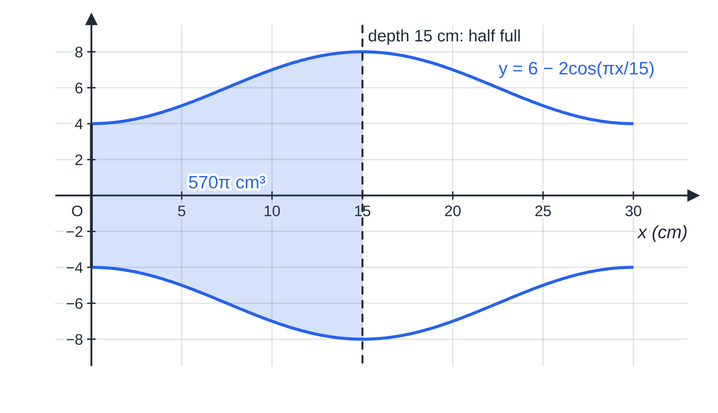
How are volumes of revolution used to model real objects? (continued)
Section 5 of 11
Worked example 7: the vase on its side, axis along the x-axis. The radius is 4 cm at the base, 8 cm at the widest point and 4 cm at the opening. Water to a depth of 15 cm (shaded) fills exactly half of the 1140π≈3581 cm³.
Notes:
How are volumes of revolution used to model real objects?. Full notes: https://examinerprep.com/notes/edexcel-ial-maths/volumes-of-revolution/

Slide 28
How do you handle a composite solid?
Section 6 of 11
When the region is bounded by a curve, a line and the x-axis, split it at the meeting point and find each piece separately. Straight-line pieces give cones (⅓πr²h) or frustums, which you can find without integrating, and doing it both ways gives an independent check.
Notes:
How do you handle a composite solid?. Full notes: https://examinerprep.com/notes/edexcel-ial-maths/volumes-of-revolution/

Slide 29
How do you handle a composite solid? (continued)
Section 6 of 11 · Worked example 8 · Hard · Show that / Find
WORKED EXAMPLE · QUESTION
The curve y=3√x and the line y=10-x meet at the point P. The region R is bounded by the curve, the line and the x-axis. (a) Show that P has coordinates (4,6). (b) R is rotated through 2π radians about the x-axis. Find the exact volume of the solid. (c) The solid models a fishing float, with 1 unit representing 1 cm, made of foam of density 0.08 g cm⁻³. Find the mass of the float.
SOLUTION
(a) Put u=√x in 3√x=10-x: u²+3u-10=0⇒(u-2)(u+5)=0⇒u=2 (as u≥0), so x=4, y=6: P(4,6).
(b) Split at x=4. Curve part: π∫₀⁴9x dx=π[(9/2)x²]₀⁴=72π. Line part: the line meets the x-axis at x=10, so this is a cone of radius 6 and height 6: ⅓π×6²×6=72π (or π∫₄¹⁰(10-x)² dx=72π). Add: V=144π.
(c) Mass = density × volume =0.08×144π=36.19…≈ 36.2 g.
Both pieces happen to have the same volume, but you cannot assume that; always work out each part.
Notes:
How do you handle a composite solid?: Worked example 8. Full notes: https://examinerprep.com/notes/edexcel-ial-maths/volumes-of-revolution/

Slide 30
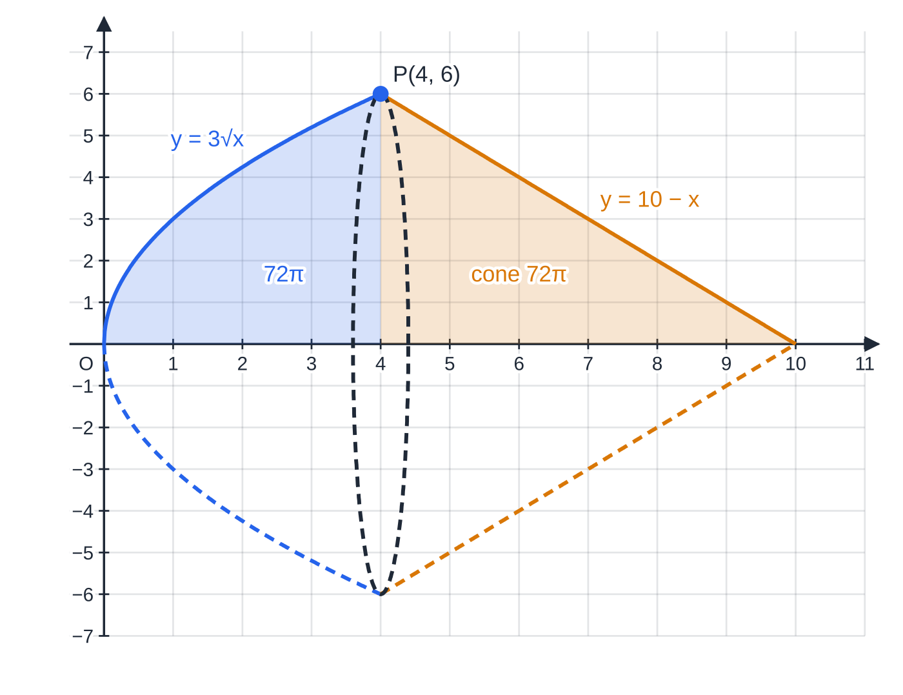
How do you handle a composite solid? (continued)
Section 6 of 11
Exam tip
Before integrating a straight-line piece, ask whether it is a cone or a frustum. ⅓πr²h is quicker and gives an independent check on your integral.
Worked example 8: the region splits at P(4,6) into the part under y=3√x and a triangle under the line. Rotated, they become a paraboloid (72π) and a cone of radius 6 and height 6 (72π), joined along the circle of radius 6 at x=4.
Notes:
How do you handle a composite solid?. Full notes: https://examinerprep.com/notes/edexcel-ial-maths/volumes-of-revolution/

Slide 31
Exam tips for P4.6
Section 7 of 11
Exam tip 1 — write the formula with π outside
Start every answer with V=π∫…dx and carry the π to the end. Dropping π part-way is an easy way to lose the final answer.
Exam tip 2 — "exact" means keep π, e and ln
Answers such as 125π/3, π/4(e²+1) or πln(9/4) are exact. Give a decimal only when the question asks for one, and then to the accuracy stated.
Exam tip 3 — sketch the region first
A quick sketch shows the limits, whether one graph is outside the other, and whether part of the solid is a cone. Find the meeting points algebraically and mark them.
Notes:
Exam tips for P4.6. Full notes: https://examinerprep.com/notes/edexcel-ial-maths/volumes-of-revolution/

Slide 32
Exam tips for P4.6 (continued)
Section 7 of 11
Exam tip 4 — show-that parts need every step
When the answer is given, the working is the whole point: show y², the identity or partial fractions used, the integrated expression and the substituted limits.
Exam tip 5 — parametric limits
Find the t-values at the ends of the region before you write the integral, and write them on the integral sign. A quick table of (t,x,y) values also confirms that y≥0 over the region.
Notes:
Exam tips for P4.6. Full notes: https://examinerprep.com/notes/edexcel-ial-maths/volumes-of-revolution/

Slide 33
Common misconceptions
Section 8 of 11
Misconception | Why it is wrong | Correct idea
V=π(∫y dx)². | Each disc has volume πy² δx; the square belongs to each radius. | Square y first, then integrate.
(a+b)²=a²+b² when squaring y. | The cross term 2ab is missing. | Expand fully: (a+b)²=a²+2ab+b².
Between two graphs, V=π∫(y₁-y₂)² dx. | That is a solid of radius equal to the gap, not the hollow solid. | π∫(y₁²-y₂²) dx: outer minus inner.
A region below the x-axis gives a negative volume. | y²≥0, so π∫y² dx is never negative. | No splitting at the roots is needed for volumes.
In the parametric formula, the limits stay as x-values. | After the change of variable the integral is in t. | Convert the limits to t-values.
A rounded decimal counts as an exact answer. | Rounding loses exactness. | Keep π (and e, ln, surds) unless a decimal is asked for.
Notes:
Common misconceptions. Full notes: https://examinerprep.com/notes/edexcel-ial-maths/volumes-of-revolution/

Slide 34
How this topic connects
Section 9 of 11
Areas (P2) and P4.2 Parametric equations
The same slicing idea: thin rectangles for area, thin discs for volume. Parametric volumes use the same change of variable as the parametric area ∫ydx/dt dt.
P3.7 and P4.5 Integration techniques
Trigonometric identities, integration by parts, partial fractions and substitution are what turn π∫y² dx into a number; this topic is where they are combined. The cone and sphere formulae from P1 mensuration come out of the disc formula.
Density and modelling
Mass = density × volume links a solid of revolution to a real object, the same density calculation used in Mechanics and in IAL Physics Unit 1 (materials).
Notes:
How this topic connects. Full notes: https://examinerprep.com/notes/edexcel-ial-maths/volumes-of-revolution/

Slide 35
Key formulae
Section 10 of 11
Formula | Use | In the formulae list?
V=π∫ₐᵇy² dx | volume of revolution about the x-axis | No — learn it
V=π∫ₐᵇ(yₒᵤₜₑᵣ²-yᵢₙₙₑᵣ²)dx | region between two graphs (outer minus inner) | No — derive it
V=π∫_(t₁)^(t₂)y²dx/dt dt | curve given parametrically | No — derive it
cos²x=½(1+cos 2x), sin²x=½(1-cos 2x) | integrating squared trigonometric terms | No — learn it
∫udv/dx dx=uv-∫vdu/dx dx | products such as xe²ˣ | Yes
cone ⅓πr²h, sphere (4/3)πr³ | straight-line pieces of composite solids; checks | No — learn it
Notes:
Key formulae. Full notes: https://examinerprep.com/notes/edexcel-ial-maths/volumes-of-revolution/

Slide 36
Check your understanding
Section 11 of 11
1. The region under y=2x for 0≤x≤3 is rotated about the x-axis. Find the volume, and check it with a standard formula.
2. Why is π∫(y₁-y₂)² dx not the volume of the solid between two graphs?
3. Find the exact volume when the region under y=e⁻ˣ for 0≤x≤ln 2 is rotated about the x-axis.
4. A curve has x=t³. A region runs from x=1 to x=8. What are the limits of the parametric integral, and what replaces dx?
5. The curve y=x²-4 is below the x-axis for -2<x<2. Is the volume of the solid formed by rotating the region between the curve and the axis negative?
Notes:
Check your understanding: questions. Full notes: https://examinerprep.com/notes/edexcel-ial-maths/volumes-of-revolution/

Slide 37
Check your understanding · answers
Section 11 of 11
1. π∫₀³4x² dx=π[(4/3)x³]₀³=36π. It is a cone of radius 6 and height 3: ⅓π×36×3=36π.
2. Each slice is a washer with area πy₁²-πy₂², not a disc of radius y₁-y₂. With radii 4 and 2: 12π against 4π.
3. π∫₀^(ln 2)e⁻²ˣ dx=π[-½e⁻²ˣ]₀^(ln 2)=π(-⅛+½)=3π/8.
4. t=1 to t=2, and dx becomes 3t² dt.
5. No. π∫₋₂²(x²-4)² dx=512π/15. Squaring makes every disc positive, so no splitting is needed.
Notes:
Check your understanding: answers. Full notes: https://examinerprep.com/notes/edexcel-ial-maths/volumes-of-revolution/

Slide 38
Practice questions
2 original exam-style questions. Answers at the end of the deck.

Slide 39
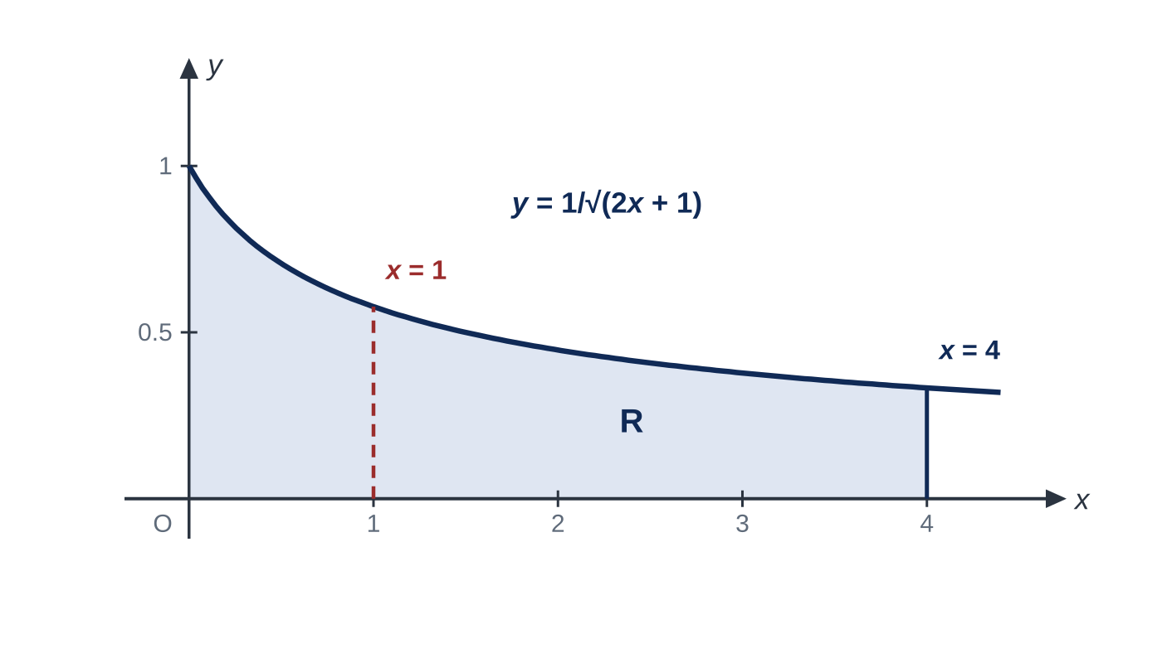
Question 1
6 marks
Figure 1 shows part of the curve C with equation y = 1/√(2x + 1), x ≥ 0. The shaded region R is bounded by C, the coordinate axes and the line x = 4. The region R is rotated through 360° about the x-axis to form the solid S.
(a) Show that the volume of S is π ln 3. [4]
(b) The plane x = 1, shown dashed in Figure 1, cuts S into two pieces. Show that the two pieces have equal volumes. [2]
Notes:
Online with the full mark scheme: https://examinerprep.com/ial-maths-p4-6-volumes-of-revolution-questions#IALM-P4-6-FB-02

Slide 40
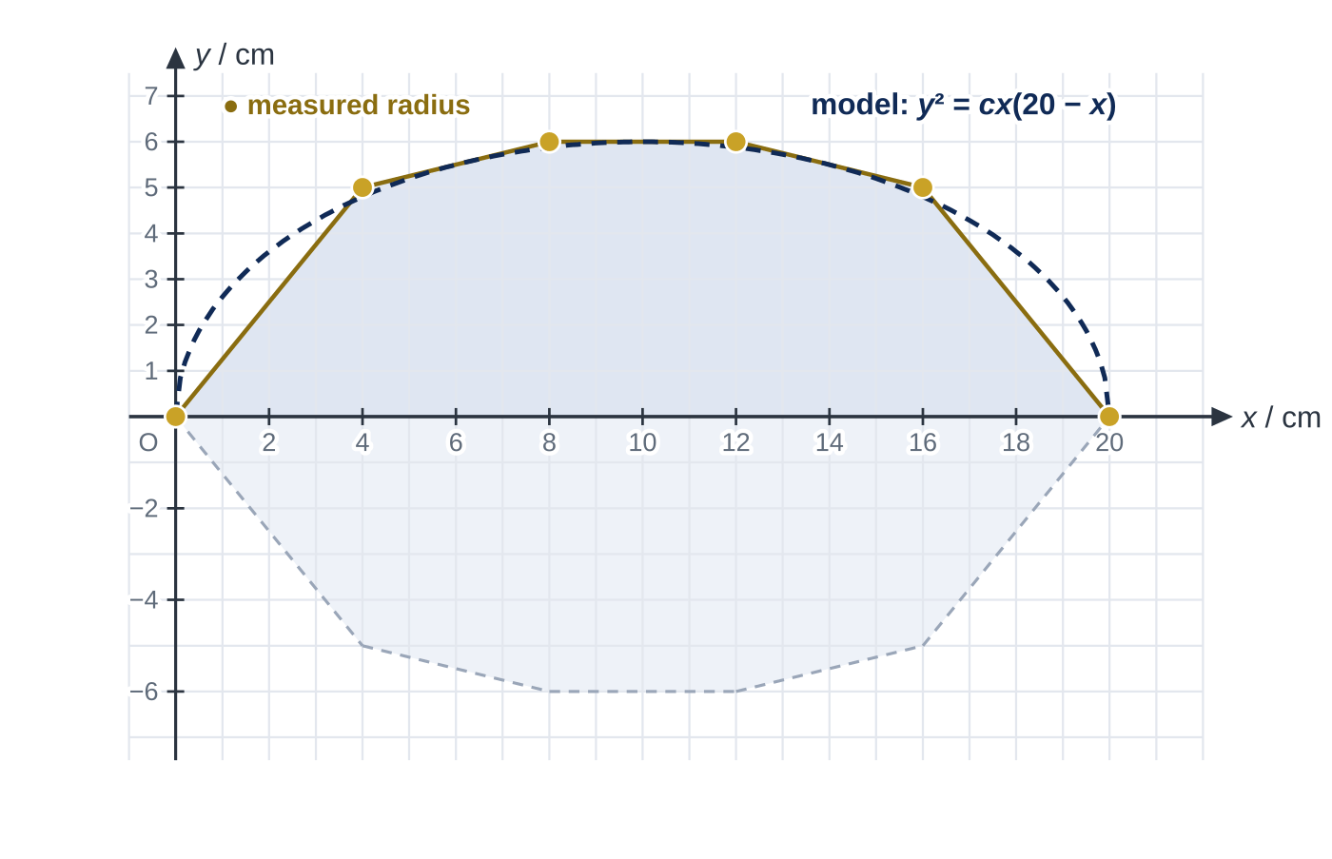
Question 2
9 marks
A fishing float is a solid of revolution. Figure 1 shows its profile on a centimetre grid, with the x-axis along its axis of symmetry. The radius y cm of the float was measured at x = 0, 4, 8, 12, 16 and 20. The measurements lie on grid points, shown as dots in Figure 1.
(a) Use the trapezium rule with all six measurements to estimate the volume of the float. Give your answer to 3 significant figures. [4]
(b) A designer models the profile by the curve with equation y² = cx(20 − x), 0 ≤ x ≤ 20, shown dashed in Figure 1. The constant c is chosen so that the greatest radius of the model is 6 cm. Find c. [2]
(c) Find the volume of the model, giving your answer as an exact multiple of π. [3]
Notes:
Online with the full mark scheme: https://examinerprep.com/ial-maths-p4-6-volumes-of-revolution-questions#IALM-P4-6-FB-10

Slide 41
Answers

Slide 42
Question 1 · answer
Mark scheme
V = π∫₀⁴ 1/(2x + 1) dx
π[½ ln(2x + 1)]
π(½ ln 9 − ½ ln 1)
½ ln 9 = ln 3 and ln 1 = 0, so V = π ln 3 cso
π∫₀¹ 1/(2x + 1) dx = ½π ln 3
this is half of π ln 3, so the other piece also has volume ½π ln 3
Notes:
Full mark scheme: https://examinerprep.com/ial-maths-p4-6-volumes-of-revolution-questions#IALM-P4-6-FB-02

Slide 43
Question 2 · answer
Mark scheme
values of y²: 0, 25, 36, 36, 25, 0
V ≈ π∫₀²⁰ y² dx with strip width 4
π × ½ × 4 × [0 + 0 + 2(25 + 36 + 36 + 25)] = 488π
1530 cm³
y is greatest where x(20 − x) is greatest, at x = 10
100c = 36, c = 0.36
V = π∫₀²⁰ 0.36(20x − x²) dx
0.36π[10x² − x³/3]₀²⁰
Notes:
Full mark scheme: https://examinerprep.com/ial-maths-p4-6-volumes-of-revolution-questions#IALM-P4-6-FB-10

Slide 44
Keep practising
Notes for this topic
Questions on this topic
Build a printable test
ExaminerPrep is an independent tutoring service. It has been developed independently from and is not endorsed by the International Baccalaureate Organization. "International Baccalaureate", "IB" and "IB Diploma Programme" are registered trademarks of the IBO, used here for descriptive purposes only.
Pearson Edexcel and Cambridge are trademarks of their owners; ExaminerPrep is not affiliated with any exam board.

