Slide 1
EP
EDEXCEL IAL MATHS
M2.4 Work, energy and power
The full notes page in 12 sections · practice questions with answers · simulations
ExaminerPrep is an independent tutoring service. It has been developed independently from and is not endorsed by the International Baccalaureate Organization. "International Baccalaureate", "IB" and "IB Diploma Programme" are registered trademarks of the IBO, used here for descriptive purposes only.
Pearson Edexcel and Cambridge are trademarks of their owners; ExaminerPrep is not affiliated with any exam board.
Notes:
M2.4 Work, energy and power. Notes for this topic: https://examinerprep.com/notes/edexcel-ial-maths/work-energy-and-power/

Slide 2
What this page covers
Overview
Kinetic energy ½ mv² and gravitational potential energy mgh
Work done by a constant force, including a force at an angle to the motion
Work done against friction and resistances, and against gravity on a slope
The work–energy principle
Conservation of mechanical energy when only gravity does work
Power as the rate of doing work, and P=Fv
Vehicles and cyclists working at constant power: driving force P/v, acceleration at a given speed and maximum speed, on level roads and on slopes
Notes:
What this page covers. Full notes: https://examinerprep.com/notes/edexcel-ial-maths/work-energy-and-power/

Slide 3
In one minute
Key points
1. Energy methods account for what a particle had, what forces added or took away, and what is left, which is often quicker than finding an acceleration first.
2. KE=½ mv² and GPE=mgh, both in joules; GPE depends only on the vertical height above a level you choose.
3. Work done by a constant force = force × distance moved in the direction of the force, Fscos θ. Forces perpendicular to the motion (such as the normal reaction) do no work.
4. Work–energy principle: starting energy + work done by driving forces − work done against resistances = final energy (KE + PE).
5. If no work is done against resistances and no driving force acts, KE + PE stays constant.
6. Power is the rate of doing work: P=Fv, in watts. At constant power the driving force is P/v, so it falls as the vehicle speeds up.
7. Maximum speed is reached when the acceleration is zero: P/v= resistance (+ mgsin α uphill).
Notes:
In one minute. Full notes: https://examinerprep.com/notes/edexcel-ial-maths/work-energy-and-power/

Slide 4
What are kinetic and gravitational potential energy?
Section 1 of 12
This topic gives you a second way into mechanics. Instead of finding an acceleration and then using the constant-acceleration formulae, you keep an account of energy. Two kinds of mechanical energy appear in M2.
KE=½ mv² GPE=mgh
Here m is the mass in kg, v the speed in m s⁻¹, g=9.8 m s⁻² and h the height in metres above a chosen zero level. Neither formula is in the formulae booklet: both must be known.
Energy is a scalar measured in joules (J), and 1 J = 1 N m. Kinetic energy depends on speed, not direction, so it is never negative. Only changes in GPE matter, so you may put the zero level anywhere; the lowest point of the motion is usually the best choice because every PE is then positive.
The h in mgh is always a vertical height. A particle that moves a distance d along a slope at angle α to the horizontal changes its height by dsin α.
Notes:
What are kinetic and gravitational potential energy?. Full notes: https://examinerprep.com/notes/edexcel-ial-maths/work-energy-and-power/

Slide 5
What are kinetic and gravitational potential energy? (continued)
Section 1 of 12
A change of speed from u to v changes the KE by ½ m(v²-u²): square first, then subtract. It is not ½ m(v-u)².
Notes:
What are kinetic and gravitational potential energy?. Full notes: https://examinerprep.com/notes/edexcel-ial-maths/work-energy-and-power/

Slide 6
What are kinetic and gravitational potential energy? (continued)
Section 1 of 12 · Worked example 1 · Easy · Find
WORKED EXAMPLE · QUESTION
(a) A car of mass 1200 kg travels at 54 km h⁻¹. Find its kinetic energy. (b) A walker of mass 70 kg follows a winding path 3.2 km long from a car park to a summit 240 m higher. Find the gain in her gravitational potential energy.
SOLUTION
(a) Convert the speed: 54×1000÷3600=15 m s⁻¹. Then KE=½×1200×15²= 135 000 J (135 kJ)
(b) GPE depends only on the vertical height gained, not on the length of the path: 70×9.8×240=164 640 J = 165 kJ (3 s.f.)
Notes:
What are kinetic and gravitational potential energy?: Worked example 1. Full notes: https://examinerprep.com/notes/edexcel-ial-maths/work-energy-and-power/

Slide 7
How do you calculate the work done by a force?
Section 2 of 12
Work done by a constant force = the magnitude of the force × the distance moved in the direction of the force.
W=Fscos θ
Here F is the force in N, s the distance moved in m, and θ the angle between the force and the direction of motion. This is not in the formulae booklet: learn the definition and the formula follows from it. Only the component of the force along the motion, Fcos θ, does work. A force perpendicular to the motion (θ=90°) does no work at all, because cos 90°=0.
Notes:
How do you calculate the work done by a force?. Full notes: https://examinerprep.com/notes/edexcel-ial-maths/work-energy-and-power/

Slide 8
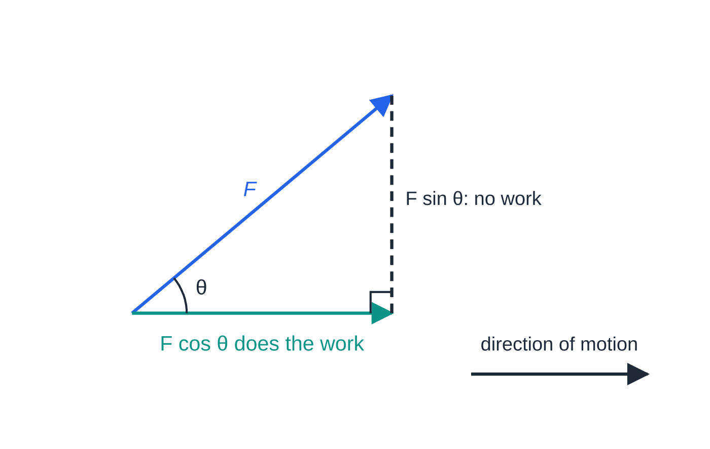
How do you calculate the work done by a force? (continued)
Section 2 of 12
Split a force into components along and across the motion. Only the component along the motion, F cos θ, does work; the perpendicular component F sin θ does none.
Notes:
How do you calculate the work done by a force?. Full notes: https://examinerprep.com/notes/edexcel-ial-maths/work-energy-and-power/

Slide 9
How do you calculate the work done by a force? (continued)
Section 2 of 12
Situation | Work done
Force along the motion | Fs
Force at angle θ to the motion | Fscos θ
Against constant friction or resistance R over a distance s | Rs (with F=μR for friction at its limit)
Against gravity, raising a particle through a height h | mgh (the gain in GPE)
Against gravity, moving d up a slope at angle α | mgsin α×d=mg(dsin α)
By the normal reaction on a surface | zero — it is perpendicular to the motion
Notice the last two rows of the table together. Pushing a particle up a slope against gravity costs the same as lifting it vertically through the same height: the component mgsin α is smaller than mg, but it acts over the longer distance d, and dsin α is just the height.
Notes:
How do you calculate the work done by a force?. Full notes: https://examinerprep.com/notes/edexcel-ial-maths/work-energy-and-power/

Slide 10
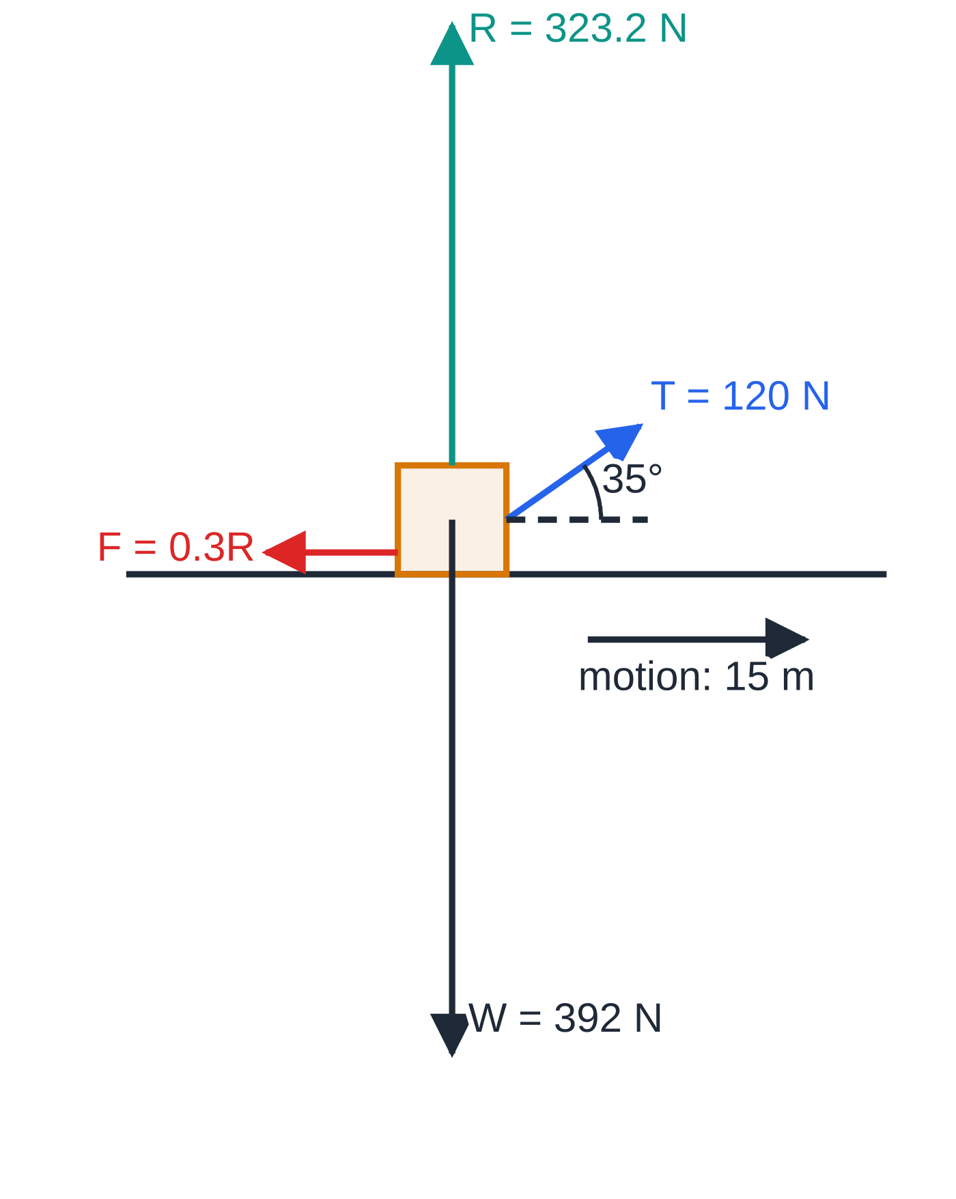
How do you calculate the work done by a force? (continued)
Section 2 of 12
Worked example 2, forces to scale. The rope lifts the crate slightly, so the normal reaction (323.2 N) is less than the weight, and so is the friction μR.
Notes:
How do you calculate the work done by a force?. Full notes: https://examinerprep.com/notes/edexcel-ial-maths/work-energy-and-power/

Slide 11
How do you calculate the work done by a force? (continued)
Section 2 of 12 · Worked example 2 · Medium · Find
WORKED EXAMPLE · QUESTION
A crate of mass 40 kg is pulled 15 m along rough horizontal ground by a light rope inclined at 35° above the horizontal. The tension in the rope is 120 N and the coefficient of friction between the crate and the ground is 0.3. The crate starts from rest. Find (a) the work done by the tension, (b) the work done against friction, (c) the speed of the crate after 15 m.
SOLUTION
(a) Only the horizontal component of the tension does work: 120cos 35°×15=1474.5 J = 1470 J (3 s.f.)
(b) Resolve vertically to find R: R+120sin 35°=40×9.8, so R=392-68.83=323.17 N. Then F=0.3×323.17=96.95 N and the work against friction =96.95×15= 1450 J (3 s.f.)
(c) Weight and R do no work, being perpendicular to the motion. The difference is the KE gained: ½×40×v²=1474.47-1454.27=20.20 J, so v=1.0 m s⁻¹ (2 s.f.)
Notes:
How do you calculate the work done by a force?: Worked example 2. Full notes: https://examinerprep.com/notes/edexcel-ial-maths/work-energy-and-power/

Slide 12
How do you calculate the work done by a force? (continued)
Section 2 of 12 · Worked example 2 · Medium · Find (continued)
Keep unrounded values until the end: subtracting two numbers that are close together magnifies rounding errors. Using 1470-1450 would give 20 J and the same answer only by luck.
Notes:
How do you calculate the work done by a force?: Worked example 2. Full notes: https://examinerprep.com/notes/edexcel-ial-maths/work-energy-and-power/

Slide 13
How do you calculate the work done by a force? (continued)
Section 2 of 12
Common error
Using R=mg when a pulling force acts at an angle. The vertical component of the pull reduces the normal reaction (or increases it, for a push downwards), so friction changes too.
Notes:
How do you calculate the work done by a force?. Full notes: https://examinerprep.com/notes/edexcel-ial-maths/work-energy-and-power/

Slide 14
What is the work–energy principle?
Section 3 of 12
Work–energy principle: the change in the total mechanical energy of a body equals the work done on it by forces other than its weight.
Written as an energy account, it reads
KEₛₜₐᵣₜ+PEₛₜₐᵣₜ+work done by driving forces=KE_end+PE_end+work done against resistances.
"Resistances" means friction, air resistance or any constant resistive force; "driving forces" means engine forces, pushes and pulls. This equation is not in the formulae booklet: build it from the definitions each time.
There is an equivalent form without PE: work done by the resultant force = change in KE. Use one form or the other, never both.
Notes:
What is the work–energy principle?. Full notes: https://examinerprep.com/notes/edexcel-ial-maths/work-energy-and-power/

Slide 15
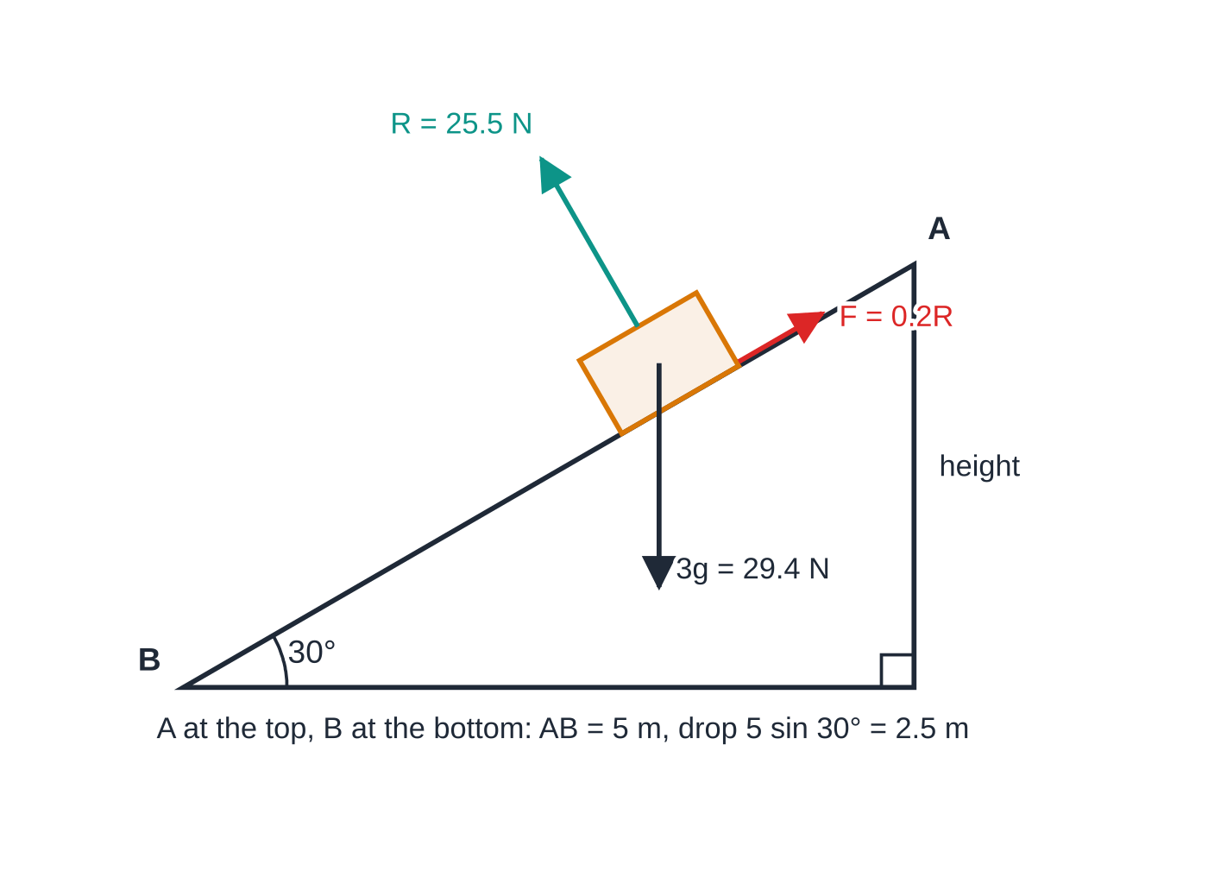
What is the work–energy principle? (continued)
Section 3 of 12
Gravity is either a PE term or a work term, not both, otherwise you count it twice.
A reliable method:
1. Choose the zero level for PE (usually the lowest point) and write the KE and PE at the start and the end.
2. Find the friction or resistance and the distance over which it acts; work against it = force × distance.
3. Write one energy equation and solve. No acceleration is needed, and the energy route also works when the acceleration is not constant.
Worked example 3: a 3 kg parcel slides 5 m down a rough ramp at 30° (μ = 0.2). The forces are to scale; the slope is drawn to its own scale. The parcel falls a vertical height of 5 sin 30° = 2.5 m.
Notes:
What is the work–energy principle?. Full notes: https://examinerprep.com/notes/edexcel-ial-maths/work-energy-and-power/

Slide 16
What is the work–energy principle? (continued)
Section 3 of 12 · Worked example 3 · Medium · Find
WORKED EXAMPLE · QUESTION
A parcel of mass 3 kg is released from rest at the top A of a rough ramp inclined at 30° to the horizontal. It slides down a line of greatest slope to B, where AB = 5 m. The coefficient of friction between the parcel and the ramp is 0.2. Use the work–energy principle to find the speed of the parcel at B.
SOLUTION
Step 1 Loss of PE, with the zero level at B: 3×9.8×5sin 30°=73.5 J.
Step 2 Friction. Perpendicular to the slope R=3×9.8cos 30°=25.461 N, so F=0.2R=5.0922 N and the work against friction is 5.0922×5=25.46 J.
Step 3 PE lost = KE gained + work done against friction: 73.5=½×3×v²+25.46, so ½×3×v²=48.04 and v=5.66 m s⁻¹ (3 s.f.)
Check: on a smooth ramp the speed would be √(2×9.8×2.5)=7.0 m s⁻¹, so friction has reduced it, as it should.
Notes:
What is the work–energy principle?: Worked example 3. Full notes: https://examinerprep.com/notes/edexcel-ial-maths/work-energy-and-power/

Slide 17
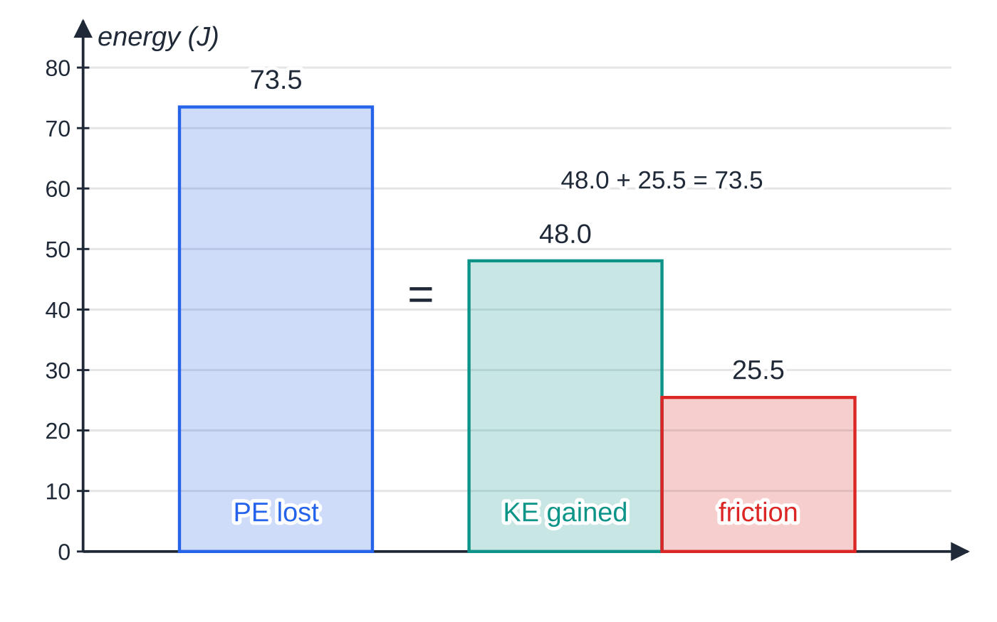
What is the work–energy principle? (continued)
Section 3 of 12
The energy method is particularly good at finding an unknown resistance. If you know the speeds at two points and the distance between them, the work done against the resistance is whatever energy is left over, and dividing by the distance gives the force.
The same energy equation as a bar chart, to scale: the 73.5 J of potential energy lost is shared between kinetic energy gained (48.0 J) and work done against friction (25.5 J).
Notes:
What is the work–energy principle?. Full notes: https://examinerprep.com/notes/edexcel-ial-maths/work-energy-and-power/

Slide 18
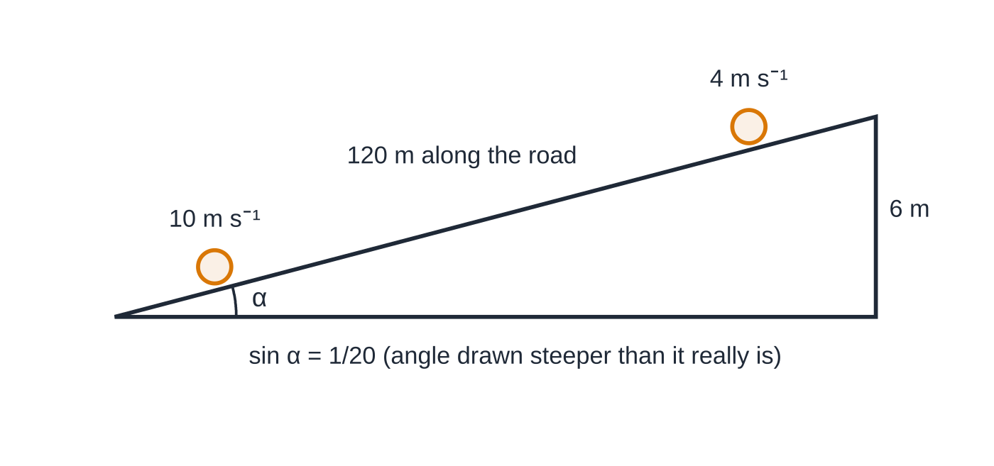
What is the work–energy principle? (continued)
Section 3 of 12
Worked example 4: the cyclist freewheels 120 m down a road with sin α = 1/20, so she drops 120 ÷ 20 = 6 m while speeding up from 4 to 10 m s⁻¹.
Notes:
What is the work–energy principle?. Full notes: https://examinerprep.com/notes/edexcel-ial-maths/work-energy-and-power/

Slide 19
What is the work–energy principle? (continued)
Section 3 of 12 · Worked example 4 · Medium · Find
WORKED EXAMPLE · QUESTION
A cyclist and her bicycle have a total mass of 80 kg. She freewheels (does not pedal) down a straight road inclined at an angle α to the horizontal, where sin α=(1/20). Her speed increases from 4 m s⁻¹ to 10 m s⁻¹ while she travels 120 m. The resistance to motion is modelled as a constant force. Find the magnitude of the resistance.
SOLUTION
Step 1 Vertical height lost: 120×(1/20)=6 m, so PE lost =80×9.8×6=4704 J.
Step 2 KE gained: ½×80×(10²-4²)=3360 J.
Step 3 The rest of the PE lost is used doing work against the resistance R over 120 m: 120R=4704-3360=1344, so R=11.2 N
Notes:
What is the work–energy principle?: Worked example 4. Full notes: https://examinerprep.com/notes/edexcel-ial-maths/work-energy-and-power/

Slide 20
What is the work–energy principle? (continued)
Section 3 of 12
Exam tip
When a question says "use the work–energy principle", an answer found with F=ma and v²=u²+2as does not follow the instruction. Write the energy equation in words first ("PE lost = KE gained + work done against friction"), then substitute.
Notes:
What is the work–energy principle?. Full notes: https://examinerprep.com/notes/edexcel-ial-maths/work-energy-and-power/

Slide 21
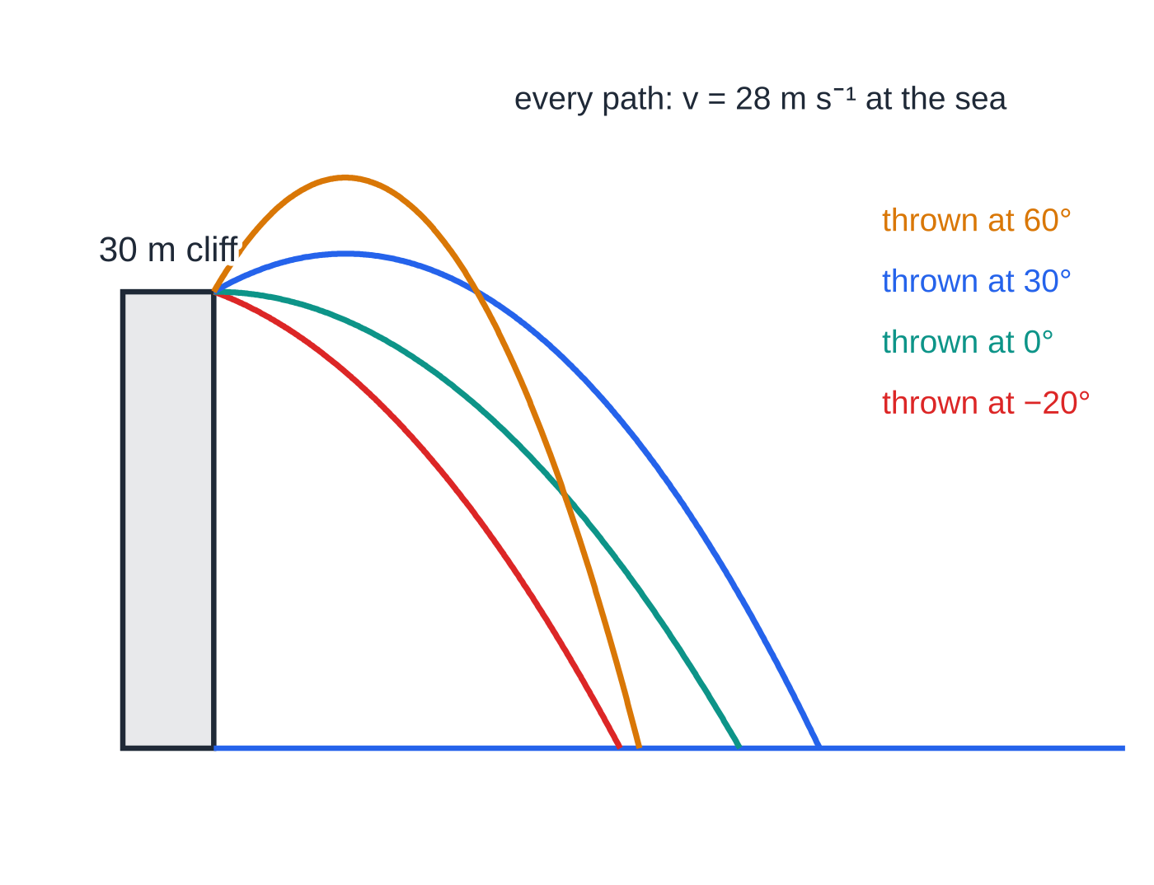
When is mechanical energy conserved?
Section 4 of 12
Conservation of mechanical energy: if the only force doing work is the weight, the sum KE + PE stays constant.
This applies to a particle moving freely under gravity, such as a projectile with no air resistance, and to a particle on a smooth surface, where the normal reaction does no work. It does not depend on the shape of the path or the direction of projection: only the change in height matters. Once friction, resistance or a driving force does work, use the full work–energy principle instead.
Worked example 5(a): a ball thrown at 14 m s⁻¹ from a 30 m cliff in four different directions. The paths differ, but each ball loses the same 30 m of height, so each reaches the sea at 28 m s⁻¹.
Notes:
When is mechanical energy conserved?. Full notes: https://examinerprep.com/notes/edexcel-ial-maths/work-energy-and-power/

Slide 22
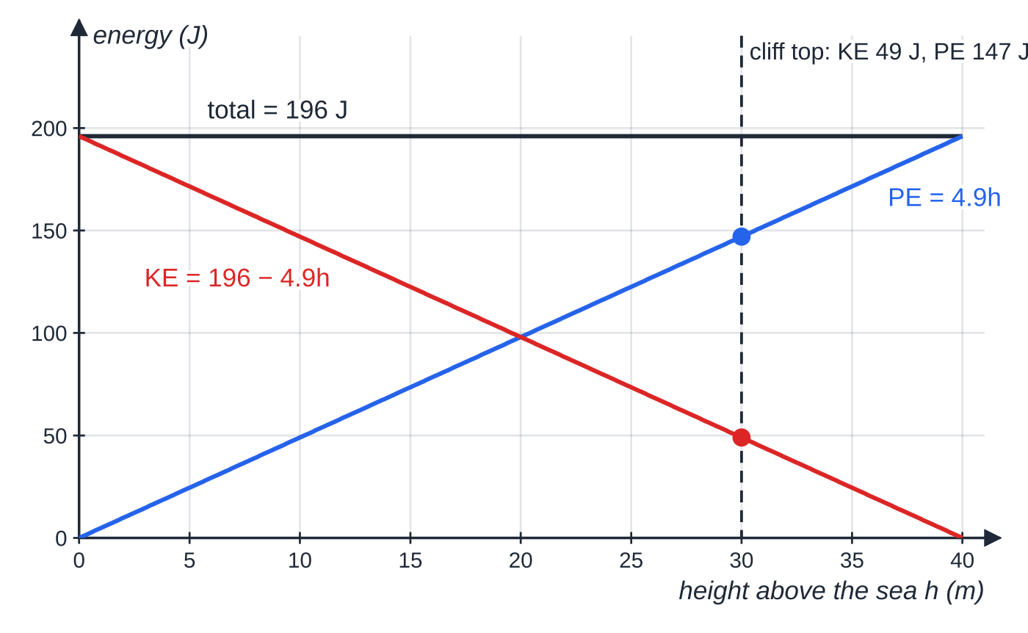
When is mechanical energy conserved? (continued)
Section 4 of 12
For the 0.5 kg ball (sea level as the zero of PE), KE and PE trade off along straight lines in h while the total stays at 196 J. At the cliff top KE = 49 J and PE = 147 J; at the sea all 196 J is kinetic.
Notes:
When is mechanical energy conserved?. Full notes: https://examinerprep.com/notes/edexcel-ial-maths/work-energy-and-power/

Slide 23
When is mechanical energy conserved? (continued)
Section 4 of 12 · Worked example 5 · Medium · Find
WORKED EXAMPLE · QUESTION
(a) A ball of mass 0.5 kg is thrown from the top of a vertical cliff 30 m above the sea with speed 14 m s⁻¹. Air resistance is negligible. Find the speed with which the ball hits the sea. (b) A small block is projected with speed 8 m s⁻¹ up a line of greatest slope of a smooth plane inclined at 25° to the horizontal. Find the distance it travels up the plane before coming to instantaneous rest.
SOLUTION
(a) KE + PE is constant; take sea level as zero: ½×0.5×14²+0.5×9.8×30=½×0.5×v². The mass cancels: v²=196+588=784, so v=28 m s⁻¹
(b) KE lost = PE gained, with height dsin 25°: ½ m×8²=m×9.8×dsin 25°, so d=64/19.6sin 25°= 7.73 m (3 s.f.)
In (a) the angle of the throw is not given and is not needed — a strong hint that an energy method is expected.
Notes:
When is mechanical energy conserved?: Worked example 5. Full notes: https://examinerprep.com/notes/edexcel-ial-maths/work-energy-and-power/

Slide 24
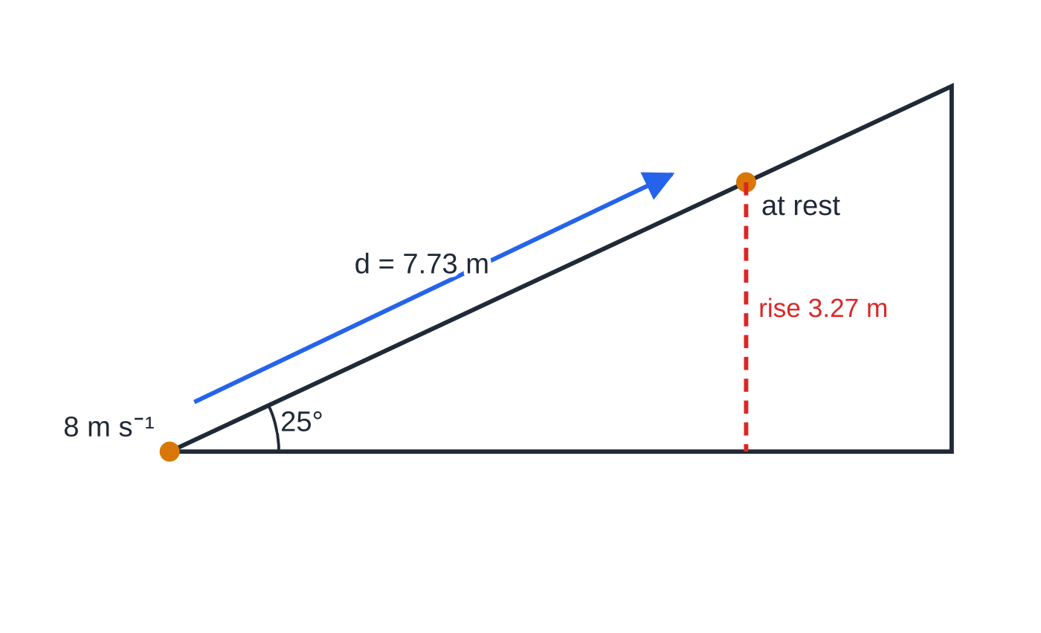
When is mechanical energy conserved? (continued)
Section 4 of 12
Common error
Using conservation of mechanical energy on a rough surface, or for a vehicle with an engine. If any force other than the weight does work, an extra work term must appear in the equation.
Worked example 5(b): the block rises 7.73 m along the smooth plane, which is a vertical rise of 7.73 sin 25° = 3.27 m. Its 32 J per kilogram of kinetic energy becomes 9.8 × 3.27 J per kilogram of potential energy.
Notes:
When is mechanical energy conserved?. Full notes: https://examinerprep.com/notes/edexcel-ial-maths/work-energy-and-power/

Slide 25
What is power, and how does it fix the driving force?
Section 5 of 12
Power is the rate at which work is done.
P=(work done)/(time taken) P=Fv
Here P is the power in watts, F the driving force in N and v the speed in m s⁻¹. Neither form is in the formulae booklet: learn both. P=Fv follows from work = F× distance: divide both sides by time, and distance ÷ time is speed. 1 W = 1 J s⁻¹ and 1 kW = 1000 W.
A crane raising a 450 kg load at a steady 0.60 m s⁻¹ pulls with a force equal to the weight, so it works at 450×9.8×0.60=2646 W ≈ 2.65 kW.
The important consequence is for vehicles. If an engine works at a constant rate P, then the driving force at speed v is P/v: the faster the vehicle goes, the smaller the driving force. At the instant the speed is v, Newton's second law on a level road gives
Notes:
What is power, and how does it fix the driving force?. Full notes: https://examinerprep.com/notes/edexcel-ial-maths/work-energy-and-power/

Slide 26
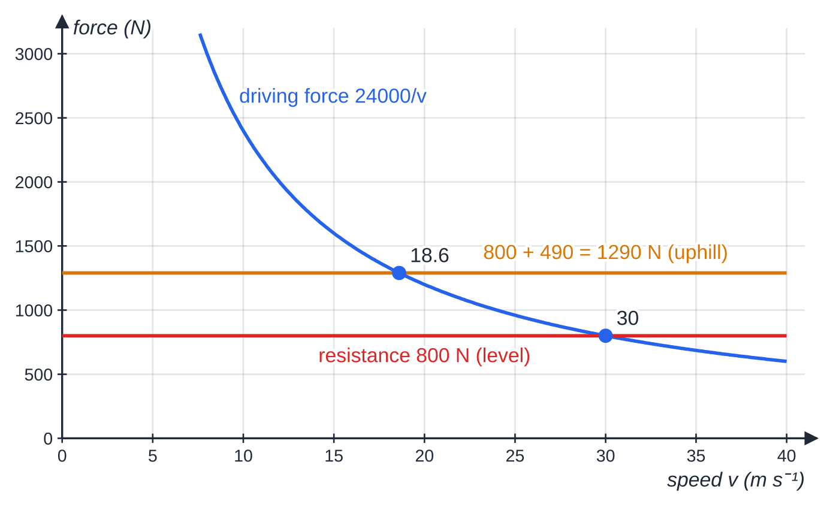
What is power, and how does it fix the driving force? (continued)
Section 5 of 12
P/v-resistance=ma.
As v rises the left-hand side shrinks, so the acceleration falls. The vehicle reaches its maximum speed when a=0, that is when P/v_(max)= resistance.
Driving force P/v for a 24 kW engine. Where the curve meets the resistance line the resultant force is zero and the speed can rise no further: 30 m s⁻¹ on the level, 18.6 m s⁻¹ up a slope with sin α = 1/20 for a 1000 kg car.
Notes:
What is power, and how does it fix the driving force?. Full notes: https://examinerprep.com/notes/edexcel-ial-maths/work-energy-and-power/

Slide 27
What is power, and how does it fix the driving force? (continued)
Section 5 of 12 · Worked example 6 · Medium · Find
WORKED EXAMPLE · QUESTION
A car of mass 1000 kg has an engine working at a constant rate of 24 kW. The resistance to motion is constant, 800 N. (a) Find the maximum speed of the car on a straight horizontal road. (b) Find its acceleration on that road when its speed is 12 m s⁻¹. (c) The car now drives up a straight road inclined at α to the horizontal, where sin α=(1/20), with the same power and resistance. Find its maximum speed up the hill.
SOLUTION
(a) At maximum speed the driving force equals the resistance: 24 000/v=800, so v=30 m s⁻¹
(b) Driving force at 12 m s⁻¹: 24 000÷12=2000 N. Then 2000-800=1000a, so a=1.2 m s⁻²
(c) Uphill, the component of the weight mgsin α=1000×9.8×(1/20)=490 N also opposes the motion: 24 000/v=800+490=1290, so v=18.6 m s⁻¹ (3 s.f.)
Notes:
What is power, and how does it fix the driving force?: Worked example 6. Full notes: https://examinerprep.com/notes/edexcel-ial-maths/work-energy-and-power/

Slide 28
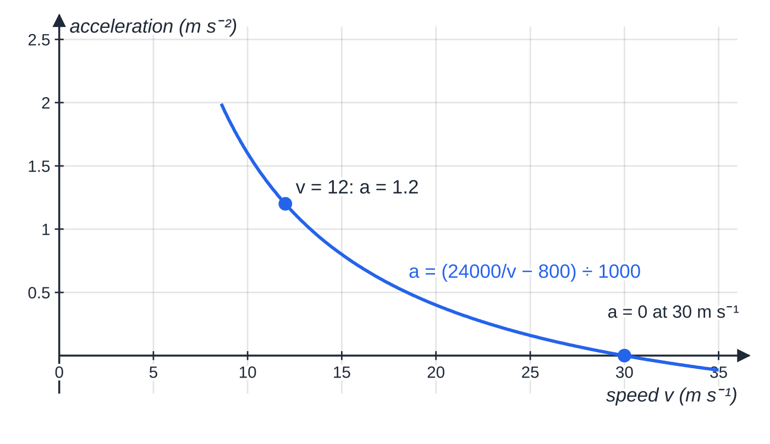
What is power, and how does it fix the driving force? (continued)
Section 5 of 12
Exam tip
Powers are often given in kW. Convert to watts before dividing by the speed: 24 kW ÷ 12 m s⁻¹ is 2000 N, not 2 N.
The car of worked example 6 on the level. At constant power the acceleration is not constant: it falls as the speed rises and reaches zero at the maximum speed, 30 m s⁻¹.
Notes:
What is power, and how does it fix the driving force?. Full notes: https://examinerprep.com/notes/edexcel-ial-maths/work-energy-and-power/

Slide 29
How do you handle vehicles on slopes?
Section 6 of 12
Resolve along the slope. Up a slope at angle α, the forces opposing the motion are the resistance R and the weight component mgsin α:
P/v-R-mgsin α=ma.
Down a slope the weight component helps instead: P/v+mgsin α-R=ma.
Slopes are usually given as sin α=1/n, meaning a rise of 1 m for every n m travelled along the road. Use the fraction directly; there is no need to find α. The normal reaction and mgcos α are perpendicular to the motion and do not appear in the equation along the slope.
Notes:
How do you handle vehicles on slopes?. Full notes: https://examinerprep.com/notes/edexcel-ial-maths/work-energy-and-power/

Slide 30
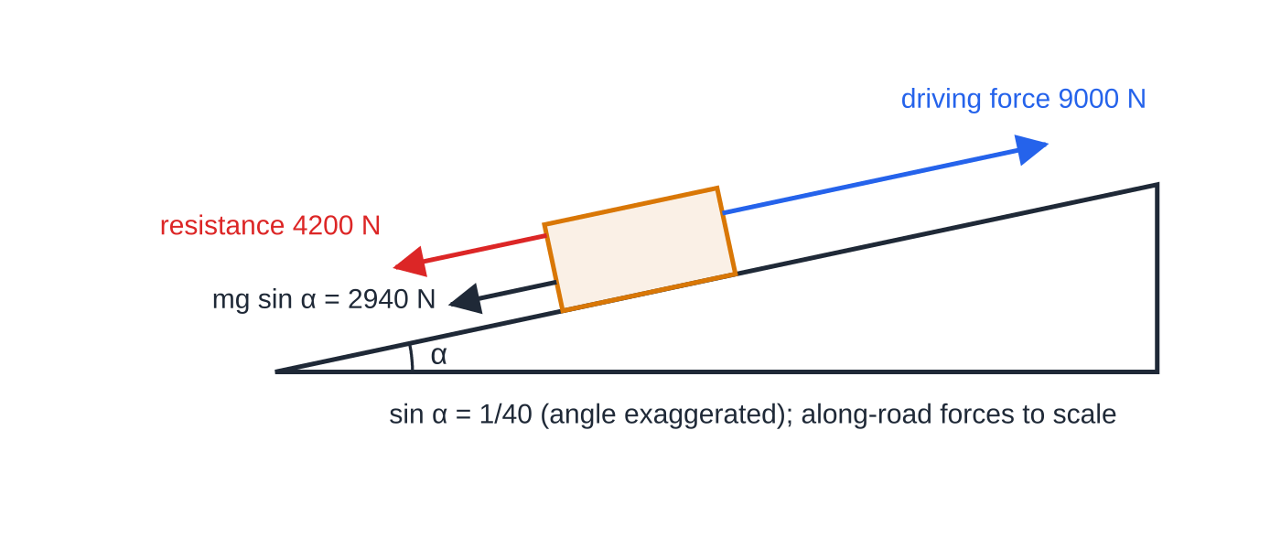
How do you handle vehicles on slopes? (continued)
Section 6 of 12
Worked example 7: the 12 000 kg lorry climbing at 10 m s⁻¹ with the engine at 90 kW. Along the road, 9000 − 4200 − 2940 = 1860 N of resultant force gives an acceleration of 0.155 m s⁻².
Notes:
How do you handle vehicles on slopes?. Full notes: https://examinerprep.com/notes/edexcel-ial-maths/work-energy-and-power/

Slide 31
How do you handle vehicles on slopes? (continued)
Section 6 of 12 · Worked example 7 · Medium · Find
WORKED EXAMPLE · QUESTION
A lorry of mass 12 000 kg moves along a straight road inclined at α to the horizontal, where sin α=(1/40). The resistance to motion from non-gravitational forces is constant, 4200 N. (a) The lorry moves up the road with its engine working at 90 kW. Find its acceleration when its speed is 10 m s⁻¹, and its maximum speed. (b) The lorry then moves down the same road at a constant speed of 20 m s⁻¹. Find the rate at which its engine is now working.
SOLUTION
Step 1 Weight component along the road: 12 000×9.8×(1/40)=2940 N.
Step 2 (a) Driving force 90 000÷10=9000 N. Newton's second law up the slope: 9000-4200-2940=12 000a, so a=0.155 m s⁻²
Step 3 Maximum speed when a=0: 90 000/v=4200+2940=7140, so v=12.6 m s⁻¹ (3 s.f.)
Notes:
How do you handle vehicles on slopes?: Worked example 7. Full notes: https://examinerprep.com/notes/edexcel-ial-maths/work-energy-and-power/

Slide 32
How do you handle vehicles on slopes? (continued)
Section 6 of 12 · Worked example 7 · Medium · Find (continued)
Step 4 (b) Constant speed downhill: driving force + weight component = resistance, so D=4200-2940=1260 N and P=1260×20=25 200 W = 25.2 kW
Notes:
How do you handle vehicles on slopes?: Worked example 7. Full notes: https://examinerprep.com/notes/edexcel-ial-maths/work-energy-and-power/

Slide 33
How do you handle vehicles on slopes? (continued)
Section 6 of 12
Common error
Using mg instead of mgsin α along the slope, or putting mgsin α on the wrong side when the vehicle goes downhill. Draw an arrow for each force along the slope before writing the equation.
Notes:
How do you handle vehicles on slopes?. Full notes: https://examinerprep.com/notes/edexcel-ial-maths/work-energy-and-power/

Slide 34
How do you put it all together?
Section 7 of 12
Longer questions mix the two halves of this topic, and the first job is to decide which tool each part needs.
At an instant (acceleration at a given speed, maximum speed): use P=Fv and Newton's second law.
Over a distance (speed changes between two points, a time taken at constant power): use the work–energy principle, with work done by the engine = P× time.
An engine working at constant power does not give constant acceleration, so the constant-acceleration formulae cannot be used for that stage.
Notes:
How do you put it all together?. Full notes: https://examinerprep.com/notes/edexcel-ial-maths/work-energy-and-power/

Slide 35
How do you put it all together? (continued)
Section 7 of 12 · Worked example 8 · Hard · Find
WORKED EXAMPLE · QUESTION
A car of mass 1100 kg drives up a straight road inclined at α to the horizontal, where sin α=(1/25). The resistance to motion from non-gravitational forces is constant, 650 N. (a) The engine works at a constant rate of 30 kW. Find the acceleration of the car when its speed is 12 m s⁻¹. (b) Find the maximum speed of the car up the road at this rate of working. (c) On another occasion the car passes a point A on the road at 20 m s⁻¹ and a point B, 400 m further up the road, at 14 m s⁻¹. It takes 25 s to go from A to B. Find the work done by the engine between A and B, and the average rate at which it works.
SOLUTION
(a) Weight component mgsin α=1100×9.8÷25=431.2 N; driving force =30 000÷12=2500 N. Newton's second law up the slope: 2500-650-431.2=1100a, so a=1.2898…= 1.29 m s⁻² (3 s.f.)
(b) Maximum speed when the resultant force is zero: 30 000/v=650+431.2=1081.2, so v=27.747…= 27.7 m s⁻¹ (3 s.f.)
Notes:
How do you put it all together?: Worked example 8. Full notes: https://examinerprep.com/notes/edexcel-ial-maths/work-energy-and-power/

Slide 36
How do you put it all together? (continued)
Section 7 of 12 · Worked example 8 · Hard · Find (continued)
(c) Height gained =400÷25=16 m. KE lost =½×1100×(20²-14²)=112 200 J; PE gained =1100×9.8×16=172 480 J; work against resistance =650×400=260 000 J.
KE lost + work by engine = PE gained + work against resistance, so work by engine =172 480+260 000-112 200=320 280 J ≈ 3.20×10⁵ J
Average power = work ÷ time =320 280÷25=12 811.2 W ≈ 12.8 kW (3 s.f.)
Sense check: the average power is well below 30 kW, which fits a car that is slowing down on the hill.
Notes:
How do you put it all together?: Worked example 8. Full notes: https://examinerprep.com/notes/edexcel-ial-maths/work-energy-and-power/

Slide 37
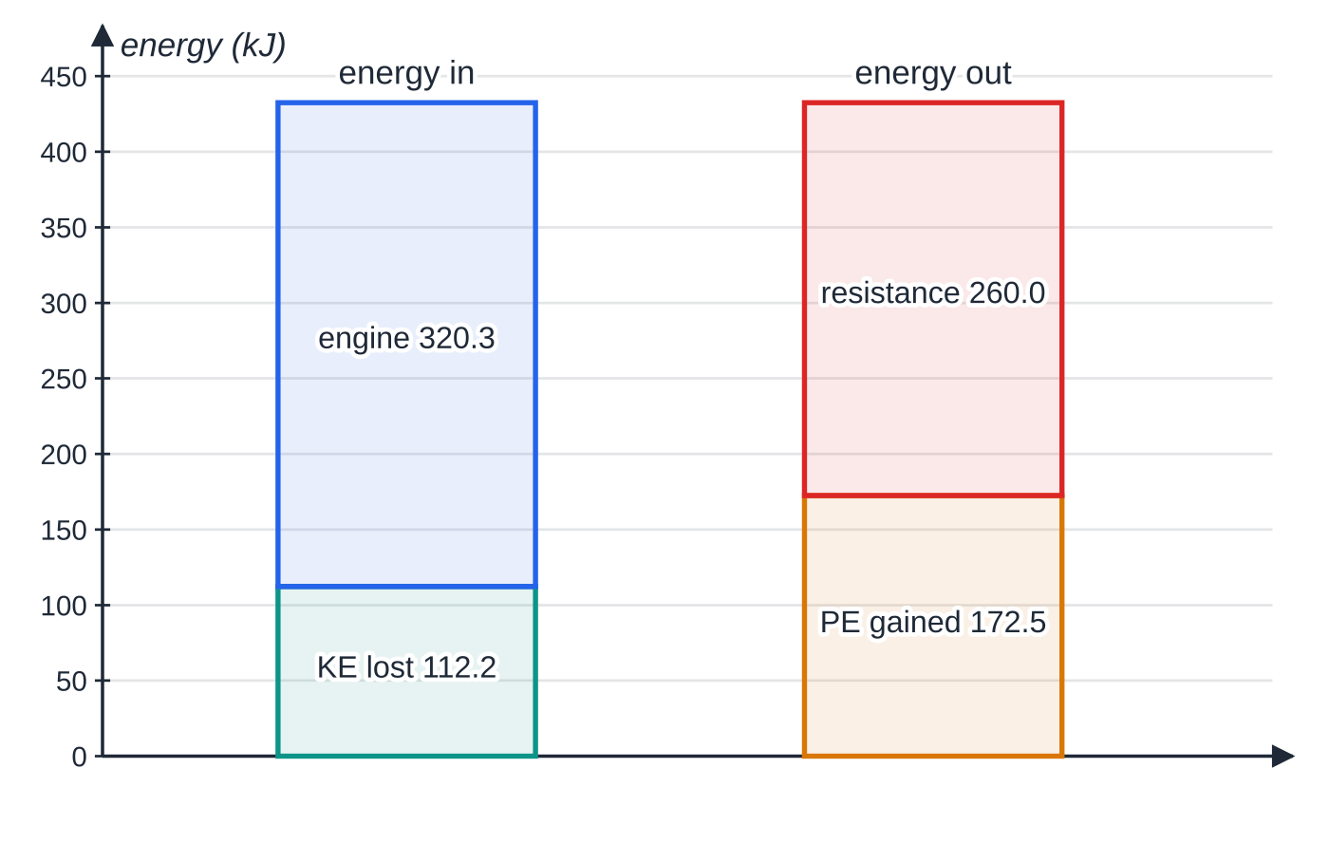
How do you put it all together? (continued)
Section 7 of 12
The energy account for A to B in worked example 8(c), in kJ. Energy in (KE lost + work by the engine) must equal energy out (PE gained + work against resistance): 432.48 kJ each side.
Notes:
How do you put it all together?. Full notes: https://examinerprep.com/notes/edexcel-ial-maths/work-energy-and-power/

Slide 38
Exam tips for M2.4
Section 8 of 12
Exam tip 1 — say which principle you are using
Start an energy solution with a word equation, such as "KE lost + work done by the engine = PE gained + work done against resistance". It shows the method clearly even if an arithmetic slip follows.
Exam tip 2 — heights are vertical
On a slope, PE changes by mg×dsin α. With sin α=1/n given, the height is simply the distance along the road divided by n.
Exam tip 3 — instant or interval?
"When its speed is …" or "maximum speed" points to P=Fv with Newton's second law at one instant. "Between A and B" or "in moving … m" points to the work–energy principle over an interval.
Notes:
Exam tips for M2.4. Full notes: https://examinerprep.com/notes/edexcel-ial-maths/work-energy-and-power/

Slide 39
Exam tips for M2.4 (continued)
Section 8 of 12
Exam tip 4 — accuracy with g = 9.8
Answers that use g=9.8 should be given to 2 or 3 significant figures. Keep full calculator values in the working and round only the final answer.
Exam tip 5 — units of power
Convert kW to W before using P=Fv, and give the answer in the unit asked for. A rate of working in watts, a force in newtons and an energy in joules are easy to mix up when all three appear in one question.
Notes:
Exam tips for M2.4. Full notes: https://examinerprep.com/notes/edexcel-ial-maths/work-energy-and-power/

Slide 40
Common misconceptions
Section 9 of 12
Misconception | Why it is wrong | Correct idea
Change in KE =½ m(v-u)². | KE is not linear in speed. | Change in KE =½ mv²-½ mu².
The normal reaction does work on a body sliding down a slope. | It is perpendicular to the motion, so cos 90°=0. | Forces perpendicular to the motion do no work.
GPE depends on the distance moved along the slope. | Only vertical height changes the GPE. | ΔGPE=mg× vertical height =mgdsin α.
An engine at constant power gives a constant driving force. | P=Fv, so F=P/v falls as v rises. | The acceleration decreases as the vehicle speeds up.
At maximum speed there is no driving force. | The driving force is still P/v. | At maximum speed the driving force balances the resistance (and mgsin α uphill).
Energy is always conserved, so KE + PE is always constant. | Work done against friction or by an engine changes the mechanical energy. | KE + PE is constant only when the weight is the only force doing work.
Notes:
Common misconceptions. Full notes: https://examinerprep.com/notes/edexcel-ial-maths/work-energy-and-power/

Slide 41
How this topic connects
Section 10 of 12
M1 Dynamics
Friction F=μR, resolving on inclined planes and Newton's second law are all reused here; the energy method is an alternative to F=ma plus the constant-acceleration formulae whenever forces are constant.
M2.5 Collisions and M2 projectiles
Loss of kinetic energy in an impact is calculated with ½ mv², and the speed of a projectile at a given height comes straight from conservation of energy, without the angle of projection.
Pure and IAL Physics
Rearranging P/v-R=ma for v and solving for unknown resistances is straightforward algebra; work done by a variable force (an integral) is a natural extension met in later mechanics. In IAL Physics Unit 1 the same ideas of work, kinetic and gravitational potential energy and power appear, with efficiency added.
Notes:
How this topic connects. Full notes: https://examinerprep.com/notes/edexcel-ial-maths/work-energy-and-power/

Slide 42
Key formulae
Section 11 of 12
Formula | Use | In the formulae list?
KE=½ mv² | kinetic energy | No — must be known
GPE=mgh | gravitational potential energy, h vertical | No — must be known
W=Fscos θ | work done by a constant force at angle θ to the motion | No — derive it from the definition of work
KE₁+PE₁+work in=KE₂+PE₂+work against resistances | work–energy principle | No — derive it
P=work÷time, P=Fv | power; driving force F=P/v | No — derive it
P/v-R∓mgsin α=ma | vehicle at constant power, up (−) or down (+) a slope; a=0 at maximum speed | No — derive it
Notes:
Key formulae. Full notes: https://examinerprep.com/notes/edexcel-ial-maths/work-energy-and-power/

Slide 43
Check your understanding
Section 12 of 12
1. Find the kinetic energy of a ball of mass 0.06 kg moving at 25 m s⁻¹.
2. A box of mass 15 kg is lifted at constant speed onto a shelf 1.8 m higher. Find the work done against gravity.
3. A car travels at a constant 25 m s⁻¹ along a level road against a constant resistance of 720 N. Find the rate at which its engine is working.
4. Explain why the normal reaction does no work on a particle sliding down a slope.
5. A particle slides from rest down a smooth curved surface and ends 2.5 m lower than it started. Find its speed.
6. A cyclist works at a constant 150 W on a level road against a constant resistance of 20 N. Find her maximum speed, and her acceleration at 5 m s⁻¹ if she and her bicycle have mass 75 kg.
Notes:
Check your understanding: questions. Full notes: https://examinerprep.com/notes/edexcel-ial-maths/work-energy-and-power/

Slide 44
Check your understanding · answers
Section 12 of 12
1. ½×0.06×25²=18.75 J (18.8 J to 3 s.f.).
2. mgh=15×9.8×1.8=264.6 J ≈ 265 J.
3. Constant speed, so the driving force = 720 N. P=Fv=720×25=18 000 W = 18 kW.
4. The normal reaction is perpendicular to the slope, and so perpendicular to the direction of motion. Its component along the motion is zero (cos 90°=0), so the work it does is zero.
5. Only the weight does work, so mechanical energy is conserved: ½ v²=9.8×2.5, v=7 m s⁻¹. The shape of the surface does not matter.
6. Maximum speed when 150/v=20: v=7.5 m s⁻¹. At 5 m s⁻¹ the driving force is 150÷5=30 N, so 30-20=75a and a=0.133 m s⁻² (3 s.f.).
Notes:
Check your understanding: answers. Full notes: https://examinerprep.com/notes/edexcel-ial-maths/work-energy-and-power/

Slide 45
Practice questions
2 original exam-style questions. Answers at the end of the deck.

Slide 46
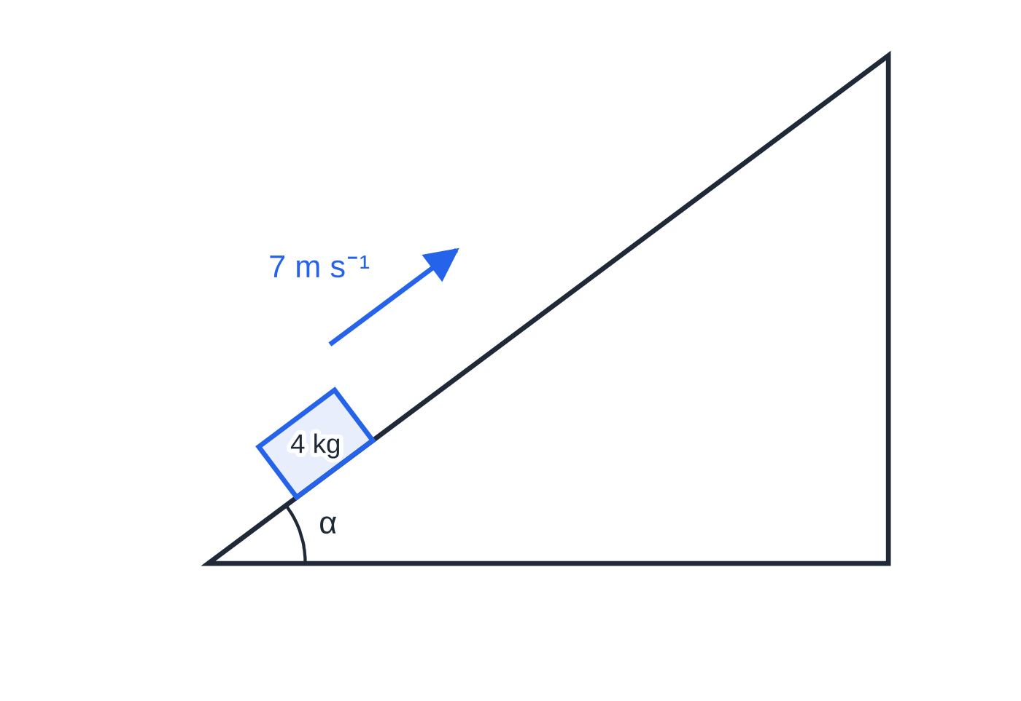
Question 1
9 marks
A box of mass 4 kg is projected with speed 7 m s⁻¹ up a line of greatest slope of a rough ramp. The ramp is inclined at an angle α to the horizontal, where tan α = 34. The coefficient of friction between the box and the ramp is 0.5. The box is modelled as a particle. Take g = 9.8 m s⁻².
Figure: the box projected up the rough ramp; tan α = 3/4; not to scale.
(a) Use the work–energy principle to find the distance the box travels up the ramp before it comes to instantaneous rest. [5]
(b) Show that the box does not remain at rest. [2]
(c) Find the speed of the box when it returns to its point of projection. [2]
Notes:
Online with the full mark scheme: https://examinerprep.com/ial-maths-m2-4-work-energy-and-power-questions#IALM-M2-4-B-07

Slide 47
Question 2
7 marks
A lorry of mass 16 000 kg is travelling at 25 m s⁻¹ when its engine is disengaged and its brakes are applied. The total resistance to motion, including braking, is modelled as a constant force of magnitude R newtons. Take g = 9.8 m s⁻².
(a) On a straight horizontal road the lorry comes to rest in a distance of 80 m. Use the work–energy principle to find R. [3]
(b) The lorry is now travelling at 25 m s⁻¹ down a straight road inclined at α to the horizontal, where sin α = 114, when the same braking begins. The resistance is unchanged. Find the distance the lorry travels before it comes to rest. [4]
Notes:
Online with the full mark scheme: https://examinerprep.com/ial-maths-m2-4-work-energy-and-power-questions#IALM-M2-4-B-08

Slide 48
Answers

Slide 49
Question 1 · answer
Mark scheme
sin α = 0.6, cos α = 0.8; R = 4 × 9.8 × 0.8 = 31.36 N
F = 0.5 × 31.36 = 15.68 N
PE gained = 4 × 9.8 × 0.6d = 23.52d
½ × 4 × 7² = 23.52d + 15.68d
d = 2.5 m
component of weight down the ramp = 23.52 N, maximum friction = 15.68 N
23.52 > 15.68 so the box slides back down
½ × 4 × v² = 23.52 × 2.5 − 15.68 × 2.5 (= 19.6)
Notes:
Full mark scheme: https://examinerprep.com/ial-maths-m2-4-work-energy-and-power-questions#IALM-M2-4-B-07

Slide 50
Question 2 · answer
Mark scheme
KE = ½ × 16 000 × 25² = 5 000 000 J
80R = 5 000 000
R = 62 500
PE lost over distance d = 16 000 × 9.8 × d/14 = 11 200d
KE lost + PE lost = work done against R
5 000 000 + 11 200d = 62 500d
d = 97.5 m
Notes:
Full mark scheme: https://examinerprep.com/ial-maths-m2-4-work-energy-and-power-questions#IALM-M2-4-B-08

Slide 51
Keep practising
Notes for this topic
Questions on this topic
Build a printable test
ExaminerPrep is an independent tutoring service. It has been developed independently from and is not endorsed by the International Baccalaureate Organization. "International Baccalaureate", "IB" and "IB Diploma Programme" are registered trademarks of the IBO, used here for descriptive purposes only.
Pearson Edexcel and Cambridge are trademarks of their owners; ExaminerPrep is not affiliated with any exam board.

