Slide 1
EP
EDEXCEL IAL PHYSICS
4.7 Atomic structure and particle accelerators
The full notes page in 12 sections · practice questions with answers · simulations
ExaminerPrep is an independent tutoring service. It has been developed independently from and is not endorsed by the International Baccalaureate Organization. "International Baccalaureate", "IB" and "IB Diploma Programme" are registered trademarks of the IBO, used here for descriptive purposes only.
Pearson Edexcel and Cambridge are trademarks of their owners; ExaminerPrep is not affiliated with any exam board.
Notes:
4.7 Atomic structure and particle accelerators. Notes for this topic: https://examinerprep.com/notes/edexcel-ial-physics/atomic-structure-and-particle-accelerators/

Slide 2
What this page covers
Overview
Nucleon number A and proton number Z; nuclide notation and isotopes
Large-angle alpha-particle scattering as evidence for a small, massive, positive nucleus, and how models of the atom changed
Thermionic emission and accelerating electrons through a p.d.: eV = ½ mv²
The roles of electric and magnetic fields in linear accelerators, cyclotrons and detectors
Deriving and using r = p/BQ
Conservation of charge, energy and momentum in interactions; reading particle tracks
Why high energies are needed to investigate the structure of nucleons
Notes:
What this page covers. Full notes: https://examinerprep.com/notes/edexcel-ial-physics/atomic-structure-and-particle-accelerators/

Slide 3
In one minute
Key points
1. Alpha-particle scattering showed that an atom is mostly empty space with its positive charge and almost all its mass in a tiny nucleus, and accelerators use electric fields to speed charged particles up and magnetic fields to steer them.
2. ᴬ_ZX: A = nucleon number (protons + neutrons), Z = proton number; neutrons N = A - Z.
3. A heated filament releases electrons (thermionic emission); a p.d. V gives each one kinetic energy eV = ½ mv².
4. Electric fields accelerate charged particles (they do work); magnetic fields bend their paths (force perpendicular to velocity, no work done).
5. In a uniform magnetic field a charged particle moves in a circle of radius r = p/BQ: bigger momentum, bigger circle.
6. Charge, energy and momentum are conserved in every interaction; neutral particles leave no track.
7. To see detail of size d, a probe needs a de Broglie wavelength λ= h/p no bigger than d.
Notes:
In one minute. Full notes: https://examinerprep.com/notes/edexcel-ial-physics/atomic-structure-and-particle-accelerators/

Slide 4
In one minute (continued)
Key points
For a nucleon (≈ 10⁻¹⁵ m) that means energies of about 1 GeV.
Notes:
In one minute. Full notes: https://examinerprep.com/notes/edexcel-ial-physics/atomic-structure-and-particle-accelerators/

Slide 5
What do the nucleon number and proton number tell you?
Section 1 of 12
The proton number Z is the number of protons in the nucleus. The nucleon number A is the total number of protons and neutrons in the nucleus.
A nuclide is written ᴬ_ZX, for example ²⁷₁₃Al: 13 protons and 27 − 13 = 14 neutrons. The number of neutrons is N = A - Z, and in a neutral atom the number of electrons equals Z.
Z fixes the element and its chemistry. Isotopes of an element have the same Z but different numbers of neutrons, so different A. The charge on a nucleus is +Ze, with e = 1.60×10⁻¹⁹ C. Protons and neutrons have almost the same mass (1.67 × 10⁻²⁷ kg), about 1800 times the mass of an electron, so A is a measure of the mass of the atom.
Notes:
What do the nucleon number and proton number tell you?. Full notes: https://examinerprep.com/notes/edexcel-ial-physics/atomic-structure-and-particle-accelerators/

Slide 6
What do the nucleon number and proton number tell you? (continued)
Section 1 of 12 · Worked example 1 · Easy · State
WORKED EXAMPLE · QUESTION
A nucleus of a radioactive isotope of strontium is written ⁹⁰₃₈Sr. (a) State the number of protons and neutrons in the nucleus. (b) Calculate the charge on the nucleus. (c) A stable isotope of strontium has two fewer neutrons. Write its symbol.
SOLUTION
(a) Z = 38 and N = A - Z: 38 protons, 90 − 38 = 52 neutrons
(b) Only the protons are charged: Q = 38 ×1.60×10⁻¹⁹ = 6.08 × 10⁻¹⁸ C
(c) Same element, so same Z; two fewer neutrons lowers A by 2: ⁸⁸₃₈Sr
Notes:
What do the nucleon number and proton number tell you?: Worked example 1. Full notes: https://examinerprep.com/notes/edexcel-ial-physics/atomic-structure-and-particle-accelerators/

Slide 7
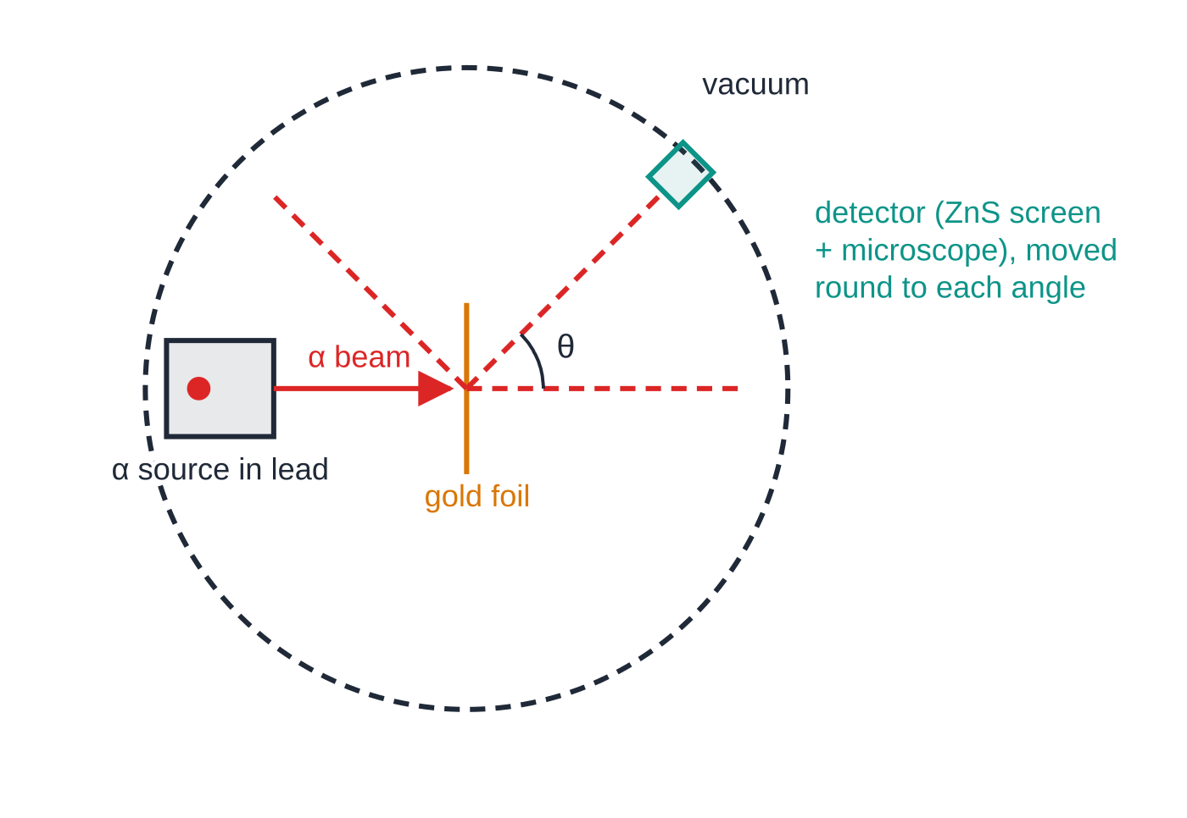
How did alpha-particle scattering reveal the nucleus?
Section 2 of 12
A narrow beam of alpha particles (helium nuclei, charge +2e), all with the same energy, is aimed at a very thin sheet of gold foil, only a few hundred atoms thick. The apparatus is in a vacuum, so the alpha particles are not stopped or scattered by air. A detector, originally a zinc sulfide screen that gives a tiny flash for each alpha particle, watched through a microscope, is moved round the foil to count the alpha particles arriving at each angle.
Alpha-scattering apparatus seen from above. The detector is moved round the foil to count the alpha particles scattered through each angle θ.
Notes:
How did alpha-particle scattering reveal the nucleus?. Full notes: https://examinerprep.com/notes/edexcel-ial-physics/atomic-structure-and-particle-accelerators/

Slide 8
How did alpha-particle scattering reveal the nucleus? (continued)
Section 2 of 12
Observation | Conclusion
Almost all alpha particles pass straight through, or are deflected by only a few degrees | Most of the atom is empty space
A small fraction are deflected through large angles | There is a concentrated charge in the atom; it must be positive to repel the positive alpha particles
A very small number (of the order of 1 in 10⁴) are deflected by more than 90°, some almost straight back | The positive charge and almost all the mass are in a tiny nucleus: only a very close approach to a massive charge can reverse an alpha particle
Notes:
How did alpha-particle scattering reveal the nucleus?. Full notes: https://examinerprep.com/notes/edexcel-ial-physics/atomic-structure-and-particle-accelerators/

Slide 9
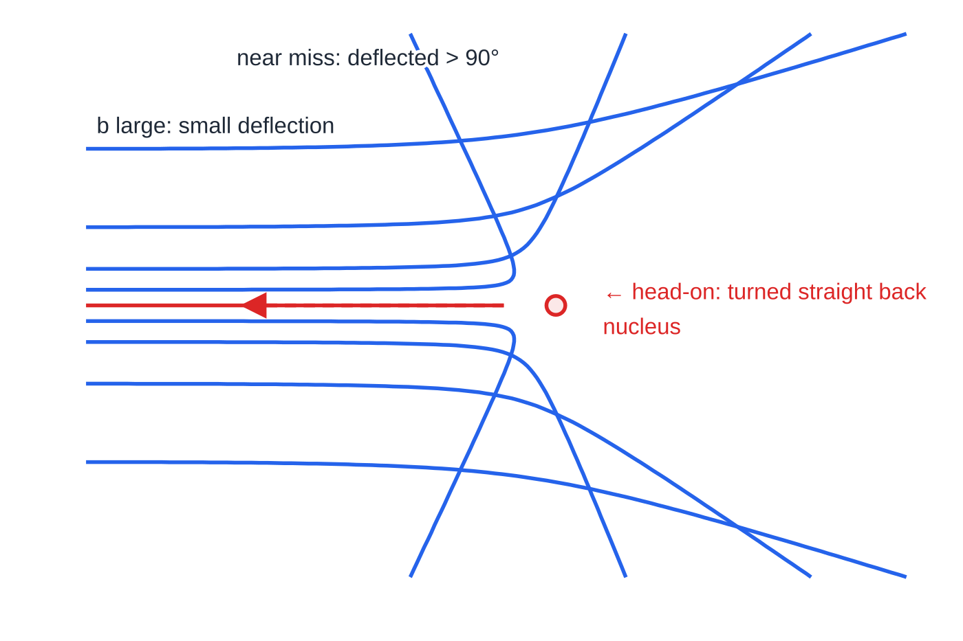
How did alpha-particle scattering reveal the nucleus? (continued)
Section 2 of 12
Paths of identical alpha particles past one nucleus, computed from the Coulomb repulsion. The closer the original line of a path is to the nucleus, the larger the deflection; only near-misses are turned through more than 90°.
Notes:
How did alpha-particle scattering reveal the nucleus?. Full notes: https://examinerprep.com/notes/edexcel-ial-physics/atomic-structure-and-particle-accelerators/

Slide 10
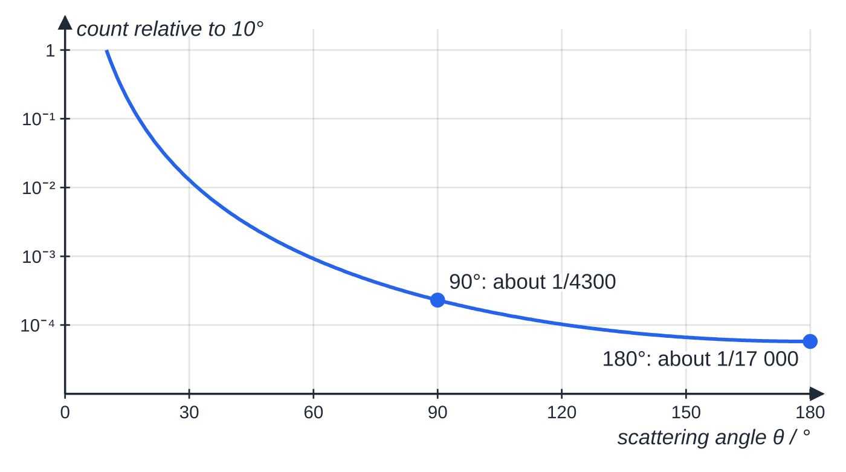
How did alpha-particle scattering reveal the nucleus? (continued)
Section 2 of 12
Electrons cannot cause the large deflections: an alpha particle is about 7300 times as massive as an electron and pushes electrons aside, as a bowling ball would a table-tennis ball.
A head-on alpha particle slows down, stops for an instant and returns along its path. At the distance of closest approach all of its kinetic energy has become electric potential energy.
How the number of alpha particles reaching a detector falls with angle (the pattern predicted for a point-like nucleus, compared with 10°, on a logarithmic scale). At 90° the count is about 1/4300 of the count at 10°; at 180° it is about 1/17 000.
Distance of closest approach (head-on)
Notes:
How did alpha-particle scattering reveal the nucleus?. Full notes: https://examinerprep.com/notes/edexcel-ial-physics/atomic-structure-and-particle-accelerators/

Slide 11
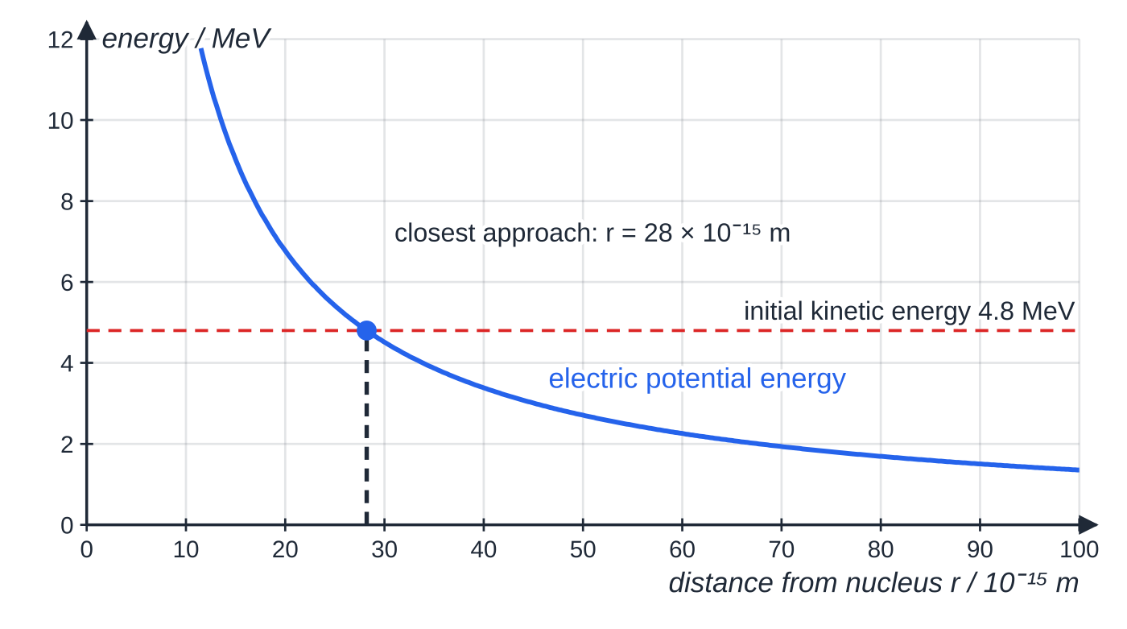
How did alpha-particle scattering reveal the nucleus? (continued)
Section 2 of 12
Eₖ = (Q₁ Q₂)/(4πε₀ r) Eₖ initial kinetic energy of the alpha particle (J), Q₁ = 2e, Q₂ = Ze (C), r closest approach (m). Not in the formulae list: derive it from conservation of energy and V = Q/4πε₀ r, which is in the formulae list. The nucleus is far more massive than the alpha particle, so its recoil is ignored. The result is an
upper limit for the radius of the nucleus.
Electric potential energy of an alpha particle near a silver nucleus (Z = 47). A 4.8 MeV alpha particle moving head-on stops where the curve reaches 4.8 MeV, about 28 × 10⁻¹⁵ m from the centre.
Notes:
How did alpha-particle scattering reveal the nucleus?. Full notes: https://examinerprep.com/notes/edexcel-ial-physics/atomic-structure-and-particle-accelerators/

Slide 12
How did alpha-particle scattering reveal the nucleus? (continued)
Section 2 of 12 · Worked example 2 · Medium · Calculate
WORKED EXAMPLE · QUESTION
An alpha particle with kinetic energy 4.8 MeV travels directly towards a silver nucleus (Z = 47). Calculate the distance of closest approach.
SOLUTION
Convert to joules: Eₖ = 4.8×10⁶ ×1.60×10⁻¹⁹ = 7.68×10⁻¹³ J.
At closest approach all of it is electric potential energy:
7.68×10⁻¹³ = (8.99×10⁹ ×(2 ×1.60×10⁻¹⁹) ×(47 ×1.60×10⁻¹⁹))/r
Rearrange for r: r = 2.8 × 10⁻¹⁴ m (2.82 × 10⁻¹⁴ m)
This is about 10⁴ times smaller than an atom (≈ 10⁻¹⁰ m); the nucleus itself must be smaller still.
Notes:
How did alpha-particle scattering reveal the nucleus?: Worked example 2. Full notes: https://examinerprep.com/notes/edexcel-ial-physics/atomic-structure-and-particle-accelerators/

Slide 13
How did alpha-particle scattering reveal the nucleus? (continued)
Section 2 of 12
How models of the atom changed
Model | Picture of the atom | What changed it
Solid sphere (early 1800s) | Tiny indivisible balls, different for each element | Discovery of the electron (1897): atoms contain smaller, negative particles
"Plum pudding" | A sphere of spread-out positive charge with electrons dotted through it | Alpha scattering (1909–1911): spread-out charge could never turn an alpha particle back
Nuclear model | Tiny, dense, positive nucleus; electrons around it; mostly empty space | Line spectra: electrons occupy fixed energy levels (Unit 2)
Nucleus of protons and neutrons | Neutrons (found 1932) explain why A is larger than Z | High-energy electron scattering (1960s): protons and neutrons themselves have structure, quarks (4.8)
Each model was kept until an experiment gave a result it could not explain.
Notes:
How did alpha-particle scattering reveal the nucleus?. Full notes: https://examinerprep.com/notes/edexcel-ial-physics/atomic-structure-and-particle-accelerators/

Slide 14
How did alpha-particle scattering reveal the nucleus? (continued)
Section 2 of 12
That is how scientific models develop: they are tested by prediction and replaced or refined by evidence.
Common error — "Most bounced back"
Writing that "most alpha particles bounced back". Only a tiny fraction were deflected by more than 90°; the striking result was that any did. Keep the three observations separate and match each one to its own conclusion.
Notes:
How did alpha-particle scattering reveal the nucleus?. Full notes: https://examinerprep.com/notes/edexcel-ial-physics/atomic-structure-and-particle-accelerators/

Slide 15
How are electrons released and accelerated?
Section 3 of 12
Thermionic emission: a metal filament is heated by a current, and some free electrons near the surface gain enough energy to escape from the metal. In an electron gun the hot filament (cathode) sits near a positive anode with a small hole in it. The p.d. V between them sets up an electric field that accelerates the electrons towards the anode, and a narrow beam passes through the hole. Beyond the anode there is no field, so the electrons move at constant velocity. The tube is evacuated so that electrons do not lose energy in collisions with gas molecules.
Notes:
How are electrons released and accelerated?. Full notes: https://examinerprep.com/notes/edexcel-ial-physics/atomic-structure-and-particle-accelerators/

Slide 16
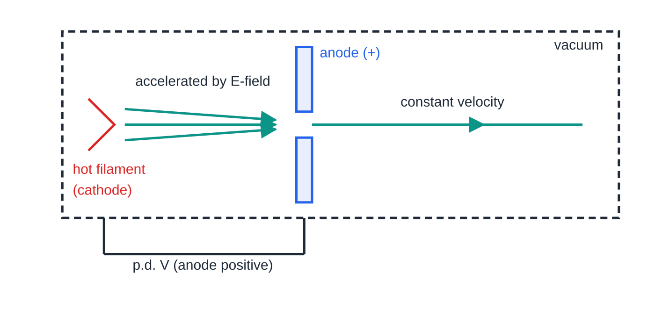
How are electrons released and accelerated? (continued)
Section 3 of 12
Energy gained by a charge accelerated through a p.d.
eV = ½ mv² e charge of the electron (C), V accelerating p.d. (V), m mass (kg), v final speed (m s⁻¹). In the formulae list (work done by the field = kinetic energy gained). Assumes the electron starts almost from rest and its speed stays well below c. For any charge Q, the energy gained is QV.
An electron gun. Electrons released from the hot filament are accelerated by the field between filament and anode; after the hole they travel at constant velocity.
Notes:
How are electrons released and accelerated?. Full notes: https://examinerprep.com/notes/edexcel-ial-physics/atomic-structure-and-particle-accelerators/

Slide 17
How are electrons released and accelerated? (continued)
Section 3 of 12
The electronvolt: 1 eV is the energy gained by an electron accelerated through 1 V, so 1 eV = 1.60 × 10⁻¹⁹ J. An electron through 3.2 kV gains 3.2 keV; an alpha particle (charge 2e) through the same p.d. gains 6.4 keV.
Exam tip — Convert eV first
Energies in particle physics are usually given in eV, keV, MeV or GeV. Convert to joules (× 1.60 × 10⁻¹⁹ J per eV) before you use Eₖ = ½ mv² or Eₖ = p²/2m, and convert kV to V.
Notes:
How are electrons released and accelerated?. Full notes: https://examinerprep.com/notes/edexcel-ial-physics/atomic-structure-and-particle-accelerators/

Slide 18
How does a magnetic field bend the path of a charged particle?
Section 4 of 12
A charge Q moving at speed v at right angles to a uniform magnetic field of flux density B feels a force F = BQv (4.5), with direction from Fleming's left-hand rule; for a negative particle, point the "current" finger opposite to its velocity. The force is always perpendicular to the velocity, so it does no work: the speed and kinetic energy stay constant and only the direction changes. A force of constant size at right angles to the motion is exactly what circular motion needs, so the particle moves in a circle.
Deriving r = p/BQ.
The magnetic force provides the centripetal force: BQv = mv²/r ⇒ r = mv/BQ = p/BQ r radius of the path (m), p momentum (kg m s⁻¹), B magnetic flux density (T), Q charge (C). In the formulae list, but you may be asked to derive it, so learn the two-line argument. Larger momentum gives a larger radius (gentler curve); larger charge or stronger field gives a tighter curve.
Notes:
How does a magnetic field bend the path of a charged particle?. Full notes: https://examinerprep.com/notes/edexcel-ial-physics/atomic-structure-and-particle-accelerators/

Slide 19
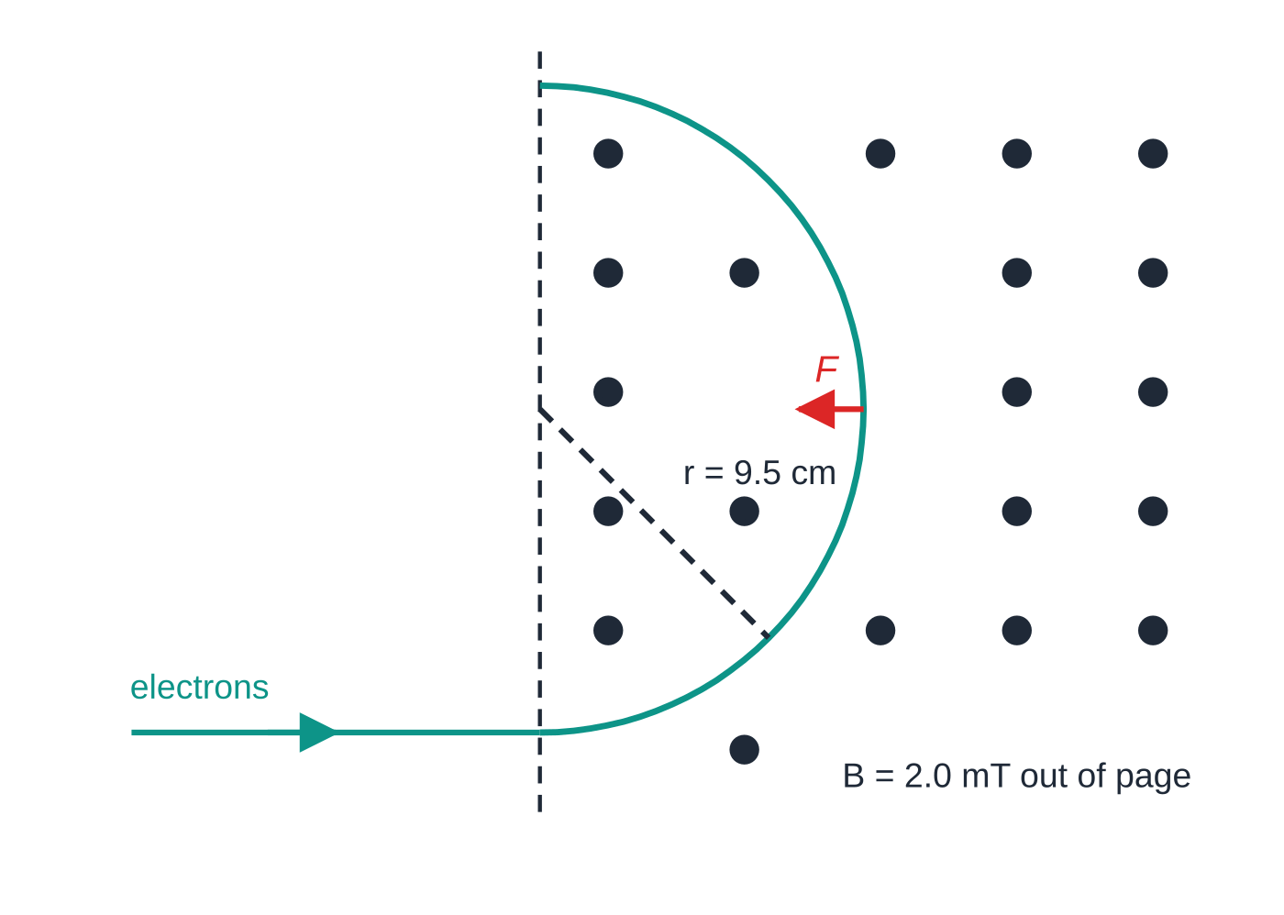
How does a magnetic field bend the path of a charged particle? (continued)
Section 4 of 12
Electrons accelerated through 3.2 kV entering a 2.0 mT field directed out of the page, drawn to scale. The force is always towards the centre, so the beam follows a circle of radius 9.5 cm.
Notes:
How does a magnetic field bend the path of a charged particle?. Full notes: https://examinerprep.com/notes/edexcel-ial-physics/atomic-structure-and-particle-accelerators/

Slide 20
How does a magnetic field bend the path of a charged particle? (continued)
Section 4 of 12 · Worked example 3 · Medium · Show that
WORKED EXAMPLE · QUESTION
Electrons are released by thermionic emission and accelerated from rest through a p.d. of 3.2 kV. The beam then enters a uniform magnetic field of flux density 2.0 mT at right angles to the field. (a) Show that the speed of the electrons is about 3.4 × 10⁷ m s⁻¹. (b) Calculate the radius of their circular path.
SOLUTION
(a) Kinetic energy gained = eV = 1.60×10⁻¹⁹ ×3200 = 5.12×10⁻¹⁶ J. Rearranging eV = ½ mv²: v = √(2 ×5.12×10⁻¹⁶ ÷9.11×10⁻³¹) = 3.35 × 10⁷ m s⁻¹
(b) p = 9.11×10⁻³¹ ×3.35×10⁷ = 3.05×10⁻²³ kg m s⁻¹, so r = p/BQ = 3.05×10⁻²³ ÷(2.0×10⁻³ ×1.60×10⁻¹⁹) = 0.095 m (9.5 cm)
The speed is about 0.11c, so the non-relativistic equation is a good approximation here.
Notes:
How does a magnetic field bend the path of a charged particle?: Worked example 3. Full notes: https://examinerprep.com/notes/edexcel-ial-physics/atomic-structure-and-particle-accelerators/

Slide 21
How do linear accelerators and cyclotrons work?
Section 5 of 12
Field | What it does to a charged particle | Where it is used
Electric | Force along the field, does work: changes the speed and kinetic energy | Electron gun; gaps between drift tubes of a linac; gap between the dees of a cyclotron
Magnetic | Force perpendicular to the velocity, does no work: changes the direction only | Keeps particles on a curved path in a cyclotron; bends beams; curves tracks in detectors
The linear accelerator (linac)
A linac is a line of hollow metal drift tubes in an evacuated pipe, connected alternately to the two terminals of a high-frequency alternating supply. Inside a tube there is no electric field, so the particle drifts at constant speed. It is accelerated only in the gaps, where neighbouring tubes are at different potentials. While the particle is inside a tube the p.d. reverses, so when it reaches the next gap the field there again points the right way to accelerate it.
The particle must spend the same time, half a period of the supply, in every tube.
Notes:
How do linear accelerators and cyclotrons work?. Full notes: https://examinerprep.com/notes/edexcel-ial-physics/atomic-structure-and-particle-accelerators/

Slide 22
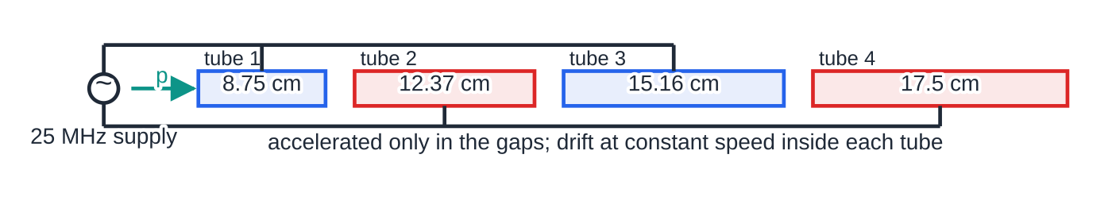
How do linear accelerators and cyclotrons work? (continued)
Section 5 of 12
As it speeds up it covers more distance in that time, so the tubes get longer: L = v/2f. Once the particles approach the speed of light their speed hardly changes, so the tubes become almost equal in length.
A proton linac drawn to scale for Worked example 4. Each gap adds the same energy, so the speed in tube n is proportional to √n and so is the length: tube 4 is twice as long as tube 1.
Notes:
How do linear accelerators and cyclotrons work?. Full notes: https://examinerprep.com/notes/edexcel-ial-physics/atomic-structure-and-particle-accelerators/

Slide 23
How do linear accelerators and cyclotrons work? (continued)
Section 5 of 12 · Worked example 4 · Medium · Calculate
WORKED EXAMPLE · QUESTION
Protons enter a linac with negligible energy and gain 100 keV at each gap. The alternating supply has a frequency of 25 MHz. (a) Calculate the speed of a proton in tube 1. (b) Calculate the length of tube 1. (c) Explain why tube 4 is twice as long as tube 1.
SOLUTION
(a) Kinetic energy after one gap = 100 keV = 1.0 × 10⁵ × 1.60 × 10⁻¹⁹ J = 1.60 × 10⁻¹⁴ J: v = √(2 ×1.60×10⁻¹⁴ ÷1.67×10⁻²⁷) = 4.38 × 10⁶ m s⁻¹
(b) Time in a tube = half a period = 1 ÷ (2 × 25 × 10⁶) = 20 ns, so L = 4.38×10⁶ ×2.0×10⁻⁸ = 0.0875 m (8.75 cm)
(c) In tube 4 the kinetic energy is 4 × 100 keV. v ∝√(Eₖ), so the speed is √4 = 2 times larger; the time is the same, so the tube is twice as long (17.5 cm).
Notes:
How do linear accelerators and cyclotrons work?: Worked example 4. Full notes: https://examinerprep.com/notes/edexcel-ial-physics/atomic-structure-and-particle-accelerators/

Slide 24
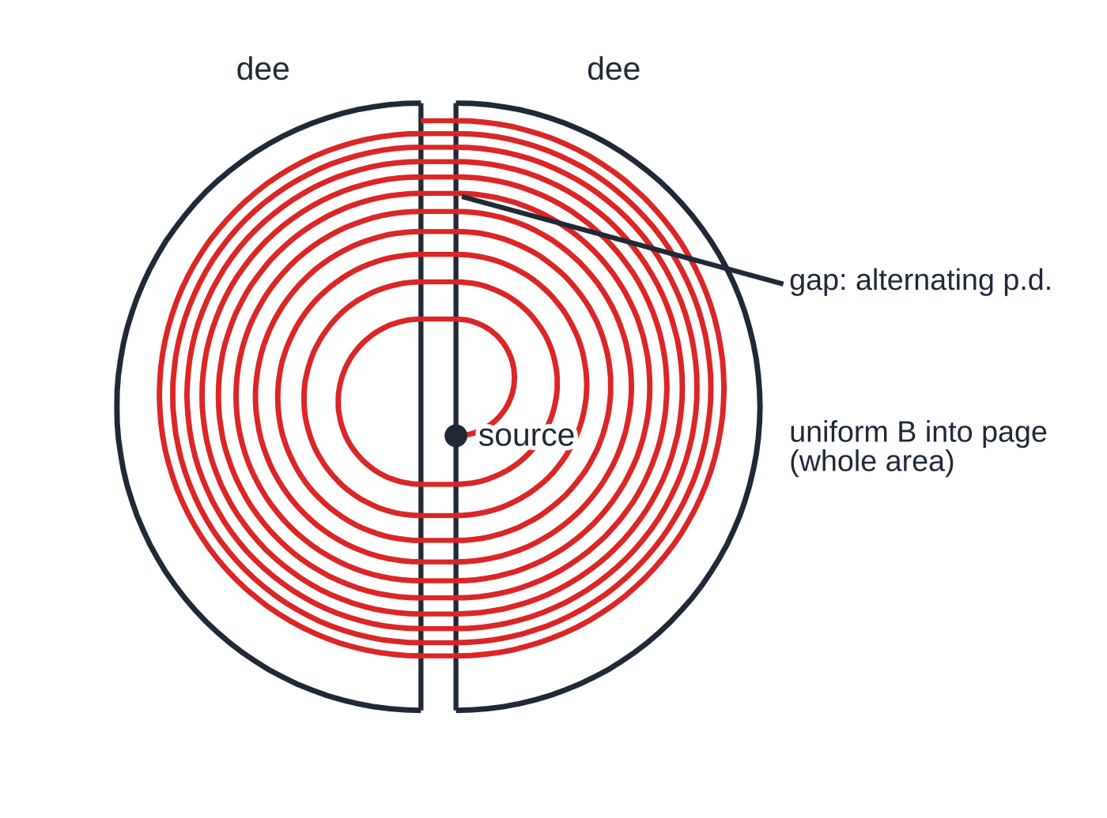
How do linear accelerators and cyclotrons work? (continued)
Section 5 of 12
The cyclotron
A cyclotron has two hollow D-shaped electrodes (dees) with a narrow gap between them, in a vacuum, between the poles of a large magnet giving a uniform field B perpendicular to the dees. Inside a dee there is no electric field; the magnetic force makes the particle travel a semicircle at constant speed. At the gap an alternating p.d. accelerates the particle each time it crosses, twice per revolution. After each crossing the particle is faster, so the next semicircle has a larger radius (r ∝v): the path spirals outwards until the particle leaves at the edge.
A cyclotron seen from above. Each crossing of the gap adds the same energy, so the radius of the nth semicircle is proportional to √n. Far fewer turns are drawn than in a real machine.
Why one fixed frequency works
Notes:
How do linear accelerators and cyclotrons work?. Full notes: https://examinerprep.com/notes/edexcel-ial-physics/atomic-structure-and-particle-accelerators/

Slide 25
How do linear accelerators and cyclotrons work? (continued)
Section 5 of 12
t_half = πr/v = πm/BQ ⇒ f = BQ/2πm Not in the formulae list: derive it from r = mv/BQ. The radius grows in proportion to the speed, so the time for each semicircle does not depend on the speed. This holds while v ≪c; close to c the particles fall out of step with the supply, which limits the energy a cyclotron can reach.
Notes:
How do linear accelerators and cyclotrons work?. Full notes: https://examinerprep.com/notes/edexcel-ial-physics/atomic-structure-and-particle-accelerators/

Slide 26
How do linear accelerators and cyclotrons work? (continued)
Section 5 of 12 · Worked example 5 · Hard · Calculate
WORKED EXAMPLE · QUESTION
A cyclotron accelerates protons in a uniform magnetic field of 0.80 T. The protons leave at a radius of 0.45 m. The p.d. across the gap is 20 kV. (a) Calculate the frequency of the alternating p.d. (b) Calculate the maximum kinetic energy of the protons, in MeV. (c) Estimate the number of complete revolutions each proton makes.
SOLUTION
(a) One revolution of the proton = one cycle of the supply: f = BQ/2πm = (0.80 ×1.60×10⁻¹⁹) ÷(2π×1.67×10⁻²⁷) = 1.22 × 10⁷ Hz (12.2 MHz)
(b) Maximum momentum from r = p/BQ with r = 0.45 m: p = 0.80 ×1.60×10⁻¹⁹ ×0.45 = 5.76×10⁻²⁰ kg m s⁻¹. Then Eₖ = p²/2m = (5.76×10⁻²⁰)² ÷(2 ×1.67×10⁻²⁷) = 9.93×10⁻¹³ J = 6.2 MeV (6.21 MeV)
(c) Each revolution includes two gap crossings, each adding 20 keV: 6.21 MeV ÷ (2 × 20 keV) ≈ 155 revolutions
Notes:
How do linear accelerators and cyclotrons work?: Worked example 5. Full notes: https://examinerprep.com/notes/edexcel-ial-physics/atomic-structure-and-particle-accelerators/

Slide 27
How do linear accelerators and cyclotrons work? (continued)
Section 5 of 12 · Worked example 5 · Hard · Calculate (continued)
Check: v = p/m = 3.45×10⁷ m s⁻¹ ≈ 0.11c, so the fixed frequency stays in step.
Notes:
How do linear accelerators and cyclotrons work?: Worked example 5. Full notes: https://examinerprep.com/notes/edexcel-ial-physics/atomic-structure-and-particle-accelerators/

Slide 28
How do linear accelerators and cyclotrons work? (continued)
Section 5 of 12
Common error — The magnet does not accelerate
Saying the magnetic field accelerates the particles in a cyclotron. It only changes their direction; every bit of kinetic energy comes from the electric field in the gap.
Notes:
How do linear accelerators and cyclotrons work?. Full notes: https://examinerprep.com/notes/edexcel-ial-physics/atomic-structure-and-particle-accelerators/

Slide 29
How do detectors reveal particles, and how do you read their tracks?
Section 6 of 12
Ionisation
A fast charged particle knocks electrons out of the atoms it passes, leaving a trail of ions. In a cloud chamber droplets form on the ions; in a bubble chamber small bubbles form; in electronic detectors the ions are collected as a pulse of current. The trail is the track. A heavily ionising particle (large charge, slow, for example an alpha particle) leaves a short, thick track; a fast electron leaves a long, thin one. Neutral particles (neutrons, photons, neutral hadrons) do not ionise directly and leave no track; their presence is inferred from gaps and from conservation laws.
Deflection
A magnetic field across the detector curves each track. The direction of curvature gives the sign of the charge (Fleming's left-hand rule); the radius gives the momentum, p = BQr. A particle losing energy by ionisation slows down, so its radius shrinks and its track is a spiral inwards, which also shows which way it was travelling.
Notes:
How do detectors reveal particles, and how do you read their tracks?. Full notes: https://examinerprep.com/notes/edexcel-ial-physics/atomic-structure-and-particle-accelerators/

Slide 30
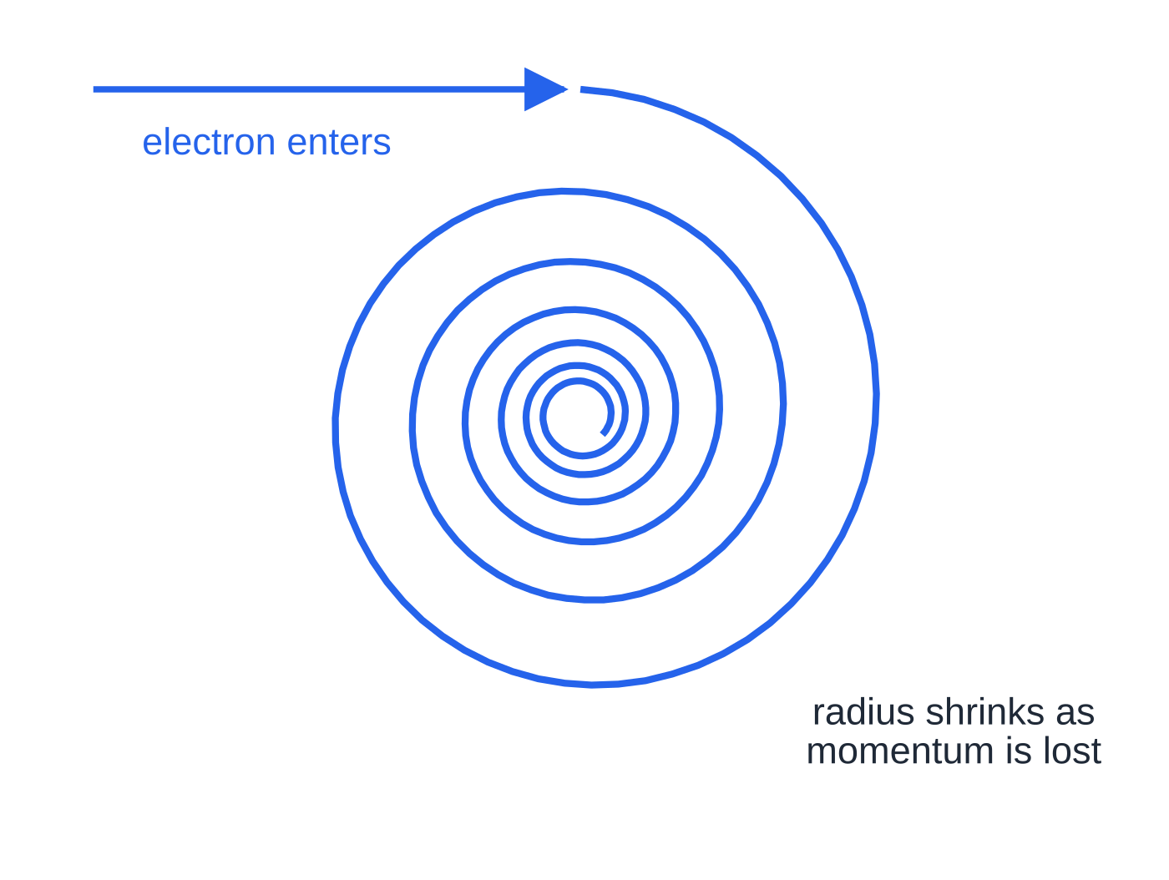
How do detectors reveal particles, and how do you read their tracks? (continued)
Section 6 of 12
Two particles with charges of equal size but opposite sign, and the same momentum, curve with the same radius in opposite directions.
Conservation laws in interactions
Charge: total charge before = total charge after. A neutral particle must decay into products whose charges add to zero.
Momentum (a vector): add components along two perpendicular directions. A particle at rest that decays into two particles sends them off in opposite directions with equal-sized momenta.
An electron spiralling inwards in a detector: as it ionises the material it loses momentum, so r = p/BQ shrinks.
Notes:
How do detectors reveal particles, and how do you read their tracks?. Full notes: https://examinerprep.com/notes/edexcel-ial-physics/atomic-structure-and-particle-accelerators/

Slide 31
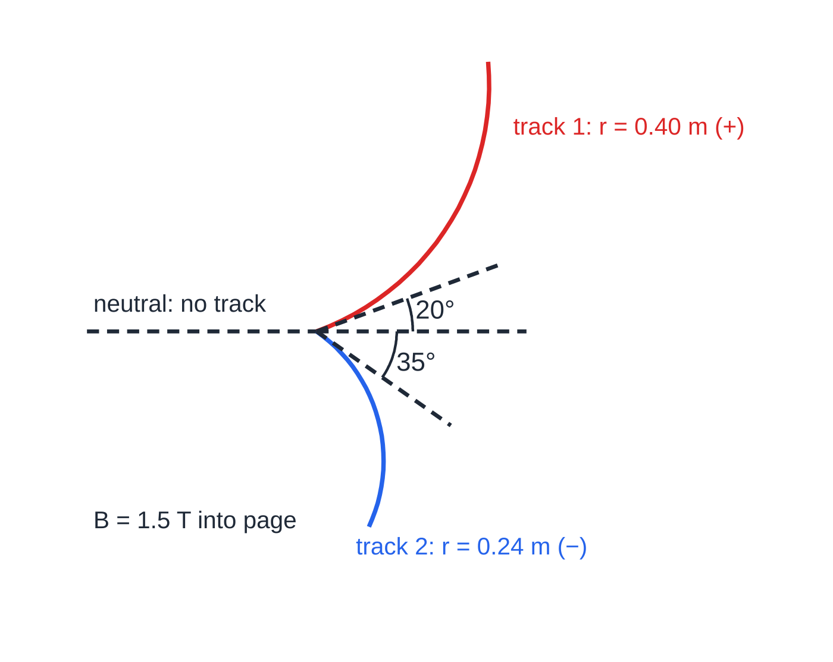
How do detectors reveal particles, and how do you read their tracks? (continued)
Section 6 of 12
Energy: total energy is conserved (including rest-mass energy, 4.8). Kinetic energy alone need not be.
A neutral particle (dashed, no track) decays at the vertex into a positive particle (anticlockwise curve, r = 0.40 m) and a negative particle (clockwise curve, r = 0.24 m), drawn to scale for Worked example 6.
Notes:
How do detectors reveal particles, and how do you read their tracks?. Full notes: https://examinerprep.com/notes/edexcel-ial-physics/atomic-structure-and-particle-accelerators/

Slide 32
How do detectors reveal particles, and how do you read their tracks? (continued)
Section 6 of 12 · Worked example 6 · Hard · Calculate
WORKED EXAMPLE · QUESTION
A bubble chamber has a uniform magnetic field of 1.5 T into the page. A neutral particle leaves no track, then decays into two particles with charges of magnitude e. Track 1 starts at 20° above the original direction and has radius 0.40 m; track 2 starts at 35° below it and has radius 0.24 m (figure above). (a) Explain what conservation of charge tells you about the two particles. (b) Calculate the momentum of each particle just after the decay. (c) Show that momentum is conserved at right angles to the original direction. (d) Calculate the momentum of the neutral particle.
SOLUTION
(a) Total charge before = 0, so the charges after must add to zero: one particle is +e and the other −e, and they curve in opposite directions. With B into the page, Fleming's left-hand rule gives an anticlockwise curve for a positive charge, so track 1 is the positive particle.
(b) p = BQr: p₁ = 1.5 ×1.60×10⁻¹⁹ ×0.40 = 9.6 × 10⁻²⁰ kg m s⁻¹; p₂ = 1.5 ×1.60×10⁻¹⁹ ×0.24 = 5.76 × 10⁻²⁰ kg m s⁻¹
Notes:
How do detectors reveal particles, and how do you read their tracks?: Worked example 6. Full notes: https://examinerprep.com/notes/edexcel-ial-physics/atomic-structure-and-particle-accelerators/

Slide 33
How do detectors reveal particles, and how do you read their tracks? (continued)
Section 6 of 12 · Worked example 6 · Hard · Calculate (continued)
(c) The neutral particle had no sideways momentum, so the sideways components must cancel: 9.6×10⁻²⁰sin 20° = 3.28×10⁻²⁰ and 5.76×10⁻²⁰sin 35° = 3.30×10⁻²⁰ kg m s⁻¹, equal and opposite within 1%.
(d) Add the components along the original direction: p = 9.6×10⁻²⁰cos 20° + 5.76×10⁻²⁰cos 35° = 9.02×10⁻²⁰ + 4.72×10⁻²⁰ = 1.37 × 10⁻¹⁹ kg m s⁻¹
Notes:
How do detectors reveal particles, and how do you read their tracks?: Worked example 6. Full notes: https://examinerprep.com/notes/edexcel-ial-physics/atomic-structure-and-particle-accelerators/

Slide 34
How do detectors reveal particles, and how do you read their tracks? (continued)
Section 6 of 12
Exam tip — Sign of charge from a track
Say which way the field points, which way the particle moves and which way the force acts (towards the centre of the curve), then name the rule. For a negative particle the conventional current is opposite to its velocity.
Notes:
How do detectors reveal particles, and how do you read their tracks?. Full notes: https://examinerprep.com/notes/edexcel-ial-physics/atomic-structure-and-particle-accelerators/

Slide 35
Why are high energies needed to probe inside a nucleon?
Section 7 of 12
To reveal detail, a probe must be diffracted or scattered by it, and that only happens strongly when its wavelength is similar to or smaller than the size of the detail (Unit 2, electron diffraction). A moving particle has a de Broglie wavelength λ= h/p, so a shorter wavelength needs a larger momentum, and so a larger energy.
A nucleon is about 10⁻¹⁵ m across. Electrons from an ordinary electron gun have wavelengths around 10⁻¹¹ m: fine for the spacing of atoms in a crystal, far too long to see inside a nucleon. The momenta needed are so large that the particles travel at very nearly the speed of light, and the energies are of the order of GeV. Only large accelerators reach them. Scattering electrons of this energy off protons and neutrons gave the first evidence that nucleons contain smaller particles, quarks (4.8).
Notes:
Why are high energies needed to probe inside a nucleon?. Full notes: https://examinerprep.com/notes/edexcel-ial-physics/atomic-structure-and-particle-accelerators/

Slide 36
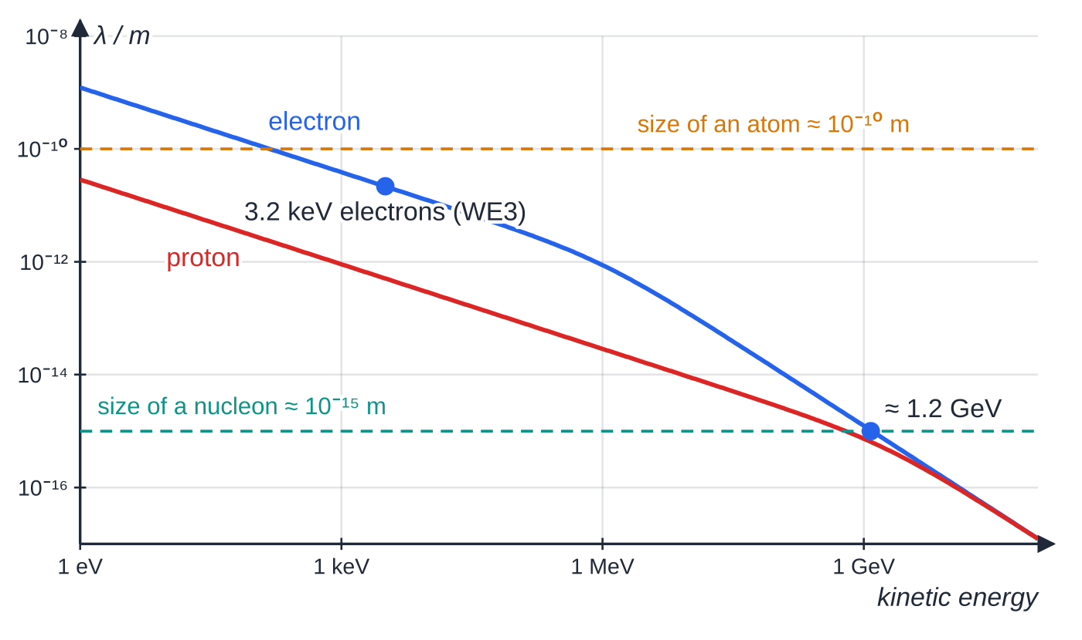
Why are high energies needed to probe inside a nucleon? (continued)
Section 7 of 12
De Broglie wavelength against kinetic energy (logarithmic scales; curves drawn with the full relativistic link between energy and momentum). The wavelength reaches the size of a nucleon only at energies of the order of 1 GeV.
Notes:
Why are high energies needed to probe inside a nucleon?. Full notes: https://examinerprep.com/notes/edexcel-ial-physics/atomic-structure-and-particle-accelerators/

Slide 37
Why are high energies needed to probe inside a nucleon? (continued)
Section 7 of 12 · Worked example 7 · Hard · Estimate
WORKED EXAMPLE · QUESTION
To study structure inside a proton, electrons with a de Broglie wavelength of 1.0 × 10⁻¹⁵ m are needed. (a) Calculate the momentum of such an electron. (b) Show that the electron cannot be treated as moving slowly compared with light. (c) For a particle moving at very nearly c, energy ≈ pc. Estimate the energy of the electrons in GeV. (d) Compare with the electrons in Worked example 3.
SOLUTION
(a) p = h/λ= 6.63×10⁻³⁴ ÷1.0×10⁻¹⁵ = 6.63 × 10⁻¹⁹ kg m s⁻¹
(b) Try v = p/m = 6.63×10⁻¹⁹ ÷9.11×10⁻³¹ = 7.3×10¹¹ m s⁻¹, more than 2000 times c, which is impossible, so p = mv does not apply.
(c) pc = 6.63×10⁻¹⁹ ×3.00×10⁸ = 1.99×10⁻¹⁰ J; ÷ 1.60 × 10⁻¹⁹ gives ≈ 1.2 GeV
(d) The 3.2 kV electrons had p = 3.05×10⁻²³ kg m s⁻¹, so λ= 6.63×10⁻³⁴ ÷3.05×10⁻²³ = 2.17×10⁻¹¹ m: about 22 000 times too long.
Notes:
Why are high energies needed to probe inside a nucleon?: Worked example 7. Full notes: https://examinerprep.com/notes/edexcel-ial-physics/atomic-structure-and-particle-accelerators/

Slide 38
Why are high energies needed to probe inside a nucleon? (continued)
Section 7 of 12 · Worked example 7 · Hard · Estimate (continued)
You do not need relativistic equations in this unit; the point to explain is why the energy must be so high.
Notes:
Why are high energies needed to probe inside a nucleon?: Worked example 7. Full notes: https://examinerprep.com/notes/edexcel-ial-physics/atomic-structure-and-particle-accelerators/

Slide 39
Exam tips for 4.7
Section 8 of 12
Exam tip 1 — Pair each observation with a conclusion
For alpha scattering, write three separate pairs: most pass through → mostly empty space; some deflected → concentrated positive charge; very few back → tiny, massive nucleus. A list of conclusions with no observations attached does not explain anything.
Exam tip 2 — The right charge and mass
An alpha particle has charge 2e = 3.20 × 10⁻¹⁹ C and mass about 4u. In r = p/BQ, closest-approach calculations and QV, check you have used the charge of the particle in the question, not automatically e.
Exam tip 3 — Which field does what
In any accelerator answer, state that the electric field (in the gaps) increases the speed, and that the magnetic field (if any) changes the direction only, because its force is perpendicular to the velocity.
Notes:
Exam tips for 4.7. Full notes: https://examinerprep.com/notes/edexcel-ial-physics/atomic-structure-and-particle-accelerators/

Slide 40
Exam tips for 4.7 (continued)
Section 8 of 12
Exam tip 4 — Derivations need a starting statement
For r = p/BQ start with "the magnetic force provides the centripetal force", then equate BQv = mv²/r. For the cyclotron frequency, show that πr/v does not contain v.
Exam tip 5 — Tracks: curvature, direction, radius
Read a track in three steps: does it curve (charged or neutral)? Which way (sign of charge)? How tightly (momentum, or charge if momenta are equal)? A shrinking radius means the particle is losing momentum.
Notes:
Exam tips for 4.7. Full notes: https://examinerprep.com/notes/edexcel-ial-physics/atomic-structure-and-particle-accelerators/

Slide 41
Common misconceptions
Section 9 of 12
Misconception | Why it is wrong | Correct idea
Most alpha particles bounced back from the foil. | Only about 1 in 10⁴ were deflected by more than 90°. | Most went straight through; the few large deflections showed the nucleus.
The electrons in the foil deflected the alpha particles. | An alpha particle is about 7300 times as massive as an electron. | Large deflections need a massive, concentrated positive charge.
The magnetic field speeds the particles up in a cyclotron. | The magnetic force is perpendicular to the velocity and does no work. | The electric field across the gap does all the accelerating.
A bigger circle in a detector means a bigger charge. | r = p/BQ: radius falls as charge rises. | A bigger radius means more momentum (or less charge).
Neutral particles leave faint tracks. | Tracks are made by ionisation, which needs a charge. | Neutral particles leave no track; they show up as gaps.
Linac tubes get longer because the field inside them gets weaker. | There is no field inside a drift tube. | The particle is faster but must spend the same half-period in each tube.
Notes:
Common misconceptions. Full notes: https://examinerprep.com/notes/edexcel-ial-physics/atomic-structure-and-particle-accelerators/

Slide 42
How this topic connects
Section 10 of 12
3 Electric fields and 4.5 Magnetic fields and forces
The closest-approach calculation uses V = Q/4πε₀ r; the circular paths come from F = BQv and Fleming's left-hand rule.
1 Momentum and 4.2 Circular motion
r = p/BQ is F = mv²/r in disguise; track problems use conservation of momentum in two dimensions and Eₖ = p²/2m.
Electron diffraction (Unit 2), 4.8 The standard model and nuclear physics (Unit 5)
λ= h/p links accelerator energy to the size of detail a beam can reveal. Energies in MeV and GeV, creating particles from energy and quarks inside nucleons continue on 4.8.
Notes:
How this topic connects. Full notes: https://examinerprep.com/notes/edexcel-ial-physics/atomic-structure-and-particle-accelerators/

Slide 43
Key equations
Section 11 of 12
Equation | Use | In the formulae list?
N = A - Z | number of neutrons in a nucleus | No — learn it
eV = ½ mv² | speed of an electron accelerated from rest through p.d. V | Yes
F = Bqvsin θ | force (N) on a charge moving in a magnetic field | Yes
r = p/BQ | radius (m) of path in a uniform magnetic field | Yes (derive it from BQv = mv²/r)
Eₖ = p²/2m | kinetic energy from momentum (non-relativistic) | Yes
λ= h/p | de Broglie wavelength of a probe particle | Yes
Eₖ = Q₁Q₂/4πε₀ r | head-on distance of closest approach | No — derive it from energy conservation
f = BQ/2πm | cyclotron frequency (independent of speed) | No — derive it
L = v/2f | length of a linac drift tube | No — derive it
Notes:
Key equations. Full notes: https://examinerprep.com/notes/edexcel-ial-physics/atomic-structure-and-particle-accelerators/

Slide 44
Check your understanding
Section 12 of 12
1. How many protons, neutrons and electrons are there in a neutral atom of radon-222 (Z = 86)?
2. Why did the alpha-scattering result rule out the "plum pudding" model?
3. An electron is accelerated from rest through 600 V. Calculate its kinetic energy and its speed.
4. A proton moves at 2.0 × 10⁶ m s⁻¹ at right angles to a uniform magnetic field of 0.25 T. Calculate the radius of its path.
5. Two tracks start from the same point, with equal radii, curving in opposite directions. Nothing visible enters the point. What can you deduce?
6. Explain why the drift tubes of a proton linac get longer along the accelerator.
Notes:
Check your understanding: questions. Full notes: https://examinerprep.com/notes/edexcel-ial-physics/atomic-structure-and-particle-accelerators/

Slide 45
Check your understanding · answers
Section 12 of 12
1. 86 protons, 222 − 86 = 136 neutrons and 86 electrons.
2. In that model the positive charge is spread through the whole atom, so the electric field inside is weak everywhere and could only deflect an alpha particle by a tiny angle. Deflections of more than 90° need the positive charge and mass concentrated in a very small nucleus.
3. Eₖ = 1.60×10⁻¹⁹ ×600 = 9.6 × 10⁻¹⁷ J; v = √(2 ×9.6×10⁻¹⁷ ÷9.11×10⁻³¹) = 1.45 × 10⁷ m s⁻¹.
4. r = mv/BQ = (1.67×10⁻²⁷ ×2.0×10⁶) ÷(0.25 ×1.60×10⁻¹⁹) = 0.084 m.
5. A neutral particle (no track) decayed there. The products have opposite charges (charge conservation and opposite curvature). If their charges are equal in size, equal radii mean equal-sized momenta.
6. The proton gains energy at every gap, so it moves faster in each successive tube. The supply reverses every half-period, so the proton must spend the same time (half a period) in each tube; at a higher speed it travels further in that time, so each tube must be longer (L = v/2f).
Notes:
Check your understanding: answers. Full notes: https://examinerprep.com/notes/edexcel-ial-physics/atomic-structure-and-particle-accelerators/

Slide 46
Practice questions
5 original exam-style questions. Answers at the end of the deck.

Slide 47
Question 1
1 mark
An alpha particle travels directly towards a nucleus and is turned back.
Which change would decrease its distance of closest approach to the nucleus?
A using a nucleus with a larger proton number
B using an alpha particle with a greater initial kinetic energy
C using a thicker metal foil
D using an alpha particle with a lower initial speed
Notes:
Online with the full mark scheme: https://examinerprep.com/ial-physics-4-7-atomic-structure-and-particle-accelerators-questions#IALP-U4-7-A-03

Slide 48
Question 2
1 mark
An alpha particle has momentum 9.6 × 10⁻²⁰ kg m s⁻¹. It moves at right angles to a uniform magnetic field of flux density 0.60 T.
What is the radius of its circular path?
A 0.25 m
B 0.50 m
C 1.0 m
D 2.0 m
Notes:
Online with the full mark scheme: https://examinerprep.com/ial-physics-4-7-atomic-structure-and-particle-accelerators-questions#IALP-U4-7-A-06

Slide 49
Question 3
1 mark
In a bubble chamber with a uniform magnetic field, the track of a charged particle is a spiral of decreasing radius.
What is the reason for the decreasing radius?
A The particle gains charge as it moves.
B The magnetic field is stronger near the centre of the spiral.
C The particle loses momentum as it ionises the liquid.
D The particle speeds up as it moves.
Notes:
Online with the full mark scheme: https://examinerprep.com/ial-physics-4-7-atomic-structure-and-particle-accelerators-questions#IALP-U4-7-A-08

Slide 50
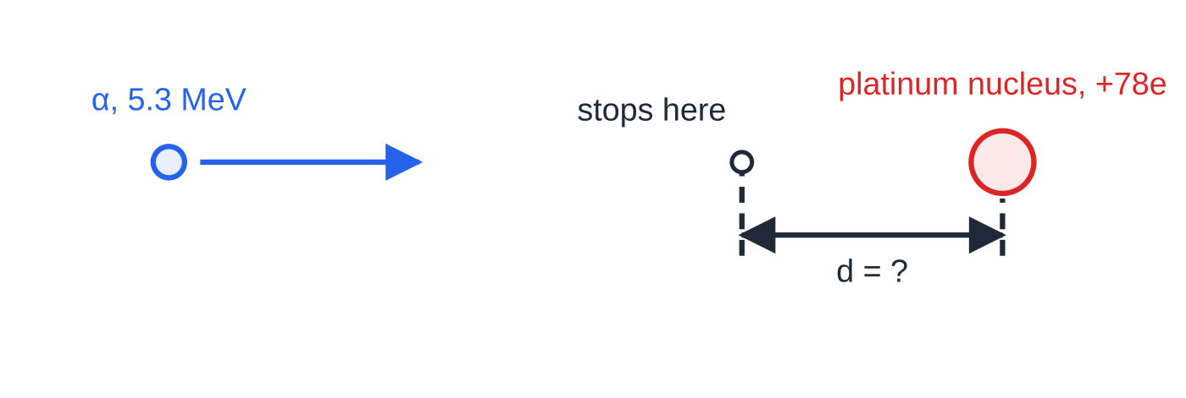
Question 4
6 marks
An alpha particle with an initial kinetic energy of 5.3 MeV travels directly towards a platinum nucleus. The proton number of platinum is 78. Assume the platinum nucleus does not move.
Figure: the α particle travelling directly towards the nucleus (not to scale)
(a) Show that the initial kinetic energy is about 8.5 × 10⁻¹³ J. [1]
(b) Calculate the distance of closest approach of the alpha particle to the centre of the nucleus. [3]
(c) Explain why your answer is an upper limit for the radius of a platinum nucleus. [1]
(d) An alpha particle with the same kinetic energy is aimed directly at an aluminium nucleus (proton number 13). State and explain how the distance of closest approach changes. [1]
Notes:
Online with the full mark scheme: https://examinerprep.com/ial-physics-4-7-atomic-structure-and-particle-accelerators-questions#IALP-U4-7-B-03

Slide 51
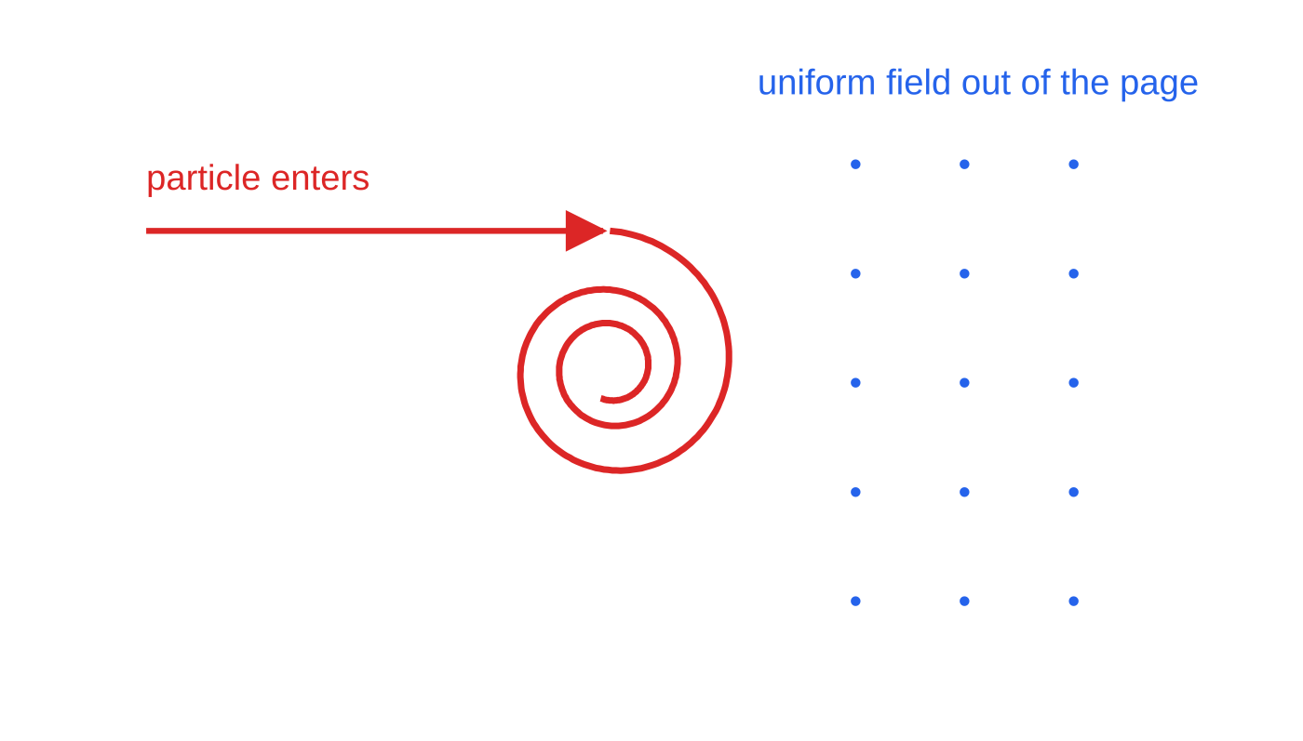
Question 5
7 marks
A cloud chamber contains air supersaturated with alcohol vapour. A uniform magnetic field acts out of the plane of the page. A charged particle enters the chamber from the left, moving to the right, and its track curves towards the bottom of the page.
Figure: the track in the cloud chamber (not to scale)
(a) Explain how the particle produces a visible track. [2]
(b) Deduce the sign of the charge on the particle. [2]
(c) The radius of the track decreases gradually along its length. Explain why. [2]
(d) A second particle has the same momentum as the first but twice its charge. State how the radius of its track compares with that of the first. [1]
Notes:
Online with the full mark scheme: https://examinerprep.com/ial-physics-4-7-atomic-structure-and-particle-accelerators-questions#IALP-U4-7-B-07

Slide 52
Answers

Slide 53
Question 1 · answer
Answer B
At closest approach the initial kinetic energy has all become electric potential energy, Eₖ = Q₁Q₂/4πε₀r. A larger Eₖ gives a smaller r; a larger proton number or a lower speed gives a larger r.
Notes:
Full mark scheme: https://examinerprep.com/ial-physics-4-7-atomic-structure-and-particle-accelerators-questions#IALP-U4-7-A-03

Slide 54
Question 2 · answer
Answer B
The charge of an alpha particle is 2e = 3.20 × 10⁻¹⁹ C. r = p/BQ = 9.6 × 10⁻²⁰ ÷ (0.60 × 3.20 × 10⁻¹⁹) = 0.50 m.
Notes:
Full mark scheme: https://examinerprep.com/ial-physics-4-7-atomic-structure-and-particle-accelerators-questions#IALP-U4-7-A-06

Slide 55
Question 3 · answer
Answer C
The particle loses kinetic energy each time it ionises an atom, so its momentum falls. Since r = p/BQ and B and Q are constant, the radius decreases as the momentum decreases.
Notes:
Full mark scheme: https://examinerprep.com/ial-physics-4-7-atomic-structure-and-particle-accelerators-questions#IALP-U4-7-A-08

Slide 56
Question 4 · answer
Mark scheme
5.3 × 10⁶ × 1.60 × 10⁻¹⁹ = 8.48 × 10⁻¹³ J
at closest approach all the kinetic energy is electric potential energy: Eₖ = Q₁Q₂/4πε₀r
8.48 × 10⁻¹³ = 8.99 × 10⁹ × (2 × 1.60 × 10⁻¹⁹) × (78 × 1.60 × 10⁻¹⁹) ÷ r
r = 4.2 × 10⁻¹⁴ m (4.23 × 10⁻¹⁴ m)
the alpha particle does not reach / touch the nucleus, so the nucleus must be smaller than the closest-approach distance
smaller, by a factor of 78/13 = 6, because the potential energy at a given distance is proportional to the charge of the nucleus
Notes:
Full mark scheme: https://examinerprep.com/ial-physics-4-7-atomic-structure-and-particle-accelerators-questions#IALP-U4-7-B-03

Slide 57
Question 5 · answer
Mark scheme
the particle ionises molecules along its path
the vapour condenses on the ions, forming a line of droplets
the force is towards the centre of curvature, i.e. towards the bottom of the page; with the field out of the page and the motion to the right, Fleming's left-hand rule gives a downward force for a positive charge
so the particle is positive
the particle loses kinetic energy as it ionises the gas
so its momentum decreases and, since r = p/BQ, the radius decreases
half the radius
Notes:
Full mark scheme: https://examinerprep.com/ial-physics-4-7-atomic-structure-and-particle-accelerators-questions#IALP-U4-7-B-07

Slide 58
Keep practising
Notes for this topic
Questions on this topic
Build a printable test
ExaminerPrep is an independent tutoring service. It has been developed independently from and is not endorsed by the International Baccalaureate Organization. "International Baccalaureate", "IB" and "IB Diploma Programme" are registered trademarks of the IBO, used here for descriptive purposes only.
Pearson Edexcel and Cambridge are trademarks of their owners; ExaminerPrep is not affiliated with any exam board.

