Slide 1
EP
EDEXCEL IAL PHYSICS
5.3 Binding energy, fission and fusion
The full notes page in 12 sections · practice questions with answers · simulations
ExaminerPrep is an independent tutoring service. It has been developed independently from and is not endorsed by the International Baccalaureate Organization. "International Baccalaureate", "IB" and "IB Diploma Programme" are registered trademarks of the IBO, used here for descriptive purposes only.
Pearson Edexcel and Cambridge are trademarks of their owners; ExaminerPrep is not affiliated with any exam board.
Notes:
5.3 Binding energy, fission and fusion. Notes for this topic: https://examinerprep.com/notes/edexcel-ial-physics/binding-energy-fission-and-fusion/

Slide 2
What this page covers
Overview
Nuclear binding energy and the mass deficit (mass defect)
Using ΔE = c²Δm for nuclear masses and energies
The atomic mass unit u, and converting between u, kg, J and MeV
The binding energy per nucleon curve and the iron peak
Energy release in fission and fusion, from masses and from the curve
Why fusion needs very high temperatures and densities
Notes:
What this page covers. Full notes: https://examinerprep.com/notes/edexcel-ial-physics/binding-energy-fission-and-fusion/

Slide 3
In one minute
Key points
1. A nucleus has less mass than the protons and neutrons it is made from, that missing mass is the binding energy, and every fission or fusion calculation is the same three steps: mass before, mass after, ΔE = c²Δm.
2. The binding energy of a nucleus is the energy needed to separate it completely into its individual protons and neutrons.
3. 1 u = 1.66 × 10⁻²⁷ kg, equivalent to about 931.5 MeV. Use kg with c² to get joules; divide by 1.60 × 10⁻¹³ for MeV.
4. Binding energy per nucleon measures stability. It peaks at about 8.8 MeV near iron-56.
5. Fission of heavy nuclei and fusion of light nuclei both move towards the peak: binding energy per nucleon rises, mass falls, energy is released.
6. Fusion needs nuclei close enough for the strong force to act, against electrostatic repulsion: very high temperature (fast nuclei) and high density (frequent collisions).
Notes:
In one minute. Full notes: https://examinerprep.com/notes/edexcel-ial-physics/binding-energy-fission-and-fusion/

Slide 4
What is binding energy, and what is the mass deficit?
Section 1 of 12
Nuclear binding energy: the energy needed to separate a nucleus completely into its individual protons and neutrons.
Mass deficit (mass defect): the total mass of the separate protons and neutrons minus the mass of the nucleus they form.
The strong nuclear force holds the nucleons together, so work must be done to pull them apart; that work is the binding energy. Run the process backwards and the same energy is released when free nucleons come together to form a nucleus. Energy has mass, so the bound nucleus, which has less energy than the separated nucleons, also has less mass. For a nucleus with Z protons and N = A - Z neutrons:
Δm = Zmₚ + (A - Z)mₙ - m_nucleus
Notes:
What is binding energy, and what is the mass deficit?. Full notes: https://examinerprep.com/notes/edexcel-ial-physics/binding-energy-fission-and-fusion/

Slide 5
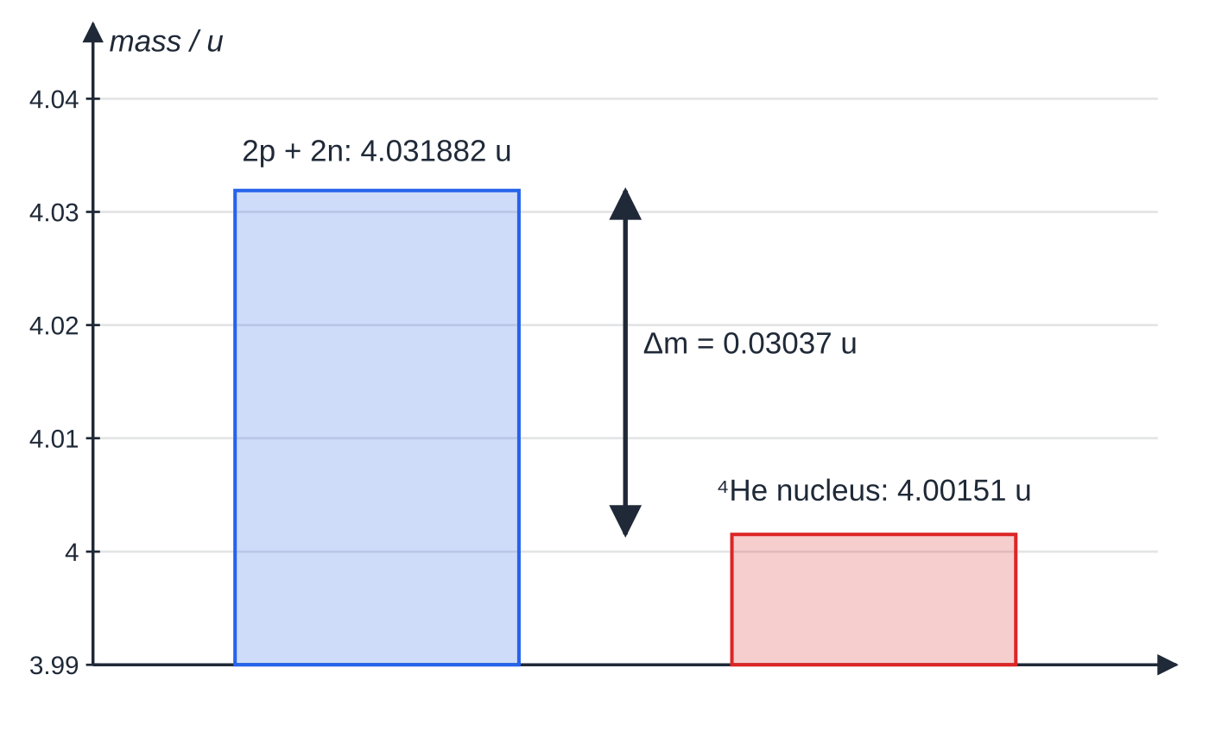
What is binding energy, and what is the mass deficit? (continued)
Section 1 of 12
Common error
Describing binding energy as energy "stored in" the nucleus that comes out when it breaks up. It is the opposite: binding energy must be supplied to break a nucleus apart. A larger binding energy means a nucleus that is harder to take apart, and a lower energy state.
Two protons and two neutrons have more mass than the helium-4 nucleus they form. The axis is zoomed in: the difference, 0.03037 u, is real but small (under 1%).
Notes:
What is binding energy, and what is the mass deficit?. Full notes: https://examinerprep.com/notes/edexcel-ial-physics/binding-energy-fission-and-fusion/

Slide 6
How are mass and energy linked?
Section 2 of 12
ΔE = c²Δm
ΔE is in J, Δm in kg and c = 3.00 ×10⁸ m s⁻¹. This equation is in the formulae list. Any change in energy comes with a change in mass. In chemical reactions the change is far too small to measure; in nuclear reactions it is about a million times larger per particle and easily measured.
Notes:
How are mass and energy linked?. Full notes: https://examinerprep.com/notes/edexcel-ial-physics/binding-energy-fission-and-fusion/

Slide 7
How are mass and energy linked? (continued)
Section 2 of 12 · Worked example 1 · Medium · Calculate
WORKED EXAMPLE · QUESTION
Mass of a proton = 1.007276 u, mass of a neutron = 1.008665 u, mass of a helium-4 nucleus = 4.00151 u; 1 u = 1.66 × 10⁻²⁷ kg. Calculate the binding energy of a helium-4 nucleus in J and in MeV, and its binding energy per nucleon.
SOLUTION
Separate nucleons: 2 ×1.007276 + 2 ×1.008665 = 4.031882 u.
Mass deficit: Δm = 4.031882 - 4.00151 = 0.03037 u = 0.03037 ×1.66 ×10⁻²⁷ = 5.04 ×10⁻²⁹ kg.
ΔE = (3.00 ×10⁸)² ×5.04 ×10⁻²⁹: 4.54 ×10⁻¹² J = 4.54 ×10⁻¹² ÷1.60 ×10⁻¹³ = 28.4 MeV.
Per nucleon (A = 4): 28.4 ÷4: 7.09 MeV.
Using 1 u = 931.5 MeV directly gives 28.3 MeV; the small difference comes from rounding the data-list constants to 3 s.f., and either route is acceptable if you show it.
Notes:
How are mass and energy linked?: Worked example 1. Full notes: https://examinerprep.com/notes/edexcel-ial-physics/binding-energy-fission-and-fusion/

Slide 8
How are mass and energy linked? (continued)
Section 2 of 12
Exam tip — keep the figures
The mass deficit is a small difference between two nearly equal numbers, so keep every figure of the masses until the subtraction is done. Rounding first (for example 1.67 × 10⁻²⁷ kg for both nucleons) can wipe out the answer completely.
Notes:
How are mass and energy linked?. Full notes: https://examinerprep.com/notes/edexcel-ial-physics/binding-energy-fission-and-fusion/

Slide 9
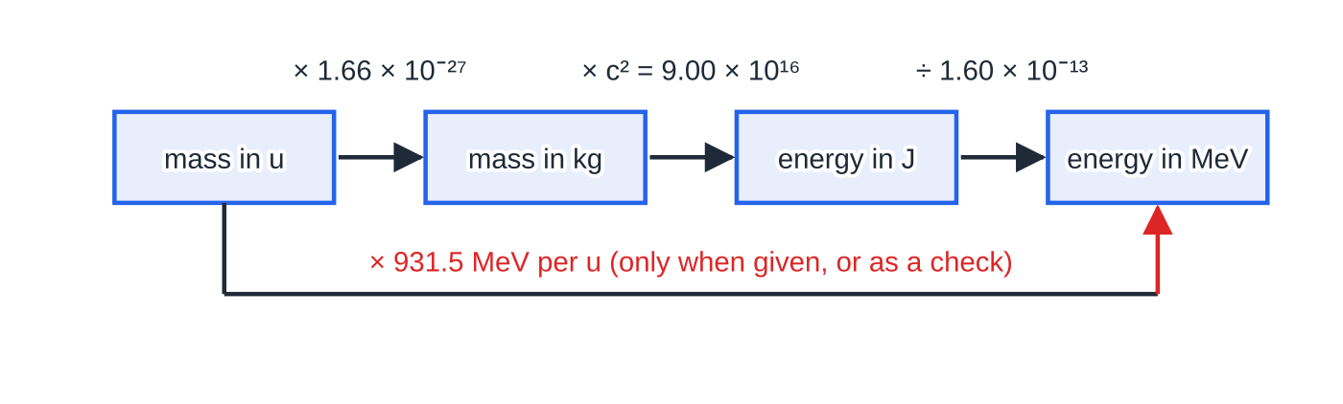
How do you convert between u, kg, J and MeV?
Section 3 of 12
The atomic mass unit u is one twelfth of the mass of a carbon-12 atom: 1 u = 1.66 × 10⁻²⁷ kg.
Nuclear masses are quoted in u because they are then close to whole numbers (a proton or neutron ≈ 1 u).
Nuclear energies are quoted in MeV: 1 MeV = 10⁶ × 1.60 × 10⁻¹⁹ J = 1.60 × 10⁻¹³ J.
The conversion route. Follow the black arrows, or take the red shortcut, but never mix the two in one step.
Notes:
How do you convert between u, kg, J and MeV?. Full notes: https://examinerprep.com/notes/edexcel-ial-physics/binding-energy-fission-and-fusion/

Slide 10
How do you convert between u, kg, J and MeV? (continued)
Section 3 of 12
From | To | Do this
mass in u | mass in kg | × 1.66 × 10⁻²⁷
mass in kg | energy in J | × c² = × 9.00 × 10¹⁶
energy in J | energy in MeV | ÷ 1.60 × 10⁻¹³
mass in u | energy in MeV | × 931.5 (only when the question gives this value, or as a check)
Notes:
How do you convert between u, kg, J and MeV?. Full notes: https://examinerprep.com/notes/edexcel-ial-physics/binding-energy-fission-and-fusion/

Slide 11
How do you convert between u, kg, J and MeV? (continued)
Section 3 of 12 · Worked example 2 · Medium · Show that
WORKED EXAMPLE · QUESTION
(a) Show that 1 u is equivalent to about 930 MeV. (b) The binding energy per nucleon of oxygen-16 is 7.98 MeV. Calculate the mass deficit of an oxygen-16 nucleus in kg and in u.
SOLUTION
(a) 1.66 ×10⁻²⁷ ×(3.00 ×10⁸)² = 1.494 ×10⁻¹⁰ J; ÷1.60 ×10⁻¹³: 934 MeV ≈ 930 MeV.
(b) Total binding energy = 7.98 ×16 = 127.7 MeV = 127.7 ×1.60 ×10⁻¹³ = 2.04 ×10⁻¹¹ J. Δm = 2.04 ×10⁻¹¹ ÷9.00 ×10¹⁶: 2.27 ×10⁻²⁸ kg = 0.137 u.
The accepted conversion is 931.5 MeV per u; the 934 MeV in (a) differs only because the data-list constants are rounded.
Notes:
How do you convert between u, kg, J and MeV?: Worked example 2. Full notes: https://examinerprep.com/notes/edexcel-ial-physics/binding-energy-fission-and-fusion/

Slide 12
How do you convert between u, kg, J and MeV? (continued)
Section 3 of 12
Common error
Multiplying a mass in u by c². ΔE = c²Δm gives joules only when Δm is in kilograms. Convert first, or use 931.5 MeV per u, but never both in the same step.
Notes:
How do you convert between u, kg, J and MeV?. Full notes: https://examinerprep.com/notes/edexcel-ial-physics/binding-energy-fission-and-fusion/

Slide 13
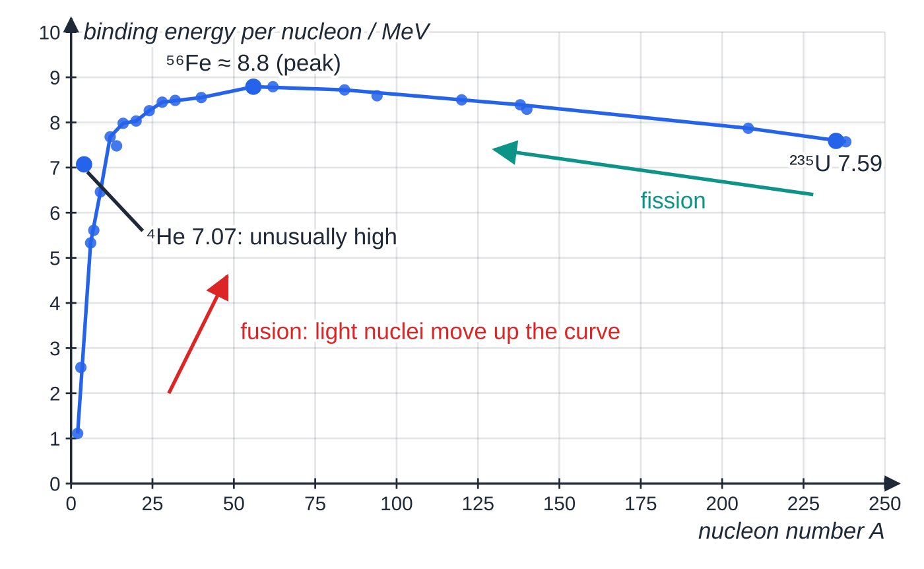
What does the binding energy per nucleon curve show?
Section 4 of 12
Binding energy per nucleon = total binding energy ÷ nucleon number A. It is the average energy needed to remove one nucleon, and it is the right measure of stability. Total binding energy simply grows with the number of nucleons, so it cannot compare nuclei of different sizes.
Helium-4 sits well above its neighbours: an unusually tightly bound nucleus, which is why alpha particles are emitted as a unit.
Binding energy per nucleon from measured atomic masses. It rises steeply for light nuclei, peaks near iron-56 at about 8.8 MeV and falls slowly to about 7.6 MeV for uranium. Any change that moves nuclei towards the peak releases energy.
Notes:
What does the binding energy per nucleon curve show?. Full notes: https://examinerprep.com/notes/edexcel-ial-physics/binding-energy-fission-and-fusion/

Slide 14
What does the binding energy per nucleon curve show? (continued)
Section 4 of 12
Why the curve has this shape (briefly)
The strong force is short range: a nucleon is attracted only by its nearest neighbours. In a small nucleus a large fraction of nucleons are at the surface with fewer neighbours, so binding per nucleon is low. The electrostatic repulsion between protons acts across the whole nucleus; in large nuclei it grows faster than the binding, so the binding energy per nucleon falls again.
Exam tip — explain energy release in order
Say what happens to the binding energy per nucleon (it increases), then the consequence: the products are more tightly bound, their total mass is less than that of the reactants, and the mass difference appears as kinetic energy of the products.
Notes:
What does the binding energy per nucleon curve show?. Full notes: https://examinerprep.com/notes/edexcel-ial-physics/binding-energy-fission-and-fusion/

Slide 15
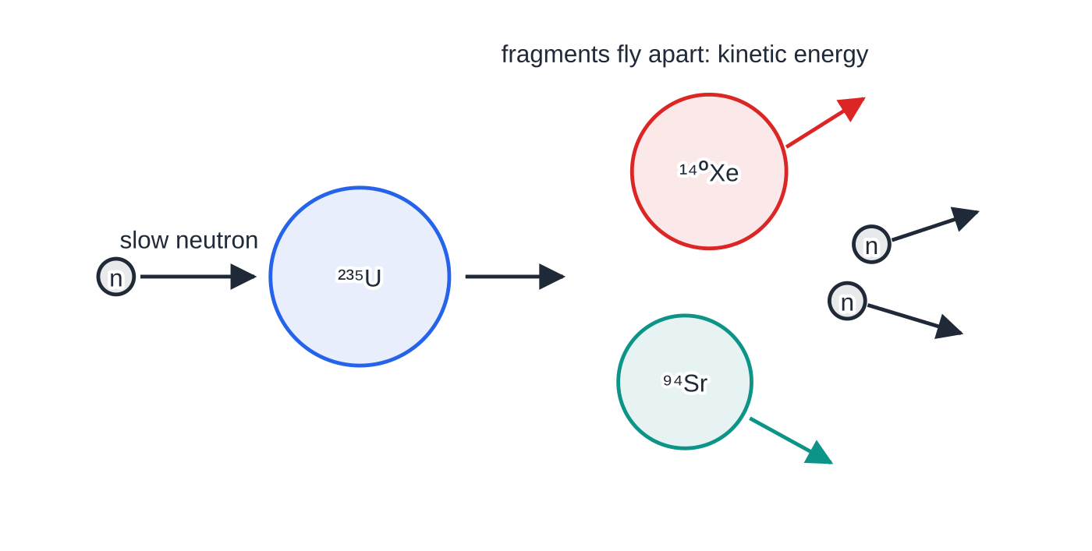
How does fission release energy?
Section 5 of 12
In fission a heavy nucleus splits into two middle-mass nuclei, usually with two or three free neutrons. In uranium-235 it is triggered by absorbing a slow neutron.
The products are nearer the peak, so their binding energy per nucleon is higher (about 8.3–8.6 MeV against 7.6 MeV). Nucleon number is conserved, so a higher binding energy per nucleon means a larger total binding energy after the split. The increase is released, mostly as kinetic energy of the fragments. Free neutrons have zero binding energy, since they are not bound to anything.
One fission of uranium-235: a slow neutron is absorbed, and the nucleus splits into xenon-140, strontium-94 and two neutrons, which fly apart with large kinetic energies.
Notes:
How does fission release energy?. Full notes: https://examinerprep.com/notes/edexcel-ial-physics/binding-energy-fission-and-fusion/

Slide 16
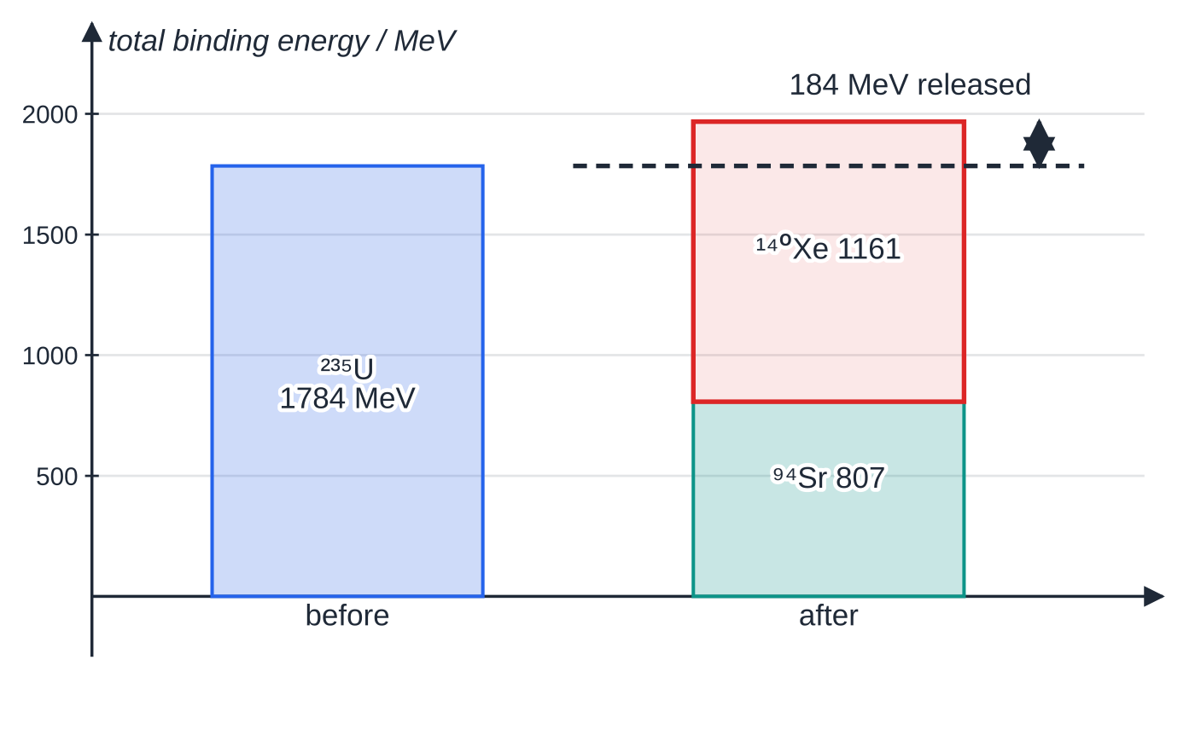
How does fission release energy? (continued)
Section 5 of 12
Total binding energies, drawn to scale. The products are bound more tightly in total than the uranium nucleus; the increase, 184 MeV, is the energy released.
Notes:
How does fission release energy?. Full notes: https://examinerprep.com/notes/edexcel-ial-physics/binding-energy-fission-and-fusion/

Slide 17
How does fission release energy? (continued)
Section 5 of 12 · Worked example 3 · Medium · Calculate
WORKED EXAMPLE · QUESTION
One possible fission of uranium-235 is ²³⁵U + n →¹⁴⁰Xe + ⁹⁴Sr + 2n. Atomic masses: ²³⁵U 235.04393 u, ¹⁴⁰Xe 139.921646 u, ⁹⁴Sr 93.915356 u; neutron 1.008665 u. Calculate (a) the energy released in one fission and (b) the energy released per kilogram of uranium-235 that undergoes fission.
SOLUTION
Check the balance: nucleons 235 + 1 = 140 + 94 + 2; protons 92 = 54 + 38. The electrons balance too, so atomic masses can be used.
(a) Before: 235.04393 + 1.008665 = 236.052595 u. After: 139.921646 + 93.915356 + 2 ×1.008665 = 235.854332 u. Δm = 0.198263 u = 3.29 ×10⁻²⁸ kg, so ΔE = c²Δm: 2.96 ×10⁻¹¹ J (185 MeV).
(b) Mass of one atom: 235.04393 ×1.66 ×10⁻²⁷ = 3.90 ×10⁻²⁵ kg. 2.96 ×10⁻¹¹ ÷3.90 ×10⁻²⁵: 7.59 ×10¹³ J kg⁻¹.
For comparison, burning a kilogram of coal releases about 3 × 10⁷ J, a factor of more than a million less.
Notes:
How does fission release energy?: Worked example 3. Full notes: https://examinerprep.com/notes/edexcel-ial-physics/binding-energy-fission-and-fusion/

Slide 18
How does fission release energy? (continued)
Section 5 of 12 · Worked example 4 · Easy · Estimate
WORKED EXAMPLE · QUESTION
Binding energies per nucleon: ²³⁵U 7.59 MeV, ¹⁴⁰Xe 8.29 MeV, ⁹⁴Sr 8.59 MeV. Estimate the energy released in the fission of Worked example 3.
SOLUTION
Total binding energy = per-nucleon value × A. U: 235 ×7.59 = 1784 MeV; Xe: 140 ×8.29 = 1161 MeV; Sr: 94 ×8.59 = 807 MeV.
Released = after − before: (1161 + 807) - 1784: 184 MeV, agreeing with Worked example 3 to within rounding.
Notes:
How does fission release energy?: Worked example 4. Full notes: https://examinerprep.com/notes/edexcel-ial-physics/binding-energy-fission-and-fusion/

Slide 19
How does fission release energy? (continued)
Section 5 of 12
Common error
Subtracting the binding energies the wrong way round, getting a negative answer, and reporting the energy as "absorbed". Energy is released when the total binding energy increases: released = after − before.
Notes:
How does fission release energy?. Full notes: https://examinerprep.com/notes/edexcel-ial-physics/binding-energy-fission-and-fusion/

Slide 20
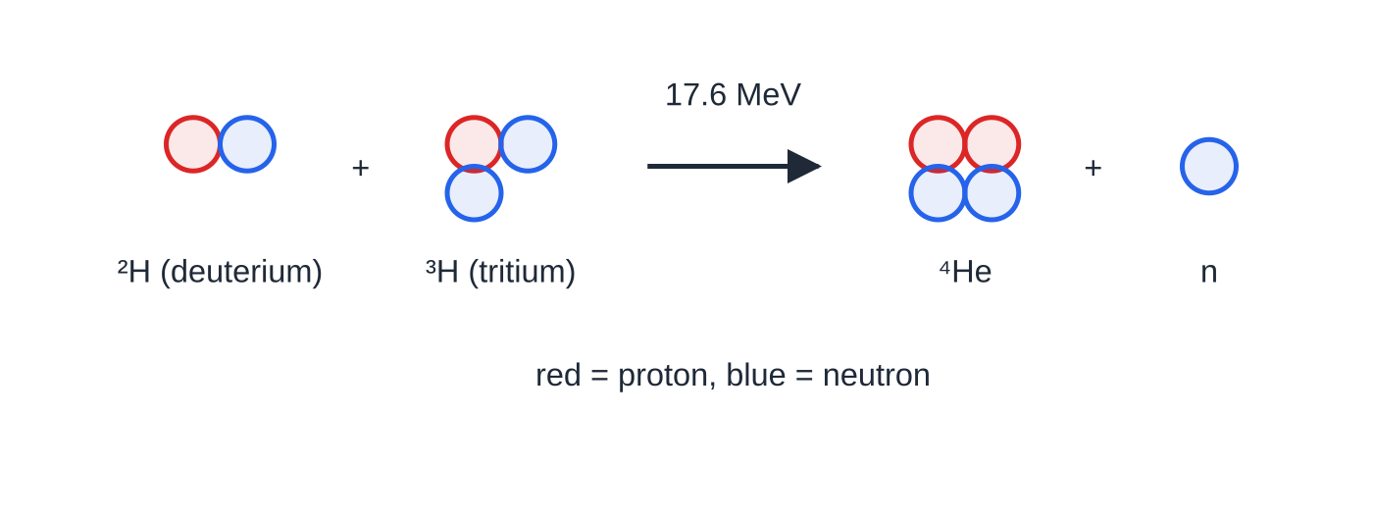
How does fusion release energy?
Section 6 of 12
In fusion two light nuclei join to form a heavier nucleus. On the steep left-hand side of the curve, the product has a much higher binding energy per nucleon than the reactants, so the total binding energy increases and energy is released.
Per reaction, fusion releases less energy than fission (about 18 MeV against about 200 MeV), but per kilogram of fuel it releases more, because the fuel nuclei are so light.
Deuterium–tritium fusion: two hydrogen isotopes form helium-4 and a free neutron, releasing 17.6 MeV.
Notes:
How does fusion release energy?. Full notes: https://examinerprep.com/notes/edexcel-ial-physics/binding-energy-fission-and-fusion/

Slide 21
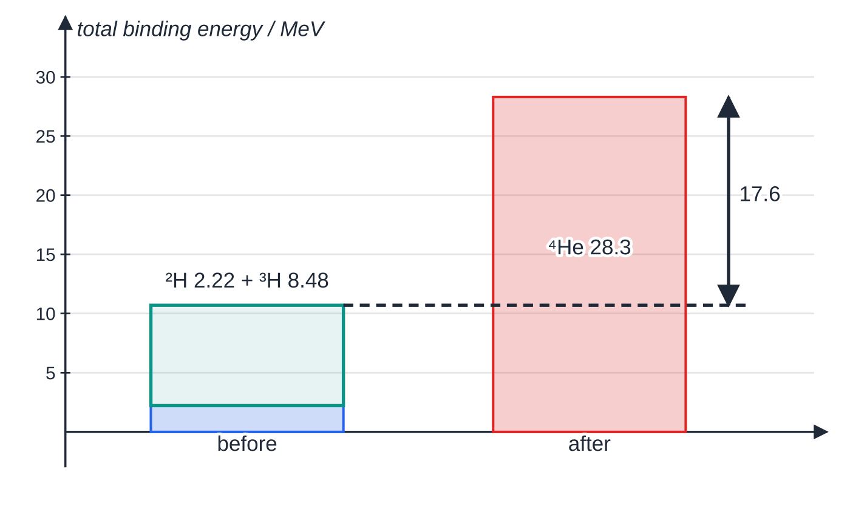
How does fusion release energy? (continued)
Section 6 of 12
Fusion of nuclei beyond the iron peak, or fission of nuclei lighter than it, would move away from the peak and would need an energy input.
Total binding energies for D–T fusion, drawn to scale: helium-4 (28.3 MeV) is far more tightly bound than the two hydrogen nuclei together (10.7 MeV).
Notes:
How does fusion release energy?. Full notes: https://examinerprep.com/notes/edexcel-ial-physics/binding-energy-fission-and-fusion/

Slide 22
How does fusion release energy? (continued)
Section 6 of 12 · Worked example 5 · Medium · Compare
WORKED EXAMPLE · QUESTION
²H + ³H →⁴He + n. Atomic masses: ²H 2.014102 u, ³H 3.016049 u, ⁴He 4.002603 u; neutron 1.008665 u. (a) Calculate the energy released in one reaction. (b) Compare the energy released per kilogram of fuel with the fission of Worked example 3.
SOLUTION
(a) Before 5.030151 u, after 5.011268 u, so Δm = 0.018883 u. ΔE = 0.018883 ×1.66 ×10⁻²⁷ ×(3.00 ×10⁸)²: 2.82 ×10⁻¹² J (17.6 MeV).
(b) Fuel mass (one deuterium plus one tritium atom): 5.030151 ×1.66 ×10⁻²⁷ = 8.35 ×10⁻²⁷ kg, so 2.82 ×10⁻¹² ÷8.35 ×10⁻²⁷ = 3.38 ×10¹⁴ J kg⁻¹. Then 3.38 ×10¹⁴ ÷7.59 ×10¹³ ≈4.5: about four and a half times as much energy per kilogram as uranium fission.
Notes:
How does fusion release energy?: Worked example 5. Full notes: https://examinerprep.com/notes/edexcel-ial-physics/binding-energy-fission-and-fusion/

Slide 23
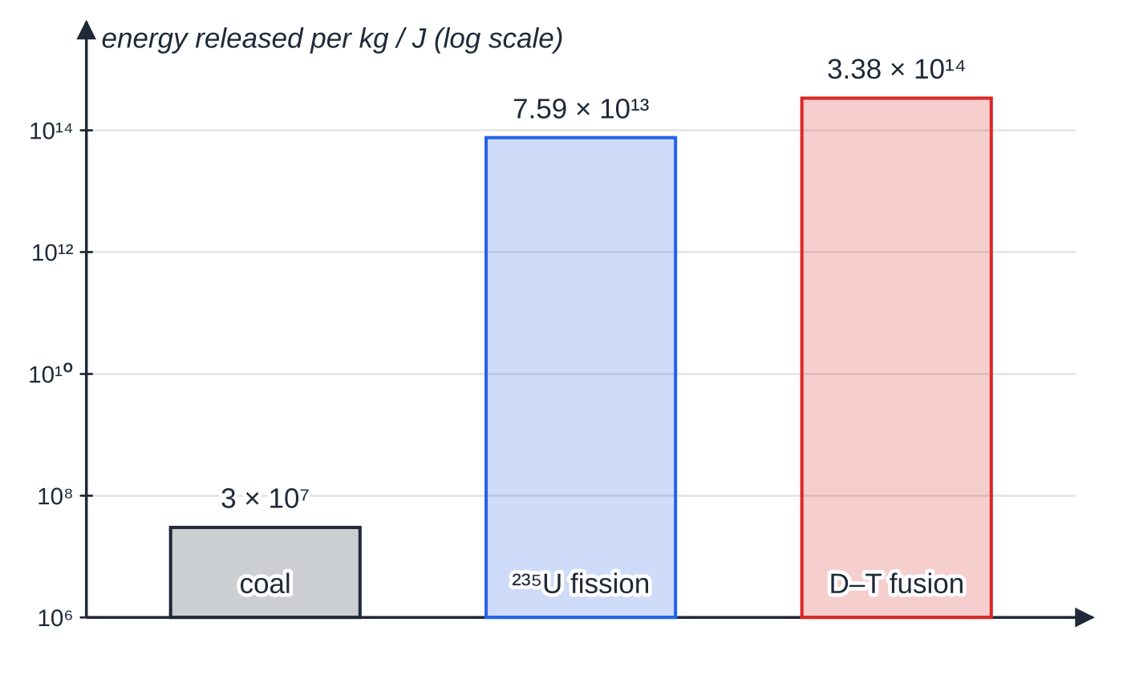
How does fusion release energy? (continued)
Section 6 of 12
Energy per kilogram of fuel on a logarithmic scale: uranium fission beats coal by more than a million times, and D–T fusion beats fission by about 4.5 times.
Notes:
How does fusion release energy?. Full notes: https://examinerprep.com/notes/edexcel-ial-physics/binding-energy-fission-and-fusion/

Slide 24
Why does fusion need very high temperatures and densities?
Section 7 of 12
Nuclei are positively charged and repel each other electrostatically.
The strong force that pulls them together has a range of only about 10⁻¹⁵ m, so the nuclei must get that close before they can fuse.
The electrostatic potential energy at that separation, kQ₁Q₂/r, is the Coulomb barrier. The nuclei need enough kinetic energy to climb it.
The mean kinetic energy of particles in a gas is proportional to the absolute temperature, ½m⟨c²⟩= (3/2)kT. Fast enough nuclei mean a very high temperature, and the material is a plasma of bare nuclei and electrons.
A high density (many nuclei per unit volume) makes collisions frequent, so enough reactions happen each second to release a useful power and to keep the plasma hot.
Notes:
Why does fusion need very high temperatures and densities?. Full notes: https://examinerprep.com/notes/edexcel-ial-physics/binding-energy-fission-and-fusion/

Slide 25
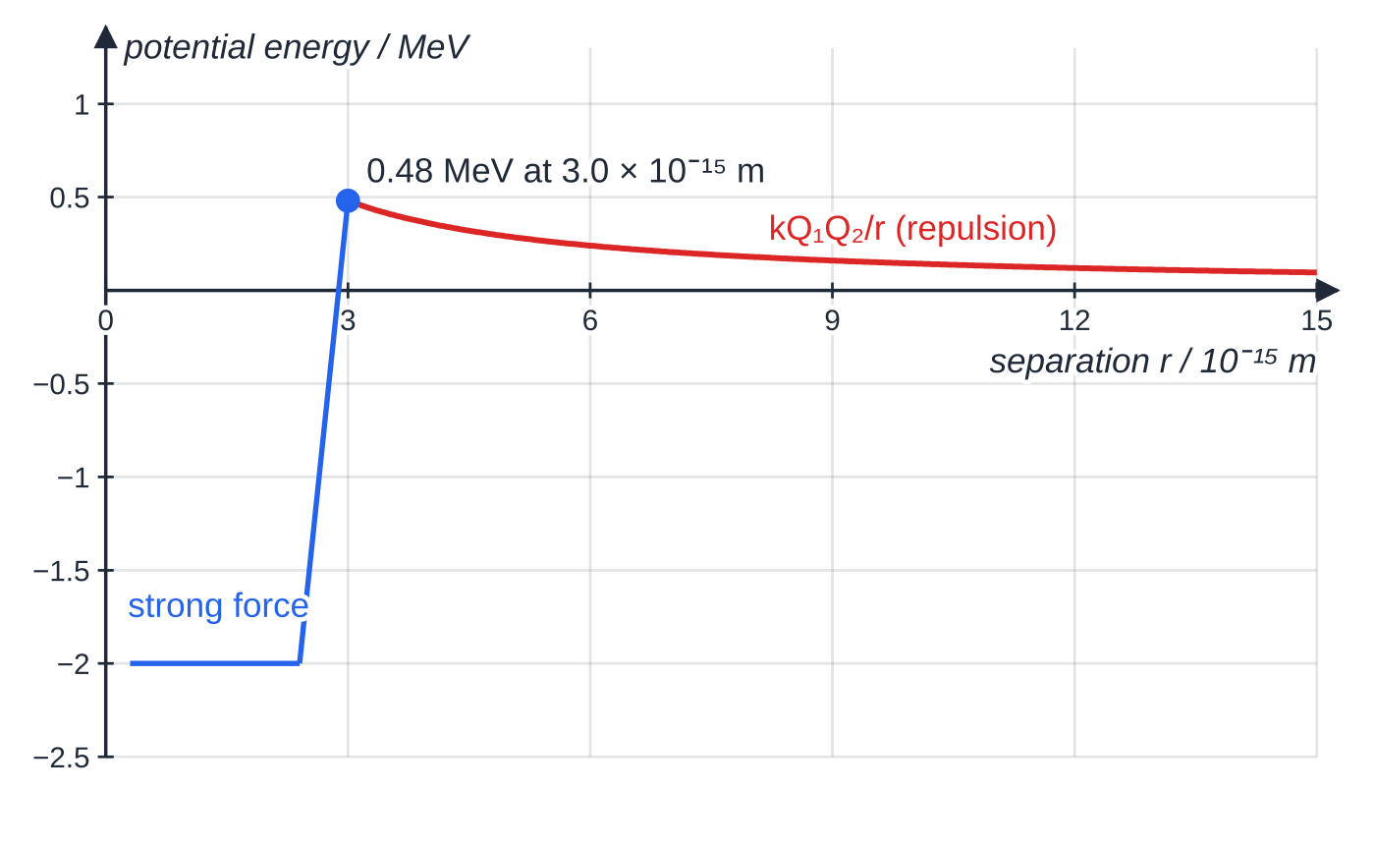
Why does fusion need very high temperatures and densities? (continued)
Section 7 of 12
Potential energy of two deuterons (sketch inside the barrier). Outside about 3 × 10⁻¹⁵ m the electrostatic repulsion dominates and the curve is kQ₁Q₂/r; inside, the strong force takes over.
Notes:
Why does fusion need very high temperatures and densities?. Full notes: https://examinerprep.com/notes/edexcel-ial-physics/binding-energy-fission-and-fusion/

Slide 26
Why does fusion need very high temperatures and densities? (continued)
Section 7 of 12 · Worked example 6 · Hard · Estimate and comment
WORKED EXAMPLE · QUESTION
Two deuterons (charge +e each) must approach to a separation of 3.0 × 10⁻¹⁵ m to fuse. They approach head-on with equal speeds. k = 8.99 ×10⁹ N m² C⁻², k_B = 1.38 ×10⁻²³ J K⁻¹. (a) Calculate the electrostatic potential energy at this separation. (b) Estimate the temperature at which the mean kinetic energy of a deuteron would be enough. (c) The core of the Sun is at about 1.5 × 10⁷ K. Comment.
SOLUTION
(a) E = kQ₁Q₂/r = (8.99 ×10⁹ ×(1.60 ×10⁻¹⁹)²)/(3.0 ×10⁻¹⁵): 7.7 ×10⁻¹⁴ J (≈ 0.48 MeV).
(b) Each deuteron supplies half, so (3/2)k_BT = 3.84 ×10⁻¹⁴ J and T = (2 ×3.84 ×10⁻¹⁴)/(3 ×1.38 ×10⁻²³): 1.9 ×10⁹ K.
(c) Mean kinetic energy in the Sun's core: (3/2) ×1.38 ×10⁻²³ ×1.5 ×10⁷ = 3.1 ×10⁻¹⁶ J, only about 0.8% of what is needed.
Notes:
Why does fusion need very high temperatures and densities?: Worked example 6. Full notes: https://examinerprep.com/notes/edexcel-ial-physics/binding-energy-fission-and-fusion/

Slide 27
Why does fusion need very high temperatures and densities? (continued)
Section 7 of 12 · Worked example 6 · Hard · Estimate and comment (continued)
Fusion still happens because the particles have a spread of speeds: a tiny fraction move much faster than average, and with an enormous number of nuclei in a very dense core, that fraction is enough. (Quantum tunnelling also helps; it is beyond this specification.)
Notes:
Why does fusion need very high temperatures and densities?: Worked example 6. Full notes: https://examinerprep.com/notes/edexcel-ial-physics/binding-energy-fission-and-fusion/

Slide 28
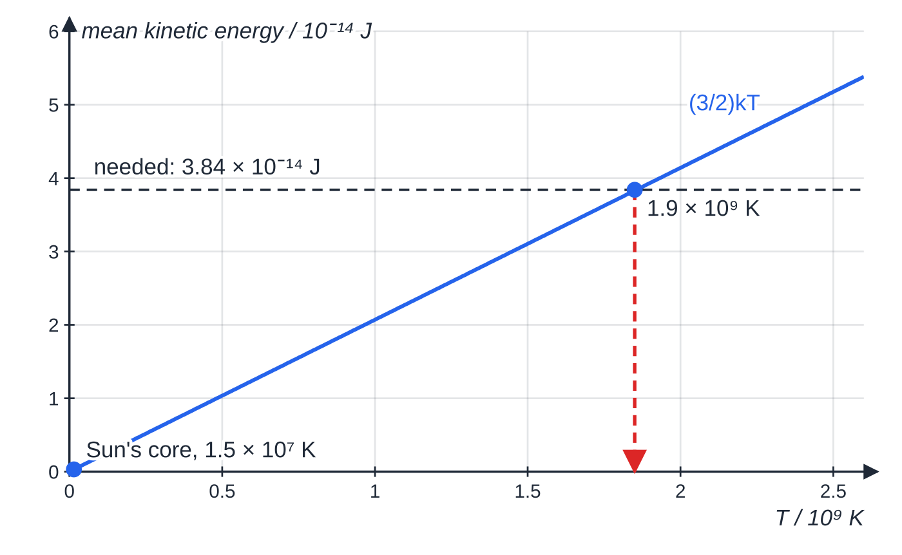
Why does fusion need very high temperatures and densities? (continued)
Section 7 of 12
Exam tip — link every step
Nuclei are positive → they repel → they must get within the short range of the strong force → so they need a large kinetic energy → mean kinetic energy ∝ T. For density, say it increases the rate of collisions, and so the rate of fusion.
Mean kinetic energy rises in proportion to the kelvin temperature. On this simple estimate about 1.9 × 10⁹ K is needed; the Sun's core is far cooler and relies on its fastest nuclei and its very high density.
Notes:
Why does fusion need very high temperatures and densities?. Full notes: https://examinerprep.com/notes/edexcel-ial-physics/binding-energy-fission-and-fusion/

Slide 29
Exam tips for 5.3
Section 8 of 12
Exam tip 1 — balance before you subtract
Check that nucleon numbers and proton numbers balance on both sides, and count the free neutrons. A missing neutron changes Δm by about 1 u, hundreds of times the answer.
Exam tip 2 — keep the figures in mass differences
Copy masses with every figure given and round only the final energy. The answer is the small difference between two large numbers.
Exam tip 3 — one conversion route per step
Either u → kg → (× c²) J → MeV, or u × 931.5 → MeV when that value is given. State the route in your working so each conversion can be followed.
Notes:
Exam tips for 5.3. Full notes: https://examinerprep.com/notes/edexcel-ial-physics/binding-energy-fission-and-fusion/

Slide 30
Exam tips for 5.3 (continued)
Section 8 of 12
Exam tip 4 — per nucleon means divide by A
Binding energy per nucleon is the total divided by the nucleon number A, not the proton number Z. To go back, multiply by A.
Exam tip 5 — "explain" needs the chain
Binding energy per nucleon increases → total binding energy increases → mass of products is less → ΔE = c²Δm released as kinetic energy. Each link is a separate point.
Notes:
Exam tips for 5.3. Full notes: https://examinerprep.com/notes/edexcel-ial-physics/binding-energy-fission-and-fusion/

Slide 31
Common misconceptions
Section 9 of 12
Misconception | Why it is wrong | Correct idea
Binding energy is energy stored in a nucleus and released when it breaks up. | Work must be done against the strong force to separate nucleons. | Binding energy is the energy needed to pull a nucleus apart; it is released when the nucleus forms.
The nucleus with the largest binding energy is the most stable. | Total binding energy grows with the number of nucleons. | Compare binding energy per nucleon; iron-56 is near the top.
In fission, some nucleons are destroyed and turned into energy. | Nucleon number and proton number are conserved. | Each nucleon ends up more tightly bound, and the total mass falls slightly.
Mass changes only in nuclear reactions. | ΔE = c²Δm applies to every energy change. | Chemical mass changes exist but are far too small to measure.
Fusion of any two nuclei releases energy. | Beyond the iron peak, the product would have a lower binding energy per nucleon. | Fusion releases energy only for light nuclei; fission only for heavy ones.
Notes:
Common misconceptions. Full notes: https://examinerprep.com/notes/edexcel-ial-physics/binding-energy-fission-and-fusion/

Slide 32
Common misconceptions (continued)
Section 9 of 12
Misconception | Why it is wrong | Correct idea
Fusion needs a high temperature to "ignite" the fuel like a fire. | Nothing is burning; the issue is electrostatic repulsion. | High temperature gives nuclei enough kinetic energy to get close enough for the strong force to act.
Notes:
Common misconceptions. Full notes: https://examinerprep.com/notes/edexcel-ial-physics/binding-energy-fission-and-fusion/

Slide 33
How this topic connects
Section 10 of 12
Atomic structure and electric fields (Unit 4)
The nucleus, nucleon and proton numbers, isotopes and the strong force are set up in Unit 4, along with the electronvolt and units such as MeV/c². The Coulomb barrier is the electric potential V = kQ/r of one nucleus multiplied by the charge of the other.
2 Internal energy and the ideal gas
½m⟨c²⟩= (3/2)kT comes from kinetic theory; here it turns a required kinetic energy into a temperature.
4 Radioactive decay, and stars
Every decay releases energy because the products have less mass, and hydrogen fusion powers main-sequence stars on the Hertzsprung–Russell diagram.
Notes:
How this topic connects. Full notes: https://examinerprep.com/notes/edexcel-ial-physics/binding-energy-fission-and-fusion/

Slide 34
Key equations
Section 11 of 12
Equation | Use | In the formulae list?
ΔE = c²Δm | energy from a mass difference (mass in kg, energy in J) | yes
Δm = Zmₚ + (A - Z)mₙ - m_nucleus | mass deficit of a nucleus | no — learn it
binding energy per nucleon = binding energy ÷ A | comparing stability | no — learn it
1 u = 1.66 × 10⁻²⁷ kg | converting masses | given in the data list
1 u ≡ 931.5 MeV | quick u → MeV conversion | no — derive it from 1 u × c², or use when given
E = kQ₁Q₂/r | Coulomb barrier height | no — derive it from V = kQ/r (in the list) × charge
½m⟨c²⟩= (3/2)kT | mean kinetic energy ↔ temperature | yes
Notes:
Key equations. Full notes: https://examinerprep.com/notes/edexcel-ial-physics/binding-energy-fission-and-fusion/

Slide 35
Check your understanding
Section 12 of 12
1. Define the binding energy of a nucleus.
2. Explain why the mass of a nucleus is less than the total mass of its separate nucleons.
3. A reaction loses 0.0500 u of mass. Calculate the energy released in MeV.
4. The binding energy of lithium-7 is 39.2 MeV. Calculate its binding energy per nucleon and state whether it is more or less stable than helium-4.
5. Explain why iron-56 cannot release energy by either fission or fusion.
6. Use the D–T result (17.6 MeV per reaction) to find the energy released per nucleon of fuel, and compare it with the 185 MeV fission of Worked example 3.
Notes:
Check your understanding: questions. Full notes: https://examinerprep.com/notes/edexcel-ial-physics/binding-energy-fission-and-fusion/

Slide 36
Check your understanding · answers
Section 12 of 12
1. The energy needed to separate the nucleus completely into its individual protons and neutrons.
2. Energy is released when the nucleons bind together, so the nucleus has less energy than the separated nucleons. By ΔE = c²Δm, less energy means less mass.
3. 0.0500 ×931.5 = 46.6 MeV (via kg and c² with the data-list values: 46.7 MeV).
4. 39.2 ÷7 = 5.60 MeV per nucleon, less than helium-4's 7.09 MeV, so lithium-7 is less stable.
5. It is at (very nearly) the peak of the binding energy per nucleon curve. Splitting it or joining it with another nucleus would give products with a lower binding energy per nucleon, so energy would have to be supplied.
6. Fusion: 17.6 ÷5 = 3.52 MeV per nucleon. Fission: 185 ÷236 = 0.784 MeV per nucleon. Fusion releases about 4.5 times more per nucleon, matching the per-kilogram comparison.
Notes:
Check your understanding: answers. Full notes: https://examinerprep.com/notes/edexcel-ial-physics/binding-energy-fission-and-fusion/

Slide 37
Practice questions
5 original exam-style questions. Answers at the end of the deck.

Slide 38
Question 1
1 mark
When a uranium-235 nucleus undergoes fission, energy is released.
Which statement explains why?
A The fission products have a greater binding energy per nucleon than the uranium nucleus.
B The fission products have a smaller binding energy per nucleon than the uranium nucleus.
C Some of the neutrons are converted completely into energy.
D The free neutrons carry away the binding energy of the uranium nucleus.
Notes:
Online with the full mark scheme: https://examinerprep.com/ial-physics-5-3-binding-energy-fission-and-fusion-questions#IALP-U5-3-A-07

Slide 39
Question 2
1 mark
A fusion reactor needs its fuel to be at a very high density as well as a very high temperature.
Why is a high density needed?
A to increase the electrostatic repulsion between the nuclei
B to increase the mean kinetic energy of the nuclei
C to reduce the binding energy per nucleon of the fuel
D to increase the rate at which nuclei collide
Notes:
Online with the full mark scheme: https://examinerprep.com/ial-physics-5-3-binding-energy-fission-and-fusion-questions#IALP-U5-3-A-09

Slide 40
Question 3
1 mark
Which statement describes the binding energy of a nucleus?
A the energy needed to remove one proton from the nucleus
B the energy released when the nucleus decays
C the kinetic energy of the nucleons inside the nucleus
D the energy needed to separate the nucleus completely into its individual protons and neutrons
Notes:
Online with the full mark scheme: https://examinerprep.com/ial-physics-5-3-binding-energy-fission-and-fusion-questions#IALP-U5-3-A-01

Slide 41
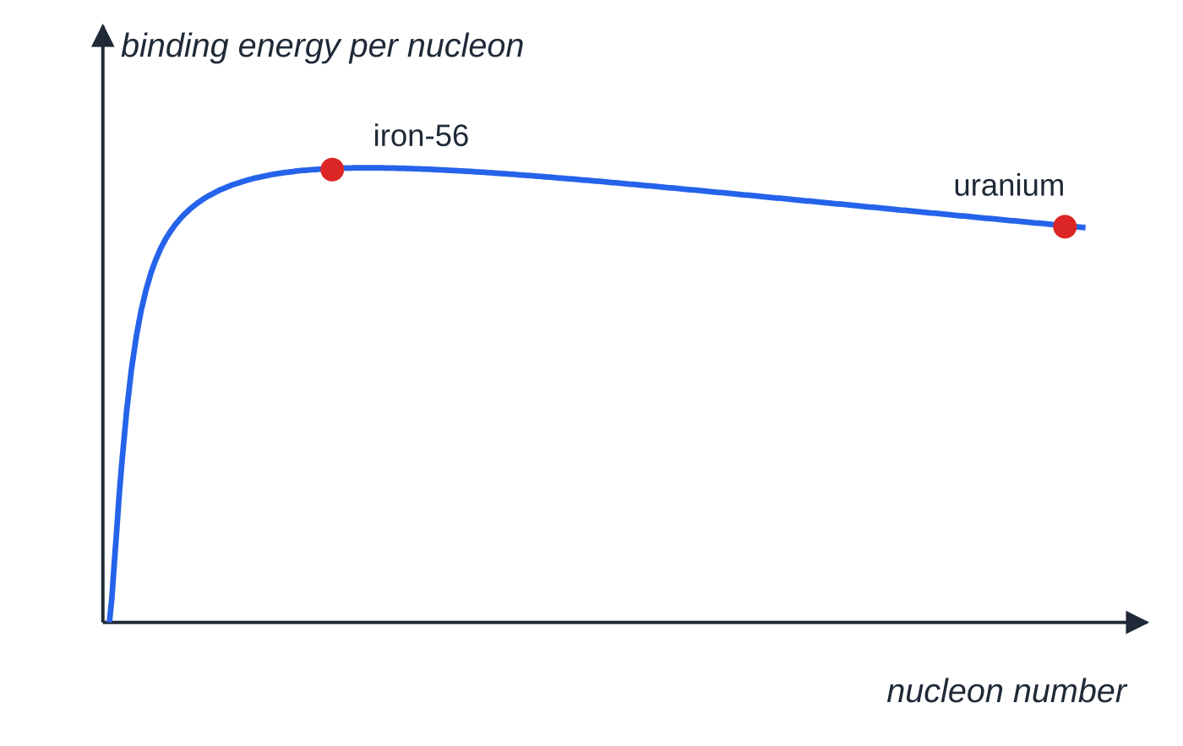
Question 4
6 marks
The graph of binding energy per nucleon against nucleon number rises steeply from hydrogen to a maximum near iron-56 and then falls gradually towards uranium.
Figure: binding energy per nucleon against nucleon number (not to scale)
(a) Explain, with reference to this graph, why energy is released both when heavy nuclei undergo fission and when light nuclei undergo fusion. You may refer to mass and energy in your answer. [6]
Notes:
Online with the full mark scheme: https://examinerprep.com/ial-physics-5-3-binding-energy-fission-and-fusion-questions#IALP-U5-3-B-04

Slide 42
Question 5
7 marks
The table gives binding energies per nucleon for some nuclei.
²H: 1.11 MeV · ⁴He: 7.07 MeV · ⁵⁶Fe: 8.79 MeV · ⁹³Rb: 8.48 MeV · ¹⁴⁰Cs: 8.31 MeV · ²³⁵U: 7.59 MeV
(a) State which nucleus in the table is the most stable. [1]
(b) One fission of uranium-235 is ²³⁵U + n → ¹⁴⁰Cs + ⁹³Rb + 3n. Calculate the energy released. [3]
(c) Two deuterium nuclei can fuse to form a helium-4 nucleus. Calculate the energy released. [2]
(d) Explain why two iron-56 nuclei would not release energy by fusing. [1]
Notes:
Online with the full mark scheme: https://examinerprep.com/ial-physics-5-3-binding-energy-fission-and-fusion-questions#IALP-U5-3-B-05

Slide 43
Answers

Slide 44
Question 1 · answer
Answer A
The products are closer to the peak of the curve, so their nucleons are more tightly bound: binding energy per nucleon increases. With the same number of nucleons, the total binding energy increases, the products have less mass and the difference is released.
Notes:
Full mark scheme: https://examinerprep.com/ial-physics-5-3-binding-energy-fission-and-fusion-questions#IALP-U5-3-A-07

Slide 45
Question 2 · answer
Answer D
More nuclei per unit volume means more collisions per second, so more fusion reactions per second and a useful power output. Temperature, not density, sets the mean kinetic energy.
Notes:
Full mark scheme: https://examinerprep.com/ial-physics-5-3-binding-energy-fission-and-fusion-questions#IALP-U5-3-A-09

Slide 46
Question 3 · answer
Answer D
Binding energy is the energy needed to separate a nucleus completely into its individual protons and neutrons. The same amount of energy is released when the nucleus forms from free nucleons.
Notes:
Full mark scheme: https://examinerprep.com/ial-physics-5-3-binding-energy-fission-and-fusion-questions#IALP-U5-3-A-01

Slide 47
Question 4 · answer
Mark scheme
Indicative content:
binding energy per nucleon is a measure of how tightly bound / stable a nucleus is; the peak near iron-56 is the most stable
in fission a heavy nucleus splits into two middle-mass nuclei, which are closer to the peak
in fusion two light nuclei form a heavier nucleus, also closer to the peak
in both cases the binding energy per nucleon of the products is greater than that of the reactants
nucleon number is conserved, so the total binding energy of the products is greater
so the products have less mass than the reactants, and the mass difference Δm is released as energy ΔE = c²Δm (as kinetic energy of the products)
Notes:
Full mark scheme: https://examinerprep.com/ial-physics-5-3-binding-energy-fission-and-fusion-questions#IALP-U5-3-B-04

Slide 48
Question 5 · answer
Mark scheme
⁵⁶Fe — it has the greatest binding energy per nucleon
before: 235 × 7.59 = 1784 MeV (the absorbed neutron has no binding energy)
after: 140 × 8.31 + 93 × 8.48 = 1163 + 789 = 1952 MeV
energy released = 1952 − 1784 = 168 MeV
before: 2 × 2 × 1.11 = 4.44 MeV; after: 4 × 7.07 = 28.28 MeV
released = 23.8 MeV
the product would be beyond the peak, with a lower binding energy per nucleon than iron-56, so energy would have to be supplied
Notes:
Full mark scheme: https://examinerprep.com/ial-physics-5-3-binding-energy-fission-and-fusion-questions#IALP-U5-3-B-05

Slide 49
Keep practising
Notes for this topic
Questions on this topic
Build a printable test
ExaminerPrep is an independent tutoring service. It has been developed independently from and is not endorsed by the International Baccalaureate Organization. "International Baccalaureate", "IB" and "IB Diploma Programme" are registered trademarks of the IBO, used here for descriptive purposes only.
Pearson Edexcel and Cambridge are trademarks of their owners; ExaminerPrep is not affiliated with any exam board.

