Slide 1
EP
EDEXCEL IAL PHYSICS
4.4 Capacitors
The full notes page in 11 sections · practice questions with answers · simulations
ExaminerPrep is an independent tutoring service. It has been developed independently from and is not endorsed by the International Baccalaureate Organization. "International Baccalaureate", "IB" and "IB Diploma Programme" are registered trademarks of the IBO, used here for descriptive purposes only.
Pearson Edexcel and Cambridge are trademarks of their owners; ExaminerPrep is not affiliated with any exam board.
Notes:
4.4 Capacitors. Notes for this topic: https://examinerprep.com/notes/edexcel-ial-physics/capacitors/

Slide 2
What this page covers
Overview
What a capacitor is, the definition of capacitance C = Q/V and the farad
Energy stored as the area under a graph of p.d. against charge: W = ½ QV = ½ CV² = ½ Q²/C
Why a supply charging a capacitor transfers twice the energy that ends up stored
Graphs of charge, p.d. and current against time for charging and discharging through a resistor
The time constant RC, and what changing R or C does
Q = Q₀ e^(-t/RC) and its current and p.d. forms, the log forms and the time to halve, RC ln 2
The p.d. across a charging capacitor, V_C = V₀(1 - e^(-t/RC))
Core Practical 11: recording a charge and discharge with a data logger or oscilloscope, and analysing it with a ln graph
Notes:
What this page covers. Full notes: https://examinerprep.com/notes/edexcel-ial-physics/capacitors/

Slide 3
In one minute
Key points
1. A capacitor is two conductors separated by an insulator that stores separated charge (+Q on one plate, -Q on the other) and the energy that goes with it, and when it discharges through a resistor its charge, current and p.d. all fall exponentially with time constant RC.
2. Capacitance C = Q/V is the charge stored per unit p.d.; 1 F = 1 C V⁻¹, and practical values are in µF, nF and pF.
3. Energy stored = area under the V–Q graph: W = ½ QV = ½ CV² = ½ Q²/C. Charging from a fixed supply, the supply transfers QV and half of it is dissipated in the resistance.
4. Through a resistor the current is largest at the start and decays exponentially, in both charging and discharging.
5. In one time constant RC, a discharge falls to 37% (e⁻¹) and a charging capacitor reaches 63% of its final p.d.; after about 5RC the change is effectively complete.
6. ln Q = ln Q₀ - t/RC: a graph of ln against t is a straight line of gradient -1/RC.
Notes:
In one minute. Full notes: https://examinerprep.com/notes/edexcel-ial-physics/capacitors/

Slide 4
In one minute (continued)
Key points
The time to halve is RC ln 2.
Notes:
In one minute. Full notes: https://examinerprep.com/notes/edexcel-ial-physics/capacitors/

Slide 5
What is a capacitor, and what does capacitance measure?
Section 1 of 11
A capacitor is two conducting plates separated by an insulator, which may be air, a plastic film, a ceramic or a thin oxide layer. On its own it does nothing. Connect it to a supply, though, and the supply pushes electrons onto one plate and pulls the same number off the other. One plate ends up with charge -Q and the other is left with +Q.
The capacitor as a whole stays neutral: "the charge stored" means Q, the charge on one plate. No charge ever crosses the gap. Current flows in the wires on both sides while the plates charge, and stops when the p.d. across the capacitor equals the supply p.d.
Notes:
What is a capacitor, and what does capacitance measure?. Full notes: https://examinerprep.com/notes/edexcel-ial-physics/capacitors/

Slide 6
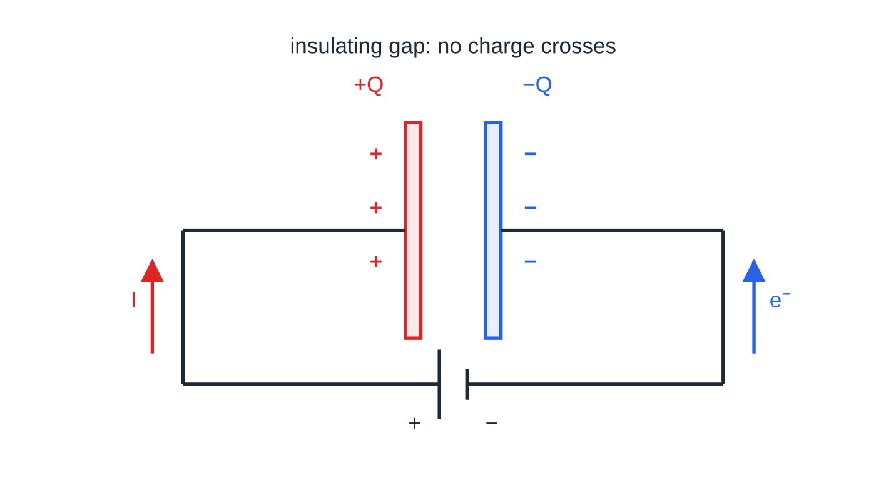
What is a capacitor, and what does capacitance measure? (continued)
Section 1 of 11
For a given capacitor, doubling the p.d. doubles the charge it holds. The constant ratio is the capacitance.
Capacitance
C is the charge stored on one plate per unit potential difference across the capacitor: C = Q/V where C is in farads (F), Q in coulombs (C) and V in volts (V). One farad is one coulomb per volt, 1 F = 1 C V⁻¹.
Charging: conventional current flows from the positive terminal to the left plate, while electrons flow from the negative terminal onto the right plate. The plates end up with equal and opposite charges; nothing crosses the gap.
Notes:
What is a capacitor, and what does capacitance measure?. Full notes: https://examinerprep.com/notes/edexcel-ial-physics/capacitors/

Slide 7
What is a capacitor, and what does capacitance measure? (continued)
Section 1 of 11
A farad is a very large capacitance: lab capacitors are in µF (10⁻⁶ F), nF (10⁻⁹ F) or pF (10⁻¹² F), and only "supercapacitors" reach whole farads. Because Q ∝V, a graph of Q against V (or V against Q) for a capacitor is a straight line through the origin, and its gradient gives C (or 1/C).
Notes:
What is a capacitor, and what does capacitance measure?. Full notes: https://examinerprep.com/notes/edexcel-ial-physics/capacitors/

Slide 8
What is a capacitor, and what does capacitance measure? (continued)
Section 1 of 11 · Worked example 1 · Easy · Calculate
WORKED EXAMPLE · QUESTION
A 470 µF capacitor is connected to a 9.0 V supply until it is fully charged. (a) Calculate the charge stored. (b) Calculate the number of electrons that have moved from one plate to the other. (c) The supply is changed to 12.0 V. Calculate the extra charge that flows onto the capacitor.
SOLUTION
(a) Rearrange C = Q/V, with 470 µF = 470 × 10⁻⁶ F: Q = CV = 470×10⁻⁶ ×9.0 = 4.2 × 10⁻³ C (4.23 mC)
(b) Divide by the charge on one electron: N = 4.23×10⁻³ ÷1.60×10⁻¹⁹ = 2.6 × 10¹⁶ electrons
(c) Charge is proportional to p.d., so the extra charge is CΔV = 470×10⁻⁶ ×(12.0 - 9.0) = 1.4 × 10⁻³ C (1.41 mC)
Notes:
What is a capacitor, and what does capacitance measure?: Worked example 1. Full notes: https://examinerprep.com/notes/edexcel-ial-physics/capacitors/

Slide 9
What is a capacitor, and what does capacitance measure? (continued)
Section 1 of 11
Common error — "The charge is 2Q" or "the charge is zero"
The two plates carry +Q and -Q. The capacitor stores Q, the charge that has been separated, and that is the Q in C = Q/V. It is neither 2Q nor zero.
Notes:
What is a capacitor, and what does capacitance measure?. Full notes: https://examinerprep.com/notes/edexcel-ial-physics/capacitors/

Slide 10
How much energy does a charged capacitor store?
Section 2 of 11
Pushing extra charge onto a plate that is already charged takes work, because the charge already there repels it. That work is stored as electric potential energy and released when the capacitor discharges.
To add a small charge ΔQ when the p.d. is V, the work done is ΔW = VΔQ. On a graph of V against Q that is the area of a thin strip. Adding up all the strips from zero to the final charge gives the key result: the energy stored is the area under the V–Q graph. Because V ∝Q, the graph is a straight line through the origin and the area is a triangle, ½ QV.
Notes:
How much energy does a charged capacitor store?. Full notes: https://examinerprep.com/notes/edexcel-ial-physics/capacitors/

Slide 11
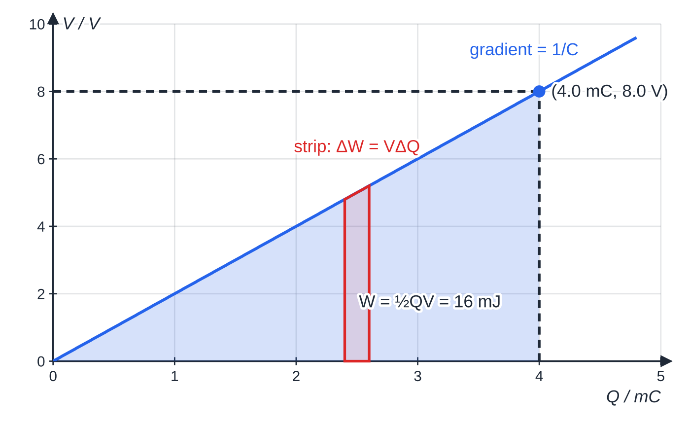
How much energy does a charged capacitor store? (continued)
Section 2 of 11
Put simply, the charge was not all moved at the final p.d. V: on average it was moved through ½ V.
Energy stored by a capacitor
W = ½ QV = ½ CV² = Q²/2C W energy stored (J), Q charge stored (C), V p.d. (V), C capacitance (F). All three forms are in the formulae list.
The second and third forms come from substituting Q = CV or V = Q/C into ½ QV.
P.d. against charge for a 500 µF capacitor. The shaded triangle up to 8.0 V is the energy stored: ½ × 4.0 mC × 8.0 V = 16 mJ. Each thin strip is the work done to add a small charge ΔQ at p.d. V.
Notes:
How much energy does a charged capacitor store?. Full notes: https://examinerprep.com/notes/edexcel-ial-physics/capacitors/

Slide 12
How much energy does a charged capacitor store? (continued)
Section 2 of 11
Pick the one that uses the quantities you already know. Notice the square: for a fixed capacitor, doubling V doubles Q and multiplies the energy by four. In the graph above, the energy at 4.0 V is only 4 mJ, so raising the p.d. from 4.0 V to 8.0 V adds 12 mJ.
Notes:
How much energy does a charged capacitor store?. Full notes: https://examinerprep.com/notes/edexcel-ial-physics/capacitors/

Slide 13
How much energy does a charged capacitor store? (continued)
Section 2 of 11 · Worked example 2 · Medium · Calculate
WORKED EXAMPLE · QUESTION
The flash unit of a camera uses a 150 µF capacitor charged to 330 V. When the flash fires, the capacitor discharges through the flash tube in 1.2 ms. (a) Calculate the energy stored. (b) Calculate the mean power delivered to the flash tube, assuming all the stored energy is transferred.
SOLUTION
(a) C and V are known, so use ½ CV²: W = ½ ×150×10⁻⁶ ×330² = 8.2 J (8.17 J)
(b) Power = energy ÷ time: P = 8.17 ÷1.2×10⁻³ = 6.8 × 10³ W
Check with another form: Q = CV = 0.0495 C and ½ QV = ½ ×0.0495 ×330 = 8.17 J. A small battery could not deliver kilowatts; a capacitor can, because it releases its energy very quickly.
Notes:
How much energy does a charged capacitor store?: Worked example 2. Full notes: https://examinerprep.com/notes/edexcel-ial-physics/capacitors/

Slide 14
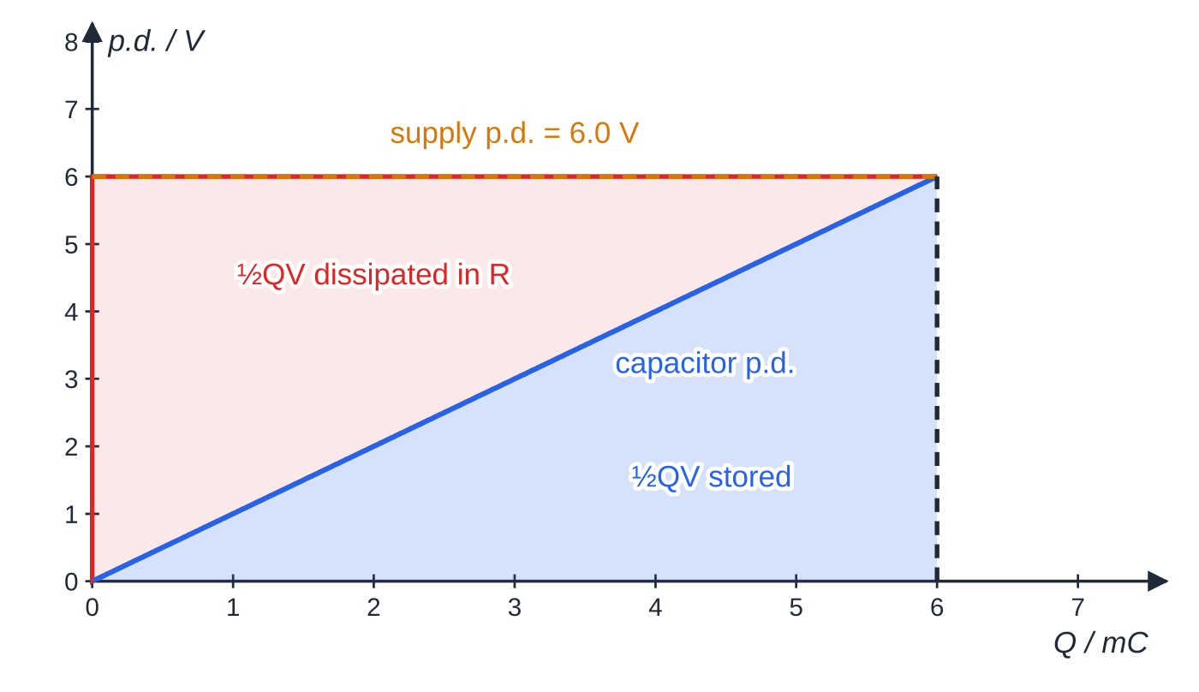
How much energy does a charged capacitor store? (continued)
Section 2 of 11
Where does the rest of the supply's energy go?
A supply of fixed p.d. V moves a total charge Q round the circuit while it charges the capacitor, and every coulomb is given V joules. So the supply transfers QV. The capacitor stores only ½ QV. The other half is dissipated as thermal energy in the resistance of the circuit: the resistor, the wires and the internal resistance of the supply.
Charging a 1000 µF capacitor to 6.0 V. The whole rectangle (QV = 36 mJ) is the energy from the supply; the blue triangle (18 mJ) is stored and the red triangle (18 mJ) is dissipated in the resistance.
Notes:
How much energy does a charged capacitor store?. Full notes: https://examinerprep.com/notes/edexcel-ial-physics/capacitors/

Slide 15
How much energy does a charged capacitor store? (continued)
Section 2 of 11
The split does not depend on the resistance: a smaller resistance gives a larger current for a shorter time, but the energy dissipated is still ½ QV.
Notes:
How much energy does a charged capacitor store?. Full notes: https://examinerprep.com/notes/edexcel-ial-physics/capacitors/

Slide 16
How much energy does a charged capacitor store? (continued)
Section 2 of 11 · Worked example 3 · Medium · Calculate
WORKED EXAMPLE · QUESTION
A 1000 µF capacitor is charged to 6.0 V through a resistor from a 6.0 V supply. Calculate (a) the energy transferred by the supply, (b) the energy stored by the capacitor and (c) the energy dissipated in the resistor.
SOLUTION
Charge moved by the supply: Q = CV = 1000×10⁻⁶ ×6.0 = 6.0×10⁻³ C.
(a) Each coulomb is given 6.0 J: W = QV = 6.0×10⁻³ ×6.0 = 0.036 J
(b) W = ½ QV = 0.018 J
(c) Dissipated = 0.036 − 0.018 = 0.018 J
Notes:
How much energy does a charged capacitor store?: Worked example 3. Full notes: https://examinerprep.com/notes/edexcel-ial-physics/capacitors/

Slide 17
How much energy does a charged capacitor store? (continued)
Section 2 of 11
Exam tip — Work in base units
Write 470 µF as 470 × 10⁻⁶ F before substituting. A forgotten 10⁻⁶ makes an energy a million times too big, which is usually obvious if you stop to read your answer.
Notes:
How much energy does a charged capacitor store?. Full notes: https://examinerprep.com/notes/edexcel-ial-physics/capacitors/

Slide 18
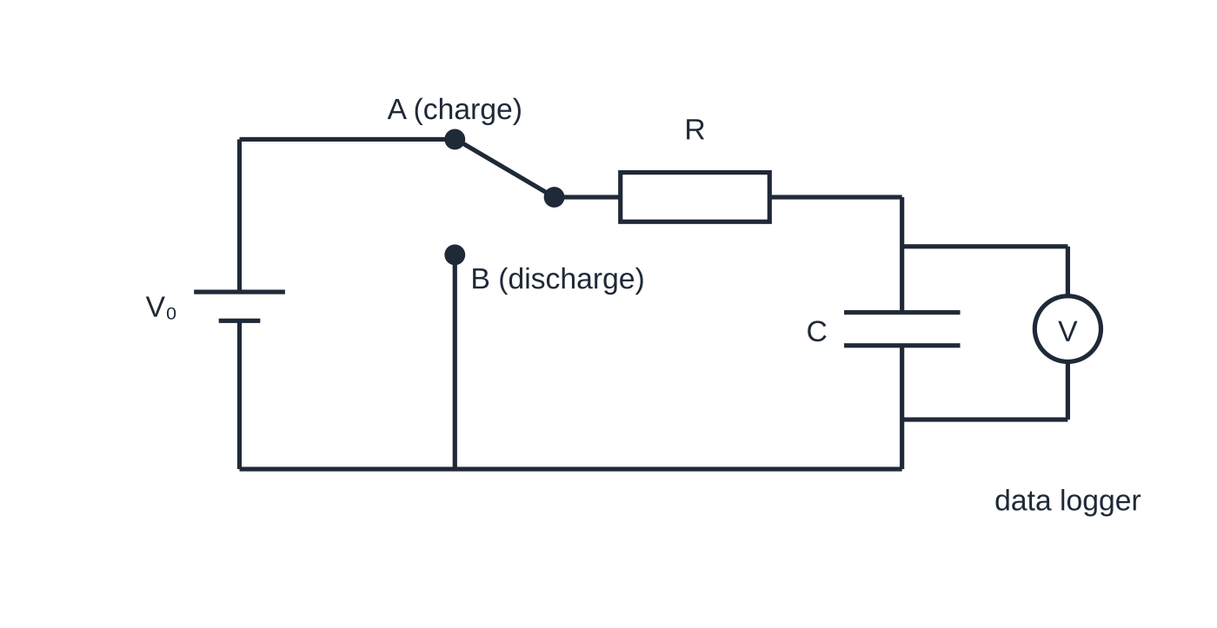
What happens when a capacitor charges or discharges through a resistor?
Section 3 of 11
The circuit below charges the capacitor through R with the switch at A, and discharges it through the same R with the switch at B. A voltmeter, or a data logger for fast changes, records the p.d. across the capacitor.
Charging
At the start the capacitor is uncharged, so V_C = 0 and the whole supply p.d. V₀ is across R. The current is at its maximum, I₀ = V₀/R. As charge builds up, V_C rises, so the p.d. across the resistor, V₀ - V_C, falls, and so does the current.
Charging (switch at A) and discharging (switch at B) through the same resistor R. The p.d. across C is recorded against time by a data logger, or displayed on an oscilloscope.
Notes:
What happens when a capacitor charges or discharges through a resistor?. Full notes: https://examinerprep.com/notes/edexcel-ial-physics/capacitors/

Slide 19
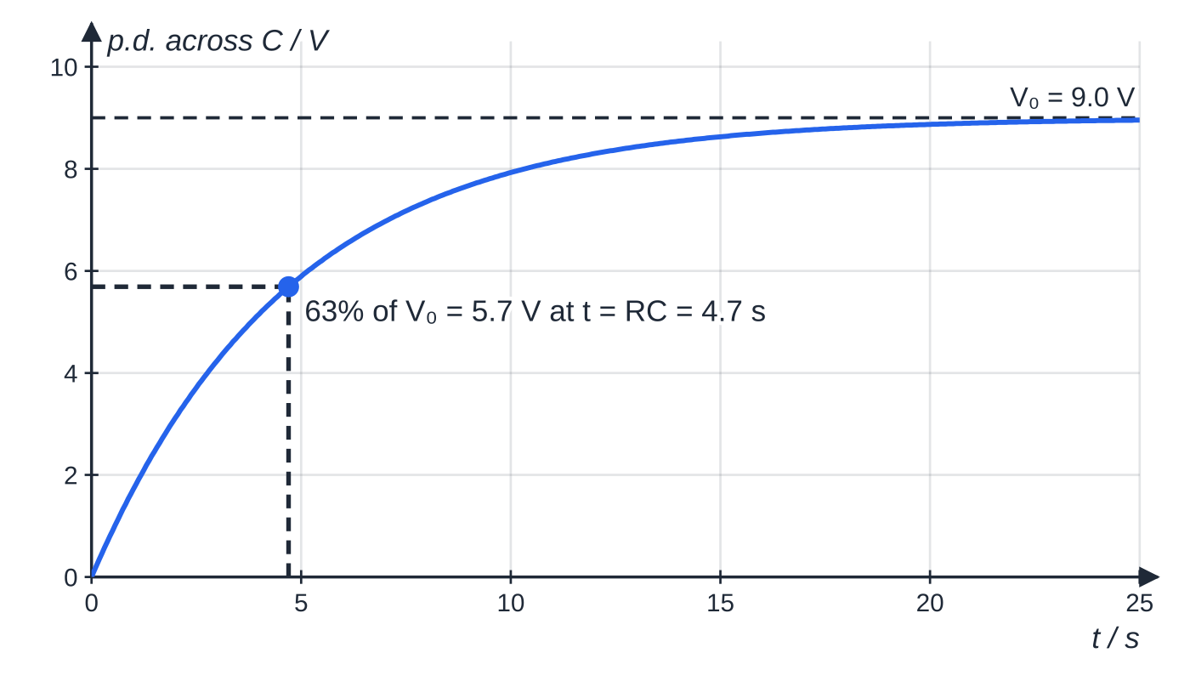
What happens when a capacitor charges or discharges through a resistor? (continued)
Section 3 of 11
A smaller current means charge arrives more slowly, so V_C rises more slowly. The result is a graph that rises steeply and then levels off towards V₀ (and the charge towards Q₀ = CV₀), while the current decays towards zero.
P.d. across a 4.7 µF capacitor charging through 1.0 MΩ from 9.0 V. In one time constant (4.7 s) it reaches 63% of its final value; after about 5RC (23.5 s) it is within 1% of 9.0 V.
Notes:
What happens when a capacitor charges or discharges through a resistor?. Full notes: https://examinerprep.com/notes/edexcel-ial-physics/capacitors/

Slide 20
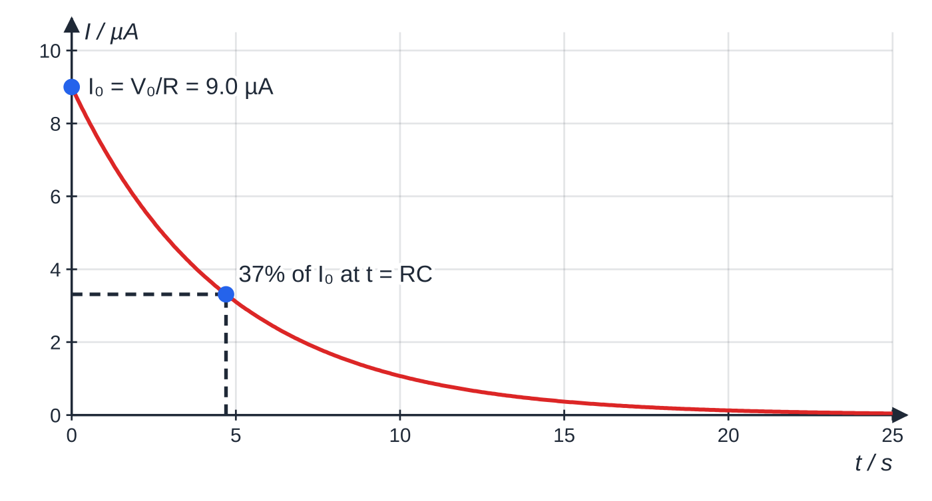
What happens when a capacitor charges or discharges through a resistor? (continued)
Section 3 of 11
Discharging
Now the capacitor acts as the source. At the start, V = V₀ and the current is largest, I₀ = V₀/R. As charge flows off, V = Q/C falls, so the current V/R falls, so the charge flows off more slowly. The rate of loss of charge is proportional to the charge left, and that is the signature of exponential decay: Q, V and I all fall by the same fraction in every equal time interval. The discharge current flows in the opposite direction to the charging current.
Current in the same charging circuit. It is largest at the start, when the empty capacitor has no p.d. across it, and falls to 37% of I₀ in one time constant. The area under this graph is the final charge, CV₀ = 42.3 µC.
Notes:
What happens when a capacitor charges or discharges through a resistor?. Full notes: https://examinerprep.com/notes/edexcel-ial-physics/capacitors/

Slide 21
What happens when a capacitor charges or discharges through a resistor? (continued)
Section 3 of 11
Time constant τ= RC, in seconds, where R is the resistance the capacitor charges or discharges through (Ω) and C its capacitance (F). Units: Ω × F = (V A⁻¹)(C V⁻¹) = C A⁻¹ = s. This is not in the formulae list as a separate equation: learn it (RC appears in every exponential equation that is listed).
In one time constant a discharge falls to e⁻¹ = 0.37 of its starting value, and a charging capacitor reaches 1 - e⁻¹ = 0.63 of its final p.d. After about 5RC the process is effectively complete, with less than 1% left to go.
Why do R and C set the timing? A larger R gives a smaller current for the same p.d., so it takes longer to move the charge. A larger C means more charge has to be moved for the same p.d., so that also takes longer. The final charge CV₀ and the final energy do not depend on R; only the timing does.
Notes:
What happens when a capacitor charges or discharges through a resistor?. Full notes: https://examinerprep.com/notes/edexcel-ial-physics/capacitors/

Slide 22
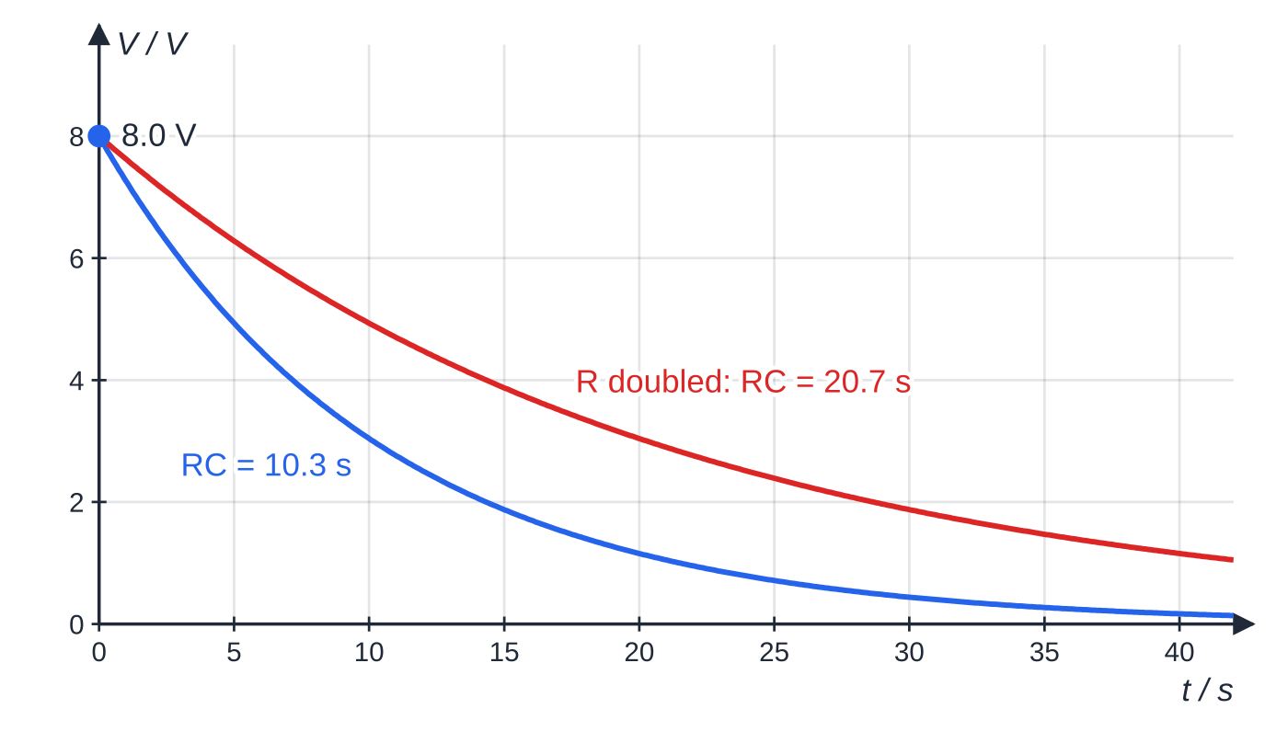
What happens when a capacitor charges or discharges through a resistor? (continued)
Section 3 of 11
Common error — A rising charging current
Drawing the charging current as a curve that rises, like the p.d. The current is largest at the very start, when the capacitor is empty and the whole supply p.d. is across the resistor. It decays in both charging and discharging.
Two discharges from 8.0 V of the same 220 µF capacitor. Doubling R doubles the time constant: the red curve takes twice as long to reach any given p.d. The starting p.d. and charge are the same.
Notes:
What happens when a capacitor charges or discharges through a resistor?. Full notes: https://examinerprep.com/notes/edexcel-ial-physics/capacitors/

Slide 23
How do you calculate charge, current and p.d. during a discharge?
Section 4 of 11
Because the rate of discharge is proportional to the charge left, the charge follows an exponential. The same shape appears for V and I, because V = Q/C and I = V/R are both proportional to Q.
Capacitor discharge
Q = Q₀ e^(-t/RC) I = I₀ e^(-t/RC) V = V₀ e^(-t/RC) Q₀, I₀, V₀ are the values at t = 0; t is the time since the discharge started (s). All three are in the formulae list, and so are the log forms ln Q = ln Q₀ - t/RC (and the same for I and V), found by taking natural logs of both sides.
Use the eˣ and ln keys on your calculator. The exponent -t/RC has no unit, so t and RC must both be in seconds.
Notes:
How do you calculate charge, current and p.d. during a discharge?. Full notes: https://examinerprep.com/notes/edexcel-ial-physics/capacitors/

Slide 24
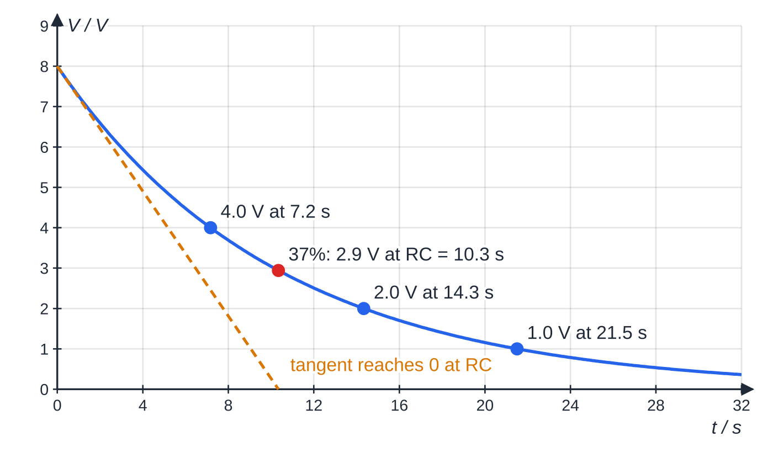
How do you calculate charge, current and p.d. during a discharge? (continued)
Section 4 of 11
Discharge of a 220 µF capacitor through 47 kΩ from 8.0 V. The p.d. halves every 7.2 s, whatever the starting value, and falls to 37% after one time constant, 10.3 s. The tangent at the start would reach zero after exactly RC.
Notes:
How do you calculate charge, current and p.d. during a discharge?. Full notes: https://examinerprep.com/notes/edexcel-ial-physics/capacitors/

Slide 25
How do you calculate charge, current and p.d. during a discharge? (continued)
Section 4 of 11 · Worked example 4 · Medium · Calculate
WORKED EXAMPLE · QUESTION
A 220 µF capacitor is charged to 8.0 V and then discharged through a 47 kΩ resistor (the capacitor in the figure above). Calculate (a) the time constant, (b) the initial discharge current and (c) the p.d. across the capacitor and the charge on it 15 s after the discharge starts.
SOLUTION
(a) RC = 47×10³ ×220×10⁻⁶ = 10.3 s (10.34 s)
(b) At t = 0 the full 8.0 V is across the resistor: I₀ = V₀/R = 8.0 ÷47×10³ = 1.7 × 10⁻⁴ A (0.170 mA)
(c) V = 8.0 ×e^(-15/10.34) = 8.0 ×0.234 = 1.9 V (1.88 V); then Q = CV = 220×10⁻⁶ ×1.88 = 4.1 × 10⁻⁴ C
Check: 15 s is a little more than two halving times (7.2 s each), so V should be a little less than 8.0 ÷ 4 = 2.0 V. It is.
Notes:
How do you calculate charge, current and p.d. during a discharge?: Worked example 4. Full notes: https://examinerprep.com/notes/edexcel-ial-physics/capacitors/

Slide 26
How do you calculate charge, current and p.d. during a discharge? (continued)
Section 4 of 11
Finding a time: the log form and the time to halve
To find when a quantity reaches a value, take logs and rearrange: t = RC ln(V₀/V). Putting V = ½ V₀ gives the time to halve, t_(1/2) = RC ln 2 ≈0.69 RC. This is not in the formulae list, so derive it when you need it: put Q = ½ Q₀ into Q = Q₀ e^(-t/RC), which gives e^(t/RC) = 2. It is the same for Q, V and I, and the same from any starting value, just like the half-life of a radioactive source.
Notes:
How do you calculate charge, current and p.d. during a discharge?. Full notes: https://examinerprep.com/notes/edexcel-ial-physics/capacitors/

Slide 27
How do you calculate charge, current and p.d. during a discharge? (continued)
Section 4 of 11 · Worked example 5 · Medium · Calculate
WORKED EXAMPLE · QUESTION
A 0.10 F capacitor keeps the clock of an alarm system running during a power cut. It starts at 5.0 V and the clock behaves as a 25 kΩ resistor. The clock stops working when the p.d. falls below 2.0 V. (a) Calculate how long the clock keeps running. (b) Calculate the time for the p.d. to halve.
SOLUTION
Time constant: RC = 25×10³ ×0.10 = 2500 s.
(a) From ln V = ln V₀ - t/RC: t = RC ln(V₀/V) = 2500 ×ln(5.0 ÷2.0) = 2500 ×0.916 = 2.3 × 10³ s (2291 s, about 38 minutes)
(b) t_(1/2) = 2500 ×ln 2 = 1.7 × 10³ s (1733 s)
The answer to (a) is more than one halving time because 2.0 V is less than half of 5.0 V, which is a quick sense check.
Notes:
How do you calculate charge, current and p.d. during a discharge?: Worked example 5. Full notes: https://examinerprep.com/notes/edexcel-ial-physics/capacitors/

Slide 28
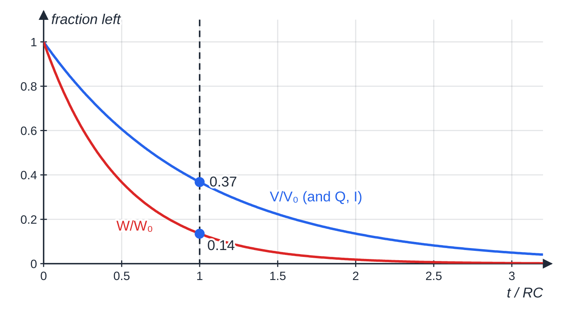
How do you calculate charge, current and p.d. during a discharge? (continued)
Section 4 of 11
What happens to the energy during a discharge?
Every quantity that decays linearly with Q (that is Q, V and I) falls with the same time constant. Energy does not, because W = ½ CV² depends on V²: W ∝e^(-2t/RC). After one time constant only e⁻² ≈14% of the energy is left, and the energy halves in half the time the p.d. takes.
Fractions of p.d. and of stored energy left during a discharge, against time measured in time constants. The energy curve falls twice as fast because W ∝ V².
Notes:
How do you calculate charge, current and p.d. during a discharge?. Full notes: https://examinerprep.com/notes/edexcel-ial-physics/capacitors/

Slide 29
How do you calculate the p.d. while a capacitor charges?
Section 5 of 11
While charging, the current still decays exponentially: I = I₀ e^(-t/RC) with I₀ = V₀/R. So the p.d. across the resistor is V_R = IR = V₀ e^(-t/RC). The supply p.d. is shared between the resistor and the capacitor, V_C = V₀ - V_R, so the capacitor's p.d. is whatever the resistor has not taken.
P.d. across a charging capacitor
V_C = V₀(1 - e^(-t/RC)) and similarly Q = Q₀(1 - e^(-t/RC)) V₀ supply p.d. (V), Q₀ = CV₀ final charge (C). Not in the formulae list: derive it from V_C = V₀ - V_R with V_R = V₀ e^(-t/RC).
Notes:
How do you calculate the p.d. while a capacitor charges?. Full notes: https://examinerprep.com/notes/edexcel-ial-physics/capacitors/

Slide 30
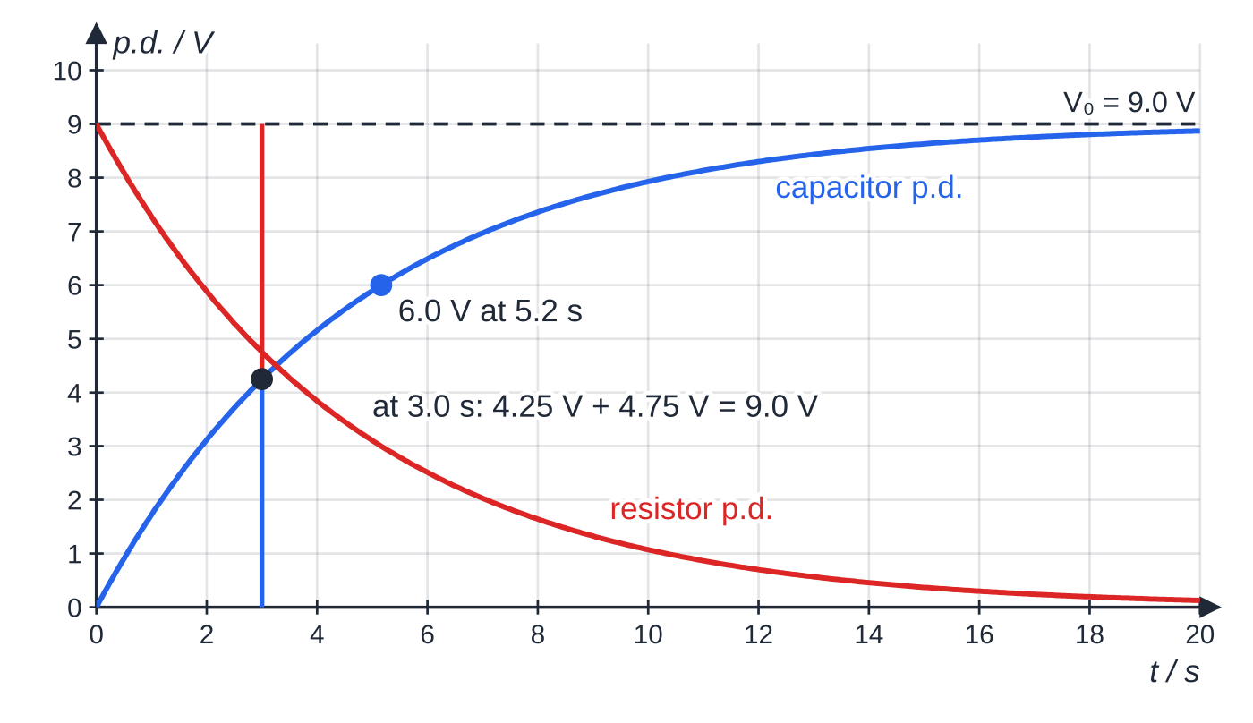
How do you calculate the p.d. while a capacitor charges? (continued)
Section 5 of 11
Charging a 4.7 µF capacitor through 1.0 MΩ from 9.0 V. At every instant V_C + V_R = 9.0 V; the two curves are mirror images about 4.5 V and cross at t = RC ln 2 = 3.3 s.
Notes:
How do you calculate the p.d. while a capacitor charges?. Full notes: https://examinerprep.com/notes/edexcel-ial-physics/capacitors/

Slide 31
How do you calculate the p.d. while a capacitor charges? (continued)
Section 5 of 11 · Worked example 6 · Hard · Calculate
WORKED EXAMPLE · QUESTION
A 4.7 µF capacitor, initially uncharged, is charged through a 1.0 MΩ resistor from a 9.0 V supply (the circuit in the charging graphs above). (a) Calculate the p.d. across the capacitor and the current 3.0 s after charging starts. (b) A circuit connected across the capacitor switches on a lamp when the p.d. across the capacitor reaches 6.0 V. Calculate the delay.
SOLUTION
Time constant: RC = 1.0×10⁶ ×4.7×10⁻⁶ = 4.7 s.
(a) V_C = 9.0 ×(1 - e^(-3.0/4.7)) = 9.0 ×(1 - 0.528) = 4.2 V (4.25 V). The rest of the 9.0 V is across the resistor: V_R = 9.0 - 4.25 = 4.75 V, so I = 4.75 ÷1.0×10⁶ = 4.8 × 10⁻⁶ A
(b) When V_C = 6.0 V, V_R = 3.0 V, so e^(-t/RC) = 3.0 ÷9.0: t = RC ln(9.0 ÷3.0) = 4.7 ×ln 3 = 5.2 s (5.16 s)
To make the delay longer, increase R or C: the delay is proportional to RC.
Notes:
How do you calculate the p.d. while a capacitor charges?: Worked example 6. Full notes: https://examinerprep.com/notes/edexcel-ial-physics/capacitors/

Slide 32
How do you calculate the p.d. while a capacitor charges? (continued)
Section 5 of 11
Common error — Using the discharge equation for charging
V = V₀ e^(-t/RC) does not give the p.d. across a charging capacitor. During charging, that expression is the p.d. across the resistor. The capacitor's p.d. is what is left: V₀ minus it.
Notes:
How do you calculate the p.d. while a capacitor charges?. Full notes: https://examinerprep.com/notes/edexcel-ial-physics/capacitors/

Slide 33
Core Practical 11: how do you record and analyse a discharge?
Section 6 of 11
Aim. Display the p.d. across a capacitor as it charges and discharges through a resistor, and use the discharge to find the time constant, and so C if R is known.
Circuit and choices. Use the two-way switch circuit above, with the data logger's voltage sensor (or an oscilloscope) across the capacitor. A time constant of a few seconds or more lets a data logger sample many points; with a voltmeter and stopwatch, aim for tens of seconds. For a time constant of milliseconds, use an oscilloscope with a square-wave supply so that the trace repeats.
Method. Charge fully (wait at least 5RC), start recording, switch to discharge and record V against t. Set the sampling rate so that there are many readings per time constant.
Analysis. ln V = ln V₀ - t/RC has the form y = c + mx. Plot ln(V/V) against t. A straight line confirms exponential decay, the gradient is -1/RC and the intercept is ln V₀.
Notes:
Core Practical 11: how do you record and analyse a discharge?. Full notes: https://examinerprep.com/notes/edexcel-ial-physics/capacitors/

Slide 34
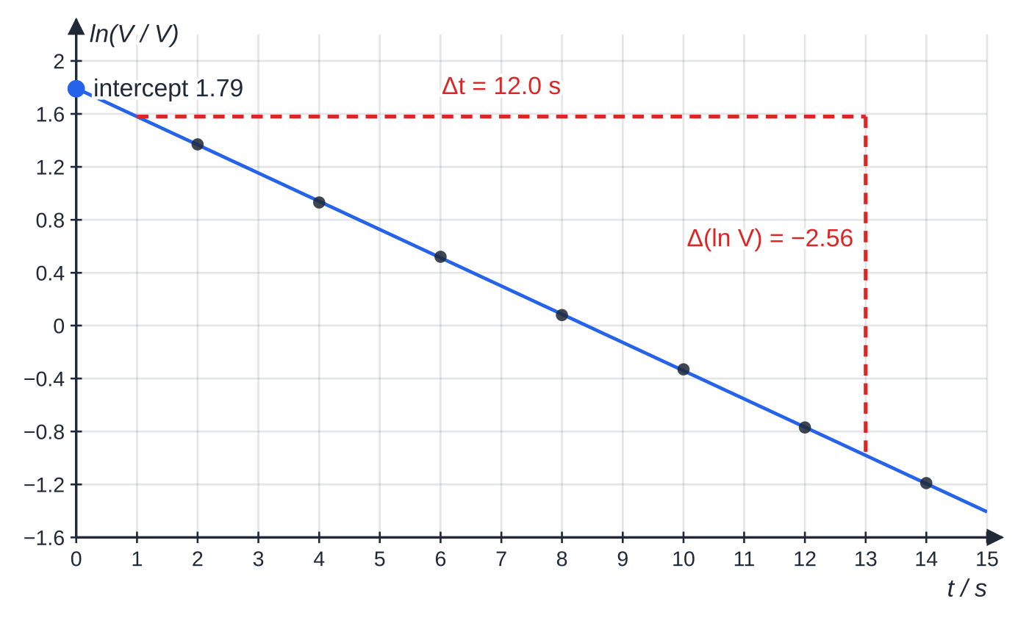
Core Practical 11: how do you record and analyse a discharge? (continued)
Section 6 of 11
Why a data logger or oscilloscope?
It takes many readings at precise, equal intervals, including at the start when the p.d. changes fastest, and removes the reaction-time error of reading a meter and a stopwatch together. It must have a very high resistance; otherwise it provides a second discharge path in parallel with R and makes the measured time constant too small.
Specimen results: a nominal 470 µF capacitor discharging through 10.0 kΩ from 6.0 V, sampled every 2 s. The points lie on a straight line, so the decay is exponential; the large gradient triangle gives RC.
Notes:
Core Practical 11: how do you record and analyse a discharge?. Full notes: https://examinerprep.com/notes/edexcel-ial-physics/capacitors/

Slide 35
Core Practical 11: how do you record and analyse a discharge? (continued)
Section 6 of 11 · Worked example 7 · Hard · Determine
WORKED EXAMPLE · QUESTION
Use the specimen graph above (resistor 10.0 kΩ ± 2%) to determine the capacitance. The gradient has a percentage uncertainty of 3%. Find the uncertainty in C.
SOLUTION
Gradient from the large triangle, from t = 1.0 s to t = 13.0 s: (-0.98 - 1.58) ÷12.0 = -2.56 ÷12.0 = -0.213 s⁻¹.
Gradient = -1/RC, so RC = 1 ÷0.213 = 4.69 s.
C = 4.69 ÷10.0×10³ = 4.7 × 10⁻⁴ F (469 µF)
C = 1/(|gradient| ×R), so the percentage uncertainties add: 3% + 2% = 5%, and ΔC = 0.05 ×469 µF ≈ ± 23 µF
The intercept, 1.79, gives V₀ = e^(1.79) ≈6.0 V, consistent with the 6.0 V charging supply.
Notes:
Core Practical 11: how do you record and analyse a discharge?: Worked example 7. Full notes: https://examinerprep.com/notes/edexcel-ial-physics/capacitors/

Slide 36
Core Practical 11: how do you record and analyse a discharge? (continued)
Section 6 of 11
Practical issues
Capacitor tolerance: electrolytic capacitors are often marked ±10% or ±20%, so a measured value a few per cent from the marked value is not necessarily an error.
Polarity: electrolytic capacitors must be connected with the + terminal to the positive side of the supply, and never above their rated voltage.
Safety: large capacitors charged to a high p.d. can give a dangerous shock even after the supply is disconnected. Discharge them through a resistor before handling.
Charging data: for charging, plot ln(V₀ - V_C) against t; it also has gradient -1/RC.
Notes:
Core Practical 11: how do you record and analyse a discharge?. Full notes: https://examinerprep.com/notes/edexcel-ial-physics/capacitors/

Slide 37
Exam tips for 4.4
Section 7 of 11
Exam tip 1 — Define capacitance in full
"Charge stored per unit p.d.", with charge meaning the charge on one plate. Writing just "Q/V" or "how much charge it holds" leaves out the idea of per unit p.d.
Exam tip 2 — Choose the energy equation that fits
All three forms of the energy equation are equivalent. If you know C and V, use ½ CV²; if you are given a V–Q graph, find the area, or use ½ QV with values read from the graph.
Exam tip 3 — Explain charging as a chain
For "explain why the current decreases": charge builds up on the plates → p.d. across the capacitor rises → p.d. across the resistor falls → current falls → charge builds up more slowly. Each arrow is a separate point.
Notes:
Exam tips for 4.4. Full notes: https://examinerprep.com/notes/edexcel-ial-physics/capacitors/

Slide 38
Exam tips for 4.4 (continued)
Section 7 of 11
Exam tip 4 — The time constant from a graph
From a discharge curve, read off the time to fall to 37% of the start value (that is RC), or the time to halve and divide by ln 2. From a ln graph, RC = -1/gradient. Show your readings on the graph, and label a log axis ln(V/V): logs are taken of numbers, not units.
Exam tip 5 — Compounding uncertainties
When C is found from RC ÷R, add the percentage uncertainties in RC and R. When a quantity is squared, as V is in ½ CV², double its percentage uncertainty.
Notes:
Exam tips for 4.4. Full notes: https://examinerprep.com/notes/edexcel-ial-physics/capacitors/

Slide 39
Common misconceptions
Section 8 of 11
Misconception | Why it is wrong | Correct idea
Current flows through a capacitor, across the gap. | The gap is an insulator. | Charge flows onto one plate and off the other; current flows in the wires while the charge separates, but none crosses the gap.
A charged capacitor carries a net charge. | The plates carry equal and opposite charges. | The capacitor is neutral overall; it stores separated charge Q, which is why it stores energy.
The energy stored is QV. | The p.d. rose from 0 to V while the charge was added. | W = ½ QV, the triangle under the V–Q graph; the supply transfers QV and half is dissipated.
A larger charging resistor means less energy is stored. | The final p.d. is still the supply p.d. | R changes only how long charging takes; the stored energy ½ CV₀² is the same.
A capacitor is fully discharged after one time constant. | Exponential decay never reaches zero in a finite time. | After RC, 37% remains; after 5RC, less than 1%.
Notes:
Common misconceptions. Full notes: https://examinerprep.com/notes/edexcel-ial-physics/capacitors/

Slide 40
Common misconceptions (continued)
Section 8 of 11
Misconception | Why it is wrong | Correct idea
The time to halve depends on the starting charge. | Each halving takes the same time for an exponential. | t_(1/2) = RC ln 2, independent of Q₀ or V₀.
Notes:
Common misconceptions. Full notes: https://examinerprep.com/notes/edexcel-ial-physics/capacitors/

Slide 41
How this topic connects
Section 9 of 11
Current and charge (Unit 2)
I = ΔQ/Δt, so the area under a current–time graph for a charging or discharging capacitor equals the charge that flowed, Q₀. The gradient of a Q–t graph is the current.
3 Electric fields
Between the charged plates there is a nearly uniform electric field, E = V/d, and the stored energy can be thought of as being in that field.
Radioactive decay (Unit 5)
The same mathematics: a rate proportional to the amount left, exponential decay, a constant half-life (here RC ln 2) and a straight-line ln graph. Turning an exponential into a straight line with logs and combining percentage uncertainties are general A2 practical skills (Unit 6).
Notes:
How this topic connects. Full notes: https://examinerprep.com/notes/edexcel-ial-physics/capacitors/

Slide 42
Key equations
Section 10 of 11
Equation | Use | In the formulae list?
C = Q/V | capacitance, charge or p.d. (C in F, Q in C, V in V) | Yes
W = ½ QV = ½ CV² = ½ Q²/C | energy stored (J) | Yes
W_supply = QV | energy transferred by the supply while charging | No — derive it: W = QV for charge moved through p.d. V
τ= RC | time constant (s) | No — learn it
Q = Q₀ e^(-t/RC), I = I₀ e^(-t/RC), V = V₀ e^(-t/RC) | discharge | Yes
ln Q = ln Q₀ - t/RC (and for I, V) | finding a time; straight-line graph | Yes
t_(1/2) = RC ln 2 | time to halve | No — derive it
V_C = V₀(1 - e^(-t/RC)) | p.d. across a charging capacitor | No — derive it: V₀ - V_R
Notes:
Key equations. Full notes: https://examinerprep.com/notes/edexcel-ial-physics/capacitors/

Slide 43
Check your understanding
Section 11 of 11
1. A 100 µF capacitor stores a charge of 1.5 mC. Calculate the p.d. across it.
2. The p.d. across a capacitor is tripled. By what factor does the energy stored change?
3. Calculate the time constant of a 2.2 µF capacitor discharging through a 330 kΩ resistor.
4. What percentage of its initial charge does a discharging capacitor keep after three time constants?
5. In the core practical, a graph of ln(V/V) against t has a gradient of −0.050 s⁻¹. The resistor is 20 kΩ. Calculate the capacitance, and state why ln V is plotted rather than V.
6. Explain why the current in a charging circuit decreases, even though the supply p.d. stays the same.
Notes:
Check your understanding: questions. Full notes: https://examinerprep.com/notes/edexcel-ial-physics/capacitors/

Slide 44
Check your understanding · answers
Section 11 of 11
1. V = Q/C = 1.5×10⁻³ ÷100×10⁻⁶ = 15 V.
2. W = ½ CV², so the energy increases by a factor of 3² = 9.
3. RC = 330×10³ ×2.2×10⁻⁶ = 0.73 s (0.726 s).
4. Q/Q₀ = e⁻³ = 0.050, so 5.0%.
5. RC = 1 ÷0.050 = 20 s, so C = 20 ÷20×10³ = 1.0 × 10⁻³ F (1000 µF). ln V against t is a straight line for an exponential decay, which tests the relationship and gives RC from the gradient.
6. As charge builds up on the plates, the p.d. across the capacitor rises. The supply p.d. is shared, so the p.d. across the resistor, V₀ - V_C, falls. The current I = (V₀ - V_C)/R therefore falls, so charge arrives more slowly, and the current tends to zero as V_C approaches V₀.
Notes:
Check your understanding: answers. Full notes: https://examinerprep.com/notes/edexcel-ial-physics/capacitors/

Slide 45
Practice questions
1 original exam-style questions. Answers at the end of the deck.

Slide 46
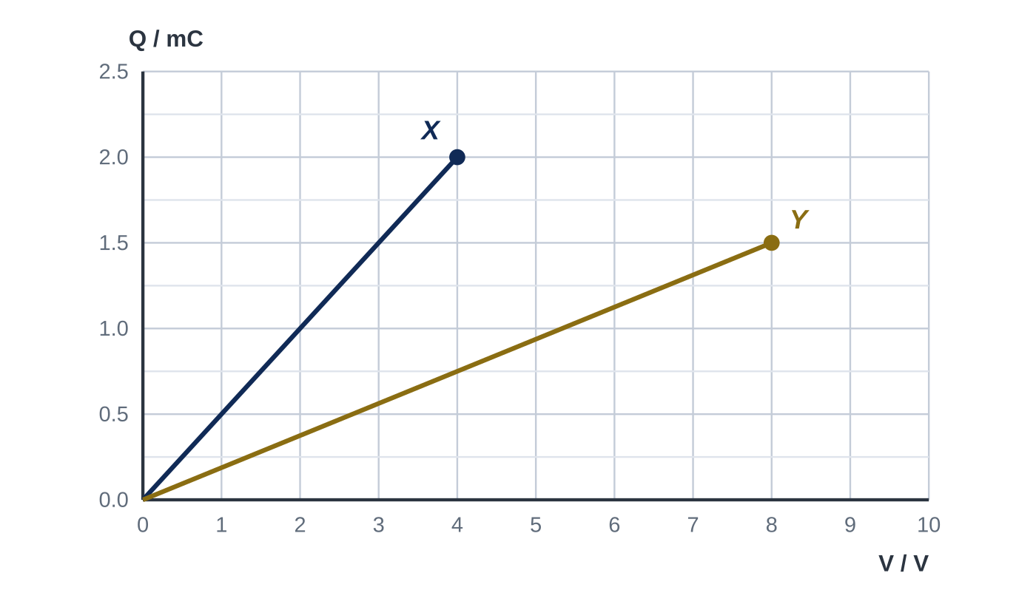
Question 1
1 mark
The graph shows how the charge Q stored varies with the potential difference V for two capacitors, X and Y.
Both capacitors are charged to a p.d. of 4.0 V. What is the ratio
charge stored on X ÷ charge stored on Y?
A 0.38
B 1.3
C 2.7
D 7.1
Notes:
Online with the full mark scheme: https://examinerprep.com/ial-physics-4-4-capacitors-questions#IALP-U4-4-FA-01

Slide 47
Answers

Slide 48
Question 1 · answer
Answer C
Capacitance is the gradient of the Q–V line. C_X = 2.0 mC ÷ 4.0 V = 0.50 mF and C_Y = 1.5 mC ÷ 8.0 V = 0.1875 mF. At the same p.d. Q ∝ C, so the ratio = 0.50 ÷ 0.1875 = 2.7. (Directly: at 4.0 V, Q_X = 2.0 mC and Q_Y = 0.75 mC.)
Notes:
Full mark scheme: https://examinerprep.com/ial-physics-4-4-capacitors-questions#IALP-U4-4-FA-01

Slide 49
Keep practising
Notes for this topic
Questions on this topic
Build a printable test
ExaminerPrep is an independent tutoring service. It has been developed independently from and is not endorsed by the International Baccalaureate Organization. "International Baccalaureate", "IB" and "IB Diploma Programme" are registered trademarks of the IBO, used here for descriptive purposes only.
Pearson Edexcel and Cambridge are trademarks of their owners; ExaminerPrep is not affiliated with any exam board.

