Slide 1
EP
EDEXCEL IAL PHYSICS
4.2 Circular motion
The full notes page in 13 sections · practice questions with answers · simulations
ExaminerPrep is an independent tutoring service. It has been developed independently from and is not endorsed by the International Baccalaureate Organization. "International Baccalaureate", "IB" and "IB Diploma Programme" are registered trademarks of the IBO, used here for descriptive purposes only.
Pearson Edexcel and Cambridge are trademarks of their owners; ExaminerPrep is not affiliated with any exam board.
Notes:
4.2 Circular motion. Notes for this topic: https://examinerprep.com/notes/edexcel-ial-physics/circular-motion/

Slide 2
What this page covers
Overview
Angular displacement in radians and degrees, and converting between them
Angular velocity ω, period and frequency; v = ωr and T = 2π/ω
Deriving the centripetal acceleration a = v²/r = rω² from a vector diagram
Why a resultant (centripetal) force is needed, and F = mv²/r = mrω²
Cars on flat bends and banked tracks (qualitatively)
Vertical loops, the conical pendulum and fairground rides
Testing F = mrω² with a graph, including combining percentage uncertainties
Notes:
What this page covers. Full notes: https://examinerprep.com/notes/edexcel-ial-physics/circular-motion/

Slide 3
In one minute
Key points
1. A body moving in a circle is always changing direction, so it is always accelerating towards the centre, and a real resultant force must supply that acceleration: F = mv²/r = mrω².
2. An angle in radians is arc length ÷ radius: θ = s/r. One full turn = 2π rad = 360°.
3. Angular velocity ω is the angle turned per second (rad s⁻¹): v = ωr, T = 2π/ω, ω = 2πf.
4. The centripetal acceleration is a = v²/r = rω². The force is provided by real forces: tension, friction, a normal reaction, weight, lift.
5. Remove the force and the object moves off along the tangent, not outwards.
6. In a vertical loop the minimum speed at the top is √(gr), when weight alone supplies the centripetal force.
Notes:
In one minute. Full notes: https://examinerprep.com/notes/edexcel-ial-physics/circular-motion/

Slide 4
What is angular displacement, and why use radians?
Section 1 of 13
Angular displacement is the angle through which a radius line turns about the centre of the circle. One radian is the angle at the centre of a circle subtended by an arc whose length equals the radius.
From the definition, the angle in radians is the arc length divided by the radius:
θ= s/r so s = rθ
with θ in rad, s the arc length (m) and r the radius (m). This is not in the formulae list; learn it, because it is the definition of the radian. A whole circle has arc length 2πr, so 360° = 2π rad. To convert: radians = degrees × π/180 and degrees = radians × 180/π; 1 rad ≈ 57.3°.
Notes:
What is angular displacement, and why use radians?. Full notes: https://examinerprep.com/notes/edexcel-ial-physics/circular-motion/

Slide 5
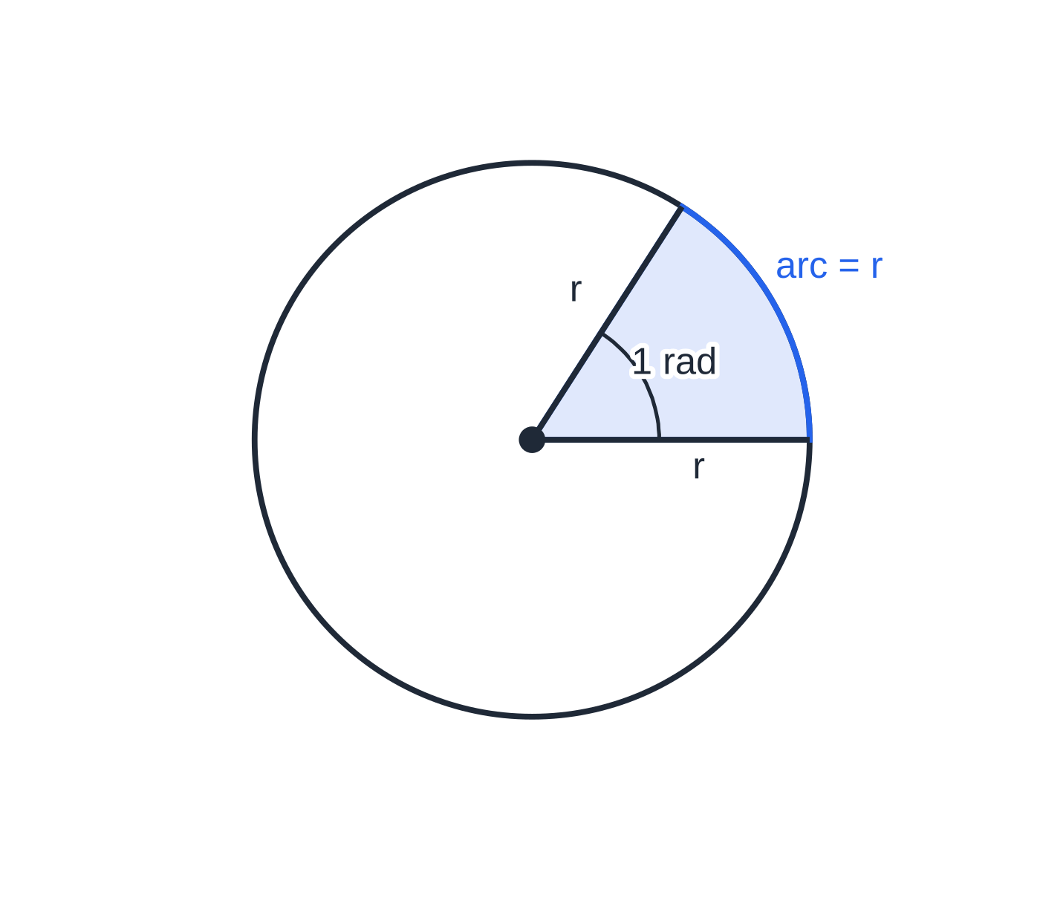
What is angular displacement, and why use radians? (continued)
Section 1 of 13
The radian is a ratio of two lengths, so it has no dimensions; "rad" is written to remind you which angle measure is in use. Useful values: 90° = π/2 rad, 180° = π rad, one revolution = 2π rad. Every equation on this page that contains θ or ω needs the angle in radians.
One radian: the angle at the centre when the arc length equals the radius. A full circle has arc 2πr, so it contains 2π rad = 360°, and 1 rad ≈ 57.3°.
Notes:
What is angular displacement, and why use radians?. Full notes: https://examinerprep.com/notes/edexcel-ial-physics/circular-motion/

Slide 6
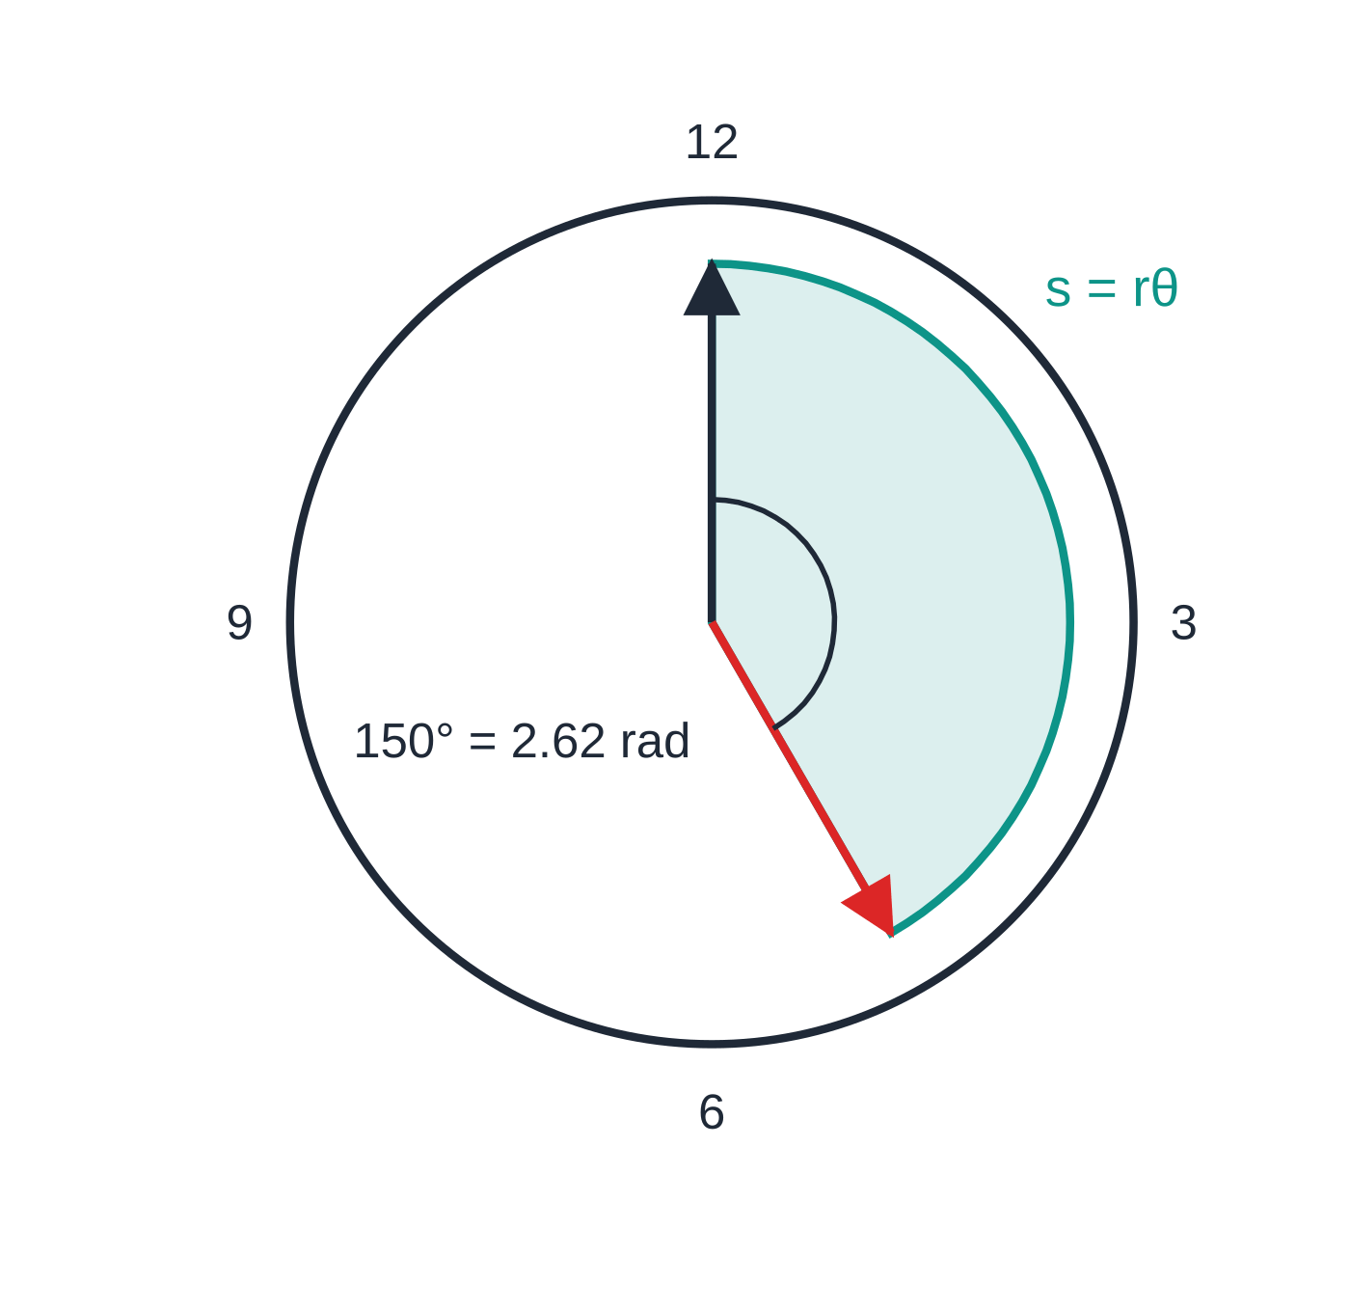
What is angular displacement, and why use radians? (continued)
Section 1 of 13 · Worked example 1 · Easy · Calculate
WORKED EXAMPLE · QUESTION
The minute hand of a station clock is 0.85 m long. Calculate (a) the angle, in radians, through which it turns in 25 minutes and (b) the distance moved by its tip in this time.
SOLUTION
(a) The hand turns 360° in 60 minutes: angle = (25 ÷ 60) × 360° = 150° = 150 × π/180 = 2.62 rad
(b) Arc length = radius × angle in radians: s = 0.85 × 2.618 = 2.23 m ≈ 2.2 m
Using 150 instead of 2.62 would give 128 m. An angle in degrees in s = rθ is the most common slip in this topic.
Worked example 1: in 25 minutes the minute hand turns from 12 to 25 past, 150° = 2.62 rad, and its tip sweeps an arc s = rθ.
Notes:
What is angular displacement, and why use radians?: Worked example 1. Full notes: https://examinerprep.com/notes/edexcel-ial-physics/circular-motion/

Slide 7
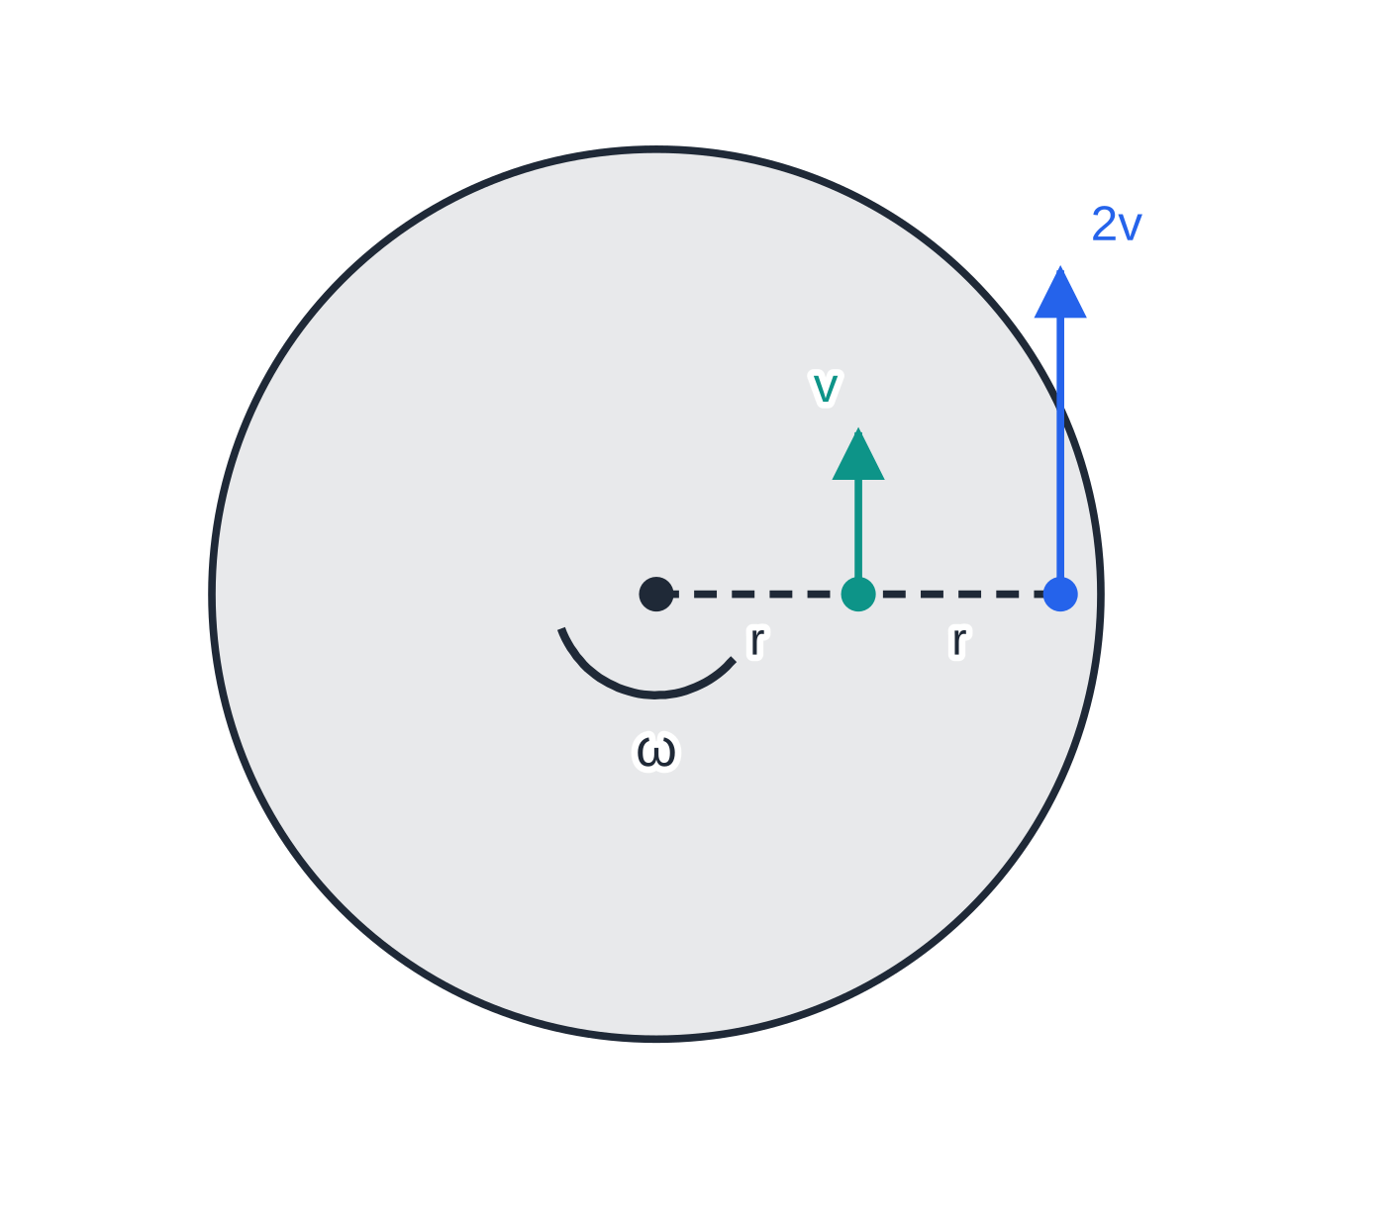
What are angular velocity, period and frequency?
Section 2 of 13
Angular velocity ω is the angle turned through by the radius per unit time, ω= Δθ/Δt, measured in rad s⁻¹. The period T is the time for one complete revolution; the frequency f is the number of revolutions per second, f = 1/T.
v = ωr T = 2π/ω
Here v is the linear speed (m s⁻¹), ω the angular velocity (rad s⁻¹), r the radius (m) and T the period (s). Both equations are in the formulae list. Why v = ωr: in time Δt the arc travelled is rΔθ, so the speed is rΔθ/Δt = rω. One revolution is 2π rad, so T = 2π/ω and therefore ω = 2πf.
On a rigid rotating body every point has the same angular velocity ω, but the linear speed v = ωr is proportional to the distance from the axis.
Notes:
What are angular velocity, period and frequency?. Full notes: https://examinerprep.com/notes/edexcel-ial-physics/circular-motion/

Slide 8
What are angular velocity, period and frequency? (continued)
Section 2 of 13 · Worked example 2 · Easy · Calculate
WORKED EXAMPLE · QUESTION
The rotor of a wind turbine makes 18 revolutions per minute. Each blade is 42 m long. Calculate (a) the period, (b) the angular velocity and (c) the speed of a blade tip.
SOLUTION
(a) f = 18 ÷ 60 = 0.30 Hz, so T = 1 ÷ 0.30 = 3.33 s ≈ 3.3 s
(b) ω = 2π ÷ T = 2π × 0.30 = 1.885 rad s⁻¹ ≈ 1.9 rad s⁻¹
(c) v = ωr = 1.885 × 42 = 79.2 m s⁻¹ ≈ 79 m s⁻¹
A point halfway along the blade has the same ω but only half the speed, about 40 m s⁻¹.
Notes:
What are angular velocity, period and frequency?: Worked example 2. Full notes: https://examinerprep.com/notes/edexcel-ial-physics/circular-motion/

Slide 9
What are angular velocity, period and frequency? (continued)
Section 2 of 13
Exam tip — revolutions per minute
Rotation rates are often given in rev min⁻¹. Convert in one line: ω = 2π × (rev min⁻¹) ÷ 60, and write the conversion down so that a slip is easy to spot.
Notes:
What are angular velocity, period and frequency?. Full notes: https://examinerprep.com/notes/edexcel-ial-physics/circular-motion/

Slide 10
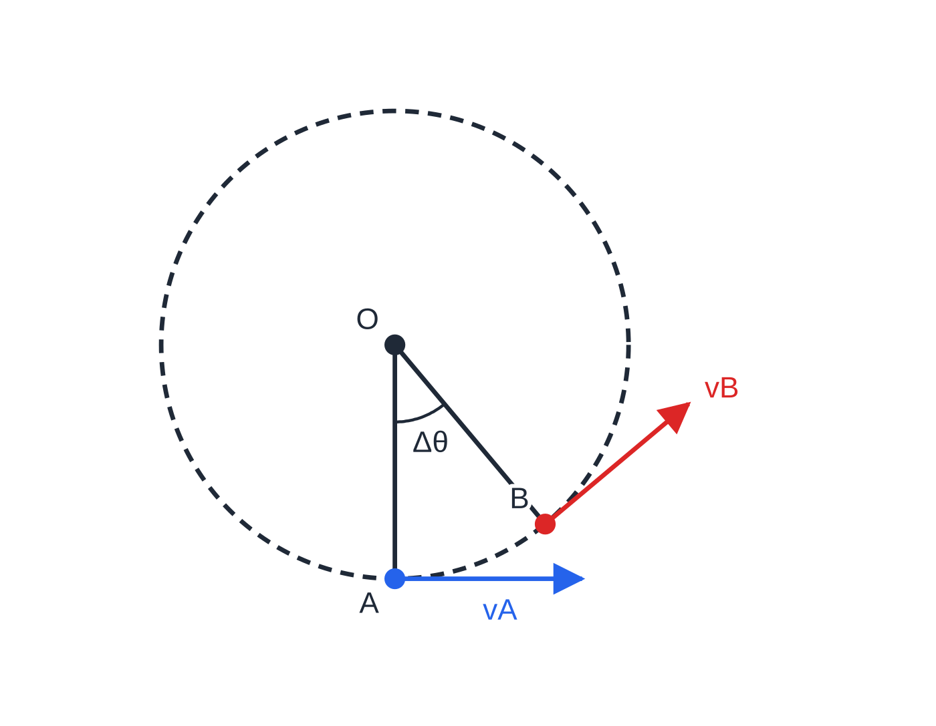
Why is a body moving at constant speed in a circle accelerating?
Section 3 of 13
Velocity is a vector. In a circle the direction of the velocity changes continuously, even if its magnitude (the speed) does not. A change of velocity in a time interval is an acceleration, so uniform circular motion is accelerated motion. The acceleration is directed towards the centre of the circle and is called the centripetal acceleration.
Deriving a = v²/r
The body moves from A to B at constant speed v while the radius turns through a small angle Δθ.
The velocities v_A and v_B are each perpendicular to their radius, so the angle between them is also Δθ.
Drawn tail to tail, they form an isosceles triangle.
The body passes A and then B at constant speed while the radius turns through Δθ. Each velocity is along the tangent, perpendicular to its radius, so the angle between vA and vB is also Δθ.
Notes:
Why is a body moving at constant speed in a circle accelerating?. Full notes: https://examinerprep.com/notes/edexcel-ial-physics/circular-motion/

Slide 11
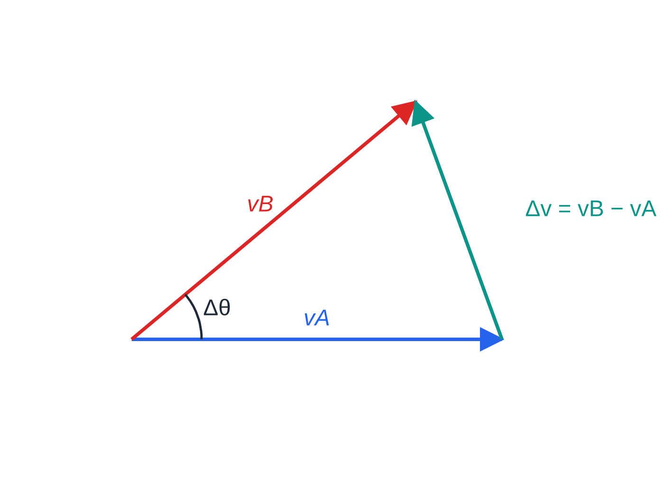
Why is a body moving at constant speed in a circle accelerating? (continued)
Section 3 of 13
The change in velocity Δv = v_B - v_A joins their tips and points towards the centre.
For small Δθ the short side is almost an arc of radius v, so |Δv| = vΔθ.
The time taken is Δt = arc AB ÷ speed = rΔθ/v.
So a = |Δv|/Δt = vΔθ×v/rΔθ = v²/r; with v = ωr this is also rω².
a = v²/r = rω²
The centripetal acceleration (m s⁻²) is always directed towards the centre. The equation is in the formulae list, but you may be asked to derive it.
The velocities drawn tail to tail. Δv = vB − vA joins their tips; for a small Δθ its length is vΔθ and it points towards the centre of the circle (perpendicular to the average velocity).
Notes:
Why is a body moving at constant speed in a circle accelerating?. Full notes: https://examinerprep.com/notes/edexcel-ial-physics/circular-motion/

Slide 12
Why is a body moving at constant speed in a circle accelerating? (continued)
Section 3 of 13
In uniform circular motion its magnitude is constant while its direction rotates with the body.
Notes:
Why is a body moving at constant speed in a circle accelerating?. Full notes: https://examinerprep.com/notes/edexcel-ial-physics/circular-motion/

Slide 13
Why is a body moving at constant speed in a circle accelerating? (continued)
Section 3 of 13 · Worked example 3 · Medium · Calculate
WORKED EXAMPLE · QUESTION
A sample tube in a centrifuge is 8.5 cm from the axis. The rotor turns at 7200 revolutions per minute. Calculate the centripetal acceleration of the sample and express it as a multiple of g.
SOLUTION
ω= 2π×7200 ÷60 = 2π×120 = 754 rad s⁻¹.
With r in metres: a = rω² = 0.085 ×754.0² = 4.83×10⁴ m s⁻² ≈ 4.8 ×10⁴ m s⁻²
a/g = 4.83 × 10⁴ ÷ 9.81 ≈ 4900 g
Check with the other form: v = ωr = 64.1 m s⁻¹, and v²/r gives the same 4.83 × 10⁴ m s⁻².
Notes:
Why is a body moving at constant speed in a circle accelerating?: Worked example 3. Full notes: https://examinerprep.com/notes/edexcel-ial-physics/circular-motion/

Slide 14
Why is a body moving at constant speed in a circle accelerating? (continued)
Section 3 of 13
Common error — "constant speed, so no acceleration"
Constant speed and constant velocity are not the same thing. In a circle only the speed is constant.
Notes:
Why is a body moving at constant speed in a circle accelerating?. Full notes: https://examinerprep.com/notes/edexcel-ial-physics/circular-motion/

Slide 15
What force keeps a body moving in a circle?
Section 4 of 13
By Newton's first law, a body with no resultant force moves in a straight line at constant speed. To make it follow a circle, a resultant force must act, and by Newton's second law it is in the direction of the acceleration: towards the centre. It is called the centripetal force. The force is perpendicular to the velocity, so it does no work: it changes the direction of motion but not the speed or the kinetic energy.
F = ma = mv²/r = mrω²
F is the resultant force towards the centre (N) and m the mass (kg); the equation is in the formulae list. Use the v form when you know the speed and the ω form when you know the rotation rate or period. "Centripetal force" is a job description, not a new kind of force: some real force, or the resultant of several, does the job.
Notes:
What force keeps a body moving in a circle?. Full notes: https://examinerprep.com/notes/edexcel-ial-physics/circular-motion/

Slide 16
What force keeps a body moving in a circle? (continued)
Section 4 of 13
Situation | What provides the centripetal force
ball whirled on a string in a horizontal circle | tension in the string
car on a flat bend | sideways friction between the tyres and the road
car or bicycle on a banked track | horizontal component of the normal reaction (plus any friction)
aircraft banking to turn | horizontal component of the lift
passenger on a rotor ride, back against the wall | normal reaction from the wall
satellite or moon in orbit | gravitational attraction (Unit 5)
Notes:
What force keeps a body moving in a circle?. Full notes: https://examinerprep.com/notes/edexcel-ial-physics/circular-motion/

Slide 17
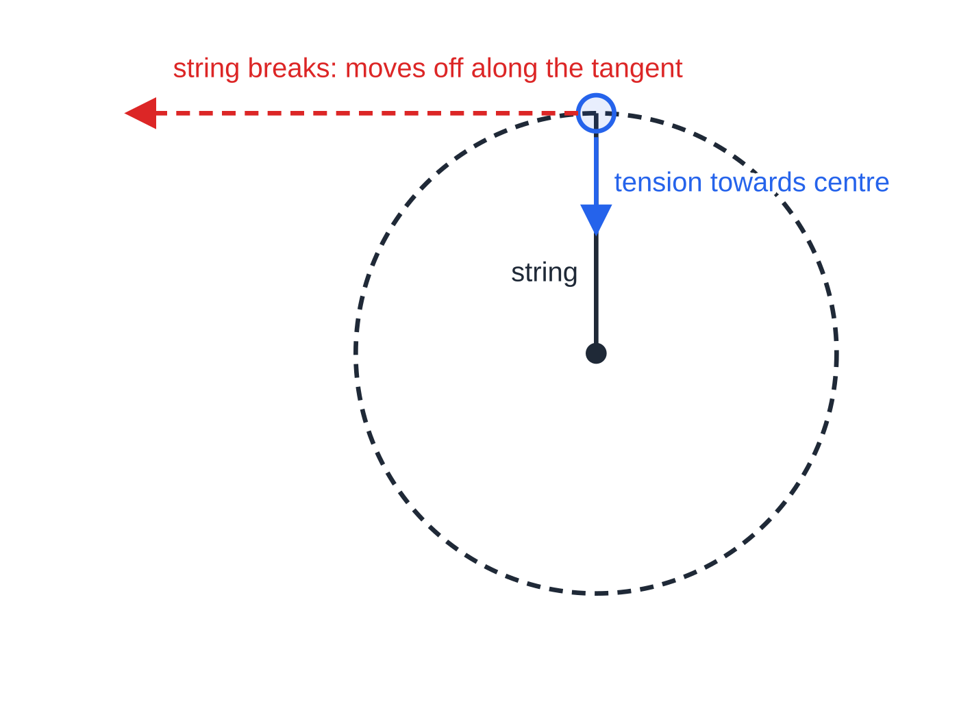
What force keeps a body moving in a circle? (continued)
Section 4 of 13
Common error — an extra arrow
Drawing an arrow labelled "centripetal force" on a free-body diagram, or an outward "centrifugal force". Draw only the real forces; their resultant towards the centre is the centripetal force.
A ball whirled anticlockwise on a string. The tension pulls it towards the centre. If the string breaks, there is no resultant force and the ball moves off along the tangent, not outwards along the radius.
Notes:
What force keeps a body moving in a circle?. Full notes: https://examinerprep.com/notes/edexcel-ial-physics/circular-motion/

Slide 18
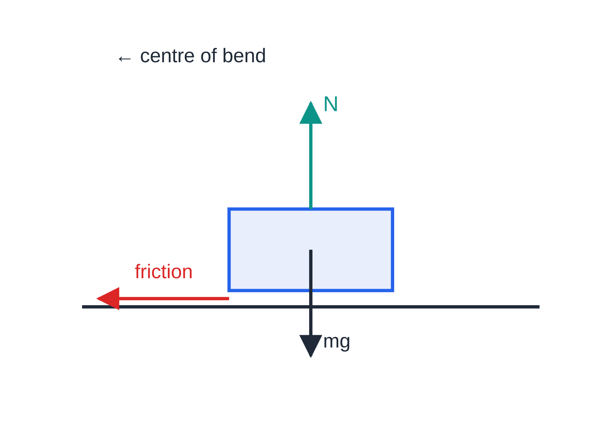
How do vehicles get round bends?
Section 5 of 13
A flat bend
On a level road the only horizontal force on the car is friction between the tyres and the road, acting sideways towards the centre of the bend. Friction has a maximum value, while the force needed, mv²/r, rises with the square of the speed, so there is a maximum safe speed for each bend. If the speed is too high, friction cannot supply mv²/r; the car follows a path of larger radius and slides towards the outside of the bend.
A car on a flat bend, seen from behind. N balances the weight; the only horizontal force, sideways friction from the road, points towards the centre and provides mv²/r.
Notes:
How do vehicles get round bends?. Full notes: https://examinerprep.com/notes/edexcel-ial-physics/circular-motion/

Slide 19
How do vehicles get round bends? (continued)
Section 5 of 13 · Worked example 4 · Medium · Calculate
WORKED EXAMPLE · QUESTION
A car of mass 1250 kg travels round a level bend of radius 45 m. (a) Calculate the sideways friction needed at 14 m s⁻¹. (b) The greatest sideways friction the tyres can provide on this road is 9.6 kN. Calculate the maximum speed at which the car can take the bend.
SOLUTION
(a) Friction is the only horizontal force, so it must equal mv²/r: F = (1250 ×14²)/45 = 5444 N ≈ 5.4 kN
(b) Set mv²/r equal to the maximum friction: vₘₐₓ = √(Fr/m) = √((9600 ×45)/1250) = 18.6 m s⁻¹ ≈ 19 m s⁻¹
Doubling the speed needs four times the friction: F ∝ v².
Notes:
How do vehicles get round bends?: Worked example 4. Full notes: https://examinerprep.com/notes/edexcel-ial-physics/circular-motion/

Slide 20
How do vehicles get round bends? (continued)
Section 5 of 13
A banked track: the qualitative idea
Velodromes, race tracks and some motorway slip roads are banked: the outer edge is higher than the inner edge. The normal reaction acts perpendicular to the surface, so it is tilted towards the centre of the bend, and its horizontal component provides some or all of the centripetal force. At one particular speed the horizontal component of the normal reaction alone is exactly mv²/r, and no sideways friction is needed at all. Faster than this, friction acts down the slope as well; slower, it acts up the slope. Either way, banking reduces the reliance on friction, so the bend can be taken more safely at higher speeds. A banking aircraft or a cyclist leaning into a bend uses the same idea: a force that would otherwise be vertical is tilted so that it gains a horizontal component.
Notes:
How do vehicles get round bends?. Full notes: https://examinerprep.com/notes/edexcel-ial-physics/circular-motion/

Slide 21
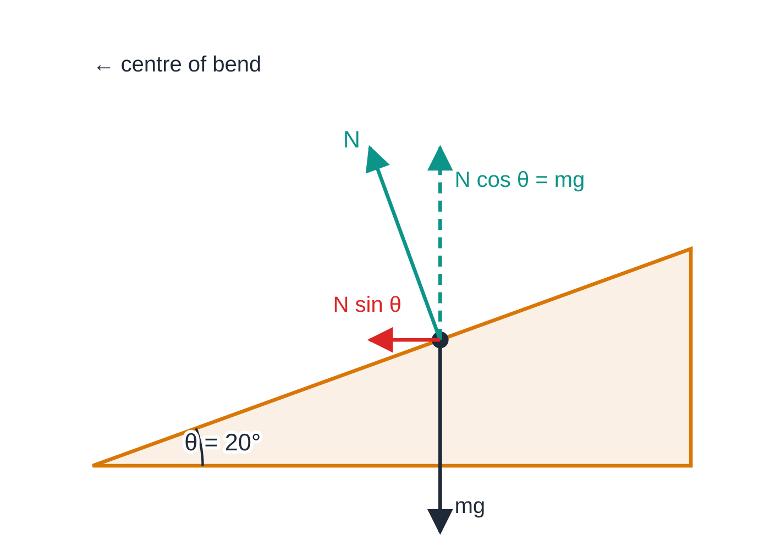
How do vehicles get round bends? (continued)
Section 5 of 13
A car (dot) on a track banked at θ = 20°, at the speed where no friction is needed; forces drawn to scale. The normal reaction tilts towards the centre: N cos θ balances the weight and N sin θ provides the centripetal force.
Notes:
How do vehicles get round bends?. Full notes: https://examinerprep.com/notes/edexcel-ial-physics/circular-motion/

Slide 22
What happens in a vertical circle?
Section 6 of 13
In a vertical circle the weight acts down at every point, so its role changes around the loop. Take towards the centre as positive at each point and write: resultant force towards centre = mv²/r.
At the top (rider on the inside of a loop, or a ball on a string), the weight and the reaction or tension both act down, towards the centre: N + mg = mv²/r.
At the bottom, the reaction or tension acts up, towards the centre, and the weight acts away from it: N - mg = mv²/r.
The speed is not constant: the body speeds up on the way down and slows on the way up, so use conservation of energy to link the speeds at different heights.
At the minimum speed at the top, the reaction (or tension) is zero, so weight alone provides the centripetal force: mg = mv²/r, giving
vₘᵢₙ = √(gr)
Notes:
What happens in a vertical circle?. Full notes: https://examinerprep.com/notes/edexcel-ial-physics/circular-motion/

Slide 23
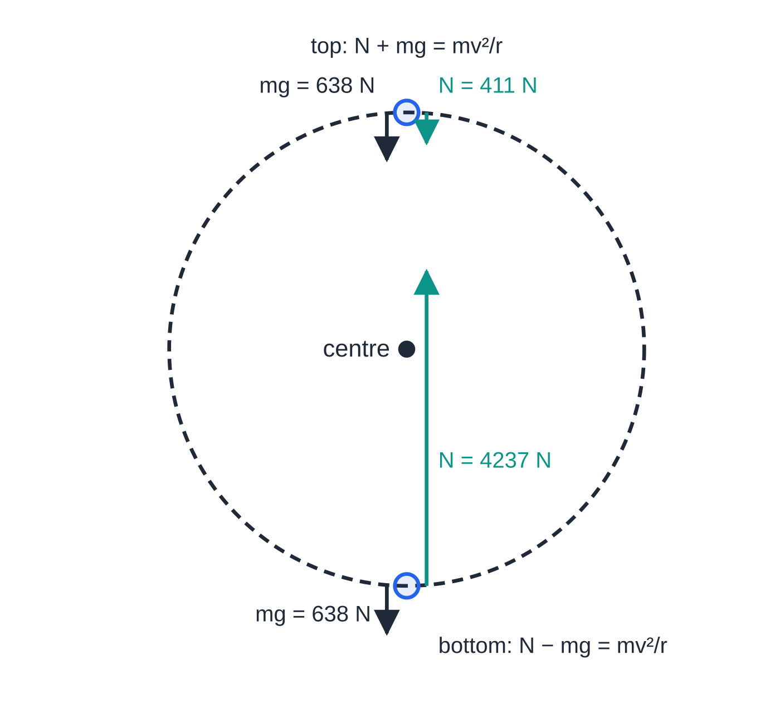
What happens in a vertical circle? (continued)
Section 6 of 13
This is not in the formulae list, so derive it. Slower than this, the weight is more than enough to provide the centripetal force; the body falls inside the circle and the string goes slack or the rider leaves the track.
Free-body diagrams for the rider in worked example 5, drawn to the same scale. At the top the reaction is only 0.64 × the weight; at the bottom it is 6.6 × the weight, which is why riders feel pressed into their seats there.
Notes:
What happens in a vertical circle?. Full notes: https://examinerprep.com/notes/edexcel-ial-physics/circular-motion/

Slide 24
What happens in a vertical circle? (continued)
Section 6 of 13 · Worked example 5 · Hard · Calculate
WORKED EXAMPLE · QUESTION
A rider of mass 65 kg goes round a vertical loop of radius 7.5 m on a fairground ride, sitting on the inside of the track. At the top of the loop the rider's speed is 11 m s⁻¹. Friction and air resistance are negligible. (a) Calculate the force exerted on the rider by the seat at the top. (b) Calculate the minimum speed at the top for the rider to stay in contact with the seat without a harness. (c) Calculate the force from the seat at the bottom of the loop.
SOLUTION
(a) At the top both forces act towards the centre: N + mg = mv²/r, so N = (65 ×11²)/7.5 - 65 ×9.81 = 1049 - 638 = 411 N ≈ 410 N
(b) Contact is just lost when N = 0: mg = mv²/r, so v = √(9.81 ×7.5) = 8.58 m s⁻¹ ≈ 8.6 m s⁻¹
(c) Speed at the bottom from energy, as the rider falls 2r = 15 m: v² = 11² + 2 ×9.81 ×15 = 415.3 m² s⁻² (v = 20.4 m s⁻¹).
Notes:
What happens in a vertical circle?: Worked example 5. Full notes: https://examinerprep.com/notes/edexcel-ial-physics/circular-motion/

Slide 25
What happens in a vertical circle? (continued)
Section 6 of 13 · Worked example 5 · Hard · Calculate (continued)
At the bottom the reaction acts towards the centre and the weight away from it: N = mg + mv²/r = 638 + (65 ×415.3)/7.5 = 4237 N ≈ 4.2 kN
Notes:
What happens in a vertical circle?: Worked example 5. Full notes: https://examinerprep.com/notes/edexcel-ial-physics/circular-motion/

Slide 26
What happens in a vertical circle? (continued)
Section 6 of 13
Exam tip — write the equation for the point first
Before you substitute, write the equation with the force towards the centre first: "N + mg = mv²/r at the top", "T − mg = mv²/r at the bottom". A sign error in this line spoils everything that follows.
Notes:
What happens in a vertical circle?. Full notes: https://examinerprep.com/notes/edexcel-ial-physics/circular-motion/

Slide 27
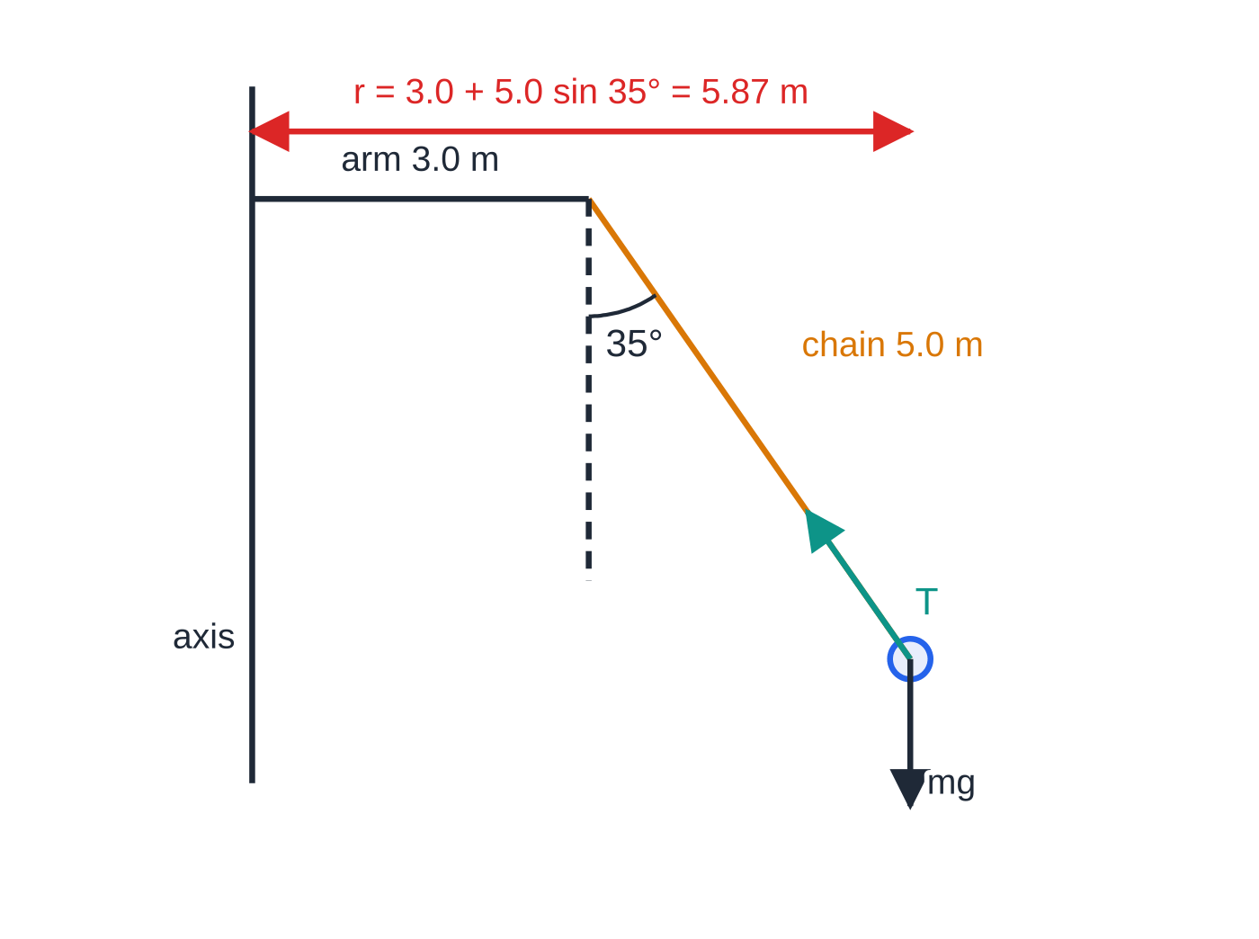
How do you analyse a conical pendulum?
Section 7 of 13
A conical pendulum is a mass on a string (or a chair on a chain) moving in a horizontal circle, with the string sweeping out a cone. Only two forces act: the tension T along the string and the weight mg.
Vertically there is no acceleration: T cos θ = mg.
Horizontally the component of tension towards the centre provides the centripetal force: T sin θ = mv²/r.
Dividing the two equations removes T and m: tan θ= v²/rg. Faster rotation gives a larger angle, and the mass of the rider does not matter.
The radius is the radius of the horizontal circle, not the length of the string.
A swing-chair ride drawn to scale (worked example 6). The chain hangs from the end of a rotating arm, so the radius of the seat's circle is the arm plus the horizontal reach of the chain. Only T and mg act; their resultant is horizontal, towards the axis.
Notes:
How do you analyse a conical pendulum?. Full notes: https://examinerprep.com/notes/edexcel-ial-physics/circular-motion/

Slide 28
How do you analyse a conical pendulum? (continued)
Section 7 of 13 · Worked example 6 · Hard · Calculate
WORKED EXAMPLE · QUESTION
On a fairground swing-chair ride, each chair hangs from a chain 5.0 m long attached to the end of an arm 3.0 m from the central axis. When the ride turns steadily, each chain makes 35° with the vertical. A chair and rider have a combined mass of 80 kg. Calculate (a) the radius of the chair's circle, (b) the speed of the chair, (c) the time for one revolution and (d) the tension in the chain.
SOLUTION
(a) Add the horizontal reach of the chain to the arm: r = 3.0 + 5.0 sin 35° = 3.0 + 2.87 = 5.87 m
(b) tan θ = v²/(rg): v² = 5.868 × 9.81 × tan 35° = 40.3, so v = 6.35 m s⁻¹ ≈ 6.3 m s⁻¹
(c) One revolution is a distance 2πr: period = 2π × 5.868 ÷ 6.349 = 5.81 s ≈ 5.8 s
(d) Vertical equilibrium: T = mg/cos 35° = 80 × 9.81 ÷ 0.8192 = 958 N ≈ 960 N
Check: T sin 35° = 550 N, and mv²/r = 80 × 40.3 ÷ 5.868 = 550 N, so the horizontal component is exactly the centripetal force.
Notes:
How do you analyse a conical pendulum?: Worked example 6. Full notes: https://examinerprep.com/notes/edexcel-ial-physics/circular-motion/

Slide 29
How do you analyse a conical pendulum? (continued)
Section 7 of 13
Common error — the chain as the radius
Using the chain length (5.0 m) as the radius. The body moves in a horizontal circle; its radius is the horizontal distance from the axis of rotation to the body.
Notes:
How do you analyse a conical pendulum?. Full notes: https://examinerprep.com/notes/edexcel-ial-physics/circular-motion/

Slide 30
How can you test F = mrω² by experiment?
Section 8 of 13
Keep m and r fixed, vary ω, and measure the force needed. Since F = (mr)ω², a graph of F against ω² should be a straight line through the origin with gradient mr.
One method: a mass fixed to a force sensor on a motor-driven arm; a light gate counts revolutions so that the period, and hence ω = 2π/T, is found from the time for many turns.
Simpler version: a rubber bung whirled on a string that passes through a glass tube, with hanging masses providing the tension. The radius is kept constant with a small clip fixed to the string, and the period is timed over 10–20 revolutions.
Safety: safety glasses, a clear space, and a string checked for wear before whirling anything.
Notes:
How can you test F = mrω² by experiment?. Full notes: https://examinerprep.com/notes/edexcel-ial-physics/circular-motion/

Slide 31
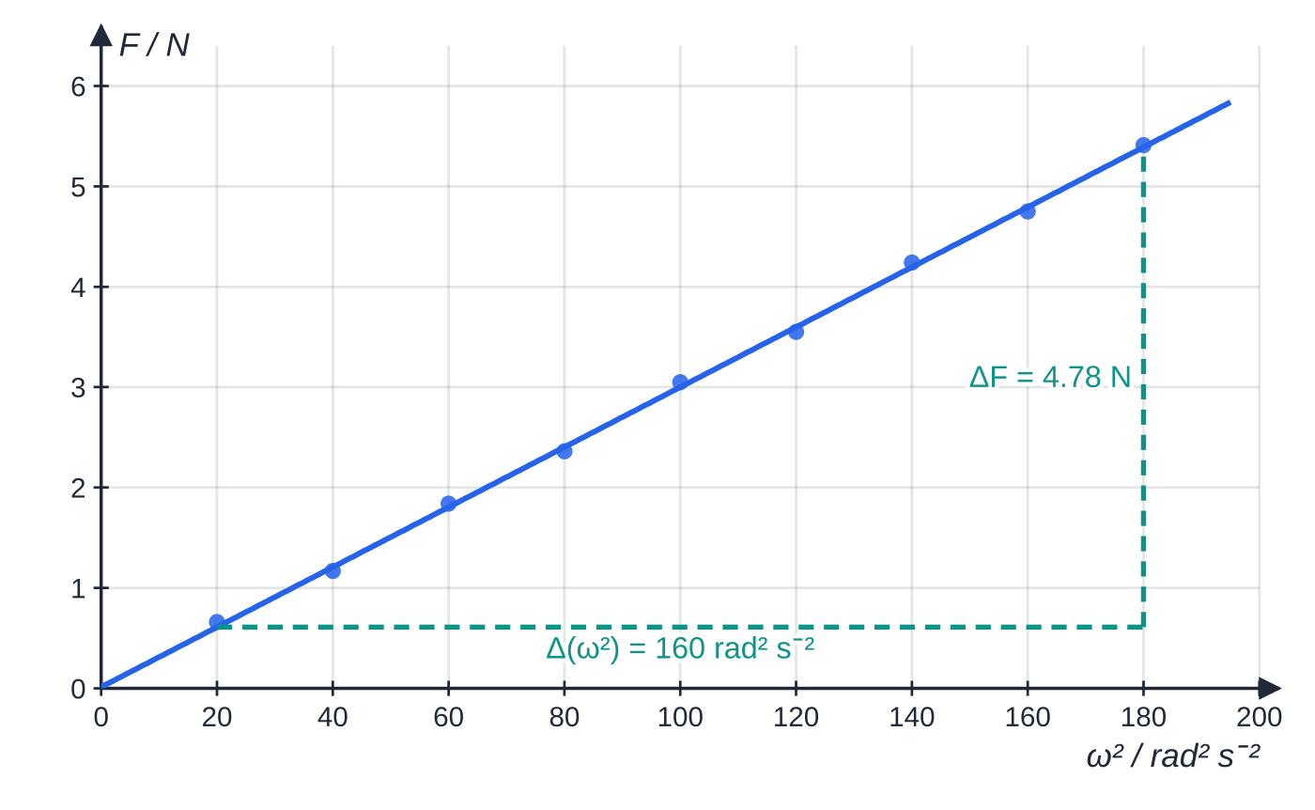
How can you test F = mrω² by experiment? (continued)
Section 8 of 13
Specimen results for a 0.150 kg mass at r = 0.200 m: the points lie close to a straight line through the origin, as F = mrω² predicts. The gradient is mr.
Notes:
How can you test F = mrω² by experiment?. Full notes: https://examinerprep.com/notes/edexcel-ial-physics/circular-motion/

Slide 32
How can you test F = mrω² by experiment? (continued)
Section 8 of 13 · Worked example 7 · Hard · Determine
WORKED EXAMPLE · QUESTION
Use the graph above, for which r = 0.200 ± 0.002 m, to determine the mass on the arm. The uncertainty in the gradient is estimated as ±3%. Give the mass with its absolute uncertainty.
SOLUTION
Gradient from a large triangle on the line: (5.39 - 0.61)/(180 - 20) = 0.0299 kg m.
Gradient = mr, so m = 0.0299 ÷ 0.200 = 0.149 kg.
For a quotient, add percentage uncertainties: r has 0.002 ÷ 0.200 × 100 = 1.0%, so m has 3% + 1.0% = 4%. m = 0.149 ± 0.006 kg
The known mass, 0.150 kg, lies inside this range, so the results support F = mrω².
Notes:
How can you test F = mrω² by experiment?: Worked example 7. Full notes: https://examinerprep.com/notes/edexcel-ial-physics/circular-motion/

Slide 33
How can you test F = mrω² by experiment? (continued)
Section 8 of 13
Exam tip — timing many revolutions
Timing many revolutions and dividing reduces the percentage uncertainty in the period. Because ω = 2π/T is squared, the percentage uncertainty in T counts twice in the percentage uncertainty in ω², and so in a calculated value of mrω².
Notes:
How can you test F = mrω² by experiment?. Full notes: https://examinerprep.com/notes/edexcel-ial-physics/circular-motion/

Slide 34
Exam tips for 4.2
Section 9 of 13
Exam tip 1 — radians, always
Every formula with θ or ω assumes radians. Convert degrees first, and check that your calculator is in the right mode before any trigonometry on a conical pendulum or banked track.
Exam tip 2 — name the real force
"What provides the centripetal force?" wants a real force (tension, friction, a normal reaction, a component of lift or weight) and its direction: towards the centre of the circle.
Exam tip 3 — one equation per point
For each position on a vertical circle, take towards the centre as positive, write resultant force = mv²/r, and only then substitute. Find speeds at different heights with conservation of energy.
Notes:
Exam tips for 4.2. Full notes: https://examinerprep.com/notes/edexcel-ial-physics/circular-motion/

Slide 35
Exam tips for 4.2 (continued)
Section 9 of 13
Exam tip 4 — resolve, then divide
For a conical pendulum, banked track or banking aircraft, resolve vertically (equilibrium) and horizontally (mv²/r). Dividing the two equations gives tan θ = v²/(rg) and removes the unknown force.
Exam tip 5 — explaining circular motion
A complete explanation links three steps: the velocity changes direction → so there is an acceleration towards the centre → so a resultant force towards the centre is needed (Newton's second law). Then name what provides it.
Notes:
Exam tips for 4.2. Full notes: https://examinerprep.com/notes/edexcel-ial-physics/circular-motion/

Slide 36
Common misconceptions
Section 10 of 13
Misconception | Why it is wrong | Correct idea
A body moving in a circle at constant speed has no acceleration. | Its velocity changes direction all the time. | It accelerates towards the centre at v²/r.
An outward "centrifugal force" pushes you to the outside of a bend. | No body exerts such a force on you; your body simply tends to keep moving in a straight line. | The only resultant force is inwards; the seat or door pushes you towards the centre.
Centripetal force is an extra force to add to a free-body diagram. | It is the name for the resultant of the real forces. | Draw tension, friction, reaction, weight; their resultant towards the centre equals mv²/r.
If the string breaks, the ball flies outwards along the radius. | With no force there is no change of velocity. | It moves off along the tangent at the speed it had.
Points further from the axis of a turning wheel have a larger angular velocity. | Every radius line of a rigid body turns through the same angle in the same time. | Same ω everywhere; the speed v = ωr is larger further out.
Notes:
Common misconceptions. Full notes: https://examinerprep.com/notes/edexcel-ial-physics/circular-motion/

Slide 37
Common misconceptions (continued)
Section 10 of 13
Misconception | Why it is wrong | Correct idea
At the top of a loop at the minimum speed no forces act on the rider. | The weight never disappears. | The reaction is zero and the weight alone provides the centripetal force.
Notes:
Common misconceptions. Full notes: https://examinerprep.com/notes/edexcel-ial-physics/circular-motion/

Slide 38
How this topic connects
Section 11 of 13
2 Forces and Newton's laws
Circular motion is F = ma with the acceleration pointing to the centre; the first law explains why a force is needed at all, and resolving forces handles the conical pendulum and banked track.
5 Magnetic fields and 4.7 Particle accelerators
A charged particle moving at right angles to a uniform magnetic field moves in a circle because the magnetic force BQv provides mv²/r; this gives r = p/BQ, the basis of cyclotrons and particle detectors.
7 Gravitational fields and orbits, and 5.5 Simple harmonic motion
For a satellite or planet, gravity is the centripetal force: GMm/r² = mv²/r. The same ω appears in SHM: the shadow of a point moving round a circle at constant ω moves with simple harmonic motion, and T = 2π/ω carries over unchanged.
Notes:
How this topic connects. Full notes: https://examinerprep.com/notes/edexcel-ial-physics/circular-motion/

Slide 39
Key equations
Section 12 of 13
Equation | Use | In the formulae list?
θ = s/r; 2π rad = 360° | angle in radians; converting angles | No — learn it
ω= Δθ/Δt | definition of angular velocity | No — learn it
v = ωr | linear speed from angular velocity | Yes
T = 2π/ω | period from angular velocity | Yes
f = 1/T, ω = 2πf | frequency and rotation rate | No — learn it / derive it
a = v²/r = rω² | centripetal acceleration | Yes (derivation may be asked)
F = mv²/r = mrω² | resultant force towards the centre | Yes
vₘᵢₙ = √(gr) | top of a vertical circle, reaction or tension zero | No — derive it
tan θ= v²/(rg) | conical pendulum (angle to the vertical) | No — derive it
Notes:
Key equations. Full notes: https://examinerprep.com/notes/edexcel-ial-physics/circular-motion/

Slide 40
Check your understanding
Section 13 of 13
1. Convert an angle of 2.5 rad to degrees.
2. A computer hard disk spins at 5400 revolutions per minute. Calculate its angular velocity.
3. A car turns sharply left. Explain why a passenger feels pressed against the right-hand door.
4. A 0.060 kg ball on a string 0.50 m long moves in a horizontal circle on a smooth table at 4.0 m s⁻¹. Calculate the tension.
5. A toy car runs round the inside of a vertical loop of track of radius 0.25 m. Calculate the minimum speed at the top of the loop for the car to stay on the track.
Notes:
Check your understanding: questions. Full notes: https://examinerprep.com/notes/edexcel-ial-physics/circular-motion/

Slide 41
Check your understanding · answers
Section 13 of 13
1. 2.5 × 180/π = 143°.
2. ω = 2π × 5400 ÷ 60 = 565 rad s⁻¹.
3. The passenger's body tends to continue in a straight line. The car turns left underneath them until the right-hand door reaches them; the door then pushes them to the left, towards the centre of the turn, providing their centripetal force. There is no outward force on the passenger.
4. T = mv²/r = (0.060 ×4.0²)/0.50 = 1.9 N.
5. v = √(gr) = √(9.81 ×0.25) = 1.57 m s⁻¹ ≈ 1.6 m s⁻¹. At this speed the track exerts no force on the car and its weight alone provides the centripetal force.
Notes:
Check your understanding: answers. Full notes: https://examinerprep.com/notes/edexcel-ial-physics/circular-motion/

Slide 42
Practice questions
4 original exam-style questions. Answers at the end of the deck.

Slide 43
Question 1
1 mark
A car is driven round a circular roundabout at constant speed.
What is the direction of the acceleration of the car?
A Towards the centre of the roundabout.
B Away from the centre of the roundabout.
C In the direction the car is moving.
D There is no acceleration.
Notes:
Online with the full mark scheme: https://examinerprep.com/ial-physics-4-2-circular-motion-questions#IALP-U4-2-A-04

Slide 44
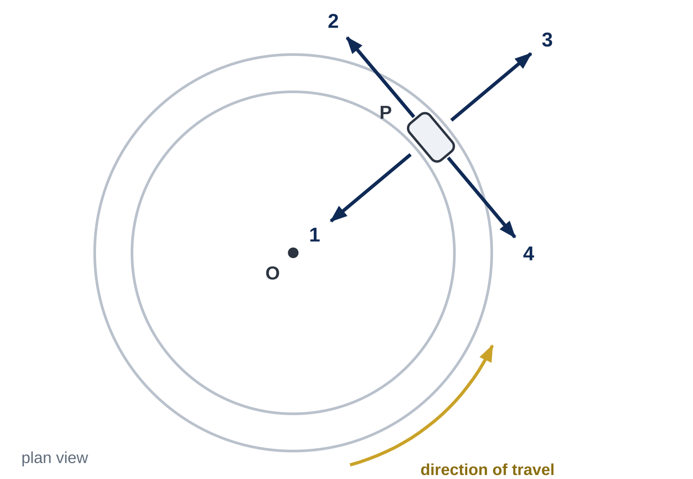
Question 2
1 mark
The figure shows a car, seen from above, moving at constant speed round a circular test track with centre O. Four arrows are drawn at the car's position P.
Which arrow shows the direction of the resultant force on the car at P?
A Arrow 1
B Arrow 2
C Arrow 3
D Arrow 4
Notes:
Online with the full mark scheme: https://examinerprep.com/ial-physics-4-2-circular-motion-questions#IALP-U4-2-FA-04

Slide 45
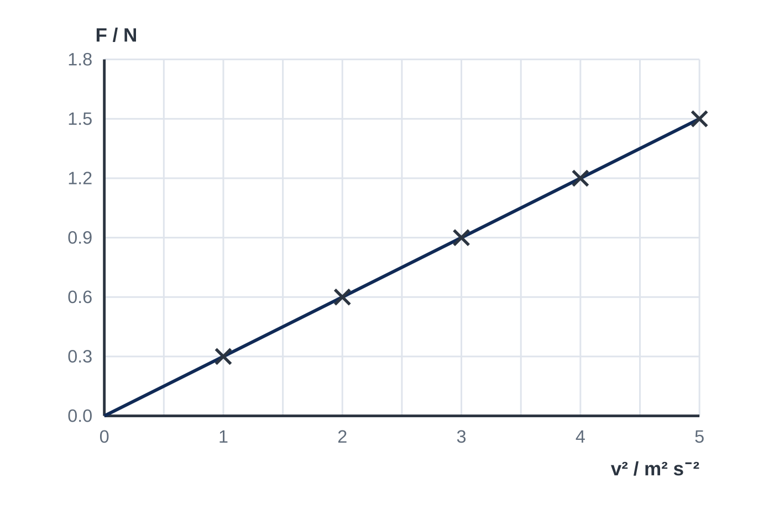
Question 3
1 mark
A toy car runs at different steady speeds round a circular track of radius 0.40 m. A sensor measures the resultant force F on the car towards the centre. The graph shows F against v².
What is the mass of the car?
A 0.12 kg
B 0.30 kg
C 0.75 kg
D 1.3 kg
Notes:
Online with the full mark scheme: https://examinerprep.com/ial-physics-4-2-circular-motion-questions#IALP-U4-2-FA-06

Slide 46
Question 4
7 marks
A car of mass 980 kg travels round a level roundabout on a circular path of radius 18 m at a constant speed of 8.5 m s⁻¹.
(a) Calculate the resultant force on the car. [2]
(b) State what provides this force. [1]
(c) On a dry day the largest sideways friction the road can provide is 6.5 kN. Calculate the greatest speed at which the car can travel round this path. [2]
(d) On an icy day the largest sideways friction is only 3.0 kN. Explain what happens if the car tries to follow the same path at 8.5 m s⁻¹. [2]
Notes:
Online with the full mark scheme: https://examinerprep.com/ial-physics-4-2-circular-motion-questions#IALP-U4-2-B-04

Slide 47
Answers

Slide 48
Question 1 · answer
Answer A
The direction of the velocity changes continuously, so the car accelerates even at constant speed. The change in velocity, and so the acceleration, is directed towards the centre of the circle.
Notes:
Full mark scheme: https://examinerprep.com/ial-physics-4-2-circular-motion-questions#IALP-U4-2-A-04

Slide 49
Question 2 · answer
Answer A
At constant speed the velocity changes only in direction, and that change is towards the centre. So the resultant force (sideways friction from the road) acts towards O: arrow 1. Arrow 2 shows the direction of the velocity.
Notes:
Full mark scheme: https://examinerprep.com/ial-physics-4-2-circular-motion-questions#IALP-U4-2-FA-04

Slide 50
Question 3 · answer
Answer A
F = mv²/r, so the gradient of F against v² is m/r. Gradient = 1.5 N ÷ 5.0 m² s⁻² = 0.30 kg m⁻¹, so m = 0.30 × 0.40 = 0.12 kg.
Notes:
Full mark scheme: https://examinerprep.com/ial-physics-4-2-circular-motion-questions#IALP-U4-2-FA-06

Slide 51
Question 4 · answer
Mark scheme
F = mv²/r = 980 × 8.5² ÷ 18
= 3.9 kN (3930 N) towards the centre
(sideways) friction between the tyres and the road
6500 = 980v² ÷ 18
v = 10.93 m s⁻¹, so 10.9 m s⁻¹ (rounded down: at 11 m s⁻¹ the car would skid)
the friction available (3.0 kN) is less than the 3.9 kN needed
so the car cannot keep to the 18 m circle; it follows a path of larger radius / slides towards the outside of the roundabout
Notes:
Full mark scheme: https://examinerprep.com/ial-physics-4-2-circular-motion-questions#IALP-U4-2-B-04

Slide 52
Keep practising
Notes for this topic
Questions on this topic
Build a printable test
ExaminerPrep is an independent tutoring service. It has been developed independently from and is not endorsed by the International Baccalaureate Organization. "International Baccalaureate", "IB" and "IB Diploma Programme" are registered trademarks of the IBO, used here for descriptive purposes only.
Pearson Edexcel and Cambridge are trademarks of their owners; ExaminerPrep is not affiliated with any exam board.

