Slide 1
EP
EDEXCEL IAL PHYSICS
2.6 Current, potential difference and resistance
The full notes page in 11 sections · practice questions with answers · simulations
ExaminerPrep is an independent tutoring service. It has been developed independently from and is not endorsed by the International Baccalaureate Organization. "International Baccalaureate", "IB" and "IB Diploma Programme" are registered trademarks of the IBO, used here for descriptive purposes only.
Pearson Edexcel and Cambridge are trademarks of their owners; ExaminerPrep is not affiliated with any exam board.
Notes:
2.6 Current, potential difference and resistance. Notes for this topic: https://examinerprep.com/notes/edexcel-ial-physics/current-potential-difference-and-resistance/

Slide 2
What this page covers
Overview
Current as the rate of flow of charge; the coulomb and the ampere; counting electrons
Potential difference as energy transferred per unit charge; the volt
Resistance R = V/I, the ohm, and Ohm's law as a special case
Electrical power and energy: P = VI, W = VIt, P = I²R, P = V²/R, kilowatt-hours
Drift velocity and the derivation of I = nqvA
How the number density of charge carriers explains the resistivities of metals, semiconductors and insulators
Notes:
What this page covers. Full notes: https://examinerprep.com/notes/edexcel-ial-physics/current-potential-difference-and-resistance/

Slide 3
In one minute
Key points
1
Current is the rate of flow of charge, I = ΔQ/Δt, with 1 A = 1 C s⁻¹, and charge comes in multiples of e = 1.60 ×10⁻¹⁹ C.
4
Power P = VI = I²R = V²/R; energy W = VIt. 1 kWh = 3.6 × 10⁶ J.
2
Potential difference is the energy transferred per unit charge: V = W/Q. 1 V = 1 J C⁻¹.
5
I = nqvA: current depends on the number of carriers per m³, their charge, their drift velocity and the cross-sectional area.
3
Resistance is defined by R = V/I. Ohm's law: for a metallic conductor at constant temperature, I ∝V.
6
Metals have a huge n (low resistivity), semiconductors far fewer carriers, insulators almost none.
Notes:
In one minute: the key points of this topic.

Slide 4
What is electric current?
Section 1 of 11
Every circuit question rests on three quantities: how much charge flows each second, how much energy each coulomb carries, and how hard it is to push the charge through. Current is the first.
Electric current is the rate of flow of charged particles (the rate of flow of charge): I = ΔQ/Δt, with I in A, ΔQ in C and Δt in s.
This equation is in the formulae list supplied in the exam. For a steady current ΔQ = IΔt; for a changing current, the charge is the area under the current–time graph.
Units: the ampere is an SI base unit. The coulomb is defined from it: 1 C = 1 A s, the charge passing a point when 1 A flows for 1 s.
Charge carriers: free (delocalised) electrons in metals; positive and negative ions in electrolytes and ionised gases; electrons and "holes" in semiconductors.
Notes:
What is electric current?. Full notes: https://examinerprep.com/notes/edexcel-ial-physics/current-potential-difference-and-resistance/

Slide 5
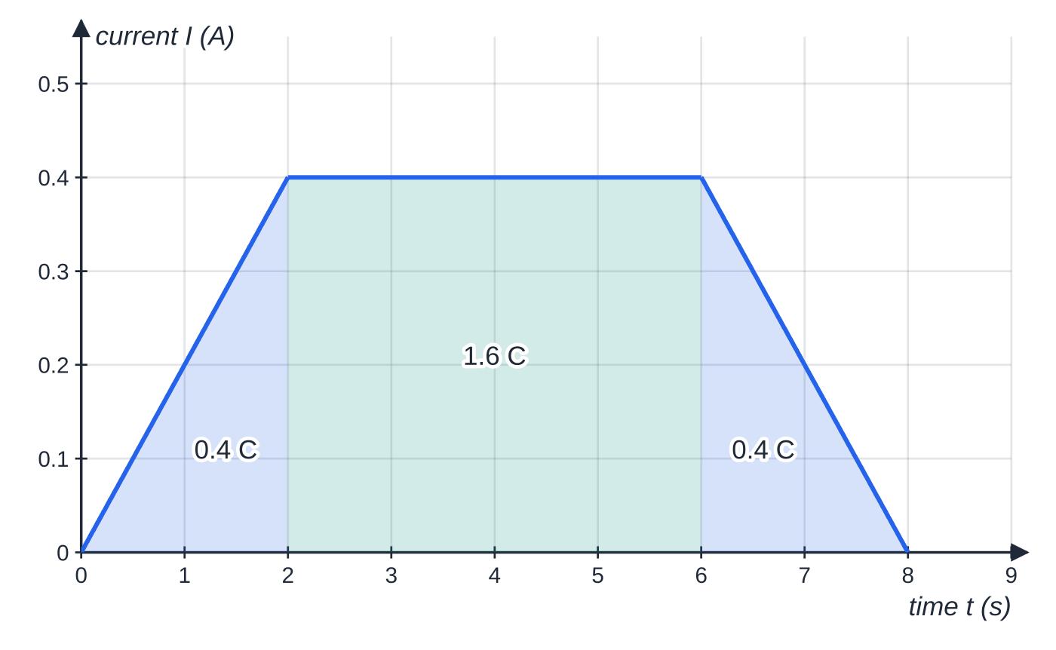
What is electric current? (continued)
Section 1 of 11
Charge is quantised: any charge is a whole number of electron charges, Q = Ne, so the number of electrons passing is N = Q/e (learn this; it is not given).
Charge is conserved: it is not used up in a component, so the current into a component equals the current out of it. Measure current with an ammeter in series; an ideal ammeter has zero resistance.
Conventional current is drawn from the positive terminal to the negative terminal round the external circuit.
A current that rises, stays steady and then falls. The charge that has passed is the area under the graph: 0.4 C + 1.6 C + 0.4 C = 2.4 C in 8.0 s, a mean current of 0.30 A.
Notes:
What is electric current?. Full notes: https://examinerprep.com/notes/edexcel-ial-physics/current-potential-difference-and-resistance/

Slide 6
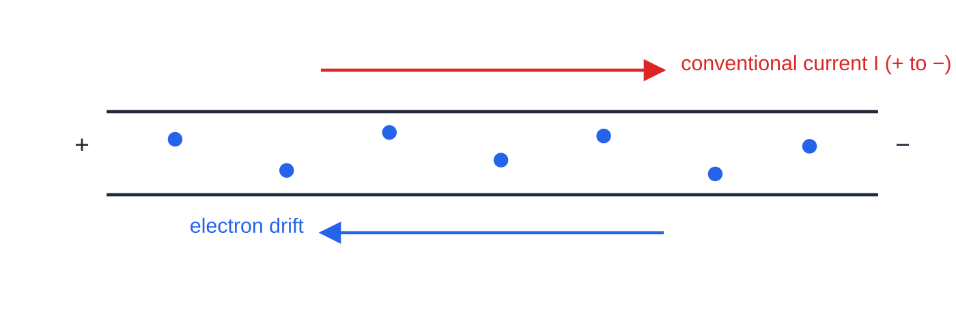
What is electric current? (continued)
Section 1 of 11
In a metal the electrons actually move the opposite way; the convention was fixed before the electron was discovered.
In a metal wire the free electrons (blue) drift towards the positive end, opposite to the conventional current.
Notes:
What is electric current?. Full notes: https://examinerprep.com/notes/edexcel-ial-physics/current-potential-difference-and-resistance/

Slide 7
What is electric current? (continued)
Section 1 of 11 · Worked example 1 · Easy · Calculate
WORKED EXAMPLE · QUESTION
A phone charger delivers a steady current of 1.8 A for 45 minutes. e = 1.60 ×10⁻¹⁹ C. Calculate (a) the charge that flows and (b) the number of electrons this represents.
SOLUTION
Time in seconds: t = 45 ×60 = 2700 s.
(a) ΔQ = IΔt = 1.8 ×2700 = 4.9 × 10³ C (4860 C).
(b) N = Q/e = 4860 ÷1.60 ×10⁻¹⁹ = 3.0 × 10²² electrons.
Notes:
What is electric current?: Worked example 1. Full notes: https://examinerprep.com/notes/edexcel-ial-physics/current-potential-difference-and-resistance/

Slide 8
What is electric current? (continued)
Section 1 of 11
Common error
Leaving the time in minutes or hours. I = ΔQ/Δt gives coulombs only if the current is in amperes and the time in seconds; 1.8 ×45 = 81 is not a charge in any standard unit.
Notes:
What is electric current?. Full notes: https://examinerprep.com/notes/edexcel-ial-physics/current-potential-difference-and-resistance/

Slide 9
What is potential difference?
Section 2 of 11
The potential difference between two points is the energy transferred per unit charge as charge moves between the two points: V = W/Q, with V in V, W in J and Q in C.
This equation is in the formulae list supplied in the exam. Across a component such as a resistor or lamp, energy is transferred from the charge carriers to the component, for example as thermal energy.
The volt: 1 V = 1 J C⁻¹. A p.d. of 1 V means 1 J is transferred for every coulomb that passes.
P.d. is measured with a voltmeter in parallel with the component; an ideal voltmeter has infinite resistance, so it draws no current.
For a single electron, the energy transferred is W = eV, which gives the electronvolt used on 2.5. The energy given to each coulomb by a source is its e.m.f. (2.9).
Notes:
What is potential difference?. Full notes: https://examinerprep.com/notes/edexcel-ial-physics/current-potential-difference-and-resistance/

Slide 10
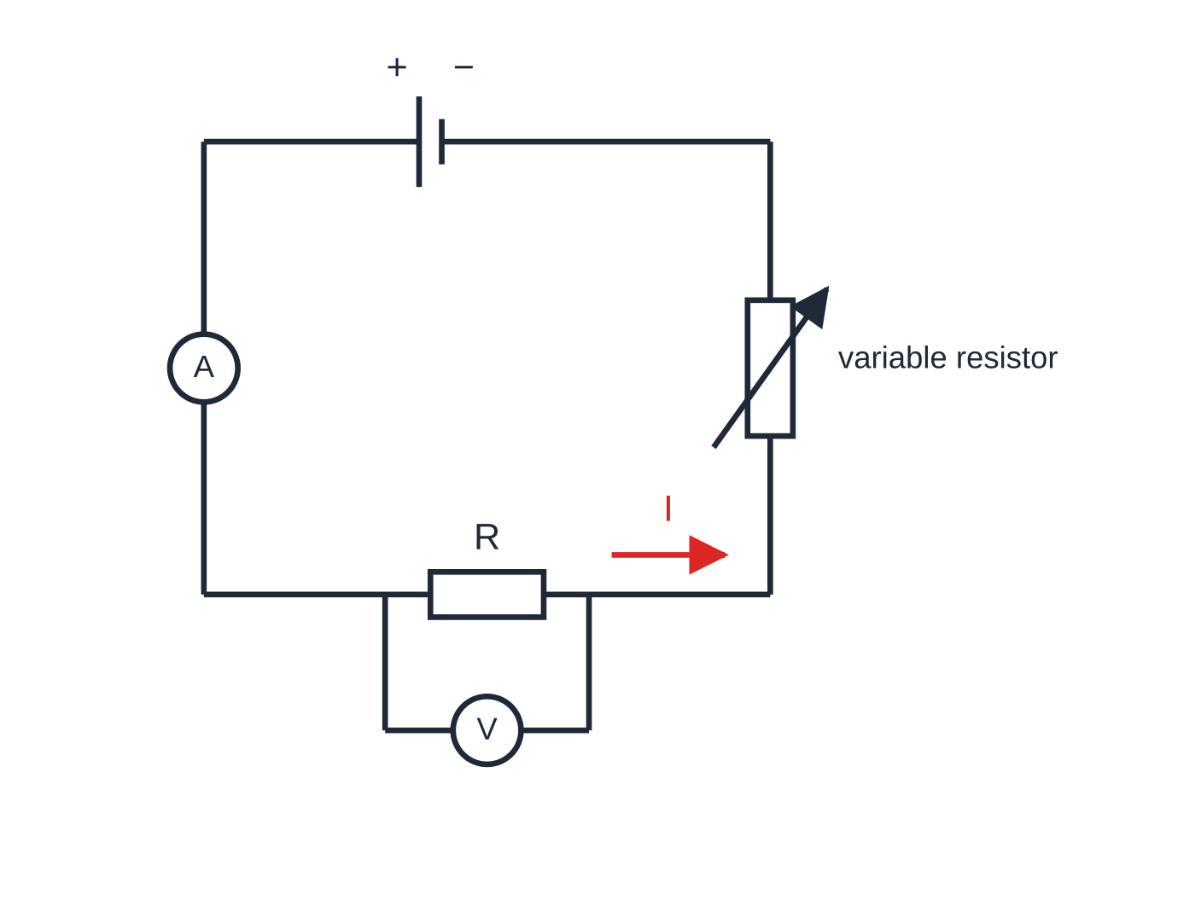
What is potential difference? (continued)
Section 2 of 11
Circuit for measuring the current in, and the p.d. across, a resistor R. The ammeter is in series, the voltmeter in parallel, and the variable resistor sets the current. Conventional current leaves the + terminal (long plate), so it flows anticlockwise here; electrons drift clockwise.
Notes:
What is potential difference?. Full notes: https://examinerprep.com/notes/edexcel-ial-physics/current-potential-difference-and-resistance/

Slide 11
What is potential difference? (continued)
Section 2 of 11 · Worked example 2 · Easy · Calculate
WORKED EXAMPLE · QUESTION
The p.d. across the lamp of an LED torch is 3.6 V and the current in it is 0.25 A. The torch is switched on for 20 minutes. e = 1.60 ×10⁻¹⁹ C. Calculate (a) the charge that passes through the lamp, (b) the energy transferred to the lamp and (c) the energy transferred by each electron.
SOLUTION
(a) t = 20 ×60 = 1200 s, so ΔQ = 0.25 ×1200 = 300 C.
(b) W = VQ = 3.6 ×300 = 1.1 × 10³ J (1080 J).
(c) The same equation for one electron's charge: W = 3.6 ×1.60 ×10⁻¹⁹ = 5.8 × 10⁻¹⁹ J (= 3.6 eV).
Notes:
What is potential difference?: Worked example 2. Full notes: https://examinerprep.com/notes/edexcel-ial-physics/current-potential-difference-and-resistance/

Slide 12
What is resistance, and what does Ohm's law say?
Section 3 of 11
Resistance is defined by R = V/I, with R in Ω, V the p.d. across the component (V) and I the current in it (A). 1 Ω = 1 V A⁻¹.
R = V/I is in the formulae list supplied in the exam. It defines resistance for any component at any instant: use the values of V and I at the same operating point. Resistance measures how much p.d. is needed per ampere: the larger R, the smaller the current for a given p.d.
Ohm's law: for a metallic conductor at constant temperature, the current is directly proportional to the potential difference across it.
Ohm's law is a special case: an ohmic conductor has a resistance that stays the same whatever the current, and its I–V graph is a straight line through the origin.
R = V/I is not Ohm's law. It holds for every component; Ohm's law adds the claim that R is constant.
Notes:
What is resistance, and what does Ohm's law say?. Full notes: https://examinerprep.com/notes/edexcel-ial-physics/current-potential-difference-and-resistance/

Slide 13
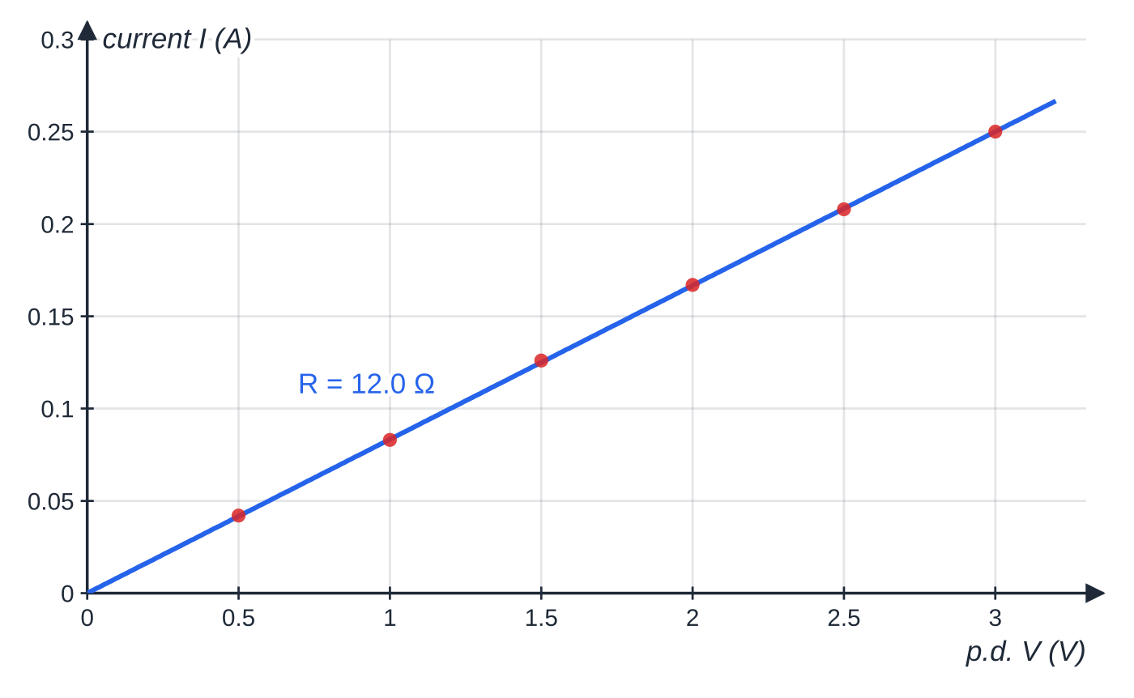
What is resistance, and what does Ohm's law say? (continued)
Section 3 of 11
The condition matters: if a wire heats up, its resistance rises and I is no longer proportional to V. Filament lamps, thermistors and diodes are non-ohmic (2.7).
Results for the coil of wire in worked example 3, plotted as current against p.d. The points lie on a straight line through the origin, so the coil obeys Ohm's law; its resistance is 12.0 Ω.
Notes:
What is resistance, and what does Ohm's law say?. Full notes: https://examinerprep.com/notes/edexcel-ial-physics/current-potential-difference-and-resistance/

Slide 14
What is resistance, and what does Ohm's law say? (continued)
Section 3 of 11 · Worked example 3 · Medium · Show that
WORKED EXAMPLE · QUESTION
A student uses the circuit above to measure the current in a coil of constantan wire for several p.d.s. The coil is kept in a beaker of water at room temperature.
V / V | 0.50 | 1.00 | 1.50 | 2.00 | 2.50 | 3.00
I / A | 0.042 | 0.083 | 0.126 | 0.167 | 0.208 | 0.250
Show that the coil obeys Ohm's law and determine its resistance.
SOLUTION
V/I for every row: 11.9, 12.0, 11.9, 12.0, 12.0, 12.0 Ω. All values agree to within 1%, so V/I is constant: I ∝V at constant temperature, and Ohm's law is obeyed.
Resistance: the mean of the ratios, or the inverse gradient of the line: R = 12 Ω (12.0 Ω).
The water bath keeps the temperature constant, and small currents also limit heating.
Notes:
What is resistance, and what does Ohm's law say?: Worked example 3. Full notes: https://examinerprep.com/notes/edexcel-ial-physics/current-potential-difference-and-resistance/

Slide 15
What is resistance, and what does Ohm's law say? (continued)
Section 3 of 11 · Worked example 3 · Medium · Show that (continued)
Plotting the graph is the stronger test: a straight line through the origin shows proportionality, not just a straight line.
Notes:
What is resistance, and what does Ohm's law say?: Worked example 3. Full notes: https://examinerprep.com/notes/edexcel-ial-physics/current-potential-difference-and-resistance/

Slide 16
What is resistance, and what does Ohm's law say? (continued)
Section 3 of 11
Common error
Using the gradient of a curved I–V graph as the resistance. The resistance at a point is V/I read from that point; the inverse gradient equals the resistance only for a straight line through the origin.
Notes:
What is resistance, and what does Ohm's law say?. Full notes: https://examinerprep.com/notes/edexcel-ial-physics/current-potential-difference-and-resistance/

Slide 17
How do you calculate electrical power and energy?
Section 4 of 11
P = VI W = VIt P = I²R P = V²/R
Here P is power (W), W energy transferred (J) and t time (s); all four are in the formulae list supplied in the exam. They follow from the definitions: W = VQ and Q = It, so W = VIt and P = W/t = VI. Substituting V = IR gives I²R; substituting I = V/R gives V²/R.
Use P = I²R when you know the current (components in series share a current); use P = V²/R when you know the p.d. (appliances in parallel on the same supply).
All the quantities must refer to the same component: the p.d. across it, the current in it and its resistance.
Kilowatt-hours: energy in kWh = power in kW × time in hours; 1 kWh = 3.6 × 10⁶ J (1000 W × 3600 s; learn it).
Notes:
How do you calculate electrical power and energy?. Full notes: https://examinerprep.com/notes/edexcel-ial-physics/current-potential-difference-and-resistance/

Slide 18
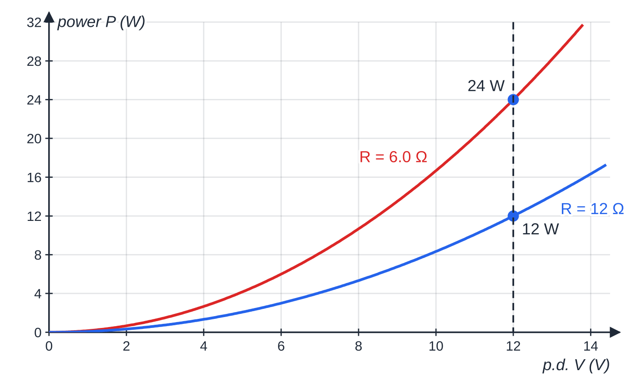
How do you calculate electrical power and energy? (continued)
Section 4 of 11
P = V²/R for two resistors. On the same p.d. the smaller resistance dissipates more power: at 12 V, 24 W for 6.0 Ω and 12 W for 12 Ω.
Notes:
How do you calculate electrical power and energy?. Full notes: https://examinerprep.com/notes/edexcel-ial-physics/current-potential-difference-and-resistance/

Slide 19
How do you calculate electrical power and energy? (continued)
Section 4 of 11 · Worked example 4 · Medium · Calculate
WORKED EXAMPLE · QUESTION
A fan heater is rated at 2.5 kW when connected to a 230 V supply. It runs for 3.5 hours. Calculate (a) the current, (b) the resistance of the heater when operating and (c) the energy transferred, in kWh and in J.
SOLUTION
(a) I = P/V = 2500 ÷230 = 11 A (10.87 A).
(b) R = V²/P = 230² ÷2500 = 21 Ω (21.2 Ω).
(c) E = 2.5 kW ×3.5 h = 8.75 kWh; ×3.6 ×10⁶: 8.8 kWh = 3.2 × 10⁷ J.
Check: I²R = 10.87² ×21.16 = 2500 W, the rated power.
Notes:
How do you calculate electrical power and energy?: Worked example 4. Full notes: https://examinerprep.com/notes/edexcel-ial-physics/current-potential-difference-and-resistance/

Slide 20
How do you calculate electrical power and energy? (continued)
Section 4 of 11 · Worked example 5 · Hard · Compare
WORKED EXAMPLE · QUESTION
A workshop takes 25 kW from a supply through a cable whose total resistance is 0.15 Ω. Compare the power wasted in the cable when the power is delivered at 240 V and when it is delivered at 2400 V.
SOLUTION
At 240 V: I = P/V = 25 000 ÷240 = 104.2 A. The cable's current is known, so use I²R: P = 104.2² ×0.15 = 1.6 kW (1628 W, 6.5% of 25 kW).
At 2400 V: I = 10.42 A; P = 10.42² ×0.15 = 16 W (0.065% of 25 kW).
Ten times the p.d. → one tenth of the current → one hundredth of the power wasted (1.6 kW → 16 W).
The p.d. across the cable at 240 V is only IR = 15.6 V. Using 240²/0.15 = 384 kW mixes the supply p.d. with the cable's resistance, an impossible answer.
Notes:
How do you calculate electrical power and energy?: Worked example 5. Full notes: https://examinerprep.com/notes/edexcel-ial-physics/current-potential-difference-and-resistance/

Slide 21
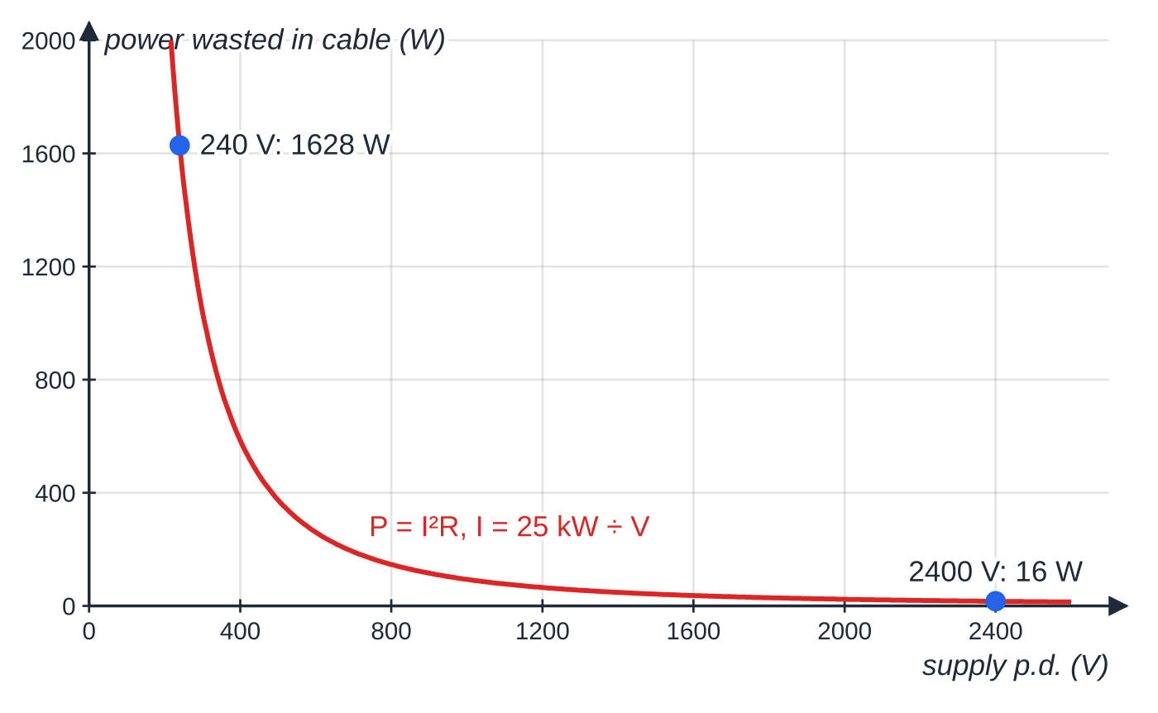
How do you calculate electrical power and energy? (continued)
Section 4 of 11
Common error
Saying "a bigger resistance always gets hotter". With the same current (series), P = I²R, so yes. With the same p.d. (parallel), P = V²/R, so the smaller resistance transfers more power. Say which quantity is fixed.
Power wasted in the 0.15 Ω cable of worked example 5 as the supply p.d. changes, for the same 25 kW delivered. The wasted power falls as 1/V².
Notes:
How do you calculate electrical power and energy?. Full notes: https://examinerprep.com/notes/edexcel-ial-physics/current-potential-difference-and-resistance/

Slide 22
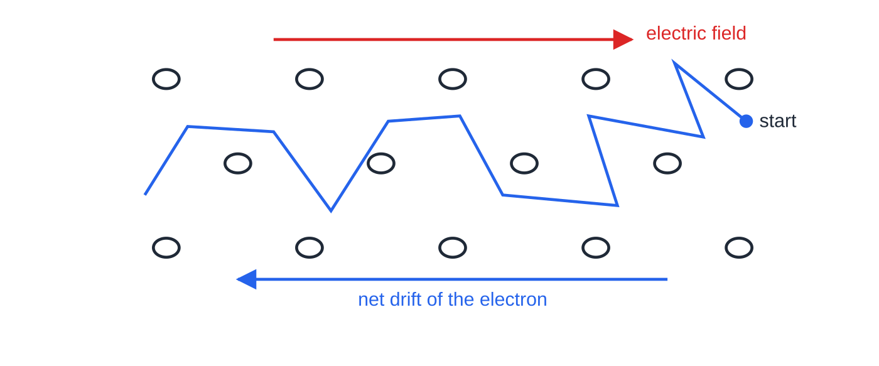
What is drift velocity, and where does I = nqvA come from?
Section 5 of 11
The free electrons in a metal move randomly at high speed, colliding with the vibrating ions of the lattice; with no p.d. there is no net movement. A p.d. creates an electric field in the wire. Superimposed on the random motion, the electrons gain a small average velocity along the wire: the drift velocity v. The number density n is the number of charge carriers per unit volume (m⁻³).
An electron's path among the lattice ions (black circles): fast random motion between collisions, with a slow net drift opposite to the electric field.
Notes:
What is drift velocity, and where does I = nqvA come from?. Full notes: https://examinerprep.com/notes/edexcel-ial-physics/current-potential-difference-and-resistance/

Slide 23
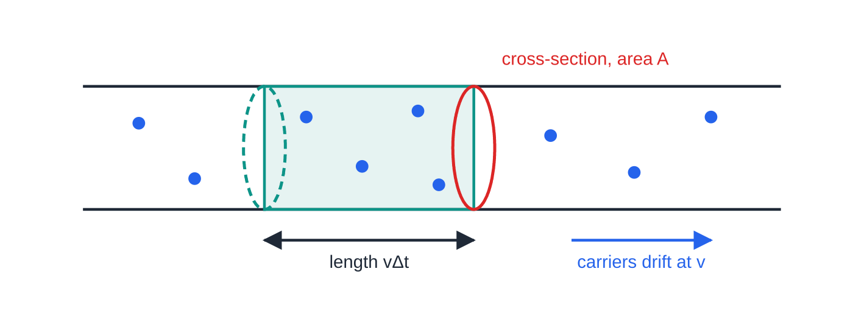
What is drift velocity, and where does I = nqvA come from? (continued)
Section 5 of 11
Deriving I = nqvA
The volume of wire swept through the cross-section in Δt is A ×vΔt. It contains nAvΔt carriers, so the charge passing is ΔQ = nAvΔt ×q. Dividing by Δt:
I = ΔQ/Δt = nqvA
Here n is in m⁻³, q the charge on each carrier (C), v the drift velocity (m s⁻¹) and A the cross-sectional area (m²). The equation is in the formulae list supplied in the exam, but be ready to derive it as above.
In time Δt every carrier within a length vΔt of the cross-section (the shaded volume A × vΔt) passes through it. That volume holds nAvΔt carriers, so the charge passing is nqAvΔt.
Notes:
What is drift velocity, and where does I = nqvA come from?. Full notes: https://examinerprep.com/notes/edexcel-ial-physics/current-potential-difference-and-resistance/

Slide 24
What is drift velocity, and where does I = nqvA come from? (continued)
Section 5 of 11
In a series circuit the current is the same everywhere, so where a wire is thinner the electrons drift faster: v ∝1/A.
Drift velocities in metal wires are tiny, typically fractions of a millimetre per second, because n is enormous.
A lamp still lights almost at once when you close a switch: the electric field is set up round the whole circuit almost instantly, so the free electrons everywhere start drifting together. No electron has to travel from the switch to the lamp.
Notes:
What is drift velocity, and where does I = nqvA come from?. Full notes: https://examinerprep.com/notes/edexcel-ial-physics/current-potential-difference-and-resistance/

Slide 25
What is drift velocity, and where does I = nqvA come from? (continued)
Section 5 of 11 · Worked example 6 · Medium · Calculate
WORKED EXAMPLE · QUESTION
A copper connecting lead has a diameter of 0.80 mm and carries a current of 2.5 A. Copper has 8.5 ×10²⁸ free electrons per m³. e = 1.60 ×10⁻¹⁹ C. Calculate (a) the drift velocity of the electrons and (b) the time for an electron to drift along the 1.5 m length of the lead.
SOLUTION
Area: radius 0.40 mm = 0.40 ×10⁻³ m, so A = π(0.40 ×10⁻³)² = 5.03 ×10⁻⁷ m².
(a) v = I/nqA = 2.5 ÷(8.5 ×10²⁸ ×1.60 ×10⁻¹⁹ ×5.03 ×10⁻⁷) = 3.7 × 10⁻⁴ m s⁻¹.
(b) t = 1.5 ÷3.66 ×10⁻⁴ = 4.1 × 10³ s (about 68 minutes).
Notes:
What is drift velocity, and where does I = nqvA come from?: Worked example 6. Full notes: https://examinerprep.com/notes/edexcel-ial-physics/current-potential-difference-and-resistance/

Slide 26
What is drift velocity, and where does I = nqvA come from? (continued)
Section 5 of 11
Common error
Using the diameter as the radius, or converting mm² with 10⁻³. Halve the diameter first, convert mm to m, then square; or remember 1 mm² = 10⁻⁶ m².
Notes:
What is drift velocity, and where does I = nqvA come from?. Full notes: https://examinerprep.com/notes/edexcel-ial-physics/current-potential-difference-and-resistance/

Slide 27
Why do metals, semiconductors and insulators have such different resistivities?
Section 6 of 11
Resistivity is a property of the material (the resistance of a 1 m cube of it); its equation R = ρl/A is on 2.8. Here the question is why it varies so much. Rearranging I = nqvA: for a given current in a given sample, the fewer carriers there are, the faster each must drift, and a larger p.d. is needed to drive them. So a material with a small n has a large resistance and a large resistivity.
Metals: roughly one or more free electrons per atom, n ~10²⁸–10²⁹ m⁻³, so very low resistivity.
Semiconductors (silicon, germanium): far fewer free carriers at room temperature, so a much higher resistivity. Their n rises steeply as temperature rises or light falls on them, the basis of thermistors and LDRs (2.10).
Insulators: almost all electrons are bound to atoms; n is negligibly small, so the resistivity is enormous.
Notes:
Why do metals, semiconductors and insulators have such different resistivities?. Full notes: https://examinerprep.com/notes/edexcel-ial-physics/current-potential-difference-and-resistance/

Slide 28
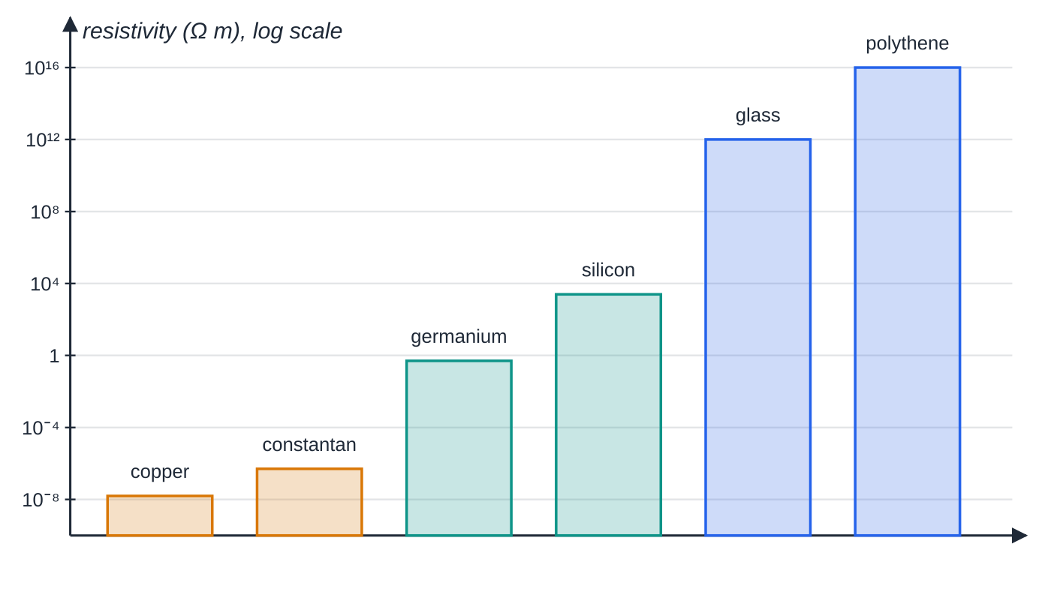
Why do metals, semiconductors and insulators have such different resistivities? (continued)
Section 6 of 11
Approximate resistivities at room temperature on a logarithmic scale: metals (amber), semiconductors (teal), insulators (blue). Copper and polythene differ by a factor of about 10²⁴, mostly because of the difference in the number density of free charge carriers.
Notes:
Why do metals, semiconductors and insulators have such different resistivities?. Full notes: https://examinerprep.com/notes/edexcel-ial-physics/current-potential-difference-and-resistance/

Slide 29
Why do metals, semiconductors and insulators have such different resistivities? (continued)
Section 6 of 11 · Worked example 7 · Hard · Explain
WORKED EXAMPLE · QUESTION
A rectangular semiconductor sample is 4.0 mm wide and 0.50 mm thick, and carries a current of 15 mA. The number density of charge carriers in it is 2.0 ×10²² m⁻³, each with charge 1.60 ×10⁻¹⁹ C. For copper, n = 8.5 ×10²⁸ m⁻³. (a) Calculate the drift velocity in the sample. (b) Calculate the drift velocity in a copper strip of the same cross-section carrying the same current. (c) Explain what the comparison shows.
SOLUTION
Area: A = 4.0 ×10⁻³ ×0.50 ×10⁻³ = 2.0 ×10⁻⁶ m².
(a) v = I/nqA = 0.015 ÷(2.0 ×10²² ×1.60 ×10⁻¹⁹ ×2.0 ×10⁻⁶) = 2.3 m s⁻¹ (2.34 m s⁻¹).
(b) The same equation with copper's n: 5.5 × 10⁻⁷ m s⁻¹.
(c) The ratio 2.34 ÷5.51 ×10⁻⁷ = 4.25 ×10⁶ equals 8.5 ×10²⁸ ÷2.0 ×10²².
Notes:
Why do metals, semiconductors and insulators have such different resistivities?: Worked example 7. Full notes: https://examinerprep.com/notes/edexcel-ial-physics/current-potential-difference-and-resistance/

Slide 30
Why do metals, semiconductors and insulators have such different resistivities? (continued)
Section 6 of 11 · Worked example 7 · Hard · Explain (continued)
With millions of times fewer carriers, each must drift millions of times faster; driving them needs a far larger p.d., which is why the semiconductor's resistivity is so much greater.
Notes:
Why do metals, semiconductors and insulators have such different resistivities?: Worked example 7. Full notes: https://examinerprep.com/notes/edexcel-ial-physics/current-potential-difference-and-resistance/

Slide 31
Exam tips for 2.6
Section 7 of 11
Exam tip 1 — convert prefixes before substituting
mA → × 10⁻³, μA → × 10⁻⁶, kW → × 10³, minutes → × 60, mm² → × 10⁻⁶ m². A prefix slip loses credit just as surely as a physics error.
Exam tip 2 — state Ohm's law completely
"Current is directly proportional to potential difference" needs the condition "for a metallic conductor at constant temperature" (constant physical conditions). Writing V = IR alone is the definition of resistance, not the law.
Exam tip 3 — resistance from a graph is V/I at a point
Read a pair of values off the curve and divide. Only for a straight line through the origin does the gradient give the resistance (as 1/gradient on an I–V graph).
Notes:
Exam tips for 2.6. Full notes: https://examinerprep.com/notes/edexcel-ial-physics/current-potential-difference-and-resistance/

Slide 32
Exam tips for 2.6 (continued)
Section 7 of 11
Exam tip 4 — pick the power equation that fits the data
Same current through several components: compare with I²R. Same p.d. across them: compare with V²/R. Always use the p.d. across, and the current in, the component you are asking about.
Exam tip 5 — say what stays the same in an I = nqvA argument
Start with "the current is the same at every point in series" or "the material, so n, is the same", then deduce how v must change. Each link in the chain is a separate statement.
Notes:
Exam tips for 2.6. Full notes: https://examinerprep.com/notes/edexcel-ial-physics/current-potential-difference-and-resistance/

Slide 33
Common misconceptions
Section 8 of 11
Misconception | Why it is wrong | Correct idea
Current is used up as it passes through a lamp. | Charge is conserved; the current into the lamp equals the current out. | Energy is transferred from the charge carriers to the lamp; the charge carries on.
Electrons travel round a circuit at nearly the speed of light. | Drift velocities in metal wires are typically below 1 mm s⁻¹. | The electric field is established almost instantly, so all the electrons start drifting at once.
R = V/I is Ohm's law. | It applies to every component, ohmic or not. | R = V/I defines resistance; Ohm's law says R is constant for a metal at constant temperature.
Resistance is the gradient (or inverse gradient) of an I–V graph at a point. | For a curved graph the tangent gives neither V nor I at that point. | Resistance at a point = V/I for that point.
Conventional current shows the direction in which electrons move. | Electrons are negative, so they drift from − to + round the external circuit. | Conventional current is the direction positive charge would flow: + to −.
Notes:
Common misconceptions. Full notes: https://examinerprep.com/notes/edexcel-ial-physics/current-potential-difference-and-resistance/

Slide 34
Common misconceptions (continued)
Section 8 of 11
Misconception | Why it is wrong | Correct idea
A larger resistance always transfers more power. | On a fixed p.d., P = V²/R falls as R rises. | Larger R → more power only when the current is fixed (P = I²R).
Notes:
Common misconceptions. Full notes: https://examinerprep.com/notes/edexcel-ial-physics/current-potential-difference-and-resistance/

Slide 35
How this topic connects
Section 9 of 11
Unit 1 power and efficiency
P = W/t and the kilowatt-hour are the same ideas as before; P = VI is the electrical input power to motors, heaters and lamps whose efficiency you calculate.
7 Series and parallel circuits; 2.8 Resistivity and potential dividers
Conservation of charge (currents at a junction) and of energy (p.d.s round a loop) build directly on the definitions of current and p.d. here, and I–V graphs for lamps, diodes and thermistors extend the resistance section. R = ρl/A puts numbers on the material property explained by n.
10 Resistance, temperature and light
Thermistors and LDRs are explained by changes in n and in lattice vibrations, using I = nqvA.
Notes:
How this topic connects. Full notes: https://examinerprep.com/notes/edexcel-ial-physics/current-potential-difference-and-resistance/

Slide 36
Key equations
Section 10 of 11
Equation | Use | In the formulae list?
I = ΔQ/Δt | current as rate of flow of charge; I in A, Q in C, t in s | Yes
V = W/Q | p.d. as energy per unit charge; V in V, W in J | Yes
R = V/I | definition of resistance; R in Ω | Yes
P = VI and W = VIt | electrical power and energy; P in W | Yes
P = I²R and P = V²/R | power when the current or the p.d. is known | Yes
I = nqvA | current in terms of drift velocity; n in m⁻³, v in m s⁻¹, A in m² | Yes
N = Q/e | number of electrons in a charge | No — learn it (charge is quantised)
I ∝V at constant temperature | Ohm's law | No — learn the statement
1 kWh = 3.6 ×10⁶ J | energy unit conversion | No — learn it (1000 W × 3600 s)
Notes:
Key equations. Full notes: https://examinerprep.com/notes/edexcel-ial-physics/current-potential-difference-and-resistance/

Slide 37
Check your understanding
Section 11 of 11
1. Show that 1 V = 1 J C⁻¹ is the same as 1 W A⁻¹.
2. Use the current–time graph in the first section to find the mean current over the 8.0 s.
3. A 60 Ω resistor carries 0.20 A. Calculate the p.d. across it and the power it dissipates, two ways.
4. Explain why a lamp lights almost immediately when a switch is closed, even though the drift velocity is less than 1 mm s⁻¹.
5. Two wires of the same metal are joined in series. Wire B has half the diameter of wire A. Compare the currents and the drift velocities.
6. A 9.0 V battery drives 0.15 A through a lamp for 2.0 minutes. Calculate the energy transferred and the number of electrons that pass.
Notes:
Check your understanding: questions. Full notes: https://examinerprep.com/notes/edexcel-ial-physics/current-potential-difference-and-resistance/

Slide 38
Check your understanding · answers
Section 11 of 11
1. 1 W A⁻¹ = 1 J s⁻¹ ÷ 1 C s⁻¹ = 1 J C⁻¹. (This is V = P/I from P = VI.)
2. Charge = area = 2.4 C; mean current = 2.4 ÷8.0 = 0.30 A.
3. V = IR = 12 V; P = VI = 12 ×0.20 = 2.4 W, and I²R = 0.20² ×60 = 2.4 W.
4. Closing the switch sets up an electric field throughout the circuit almost instantly. Free electrons are already present everywhere in the wires and the lamp filament, so they all start drifting at once, including those already in the filament.
5. The currents are equal (series). B's area is one quarter of A's, and n and q are the same, so the drift velocity in B is 4 times that in A.
6. W = VIt = 9.0 ×0.15 ×120 = 162 J. Q = It = 18 C, so N = 18 ÷1.60 ×10⁻¹⁹ = 1.1 × 10²⁰ electrons.
Notes:
Check your understanding: answers. Full notes: https://examinerprep.com/notes/edexcel-ial-physics/current-potential-difference-and-resistance/

Slide 39
Practice questions
5 original exam-style questions. Answers at the end of the deck.

Slide 40
Question 1
1 mark
Which of the following is a statement of Ohm's law?
A For a metallic conductor at constant temperature, the current is directly proportional to the potential difference across it.
B For any electrical component, the resistance equals the potential difference divided by the current.
C For any electrical component, the current is inversely proportional to its resistance.
D For a metallic conductor, the resistance increases in proportion to the current.
Notes:
Online with the full mark scheme: https://examinerprep.com/ial-physics-2-6-current-potential-difference-and-resistance-questions#IALP-U2-6-A-06

Slide 41
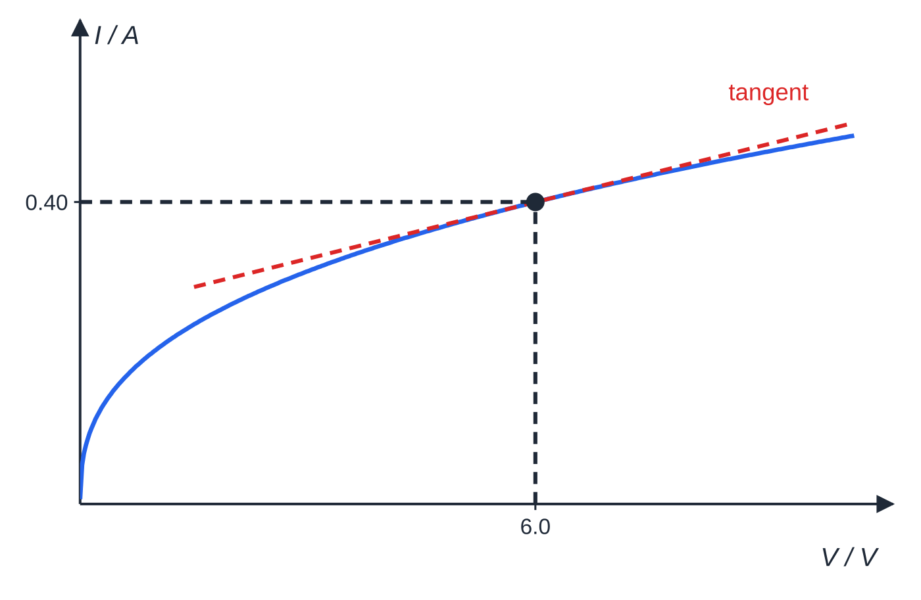
Question 2
1 mark
The current–potential difference graph for a component is a curve. At a p.d. of 6.0 V the current is 0.40 A, and the gradient of the tangent to the curve at this point is 0.025 A V⁻¹.
What is the resistance of the component at 6.0 V?
Figure: I–V graph for the component with the tangent drawn at 6.0 V (not to scale)
A 0.067 Ω
B 2.4 Ω
C 15 Ω
D 40 Ω
Notes:
Online with the full mark scheme: https://examinerprep.com/ial-physics-2-6-current-potential-difference-and-resistance-questions#IALP-U2-6-A-07

Slide 42
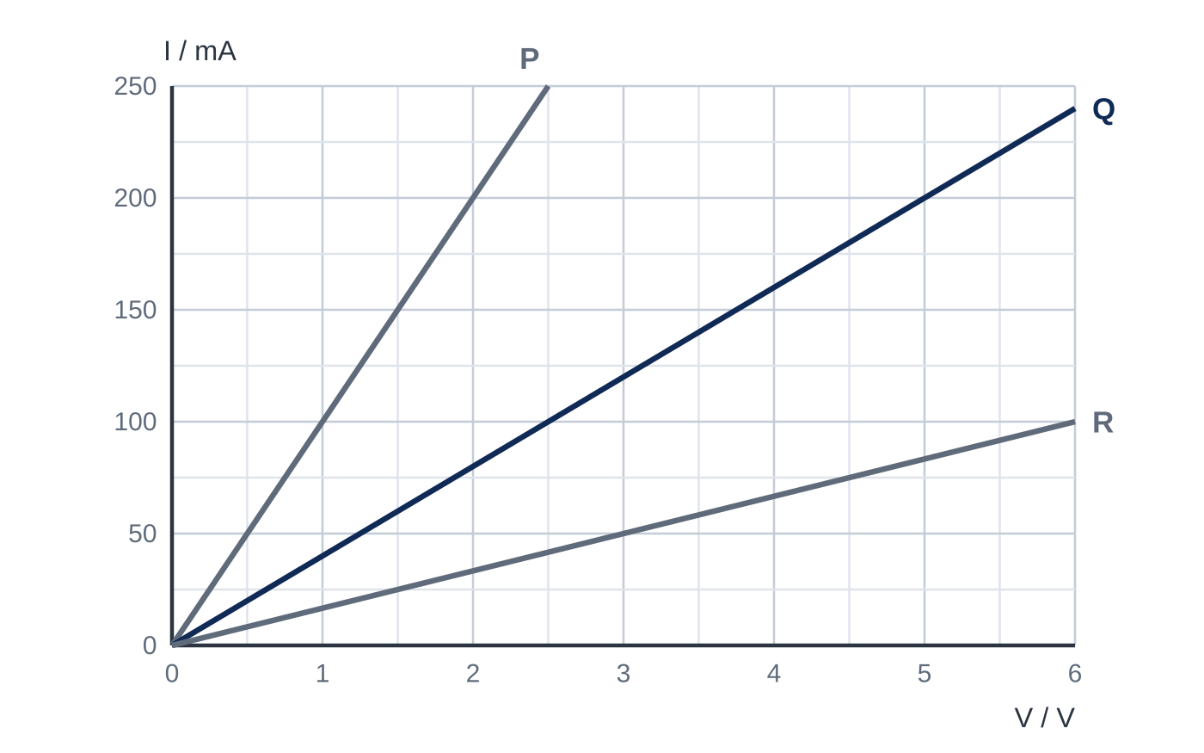
Question 3
1 mark
The graph shows how the current I in each of three conductors P, Q and R depends on the potential difference V across it. The current is in milliamperes.
What is the resistance of Q?
A 0.025 Ω
B 0.040 Ω
C 25 Ω
D 40 Ω
Notes:
Online with the full mark scheme: https://examinerprep.com/ial-physics-2-6-current-potential-difference-and-resistance-questions#IALP-U2-6-FA-05

Slide 43
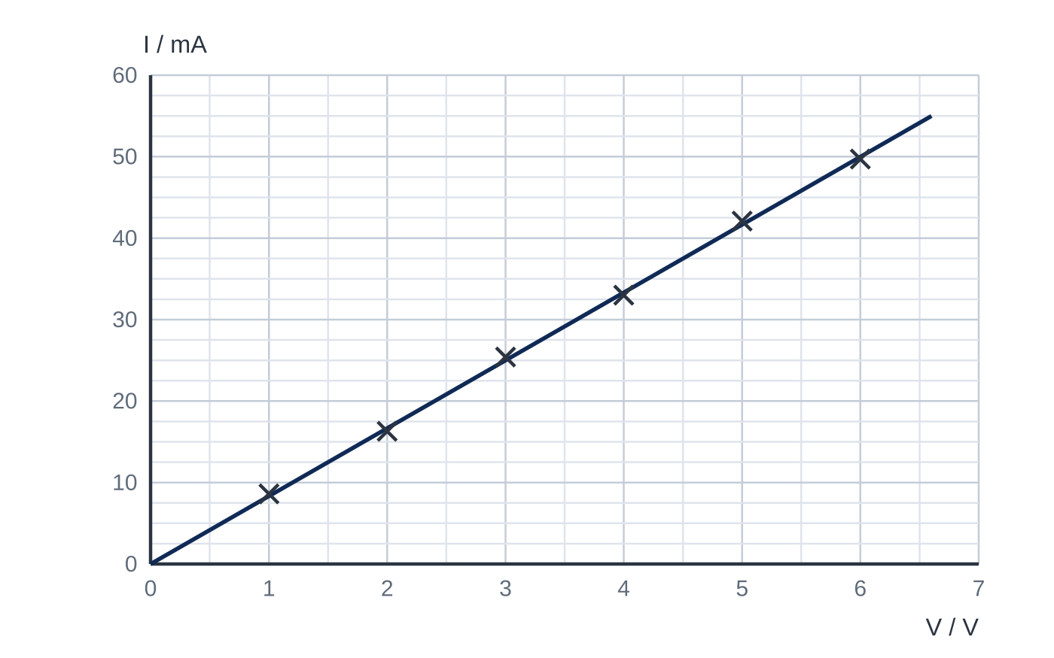
Question 4
6 marks
A student measures the current I in a carbon resistor for different values of the potential difference V across it, keeping the current small. The graph shows her results and her line of best fit.
(a) Explain how the graph shows that the resistor obeys Ohm's law. [2]
(b) Use the graph to determine the resistance of the resistor. [3]
(c) The resistor is replaced by one of resistance 240 Ω. State the current in it when the p.d. across it is 6.0 V. [1]
Notes:
Online with the full mark scheme: https://examinerprep.com/ial-physics-2-6-current-potential-difference-and-resistance-questions#IALP-U2-6-FB-02

Slide 44
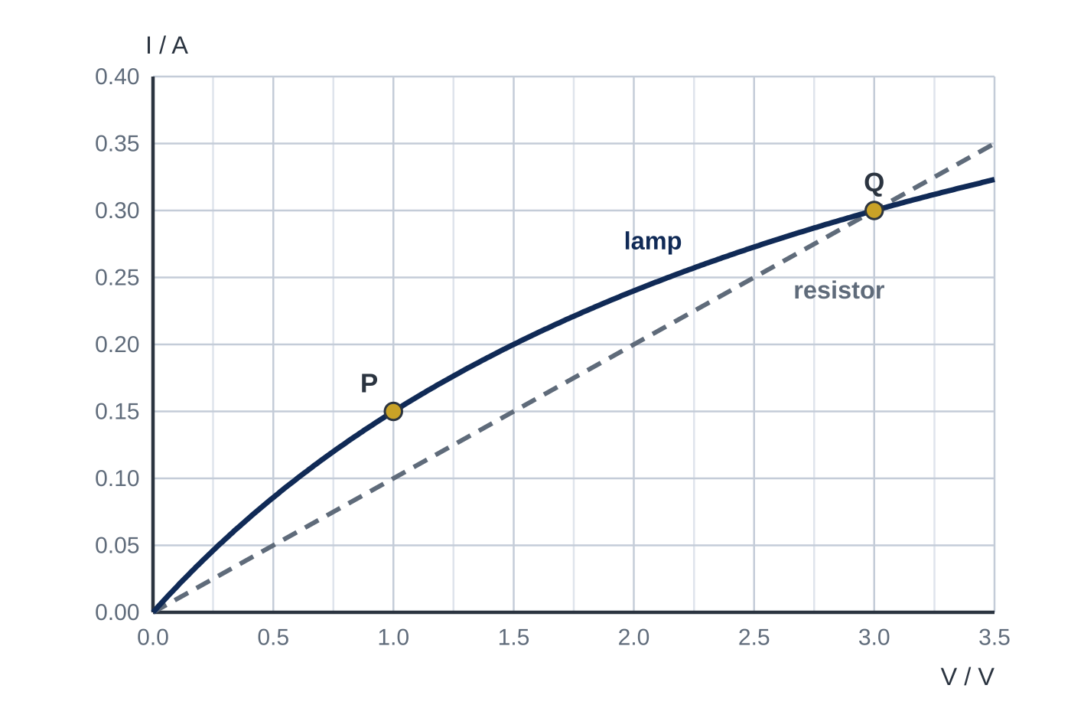
Question 5
7 marks
The graph shows the current–potential difference characteristics of a small torch lamp and of a fixed resistor.
(a) Calculate the resistance of the lamp at point P. [1]
(b) State the p.d. at which the lamp and the resistor have the same resistance, and give the value of this resistance. [2]
(c) The p.d. across each component is 1.0 V. Calculate the ratio power dissipated in the lamp ÷ power dissipated in the resistor. [2]
(d) Explain why the lamp does not obey Ohm's law. [2]
Notes:
Online with the full mark scheme: https://examinerprep.com/ial-physics-2-6-current-potential-difference-and-resistance-questions#IALP-U2-6-FB-03

Slide 45
Answers

Slide 46
Question 1 · answer
Answer A
A. Ohm's law is the special case in which I ∝ V, which holds for a metal only if its temperature (and other physical conditions) stay constant. Statement B is the definition of resistance, which applies to every component.
Notes:
Full mark scheme: https://examinerprep.com/ial-physics-2-6-current-potential-difference-and-resistance-questions#IALP-U2-6-A-06

Slide 47
Question 2 · answer
Answer C
Resistance is defined by R = V/I at the operating point: 6.0 ÷ 0.40 = 15 Ω. The tangent gradient does not give the resistance for a curved graph.
Notes:
Full mark scheme: https://examinerprep.com/ial-physics-2-6-current-potential-difference-and-resistance-questions#IALP-U2-6-A-07

Slide 48
Question 3 · answer
Answer C
Q passes through (5.0 V, 200 mA). R = V/I = 5.0 ÷ 0.200 = 25 Ω.
Notes:
Full mark scheme: https://examinerprep.com/ial-physics-2-6-current-potential-difference-and-resistance-questions#IALP-U2-6-FA-05

Slide 49
Question 4 · answer
Mark scheme
the best-fit line is straight
and passes through the origin, so I is directly proportional to V
uses a large triangle on the line, e.g. 50 mA at 6.0 V
gradient = 0.050 ÷ 6.0 = 8.3 × 10⁻³ A V⁻¹ (or R = V/I = 6.0 ÷ 0.050)
R = 1/gradient = 120 Ω (allow 115–125 Ω)
25 mA (0.025 A)
Notes:
Full mark scheme: https://examinerprep.com/ial-physics-2-6-current-potential-difference-and-resistance-questions#IALP-U2-6-FB-02

Slide 50
Question 5 · answer
Mark scheme
R = V/I = 1.0 ÷ 0.15 = 6.7 Ω (6.67 Ω)
3.0 V, where the graphs cross at Q
R = 3.0 ÷ 0.30 = 10 Ω
current in resistor at 1.0 V = 0.10 A (from graph or 1.0 ÷ 10)
ratio = (1.0 × 0.15) ÷ (1.0 × 0.10) = 1.5
the graph is a curve / V/I changes (from 6.7 Ω to 10 Ω), so I is not proportional to V
the filament gets hotter as the current increases, so its temperature is not constant
Notes:
Full mark scheme: https://examinerprep.com/ial-physics-2-6-current-potential-difference-and-resistance-questions#IALP-U2-6-FB-03

Slide 51
Keep practising
Notes for this topic
Questions on this topic
Build a printable test
ExaminerPrep is an independent tutoring service. It has been developed independently from and is not endorsed by the International Baccalaureate Organization. "International Baccalaureate", "IB" and "IB Diploma Programme" are registered trademarks of the IBO, used here for descriptive purposes only.
Pearson Edexcel and Cambridge are trademarks of their owners; ExaminerPrep is not affiliated with any exam board.

