Slide 1
EP
EDEXCEL IAL PHYSICS
1.7 Density, upthrust and viscous drag
The full notes page in 12 sections · practice questions with answers · simulations
ExaminerPrep is an independent tutoring service. It has been developed independently from and is not endorsed by the International Baccalaureate Organization. "International Baccalaureate", "IB" and "IB Diploma Programme" are registered trademarks of the IBO, used here for descriptive purposes only.
Pearson Edexcel and Cambridge are trademarks of their owners; ExaminerPrep is not affiliated with any exam board.
Notes:
1.7 Density, upthrust and viscous drag. Notes for this topic: https://examinerprep.com/notes/edexcel-ial-physics/density-upthrust-and-viscous-drag/

Slide 2
What this page covers
Overview
Density, ρ= m/V, and how to measure it for regular and irregular solids and for liquids
Upthrust as the weight of fluid displaced, and why it exists
Floating and sinking, and the fraction of a floating body below the surface
Hydrometers and hot-air balloons
Viscosity, laminar and turbulent flow, and how viscosity depends on temperature
Stokes' law, F = 6πηrv, and when it can be used
Terminal velocity of a sphere in a liquid: weight = upthrust + viscous drag
Core Practical 2: measuring viscosity by the falling-ball method
Notes:
What this page covers. Full notes: https://examinerprep.com/notes/edexcel-ial-physics/density-upthrust-and-viscous-drag/

Slide 3
In one minute
Key points
1. A fluid exerts two forces on a body inside it, upthrust (always up, equal to the weight of fluid displaced) and viscous drag (opposing motion), and with the weight these explain floating, balloons and terminal velocity in a liquid.
2. Density ρ= m/V, in kg m⁻³; 1 g cm⁻³ = 1000 kg m⁻³.
3. Upthrust = weight of fluid displaced = ρ_fluidV_displaced g. It exists because fluid pressure increases with depth.
4. A body floats when upthrust = weight; the fraction submerged is ρ_body/ρ_fluid.
5. Stokes' law F = 6πηrv gives the drag on a small sphere moving slowly in laminar flow. The viscosity η (Pa s) of a liquid falls steeply as it warms.
6. At terminal velocity in a liquid W = U + F, which gives v = 2r²g(ρₛ - ρ_f)/9η; Core Practical 2 finds η from the gradient of v against r².
Notes:
In one minute. Full notes: https://examinerprep.com/notes/edexcel-ial-physics/density-upthrust-and-viscous-drag/

Slide 4
What is density, and how do you measure it?
Section 1 of 12
Density is the mass per unit volume of a substance: ρ= m/V, with ρ in kg m⁻³, m in kg and V in m³.
Because 1 cm³ = 10⁻⁶ m³ and 1 g = 10⁻³ kg, 1 g cm⁻³ = 10⁻³ ÷ 10⁻⁶ = 1000 kg m⁻³. One litre is 1000 cm³ = 10⁻³ m³.
Substance | Typical density / kg m⁻³ | Substance | Typical density / kg m⁻³
air (room temperature) | 1.2 | glycerol | 1260
pine wood | about 550 | aluminium | 2700
ice | 917 | steel | 7800
fresh water | 1000 | lead | 11 300
sea water | about 1030 | gold | 19 300
Notes:
What is density, and how do you measure it?. Full notes: https://examinerprep.com/notes/edexcel-ial-physics/density-upthrust-and-viscous-drag/

Slide 5
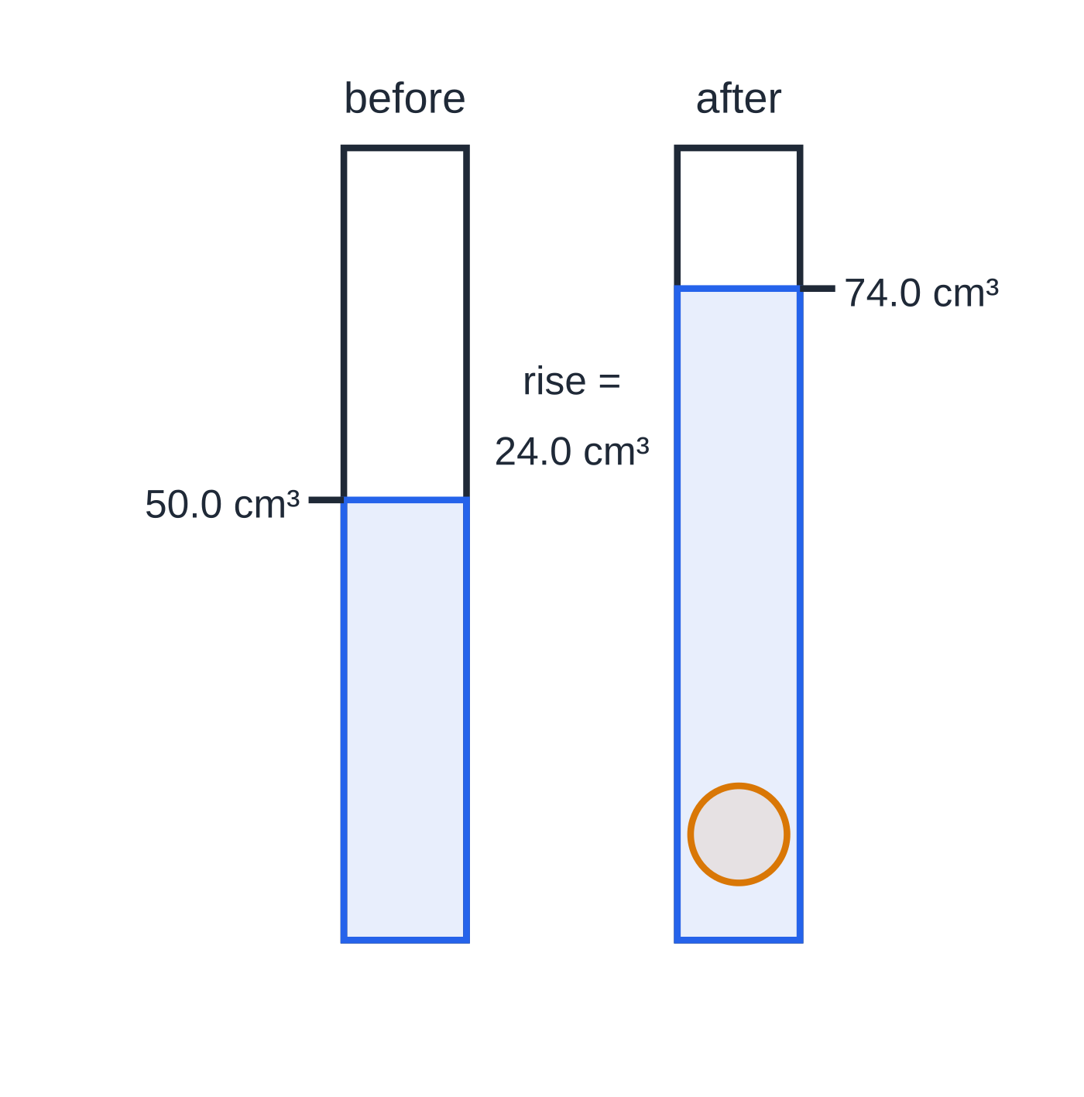
What is density, and how do you measure it? (continued)
Section 1 of 12
Measuring density
Regular solid: mass on a top-pan balance; dimensions with a ruler, vernier calipers or a micrometer; then calculate the volume (cuboid lwh, sphere (4/3)πr³, cylinder πr²h).
Irregular solid: find the volume by displacement. Lower it into water in a measuring cylinder and record the rise in level, or use a displacement (eureka) can and collect the overflow.
Liquid: weigh an empty measuring cylinder, add a measured volume of liquid, weigh again; the difference is the mass of the liquid.
Read a measuring cylinder at eye level, from the bottom of the meniscus, to avoid parallax.
Measuring the volume of an irregular solid by displacement (worked example 1). The rise in water level, 74.0 − 50.0 = 24.0 cm³, is the volume of the pebble.
Notes:
What is density, and how do you measure it?. Full notes: https://examinerprep.com/notes/edexcel-ial-physics/density-upthrust-and-viscous-drag/

Slide 6
What is density, and how do you measure it? (continued)
Section 1 of 12 · Worked example 1 · Easy · Calculate
WORKED EXAMPLE · QUESTION
A pebble of mass 64.8 g is lowered into a measuring cylinder containing water. The water level rises from 50.0 cm³ to 74.0 cm³. Calculate the density of the pebble in kg m⁻³.
SOLUTION
Volume of pebble = volume of water displaced: V = 74.0 - 50.0 = 24.0 cm³ = 24.0×10⁻⁶ m³. Mass: m = 64.8×10⁻³ kg.
ρ= m/V = 64.8×10⁻³ ÷24.0×10⁻⁶ → ρ = 2.70 × 10³ kg m⁻³.
Quick check: 64.8 ÷24.0 = 2.70 g cm⁻³, and × 1000 gives the same answer.
Notes:
What is density, and how do you measure it?: Worked example 1. Full notes: https://examinerprep.com/notes/edexcel-ial-physics/density-upthrust-and-viscous-drag/

Slide 7
What is density, and how do you measure it? (continued)
Section 1 of 12
Common error
Converting cm³ to m³ by dividing by 100. A cube 1 m across is 100 cm × 100 cm × 100 cm, so 1 m³ = 10⁶ cm³. A density that comes out a thousand times too big or too small usually means this step went wrong.
Notes:
What is density, and how do you measure it?. Full notes: https://examinerprep.com/notes/edexcel-ial-physics/density-upthrust-and-viscous-drag/

Slide 8
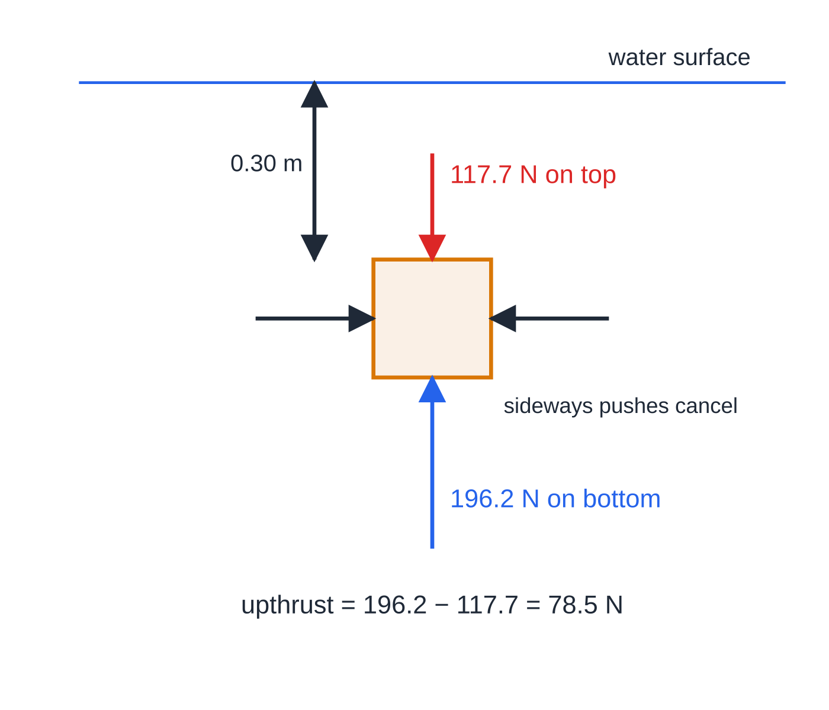
What is upthrust, and why does it exist?
Section 2 of 12
Upthrust is the upward force a fluid exerts on a body wholly or partly immersed in it. It is equal to the weight of the fluid the body displaces.
A fluid (liquid or gas) pushes on every surface in contact with it, at right angles to the surface. The pressure in a fluid increases with depth, because there is more fluid above pushing down. So the bottom of an immersed body is pushed up harder than its top is pushed down. The sideways pushes at each depth cancel. The resultant of all these pushes is the upthrust, acting vertically upwards.
The upthrust does not depend on what the body is made of, only on the volume it displaces and the density of the fluid.
A 0.20 m cube with its top 0.30 m under water. The water pushes 196.2 N up on the bottom and 117.7 N down on the top; the difference, 78.5 N, is the weight of the 0.0080 m³ of water displaced.
Notes:
What is upthrust, and why does it exist?. Full notes: https://examinerprep.com/notes/edexcel-ial-physics/density-upthrust-and-viscous-drag/

Slide 9
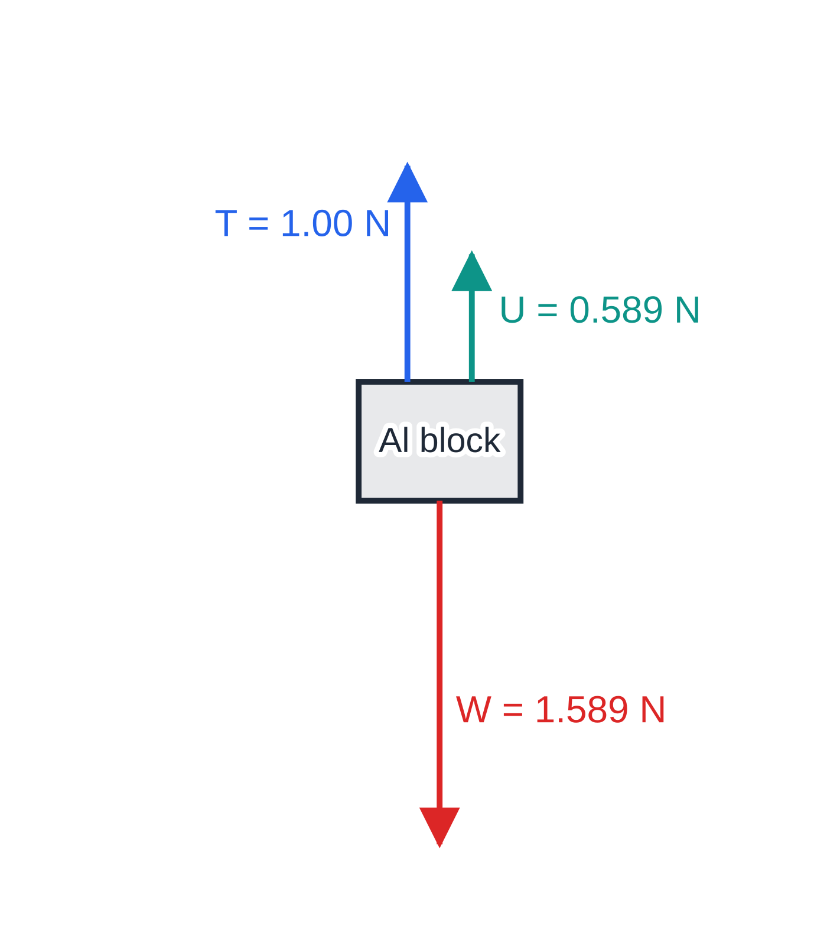
What is upthrust, and why does it exist? (continued)
Section 2 of 12
That is why it equals the weight of the fluid displaced: the same pushes would exactly hold up a "body" made of the fluid itself, which simply sits in equilibrium.
U = ρ_fluid V_displaced g
U = upthrust (N), ρ_fluid = density of the fluid (kg m⁻³), V_displaced = volume of fluid pushed aside (m³), g = 9.81 N kg⁻¹. "Upthrust = weight of fluid displaced" is in the formulae list; writing it as ρVg is up to you.
For a fully submerged body V_displaced is the whole volume of the body. For a floating body it is only the volume below the surface.
Free-body diagram of the submerged aluminium block in worked example 2, drawn to scale. The newton-meter tension and the upthrust together balance the unchanged weight.
Notes:
What is upthrust, and why does it exist?. Full notes: https://examinerprep.com/notes/edexcel-ial-physics/density-upthrust-and-viscous-drag/

Slide 10
What is upthrust, and why does it exist? (continued)
Section 2 of 12 · Worked example 2 · Medium · Calculate
WORKED EXAMPLE · QUESTION
An aluminium block measures 5.0 cm × 4.0 cm × 3.0 cm. It hangs from a newton-meter and is lowered until it is completely under water. Density of aluminium = 2700 kg m⁻³; density of water = 1000 kg m⁻³. Calculate the reading on the newton-meter when the block is fully submerged.
SOLUTION
Volume: V = 5.0×4.0×3.0 = 60 cm³ = 6.0×10⁻⁵ m³.
Weight: W = ρVg = 2700×6.0×10⁻⁵×9.81 = 1.589 N. Upthrust = weight of water displaced: U = 1000×6.0×10⁻⁵×9.81 = 0.589 N.
Equilibrium, so the newton-meter supplies the rest: T = W - U → T = 1.00 N.
The block's weight has not changed; the newton-meter reads less because the water now carries part of the weight.
Notes:
What is upthrust, and why does it exist?: Worked example 2. Full notes: https://examinerprep.com/notes/edexcel-ial-physics/density-upthrust-and-viscous-drag/

Slide 11
Why do some objects float?
Section 3 of 12
When a body is released in a fluid, compare its weight W with the upthrust U_(max) it would feel if fully submerged:
U_(max) > W: it rises, and floats with part of it above the surface.
U_(max) = W: it stays wherever it is put, like a submarine trimmed for neutral buoyancy.
U_(max) < W: it sinks.
Both forces depend on the same volume, so this is the same as comparing densities: a body floats if its average density is less than the fluid's. A steel ship floats because its average density, steel plus the air inside the hull, is less than that of water.
A floating body is in equilibrium, U = W. It sinks just far enough to displace its own weight of fluid. Setting ρ_fluidV_subg = ρ_bodyVg and cancelling g gives the fraction submerged:
V_sub/V = ρ_body/ρ_fluid
Notes:
Why do some objects float?. Full notes: https://examinerprep.com/notes/edexcel-ial-physics/density-upthrust-and-viscous-drag/

Slide 12
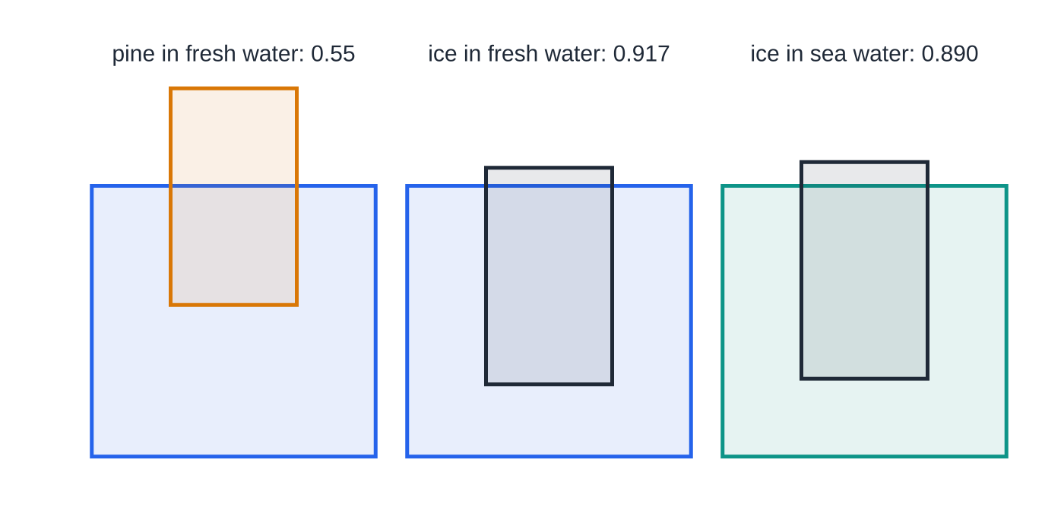
Why do some objects float? (continued)
Section 3 of 12
Blocks of equal height, with depths drawn from the flotation condition: fraction submerged = ρ(body)/ρ(fluid). Ice floats lower than pine, and slightly higher in denser sea water.
Notes:
Why do some objects float?. Full notes: https://examinerprep.com/notes/edexcel-ial-physics/density-upthrust-and-viscous-drag/

Slide 13
Why do some objects float? (continued)
Section 3 of 12 · Worked example 3 · Medium · Calculate
WORKED EXAMPLE · QUESTION
A cylindrical navigation buoy has a mass of 85 kg and a radius of 0.30 m. It floats upright in sea water of density 1030 kg m⁻³. (a) Calculate the depth of the buoy below the surface. (b) Calculate the extra mass that must be attached on top so that its base is 0.50 m below the surface.
SOLUTION
(a) Floating, so weight of sea water displaced = weight of buoy, and g cancels: ρ(πr²h) = m, so h = 85 ÷(1030×π×0.30²) = 85 ÷(1030×0.283) = 0.292 m → h = 0.29 m.
(b) Mass of sea water displaced at 0.50 m depth: 1030×0.283×0.50 = 145.6 kg. This must equal the total floating mass, so the extra mass = 145.6 - 85 = 60.6 kg → 61 kg.
Notes:
Why do some objects float?: Worked example 3. Full notes: https://examinerprep.com/notes/edexcel-ial-physics/density-upthrust-and-viscous-drag/

Slide 14
Why do some objects float? (continued)
Section 3 of 12
Exam tip
For any floating body, start by writing "floating, so upthrust = weight". Then write each side as ρVg and cancel g. Make sure the volume on the upthrust side is only the part below the surface.
Notes:
Why do some objects float?. Full notes: https://examinerprep.com/notes/edexcel-ial-physics/density-upthrust-and-viscous-drag/

Slide 15
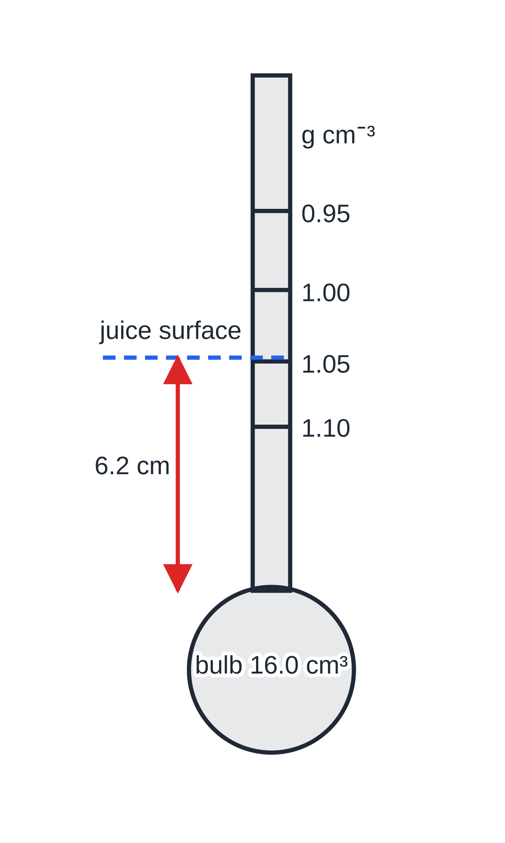
How do hydrometers and hot-air balloons use upthrust?
Section 4 of 12
The hydrometer
A hydrometer is a sealed glass float: a weighted bulb with a narrow, uniform stem marked with a density scale. Its weight is fixed, so it always floats with the same weight of liquid displaced. In a denser liquid a smaller volume is enough, so it floats higher. The density is read where the liquid surface crosses the stem, which means higher densities are marked lower down the stem.
The scale is not uniform. Each equal step in density needs a smaller change of submerged volume at higher densities, so the marks crowd together towards the bulb. A narrow stem makes it sensitive.
A 20.0 g hydrometer with a 16.0 cm³ bulb and a stem of cross-section 0.50 cm². The stem length below the surface is (20.0/ρ − 16.0) ÷ 0.50 cm, with ρ in g cm⁻³. The scale marks are 2.1 cm, 1.9 cm and 1.7 cm apart going down the stem.
Notes:
How do hydrometers and hot-air balloons use upthrust?. Full notes: https://examinerprep.com/notes/edexcel-ial-physics/density-upthrust-and-viscous-drag/

Slide 16
How do hydrometers and hot-air balloons use upthrust? (continued)
Section 4 of 12 · Worked example 4 · Medium · Calculate
WORKED EXAMPLE · QUESTION
The hydrometer in the figure is placed in a sample of fruit juice. It floats with 6.2 cm of its stem below the surface. Calculate the density of the juice in kg m⁻³.
SOLUTION
Volume of juice displaced = bulb + submerged part of the stem: V = 16.0 + 0.50×6.2 = 19.1 cm³.
Floating, so mass of juice displaced = mass of hydrometer: ρ= 20.0 ÷19.1 = 1.047 g cm⁻³ → ρ = 1.05 × 10³ kg m⁻³.
Notes:
How do hydrometers and hot-air balloons use upthrust?: Worked example 4. Full notes: https://examinerprep.com/notes/edexcel-ial-physics/density-upthrust-and-viscous-drag/

Slide 17
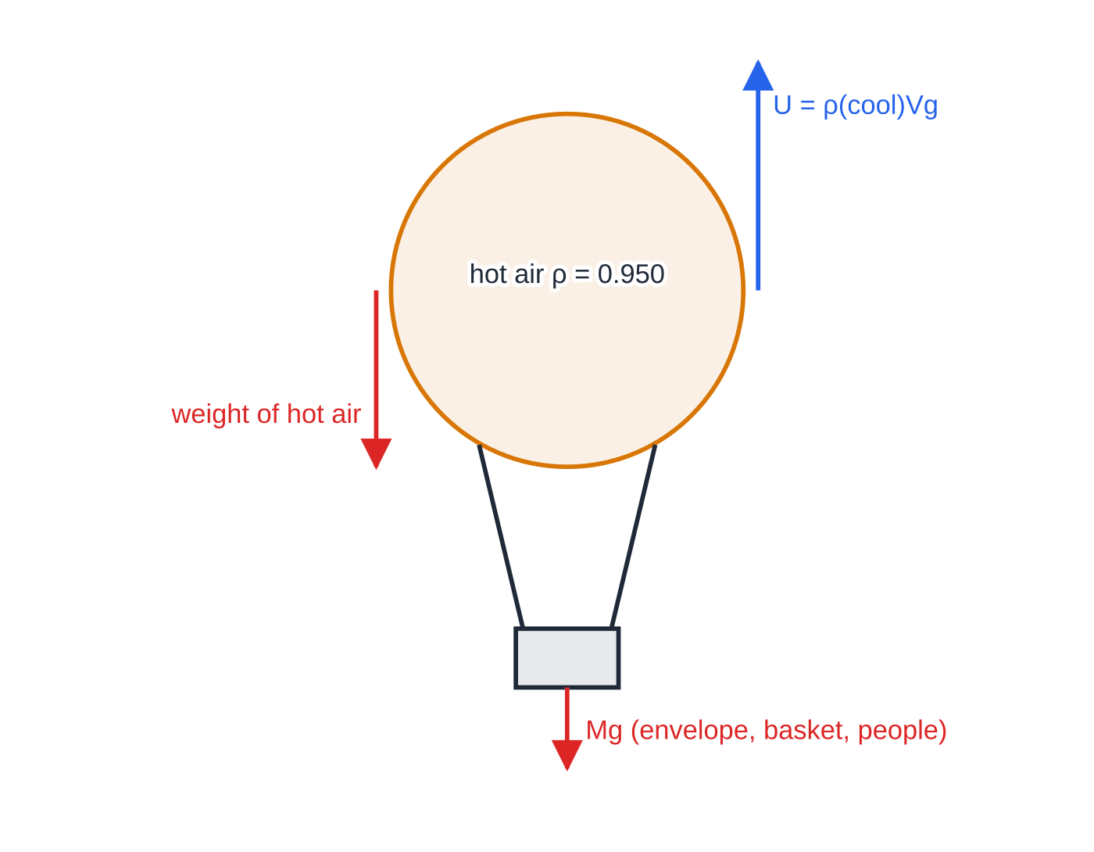
How do hydrometers and hot-air balloons use upthrust? (continued)
Section 4 of 12
The hot-air balloon
The envelope displaces its own volume of the cool outside air, so the upthrust is ρ_coolVg. Heating the air inside makes it expand; some leaves through the open bottom, so the air left inside is less dense and weighs ρₕₒₜVg. The balloon rises when the upthrust is greater than the total weight: hot air + envelope + basket + burner + people.
The useful lift per cubic metre is (ρ_cool - ρₕₒₜ)g, only a few newtons, which is why envelopes are so large. On a hot day, or at altitude, the possible load is smaller.
Forces on a hot-air balloon (not to scale). Lift-off needs the upthrust to exceed the weight of the hot air plus everything else.
Notes:
How do hydrometers and hot-air balloons use upthrust?. Full notes: https://examinerprep.com/notes/edexcel-ial-physics/density-upthrust-and-viscous-drag/

Slide 18
How do hydrometers and hot-air balloons use upthrust? (continued)
Section 4 of 12 · Worked example 5 · Medium · Calculate
WORKED EXAMPLE · QUESTION
A balloon envelope holds 2800 m³ of air. The outside air has a density of 1.20 kg m⁻³ and the hot air inside has a density of 0.950 kg m⁻³. Calculate (a) the upthrust on the balloon and (b) the maximum total mass of envelope, basket, burner and passengers for the balloon to lift off. Ignore the volume of everything except the envelope.
SOLUTION
(a) Upthrust = weight of cool air displaced: U = 1.20×2800×9.81 = 32 962 N → U = 3.30 × 10⁴ N.
(b) Weight of the hot air: 0.950×2800×9.81 = 26 095 N. Lift-off when U ≥ weight of hot air + Mg: M = (32 962 - 26 095)÷9.81 → M = 700 kg.
Shortcut: M = (ρ_cool - ρₕₒₜ)V = (1.20 - 0.950)×2800 = 700 kg.
Notes:
How do hydrometers and hot-air balloons use upthrust?: Worked example 5. Full notes: https://examinerprep.com/notes/edexcel-ial-physics/density-upthrust-and-viscous-drag/

Slide 19
How do hydrometers and hot-air balloons use upthrust? (continued)
Section 4 of 12
Common error
Forgetting the weight of the hot air. The upthrust comes from the cool air displaced, but the balloon must also carry the hot air inside it. Using U alone would suggest a load of 3360 kg, almost five times too big.
Notes:
How do hydrometers and hot-air balloons use upthrust?. Full notes: https://examinerprep.com/notes/edexcel-ial-physics/density-upthrust-and-viscous-drag/

Slide 20
What is viscosity, and what is Stokes' law?
Section 5 of 12
Viscosity is a measure of a fluid's resistance to flow, how "thick" it is. Treacle and glycerol have high viscosity; water and air have low viscosity. When a body moves through a fluid, the fluid next to its surface moves with it and drags on the layers beyond. The result is a viscous drag force opposing the motion.
The coefficient of viscosity η (eta) has the unit Pa s (equivalently N s m⁻² or kg m⁻¹ s⁻¹). Typical values at 20 °C: air 1.8 × 10⁻⁵ Pa s, water 1.0 × 10⁻³ Pa s, glycerol about 1.4 Pa s.
Laminar and turbulent flow
 | Laminar (streamline) flow | Turbulent flow
Description | the fluid moves in smooth layers that slide past one another; streamlines never cross | the fluid swirls in eddies; the layers mix and the velocity at a point changes irregularly
Velocity at a fixed point | constant in time | changes randomly in size and direction
Notes:
What is viscosity, and what is Stokes' law?. Full notes: https://examinerprep.com/notes/edexcel-ial-physics/density-upthrust-and-viscous-drag/

Slide 21
What is viscosity, and what is Stokes' law? (continued)
Section 5 of 12
 | Laminar (streamline) flow | Turbulent flow
When it happens | low speeds, small bodies, viscous fluids, streamlined shapes | high speeds, large bodies, low-viscosity fluids, blunt shapes
Drag | relatively small; proportional to speed | much larger; grows faster than speed
Notes:
What is viscosity, and what is Stokes' law?. Full notes: https://examinerprep.com/notes/edexcel-ial-physics/density-upthrust-and-viscous-drag/

Slide 22
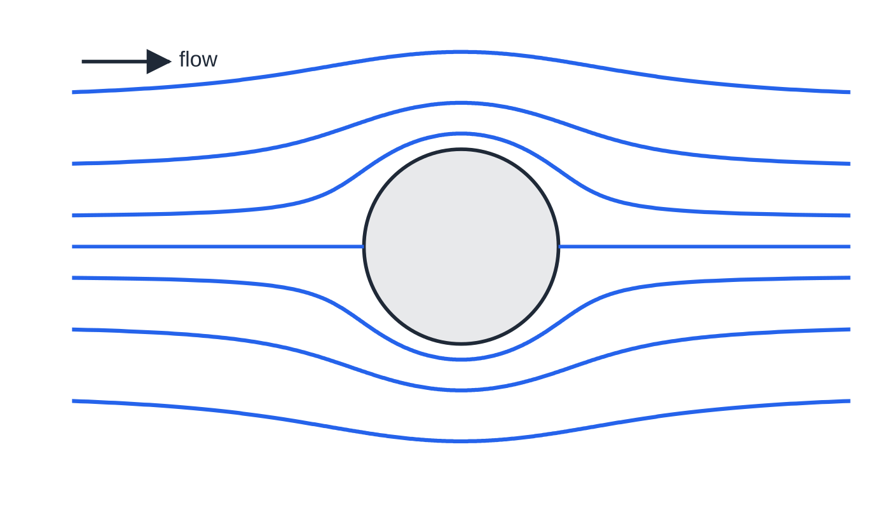
What is viscosity, and what is Stokes' law? (continued)
Section 5 of 12
Laminar flow past a sphere (sketch): smooth streamlines, symmetrical front to back, that never cross.
Notes:
What is viscosity, and what is Stokes' law?. Full notes: https://examinerprep.com/notes/edexcel-ial-physics/density-upthrust-and-viscous-drag/

Slide 23
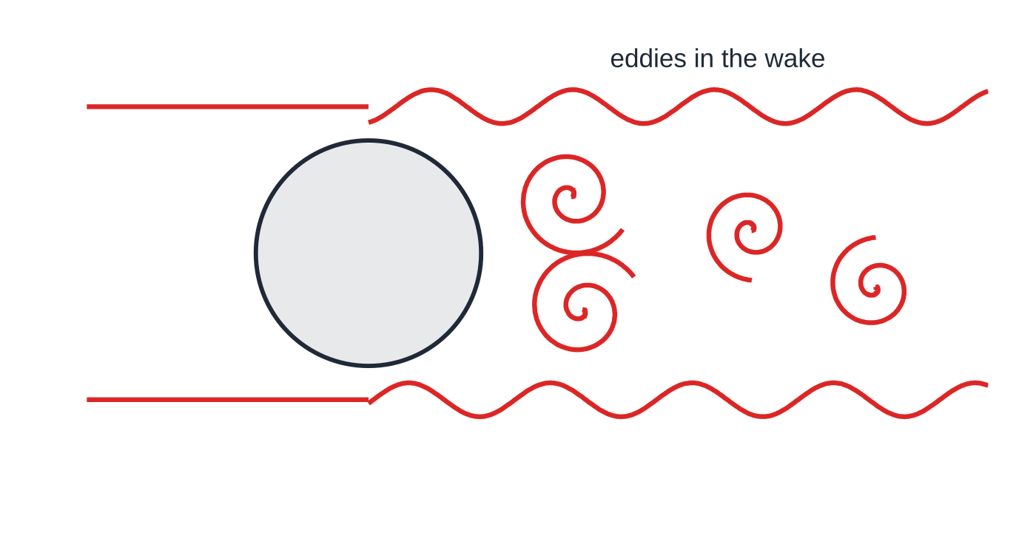
What is viscosity, and what is Stokes' law? (continued)
Section 5 of 12
Stokes' law (viscous drag on a sphere): F = 6πηrv
F = viscous drag (N), η = viscosity of the fluid (Pa s), r = radius of the sphere (m), v = speed of the sphere relative to the fluid (m s⁻¹). Valid only for a small sphere moving at low speed so that the flow is laminar, in a fluid that extends far from the sphere (well away from the container walls). Use the radius, not the diameter.
Turbulent flow at higher speed (sketch only): the flow separates and forms eddies, and the drag is much larger than Stokes' law predicts.
Notes:
What is viscosity, and what is Stokes' law?. Full notes: https://examinerprep.com/notes/edexcel-ial-physics/density-upthrust-and-viscous-drag/

Slide 24
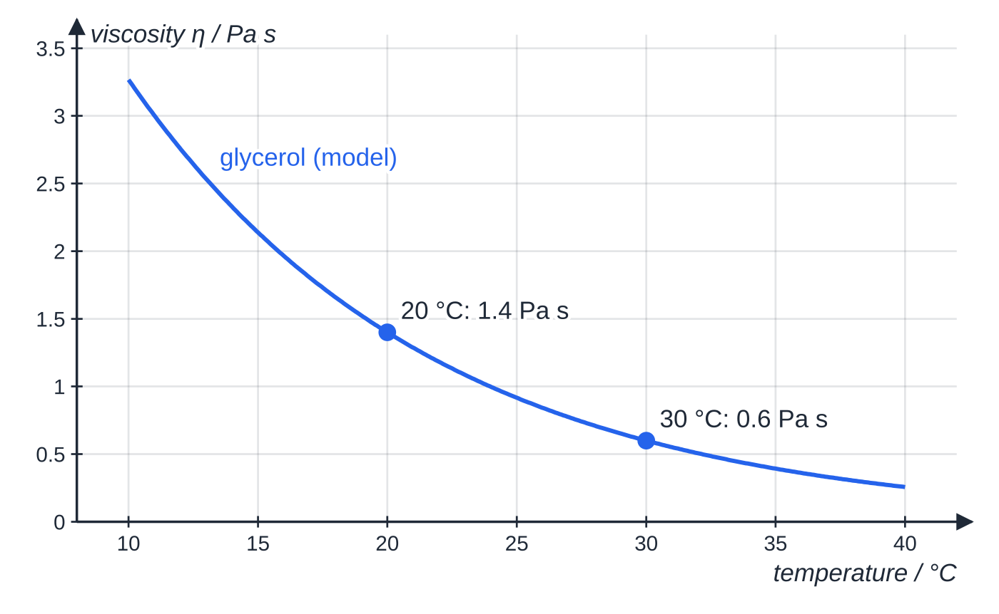
What is viscosity, and what is Stokes' law? (continued)
Section 5 of 12
Viscosity depends on temperature
For liquids, viscosity decreases sharply as the temperature rises: glycerol is about 1.4 Pa s at 20 °C but only about 0.6 Pa s at 30 °C. (Gas viscosity rises slowly with temperature.) So any viscosity value must be quoted with its temperature, and in an experiment the temperature must be measured and kept constant.
An exponential model through the two glycerol values quoted above. A 10 °C rise more than halves the viscosity, which is why the temperature must be controlled in Core Practical 2.
Notes:
What is viscosity, and what is Stokes' law?. Full notes: https://examinerprep.com/notes/edexcel-ial-physics/density-upthrust-and-viscous-drag/

Slide 25
How does a sphere reach terminal velocity in a liquid?
Section 6 of 12
Three forces act on a sphere falling through a liquid: weight W down, upthrust U up, and viscous drag F up, opposing the motion. W and U are constant, but F starts at zero and increases with speed. The resultant force W - U - F therefore shrinks as the sphere speeds up, so the acceleration falls. When F has grown until W = U + F, the resultant force is zero and the sphere moves at its terminal velocity.
With Stokes' law and V = (4/3)πr³:
(4/3)πr³ρₛ g = (4/3)πr³ρ_f g + 6πηrv ⇒ v = (2r²g(ρₛ - ρ_f))/9η
Here ρₛ is the density of the sphere, ρ_f the density of the fluid and v the terminal velocity. This result is not in the formulae list: derive it from W = U + F, and learn the volume of a sphere. Terminal velocity is proportional to r²: double the radius and (weight − upthrust) goes up 8 times, while the drag at a given speed goes up only 2 times, so v goes up 4 times.
Notes:
How does a sphere reach terminal velocity in a liquid?. Full notes: https://examinerprep.com/notes/edexcel-ial-physics/density-upthrust-and-viscous-drag/

Slide 26
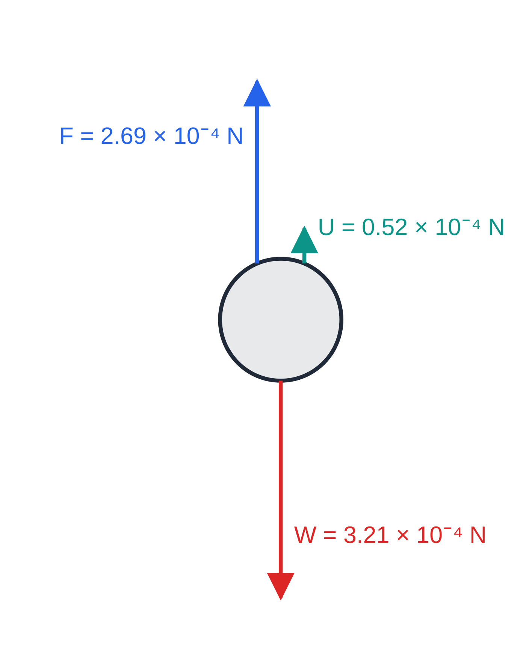
How does a sphere reach terminal velocity in a liquid? (continued)
Section 6 of 12
Forces on a steel ball of radius 1.0 mm at terminal velocity in glycerol, drawn to scale (worked example 6). Upthrust plus viscous drag exactly balance the weight.
Notes:
How does a sphere reach terminal velocity in a liquid?. Full notes: https://examinerprep.com/notes/edexcel-ial-physics/density-upthrust-and-viscous-drag/

Slide 27
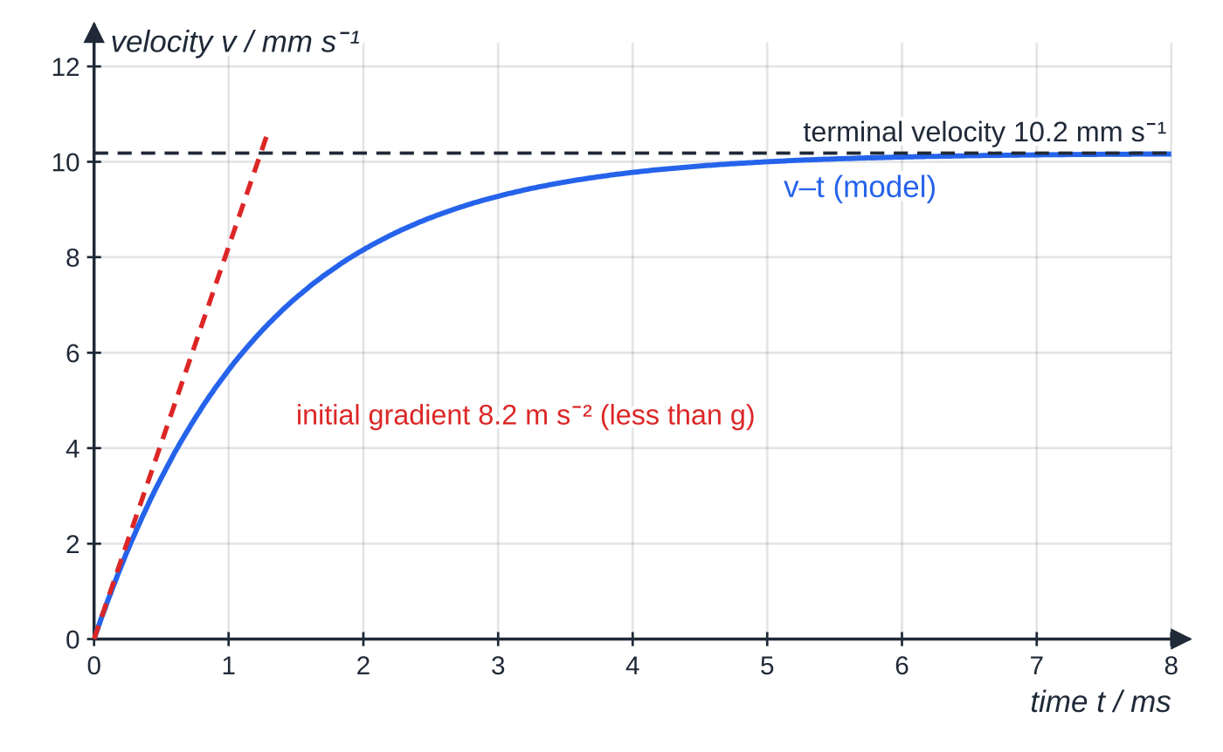
How does a sphere reach terminal velocity in a liquid? (continued)
Section 6 of 12
Modelled velocity–time graph for the same ball. It reaches 10.2 mm s⁻¹ within a few milliseconds. The initial acceleration, g(1 − ρ_f/ρ_s) = 8.2 m s⁻², is less than g because the upthrust acts from the start.
Notes:
How does a sphere reach terminal velocity in a liquid?. Full notes: https://examinerprep.com/notes/edexcel-ial-physics/density-upthrust-and-viscous-drag/

Slide 28
How does a sphere reach terminal velocity in a liquid? (continued)
Section 6 of 12 · Worked example 6 · Hard · Calculate
WORKED EXAMPLE · QUESTION
A steel ball bearing of radius 1.0 mm falls through glycerol. Density of steel = 7800 kg m⁻³; density of glycerol = 1260 kg m⁻³; viscosity of glycerol = 1.4 Pa s. Calculate the terminal velocity of the ball bearing.
SOLUTION
Volume: V = (4/3)π(1.0×10⁻³)³ = 4.19×10⁻⁹ m³.
Weight: W = 7800×4.19×10⁻⁹×9.81 = 3.21×10⁻⁴ N. Upthrust: U = 1260×4.19×10⁻⁹×9.81 = 5.18×10⁻⁵ N.
At terminal velocity F = W - U = 2.69×10⁻⁴ N. Stokes' law: v = F/(6πηr) = 2.69×10⁻⁴ ÷(6π×1.4×1.0×10⁻³) = 0.0102 m s⁻¹ → v = 1.0 × 10⁻² m s⁻¹.
Check with the formula: 2×(1.0×10⁻³)²×9.81×(7800 - 1260)÷(9×1.4) = 0.0102 m s⁻¹. The speed is low and the ball is small, so the flow really is laminar and Stokes' law is justified.
Notes:
How does a sphere reach terminal velocity in a liquid?: Worked example 6. Full notes: https://examinerprep.com/notes/edexcel-ial-physics/density-upthrust-and-viscous-drag/

Slide 29
How does a sphere reach terminal velocity in a liquid? (continued)
Section 6 of 12
Exam tip
Draw the three forces before writing any equation, and decide whether upthrust must be included. In air, the upthrust on a dense sphere is tiny and usually ignored; in a liquid it is a significant fraction of the weight (here 16%) and must be included.
Notes:
How does a sphere reach terminal velocity in a liquid?. Full notes: https://examinerprep.com/notes/edexcel-ial-physics/density-upthrust-and-viscous-drag/

Slide 30
How do you measure viscosity with a falling ball (Core Practical 2)?
Section 7 of 12
Idea: measure the terminal velocity of small spheres falling through the liquid, then use W = U + F with Stokes' law to find η.
Apparatus: a tall, wide tube of the liquid with marks (rubber bands) at equal spacings, small steel balls, a stopwatch, a metre rule, a micrometer, a thermometer, a balance and a measuring cylinder.
Diameter: micrometer, several readings at different orientations, averaged; halve for the radius.
Densities: the steel from the mass and volume of a batch of balls; the liquid from the mass of a measured volume.
Terminal velocity: set the top band far enough below the surface that the ball is already at terminal velocity. Check that the times for successive equal intervals are the same, then v = distance ÷ time.
Release each wetted ball at the centre of the surface, away from the walls; repeat each size several times, use five or six sizes, and keep the temperature constant.
Safety: tube clamped in a tray; wipe up slippery spills at once.
Notes:
How do you measure viscosity with a falling ball (Core Practical 2)?. Full notes: https://examinerprep.com/notes/edexcel-ial-physics/density-upthrust-and-viscous-drag/

Slide 31
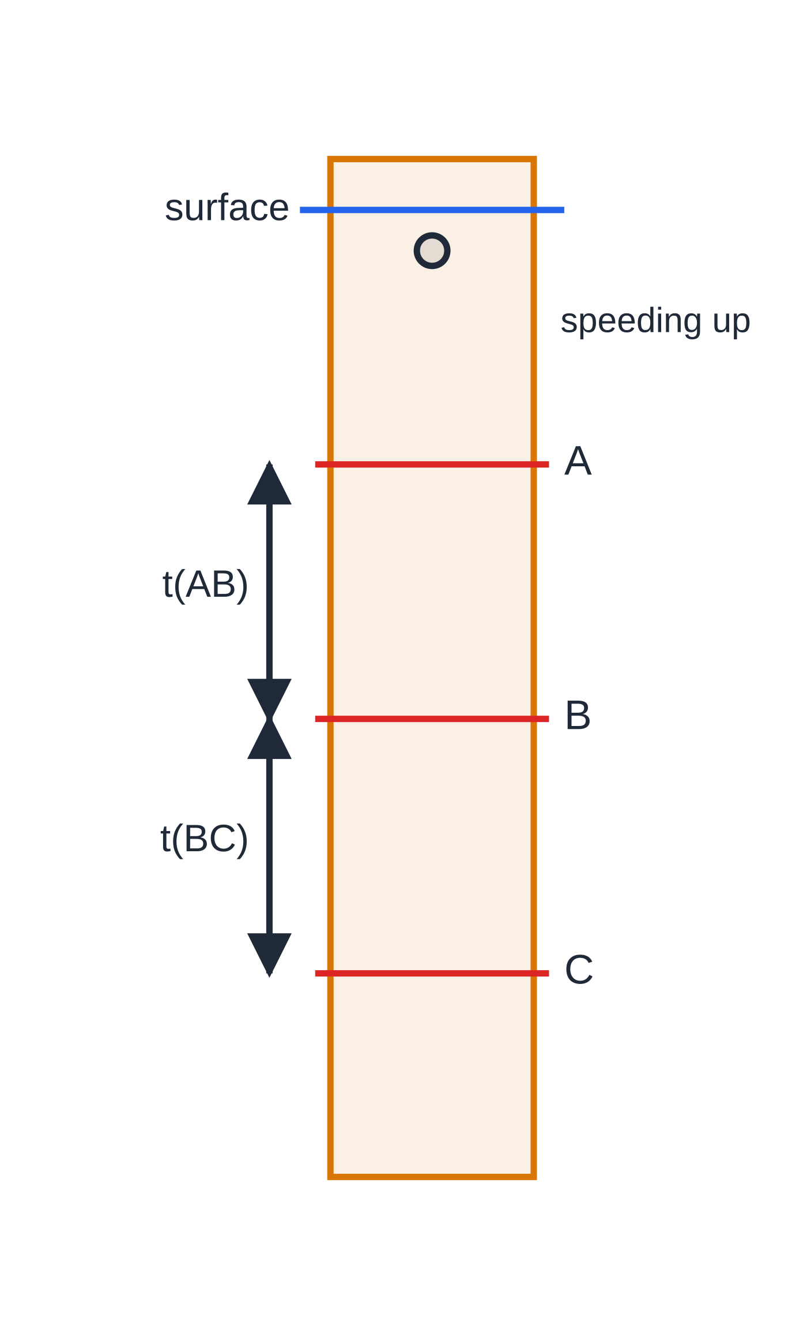
How do you measure viscosity with a falling ball (Core Practical 2)? (continued)
Section 7 of 12
Analysing the results
Rearranged, v = [(2g(ρₛ - ρ_f))/9η] r², so a graph of v against r² should be a straight line through the origin, with gradient 2g(ρₛ - ρ_f)/9η. Hence η= 2g(ρₛ - ρ_f)/(9×gradient). The graph uses every ball and shows up any anomaly, such as a large ball slowed by the walls.
The falling-ball method. Equal times from A to B and from B to C confirm that the ball has reached terminal velocity before A.
Notes:
How do you measure viscosity with a falling ball (Core Practical 2)?. Full notes: https://examinerprep.com/notes/edexcel-ial-physics/density-upthrust-and-viscous-drag/

Slide 32
How do you measure viscosity with a falling ball (Core Practical 2)? (continued)
Section 7 of 12
Diameter d / mm | r² / mm² | Mean time for 0.200 m / s | v / mm s⁻¹
1.50 | 0.563 | 29.34 | 6.82
2.00 | 1.000 | 17.18 | 11.6
2.50 | 1.563 | 10.67 | 18.7
3.00 | 2.250 | 7.56 | 26.5
3.50 | 3.063 | 5.42 | 36.9
4.00 | 4.000 | 4.27 | 46.8
Notes:
How do you measure viscosity with a falling ball (Core Practical 2)?. Full notes: https://examinerprep.com/notes/edexcel-ial-physics/density-upthrust-and-viscous-drag/

Slide 33
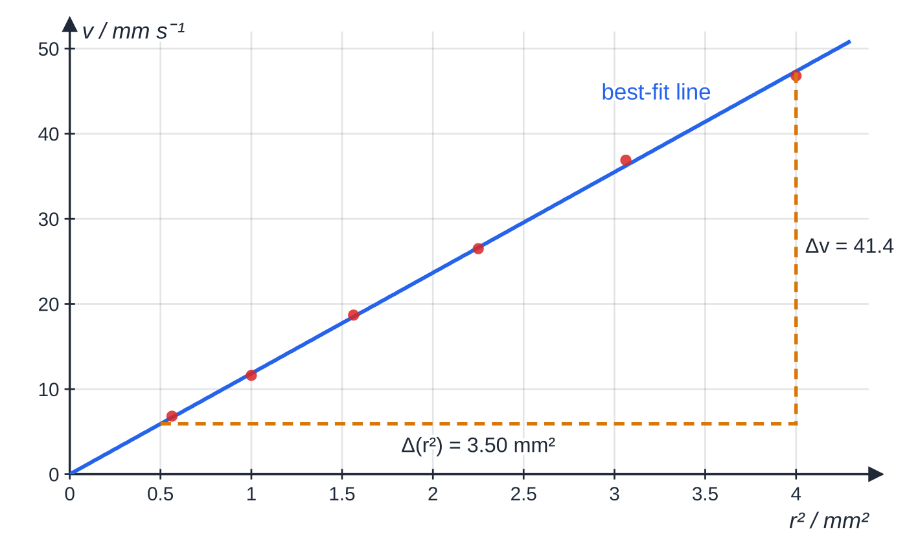
How do you measure viscosity with a falling ball (Core Practical 2)? (continued)
Section 7 of 12
Specimen results for steel balls (ρ_s = 7800 kg m⁻³) in a liquid of density 1260 kg m⁻³. The best-fit line passes through the origin; the dashed gradient triangle is read from the line, not from the points.
Notes:
How do you measure viscosity with a falling ball (Core Practical 2)?. Full notes: https://examinerprep.com/notes/edexcel-ial-physics/density-upthrust-and-viscous-drag/

Slide 34
How do you measure viscosity with a falling ball (Core Practical 2)? (continued)
Section 7 of 12 · Worked example 7 · Hard · Determine
WORKED EXAMPLE · QUESTION
Use the graph above to determine the viscosity of the liquid.
SOLUTION
Gradient from the large triangle: 41.4 mm s⁻¹ ÷3.50 mm² = 11.83 mm s⁻¹ mm⁻².
Convert to SI: 1 mm s⁻¹ ÷ 1 mm² = 10⁻³ ÷ 10⁻⁶ = 10³ m⁻¹ s⁻¹, so gradient = 11.83×10³ m⁻¹ s⁻¹.
η= (2g(ρₛ - ρ_f))/(9×gradient) = (2×9.81×(7800 - 1260))/(9×11.83×10³) = 1.205 Pa s → η = 1.21 Pa s.
Notes:
How do you measure viscosity with a falling ball (Core Practical 2)?: Worked example 7. Full notes: https://examinerprep.com/notes/edexcel-ial-physics/density-upthrust-and-viscous-drag/

Slide 35
How do you measure viscosity with a falling ball (Core Practical 2)? (continued)
Section 7 of 12
Uncertainties
Diameter: a micrometer reads to 0.01 mm, so the uncertainty is half of that, 0.005 mm. For a 2.00 mm ball: 0.005 ÷ 2.00 × 100 = 0.25%.
Time: repeat readings vary by more than the stopwatch resolution (reaction time), so use half the range. For times of 7.62 s, 7.50 s and 7.56 s: mean 7.56 s, uncertainty ± 0.06 s, which is 0.8%.
The timing is usually the largest source of uncertainty. Longer distances between the bands, or filming the fall with a timer in view, reduce it.
Exam tip
If you are asked how you know the ball has reached terminal velocity, give evidence from a measurement, not an assumption: the times for two (or more) equal distances are the same, so the speed is constant.
Notes:
How do you measure viscosity with a falling ball (Core Practical 2)?. Full notes: https://examinerprep.com/notes/edexcel-ial-physics/density-upthrust-and-viscous-drag/

Slide 36
Exam tips for 1.7
Section 8 of 12
Exam tip 1 — units first
Convert every quantity to SI before substituting: g to kg, cm³ to m³ (× 10⁻⁶), mm to m, mPa s to Pa s. A power-of-ten slip in a unit conversion is the easiest mistake to make in this topic.
Exam tip 2 — radius, not diameter
Stokes' law and the volume of a sphere both use the radius. Measurements are usually given as diameters, so halve them first; r³ makes a diameter mistake eight times too big.
Exam tip 3 — name the three forces
For a sphere in a liquid write W = U + F in words first: "weight = upthrust + viscous drag".
Notes:
Exam tips for 1.7. Full notes: https://examinerprep.com/notes/edexcel-ial-physics/density-upthrust-and-viscous-drag/

Slide 37
Exam tips for 1.7 (continued)
Section 8 of 12
Exam tip 4 — state the conditions
When asked when Stokes' law applies, give all the conditions: a small sphere, at low speed, in laminar flow (and far from the container walls). "It works for spheres" is not enough.
Notes:
Exam tips for 1.7. Full notes: https://examinerprep.com/notes/edexcel-ial-physics/density-upthrust-and-viscous-drag/

Slide 38
Common misconceptions
Section 9 of 12
Misconception | Why it is wrong | Correct idea
Heavy objects sink and light objects float. | A large ship floats and a small pebble sinks. | What matters is average density compared with the fluid's, or weight compared with the maximum upthrust.
Upthrust depends on the material of the body. | The fluid pushes in the same way on any body of the same shape at the same depth. | Upthrust depends only on the volume displaced and the density of the fluid.
A body loses weight when it is put in water. | Its mass and the Earth's pull on it are unchanged. | The upthrust supports part of the weight, so a newton-meter reads less (apparent weight).
Upthrust grows the deeper a submerged body goes. | The pressure on every face rises by the same amount, so the difference does not change. | For a fully submerged body in a liquid of constant density, upthrust is the same at any depth.
Notes:
Common misconceptions. Full notes: https://examinerprep.com/notes/edexcel-ial-physics/density-upthrust-and-viscous-drag/

Slide 39
Common misconceptions (continued)
Section 9 of 12
Misconception | Why it is wrong | Correct idea
Stokes' law gives the air resistance on any falling object. | Large or fast bodies cause turbulent flow, with much larger drag. | Stokes' law holds only for small spheres at low speed in laminar flow.
A warmer liquid is "thicker" because the molecules move faster. | For liquids, viscosity falls as temperature rises. | Warm oil and warm syrup flow more easily; terminal velocities in them are higher.
Notes:
Common misconceptions. Full notes: https://examinerprep.com/notes/edexcel-ial-physics/density-upthrust-and-viscous-drag/

Slide 40
How this topic connects
Section 10 of 12
2 Forces and Newton's laws
Free-body diagrams, resultant force and the chain of reasoning for terminal velocity all carry over; here the drag has a formula and upthrust is added to the diagram.
8 Hooke's law and 3.3 The AS core practicals
Density and viscosity describe materials in bulk; the next pages describe how solids stretch. The falling-ball analysis (rearrange to y = mx, plot v against r², read a large gradient, find percentage uncertainties) is a pattern that recurs throughout practical work.
Thermal physics (Unit 5)
Hot-air balloons rely on air becoming less dense as it is heated at constant pressure, which the gas laws describe quantitatively.
Notes:
How this topic connects. Full notes: https://examinerprep.com/notes/edexcel-ial-physics/density-upthrust-and-viscous-drag/

Slide 41
Key equations
Section 11 of 12
Equation | Use | In the formulae list?
ρ= m/V | density; ρ in kg m⁻³ | yes
upthrust = weight of fluid displaced | upthrust on any immersed body | yes
U = ρ_fluidV_displaced g | upthrust as a calculation; U in N | no — derive it from the line above with W = mg
F = 6πηrv | viscous drag on a small sphere in laminar flow (Stokes' law); η in Pa s | yes
V = (4/3)πr³ | volume of a sphere | no — learn it
W = U + F | sphere at terminal velocity in a fluid | no — learn it
v = 2r²g(ρₛ - ρ_f)/9η | terminal velocity of a sphere (Stokes' law) | no — derive it
V_sub/V = ρ_body/ρ_fluid | fraction of a floating body below the surface | no — derive it
Notes:
Key equations. Full notes: https://examinerprep.com/notes/edexcel-ial-physics/density-upthrust-and-viscous-drag/

Slide 42
Check your understanding
Section 12 of 12
1. 250 cm³ of olive oil has a mass of 229 g. Calculate its density in kg m⁻³.
2. Explain why a steel ship floats although steel is much denser than water.
3. A glass bead of radius 0.50 mm moves at 4.0 mm s⁻¹ through an oil of viscosity 0.80 Pa s. Calculate the viscous drag on it.
4. In Core Practical 2 the liquid warms up during the lesson. Explain the effect on the measured times.
5. A hydrometer floats with more of its stem below the surface in liquid X than in water. Is X more or less dense than water? Explain.
Notes:
Check your understanding: questions. Full notes: https://examinerprep.com/notes/edexcel-ial-physics/density-upthrust-and-viscous-drag/

Slide 43
Check your understanding · answers
Section 12 of 12
1. ρ= 229 ÷250 = 0.916 g cm⁻³ = 916 kg m⁻³.
2. The hull encloses a large volume of air, so the average density of the ship is less than that of water. It sinks until the water it displaces weighs as much as the ship; then upthrust = weight and it floats.
3. F = 6π×0.80×0.50×10⁻³×4.0×10⁻³ = 3.02×10⁻⁵ N ≈3.0×10⁻⁵ N.
4. The viscosity of the liquid decreases as it warms, so the drag at a given speed is smaller and the terminal velocity is larger. The times between the bands become shorter, and the result for η applies to a temperature that was not constant.
5. Less dense. The hydrometer must displace its own weight of liquid; it displaces a larger volume of X, so each cubic metre of X weighs less than a cubic metre of water.
Notes:
Check your understanding: answers. Full notes: https://examinerprep.com/notes/edexcel-ial-physics/density-upthrust-and-viscous-drag/

Slide 44
Practice questions
5 original exam-style questions. Answers at the end of the deck.

Slide 45
Question 1
1 mark
Stokes' law gives the viscous drag F on a sphere of radius r moving at speed v through a fluid of viscosity η as F = 6πηrv.
Which of these is the unit of viscosity expressed in SI base units?
A kg m⁻¹ s⁻¹
B kg m s⁻¹
C kg m⁻¹ s⁻²
D kg m⁻² s⁻¹
Notes:
Online with the full mark scheme: https://examinerprep.com/ial-physics-1-7-density-upthrust-and-viscous-drag-questions#IALP-U1-7-A-04

Slide 46
Question 2
1 mark
A pollen grain can be modelled as a sphere of diameter 30 μm. It falls through still air at a steady 0.030 m s⁻¹. Viscosity of air = 1.8 × 10⁻⁵ Pa s.
What is the viscous drag on the grain?
A 2.5 × 10⁻¹¹ N
B 4.9 × 10⁻¹¹ N
C 1.5 × 10⁻¹⁰ N
D 3.1 × 10⁻¹⁰ N
Notes:
Online with the full mark scheme: https://examinerprep.com/ial-physics-1-7-density-upthrust-and-viscous-drag-questions#IALP-U1-7-A-05

Slide 47
Question 3
1 mark
A souvenir coin has a mass of 8.50 g and a volume of 0.960 cm³.
What is the density of the metal of the coin?
A 8.85 kg m⁻³
B 113 kg m⁻³
C 8.85 × 10³ kg m⁻³
D 8.85 × 10⁶ kg m⁻³
Notes:
Online with the full mark scheme: https://examinerprep.com/ial-physics-1-7-density-upthrust-and-viscous-drag-questions#IALP-U1-7-A-01

Slide 48
Question 4
7 marks
A fog droplet is a sphere of water of radius 8.0 μm, falling through still air. Density of water = 1000 kg m⁻³; viscosity of air = 1.8 × 10⁻⁵ Pa s; density of air = 1.2 kg m⁻³.
(a) State two conditions needed for Stokes' law to give the drag on the droplet. [2]
(b) Show that the weight of the droplet is about 2.1 × 10⁻¹¹ N. [2]
(c) Calculate the terminal velocity of the droplet. Ignore upthrust. [2]
(d) Explain why it is reasonable to ignore the upthrust on the droplet. [1]
Notes:
Online with the full mark scheme: https://examinerprep.com/ial-physics-1-7-density-upthrust-and-viscous-drag-questions#IALP-U1-7-B-06

Slide 49
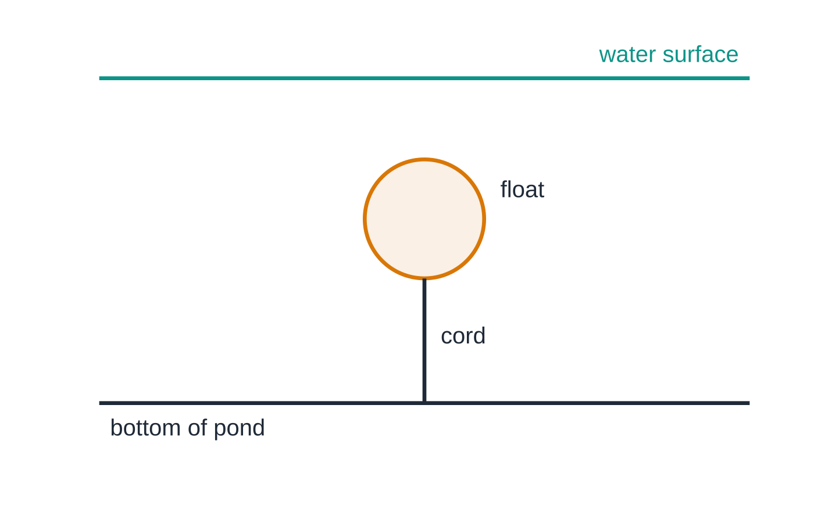
Question 5
5 marks
A hollow plastic float in an ornamental pond is held completely under the water by a vertical cord tied to the bottom of the pond. The float has a mass of 0.060 kg and a volume of 4.2 × 10⁻⁴ m³. Density of water = 1000 kg m⁻³.
Figure: the float held under the water by the cord (not to scale)
(a) Explain why the water exerts an upward force on the float. [2]
(b) Calculate the upthrust on the float. [1]
(c) Calculate the tension in the cord. [2]
Notes:
Online with the full mark scheme: https://examinerprep.com/ial-physics-1-7-density-upthrust-and-viscous-drag-questions#IALP-U1-7-B-02

Slide 50
Answers

Slide 51
Question 1 · answer
Answer A
η = F/(6πrv). Units: kg m s⁻² ÷ (m × m s⁻¹) = kg m⁻¹ s⁻¹ (the same as Pa s).
Notes:
Full mark scheme: https://examinerprep.com/ial-physics-1-7-density-upthrust-and-viscous-drag-questions#IALP-U1-7-A-04

Slide 52
Question 2 · answer
Answer C
Radius = 15 μm = 1.5 × 10⁻⁵ m. F = 6π × 1.8 × 10⁻⁵ × 1.5 × 10⁻⁵ × 0.030 = 1.5 × 10⁻¹⁰ N.
Notes:
Full mark scheme: https://examinerprep.com/ial-physics-1-7-density-upthrust-and-viscous-drag-questions#IALP-U1-7-A-05

Slide 53
Question 3 · answer
Answer C
ρ = 8.50 ÷ 0.960 = 8.85 g cm⁻³. Since 1 g cm⁻³ = 1000 kg m⁻³, ρ = 8.85 × 10³ kg m⁻³.
Notes:
Full mark scheme: https://examinerprep.com/ial-physics-1-7-density-upthrust-and-viscous-drag-questions#IALP-U1-7-A-01

Slide 54
Question 4 · answer
Mark scheme
any two from: the droplet is a small sphere; it moves at low speed; the flow around it is laminar (no turbulence)
first condition
second condition
V = 4/3π(8.0 × 10⁻⁶)³ = 2.14 × 10⁻¹⁵ m³
W = 1000 × 2.14 × 10⁻¹⁵ × 9.81 = 2.10 × 10⁻¹¹ N
6πηrv = W, so v = 2.10 × 10⁻¹¹ ÷ (6π × 1.8 × 10⁻⁵ × 8.0 × 10⁻⁶)
v = 7.8 × 10⁻³ m s⁻¹ (7.75 × 10⁻³)
air is about 800 times less dense than water, so the upthrust is only about 0.1% of the weight
Notes:
Full mark scheme: https://examinerprep.com/ial-physics-1-7-density-upthrust-and-viscous-drag-questions#IALP-U1-7-B-06

Slide 55
Question 5 · answer
Mark scheme
the pressure in the water increases with depth
so the upward force on the lower surface is greater than the downward force on the upper surface, giving a resultant force upwards
U = 1000 × 4.2 × 10⁻⁴ × 9.81 = 4.1 N (4.12 N)
weight = 0.060 × 9.81 = 0.589 N; equilibrium: T + W = U
T = 4.12 − 0.589 = 3.5 N
Notes:
Full mark scheme: https://examinerprep.com/ial-physics-1-7-density-upthrust-and-viscous-drag-questions#IALP-U1-7-B-02

Slide 56
Keep practising
Notes for this topic
Questions on this topic
Build a printable test
ExaminerPrep is an independent tutoring service. It has been developed independently from and is not endorsed by the International Baccalaureate Organization. "International Baccalaureate", "IB" and "IB Diploma Programme" are registered trademarks of the IBO, used here for descriptive purposes only.
Pearson Edexcel and Cambridge are trademarks of their owners; ExaminerPrep is not affiliated with any exam board.

