Slide 1
EP
EDEXCEL IAL PHYSICS
2.4 Diffraction and the wave nature of electrons
The full notes page in 12 sections · practice questions with answers · simulations
ExaminerPrep is an independent tutoring service. It has been developed independently from and is not endorsed by the International Baccalaureate Organization. "International Baccalaureate", "IB" and "IB Diploma Programme" are registered trademarks of the IBO, used here for descriptive purposes only.
Pearson Edexcel and Cambridge are trademarks of their owners; ExaminerPrep is not affiliated with any exam board.
Notes:
2.4 Diffraction and the wave nature of electrons. Notes for this topic: https://examinerprep.com/notes/edexcel-ial-physics/diffraction-and-the-wave-nature-of-electrons/

Slide 2
What this page covers
Overview
What diffraction is, and Huygens' construction for a gap and for an obstacle
How the amount of spreading depends on the gap width compared with the wavelength
Why a diffraction grating gives sharp maxima, and deriving nλ= dsin θ
Slit spacing from lines per mm, angles of the orders and the highest order
Measuring the wavelength of laser light with a grating (Core Practical 6), with uncertainties
Electron diffraction as evidence that electrons behave as waves
The de Broglie wavelength λ= h/p, including electrons accelerated through a p.d.
Notes:
What this page covers. Full notes: https://examinerprep.com/notes/edexcel-ial-physics/diffraction-and-the-wave-nature-of-electrons/

Slide 3
In one minute
Key points
1. Diffraction is the spreading of a wave as it passes through a gap or around the edge of an obstacle, and it is greatest when the gap is about the same size as the wavelength.
2. Huygens: every point on a wavefront acts as a source of secondary wavelets; the new wavefront is the surface that touches them all.
3. A diffraction grating gives sharp maxima where the path difference between adjacent slits is a whole number of wavelengths: nλ= dsin θ.
4. sin θ cannot exceed 1, so the highest order is the largest whole number not greater than d/λ.
5. Electrons diffract through thin crystals, so they have a wavelength: λ= h/p. Faster electrons have shorter wavelengths.
Notes:
In one minute. Full notes: https://examinerprep.com/notes/edexcel-ial-physics/diffraction-and-the-wave-nature-of-electrons/

Slide 4
What is diffraction, and how does Huygens' construction explain it?
Section 1 of 12
You can hear someone talking in the next room through an open door even when you cannot see them. Sound bends round the edges of the doorway; light, apparently, does not. Both are waves, and the difference comes down to the size of the wavelength compared with the gap.
Diffraction is the spreading out of a wave as it passes through a gap or past the edge of an obstacle.
Diffraction happens to every kind of wave (water waves, sound, light, microwaves) and is strong evidence that something is a wave.
It changes the direction of travel and the shape of the wavefronts. It does not change the wavelength, the frequency or the speed, because the medium is the same on both sides of the gap.
Energy is spread over a wider region, so the amplitude in any one direction beyond the gap is smaller.
Notes:
What is diffraction, and how does Huygens' construction explain it?. Full notes: https://examinerprep.com/notes/edexcel-ial-physics/diffraction-and-the-wave-nature-of-electrons/

Slide 5
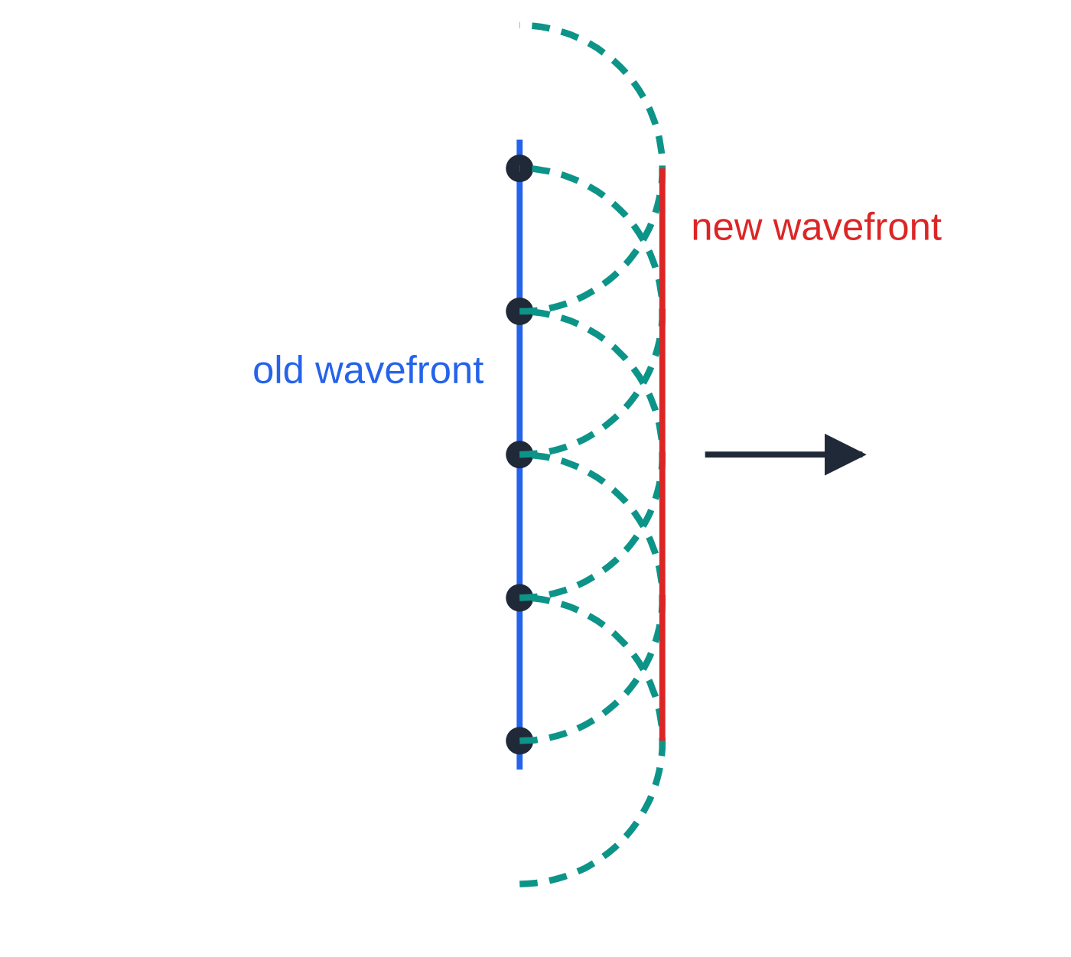
What is diffraction, and how does Huygens' construction explain it? (continued)
Section 1 of 12
Huygens' construction: every point on a wavefront acts as a source of secondary wavelets that spread out at the wave speed; a short time later, the new wavefront is the line that touches (is the envelope of) all the wavelets.
Using the construction at a gap
Plane wavefronts reach the barrier, and only the part of each wavefront inside the gap carries on. Each point in the gap sends out a semicircular wavelet. In the middle of a wide gap the wavelets overlap side by side, so their envelope is still straight. At the edges there are no neighbouring wavelets on the outside, so the envelope curves round into the region behind the barrier: this is the spreading.
Huygens' construction for a plane wave: each point on the old wavefront sends out a wavelet (dashed); the line touching all the wavelets is the new wavefront, one wavelet radius further on.
Notes:
What is diffraction, and how does Huygens' construction explain it?. Full notes: https://examinerprep.com/notes/edexcel-ial-physics/diffraction-and-the-wave-nature-of-electrons/

Slide 6
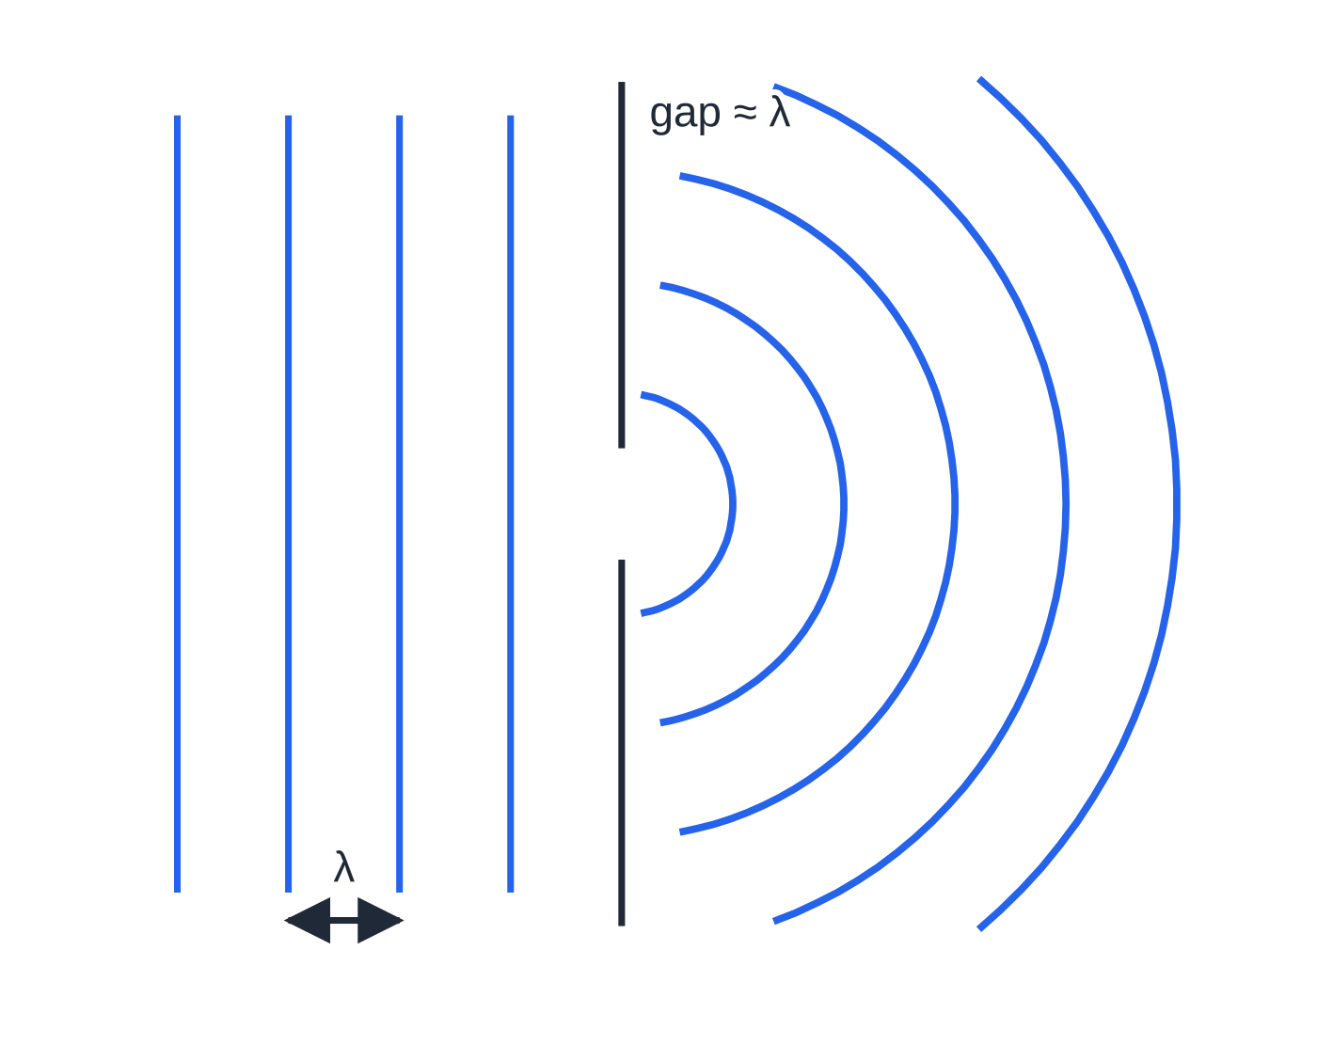
What is diffraction, and how does Huygens' construction explain it? (continued)
Section 1 of 12
With a gap about one wavelength wide there is effectively only one source of wavelets, so the wave leaves as semicircular wavefronts. At an obstacle the same thing happens at each edge: wavelets from the edge of the unblocked wavefront curve into the "shadow" behind it.
Plane waves meeting a gap about one wavelength wide. The wave leaves as almost semicircular wavefronts and fills the region behind the barrier. The wavefront spacing stays λ.
Notes:
What is diffraction, and how does Huygens' construction explain it?. Full notes: https://examinerprep.com/notes/edexcel-ial-physics/diffraction-and-the-wave-nature-of-electrons/

Slide 7
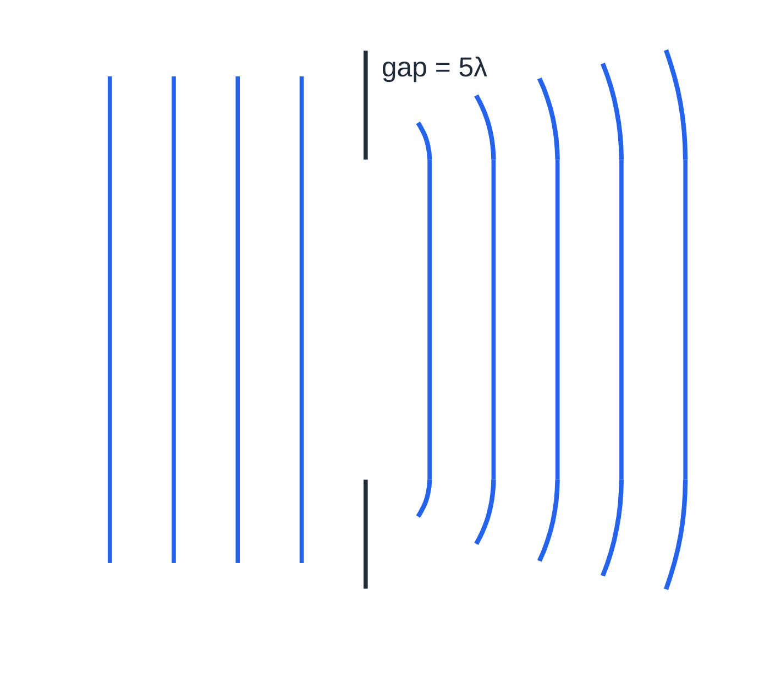
What is diffraction, and how does Huygens' construction explain it? (continued)
Section 1 of 12
Common error
Changing the spacing of the wavefronts after the gap when you sketch diffraction. The wavelength is unchanged, so the spacing must be the same on both sides.
The same plane waves meeting a gap five wavelengths wide. The wave carries on as a nearly straight-edged beam, bending only a little at the edges. Wavefronts are drawn only where the diffracted wave is strong.
Notes:
What is diffraction, and how does Huygens' construction explain it?. Full notes: https://examinerprep.com/notes/edexcel-ial-physics/diffraction-and-the-wave-nature-of-electrons/

Slide 8
What decides how much a wave spreads?
Section 2 of 12
What matters is the ratio of wavelength to gap width, λ/b, not either one on its own.
Gap width ≈ λ: maximum spreading; the wave fills almost the whole region beyond the gap.
Gap width much larger than λ: little spreading; the wave carries on almost as a straight-edged beam.
Narrowing the gap (closer to λ) or increasing the wavelength both increase the spreading.
If the gap is much smaller than λ, very little of the wave gets through at all.
Visible light has λ≈4 ×10⁻⁷ m to 7 ×10⁻⁷ m, far smaller than doorways, so light diffraction is noticeable only with very narrow slits or very fine edges. Sound has wavelengths from centimetres to metres, so it diffracts round everyday openings.
Notes:
What decides how much a wave spreads?. Full notes: https://examinerprep.com/notes/edexcel-ial-physics/diffraction-and-the-wave-nature-of-electrons/

Slide 9
What decides how much a wave spreads? (continued)
Section 2 of 12 · Worked example 1 · Easy · Explain
WORKED EXAMPLE · QUESTION
A courtyard is enclosed by a wall with a single opening 1.2 m wide. Outside, a bird sings at 2.8 kHz and a lorry engine produces a low note of 95 Hz. The speed of sound is 340 m s⁻¹. Calculate the wavelength of each sound and explain which one is heard better by a person inside the courtyard, to one side of the opening and out of the direct line.
SOLUTION
Wavelengths: bird: λ= 340 ÷2800 = 0.12 m (0.121 m). Engine: λ= 340 ÷95 = 3.6 m (3.58 m).
Compare with the gap: bird: λ/b ≈0.1; engine: λ/b ≈3.0.
The engine note is heard better. Its wavelength is larger than the gap, so it spreads strongly round behind the wall. The bird's wavelength is about a tenth of the gap, so it diffracts only a little and mostly continues straight on.
Notes:
What decides how much a wave spreads?: Worked example 1. Full notes: https://examinerprep.com/notes/edexcel-ial-physics/diffraction-and-the-wave-nature-of-electrons/

Slide 10
What decides how much a wave spreads? (continued)
Section 2 of 12
Common error
Saying "the gap must be smaller than the wavelength for diffraction". Diffraction happens at every gap; it is most noticeable when the gap is similar to the wavelength, and a gap much smaller than λ lets very little through.
Notes:
What decides how much a wave spreads?. Full notes: https://examinerprep.com/notes/edexcel-ial-physics/diffraction-and-the-wave-nature-of-electrons/

Slide 11
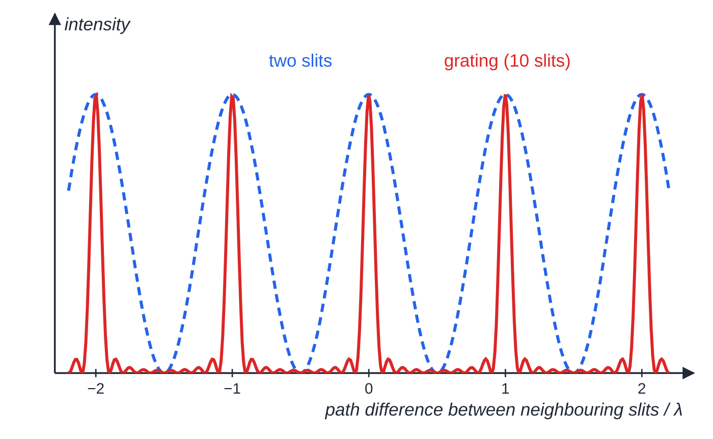
How does a diffraction grating produce sharp maxima?
Section 3 of 12
A diffraction grating is a plate with a very large number of equally spaced, parallel, very narrow slits, often specified as a number of lines per mm. Each slit is so narrow that light diffracts from it over a wide range of angles, so light from all the slits overlaps beyond the grating. In most directions the waves from the many slits arrive with a spread of phases and cancel. Only in certain directions do they all arrive in phase and superpose constructively. The result is a few sharp, bright maxima with darkness between them, much sharper and brighter than the fringes from two slits.
Intensity against the path difference between neighbouring slits. Two slits give broad maxima; ten slits give the maxima at the same places (whole numbers of λ) but far narrower, and real gratings with thousands of slits are sharper still.
Notes:
How does a diffraction grating produce sharp maxima?. Full notes: https://examinerprep.com/notes/edexcel-ial-physics/diffraction-and-the-wave-nature-of-electrons/

Slide 12
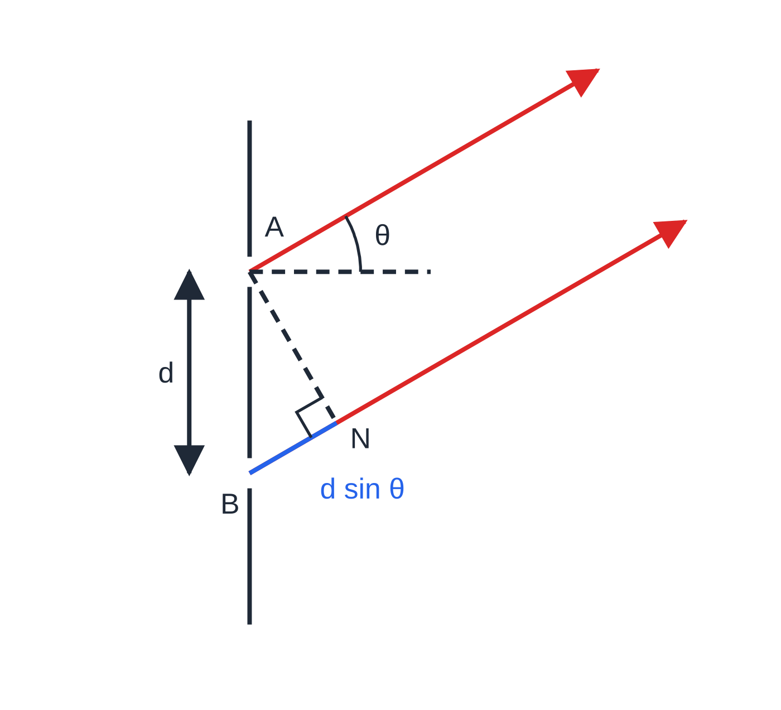
How does a diffraction grating produce sharp maxima? (continued)
Section 3 of 12
The diffraction grating equation
nλ= dsin θ
Here n is the order of the maximum (0, 1, 2, …), λ the wavelength (m), d the slit spacing, centre to centre (m), and θ the angle between the maximum and the straight-through (zero-order) direction. The equation is in the formulae list supplied in the exam, but you must be able to derive it:
Plane waves arrive normally, so adjacent slits are in phase.
The path difference from adjacent slits to a distant point at angle θ is dsin θ.
Light leaves adjacent slits A and B at angle θ to the normal. Dropping a perpendicular from A onto the ray from B shows that the ray from B travels an extra distance BN = d sin θ.
Notes:
How does a diffraction grating produce sharp maxima?. Full notes: https://examinerprep.com/notes/edexcel-ial-physics/diffraction-and-the-wave-nature-of-electrons/

Slide 13
How does a diffraction grating produce sharp maxima? (continued)
Section 3 of 12
Constructive superposition needs a path difference of a whole number of wavelengths, nλ. Then every pair of neighbouring slits is in step, so all the slits are.
The slit spacing comes from the lines per mm: d = 1 ÷ (number of lines per metre), so for N lines per mm, d = 1/(N ×10³) m. The zero order is straight through; the other orders come in pairs at ±θ. Larger λ or smaller d gives larger angles. With white light each order except zero becomes a spectrum, violet nearest the centre and red furthest out, and higher-order spectra can overlap.
Notes:
How does a diffraction grating produce sharp maxima?. Full notes: https://examinerprep.com/notes/edexcel-ial-physics/diffraction-and-the-wave-nature-of-electrons/

Slide 14
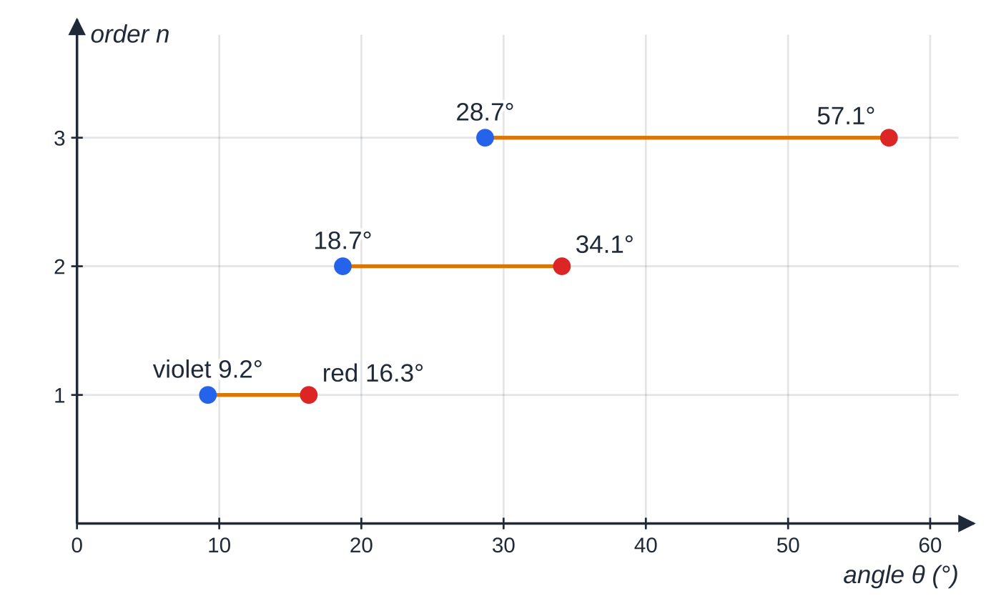
How does a diffraction grating produce sharp maxima? (continued)
Section 3 of 12
White light (400–700 nm) through a 400 lines per mm grating. Each order is a spectrum from violet to red; the second-order spectrum (18.7° to 34.1°) overlaps the start of the third (from 28.7°).
Notes:
How does a diffraction grating produce sharp maxima?. Full notes: https://examinerprep.com/notes/edexcel-ial-physics/diffraction-and-the-wave-nature-of-electrons/

Slide 15
How does a diffraction grating produce sharp maxima? (continued)
Section 3 of 12 · Worked example 2 · Medium · Calculate
WORKED EXAMPLE · QUESTION
A diode laser of wavelength 635 nm shines normally onto a grating with 400 lines per mm. Calculate (a) the slit spacing, (b) the angles of the first-order and second-order maxima, and (c) the angle between the two first-order maxima.
SOLUTION
(a) d = 1 ÷(400 ×10³) = 2.50 × 10⁻⁶ m.
(b) n = 1: sin θ₁ = 635 ×10⁻⁹ ÷2.50 ×10⁻⁶ = 0.254, so θ₁ = 14.7°. n = 2: sin θ₂ = 2 ×0.254 = 0.508, so θ₂ = 30.5°. 14.7° and 30.5°
(c) The first orders lie either side of the centre: 2 ×14.7° = 29.4°.
θ₂ is not 2θ₁: it is sin θ that doubles, not θ.
Notes:
How does a diffraction grating produce sharp maxima?: Worked example 2. Full notes: https://examinerprep.com/notes/edexcel-ial-physics/diffraction-and-the-wave-nature-of-electrons/

Slide 16
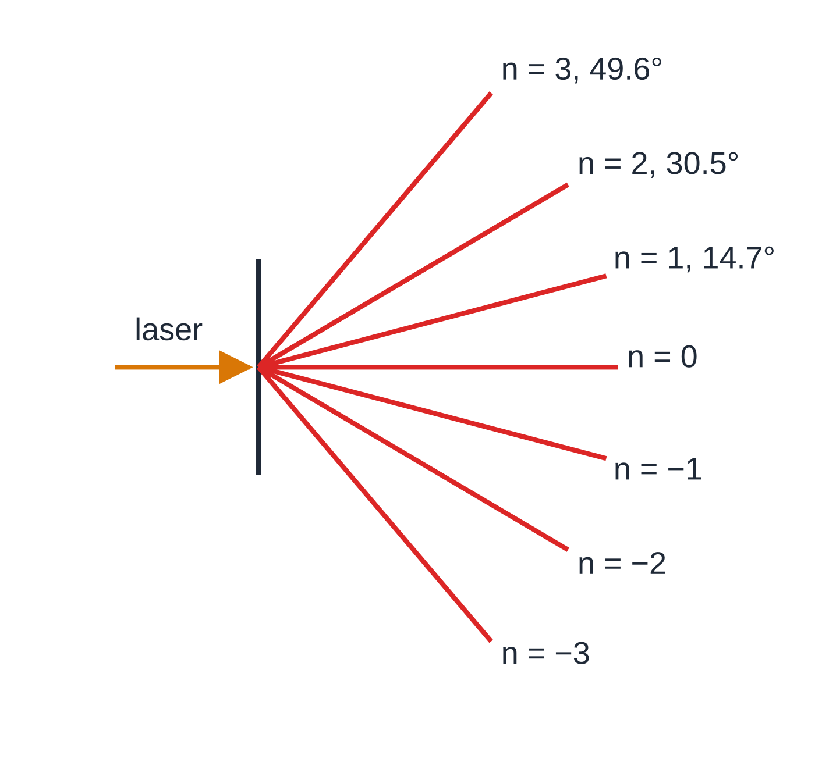
How do you find the highest order and use the grating equation in reverse?
Section 4 of 12
Since sin θ can be at most 1, nλ≤d, so n ≤d/λ. The highest order is the largest whole number not greater than d/λ: always round down. The total number of maxima is 2nₘₐₓ + 1, both sides plus the central one. Used in reverse, a measured angle and a known d give the wavelength: λ= dsin θ/n.
Directions of the maxima for the 400 lines per mm grating and 635 nm laser of worked examples 2 and 3, drawn at the calculated angles. There is no fourth order: it would need sin θ = 1.02.
Notes:
How do you find the highest order and use the grating equation in reverse?. Full notes: https://examinerprep.com/notes/edexcel-ial-physics/diffraction-and-the-wave-nature-of-electrons/

Slide 17
How do you find the highest order and use the grating equation in reverse? (continued)
Section 4 of 12 · Worked example 3 · Medium · Determine
WORKED EXAMPLE · QUESTION
For the 400 lines per mm grating and 635 nm laser of worked example 2: (a) determine the highest order and the total number of maxima; (b) the grating is replaced by one with 800 lines per mm. How many maxima are seen now?
SOLUTION
(a) d/λ= 2.50 ×10⁻⁶ ÷635 ×10⁻⁹ = 3.94, so the highest order is n = 3 (at 49.6°). Counting both sides and the centre: 2 ×3 + 1 = 7 maxima.
(b) d = 1.25 ×10⁻⁶ m; d/λ= 1.97, so the highest order is 1: 3 maxima.
Rounding 3.94 up to 4 would need sin θ= 1.02, which is impossible.
Notes:
How do you find the highest order and use the grating equation in reverse?: Worked example 3. Full notes: https://examinerprep.com/notes/edexcel-ial-physics/diffraction-and-the-wave-nature-of-electrons/

Slide 18
How do you find the highest order and use the grating equation in reverse? (continued)
Section 4 of 12 · Worked example 4 · Hard · Calculate
WORKED EXAMPLE · QUESTION
Light from a gas discharge lamp passes normally through a grating with 450 lines per mm. For one bright line, the angle between the two second-order maxima, on opposite sides of the centre, is 58.0°. (a) Calculate the wavelength of the line. (b) Determine the highest order in which this line can be seen.
SOLUTION
θ is measured from the centre, so halve the angle between the pair: θ₂ = 58.0° ÷2 = 29.0°. d = 1 ÷(450 ×10³) = 2.222 ×10⁻⁶ m.
(a) λ= dsin θ/n = 2.222 ×10⁻⁶ ×sin 29.0° ÷2 = 5.39 × 10⁻⁷ m (539 nm).
(b) Test sin θ= nλ/d: n = 3: 0.727; n = 4: 0.970; n = 5: 1.21 > 1. Highest order: 4th.
The fourth order is at about 76° and would be faint and hard to see in practice.
Notes:
How do you find the highest order and use the grating equation in reverse?: Worked example 4. Full notes: https://examinerprep.com/notes/edexcel-ial-physics/diffraction-and-the-wave-nature-of-electrons/

Slide 19
How do you find the highest order and use the grating equation in reverse? (continued)
Section 4 of 12
Common error
Using lines per mm directly as d, or forgetting the factor 10³. Write d = 1/(N ×10³) m as its own line and sense-check: grating spacings are a few micrometres.
Notes:
How do you find the highest order and use the grating equation in reverse?. Full notes: https://examinerprep.com/notes/edexcel-ial-physics/diffraction-and-the-wave-nature-of-electrons/

Slide 20
How do you measure the wavelength of light with a grating?
Section 5 of 12
This is Core Practical 6, described here in our own words.
Set-up: mount a grating of known lines per mm in a holder, with a laser shining normally onto it. Place a white screen (or a wall) parallel to the grating, about 1–2 m away.
Check it is normal: the maxima either side of the centre should be the same distance from the central spot; if not, rotate the grating until they are.
Measure D: the perpendicular distance from grating to screen, with a tape measure or metre rules (mm resolution).
Measure 2x: the distance between the two maxima of the same order on opposite sides of the centre, with a metre rule, after recording the spot centres on paper fixed to the screen. Repeat and take the mean.
Calculate: x = (2x)/2, tan θ= x/D, then λ= dsin θ/n. Repeat for the second order and compare.
Notes:
How do you measure the wavelength of light with a grating?. Full notes: https://examinerprep.com/notes/edexcel-ial-physics/diffraction-and-the-wave-nature-of-electrons/

Slide 21
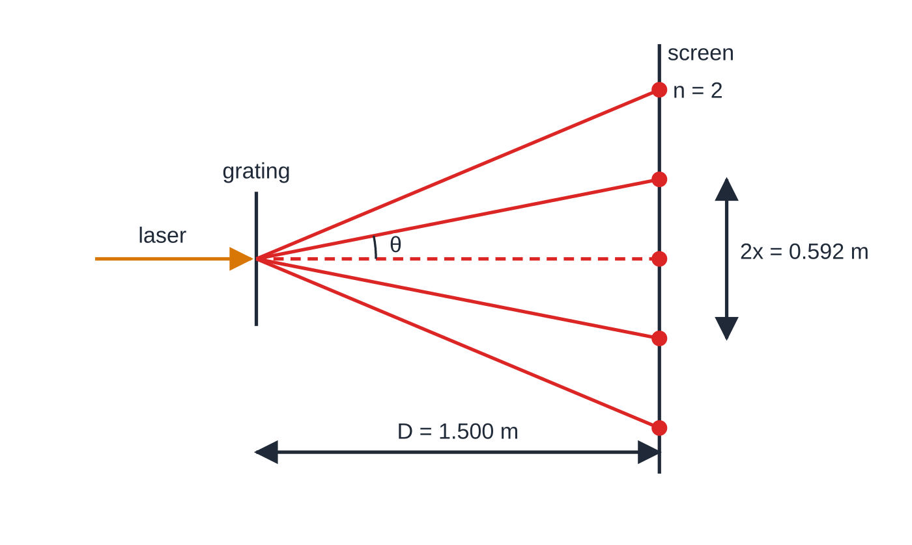
How do you measure the wavelength of light with a grating? (continued)
Section 5 of 12
Safety: never look into the laser beam or its reflections; use a low-power laser, keep the beam below eye level, remove shiny surfaces such as watches, and switch the laser off when not in use.
Measuring across the centre doubles the length measured, so the same reading uncertainty is a smaller percentage, and you avoid locating the exact centre of the central spot. A larger D or a higher order gives larger distances and smaller percentage uncertainties.
Top view to scale for worked example 5: 300 lines per mm, screen at 1.500 m. The first-order spots are 0.592 m apart and the second-order spots are 0.63 m from the centre.
Notes:
How do you measure the wavelength of light with a grating?. Full notes: https://examinerprep.com/notes/edexcel-ial-physics/diffraction-and-the-wave-nature-of-electrons/

Slide 22
How do you measure the wavelength of light with a grating? (continued)
Section 5 of 12
Grating angles are often too large for the small-angle approximation, so always find θ from tan θ= x/D, then take the sine.
Notes:
How do you measure the wavelength of light with a grating?. Full notes: https://examinerprep.com/notes/edexcel-ial-physics/diffraction-and-the-wave-nature-of-electrons/

Slide 23
How do you measure the wavelength of light with a grating? (continued)
Section 5 of 12 · Worked example 5 · Medium · Determine
WORKED EXAMPLE · QUESTION
A student uses a grating labelled 300 lines per mm. The screen is 1.500 m from the grating. Three measurements of the distance between the two first-order maxima are 0.592 m, 0.586 m and 0.598 m. Determine the wavelength of the laser light, and the percentage uncertainty in the mean distance between the first-order maxima.
SOLUTION
Mean and uncertainty (half the range): 2x = 0.592 m; uncertainty = (0.598 - 0.586) ÷2 = ±0.006 m.
Angle: x = 0.296 m; tan θ= 0.296 ÷1.500 = 0.197, so θ= 11.2°.
Wavelength: d = 1 ÷(300 ×10³) = 3.33 ×10⁻⁶ m; λ= 3.33 ×10⁻⁶ ×sin 11.2° = 6.45 × 10⁻⁷ m.
Percentage uncertainty: 0.006 ÷0.592 ×100 = 1.0%. Halving 2x to get x leaves the percentage uncertainty unchanged.
Notes:
How do you measure the wavelength of light with a grating?: Worked example 5. Full notes: https://examinerprep.com/notes/edexcel-ial-physics/diffraction-and-the-wave-nature-of-electrons/

Slide 24
How do you measure the wavelength of light with a grating? (continued)
Section 5 of 12
Common error
Writing "measure the distance between the dots" in a method. Name the instrument and what is repeated: "measure the distance between the two first-order maxima with a metre rule, repeat and take a mean".
Notes:
How do you measure the wavelength of light with a grating?. Full notes: https://examinerprep.com/notes/edexcel-ial-physics/diffraction-and-the-wave-nature-of-electrons/

Slide 25
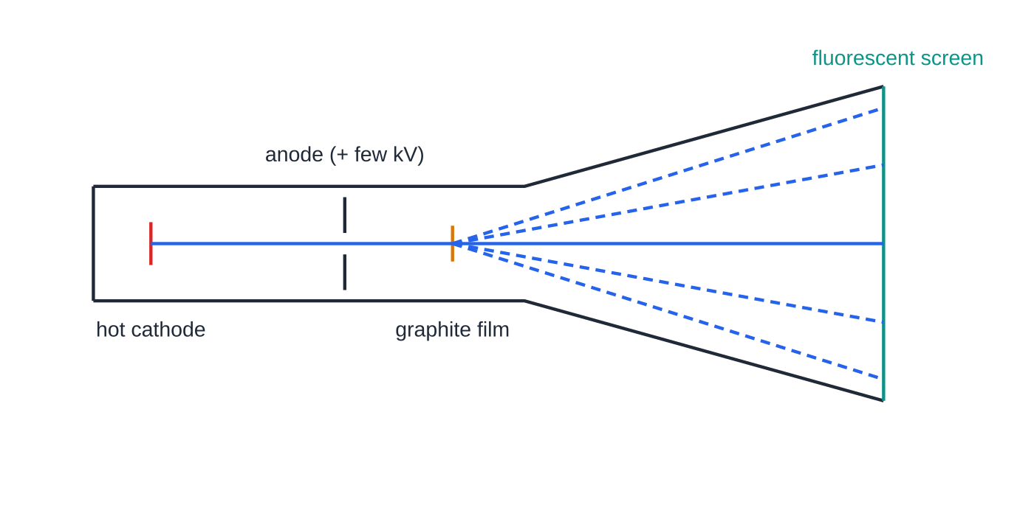
What shows that electrons behave as waves?
Section 6 of 12
In an electron diffraction tube, electrons released from a hot cathode are accelerated through a p.d. of a few kilovolts towards an anode and pass through a very thin film of graphite (carbon). On the fluorescent screen at the end you see a bright central spot surrounded by concentric bright rings.
The regularly spaced layers of atoms in the graphite act like a grating. The atomic spacing (about 10⁻¹⁰ m) is comparable with the electrons' wavelength, so the electrons diffract strongly.
An electron diffraction tube (not to scale). Electrons accelerated by the anode pass through thin graphite and spread out at particular angles, making rings on the screen.
Notes:
What shows that electrons behave as waves?. Full notes: https://examinerprep.com/notes/edexcel-ial-physics/diffraction-and-the-wave-nature-of-electrons/

Slide 26
What shows that electrons behave as waves? (continued)
Section 6 of 12
Rings arise because graphite is made of many tiny crystals at random orientations: each set of atomic layers sends electrons out at the same angle from the beam, in every direction around it.
Why this is evidence for waves: diffraction and superposition are wave behaviours. Particles travelling in straight lines would give a single bright patch, not rings with dark regions between them.
The test: increasing the accelerating p.d. makes the rings smaller. Faster electrons have more momentum, so (by λ= h/p) a shorter wavelength, and they diffract through smaller angles, exactly as a wave would.
Notes:
What shows that electrons behave as waves?. Full notes: https://examinerprep.com/notes/edexcel-ial-physics/diffraction-and-the-wave-nature-of-electrons/

Slide 27
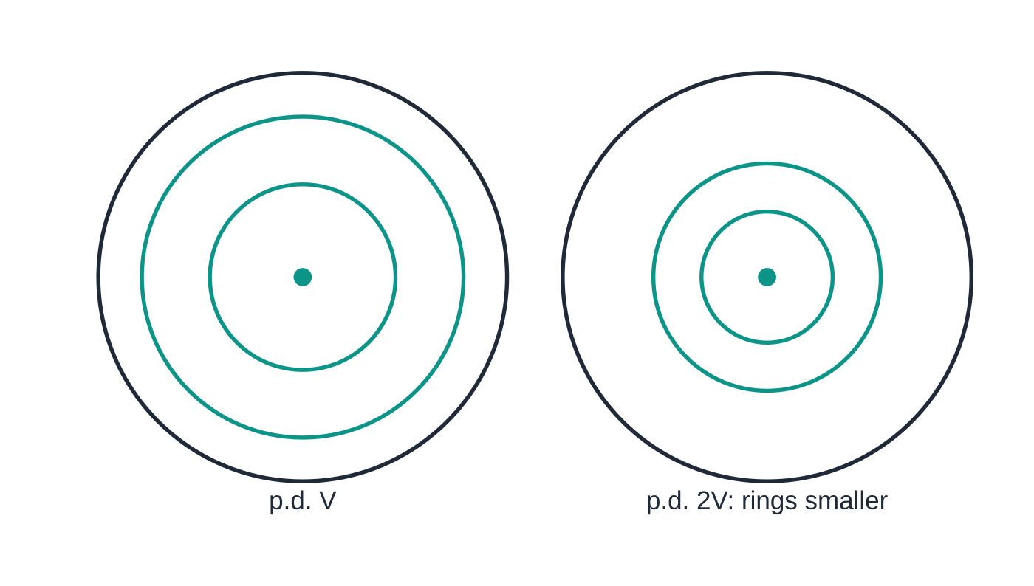
What shows that electrons behave as waves? (continued)
Section 6 of 12
Common error
Explaining the rings as electrons "bouncing off" or being repelled by atoms. Collisions or charge would not produce a regular pattern of bright and dark rings whose size depends on the electrons' speed. The explanation must use wavelength and superposition.
The screen at two accelerating p.d.s, drawn to the same scale. Doubling the p.d. reduces each ring radius by a factor of about 0.71 (≈ 1/√2), because the wavelength is proportional to 1/√V.
Notes:
What shows that electrons behave as waves?. Full notes: https://examinerprep.com/notes/edexcel-ial-physics/diffraction-and-the-wave-nature-of-electrons/

Slide 28
How do you calculate the de Broglie wavelength of an electron?
Section 7 of 12
λ= h/p
Here λ is the de Broglie wavelength (m), h the Planck constant, 6.63 ×10⁻³⁴ J s, and p the momentum of the particle (kg m s⁻¹), p = mv. Both λ= h/p and p = mv are in the formulae list. The relation applies to any moving particle, but large objects have such tiny wavelengths that their wave behaviour can never be observed.
Electrons accelerated through a potential difference
An electron accelerated from rest through a p.d. V gains kinetic energy equal to the work done on it:
eV = ½ mv²
This comes from V = W/Q and Eₖ = ½ mv²; derive it, as it is not given.
Notes:
How do you calculate the de Broglie wavelength of an electron?. Full notes: https://examinerprep.com/notes/edexcel-ial-physics/diffraction-and-the-wave-nature-of-electrons/

Slide 29
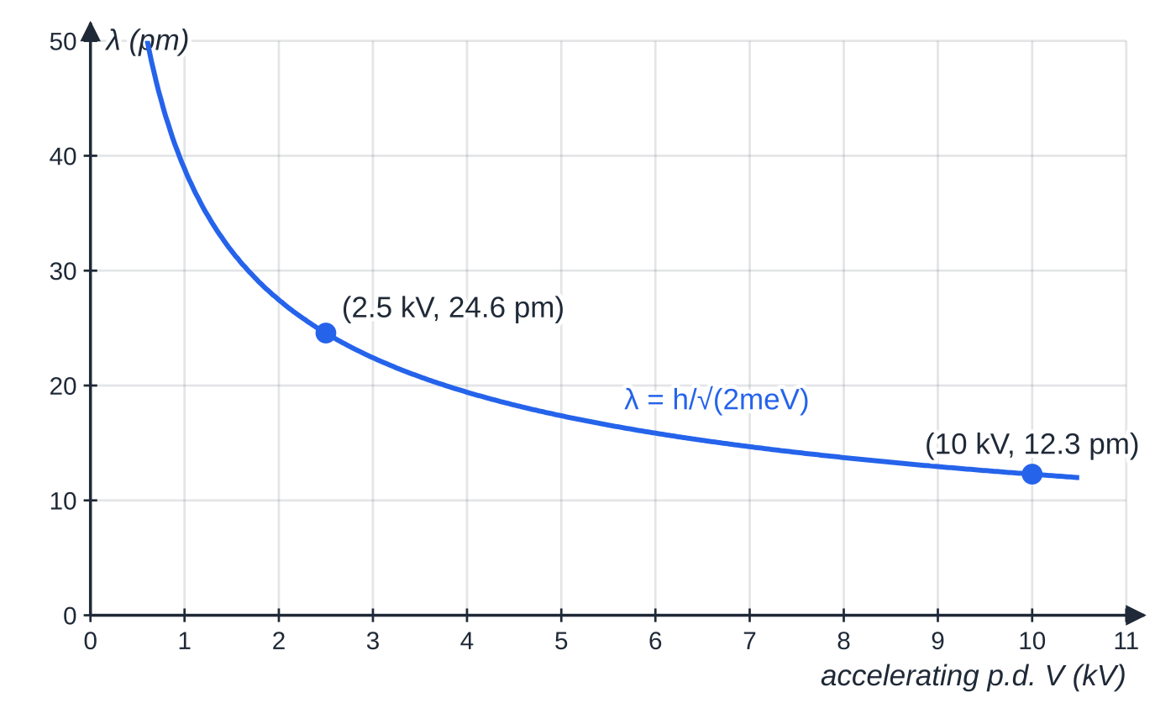
How do you calculate the de Broglie wavelength of an electron? (continued)
Section 7 of 12
Find v, then p = mv, then λ= h/p, each on its own line. Combining the steps gives λ= h/√(2meV), so λ∝1/√V: four times the p.d. halves the wavelength.
De Broglie wavelength of electrons against accelerating p.d. Quadrupling the p.d. from 2.5 kV to 10 kV halves the wavelength from 24.6 pm to 12.3 pm (1 pm = 10⁻¹² m).
Notes:
How do you calculate the de Broglie wavelength of an electron?. Full notes: https://examinerprep.com/notes/edexcel-ial-physics/diffraction-and-the-wave-nature-of-electrons/

Slide 30
How do you calculate the de Broglie wavelength of an electron? (continued)
Section 7 of 12 · Worked example 6 · Medium · Calculate
WORKED EXAMPLE · QUESTION
Electrons are accelerated from rest through a potential difference of 2.5 kV. e = 1.60 ×10⁻¹⁹ C, mₑ = 9.11 ×10⁻³¹ kg, h = 6.63 ×10⁻³⁴ J s. (a) Calculate the speed, the momentum and the de Broglie wavelength of the electrons. (b) Explain why these electrons are diffracted by a crystal with atomic spacing about 1 ×10⁻¹⁰ m.
SOLUTION
(a) Eₖ = eV = 1.60 ×10⁻¹⁹ ×2500 = 4.0 ×10⁻¹⁶ J. Speed: v = √(2 ×4.0 ×10⁻¹⁶ ÷9.11 ×10⁻³¹) = 2.96 ×10⁷ m s⁻¹. Momentum: p = 9.11 ×10⁻³¹ ×2.96 ×10⁷ = 2.70 ×10⁻²³ kg m s⁻¹. Wavelength: λ= 6.63 ×10⁻³⁴ ÷2.70 ×10⁻²³ = 2.46 × 10⁻¹¹ m.
(b) The spacing is only about 4 times λ: similar orders of magnitude, so significant diffraction.
The speed is about 10% of the speed of light, low enough for ½ mv² to be a good approximation at this level.
Notes:
How do you calculate the de Broglie wavelength of an electron?: Worked example 6. Full notes: https://examinerprep.com/notes/edexcel-ial-physics/diffraction-and-the-wave-nature-of-electrons/

Slide 31
How do you calculate the de Broglie wavelength of an electron? (continued)
Section 7 of 12 · Worked example 7 · Hard · Calculate
WORKED EXAMPLE · QUESTION
A researcher wants electrons with a de Broglie wavelength of 2.1 ×10⁻¹⁰ m, equal to an atomic spacing in a crystal under study. mₚ = 1.67 ×10⁻²⁷ kg. (a) Calculate the accelerating p.d. needed. (b) Calculate the speed a proton would need to have the same de Broglie wavelength.
SOLUTION
Momentum: p = h/λ= 6.63 ×10⁻³⁴ ÷2.1 ×10⁻¹⁰ = 3.16 ×10⁻²⁴ kg m s⁻¹.
(a) v = p/m = 3.47 ×10⁶ m s⁻¹; Eₖ = ½ mv² = 5.47 ×10⁻¹⁸ J. Then V = Eₖ/e = 5.47 ×10⁻¹⁸ ÷1.60 ×10⁻¹⁹ = 34 V (34.2 V).
(b) Same wavelength means the same momentum: vₚ = 3.16 ×10⁻²⁴ ÷1.67 ×10⁻²⁷ = 1.9 × 10³ m s⁻¹ (1891 m s⁻¹).
The proton is about 1830 times more massive, so it needs a speed about 1830 times smaller for the same momentum.
Notes:
How do you calculate the de Broglie wavelength of an electron?: Worked example 7. Full notes: https://examinerprep.com/notes/edexcel-ial-physics/diffraction-and-the-wave-nature-of-electrons/

Slide 32
Exam tips for 2.4
Section 8 of 12
Exam tip 1 — three parts to Huygens
A full Huygens answer says: each point on a wavefront is a source of secondary wavelets; the wavelets spread out at the wave speed; the new wavefront is the envelope (common tangent) of the wavelets. Then apply it to the edges of the gap.
Exam tip 2 — compare λ with the gap
For "will this wave diffract noticeably?", calculate λ (often from v = fλ) and compare it with the gap width. State the comparison explicitly: "λ is similar to the gap, so the wave spreads a lot."
Notes:
Exam tips for 2.4. Full notes: https://examinerprep.com/notes/edexcel-ial-physics/diffraction-and-the-wave-nature-of-electrons/

Slide 33
Exam tips for 2.4 (continued)
Section 8 of 12
Exam tip 3 — d first, in metres; highest order rounds down
Write d = 1/(lines per metre) as the first line: 300 lines per mm is 3.00 ×10⁵ lines per m, so d = 3.33 ×10⁻⁶ m. For the highest order take the whole-number part of d/λ, even if it is 3.94; double it and add 1 for the number of maxima.
Exam tip 4 — same wavelength means same momentum
Not the same speed or the same kinetic energy. Compare particles through p = h/λ first, then bring in their masses.
Notes:
Exam tips for 2.4. Full notes: https://examinerprep.com/notes/edexcel-ial-physics/diffraction-and-the-wave-nature-of-electrons/

Slide 34
Exam tips for 2.4 (continued)
Section 8 of 12
Exam tip 5 — evidence means "diffraction needs a wave"
To show electron diffraction is wave behaviour, link three ideas: a diffraction pattern (rings) is seen; diffraction is a property of waves; the wavelength from λ= h/p is similar to the atomic spacing, and the ring size changes with p.d. as the equation predicts.
Notes:
Exam tips for 2.4. Full notes: https://examinerprep.com/notes/edexcel-ial-physics/diffraction-and-the-wave-nature-of-electrons/

Slide 35
Common misconceptions
Section 9 of 12
Misconception | Why it is wrong | Correct idea
Diffraction changes the wavelength of a wave. | The wave stays in the same medium, so its speed and frequency, and therefore λ, are unchanged. | Diffraction changes the direction and shape of the wavefronts only.
The narrower the gap, the better the diffraction, always. | A gap much smaller than λ lets almost none of the wave through. | Spreading is greatest when the gap is similar to the wavelength.
θ in nλ= dsin θ is the angle between two maxima on opposite sides. | θ is measured from the straight-through direction. | The angle between the ±n maxima is 2θ; halve it first.
The second-order angle is twice the first-order angle. | sin θ is proportional to n, not θ. | sin θ₂ = 2sin θ₁; find each angle separately.
A grating gives as many orders as you like. | sin θ cannot exceed 1. | Highest order = whole-number part of d/λ.
Notes:
Common misconceptions. Full notes: https://examinerprep.com/notes/edexcel-ial-physics/diffraction-and-the-wave-nature-of-electrons/

Slide 36
Common misconceptions (continued)
Section 9 of 12
Misconception | Why it is wrong | Correct idea
Electrons are particles, so the rings must be caused by collisions. | Collisions cannot produce a regular bright-and-dark pattern that shrinks as the p.d. rises. | The rings are a diffraction pattern: electrons have wavelength λ= h/p.
Notes:
Common misconceptions. Full notes: https://examinerprep.com/notes/edexcel-ial-physics/diffraction-and-the-wave-nature-of-electrons/

Slide 37
How this topic connects
Section 10 of 12
2 Superposition and stationary waves
The grating equation is the condition for constructive superposition, path difference = nλ, using the same path-difference and phase ideas as two-source interference.
5 Photons, the photoelectric effect and line spectra
Light diffracts like a wave but also arrives as photons; electrons are particles that also diffract. Together these make up wave–particle duality, and h links both sides. A grating is also how line spectra are measured.
Unit 1 mechanics, Unit 4 particle physics
The electron calculation joins V = W/Q, Eₖ = ½ mv² and p = mv. To probe smaller structures such as nuclei, physicists use particles with much larger momentum, because a shorter de Broglie wavelength resolves finer detail.
Notes:
How this topic connects. Full notes: https://examinerprep.com/notes/edexcel-ial-physics/diffraction-and-the-wave-nature-of-electrons/

Slide 38
Key equations
Section 11 of 12
Equation | Use | In the formulae list?
nλ= dsin θ | angles of maxima from a diffraction grating; d and λ in m | Yes
λ= h/p | de Broglie wavelength of a moving particle; p in kg m s⁻¹ | Yes
p = mv | momentum | Yes
v = fλ | wavelength of a wave, to compare with a gap | Yes
Eₖ = ½ mv² and V = W/Q | energy of an accelerated electron | Yes
d = 1/(lines per metre) | slit spacing of a grating | No — learn it
nₘₐₓ = whole-number part of d/λ | highest order | No — derive it from sin θ ≤ 1
tan θ= x/D | angle from positions on a screen | No — derive it from the geometry
eV = ½ mv² | electron accelerated from rest through p.d. V | No — derive it from W = QV
Notes:
Key equations. Full notes: https://examinerprep.com/notes/edexcel-ial-physics/diffraction-and-the-wave-nature-of-electrons/

Slide 39
Check your understanding
Section 12 of 12
1. Explain why sound from a room can be heard through an open window from round the side, but the room cannot be seen from there.
2. A grating with 120 lines per mm gives a first-order maximum at 4.2°. Calculate the wavelength.
3. Why are the maxima from a diffraction grating much sharper than the fringes from two slits?
4. An electron has a de Broglie wavelength of 5.0 × 10⁻¹¹ m. Calculate its momentum.
5. In an electron diffraction tube, the accelerating p.d. is increased. Explain what happens to the rings.
6. Electrons are accelerated from rest through 10 kV. Calculate their de Broglie wavelength.
Notes:
Check your understanding: questions. Full notes: https://examinerprep.com/notes/edexcel-ial-physics/diffraction-and-the-wave-nature-of-electrons/

Slide 40
Check your understanding · answers
Section 12 of 12
1. Sound wavelengths (roughly 0.1 m to a few metres) are similar to the window width, so the sound diffracts strongly round the edges. Light wavelengths (about 10⁻⁷ m) are millions of times smaller than the window, so light diffracts negligibly and travels in almost straight lines.
2. d = 1 ÷1.20 ×10⁵ = 8.33 ×10⁻⁶ m; λ= 8.33 ×10⁻⁶ ×sin 4.2° = 6.10 × 10⁻⁷ m (610 nm).
3. With many slits, the waves only all arrive in phase when the path difference between neighbours is exactly nλ. Slightly away from that angle the many waves have a spread of phases and cancel, so each maximum is narrow; more slits also let through more light, so the maxima are bright.
4. p = h/λ= 6.63 ×10⁻³⁴ ÷5.0 ×10⁻¹¹ = 1.3 × 10⁻²³ kg m s⁻¹.
5. The electrons gain more kinetic energy, so they have greater speed and momentum. Their de Broglie wavelength h/p is shorter, so they are diffracted through smaller angles: the rings become smaller (closer to the centre).
Notes:
Check your understanding: answers. Full notes: https://examinerprep.com/notes/edexcel-ial-physics/diffraction-and-the-wave-nature-of-electrons/

Slide 41
Check your understanding · answers (continued)
Section 12 of 12
6. λ= h/√(2meV) = 6.63 ×10⁻³⁴ ÷√(2 ×9.11 ×10⁻³¹ ×1.60 ×10⁻¹⁹ ×10 000) = 1.23 × 10⁻¹¹ m, half the 2.5 kV value, as λ∝1/√V predicts.
Notes:
Check your understanding: answers. Full notes: https://examinerprep.com/notes/edexcel-ial-physics/diffraction-and-the-wave-nature-of-electrons/

Slide 42
Practice questions
5 original exam-style questions. Answers at the end of the deck.

Slide 43
Question 1
1 mark
Which observation provides evidence that electrons have wave properties?
A A beam of electrons is deflected by a magnetic field.
B Electrons are emitted from a metal surface when ultraviolet radiation falls on it.
C Electrons are released from a heated metal cathode.
D A beam of electrons passing through a thin graphite film produces rings on a fluorescent screen.
Notes:
Online with the full mark scheme: https://examinerprep.com/ial-physics-2-4-diffraction-and-the-wave-nature-of-electrons-questions#IALP-U2-4-A-07

Slide 44
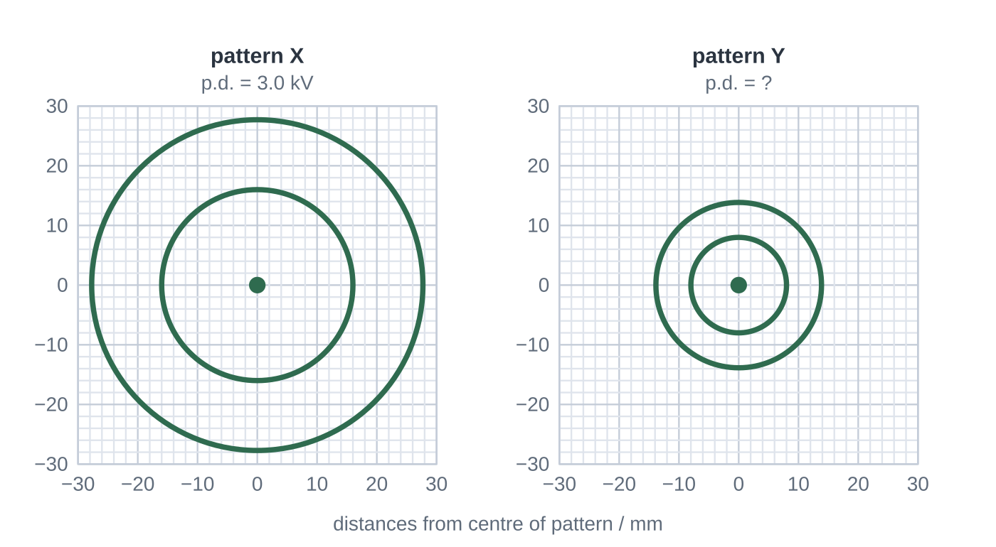
Question 2
1 mark
Figure 1 shows two electron diffraction patterns, X and Y, produced by the same graphite film in the same tube. Pattern X was obtained with an accelerating potential difference of 3.0 kV. The radius of each ring is proportional to the de Broglie wavelength of the electrons. Relativistic effects are negligible.
What accelerating potential difference was used for pattern Y?
A 0.75 kV
B 1.5 kV
C 6.0 kV
D 12 kV
Notes:
Online with the full mark scheme: https://examinerprep.com/ial-physics-2-4-diffraction-and-the-wave-nature-of-electrons-questions#IALP-U2-4-FA-08

Slide 45
Question 3
1 mark
A diffraction grating has 250 lines per mm.
What is the spacing between adjacent slits?
A 4.0 × 10⁻⁹ m
B 4.0 × 10⁻⁶ m
C 4.0 × 10⁻³ m
D 2.5 × 10⁵ m
Notes:
Online with the full mark scheme: https://examinerprep.com/ial-physics-2-4-diffraction-and-the-wave-nature-of-electrons-questions#IALP-U2-4-A-03

Slide 46
Question 4
5 marks
In an electron diffraction tube, electrons are accelerated through a potential difference of a few kilovolts and then pass through a very thin film of graphite before hitting a fluorescent screen.
(a) Describe the pattern seen on the screen. [1]
(b) Explain why this pattern is evidence that electrons behave as waves. [2]
(c) The accelerating potential difference is increased. State and explain what happens to the rings. [2]
Notes:
Online with the full mark scheme: https://examinerprep.com/ial-physics-2-4-diffraction-and-the-wave-nature-of-electrons-questions#IALP-U2-4-B-06

Slide 47
Question 5
6 marks
A student uses an electron diffraction tube to test the de Broglie equation. For each accelerating potential difference V she measures the radius r of the inner ring on the screen:
V = 2.0 kV: r = 16.9 mm; V = 3.0 kV: r = 13.7 mm; V = 4.0 kV: r = 11.9 mm; V = 5.0 kV: r = 10.6 mm.
For these small angles, r is proportional to the de Broglie wavelength λ of the electrons.
(a) An electron of mass m and charge e is accelerated from rest through a p.d. V. Show that its de Broglie wavelength is λ = h/√(2meV). [2]
(b) Use the data to show that r√V is approximately constant. [2]
(c) Explain how this result supports the idea that electrons behave as waves with λ = h/p. [1]
(d) Predict the radius of the inner ring at 6.0 kV. [1]
Notes:
Online with the full mark scheme: https://examinerprep.com/ial-physics-2-4-diffraction-and-the-wave-nature-of-electrons-questions#IALP-U2-4-B-09

Slide 48
Answers

Slide 49
Question 1 · answer
Answer D
Rings on the screen form a diffraction pattern. Diffraction is a wave property, so electron diffraction through graphite is evidence that electrons behave as waves. The other observations are explained by treating electrons as charged particles.
Notes:
Full mark scheme: https://examinerprep.com/ial-physics-2-4-diffraction-and-the-wave-nature-of-electrons-questions#IALP-U2-4-A-07

Slide 50
Question 2 · answer
Answer D
Inner ring radii: X = 16 mm, Y = 8 mm, so λ is halved for Y and the momentum p = h/λ is doubled. With eV = ½mv², p = √(2meV) ∝ √V, so doubling p needs 4 times the p.d.: 4 × 3.0 = 12 kV.
Notes:
Full mark scheme: https://examinerprep.com/ial-physics-2-4-diffraction-and-the-wave-nature-of-electrons-questions#IALP-U2-4-FA-08

Slide 51
Question 3 · answer
Answer B
250 lines per mm = 2.5 × 10⁵ lines per m, so d = 1 ÷ 2.5 × 10⁵ = 4.0 × 10⁻⁶ m.
Notes:
Full mark scheme: https://examinerprep.com/ial-physics-2-4-diffraction-and-the-wave-nature-of-electrons-questions#IALP-U2-4-A-03

Slide 52
Question 4 · answer
Mark scheme
a bright central spot surrounded by concentric bright rings (with dark regions between them)
the pattern is a diffraction pattern / is produced by diffraction and superposition
diffraction is a property of waves; the atomic spacing in graphite is similar to the electrons' wavelength
the electrons have greater speed / momentum, so their de Broglie wavelength λ = h/p is shorter
so they are diffracted through smaller angles and the rings become smaller
Notes:
Full mark scheme: https://examinerprep.com/ial-physics-2-4-diffraction-and-the-wave-nature-of-electrons-questions#IALP-U2-4-B-06

Slide 53
Question 5 · answer
Mark scheme
eV = ½mv², so v = √(2eV/m)
p = mv = √(2meV), and λ = h/p = h/√(2meV)
values of r√V (with V in kV): 23.9, 23.7, 23.8, 23.7 mm kV^(1/2)
these agree to within about 1%, so r√V is approximately constant
r ∝ 1/√V matches λ ∝ 1/√V from part (a), so the ring size depends on the p.d. exactly as the de Broglie wavelength does
r = 23.8 ÷ √6.0 = 9.7 mm
Notes:
Full mark scheme: https://examinerprep.com/ial-physics-2-4-diffraction-and-the-wave-nature-of-electrons-questions#IALP-U2-4-B-09

Slide 54
Keep practising
Notes for this topic
Questions on this topic
Build a printable test
ExaminerPrep is an independent tutoring service. It has been developed independently from and is not endorsed by the International Baccalaureate Organization. "International Baccalaureate", "IB" and "IB Diploma Programme" are registered trademarks of the IBO, used here for descriptive purposes only.
Pearson Edexcel and Cambridge are trademarks of their owners; ExaminerPrep is not affiliated with any exam board.

