Slide 1
EP
EDEXCEL IAL PHYSICS
5.9 Doppler shift, redshift and the universe
The full notes page in 11 sections · practice questions with answers · simulations
ExaminerPrep is an independent tutoring service. It has been developed independently from and is not endorsed by the International Baccalaureate Organization. "International Baccalaureate", "IB" and "IB Diploma Programme" are registered trademarks of the IBO, used here for descriptive purposes only.
Pearson Edexcel and Cambridge are trademarks of their owners; ExaminerPrep is not affiliated with any exam board.
Notes:
5.9 Doppler shift, redshift and the universe. Notes for this topic: https://examinerprep.com/notes/edexcel-ial-physics/doppler-shift-redshift-and-the-universe/

Slide 2
What this page covers
Overview
The Doppler effect for a moving source and for a moving observer, for sound and for light
Redshift and blueshift: z=Δλ/λ≈Δf/f≈v/c, and when the approximation holds
Hubble's law v=H₀d, Hubble graphs and the units of H₀
The age of the universe from 1/H₀, and why it is uncertain
Critical density and the possible fates of the universe (described qualitatively)
Galaxy rotation curves as evidence for dark matter
Notes:
What this page covers. Full notes: https://examinerprep.com/notes/edexcel-ial-physics/doppler-shift-redshift-and-the-universe/

Slide 3
In one minute
Key points
1. When a source moves towards you its waves are bunched, so the wavelength is shorter and the frequency higher; moving away, the wavelength is longer and the frequency lower, while the wave speed does not change.
2. For light from a receding galaxy every spectral line moves to a longer wavelength: redshift. z=Δλ/λ≈Δf/f≈v/c, valid when v≪c.
3. Hubble's law: recession speed is proportional to distance, v=H₀d. The gradient of a v–d graph is H₀.
4. If the expansion rate had always been the same, the age of the universe would be 1/H₀, about 14 billion years. Convert H₀ to s⁻¹ first.
5. Whether the expansion continues for ever depends on whether the mean density is above or below the critical density, which is hard to pin down because of dark matter.
6. Stars far from a galaxy's centre orbit much faster than the visible mass can explain: the flat rotation curve is the main evidence for dark matter.
Notes:
In one minute. Full notes: https://examinerprep.com/notes/edexcel-ial-physics/doppler-shift-redshift-and-the-universe/

Slide 4
What is the Doppler effect?
Section 1 of 11
This page follows one chain of reasoning: from a shifted line in a spectrum to the age of the universe. Measure a wavelength, turn it into a speed with z=v/c, combine speeds with distances to get the Hubble constant, and invert the Hubble constant to get an age. It starts with a familiar sound.
The Doppler effect is the change in the observed frequency and wavelength of a wave when the source and the observer move relative to each other.
A moving source
Each wavefront spreads out from the point where the source was when it was emitted, at the wave speed. The source's motion does not change the wave speed.
Between one wavefront and the next the source moves forward, so it emits each new wavefront closer to the one ahead.
Notes:
What is the Doppler effect?. Full notes: https://examinerprep.com/notes/edexcel-ial-physics/doppler-shift-redshift-and-the-universe/

Slide 5
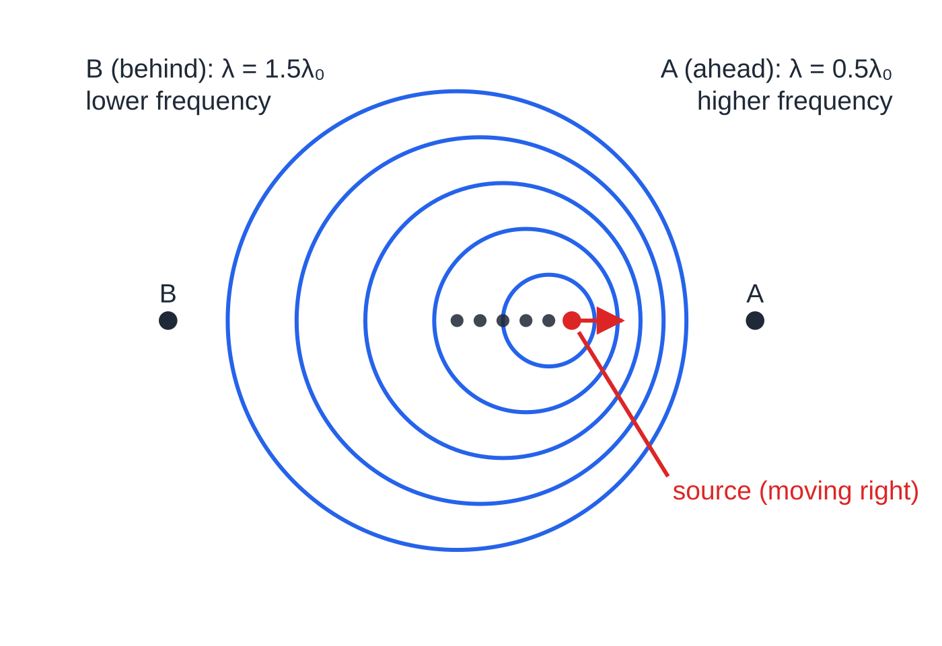
What is the Doppler effect? (continued)
Section 1 of 11
Ahead of the source the wavefronts are bunched: shorter wavelength, so a higher frequency reaches the observer (f=v/λ). Behind the source they are spread out: longer wavelength, lower frequency.
A moving observer
If the source is still and the observer moves towards it, the wavelength in the medium is unchanged, but the observer meets the wavefronts more often, so the observed frequency is higher. Moving away, the observer meets fewer wavefronts per second: lower frequency.
Wavefronts from a source moving at half the wave speed (exaggerated to make the effect visible). Each circle is centred where the source was when it emitted that wavefront (black dots). Observer A receives a wavelength of 0.5λ₀; observer B receives 1.5λ₀.
Notes:
What is the Doppler effect?. Full notes: https://examinerprep.com/notes/edexcel-ial-physics/doppler-shift-redshift-and-the-universe/

Slide 6
What is the Doppler effect? (continued)
Section 1 of 11
Only the relative motion along the line joining source and observer matters; motion at right angles to that line produces no shift (at everyday speeds).
Situation | Wavelength received | Frequency received | Everyday example
source and observer getting closer | shorter | higher | a siren sounds higher-pitched as it approaches
source and observer moving apart | longer | lower | the pitch drops as the vehicle passes and moves away
no relative motion along the line | unchanged | unchanged | riding in the vehicle with the siren
For light the same idea applies: light from a source moving away is shifted to longer wavelength (redshift); from a source moving towards us, to shorter wavelength (blueshift).
Notes:
What is the Doppler effect?. Full notes: https://examinerprep.com/notes/edexcel-ial-physics/doppler-shift-redshift-and-the-universe/

Slide 7
What is the Doppler effect? (continued)
Section 1 of 11
Doppler shifts are used in radar speed measurement and in Doppler ultrasound to measure blood flow, as well as in astronomy.
Common error — "the waves travel faster"
Saying the waves "travel faster" ahead of a moving source. The wave speed is set by the medium (or is c for light). What changes is the spacing of the wavefronts, and therefore the wavelength and the frequency received.
Notes:
What is the Doppler effect?. Full notes: https://examinerprep.com/notes/edexcel-ial-physics/doppler-shift-redshift-and-the-universe/

Slide 8
How is redshift measured and used?
Section 2 of 11
Atoms of each element absorb and emit at fixed wavelengths, measured in the laboratory: hydrogen, for example, at 410.2, 434.0, 486.1 and 656.3 nm.
In the spectrum of a star or galaxy the pattern of lines is recognisable, but the whole pattern is shifted. Shifted to longer wavelength: the source is moving away (redshift). Shifted to shorter wavelength: moving towards us (blueshift).
z=Δλ/λ≈Δf/f≈v/c
z is the redshift (no unit), Δλ = observed wavelength − laboratory (emitted) wavelength, λ the laboratory wavelength, Δf the change in frequency, f the emitted frequency, v the speed of the source along the line of sight and c=3.00×10⁸ m s⁻¹. This is in the formulae list. It is valid only when v is much less than c (in practice, z up to about 0.1). Δλ and λ must be in the same unit; nanometres cancel, so there is no need to convert to metres.
Notes:
How is redshift measured and used?. Full notes: https://examinerprep.com/notes/edexcel-ial-physics/doppler-shift-redshift-and-the-universe/

Slide 9
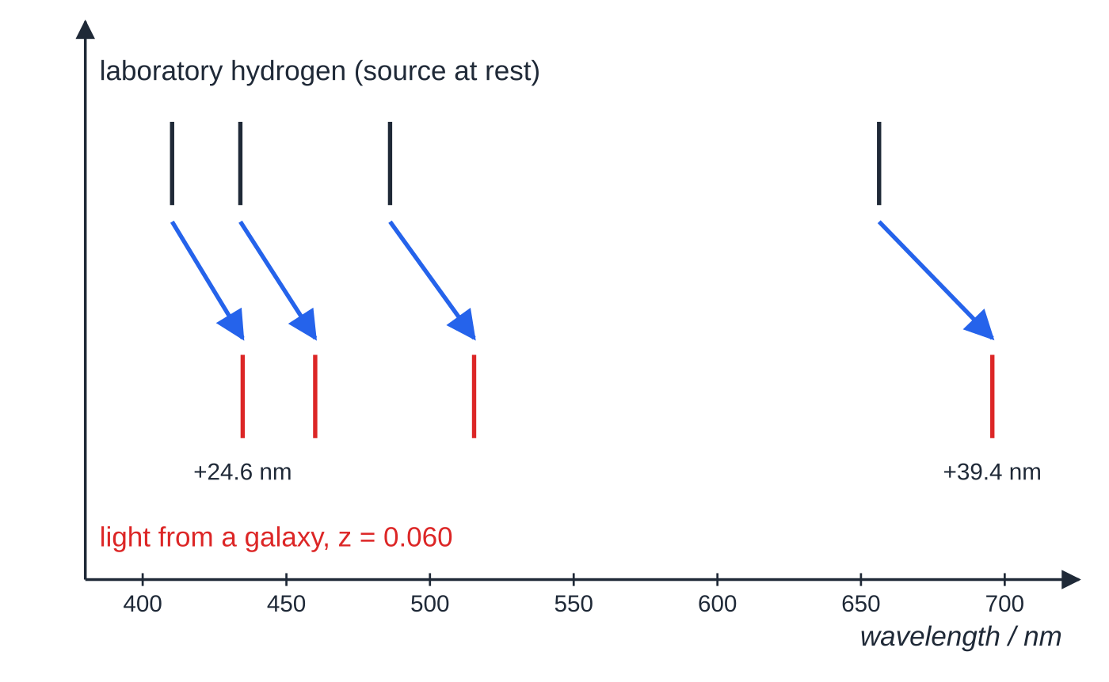
How is redshift measured and used? (continued)
Section 2 of 11
The same four hydrogen lines measured in the laboratory and in light from a galaxy with z = 0.060. Each line moves by z × its own wavelength, so the red line moves further (39.4 nm) than the violet one (24.6 nm). The ratio Δλ/λ is the same for every line.
Notes:
How is redshift measured and used?. Full notes: https://examinerprep.com/notes/edexcel-ial-physics/doppler-shift-redshift-and-the-universe/

Slide 10
How is redshift measured and used? (continued)
Section 2 of 11 · Worked example 1 · Easy · Calculate, state
WORKED EXAMPLE · QUESTION
A hydrogen absorption line has a laboratory wavelength of 656.3 nm. In the spectrum of a star the same line is at 655.62 nm. Calculate the speed of the star along the line of sight and state its direction of motion.
SOLUTION
The shift (observed − laboratory): Δλ=655.62-656.3=-0.68 nm
v=c Δλ/λ=3.00×10⁸×0.68÷656.3=3.11×10⁵≈ 3.1 × 10⁵ m s⁻¹
The wavelength is shorter, so this is a blueshift: the star is moving towards us. Δλ is known to only 2 significant figures (0.68 nm), so the speed is given to 2 s.f. even though the wavelengths have 4 and 5.
Notes:
How is redshift measured and used?: Worked example 1. Full notes: https://examinerprep.com/notes/edexcel-ial-physics/doppler-shift-redshift-and-the-universe/

Slide 11
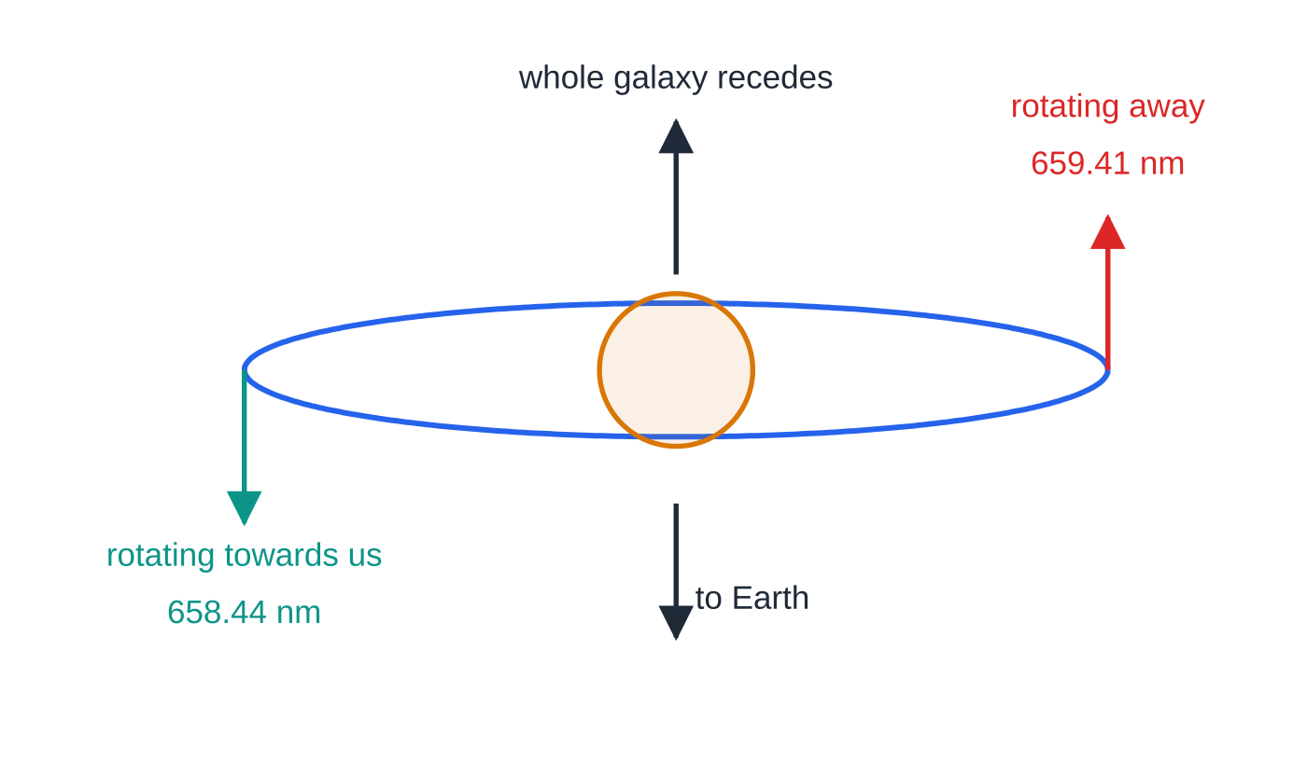
How is redshift measured and used? (continued)
Section 2 of 11
Rotating objects
When a galaxy or star rotates, one edge moves towards us and the other away, so lines from the two edges are shifted by different amounts. The average of the two shifts gives the speed of the whole object; half the difference gives the rotation speed.
A spiral galaxy seen edge-on (Worked example 2). Rotation carries one edge away from us and the other towards us, on top of the recession of the whole galaxy, so the two edges show different redshifts. The edge with the larger shift is the one rotating away.
Notes:
How is redshift measured and used?. Full notes: https://examinerprep.com/notes/edexcel-ial-physics/doppler-shift-redshift-and-the-universe/

Slide 12
How is redshift measured and used? (continued)
Section 2 of 11 · Worked example 2 · Medium · Determine
WORKED EXAMPLE · QUESTION
A spiral galaxy is seen edge-on. The hydrogen line of laboratory wavelength 656.3 nm is observed at 659.41 nm from one edge of the disc and at 658.44 nm from the opposite edge. Determine (a) the recession speed of the galaxy as a whole and (b) the orbital speed of the stars at the edge of the disc.
SOLUTION
Speed of each edge along the line of sight: v₁=3.00×10⁸×3.11÷656.3=1.42×10⁶ m s⁻¹; v₂=3.00×10⁸×2.14÷656.3=9.78×10⁵ m s⁻¹.
(a) The galaxy's own motion is the average: (v₁+v₂)÷2= 1.20 × 10⁶ m s⁻¹ away from us
(b) Rotation adds to one edge and subtracts from the other: (v₁-v₂)÷2=2.22×10⁵≈ 2.2 × 10⁵ m s⁻¹
Both edges are redshifted because the recession is larger than the rotation.
Notes:
How is redshift measured and used?: Worked example 2. Full notes: https://examinerprep.com/notes/edexcel-ial-physics/doppler-shift-redshift-and-the-universe/

Slide 13
How is redshift measured and used? (continued)
Section 2 of 11
Exam tip — always give the direction
A calculated speed with no statement "towards" or "away from" the observer is an incomplete answer to a Doppler question.
Notes:
How is redshift measured and used?. Full notes: https://examinerprep.com/notes/edexcel-ial-physics/doppler-shift-redshift-and-the-universe/

Slide 14
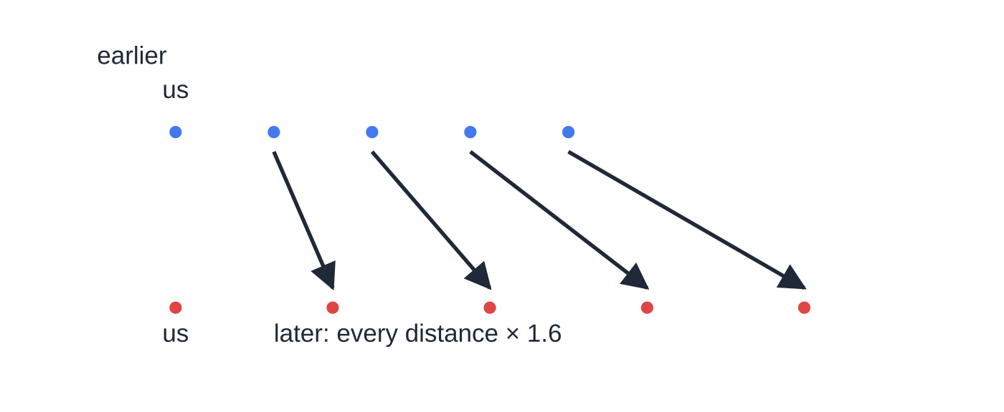
What is Hubble's law?
Section 3 of 11
Almost every galaxy beyond our local group shows a redshift: galaxies are moving away from us.
Plotting recession speed (from redshift) against distance (from standard candles) gives a straight line through the origin. The further away a galaxy is, the faster it is receding: the pattern expected if the universe is expanding.
Every observer, in any galaxy, would see the same pattern; it does not mean we are at the centre.
Uniform expansion. Every distance grows by the same factor, so a galaxy twice as far away moves twice as far in the same time: speed ∝ distance. Choose any other dot as "us" and the pattern is the same, so there is no centre.
Notes:
What is Hubble's law?. Full notes: https://examinerprep.com/notes/edexcel-ial-physics/doppler-shift-redshift-and-the-universe/

Slide 15
What is Hubble's law? (continued)
Section 3 of 11
v=H₀d
v is the recession speed, d the distance and H₀ the Hubble constant. Astronomers quote H₀ in km s⁻¹ Mpc⁻¹; in SI units it is s⁻¹. Hubble's law is in the formulae list. It applies to galaxies at cosmological distances (beyond a few megaparsecs); nearby galaxies have their own motions that can be larger than the Hubble recession, and a few are even blueshifted.
Converting the units
1 pc = 3.09 × 10¹⁶ m, so 1 Mpc = 3.09 × 10²² m. Then H₀ in s⁻¹ = (value in km s⁻¹ Mpc⁻¹) × 10³ ÷ (3.09 × 10²²). For example, 70 km s⁻¹ Mpc⁻¹ = 70 × 10³ ÷ 3.09 × 10²² = 2.27 × 10⁻¹⁸ s⁻¹.
Notes:
What is Hubble's law?. Full notes: https://examinerprep.com/notes/edexcel-ial-physics/doppler-shift-redshift-and-the-universe/

Slide 16
What is Hubble's law? (continued)
Section 3 of 11 · Worked example 3 · Medium · Calculate
WORKED EXAMPLE · QUESTION
The spectrum of a galaxy has a redshift of 0.0284. Take H₀=70 km s⁻¹ Mpc⁻¹ and 1 Mpc = 3.09 × 10²² m. Calculate (a) the recession speed, (b) the distance to the galaxy in Mpc and in metres and (c) roughly how long ago the light left the galaxy, in years (1 year = 3.15 × 10⁷ s).
SOLUTION
(a) v=zc=0.0284×3.00×10⁸= 8.52 × 10⁶ m s⁻¹ = 8520 km s⁻¹
(b) Keep v in km s⁻¹ to match the units of H₀: d=v/H₀=8520÷70=121.7 Mpc≈ 122 Mpc =121.7×3.09×10²²= 3.76 × 10²⁴ m
(c) time = distance ÷ c =3.76×10²⁴÷3.00×10⁸=1.25×10¹⁶ s≈ 4.0 × 10⁸ years. This is an estimate: the universe has expanded a little while the light was travelling.
Notes:
What is Hubble's law?: Worked example 3. Full notes: https://examinerprep.com/notes/edexcel-ial-physics/doppler-shift-redshift-and-the-universe/

Slide 17
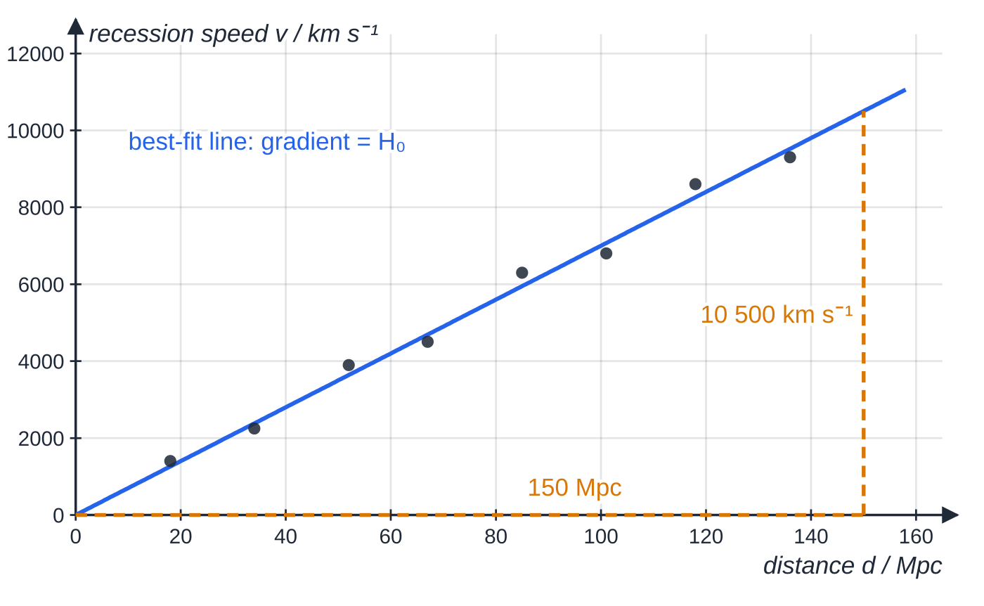
What is Hubble's law? (continued)
Section 3 of 11
Common error — mixing units in v = H₀d
With H₀ in km s⁻¹ Mpc⁻¹, the speed must be in km s⁻¹ and the distance comes out in Mpc. To get SI units, convert H₀ to s⁻¹ first, then use v in m s⁻¹ and d in m.
A Hubble graph for eight galaxies (illustrative data). The best-fit line passes through the origin; its gradient, from the large triangle, is 10 500 ÷ 150 = 70.0 km s⁻¹ Mpc⁻¹. Individual galaxies scatter about the line.
Notes:
What is Hubble's law?. Full notes: https://examinerprep.com/notes/edexcel-ial-physics/doppler-shift-redshift-and-the-universe/

Slide 18
How old is the universe?
Section 4 of 11
Run the expansion backwards. A galaxy now at distance d, receding at speed v, was at our position a time d/v ago. From Hubble's law, d/v=1/H₀: the same for every galaxy, which is why it can be read as the age of the universe. This assumes the galaxies have always moved at their present speeds (a constant rate of expansion).
t≈1/H₀
Not in the formulae list (No — derive it from v=H₀d and time = distance ÷ speed). H₀ must be in s⁻¹ to give the age in seconds.
Notes:
How old is the universe?. Full notes: https://examinerprep.com/notes/edexcel-ial-physics/doppler-shift-redshift-and-the-universe/

Slide 19
How old is the universe? (continued)
Section 4 of 11 · Worked example 4 · Medium · Determine, estimate
WORKED EXAMPLE · QUESTION
Use the Hubble graph above to determine the Hubble constant, and estimate the age of the universe in years. 1 Mpc = 3.09 × 10²² m; 1 year = 3.15 × 10⁷ s.
SOLUTION
Gradient from the large triangle: H₀=10 500÷150= 70.0 km s⁻¹ Mpc⁻¹
Convert to SI: H₀=70.0×10³÷3.09×10²²=2.27×10⁻¹⁸ s⁻¹
Age ≈ 1/H₀=1÷2.27×10⁻¹⁸=4.41×10¹⁷ s= 1.40 × 10¹⁰ years (about 14 billion years).
Read the gradient from the best-fit line, not from one data point: individual galaxies scatter about the line because of their own motions and errors in their distances.
Notes:
How old is the universe?: Worked example 4. Full notes: https://examinerprep.com/notes/edexcel-ial-physics/doppler-shift-redshift-and-the-universe/

Slide 20
How old is the universe? (continued)
Section 4 of 11
Why the age is uncertain
The value of H₀. Distances to galaxies depend on standard candles whose luminosities are themselves uncertain, so H₀ has been revised many times. Different methods today give values from about 67 to 73 km s⁻¹ Mpc⁻¹: ages from 1/H₀ of 13.4 to 14.6 billion years.
The expansion rate has not been constant. Gravity between all the matter in the universe slows the expansion. If the galaxies were moving faster in the past, they reached their present separations in less time than 1/H₀, so 1/H₀ overestimates the age.
How much the expansion has slowed depends on the mean density of the universe, which depends on how much dark matter there is.
Any estimate of the age must be at least as large as the ages of the oldest stars, which provides a cross-check.
Notes:
How old is the universe?. Full notes: https://examinerprep.com/notes/edexcel-ial-physics/doppler-shift-redshift-and-the-universe/

Slide 21
What will happen to the universe?
Section 5 of 11
The expansion is opposed by the gravitational attraction of all the mass in the universe, like a ball thrown upwards slowing as it rises. Whether the ball comes back depends on how hard it was thrown compared with how strong gravity is; for the universe, the deciding quantity is the density.
The critical density is the mean density at which gravity would just stop the expansion after an infinite time.
Mean density ρ | Name | Fate (gravity alone)
ρ > critical density | closed | expansion slows, stops and reverses; the universe ends in a collapse
ρ = critical density | flat | expansion slows for ever, approaching zero rate
ρ < critical density | open | expansion continues for ever
Notes:
What will happen to the universe?. Full notes: https://examinerprep.com/notes/edexcel-ial-physics/doppler-shift-redshift-and-the-universe/

Slide 22
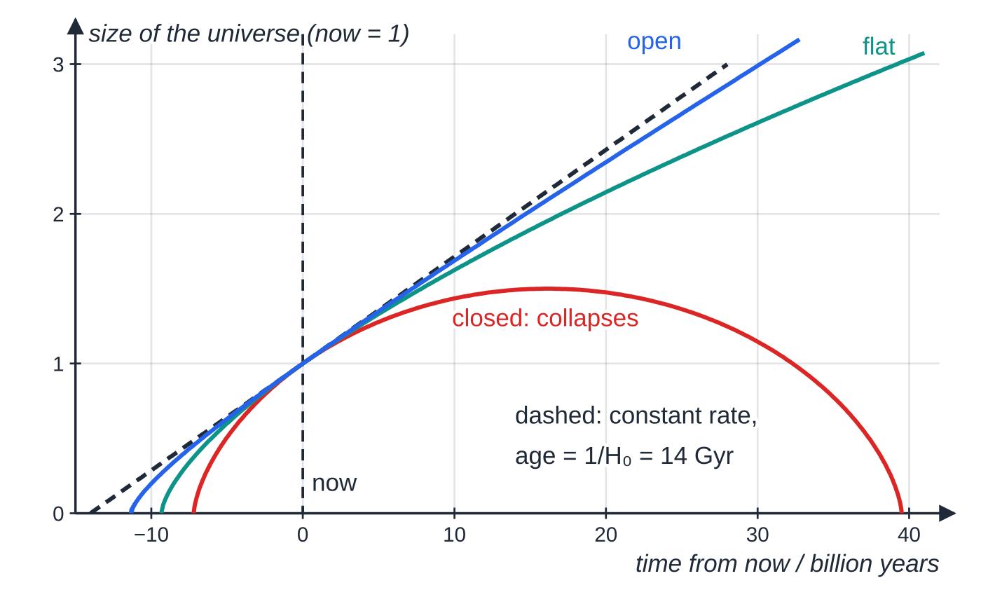
What will happen to the universe? (continued)
Section 5 of 11
For H₀=70 km s⁻¹ Mpc⁻¹ the critical density is about 9.2 × 10⁻²⁷ kg m⁻³, the mass of about 5.5 hydrogen atoms in every cubic metre. (You do not need to calculate it.)
The fate depends on the density relative to the critical density, and the critical density itself depends on H₀, so uncertainty in H₀ feeds into the prediction as well.
The visible matter (stars, gas, dust) adds up to only a few per cent of the critical density.
Three model universes with the same expansion rate today (H₀ = 70 km s⁻¹ Mpc⁻¹), computed for matter and gravity alone. Denser universes have slowed more, so they are younger: the closed model began 7.2, the flat one 9.3 and the open one 11.3 billion years ago, all less than 1/H₀ = 14 billion years.
Notes:
What will happen to the universe?. Full notes: https://examinerprep.com/notes/edexcel-ial-physics/doppler-shift-redshift-and-the-universe/

Slide 23
What will happen to the universe? (continued)
Section 5 of 11
Whether the universe is open, flat or closed therefore depends on how much dark matter exists, which can be detected only through its gravitational effects.
Beyond this page: observations of distant supernovae suggest that the expansion is in fact speeding up, which needs something beyond matter and gravity ("dark energy"). This is why the fate is still described as uncertain.
Exam tip — link the ideas in a chain
In a "discuss the fate of the universe" answer: fate depends on mean density compared with critical density → density is uncertain because of dark matter → age depends on how much the expansion has slowed, and on H₀. Isolated facts are worth less than a linked argument.
Notes:
What will happen to the universe?. Full notes: https://examinerprep.com/notes/edexcel-ial-physics/doppler-shift-redshift-and-the-universe/

Slide 24
What is the evidence for dark matter?
Section 6 of 11
Dark matter is matter that does not emit or absorb electromagnetic radiation in amounts we can detect, so it is seen only through its gravitational effect.
A star in a circular orbit about a galaxy's centre has its centripetal force provided by gravity from the mass M inside its orbit: GMm/r²=mv²/r, so v=√(GM/r).
Most of the visible matter is concentrated near the centre. Beyond it, M should stay almost constant, so the orbital speed should fall as 1/√r.
Measured with Doppler shifts, the orbital speeds of stars and gas clouds stay roughly constant out to large distances: the rotation curve is flat.
A flat curve needs M to increase in proportion to r: there must be large amounts of unseen mass far out from the centre.
Notes:
What is the evidence for dark matter?. Full notes: https://examinerprep.com/notes/edexcel-ial-physics/doppler-shift-redshift-and-the-universe/

Slide 25
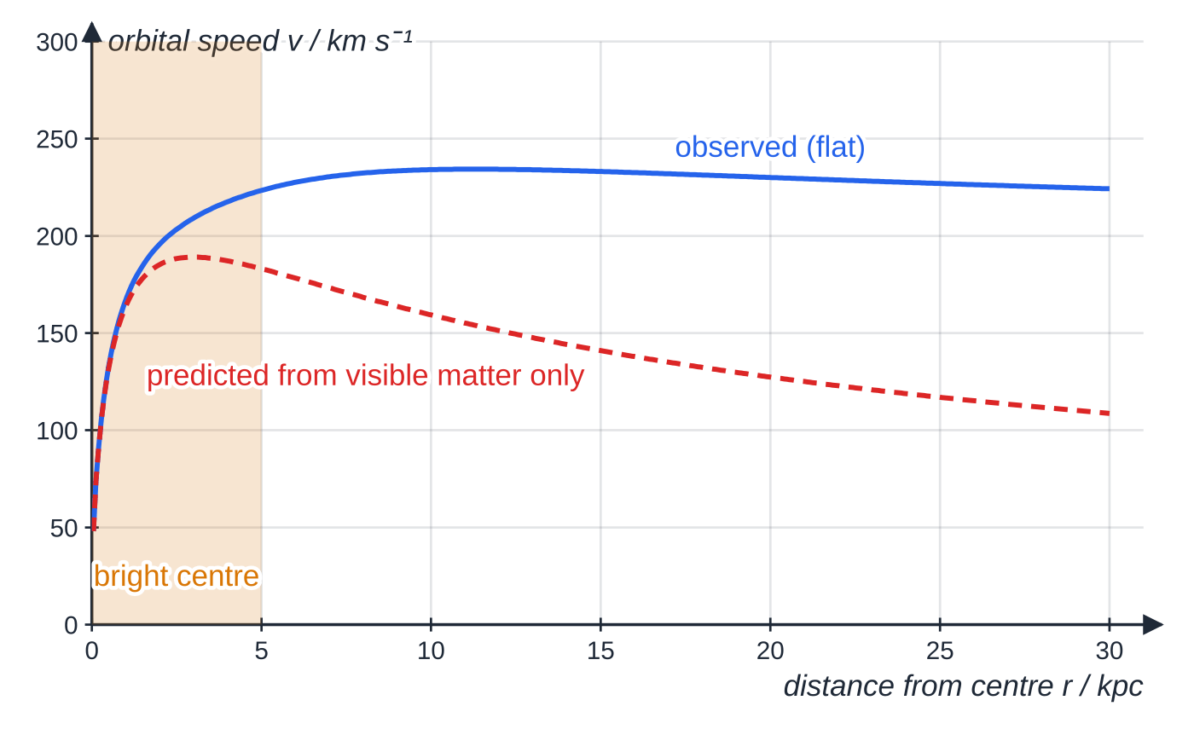
What is the evidence for dark matter? (continued)
Section 6 of 11
Rotation curve of a spiral galaxy, computed from a simple model. Beyond the bright central region the speed predicted from the visible matter falls off (to about 120 km s⁻¹ at 25 kpc), while the observed speed stays above 200 km s⁻¹.
Notes:
What is the evidence for dark matter?. Full notes: https://examinerprep.com/notes/edexcel-ial-physics/doppler-shift-redshift-and-the-universe/

Slide 26
What is the evidence for dark matter? (continued)
Section 6 of 11 · Worked example 5 · Hard · Calculate, estimate
WORKED EXAMPLE · QUESTION
Gas clouds orbit a spiral galaxy at 25 kpc from its centre with a speed of 220 km s⁻¹, measured from the Doppler shift of their 21 cm radio emission. The visible stars and gas have a total mass of 1.0 × 10¹¹ solar masses, almost all of it well inside this radius. 1 kpc = 3.09 × 10¹⁹ m; solar mass = 1.99 × 10³⁰ kg; G=6.67×10⁻¹¹ N m² kg⁻². (a) Calculate the mass inside the orbit. (b) Calculate the orbital speed expected if only the visible mass were present. (c) Estimate the fraction of the mass that is not visible.
SOLUTION
(a) Gravity provides the centripetal force, so M=v²r/G. r=25×3.09×10¹⁹=7.725×10²⁰ m; M=(2.2×10⁵)²×7.725×10²⁰÷6.67×10⁻¹¹=5.61×10⁴¹ kg= 2.82 × 10¹¹ solar masses
(b) v=√((6.67×10⁻¹¹×1.0×10¹¹×1.99×10³⁰)/(7.725×10²⁰))= 1.31 × 10⁵ m s⁻¹ (about 131 km s⁻¹)
(c) Fraction not visible =1-1.0×10¹¹÷2.82×10¹¹= 0.64, about two-thirds
Notes:
What is the evidence for dark matter?: Worked example 5. Full notes: https://examinerprep.com/notes/edexcel-ial-physics/doppler-shift-redshift-and-the-universe/

Slide 27
What is the evidence for dark matter? (continued)
Section 6 of 11 · Worked example 5 · Hard · Calculate, estimate (continued)
The measured speed is far above the 131 km s⁻¹ that the visible mass could hold in orbit; without extra unseen mass the gas would escape.
Notes:
What is the evidence for dark matter?: Worked example 5. Full notes: https://examinerprep.com/notes/edexcel-ial-physics/doppler-shift-redshift-and-the-universe/

Slide 28
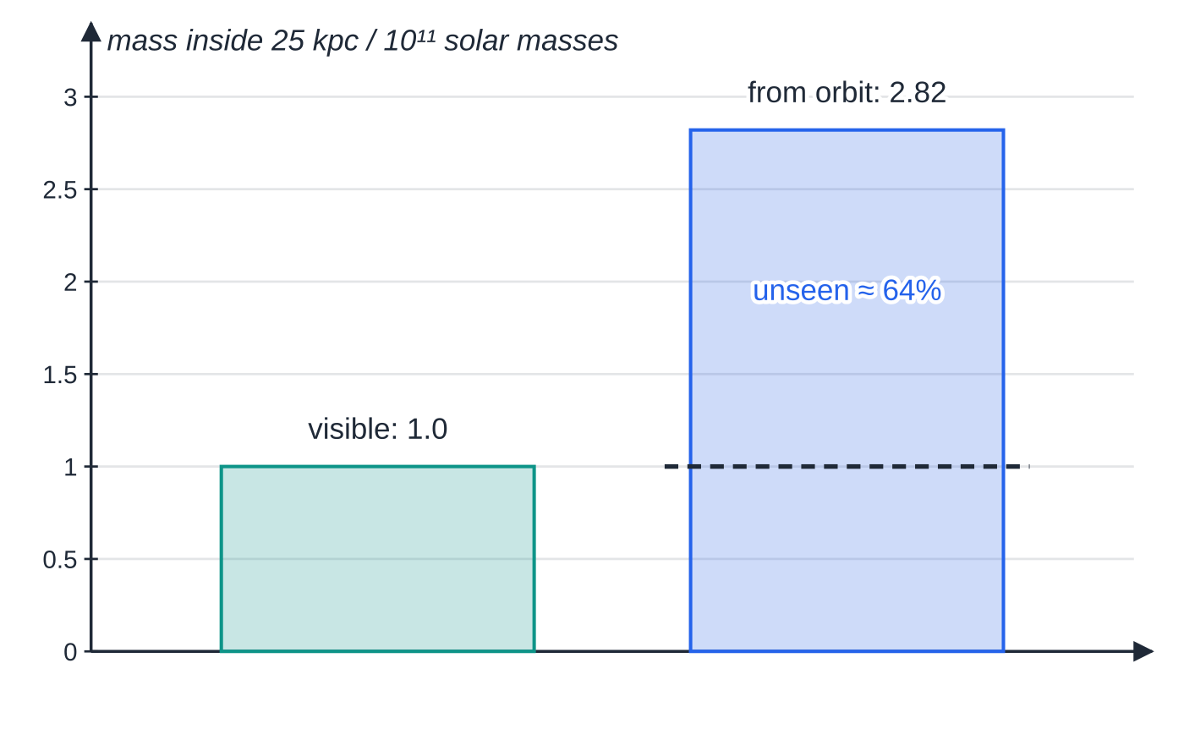
What is the evidence for dark matter? (continued)
Section 6 of 11
Common error — dark matter is not dust or black holes
Writing that dark matter is "matter in black holes" or "dust that blocks light". Dust absorbs light and glows in the infrared, so it is detectable; dark matter neither emits nor absorbs radiation that we detect. What it is remains unknown: the evidence is only its gravity.
Worked example 5 in one picture: the mass needed to hold the gas in orbit is nearly three times the mass we can see.
Notes:
What is the evidence for dark matter?. Full notes: https://examinerprep.com/notes/edexcel-ial-physics/doppler-shift-redshift-and-the-universe/

Slide 29
Exam tips for 5.9
Section 7 of 11
Exam tip 1 — subtract in the right order
Δλ = observed − laboratory. A positive answer is a redshift (moving away); a negative answer is a blueshift (moving towards). Divide by the laboratory wavelength.
Exam tip 2 — check v ≪ c
After using z=v/c, check that your speed is well below 3.00 × 10⁸ m s⁻¹. If z is large (say above 0.1), state that the approximation is no longer reliable.
Exam tip 3 — convert H₀ before finding an age
Write the conversion as a separate line: × 10³ for km to m, ÷ 3.09 × 10²² for Mpc to m. Then 1/H₀ is in seconds; divide by 3.15 × 10⁷ for years.
Notes:
Exam tips for 5.9. Full notes: https://examinerprep.com/notes/edexcel-ial-physics/doppler-shift-redshift-and-the-universe/

Slide 30
Exam tips for 5.9 (continued)
Section 7 of 11
Exam tip 4 — gradients from Hubble graphs
The best-fit line on a Hubble graph should pass through the origin. Read the gradient from a large triangle drawn on the line, and quote it in the units of the two axes, which become the units of H₀.
Exam tip 5 — extended answers on cosmology
Plan a 6-mark answer as a chain of linked points: what is measured, why it is uncertain, and what that uncertainty changes. Use the key terms (critical density, dark matter, rotation curve, Hubble constant) accurately.
Notes:
Exam tips for 5.9. Full notes: https://examinerprep.com/notes/edexcel-ial-physics/doppler-shift-redshift-and-the-universe/

Slide 31
Common misconceptions
Section 8 of 11
Misconception | Why it is wrong | Correct idea
Redshift means the light has turned red. | Every line moves to a longer wavelength; blue light may still be blue, and ultraviolet may move into the visible. | Redshift is an increase in wavelength by the factor (1+z).
A moving source changes the speed of its waves. | Wave speed depends on the medium (or is c for light). | Only the wavelength and frequency received change.
All the lines in a spectrum shift by the same number of nanometres. | The shift is Δλ=zλ, which depends on λ. | The fractional shift Δλ/λ is the same for every line.
Hubble's law shows we are at the centre of the universe. | In a uniformly expanding universe every observer sees the same pattern. | All galaxies move apart from each other; there is no centre.
1/H₀ is the exact age of the universe. | It assumes a constant expansion rate. | It is an estimate; a slowing expansion makes the true age less than 1/H₀.
Notes:
Common misconceptions. Full notes: https://examinerprep.com/notes/edexcel-ial-physics/doppler-shift-redshift-and-the-universe/

Slide 32
Common misconceptions (continued)
Section 8 of 11
Misconception | Why it is wrong | Correct idea
Stars further from a galaxy's centre should orbit faster because they have further to go. | Orbital speed is set by the mass inside the orbit: v=√(GM/r). | With visible mass alone, speed should fall with distance; the flat observed curve points to dark matter.
Notes:
Common misconceptions. Full notes: https://examinerprep.com/notes/edexcel-ial-physics/doppler-shift-redshift-and-the-universe/

Slide 33
How this topic connects
Section 9 of 11
8 Stars, distances and the HR diagram
Hubble's law needs distances, and those come from parallax and standard candles, using I=L/4πd². Errors in those distances are the main reason H₀ is uncertain.
7 Gravitational fields and orbits
The rotation-curve argument is the orbit equation v=√(GM/r) applied to stars around a galaxy instead of satellites around a planet.
Photons, line spectra and progressive waves (Unit 2)
Redshift is measured on the line spectra produced by electron transitions between energy levels; the laboratory wavelengths come from hf=E₁-E₂. The Doppler argument uses only v=fλ: the wave speed is fixed, so a change in wavelength must mean a change in frequency.
Notes:
How this topic connects. Full notes: https://examinerprep.com/notes/edexcel-ial-physics/doppler-shift-redshift-and-the-universe/

Slide 34
Key equations
Section 10 of 11
Equation | Use | In the formulae list?
z=Δλ/λ≈Δf/f≈v/c | speed of a source along the line of sight from a spectral shift (v≪c); c=3.00×10⁸ m s⁻¹ | yes
v=H₀d | recession speed and distance of a galaxy; gradient of a Hubble graph (H₀ in km s⁻¹ Mpc⁻¹ or s⁻¹) | yes
t≈1/H₀ | age of the universe, assuming constant expansion | no — derive it from v=H₀d
v=√(GM/r) | orbital speed around a mass M; mass from a rotation curve | no — derive it from F=Gm₁m₂/r² and F=mv²/r
v=fλ | linking a change in wavelength to a change in frequency | yes
Notes:
Key equations. Full notes: https://examinerprep.com/notes/edexcel-ial-physics/doppler-shift-redshift-and-the-universe/

Slide 35
Check your understanding
Section 11 of 11
1. A car sounding its horn drives past you at constant speed. Describe how the pitch you hear changes, and explain why.
2. A line of laboratory wavelength 500.0 nm is observed at 501.5 nm in light from a galaxy. Calculate the galaxy's speed and state its direction.
3. A galaxy has a redshift of 0.0125. Taking H₀ = 68 km s⁻¹ Mpc⁻¹, calculate its distance in Mpc.
4. Estimates of H₀ once ranged from 60 to 80 km s⁻¹ Mpc⁻¹. What range of ages does 1/H₀ give?
5. Explain how the rotation curves of spiral galaxies suggest that dark matter exists.
Notes:
Check your understanding: questions. Full notes: https://examinerprep.com/notes/edexcel-ial-physics/doppler-shift-redshift-and-the-universe/

Slide 36
Check your understanding · answers
Section 11 of 11
1. The pitch is higher while the car approaches and drops to a lower pitch as it passes and moves away. Approaching, the wavefronts are bunched (shorter wavelength, higher frequency); receding, they are spread out (longer wavelength, lower frequency). The change happens as the car passes you, when its motion along your line of sight reverses.
2. v=3.00×10⁸×1.5÷500.0= 9.0 × 10⁵ m s⁻¹, moving away (redshift).
3. v=0.0125×3.00×10⁵ km s⁻¹=3750 km s⁻¹; d=3750÷68= 55 Mpc.
4. 1/H₀= 1.6 × 10¹⁰ years for 60 and 1.2 × 10¹⁰ years for 80 km s⁻¹ Mpc⁻¹. A larger Hubble constant means a faster expansion and a younger universe.
5. Orbital speed depends on the mass inside the orbit, v=√(GM/r). Most visible mass is near the centre, so speeds should fall with distance beyond it. Measured (Doppler) speeds stay roughly constant, so the mass inside the orbit must keep increasing with r: there is mass far out that we cannot see.
Notes:
Check your understanding: answers. Full notes: https://examinerprep.com/notes/edexcel-ial-physics/doppler-shift-redshift-and-the-universe/

Slide 37
Practice questions
5 original exam-style questions. Answers at the end of the deck.

Slide 38
Question 1
1 mark
A galaxy is 85 Mpc from the Earth. The Hubble constant is 68 km s⁻¹ Mpc⁻¹.
What redshift z is expected in the light from this galaxy?
A 4.2 × 10⁻⁶
B 1.9 × 10⁻⁵
C 1.9 × 10⁻²
D 5.2 × 10¹
Notes:
Online with the full mark scheme: https://examinerprep.com/ial-physics-5-9-doppler-shift-redshift-and-the-universe-questions#IALP-U5-9-A-03

Slide 39
Question 2
1 mark
The Hubble constant is taken as 72 km s⁻¹ Mpc⁻¹. 1 Mpc = 3.09 × 10²² m. 1 year = 3.15 × 10⁷ s.
Assuming the universe has always expanded at the same rate, what is its age?
A 1.4 × 10⁴ years
B 1.4 × 10¹⁰ years
C 1.4 × 10¹³ years
D 4.3 × 10¹⁷ years
Notes:
Online with the full mark scheme: https://examinerprep.com/ial-physics-5-9-doppler-shift-redshift-and-the-universe-questions#IALP-U5-9-A-04

Slide 40
Question 3
1 mark
Considering gravity alone, the mean density of a model universe is greater than the critical density.
What is the ultimate fate of this universe?
A It expands for ever at a constant rate.
B It expands for ever, with the rate of expansion approaching zero.
C Its expansion stops and it then contracts.
D Its expansion speeds up for ever.
Notes:
Online with the full mark scheme: https://examinerprep.com/ial-physics-5-9-doppler-shift-redshift-and-the-universe-questions#IALP-U5-9-A-06

Slide 41
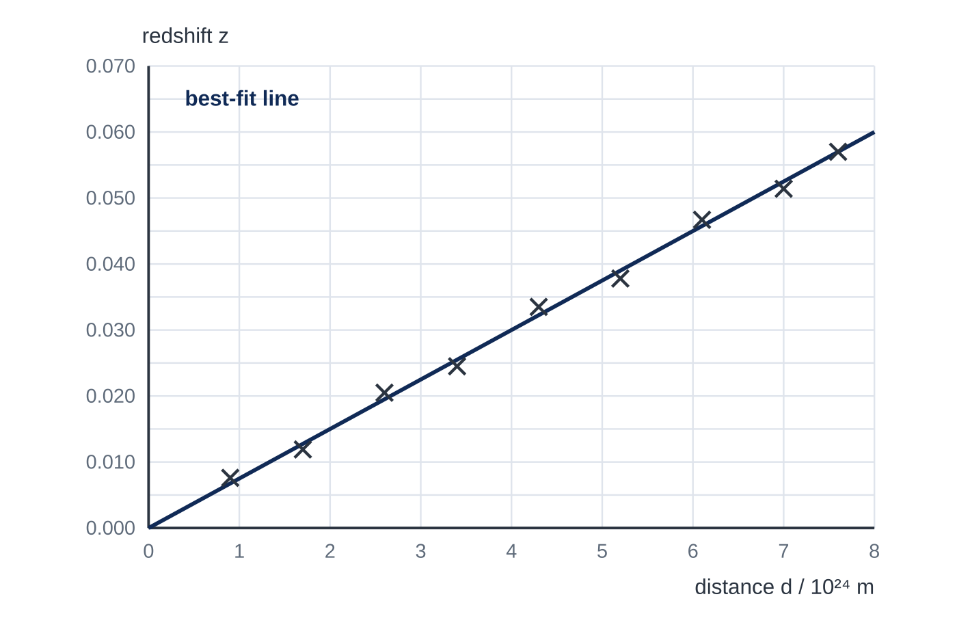
Question 4
7 marks
An astronomer measures the redshift z and the distance d of nine galaxies and plots the graph shown, with distance in metres. The best-fit line through the origin passes through the gridline intersection at 8.0 × 10²⁴ m, z = 0.060. 1 Mpc = 3.09 × 10²² m. 1 year = 3.15 × 10⁷ s.
(a) Explain how the graph supports the idea that the universe is expanding. [2]
(b) Use the graph to show that the Hubble constant is about 2.3 × 10⁻¹⁸ s⁻¹. [2]
(c) Estimate the age of the universe in years. [2]
(d) Express the Hubble constant in km s⁻¹ Mpc⁻¹. [1]
Notes:
Online with the full mark scheme: https://examinerprep.com/ial-physics-5-9-doppler-shift-redshift-and-the-universe-questions#IALP-U5-9-FB-03

Slide 42
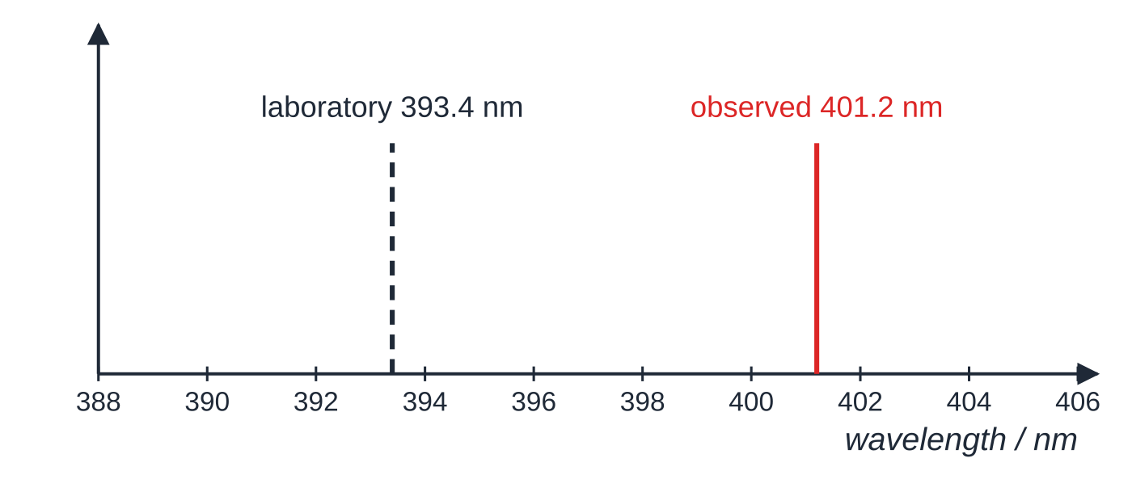
Question 5
5 marks
A calcium absorption line has a laboratory wavelength of 393.4 nm. In the spectrum of a distant galaxy the same line is observed at 401.2 nm. The Hubble constant is 70 km s⁻¹ Mpc⁻¹.
Figure: position of the calcium line in the laboratory and in the galaxy's spectrum (not to scale)
(a) State what is meant by redshift. [1]
(b) Calculate the redshift z of the galaxy. [1]
(c) Calculate the recession speed of the galaxy. [1]
(d) Calculate the distance to the galaxy in Mpc. [2]
Notes:
Online with the full mark scheme: https://examinerprep.com/ial-physics-5-9-doppler-shift-redshift-and-the-universe-questions#IALP-U5-9-B-02

Slide 43
Answers

Slide 44
Question 1 · answer
Answer C
v = H₀d = 68 × 85 = 5780 km s⁻¹ = 5.78 × 10⁶ m s⁻¹. z = v/c = 5.78 × 10⁶ ÷ 3.00 × 10⁸ = 1.9 × 10⁻².
Notes:
Full mark scheme: https://examinerprep.com/ial-physics-5-9-doppler-shift-redshift-and-the-universe-questions#IALP-U5-9-A-03

Slide 45
Question 2 · answer
Answer B
H₀ = 72 × 10³ ÷ 3.09 × 10²² = 2.33 × 10⁻¹⁸ s⁻¹. Age = 1/H₀ = 4.29 × 10¹⁷ s ÷ 3.15 × 10⁷ = 1.4 × 10¹⁰ years.
Notes:
Full mark scheme: https://examinerprep.com/ial-physics-5-9-doppler-shift-redshift-and-the-universe-questions#IALP-U5-9-A-04

Slide 46
Question 3 · answer
Answer C
Above the critical density, gravity is strong enough to stop the expansion and reverse it; the universe then contracts. At exactly the critical density the expansion rate approaches zero after infinite time; below it, expansion continues for ever.
Notes:
Full mark scheme: https://examinerprep.com/ial-physics-5-9-doppler-shift-redshift-and-the-universe-questions#IALP-U5-9-A-06

Slide 47
Question 4 · answer
Mark scheme
all the galaxies show a redshift, so all are moving away from us
z (and so recession speed) is proportional to distance, as expected if space itself is expanding uniformly
gradient = 0.060 ÷ 8.0 × 10²⁴ = 7.5 × 10⁻²⁷ m⁻¹
v = zc, so H₀ = c × gradient = 3.00 × 10⁸ × 7.5 × 10⁻²⁷ = 2.25 × 10⁻¹⁸ s⁻¹
1/H₀ = 1 ÷ 2.25 × 10⁻¹⁸ = 4.44 × 10¹⁷ s
÷ 3.15 × 10⁷ = 1.4 × 10¹⁰ years
2.25 × 10⁻¹⁸ × 3.09 × 10²² ÷ 10³ = 69.5 km s⁻¹ Mpc⁻¹ (≈ 70)
Notes:
Full mark scheme: https://examinerprep.com/ial-physics-5-9-doppler-shift-redshift-and-the-universe-questions#IALP-U5-9-FB-03

Slide 48
Question 5 · answer
Mark scheme
an increase in the observed wavelength (decrease in frequency) of radiation from a source moving away from the observer
z = (401.2 − 393.4) ÷ 393.4 = 0.0198
v = zc = 0.01983 × 3.00 × 10⁸ = 5.95 × 10⁶ m s⁻¹
v = 5950 km s⁻¹
d = v/H₀ = 5950 ÷ 70 = 85 Mpc
Notes:
Full mark scheme: https://examinerprep.com/ial-physics-5-9-doppler-shift-redshift-and-the-universe-questions#IALP-U5-9-B-02

Slide 49
Keep practising
Notes for this topic
Questions on this topic
Build a printable test
ExaminerPrep is an independent tutoring service. It has been developed independently from and is not endorsed by the International Baccalaureate Organization. "International Baccalaureate", "IB" and "IB Diploma Programme" are registered trademarks of the IBO, used here for descriptive purposes only.
Pearson Edexcel and Cambridge are trademarks of their owners; ExaminerPrep is not affiliated with any exam board.

