Slide 1
EP
EDEXCEL IAL PHYSICS
2.9 E.m.f. and internal resistance
The full notes page in 12 sections · practice questions with answers · simulations
ExaminerPrep is an independent tutoring service. It has been developed independently from and is not endorsed by the International Baccalaureate Organization. "International Baccalaureate", "IB" and "IB Diploma Programme" are registered trademarks of the IBO, used here for descriptive purposes only.
Pearson Edexcel and Cambridge are trademarks of their owners; ExaminerPrep is not affiliated with any exam board.
Notes:
2.9 E.m.f. and internal resistance. Notes for this topic: https://examinerprep.com/notes/edexcel-ial-physics/e-m-f-and-internal-resistance/

Slide 2
What this page covers
Overview
E.m.f. as the energy transferred per unit charge by a source, and how it differs from potential difference
Internal resistance, terminal p.d. and lost volts; ε= I(R + r) and V = ε- Ir
Finding ε and r from meter readings
The maximum (short-circuit) current a source can give
Power delivered to a load and power dissipated inside the source
Cells connected in series, including a cell connected the wrong way round
Core Practical 8: determining the e.m.f. and internal resistance of a cell
Notes:
What this page covers. Full notes: https://examinerprep.com/notes/edexcel-ial-physics/e-m-f-and-internal-resistance/

Slide 3
In one minute
Key points
1
A real source behaves like a perfect e.m.f. ε in series with an internal resistance r, so its terminal p.d. falls as the current it supplies rises.
4
Short circuit (R = 0): maximum current ε/r, with all the power dissipated inside the source.
2
E.m.f. = energy transferred to electrical energy per unit charge by the source; p.d. = energy transferred from electrical energy per unit charge. Both are in volts (J C⁻¹).
5
Power to the load is greatest when R = r, but then only half the energy reaches the load.
3
ε= I(R + r), so the terminal p.d. is V = ε- Ir. The Ir term is the lost volts. With no current, V = ε.
6
Plot V against I: the V-intercept is ε and the gradient is −r.
Notes:
In one minute: the key points of this topic.

Slide 4
What is e.m.f., and how is it different from p.d.?
Section 1 of 12
Until now every battery has been perfect: its voltage never changed. Real sources are not like that. A torch dims as the battery works harder, and a car's lights dim when the engine starts. One extra resistor, hidden inside the source, explains all of this. First, the two energy definitions need to be sharp.
E.m.f. ε of a source: the energy transferred to electrical energy per unit charge passing through the source.
Potential difference V across a component: the energy transferred from electrical energy per unit charge passing through the component.
As an equation, ε= W/Q, where W is the energy transferred to electrical energy by the source (J) and Q the charge passing through it (C). Not in the formulae list: learn it, noting that it has the same form as V = W/Q, which is. 1 V = 1 J C⁻¹, so a 1.5 V cell gives each coulomb that passes through it 1.5 J of electrical energy.
Notes:
What is e.m.f., and how is it different from p.d.?. Full notes: https://examinerprep.com/notes/edexcel-ial-physics/e-m-f-and-internal-resistance/

Slide 5
What is e.m.f., and how is it different from p.d.? (continued)
Section 1 of 12
 | E.m.f. ε | Potential difference V
Where | a source: cell, battery, generator, solar cell | a component: resistor, lamp, motor, or across the terminals of a source
Energy transfer | into electrical energy (from chemical, kinetic, light…) | out of electrical energy (to thermal, light, kinetic…)
Unit | volt = J C⁻¹ | volt = J C⁻¹
Depends on current? | no: a property of the source | yes, for the terminal p.d. of a real source
Despite the name, "electromotive force" is not a force; it is an energy per unit charge. Around a complete circuit energy is conserved, so the e.m.f. equals the sum of all the p.d.s, including the one across the internal resistance.
Notes:
What is e.m.f., and how is it different from p.d.?. Full notes: https://examinerprep.com/notes/edexcel-ial-physics/e-m-f-and-internal-resistance/

Slide 6
What is e.m.f., and how is it different from p.d.? (continued)
Section 1 of 12 · Worked example 1 · Easy · Calculate
WORKED EXAMPLE · QUESTION
A cell of e.m.f. 1.50 V drives a current through a torch bulb until 540 C of charge has passed. The p.d. across the cell's terminals is 1.35 V throughout. Calculate (a) the energy transferred by the cell, (b) the energy transferred to the bulb and (c) the energy dissipated inside the cell.
SOLUTION
(a) The e.m.f. gives the energy supplied per coulomb: W = εQ = 1.50 ×540 = 810 J.
(b) The terminal p.d. gives the energy delivered to the external circuit per coulomb: W = VQ = 1.35 ×540 = 729 J.
(c) The difference stays inside the cell: 810 - 729 = 81 J (0.15 J for every coulomb). The 0.15 V "missing" from the terminals is the energy per coulomb dissipated by the cell's internal resistance.
Notes:
What is e.m.f., and how is it different from p.d.?: Worked example 1. Full notes: https://examinerprep.com/notes/edexcel-ial-physics/e-m-f-and-internal-resistance/

Slide 7
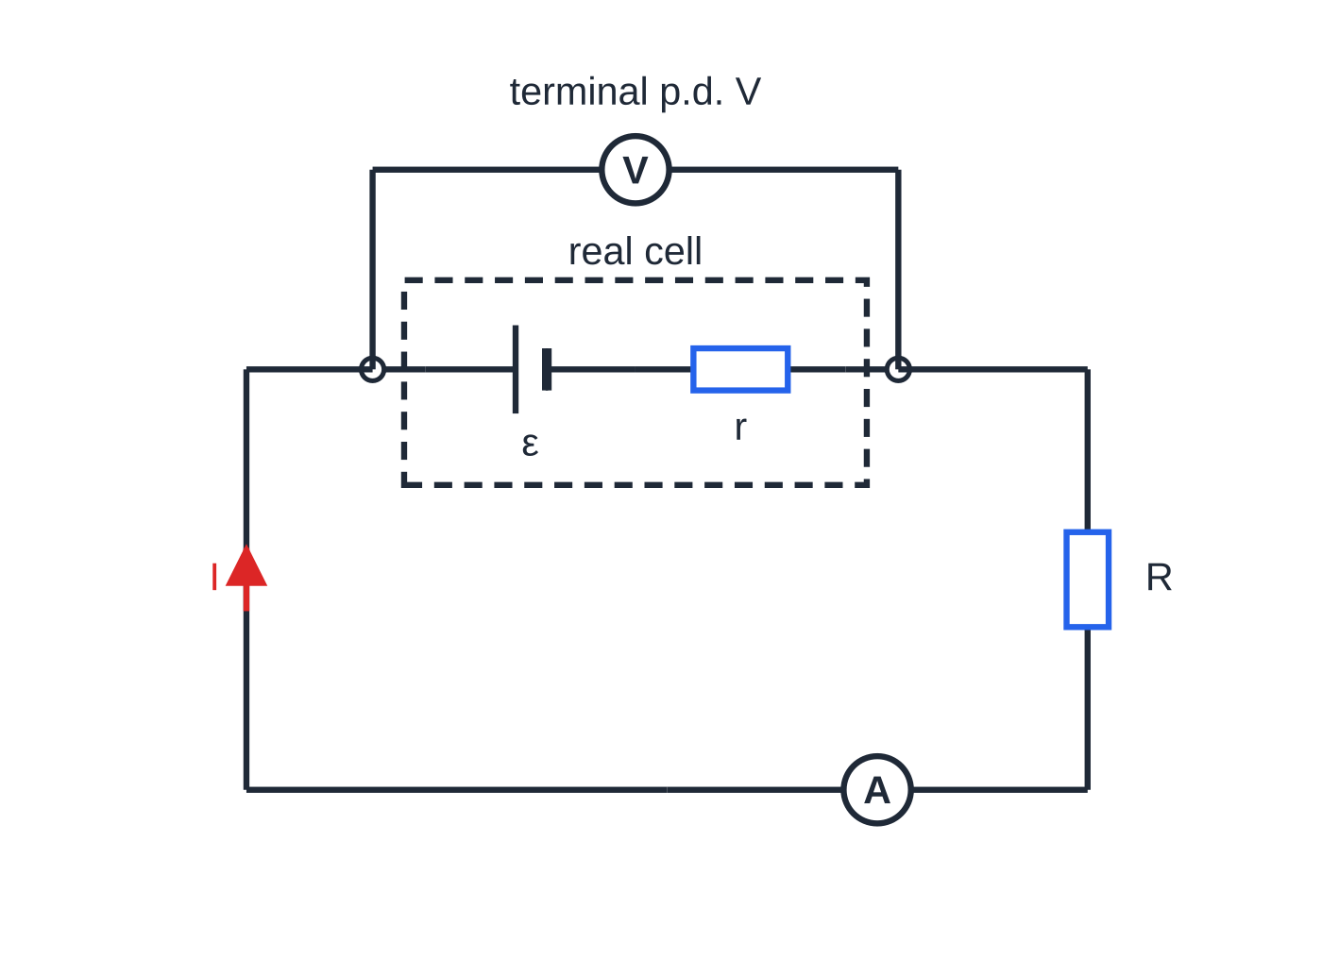
What is internal resistance, and where do the lost volts go?
Section 2 of 12
Internal resistance r: the resistance of the materials inside a source, which dissipates energy whenever current flows through the source.
Charge moving through the chemicals and electrodes of a cell meets resistance, just as it does in a wire. The model is a perfect e.m.f. ε in series with a resistor r; you cannot separate them or connect to the point between them. The terminal p.d. V is the p.d. across the terminals of the source, which is what a voltmeter across it reads. The lost volts Ir is the p.d. across the internal resistance: the energy per coulomb dissipated as thermal energy inside the source.
The model of a real cell (dashed box): a perfect e.m.f. in series with an internal resistance. The voltmeter can only reach the terminals, so it reads the terminal p.d., not the e.m.f.
Notes:
What is internal resistance, and where do the lost volts go?. Full notes: https://examinerprep.com/notes/edexcel-ial-physics/e-m-f-and-internal-resistance/

Slide 8
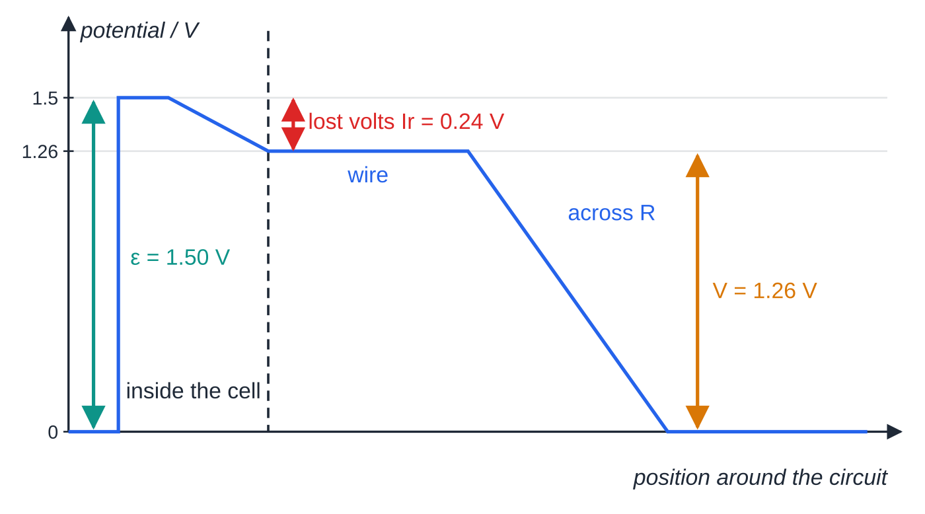
What is internal resistance, and where do the lost volts go? (continued)
Section 2 of 12
Apply V = IR to the whole circuit, whose total resistance is R + r:
ε= I(R + r) ⇒ ε= IR + Ir = V + Ir ⇒ V = ε- Ir
Here R is the total external resistance. ε= I(R + r) is in the formulae list; V = ε- Ir comes from expanding the brackets and using V = IR for the external circuit. In words: e.m.f. = terminal p.d. + lost volts, which is energy conservation for each coulomb going once round the circuit.
Potential around the circuit of worked example 2. The charge gains 1.50 V in the e.m.f., loses 0.24 V inside the cell, and the remaining 1.26 V is all that the external resistor receives.
Notes:
What is internal resistance, and where do the lost volts go?. Full notes: https://examinerprep.com/notes/edexcel-ial-physics/e-m-f-and-internal-resistance/

Slide 9
What is internal resistance, and where do the lost volts go? (continued)
Section 2 of 12 · Worked example 2 · Easy · Calculate
WORKED EXAMPLE · QUESTION
A cell of e.m.f. 1.50 V and internal resistance 0.80 Ω is connected to a 4.2 Ω resistor. Calculate (a) the current, (b) the terminal p.d. and (c) the lost volts.
SOLUTION
(a) The current depends on the total resistance: I = ε/(R + r) = 1.50/(4.2 + 0.80) = 0.300 A.
(b) The terminal p.d. is the p.d. across the external resistor: V = IR = 0.300 ×4.2 = 1.26 V.
(c) Ir = 0.300 ×0.80 = 0.24 V. Check: 1.26 + 0.24 = 1.50 V = ε.
Notes:
What is internal resistance, and where do the lost volts go?: Worked example 2. Full notes: https://examinerprep.com/notes/edexcel-ial-physics/e-m-f-and-internal-resistance/

Slide 10
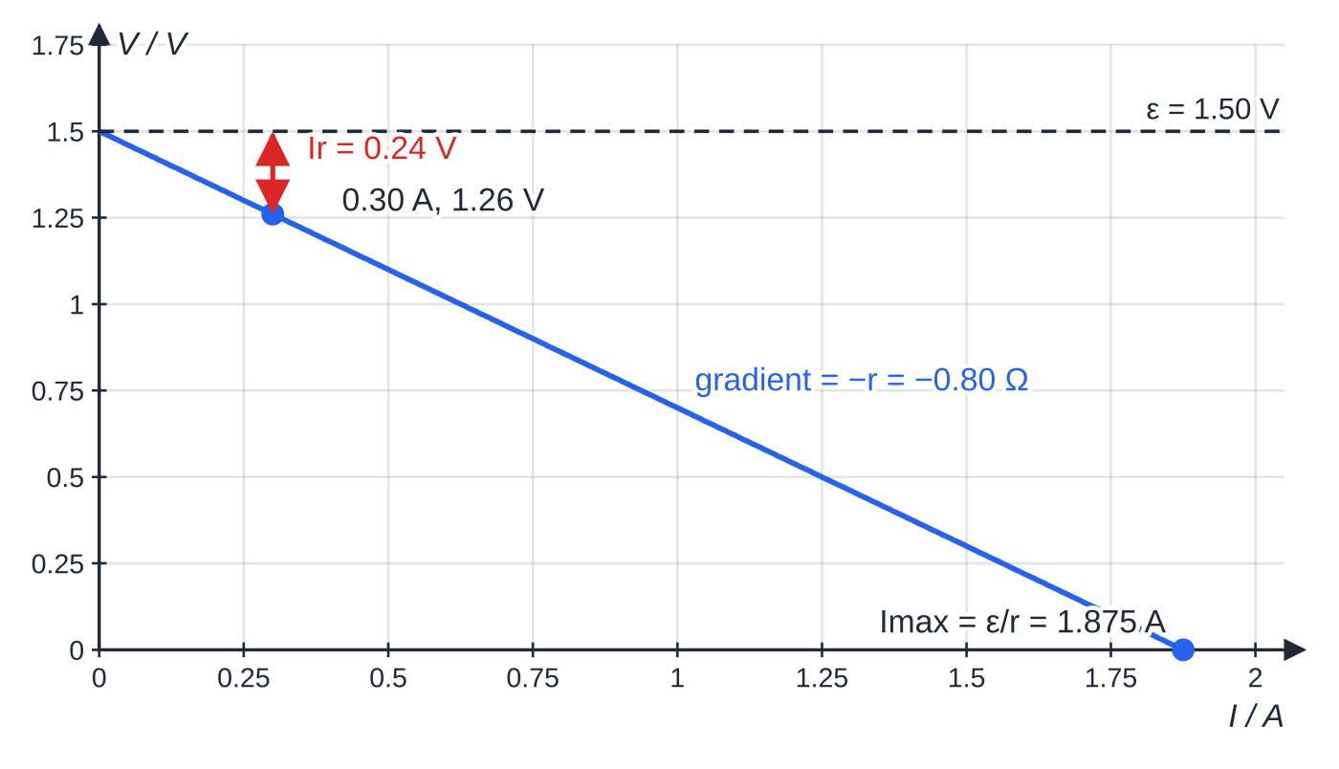
What is internal resistance, and where do the lost volts go? (continued)
Section 2 of 12
How the terminal p.d. depends on the current
V = ε- Ir has the form y = c + mx, so a graph of V against I is a straight line with intercept ε and gradient −r. Reducing R increases I, increases the lost volts and so reduces the terminal p.d. With no current (open circuit) there are no lost volts, so V = ε.
Terminal p.d. against current for the cell of worked example 2. At 0.30 A the 1.50 V e.m.f. splits into 1.26 V across the terminals and 0.24 V lost inside the cell. The line meets the current axis at the short-circuit current.
Notes:
What is internal resistance, and where do the lost volts go?. Full notes: https://examinerprep.com/notes/edexcel-ial-physics/e-m-f-and-internal-resistance/

Slide 11
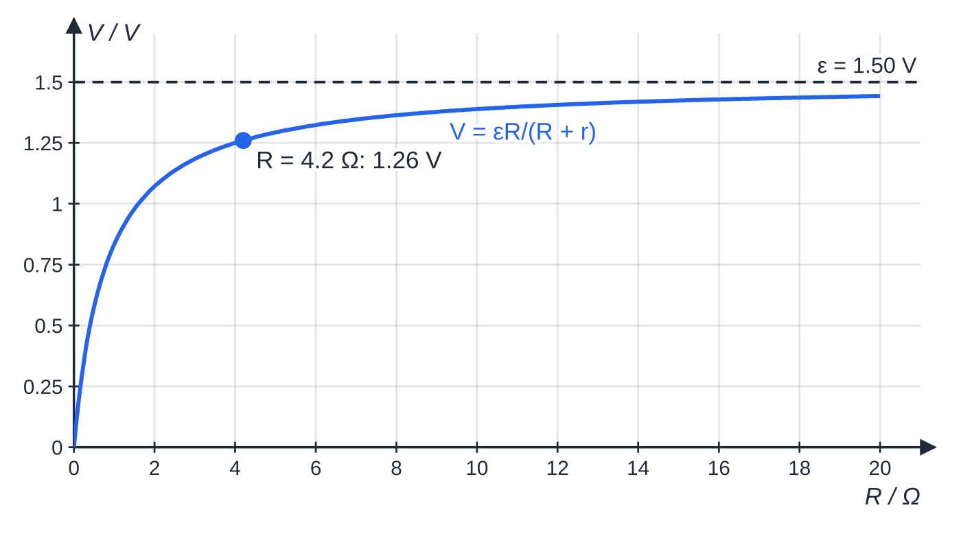
What is internal resistance, and where do the lost volts go? (continued)
Section 2 of 12
Common error
Using I = ε/R and forgetting the internal resistance. Here that would give 1.50/4.2 = 0.357 A instead of 0.300 A. The e.m.f. drives current through the whole circuit, and r is part of it.
The same cell seen from the load's side: as R increases, the current falls, the lost volts shrink, and the terminal p.d. climbs towards the e.m.f. but never reaches it.
Notes:
What is internal resistance, and where do the lost volts go?. Full notes: https://examinerprep.com/notes/edexcel-ial-physics/e-m-f-and-internal-resistance/

Slide 12
How do you find ε and r from meter readings?
Section 3 of 12
The e.m.f.: connect a high-resistance voltmeter (for example a digital meter) across the source with nothing else connected. The current is negligible, so the lost volts are negligible and the reading is very close to ε.
The internal resistance: connect a known load and measure the terminal p.d. V and the current I. Then lost volts = ε- V and r = (ε- V)/I.
If there is no ammeter, find I from the load: I = V/R.
Notes:
How do you find ε and r from meter readings?. Full notes: https://examinerprep.com/notes/edexcel-ial-physics/e-m-f-and-internal-resistance/

Slide 13
How do you find ε and r from meter readings? (continued)
Section 3 of 12 · Worked example 3 · Medium · Determine
WORKED EXAMPLE · QUESTION
A high-resistance voltmeter connected across a battery reads 6.20 V. A 5.0 Ω resistor is then connected across the battery, and the voltmeter reading falls to 5.40 V. Determine the internal resistance of the battery.
SOLUTION
With no load, the reading is the e.m.f.: ε= 6.20 V. Current through the resistor: I = V/R = 5.40/5.0 = 1.08 A. Lost volts: Ir = 6.20 - 5.40 = 0.80 V, so r = 0.80/1.08 = 0.74 Ω.
Notes:
How do you find ε and r from meter readings?: Worked example 3. Full notes: https://examinerprep.com/notes/edexcel-ial-physics/e-m-f-and-internal-resistance/

Slide 14
How do you find ε and r from meter readings? (continued)
Section 3 of 12
Exam tip
When you meet "a high-resistance voltmeter is connected across the cell" with no other load, read it as "this is the e.m.f." and say why: the current is (almost) zero, so Ir is (almost) zero.
Notes:
How do you find ε and r from meter readings?. Full notes: https://examinerprep.com/notes/edexcel-ial-physics/e-m-f-and-internal-resistance/

Slide 15
What limits the maximum current from a source?
Section 4 of 12
The current is largest when the external resistance is zero, a short circuit. Then ε= Ir, so I_(max) = ε/r, the intercept on the current axis of the V–I graph. In a short circuit the terminal p.d. is zero and all the power, I²r, is dissipated inside the source, which can heat it dangerously.
Low r wanted: car batteries and rechargeable packs must deliver large currents without a large drop in terminal p.d.
High r wanted: high-voltage laboratory supplies are built with a very large internal resistance so that, even if the terminals are touched or shorted, the current stays small and safe.
Notes:
What limits the maximum current from a source?. Full notes: https://examinerprep.com/notes/edexcel-ial-physics/e-m-f-and-internal-resistance/

Slide 16
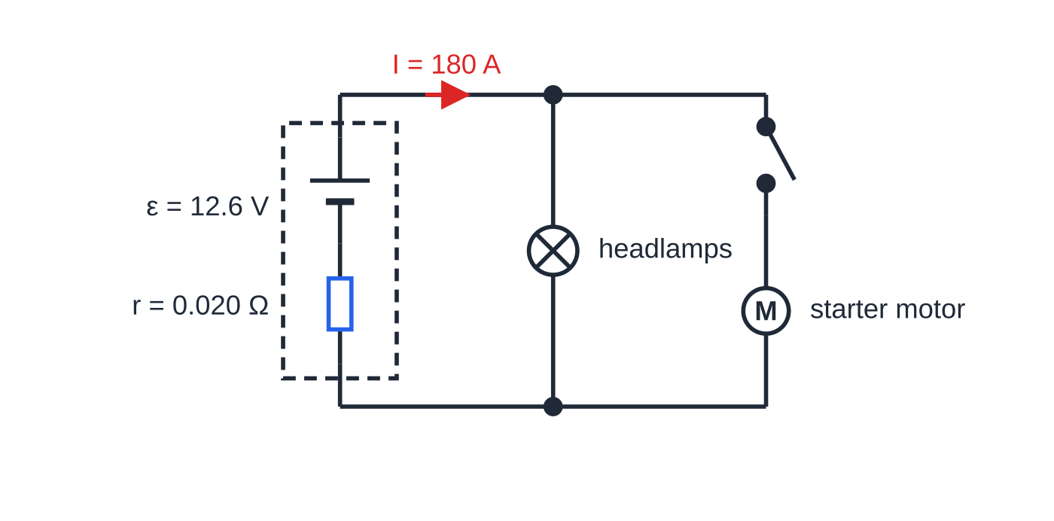
What limits the maximum current from a source? (continued)
Section 4 of 12
The headlamps and the starter motor share the battery's terminals. When the battery supplies 180 A, the lost volts in the battery rise and every device across the terminals gets less p.d.
Notes:
What limits the maximum current from a source?. Full notes: https://examinerprep.com/notes/edexcel-ial-physics/e-m-f-and-internal-resistance/

Slide 17
What limits the maximum current from a source? (continued)
Section 4 of 12 · Worked example 4 · Medium · Calculate
WORKED EXAMPLE · QUESTION
A car battery has an e.m.f. of 12.6 V and an internal resistance of 0.020 Ω. While the starter motor turns the engine, the current from the battery is 180 A. (a) Calculate the terminal p.d. while the starter motor runs. (b) Calculate the rate at which energy is dissipated inside the battery. (c) Calculate the current if the terminals were short-circuited.
SOLUTION
(a) Lost volts Ir = 180 ×0.020 = 3.6 V, so V = 12.6 - 3.6 = 9.0 V.
(b) P = I²r = 180² ×0.020 = 650 W (648 W).
(c) R = 0: I_(max) = ε/r = 12.6/0.020 = 630 A.
While the starter runs, the headlamps get 9.0 V instead of about 12.6 V and visibly dim.
Notes:
What limits the maximum current from a source?: Worked example 4. Full notes: https://examinerprep.com/notes/edexcel-ial-physics/e-m-f-and-internal-resistance/

Slide 18
What limits the maximum current from a source? (continued)
Section 4 of 12
Common error
Thinking a battery delivers a fixed current. A battery has a (nearly) fixed e.m.f.; the current depends on the total resistance it is connected to, and the terminal p.d. depends on that current.
Notes:
What limits the maximum current from a source?. Full notes: https://examinerprep.com/notes/edexcel-ial-physics/e-m-f-and-internal-resistance/

Slide 19
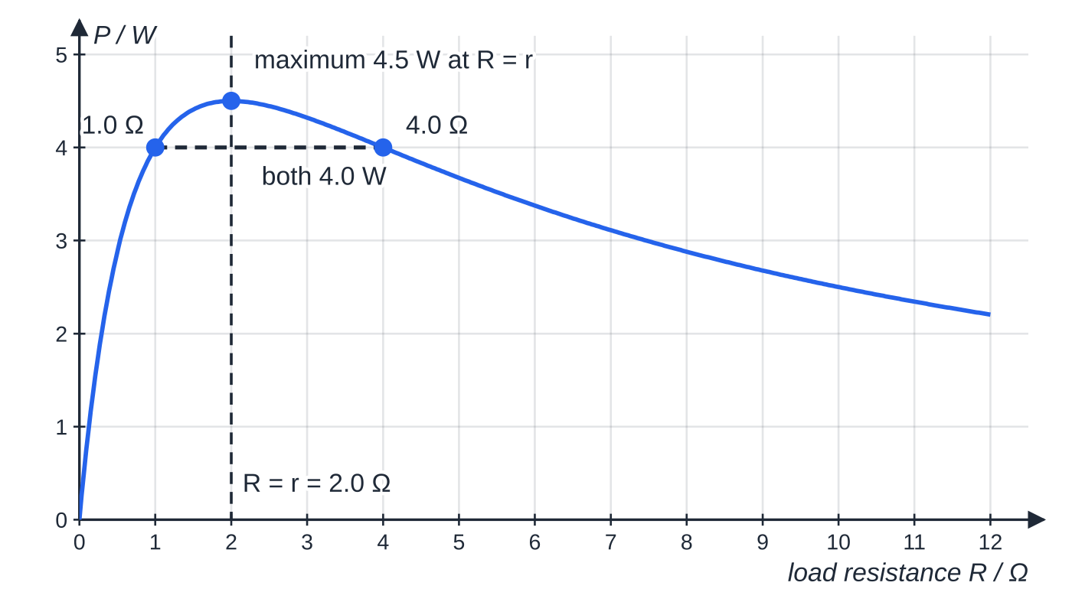
How much power reaches the load?
Section 5 of 12
Multiply ε= V + Ir by the current:
εI = VI + I²r
Power supplied by the source = power delivered to the load + power dissipated inside. The power delivered to the load is P = VI = I²R = V²/R. The fraction of the energy that reaches the load (the efficiency) is VI/εI = V/ε= R/(R + r). For a fixed source, the power in the load is greatest when R = r, but then only half the energy reaches the load.
Power delivered to a load by a 6.0 V source with internal resistance 2.0 Ω. The power peaks at 4.5 W when the load resistance equals the internal resistance.
Notes:
How much power reaches the load?. Full notes: https://examinerprep.com/notes/edexcel-ial-physics/e-m-f-and-internal-resistance/

Slide 20
How much power reaches the load? (continued)
Section 5 of 12 · Worked example 5 · Hard · Calculate, Comment
WORKED EXAMPLE · QUESTION
A supply of e.m.f. 6.0 V and internal resistance 2.0 Ω is connected in turn to loads of 1.0 Ω, 2.0 Ω and 4.0 Ω. For each load, calculate the current, the power delivered to the load and the fraction of the supplied energy that reaches the load. Comment on the results.
SOLUTION
Use I = ε/(R + r), then P = I²R and fraction = R/(R + r):
R / Ω | I / A | power in load / W | power inside / W | fraction to load
1.0 | 2.0 | 4.0 | 8.0 | 33%
2.0 | 1.5 | 4.5 | 4.5 | 50%
4.0 | 1.0 | 4.0 | 2.0 | 67%
Notes:
How much power reaches the load?: Worked example 5. Full notes: https://examinerprep.com/notes/edexcel-ial-physics/e-m-f-and-internal-resistance/

Slide 21
How much power reaches the load? (continued)
Section 5 of 12 · Worked example 5 · Hard · Calculate, Comment (continued)
Greatest power, 4.5 W, when R = r = 2.0 Ω, but only 50% of the energy then reaches the load. A larger load receives less power but wastes less: 67% of the energy reaches the 4.0 Ω load. Sources such as mains generators are designed for efficiency, not maximum power.
Notes:
How much power reaches the load?: Worked example 5. Full notes: https://examinerprep.com/notes/edexcel-ial-physics/e-m-f-and-internal-resistance/

Slide 22
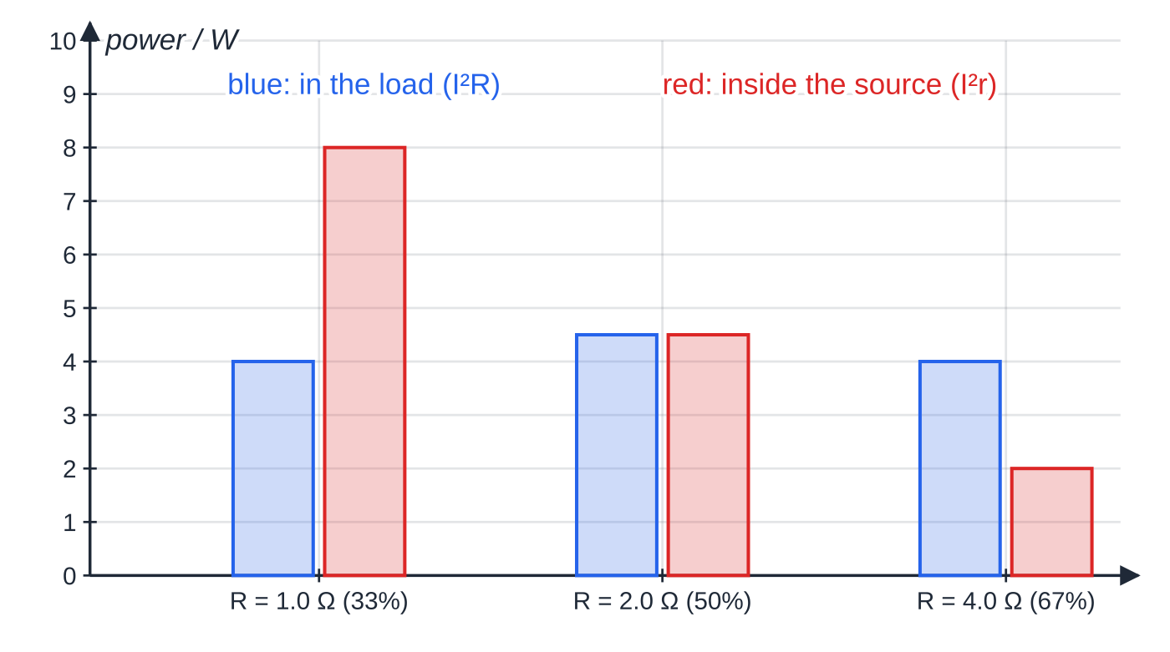
How much power reaches the load? (continued)
Section 5 of 12
Exam tip
Always say which power you have calculated. εI is the power supplied by the source, VI or I²R the power delivered to the load, and I²r the power wasted inside.
The same results as a chart. As R rises, the power wasted inside the source falls much faster than the power in the load.
Notes:
How much power reaches the load?. Full notes: https://examinerprep.com/notes/edexcel-ial-physics/e-m-f-and-internal-resistance/

Slide 23
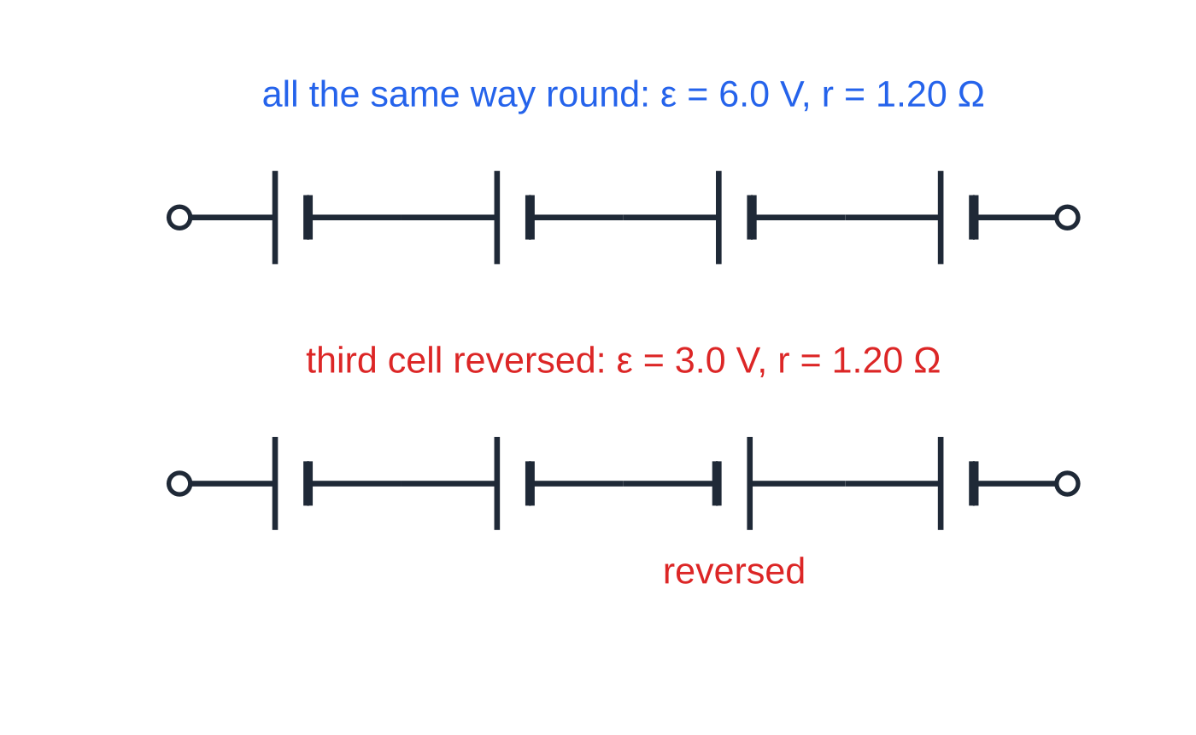
What happens when cells are connected in series?
Section 6 of 12
Cells in series, all the same way round (+ to −): the e.m.f.s add and the internal resistances add. A cell connected the wrong way round subtracts its e.m.f., so the total drops by 2ε compared with all cells correct, but its internal resistance still adds. The internal resistances add because they are in series with each other and with the external circuit, exactly like resistors in series.
Four cells, each 1.5 V and 0.30 Ω. Reversing one cell halves the total e.m.f. here but leaves the total internal resistance unchanged.
Notes:
What happens when cells are connected in series?. Full notes: https://examinerprep.com/notes/edexcel-ial-physics/e-m-f-and-internal-resistance/

Slide 24
What happens when cells are connected in series? (continued)
Section 6 of 12 · Worked example 6 · Medium · Calculate
WORKED EXAMPLE · QUESTION
A torch holds four cells in series, each of e.m.f. 1.5 V and internal resistance 0.30 Ω. The bulb has a resistance of 6.0 Ω. (a) Calculate the current in the bulb and the p.d. across it. (b) One cell is put in the wrong way round. Calculate the new current, and the factor by which the power in the bulb falls.
SOLUTION
(a) Totals: ε= 4 ×1.5 = 6.0 V and r = 4 ×0.30 = 1.20 Ω. I = 6.0/(6.0 + 1.2) = 0.83 A (0.833 A) and V = 0.833 ×6.0 = 5.0 V.
(b) One cell reversed: ε= 1.5 + 1.5 - 1.5 + 1.5 = 3.0 V, r still 1.20 Ω. I = 3.0/7.2 = 0.42 A (0.417 A). Power ∝ I² for the same bulb resistance, so P falls from 4.17 W to 1.04 W, a factor of 4.
This treats the bulb's resistance as constant; in reality a dimmer filament is cooler and has a lower resistance (page 2.7).
Notes:
What happens when cells are connected in series?: Worked example 6. Full notes: https://examinerprep.com/notes/edexcel-ial-physics/e-m-f-and-internal-resistance/

Slide 25
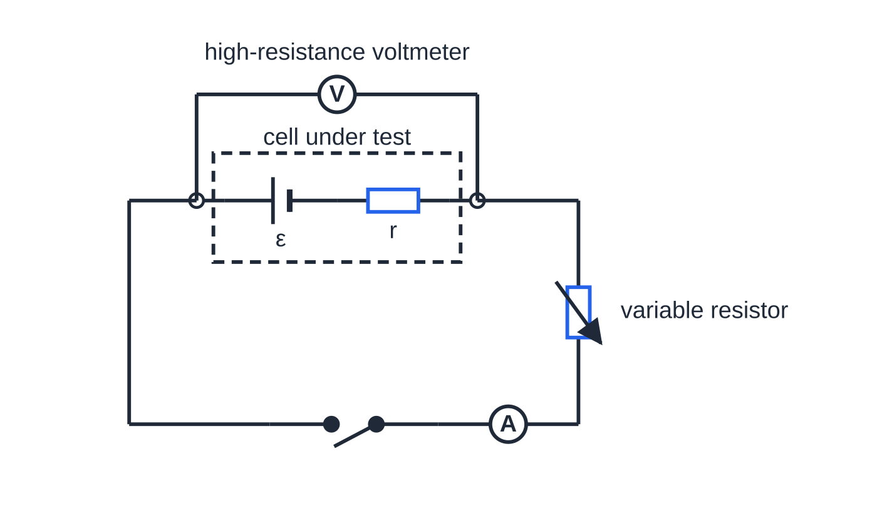
Core Practical 8: how do you measure ε and r?
Section 7 of 12
V = ε- Ir is a straight line on a graph of V (y-axis) against I (x-axis), with V-intercept ε and gradient −r.
Circuit: the cell in series with an ammeter, a variable resistor and a switch; a voltmeter connected directly across the cell's terminals.
Method: close the switch, set the variable resistor, read I and V quickly, then open the switch. Repeat for at least six settings spread over as wide a range of current as possible.
Circuit for Core Practical 8. The variable resistor changes the current; the voltmeter reads the terminal p.d. for each current.
Notes:
Core Practical 8: how do you measure ε and r?. Full notes: https://examinerprep.com/notes/edexcel-ial-physics/e-m-f-and-internal-resistance/

Slide 26
Core Practical 8: how do you measure ε and r? (continued)
Section 7 of 12
Graph: plot V against I, draw the line of best fit, read ε from the intercept at I = 0 and find r = −gradient from a large triangle.
Practical issues
The cell heats up. Current in the internal resistance dissipates energy inside the cell, and its temperature, and with it r, changes. Open the switch between readings and keep the currents moderate.
The cell runs down. A cell left delivering current loses e.m.f. and its internal resistance rises. Take the readings promptly so ε and r stay constant.
Protective resistor: a few ohms in series stops the current becoming very large if the variable resistor is turned to zero. It does not change the graph, because the voltmeter is across the cell only.
Meters: a high-resistance (digital) voltmeter takes negligible current. Choose ranges that give readings to 0.01 V and 0.01 A.
Notes:
Core Practical 8: how do you measure ε and r?. Full notes: https://examinerprep.com/notes/edexcel-ial-physics/e-m-f-and-internal-resistance/

Slide 27
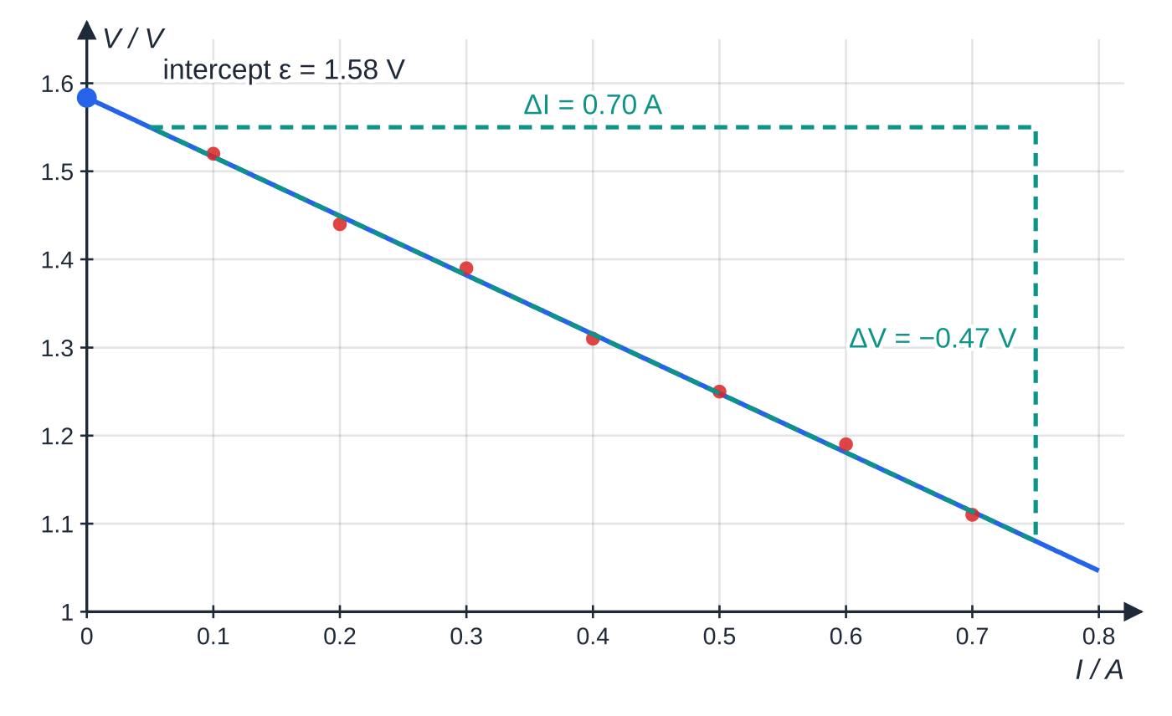
Core Practical 8: how do you measure ε and r? (continued)
Section 7 of 12
Safety: never short-circuit the cell; rechargeable cells have very low r and can deliver currents large enough to make wires dangerously hot.
Uncertainty: a reading on a meter of resolution 0.01 V has an uncertainty of ±0.005 V, about 0.45% of a 1.11 V reading.
Specimen results for one cell. The V-axis has a false origin, but the I-axis starts at zero, so the intercept of the extended line is the e.m.f.
Notes:
Core Practical 8: how do you measure ε and r?. Full notes: https://examinerprep.com/notes/edexcel-ial-physics/e-m-f-and-internal-resistance/

Slide 28
Core Practical 8: how do you measure ε and r? (continued)
Section 7 of 12 · Worked example 7 · Medium · Determine
WORKED EXAMPLE · QUESTION
Use the specimen graph above to determine the e.m.f. and the internal resistance of the cell.
SOLUTION
Extend the line to I = 0 and read the intercept: ε= 1.58 V. Gradient from a large triangle on the line, from (0.05 A, 1.55 V) to (0.75 A, 1.08 V): (1.08 - 1.55)/(0.75 - 0.05) = -0.47/0.70 = -0.67 V A⁻¹. So r = 0.67 Ω.
The gradient has units of V A⁻¹ = Ω, a quick check that it really is a resistance.
Notes:
Core Practical 8: how do you measure ε and r?: Worked example 7. Full notes: https://examinerprep.com/notes/edexcel-ial-physics/e-m-f-and-internal-resistance/

Slide 29
Core Practical 8: how do you measure ε and r? (continued)
Section 7 of 12
Exam tip
Only read ε from the intercept if the I-axis starts at zero. A false origin on the V-axis is fine and makes the graph larger. If the I-axis does not start at zero, calculate ε from one point on the line instead: ε= V + Ir.
Notes:
Core Practical 8: how do you measure ε and r?. Full notes: https://examinerprep.com/notes/edexcel-ial-physics/e-m-f-and-internal-resistance/

Slide 30
Exam tips for 2.9
Section 8 of 12
Exam tip 1 — start from ε = I(R + r)
Write the formulae-list equation ε= I(R + r) first, then decide what R is: the total external resistance, worked out with the series and parallel rules before you substitute.
Exam tip 2 — the definitions differ in one direction word
E.m.f.: energy transferred to electrical energy per unit charge, by a source. P.d.: energy transferred from electrical energy per unit charge, in a component. "Per unit charge" is needed in both; "the voltage of a battery" is not a definition.
Exam tip 3 — the lost volts are ε − V
If you know the e.m.f. and the terminal p.d., you do not need r to find the lost volts: subtract. Then r = lost volts ÷ current.
Notes:
Exam tips for 2.9. Full notes: https://examinerprep.com/notes/edexcel-ial-physics/e-m-f-and-internal-resistance/

Slide 31
Exam tips for 2.9 (continued)
Section 8 of 12
Exam tip 4 — explain dimming with a chain of reasons
For "why does the lamp dim when another device is switched on?": total current increases → lost volts Ir increase → terminal p.d. decreases → the lamp's p.d., current and power decrease. Each arrow is a separate step.
Exam tip 5 — the graph gives two answers
For the core practical, state both results with units: ε from the intercept (V) and r from minus the gradient (Ω). Show the gradient triangle on the line, spanning more than half of it.
Notes:
Exam tips for 2.9. Full notes: https://examinerprep.com/notes/edexcel-ial-physics/e-m-f-and-internal-resistance/

Slide 32
Common misconceptions
Section 9 of 12
Misconception | Why it is wrong | Correct idea
E.m.f. is a force that pushes charge round the circuit. | Its unit is the volt, J C⁻¹, not the newton. | E.m.f. is energy transferred to electrical energy per unit charge.
A voltmeter across a battery always reads its e.m.f. | When current flows, part of the e.m.f. is used across the internal resistance. | It reads the terminal p.d., ε- Ir; this equals ε only when the current is zero.
A battery supplies a fixed current. | The current depends on the resistance it is connected to. | I = ε/(R + r); the e.m.f. is (nearly) fixed, not the current.
The lost volts are energy that disappears. | Energy is conserved. | The lost volts are the energy per coulomb dissipated as thermal energy inside the source.
A cell connected the wrong way round just stops contributing. | It actively opposes the others, and current still passes through its resistance. | Its e.m.f. subtracts and its internal resistance still adds.
Notes:
Common misconceptions. Full notes: https://examinerprep.com/notes/edexcel-ial-physics/e-m-f-and-internal-resistance/

Slide 33
Common misconceptions (continued)
Section 9 of 12
Misconception | Why it is wrong | Correct idea
Maximum power to the load means the source is working most efficiently. | At R = r as much power is wasted inside as is delivered. | Maximum power transfer comes with only 50% efficiency; efficiency = R/(R + r).
Notes:
Common misconceptions. Full notes: https://examinerprep.com/notes/edexcel-ial-physics/e-m-f-and-internal-resistance/

Slide 34
How this topic connects
Section 10 of 12
6 Current, p.d. and resistance
E.m.f. is defined the same way as p.d., as energy per unit charge, and the power in the internal resistance uses the familiar P = I²R.
7 Series and parallel circuits; 2.8 The potential divider
The internal resistance is one more resistor in series with the external circuit; switching on more devices in parallel lowers R, raises I and lowers the terminal p.d. r and R share the e.m.f. like a potential divider: V = εR/(R + r).
Practical skills (Unit 3)
Rearranging an equation into y = mx + c and reading two constants from the intercept and the gradient is the pattern behind many practical questions.
Notes:
How this topic connects. Full notes: https://examinerprep.com/notes/edexcel-ial-physics/e-m-f-and-internal-resistance/

Slide 35
Key equations
Section 11 of 12
Equation | Use | In the formulae list?
ε= I(R + r) | current from a real source (ε in V, I in A, R and r in Ω) | Yes
V = ε- Ir | terminal p.d.; lost volts = Ir | No — derive it from ε= I(R + r)
ε= W/Q | definition of e.m.f. (W in J, Q in C) | No — learn it (same form as V = W/Q)
I_(max) = ε/r | short-circuit current | No — derive it: R = 0
P = VI = I²R = V²/R | power delivered to a component (P in W) | Yes
εI = VI + I²r | power supplied = power to load + power wasted | No — derive it: multiply ε= V + Ir by I
fraction to load = V/ε= R/(R + r) | efficiency of energy delivery | No — derive it
εₜₒₜₐₗ = Σε (with signs), rₜₒₜₐₗ = Σr | cells in series | No — learn it
Notes:
Key equations. Full notes: https://examinerprep.com/notes/edexcel-ial-physics/e-m-f-and-internal-resistance/

Slide 36
Check your understanding
Section 12 of 12
1. Why does a high-resistance voltmeter connected on its own across a battery read (almost exactly) the e.m.f.?
2. A battery of e.m.f. 9.0 V and internal resistance 1.0 Ω delivers a current of 0.50 A. Calculate the terminal p.d.
3. A cell of e.m.f. 2.0 V drives a current of 0.40 A through a 4.5 Ω resistor. Calculate its internal resistance.
4. Three cells, each of e.m.f. 1.2 V and internal resistance 0.20 Ω, are connected in series. Calculate the maximum current they can deliver.
5. In the core practical a student's line of best fit has a V-intercept of 1.46 V and a gradient of −0.85 V A⁻¹. State the e.m.f. and the internal resistance, and give one reason for opening the switch between readings.
Notes:
Check your understanding: questions. Full notes: https://examinerprep.com/notes/edexcel-ial-physics/e-m-f-and-internal-resistance/

Slide 37
Check your understanding (continued)
Section 12 of 12
6. A 12 V battery of internal resistance 0.50 Ω supplies a 5.5 Ω heater. Calculate the power delivered to the heater and the power wasted in the battery.
Notes:
Check your understanding: questions. Full notes: https://examinerprep.com/notes/edexcel-ial-physics/e-m-f-and-internal-resistance/

Slide 38
Check your understanding · answers
Section 12 of 12
1. The voltmeter takes almost no current, so the lost volts Ir are almost zero and the terminal p.d. ε- Ir is almost equal to ε.
2. V = 9.0 - 0.50 ×1.0 = 8.5 V.
3. Total resistance = 2.0/0.40 = 5.0 Ω, so r = 5.0 - 4.5 = 0.50 Ω.
4. ε= 3.6 V and r = 0.60 Ω, so I_(max) = 3.6/0.60 = 6.0 A.
5. ε= 1.46 V and r = 0.85 Ω. Opening the switch stops the cell heating up and running down, so that ε and r stay constant during the experiment.
6. I = 12/(5.5 + 0.50) = 2.0 A. Heater: I²R = 2.0² ×5.5 = 22 W. Battery: I²r = 2.0² ×0.50 = 2.0 W. Check: εI = 12 ×2.0 = 24 W = 22 + 2.0.
Notes:
Check your understanding: answers. Full notes: https://examinerprep.com/notes/edexcel-ial-physics/e-m-f-and-internal-resistance/

Slide 39
Practice questions
5 original exam-style questions. Answers at the end of the deck.

Slide 40
Question 1
1 mark
A cell has an e.m.f. of 3.0 V and an internal resistance of 0.50 Ω. It delivers a current of 0.80 A.
What is the potential difference across its terminals?
A 0.40 V
B 2.6 V
C 3.0 V
D 3.4 V
Notes:
Online with the full mark scheme: https://examinerprep.com/ial-physics-2-9-e-m-f-and-internal-resistance-questions#IALP-U2-9-A-03

Slide 41
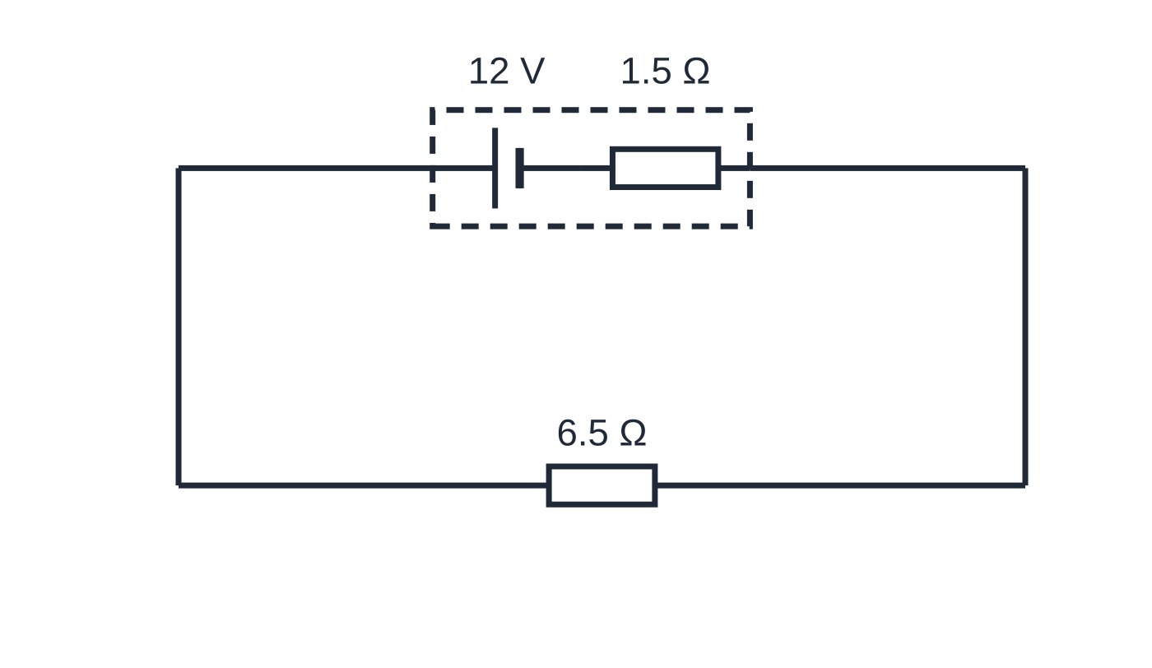
Question 2
1 mark
A power supply of e.m.f. 12 V and internal resistance 1.5 Ω is connected to a resistor of resistance 6.5 Ω.
What is the current in the resistor?
Figure: power supply (dashed box: e.m.f. and internal resistance) connected to the resistor
A 1.5 A
B 1.8 A
C 2.4 A
D 8.0 A
Notes:
Online with the full mark scheme: https://examinerprep.com/ial-physics-2-9-e-m-f-and-internal-resistance-questions#IALP-U2-9-A-04

Slide 42
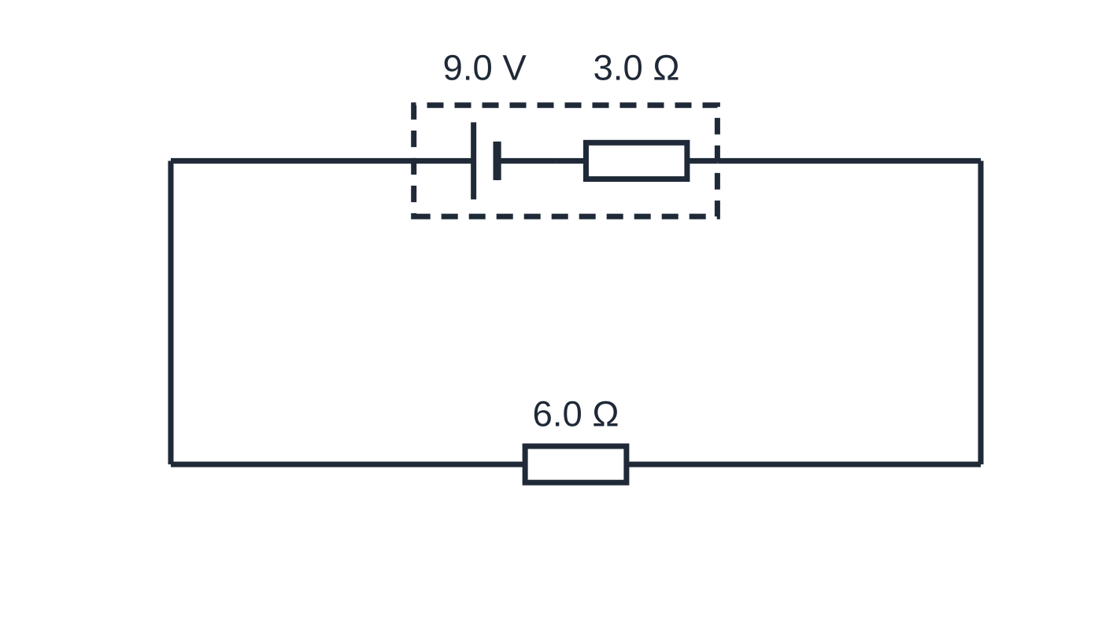
Question 3
1 mark
A battery of e.m.f. 9.0 V and internal resistance 3.0 Ω is connected to a 6.0 Ω resistor.
At what rate is energy dissipated inside the battery?
Figure: battery (dashed box: e.m.f. and internal resistance) connected to the resistor
A 3.0 W
B 6.0 W
C 9.0 W
D 27 W
Notes:
Online with the full mark scheme: https://examinerprep.com/ial-physics-2-9-e-m-f-and-internal-resistance-questions#IALP-U2-9-A-06

Slide 43
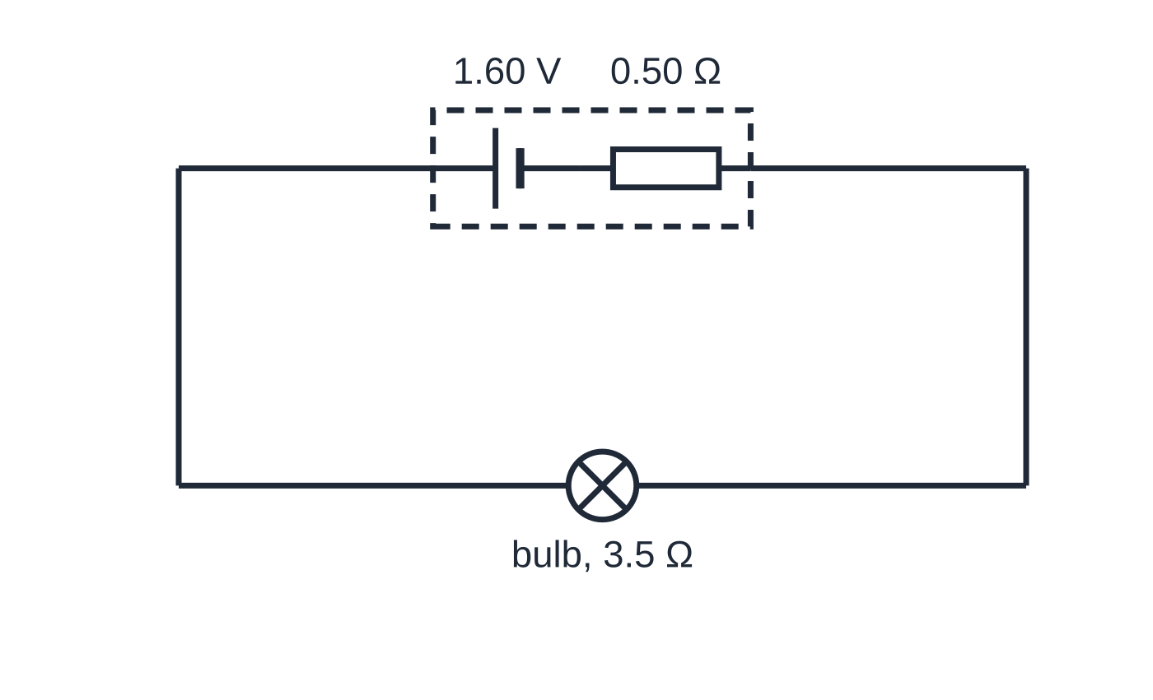
Question 4
5 marks
A torch bulb is lit by a single cell. While the bulb is lit its resistance is 3.5 Ω. The cell has an e.m.f. of 1.60 V and its internal resistance is 0.50 Ω.
Figure: torch bulb connected to the cell (dashed box: e.m.f. and internal resistance)
(a) Calculate the current in the bulb. [2]
(b) Calculate the potential difference across the terminals of the cell. [2]
(c) State the value of the lost volts. [1]
Notes:
Online with the full mark scheme: https://examinerprep.com/ial-physics-2-9-e-m-f-and-internal-resistance-questions#IALP-U2-9-B-02

Slide 44
Question 5
5 marks
A high-voltage supply used in a school laboratory has an e.m.f. of 5.0 kV. For safety it is designed with an internal resistance of 50 MΩ.
(a) Calculate the maximum current the supply can deliver. [1]
(b) Explain why a large internal resistance makes the supply safer to use. [2]
(c) The supply is connected to a resistor of resistance 10 MΩ. Calculate the potential difference across the resistor. [2]
Notes:
Online with the full mark scheme: https://examinerprep.com/ial-physics-2-9-e-m-f-and-internal-resistance-questions#IALP-U2-9-B-04

Slide 45
Answers

Slide 46
Question 1 · answer
Answer B
Lost volts = Ir = 0.80 × 0.50 = 0.40 V. Terminal p.d. V = ε − Ir = 3.0 − 0.40 = 2.6 V.
Notes:
Full mark scheme: https://examinerprep.com/ial-physics-2-9-e-m-f-and-internal-resistance-questions#IALP-U2-9-A-03

Slide 47
Question 2 · answer
Answer A
ε = I(R + r), so I = 12 ÷ (6.5 + 1.5) = 12 ÷ 8.0 = 1.5 A.
Notes:
Full mark scheme: https://examinerprep.com/ial-physics-2-9-e-m-f-and-internal-resistance-questions#IALP-U2-9-A-04

Slide 48
Question 3 · answer
Answer A
I = 9.0 ÷ (6.0 + 3.0) = 1.0 A. Power dissipated inside = I²r = 1.0² × 3.0 = 3.0 W.
Notes:
Full mark scheme: https://examinerprep.com/ial-physics-2-9-e-m-f-and-internal-resistance-questions#IALP-U2-9-A-06

Slide 49
Question 4 · answer
Mark scheme
I = ε/(R + r) = 1.60 ÷ (3.5 + 0.50)
= 0.40 A
V = IR = 0.40 × 3.5
= 1.4 V (allow error carried forward)
1.60 − 1.4 = 0.20 V / 0.40 × 0.50 = 0.20 V
Notes:
Full mark scheme: https://examinerprep.com/ial-physics-2-9-e-m-f-and-internal-resistance-questions#IALP-U2-9-B-02

Slide 50
Question 5 · answer
Mark scheme
Iₘₐₓ = ε/r = 5000 ÷ (50 × 10⁶) = 1.0 × 10⁻⁴ A (0.10 mA)
the internal resistance is in series with anything connected to the terminals, including a person / a short circuit
so the current can never exceed ε/r, which is small / about 0.1 mA
I = 5000 ÷ ((10 + 50) × 10⁶) = 8.3 × 10⁻⁵ A
V = IR = 8.33 × 10⁻⁵ × 10 × 10⁶ = 830 V (833 V)
Notes:
Full mark scheme: https://examinerprep.com/ial-physics-2-9-e-m-f-and-internal-resistance-questions#IALP-U2-9-B-04

Slide 51
Keep practising
Notes for this topic
Questions on this topic
Build a printable test
ExaminerPrep is an independent tutoring service. It has been developed independently from and is not endorsed by the International Baccalaureate Organization. "International Baccalaureate", "IB" and "IB Diploma Programme" are registered trademarks of the IBO, used here for descriptive purposes only.
Pearson Edexcel and Cambridge are trademarks of their owners; ExaminerPrep is not affiliated with any exam board.

