Slide 1
EP
EDEXCEL IAL PHYSICS
4.3 Electric fields
The full notes page in 11 sections · practice questions with answers · simulations
ExaminerPrep is an independent tutoring service. It has been developed independently from and is not endorsed by the International Baccalaureate Organization. "International Baccalaureate", "IB" and "IB Diploma Programme" are registered trademarks of the IBO, used here for descriptive purposes only.
Pearson Edexcel and Cambridge are trademarks of their owners; ExaminerPrep is not affiliated with any exam board.
Notes:
4.3 Electric fields. Notes for this topic: https://examinerprep.com/notes/edexcel-ial-physics/electric-fields/

Slide 2
What this page covers
Overview
The electric field as a region in which a charged particle feels a force; field strength E = F/Q
Coulomb's law for the force between two point charges, and the inverse-square law
The radial field of a point charge, E = Q/4πε₀ r², and combining the fields of two charges
Electric potential, V = Q/4πε₀ r, and field strength as minus the potential gradient
Field lines and equipotentials for radial and uniform fields
The uniform field between parallel plates, E = V/d, and balancing a charged drop
Charged particles in a uniform field: energy QV and the parabolic path between deflecting plates
Notes:
What this page covers. Full notes: https://examinerprep.com/notes/edexcel-ial-physics/electric-fields/

Slide 3
In one minute
Key points
1. An electric field is a region where a charged particle experiences a force; its strength E = F/Q is the force per unit positive charge, in N C⁻¹ (= V m⁻¹), and it is a vector.
2. Coulomb's law: F = Q₁Q₂/4πε₀ r². Like charges repel, unlike attract; double the distance, quarter the force.
3. Point charge: E = Q/4πε₀ r² (radial, inverse square) and V = Q/4πε₀ r (a scalar, zero at infinity).
4. Field = −potential gradient. Field lines point from high to low potential and cross equipotentials at right angles; no work is done moving along an equipotential.
5. Parallel plates: uniform field E = V/d, with equally spaced parallel field lines and equally spaced equipotentials.
6. A charge Q moved through a p.d. V gains energy QV. Fired across a uniform field it follows a parabola, like a projectile.
Notes:
In one minute. Full notes: https://examinerprep.com/notes/edexcel-ial-physics/electric-fields/

Slide 4
What is an electric field, and how is its strength defined?
Section 1 of 11
A field replaces "action at a distance" with something you can map, measure and calculate. Once you can describe it by its strength (a force per unit charge) and its potential (an energy per unit charge), the same tools explain how a cathode-ray beam is steered, how a tiny oil drop can float and why nuclei are so hard to approach.
An electric field is a region in which a charged particle experiences a force. The electric field strength E at a point is the force per unit positive charge on a small test charge placed at that point: E = F/Q.
E is in N C⁻¹, F is the force on the charge (N) and Q the charge (C); the equation is in the formulae list. E is a vector, in the direction of the force on a positive charge. A negative charge, an electron for example, is pushed the opposite way to the field.
The test charge must be small, so that it does not disturb the charges that create the field.
Notes:
What is an electric field, and how is its strength defined?. Full notes: https://examinerprep.com/notes/edexcel-ial-physics/electric-fields/

Slide 5
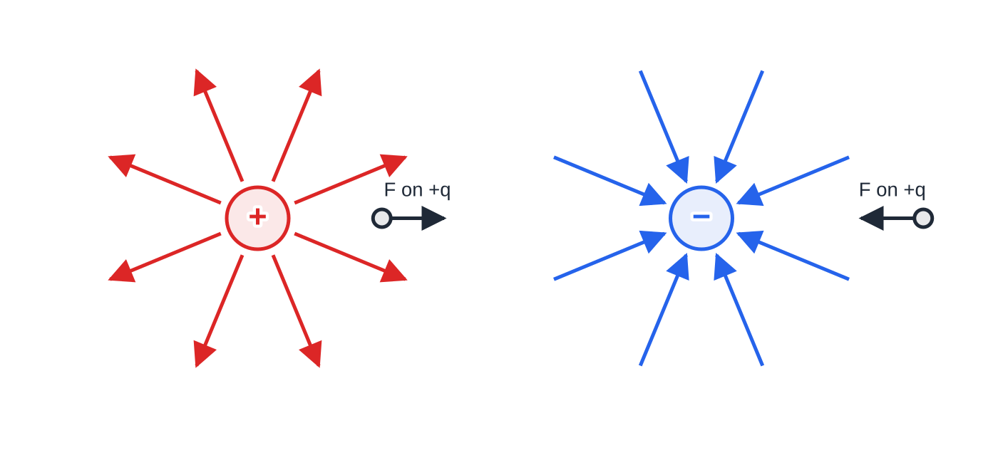
What is an electric field, and how is its strength defined? (continued)
Section 1 of 11
Field lines show the field: the arrow gives the direction of the force on a positive charge, and lines closer together mean a stronger field.
Field lines start on positive charges and end on negative charges, and they never cross, because the field has only one direction at each point.
Units: 1 N C⁻¹ = 1 V m⁻¹ (shown below, in the uniform-field section).
Radial field lines of an isolated positive and an isolated negative point charge. A small positive test charge is pushed along the field line: away from the positive charge, towards the negative one.
Notes:
What is an electric field, and how is its strength defined?. Full notes: https://examinerprep.com/notes/edexcel-ial-physics/electric-fields/

Slide 6
What is an electric field, and how is its strength defined? (continued)
Section 1 of 11 · Worked example 1 · Easy · Calculate
WORKED EXAMPLE · QUESTION
A small sphere carrying a charge of +2.5 nC is placed at point P in an electric field. It experiences a force of 6.0 × 10⁻⁵ N towards the east. (a) Calculate the electric field strength at P and state its direction. (b) The sphere is replaced by an electron. Calculate the force on the electron and its acceleration.
SOLUTION
(a) E = F/Q = (6.0×10⁻⁵)/(2.5×10⁻⁹) = 2.4 ×10⁴ N C⁻¹ towards the east
(b) Same field, different charge: F = eE = 1.60×10⁻¹⁹ ×2.4×10⁴ = 3.84×10⁻¹⁵ N. 3.8 × 10⁻¹⁵ N towards the west
a = F/m = (3.84×10⁻¹⁵)/(9.11×10⁻³¹) = 4.2 ×10¹⁵ m s⁻²
The field at P does not change when the charge is swapped: E belongs to the point, while F depends on what you put there.
Notes:
What is an electric field, and how is its strength defined?: Worked example 1. Full notes: https://examinerprep.com/notes/edexcel-ial-physics/electric-fields/

Slide 7
How big is the force between two point charges?
Section 2 of 11
F = Q₁Q₂/(4πε₀ r²)
F is the force between the charges (N), Q₁ and Q₂ the two charges (C), r the distance between their centres (m) and ε₀ the permittivity of free space, 8.85 × 10⁻¹² F m⁻¹. Coulomb's law is in the formulae list. The constant 1/4πε₀ = 8.99×10⁹ N m² C⁻² is often written k. The law applies to point charges and to charged spheres, measured from their centres.
Like charges repel, unlike charges attract. The forces on the two charges are equal in size and opposite in direction (Newton's third law).
Inverse-square law: F ∝ 1/r², so doubling the separation divides the force by 4, and trebling it divides by 9.
If you substitute the charges with their signs, a negative answer means attraction and a positive one repulsion. Many people prefer to use sizes only and state the direction in words.
Notes:
How big is the force between two point charges?. Full notes: https://examinerprep.com/notes/edexcel-ial-physics/electric-fields/

Slide 8
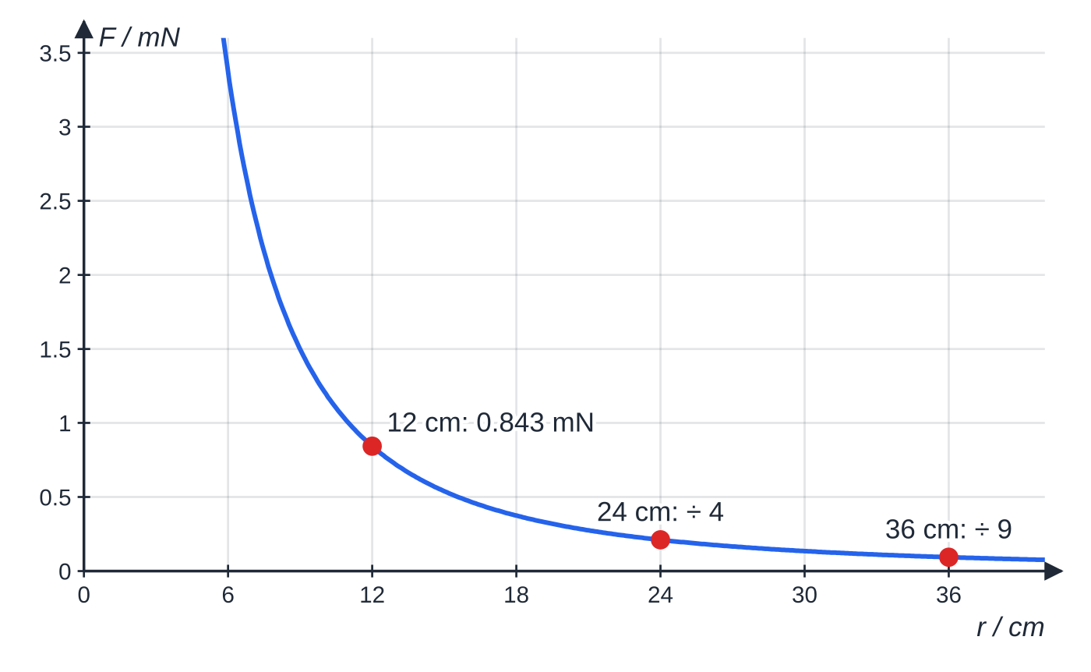
How big is the force between two point charges? (continued)
Section 2 of 11
Electric forces are enormous compared with gravitational ones. For two protons, F_electric/F_gravity = ke²/Gmₚ² ≈1.2×10³⁶ at any separation, because both forces follow an inverse-square law.
The force between the two spheres of worked example 2 as their separation changes. Each time the separation is multiplied by n, the force is divided by n².
Notes:
How big is the force between two point charges?. Full notes: https://examinerprep.com/notes/edexcel-ial-physics/electric-fields/

Slide 9
How big is the force between two point charges? (continued)
Section 2 of 11 · Worked example 2 · Medium · Calculate
WORKED EXAMPLE · QUESTION
Two small conducting spheres on insulating stands carry charges of +45 nC and −30 nC. Their centres are 12 cm apart. (a) Calculate the force between them and say whether it is attractive or repulsive. (b) Calculate the force when the separation is increased to 36 cm. (c) The spheres are touched together and then returned to 12 cm apart. Calculate the new force.
SOLUTION
(a) Sizes only, distance in metres: F = (8.99×10⁹ ×45×10⁻⁹ ×30×10⁻⁹)/0.12² = 8.43×10⁻⁴ N. 8.4 × 10⁻⁴ N, attractive
(b) Separation × 3, so force ÷ 3² = 9: F = 8.43 × 10⁻⁴ ÷ 9 = 9.4 × 10⁻⁵ N
(c) Charge is conserved and identical spheres share it equally: total = +45 − 30 = +15 nC, so each has +7.5 nC. F = (8.99×10⁹ ×(7.5×10⁻⁹)²)/0.12² = 3.5 × 10⁻⁵ N, now repulsive
Notes:
How big is the force between two point charges?: Worked example 2. Full notes: https://examinerprep.com/notes/edexcel-ial-physics/electric-fields/

Slide 10
How big is the force between two point charges? (continued)
Section 2 of 11
Common error — r not squared, or in centimetres
With r = 12 instead of 0.12 m, the answer in (a) would be 10⁴ times too small. Convert to metres, then square.
Notes:
How big is the force between two point charges?. Full notes: https://examinerprep.com/notes/edexcel-ial-physics/electric-fields/

Slide 11
What is the field of a point charge, and how do two fields combine?
Section 3 of 11
Put a test charge q at distance r from a point charge Q. Coulomb's law gives the force, and dividing by q gives the field:
E = Q/(4πε₀ r²)
E is the field strength (N C⁻¹), Q the charge creating the field (C) and r the distance from its centre (m); the equation is in the formulae list. The field points radially outwards for a positive Q and inwards for a negative Q. Outside a charged sphere the field is the same as if all the charge were at its centre. It is radial and non-uniform: the lines spread out, and E ∝ 1/r².
With two or more charges, the field at a point is the vector sum of the fields of each charge. Along a straight line, give each field a sign for its direction and add. Between two like charges there is a neutral point where the two fields are equal and opposite, so E = 0. It is closer to the smaller charge.
Notes:
What is the field of a point charge, and how do two fields combine?. Full notes: https://examinerprep.com/notes/edexcel-ial-physics/electric-fields/

Slide 12
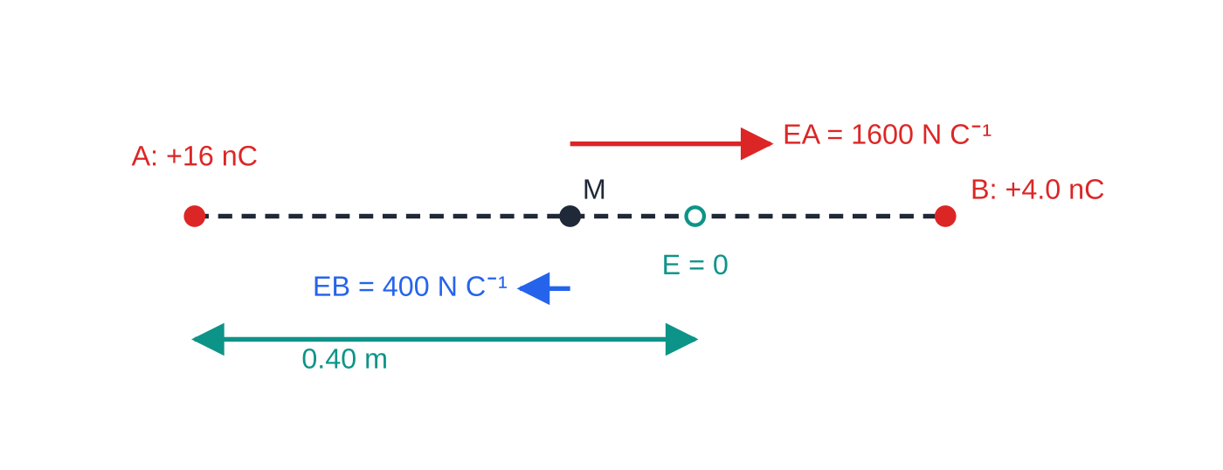
What is the field of a point charge, and how do two fields combine? (continued)
Section 3 of 11
Worked example 3. At the midpoint the two fields point in opposite directions (arrows to scale), so they subtract. The neutral point, where they cancel, is 0.40 m from A: nearer the smaller charge.
Notes:
What is the field of a point charge, and how do two fields combine?. Full notes: https://examinerprep.com/notes/edexcel-ial-physics/electric-fields/

Slide 13
What is the field of a point charge, and how do two fields combine? (continued)
Section 3 of 11 · Worked example 3 · Medium · Calculate, determine
WORKED EXAMPLE · QUESTION
A charge of +16 nC is fixed at point A and a charge of +4.0 nC at point B, 0.60 m from A. (a) Calculate the resultant field strength at the midpoint of AB and state its direction. (b) Determine the distance from A of the point on AB where the field strength is zero.
SOLUTION
(a) At 0.30 m: E_A = (8.99×10⁹ ×16×10⁻⁹)/0.30² = 1600 N C⁻¹ (towards B) and E_B = 400 N C⁻¹ (towards A).
Opposite directions, so subtract: E = 1600 − 400 = 1.2 × 10³ N C⁻¹ in the direction A → B
(b) At distance x from A the two fields have equal size: 16/x² = 4.0/((0.60 - x)²), so 4/x = 2/(0.60 - x), giving x = 0.40 m
Taking square roots of both sides keeps the algebra linear; the constant k and the 10⁻⁹ cancel.
Notes:
What is the field of a point charge, and how do two fields combine?: Worked example 3. Full notes: https://examinerprep.com/notes/edexcel-ial-physics/electric-fields/

Slide 14
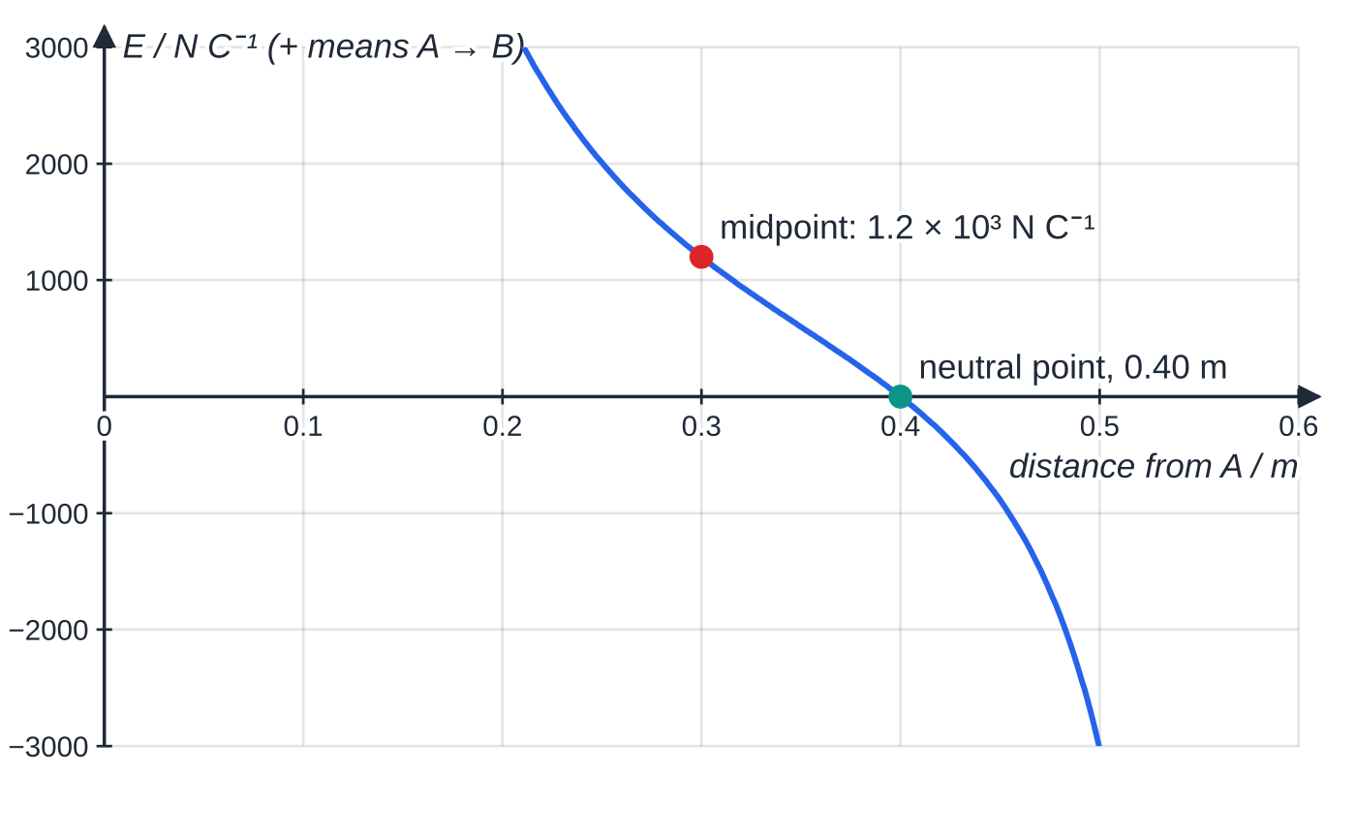
What is the field of a point charge, and how do two fields combine? (continued)
Section 3 of 11
Exam tip — vector or scalar?
Field strength is a vector and potential is a scalar. Add fields with their directions (subtract when they oppose); add potentials as plain numbers, keeping the sign of each charge.
The resultant field along AB (positive = directed from A towards B). It is zero at 0.40 m from A; on either side the field points away from the nearer charge.
Notes:
What is the field of a point charge, and how do two fields combine?. Full notes: https://examinerprep.com/notes/edexcel-ial-physics/electric-fields/

Slide 15
What is electric potential, and how is it linked to field strength?
Section 4 of 11
The electric potential V at a point is the work done per unit charge in bringing a small positive test charge from infinity to that point.
V = Q/(4πε₀ r)
V is in volts (J C⁻¹), Q is the charge creating the field (C) and r the distance from its centre (m); the equation is in the formulae list. Potential is zero at infinity. It is positive around a positive charge (work must be done to push a positive charge closer) and negative around a negative charge. Note 1/r, not 1/r².
The potential difference between two points is the work done per unit charge moving a charge between them, so moving a charge Q through a p.d. ΔV transfers energy W = QΔV.
The electric potential energy of a charge q at a point of potential V is qV.
Notes:
What is electric potential, and how is it linked to field strength?. Full notes: https://examinerprep.com/notes/edexcel-ial-physics/electric-fields/

Slide 16
What is electric potential, and how is it linked to field strength? (continued)
Section 4 of 11
For two point charges this is Qq/4πε₀ r.
An equipotential is a line (or surface) joining points at the same potential. No work is done moving a charge along it.
Field strength is the potential gradient
E = -ΔV/Δr
E is the field strength (V m⁻¹) and ΔV/Δr the potential gradient, the rate of change of potential with distance. This general form is not in the formulae list, so learn it; its uniform-field form, E = V/d, is. The minus sign says the field points the way the potential falls. On a graph of V against r, E = −(gradient of the tangent).
Because no work is done along an equipotential, the force, and so the field, has no component along it: field lines cross equipotentials at right angles.
Notes:
What is electric potential, and how is it linked to field strength?. Full notes: https://examinerprep.com/notes/edexcel-ial-physics/electric-fields/

Slide 17
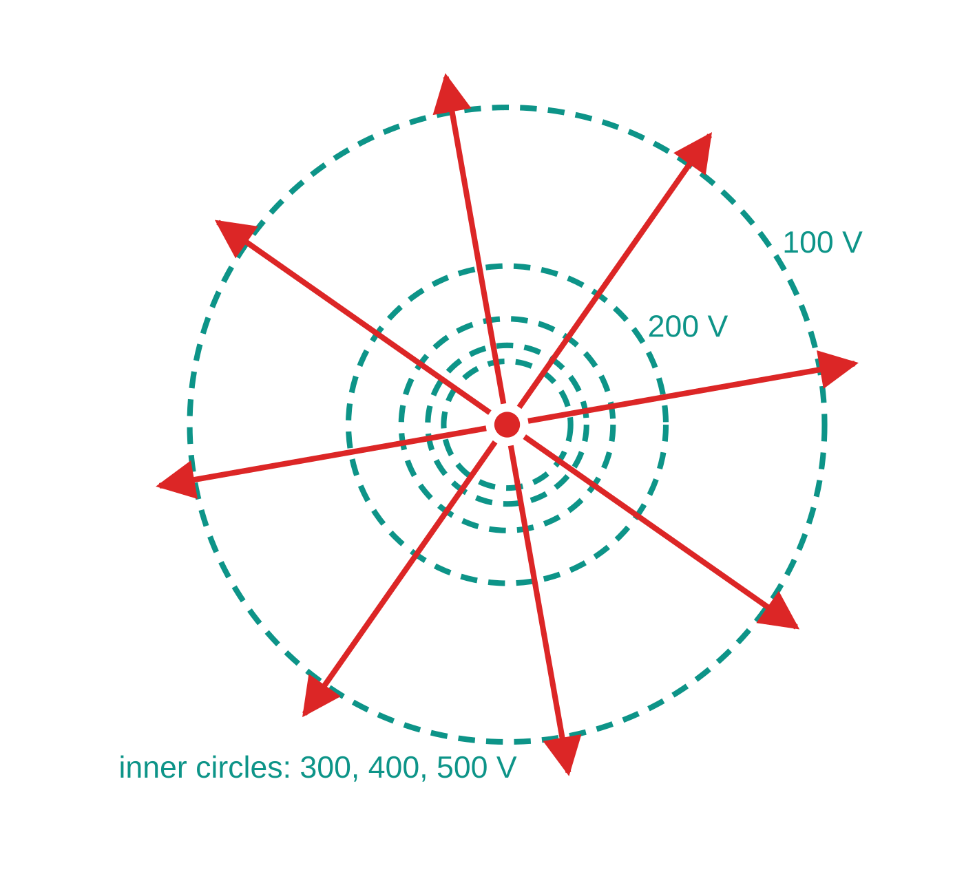
What is electric potential, and how is it linked to field strength? (continued)
Section 4 of 11
Where equipotentials drawn at equal steps of V are close together, the potential gradient is steep and the field is strong.
Around a point charge, equipotentials are concentric spheres (circles on paper). For equal steps of V they get further apart with distance, because r = Q/4πε₀ V.
Field lines (red) and equipotentials (dashed) of a +5.00 nC charge, drawn to scale. Each circle's radius is r = kQ/V; the 100 V steps get wider apart as the field weakens. Field lines cross every equipotential at right angles.
Notes:
What is electric potential, and how is it linked to field strength?. Full notes: https://examinerprep.com/notes/edexcel-ial-physics/electric-fields/

Slide 18
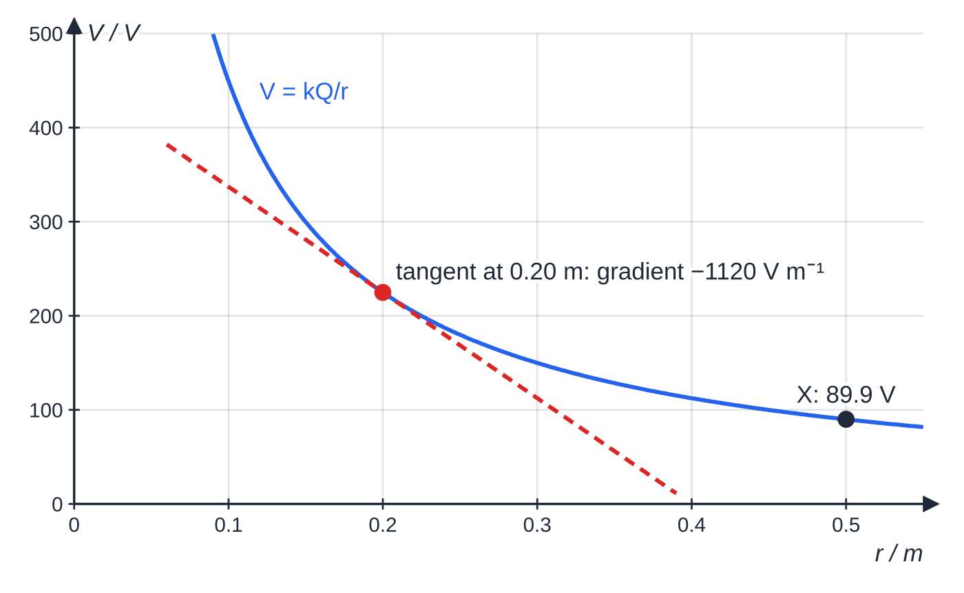
What is electric potential, and how is it linked to field strength? (continued)
Section 4 of 11
Potential against distance for the +5.00 nC charge. The tangent at 0.20 m (point Y, 225 V) has gradient −1120 V m⁻¹, so E = 1120 N C⁻¹ there: field strength is minus the potential gradient.
Notes:
What is electric potential, and how is it linked to field strength?. Full notes: https://examinerprep.com/notes/edexcel-ial-physics/electric-fields/

Slide 19
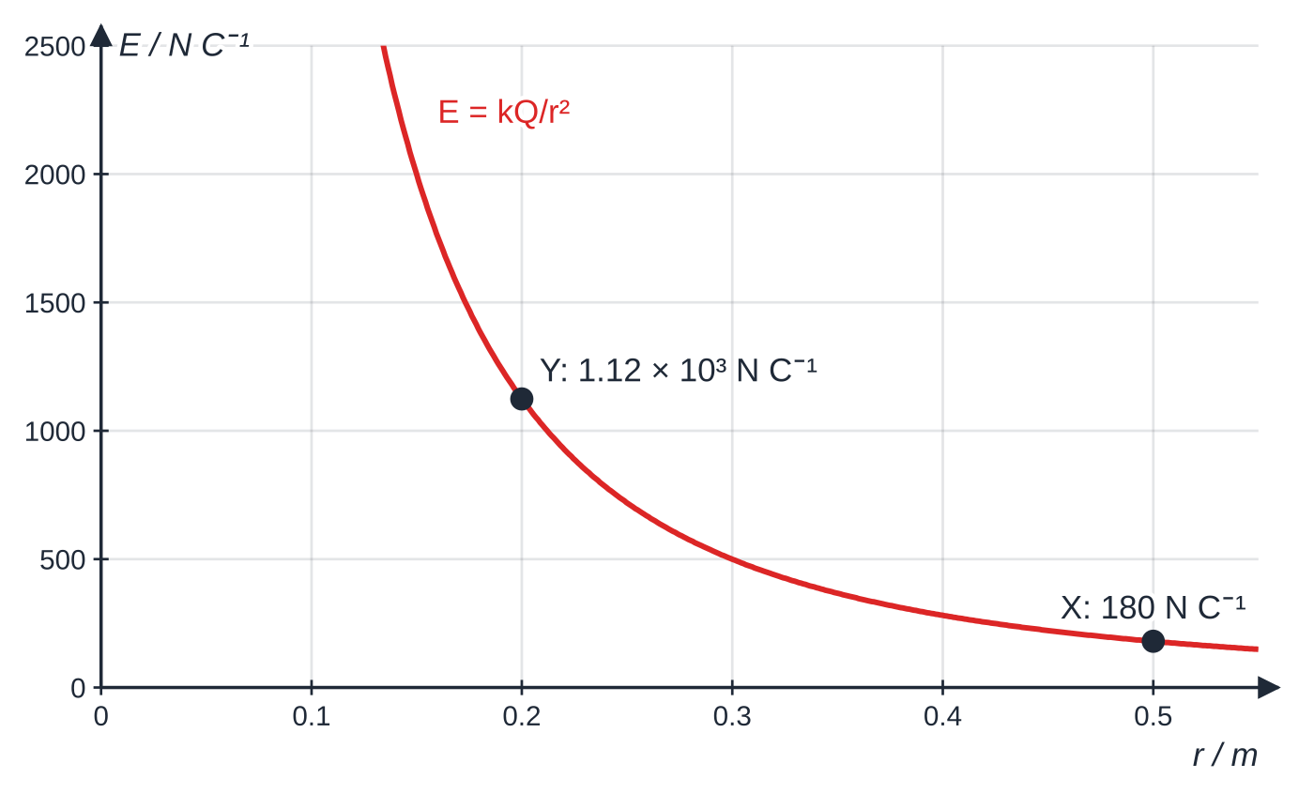
What is electric potential, and how is it linked to field strength? (continued)
Section 4 of 11
Field strength against distance for the same charge. E falls as 1/r², faster than V (1/r): between Y and X it drops by a factor of 6.25 while V drops by 2.5.
Notes:
What is electric potential, and how is it linked to field strength?. Full notes: https://examinerprep.com/notes/edexcel-ial-physics/electric-fields/

Slide 20
What is electric potential, and how is it linked to field strength? (continued)
Section 4 of 11 · Worked example 4 · Medium · Calculate, compare
WORKED EXAMPLE · QUESTION
A small sphere carries a charge of +5.00 nC. Points X and Y are 0.500 m and 0.200 m from its centre. (a) Calculate the potential at X and at Y. (b) Calculate the work done to move a +3.00 nC charge from X to Y. (c) Calculate the average potential gradient between X and Y and compare it with the field strengths at X and Y.
SOLUTION
(a) V_X = (8.99×10⁹ ×5.00×10⁻⁹)/0.500 = 89.9 V; similarly V_Y = 225 V
(b) ΔV = 225 − 89.9 = 135 V, so W = QΔV = 3.00 × 10⁻⁹ × 135 = 4.05 × 10⁻⁷ J
(c) Over 0.300 m: ΔV/Δr ≈ 135 ÷ 0.300 = 450 V m⁻¹. The actual fields are E_X = 180 N C⁻¹ and E_Y = 1.12×10³ N C⁻¹.
The average lies between the two end values: in a radial field the gradient, and so E, changes along the way. Only in a uniform field does a single ΔV/Δr give the field everywhere.
Notes:
What is electric potential, and how is it linked to field strength?: Worked example 4. Full notes: https://examinerprep.com/notes/edexcel-ial-physics/electric-fields/

Slide 21
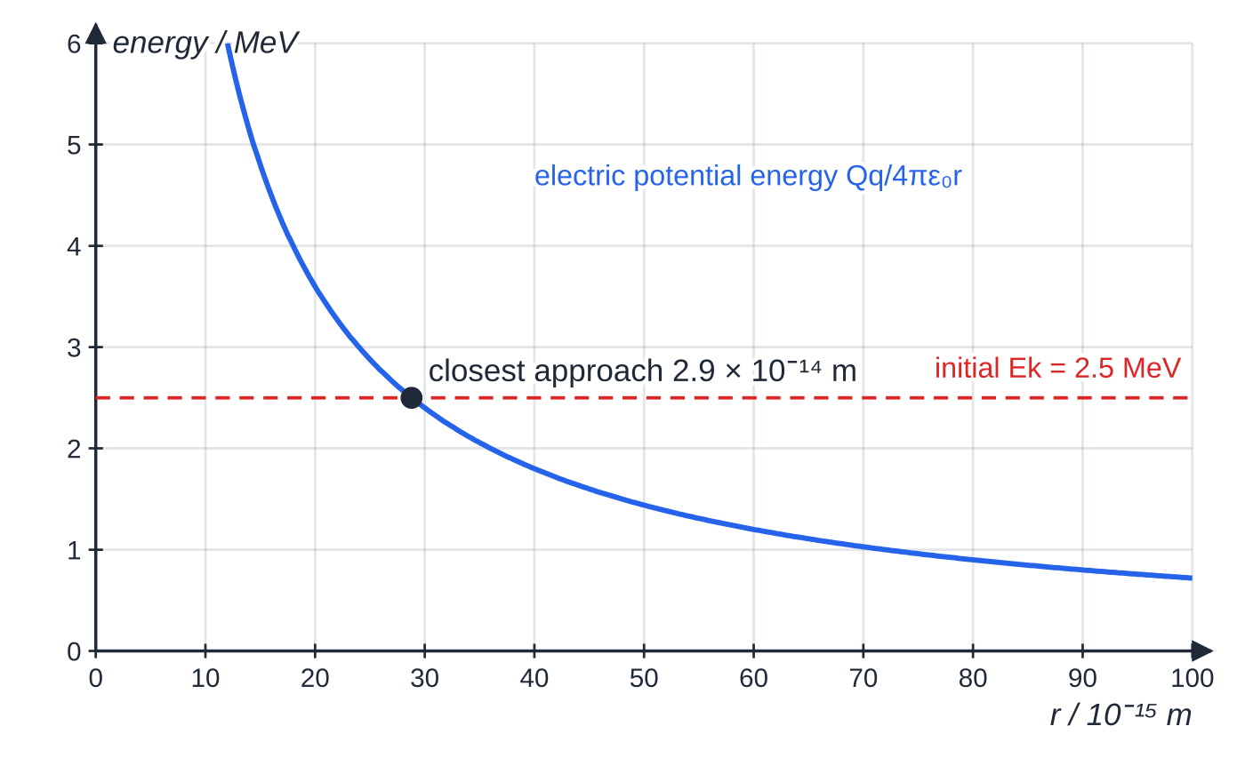
What is electric potential, and how is it linked to field strength? (continued)
Section 4 of 11 · Worked example 5 · Hard · Calculate
WORKED EXAMPLE · QUESTION
A proton with kinetic energy 2.5 MeV is fired directly towards a tin nucleus (charge +50e), which can be treated as a fixed point charge. (a) Calculate the distance of closest approach. (b) Calculate the electric field strength at that distance and the force on the proton there.
SOLUTION
(a) At closest approach all the kinetic energy has become electric potential energy. Eₖ = 2.5×10⁶ ×1.60×10⁻¹⁹ = 4.0×10⁻¹³ J.
Worked example 5. As the proton approaches the tin nucleus its kinetic energy is converted into electric potential energy. It stops (and turns back) where the potential energy equals its initial 2.5 MeV.
Notes:
What is electric potential, and how is it linked to field strength?: Worked example 5. Full notes: https://examinerprep.com/notes/edexcel-ial-physics/electric-fields/

Slide 22
What is electric potential, and how is it linked to field strength? (continued)
Section 4 of 11 · Worked example 5 · Hard · Calculate (continued)
Eₖ = (50e)e/(4πε₀ r), so r = (8.99×10⁹ ×50 ×(1.60×10⁻¹⁹)²)/(4.0×10⁻¹³) = 2.9 ×10⁻¹⁴ m
(b) E = (8.99×10⁹ ×50 ×1.60×10⁻¹⁹)/((2.88×10⁻¹⁴)²) = 8.7 ×10¹⁹ N C⁻¹, and F = eE = 14 N
Quick check: the potential at closest approach is 2.5 MV (2.5 MeV per unit charge e), and for a point charge E = V/r = 2.5 × 10⁶ ÷ 2.88 × 10⁻¹⁴, the same answer. A force of about 14 N on a single proton shows how strong fields are close to a nucleus.
Notes:
What is electric potential, and how is it linked to field strength?: Worked example 5. Full notes: https://examinerprep.com/notes/edexcel-ial-physics/electric-fields/

Slide 23
What is electric potential, and how is it linked to field strength? (continued)
Section 4 of 11
Common error — 1/r² for an energy question
Using Q/4πε₀ r² when the question is about energy or potential. Energy and potential go with 1/r; force and field strength go with 1/r².
Notes:
What is electric potential, and how is it linked to field strength?. Full notes: https://examinerprep.com/notes/edexcel-ial-physics/electric-fields/

Slide 24
What does a uniform field look like, and how strong is it?
Section 5 of 11
Two parallel metal plates connected to a supply produce a uniform field between them: the field strength has the same size and direction at every point (away from the edges).
Field lines are parallel, equally spaced and perpendicular to the plates, from the positive plate to the negative plate.
Equipotentials are planes parallel to the plates, equally spaced for equal steps of potential: the potential falls steadily from one plate to the other.
Near the edges the lines bulge outwards and the field is weaker (edge effects), so questions use the central region.
E = V/d
E is the field strength (V m⁻¹), V the p.d. between the plates (V) and d their separation (m); the equation is in the formulae list.
Notes:
What does a uniform field look like, and how strong is it?. Full notes: https://examinerprep.com/notes/edexcel-ial-physics/electric-fields/

Slide 25
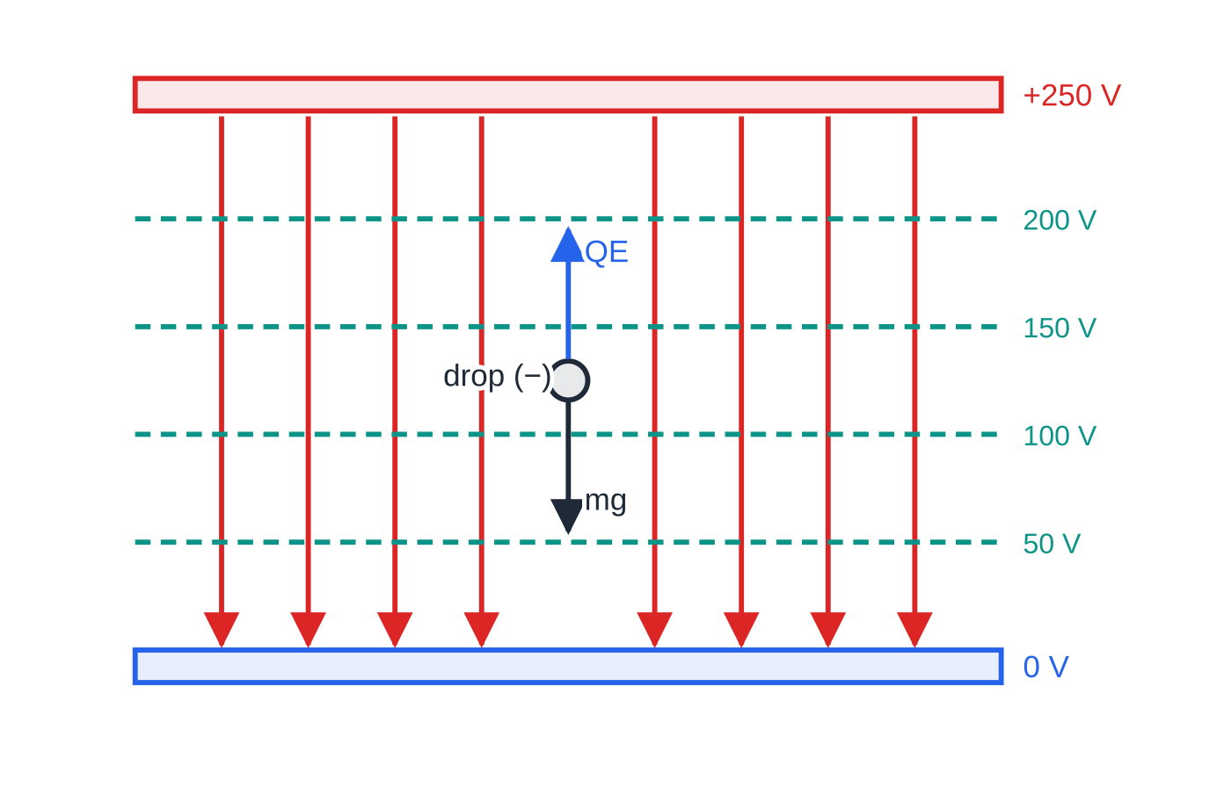
What does a uniform field look like, and how strong is it? (continued)
Section 5 of 11
Why: moving a charge Q from one plate to the other, work = force × distance = QEd, and also = QV. So E = V/d, and 1 N C⁻¹ = 1 V m⁻¹.
Balancing a charged drop
A tiny charged drop between horizontal plates feels its weight mg downwards and an electric force QE = QV/d. Adjust V until the drop is stationary: QV/d = mg, so Q = mgd/V. A negative drop needs the upper plate positive; a positive drop needs it negative. When many drops are measured, every charge is a whole-number multiple of 1.60 × 10⁻¹⁹ C: charge comes in units of e (it is quantised). This is the idea behind Millikan's oil-drop experiment.
The central region of a pair of parallel plates. Field lines are parallel and equally spaced; equipotentials at equal 50 V steps are equally spaced because the field is uniform. A negatively charged drop is held still when the upward electric force QE equals its weight.
Notes:
What does a uniform field look like, and how strong is it?. Full notes: https://examinerprep.com/notes/edexcel-ial-physics/electric-fields/

Slide 26
What does a uniform field look like, and how strong is it? (continued)
Section 5 of 11 · Worked example 6 · Medium · Calculate, deduce
WORKED EXAMPLE · QUESTION
An oil drop of mass 3.2 × 10⁻¹⁵ kg is held stationary between two horizontal plates 5.0 mm apart when the p.d. between them is 245 V. The upper plate is positive. (a) Calculate the field strength between the plates. (b) Calculate the charge on the drop and deduce how many excess electrons it carries.
SOLUTION
(a) E = V/d = 245/(5.0×10⁻³) = 4.9 ×10⁴ V m⁻¹
(b) Balance, QE = mg: Q = (3.2×10⁻¹⁵ ×9.81)/(4.9×10⁴) = 6.4 ×10⁻¹⁹ C
n = 6.41 × 10⁻¹⁹ ÷ 1.60 × 10⁻¹⁹ = 4.00, so 4 excess electrons (the drop is negative, pulled up towards the positive plate).
Notes:
What does a uniform field look like, and how strong is it?: Worked example 6. Full notes: https://examinerprep.com/notes/edexcel-ial-physics/electric-fields/

Slide 27
What does a uniform field look like, and how strong is it? (continued)
Section 5 of 11
Exam tip — plate separation in metres
Convert the plate separation to metres before using E = V/d: millimetres give an answer 1000 times too small. A sensible field between laboratory plates is typically 10³–10⁶ V m⁻¹.
Notes:
What does a uniform field look like, and how strong is it?. Full notes: https://examinerprep.com/notes/edexcel-ial-physics/electric-fields/

Slide 28
How does a charged particle move in a uniform field?
Section 6 of 11
Accelerating a charge through a p.d.
A charge Q that moves through a p.d. V has work QV done on it. Starting from rest, ½ mv² = QV, so v = √(2QV/m). The energy gained depends only on Q and V, not on the plate separation. An electron accelerated through 1 V gains 1 eV = 1.60 × 10⁻¹⁹ J. An electron and a proton accelerated through the same p.d. gain the same energy, but the electron, being about 1800 times lighter, ends up much faster.
Firing a charge across a uniform field
A particle entering the field at right angles to the field lines feels a constant force QE parallel to the field lines and no force at right angles to them.
So, exactly like a projectile under gravity, it has constant velocity at right angles to the field and constant acceleration a = QE/m along the field: the path is a parabola.
Time between the plates: t = L/v. Sideways deflection: y = ½ at². After leaving the plates, the particle moves in a straight line.
Notes:
How does a charged particle move in a uniform field?. Full notes: https://examinerprep.com/notes/edexcel-ial-physics/electric-fields/

Slide 29
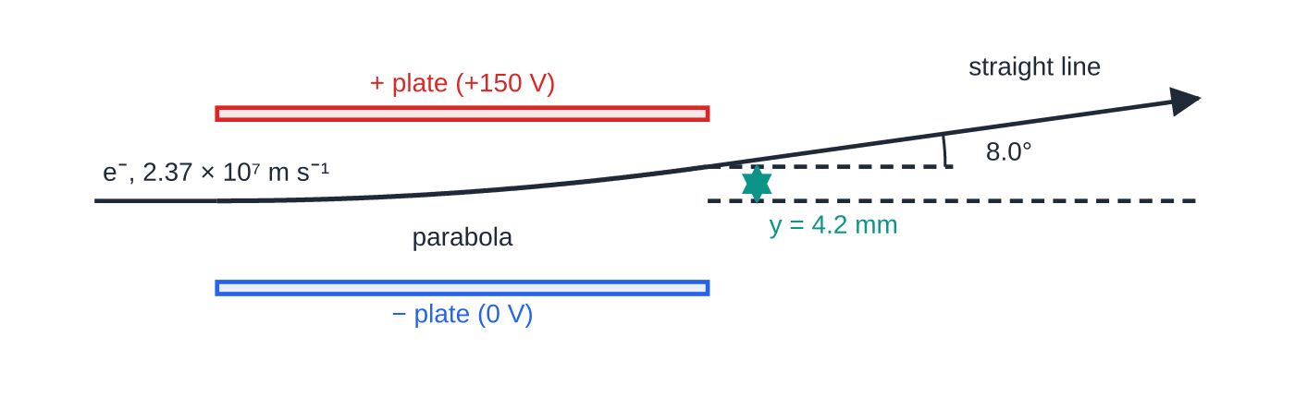
How does a charged particle move in a uniform field? (continued)
Section 6 of 11
Gravity on electrons and ions is negligible here: for the electron below, eE is about 10¹⁴ times its weight.
The electron of worked example 7, drawn to scale (plates 6.0 cm long and 2.0 cm apart). Between the plates the path is a parabola curving towards the positive plate; afterwards it is a straight line at 8.0° to the original direction.
Notes:
How does a charged particle move in a uniform field?. Full notes: https://examinerprep.com/notes/edexcel-ial-physics/electric-fields/

Slide 30
How does a charged particle move in a uniform field? (continued)
Section 6 of 11 · Worked example 7 · Hard · Calculate, show that
WORKED EXAMPLE · QUESTION
Electrons are accelerated from rest through a p.d. of 1.6 kV. They then enter the space midway between two horizontal parallel plates, travelling parallel to the plates. The plates are 6.0 cm long and 2.0 cm apart, with a p.d. of 150 V between them. (a) Calculate the speed of the electrons entering the plates. (b) Calculate the vertical deflection of an electron as it leaves the plates and show that it does not hit a plate. (c) Calculate the angle of the beam to its original direction as it leaves, and the kinetic energy gained between the plates.
SOLUTION
(a) ½ mv² = eV = 1.60×10⁻¹⁹ ×1600 = 2.56×10⁻¹⁶ J, so v = 2.37 ×10⁷ m s⁻¹
(b) E = 150 ÷ 0.020 = 7500 V m⁻¹; a = eE/m = 1.32×10¹⁵ m s⁻²; t = 0.060 ÷2.37×10⁷ = 2.53×10⁻⁹ s.
y = ½ at² = ½ ×1.32×10¹⁵ ×(2.53×10⁻⁹)² = 4.2 mm, which is less than 10 mm (half the gap), so the electron clears the plate.
Notes:
How does a charged particle move in a uniform field?: Worked example 7. Full notes: https://examinerprep.com/notes/edexcel-ial-physics/electric-fields/

Slide 31
How does a charged particle move in a uniform field? (continued)
Section 6 of 11 · Worked example 7 · Hard · Calculate, show that (continued)
(c) v_y = at = 3.33×10⁶ m s⁻¹; tan θ= (3.33×10⁶)/(2.37×10⁷), so θ = 8.0°
Energy gained = charge × p.d. moved through inside the plates: p.d. across 4.22 mm = 7500 × 0.00422 = 31.6 V, so ΔEₖ = e ×31.6 = 5.1 ×10⁻¹⁸ J (≈ 32 eV)
Combining the steps gives y = VₚₗₐₜₑₛL²/4dV_acc = (150 ×0.060²)/(4 ×0.020 ×1600) = 4.2 mm: the charge and mass cancel, so any particle accelerated from rest by the same p.d. follows the same path.
Notes:
How does a charged particle move in a uniform field?: Worked example 7. Full notes: https://examinerprep.com/notes/edexcel-ial-physics/electric-fields/

Slide 32
How does a charged particle move in a uniform field? (continued)
Section 6 of 11
Exam tip — one direction at a time
Never mix the directions across and along the field lines in one suvat equation. Find the time from the direction with constant velocity, then use that time in the direction with constant acceleration.
Notes:
How does a charged particle move in a uniform field?. Full notes: https://examinerprep.com/notes/edexcel-ial-physics/electric-fields/

Slide 33
Exam tips for 4.3
Section 7 of 11
Exam tip 1 — definitions need "per unit positive charge"
Field strength: force per unit positive charge on a small test charge. Potential: work done per unit charge bringing a small positive charge from infinity. "The force on a charge" or "the energy of a charge" is not a definition.
Exam tip 2 — 1/r² for force and field, 1/r for potential and energy
Before substituting, check which one the question asks for. Measure r from the centre of a charged sphere, in metres, and square it only for F and E.
Exam tip 3 — always state a direction
Field lines run from + to −. A positive charge is pushed along the field, a negative charge (an electron) against it. For Coulomb forces, say "attractive" or "repulsive".
Notes:
Exam tips for 4.3. Full notes: https://examinerprep.com/notes/edexcel-ial-physics/electric-fields/

Slide 34
Exam tips for 4.3 (continued)
Section 7 of 11
Exam tip 4 — drawing field patterns
Radial field: straight lines, evenly spread, arrows outwards from + (inwards to −). Uniform field: parallel, equally spaced lines meeting the plates at 90°. Equipotentials always cross field lines at right angles.
Exam tip 5 — energy first for speeds
If the question gives a p.d. and asks for a speed, use QV = ½mv². It works for any field shape, uniform or radial, and avoids finding the acceleration.
Notes:
Exam tips for 4.3. Full notes: https://examinerprep.com/notes/edexcel-ial-physics/electric-fields/

Slide 35
Common misconceptions
Section 8 of 11
Misconception | Why it is wrong | Correct idea
Field lines show the path a charge will follow. | They show the direction of the force. A charge that is already moving keeps its velocity across the lines. | The acceleration is along the field line; an electron fired across a uniform field follows a parabola.
Doubling the distance from a point charge halves the field. | The field follows an inverse-square law. | E falls to a quarter; it is the potential that halves (1/r).
Where the potential is zero, the field must be zero. | Field depends on how fast the potential changes, not on its value. | E = −ΔV/Δr. Midway between equal and opposite charges V = 0 but E is large.
The field between parallel plates is strongest close to the plates. | Field lines are equally spaced across the whole gap. | The field is uniform, E = V/d, everywhere away from the edges.
Equipotentials around a point charge are equally spaced for equal steps of potential. | V ∝ 1/r, so the same drop in V needs a longer distance further out. | They spread out with distance, showing the field getting weaker.
Notes:
Common misconceptions. Full notes: https://examinerprep.com/notes/edexcel-ial-physics/electric-fields/

Slide 36
Common misconceptions (continued)
Section 8 of 11
Misconception | Why it is wrong | Correct idea
An electron and a proton accelerated through the same p.d. reach the same speed. | The energy gained is the same, eV, but their masses are very different. | Same kinetic energy; the lighter electron is about 43 times faster.
Notes:
Common misconceptions. Full notes: https://examinerprep.com/notes/edexcel-ial-physics/electric-fields/

Slide 37
How this topic connects
Section 9 of 11
6 Current and p.d., 2.5 Photons, and 1.1 Projectiles
V = W/Q from electric circuits is the same idea as the potential difference between two points in a field, and the electronvolt is the energy gained crossing 1 V. A charge fired across a uniform field moves like a ball thrown horizontally: resolve, use constant velocity one way and suvat the other.
4 Capacitors, 4.5 Magnetic fields and 4.7 Particle accelerators
A capacitor is a pair of parallel plates storing charge in a uniform field. In a magnetic field a moving charge follows a circle, not a parabola: the basis of particle accelerators and detectors, along with the alpha-scattering evidence for the nucleus.
7 Gravitational fields
Newton's law of gravitation has the same inverse-square form as Coulomb's law, with field strength, potential and equipotentials defined the same way, but gravity only attracts.
Notes:
How this topic connects. Full notes: https://examinerprep.com/notes/edexcel-ial-physics/electric-fields/

Slide 38
Key equations
Section 10 of 11
Equation | Use | In the formulae list?
E = F/Q | definition of field strength; force on a charge in a field | Yes
F = Q₁Q₂/4πε₀ r² | Coulomb's law: force between two point charges | Yes
E = Q/4πε₀ r² | radial field of a point charge | Yes
V = Q/4πε₀ r | potential in a radial field | Yes
E = V/d | uniform field between parallel plates | Yes
E = -ΔV/Δr | field strength as minus the potential gradient | No — learn it
W = QΔV; ½mv² = QV | energy gained by a charge moving through a p.d. | No — derive it from V = W/Q and Eₖ = ½ mv²
Eₚ = Qq/4πε₀ r | electric potential energy of two point charges | No — derive it: Eₚ = qV
Q = mgd/V | charge on a drop balanced between horizontal plates | No — derive it: QV/d = mg
Notes:
Key equations. Full notes: https://examinerprep.com/notes/edexcel-ial-physics/electric-fields/

Slide 39
Check your understanding
Section 11 of 11
1. Explain why two electric field lines can never cross.
2. Calculate the electric field strength 5.0 cm from a point charge of +2.0 nC.
3. The distance from a point charge is trebled. By what factors do the field strength and the potential change?
4. Two parallel plates 2.0 mm apart have a p.d. of 12 V between them. Calculate the field strength and the force on an electron between them.
5. An electron is accelerated from rest through a p.d. of 250 V. Calculate its kinetic energy in joules and its final speed.
Notes:
Check your understanding: questions. Full notes: https://examinerprep.com/notes/edexcel-ial-physics/electric-fields/

Slide 40
Check your understanding · answers
Section 11 of 11
1. The field has a single direction at each point, the direction of the force on a positive charge. Two lines crossing would give two directions at the same point.
2. E = (8.99×10⁹ ×2.0×10⁻⁹)/0.050² = 7.2×10³ N C⁻¹, directed away from the charge.
3. The field strength falls to 1/9 (inverse square); the potential falls to 1/3 (inverse proportion).
4. E = 12 ÷2.0×10⁻³ = 6.0×10³ V m⁻¹; F = eE = 9.6×10⁻¹⁶ N, towards the positive plate.
5. Eₖ = 250 ×1.60×10⁻¹⁹ = 4.0×10⁻¹⁷ J; v = √(2 ×4.0×10⁻¹⁷ ÷9.11×10⁻³¹) = 9.4×10⁶ m s⁻¹.
Notes:
Check your understanding: answers. Full notes: https://examinerprep.com/notes/edexcel-ial-physics/electric-fields/

Slide 41
Practice questions
5 original exam-style questions. Answers at the end of the deck.

Slide 42
Question 1
1 mark
Which of the following units is equivalent to the unit of electric field strength, N C⁻¹?
A C N⁻¹
B J C⁻¹
C N m C⁻¹
D V m⁻¹
Notes:
Online with the full mark scheme: https://examinerprep.com/ial-physics-4-3-electric-fields-questions#IALP-U4-3-A-01

Slide 43
Question 2
1 mark
A particle with a charge of 3.0 μC is placed at a point where the electric field strength is 4.0 × 10³ N C⁻¹.
What is the size of the electric force on the particle?
A 7.5 × 10⁻¹⁰ N
B 1.2 × 10⁻² N
C 1.2 × 10¹ N
D 1.2 × 10⁴ N
Notes:
Online with the full mark scheme: https://examinerprep.com/ial-physics-4-3-electric-fields-questions#IALP-U4-3-A-02

Slide 44
Question 3
1 mark
A small sphere carries a charge of −8.0 nC.
What is the size of the electric field strength at a distance of 15 cm from the centre of the sphere?
A 3.2 × 10⁻¹ N C⁻¹
B 4.8 × 10² N C⁻¹
C 3.2 × 10³ N C⁻¹
D 4.0 × 10⁴ N C⁻¹
Notes:
Online with the full mark scheme: https://examinerprep.com/ial-physics-4-3-electric-fields-questions#IALP-U4-3-A-04

Slide 45
Question 4
7 marks
Electric fields can be radial, such as the field around an isolated point charge, or uniform, such as the field between the central parts of two oppositely charged parallel plates.
(a) Define the electric potential at a point. [1]
(b) Compare the electric field and the potential around an isolated positive point charge with those between two oppositely charged parallel plates. Your answer should refer to field lines, equipotentials, and how the field strength and potential vary with position. [6]
Notes:
Online with the full mark scheme: https://examinerprep.com/ial-physics-4-3-electric-fields-questions#IALP-U4-3-B-10

Slide 46
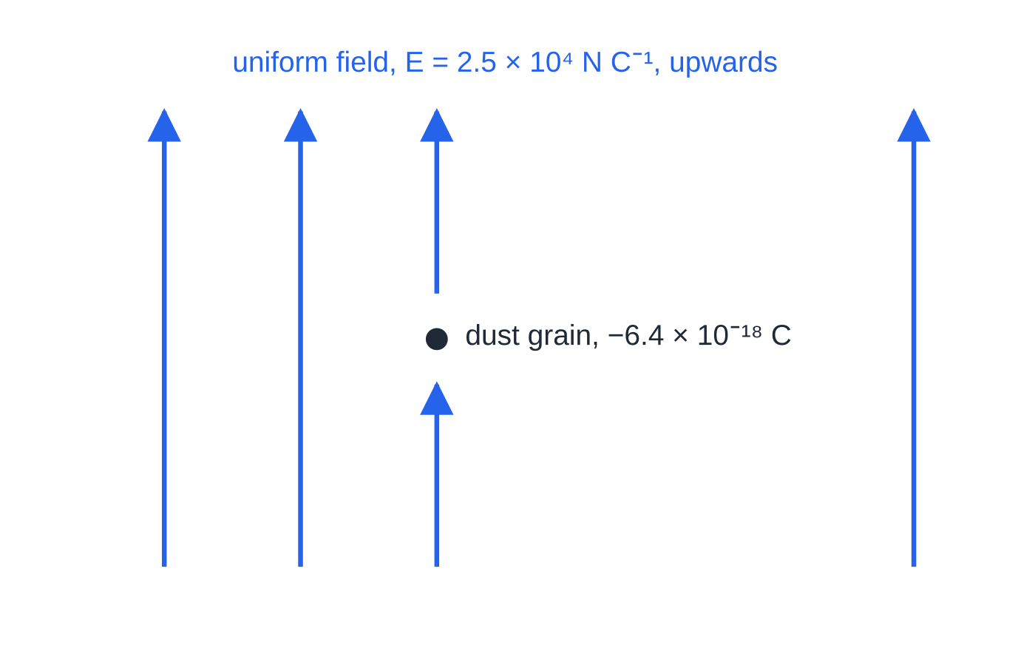
Question 5
4 marks
A grain of dust carries a charge of −6.4 × 10⁻¹⁸ C. It is in a region where there is a uniform electric field of strength 2.5 × 10⁴ N C⁻¹, directed vertically upwards.
Figure: the dust grain in the uniform electric field
(a) Define electric field strength. [1]
(b) Calculate the size of the electric force on the grain. [2]
(c) State the direction of the electric force on the grain and explain your answer. [1]
Notes:
Online with the full mark scheme: https://examinerprep.com/ial-physics-4-3-electric-fields-questions#IALP-U4-3-B-01

Slide 47
Answers

Slide 48
Question 1 · answer
Answer D
For a uniform field E = V/d, so field strength can be measured in V m⁻¹. Check: V m⁻¹ = J C⁻¹ m⁻¹ = N m C⁻¹ m⁻¹ = N C⁻¹. Options B and C are both the volt, the unit of potential.
Notes:
Full mark scheme: https://examinerprep.com/ial-physics-4-3-electric-fields-questions#IALP-U4-3-A-01

Slide 49
Question 2 · answer
Answer B
F = EQ = 4.0 × 10³ × 3.0 × 10⁻⁶ = 1.2 × 10⁻² N.
Notes:
Full mark scheme: https://examinerprep.com/ial-physics-4-3-electric-fields-questions#IALP-U4-3-A-02

Slide 50
Question 3 · answer
Answer C
E = Q/4πε₀r² = 8.99 × 10⁹ × 8.0 × 10⁻⁹ ÷ 0.15² = 3.2 × 10³ N C⁻¹ (3196 N C⁻¹), directed towards the sphere.
Notes:
Full mark scheme: https://examinerprep.com/ial-physics-4-3-electric-fields-questions#IALP-U4-3-A-04

Slide 51
Question 4 · answer
Mark scheme
the work done per unit charge in bringing a small positive test charge from infinity to that point
Indicative content:
point charge: field lines are radial, pointing outwards from the charge
point charge: field strength E = Q/4πε₀r², so the field is non-uniform and weakens with distance (inverse square)
point charge: potential V = Q/4πε₀r; equipotentials are concentric spheres that get further apart for equal steps of potential
plates: field lines are parallel, equally spaced and perpendicular to the plates, from the positive to the negative plate
plates: field strength E = V/d is the same everywhere (uniform) away from the edges, and the potential falls linearly across the gap
plates: equipotentials are equally spaced planes parallel to the plates; in both fields equipotentials are perpendicular to field lines and E is minus the potential gradient
Notes:
Full mark scheme: https://examinerprep.com/ial-physics-4-3-electric-fields-questions#IALP-U4-3-B-10

Slide 52
Question 5 · answer
Mark scheme
the force per unit positive charge (acting on a small test charge) at that point
F = EQ = 2.5 × 10⁴ × 6.4 × 10⁻¹⁸
= 1.6 × 10⁻¹³ N
vertically downwards, because the grain is negatively charged and the force on a negative charge is opposite to the field direction
Notes:
Full mark scheme: https://examinerprep.com/ial-physics-4-3-electric-fields-questions#IALP-U4-3-B-01

Slide 53
Keep practising
Notes for this topic
Questions on this topic
Build a printable test
ExaminerPrep is an independent tutoring service. It has been developed independently from and is not endorsed by the International Baccalaureate Organization. "International Baccalaureate", "IB" and "IB Diploma Programme" are registered trademarks of the IBO, used here for descriptive purposes only.
Pearson Edexcel and Cambridge are trademarks of their owners; ExaminerPrep is not affiliated with any exam board.

