Slide 1
EP
EDEXCEL IAL PHYSICS
4.6 Electromagnetic induction
The full notes page in 13 sections · practice questions with answers · simulations
ExaminerPrep is an independent tutoring service. It has been developed independently from and is not endorsed by the International Baccalaureate Organization. "International Baccalaureate", "IB" and "IB Diploma Programme" are registered trademarks of the IBO, used here for descriptive purposes only.
Pearson Edexcel and Cambridge are trademarks of their owners; ExaminerPrep is not affiliated with any exam board.
Notes:
4.6 Electromagnetic induction. Notes for this topic: https://examinerprep.com/notes/edexcel-ial-physics/electromagnetic-induction/

Slide 2
What this page covers
Overview
A short recap of magnetic flux and flux linkage, the quantities this topic is built on
The factors that decide the e.m.f. induced when a magnet and a coil move relative to each other
The e.m.f. induced in a coil by a changing current in a linked coil, and how a transformer works (qualitatively)
Faraday's law and Lenz's law: ε= -d(Nφ)/dt
Flux-linkage–time and e.m.f.–time graphs: the e.m.f. is minus the gradient
A straight conductor moving through a uniform field: ε= Blv
A coil rotating in a uniform field and its sinusoidal e.m.f. (qualitatively)
Eddy currents and magnetic braking as applications of Lenz's law
Notes:
What this page covers. Full notes: https://examinerprep.com/notes/edexcel-ial-physics/electromagnetic-induction/

Slide 3
In one minute
Key points
1. An e.m.f. is induced in a circuit whenever the magnetic flux linking it changes, and its size equals the rate of change of flux linkage while its direction opposes the change: ε= -d(Nφ)/dt.
2. Flux φ= BA (field perpendicular to the area) is in webers, Wb = T m²; flux linkage is Nφ for a coil of N turns.
3. The flux linkage can change by moving a magnet or the coil, changing a current nearby, or rotating the coil; a steady flux linkage, however large, induces nothing.
4. On a graph of Nφ against t, the e.m.f. is minus the gradient; the area under an ε–t graph equals the change in flux linkage in size.
5. A rod of length l moving at v at right angles to a field B has ε= Blv; a coil turning steadily gives a sinusoidal e.m.f., largest when the coil is edge-on to the field.
6. Eddy currents in solid metal oppose relative motion (magnetic braking) and waste energy as heat in transformer cores.
Notes:
In one minute. Full notes: https://examinerprep.com/notes/edexcel-ial-physics/electromagnetic-induction/

Slide 4
What are magnetic flux and flux linkage?
Section 1 of 13
These are defined on 4.5 Magnetic fields and forces; here is what this topic needs from them.
Magnetic flux and flux linkage
φ= BA flux linkage = Nφ φ magnetic flux (Wb), B magnetic flux density (T), A area at right angles to the field (m²), N number of turns. 1 Wb = 1 T m²; flux linkage is also measured in Wb (sometimes written Wb-turns). In the formulae list; know what each symbol means, including that only the area
at right angles to the field counts.
Think of flux as the amount of field passing through an area. If the area is tilted, less field passes through it; when the plane of the coil is parallel to the field lines, the flux through it is zero. Each turn of a coil has the same flux through it, so a coil of N turns has N times the flux linkage of a single turn.
Notes:
What are magnetic flux and flux linkage?. Full notes: https://examinerprep.com/notes/edexcel-ial-physics/electromagnetic-induction/

Slide 5
What are magnetic flux and flux linkage? (continued)
Section 1 of 13
Flux linkage can change in three ways: change B, change the area inside the field, or change the angle between the coil and the field. Every example on this page is one of these.
Notes:
What are magnetic flux and flux linkage?. Full notes: https://examinerprep.com/notes/edexcel-ial-physics/electromagnetic-induction/

Slide 6
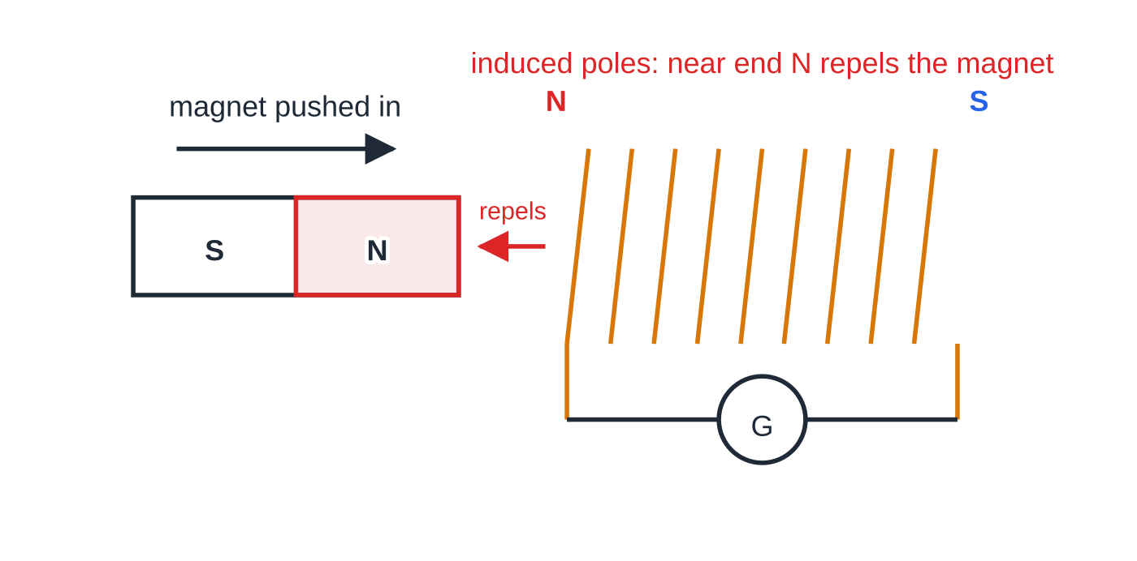
What happens when a magnet moves relative to a coil?
Section 2 of 13
Connect a coil to a sensitive centre-zero meter and push a bar magnet into it: the needle flicks one way. Hold the magnet still: the reading returns to zero. Pull it out: the needle flicks the other way. Moving the coil over a stationary magnet does exactly the same, so only the relative motion matters.
The e.m.f. exists whenever the flux linkage is changing, even if the coil is not part of a complete circuit. A current flows only if the circuit is complete.
Pushing the N pole of a magnet into a coil connected to a galvanometer G. The flux linkage increases, so an e.m.f. is induced; the induced current makes the near end of the coil a N pole, which repels the approaching magnet.
Notes:
What happens when a magnet moves relative to a coil?. Full notes: https://examinerprep.com/notes/edexcel-ial-physics/electromagnetic-induction/

Slide 7
What happens when a magnet moves relative to a coil? (continued)
Section 2 of 13
Change made | Effect on the induced e.m.f. | Reason
Move the magnet faster | larger | the flux linkage changes in less time
Use a stronger magnet | larger | bigger change in flux for the same movement
Use a coil with more turns | larger | each turn adds its own e.m.f.: flux linkage is Nφ
Use a coil of larger cross-sectional area | larger (for a wide enough field) | more flux passes through each turn
Reverse the direction of motion, or turn the magnet round | reverses | the flux linkage now changes the other way
Hold the magnet still inside the coil | zero | flux linkage is large but not changing
Notes:
What happens when a magnet moves relative to a coil?. Full notes: https://examinerprep.com/notes/edexcel-ial-physics/electromagnetic-induction/

Slide 8
What happens when a magnet moves relative to a coil? (continued)
Section 2 of 13
Common error — "A lot of flux"
Saying that a magnet resting inside a coil induces an e.m.f. because "there is a lot of flux". The e.m.f. depends on the rate of change of flux linkage, not on its size. A large, steady flux linkage induces nothing.
Notes:
What happens when a magnet moves relative to a coil?. Full notes: https://examinerprep.com/notes/edexcel-ial-physics/electromagnetic-induction/

Slide 9
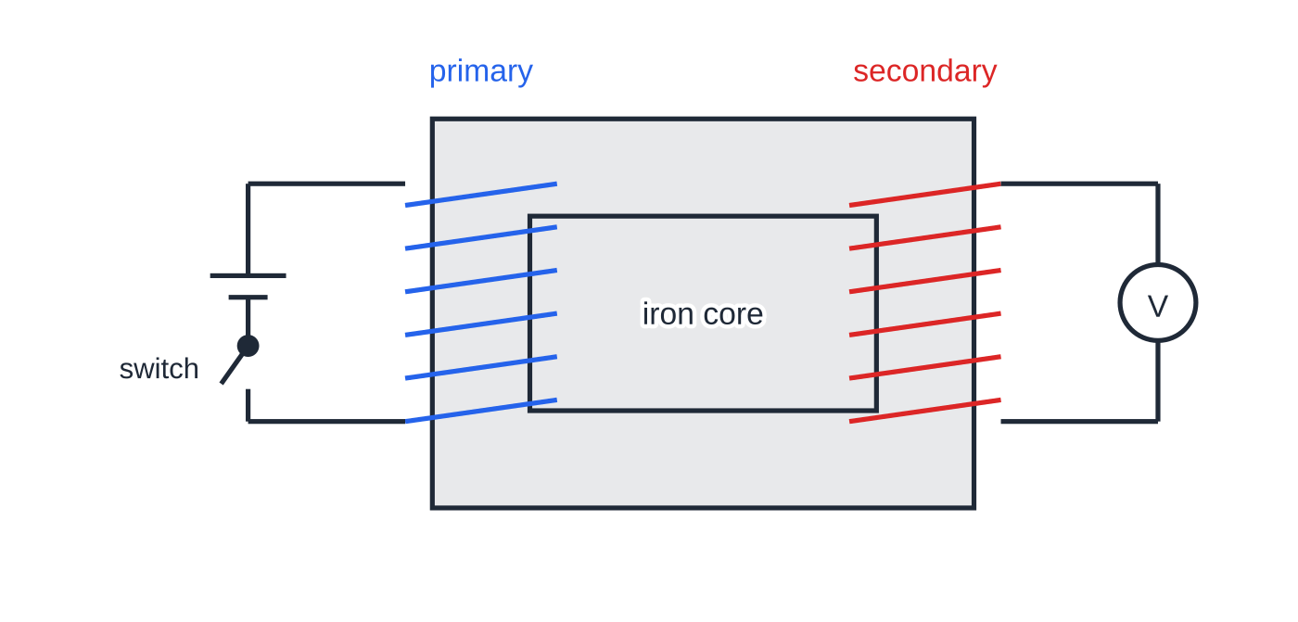
How can a changing current in one coil induce an e.m.f. in another?
Section 3 of 13
A current in a primary coil makes a magnetic field. If a secondary coil sits in that field, best of all wound on the same iron core, some of the primary's flux links the secondary. When the primary current changes, the flux linking the secondary changes, so an e.m.f. is induced in the secondary. Nothing needs to move. A steady primary current gives a steady flux and no e.m.f. in the secondary.
Two coils wound on one iron core. The primary is connected to a cell and a switch; the secondary to a voltmeter. The core guides almost all of the primary's flux through the secondary.
Notes:
How can a changing current in one coil induce an e.m.f. in another?. Full notes: https://examinerprep.com/notes/edexcel-ial-physics/electromagnetic-induction/

Slide 10
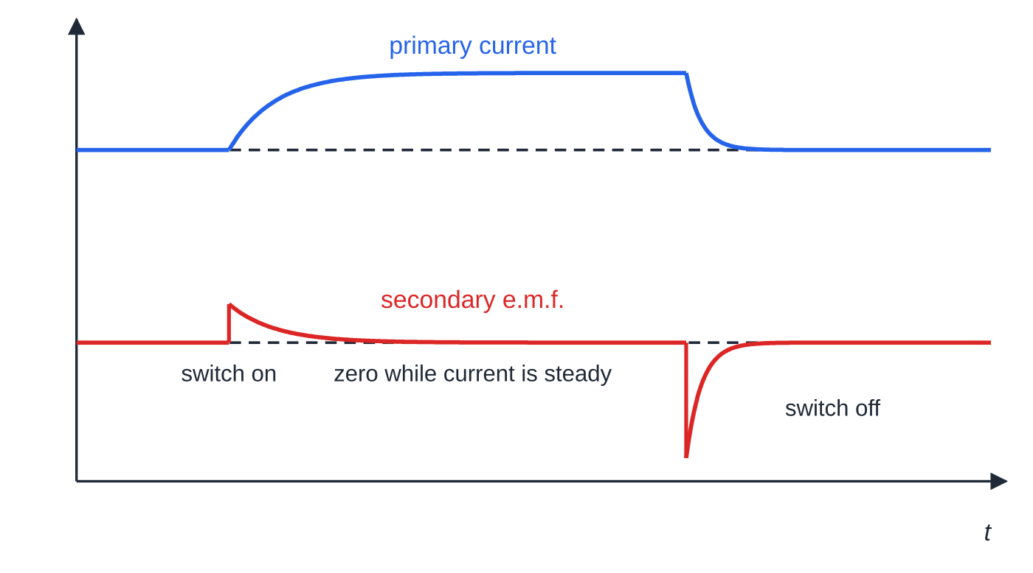
How can a changing current in one coil induce an e.m.f. in another? (continued)
Section 3 of 13
What makes the secondary e.m.f. larger?
a faster rate of change of the primary current (switching more quickly, or a higher a.c. frequency)
a larger change in the primary current
more turns on the primary (stronger field for the same current) or on the secondary (more flux linkage)
an iron core linking the two coils: iron concentrates the flux and guides almost all of it through the secondary
Switching the primary current on and off. The secondary e.m.f. is proportional to the rate of change of the primary current, so it is a pulse at each switching and zero while the current is steady. The current dies away faster than it grew, so the switch-off pulse is larger and in the opposite direction.
Notes:
How can a changing current in one coil induce an e.m.f. in another?. Full notes: https://examinerprep.com/notes/edexcel-ial-physics/electromagnetic-induction/

Slide 11
How can a changing current in one coil induce an e.m.f. in another? (continued)
Section 3 of 13
placing the coils closer together, so more of the primary's flux passes through the secondary
Transformers (qualitatively)
An alternating p.d. across the primary drives an alternating current, which produces a continuously changing flux in the iron core. The core carries this changing flux through the secondary, so an alternating e.m.f. of the same frequency is induced across it. More secondary turns than primary turns gives a larger secondary e.m.f. (step-up); fewer gives a smaller one (step-down). A transformer will not work on a steady d.c. supply: the flux is constant, so no e.m.f. is induced in the secondary, apart from a pulse at switch-on and switch-off.
Notes:
How can a changing current in one coil induce an e.m.f. in another?. Full notes: https://examinerprep.com/notes/edexcel-ial-physics/electromagnetic-induction/

Slide 12
How can a changing current in one coil induce an e.m.f. in another? (continued)
Section 3 of 13 · Worked example 1 · Medium · Explain
WORKED EXAMPLE · QUESTION
Two coils are wound on the same iron core, as in the figure above. The primary is connected to a cell and a switch; the secondary is connected to a voltmeter. Describe and explain what the voltmeter shows (a) as the switch is closed, (b) while it stays closed and (c) as it is opened.
SOLUTION
(a) The primary current grows from zero, so the flux in the core increases. The changing flux linkage of the secondary induces an e.m.f.: a brief reading
(b) The current is steady, so the flux is constant and the flux linkage is not changing: reading zero
(c) The current falls to zero, so the flux decreases, which is the opposite change, and a faster one: a brief reading in the opposite direction, larger than in (a), because the flux changes more quickly.
Notes:
How can a changing current in one coil induce an e.m.f. in another?: Worked example 1. Full notes: https://examinerprep.com/notes/edexcel-ial-physics/electromagnetic-induction/

Slide 13
What do Faraday's law and Lenz's law say?
Section 4 of 13
The experiments above all point to two rules: one for the size of the e.m.f. and one for its direction.
Faraday's law: the magnitude of the induced e.m.f. is equal to the rate of change of flux linkage.
Lenz's law: the direction of the induced e.m.f. is such that any current it drives opposes the change that produced it.
Faraday's and Lenz's laws together
ε= -d(Nφ)/dt ε induced e.m.f. (V), Nφ flux linkage (Wb), t time (s). The minus sign is Lenz's law, and 1 V = 1 Wb s⁻¹. In the formulae list. For a steady change over a time Δt, or for the
average e.m.f., use ε= -Δ(Nφ)/Δt. The e.m.f. depends only on how fast the flux linkage changes, not on how large it is.
Notes:
What do Faraday's law and Lenz's law say?. Full notes: https://examinerprep.com/notes/edexcel-ial-physics/electromagnetic-induction/

Slide 14
What do Faraday's law and Lenz's law say? (continued)
Section 4 of 13
Why Lenz's law must be true
Suppose the induced current helped the change. Pushing a magnet in would make the coil attract it, so the magnet would speed up, inducing more current, attracting it more, and so on: electrical energy and kinetic energy from nothing. Instead the induced current always makes you do work against a magnetic force, and that work is the source of the electrical energy. Lenz's law is conservation of energy.
Using it: push a north pole into a coil and the near end of the coil becomes a north pole, which repels it. Pull the north pole away and the near end becomes a south pole, which attracts it and so opposes the withdrawal.
Notes:
What do Faraday's law and Lenz's law say?. Full notes: https://examinerprep.com/notes/edexcel-ial-physics/electromagnetic-induction/

Slide 15
What do Faraday's law and Lenz's law say? (continued)
Section 4 of 13 · Worked example 2 · Medium · Calculate
WORKED EXAMPLE · QUESTION
The north pole of a magnet is pushed into a coil of 250 turns and cross-sectional area 3.2 × 10⁻⁴ m². The flux density inside the coil rises from zero to 0.060 T in 0.15 s. (a) Calculate the average e.m.f. induced. (b) State the polarity of the end of the coil nearest the magnet. (c) The magnet is then pulled out in 0.050 s. Calculate the new average e.m.f.
SOLUTION
Change in flux linkage: Δ(Nφ) = N ×ΔB ×A = 250 ×0.060 ×3.2×10⁻⁴ = 4.8×10⁻³ Wb.
(a) ε= 4.8×10⁻³ ÷0.15 = 0.032 V (32 mV)
(b) By Lenz's law the coil opposes the approaching north pole: the near end is a north pole
(c) Same change in flux linkage in one-third of the time: ε= 4.8×10⁻³ ÷0.050 = 0.096 V, in the opposite direction.
Notes:
What do Faraday's law and Lenz's law say?: Worked example 2. Full notes: https://examinerprep.com/notes/edexcel-ial-physics/electromagnetic-induction/

Slide 16
What do Faraday's law and Lenz's law say? (continued)
Section 4 of 13
Common error — Forgetting N
Flux is a property of one turn; Faraday's law uses the flux linkage, Nφ. Leaving out the 250 here gives 1.3 × 10⁻⁴ V, which is 250 times too small.
Notes:
What do Faraday's law and Lenz's law say?. Full notes: https://examinerprep.com/notes/edexcel-ial-physics/electromagnetic-induction/

Slide 17
How do you use flux-linkage–time and e.m.f.–time graphs?
Section 5 of 13
Graph | Gradient gives | Area under the line gives
flux linkage Nφ against time | minus the e.m.f. (ε = −gradient) | no useful quantity
e.m.f. ε against time | no useful quantity at this level | minus the change in flux linkage
Where Nφ is constant (a horizontal line, or a maximum or minimum of a curve) the e.m.f. is zero. Where the Nφ graph is steepest, the e.m.f. is largest. A rising Nφ gives one sign of e.m.f. and a falling Nφ the other. For a curve, find the e.m.f. at an instant from the gradient of the tangent.
Notes:
How do you use flux-linkage–time and e.m.f.–time graphs?. Full notes: https://examinerprep.com/notes/edexcel-ial-physics/electromagnetic-induction/

Slide 18
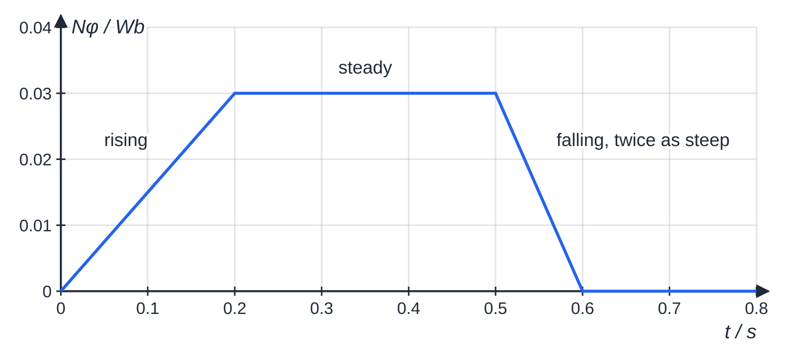
How do you use flux-linkage–time and e.m.f.–time graphs? (continued)
Section 5 of 13
Flux linkage of a coil made of straight-line sections: rising, steady, then falling twice as steeply.
Notes:
How do you use flux-linkage–time and e.m.f.–time graphs?. Full notes: https://examinerprep.com/notes/edexcel-ial-physics/electromagnetic-induction/

Slide 19
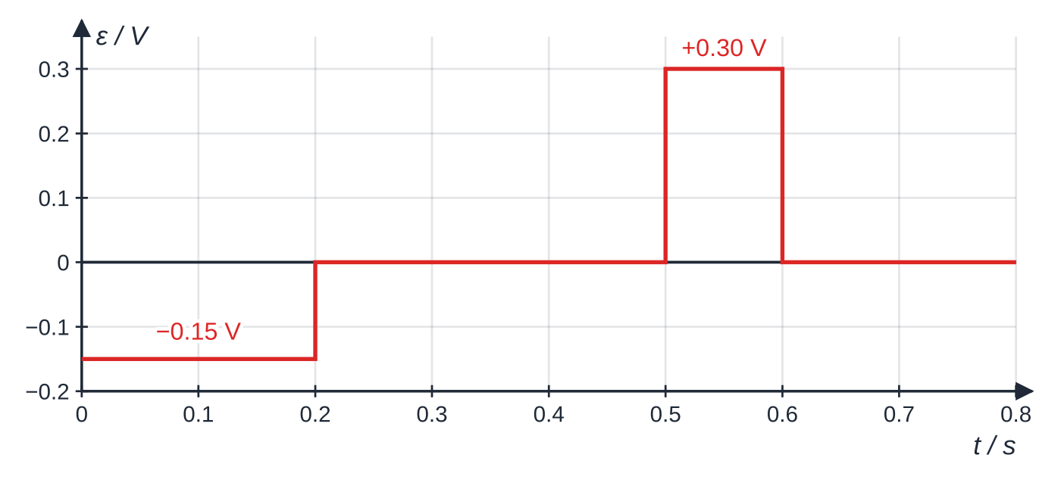
How do you use flux-linkage–time and e.m.f.–time graphs? (continued)
Section 5 of 13
The matching e.m.f., minus the gradient of the graph above: −0.15 V while the flux linkage rises, zero while it is steady and +0.30 V while it falls twice as fast.
Notes:
How do you use flux-linkage–time and e.m.f.–time graphs?. Full notes: https://examinerprep.com/notes/edexcel-ial-physics/electromagnetic-induction/

Slide 20
How do you use flux-linkage–time and e.m.f.–time graphs? (continued)
Section 5 of 13 · Worked example 3 · Medium · Determine
WORKED EXAMPLE · QUESTION
The flux-linkage graph above shows how the flux linkage of a coil varies with time. (a) Determine the e.m.f. induced between 0 and 0.20 s, and between 0.50 s and 0.60 s. (b) The coil is part of a circuit of total resistance 2.5 Ω. Calculate the current between 0.50 s and 0.60 s.
SOLUTION
(a) ε = −gradient. For 0–0.20 s: ε= -(0.030 - 0) ÷(0.20 - 0) = −0.15 V. For 0.50–0.60 s: ε= -(0 - 0.030) ÷(0.60 - 0.50) = +0.30 V, twice as large and of opposite sign.
(b) I = ε/R = 0.30 ÷2.5 = 0.12 A
Notes:
How do you use flux-linkage–time and e.m.f.–time graphs?: Worked example 3. Full notes: https://examinerprep.com/notes/edexcel-ial-physics/electromagnetic-induction/

Slide 21
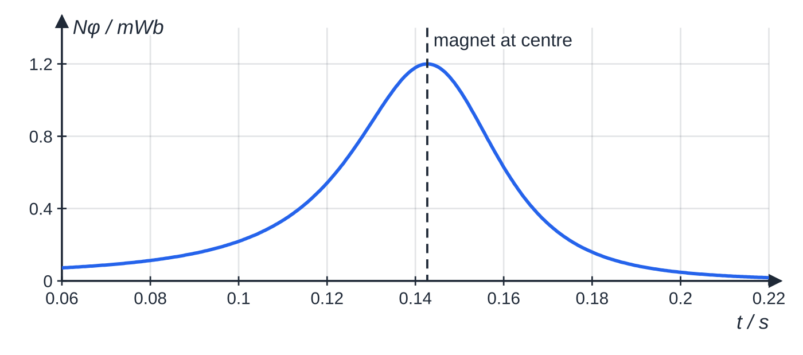
How do you use flux-linkage–time and e.m.f.–time graphs? (continued)
Section 5 of 13
A magnet falling through a coil
As the magnet enters, the flux linkage rises, so the e.m.f. has one sign; as it leaves, the flux linkage falls and the e.m.f. reverses. At the instant the magnet is at the centre of the coil, the flux linkage is at its maximum and momentarily not changing, so the e.m.f. is zero.
Flux linkage of a short coil as a magnet falls through it (computed for a peak flux linkage of 1.2 mWb, passing the centre at about 1.4 m s⁻¹). It falls faster than it rose, because the magnet is speeding up.
Notes:
How do you use flux-linkage–time and e.m.f.–time graphs?. Full notes: https://examinerprep.com/notes/edexcel-ial-physics/electromagnetic-induction/

Slide 22
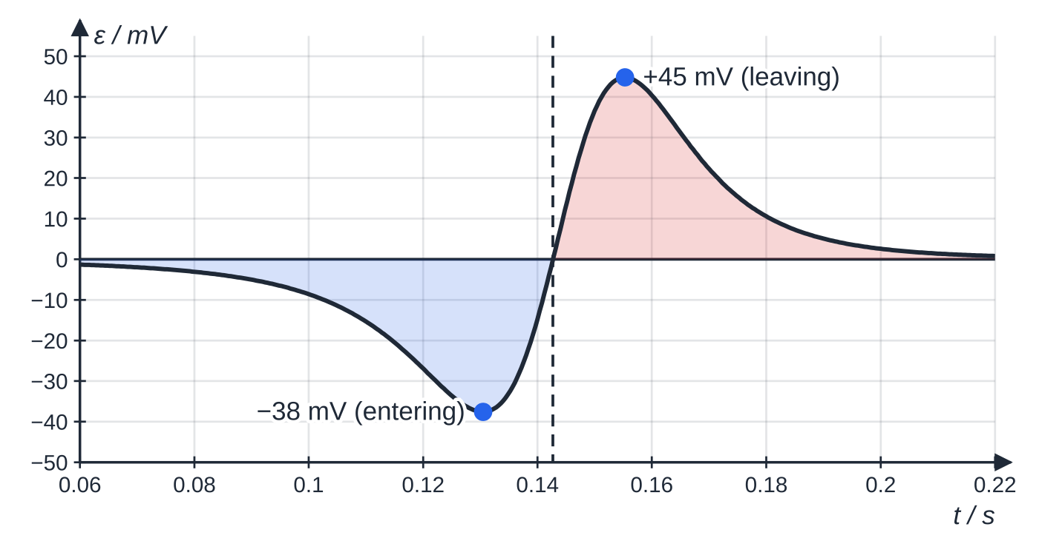
How do you use flux-linkage–time and e.m.f.–time graphs? (continued)
Section 5 of 13
The magnet is accelerating, so the flux linkage falls faster than it rose: the second peak is larger and lasts a shorter time. The area under each pulse equals the change in flux linkage during that pulse. The flux linkage starts and ends close to zero, so the two areas are very nearly equal in size.
The induced e.m.f. The pulses are opposite in sign; the second is taller (45 mV against 38 mV) and narrower because the magnet leaves faster than it enters. The two shaded areas are equal in size to the rise and fall of the flux linkage.
Notes:
How do you use flux-linkage–time and e.m.f.–time graphs?. Full notes: https://examinerprep.com/notes/edexcel-ial-physics/electromagnetic-induction/

Slide 23
How do you use flux-linkage–time and e.m.f.–time graphs? (continued)
Section 5 of 13
Exam tip — Line the graphs up
When you sketch an e.m.f.–time graph from a flux-linkage graph, line the two up vertically. Put a zero of e.m.f. under every peak, trough and flat section of Nφ, and the largest e.m.f. under every steepest part.
Notes:
How do you use flux-linkage–time and e.m.f.–time graphs?. Full notes: https://examinerprep.com/notes/edexcel-ial-physics/electromagnetic-induction/

Slide 24
What e.m.f. is induced in a rod moving through a field?
Section 6 of 13
A straight conductor moving across a field "cuts" flux. The free electrons inside it move with it, so each feels a magnetic force along the rod: charge separates and an e.m.f. appears between the ends. The same result comes from Faraday's law. In a time Δt a rod of length l moving at speed v sweeps out an area lvΔt, so the flux it cuts is BlvΔt.
E.m.f. induced in a moving straight conductor
ε= Blv Δt/Δt = Blv B flux density (T), l length of conductor in the field (m), v speed (m s⁻¹). B, l and v must be mutually at right angles; a rod moving
along the field lines cuts no flux and has no e.m.f. Not in the formulae list: derive it from ε= -d(Nφ)/dt with N = 1.
Notes:
What e.m.f. is induced in a rod moving through a field?. Full notes: https://examinerprep.com/notes/edexcel-ial-physics/electromagnetic-induction/

Slide 25
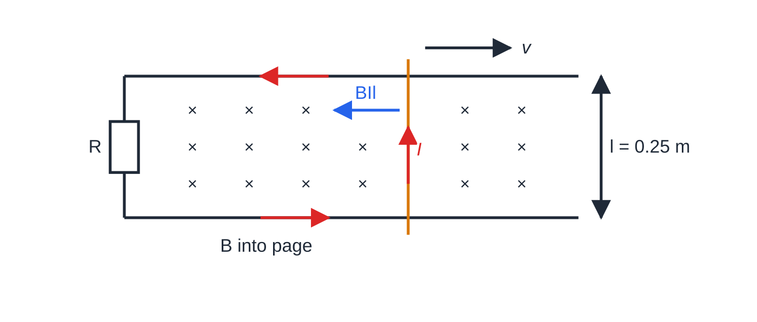
What e.m.f. is induced in a rod moving through a field? (continued)
Section 6 of 13
A rod sliding on rails in a field into the page. The circuit's area grows, so the flux linkage into the page increases; the induced current is anticlockwise, which makes a field out of the page inside the loop. The force BIl on the current in the rod acts against the motion.
Notes:
What e.m.f. is induced in a rod moving through a field?. Full notes: https://examinerprep.com/notes/edexcel-ial-physics/electromagnetic-induction/

Slide 26
What e.m.f. is induced in a rod moving through a field? (continued)
Section 6 of 13 · Worked example 4 · Hard · Calculate
WORKED EXAMPLE · QUESTION
A metal rod rests across two horizontal rails 0.25 m apart, joined at one end by a resistor. The total resistance of the circuit is 0.50 Ω. A uniform vertical field of 0.40 T acts over the rails. The rod is pulled along the rails at a steady 3.0 m s⁻¹. Calculate (a) the e.m.f., (b) the current, (c) the force needed to keep the rod moving at constant speed (ignore friction) and (d) the power supplied by that force. Comment on your answer to (d).
SOLUTION
(a) B, l and v are mutually perpendicular: ε= Blv = 0.40 ×0.25 ×3.0 = 0.30 V
(b) I = 0.30 ÷0.50 = 0.60 A
(c) The current in the rod feels a force BIl opposing the motion (Lenz); at constant speed the pull must balance it: F = BIl = 0.40 ×0.60 ×0.25 = 0.060 N
(d) P = Fv = 0.060 ×3.0 = 0.18 W.
Notes:
What e.m.f. is induced in a rod moving through a field?: Worked example 4. Full notes: https://examinerprep.com/notes/edexcel-ial-physics/electromagnetic-induction/

Slide 27
What e.m.f. is induced in a rod moving through a field? (continued)
Section 6 of 13 · Worked example 4 · Hard · Calculate (continued)
This equals I²R = 0.60² ×0.50 = 0.18 W: every joule of work done pulling the rod is dissipated in the resistance. Lenz's law is energy conservation.
Notes:
What e.m.f. is induced in a rod moving through a field?: Worked example 4. Full notes: https://examinerprep.com/notes/edexcel-ial-physics/electromagnetic-induction/

Slide 28
What e.m.f. is induced in a rod moving through a field? (continued)
Section 6 of 13
Exam tip — Directions in two steps
Use Lenz's law in two steps and write both: (1) say what is changing ("the flux linkage into the page is increasing"), (2) say what the induced current must do ("so it flows to create flux out of the page: anticlockwise"). The force on the rod then always opposes its motion.
Notes:
What e.m.f. is induced in a rod moving through a field?. Full notes: https://examinerprep.com/notes/edexcel-ial-physics/electromagnetic-induction/

Slide 29
Why does a rotating coil give an alternating e.m.f.?
Section 7 of 13
A flat coil turning at a steady rate in a uniform field has a flux linkage that varies like a cosine: maximum when the coil faces the field, zero when it is edge-on, and maximum the other way round half a turn later. The e.m.f. is minus the gradient of this curve, so it varies like a sine: an alternating e.m.f. with the same frequency as the rotation. This is the principle of the a.c. generator (alternator).
The e.m.f. is zero when the coil is face-on to the field (flux linkage at a maximum, momentarily not changing) and largest when the coil is edge-on (flux linkage zero, but changing fastest, because the sides of the coil are cutting straight across the field lines).
Notes:
Why does a rotating coil give an alternating e.m.f.?. Full notes: https://examinerprep.com/notes/edexcel-ial-physics/electromagnetic-induction/

Slide 30
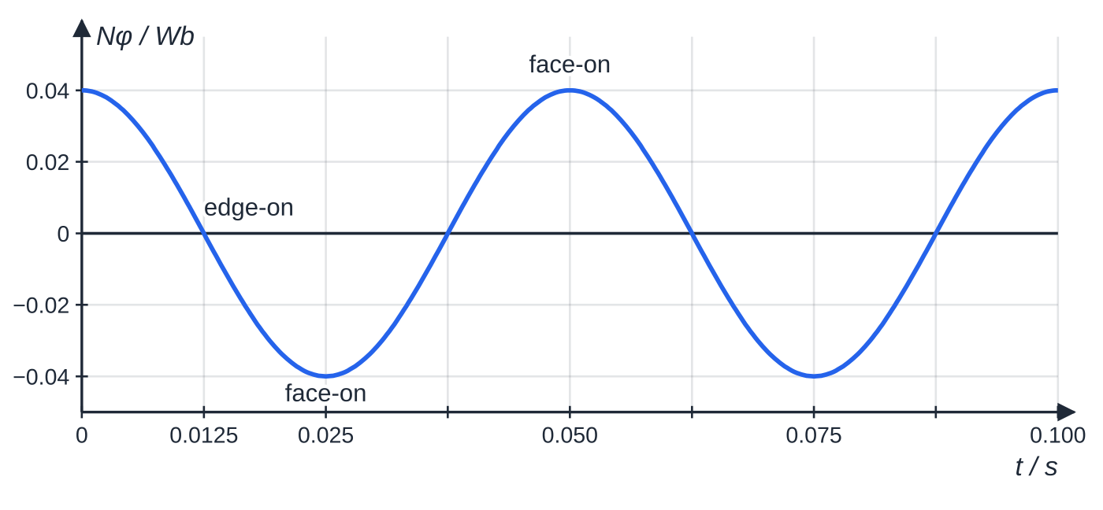
Why does a rotating coil give an alternating e.m.f.? (continued)
Section 7 of 13
Flux linkage of a coil of 200 turns and area 2.5 × 10⁻³ m² turning 20 times a second in a 0.080 T field: a cosine of amplitude 0.040 Wb and period 0.050 s.
Notes:
Why does a rotating coil give an alternating e.m.f.?. Full notes: https://examinerprep.com/notes/edexcel-ial-physics/electromagnetic-induction/

Slide 31
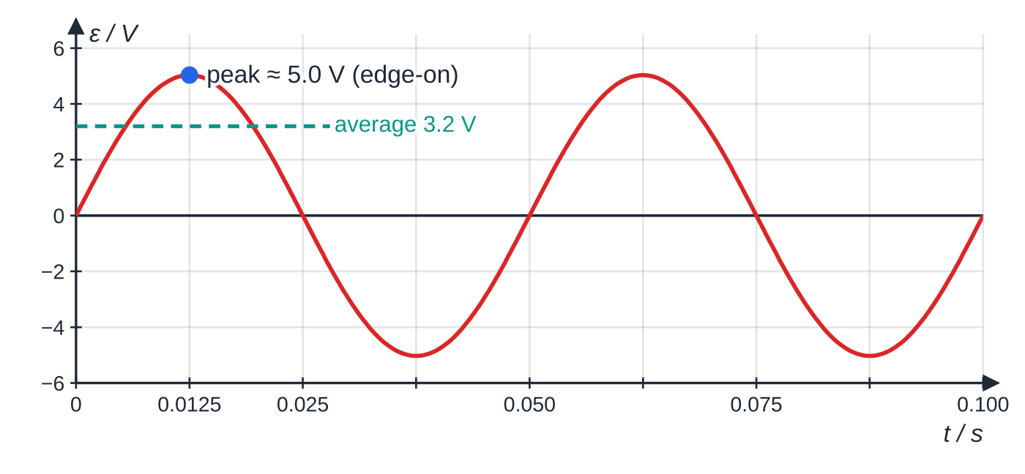
Why does a rotating coil give an alternating e.m.f.? (continued)
Section 7 of 13
The e.m.f. of the same coil: a sine wave that peaks where the flux-linkage graph is steepest (edge-on) and is zero where the flux linkage is at a maximum or minimum (face-on).
Notes:
Why does a rotating coil give an alternating e.m.f.?. Full notes: https://examinerprep.com/notes/edexcel-ial-physics/electromagnetic-induction/

Slide 32
Why does a rotating coil give an alternating e.m.f.? (continued)
Section 7 of 13
Change | Peak e.m.f. | Frequency
Turn the coil faster | larger (flux linkage changes faster) | larger
More turns, larger area or stronger field | larger (larger maximum flux linkage) | unchanged
Notes:
Why does a rotating coil give an alternating e.m.f.?. Full notes: https://examinerprep.com/notes/edexcel-ial-physics/electromagnetic-induction/

Slide 33
Why does a rotating coil give an alternating e.m.f.? (continued)
Section 7 of 13 · Worked example 5 · Hard · Calculate
WORKED EXAMPLE · QUESTION
For the coil in the figures above (200 turns, area 2.5 × 10⁻³ m², field 0.080 T, 20 revolutions per second): (a) calculate the maximum flux linkage; (b) calculate the average e.m.f. while the coil turns from face-on to edge-on; (c) explain why the peak e.m.f. on the graph is larger than this average; (d) state the effect on the graph of doubling the rate of rotation.
SOLUTION
(a) Face-on, the whole area is at right angles to the field: Nφ= NBA = 200 ×0.080 ×2.5×10⁻³ = 0.040 Wb
(b) T = 1 ÷20 = 0.050 s, so a quarter turn takes 0.0125 s while the flux linkage falls from 0.040 Wb to zero: ε= 0.040 ÷0.0125 = 3.2 V
(c) The rate of change is not constant: the flux linkage changes slowly near face-on and fastest at edge-on, so the instantaneous e.m.f. there (about 5.0 V) exceeds the average.
Notes:
Why does a rotating coil give an alternating e.m.f.?: Worked example 5. Full notes: https://examinerprep.com/notes/edexcel-ial-physics/electromagnetic-induction/

Slide 34
Why does a rotating coil give an alternating e.m.f.? (continued)
Section 7 of 13 · Worked example 5 · Hard · Calculate (continued)
(d) The same change in flux linkage happens in half the time: the peak e.m.f. doubles and the period halves (the frequency doubles).
Notes:
Why does a rotating coil give an alternating e.m.f.?: Worked example 5. Full notes: https://examinerprep.com/notes/edexcel-ial-physics/electromagnetic-induction/

Slide 35
Why does a rotating coil give an alternating e.m.f.? (continued)
Section 7 of 13
Common error — Face-on is not the peak
Saying the e.m.f. is largest when the coil is face-on "because the flux is biggest". At that instant the flux linkage is at a turning point, so its gradient, and the e.m.f., is zero. A large e.m.f. needs a large rate of change.
Notes:
Why does a rotating coil give an alternating e.m.f.?. Full notes: https://examinerprep.com/notes/edexcel-ial-physics/electromagnetic-induction/

Slide 36
What are eddy currents and how do they brake motion?
Section 8 of 13
Any piece of metal in a changing flux has e.m.f.s induced in it. In a solid conductor these drive loops of current inside the metal itself: eddy currents. By Lenz's law, eddy currents flow so as to oppose the change. If the change comes from motion, the result is a force that opposes the relative motion, and the kinetic energy removed becomes thermal energy in the metal.
Magnetic braking
Train and ride brakes: strong magnets near a moving metal fin or rail induce eddy currents that slow it without any contact or wear. The braking force grows with speed, so it is gentle at low speeds and cannot bring the object fully to rest on its own.
Damping a swinging plate: a solid aluminium plate swinging between magnet poles stops within a few swings; a plate with slots cut in it swings for much longer, because the slots break up the current loops.
A magnet falling down a metal tube falls far more slowly than down a plastic tube (below).
Notes:
What are eddy currents and how do they brake motion?. Full notes: https://examinerprep.com/notes/edexcel-ial-physics/electromagnetic-induction/

Slide 37
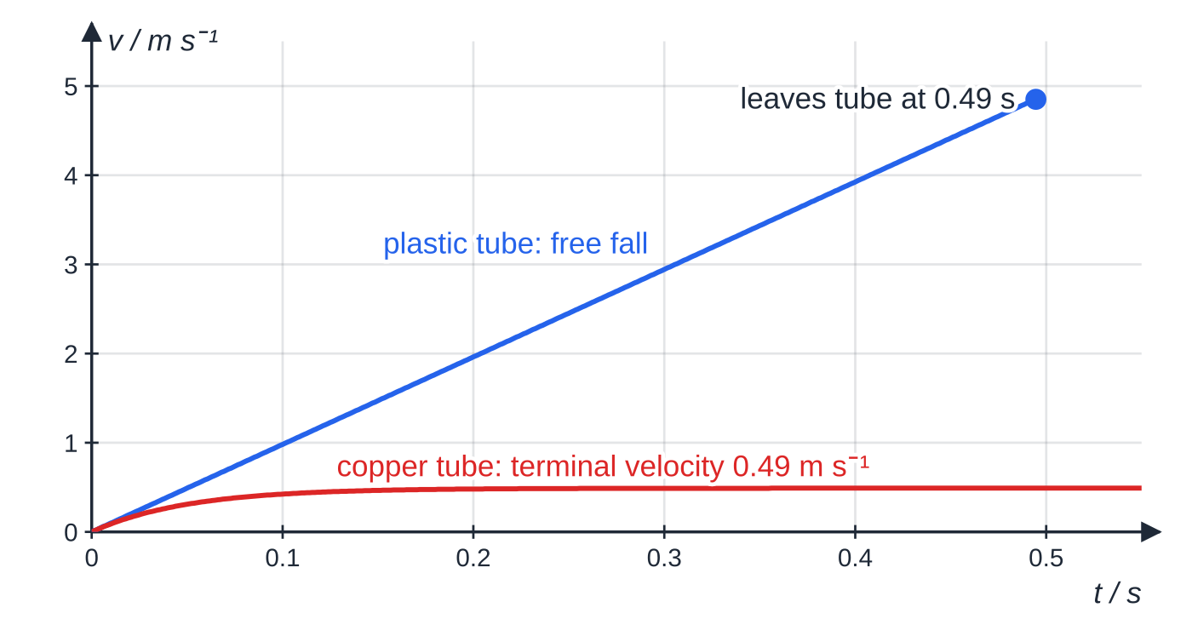
What are eddy currents and how do they brake motion? (continued)
Section 8 of 13
Eddy currents as a nuisance
The alternating flux in a transformer core induces eddy currents in the iron, which waste energy as heat. Cores are made from thin laminated sheets, insulated from each other: the insulation breaks the large current loops, so the eddy currents and the energy wasted are much smaller.
The same magnet dropped down a plastic tube and a copper tube. In the copper tube the braking force from eddy currents grows with speed until it equals the weight: terminal velocity, here reached within about 0.15 s.
Notes:
What are eddy currents and how do they brake motion?. Full notes: https://examinerprep.com/notes/edexcel-ial-physics/electromagnetic-induction/

Slide 38
What are eddy currents and how do they brake motion? (continued)
Section 8 of 13 · Worked example 6 · Hard · Explain
WORKED EXAMPLE · QUESTION
A small strong magnet is dropped down a vertical copper tube 1.20 m long. It takes about 2.5 s to emerge. The same magnet dropped down a plastic tube of the same length takes 0.49 s. Explain these observations.
SOLUTION
1. As the magnet falls, the flux linking each ring of the tube changes, so an e.m.f. is induced in it (Faraday).
2. Copper is a good conductor, so these e.m.f.s drive large eddy currents around the tube.
3. The currents oppose the change (Lenz): the ring below repels the approaching magnet and the ring above attracts it, giving an upward force on the magnet.
4. The faster the magnet falls, the faster the flux changes, so the larger the eddy currents and the upward force.
Notes:
What are eddy currents and how do they brake motion?: Worked example 6. Full notes: https://examinerprep.com/notes/edexcel-ial-physics/electromagnetic-induction/

Slide 39
What are eddy currents and how do they brake motion? (continued)
Section 8 of 13 · Worked example 6 · Hard · Explain (continued)
It soon equals the weight, the resultant force is zero and the magnet falls at a constant (terminal) velocity.
5. Gravitational potential energy is transferred to thermal energy in the tube instead of to kinetic energy of the magnet.
6. Plastic is an insulator, so no eddy currents flow and there is no braking force: the magnet is in free fall, t = √(2 ×1.20 ÷9.81) = 0.49 s
Notes:
What are eddy currents and how do they brake motion?: Worked example 6. Full notes: https://examinerprep.com/notes/edexcel-ial-physics/electromagnetic-induction/

Slide 40
What are eddy currents and how do they brake motion? (continued)
Section 8 of 13
Exam tip — The induction chain
Long explanations on induction follow the same chain: change of flux linkage → e.m.f. (Faraday) → current, if there is a complete path → direction opposes the change (Lenz) → force or energy consequence. Name each link rather than jumping from "the magnet moves" straight to "it slows down".
Notes:
What are eddy currents and how do they brake motion?. Full notes: https://examinerprep.com/notes/edexcel-ial-physics/electromagnetic-induction/

Slide 41
Exam tips for 4.6
Section 9 of 13
Exam tip 1 — Say "change"
Every explanation of an induced e.m.f. must contain the idea of a changing flux linkage (or of a conductor cutting flux). "There is a magnetic field" is not enough.
Exam tip 2 — E.m.f. versus current
An e.m.f. is induced whenever the flux linkage changes. A current flows only if there is a complete circuit. Read the question to see which one it asks about.
Exam tip 3 — Flux linkage, not flux
Write Nφ= NBA as a separate line before dividing by time, and check that A is in m²: 1 cm² = 1 × 10⁻⁴ m².
Notes:
Exam tips for 4.6. Full notes: https://examinerprep.com/notes/edexcel-ial-physics/electromagnetic-induction/

Slide 42
Exam tips for 4.6 (continued)
Section 9 of 13
Exam tip 4 — Graphs come in pairs
ε = −gradient of Nφ–t. A sine-shaped flux linkage gives a cosine-shaped e.m.f. and vice versa; a straight-line section gives a constant e.m.f.; a flat section gives zero.
Exam tip 5 — Lenz's law needs a reason
When asked for a direction or a pole, state what change is happening and that the induced current opposes it. A bare "north pole" or "clockwise" without the reason is an incomplete answer.
Notes:
Exam tips for 4.6. Full notes: https://examinerprep.com/notes/edexcel-ial-physics/electromagnetic-induction/

Slide 43
Common misconceptions
Section 10 of 13
Misconception | Why it is wrong | Correct idea
A large flux linkage means a large e.m.f. | Faraday's law involves the rate of change, not the size. | A steady flux linkage, however large, induces no e.m.f.
A transformer works with a steady d.c. supply. | A steady current gives a constant flux in the core. | Only a changing (e.g. alternating) primary current induces a secondary e.m.f.
Lenz's law means the induced current opposes the magnet's field. | It opposes the change in flux, not the field itself. | When the flux is decreasing, the induced field acts in the same direction as the magnet's field.
A rotating coil gives its largest e.m.f. when face-on to the field. | There the flux linkage is at a maximum and not changing. | The e.m.f. is largest when the coil is edge-on (flux linkage zero, changing fastest).
An e.m.f. needs a complete circuit. | The e.m.f. comes from the changing flux linkage alone. | A complete circuit is needed only for a current.
Notes:
Common misconceptions. Full notes: https://examinerprep.com/notes/edexcel-ial-physics/electromagnetic-induction/

Slide 44
Common misconceptions (continued)
Section 10 of 13
Misconception | Why it is wrong | Correct idea
Magnetic braking works because the magnet attracts the metal. | Copper and aluminium are not attracted to magnets. | The braking force comes from induced eddy currents opposing the relative motion.
Notes:
Common misconceptions. Full notes: https://examinerprep.com/notes/edexcel-ial-physics/electromagnetic-induction/

Slide 45
How this topic connects
Section 11 of 13
5 Magnetic fields and forces
The force F = BIl on the induced current is what opposes the motion in every Lenz's-law example, and φ= BA is defined there.
Electric circuits (Unit 2) and energy (Unit 1)
An induced e.m.f. drives a current through the circuit resistance exactly like a cell; the power dissipated is I²R. Lenz's law is conservation of energy, and the magnet in a copper tube reaches a terminal velocity for the same reason a ball does in oil: a resistive force that grows with speed.
Oscillations (Unit 5)
Eddy-current damping is a practical way of removing energy from an oscillating system, and a rotating coil's output varies sinusoidally like simple harmonic motion.
Notes:
How this topic connects. Full notes: https://examinerprep.com/notes/edexcel-ial-physics/electromagnetic-induction/

Slide 46
Key equations
Section 12 of 13
Equation | Use | In the formulae list?
ε= -d(Nφ)/dt | Faraday's and Lenz's laws: induced e.m.f. (V) | Yes
ε= -Δ(Nφ)/Δt | average e.m.f. over a time interval | No — derive it from the line above
φ= BA, flux linkage = Nφ | flux (Wb) through a coil at right angles to the field | Yes
ε= Blv | straight conductor moving across a field | No — derive it from Faraday's law
F = BIl | force on the induced current in a conductor (4.5) | Yes
P = Fv = I²R | energy check for a conductor pulled at constant speed | No — combine P = W/t and P = I²R
Notes:
Key equations. Full notes: https://examinerprep.com/notes/edexcel-ial-physics/electromagnetic-induction/

Slide 47
Check your understanding
Section 13 of 13
1. A magnet is held at rest inside a coil connected to a meter. What does the meter read, and why?
2. A metal rod 0.30 m long moves at 6.0 m s⁻¹ at right angles to a 0.050 T field. Calculate the e.m.f. between its ends.
3. A coil of 500 turns and area 2.0 × 10⁻⁴ m² is in a field that falls steadily from 0.24 T to zero in 20 ms. Calculate the e.m.f.
4. Why is a transformer core made of thin insulated sheets rather than solid iron?
5. The flux linkage of a coil falls steadily from 0.012 Wb to zero in 40 ms. Calculate the e.m.f. and sketch the e.m.f.–time graph for this interval.
6. A north pole is pulled away from the end of a coil. State and explain the polarity of that end of the coil while the magnet moves.
Notes:
Check your understanding: questions. Full notes: https://examinerprep.com/notes/edexcel-ial-physics/electromagnetic-induction/

Slide 48
Check your understanding · answers
Section 13 of 13
1. Zero. The flux linkage is large but not changing, and the e.m.f. depends on the rate of change of flux linkage.
2. ε= Blv = 0.050 ×0.30 ×6.0 = 0.090 V.
3. Δ(Nφ) = 500 ×0.24 ×2.0×10⁻⁴ = 0.024 Wb; ε= 0.024 ÷0.020 = 1.2 V.
4. The changing flux induces eddy currents in the core. The insulated laminations break up the current loops, so the eddy currents, and the energy wasted heating the core, are much smaller.
5. ε = −gradient = -(0 - 0.012) ÷0.040 = +0.30 V: a horizontal line at 0.30 V for the 40 ms, dropping to zero when the flux linkage stops changing.
6. The flux linkage is decreasing, so the induced current opposes the decrease: the near end becomes a south pole, which attracts the receding north pole. Work must be done against this attraction, which supplies the electrical energy.
Notes:
Check your understanding: answers. Full notes: https://examinerprep.com/notes/edexcel-ial-physics/electromagnetic-induction/

Slide 49
Practice questions
5 original exam-style questions. Answers at the end of the deck.

Slide 50
Question 1
1 mark
A bar magnet is pushed into a coil that is connected to a sensitive meter.
Which change would not increase the maximum e.m.f. induced in the coil?
A pushing the magnet in more quickly
B using a stronger magnet
C using a coil with more turns of the same area
D rewinding the coil with thicker wire, keeping the same number of turns and area
Notes:
Online with the full mark scheme: https://examinerprep.com/ial-physics-4-6-electromagnetic-induction-questions#IALP-U4-6-A-01

Slide 51
Question 2
1 mark
Which unit is equivalent to the weber, the unit of magnetic flux?
A N A⁻¹ m⁻¹
B T m⁻²
C T m²
D V s⁻¹
Notes:
Online with the full mark scheme: https://examinerprep.com/ial-physics-4-6-electromagnetic-induction-questions#IALP-U4-6-A-02

Slide 52
Question 3
1 mark
A coil has 400 turns. The magnetic flux through each turn falls steadily from 3.0 × 10⁻⁴ Wb to zero in 0.060 s.
What is the e.m.f. induced in the coil?
A 5.0 × 10⁻³ V
B 7.2 × 10⁻³ V
C 2.0 V
D 4.0 V
Notes:
Online with the full mark scheme: https://examinerprep.com/ial-physics-4-6-electromagnetic-induction-questions#IALP-U4-6-A-03

Slide 53
Question 4
4 marks
A student connects a coil to a sensitive centre-zero ammeter. When she pushes the north pole of a bar magnet into the coil, the needle deflects briefly to the right.
(a) State what the needle shows while the magnet is held stationary inside the coil. [1]
(b) State what the needle shows when the magnet is pulled out of the coil at the same speed. [1]
(c) State two changes that would give a larger deflection when the magnet is pushed in. [2]
Notes:
Online with the full mark scheme: https://examinerprep.com/ial-physics-4-6-electromagnetic-induction-questions#IALP-U4-6-B-01

Slide 54
Question 5
5 marks
A small search coil has 60 turns, each of area 1.5 × 10⁻⁴ m². It is held with its plane perpendicular to a uniform magnetic field of flux density 0.12 T. It is then pulled out of the field in 0.20 s.
(a) Calculate the flux linkage of the coil while it is in the field. [2]
(b) Calculate the average e.m.f. induced while the coil is pulled out of the field. [2]
(c) Explain why the average e.m.f. would be larger if the coil were pulled out more quickly. [1]
Notes:
Online with the full mark scheme: https://examinerprep.com/ial-physics-4-6-electromagnetic-induction-questions#IALP-U4-6-B-02

Slide 55
Answers

Slide 56
Question 1 · answer
Answer D
The e.m.f. depends on the rate of change of flux linkage. Speed, magnet strength and number of turns all change that rate. Thicker wire lowers the resistance of the coil, which would increase the current, but the flux linkage and its rate of change are unchanged, so the e.m.f. is the same.
Notes:
Full mark scheme: https://examinerprep.com/ial-physics-4-6-electromagnetic-induction-questions#IALP-U4-6-A-01

Slide 57
Question 2 · answer
Answer C
Flux φ = BA, so 1 Wb = 1 T × 1 m² = 1 T m². (From ε = −d(Nφ)/dt it is also 1 V s.)
Notes:
Full mark scheme: https://examinerprep.com/ial-physics-4-6-electromagnetic-induction-questions#IALP-U4-6-A-02

Slide 58
Question 3 · answer
Answer C
Change in flux linkage = NΔφ = 400 × 3.0 × 10⁻⁴ = 0.12 Wb. ε = 0.12 ÷ 0.060 = 2.0 V.
Notes:
Full mark scheme: https://examinerprep.com/ial-physics-4-6-electromagnetic-induction-questions#IALP-U4-6-A-03

Slide 59
Question 4 · answer
Mark scheme
no deflection / reads zero
a brief deflection to the left, of about the same size
any two of: push the magnet in faster / use a stronger magnet / use a coil with more turns
Notes:
Full mark scheme: https://examinerprep.com/ial-physics-4-6-electromagnetic-induction-questions#IALP-U4-6-B-01

Slide 60
Question 5 · answer
Mark scheme
Nφ = NBA = 60 × 0.12 × 1.5 × 10⁻⁴
= 1.1 × 10⁻³ Wb (1.08 × 10⁻³ Wb)
ε = Δ(Nφ)/Δt = 1.08 × 10⁻³ ÷ 0.20
= 5.4 × 10⁻³ V — allow error carried forward from (a)
the same change in flux linkage happens in less time, so the rate of change of flux linkage is greater
Notes:
Full mark scheme: https://examinerprep.com/ial-physics-4-6-electromagnetic-induction-questions#IALP-U4-6-B-02

Slide 61
Keep practising
Notes for this topic
Questions on this topic
Build a printable test
ExaminerPrep is an independent tutoring service. It has been developed independently from and is not endorsed by the International Baccalaureate Organization. "International Baccalaureate", "IB" and "IB Diploma Programme" are registered trademarks of the IBO, used here for descriptive purposes only.
Pearson Edexcel and Cambridge are trademarks of their owners; ExaminerPrep is not affiliated with any exam board.

