Slide 1
EP
EDEXCEL IAL PHYSICS
5.6 Energy, damping and resonance
The full notes page in 11 sections · practice questions with answers · simulations
ExaminerPrep is an independent tutoring service. It has been developed independently from and is not endorsed by the International Baccalaureate Organization. "International Baccalaureate", "IB" and "IB Diploma Programme" are registered trademarks of the IBO, used here for descriptive purposes only.
Pearson Edexcel and Cambridge are trademarks of their owners; ExaminerPrep is not affiliated with any exam board.
Notes:
5.6 Energy, damping and resonance. Notes for this topic: https://examinerprep.com/notes/edexcel-ial-physics/energy-damping-and-resonance/

Slide 2
What this page covers
Overview
The exchange of kinetic and potential energy in an undamped oscillator, and why total energy ∝ amplitude²
Energy–displacement and energy–time graphs, and how to sketch them
Damping: what it does to amplitude and energy; light, critical and heavy damping
Free and forced oscillations, natural frequency and driving frequency
Resonance, and how damping changes the resonance curve
How damping and the plastic deformation of ductile materials protect buildings in earthquake zones and smooth a car's ride
Core Practical 16: finding an unknown mass from the resonant frequencies of a mass–spring system
Notes:
What this page covers. Full notes: https://examinerprep.com/notes/edexcel-ial-physics/energy-damping-and-resonance/

Slide 3
In one minute
Key points
1. In an undamped oscillator, energy passes back and forth between kinetic and potential energy while the total stays constant, and that total is proportional to the amplitude squared.
2. For a mass on a spring, E=½kA²: halve the amplitude and only a quarter of the energy is left.
3. Damping is a resistive force that transfers energy out of the oscillator, usually to thermal energy, so the amplitude decreases. Critical damping returns the system to equilibrium in the shortest time without oscillating.
4. A free oscillation has no external driving force and happens at the natural frequency f₀; a forced oscillation is driven by a periodic force and happens at the driving frequency.
5. Resonance: when the driving frequency equals the natural frequency, energy is transferred most efficiently and the amplitude is a maximum.
6. More damping makes the resonance peak lower, broader and at a slightly lower frequency.
Notes:
In one minute. Full notes: https://examinerprep.com/notes/edexcel-ial-physics/energy-damping-and-resonance/

Slide 4
How is energy shared in an undamped oscillation?
Section 1 of 11
Before letting real oscillators lose energy, follow the energy in an ideal one. Every oscillator has two energy stores. One is the kinetic energy of the moving mass. The other is potential energy: elastic strain energy in a spring, or gravitational potential energy for a pendulum.
At the extremes (x=±A) the mass is momentarily at rest, so its kinetic energy is zero and its potential energy is a maximum.
At the equilibrium position (x=0) the speed is a maximum, so the kinetic energy is a maximum and the potential energy is zero (taking the equilibrium position as the zero of potential energy).
With no damping, no energy leaves the system, so kinetic + potential energy is the same at every instant.
For a mass on a spring the potential energy is the elastic strain energy, the area under the force–extension graph. With F=kx, that area is a triangle, ½Fx=½kx². At the extreme all the energy is stored this way, which gives the total energy:
Notes:
How is energy shared in an undamped oscillation?. Full notes: https://examinerprep.com/notes/edexcel-ial-physics/energy-damping-and-resonance/

Slide 5
How is energy shared in an undamped oscillation? (continued)
Section 1 of 11
Eₚ=½kx² Eₜₒₜₐₗ=½kA² Eₖ=½k(A²-x²)
Here k is the spring constant (N m⁻¹), x the displacement from equilibrium (m) and A the amplitude (m). These three are not in the formulae list: derive them from the elastic strain energy ΔEₑₗ=½FΔx with F=kx; the total is the strain energy at the extreme, x=A.
The key result for every oscillator, not only springs: total energy ∝ (amplitude)². Double the amplitude and the energy is four times as big; halve it and only a quarter is left.
Notes:
How is energy shared in an undamped oscillation?. Full notes: https://examinerprep.com/notes/edexcel-ial-physics/energy-damping-and-resonance/

Slide 6
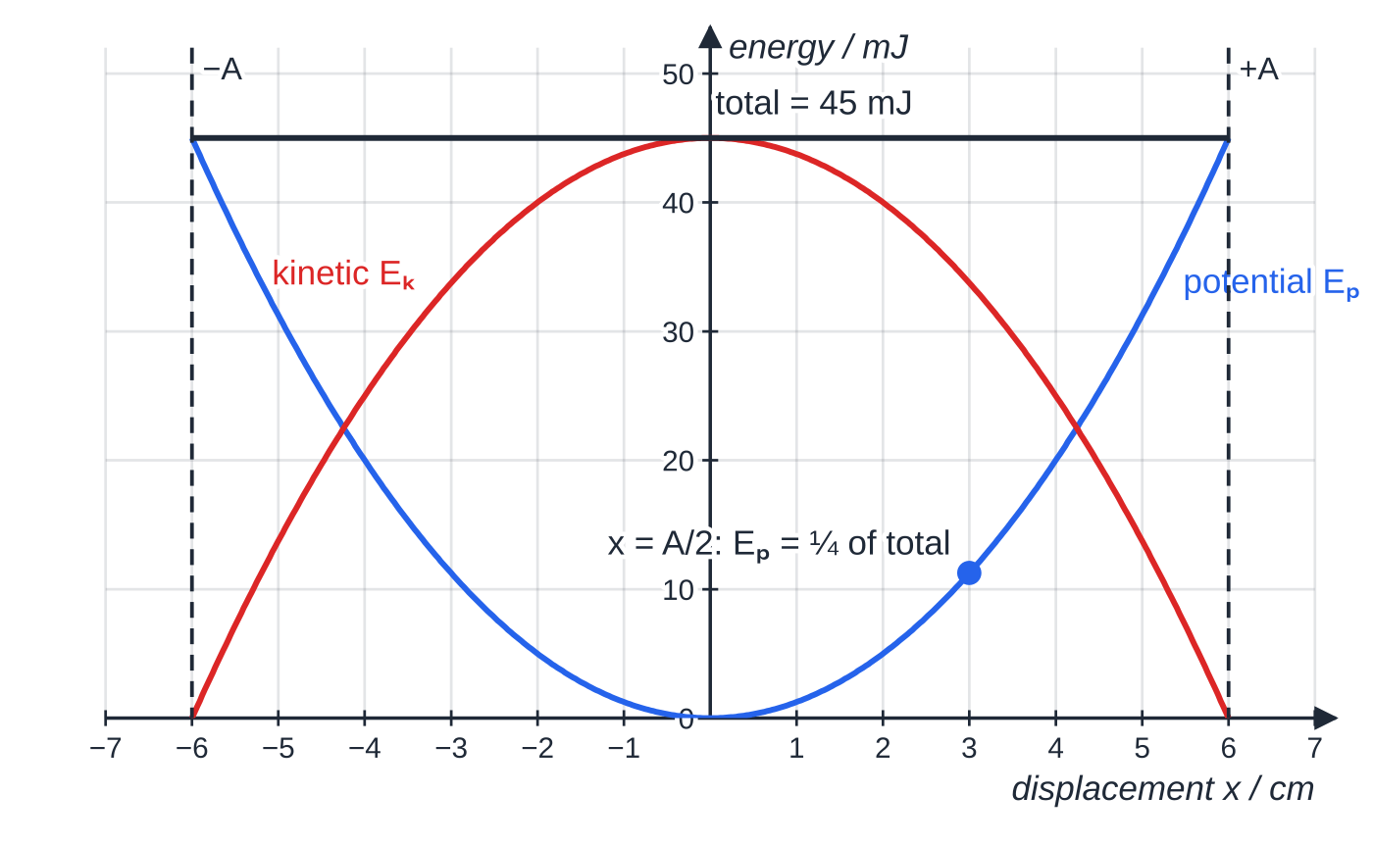
How is energy shared in an undamped oscillation? (continued)
Section 1 of 11
Energy against time
Kinetic energy reaches a maximum twice in every cycle, once each way through the centre. Potential energy also peaks twice, once at each extreme. So graphs of Eₖ and Eₚ against time oscillate at twice the frequency of the displacement. They are never negative, they are out of step (one is a maximum when the other is zero), and their sum is a horizontal line: the total energy.
Energy against displacement for a mass on a spring (k = 25 N m⁻¹, A = 6.0 cm). Potential energy is a parabola, kinetic energy is the same parabola upside down, and the two always add up to the constant total of 45 mJ. Halfway out, only a quarter of the energy is potential.
Notes:
How is energy shared in an undamped oscillation?. Full notes: https://examinerprep.com/notes/edexcel-ial-physics/energy-damping-and-resonance/

Slide 7
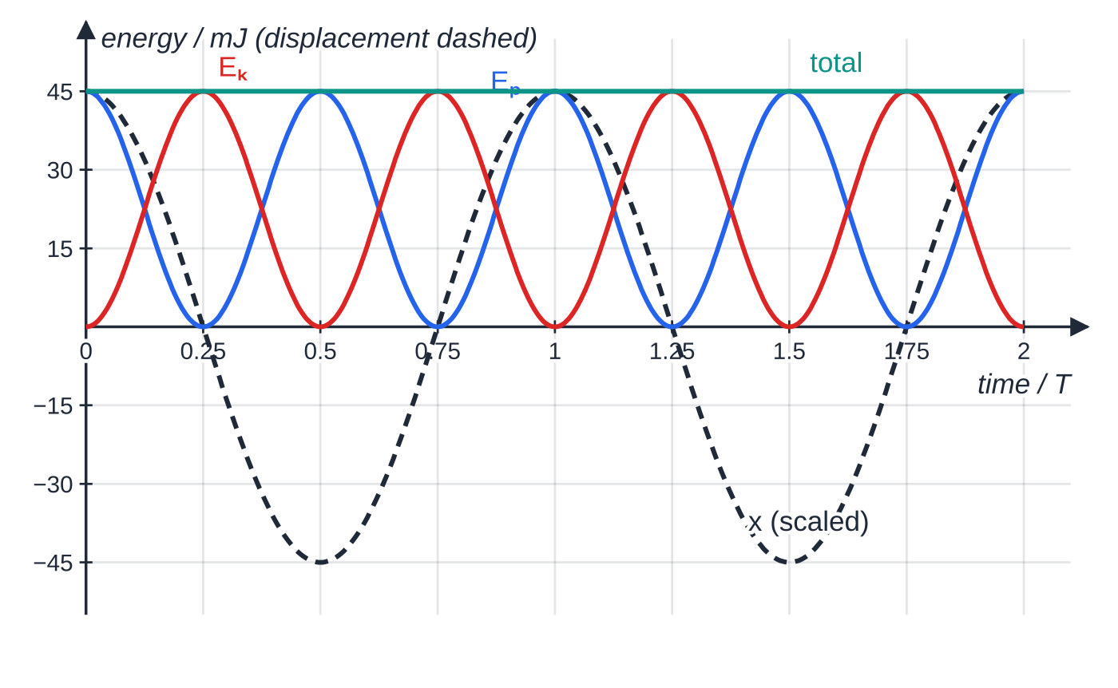
How is energy shared in an undamped oscillation? (continued)
Section 1 of 11
Over two periods of the displacement (dashed), each energy rises and falls four times. Eₚ peaks at the extremes, Eₖ peaks as the mass passes through equilibrium, and the total stays at 45 mJ.
Notes:
How is energy shared in an undamped oscillation?. Full notes: https://examinerprep.com/notes/edexcel-ial-physics/energy-damping-and-resonance/

Slide 8
How is energy shared in an undamped oscillation? (continued)
Section 1 of 11 · Worked example 1 · Medium · Calculate
WORKED EXAMPLE · QUESTION
A trolley of mass 0.40 kg is attached to a spring of spring constant 25 N m⁻¹ and oscillates horizontally with negligible friction. The amplitude is 6.0 cm. Calculate (a) the total energy of the oscillation, (b) the maximum speed of the trolley and (c) its potential energy, kinetic energy and speed when its displacement is 3.0 cm.
SOLUTION
(a) The total energy equals the strain energy at the extreme: E=½kA²=½×25×0.060²= 0.045 J
(b) At the centre all of it is kinetic: ½mv_(max)²=0.045, so v_(max)=√(2×0.045÷0.40)= 0.47 m s⁻¹. Check with v_(max)=ωA: ω=√(k/m)=7.91 rad s⁻¹, and 7.91×0.060=0.47 m s⁻¹.
(c) Eₚ=½×25×0.030²=0.01125 J≈ 0.011 J; Eₖ=0.045-0.01125=0.03375 J≈ 0.034 J; v=√(2×0.03375÷0.40)= 0.41 m s⁻¹.
Halfway out, only a quarter of the energy is potential, so three-quarters is still kinetic.
Notes:
How is energy shared in an undamped oscillation?: Worked example 1. Full notes: https://examinerprep.com/notes/edexcel-ial-physics/energy-damping-and-resonance/

Slide 9
How is energy shared in an undamped oscillation? (continued)
Section 1 of 11
Common error — "equal shares halfway out"
Potential energy depends on x², so at x=A/2 it is only ¼ of the total. Kinetic and potential energy are equal at x=A/√2≈0.71A.
Notes:
How is energy shared in an undamped oscillation?. Full notes: https://examinerprep.com/notes/edexcel-ial-physics/energy-damping-and-resonance/

Slide 10
What does damping do to an oscillation?
Section 2 of 11
Damping is a force opposing the motion of an oscillator that transfers energy out of the oscillating system, so its amplitude decreases.
Typical damping forces are air resistance, friction, drag in a liquid, and the internal friction of a material as it is repeatedly deformed.
The energy is not destroyed. It is transferred, usually to thermal energy of the oscillator and its surroundings, sometimes to sound.
Because E∝A², a fall in energy shows up as a fall in amplitude: new amplitude = √(energy fraction) × original amplitude.
With light damping the period is almost unchanged; only the amplitude shrinks. For many systems the amplitude falls by the same fraction each cycle, which is an exponential decay.
Notes:
What does damping do to an oscillation?. Full notes: https://examinerprep.com/notes/edexcel-ial-physics/energy-damping-and-resonance/

Slide 11
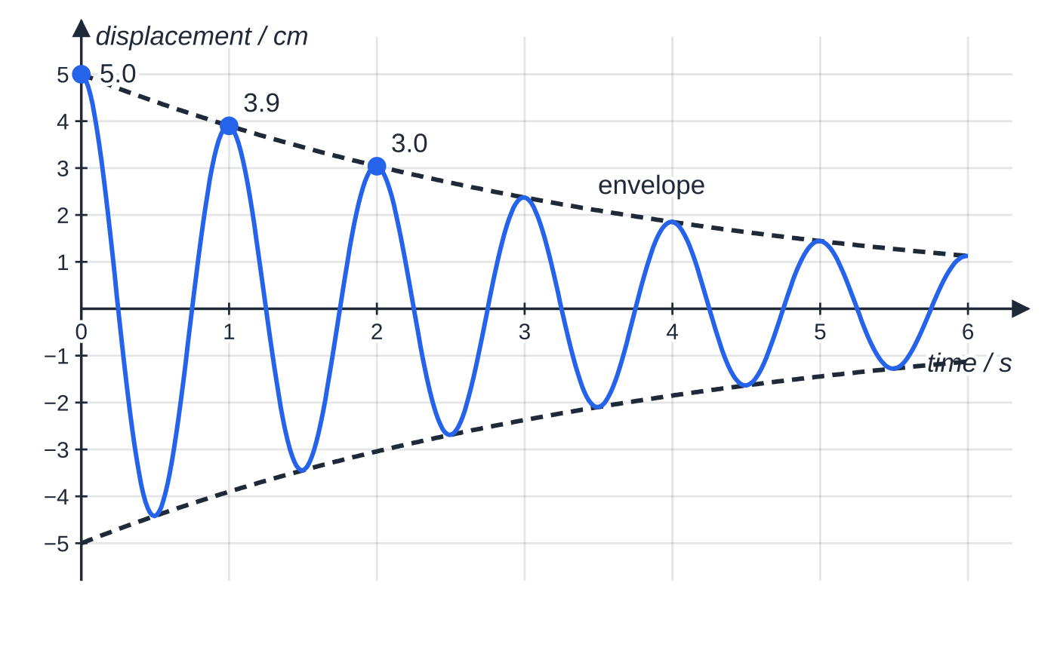
What does damping do to an oscillation? (continued)
Section 2 of 11
Light, critical and heavy damping
A lightly damped oscillation. Each peak is 0.78 times the one before, so each cycle keeps 0.78² = 0.61 of the energy. The period, 1.0 s, does not change as the amplitude decays.
Notes:
What does damping do to an oscillation?. Full notes: https://examinerprep.com/notes/edexcel-ial-physics/energy-damping-and-resonance/

Slide 12
What does damping do to an oscillation? (continued)
Section 2 of 11
Degree of damping | What happens after the system is displaced and released
Light (under-damped) | oscillates with gradually decreasing amplitude, at almost the natural frequency
Critical | returns to equilibrium in the shortest possible time without oscillating
Heavy (over-damped) | does not oscillate, but creeps back to equilibrium more slowly than with critical damping
Notes:
What does damping do to an oscillation?. Full notes: https://examinerprep.com/notes/edexcel-ial-physics/energy-damping-and-resonance/

Slide 13
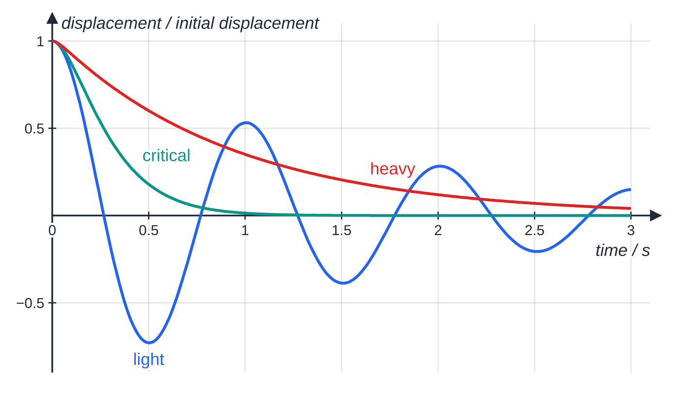
What does damping do to an oscillation? (continued)
Section 2 of 11
Three oscillators with the same natural period (1.0 s), each released from rest at the same displacement. The critically damped one settles first; the heavily damped one takes several times as long; the lightly damped one keeps crossing equilibrium.
Notes:
What does damping do to an oscillation?. Full notes: https://examinerprep.com/notes/edexcel-ial-physics/energy-damping-and-resonance/

Slide 14
What does damping do to an oscillation? (continued)
Section 2 of 11 · Worked example 2 · Medium · Calculate
WORKED EXAMPLE · QUESTION
A lightly damped oscillator has a period of 1.5 s. Its amplitude falls from 8.0 cm to 6.0 cm over 10 complete oscillations. When the amplitude was 8.0 cm the total energy was 0.064 J. Calculate (a) the energy when the amplitude is 6.0 cm, (b) the mean rate at which energy is transferred out of the oscillator and (c) the fraction of its energy lost in each cycle, assuming the amplitude falls by the same fraction every cycle.
SOLUTION
(a) Energy ∝ amplitude²: E=0.064×(6.0÷8.0)²=0.064×0.5625= 0.036 J
(b) ΔE=0.064-0.036=0.028 J in 10×1.5=15 s, so P=0.028÷15= 1.9 × 10⁻³ W (1.87 mW).
(c) The amplitude ratio per cycle is the tenth root of the overall ratio: (6.0/8.0)^(1/10)=0.972. The energy ratio per cycle is 0.972²=0.944, so 5.6% of the energy is lost each cycle.
The amplitude has fallen by 25% but the energy by 44%.
Notes:
What does damping do to an oscillation?: Worked example 2. Full notes: https://examinerprep.com/notes/edexcel-ial-physics/energy-damping-and-resonance/

Slide 15
What does damping do to an oscillation? (continued)
Section 2 of 11 · Worked example 2 · Medium · Calculate (continued)
Always square the amplitude ratio before talking about energy.
Notes:
What does damping do to an oscillation?: Worked example 2. Full notes: https://examinerprep.com/notes/edexcel-ial-physics/energy-damping-and-resonance/

Slide 16
What is the difference between free and forced oscillations?
Section 3 of 11
A free oscillation is an oscillation with no external periodic force acting, so the system oscillates at its natural frequency. A forced oscillation is an oscillation in which an external periodic driving force makes the system oscillate at the frequency of that force.
Natural frequency f₀: the frequency at which a system oscillates when displaced and released. For a mass on a spring f₀=1/T with T=2π√(m/k); for a simple pendulum T=2π√(l/g).
Driving frequency: the frequency of the external periodic force. Once the motion has settled (the steady state), a forced oscillator moves at the driving frequency, whatever its natural frequency.
Examples of forced oscillation: a loudspeaker cone driven by the current in its coil, a vibration generator shaking a string, an engine shaking a car body, wind gusts on a tall chimney.
Energy: a free oscillation that is damped dies away. A forced oscillation reaches a steady amplitude when the energy supplied by the driver each cycle equals the energy removed by damping each cycle.
Notes:
What is the difference between free and forced oscillations?. Full notes: https://examinerprep.com/notes/edexcel-ial-physics/energy-damping-and-resonance/

Slide 17
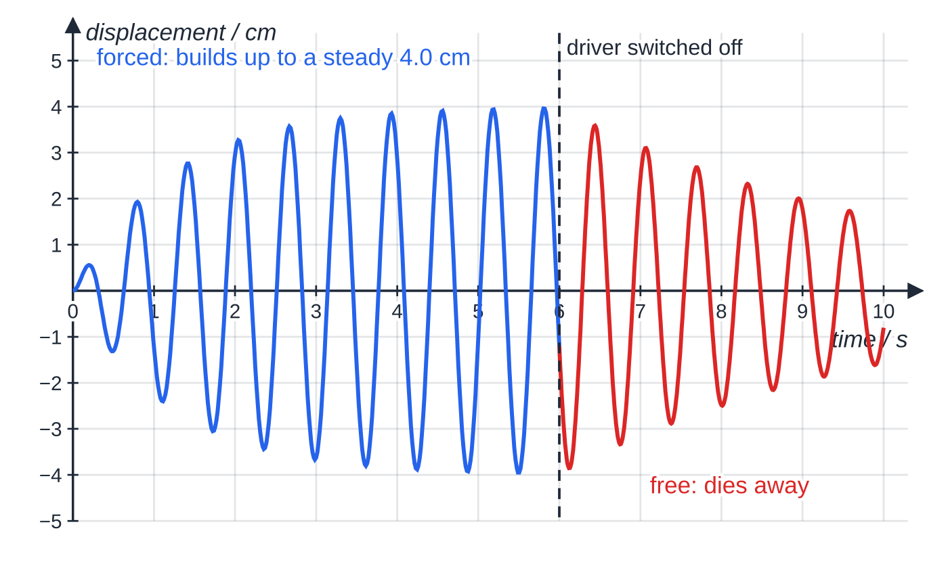
What is the difference between free and forced oscillations? (continued)
Section 3 of 11
The period formulae T=2π√(m/k), T=2π√(l/g), f=1/T and ω=2πf are in the formulae list supplied in the exam (you met them on the simple harmonic motion page). Here m is the oscillating mass (kg), k the spring constant (N m⁻¹) and l the length of the pendulum (m).
The mass in Worked example 3. Driven at its natural frequency, its amplitude grows until the energy supplied each cycle balances the energy lost; this steady amplitude is 4.0 cm. After the driver is switched off, the free oscillation decays: the amplitude halves to 2.0 cm in 3.0 s.
Notes:
What is the difference between free and forced oscillations?. Full notes: https://examinerprep.com/notes/edexcel-ial-physics/energy-damping-and-resonance/

Slide 18
What is the difference between free and forced oscillations? (continued)
Section 3 of 11 · Worked example 3 · Medium · Calculate, explain
WORKED EXAMPLE · QUESTION
A 0.50 kg mass hangs from a spring of spring constant 50 N m⁻¹. A vibration generator drives it at its natural frequency, and it oscillates with a steady amplitude of 4.0 cm. The generator is switched off, and the amplitude falls to 2.0 cm in 3.0 s. (a) Calculate the natural frequency. (b) Calculate the energy of the oscillation while it was driven. (c) Calculate the mean rate of energy loss in the 3.0 s after switching off, and explain what the generator was doing while the amplitude was steady.
SOLUTION
(a) From the formulae list, f₀=1/2π√(k/m)=1/2π√(50/0.50)= 1.59 Hz
(b) E=½×50×0.040²= 0.040 J
(c) At 2.0 cm, E=½×50×0.020²=0.010 J, so P=(0.040-0.010)÷3.0= 0.010 W.
While the amplitude was steady, the generator was supplying energy at the same rate as damping removed it.
Notes:
What is the difference between free and forced oscillations?: Worked example 3. Full notes: https://examinerprep.com/notes/edexcel-ial-physics/energy-damping-and-resonance/

Slide 19
What is the difference between free and forced oscillations? (continued)
Section 3 of 11 · Worked example 3 · Medium · Calculate, explain (continued)
Damping losses grow with amplitude, so at 4.0 cm that rate was greater than the 0.010 W average found here.
Notes:
What is the difference between free and forced oscillations?: Worked example 3. Full notes: https://examinerprep.com/notes/edexcel-ial-physics/energy-damping-and-resonance/

Slide 20
What is resonance, and how does damping change it?
Section 4 of 11
Drive an oscillator at a range of frequencies, wait for the steady state at each one, and record the amplitude.
Resonance is the large increase in amplitude of a forced oscillation when the driving frequency equals the natural frequency of the system.
At resonance the driving force is in step with the motion, so it does positive work on the oscillator throughout every cycle: energy is transferred from the driver to the oscillator most efficiently.
The amplitude builds up until the energy lost to damping per cycle equals the energy supplied per cycle. With very little damping that takes a very large amplitude.
Driven well below f₀, the system just follows the driver with a small amplitude. Driven well above f₀, it cannot keep up and the amplitude becomes very small.
Notes:
What is resonance, and how does damping change it?. Full notes: https://examinerprep.com/notes/edexcel-ial-physics/energy-damping-and-resonance/

Slide 21
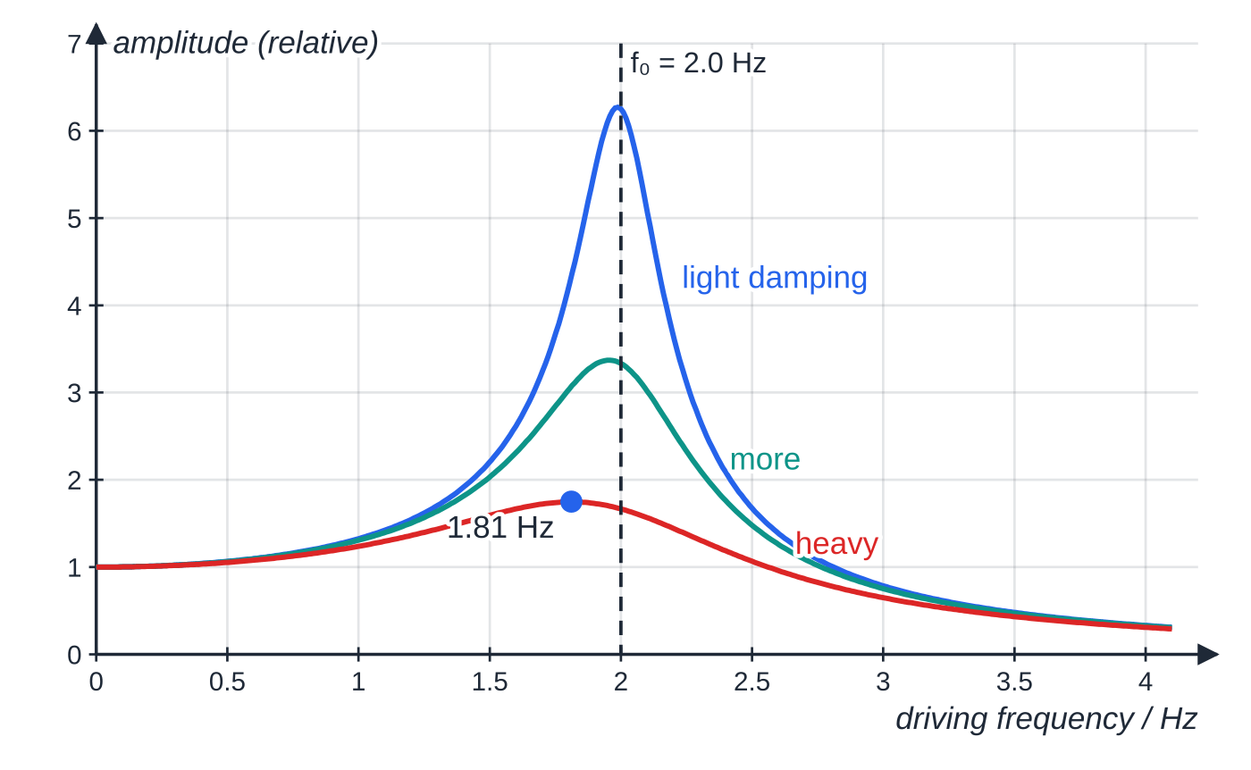
What is resonance, and how does damping change it? (continued)
Section 4 of 11
How damping changes the resonance curve
Lower peak: damping removes more energy per cycle, so the balance with the energy supplied is reached at a smaller amplitude.
Broader peak: the system responds over a wider range of driving frequencies (it is less "selective").
Peak at a slightly lower frequency than the natural frequency; with light damping the shift is negligible.
Little change far from f₀: all the curves start at the same low-frequency amplitude.
Resonance curves for one oscillator (f₀ = 2.0 Hz) with three amounts of damping. Light damping gives a tall, sharp peak almost exactly at f₀. More damping makes the peak lower and broader and moves it slightly below f₀ (1.81 Hz for the heaviest damping shown). Far from resonance, damping makes little difference.
Notes:
What is resonance, and how does damping change it?. Full notes: https://examinerprep.com/notes/edexcel-ial-physics/energy-damping-and-resonance/

Slide 22
What is resonance, and how does damping change it? (continued)
Section 4 of 11
Resonance that is useful | Resonance that is a problem
pushing a child on a swing once per swing; tuning a radio circuit to one station; musical instruments (air columns and strings); the quartz crystal in a clock; a microwave oven heating water molecules | a suspension bridge or footbridge driven by wind or footsteps; machine parts at certain engine speeds; a washing machine shaking during spin-up; buildings shaken by an earthquake at their natural frequency
Notes:
What is resonance, and how does damping change it?. Full notes: https://examinerprep.com/notes/edexcel-ial-physics/energy-damping-and-resonance/

Slide 23
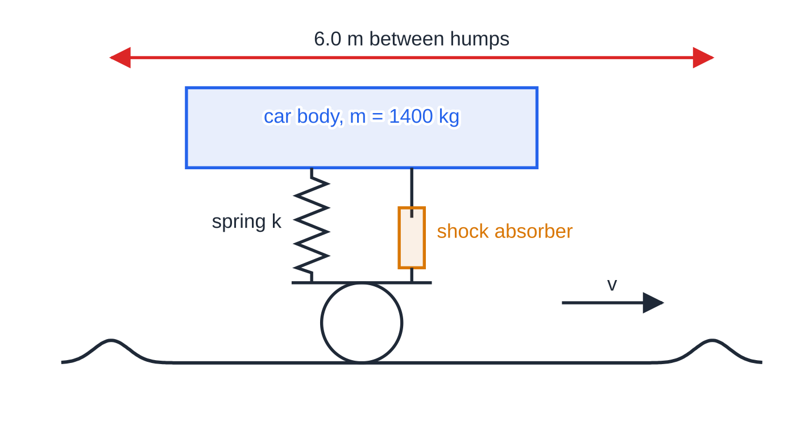
What is resonance, and how does damping change it? (continued)
Section 4 of 11 · Worked example 4 · Medium · Calculate, explain
WORKED EXAMPLE · QUESTION
The body of a car has mass 1400 kg. Its suspension springs together act like a single spring of spring constant 2.0 × 10⁵ N m⁻¹. The car drives along a road with a series of identical humps 6.0 m apart. (a) Calculate the natural frequency of vertical oscillation of the car body. (b) Calculate the speed at which the humps would make the body resonate. (c) Explain why the bouncing is small at 5.0 m s⁻¹.
The car body behaves as a mass on a spring, damped by the shock absorbers. Each hump gives a push, so at speed v the humps drive the body at frequency v ÷ 6.0 m.
Notes:
What is resonance, and how does damping change it?: Worked example 4. Full notes: https://examinerprep.com/notes/edexcel-ial-physics/energy-damping-and-resonance/

Slide 24
What is resonance, and how does damping change it? (continued)
Section 4 of 11 · Worked example 4 · Medium · Calculate, explain (continued)
SOLUTION
(a) f₀=1/2π√((2.0×10⁵)/1400)=1.902 Hz≈ 1.9 Hz
(b) The humps drive the body at f=speed÷spacing; resonance happens when this equals f₀: v=f₀×spacing=1.902×6.0=11.4 m s⁻¹≈ 11 m s⁻¹ (about 41 km h⁻¹).
(c) At 5.0 m s⁻¹ the driving frequency is 5.0÷6.0=0.83 Hz, well below 1.9 Hz, so the body is far from resonance and its amplitude is small.
Shock absorbers damp the suspension strongly (close to critical damping), so even at 11 m s⁻¹ the resonance peak is low and broad.
Notes:
What is resonance, and how does damping change it?: Worked example 4. Full notes: https://examinerprep.com/notes/edexcel-ial-physics/energy-damping-and-resonance/

Slide 25
What is resonance, and how does damping change it? (continued)
Section 4 of 11
Exam tip — define resonance with both frequencies
Write "the driving frequency equals the natural frequency", followed by "maximum amplitude" and "maximum (most efficient) transfer of energy". "The frequencies match" on its own is too vague.
Notes:
What is resonance, and how does damping change it?. Full notes: https://examinerprep.com/notes/edexcel-ial-physics/energy-damping-and-resonance/

Slide 26
How do damping and plastic deformation protect buildings and vehicles?
Section 5 of 11
Engineers have two weapons against unwanted resonance: keep the natural frequency away from the driving frequency, and take energy out of the oscillation quickly.
Car suspension
Springs let the wheels follow bumps without passing every jolt to the passengers. On their own, though, they would keep the car bouncing long after each bump, and resonate at certain speeds.
A shock absorber (damper) beside each spring forces oil through small holes as the suspension moves. The viscous drag transfers the oscillation energy to thermal energy of the oil.
The damping is set close to critical: after a bump the body returns to its normal height quickly with at most one small overshoot, and the resonance peak is low and broad.
A worn shock absorber gives light damping: the car keeps bouncing after a bump and the tyres can lose grip.
Notes:
How do damping and plastic deformation protect buildings and vehicles?. Full notes: https://examinerprep.com/notes/edexcel-ial-physics/energy-damping-and-resonance/

Slide 27
How do damping and plastic deformation protect buildings and vehicles? (continued)
Section 5 of 11
Buildings in earthquake zones
Earthquake ground motion contains a range of frequencies. A building whose natural frequency lies in that range is a forced oscillator near resonance, and its amplitude can grow until it is damaged.
Avoid resonance: engineers design so that the building's natural frequencies are away from the strongest earthquake frequencies for that site. Flexible base isolators (layered rubber and steel bearings) under the building lower its natural frequency well below them.
Add damping: fluid dampers in the frame, and large tuned masses near the top, absorb energy from the sway and transfer it to thermal energy, keeping the resonance peak low.
Use plastic deformation of ductile materials: steel braces and dampers, and the lead core of some base isolators, are designed to yield. Each time they are stretched and compressed beyond the elastic limit, work is done deforming the metal permanently, and that energy is dissipated as thermal energy, not returned to the oscillation.
Notes:
How do damping and plastic deformation protect buildings and vehicles?. Full notes: https://examinerprep.com/notes/edexcel-ial-physics/energy-damping-and-resonance/

Slide 28
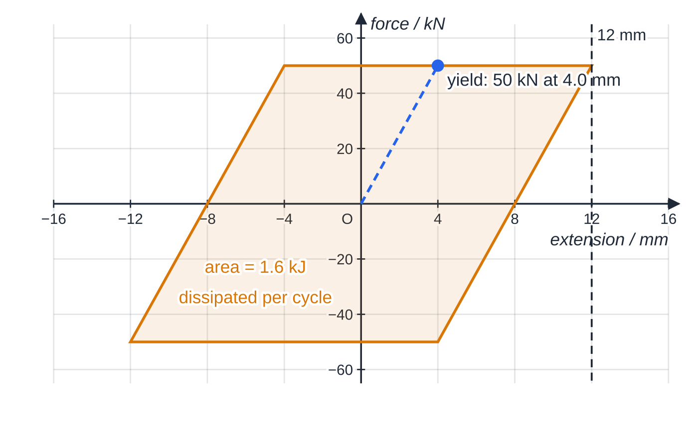
How do damping and plastic deformation protect buildings and vehicles? (continued)
Section 5 of 11
The material must be ductile, able to deform plastically many times without fracturing. A brittle material would simply crack and absorb very little energy.
Why does a loop mean energy is lost? On loading, the work done on the damper is the area under the loading line. On unloading, the damper does work back, equal to the area under the unloading line. Because the unloading line sits lower, less work comes back than went in. The difference, the area enclosed by the loop, is the energy dissipated in each cycle.
Force–extension loop of a ductile steel damper taken once through ±12 mm. On first loading (dashed) it behaves elastically up to 50 kN, then deforms plastically; it unloads along a line parallel to the elastic one. The enclosed area, 100 kN × 16 mm = 1.6 kJ, is removed from the building's oscillation in each cycle.
Notes:
How do damping and plastic deformation protect buildings and vehicles?. Full notes: https://examinerprep.com/notes/edexcel-ial-physics/energy-damping-and-resonance/

Slide 29
How do damping and plastic deformation protect buildings and vehicles? (continued)
Section 5 of 11 · Worked example 5 · Hard · Calculate
WORKED EXAMPLE · QUESTION
During an earthquake the upper part of a building, of effective mass 4.0 × 10⁵ kg, sways with a natural frequency of 0.50 Hz and an amplitude of 0.10 m. When the ground motion stops, the building oscillates freely. In the first cycle of the free oscillation, each of two ductile steel dampers goes once round the loop in the figure above. Ignore all other energy losses. (a) Calculate the effective spring constant of the building. (b) Calculate the energy of the oscillation at 0.10 m amplitude. (c) Calculate the amplitude after the first cycle.
SOLUTION
(a) Rearrange T=2π√(m/k) with T=1/f: k=4π²mf²=4π²×4.0×10⁵×0.50²=3.95×10⁶ N m⁻¹≈ 3.9 × 10⁶ N m⁻¹
(b) E=½kA²=½×3.948×10⁶×0.10²=19 739 J≈ 2.0 × 10⁴ J
(c) Energy dissipated = 2 × loop area = 2 × 1600 = 3200 J, so E=19 739-3200=16 539 J. Amplitude ∝ √energy: A=0.10×√(16 539÷19 739)=0.0915 m≈ 0.092 m
Notes:
How do damping and plastic deformation protect buildings and vehicles?: Worked example 5. Full notes: https://examinerprep.com/notes/edexcel-ial-physics/energy-damping-and-resonance/

Slide 30
How do damping and plastic deformation protect buildings and vehicles? (continued)
Section 5 of 11 · Worked example 5 · Hard · Calculate (continued)
About 16% of the energy goes in one cycle, but the amplitude falls by less than 10%: the square-root effect of E∝A² again.
Notes:
How do damping and plastic deformation protect buildings and vehicles?: Worked example 5. Full notes: https://examinerprep.com/notes/edexcel-ial-physics/energy-damping-and-resonance/

Slide 31
How do damping and plastic deformation protect buildings and vehicles? (continued)
Section 5 of 11
Common error — "damping removes the resonance"
Saying that damping "reduces the natural frequency so there is no resonance" is wrong. Damping mainly lowers and broadens the resonance peak; the shift in frequency is small. Moving the natural frequency away from the driving frequency is a separate strategy (for example, base isolation).
Notes:
How do damping and plastic deformation protect buildings and vehicles?. Full notes: https://examinerprep.com/notes/edexcel-ial-physics/energy-damping-and-resonance/

Slide 32
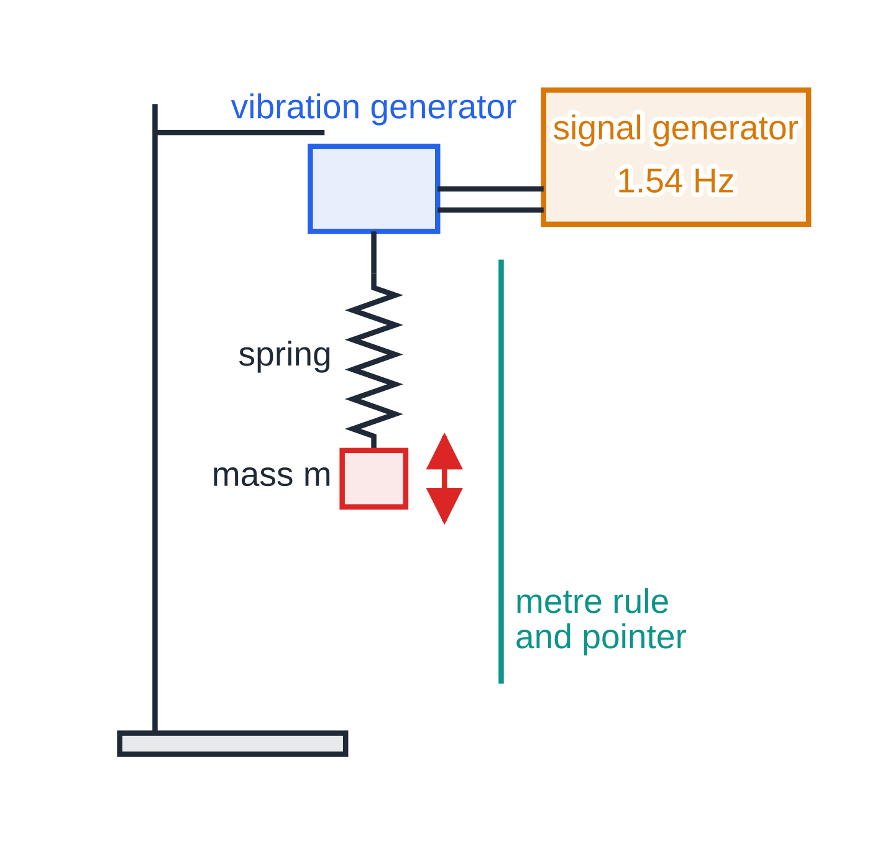
Core Practical 16: how do you find an unknown mass from resonant frequencies?
Section 6 of 11
This practical turns resonance into a weighing machine. For a mass on a spring, T=2π√(m/k), so squaring gives
T²=4π²/k m
A graph of T² against m for known masses is therefore a straight line of gradient 4π²/k: a calibration line. Measure the resonant frequency with the unknown mass and read its mass off the line. The relation is not in the formulae list: derive it by squaring T=2π√(m/k).
Apparatus: a spring hung from the vibrating rod of a vibration generator, driven by a signal generator; a mass hanger with slotted masses; a metre rule and pointer to judge the amplitude.
Core Practical 16 arrangement. The signal generator sets the driving frequency; the amplitude of the mass is greatest when that frequency equals the natural frequency of the mass–spring system.
Notes:
Core Practical 16: how do you find an unknown mass from resonant frequencies?. Full notes: https://examinerprep.com/notes/edexcel-ial-physics/energy-damping-and-resonance/

Slide 33
Core Practical 16: how do you find an unknown mass from resonant frequencies? (continued)
Section 6 of 11
Method: with a known mass on the spring, slowly increase the signal-generator frequency from well below resonance. Find the frequency at which the amplitude of the mass is greatest; approach it from above as well, and take the mean as the resonant frequency f. Repeat for at least six masses, then for the unknown mass.
Processing: T=1/f; plot T² against m; draw the line of best fit.
Check: displace each mass and time 20 free oscillations with a stopwatch. The natural frequency found this way should agree with the resonant frequency.
Practical issues
The peak is hard to locate when it is broad. Keep damping low (no paddle or card on the mass), change the frequency in small steps near the peak and wait for the amplitude to settle at each setting.
The spring has mass.
Notes:
Core Practical 16: how do you find an unknown mass from resonant frequencies?. Full notes: https://examinerprep.com/notes/edexcel-ial-physics/energy-damping-and-resonance/

Slide 34
Core Practical 16: how do you find an unknown mass from resonant frequencies? (continued)
Section 6 of 11
Part of the spring moves with the load, so the line does not pass through the origin: it has a small positive intercept on the T² axis. This does not affect the gradient or a value read off the line.
Keep the amplitude small so the spring obeys Hooke's law and the coils never close up; stop the mass swinging sideways.
Uncertainty: if f=1.45 Hz is found to ±0.02 Hz, the percentage uncertainty in f is 1.4%, and in T² (=1/f²) it is 2 × 1.4% = 2.8%.
Safety: clamp the stand firmly (counterweight on the base) and keep feet clear of slotted masses that could fall.
Notes:
Core Practical 16: how do you find an unknown mass from resonant frequencies?. Full notes: https://examinerprep.com/notes/edexcel-ial-physics/energy-damping-and-resonance/

Slide 35
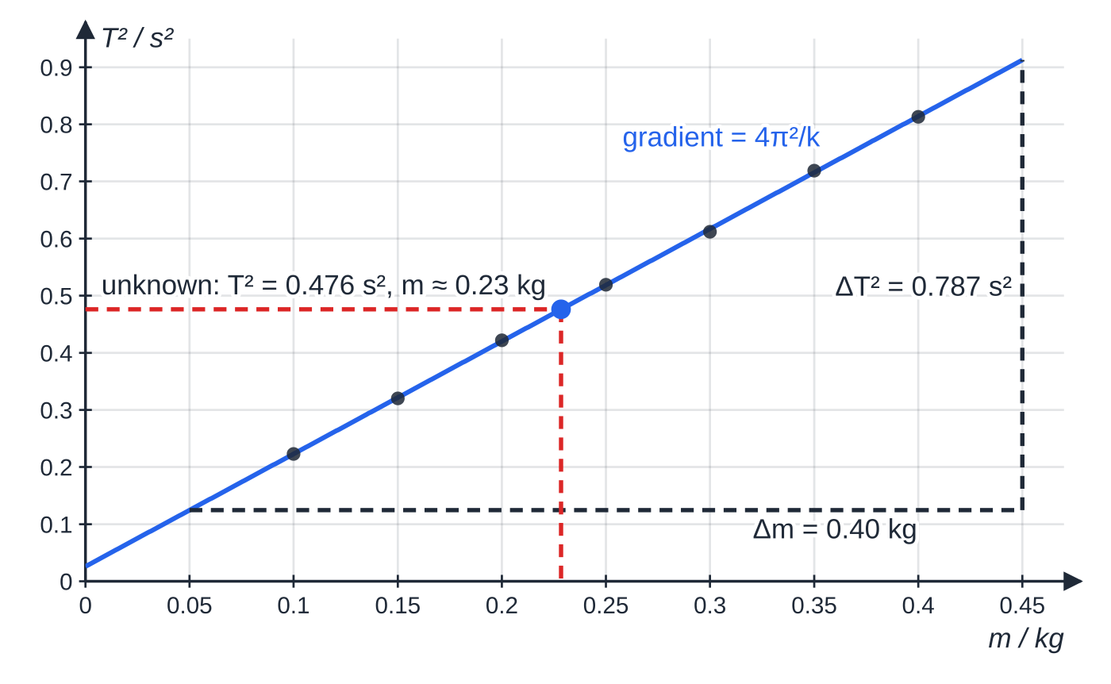
Core Practical 16: how do you find an unknown mass from resonant frequencies? (continued)
Section 6 of 11
Specimen results for seven known masses. The unknown mass gave a resonant frequency of 1.45 Hz, so T² = 0.476 s²; reading across to the line and down gives its mass. The small intercept, 0.026 s², comes from the moving mass of the spring.
Notes:
Core Practical 16: how do you find an unknown mass from resonant frequencies?. Full notes: https://examinerprep.com/notes/edexcel-ial-physics/energy-damping-and-resonance/

Slide 36
Core Practical 16: how do you find an unknown mass from resonant frequencies? (continued)
Section 6 of 11 · Worked example 6 · Hard · Determine, explain
WORKED EXAMPLE · QUESTION
Use the specimen graph above to determine (a) the spring constant and (b) the unknown mass, whose resonant frequency was 1.45 Hz. (c) Explain the intercept on the T² axis.
SOLUTION
(a) Gradient from a large triangle on the line, from m=0.05 kg to 0.45 kg: gradient =0.787÷0.40=1.97 s² kg⁻¹. Gradient =4π²/k, so k=4π²÷1.97= 20 N m⁻¹
(b) T²=1÷1.45²=0.476 s², so (reading across and down, or using the line's equation) m=(0.476-0.026)÷1.97= 0.23 kg
(c) The intercept, 0.026 s², is T² for "zero load": the spring's own moving mass, equivalent to an extra 0.026÷1.97≈0.013 kg on the end.
Reading the unknown mass from the calibration line, not from the formula with k, automatically allows for the mass of the spring.
Notes:
Core Practical 16: how do you find an unknown mass from resonant frequencies?: Worked example 6. Full notes: https://examinerprep.com/notes/edexcel-ial-physics/energy-damping-and-resonance/

Slide 37
Core Practical 16: how do you find an unknown mass from resonant frequencies? (continued)
Section 6 of 11
Exam tip — why plot T² against m
T²=(4π²/k) m has the form y=mx+c, so the graph is a straight line whose gradient gives k. A curve of T against m is much harder to read accurately.
Notes:
Core Practical 16: how do you find an unknown mass from resonant frequencies?. Full notes: https://examinerprep.com/notes/edexcel-ial-physics/energy-damping-and-resonance/

Slide 38
Exam tips for 5.6
Section 7 of 11
Exam tip 1 — square the amplitude ratio
Energy ∝ amplitude². If the amplitude falls to 60%, the energy falls to 36%; if the energy halves, the amplitude falls to 71%. Write the ratio, then square it (or square-root it) as a separate step.
Exam tip 2 — energy graphs have twice the frequency
When you sketch kinetic or potential energy against time, draw two peaks in every period of the displacement, never go below zero, and draw a flat total-energy line. Against displacement, draw parabolas meeting the total at ±A.
Exam tip 3 — describe damping with three words
For "how does increasing the damping affect the resonance curve?": the peak is lower, broader, and at a slightly lower frequency. Add that the amplitude far from resonance is barely changed.
Notes:
Exam tips for 5.6. Full notes: https://examinerprep.com/notes/edexcel-ial-physics/energy-damping-and-resonance/

Slide 39
Exam tips for 5.6 (continued)
Section 7 of 11
Exam tip 4 — say where the energy goes
"Damping removes energy" is incomplete. Say it is transferred from the oscillator (kinetic and potential energy) to thermal energy of the surroundings or the damper, or, for plastic deformation, dissipated as thermal energy in the deformed metal.
Exam tip 5 — critical damping in one sentence
Critical damping: the system returns to equilibrium in the shortest time without oscillating. Both halves are needed; heavy damping also avoids oscillation but takes longer.
Notes:
Exam tips for 5.6. Full notes: https://examinerprep.com/notes/edexcel-ial-physics/energy-damping-and-resonance/

Slide 40
Common misconceptions
Section 8 of 11
Misconception | Why it is wrong | Correct idea
Doubling the amplitude doubles the energy. | Potential energy at the extreme is ½kA², which depends on A². | Doubling the amplitude gives four times the energy.
At half the amplitude, kinetic and potential energy are equal. | Eₚ∝x², so at A/2 it is only ¼ of the total. | They are equal at x=A/√2≈0.71A.
Damping slows the oscillation down, so the period gets longer as it dies away. | With light damping the period is almost exactly the natural period. | Light damping reduces the amplitude, not the frequency.
Heavy damping stops the system fastest. | Very large damping makes the return to equilibrium slow. | Critical damping gives the quickest return without oscillation.
A forced oscillator vibrates at its natural frequency. | In the steady state it follows the driver. | It oscillates at the driving frequency; the amplitude is largest when that equals the natural frequency.
Notes:
Common misconceptions. Full notes: https://examinerprep.com/notes/edexcel-ial-physics/energy-damping-and-resonance/

Slide 41
Common misconceptions (continued)
Section 8 of 11
Misconception | Why it is wrong | Correct idea
Damping removes resonance. | The peak is still there, just lower and broader. | Damping limits the amplitude at resonance; it does not remove the peak.
Notes:
Common misconceptions. Full notes: https://examinerprep.com/notes/edexcel-ial-physics/energy-damping-and-resonance/

Slide 42
How this topic connects
Section 9 of 11
5 Simple harmonic motion
The period formulae T=2π√(m/k) and T=2π√(l/g), and v_(max)=ωA, all come from there; this page adds energy and what happens when the oscillator is damped or driven.
Hooke's law and elastic strain energy (Unit 1)
The spring's potential energy is the area under the force–extension graph, ½FΔx; the energy dissipated by plastic deformation is the area enclosed by a loading–unloading loop.
Stationary waves (Unit 2) and practical skills (6.1)
A string or air column has many natural frequencies, its harmonics, and a vibration generator or a musician drives it into resonance at one of them. Linearising T=2π√(m/k) into a T²–m graph, combining percentage uncertainties and explaining an intercept are typical of the A2 practical paper.
Notes:
How this topic connects. Full notes: https://examinerprep.com/notes/edexcel-ial-physics/energy-damping-and-resonance/

Slide 43
Key equations
Section 10 of 11
Equation | Use | In the formulae list?
T=2π√(m/k) | period of a mass–spring oscillator; m in kg, k in N m⁻¹ | yes
T=2π√(l/g) | period of a simple pendulum; l in m | yes
f=1/T, ω=2πf | frequency (Hz) and angular frequency (rad s⁻¹) | yes
ΔEₑₗ=½FΔx | elastic strain energy in a spring (J) | yes
Eₜₒₜₐₗ=½kA² | total energy of a mass–spring oscillator | no — derive it from ½FΔx with F=kA
Eₖ=½k(A²-x²) | kinetic energy at displacement x | no — derive it: total − ½kx²
E∝A² | energy and amplitude, any oscillator | no — learn it
Notes:
Key equations. Full notes: https://examinerprep.com/notes/edexcel-ial-physics/energy-damping-and-resonance/

Slide 44
Key equations (continued)
Section 10 of 11
Equation | Use | In the formulae list?
T²=(4π²/k) m; k=4π²/gradient | Core Practical 16 graph | no — derive it by squaring T=2π√(m/k)
energy dissipated per cycle = area of force–extension loop | plastic deformation in a damper | no — learn it
Notes:
Key equations. Full notes: https://examinerprep.com/notes/edexcel-ial-physics/energy-damping-and-resonance/

Slide 45
Check your understanding
Section 11 of 11
1. The amplitude of an undamped oscillator is doubled. By what factor does its total energy change?
2. At what displacement, as a fraction of the amplitude, are the kinetic and potential energies of a mass–spring oscillator equal?
3. State two ways in which increasing the damping changes the resonance curve of a forced oscillator.
4. Explain, using the idea of resonance, why a small push once every swing can build up a large swing on a playground swing.
5. A 0.200 kg mass on a spring resonates at 1.60 Hz. Calculate the spring constant, ignoring the mass of the spring.
6. A lightly damped pendulum loses 19% of its energy in each cycle. By what fraction does its amplitude fall each cycle?
Notes:
Check your understanding: questions. Full notes: https://examinerprep.com/notes/edexcel-ial-physics/energy-damping-and-resonance/

Slide 46
Check your understanding · answers
Section 11 of 11
1. Energy ∝ amplitude², so it increases by a factor of 2²= 4.
2. ½kx²=½×½kA², so x=A/√2≈ 0.71A.
3. Any two of: the peak amplitude is lower; the peak is broader; the peak occurs at a slightly lower frequency.
4. The pushes are a periodic driving force at the swing's natural frequency, so each push is in step with the motion and transfers energy to it. The amplitude grows until the energy lost to air resistance and friction each cycle equals the energy supplied by each push.
5. k=4π²mf²=4π²×0.200×1.60²= 20.2 N m⁻¹.
6. Energy kept = 0.81 of the previous value, so amplitude kept =√0.81=0.90. The amplitude falls by 10% each cycle, much less than the 19% fall in energy.
Notes:
Check your understanding: answers. Full notes: https://examinerprep.com/notes/edexcel-ial-physics/energy-damping-and-resonance/

Slide 47
Practice questions
5 original exam-style questions. Answers at the end of the deck.

Slide 48
Question 1
1 mark
A mass on a spring of spring constant 40 N m⁻¹ oscillates without damping with an amplitude of 0.050 m.
What is the total energy of the oscillation?
A 0.050 J
B 0.10 J
C 1.0 J
D 2.0 J
Notes:
Online with the full mark scheme: https://examinerprep.com/ial-physics-5-6-energy-damping-and-resonance-questions#IALP-U5-6-A-02

Slide 49
Question 2
1 mark
Which statement describes the condition for resonance of a forced oscillator?
A the amplitude of the driving force equals the amplitude of the oscillator
B the driving frequency equals the natural frequency of the oscillator
C the damping force equals the driving force
D the natural frequency is twice the driving frequency
Notes:
Online with the full mark scheme: https://examinerprep.com/ial-physics-5-6-energy-damping-and-resonance-questions#IALP-U5-6-A-04

Slide 50
Question 3
1 mark
The damping of a forced oscillator is increased, but nothing else is changed.
Which row describes the effect on the peak of its resonance curve (amplitude against driving frequency)?
A peak higher, narrower, at the same frequency
B peak lower, broader, at a slightly higher frequency
C peak lower, narrower, at the same frequency
D peak lower, broader, at a slightly lower frequency
Notes:
Online with the full mark scheme: https://examinerprep.com/ial-physics-5-6-energy-damping-and-resonance-questions#IALP-U5-6-A-05

Slide 51
Question 4
6 marks
A mass oscillates on a spring with simple harmonic motion and negligible damping. Its amplitude is 0.12 m and the total energy of the oscillation is 0.18 J.
(a) Show that the spring constant is about 25 N m⁻¹. [2]
(b) Calculate the potential energy and the kinetic energy of the oscillator when its displacement is 0.040 m. [2]
(c) Describe how the potential energy and the kinetic energy vary with displacement between −0.12 m and +0.12 m. [2]
Notes:
Online with the full mark scheme: https://examinerprep.com/ial-physics-5-6-energy-damping-and-resonance-questions#IALP-U5-6-B-03

Slide 52
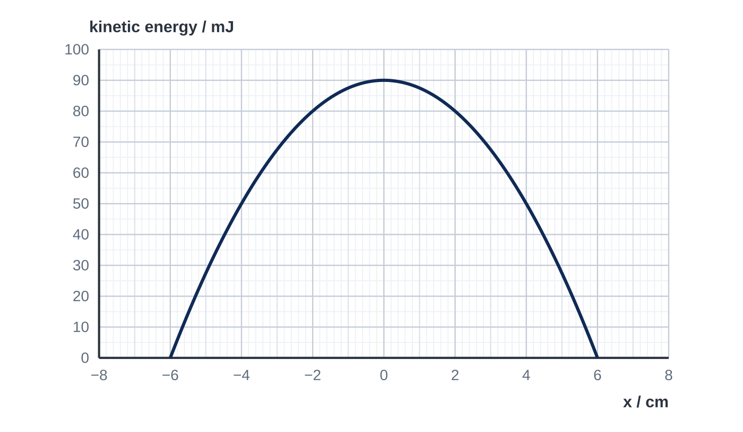
Question 5
6 marks
A 0.80 kg block oscillates horizontally on the end of a spring on a smooth surface. Damping is negligible. The graph shows how the kinetic energy of the block varies with its displacement x.
(a) Use the graph to show that the spring constant is 50 N m⁻¹. [2]
(b) Calculate the frequency of the oscillation. [2]
(c) Determine the displacements at which the kinetic energy equals the potential energy. [2]
Notes:
Online with the full mark scheme: https://examinerprep.com/ial-physics-5-6-energy-damping-and-resonance-questions#IALP-U5-6-FB-03

Slide 53
Answers

Slide 54
Question 1 · answer
Answer A
The total energy equals the elastic potential energy at the extreme: E = ½kA² = ½ × 40 × 0.050² = 0.050 J.
Notes:
Full mark scheme: https://examinerprep.com/ial-physics-5-6-energy-damping-and-resonance-questions#IALP-U5-6-A-02

Slide 55
Question 2 · answer
Answer B
Resonance occurs when the driving frequency equals the natural frequency. Energy is then transferred from the driver most efficiently and the amplitude is a maximum.
Notes:
Full mark scheme: https://examinerprep.com/ial-physics-5-6-energy-damping-and-resonance-questions#IALP-U5-6-A-04

Slide 56
Question 3 · answer
Answer D
More damping removes more energy per cycle, so the maximum amplitude is lower; the system responds over a wider range of frequencies, so the peak is broader; and the peak moves to a slightly lower frequency than the natural frequency.
Notes:
Full mark scheme: https://examinerprep.com/ial-physics-5-6-energy-damping-and-resonance-questions#IALP-U5-6-A-05

Slide 57
Question 4 · answer
Mark scheme
0.18 = ½ × k × 0.12²
k = 0.36 ÷ 0.0144 = 25 N m⁻¹
potential energy = ½ × 25 × 0.040² = 0.020 J
kinetic energy = 0.18 − 0.020 = 0.16 J
potential energy: a parabola / ∝ x², zero at x = 0 and 0.18 J at ±0.12 m
kinetic energy: an inverted parabola, 0.18 J at x = 0 and zero at ±0.12 m, so that the two always add to 0.18 J
Notes:
Full mark scheme: https://examinerprep.com/ial-physics-5-6-energy-damping-and-resonance-questions#IALP-U5-6-B-03

Slide 58
Question 5 · answer
Mark scheme
total energy = maximum kinetic energy = 90 mJ and amplitude = 6.0 cm, both read from the graph
k = 2E/A² = 2 × 0.090 ÷ 0.060² = 50 N m⁻¹
f = (1/2π)√(k/m) = (1/2π)√(50 ÷ 0.80)
= 1.3 Hz (1.26 Hz)
each is then half the total, so ½kx² = 45 mJ / KE = 45 mJ on the graph
x = ±A/√2 = ±4.2 cm (allow ±4.1 to ±4.3 cm)
Notes:
Full mark scheme: https://examinerprep.com/ial-physics-5-6-energy-damping-and-resonance-questions#IALP-U5-6-FB-03

Slide 59
Keep practising
Notes for this topic
Questions on this topic
Build a printable test
ExaminerPrep is an independent tutoring service. It has been developed independently from and is not endorsed by the International Baccalaureate Organization. "International Baccalaureate", "IB" and "IB Diploma Programme" are registered trademarks of the IBO, used here for descriptive purposes only.
Pearson Edexcel and Cambridge are trademarks of their owners; ExaminerPrep is not affiliated with any exam board.

