Slide 1
EP
EDEXCEL IAL PHYSICS
1.2 Forces and Newton's laws
The full notes page in 13 sections · practice questions with answers · simulations
ExaminerPrep is an independent tutoring service. It has been developed independently from and is not endorsed by the International Baccalaureate Organization. "International Baccalaureate", "IB" and "IB Diploma Programme" are registered trademarks of the IBO, used here for descriptive purposes only.
Pearson Edexcel and Cambridge are trademarks of their owners; ExaminerPrep is not affiliated with any exam board.
Notes:
1.2 Forces and Newton's laws. Notes for this topic: https://examinerprep.com/notes/edexcel-ial-physics/forces-and-newtons-laws/

Slide 2
What this page covers
Overview
Free-body diagrams for a particle and for an extended body, with the weight acting at the centre of gravity
Weight, mass and gravitational field strength: g = F/m and W = mg
Newton's first law and equilibrium, including resolving forces
Forces on slopes: components of the weight along and perpendicular to the slope
Newton's second law, ΣF = ma, for a body of constant mass
Connected bodies (towing) and the forces on a person in a lift
Terminal velocity, explained with forces
Newton's third law and the properties of the pair of forces in an interaction
Notes:
What this page covers. Full notes: https://examinerprep.com/notes/edexcel-ial-physics/forces-and-newtons-laws/

Slide 3
In one minute
Key points
1. One diagram — the free-body diagram — and one equation — ΣF = ma — link force to motion, from a sign hanging still to a skydiver opening a parachute.
2. A free-body diagram shows every force acting on one body, drawn as arrows starting on that body. The weight of an extended body acts at its centre of gravity.
3. Weight W = mg. Mass (kg) is the same everywhere; weight (N) depends on g, which is 9.81 N kg⁻¹ at the Earth's surface.
4. First law: zero resultant force ⇔ at rest or constant velocity. Resolve in two perpendicular directions and set each sum to zero.
5. Second law: ΣF = ma. The acceleration is in the direction of the resultant force.
6. Terminal velocity: drag grows with speed until it equals the weight; the resultant force, and so the acceleration, become zero.
Notes:
In one minute. Full notes: https://examinerprep.com/notes/edexcel-ial-physics/forces-and-newtons-laws/

Slide 4
In one minute (continued)
Key points
7. Third law: if A pushes or pulls B, B pushes or pulls A with a force of equal size, opposite direction and the same type — acting on the other body.
Notes:
In one minute. Full notes: https://examinerprep.com/notes/edexcel-ial-physics/forces-and-newtons-laws/

Slide 5
What is a free-body diagram?
Section 1 of 13
Almost every mistake in a forces question comes from a force that is missing, doubled or acting on the wrong body. A free-body diagram prevents this by isolating one body and asking a single question: what is pushing or pulling this object?
Free-body diagram: a diagram of one body showing every force that acts on it, and no others.
Force | Caused by | Direction
Weight W | the gravitational pull of the Earth | vertically down, from the centre of gravity
Normal contact force R | a surface pushing on the body | perpendicular to the surface, away from it
Friction F | a surface resisting sliding | along the surface, opposing the (tendency to) slide
Tension T | a stretched string, rope, cable or tow bar | along the string, pulling away from the body
Notes:
What is a free-body diagram?. Full notes: https://examinerprep.com/notes/edexcel-ial-physics/forces-and-newtons-laws/

Slide 6
What is a free-body diagram? (continued)
Section 1 of 13
Force | Caused by | Direction
Drag / air resistance D | a fluid the body moves through | opposite to the velocity
Upthrust U | a fluid the body is immersed in | vertically up
Driving force | the road pushing forward on driven wheels (or the water on a propeller) | forwards
Drawing one well
Draw only the body you are interested in — a dot for a particle, an outline for an extended body.
Every arrow starts on the body and points the way the force acts; label it with its name or symbol and value.
Make arrow lengths roughly proportional to the sizes of the forces — balanced forces get equal arrows.
Notes:
What is a free-body diagram?. Full notes: https://examinerprep.com/notes/edexcel-ial-physics/forces-and-newtons-laws/

Slide 7
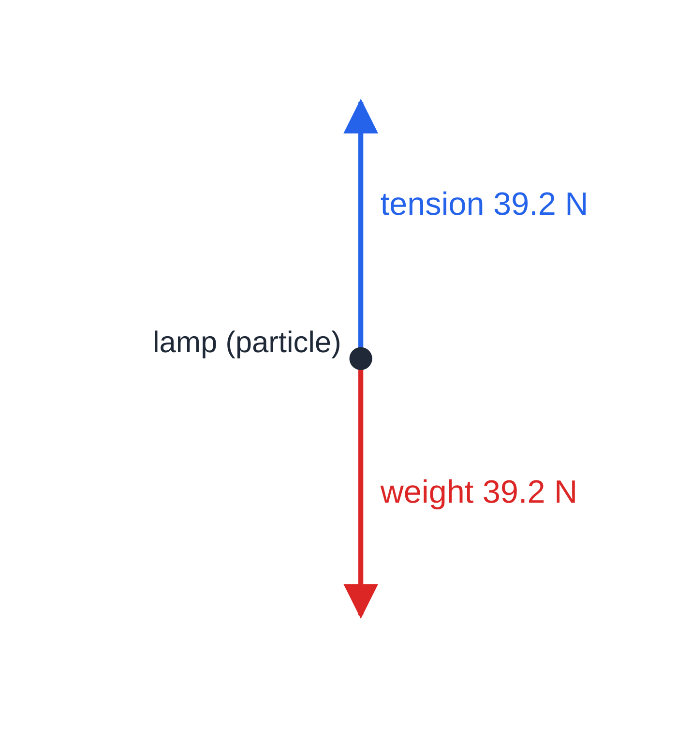
What is a free-body diagram? (continued)
Section 1 of 13
For an extended body, draw the weight from the centre of gravity: the single point at which the whole weight can be taken to act. For a uniform body it is at the geometric centre.
Never include forces that the body exerts on other things.
A 4.0 kg lamp hanging at rest, treated as a particle (a dot). Two equal and opposite forces: the tension in the flex, 39.2 N up, and the weight, 4.0 × 9.81 = 39.2 N down.
Notes:
What is a free-body diagram?. Full notes: https://examinerprep.com/notes/edexcel-ial-physics/forces-and-newtons-laws/

Slide 8
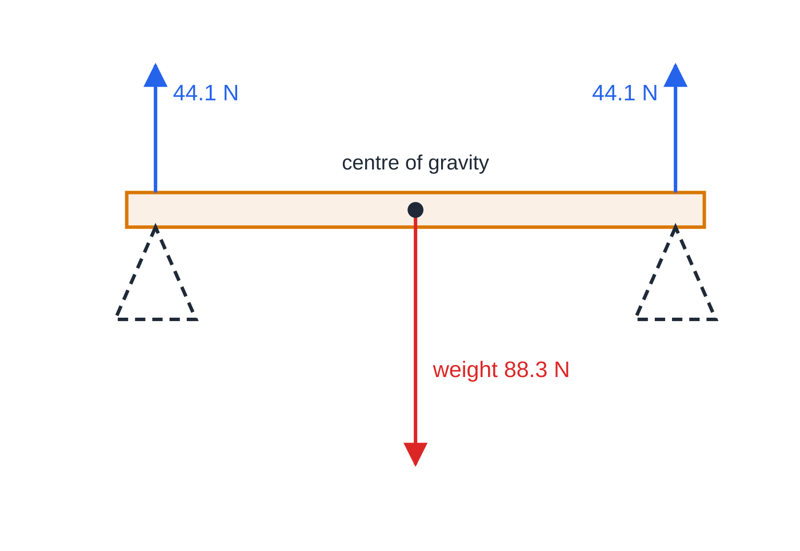
What is a free-body diagram? (continued)
Section 1 of 13
Common error
Adding a "force of motion" or a "force of the throw" to a moving body. Once a ball leaves the hand, the hand exerts no force on it: the only forces are its weight and air resistance.
A uniform 9.0 kg plank is an extended body: its 88.3 N weight acts at the centre of gravity, halfway between the two trestles, which each push up with 44.1 N. The dashed trestles are not part of the body.
Notes:
What is a free-body diagram?. Full notes: https://examinerprep.com/notes/edexcel-ial-physics/forces-and-newtons-laws/

Slide 9
What is the difference between mass and weight?
Section 2 of 13
In everyday speech "weight" is often measured in kilograms, but in physics the two are different quantities. Mass tells you how much matter there is and how hard the body is to accelerate. Weight is a force: the pull of a gravitational field on that mass.
Gravitational field strength g:
the gravitational force per unit mass on a body placed in the field.
g = F/m W = mg
g = gravitational field strength (N kg⁻¹) · F = gravitational force (N) · m = mass (kg) · W = weight (N). Both are supplied in the formulae list.
At the Earth's surface g = 9.81 N kg⁻¹. Since 1 N = 1 kg m s⁻², this is the same as a free-fall acceleration of 9.81 m s⁻².
Notes:
What is the difference between mass and weight?. Full notes: https://examinerprep.com/notes/edexcel-ial-physics/forces-and-newtons-laws/

Slide 10
What is the difference between mass and weight? (continued)
Section 2 of 13
 | Mass | Weight
What it is | the amount of matter; how hard the body is to accelerate | the gravitational force on the body
Type | scalar | vector (down, towards the centre of the planet)
Unit | kg | N
Changes from place to place? | no | yes, with g
Measured with | a balance (compares masses) | a newton-meter or force sensor
Notes:
What is the difference between mass and weight?. Full notes: https://examinerprep.com/notes/edexcel-ial-physics/forces-and-newtons-laws/

Slide 11
What is the difference between mass and weight? (continued)
Section 2 of 13 · Worked example 1 · Easy · Calculate
WORKED EXAMPLE · QUESTION
A planetary rover has a mass of 1025 kg. The gravitational field strength at the surface of Mars is 3.71 N kg⁻¹. Calculate the weight of the rover on Earth and on Mars, and state its mass on Mars.
SOLUTION
Step 1 Weight on Earth: W = mg = 1025 ×9.81 = 10 055 N = 1.01 × 10⁴ N
Step 2 Weight on Mars: W = 1025 ×3.71 = 3803 N = 3.80 × 10³ N
Step 3 Mass does not depend on the field: mass on Mars = 1025 kg
Notes:
What is the difference between mass and weight?: Worked example 1. Full notes: https://examinerprep.com/notes/edexcel-ial-physics/forces-and-newtons-laws/

Slide 12
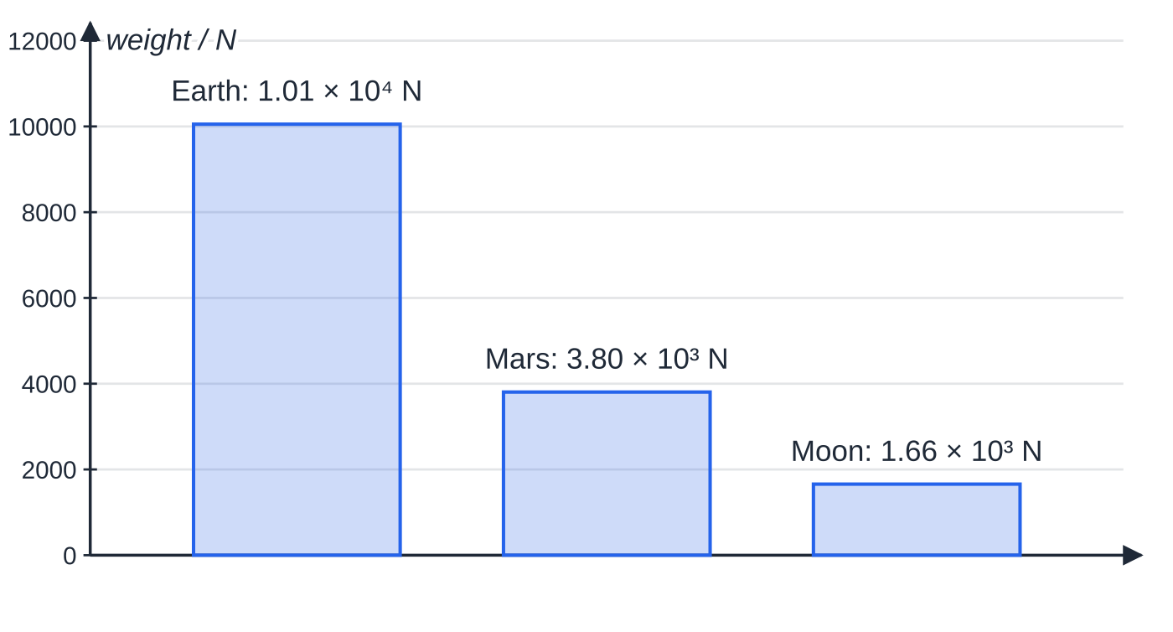
What is the difference between mass and weight? (continued)
Section 2 of 13
The same 1025 kg rover weighs 1.01 × 10⁴ N on Earth (g = 9.81 N kg⁻¹), 3.80 × 10³ N on Mars (3.71 N kg⁻¹) and 1.66 × 10³ N on the Moon (1.62 N kg⁻¹). Its mass is 1025 kg in all three places.
Notes:
What is the difference between mass and weight?. Full notes: https://examinerprep.com/notes/edexcel-ial-physics/forces-and-newtons-laws/

Slide 13
What does Newton's first law tell you?
Section 3 of 13
Newton's first law: a body stays at rest or moves with constant velocity unless a resultant force acts on it.
The law says that motion does not need a cause; changes in motion do. Zero resultant force means zero acceleration: the body is at rest or moving in a straight line at constant speed. It is the special case a = 0 of the second law. A body with zero resultant force is in equilibrium (translational equilibrium; turning effects are on the moments page). Constant speed round a bend is not equilibrium: the direction of the velocity changes, so there is a resultant force.
Solving an equilibrium problem
1. Draw the free-body diagram.
2. Choose two perpendicular directions (horizontal and vertical, or along and perpendicular to a slope).
3. Resolve every force and write: sum of components = 0 in each direction.
4. Or draw the forces tip to tail — for three forces in equilibrium they form a closed triangle.
Notes:
What does Newton's first law tell you?. Full notes: https://examinerprep.com/notes/edexcel-ial-physics/forces-and-newtons-laws/

Slide 14
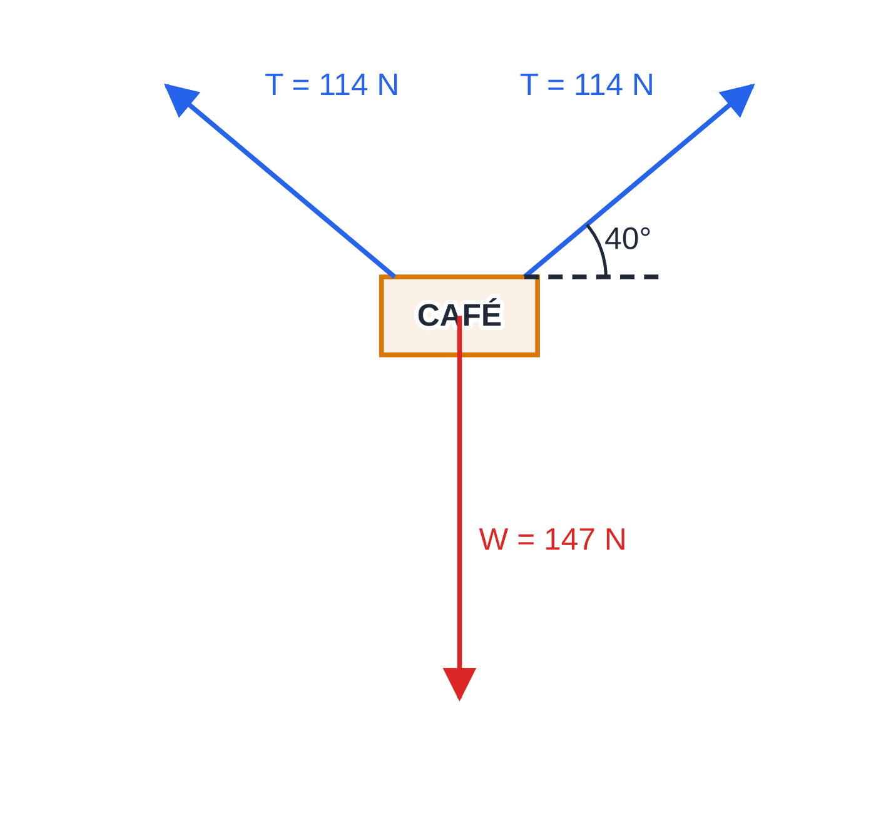
What does Newton's first law tell you? (continued)
Section 3 of 13
Free-body diagram of a 15.0 kg sign hanging from two cables, each at 40° to the horizontal, roughly to scale. The two tensions are equal because the arrangement is symmetrical.
Notes:
What does Newton's first law tell you?. Full notes: https://examinerprep.com/notes/edexcel-ial-physics/forces-and-newtons-laws/

Slide 15
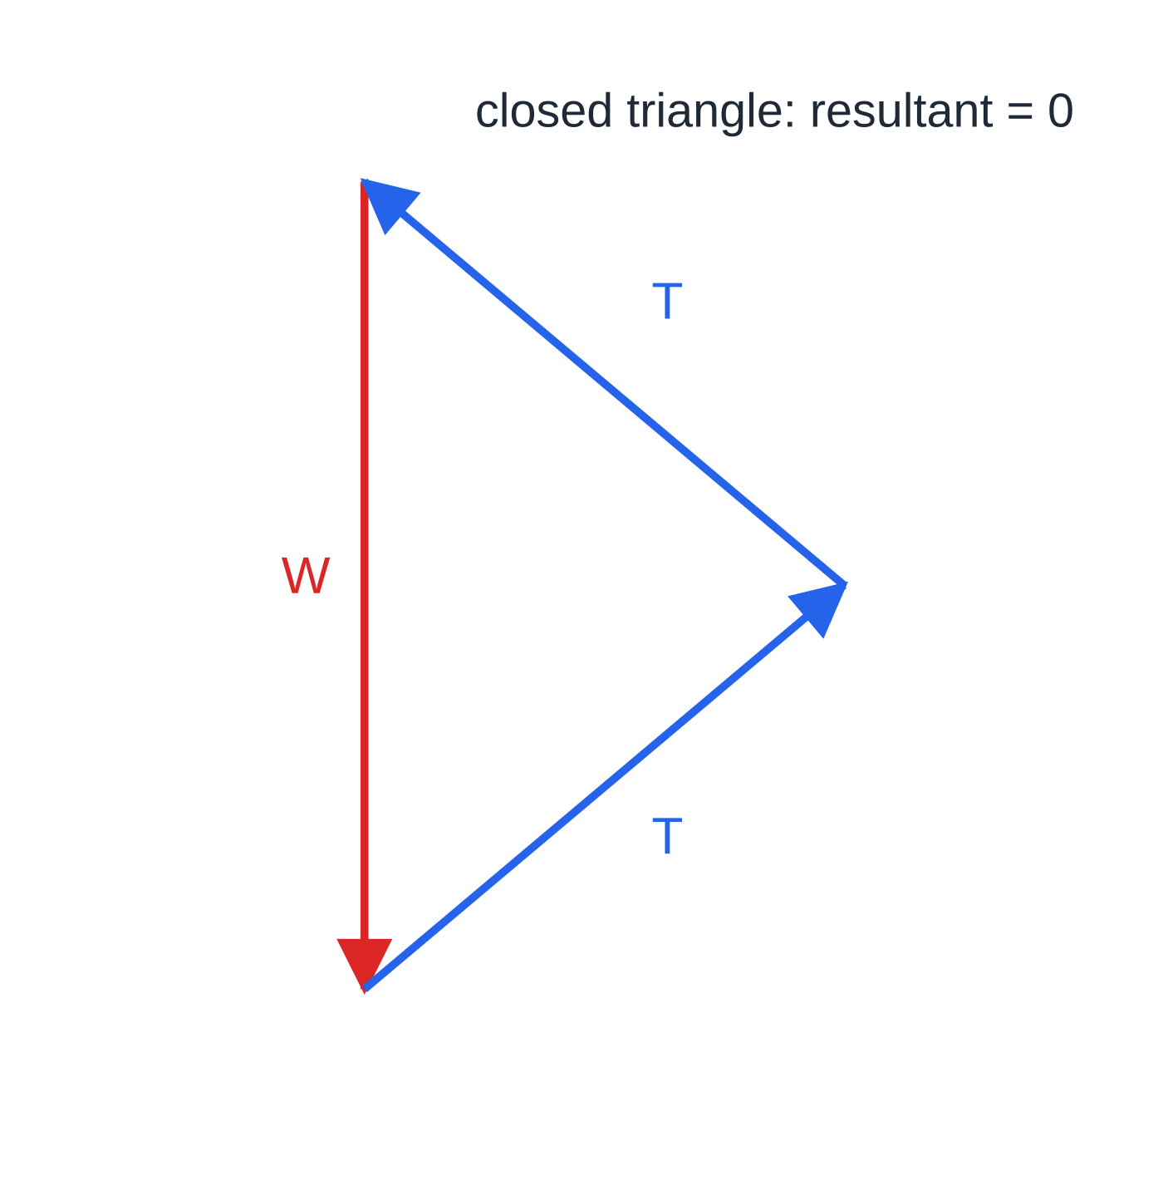
What does Newton's first law tell you? (continued)
Section 3 of 13
The same three forces drawn tip to tail close into a triangle: the end of the last arrow meets the start of the first, so the resultant force is zero and the sign is in equilibrium.
Notes:
What does Newton's first law tell you?. Full notes: https://examinerprep.com/notes/edexcel-ial-physics/forces-and-newtons-laws/

Slide 16
What does Newton's first law tell you? (continued)
Section 3 of 13 · Worked example 2 · Medium · Calculate
WORKED EXAMPLE · QUESTION
A café sign of mass 15.0 kg hangs at rest from two cables. Each cable makes an angle of 40° with the horizontal, and the arrangement is symmetrical. Calculate the tension in each cable.
SOLUTION
Step 1 The sign is in equilibrium. Horizontally, the two horizontal components (Tcos 40°) cancel, so the tensions are equal.
Step 2 Vertically, the upward components balance the weight: 2Tsin 40° = 15.0 ×9.81 = 147.2 N
Step 3 Rearrange: T = 147.2/2sin 40° = 114.5 N ≈ 114 N
Each tension is bigger than half the weight (73.6 N), because only its vertical component, 73.6 N, holds the sign up.
Notes:
What does Newton's first law tell you?: Worked example 2. Full notes: https://examinerprep.com/notes/edexcel-ial-physics/forces-and-newtons-laws/

Slide 17
What does Newton's first law tell you? (continued)
Section 3 of 13
Exam tip
The flatter the cables, the smaller sin θ and the larger the tension. A cable pulled perfectly horizontal could never support a weight — a useful check that your answer gets bigger as the angle gets smaller.
Notes:
What does Newton's first law tell you?. Full notes: https://examinerprep.com/notes/edexcel-ial-physics/forces-and-newtons-laws/

Slide 18
How do you resolve forces on a slope?
Section 4 of 13
On a slope, horizontal and vertical are the wrong axes. Resolve along the slope and perpendicular to it: the normal contact force and friction then each lie along one direction, and only the weight needs resolving. For a slope at angle θ to the horizontal, the weight mg has components
mgsin θ down the slope mgcos θ into the slope
The angle between the weight and the perpendicular to the slope is equal to θ, the slope angle.
Perpendicular to the slope there is no acceleration, so R = mgcos θ (when no other force has a component in that direction). A quick check on which component gets sin: if the slope were flat (θ= 0) there would be no pull down the slope, and sin 0 = 0.
Notes:
How do you resolve forces on a slope?. Full notes: https://examinerprep.com/notes/edexcel-ial-physics/forces-and-newtons-laws/

Slide 19
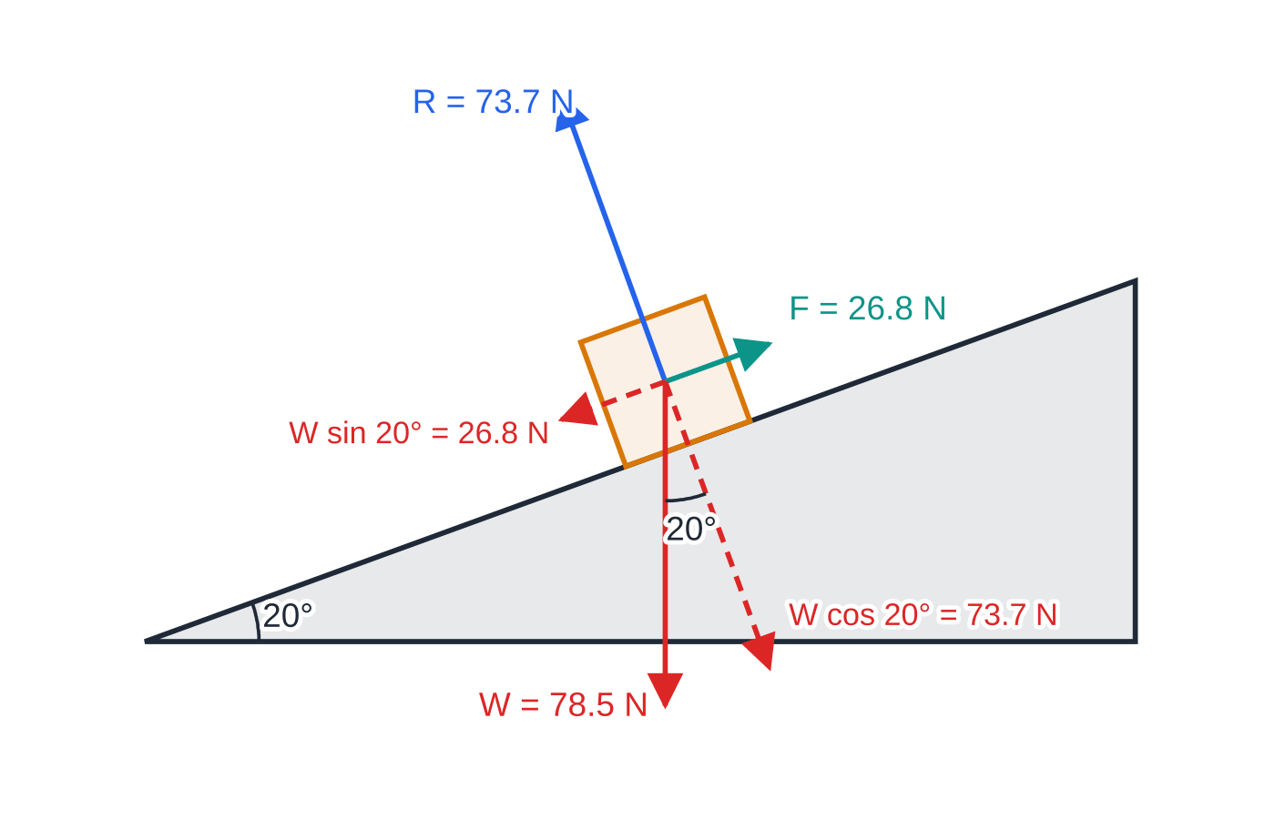
How do you resolve forces on a slope? (continued)
Section 4 of 13
Forces on an 8.00 kg crate at rest on a 20° ramp, roughly to scale. The dashed arrows are the components of the weight — they replace W, they are not extra forces.
Notes:
How do you resolve forces on a slope?. Full notes: https://examinerprep.com/notes/edexcel-ial-physics/forces-and-newtons-laws/

Slide 20
How do you resolve forces on a slope? (continued)
Section 4 of 13 · Worked example 3 · Medium · Calculate
WORKED EXAMPLE · QUESTION
A crate of mass 8.00 kg rests without sliding on a loading ramp inclined at 20° to the horizontal. Calculate (a) the frictional force on the crate and (b) the normal contact force on the crate.
SOLUTION
Step 1 Weight: W = 8.00 ×9.81 = 78.5 N
(a) Along the slope, friction balances the component of the weight down the slope: F = 78.5sin 20° = 26.8 N up the slope
(b) Perpendicular to the slope, R balances the other component: R = 78.5cos 20° = 73.7 N perpendicular to the slope
Check: √(26.8² + 73.7²) = 78.5 N — friction and the normal contact force together exactly cancel the weight.
Notes:
How do you resolve forces on a slope?: Worked example 3. Full notes: https://examinerprep.com/notes/edexcel-ial-physics/forces-and-newtons-laws/

Slide 21
How do you resolve forces on a slope? (continued)
Section 4 of 13
Common error
Writing R = mg for a body on a slope. The normal contact force balances only the component of the weight perpendicular to the slope, mgcos θ, which is always less than mg.
Notes:
How do you resolve forces on a slope?. Full notes: https://examinerprep.com/notes/edexcel-ial-physics/forces-and-newtons-laws/

Slide 22
How do you use Newton's second law?
Section 5 of 13
When the forces do not balance, the body accelerates — and the second law tells you by how much.
Newton's second law (constant mass)
ΣF = ma
ΣF = resultant (net) force (N) · m = mass (kg) · a = acceleration (m s⁻²). Supplied in the formulae list. The acceleration is in the direction of the resultant force. 1 N is the resultant force that gives a mass of 1 kg an acceleration of 1 m s⁻².
A reliable method
1. Draw the free-body diagram and choose the positive direction — the direction of the acceleration is usually best.
Notes:
How do you use Newton's second law?. Full notes: https://examinerprep.com/notes/edexcel-ial-physics/forces-and-newtons-laws/

Slide 23
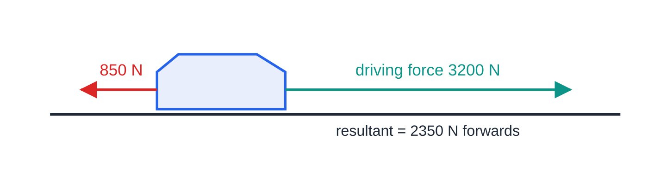
How do you use Newton's second law? (continued)
Section 5 of 13
2. Find the resultant force along that direction: forces that way count positive, forces the other way negative.
3. Write ΣF = ma and solve; then use the equations of motion if you need a speed, time or distance.
Horizontal forces on the electric car of worked example 4, to scale. The resultant is the difference, 3200 − 850 = 2350 N, not the driving force alone.
Notes:
How do you use Newton's second law?. Full notes: https://examinerprep.com/notes/edexcel-ial-physics/forces-and-newtons-laws/

Slide 24
How do you use Newton's second law? (continued)
Section 5 of 13 · Worked example 4 · Easy · Calculate
WORKED EXAMPLE · QUESTION
An electric car of mass 1450 kg has a forward driving force of 3200 N. At one instant, the total resistive force on it is 850 N. (a) Calculate the acceleration of the car. (b) State and explain the resistive force when the car reaches a steady top speed with the same driving force.
SOLUTION
(a) Resultant force, forwards positive: ΣF = 3200 - 850 = 2350 N. Then a = 2350 ÷1450 = 1.62 m s⁻² ≈ 1.6 m s⁻² forwards
(b) Steady speed means constant velocity, so the resultant force is zero (first law): resistive force = 3200 N, equal and opposite to the driving force.
Notes:
How do you use Newton's second law?: Worked example 4. Full notes: https://examinerprep.com/notes/edexcel-ial-physics/forces-and-newtons-laws/

Slide 25
How do you use Newton's second law? (continued)
Section 5 of 13 · Worked example 5 · Medium · Calculate
WORKED EXAMPLE · QUESTION
A child on a toboggan, total mass 42 kg, slides from rest down a straight snow slope at 18° to the horizontal. A constant frictional force of 60 N acts up the slope; air resistance is negligible. Calculate (a) the acceleration and (b) the speed after 4.0 s.
SOLUTION
Step 1 Component of the weight down the slope: 42 ×9.81 ×sin 18° = 127.3 N
(a) Resultant force down the slope, then ΣF = ma: a = (127.3 - 60)/42 = 1.60 m s⁻² ≈ 1.6 m s⁻² down the slope
(b) Constant force, so constant acceleration: v = u + at = 0 + 1.603 ×4.0 = 6.4 m s⁻¹
The normal contact force does not appear: it is perpendicular to the slope, so it has no component along the motion.
Notes:
How do you use Newton's second law?: Worked example 5. Full notes: https://examinerprep.com/notes/edexcel-ial-physics/forces-and-newtons-laws/

Slide 26
How do you use Newton's second law? (continued)
Section 5 of 13
Exam tip
ΣF means the resultant force. Substituting just the driving force, or just the weight component, into F = ma gives the wrong acceleration — write the subtraction out in full so that every force can be seen.
Notes:
How do you use Newton's second law?. Full notes: https://examinerprep.com/notes/edexcel-ial-physics/forces-and-newtons-laws/

Slide 27
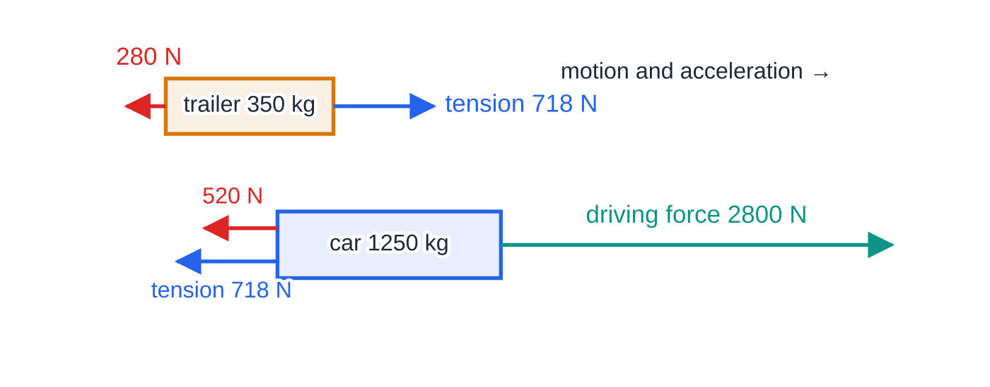
How do you analyse connected bodies and lifts?
Section 6 of 13
Connected bodies
Bodies joined by a taut rope or rigid tow bar have the same acceleration. Treat the whole system first: the tension is internal (it pulls the two bodies equally in opposite directions), so it cancels and ΣFₑₓₜₑᵣₙₐₗ = (total mass) ×a. Then take one body on its own to find the tension: its free-body diagram now includes the tension. Pick the body with fewer forces for the second step, and use the other one as a check.
Separate free-body diagrams (horizontal forces only) for a 1250 kg car towing a 350 kg trailer, to scale. The tow bar pulls the trailer forwards and the car backwards with the same 718 N.
Notes:
How do you analyse connected bodies and lifts?. Full notes: https://examinerprep.com/notes/edexcel-ial-physics/forces-and-newtons-laws/

Slide 28
How do you analyse connected bodies and lifts? (continued)
Section 6 of 13 · Worked example 6 · Hard · Calculate
WORKED EXAMPLE · QUESTION
A car of mass 1250 kg tows a trailer of mass 350 kg along a straight, level road. The driving force on the car is 2800 N. The resistive forces are 520 N on the car and 280 N on the trailer. Calculate (a) the acceleration and (b) the tension in the tow bar.
SOLUTION
(a) Whole system — the tension cancels: a = (2800 - 520 - 280)/(1250 + 350) = (2000/1600) = 1.25 m s⁻²
(b) Trailer alone — forward tension, backward resistance: T - 280 = 350 ×1.25, so T = 717.5 N ≈ 718 N
Check with the car alone: 2800 - 520 - 717.5 = 1562.5 N = 1250 ×1.25 ✓
Notes:
How do you analyse connected bodies and lifts?: Worked example 6. Full notes: https://examinerprep.com/notes/edexcel-ial-physics/forces-and-newtons-laws/

Slide 29
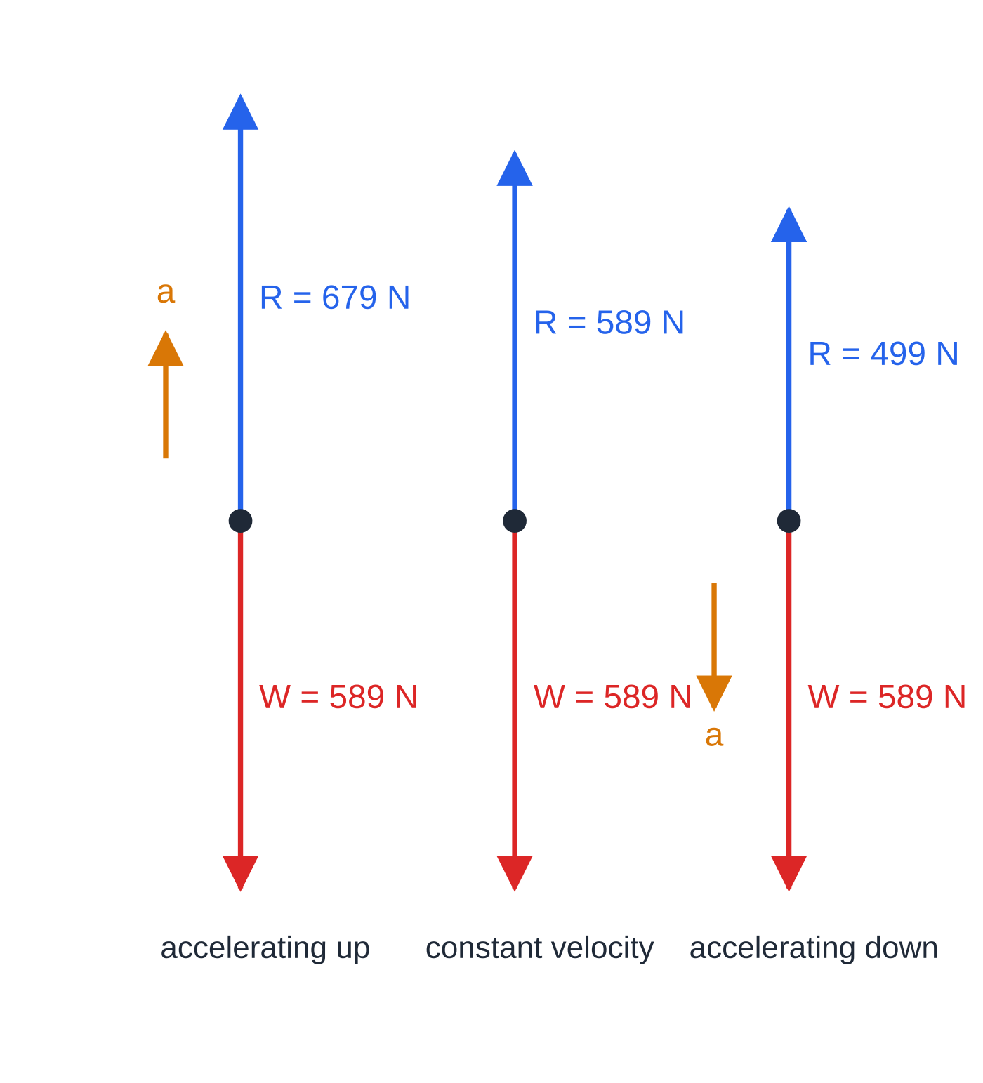
How do you analyse connected bodies and lifts? (continued)
Section 6 of 13
A person in a lift
Two forces act on the person: weight mg down and the normal contact force R from the floor (or scales) up. Scales read R, the apparent weight — what you feel through your feet. Taking upwards as positive, R - mg = ma, so R = m(g + a).
Accelerating upwards (speeding up going up, or slowing down going down): R > mg.
Constant velocity, in either direction: R = mg.
Accelerating downwards (speeding up going down, or slowing down going up): R < mg.
It is the direction of the acceleration, not of the velocity, that decides.
A 60.0 kg person on scales in a lift, to scale. The weight never changes; the normal contact force changes so that the resultant gives the acceleration (1.50 m s⁻², amber arrows).
Notes:
How do you analyse connected bodies and lifts?. Full notes: https://examinerprep.com/notes/edexcel-ial-physics/forces-and-newtons-laws/

Slide 30
How do you analyse connected bodies and lifts? (continued)
Section 6 of 13 · Worked example 7 · Medium · Calculate
WORKED EXAMPLE · QUESTION
A student of mass 60.0 kg stands on bathroom scales in a lift. The lift accelerates upwards at 1.50 m s⁻², then moves at constant velocity, then accelerates downwards at 1.50 m s⁻² as it slows to a stop on a higher floor. (a) Calculate the force the scales exert on the student in each stage. (b) The scales are marked in kilograms (they divide R by 9.81). Calculate their reading in the first stage.
SOLUTION
(a) R = m(g + a), upwards positive: 60.0 ×(9.81 + 1.50) = 679 N; 60.0 ×9.81 = 589 N; 60.0 ×(9.81 - 1.50) = 499 N. 679 N, 589 N, 499 N
(b) Reading = R ÷9.81 = 678.6 ÷9.81 = 69.2 kg. The student's mass is still 60.0 kg — the scales only measure the contact force.
Notes:
How do you analyse connected bodies and lifts?: Worked example 7. Full notes: https://examinerprep.com/notes/edexcel-ial-physics/forces-and-newtons-laws/

Slide 31
How do you analyse connected bodies and lifts? (continued)
Section 6 of 13
Common error
Using g + a whenever the lift is "going up". A lift slowing down on its way up is accelerating downwards, so R = m(g - a).
Notes:
How do you analyse connected bodies and lifts?. Full notes: https://examinerprep.com/notes/edexcel-ial-physics/forces-and-newtons-laws/

Slide 32
What is terminal velocity?
Section 7 of 13
Terminal velocity: the constant, maximum velocity of a body when the resistive forces on it balance the driving force (for a falling body, its weight).
The key fact is that drag (air resistance) increases with speed, while the weight stays the same. Follow a skydiver from the moment of jumping:
At release the speed is zero, so there is no drag: the resultant force is mg and the acceleration is g.
As the speed rises the drag rises, the resultant force mg - D falls, so the acceleration falls — the v–t graph gets less steep.
When D = mg the resultant force is zero, so the acceleration is zero (first law): the body falls at terminal velocity.
Opening a parachute greatly increases the drag at that speed: D > mg, the resultant force is upwards and the skydiver decelerates.
Notes:
What is terminal velocity?. Full notes: https://examinerprep.com/notes/edexcel-ial-physics/forces-and-newtons-laws/

Slide 33
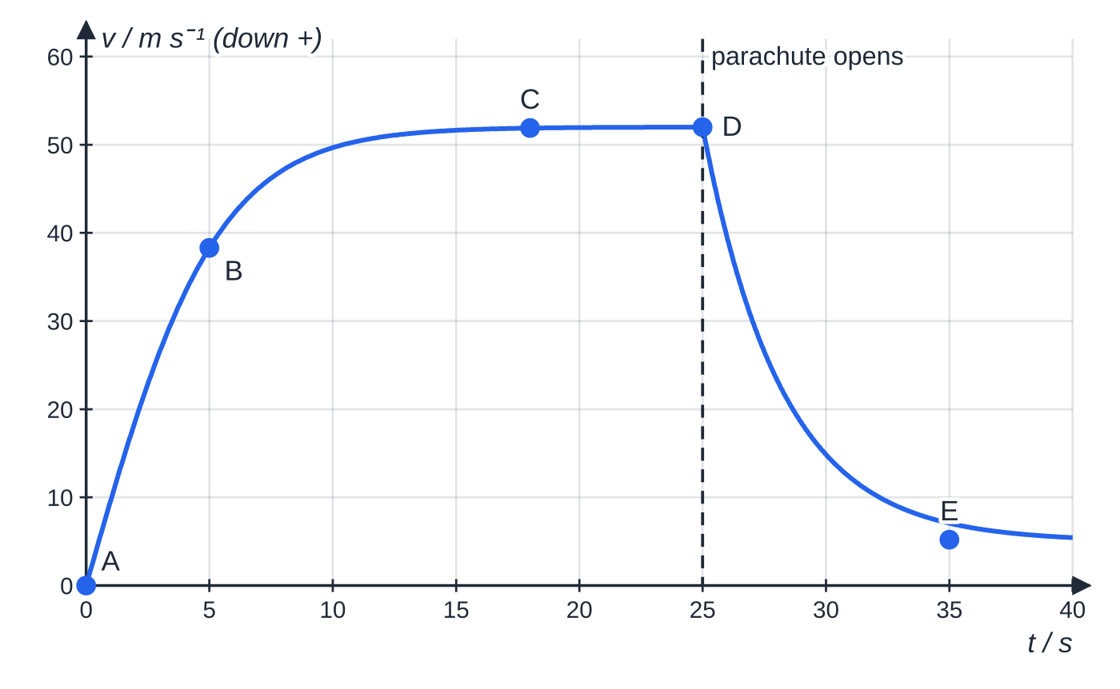
What is terminal velocity? (continued)
Section 7 of 13
As the speed falls the drag falls, until D = mg again at a new, lower terminal velocity.
The same idea applies horizontally: a vehicle reaches top speed when the resistive forces equal the driving force.
A model skydive (mass 80 kg, weight 785 N, downwards positive). The gradient falls from 9.81 m s⁻² at A to zero at the terminal velocity of 52 m s⁻¹ (C). After the parachute opens (D) the gradient is steeply negative, then the speed levels off at a new terminal velocity of 5 m s⁻¹ (E).
Notes:
What is terminal velocity?. Full notes: https://examinerprep.com/notes/edexcel-ial-physics/forces-and-newtons-laws/

Slide 34
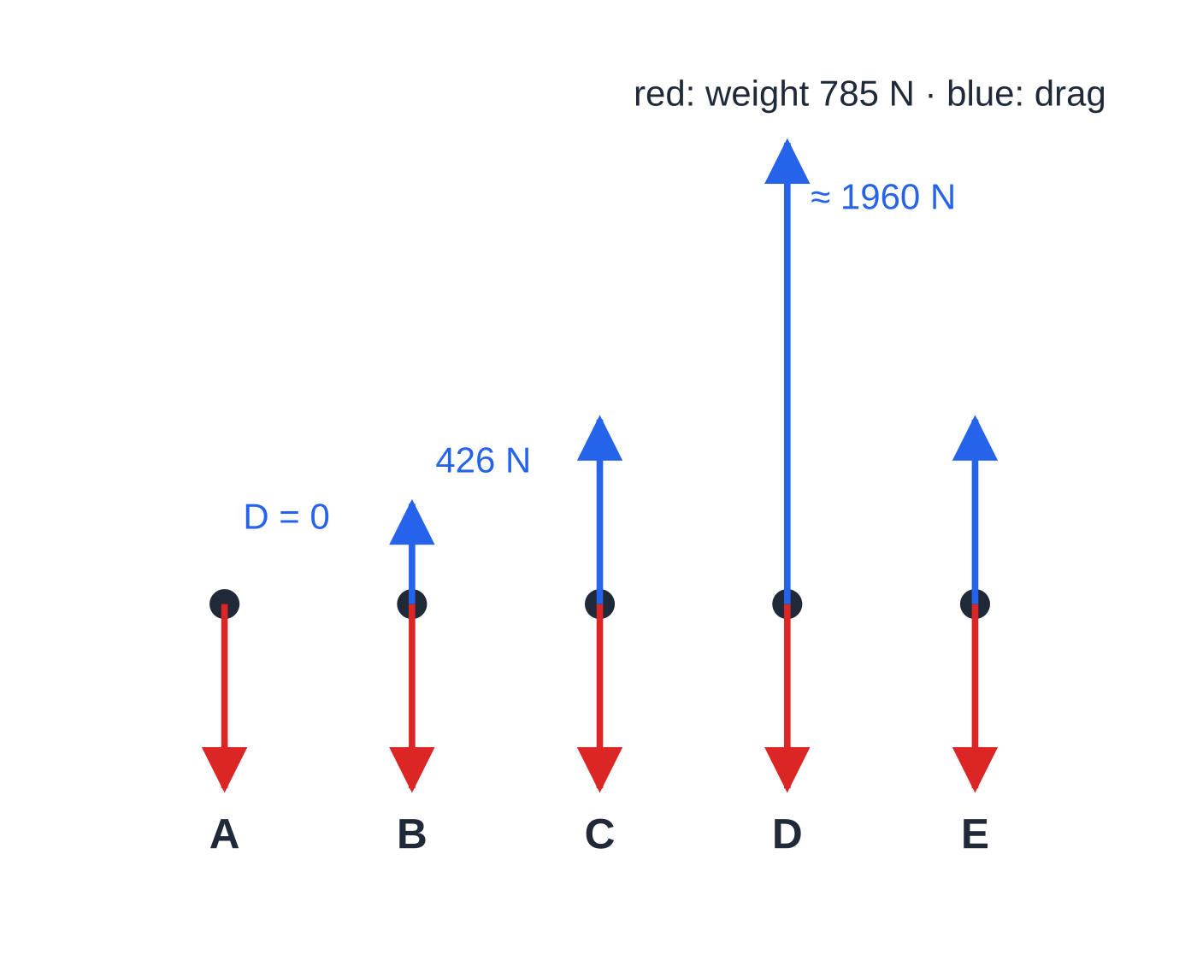
What is terminal velocity? (continued)
Section 7 of 13
Exam tip
An "explain" answer about terminal velocity needs the full chain: speed increases → drag increases → resultant force decreases → acceleration decreases → when drag = weight, resultant force = 0, so acceleration = 0 and velocity is constant. Each arrow is a separate idea; leaving one out leaves a gap.
Forces at the five labelled instants, to scale. At B the drag is 426 N, so a = (785 − 426) ÷ 80 = 4.5 m s⁻². At C and E drag equals weight. At D, just after the parachute opens, the drag is about 2.5 times the weight, giving a deceleration of about 1.5g.
Notes:
What is terminal velocity?. Full notes: https://examinerprep.com/notes/edexcel-ial-physics/forces-and-newtons-laws/

Slide 35
What does Newton's third law say?
Section 8 of 13
Newton's third law: when body A exerts a force on body B, body B exerts a force on body A that is equal in size and opposite in direction.
Forces always come in pairs, because a force is an interaction between two bodies. The two forces of a pair have four properties:
They act on different bodies — so they never cancel each other.
They are equal in magnitude and opposite in direction, along the same line.
They are the same type of force (both gravitational, both contact, both electrostatic…).
They act at the same time, for the same duration.
Notes:
What does Newton's third law say?. Full notes: https://examinerprep.com/notes/edexcel-ial-physics/forces-and-newtons-laws/

Slide 36
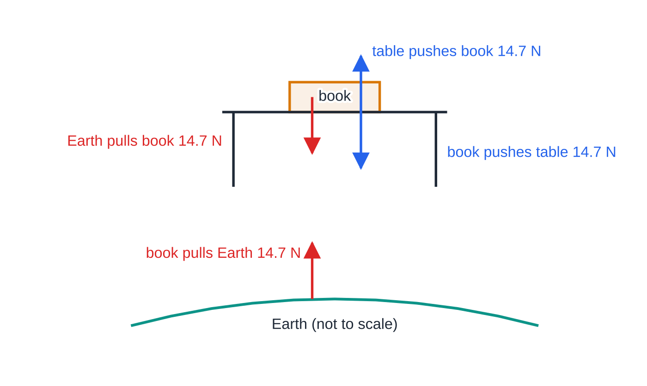
What does Newton's third law say? (continued)
Section 8 of 13
The third law explains how anything starts moving. Walking: your foot pushes backwards on the ground; the ground pushes forwards on you with an equal friction force — that is the force that accelerates you. A rocket engine pushes exhaust gas backwards; the gas pushes the rocket forwards. A swimmer's hands push water backwards; the water pushes the swimmer forwards.
A 1.5 kg book resting on a table: two third-law pairs, each of 14.7 N. Red: the gravitational pair (Earth ↔ book). Blue: the contact pair (table ↔ book). The book's weight and the table's push on the book are equal and opposite too — but they act on the same body, so they are not a third-law pair (they are equal because of the first law).
Notes:
What does Newton's third law say?. Full notes: https://examinerprep.com/notes/edexcel-ial-physics/forces-and-newtons-laws/

Slide 37
What does Newton's third law say? (continued)
Section 8 of 13
Common error
Naming the weight and the normal contact force on a resting body as a third-law pair. Test any pair with three questions: are they on different bodies? the same type? described by swapping the words "A on B" to "B on A"? All three must be yes.
Notes:
What does Newton's third law say?. Full notes: https://examinerprep.com/notes/edexcel-ial-physics/forces-and-newtons-laws/

Slide 38
Exam tips for 1.2
Section 9 of 13
Exam tip 1 — a diagram before an equation
Sketch a free-body diagram for every forces question, even when it is not asked for. A missing resistive force, a tension in the wrong direction or a force on the wrong body is easy to spot on a diagram and hard to spot in an equation.
Exam tip 2 — name forces precisely
When asked to label or identify forces, write who exerts the force on whom, or use the standard name: "normal contact force of the floor on the box", not "reaction"; "weight", not "gravity".
Exam tip 3 — choose sensible axes
On a slope, resolve along and perpendicular to the slope. For a hanging object, resolve horizontally and vertically. The right choice leaves only one force to resolve.
Notes:
Exam tips for 1.2. Full notes: https://examinerprep.com/notes/edexcel-ial-physics/forces-and-newtons-laws/

Slide 39
Exam tips for 1.2 (continued)
Section 9 of 13
Exam tip 4 — mass in kilograms, weight in newtons
ΣF = ma needs the mass. If a question gives a weight, divide by 9.81 first; if it gives grams, convert to kilograms.
Exam tip 5 — read the command word
State needs a short answer; calculate needs working and a unit; explain needs the physics reason linked step by step; draw a free-body diagram needs labelled arrows starting on the body.
Notes:
Exam tips for 1.2. Full notes: https://examinerprep.com/notes/edexcel-ial-physics/forces-and-newtons-laws/

Slide 40
Common misconceptions
Section 10 of 13
Misconception | Why it is wrong | Correct idea
A moving body needs a resultant force to keep moving. | The first law: with no resultant force, velocity stays constant. | A resultant force is needed to change the velocity.
Weight and the normal contact force are a third-law pair. | They act on the same body and are different types of force. | The pair of the weight is the pull of the body on the Earth.
Third-law forces cancel, so nothing can accelerate. | The two forces act on different bodies. | Only forces on the same body are added to find its resultant.
Mass and weight are the same thing. | Mass is a scalar in kg; weight is a force in N that depends on g. | W = mg; mass is the same on the Moon, weight is not.
At terminal velocity there are no forces on the skydiver. | The weight still acts. | The forces are balanced: drag = weight, resultant = 0.
Notes:
Common misconceptions. Full notes: https://examinerprep.com/notes/edexcel-ial-physics/forces-and-newtons-laws/

Slide 41
Common misconceptions (continued)
Section 10 of 13
Misconception | Why it is wrong | Correct idea
Opening a parachute makes the skydiver move upwards. | An upward resultant force gives an upward acceleration, which only slows the downward motion. | The skydiver still moves down, but slows down.
Notes:
Common misconceptions. Full notes: https://examinerprep.com/notes/edexcel-ial-physics/forces-and-newtons-laws/

Slide 42
How this topic connects
Section 11 of 13
1 Motion, vectors and projectiles
A constant resultant force gives the constant acceleration the equations of motion need, and resolving vectors is the tool for every slope and equilibrium problem here.
3 Momentum
Newton's second law can also be written as force = rate of change of momentum; together with the third law it leads to conservation of momentum in collisions.
4 Moments, Materials and Unit 4
Extended bodies in equilibrium also need balanced turning effects, using the centre of gravity met here. Drag and upthrust on a sphere in a fluid are calculated with Stokes' law in the Materials topic. In Unit 4, a body moving in a circle at constant speed needs a resultant force towards the centre — the second law again.
Notes:
How this topic connects. Full notes: https://examinerprep.com/notes/edexcel-ial-physics/forces-and-newtons-laws/

Slide 43
Key equations
Section 12 of 13
Equation | Use | In the formulae list?
ΣF = ma | resultant force and acceleration, constant mass | Yes
g = F/m | gravitational field strength | Yes
W = mg | weight from mass | Yes
mgsin θ, mgcos θ | components of weight along and perpendicular to a slope | No — derive it
R = m(g + a) | normal contact force in a lift, upwards positive | No — derive it from ΣF = ma
ΣFₓ = 0, ΣF_y = 0 | equilibrium (first law) | No — learn it
Notes:
Key equations. Full notes: https://examinerprep.com/notes/edexcel-ial-physics/forces-and-newtons-laws/

Slide 44
Check your understanding
Section 13 of 13
1. An astronaut has a mass of 72 kg. State her mass on the Moon and calculate her weight there (g = 1.62 N kg⁻¹).
2. A swimmer's hands push backwards on the water. State the Newton's third law partner of this force.
3. A 900 kg lift car accelerates downwards at 0.60 m s⁻². Calculate the tension in its cable.
4. Explain why a falling raindrop reaches a terminal velocity.
5. A 2.0 kg block slides down a smooth (frictionless) slope at 30° to the horizontal. Calculate its acceleration and the normal contact force on it.
Notes:
Check your understanding: questions. Full notes: https://examinerprep.com/notes/edexcel-ial-physics/forces-and-newtons-laws/

Slide 45
Check your understanding · answers
Section 13 of 13
1. Mass is unchanged: 72 kg. Weight = 72 ×1.62 = 116.6 N ≈ 117 N.
2. The water pushes forwards on the swimmer's hands, with a force of equal size — a contact force, acting on the swimmer.
3. Upwards positive: T - 900 ×9.81 = 900 ×(-0.60), so T = 900 ×9.21 = 8.29 × 10³ N.
4. As its speed increases, the air resistance on it increases while its weight stays constant, so the resultant force and the acceleration decrease. When the air resistance equals the weight the resultant force is zero, so the acceleration is zero and the velocity stays constant.
5. a = gsin 30° = 4.9 m s⁻² down the slope (the mass cancels). R = 2.0 ×9.81 ×cos 30° = 17 N.
Notes:
Check your understanding: answers. Full notes: https://examinerprep.com/notes/edexcel-ial-physics/forces-and-newtons-laws/

Slide 46
Practice questions
5 original exam-style questions. Answers at the end of the deck.

Slide 47
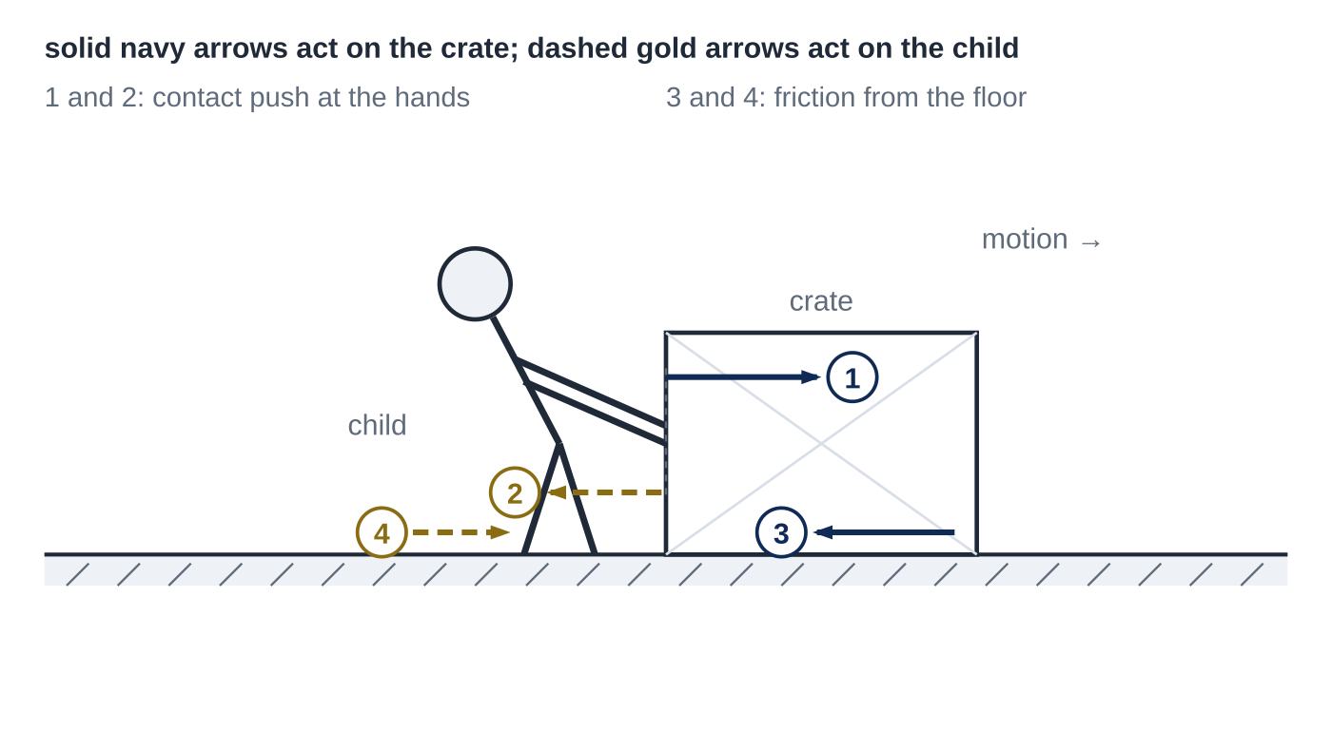
Question 1
1 mark
The figure shows a child pushing a heavy crate across a floor at constant velocity. Arrows 1 to 4 show four of the horizontal forces. The solid navy arrows act on the crate and the dashed gold arrows act on the child.
Which two forces form a Newton's third law pair?
A 1 and 3
B 1 and 4
C 1 and 2
D 2 and 4
Notes:
Online with the full mark scheme: https://examinerprep.com/ial-physics-1-2-forces-and-newtons-laws-questions#IALP-U1-2-FA-02

Slide 48
Question 2
1 mark
A climbing helmet rests on a shelf. Its weight is the gravitational pull of the Earth on the helmet.
Which force forms a Newton's third law pair with the weight of the helmet?
A the normal contact force of the shelf on the helmet
B the contact force of the helmet on the shelf
C the gravitational pull of the Earth on the shelf
D the gravitational pull of the helmet on the Earth
Notes:
Online with the full mark scheme: https://examinerprep.com/ial-physics-1-2-forces-and-newtons-laws-questions#IALP-U1-2-A-02

Slide 49
Question 3
1 mark
A sycamore seed spins as it falls and quickly reaches terminal velocity.
Which statement about the seed at terminal velocity is correct?
A The air resistance is greater than the weight.
B The acceleration is equal to g.
C No forces act on the seed.
D The air resistance is equal to the weight.
Notes:
Online with the full mark scheme: https://examinerprep.com/ial-physics-1-2-forces-and-newtons-laws-questions#IALP-U1-2-A-07

Slide 50
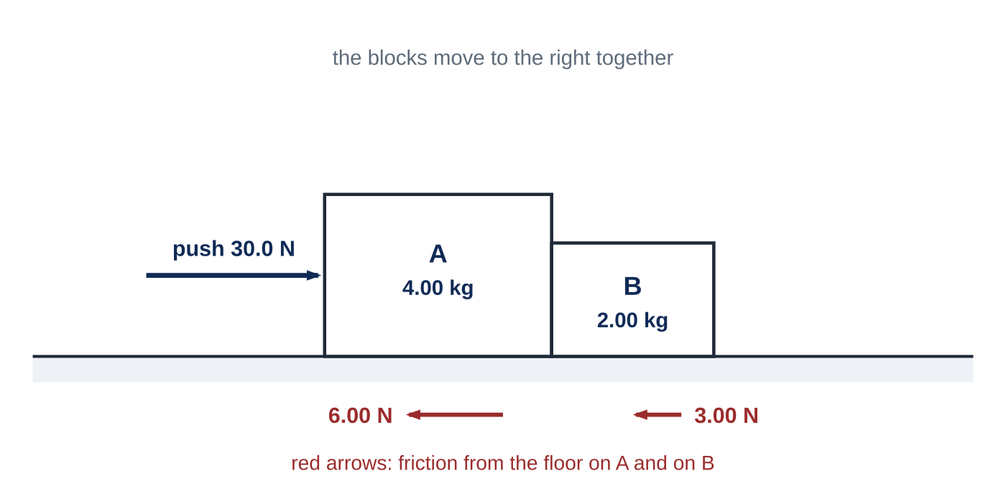
Question 4
8 marks
Two blocks, A and B, are pushed along a rough horizontal floor by a horizontal force applied to A (Figure 1). The blocks stay in contact. The frictional forces on the blocks are constant.
(a) Calculate the acceleration of the blocks. [2]
(b) Calculate the contact force between A and B. [2]
(c) Describe the force that forms a Newton's third law pair with the contact force of A on B. [2]
(d) The 30.0 N push is now applied to B instead, so that the blocks move to the left. The frictional forces keep the same sizes. Calculate the new contact force between the blocks. [2]
Notes:
Online with the full mark scheme: https://examinerprep.com/ial-physics-1-2-forces-and-newtons-laws-questions#IALP-U1-2-FB-10

Slide 51
Question 5
4 marks
A geologist on the Moon collects a rock sample of mass 3.6 kg. g at the Earth's surface = 9.81 N kg⁻¹.
(a) State one difference between mass and weight. [1]
(b) Calculate the weight of the sample on the Earth. [1]
(c) On the Moon, a newton-meter shows that the weight of the sample is 5.8 N. Calculate the gravitational field strength at the surface of the Moon. [2]
Notes:
Online with the full mark scheme: https://examinerprep.com/ial-physics-1-2-forces-and-newtons-laws-questions#IALP-U1-2-B-01

Slide 52
Answers

Slide 53
Question 1 · answer
Answer C
A third-law pair acts on two different bodies, is the same type of force, and has equal size and opposite direction. Force 1 (child pushes crate) and force 2 (crate pushes child) are both contact forces at the hands, act on different bodies and point in opposite directions: 1 and 2.
Notes:
Full mark scheme: https://examinerprep.com/ial-physics-1-2-forces-and-newtons-laws-questions#IALP-U1-2-FA-02

Slide 54
Question 2 · answer
Answer D
A third-law pair involves the same two bodies and the same type of force, with the bodies swapped. The weight is a gravitational pull of the Earth on the helmet, so its partner is the gravitational pull of the helmet on the Earth.
Notes:
Full mark scheme: https://examinerprep.com/ial-physics-1-2-forces-and-newtons-laws-questions#IALP-U1-2-A-02

Slide 55
Question 3 · answer
Answer D
At terminal velocity the velocity is constant, so the resultant force is zero: the air resistance equals the weight.
Notes:
Full mark scheme: https://examinerprep.com/ial-physics-1-2-forces-and-newtons-laws-questions#IALP-U1-2-A-07

Slide 56
Question 4 · answer
Mark scheme
resultant force = 30.0 − 6.00 − 3.00 = 21.0 N
a = 21.0 ÷ 6.00 = 3.50 m s⁻²
for B: C − 3.00 = 2.00 × 3.50
C = 10.0 N
the contact force of B on A, 10.0 N
acting on A, to the left (opposite direction), and the same type of force (contact)
the resultant force and so the acceleration are unchanged, 3.50 m s⁻²
B now pushes A: C′ − 6.00 = 4.00 × 3.50, so C′ = 20.0 N
Notes:
Full mark scheme: https://examinerprep.com/ial-physics-1-2-forces-and-newtons-laws-questions#IALP-U1-2-FB-10

Slide 57
Question 5 · answer
Mark scheme
mass is the amount of matter / a scalar in kg and is the same everywhere, whereas weight is the gravitational force on the body, a vector in N, which depends on g
3.6 × 9.81 = 35 N (35.3 N)
g = F ÷ m = 5.8 ÷ 3.6
= 1.6 N kg⁻¹ (1.61)
Notes:
Full mark scheme: https://examinerprep.com/ial-physics-1-2-forces-and-newtons-laws-questions#IALP-U1-2-B-01

Slide 58
Keep practising
Notes for this topic
Questions on this topic
Build a printable test
ExaminerPrep is an independent tutoring service. It has been developed independently from and is not endorsed by the International Baccalaureate Organization. "International Baccalaureate", "IB" and "IB Diploma Programme" are registered trademarks of the IBO, used here for descriptive purposes only.
Pearson Edexcel and Cambridge are trademarks of their owners; ExaminerPrep is not affiliated with any exam board.

