Slide 1
EP
EDEXCEL IAL PHYSICS
5.7 Gravitational fields and orbits
The full notes page in 11 sections · practice questions with answers · simulations
ExaminerPrep is an independent tutoring service. It has been developed independently from and is not endorsed by the International Baccalaureate Organization. "International Baccalaureate", "IB" and "IB Diploma Programme" are registered trademarks of the IBO, used here for descriptive purposes only.
Pearson Edexcel and Cambridge are trademarks of their owners; ExaminerPrep is not affiliated with any exam board.
Notes:
5.7 Gravitational fields and orbits. Notes for this topic: https://examinerprep.com/notes/edexcel-ial-physics/gravitational-fields-and-orbits/

Slide 2
What this page covers
Overview
What a gravitational field is, and gravitational field strength g=F/m
Newton's law of gravitation, F=Gm₁m₂/r², and the inverse square law
Deriving and using g=Gm/r² for a radial field
Gravitational potential V_grav=-Gm/r, equipotentials, and the work done moving a mass between two points
Similarities and differences between gravitational and electric fields
Circular orbits: orbital speed, period, geostationary satellites and the derivation of T²∝r³
Notes:
What this page covers. Full notes: https://examinerprep.com/notes/edexcel-ial-physics/gravitational-fields-and-orbits/

Slide 3
In one minute
Key points
1
A gravitational field is a region where a mass experiences a force, and its strength g=F/m is the force per unit mass, in N kg⁻¹.
4
Potential V_grav=-GM/r is zero at infinity and negative everywhere else. The work to move a mass m is mΔV; no work is done along an equipotential.
2
Two point masses attract with F=Gm₁m₂/r², where r is the distance between their centres: double r and the force falls to one quarter.
5
Gravity and the electric force are both inverse square laws; gravity only attracts and is far weaker between particles.
3
Around a planet of mass M, g=GM/r² (a radial field); close to the surface the field is almost uniform.
6
In a circular orbit gravity provides the centripetal force: GMm/r²=mv²/r, so v=√(GM/r) and T²=(4π²/GM) r³.
Notes:
In one minute: the key points of this topic.

Slide 4
What is a gravitational field?
Section 1 of 11
This whole topic grows from one force law. Before meeting it, we need a way to describe what a mass does to the space around it.
A gravitational field is a region of space in which a mass experiences a force. The gravitational field strength at a point is the force per unit mass, g=F/m, where F is the gravitational force (N) on a mass m (kg). The unit is N kg⁻¹. This equation is in the formulae list.
Field strength is a vector: its direction is the direction of the force on a mass. 1 N kg⁻¹ is the same as 1 m s⁻², so g is also the acceleration of a freely falling object.
The field is drawn with field lines. The arrow shows the direction of the force on a mass; the closer the lines, the stronger the field.
Around a spherical planet the field is radial: the lines point in towards the centre and spread out with distance, so the field weakens.
Notes:
What is a gravitational field?. Full notes: https://examinerprep.com/notes/edexcel-ial-physics/gravitational-fields-and-orbits/

Slide 5
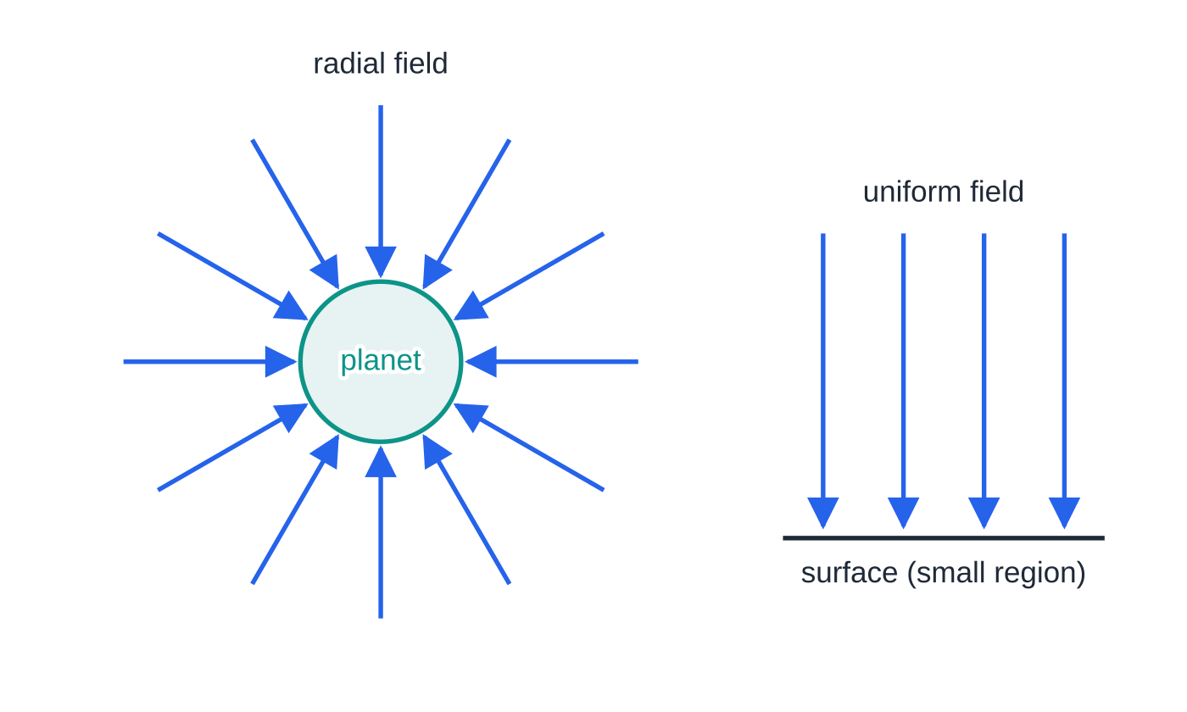
What is a gravitational field? (continued)
Section 1 of 11
Over a region that is small compared with the planet, the lines are almost parallel and equally spaced: the field is uniform. That is why g=9.81 N kg⁻¹ can be used everywhere in a laboratory.
g=F/m defines the field at a point whatever is producing it; the test mass must be small enough not to disturb that field.
Left: 12 field lines at equal angles around a spherical planet. Their spacing grows in proportion to the distance from the centre, so the density of lines, and the field strength, falls with distance. Right: a small region at the surface, where the lines are parallel and equally spaced and the field is uniform.
Notes:
What is a gravitational field?. Full notes: https://examinerprep.com/notes/edexcel-ial-physics/gravitational-fields-and-orbits/

Slide 6
What is a gravitational field? (continued)
Section 1 of 11 · Worked example 1 · Easy · Calculate
WORKED EXAMPLE · QUESTION
A lander of mass 420 kg rests on the surface of Titan, Saturn's largest moon. The gravitational force on it is 567 N. (a) Calculate the gravitational field strength at Titan's surface. (b) An astronaut with a spacesuit has a total mass of 115 kg. Calculate the gravitational force on the astronaut on Titan, and compare it with the force on Earth (g=9.81 N kg⁻¹).
SOLUTION
(a) g=F/m=567÷420= 1.35 N kg⁻¹
(b) Same field, different mass: F=mg=115×1.35= 155 N. On Earth, 115×9.81=1130 N, so the force on Titan is about 0.14 of the Earth value.
Notes:
What is a gravitational field?: Worked example 1. Full notes: https://examinerprep.com/notes/edexcel-ial-physics/gravitational-fields-and-orbits/

Slide 7
What is Newton's law of gravitation?
Section 2 of 11
Newton's insight was that the force that makes an apple fall also holds the Moon in orbit, and that it weakens with distance in a precise way.
F=Gm₁m₂/r²
F is the force each mass exerts on the other (N), m₁ and m₂ are the two masses (kg), r is the distance between their centres (m) and G is the gravitational constant, 6.67×10⁻¹¹ N m² kg⁻². The law is in the formulae list. It is valid for point masses, and for uniform spheres if r is measured between their centres. The force is always attractive.
The force is proportional to each mass and to 1/r²: an inverse square law. Doubling r divides the force by 4; tripling it divides it by 9.
The forces on the two masses form a Newton's third law pair: equal in size and opposite in direction, even if one is a planet and the other a pebble.
Notes:
What is Newton's law of gravitation?. Full notes: https://examinerprep.com/notes/edexcel-ial-physics/gravitational-fields-and-orbits/

Slide 8
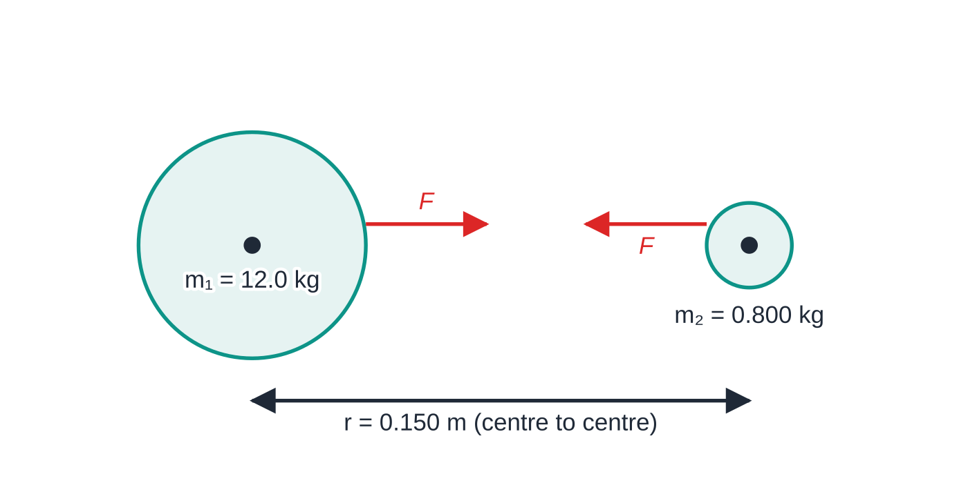
What is Newton's law of gravitation? (continued)
Section 2 of 11
The pebble accelerates far more because its mass is so much smaller.
A uniform sphere attracts as if all its mass were at its centre. So for a satellite, r = radius of the planet + height above the surface.
G is tiny, so gravitational forces between everyday objects are minute; gravity only becomes important when at least one mass is astronomical.
Two uniform spheres (Worked example 2). Each pulls the other with a force of the same size F, towards its centre: a Newton's third law pair. The distance r is always measured between centres.
Notes:
What is Newton's law of gravitation?. Full notes: https://examinerprep.com/notes/edexcel-ial-physics/gravitational-fields-and-orbits/

Slide 9
What is Newton's law of gravitation? (continued)
Section 2 of 11 · Worked example 2 · Medium · Calculate, compare
WORKED EXAMPLE · QUESTION
In a laboratory, a lead sphere of mass 12.0 kg and a small lead sphere of mass 0.800 kg are placed with their centres 0.150 m apart. (a) Calculate the gravitational force between them. (b) Compare it with the weight of the small sphere. (c) Calculate the gravitational field strength due to the large sphere at the centre of the small one.
SOLUTION
(a) F=(6.67×10⁻¹¹×12.0×0.800)/0.150²= 2.85 × 10⁻⁸ N
(b) W=0.800×9.81=7.85 N, so F/W= 3.6 × 10⁻⁹, far too small to notice without very sensitive apparatus.
(c) g=F/m=2.85×10⁻⁸÷0.800= 3.56 × 10⁻⁸ N kg⁻¹ (the same as GM/r²).
Notes:
What is Newton's law of gravitation?: Worked example 2. Full notes: https://examinerprep.com/notes/edexcel-ial-physics/gravitational-fields-and-orbits/

Slide 10
How does g change with distance from a planet?
Section 3 of 11
Place a small test mass m at distance r from the centre of a planet of mass M. By Newton's law the force on it is F=GMm/r². By definition g=F/m, so the test mass cancels:
g=F/m=(GMm/r²)/m ⇒ g=Gm/r²
(In the formulae list the producing mass is written m; here it is M to keep it apart from the test mass.) The equation is in the formulae list, and you must also be able to derive it in two lines, as above. It applies outside a spherical mass (r ≥ its radius), and the field points towards the centre.
g does not depend on the mass placed in the field: a feather and a hammer fall with the same acceleration in a vacuum.
Outside the planet, g∝1/r². The graph is a steep curve that never reaches zero.
Rearranged, M=gr²/G: measuring g at the surface and knowing the radius gives the planet's mass. For the Earth, 9.81×(6.37×10⁶)²÷6.67×10⁻¹¹=5.97×10²⁴ kg.
Notes:
How does g change with distance from a planet?. Full notes: https://examinerprep.com/notes/edexcel-ial-physics/gravitational-fields-and-orbits/

Slide 11
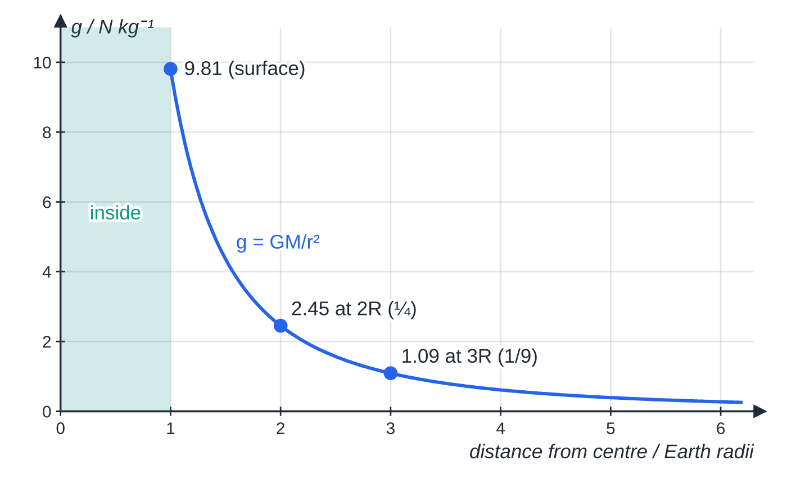
How does g change with distance from a planet? (continued)
Section 3 of 11
Field strength of the Earth (M = 5.97 × 10²⁴ kg, R = 6.37 × 10⁶ m) from g = GM/r². It is 9.81 N kg⁻¹ at the surface, 2.45 N kg⁻¹ at 2R (one quarter) and 1.09 N kg⁻¹ at 3R (one ninth). The formula does not apply inside the planet (shaded).
Notes:
How does g change with distance from a planet?. Full notes: https://examinerprep.com/notes/edexcel-ial-physics/gravitational-fields-and-orbits/

Slide 12
How does g change with distance from a planet? (continued)
Section 3 of 11 · Worked example 3 · Medium · Calculate, explain
WORKED EXAMPLE · QUESTION
A space station orbits 420 km above the Earth's surface. The Earth has mass 5.97 × 10²⁴ kg and radius 6.37 × 10⁶ m. (a) Calculate the gravitational field strength at the station. (b) Express it as a percentage of the surface value, and explain why astronauts inside still seem weightless.
SOLUTION
(a) Distance from the centre, not from the surface: r=6.37×10⁶+0.42×10⁶=6.79×10⁶ m. Then g=(6.67×10⁻¹¹×5.97×10²⁴)/((6.79×10⁶)²)= 8.64 N kg⁻¹
(b) 8.64÷9.81= 88% of the surface value. Gravity is still strong; the astronauts and the station are both in free fall with acceleration g, so nothing presses them against the floor.
Notes:
How does g change with distance from a planet?: Worked example 3. Full notes: https://examinerprep.com/notes/edexcel-ial-physics/gravitational-fields-and-orbits/

Slide 13
How does g change with distance from a planet? (continued)
Section 3 of 11
Common error — height instead of radius
Using the height above the surface as r. With r=4.2×10⁵ m the answer would be over 2000 N kg⁻¹, a sign that something is wrong. Always add the planet's radius.
Notes:
How does g change with distance from a planet?. Full notes: https://examinerprep.com/notes/edexcel-ial-physics/gravitational-fields-and-orbits/

Slide 14
What is gravitational potential?
Section 4 of 11
Field strength tells you the force. Potential tells you about energy: how much work it takes to move a mass around in the field.
The gravitational potential at a point is the work done per unit mass in bringing a small mass from infinity to that point. In a radial field V_grav=-Gm/r, in J kg⁻¹, where m is the mass producing the field and r the distance from its centre. This is in the formulae list. Potential is a scalar; it is zero at infinity and negative at every finite distance.
Why negative? Zero is defined at infinity. Gravity attracts, so a mass moving in from infinity has work done on it by the field, and the work done by an external agent is negative. Every point near a planet is therefore at a potential below zero.
As r increases, V increases (becomes less negative) towards zero. Moving away from a planet means moving to a higher potential.
Notes:
What is gravitational potential?. Full notes: https://examinerprep.com/notes/edexcel-ial-physics/gravitational-fields-and-orbits/

Slide 15
What is gravitational potential? (continued)
Section 4 of 11
Work done moving a mass m between two points: W=mΔV=m(V_final-Vᵢₙᵢₜᵢₐₗ). This is the change in gravitational potential energy, and it depends only on the start and end points, not on the path.
Near the surface, where g is almost constant, mΔV reduces to the familiar mgΔh. Over large distances you must use mΔV, because g falls with height.
The field strength is the potential gradient: g=-ΔV/Δr. The tangent to a V–r graph gives the size of g; the minus sign means the field points towards decreasing potential.
Notes:
What is gravitational potential?. Full notes: https://examinerprep.com/notes/edexcel-ial-physics/gravitational-fields-and-orbits/

Slide 16
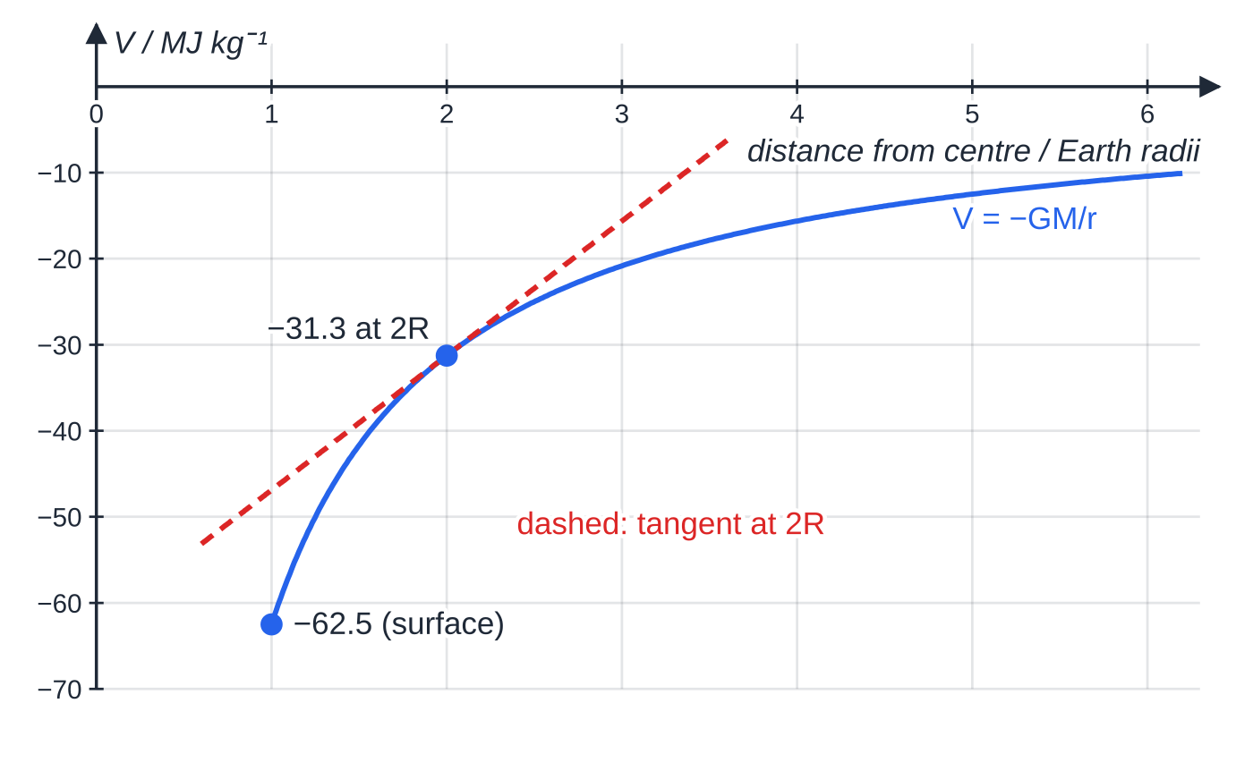
What is gravitational potential? (continued)
Section 4 of 11
Equipotentials
An equipotential is a surface on which every point has the same potential. Around a spherical planet they are concentric spheres (circles in a diagram).
ΔV=0 along an equipotential, so no work is done moving a mass along it. A satellite in a circular orbit stays on one equipotential.
Field lines always cross equipotentials at right angles.
Potential around the Earth from V = −GM/r: −62.5 MJ kg⁻¹ at the surface and −31.3 MJ kg⁻¹ at 2R. The tangent at 2R has gradient 2.45 J kg⁻¹ m⁻¹, the same as GM/(2R)², the field strength found in the previous section.
Notes:
What is gravitational potential?. Full notes: https://examinerprep.com/notes/edexcel-ial-physics/gravitational-fields-and-orbits/

Slide 17
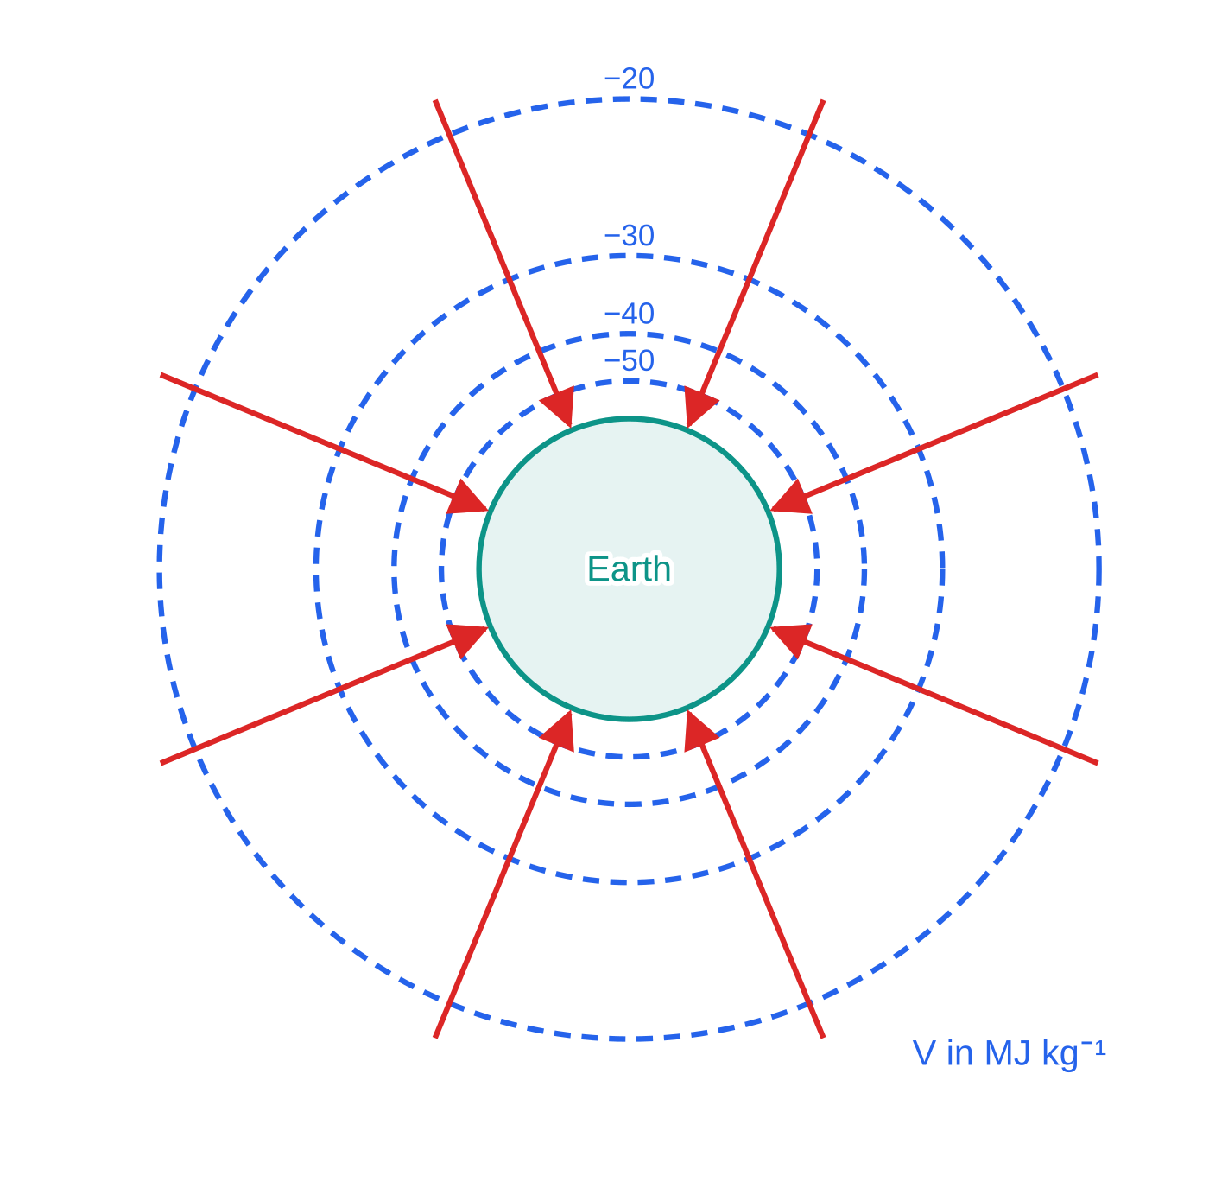
What is gravitational potential? (continued)
Section 4 of 11
Drawn at equal steps of potential, equipotentials get further apart with distance, because the field (the potential gradient) gets weaker. In a uniform field they are equally spaced, parallel planes.
The Earth and equipotentials at equal steps of 10 MJ kg⁻¹ (−50 to −20 MJ kg⁻¹), drawn to scale with r = GM/|V|. Their spacing grows from 1.99 × 10⁶ m (−50 to −40) to 6.64 × 10⁶ m (−30 to −20). Field lines (red) cross every equipotential at right angles.
Notes:
What is gravitational potential?. Full notes: https://examinerprep.com/notes/edexcel-ial-physics/gravitational-fields-and-orbits/

Slide 18
What is gravitational potential? (continued)
Section 4 of 11 · Worked example 4 · Hard · Calculate, explain
WORKED EXAMPLE · QUESTION
Mars has mass 6.42 × 10²³ kg and radius 3.39 × 10⁶ m. A probe of mass 250 kg is lifted from the surface to a point 3.39 × 10⁶ m above the surface. (a) Calculate the gravitational potential at the surface and at the final position. (b) Calculate the minimum work done on the probe. (c) Explain why using W=mgΔh with the surface value of g gives too large an answer.
SOLUTION
(a) The final point is at r=2R. V_surface=-(6.67×10⁻¹¹×6.42×10²³)/(3.39×10⁶)= −1.263 × 10⁷ J kg⁻¹; V_2R=-1.263×10⁷÷2= −6.32 × 10⁶ J kg⁻¹
(b) W=mΔV=250×(-6.32×10⁶-(-1.263×10⁷))=250×6.32×10⁶= 1.58 × 10⁹ J
(c) g_surface=GM/R²=3.73 N kg⁻¹, so mgΔh=250×3.73×3.39×10⁶=3.16×10⁹ J, twice the true value, because g falls to one quarter of its surface value at 2R. Over large heights, use potential.
Taking the probe all the way to infinity (V=0) needs 250×1.263×10⁷=3.16×10⁹ J.
Notes:
What is gravitational potential?: Worked example 4. Full notes: https://examinerprep.com/notes/edexcel-ial-physics/gravitational-fields-and-orbits/

Slide 19
What is gravitational potential? (continued)
Section 4 of 11 · Worked example 4 · Hard · Calculate, explain (continued)
A probe launched from the surface with at least this much kinetic energy would never fall back: the idea of escape from a planet.
Notes:
What is gravitational potential?: Worked example 4. Full notes: https://examinerprep.com/notes/edexcel-ial-physics/gravitational-fields-and-orbits/

Slide 20
What is gravitational potential? (continued)
Section 4 of 11
Exam tip — signs on potential differences
Write both potentials with their signs, then subtract: ΔV=V_final-Vᵢₙᵢₜᵢₐₗ. Moving away from a planet always gives a positive ΔV and positive work done on the mass; if your answer is negative, check the order of subtraction.
Notes:
What is gravitational potential?. Full notes: https://examinerprep.com/notes/edexcel-ial-physics/gravitational-fields-and-orbits/

Slide 21
How do gravitational and electric fields compare?
Section 5 of 11
The field of a point mass and the field of a point charge have the same mathematical shape. Learn the pairs side by side:
Feature | Gravitational field (point mass m) | Electric field (point charge Q)
Acts on | mass | charge
Field strength defined as | g=F/m (N kg⁻¹) | E=F/Q (N C⁻¹)
Force law | F=Gm₁m₂/r² | F=Q₁Q₂/4πε₀r²
Radial field strength | g=Gm/r² | E=Q/4πε₀r²
Potential | V=-Gm/r | V=Q/4πε₀r
Dependence on distance | inverse square (force, field); 1/r (potential) | inverse square (force, field); 1/r (potential)
Attract or repel? | always attracts (mass is never negative) | like charges repel, unlike charges attract
Sign of potential | always negative | positive near +Q, negative near -Q
Notes:
How do gravitational and electric fields compare?. Full notes: https://examinerprep.com/notes/edexcel-ial-physics/gravitational-fields-and-orbits/

Slide 22
How do gravitational and electric fields compare? (continued)
Section 5 of 11
Feature | Gravitational field (point mass m) | Electric field (point charge Q)
Strength | very weak (G=6.67×10⁻¹¹ N m² kg⁻²) | very strong (k=8.99×10⁹ N m² C⁻²)
Can it be shielded or cancelled? | no, there is no negative mass | yes, positive and negative charges cancel
Notes:
How do gravitational and electric fields compare?. Full notes: https://examinerprep.com/notes/edexcel-ial-physics/gravitational-fields-and-orbits/

Slide 23
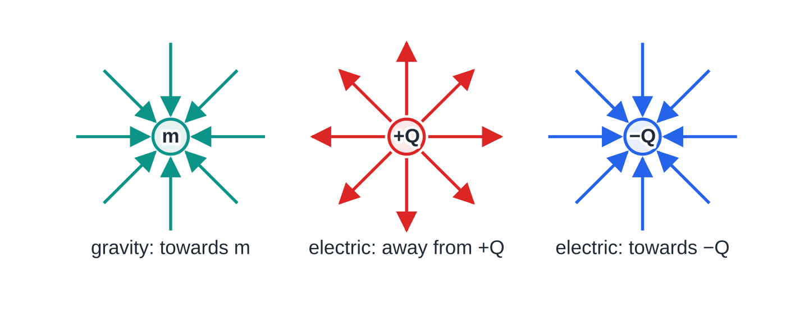
How do gravitational and electric fields compare? (continued)
Section 5 of 11
Between individual particles the electric force is overwhelmingly stronger. Yet gravity dominates on the scale of planets and galaxies, because large bodies are almost exactly electrically neutral (their positive and negative charges cancel) while every bit of mass adds to the gravitational pull.
The three radial fields have the same pattern because all follow an inverse square law. Only the arrow directions differ: a gravitational field always points towards the mass.
Notes:
How do gravitational and electric fields compare?. Full notes: https://examinerprep.com/notes/edexcel-ial-physics/gravitational-fields-and-orbits/

Slide 24
How do gravitational and electric fields compare? (continued)
Section 5 of 11 · Worked example 5 · Medium · Calculate
WORKED EXAMPLE · QUESTION
In an atom, an electron and a proton are 1.0 × 10⁻¹⁰ m apart. Calculate the electric force and the gravitational force between them, and the ratio of the two.
SOLUTION
Electric: F_E=(8.99×10⁹×(1.60×10⁻¹⁹)²)/((1.0×10⁻¹⁰)²)= 2.30 × 10⁻⁸ N
Gravitational: F_G=(6.67×10⁻¹¹×9.11×10⁻³¹×1.67×10⁻²⁷)/((1.0×10⁻¹⁰)²)= 1.01 × 10⁻⁴⁷ N
Ratio: F_E/F_G= 2.27 × 10³⁹. Both forces follow 1/r², so this ratio is the same at any separation: gravity is negligible inside atoms.
Notes:
How do gravitational and electric fields compare?: Worked example 5. Full notes: https://examinerprep.com/notes/edexcel-ial-physics/gravitational-fields-and-orbits/

Slide 25
How do Newton's laws explain orbits?
Section 6 of 11
A satellite in a circular orbit moves at constant speed, but its velocity changes direction continuously, so it is accelerating towards the centre. By Newton's second law there must be a resultant force towards the centre: the centripetal force. The only force on it is gravity, which points towards the centre of the planet, at right angles to the velocity. Gravity therefore does no work, and the speed stays constant. Setting the gravitational force equal to the centripetal force gives everything else:
GMm/r²=mv²/r ⇒ v=√(GM/r) v=2πr/T ⇒ 4π²r²/T²=GM/r ⇒ T²=4π²/GM r³
M is the mass of the central body, m the mass of the satellite, r the orbital radius from the centre, v the orbital speed and T the period. These results are not in the formulae list: derive them from F=Gm₁m₂/r² and F=mv²/r, both of which are in the formulae list.
The satellite's mass m cancels: every object at the same orbital radius has the same speed and period. Since 4π²/GM is a constant for one central body, T²∝r³.
Notes:
How do Newton's laws explain orbits?. Full notes: https://examinerprep.com/notes/edexcel-ial-physics/gravitational-fields-and-orbits/

Slide 26
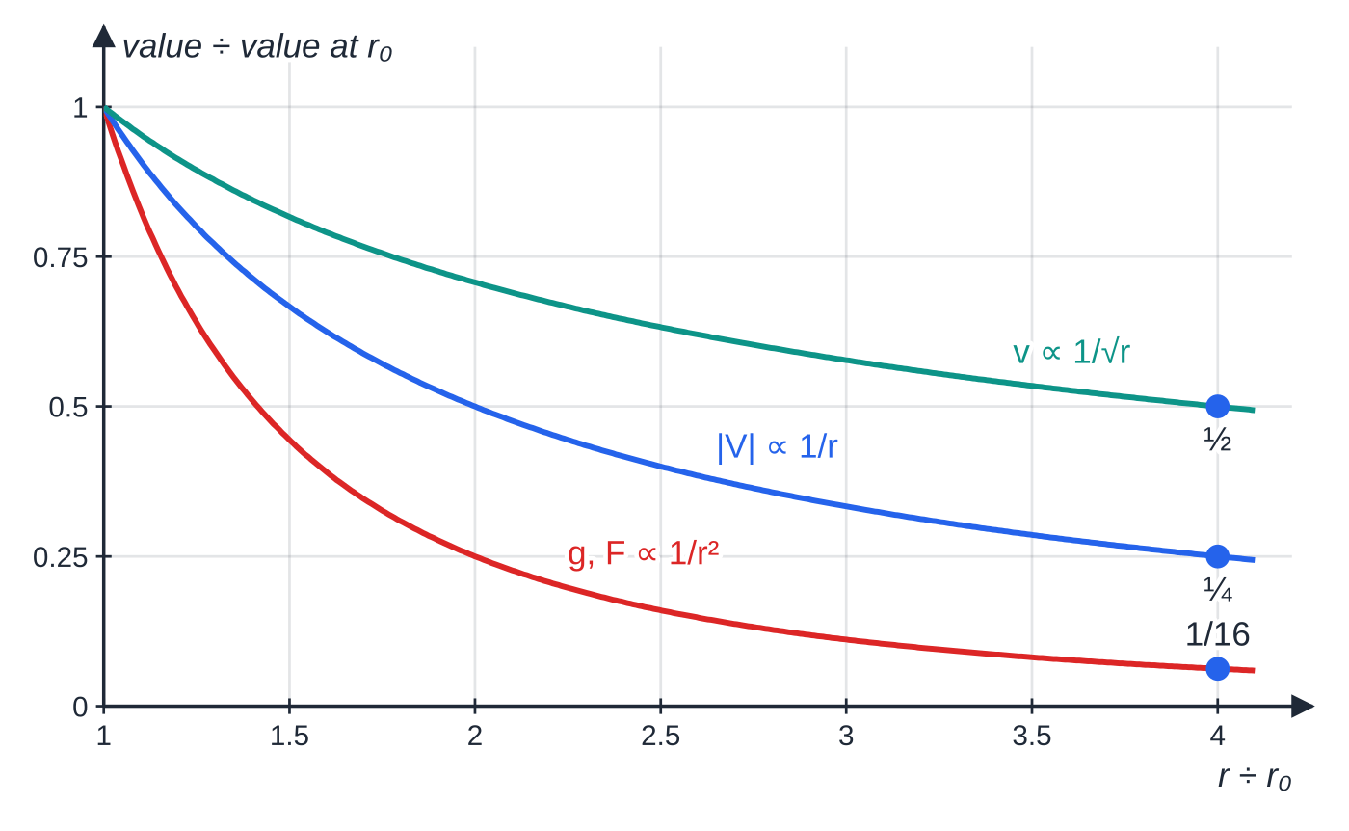
How do Newton's laws explain orbits? (continued)
Section 6 of 11
Further out means slower and longer: v∝1/√r and T∝r^(3/2). A satellite at 4 times the radius moves at half the speed and takes 8 times as long to go round.
Rearranged, M=4π²r³/GT²: timing any moon or satellite gives the mass of the body it orbits.
Geostationary orbits
A geostationary satellite stays above the same point on the Earth's surface, so a fixed dish can point at it. It must:
How the quantities on this page scale with distance from the centre. At four times the radius, orbital speed halves, |V| is a quarter and g is one sixteenth; the period (not shown) grows eightfold.
Notes:
How do Newton's laws explain orbits?. Full notes: https://examinerprep.com/notes/edexcel-ial-physics/gravitational-fields-and-orbits/

Slide 27
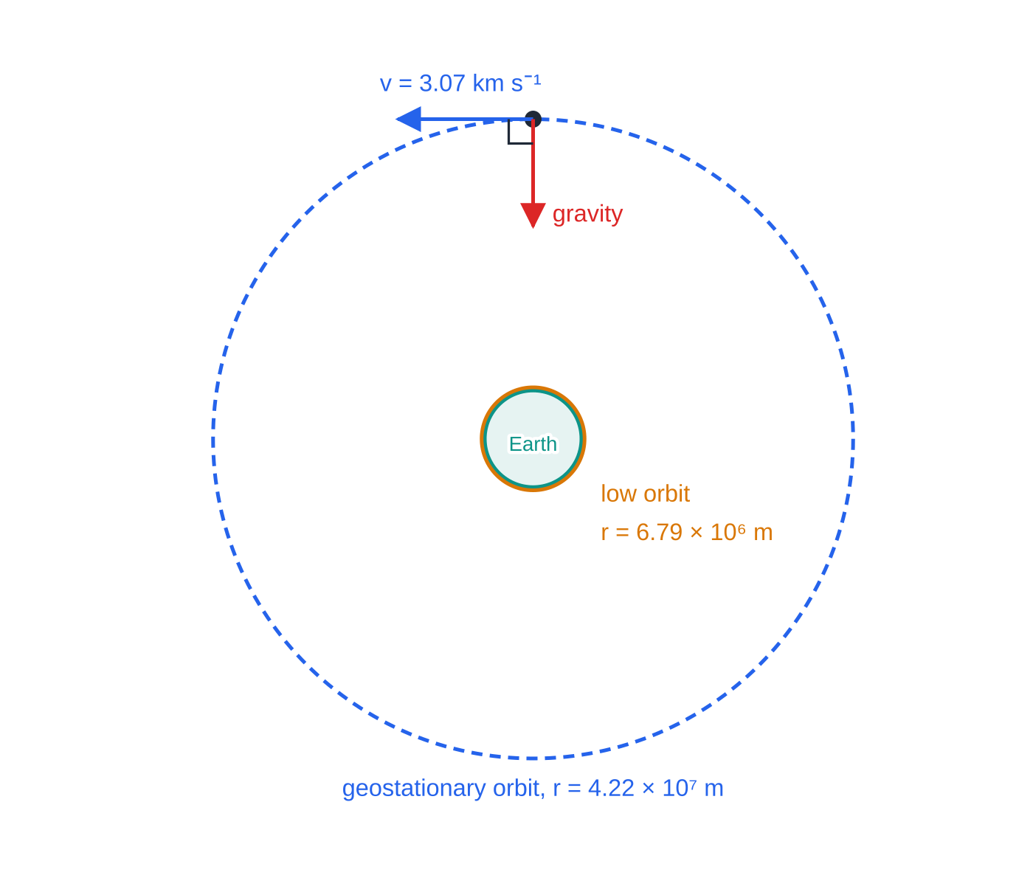
How do Newton's laws explain orbits? (continued)
Section 6 of 11
have a period equal to the Earth's rotation period (about 24 hours);
orbit above the equator (its orbit must be centred on the Earth's centre and lie in the plane in which the surface rotates);
move in the same direction as the Earth rotates (west to east).
Because T fixes r through T²=(4π²/GM) r³, there is only one possible radius for a geostationary orbit.
Orbits drawn to scale. A low orbit (6.79 × 10⁶ m) is only just outside the Earth; the geostationary orbit, from Worked example 6, is 6.6 Earth radii from the centre. Gravity on the satellite points to the centre, at right angles to its velocity, so it changes the direction of motion but not the speed.
Notes:
How do Newton's laws explain orbits?. Full notes: https://examinerprep.com/notes/edexcel-ial-physics/gravitational-fields-and-orbits/

Slide 28
How do Newton's laws explain orbits? (continued)
Section 6 of 11 · Worked example 6 · Medium · Show that, calculate
WORKED EXAMPLE · QUESTION
The Earth rotates once every 8.62 × 10⁴ s. Its mass is 5.97 × 10²⁴ kg and its radius is 6.37 × 10⁶ m. (a) Show that the radius of a geostationary orbit is about 4.2 × 10⁷ m. (b) Calculate the height of the orbit above the surface and the orbital speed.
SOLUTION
(a) The gravitational force provides the centripetal force, so T²=4π²r³/GM. Rearranged: r³=GMT²/4π²=(6.67×10⁻¹¹×5.97×10²⁴×(8.62×10⁴)²)/4π²=7.49×10²² m³, so r= 4.22 × 10⁷ m ≈ 4.2 × 10⁷ m
(b) h=4.22×10⁷-6.37×10⁶= 3.58 × 10⁷ m; v=2π×4.22×10⁷÷8.62×10⁴= 3.07 × 10³ m s⁻¹. Check: √(GM/r) gives the same 3.07 × 10³ m s⁻¹.
Notes:
How do Newton's laws explain orbits?: Worked example 6. Full notes: https://examinerprep.com/notes/edexcel-ial-physics/gravitational-fields-and-orbits/

Slide 29
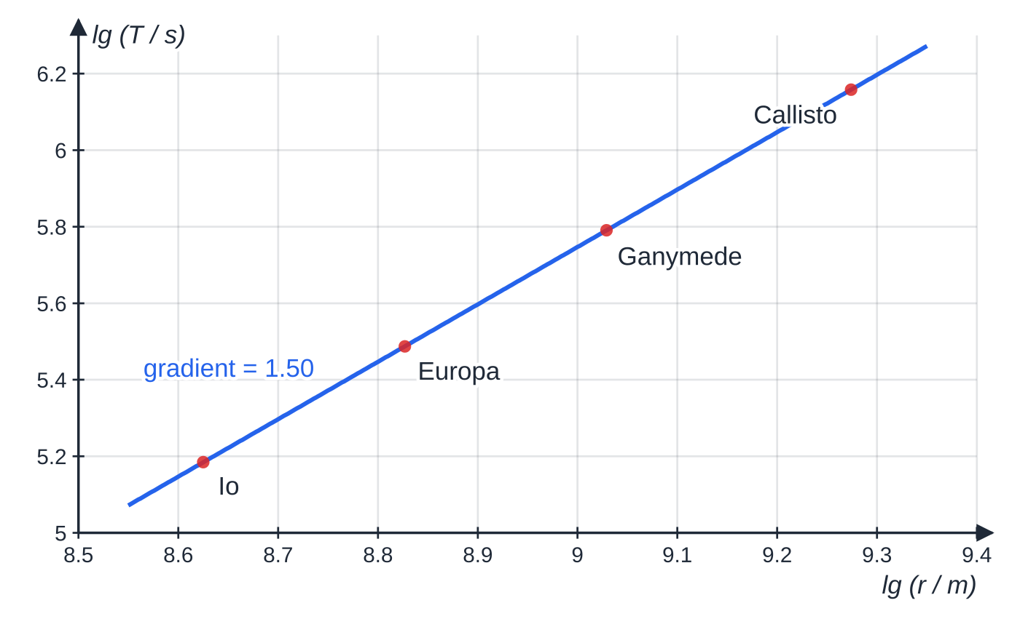
How do Newton's laws explain orbits? (continued)
Section 6 of 11
Testing T² ∝ r³ with real orbits
If T=krⁿ, then lg T=nlg r+lg k, so a graph of lg T against lg r is a straight line of gradient n. For moons of one planet the gradient should be 1.5, confirming T²∝r³. Equally, a graph of T² against r³ is a straight line through the origin of gradient 4π²/GM.
Four moons of Jupiter. Orbital radii (m): Io 4.22 × 10⁸, Europa 6.71 × 10⁸, Ganymede 1.07 × 10⁹, Callisto 1.88 × 10⁹; periods (s): 1.53 × 10⁵, 3.07 × 10⁵, 6.18 × 10⁵, 1.44 × 10⁶. The best-fit gradient is 1.50.
Notes:
How do Newton's laws explain orbits?. Full notes: https://examinerprep.com/notes/edexcel-ial-physics/gravitational-fields-and-orbits/

Slide 30
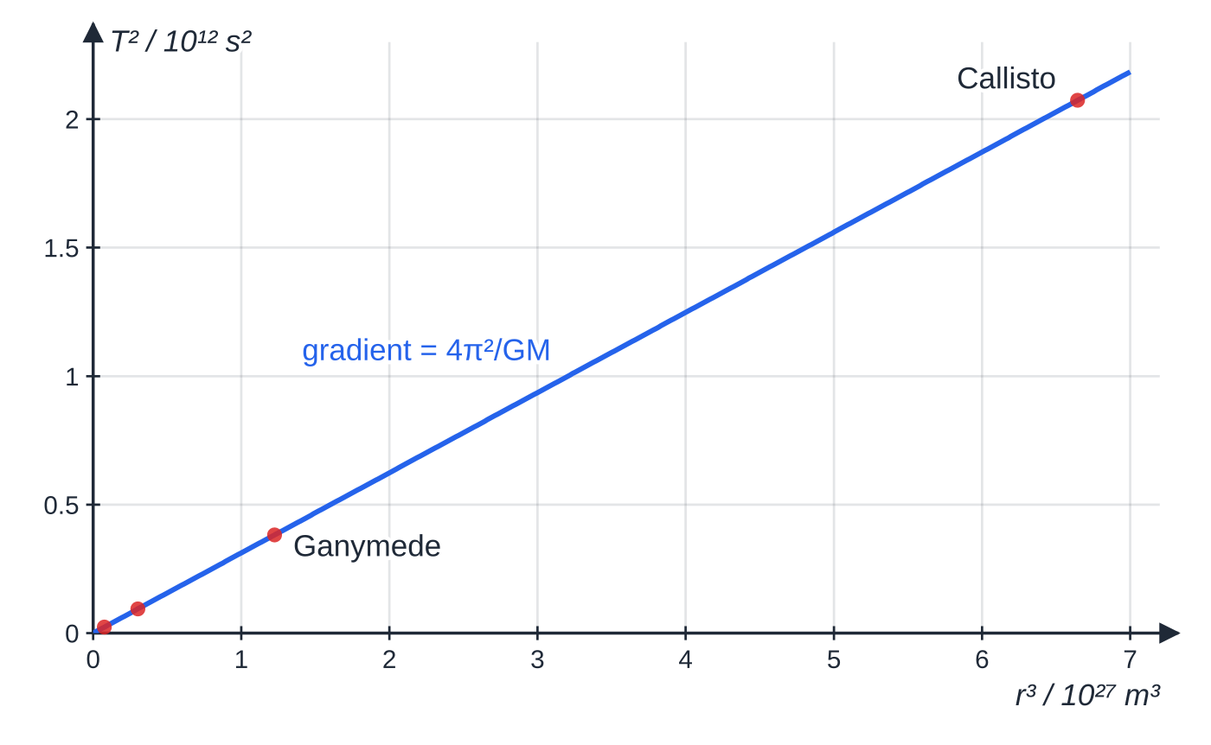
How do Newton's laws explain orbits? (continued)
Section 6 of 11
The same four moons on a T² against r³ graph: a straight line through the origin. Its gradient, 3.12 × 10⁻¹⁶ s² m⁻³, equals 4π²/GM, which gives Jupiter's mass, about 1.90 × 10²⁷ kg.
Notes:
How do Newton's laws explain orbits?. Full notes: https://examinerprep.com/notes/edexcel-ial-physics/gravitational-fields-and-orbits/

Slide 31
How do Newton's laws explain orbits? (continued)
Section 6 of 11 · Worked example 7 · Medium · Calculate
WORKED EXAMPLE · QUESTION
Europa orbits Jupiter in a circle of radius 6.71 × 10⁸ m with a period of 3.07 × 10⁵ s (3.55 days). Calculate the mass of Jupiter.
SOLUTION
Gravity provides the centripetal force, so T²=4π²r³/GM; make M the subject: M=4π²r³/GT².
Substitute, with the period in seconds: M=(4π²×3.02×10²⁶)/(6.67×10⁻¹¹×9.42×10¹⁰)= 1.90 × 10²⁷ kg
The mass of Europa does not appear: it cancelled in the derivation. Any of the other three moons gives the same answer.
Notes:
How do Newton's laws explain orbits?: Worked example 7. Full notes: https://examinerprep.com/notes/edexcel-ial-physics/gravitational-fields-and-orbits/

Slide 32
How do Newton's laws explain orbits? (continued)
Section 6 of 11
Common error — period not in seconds
Leaving the period in hours or days. G is in SI units, so T must be in seconds and r in metres. A period of 3.55 days left unconverted would make the mass about 7 × 10⁹ times too large (86 400²).
Notes:
How do Newton's laws explain orbits?. Full notes: https://examinerprep.com/notes/edexcel-ial-physics/gravitational-fields-and-orbits/

Slide 33
Exam tips for 5.7
Section 7 of 11
Exam tip 1 — r is always from the centre
In every equation on this page, r is the distance from the centre of the planet or star. For a satellite, add the planet's radius to the height above the surface before substituting.
Exam tip 2 — use ratios for "what happens if" questions
If the distance is multiplied by k: force and field strength are divided by k², potential by k, orbital speed by √k, and the period is multiplied by k^(3/2). Ratios are quicker and avoid rounding errors.
Exam tip 3 — show the derivation in full
For "show that" or "derive" questions on orbits, start with the physics, not the answer: "the gravitational force provides the centripetal force", then write GMm/r²=mv²/r, substitute v=2πr/T, and rearrange step by step.
Notes:
Exam tips for 5.7. Full notes: https://examinerprep.com/notes/edexcel-ial-physics/gravitational-fields-and-orbits/

Slide 34
Exam tips for 5.7 (continued)
Section 7 of 11
Exam tip 4 — keep the minus sign on potential
Gravitational potentials are negative. Write them with their signs, find ΔV as final minus initial, then multiply by the mass. The work done in moving away from a planet is always positive.
Exam tip 5 — list both similarities and differences
When asked to compare the two fields, give matching pairs: both inverse square, both have field strength = force per unit (mass or charge); gravity only attracts while electric forces can attract or repel; gravity is far weaker between particles.
Notes:
Exam tips for 5.7. Full notes: https://examinerprep.com/notes/edexcel-ial-physics/gravitational-fields-and-orbits/

Slide 35
Common misconceptions
Section 8 of 11
Misconception | Why it is wrong | Correct idea
Astronauts in orbit float because there is no gravity in space. | At a low orbit g is still about 90% of its surface value. | The astronauts and their craft are in free fall together, so there is no contact force.
A heavier satellite needs to go faster to stay in the same orbit. | The satellite's mass cancels in GMm/r²=mv²/r. | Orbital speed and period depend only on M and r.
Gravitational potential is zero at the Earth's surface. | That is a convenient choice for mgΔh, not the definition used for radial fields. | V=0 at infinity, so V is negative everywhere near a planet.
Field strength halves when the distance doubles. | The field follows an inverse square law. | Doubling r gives one quarter of g; it is the potential that halves.
An orbiting satellite needs a forward force to keep it moving. | No force is needed to maintain speed (Newton's first law). | Only a force towards the centre is needed, to change the direction of the velocity.
Notes:
Common misconceptions. Full notes: https://examinerprep.com/notes/edexcel-ial-physics/gravitational-fields-and-orbits/

Slide 36
Common misconceptions (continued)
Section 8 of 11
Misconception | Why it is wrong | Correct idea
A geostationary satellite can hover above any city. | Its orbit must be centred on the Earth's centre and match the surface's rotation. | It must orbit above the equator, west to east, at one particular radius.
Notes:
Common misconceptions. Full notes: https://examinerprep.com/notes/edexcel-ial-physics/gravitational-fields-and-orbits/

Slide 37
How this topic connects
Section 9 of 11
2 Circular motion and 4.3 Electric fields
F=mv²/r and v=ωr are what turn the law of gravitation into orbital speed and period. Coulomb's law, E=Q/4πε₀r² and electric potential have exactly the same structure as the equations here; learn the two topics as a pair.
Work and energy (Unit 1)
mgΔh is the special case of mΔV for a uniform field; this page explains when that approximation fails.
8 Stars and 5.9 The universe
Gravity holds stars and galaxies together; orbital speeds of stars in galaxies give evidence for dark matter, and the fate of the universe depends on its mean density.
Notes:
How this topic connects. Full notes: https://examinerprep.com/notes/edexcel-ial-physics/gravitational-fields-and-orbits/

Slide 38
Key equations
Section 10 of 11
Equation | Use | In the formulae list?
g=F/m | defines gravitational field strength (N kg⁻¹) | yes
F=Gm₁m₂/r² | force between two point masses or spheres; G=6.67×10⁻¹¹ N m² kg⁻² | yes
g=Gm/r² | field strength in a radial field | yes (and derive it from the two above)
V_grav=-Gm/r | potential in a radial field (J kg⁻¹) | yes
W=mΔV | work done moving a mass between two points | no — learn it
g=-ΔV/Δr | field strength from the gradient of a V–r graph | no — learn it
v=√(GM/r) | speed in a circular orbit (m s⁻¹) | no — derive it from GMm/r²=mv²/r
T²=(4π²/GM) r³ | period and radius of a circular orbit; mass of the central body | no — derive it, using v=2πr/T
Notes:
Key equations. Full notes: https://examinerprep.com/notes/edexcel-ial-physics/gravitational-fields-and-orbits/

Slide 39
Check your understanding
Section 11 of 11
1. Two asteroids attract each other with a force of 800 N. What is the force when the distance between their centres is doubled?
2. Explain why gravitational potential is negative near a planet.
3. At what height above the Earth's surface is the field strength one quarter of its surface value? (Earth radius 6.37 × 10⁶ m)
4. Satellite B orbits the Earth at four times the orbital radius of satellite A. How do their periods compare?
5. A satellite moves in a circular orbit. How much work does gravity do on it during one orbit, and why?
Notes:
Check your understanding: questions. Full notes: https://examinerprep.com/notes/edexcel-ial-physics/gravitational-fields-and-orbits/

Slide 40
Check your understanding · answers
Section 11 of 11
1. 200 N. The force is proportional to 1/r², so doubling r divides it by 4.
2. Potential is zero at infinity. Because gravity attracts, the field does work on a mass as it moves in from infinity, so the work done per unit mass by an external agent is negative; every nearby point is below zero.
3. g∝1/r², so one quarter needs r=2R. The height is 2R-R= 6.37 × 10⁶ m.
4. T²∝r³, so T∝r^(3/2): 4^(3/2)=8. Satellite B's period is 8 times A's.
5. None. The orbit lies on an equipotential (ΔV=0), and the gravitational force is always at right angles to the velocity, so the speed and kinetic energy stay constant.
Notes:
Check your understanding: answers. Full notes: https://examinerprep.com/notes/edexcel-ial-physics/gravitational-fields-and-orbits/

Slide 41
Practice questions
5 original exam-style questions. Answers at the end of the deck.

Slide 42
Question 1
1 mark
Which statement correctly defines the gravitational field strength at a point?
A The acceleration of any object placed at that point, whatever other forces act on it.
B The force per unit mass on a small mass placed at that point.
C The work done per unit mass in bringing a small mass from infinity to that point.
D The force on any object placed at that point.
Notes:
Online with the full mark scheme: https://examinerprep.com/ial-physics-5-7-gravitational-fields-and-orbits-questions#IALP-U5-7-A-01

Slide 43
Question 2
1 mark
Two small spheres attract each other with a gravitational force F. The distance between their centres is tripled.
What is the new gravitational force between them?
A F/9
B F/3
C 3F
D 9F
Notes:
Online with the full mark scheme: https://examinerprep.com/ial-physics-5-7-gravitational-fields-and-orbits-questions#IALP-U5-7-A-02

Slide 44
Question 3
1 mark
A planet has 3 times the mass of the Earth and twice the Earth's radius. The gravitational field strength at the Earth's surface is 9.81 N kg⁻¹.
What is the gravitational field strength at the surface of the planet?
A 3.68 N kg⁻¹
B 7.36 N kg⁻¹
C 14.7 N kg⁻¹
D 29.4 N kg⁻¹
Notes:
Online with the full mark scheme: https://examinerprep.com/ial-physics-5-7-gravitational-fields-and-orbits-questions#IALP-U5-7-A-03

Slide 45
Question 4
4 marks
An astronaut on Mars hangs a 2.50 kg mass from a calibrated newtonmeter. The newtonmeter reads 9.28 N.
(a) State what is meant by a gravitational field. [1]
(b) Calculate the gravitational field strength at the surface of Mars. [2]
(c) The astronaut walks 200 m across the surface and repeats the measurement. Explain why the reading does not change measurably. [1]
Notes:
Online with the full mark scheme: https://examinerprep.com/ial-physics-5-7-gravitational-fields-and-orbits-questions#IALP-U5-7-B-01

Slide 46
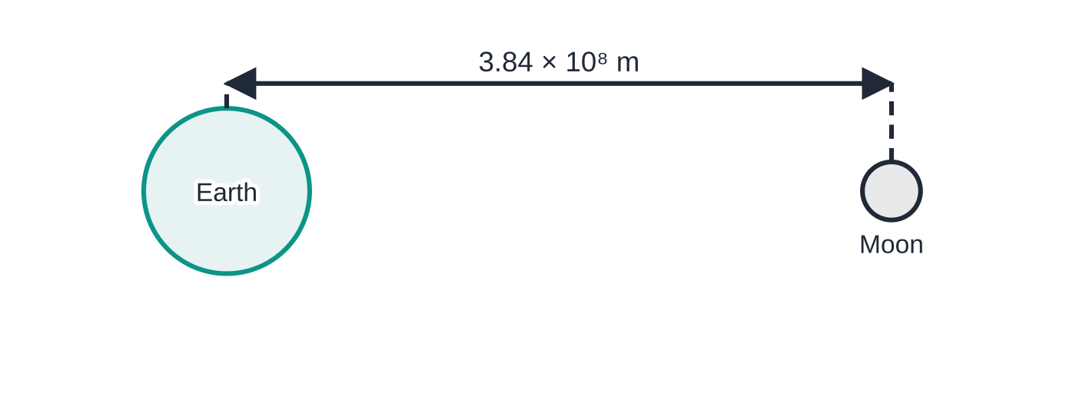
Question 5
5 marks
The Earth has mass 5.97 × 10²⁴ kg and the Moon has mass 7.35 × 10²² kg. The distance between their centres is 3.84 × 10⁸ m. G = 6.67 × 10⁻¹¹ N m² kg⁻².
Figure: the Earth and the Moon, separation between centres (not to scale)
(a) Calculate the gravitational force between the Earth and the Moon. [2]
(b) Calculate the acceleration of the Moon towards the Earth. [1]
(c) State the size and direction of the gravitational force that the Moon exerts on the Earth, and explain why the Earth's acceleration is much smaller than the Moon's. [2]
Notes:
Online with the full mark scheme: https://examinerprep.com/ial-physics-5-7-gravitational-fields-and-orbits-questions#IALP-U5-7-B-02

Slide 47
Answers

Slide 48
Question 1 · answer
Answer B
Gravitational field strength is defined as g = F/m: the force per unit mass on a small (test) mass at the point. It is a vector, measured in N kg⁻¹.
Notes:
Full mark scheme: https://examinerprep.com/ial-physics-5-7-gravitational-fields-and-orbits-questions#IALP-U5-7-A-01

Slide 49
Question 2 · answer
Answer A
F ∝ 1/r². Tripling r multiplies r² by 9, so the force becomes F/9.
Notes:
Full mark scheme: https://examinerprep.com/ial-physics-5-7-gravitational-fields-and-orbits-questions#IALP-U5-7-A-02

Slide 50
Question 3 · answer
Answer B
g = GM/r², so g ∝ M/r². Factor = 3 ÷ 2² = 0.75, so g = 0.75 × 9.81 = 7.36 N kg⁻¹.
Notes:
Full mark scheme: https://examinerprep.com/ial-physics-5-7-gravitational-fields-and-orbits-questions#IALP-U5-7-A-03

Slide 51
Question 4 · answer
Mark scheme
a region (of space) in which a mass experiences a force
g = F/m = 9.28 ÷ 2.50
= 3.71 N kg⁻¹
200 m is tiny compared with the radius of Mars, so the field over this region is (effectively) uniform / the distance from the centre is effectively unchanged
Notes:
Full mark scheme: https://examinerprep.com/ial-physics-5-7-gravitational-fields-and-orbits-questions#IALP-U5-7-B-01

Slide 52
Question 5 · answer
Mark scheme
F = Gm₁m₂/r² = 6.67 × 10⁻¹¹ × 5.97 × 10²⁴ × 7.35 × 10²² ÷ (3.84 × 10⁸)²
= 1.98 × 10²⁰ N
a = F/m = 1.98 × 10²⁰ ÷ 7.35 × 10²² = 2.70 × 10⁻³ m s⁻² (2.69 × 10⁻³ m s⁻² from the rounded force; allow error carried forward)
1.98 × 10²⁰ N, directed towards the Moon (Newton's third law pair)
the Earth's mass is much larger (about 81 times), so for the same force its acceleration F/m is much smaller
Notes:
Full mark scheme: https://examinerprep.com/ial-physics-5-7-gravitational-fields-and-orbits-questions#IALP-U5-7-B-02

Slide 53
Keep practising
Notes for this topic
Questions on this topic
Build a printable test
ExaminerPrep is an independent tutoring service. It has been developed independently from and is not endorsed by the International Baccalaureate Organization. "International Baccalaureate", "IB" and "IB Diploma Programme" are registered trademarks of the IBO, used here for descriptive purposes only.
Pearson Edexcel and Cambridge are trademarks of their owners; ExaminerPrep is not affiliated with any exam board.

