Slide 1
EP
EDEXCEL IAL PHYSICS
1.8 Hooke's law and elastic strain energy
The full notes page in 12 sections · practice questions with answers · simulations
ExaminerPrep is an independent tutoring service. It has been developed independently from and is not endorsed by the International Baccalaureate Organization. "International Baccalaureate", "IB" and "IB Diploma Programme" are registered trademarks of the IBO, used here for descriptive purposes only.
Pearson Edexcel and Cambridge are trademarks of their owners; ExaminerPrep is not affiliated with any exam board.
Notes:
1.8 Hooke's law and elastic strain energy. Notes for this topic: https://examinerprep.com/notes/edexcel-ial-physics/hookes-law-and-elastic-strain-energy/

Slide 2
What this page covers
Overview
Hooke's law, ΔF = kΔx, and the stiffness k of an object
Measuring the stiffness of a spring from a force–extension graph
Springs in series and in parallel
Force–extension and force–compression graphs: limit of proportionality, elastic limit, yield point
Elastic and plastic deformation; loading and unloading a metal wire and a rubber band; hysteresis
Elastic strain energy from ΔEₑₗ = ½FΔx and from the area under a graph
Estimating the area under a curved graph by counting squares or adding strips
Notes:
What this page covers. Full notes: https://examinerprep.com/notes/edexcel-ial-physics/hookes-law-and-elastic-strain-energy/

Slide 3
In one minute
Key points
1. Hooke's law says the extension of an object is proportional to the force applied, up to the limit of proportionality, so ΔF = kΔx and the gradient of the straight part of a force–extension graph is the stiffness.
2. k is the stiffness (N m⁻¹), the force per unit extension. It belongs to that object: its material, length, thickness and shape.
3. Series: 1/k = 1/k₁ + 1/k₂ (less stiff). Parallel: k = k₁ + k₂ (stiffer).
4. Elastic deformation disappears when the force is removed; plastic deformation is permanent. The elastic limit separates them.
5. Rubber returns to its length but its unloading curve lies below its loading curve; the hysteresis loop is energy dissipated as heat.
6. Elastic strain energy = area under the force–extension graph; for a straight line through the origin, ΔEₑₗ = ½FΔx.
Notes:
In one minute. Full notes: https://examinerprep.com/notes/edexcel-ial-physics/hookes-law-and-elastic-strain-energy/

Slide 4
What is Hooke's law?
Section 1 of 12
Pull on a spring and it gets longer; pull twice as hard and, for a while, it gets twice as much longer. That simple proportionality is Hooke's law, and it holds for springs, metal wires and rods as long as the deformation stays small.
Hooke's law:
the extension of an object is directly proportional to the force applied to it, provided the limit of proportionality is not exceeded.
ΔF = k Δx
ΔF = change in the stretching (or compressing) force (N); Δx = change in length, the extension or compression (m); k = stiffness of the object, often called the spring constant (N m⁻¹). Valid only on the straight, proportional part of the force–extension graph.
Notes:
What is Hooke's law?. Full notes: https://examinerprep.com/notes/edexcel-ial-physics/hookes-law-and-elastic-strain-energy/

Slide 5
What is Hooke's law? (continued)
Section 1 of 12
Extension = stretched length − original length. A compression is the reduction in length when a force squashes the object.
Stiffness k is the force needed per unit extension. A stiff object has a large k and stretches little.
k is a property of the object, not of the material alone: a longer spring of the same wire has a smaller k, a thicker one a larger k.
The law applies to tension (stretching) and to compression (squashing). Springs, metal wires and rods obey it for small deformations; rubber largely does not.
In SI base units, 1 N m⁻¹ = 1 kg s⁻².
Notes:
What is Hooke's law?. Full notes: https://examinerprep.com/notes/edexcel-ial-physics/hookes-law-and-elastic-strain-energy/

Slide 6
How do you measure the stiffness of a spring?
Section 2 of 12
The standard experiment hangs masses on a spring and measures how far it stretches. The method matters because the gradient you draw is only as good as the readings behind it.
Hang the spring from a clamp, with a metre rule clamped vertically beside it. Fix a horizontal pointer to the bottom of the spring.
Record the pointer reading with no load (or a small hanger to straighten the coils). Read at eye level to avoid parallax.
Add masses in equal steps (for example 100 g) and record each new reading. Extension = reading − original reading; load = mg.
Remove the masses one at a time and read again. If the readings return to the originals, the spring was not taken past its elastic limit.
Plot force on the y-axis against extension on the x-axis; the gradient of the straight section is k.
Notes:
How do you measure the stiffness of a spring?. Full notes: https://examinerprep.com/notes/edexcel-ial-physics/hookes-law-and-elastic-strain-energy/

Slide 7
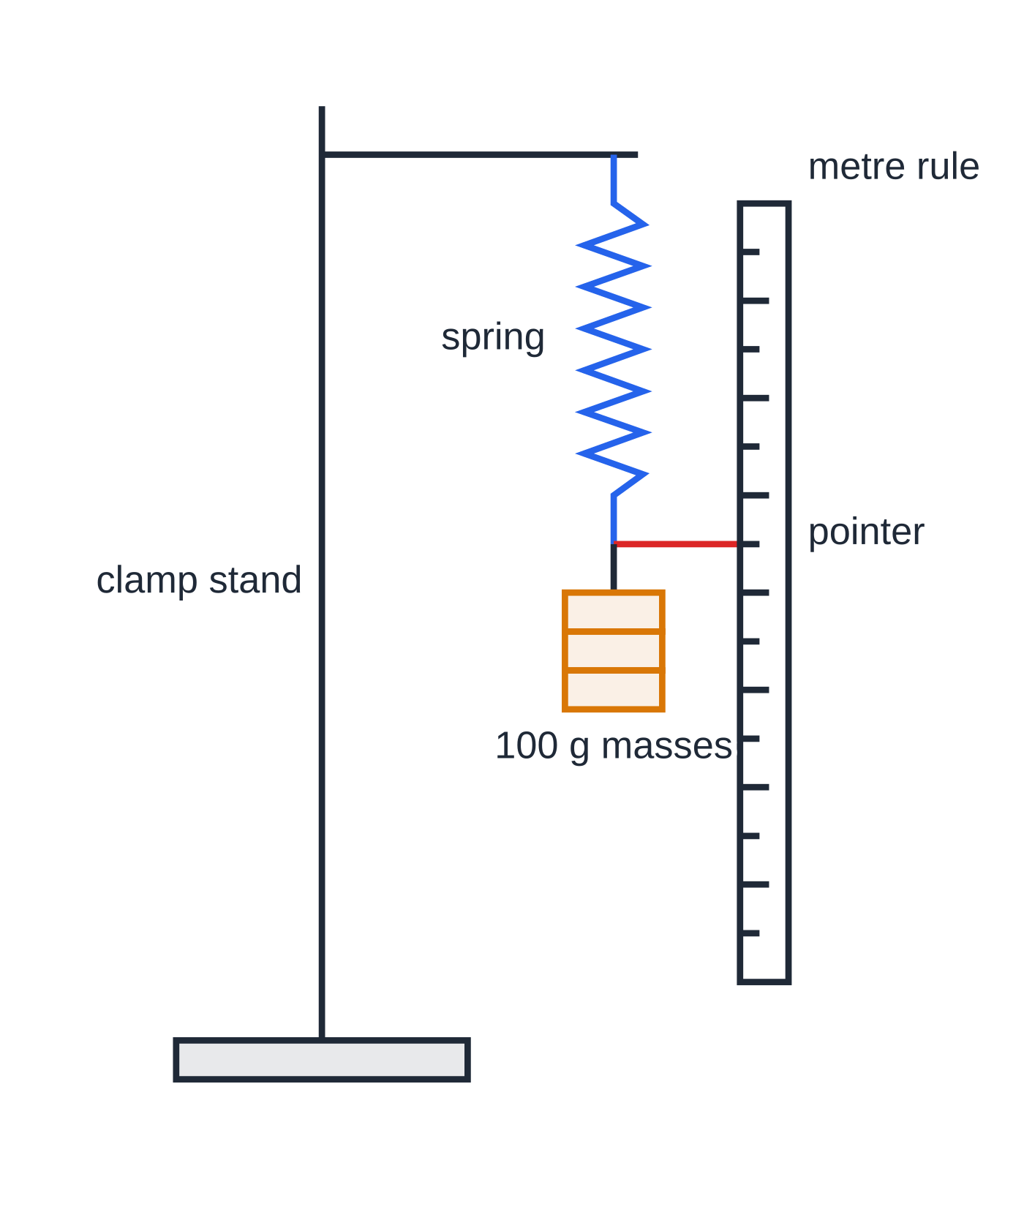
How do you measure the stiffness of a spring? (continued)
Section 2 of 12
Safety: clamp the stand to the bench, keep feet clear of the masses, and wear eye protection in case the spring flies off.
Measuring the stiffness of a spring. The pointer is read against the vertical metre rule at eye level after each 100 g mass is added.
Notes:
How do you measure the stiffness of a spring?. Full notes: https://examinerprep.com/notes/edexcel-ial-physics/hookes-law-and-elastic-strain-energy/

Slide 8
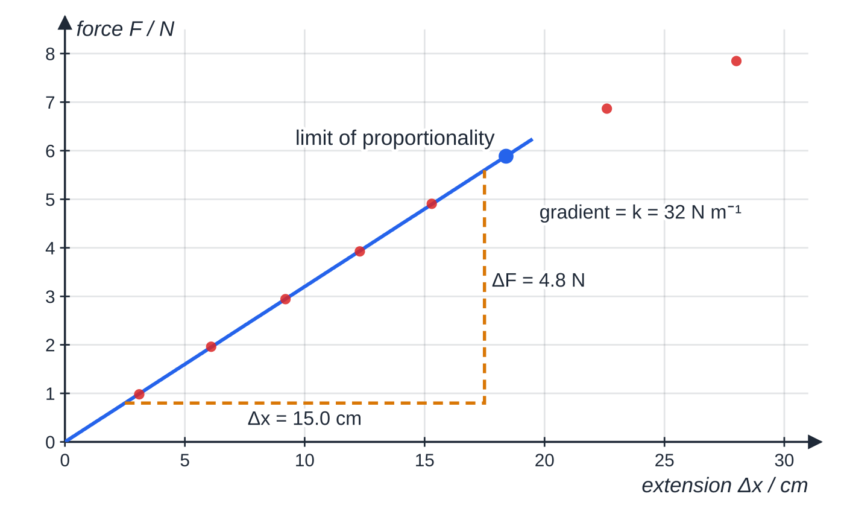
How do you measure the stiffness of a spring? (continued)
Section 2 of 12
Specimen results for a steel spring loaded in 100 g steps. Up to 600 g (5.89 N) the points lie on a straight line through the origin; after that the spring stretches more than Hooke's law predicts. The dashed triangle covers most of the straight section.
Notes:
How do you measure the stiffness of a spring?. Full notes: https://examinerprep.com/notes/edexcel-ial-physics/hookes-law-and-elastic-strain-energy/

Slide 9
How do you measure the stiffness of a spring? (continued)
Section 2 of 12 · Worked example 1 · Easy · Determine
WORKED EXAMPLE · QUESTION
Use the graph above to (a) determine the stiffness of the spring, (b) state the force at the limit of proportionality and (c) calculate the extension produced by a force of 4.0 N.
SOLUTION
(a) Gradient of the straight section from the large triangle, with cm converted to m: k = ΔF/Δx = 4.8 ÷0.150 → k = 32 N m⁻¹.
(b) The last point on the straight line is the 600 g load: F = 0.600×9.81 = 5.886 N → 5.9 N.
(c) 4.0 N is below the limit, so Hooke's law applies: Δx = F/k = 4.0 ÷32 = 0.125 m → 12.5 cm.
Notes:
How do you measure the stiffness of a spring?: Worked example 1. Full notes: https://examinerprep.com/notes/edexcel-ial-physics/hookes-law-and-elastic-strain-energy/

Slide 10
How do you measure the stiffness of a spring? (continued)
Section 2 of 12
Exam tip
If a graph has extension on the y-axis and force on the x-axis, its gradient is 1/k, not k. Check the axes before you call a gradient "the stiffness".
Notes:
How do you measure the stiffness of a spring?. Full notes: https://examinerprep.com/notes/edexcel-ial-physics/hookes-law-and-elastic-strain-energy/

Slide 11
How do springs combine in series and in parallel?
Section 3 of 12
Series: one after the other
Each spring carries the whole load F, so each stretches by its own amount, F/k₁ and F/k₂. The extensions add: Δx = F/k₁ + F/k₂. Dividing by F gives the combined stiffness.
Parallel: side by side
Joined by a bar that stays level, both springs stretch by the same Δx and the load is shared: F = k₁Δx + k₂Δx = (k₁ + k₂)Δx. The stiffer spring carries the larger share.
1/kₛₑᵣᵢₑₛ = 1/k₁ + 1/k₂ kₚₐᵣₐₗₗₑₗ = k₁ + k₂
Not in the formulae list: derive them from ΔF = kΔx as above. For two identical springs, series gives k/2 (twice the extension) and parallel gives 2k (half the extension).
Notes:
How do springs combine in series and in parallel?. Full notes: https://examinerprep.com/notes/edexcel-ial-physics/hookes-law-and-elastic-strain-energy/

Slide 12
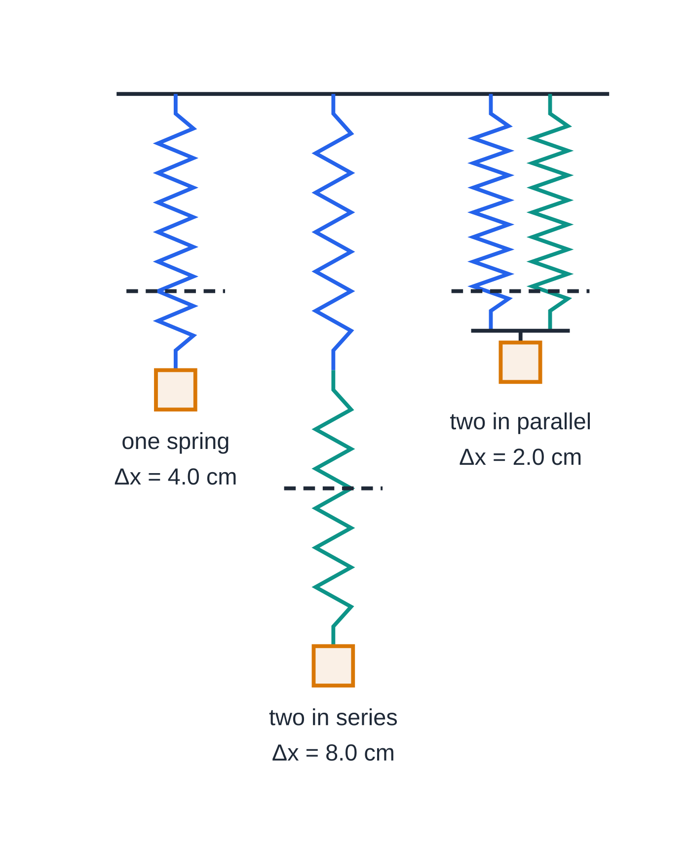
How do springs combine in series and in parallel? (continued)
Section 3 of 12
Drawn to scale: each spring is 10 cm long unstretched with k = 50 N m⁻¹, and each arrangement holds 2.0 N. The dashed lines mark the unstretched lengths: one spring extends 4.0 cm (k = 50 N m⁻¹), two in series 8.0 cm (k = 25 N m⁻¹), two in parallel 2.0 cm (k = 100 N m⁻¹).
Notes:
How do springs combine in series and in parallel?. Full notes: https://examinerprep.com/notes/edexcel-ial-physics/hookes-law-and-elastic-strain-energy/

Slide 13
How do springs combine in series and in parallel? (continued)
Section 3 of 12 · Worked example 2 · Medium · Calculate
WORKED EXAMPLE · QUESTION
Spring A has stiffness 120 N m⁻¹ and spring B has stiffness 80 N m⁻¹. A load of 3.6 N is hung from them (a) in series and (b) in parallel, joined by a light bar that stays horizontal. Calculate the total extension in each case, and the force on each spring in (b).
SOLUTION
(a) Each spring carries the full 3.6 N: Δx_A = 3.6÷120 = 0.030 m, Δx_B = 3.6÷80 = 0.045 m; total → 0.075 m. Check: kₛₑᵣᵢₑₛ = 1/(1/120 + 1/80) = 48 N m⁻¹ and 3.6÷48 = 0.075 m.
(b) kₚₐᵣₐₗₗₑₗ = 120 + 80 = 200 N m⁻¹, so Δx = 3.6÷200 → 0.018 m. Same extension for both: F_A = 120×0.018 → 2.16 N; F_B = 80×0.018 → 1.44 N.
Check: 2.16 + 1.44 = 3.6 N, the whole load. The series arrangement stretches 4.2 times as far.
Notes:
How do springs combine in series and in parallel?: Worked example 2. Full notes: https://examinerprep.com/notes/edexcel-ial-physics/hookes-law-and-elastic-strain-energy/

Slide 14
How do springs combine in series and in parallel? (continued)
Section 3 of 12
Common error
Adding stiffnesses for springs in series. Joining springs end to end makes the arrangement easier to stretch, so the combined stiffness must be smaller than either one: a quick check on any answer.
Notes:
How do springs combine in series and in parallel?. Full notes: https://examinerprep.com/notes/edexcel-ial-physics/hookes-law-and-elastic-strain-energy/

Slide 15
What happens when a wire is stretched beyond the straight line?
Section 4 of 12
Point or region | What it means
Limit of proportionality (P) | the end of the straight section: beyond it, force and extension are no longer proportional
Elastic limit (E) | the greatest force for which the object still returns to its original length when the force is removed
Yield point (Y) | where the material starts to stretch a lot for little or no increase in force: the start of large plastic flow
Elastic deformation | a change of shape that is fully reversed when the force is removed
Plastic deformation | a permanent change of shape: the object does not return to its original length
P and E are often close together, but they are different points: between them the graph curves yet the deformation is still elastic. Beyond E, layers of atoms in a metal slip past one another, so part of the extension remains after the force is removed.
Notes:
What happens when a wire is stretched beyond the straight line?. Full notes: https://examinerprep.com/notes/edexcel-ial-physics/hookes-law-and-elastic-strain-energy/

Slide 16
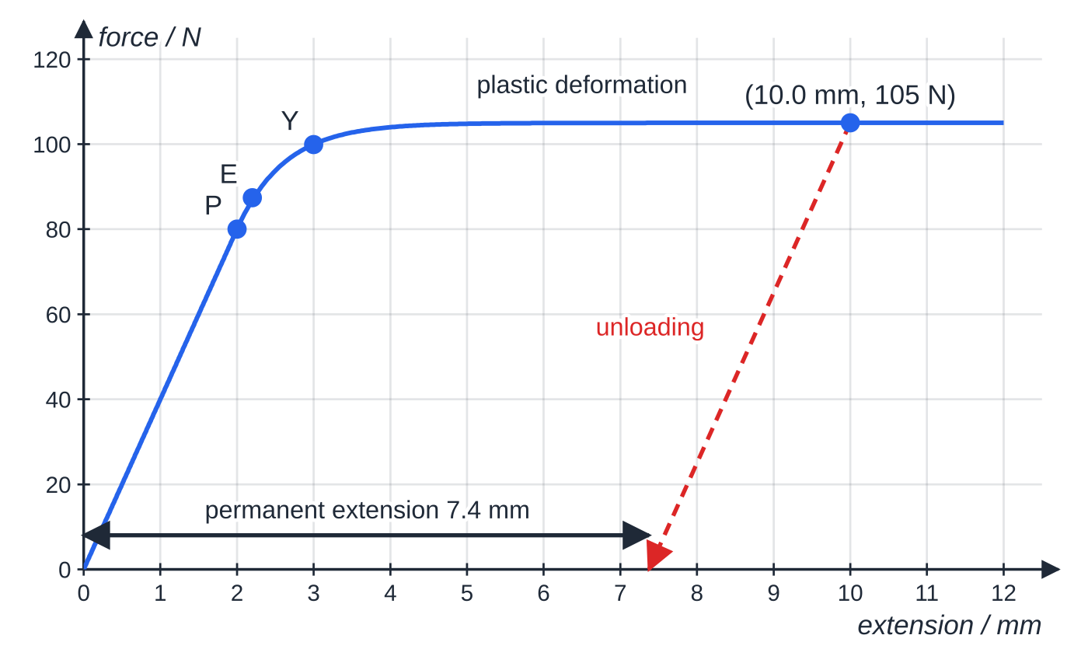
What happens when a wire is stretched beyond the straight line? (continued)
Section 4 of 12
When a metal is unloaded from beyond E, the unloading line is (nearly) parallel to the original straight section, because the stiffness of the atomic bonds is unchanged. Where that unloading line meets the extension axis gives the permanent extension.
Force–extension graph for a metal wire: straight to P (limit of proportionality), elastic to E (elastic limit), then yielding at Y. Unloaded from 10.0 mm and 105 N, the wire follows the dashed line, parallel to OP, and is left 7.4 mm longer than at the start.
Notes:
What happens when a wire is stretched beyond the straight line?. Full notes: https://examinerprep.com/notes/edexcel-ial-physics/hookes-law-and-elastic-strain-energy/

Slide 17
What happens when a wire is stretched beyond the straight line? (continued)
Section 4 of 12 · Worked example 3 · Medium · Determine
WORKED EXAMPLE · QUESTION
The graph above is for a metal wire. The wire is stretched to an extension of 10.0 mm, where the force is 105 N, and then the force is removed. (a) Determine the stiffness of the wire on the straight section. (b) Calculate the permanent extension of the wire.
SOLUTION
(a) Gradient of OP, with mm converted to m: k = 80 ÷(2.0×10⁻³) → k = 4.0 × 10⁴ N m⁻¹.
(b) The unloading line has the same gradient, so the extension recovered is Δx = F/k = 105 ÷(4.0×10⁴) = 2.63×10⁻³ m = 2.63 mm. Permanent extension = total − recovered = 10.0 - 2.63 → 7.4 mm.
Notes:
What happens when a wire is stretched beyond the straight line?: Worked example 3. Full notes: https://examinerprep.com/notes/edexcel-ial-physics/hookes-law-and-elastic-strain-energy/

Slide 18
What happens when a wire is stretched beyond the straight line? (continued)
Section 4 of 12
Compression graphs are read the same way. For a compression spring the line stays straight until the coils touch; after that the force rises very steeply (see the pop-up toy graph below).
Exam tip
When you label a graph, put the limit of proportionality exactly where the straight line ends. Do not put the elastic limit at the same point unless the question says they coincide, and never place the yield point on the straight section.
Notes:
What happens when a wire is stretched beyond the straight line?. Full notes: https://examinerprep.com/notes/edexcel-ial-physics/hookes-law-and-elastic-strain-energy/

Slide 19
Why does rubber behave differently?
Section 5 of 12
A rubber band does not obey Hooke's law: its force–extension graph is curved almost from the start. Rubber is made of long, tangled polymer chains. A small force straightens and lines up the chains easily; once they are nearly straight, further stretching pulls on the bonds and the band becomes stiffer. Rubber can stretch to several times its length and still return to (almost) its original length: a large elastic deformation.
The unloading curve lies below the loading curve: at each extension the band pulls back with less force than was needed to stretch it. This is hysteresis. The area under the loading curve is the work done on the band; the area under the unloading curve is the energy returned. The loop area is the energy dissipated, mainly as thermal energy in the rubber, which is why a band stretched and released repeatedly gets warm.
Notes:
Why does rubber behave differently?. Full notes: https://examinerprep.com/notes/edexcel-ial-physics/hookes-law-and-elastic-strain-energy/

Slide 20
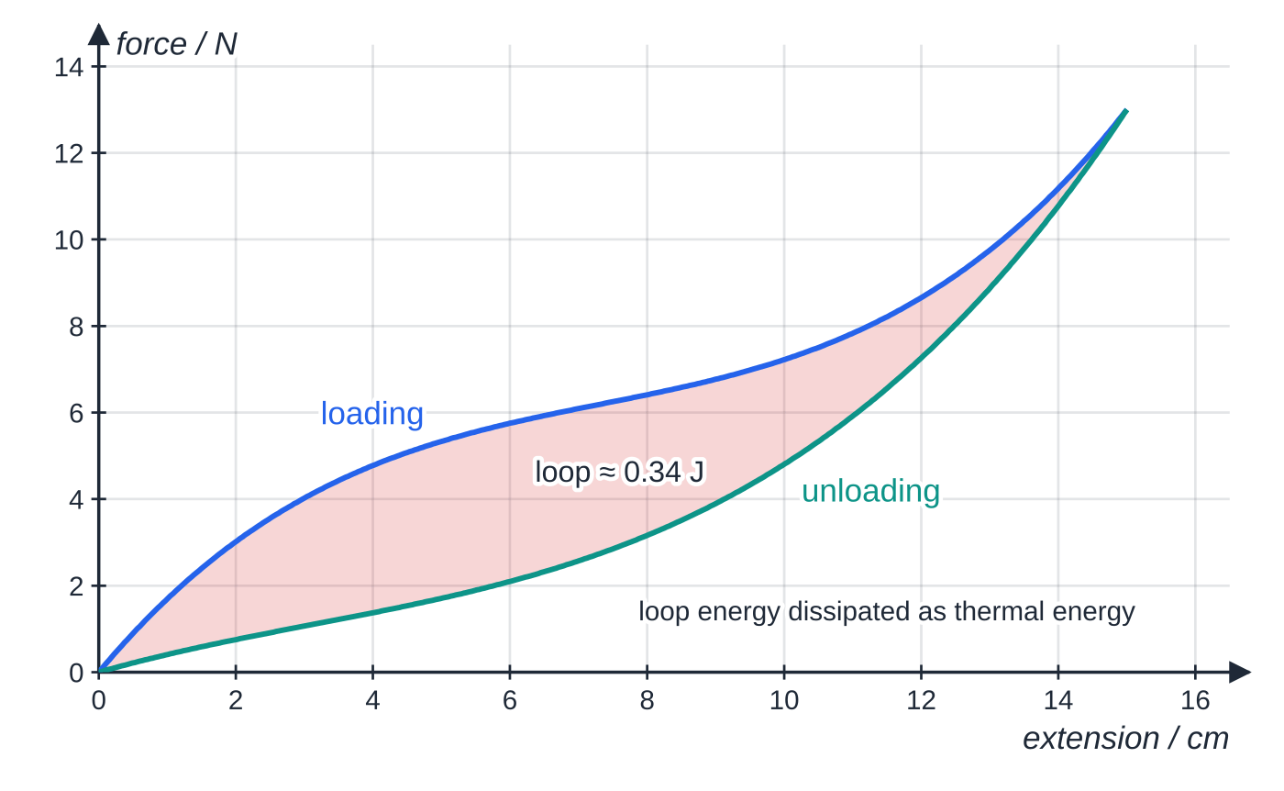
Why does rubber behave differently? (continued)
Section 5 of 12
Loading and unloading a rubber band to 15 cm. Work done stretching it = 0.95 J; energy returned = 0.61 J; the shaded loop, 0.34 J, is about 36% of the input and heats the band.
Notes:
Why does rubber behave differently?. Full notes: https://examinerprep.com/notes/edexcel-ial-physics/hookes-law-and-elastic-strain-energy/

Slide 21
Why does rubber behave differently? (continued)
Section 5 of 12
 | Metal wire past its elastic limit | Rubber band
After unloading | permanent extension | returns to (almost) its original length
Unloading curve | straight, parallel to the loading line | curved, below the loading curve
Energy not returned | area between loading curve and unloading line: work done in permanently deforming the wire | loop area: dissipated as thermal energy
Common error
Describing rubber after hysteresis as "plastically deformed". The band goes back to its original length, so the deformation is elastic; the energy loss comes from the loading and unloading curves being different, not from a permanent change of shape.
Notes:
Why does rubber behave differently?. Full notes: https://examinerprep.com/notes/edexcel-ial-physics/hookes-law-and-elastic-strain-energy/

Slide 22
How much energy does a stretched object store?
Section 6 of 12
Stretching an object needs work. While the deformation is elastic, that work is stored as elastic strain energy and can be recovered. Work = force × distance, but here the force grows as the extension grows, so the work is the area under the force–extension graph. For a straight line through the origin that area is a triangle:
ΔEₑₗ = ½FΔx and, with F = kΔx, ΔEₑₗ = ½k(Δx)²
ΔEₑₗ = elastic strain energy (J), F = final force (N), Δx = extension or compression (m). Only for the proportional (Hooke's law) region; for a curved graph find the area instead.
Doubling the extension doubles the force, so the stored energy goes up four times (ΔE ∝Δx²). The energy added between two extensions is the trapezium under the line between them, not ½FΔx using the change in extension.
Notes:
How much energy does a stretched object store?. Full notes: https://examinerprep.com/notes/edexcel-ial-physics/hookes-law-and-elastic-strain-energy/

Slide 23
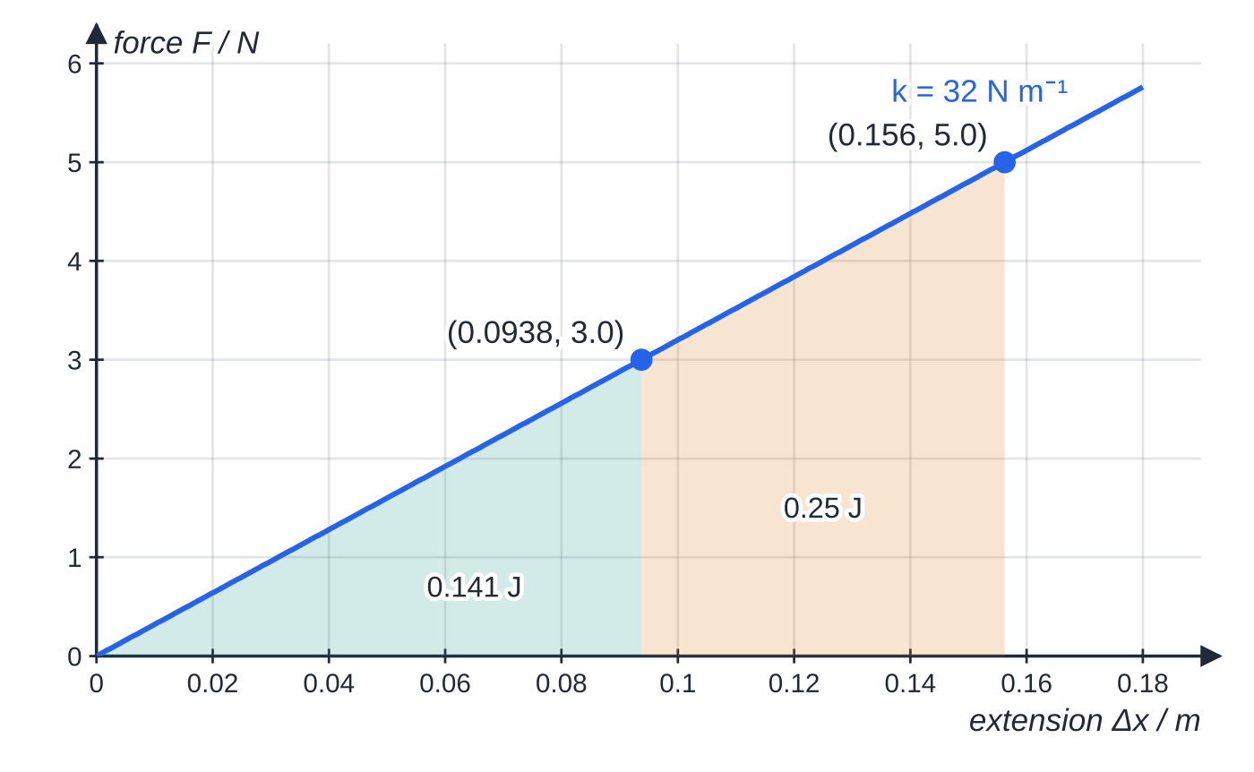
How much energy does a stretched object store? (continued)
Section 6 of 12
Energy stored in the spring of worked example 4. The triangle up to 3.0 N is 0.141 J; the trapezium from 3.0 N to 5.0 N adds 0.25 J, giving 0.391 J in total at 5.0 N.
Notes:
How much energy does a stretched object store?. Full notes: https://examinerprep.com/notes/edexcel-ial-physics/hookes-law-and-elastic-strain-energy/

Slide 24
How much energy does a stretched object store? (continued)
Section 6 of 12 · Worked example 4 · Medium · Calculate
WORKED EXAMPLE · QUESTION
The spring of worked example 1 has stiffness 32 N m⁻¹. Calculate (a) the elastic strain energy stored when the force is 5.0 N and (b) the extra energy stored when the force is increased from 3.0 N to 5.0 N.
SOLUTION
(a) Δx = 5.0÷32 = 0.1562 m, then ΔEₑₗ = ½×5.0×0.1562 = 0.391 J → 0.39 J.
(b) At 3.0 N, Δx = 3.0÷32 = 0.0938 m. Trapezium: ½×(3.0 + 5.0)×(0.1562 - 0.0938) → 0.25 J.
Check: ½k(Δx)² at each force gives 0.391 - 0.141 = 0.25 J.
Notes:
How much energy does a stretched object store?: Worked example 4. Full notes: https://examinerprep.com/notes/edexcel-ial-physics/hookes-law-and-elastic-strain-energy/

Slide 25
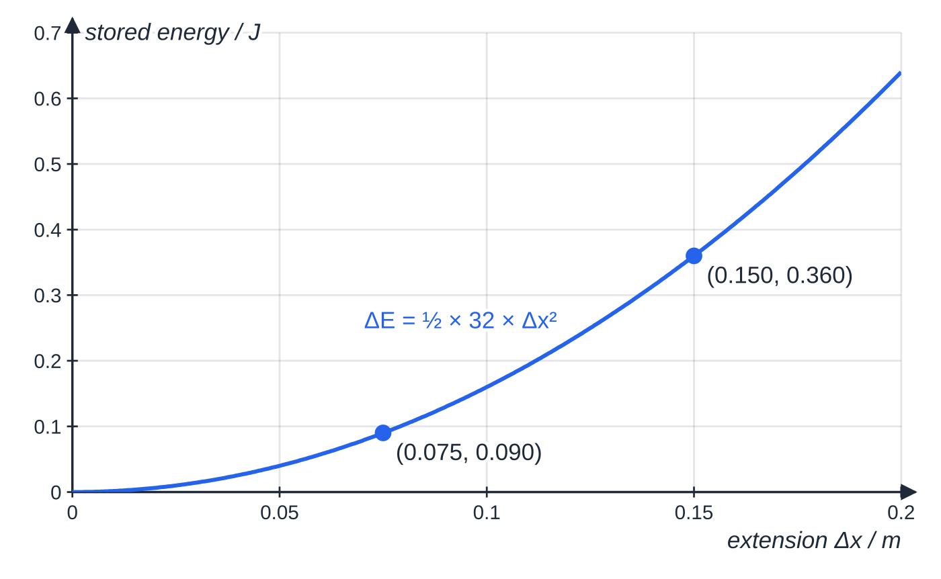
How much energy does a stretched object store? (continued)
Section 6 of 12
Stored energy against extension for the same 32 N m⁻¹ spring (assuming it stayed proportional). Doubling the extension from 0.075 m to 0.150 m quadruples the energy, from 0.090 J to 0.360 J.
Notes:
How much energy does a stretched object store?. Full notes: https://examinerprep.com/notes/edexcel-ial-physics/hookes-law-and-elastic-strain-energy/

Slide 26
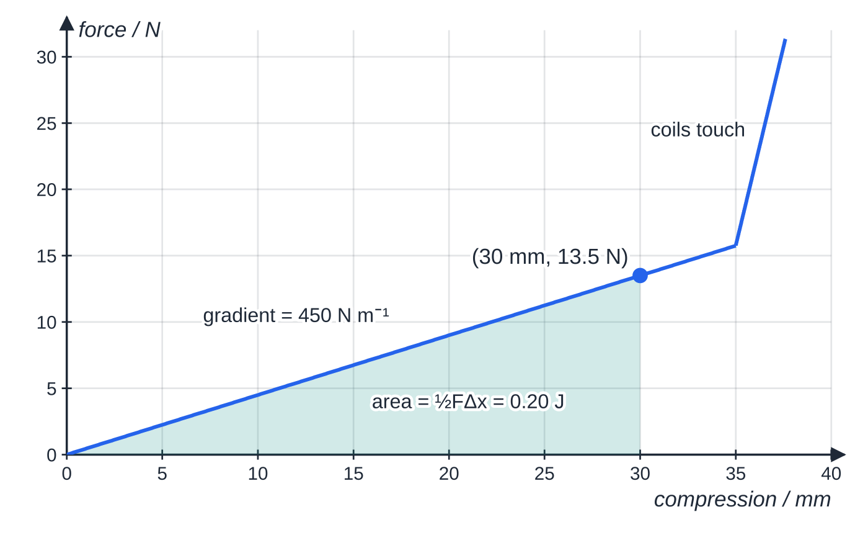
How much energy does a stretched object store? (continued)
Section 6 of 12
Force–compression graph for the spring in a pop-up toy. The shaded triangle up to 30 mm is the energy stored, 0.20 J. Beyond 35 mm the coils touch and the spring becomes a solid column, so the force rises steeply.
Notes:
How much energy does a stretched object store?. Full notes: https://examinerprep.com/notes/edexcel-ial-physics/hookes-law-and-elastic-strain-energy/

Slide 27
How much energy does a stretched object store? (continued)
Section 6 of 12 · Worked example 5 · Medium · Calculate, suggest
WORKED EXAMPLE · QUESTION
A toy of mass 25 g sits on a spring of stiffness 450 N m⁻¹ (graph above). The toy is pressed down, compressing the spring by 30 mm, and held by a suction cup. When the cup lets go, the toy jumps vertically. g = 9.81 N kg⁻¹. (a) Calculate the elastic strain energy stored. (b) Calculate the maximum height the toy could rise. (c) Suggest why the real height is less.
SOLUTION
(a) F = 450×0.030 = 13.5 N, so ΔEₑₗ = ½×13.5×0.030 = 0.2025 J → 0.20 J.
(b) All of it becomes gravitational potential energy at the top: mgΔh = 0.2025, so Δh = 0.2025÷(0.025×9.81) → 0.83 m.
(c) Not all the stored energy ends up as gravitational potential energy: some becomes kinetic energy of the spring itself, thermal energy in the spring, and work against air resistance.
Notes:
How much energy does a stretched object store?: Worked example 5. Full notes: https://examinerprep.com/notes/edexcel-ial-physics/hookes-law-and-elastic-strain-energy/

Slide 28
How much energy does a stretched object store? (continued)
Section 6 of 12
Exam tip
Convert millimetres and centimetres to metres before you use ½FΔx. N × mm gives millijoules, so an answer 1000 times too big is the usual sign of a missed conversion.
Notes:
How much energy does a stretched object store?. Full notes: https://examinerprep.com/notes/edexcel-ial-physics/hookes-law-and-elastic-strain-energy/

Slide 29
How do you find the energy when the graph is curved?
Section 7 of 12
The energy is still the area under the graph up to the extension reached, but ½FΔx no longer applies. Two methods work:
Counting squares: find the energy of one grid square (its width in m × its height in N), count whole squares under the curve, count squares that are about half or more as whole and ignore the rest, then multiply.
Strips: split the area into vertical strips of equal width Δx, treat each as a trapezium of area ½(F₁ + F₂)Δx, and add them.
For a curve that bends over (gets less steep), each straight strip top lies slightly below the curve, so the strip method slightly underestimates; narrower strips give a better estimate.
Notes:
How do you find the energy when the graph is curved?. Full notes: https://examinerprep.com/notes/edexcel-ial-physics/hookes-law-and-elastic-strain-energy/

Slide 30
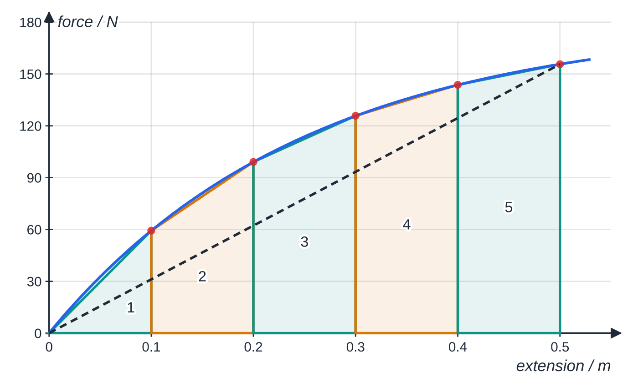
How do you find the energy when the graph is curved? (continued)
Section 7 of 12
Force–extension readings for a nylon cord every 0.10 m. Each shaded strip is a trapezium; their total, 50.6 J, estimates the energy stored at 0.50 m. The dashed straight line shows why ½FΔx (38.9 J) would be far too small.
Notes:
How do you find the energy when the graph is curved?. Full notes: https://examinerprep.com/notes/edexcel-ial-physics/hookes-law-and-elastic-strain-energy/

Slide 31
How do you find the energy when the graph is curved? (continued)
Section 7 of 12 · Worked example 6 · Hard · Estimate, explain
WORKED EXAMPLE · QUESTION
A nylon cord is stretched in steps of 0.10 m. The force readings at 0, 0.10, 0.20, 0.30, 0.40 and 0.50 m are 0.0, 59.3, 99.1, 125.8, 143.7 and 155.6 N. (a) Estimate the elastic strain energy stored at an extension of 0.50 m, assuming the cord is still elastic. (b) Explain why ½FΔx would give the wrong answer.
SOLUTION
(a) Area of each strip = ½(F₁ + F₂)×0.10: 2.965 + 7.920 + 11.245 + 13.475 + 14.965 J. Adding: ΔEₑₗ ≈50.6 J → ≈ 51 J.
(b) ½FΔx is the area of a triangle under a straight line: ½×155.6×0.50 = 38.9 J. This is too small, because the curve lies above the straight line from the origin.
The exact area under the curve drawn is 51.1 J: the strip estimate is slightly low, as expected for a curve that bends over.
Notes:
How do you find the energy when the graph is curved?: Worked example 6. Full notes: https://examinerprep.com/notes/edexcel-ial-physics/hookes-law-and-elastic-strain-energy/

Slide 32
How do you find the energy when the graph is curved? (continued)
Section 7 of 12
Common error
Using the force at the end × the extension (FΔx = 77.8 J here). That is the area of the whole rectangle, which includes the region above the curve, and overestimates the energy.
Notes:
How do you find the energy when the graph is curved?. Full notes: https://examinerprep.com/notes/edexcel-ial-physics/hookes-law-and-elastic-strain-energy/

Slide 33
Exam tips for 1.8
Section 8 of 12
Exam tip 1 — extension, not length
Hooke's law and ½FΔx use the extension (or compression). If a question gives lengths, subtract the original length first.
Exam tip 2 — definitions with conditions
A statement of Hooke's law needs the condition "provided the limit of proportionality is not exceeded". A definition of the elastic limit must mention returning to the original length when the force is removed.
Exam tip 3 — ½ only for a straight line
Use ½FΔx only on the proportional part. For a curved graph, or for energy added between two extensions, find the area of the region you actually need.
Notes:
Exam tips for 1.8. Full notes: https://examinerprep.com/notes/edexcel-ial-physics/hookes-law-and-elastic-strain-energy/

Slide 34
Exam tips for 1.8 (continued)
Section 8 of 12
Exam tip 4 — series or parallel?
Ask two questions: does each spring carry the whole load (series) or a share of it (parallel)? Do the extensions add (series) or are they equal (parallel)? Then use ΔF = kΔx for each spring.
Exam tip 5 — describing a graph
When asked to describe a force–extension graph, name the regions in order (straight section, curve, plastic region) and give the values where they change. When asked to explain, link each feature to what is happening: proportional, elastic, permanent.
Notes:
Exam tips for 1.8. Full notes: https://examinerprep.com/notes/edexcel-ial-physics/hookes-law-and-elastic-strain-energy/

Slide 35
Common misconceptions
Section 9 of 12
Misconception | Why it is wrong | Correct idea
The limit of proportionality and the elastic limit are the same point. | An object can still return to its original length after the graph has started to curve. | P is where the line stops being straight; E is where permanent deformation starts. E is at or beyond P.
A spring obeys Hooke's law because it returns to its original length. | Returning to the original length shows elastic behaviour; rubber does this without obeying Hooke's law. | Hooke's law means force ∝ extension: a straight line through the origin.
Stiffness is a property of the material. | Two springs of the same steel can have very different k. | k depends on the object's material, length, thickness and shape; the Young modulus describes the material.
Springs in series are stiffer. | Each spring carries the full load, so the extensions add. | In series the combined stiffness is less than either spring; in parallel it is the sum.
Notes:
Common misconceptions. Full notes: https://examinerprep.com/notes/edexcel-ial-physics/hookes-law-and-elastic-strain-energy/

Slide 36
Common misconceptions (continued)
Section 9 of 12
Misconception | Why it is wrong | Correct idea
Doubling the extension doubles the stored energy. | The force also doubles, and the energy is ½ × force × extension. | ΔEₑₗ ∝(Δx)²: double the extension, four times the energy.
All the work done stretching rubber is stored and returned. | The unloading curve is below the loading curve. | The hysteresis loop area is dissipated as thermal energy each cycle.
Notes:
Common misconceptions. Full notes: https://examinerprep.com/notes/edexcel-ial-physics/hookes-law-and-elastic-strain-energy/

Slide 37
How this topic connects
Section 10 of 12
9 Stress, strain and the Young modulus
Dividing force by area and extension by length removes the size of the object: the stress–strain graph describes the material, and its gradient (the Young modulus) replaces the stiffness k.
5 Work and energy
The area under a force–extension graph is the work done, and the stored elastic strain energy can become kinetic or gravitational potential energy, as in a catapult or a trampoline.
Oscillations (Unit 5) and practical skills (3.3)
A mass on a spring that obeys Hooke's law oscillates with simple harmonic motion, with a period that depends on k. The spring experiment is also a model for choosing equal steps, reading scales at eye level and taking a gradient from a large triangle.
Notes:
How this topic connects. Full notes: https://examinerprep.com/notes/edexcel-ial-physics/hookes-law-and-elastic-strain-energy/

Slide 38
Key equations
Section 11 of 12
Equation | Use | In the formulae list?
ΔF = kΔx | Hooke's law; stiffness from force and extension (k in N m⁻¹) | yes
ΔEₑₗ = ½FΔx | elastic strain energy, straight-line region (J) | yes
ΔEₑₗ = ½k(Δx)² | strain energy from stiffness and extension | no — derive it, substituting F = kΔx
1/k = 1/k₁ + 1/k₂ | springs in series | no — derive it
k = k₁ + k₂ | springs in parallel | no — derive it
energy = area under F–Δx graph | any graph, including curves (squares or strips) | no — learn it
Notes:
Key equations. Full notes: https://examinerprep.com/notes/edexcel-ial-physics/hookes-law-and-elastic-strain-energy/

Slide 39
Check your understanding
Section 12 of 12
1. A spring of natural length 0.250 m and stiffness 60 N m⁻¹ supports a load of 4.5 N. What is its new length?
2. Two identical springs are joined first in series and then in parallel, with the same load. Compare the extensions.
3. Explain the difference between the limit of proportionality and the elastic limit.
4. A spring of stiffness 800 N m⁻¹ is compressed by 5.0 cm. How much elastic strain energy does it store?
5. Why does a rubber band become warm when it is stretched and released many times?
6. A wire with stiffness 4.0 × 10⁴ N m⁻¹ on its straight section is loaded beyond its elastic limit to 8.0 mm at 100 N, then unloaded. Find the permanent extension.
Notes:
Check your understanding: questions. Full notes: https://examinerprep.com/notes/edexcel-ial-physics/hookes-law-and-elastic-strain-energy/

Slide 40
Check your understanding · answers
Section 12 of 12
1. Extension = 4.5÷60 = 0.075 m, so length = 0.250 + 0.075 = 0.325 m (assuming the limit of proportionality is not passed).
2. Series stiffness = k/2, parallel stiffness = 2k, so the series extension is 4 times the parallel extension.
3. Beyond the limit of proportionality the extension is no longer proportional to the force (the graph curves). Beyond the elastic limit the object no longer returns to its original length when the force is removed (it is permanently deformed).
4. ½k(Δx)² = ½×800×0.050² = 1.0 J.
5. Its unloading curve lies below its loading curve. The area of the hysteresis loop is energy that is not returned on unloading; it is dissipated as thermal energy in the rubber every cycle.
6. Recovered extension = 100÷(4.0×10⁴) = 2.5×10⁻³ m = 2.5 mm, so permanent extension = 8.0 - 2.5 = 5.5 mm.
Notes:
Check your understanding: answers. Full notes: https://examinerprep.com/notes/edexcel-ial-physics/hookes-law-and-elastic-strain-energy/

Slide 41
Practice questions
5 original exam-style questions. Answers at the end of the deck.

Slide 42
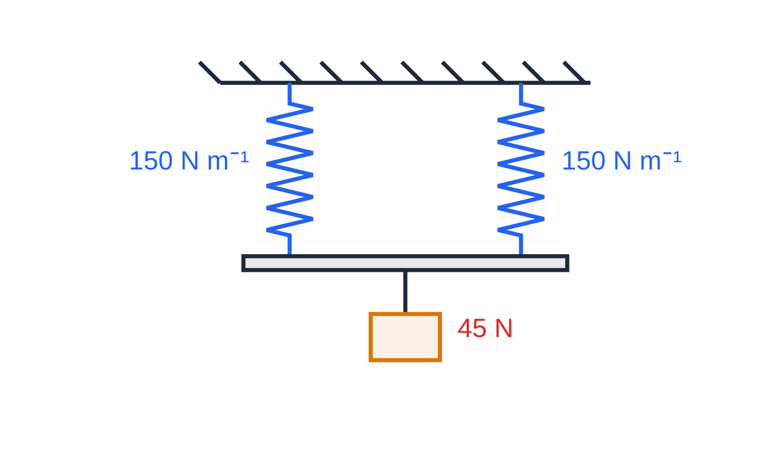
Question 1
1 mark
Two identical springs, each of stiffness 150 N m⁻¹, hang side by side and are joined at the bottom by a light horizontal bar. A load of weight 45 N hangs from the centre of the bar. The springs obey Hooke's law.
What is the total elastic strain energy stored in the two springs?
Figure: two identical springs side by side supporting the bar (not to scale)
A 1.7 J
B 3.4 J
C 6.8 J
D 14 J
Notes:
Online with the full mark scheme: https://examinerprep.com/ial-physics-1-8-hookes-law-and-elastic-strain-energy-questions#IALP-U1-8-A-05

Slide 43
Question 2
1 mark
A force of 18 N extends a spring by 40 mm. The spring obeys Hooke's law.
What is the elastic strain energy stored in the spring?
A 0.36 J
B 0.72 J
C 360 J
D 720 J
Notes:
Online with the full mark scheme: https://examinerprep.com/ial-physics-1-8-hookes-law-and-elastic-strain-energy-questions#IALP-U1-8-A-08

Slide 44
Question 3
1 mark
A spring that obeys Hooke's law is stretched from an extension of 2.0 cm to an extension of 6.0 cm.
The extra elastic strain energy stored is how many times the energy stored at 2.0 cm?
A 2
B 3
C 8
D 9
Notes:
Online with the full mark scheme: https://examinerprep.com/ial-physics-1-8-hookes-law-and-elastic-strain-energy-questions#IALP-U1-8-A-09

Slide 45
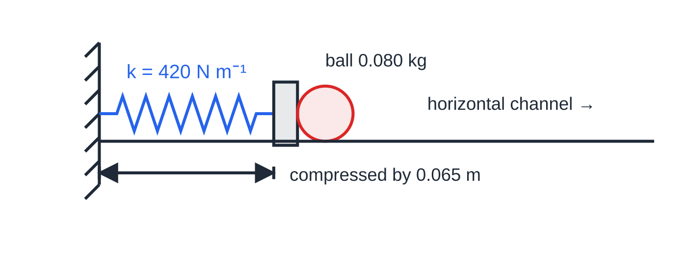
Question 4
5 marks
In a pinball machine, a ball of mass 0.080 kg rests against a plunger. The plunger spring, of stiffness 420 N m⁻¹, is compressed by 0.065 m and then released, launching the ball along a horizontal channel. The spring obeys Hooke's law.
Figure: the compressed plunger spring with the ball resting against it (not to scale)
(a) Calculate the elastic strain energy stored in the compressed spring. [2]
(b) Calculate the speed of the ball as it leaves the plunger, assuming all the stored energy becomes kinetic energy of the ball. [2]
(c) Suggest why the actual speed of the ball is less than this. [1]
Notes:
Online with the full mark scheme: https://examinerprep.com/ial-physics-1-8-hookes-law-and-elastic-strain-energy-questions#IALP-U1-8-B-06

Slide 46
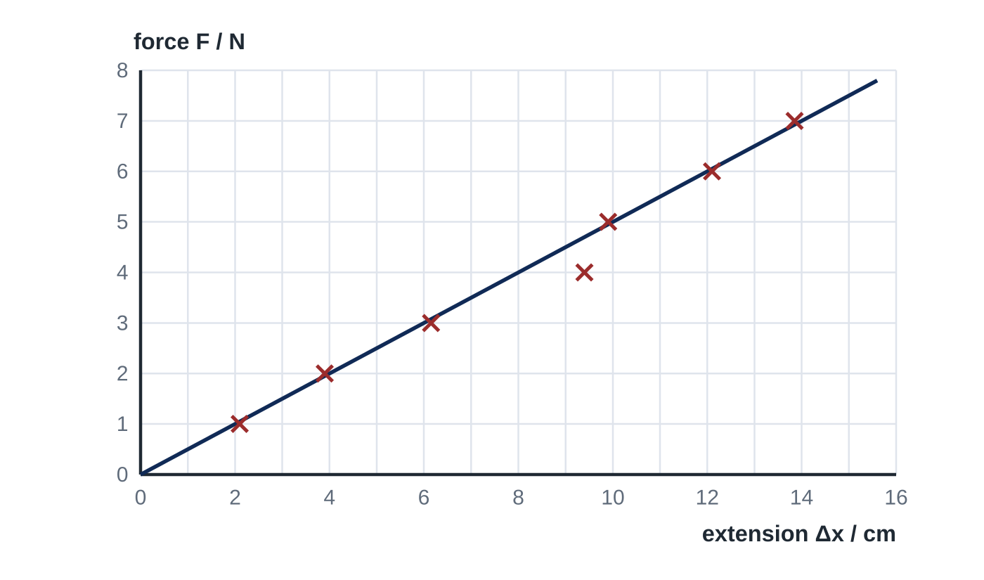
Question 5
5 marks
A student measures the extension of a spring from a toy trampoline as she adds weights to it. The graph shows her results and her best-fit line.
(a) State how the graph shows that the spring obeys Hooke's law over this range. [1]
(b) Identify the anomalous result. [1]
(c) Use the best-fit line to determine the stiffness of the spring. [2]
(d) Calculate the elastic strain energy stored in the spring when the force on it is 5.0 N. Use the best-fit line. [1]
Notes:
Online with the full mark scheme: https://examinerprep.com/ial-physics-1-8-hookes-law-and-elastic-strain-energy-questions#IALP-U1-8-FB-01

Slide 47
Answers

Slide 48
Question 1 · answer
Answer B
In parallel the combined stiffness is 300 N m⁻¹, so the extension is 45 ÷ 300 = 0.15 m. Total energy = ½FΔx = ½ × 45 × 0.15 = 3.4 J (3.375 J).
Notes:
Full mark scheme: https://examinerprep.com/ial-physics-1-8-hookes-law-and-elastic-strain-energy-questions#IALP-U1-8-A-05

Slide 49
Question 2 · answer
Answer A
ΔEₑₗ = ½FΔx = ½ × 18 × 0.040 = 0.36 J.
Notes:
Full mark scheme: https://examinerprep.com/ial-physics-1-8-hookes-law-and-elastic-strain-energy-questions#IALP-U1-8-A-08

Slide 50
Question 3 · answer
Answer C
ΔEₑₗ = ½k(Δx)² ∝ (Δx)². Energy at 6.0 cm = 3² = 9 times the energy at 2.0 cm, so the extra energy is 9 − 1 = 8 times it.
Notes:
Full mark scheme: https://examinerprep.com/ial-physics-1-8-hookes-law-and-elastic-strain-energy-questions#IALP-U1-8-A-09

Slide 51
Question 4 · answer
Mark scheme
F = 420 × 0.065 = 27.3 N, or use ½k(Δx)²
ΔEₑₗ = ½ × 27.3 × 0.065 = 0.89 J (0.887 J)
½mv² = 0.887
v = √(2 × 0.887 ÷ 0.080) = 4.7 m s⁻¹ (allow error carried forward)
some of the energy becomes kinetic energy of the plunger and spring / is dissipated by friction as thermal energy
Notes:
Full mark scheme: https://examinerprep.com/ial-physics-1-8-hookes-law-and-elastic-strain-energy-questions#IALP-U1-8-B-06

Slide 52
Question 5 · answer
Mark scheme
the best-fit line is straight and passes through the origin, so the extension is proportional to the force
the reading at 4.0 N (extension about 9.4 cm), which lies well off the line
gradient = ΔF/Δx from a large triangle, e.g. 6.0 N ÷ 0.120 m
= 50 N m⁻¹ (allow 48–52 N m⁻¹)
Δx = 5.0 ÷ 50 = 0.10 m, so ΔEₑₗ = ½ × 5.0 × 0.10 = 0.25 J (allow error carried forward)
Notes:
Full mark scheme: https://examinerprep.com/ial-physics-1-8-hookes-law-and-elastic-strain-energy-questions#IALP-U1-8-FB-01

Slide 53
Keep practising
Notes for this topic
Questions on this topic
Build a printable test
ExaminerPrep is an independent tutoring service. It has been developed independently from and is not endorsed by the International Baccalaureate Organization. "International Baccalaureate", "IB" and "IB Diploma Programme" are registered trademarks of the IBO, used here for descriptive purposes only.
Pearson Edexcel and Cambridge are trademarks of their owners; ExaminerPrep is not affiliated with any exam board.

