Slide 1
EP
EDEXCEL IAL PHYSICS
4.1 Impulse and momentum in two dimensions
The full notes page in 13 sections · practice questions with answers · simulations
ExaminerPrep is an independent tutoring service. It has been developed independently from and is not endorsed by the International Baccalaureate Organization. "International Baccalaureate", "IB" and "IB Diploma Programme" are registered trademarks of the IBO, used here for descriptive purposes only.
Pearson Edexcel and Cambridge are trademarks of their owners; ExaminerPrep is not affiliated with any exam board.
Notes:
4.1 Impulse and momentum in two dimensions. Notes for this topic: https://examinerprep.com/notes/edexcel-ial-physics/impulse-and-momentum-in-two-dimensions/

Slide 2
What this page covers
Overview
Newton's second law in momentum form, F = Δp/Δt, and impulse FΔt = Δp
Impulse as the area under a force–time graph; why longer contact times mean smaller forces
Core Practical 9: investigating the relationship between force and change of momentum
Conservation of momentum in two dimensions: glancing collisions
Explosions into several directions
Elastic and inelastic collisions, and how to decide which one you have
Deriving and using Eₖ = p²/2m
Core Practical 10: using video analysis to study collisions between small spheres
Notes:
What this page covers. Full notes: https://examinerprep.com/notes/edexcel-ial-physics/impulse-and-momentum-in-two-dimensions/

Slide 3
In one minute
Key points
1
Newton's second law says the resultant force equals the rate of change of momentum, F = Δp/Δt, so a force acting for a time gives an impulse FΔt = Δp.
4
In two dimensions, momentum is conserved separately in each of two perpendicular directions (if no resultant external force acts).
2
Impulse has unit N s (= kg m s⁻¹). For a varying force it is the area under the force–time graph.
5
Elastic: total kinetic energy is unchanged. Inelastic: some kinetic energy is transferred to other stores. Momentum is conserved in both.
3
For the same change in momentum, a longer contact time means a smaller average force.
6
Eₖ = p²/2m: for the same momentum, the lighter body has more kinetic energy.
Notes:
In one minute: the key points of this topic.

Slide 4
What is impulse, and how is it linked to Newton's second law?
Section 1 of 13
In Unit 1 you met momentum, p = mv, and its conservation along a line. At A2 force itself is defined through momentum.
Newton's second law (momentum form): the resultant force on a body is equal to its rate of change of momentum, F = Δp/Δt.
For a body of constant mass, Δp/Δt = mΔv/Δt = ma, so F = ma is a special case. The momentum form also works when the mass changes, for example a jet of water hitting a wall, where the force is (mass arriving per second) × (change in velocity). Multiplying both sides by Δt gives the impulse of the force:
FΔt = Δp
Here F is the resultant force (N), Δt the time for which it acts (s) and Δp the change of momentum (kg m s⁻¹). This equation is in the formulae list. If the force varies, F is the average resultant force over Δt.
Notes:
What is impulse, and how is it linked to Newton's second law?. Full notes: https://examinerprep.com/notes/edexcel-ial-physics/impulse-and-momentum-in-two-dimensions/

Slide 5
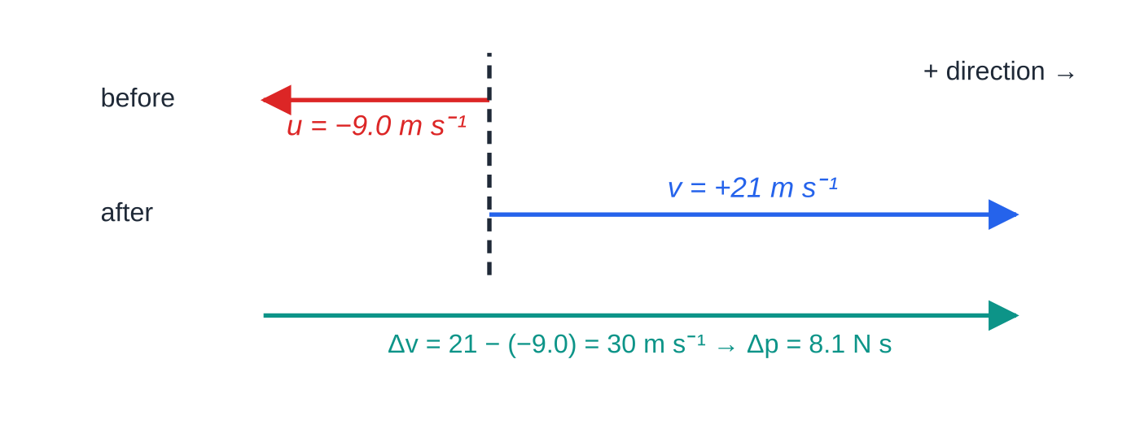
What is impulse, and how is it linked to Newton's second law? (continued)
Section 1 of 13
Impulse is a vector in the direction of the resultant force, and its unit N s is the same as kg m s⁻¹.
Worked example 1. Because the ball reverses, the change in velocity is the length of the whole teal arrow, 30 m s⁻¹, not 21 − 9.0 = 12 m s⁻¹.
Notes:
What is impulse, and how is it linked to Newton's second law?. Full notes: https://examinerprep.com/notes/edexcel-ial-physics/impulse-and-momentum-in-two-dimensions/

Slide 6
What is impulse, and how is it linked to Newton's second law? (continued)
Section 1 of 13 · Worked example 1 · Easy · Calculate
WORKED EXAMPLE · QUESTION
A volleyball of mass 0.27 kg travels horizontally towards a player at 9.0 m s⁻¹. She hits it straight back along the same line at 21 m s⁻¹. Her hand is in contact with the ball for 0.015 s. Calculate the average force her hand exerts on the ball.
SOLUTION
Take the return direction as positive, so u = −9.0 m s⁻¹ and v = +21 m s⁻¹. Δp = 0.27 ×(21 - (-9.0)) = 0.27 ×30 = 8.1 N s.
F = Δp/Δt = (8.1/0.015) = 540 N in the return direction
Using 21 − 9.0 instead gives 220 N: the reversal of direction has been ignored.
Notes:
What is impulse, and how is it linked to Newton's second law?: Worked example 1. Full notes: https://examinerprep.com/notes/edexcel-ial-physics/impulse-and-momentum-in-two-dimensions/

Slide 7
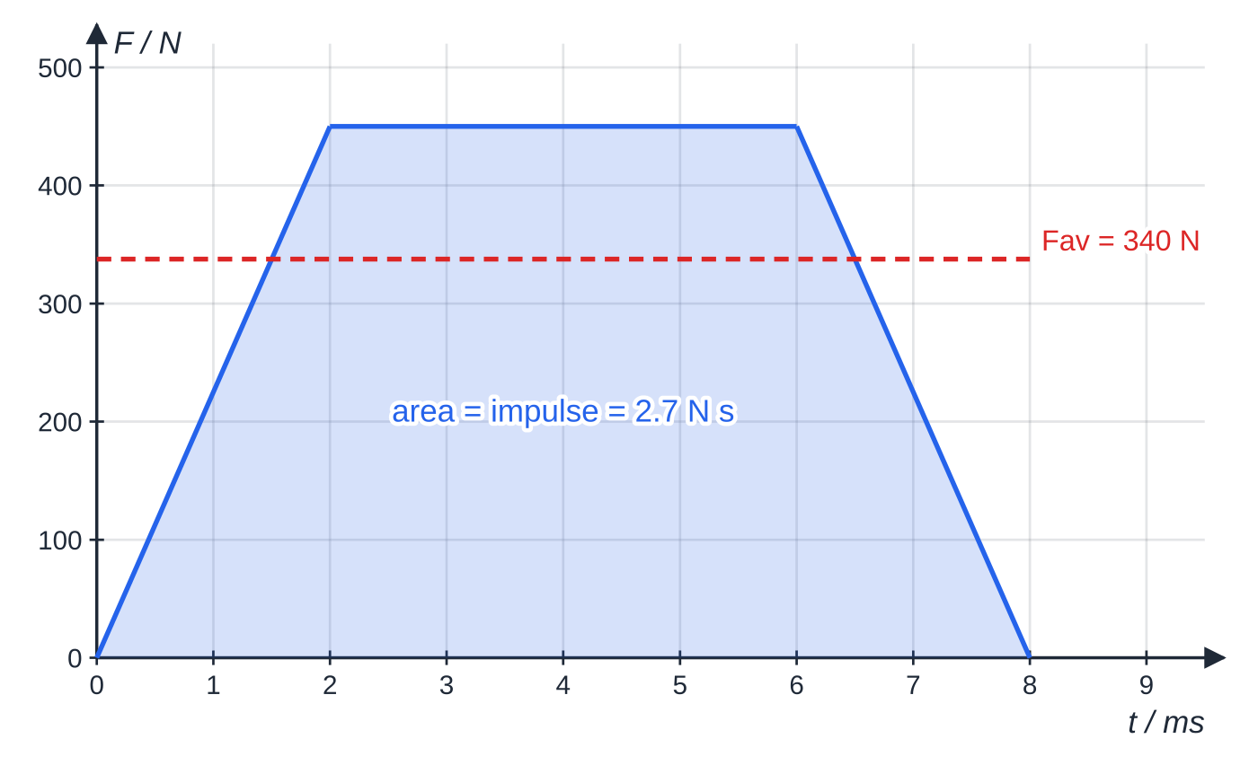
How do you find an impulse from a force–time graph?
Section 2 of 13
In a real impact the force is not constant: it rises, peaks and falls in a few milliseconds. Each thin strip under a force–time graph has area FΔt, so the area under the graph is the impulse, and therefore the change of momentum. For straight-line graphs, split the area into triangles and rectangles. For a curve, count squares and multiply by the impulse that one square represents. The average force is the area divided by the total contact time.
Force on a puck from a hockey stick. The shaded area is the impulse, 2.7 N s. The dashed line is the constant force that would give the same area over the same 8.0 ms.
Notes:
How do you find an impulse from a force–time graph?. Full notes: https://examinerprep.com/notes/edexcel-ial-physics/impulse-and-momentum-in-two-dimensions/

Slide 8
How do you find an impulse from a force–time graph? (continued)
Section 2 of 13 · Worked example 2 · Medium · Calculate
WORKED EXAMPLE · QUESTION
A hockey puck of mass 0.17 kg is at rest on the ice. A stick strikes it. The force on the puck rises steadily from zero to 450 N in 2.0 ms, stays at 450 N for 4.0 ms, then falls steadily to zero over 2.0 ms (figure above). Friction from the ice is negligible during the strike. (a) Calculate the speed of the puck as it leaves the stick. (b) Calculate the average force on the puck during the contact.
SOLUTION
(a) Area = two triangles + one rectangle, with times in seconds: 2 ×½ ×450 ×2.0×10⁻³ + 450 ×4.0×10⁻³ = 0.90 + 1.80 = 2.7 N s.
Impulse = change of momentum, from rest: v = (2.7/0.17) = 15.9 m s⁻¹ ≈ 16 m s⁻¹
(b) Fₐᵥ = 2.7/(8.0×10⁻³) = 337.5 N ≈ 340 N
Notes:
How do you find an impulse from a force–time graph?: Worked example 2. Full notes: https://examinerprep.com/notes/edexcel-ial-physics/impulse-and-momentum-in-two-dimensions/

Slide 9
How do you find an impulse from a force–time graph? (continued)
Section 2 of 13
Common error — leaving time in milliseconds
450 N × 4.0 ms is 1.8 N s, not 1800 N s. Convert ms to s before you multiply, or the impulse comes out a thousand times too big.
Why longer contact times protect you
When a moving body is brought to rest, its change of momentum is fixed by its mass and speed. Only the contact time can be changed. Since F = Δp/Δt, increasing Δt reduces the average force. Crumple zones, airbags, helmet foam, gym mats and phone cases all work this way. The same idea works in reverse: to give a ball a large change of momentum, "follow through" so the force acts for longer.
Notes:
How do you find an impulse from a force–time graph?. Full notes: https://examinerprep.com/notes/edexcel-ial-physics/impulse-and-momentum-in-two-dimensions/

Slide 10
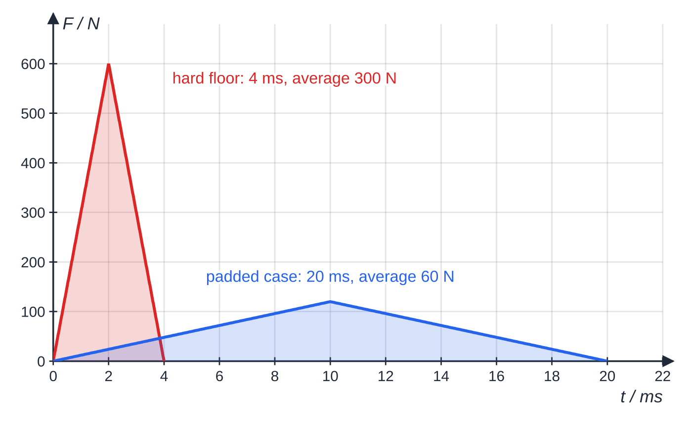
How do you find an impulse from a force–time graph? (continued)
Section 2 of 13
A 0.20 kg phone hits the floor at 6.0 m s⁻¹ and stops, so its change of momentum is 1.2 N s either way. The two shaded areas are equal; spreading the stop over five times as long cuts the average force to a fifth.
Notes:
How do you find an impulse from a force–time graph?. Full notes: https://examinerprep.com/notes/edexcel-ial-physics/impulse-and-momentum-in-two-dimensions/

Slide 11
Core Practical 9: how do you investigate force and change of momentum?
Section 3 of 13
The aim is to show that the impulse of a force (the area under its force–time graph) equals the change of momentum it produces. One way to do it:
Set-up: a trolley carrying a card runs down a runway towards a force sensor fixed at the end. A pad of modelling clay on the sensor makes the trolley stop dead rather than bounce. A light gate just before the sensor times the card. Both connect to a data logger.
Friction compensation: tilt the runway until a trolley given a small push moves at constant speed (the light-gate times at two points are equal). Then there is no resultant external force on the trolley before the impact.
Measurements: mass of trolley and card on a top-pan balance; card length with a ruler or vernier calipers; the time for the card to pass through the gate; the force–time graph of the impact, sampled at a high rate (at least 1000 readings per second, because the impact lasts only tens of milliseconds).
Calculations: u = card length ÷ time, so the change of momentum is mu (final momentum zero). The logger's software finds the area under the force–time graph.
Notes:
Core Practical 9: how do you investigate force and change of momentum?. Full notes: https://examinerprep.com/notes/edexcel-ial-physics/impulse-and-momentum-in-two-dimensions/

Slide 12
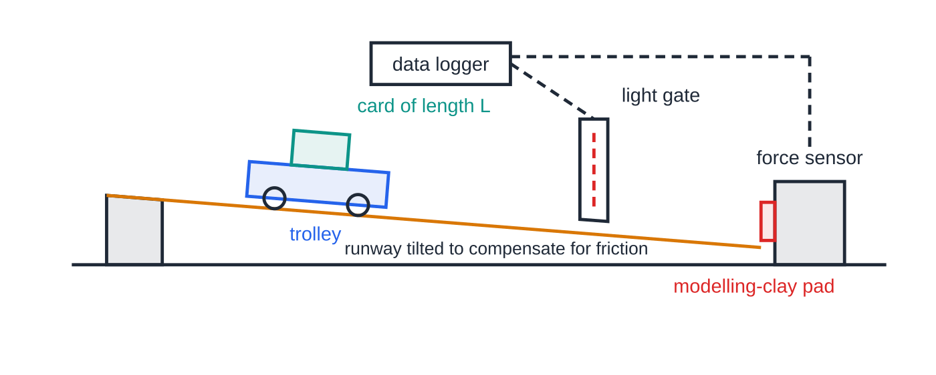
Core Practical 9: how do you investigate force and change of momentum? (continued)
Section 3 of 13
Range: release the trolley from different points to change u, and repeat each run. Plot impulse (area) against mΔv: a straight line through the origin with gradient 1 supports FΔt = Δp.
Safety: stop the trolley at the end of the bench; keep the runway stable when it is tilted.
Core Practical 9 arrangement. The light gate gives the speed just before impact; the force sensor, sampled by the data logger, gives the force–time graph of the impact itself.
Notes:
Core Practical 9: how do you investigate force and change of momentum?. Full notes: https://examinerprep.com/notes/edexcel-ial-physics/impulse-and-momentum-in-two-dimensions/

Slide 13
Core Practical 9: how do you investigate force and change of momentum? (continued)
Section 3 of 13 · Worked example 3 · Hard · Calculate, deduce
WORKED EXAMPLE · QUESTION
In one run, the trolley and card have mass (0.640 ± 0.005) kg. The card is (0.0500 ± 0.0005) m long and passes through the light gate in (0.0625 ± 0.0010) s. The trolley stops against the pad. The data logger gives the area under the force–time graph as 0.501 N s. (a) Calculate the change of momentum of the trolley and its percentage uncertainty. (b) Deduce whether the result supports impulse = change of momentum.
SOLUTION
(a) u = (0.0500/0.0625) = 0.800 m s⁻¹, so Δp = 0.640 ×0.800 = 0.512 N s.
Δp = mL/t, so add the percentage uncertainties: 0.78% + 1.0% + 1.6% = 3.4%. Δp = 0.512 N s ± 3.4% (± 0.017 N s)
(b) Δp lies between 0.495 and 0.529 N s, and the impulse, 0.501 N s, is inside this range. The two values differ by 2.1%, less than the 3.4% uncertainty, so the result supports FΔt = Δp.
Notes:
Core Practical 9: how do you investigate force and change of momentum?: Worked example 3. Full notes: https://examinerprep.com/notes/edexcel-ial-physics/impulse-and-momentum-in-two-dimensions/

Slide 14
Core Practical 9: how do you investigate force and change of momentum? (continued)
Section 3 of 13 · Worked example 3 · Hard · Calculate, deduce (continued)
The timing is the largest source of uncertainty; a longer card would reduce it.
Notes:
Core Practical 9: how do you investigate force and change of momentum?: Worked example 3. Full notes: https://examinerprep.com/notes/edexcel-ial-physics/impulse-and-momentum-in-two-dimensions/

Slide 15
Core Practical 9: how do you investigate force and change of momentum? (continued)
Section 3 of 13
Exam tip — combining uncertainties
In Unit 4 you are expected to combine uncertainties. For a quantity found by multiplying or dividing (such as mL/t), add the percentage uncertainties. For a quantity found by adding or subtracting, add the absolute uncertainties.
Notes:
Core Practical 9: how do you investigate force and change of momentum?. Full notes: https://examinerprep.com/notes/edexcel-ial-physics/impulse-and-momentum-in-two-dimensions/

Slide 16
How do you apply conservation of momentum in two dimensions?
Section 4 of 13
Momentum is a vector. When bodies move in a plane, the total momentum is the vector sum of the individual momenta. If no resultant external force acts, the total momentum vector is constant, so its component in every direction is constant. That turns one vector equation into two ordinary ones.
Choose two perpendicular directions (usually the original line of motion, x, and at right angles to it, y) and write one conservation equation for each.
Resolve each momentum: pₓ = pcos θ, p_y = psin θ, with θ measured from the x direction. Signs show which side of the line a body moves.
Recombine at the end: magnitude √(pₓ² + p_y²), direction tan⁻¹(p_y/pₓ).
A glancing (oblique) collision is one where the bodies do not move along the line joining their centres, so they move off at angles to the original line.
Notes:
How do you apply conservation of momentum in two dimensions?. Full notes: https://examinerprep.com/notes/edexcel-ial-physics/impulse-and-momentum-in-two-dimensions/

Slide 17
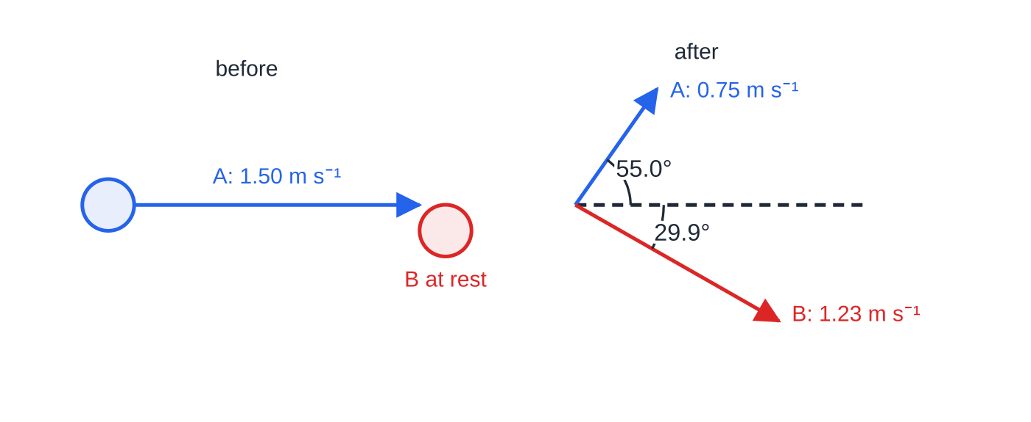
How do you apply conservation of momentum in two dimensions? (continued)
Section 4 of 13
A glancing collision between two curling stones of equal mass, seen from above. Arrow lengths are proportional to the speeds; B's speed and angle after the collision are the results of worked example 4.
Notes:
How do you apply conservation of momentum in two dimensions?. Full notes: https://examinerprep.com/notes/edexcel-ial-physics/impulse-and-momentum-in-two-dimensions/

Slide 18
How do you apply conservation of momentum in two dimensions? (continued)
Section 4 of 13 · Worked example 4 · Hard · Determine
WORKED EXAMPLE · QUESTION
A curling stone A of mass 19.0 kg slides at 1.50 m s⁻¹ and strikes a stationary stone B of the same mass a glancing blow. Afterwards A moves at 0.75 m s⁻¹ at 55.0° to its original direction. Friction is negligible during the collision. Determine the velocity of B just after the collision.
SOLUTION
Take x along A's original direction and y towards the side A moves to. Momentum before: x: 19.0 × 1.50 = 28.5 kg m s⁻¹; y: 0.
A after: x: 19.0 × 0.75 cos 55.0° = 8.17 kg m s⁻¹; y: 19.0 × 0.75 sin 55.0° = 11.67 kg m s⁻¹.
Conserve x: 28.5 = 8.17 + 19.0vₓ, so vₓ = 1.070 m s⁻¹. Conserve y: 0 = 11.67 + 19.0v_y, so v_y = -0.614 m s⁻¹.
Recombine: v = √(1.070² + 0.614²) = 1.23 m s⁻¹ at tan⁻¹(0.614/1.070) = 29.9°. 1.23 m s⁻¹ at 29.9° to A's original direction, on the opposite side of the line from A
Notes:
How do you apply conservation of momentum in two dimensions?: Worked example 4. Full notes: https://examinerprep.com/notes/edexcel-ial-physics/impulse-and-momentum-in-two-dimensions/

Slide 19
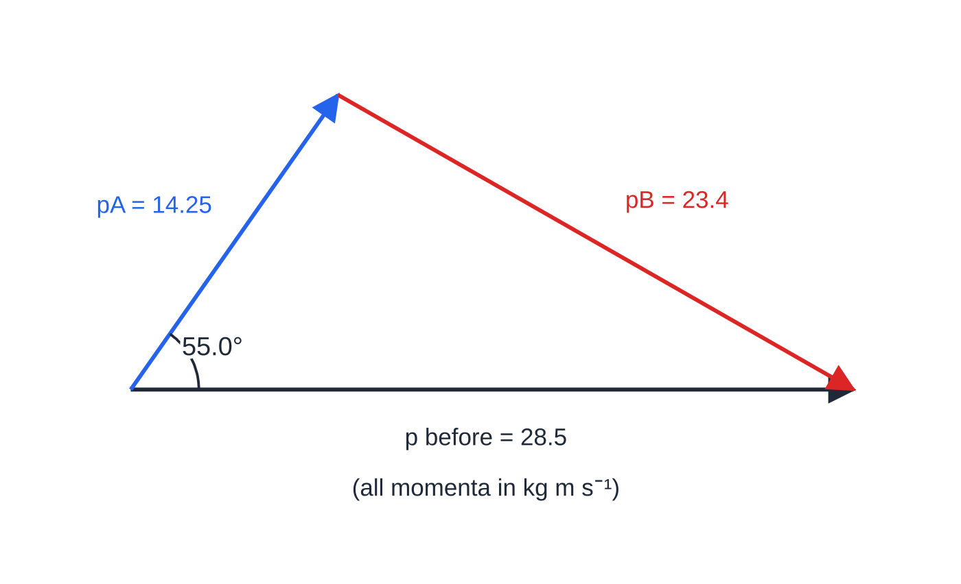
How do you apply conservation of momentum in two dimensions? (continued)
Section 4 of 13
Exam tip — components or a triangle
You can also solve a two-body problem with a scale drawing or the cosine rule on the vector triangle, but components are safer and are expected when angles and speeds are both unknown. Always state the direction of a final velocity as an angle and a reference line.
The same collision as a momentum vector triangle, drawn to scale. Placed head to tail, the two momenta after the collision add up to the single momentum before it.
Notes:
How do you apply conservation of momentum in two dimensions?. Full notes: https://examinerprep.com/notes/edexcel-ial-physics/impulse-and-momentum-in-two-dimensions/

Slide 20
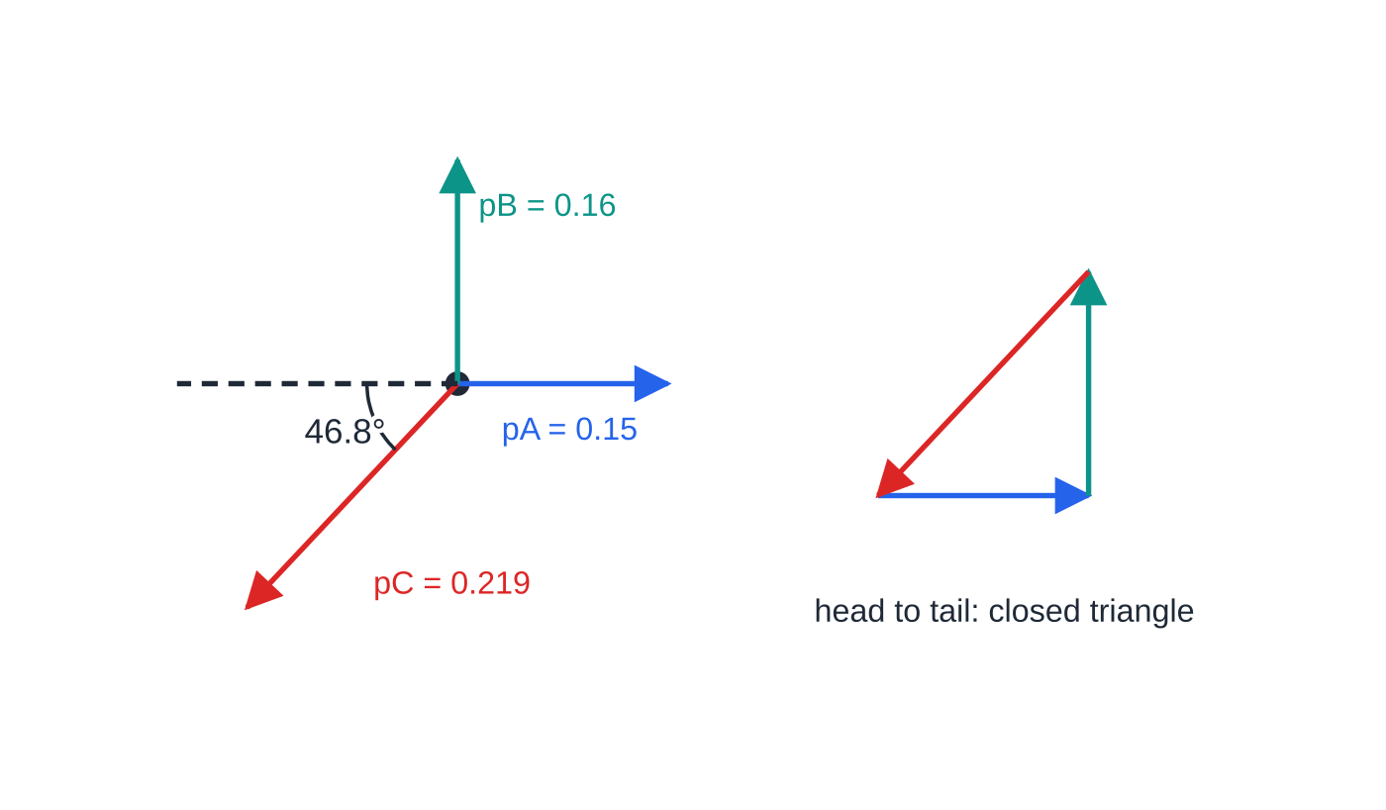
How do you handle an explosion into several directions?
Section 5 of 13
An object at rest has zero momentum, so after it breaks apart the vector sum of the fragments' momenta is still zero. With two fragments, they fly apart in exactly opposite directions. With three, their momenta drawn head to tail form a closed triangle, so the three velocities lie in one plane. If the object was moving before the explosion, the total momentum after equals its momentum before, in both components. Kinetic energy is not conserved: chemical or elastic potential energy is transferred to kinetic energy of the fragments.
Momenta (kg m s⁻¹) of the three fragments from debris at rest, drawn to scale. Left: C's momentum cancels the resultant of A and B. Right: head to tail, the three momenta form a closed triangle, so their sum is zero.
Notes:
How do you handle an explosion into several directions?. Full notes: https://examinerprep.com/notes/edexcel-ial-physics/impulse-and-momentum-in-two-dimensions/

Slide 21
How do you handle an explosion into several directions? (continued)
Section 5 of 13 · Worked example 5 · Medium · Determine
WORKED EXAMPLE · QUESTION
A piece of space debris of mass 0.200 kg is at rest relative to an observer. It breaks into three fragments. A (0.050 kg) moves at 3.0 m s⁻¹ in the +x direction; B (0.080 kg) moves at 2.0 m s⁻¹ in the +y direction. Determine the velocity of the third fragment, C.
SOLUTION
m_C = 0.200 - 0.050 - 0.080 = 0.070 kg; p_A = 0.15 kg m s⁻¹ (+x); p_B = 0.16 kg m s⁻¹ (+y).
Total momentum is zero in each direction: p_(C,x) = -0.15, p_(C,y) = -0.16, so p_C = √(0.15² + 0.16²) = 0.219 kg m s⁻¹.
v_C = (0.219/0.070) = 3.13 m s⁻¹, at tan⁻¹(0.16/0.15) = 46.8°. 3.1 m s⁻¹ at 46.8° below the −x direction
C moves into the quadrant opposite to both A and B, as it must for the total to be zero.
Notes:
How do you handle an explosion into several directions?: Worked example 5. Full notes: https://examinerprep.com/notes/edexcel-ial-physics/impulse-and-momentum-in-two-dimensions/

Slide 22
What makes a collision elastic or inelastic?
Section 6 of 13
Type of collision | Momentum | Total kinetic energy | Example
Elastic | conserved | conserved (same before and after) | collisions between gas molecules; very nearly, two steel spheres
Inelastic | conserved | decreases: some is transferred to internal (thermal) energy, sound and deformation | most real collisions: cars, balls, curling stones
Bodies stick together (totally inelastic) | conserved | the largest decrease that momentum conservation allows | a dart sticking in a target
Explosion | conserved | increases: energy comes from a chemical or elastic store | a spring-loaded separation; a firework
Momentum is conserved in every one of these, provided no resultant external force acts, because the internal forces are equal and opposite. Kinetic energy is what tells them apart.
Notes:
What makes a collision elastic or inelastic?. Full notes: https://examinerprep.com/notes/edexcel-ial-physics/impulse-and-momentum-in-two-dimensions/

Slide 23
What makes a collision elastic or inelastic? (continued)
Section 6 of 13
To test a collision, calculate the total kinetic energy before and after and compare. Kinetic energy is a scalar, so just add the values; no components are needed.
Applied to worked example 4: before, ½ ×19.0 ×1.50² = 21.4 J; after, 5.34 J + 14.5 J = 19.8 J. About 1.6 J (7.4%) has been transferred, so the collision is inelastic.
Exam tip — the 90° check for equal masses
If a body hits an identical stationary body elastically, they move off at 90° to each other. Momentum gives u⃗ = v⃗_A + v⃗_B, and kinetic energy gives u² = v_A² + v_B²; together they are Pythagoras' theorem. In worked example 4 the angle between the paths is 55.0° + 29.9° = 84.9°, less than 90°, which agrees with the collision being inelastic.
Notes:
What makes a collision elastic or inelastic?. Full notes: https://examinerprep.com/notes/edexcel-ial-physics/impulse-and-momentum-in-two-dimensions/

Slide 24
Where does Eₖ = p²/2m come from, and when is it useful?
Section 7 of 13
Start from Eₖ = ½ mv² and p = mv, so v = p/m. Substitute:
Eₖ = ½ m(p/m)² = p²/2m
Here Eₖ is in J, p in kg m s⁻¹ and m in kg. It is in the formulae list, but you may be asked to derive it. It is valid for speeds much less than the speed of light. It is useful when you know the momentum rather than the velocity, especially after an explosion or decay from rest, where the fragments have momenta of equal size. Then Eₖ ∝1/m: the light fragment takes almost all the kinetic energy. Rearranged, p = √(2mEₖ) gives the momentum of a particle of known kinetic energy.
Notes:
Where does Eₖ = p²/2m come from, and when is it useful?. Full notes: https://examinerprep.com/notes/edexcel-ial-physics/impulse-and-momentum-in-two-dimensions/

Slide 25
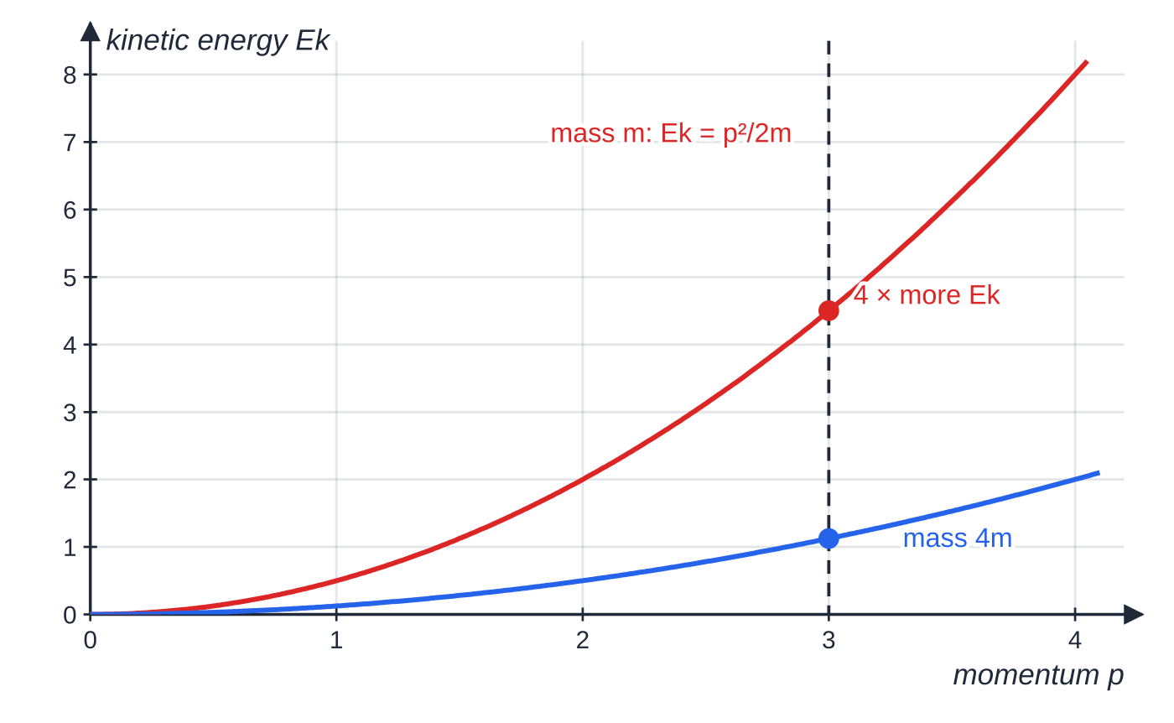
Where does Eₖ = p²/2m come from, and when is it useful? (continued)
Section 7 of 13
Ek = p²/2m for two bodies, one four times as massive as the other (arbitrary units). At the same momentum, the lighter body has four times the kinetic energy: Ek ∝ 1/m.
Notes:
Where does Eₖ = p²/2m come from, and when is it useful?. Full notes: https://examinerprep.com/notes/edexcel-ial-physics/impulse-and-momentum-in-two-dimensions/

Slide 26
Where does Eₖ = p²/2m come from, and when is it useful? (continued)
Section 7 of 13 · Worked example 6 · Medium · Calculate
WORKED EXAMPLE · QUESTION
A nucleus at rest emits an alpha particle (mass 6.64 × 10⁻²⁷ kg) with kinetic energy 5.30 MeV. The nucleus left behind has mass 3.42 × 10⁻²⁵ kg. 1 eV = 1.60 × 10⁻¹⁹ J. (a) Calculate the momentum of the alpha particle. (b) Calculate the kinetic energy of the recoiling nucleus.
SOLUTION
(a) Eₖ = 5.30×10⁶ ×1.60×10⁻¹⁹ = 8.48×10⁻¹³ J. p = √(2 ×6.64×10⁻²⁷ ×8.48×10⁻¹³) = 1.06 ×10⁻¹⁹ kg m s⁻¹
(b) Momentum is conserved from rest, so the nucleus has a momentum of the same size: Eₖ = ((1.06×10⁻¹⁹)²)/(2 ×3.42×10⁻²⁵) = 1.65 ×10⁻¹⁴ J (≈ 0.103 MeV)
Quick route: with equal momenta, Eₖ ∝1/m, so the recoil energy is 5.30 MeV × (6.64 × 10⁻²⁷ / 3.42 × 10⁻²⁵). The alpha particle carries 98.1% of the kinetic energy released.
Notes:
Where does Eₖ = p²/2m come from, and when is it useful?: Worked example 6. Full notes: https://examinerprep.com/notes/edexcel-ial-physics/impulse-and-momentum-in-two-dimensions/

Slide 27
Core Practical 10: how do you analyse collisions between spheres using video?
Section 8 of 13
Set-up: two small spheres (for example a steel ball bearing and a glass marble) on a smooth, level surface. Sphere B is at rest; sphere A is rolled at it slightly off-centre so that they collide at a glancing angle.
Camera: fixed directly above, pointing straight down, so the plane of motion is perpendicular to the line of sight. A ruler or grid of known spacing in the plane of the spheres calibrates distances and avoids parallax errors.
Recording: use a high frame rate and good lighting to reduce motion blur. The frame rate gives the time between frames.
Analysis (ICT): video-analysis software tracks the centre of each sphere frame by frame and outputs x and y coordinates against time. Velocity components = change in coordinate ÷ time interval (or the gradient of the position–time graphs).
Masses on a top-pan balance. Then compare the total momentum in x and in y before and after, and the total kinetic energy.
Notes:
Core Practical 10: how do you analyse collisions between spheres using video?. Full notes: https://examinerprep.com/notes/edexcel-ial-physics/impulse-and-momentum-in-two-dimensions/

Slide 28
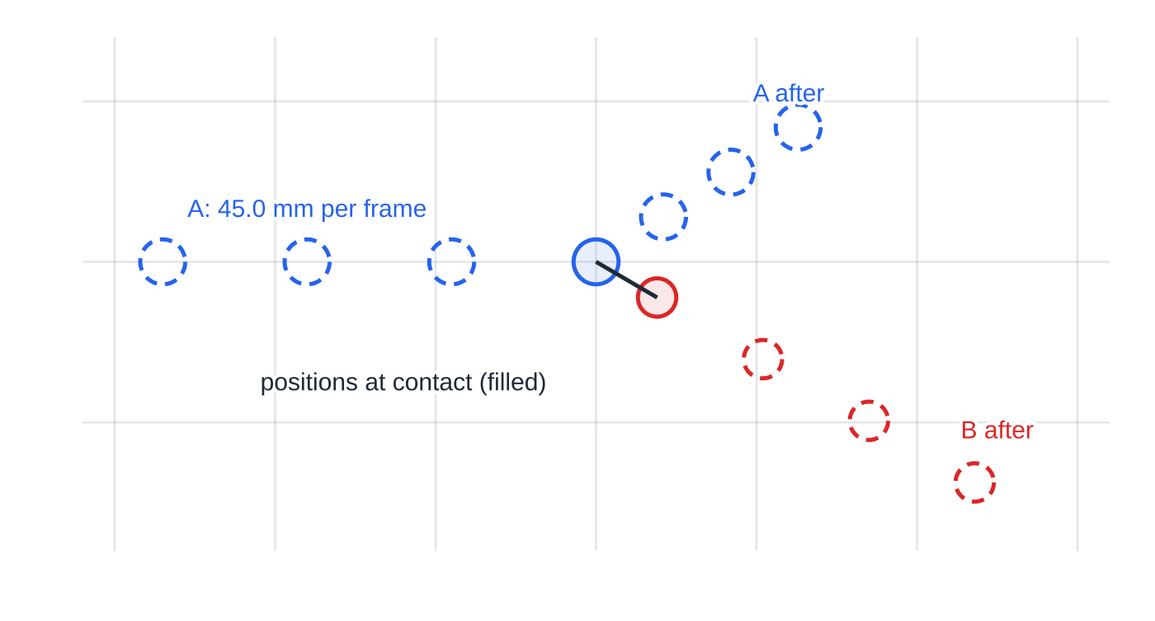
Core Practical 10: how do you analyse collisions between spheres using video? (continued)
Section 8 of 13
Limitations: rolling spheres also store rotational kinetic energy, and rolling friction slows them, so take velocities from frames close to the collision.
Positions of the two spheres from the video, one image every 0.0500 s, on a 50 mm grid (worked example 7). At contact, the line joining the centres points along B's later direction of motion.
Notes:
Core Practical 10: how do you analyse collisions between spheres using video?. Full notes: https://examinerprep.com/notes/edexcel-ial-physics/impulse-and-momentum-in-two-dimensions/

Slide 29
Core Practical 10: how do you analyse collisions between spheres using video? (continued)
Section 8 of 13 · Worked example 7 · Hard · Calculate, deduce
WORKED EXAMPLE · QUESTION
In the video above, sphere A (mass 28.0 g) moves 45.0 mm along x between images before the collision. Afterwards, between images, A moves 21.0 mm in x and +14.0 mm in y, while sphere B (mass 20.0 g) moves 33.0 mm in x and −19.2 mm in y. Images are 0.0500 s apart. Each position is read to ± 0.5 mm, and each mass to ± 0.1 g. (a) Calculate the total momentum in the x and y directions before and after. (b) Deduce whether momentum is conserved within the uncertainties. (c) State whether the collision is elastic.
SOLUTION
(a) Velocities (displacement ÷ 0.0500 s): u_A = 0.900 m s⁻¹; v_A = (0.420, 0.280); v_B = (0.660, -0.384) m s⁻¹.
Before: x = 0.0280 × 0.900 = 0.0252 kg m s⁻¹, y = 0. After: x = 0.01176 + 0.0132 = 0.0250 kg m s⁻¹; y = 0.00784 − 0.00768 = 0.00016 kg m s⁻¹
Notes:
Core Practical 10: how do you analyse collisions between spheres using video?: Worked example 7. Full notes: https://examinerprep.com/notes/edexcel-ial-physics/impulse-and-momentum-in-two-dimensions/

Slide 30
Core Practical 10: how do you analyse collisions between spheres using video? (continued)
Section 8 of 13 · Worked example 7 · Hard · Calculate, deduce (continued)
(b) Each displacement is the difference of two readings, so ± 1.0 mm. Before: 1.0/45.0 + 0.1/28.0 = 2.6%, so ± 0.00065. After: ± 0.00060 (A) and ± 0.00047 (B), so ± 0.0011 in total.
The x totals differ by 0.0002 kg m s⁻¹ (0.95%), much less than the combined uncertainty, and the y total after is close to zero compared with the individual y momenta (about 0.0078). Momentum is conserved within experimental uncertainty.
(c) Kinetic energy before 11.3 mJ, after 9.4 mJ, about 17% less: inelastic. Part of the apparent loss is rotational kinetic energy of the rolling spheres, which the video analysis does not count.
Notes:
Core Practical 10: how do you analyse collisions between spheres using video?: Worked example 7. Full notes: https://examinerprep.com/notes/edexcel-ial-physics/impulse-and-momentum-in-two-dimensions/

Slide 31
Exam tips for 4.1
Section 9 of 13
Exam tip 1 — one equation per direction
In a two-dimensional problem, label your axes and write two separate conservation equations, "in x: …" and "in y: …". Mixing a component with a whole momentum in one equation is the quickest way to lose the thread.
Exam tip 2 — impulse needs a direction and a sign
For a rebound, Δp = m(v − u) with opposite signs for u and v. State the direction of the force or impulse in words at the end.
Exam tip 3 — area under a force–time graph
Check the time unit on the axis. If you count squares, work out the impulse of one square first (its height in N × its width in s) and say how many squares you counted.
Notes:
Exam tips for 4.1. Full notes: https://examinerprep.com/notes/edexcel-ial-physics/impulse-and-momentum-in-two-dimensions/

Slide 32
Exam tips for 4.1 (continued)
Section 9 of 13
Exam tip 4 — deciding elastic or inelastic
"Show that the collision is inelastic" needs numbers: total kinetic energy before, total after, and a sentence comparing them. "Energy is lost as heat" without a calculation is not enough.
Exam tip 5 — explaining protective padding
Use the chain: the change of momentum is fixed → the padding increases the time over which it happens → F = Δp/Δt, so the average force is smaller. Mention all three links.
Notes:
Exam tips for 4.1. Full notes: https://examinerprep.com/notes/edexcel-ial-physics/impulse-and-momentum-in-two-dimensions/

Slide 33
Common misconceptions
Section 10 of 13
Misconception | Why it is wrong | Correct idea
Padding reduces the change of momentum. | The body still goes from the same speed to rest, so Δp is the same. | Padding increases the contact time, which reduces the average force.
Impulse and force are the same thing. | Impulse includes how long the force acts; its unit is N s, not N. | Impulse = average force × time = change of momentum.
In two dimensions you can add the speeds of the bodies. | Velocities in different directions partly cancel; speed is a scalar. | Add momentum components, then recombine with Pythagoras.
Kinetic energy is conserved separately in x and y. | Kinetic energy is a scalar and has no components. | Conserve momentum in each direction; compare total kinetic energy once.
In an inelastic collision some momentum is lost. | Internal forces are equal and opposite, so the total momentum cannot change. | Only kinetic energy is transferred to other stores; momentum is still conserved.
Notes:
Common misconceptions. Full notes: https://examinerprep.com/notes/edexcel-ial-physics/impulse-and-momentum-in-two-dimensions/

Slide 34
Common misconceptions (continued)
Section 10 of 13
Misconception | Why it is wrong | Correct idea
Two fragments with equal momenta have equal kinetic energies. | Eₖ = p²/2m depends on mass as well. | For equal momenta, the lighter fragment has more kinetic energy, in inverse proportion to mass.
Notes:
Common misconceptions. Full notes: https://examinerprep.com/notes/edexcel-ial-physics/impulse-and-momentum-in-two-dimensions/

Slide 35
How this topic connects
Section 11 of 13
Momentum, vectors and energy (Unit 1)
The definition p = mv, signs in one dimension and the conservation principle come from the Unit 1 momentum page. Resolving into components is the same skill used for projectiles and forces on slopes, and Eₖ = ½ mv² is the starting point for Eₖ = p²/2m.
5 Magnetic fields and 4.7–4.8 Particle physics
The radius of a charged particle's path in a magnetic field depends on its momentum, and momentum conservation in two dimensions is used to read particle tracks and interactions.
2 The ideal gas and 5.4 Radioactive decay
Gas pressure comes from the change of momentum of molecules hitting a wall (F = Δp/Δt again), and alpha-decay energies split between the fragments exactly as in worked example 6.
Notes:
How this topic connects. Full notes: https://examinerprep.com/notes/edexcel-ial-physics/impulse-and-momentum-in-two-dimensions/

Slide 36
Key equations
Section 12 of 13
Equation | Use | In the formulae list?
FΔt = Δp | impulse; average force during an impact | Yes
F = Δp/Δt | Newton's second law in momentum form, including changing mass | No — rearrange FΔt = Δp
impulse = area under F–t graph | varying forces | No — learn it
p = mv | momentum of each body | Yes
pₓ = pcos θ, p_y = psin θ | resolving momentum in two dimensions | No — learn it
Σpₓ before = Σpₓ after; Σp_y before = Σp_y after | collisions and explosions in a plane | No — learn the principle
Eₖ = ½ mv² | testing whether a collision is elastic | Yes
Eₖ = p²/2m | kinetic energy from momentum; sharing of energy in a decay | Yes (but learn the derivation)
Notes:
Key equations. Full notes: https://examinerprep.com/notes/edexcel-ial-physics/impulse-and-momentum-in-two-dimensions/

Slide 37
Check your understanding
Section 13 of 13
1. Show that the newton second and the kilogram metre per second are the same unit.
2. A 0.050 kg ball hits a wall at 10 m s⁻¹ and rebounds along the same line at 8.0 m s⁻¹. Contact lasts 0.020 s. Find the average force on the ball.
3. On an air table, puck P (0.30 kg) moving east at 1.2 m s⁻¹ and puck Q (0.20 kg) moving north at 2.4 m s⁻¹ collide and stick. Find their velocity afterwards.
4. An electron and a proton have the same kinetic energy. Which has the larger momentum, and by what factor?
5. Explain why the foam lining of a cycle helmet reduces the risk of head injury in a fall.
Notes:
Check your understanding: questions. Full notes: https://examinerprep.com/notes/edexcel-ial-physics/impulse-and-momentum-in-two-dimensions/

Slide 38
Check your understanding · answers
Section 13 of 13
1. 1 N = 1 kg m s⁻², so 1 N s = 1 kg m s⁻² × 1 s = 1 kg m s⁻¹.
2. Δp = 0.050 ×(8.0 - (-10)) = 0.90 N s, so F = 0.90 ÷0.020 = 45 N, directed away from the wall.
3. East: 0.36 kg m s⁻¹; north: 0.48 kg m s⁻¹. Total = √(0.36² + 0.48²) = 0.60 kg m s⁻¹, so v = 0.60 ÷ 0.50 = 1.2 m s⁻¹ at tan⁻¹(0.48/0.36) = 53° north of east.
4. p = √(2mEₖ), so for equal Eₖ, p ∝√m. The proton has the larger momentum, by √(1.67×10⁻²⁷ / 9.11×10⁻³¹) ≈43 times.
5. The head's change of momentum as it stops is fixed by its mass and speed. The foam crushes, so the head takes longer to stop. Since force = rate of change of momentum, a longer time means a smaller average force on the head.
Notes:
Check your understanding: answers. Full notes: https://examinerprep.com/notes/edexcel-ial-physics/impulse-and-momentum-in-two-dimensions/

Slide 39
Practice questions
5 original exam-style questions. Answers at the end of the deck.

Slide 40
Question 1
1 mark
An airbag reduces the risk of injury to a driver in a crash. Compared with the driver hitting the steering wheel, the airbag
A reduces the driver's change of momentum
B increases the time taken for the driver to stop
C reduces the driver's initial momentum
D increases the impulse on the driver
Notes:
Online with the full mark scheme: https://examinerprep.com/ial-physics-4-1-impulse-and-momentum-in-two-dimensions-questions#IALP-U4-1-A-04

Slide 41
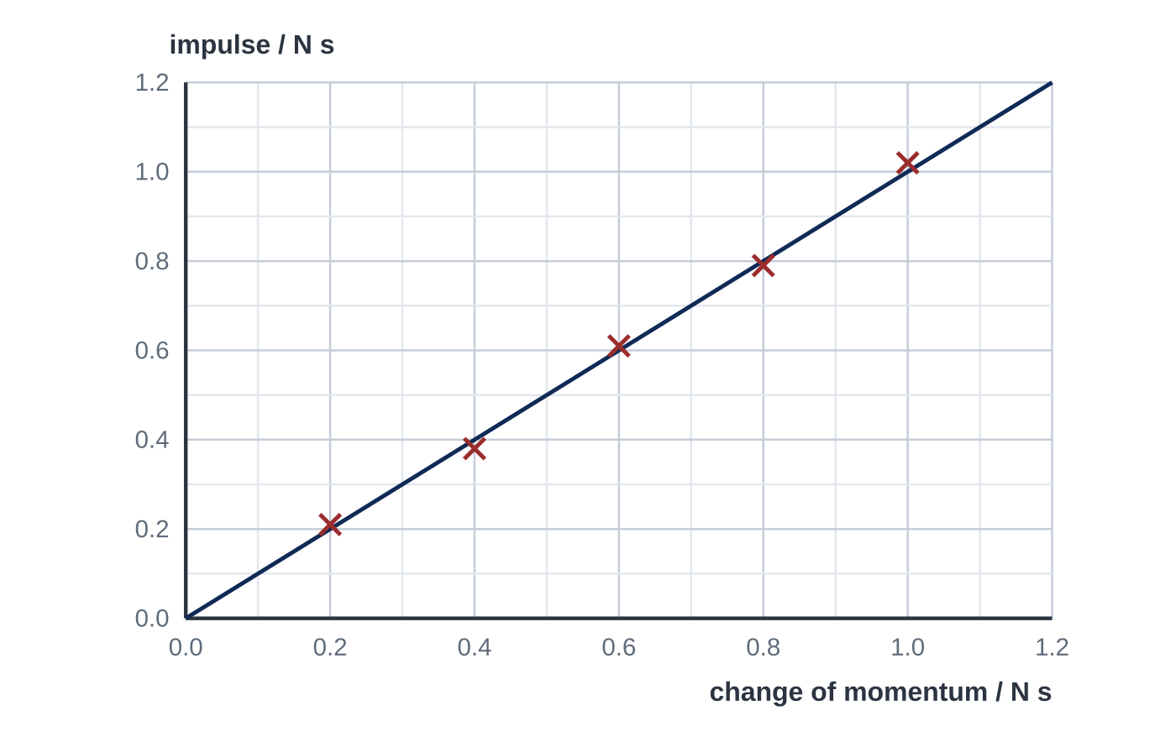
Question 2
1 mark
A student measures the impulse of the force on a trolley with a force sensor and data logger, and the change of momentum of the trolley using a light gate, for five different collisions. The graph shows her results.
Which conclusion is supported by the graph?
A The impulse is about twice the change of momentum.
B The impulse does not depend on the change of momentum.
C The change of momentum is proportional to the square of the impulse.
D The impulse is equal to the change of momentum.
Notes:
Online with the full mark scheme: https://examinerprep.com/ial-physics-4-1-impulse-and-momentum-in-two-dimensions-questions#IALP-U4-1-FA-10

Slide 42
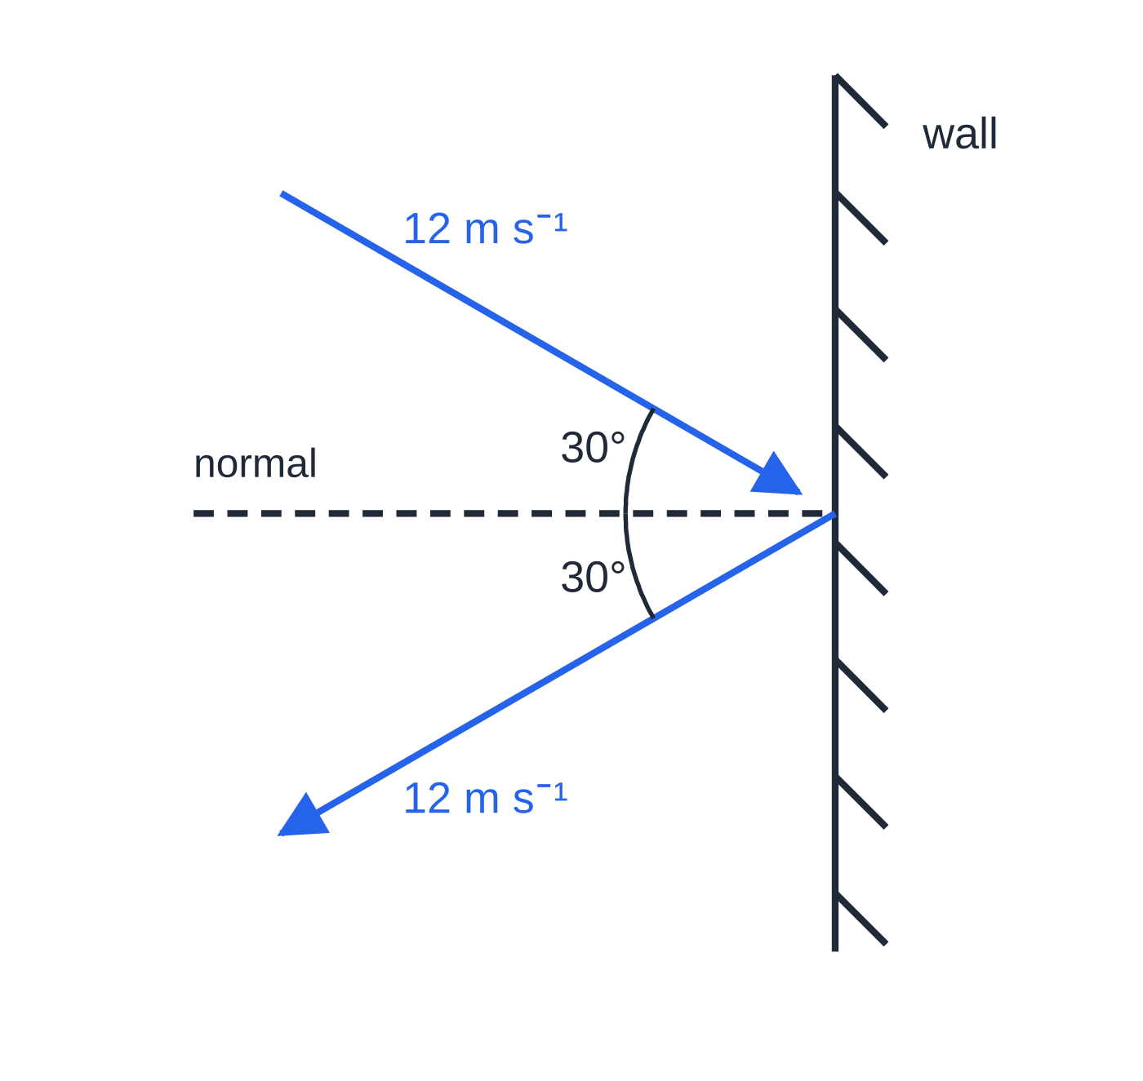
Question 3
1 mark
A ball of mass 0.060 kg hits a smooth wall at 12 m s⁻¹, travelling at 30° to the normal (the line perpendicular to the wall). It rebounds at the same speed and at 30° to the normal on the other side.
What is the magnitude of the impulse on the ball?
Figure: the ball's path before and after hitting the wall (plan view)
A 0.62 N s
B 0.72 N s
C 1.2 N s
D 1.4 N s
Notes:
Online with the full mark scheme: https://examinerprep.com/ial-physics-4-1-impulse-and-momentum-in-two-dimensions-questions#IALP-U4-1-A-07

Slide 43
Question 4
8 marks
A student wants to show that the impulse of a force on a trolley is equal to the change of momentum of the trolley. She has a runway, a trolley carrying a card, a light gate, a force sensor, a data logger and a top-pan balance.
(a) Describe how she could carry out the investigation. Your answer should include the measurements she makes and how she uses them. [6]
(b) She plots the impulse (area) on the y-axis against the change of momentum on the x-axis. State the shape and gradient of the graph that would confirm her hypothesis. [2]
Notes:
Online with the full mark scheme: https://examinerprep.com/ial-physics-4-1-impulse-and-momentum-in-two-dimensions-questions#IALP-U4-1-B-04

Slide 44
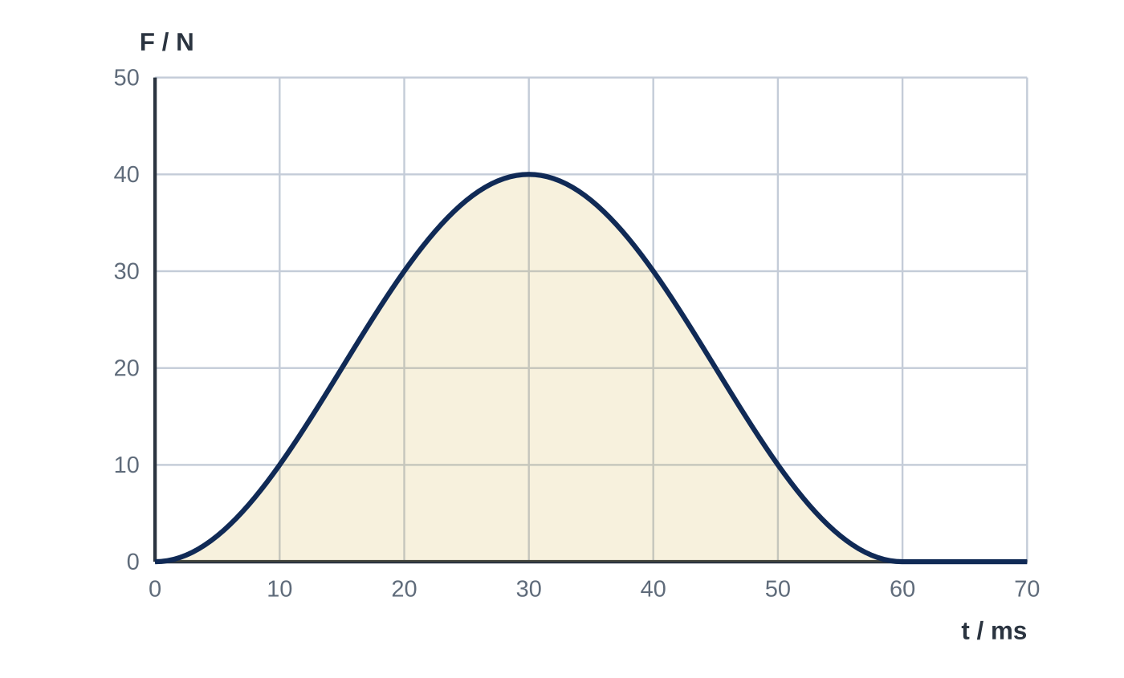
Question 5
7 marks
A student investigates the impulse of a force and the change of momentum it produces. A trolley of mass 0.620 kg carries a card of length 0.0500 m. It passes through a light gate, collides with a buffer fixed to a force sensor, and rebounds back through the same light gate. The card blocks the gate for 0.0400 s before the collision and for 0.0625 s after it. The graph shows the force recorded by the sensor during the collision.
(a) Calculate the magnitude of the change of momentum of the trolley. [3]
(b) Use the graph to estimate the impulse of the force on the trolley. [2]
(c) The buffer is replaced by a stiffer one. The trolley reaches the buffer and leaves it with the same speeds as before. Describe and explain how the force–time graph would differ from the one shown. [2]
Notes:
Online with the full mark scheme: https://examinerprep.com/ial-physics-4-1-impulse-and-momentum-in-two-dimensions-questions#IALP-U4-1-FB-04

Slide 45
Answers

Slide 46
Question 1 · answer
Answer B
The driver's change of momentum is the same either way (from the same speed to rest). The airbag increases the time taken for the driver to stop, so the average force F = Δp/Δt is smaller.
Notes:
Full mark scheme: https://examinerprep.com/ial-physics-4-1-impulse-and-momentum-in-two-dimensions-questions#IALP-U4-1-A-04

Slide 47
Question 2 · answer
Answer D
The points lie close to a straight line through the origin with gradient 1 (for example 1.0 N s of impulse for 1.0 N s change of momentum), so the impulse is equal to the change of momentum, as Newton's second law predicts.
Notes:
Full mark scheme: https://examinerprep.com/ial-physics-4-1-impulse-and-momentum-in-two-dimensions-questions#IALP-U4-1-FA-10

Slide 48
Question 3 · answer
Answer C
The component parallel to the wall is unchanged. The perpendicular component reverses: Δp = 2 × 0.060 × 12 cos 30° = 1.2 N s (1.25), directed away from the wall.
Notes:
Full mark scheme: https://examinerprep.com/ial-physics-4-1-impulse-and-momentum-in-two-dimensions-questions#IALP-U4-1-A-07

Slide 49
Question 4 · answer
Mark scheme
Indicative content:
tilt the runway until the trolley moves at constant speed after a small push, so friction is compensated
measure the mass of the trolley and card with the balance and the length of the card (with a ruler or calipers)
fix the force sensor at the end so the trolley collides with it; connect the sensor and light gate to the data logger
use the light gate to find the speed before (and after, if it rebounds) the impact: speed = card length ÷ time
record a force–time graph of the impact at a high sampling rate and find the area under it, which is the impulse
calculate the change of momentum m(v − u) and compare with the impulse; repeat for different starting points on the runway
a straight line through the origin
Notes:
Full mark scheme: https://examinerprep.com/ial-physics-4-1-impulse-and-momentum-in-two-dimensions-questions#IALP-U4-1-B-04

Slide 50
Question 5 · answer
Mark scheme
speed before = 0.0500 ÷ 0.0400 = 1.25 m s⁻¹
speed after = 0.0500 ÷ 0.0625 = 0.800 m s⁻¹, in the opposite direction
Δp = 0.620 × (1.25 + 0.800) = 1.27 N s
each square represents 10 × 10⁻³ s × 10 N = 0.10 N s, and the area is about 12 squares
impulse ≈ 1.2 N s (allow 1.1–1.3 N s)
the area under the graph is unchanged, because the change of momentum, and so the impulse, is unchanged
the contact time is shorter, so the peak force (and the average force) is greater: a narrower, taller pulse
Notes:
Full mark scheme: https://examinerprep.com/ial-physics-4-1-impulse-and-momentum-in-two-dimensions-questions#IALP-U4-1-FB-04

Slide 51
Keep practising
Notes for this topic
Questions on this topic
Build a printable test
ExaminerPrep is an independent tutoring service. It has been developed independently from and is not endorsed by the International Baccalaureate Organization. "International Baccalaureate", "IB" and "IB Diploma Programme" are registered trademarks of the IBO, used here for descriptive purposes only.
Pearson Edexcel and Cambridge are trademarks of their owners; ExaminerPrep is not affiliated with any exam board.

