Slide 1
EP
EDEXCEL IAL PHYSICS
2.3 Intensity, refraction and polarisation
The full notes page in 12 sections · practice questions with answers · simulations
ExaminerPrep is an independent tutoring service. It has been developed independently from and is not endorsed by the International Baccalaureate Organization. "International Baccalaureate", "IB" and "IB Diploma Programme" are registered trademarks of the IBO, used here for descriptive purposes only.
Pearson Edexcel and Cambridge are trademarks of their owners; ExaminerPrep is not affiliated with any exam board.
Notes:
2.3 Intensity, refraction and polarisation. Notes for this topic: https://examinerprep.com/notes/edexcel-ial-physics/intensity-refraction-and-polarisation/

Slide 2
What this page covers
Overview
Intensity as power per unit area, and the inverse-square law for a point source
Partial reflection and transmission of a wave at a boundary between two media
Refractive index, n = c/v, and Snell's law n₁ sin θ₁ = n₂ sin θ₂
Critical angle and predicting total internal reflection, including optical fibres
Measuring the refractive index of a glass block from a graph of sin i against sin r
Plane polarisation, polarising filters and their uses
The pulse-echo technique and what limits the detail it can show
Notes:
What this page covers. Full notes: https://examinerprep.com/notes/edexcel-ial-physics/intensity-refraction-and-polarisation/

Slide 3
In one minute
Key points
1
Intensity is power per unit area, I = P/A in W m⁻², and from a point source I = P/4πr², so doubling the distance gives a quarter of the intensity.
4
Total internal reflection needs light travelling towards a lower refractive index and an angle of incidence greater than the critical angle, sin C = 1/n.
2
At a boundary a wave is partly reflected and partly transmitted; its frequency stays the same while its speed and wavelength change.
5
Plane-polarised waves oscillate in one plane only. Only transverse waves can be polarised.
3
Refractive index n = c/v. Across a boundary, n₁ sin θ₁ = n₂ sin θ₂, with angles measured from the normal.
6
Pulse-echo: distance = vt/2. Detail is limited by the wavelength and by the pulse duration.
Notes:
In one minute: the key points of this topic.

Slide 4
What is intensity, and how does it fall with distance?
Section 1 of 12
A lamp seems dimmer and a siren quieter the further away you are, even though the source puts out the same power. What changes is how concentrated that power is when it reaches you.
Intensity is the power transferred per unit area, measured on an area perpendicular to the direction the wave travels: I = P/A, with I in W m⁻², P in W and A in m².
I = P/A is in the formulae list supplied in the exam. A point source radiating equally in all directions spreads its power over the surface of a sphere, of area 4πr². This sphere area is not given, so learn it. With no absorption,
I = P/4πr² so I ∝1/r²
This is the inverse-square law. Doubling the distance spreads the same power over four times the area, because both dimensions of any patch double; the intensity falls to a quarter.
Notes:
What is intensity, and how does it fall with distance?. Full notes: https://examinerprep.com/notes/edexcel-ial-physics/intensity-refraction-and-polarisation/

Slide 5
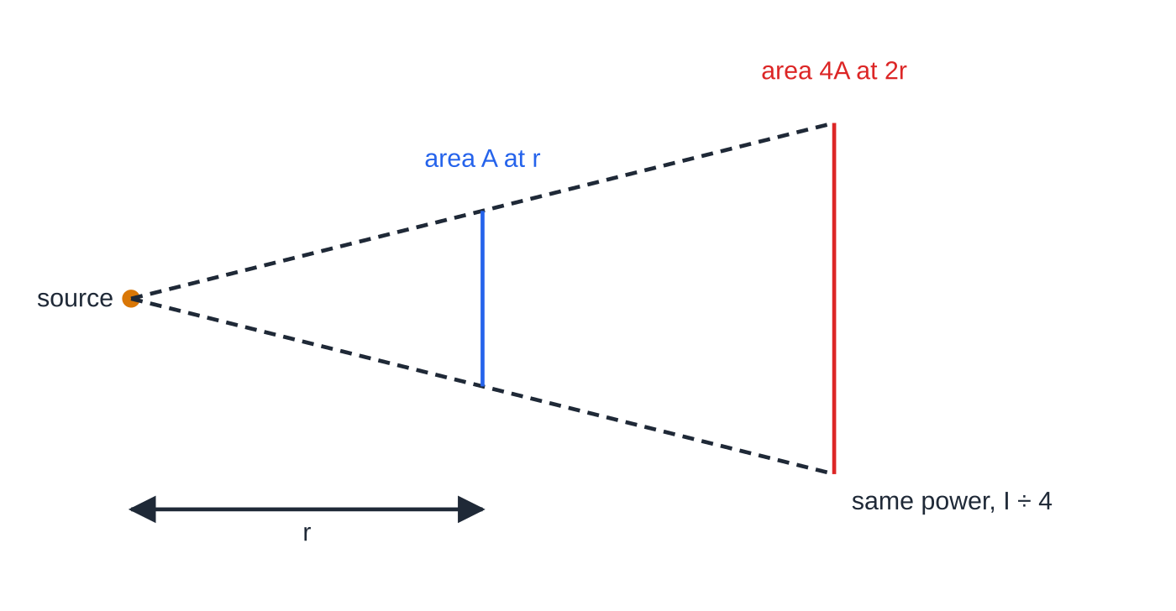
What is intensity, and how does it fall with distance? (continued)
Section 1 of 12
Trebling the distance gives a ninth.
A beam that does not spread (an ideal laser beam) keeps the same area, so its intensity does not fall with distance.
Real intensities often fall faster than 1/r², because the medium absorbs some of the energy.
Side view of the power from a point source. At twice the distance the same power covers a patch twice as wide and twice as tall, four times the area, so the intensity is a quarter.
Notes:
What is intensity, and how does it fall with distance?. Full notes: https://examinerprep.com/notes/edexcel-ial-physics/intensity-refraction-and-polarisation/

Slide 6
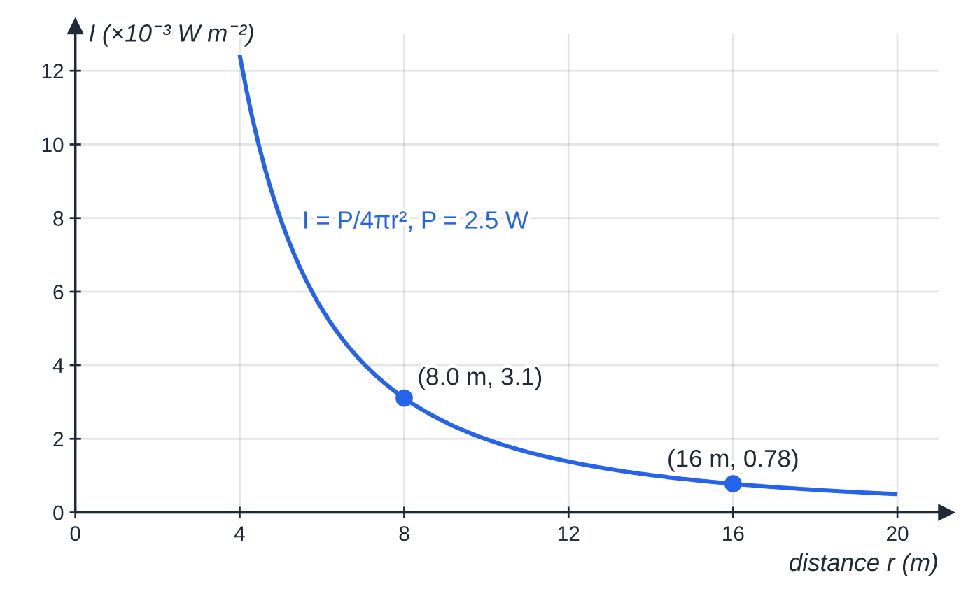
What is intensity, and how does it fall with distance? (continued)
Section 1 of 12
Intensity from a 2.5 W point source. Going from 8.0 m to 16 m quarters the intensity, from 3.1 × 10⁻³ to 7.8 × 10⁻⁴ W m⁻².
Notes:
What is intensity, and how does it fall with distance?. Full notes: https://examinerprep.com/notes/edexcel-ial-physics/intensity-refraction-and-polarisation/

Slide 7
What is intensity, and how does it fall with distance? (continued)
Section 1 of 12 · Worked example 1 · Medium · Calculate
WORKED EXAMPLE · QUESTION
A siren on a factory roof emits sound with a power of 2.5 W, equally in all directions. Ignore absorption and reflections. (a) Calculate the intensity 8.0 m from the siren. (b) State the intensity at 16 m. (c) Calculate the distance at which the intensity has fallen to 1.0 × 10⁻⁵ W m⁻².
SOLUTION
(a) A = 4π×8.0² = 804 m², so I = 2.5 ÷804 = 3.1 × 10⁻³ W m⁻².
(b) Twice the distance, a quarter of the intensity: 3.11 ×10⁻³ ÷4 = 7.8 × 10⁻⁴ W m⁻².
(c) r = √(2.5 ÷(4π×1.0 ×10⁻⁵)) = 141 m ≈ 140 m.
Notes:
What is intensity, and how does it fall with distance?: Worked example 1. Full notes: https://examinerprep.com/notes/edexcel-ial-physics/intensity-refraction-and-polarisation/

Slide 8
What is intensity, and how does it fall with distance? (continued)
Section 1 of 12
Common error
Using πr² (the area of a circle) instead of 4πr² (the surface area of a sphere) for a source that radiates in all directions. The answer is then four times too big.
Notes:
What is intensity, and how does it fall with distance?. Full notes: https://examinerprep.com/notes/edexcel-ial-physics/intensity-refraction-and-polarisation/

Slide 9
What happens when a wave reaches a boundary between two media?
Section 2 of 12
At a boundary, part of the wave is reflected and part is transmitted into the new medium; some energy may also be absorbed. Ignoring absorption, energy is conserved: incident intensity = reflected intensity + transmitted intensity.
The more different the two media (for light, the bigger the difference in refractive index; for sound and ultrasound, the bigger the difference in density and wave speed), the larger the fraction reflected.
The frequency does not change: it is set by the source, and every wavefront that arrives must leave. The speed changes, so the wavelength changes too, since v = fλ.
If the wave meets the boundary at an angle and its speed changes, its direction changes: this is refraction.
Almost all ultrasound is reflected at an air–skin boundary, so a gel is spread on the skin to remove the air layer and let the ultrasound in.
Notes:
What happens when a wave reaches a boundary between two media?. Full notes: https://examinerprep.com/notes/edexcel-ial-physics/intensity-refraction-and-polarisation/

Slide 10
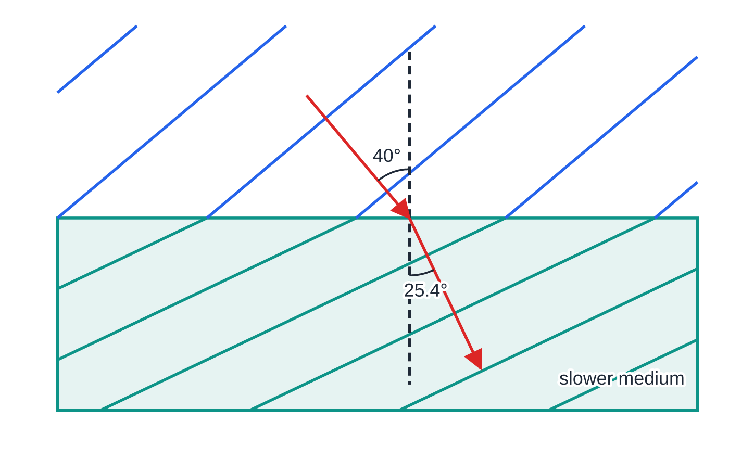
What happens when a wave reaches a boundary between two media? (continued)
Section 2 of 12
Plane wavefronts entering a medium in which the wave is 1.50 times slower. Each wavefront stays continuous at the boundary, so the wavelength shrinks by the same factor and the direction of travel (red) bends towards the normal, from 40° to 25.4°.
Notes:
What happens when a wave reaches a boundary between two media?. Full notes: https://examinerprep.com/notes/edexcel-ial-physics/intensity-refraction-and-polarisation/

Slide 11
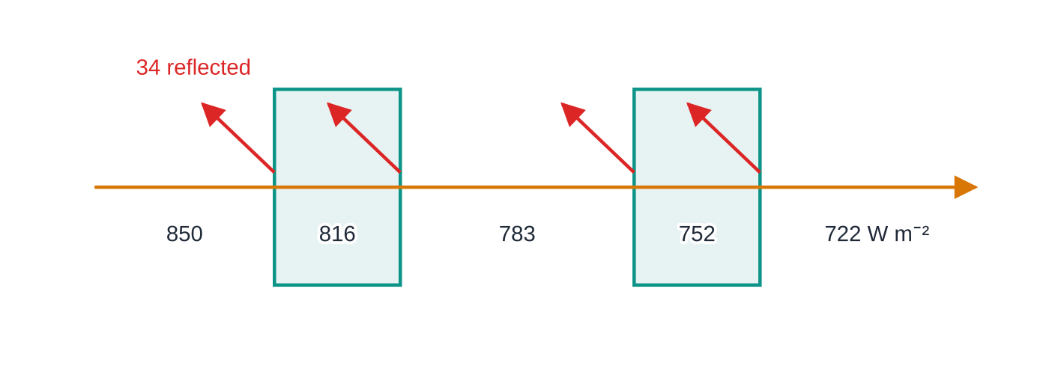
What happens when a wave reaches a boundary between two media? (continued)
Section 2 of 12 · Worked example 2 · Medium · Calculate
WORKED EXAMPLE · QUESTION
Sunlight of intensity 850 W m⁻² falls at right angles on a double-glazed window of area 1.8 m². The window has two panes, so the light crosses four glass–air surfaces. At each surface 4.0% of the intensity arriving there is reflected. Ignore absorption in the glass. (a) Calculate the intensity reflected at the first surface. (b) Calculate the power of the sunlight that reaches the room.
SOLUTION
(a) 0.040 ×850 = 34 W m⁻².
Each of the four surfaces reflects 4.0% of the intensity arriving there (red), so the transmitted intensity is multiplied by 0.96 four times: 850 → 816 → 783 → 752 → 722 W m⁻².
Notes:
What happens when a wave reaches a boundary between two media?: Worked example 2. Full notes: https://examinerprep.com/notes/edexcel-ial-physics/intensity-refraction-and-polarisation/

Slide 12
What happens when a wave reaches a boundary between two media? (continued)
Section 2 of 12 · Worked example 2 · Medium · Calculate (continued)
(b) 96% of what arrives is transmitted at each surface: fraction transmitted = 0.96⁴ = 0.849, so I = 0.849 ×850 = 722 W m⁻². Power = intensity × area: P = 722 ×1.8 = 1.3 kW (1300 W).
Subtracting 4 ×4.0% = 16% would be wrong: each surface reflects 4.0% of a slightly smaller intensity.
Notes:
What happens when a wave reaches a boundary between two media?: Worked example 2. Full notes: https://examinerprep.com/notes/edexcel-ial-physics/intensity-refraction-and-polarisation/

Slide 13
How do you use refractive index and Snell's law?
Section 3 of 12
The refractive index of a material is the speed of light in a vacuum divided by the speed of light in the material: n = c/v.
n₁ sin θ₁ = n₂ sin θ₂
Here c = 3.00 ×10⁸ m s⁻¹, v is the speed of light in the material, and θ₁, θ₂ are the angles to the normal in media 1 and 2. Both equations are in the formulae list supplied in the exam. Take n = 1.00 for air, and always measure angles from the normal, never from the surface.
n has no unit and is at least 1. A larger n means slower light (an "optically denser" material).
Entering a medium of higher n, light slows and bends towards the normal; entering a lower n, it bends away from the normal.
A ray along the normal (θ= 0) does not bend, although it still slows down.
Notes:
How do you use refractive index and Snell's law?. Full notes: https://examinerprep.com/notes/edexcel-ial-physics/intensity-refraction-and-polarisation/

Slide 14
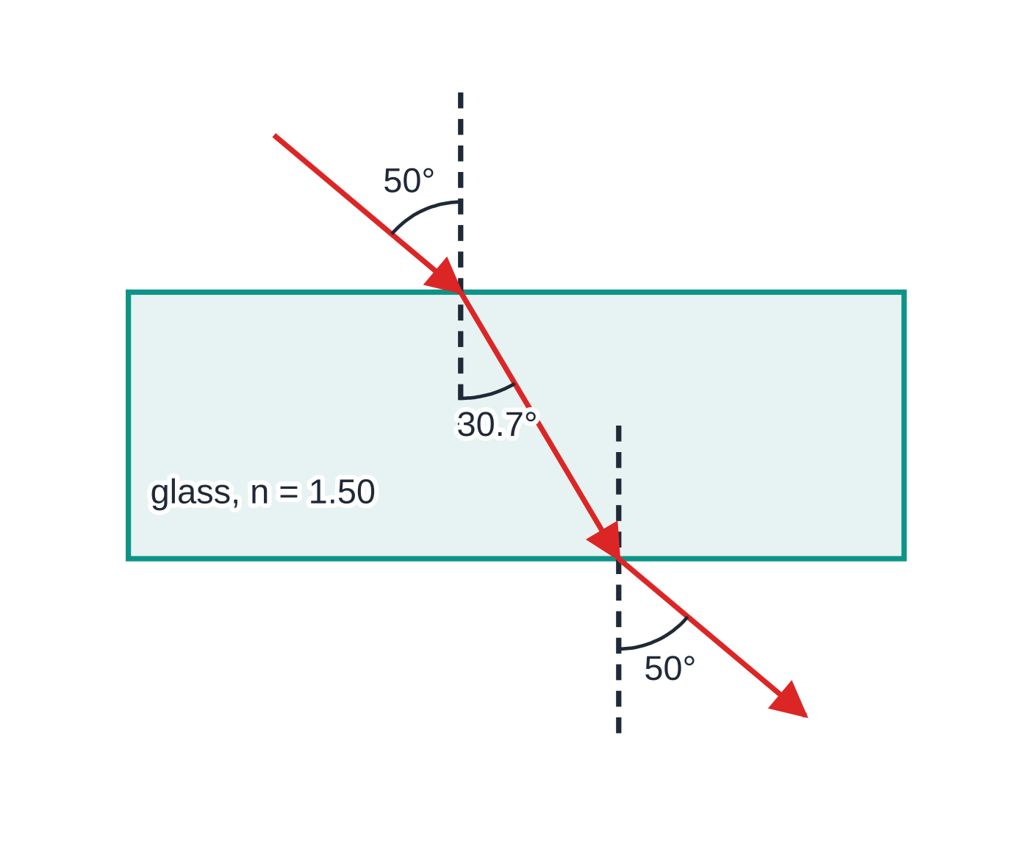
How do you use refractive index and Snell's law? (continued)
Section 3 of 12
Through a parallel-sided block, the ray leaves parallel to its original direction but shifted sideways.
A ray through a glass block (n = 1.50), drawn at the calculated angles. At the top face it bends towards the normal (30.7°); at the bottom face it bends away again and leaves at 50°, parallel to the incident ray.
Notes:
How do you use refractive index and Snell's law?. Full notes: https://examinerprep.com/notes/edexcel-ial-physics/intensity-refraction-and-polarisation/

Slide 15
How do you use refractive index and Snell's law? (continued)
Section 3 of 12 · Worked example 3 · Medium · Calculate
WORKED EXAMPLE · QUESTION
A beam of red laser light of wavelength 633 nm in air strikes a glass surface at 52° to the normal. The refractive index of the glass is 1.52. Calculate (a) the angle of refraction, (b) the speed of the light in the glass and (c) its wavelength in the glass.
SOLUTION
(a) Snell's law with n₁ = 1.00: sin θ₂ = sin 52° ÷1.52 = 0.788 ÷1.52 = 0.518, so θ₂ = 31.2°.
(b) v = c/n = 3.00 ×10⁸ ÷1.52 = 1.97 × 10⁸ m s⁻¹.
(c) The frequency is unchanged, so the wavelength falls by the same factor as the speed: λ= 633 ÷1.52 = 416 nm.
Check: f = c/λ= 4.74 ×10¹⁴ Hz in air, and (1.97 ×10⁸) ÷(416 ×10⁻⁹) gives the same frequency in glass.
Notes:
How do you use refractive index and Snell's law?: Worked example 3. Full notes: https://examinerprep.com/notes/edexcel-ial-physics/intensity-refraction-and-polarisation/

Slide 16
How do you use refractive index and Snell's law? (continued)
Section 3 of 12 · Worked example 4 · Medium · Calculate
WORKED EXAMPLE · QUESTION
Light travelling in the water of an aquarium (n = 1.33) meets the glass wall (n = 1.52) at 40° to the normal. The wall has parallel faces and the light passes through it into the air. Calculate (a) the angle of refraction in the glass and (b) the angle at which the light leaves into the air.
SOLUTION
(a) 1.33 sin 40° = 1.52 sin θ_g, so sin θ_g = 0.855 ÷1.52 = 0.562 and θ_g = 34.2°.
(b) With parallel faces, the angle of incidence at the glass–air face is 34.2°: 1.52 ×0.562 = 1.00 ×sin θₐ, so sin θₐ = 0.855 and θₐ = 58.7°.
The product nsin θ is the same in every layer, so a parallel-sided wall has no effect on the final direction: 1.33 sin 40° = sin θₐ directly.
Notes:
How do you use refractive index and Snell's law?: Worked example 4. Full notes: https://examinerprep.com/notes/edexcel-ial-physics/intensity-refraction-and-polarisation/

Slide 17
When does total internal reflection happen?
Section 4 of 12
The critical angle is the angle of incidence, in the denser medium, for which the angle of refraction is 90°. For light going from a material into air, sin C = 1/n.
sin C = 1/n is in the formulae list supplied in the exam. Between two materials, put θ₂ = 90° into Snell's law to get sin C = n₂/n₁ with n₁ > n₂; derive this, as it is not given. Total internal reflection (TIR) happens only when both conditions hold:
the light is travelling from a medium of higher refractive index towards one of lower refractive index, and
the angle of incidence is greater than the critical angle.
Below C there is refraction out plus a weak partial reflection. At C the refracted ray runs along the surface. Above C all the light is reflected. To predict TIR, calculate C for that pair of materials and compare it with the actual angle of incidence.
Notes:
When does total internal reflection happen?. Full notes: https://examinerprep.com/notes/edexcel-ial-physics/intensity-refraction-and-polarisation/

Slide 18
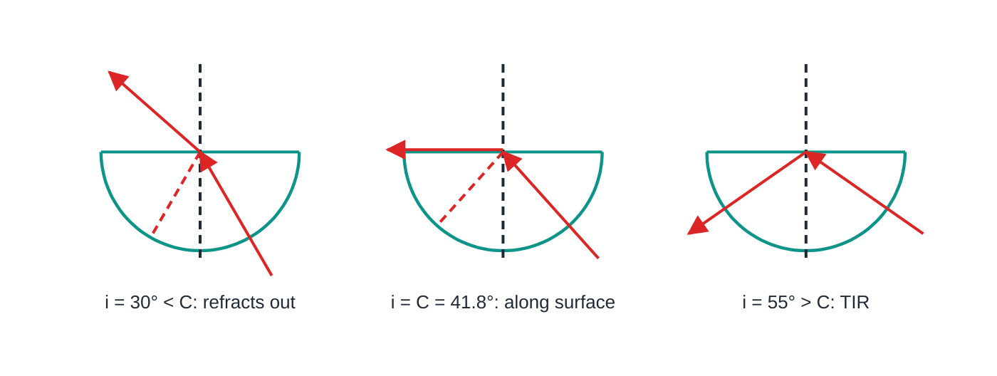
When does total internal reflection happen? (continued)
Section 4 of 12
Optical fibres
A thin glass core is surrounded by cladding of slightly lower refractive index. Light hitting the core–cladding boundary above the critical angle is totally internally reflected and guided along the fibre, even round gentle bends. The cladding keeps the core surface clean and unscratched, stops light leaking into a touching fibre, and keeps the boundary condition the same all along the fibre. Because n_core and n_cladding are close, the critical angle is large, so only rays nearly parallel to the axis are guided.
Rays aimed at the centre of a semicircular glass block (n = 1.50) cross the curved face along a radius, so they do not bend there. At the flat face the outcome depends on the angle of incidence compared with C = 41.8°. Dashed lines are weak partial reflections.
Notes:
When does total internal reflection happen?. Full notes: https://examinerprep.com/notes/edexcel-ial-physics/intensity-refraction-and-polarisation/

Slide 19
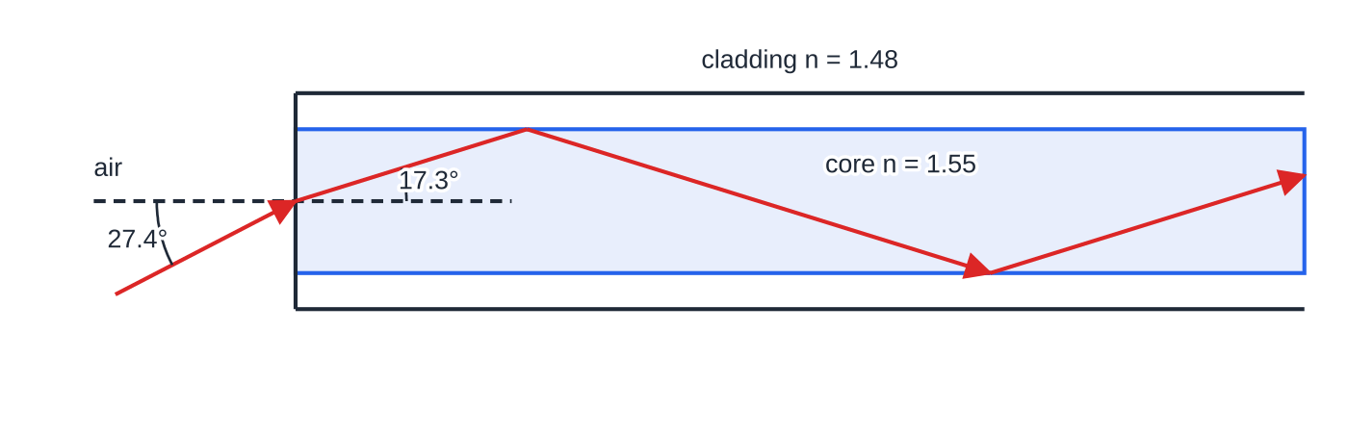
When does total internal reflection happen? (continued)
Section 4 of 12
Uses include data communication and endoscopes that carry images out of the body.
The fibre of worked example 5. The steepest guided ray travels at 17.3° to the axis, meeting the core–cladding boundary at exactly C = 72.7°; outside, this corresponds to 27.4° to the axis in air.
Notes:
When does total internal reflection happen?. Full notes: https://examinerprep.com/notes/edexcel-ial-physics/intensity-refraction-and-polarisation/

Slide 20
When does total internal reflection happen? (continued)
Section 4 of 12 · Worked example 5 · Hard · Calculate
WORKED EXAMPLE · QUESTION
An optical fibre has a core of refractive index 1.55 and cladding of refractive index 1.48. The end face of the fibre is flat and perpendicular to its axis, with air outside. (a) Calculate the critical angle at the core–cladding boundary. (b) A ray meets this boundary at 76° to the normal. State and explain what happens. (c) Calculate the largest angle a ray in the core can make with the fibre axis and still be guided. (d) Hence find the largest angle to the axis at which light in the air can enter the end face and be guided.
SOLUTION
(a) sin C = 1.48 ÷1.55 = 0.955, so C = 72.7°.
(b) 76° > 72.7°, and the light is going from higher to lower n, so total internal reflection.
(c) The boundary is parallel to the axis, so the angle to the axis is 90° minus the angle of incidence: 90° - 72.7° = 17.3°.
Notes:
When does total internal reflection happen?: Worked example 5. Full notes: https://examinerprep.com/notes/edexcel-ial-physics/intensity-refraction-and-polarisation/

Slide 21
When does total internal reflection happen? (continued)
Section 4 of 12 · Worked example 5 · Hard · Calculate (continued)
(d) Snell's law at the end face, air → core (the normal is the axis): sin θₐᵢᵣ = 1.55 ×sin 17.3° = 0.461, so θₐᵢᵣ = 27.4°.
A ray meeting the boundary at 70° would be partly transmitted into the cladding at every reflection and the signal would fade. Using 1/1.55 would give 40.2°, the critical angle for core to air, which is not the boundary the light meets.
Notes:
When does total internal reflection happen?: Worked example 5. Full notes: https://examinerprep.com/notes/edexcel-ial-physics/intensity-refraction-and-polarisation/

Slide 22
How do you measure the refractive index of a glass block?
Section 5 of 12
Set-up: place a rectangular glass block on paper and draw round it. Use a ray box with a single narrow slit to send a thin ray at the long face.
Recording rays: mark the incident and emergent rays with small pencil crosses, well apart. Remove the block and join the entry and exit points: this line is the refracted ray inside the glass.
Angles: draw the normal at the entry point and measure i and r from the normal with a protractor. Repeat for at least six angles of incidence, for example 20° to 70°.
Analysis: with air outside, sin i = n sin r. A graph of sin i (y-axis) against sin r (x-axis) is a straight line through the origin with gradient n.
Precision: a protractor reading to 1° has an uncertainty of ±0.5°, a smaller percentage of a larger angle, so large angles are more reliable. A thin ray and a sharp pencil help.
Safety: the ray box lamp gets hot; handle it by its case and let it cool.
Notes:
How do you measure the refractive index of a glass block?. Full notes: https://examinerprep.com/notes/edexcel-ial-physics/intensity-refraction-and-polarisation/

Slide 23
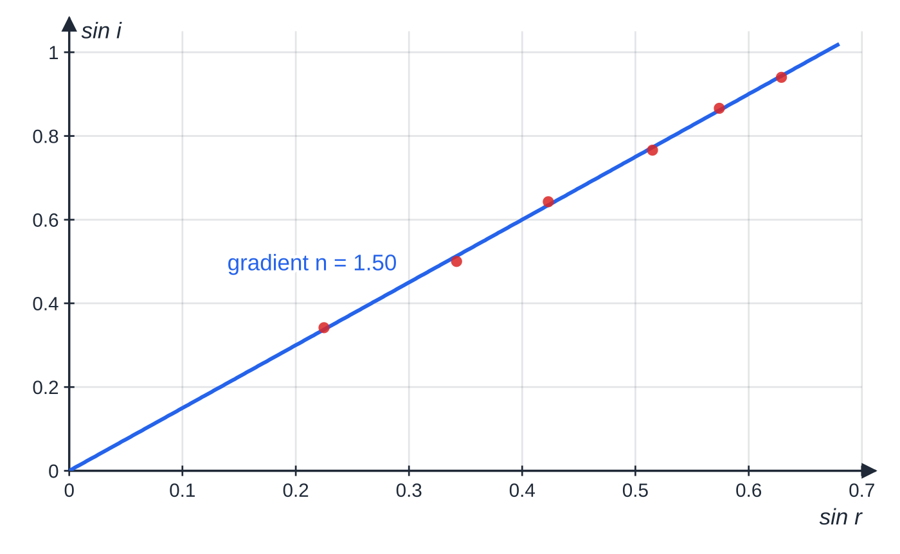
How do you measure the refractive index of a glass block? (continued)
Section 5 of 12
The six readings of worked example 6. The best-fit line passes through the origin, as Snell's law predicts, and its gradient is the refractive index, 1.50.
Notes:
How do you measure the refractive index of a glass block?. Full notes: https://examinerprep.com/notes/edexcel-ial-physics/intensity-refraction-and-polarisation/

Slide 24
How do you measure the refractive index of a glass block? (continued)
Section 5 of 12 · Worked example 6 · Medium · Determine
WORKED EXAMPLE · QUESTION
A student measures these angles for a glass block, to the nearest degree.
i / ° | 20 | 30 | 40 | 50 | 60 | 70
r / ° | 13 | 20 | 25 | 31 | 35 | 39
(a) Use a graph to find the refractive index of the glass. (b) Compare the percentage uncertainties in r = 13° and r = 39°.
SOLUTION
(a) sin r: 0.225, 0.342, 0.423, 0.515, 0.574, 0.629. sin i: 0.342, 0.500, 0.643, 0.766, 0.866, 0.940. Plot sin i against sin r, draw the best-fit line and find its gradient from a large triangle: gradient = 0.749 ÷0.50 = n = 1.50.
(b) Uncertainty = half the 1° resolution = ±0.5°. 13°: 0.5 ÷13 ×100 = 3.8%; 39°: 0.5 ÷39 ×100 = 1.3%.
Notes:
How do you measure the refractive index of a glass block?: Worked example 6. Full notes: https://examinerprep.com/notes/edexcel-ial-physics/intensity-refraction-and-polarisation/

Slide 25
How do you measure the refractive index of a glass block? (continued)
Section 5 of 12 · Worked example 6 · Medium · Determine (continued)
The large-angle reading is about three times more precise.
A single reading gives only one estimate, for example sin 70° ÷sin 39° = 1.49; the gradient uses all six.
Notes:
How do you measure the refractive index of a glass block?: Worked example 6. Full notes: https://examinerprep.com/notes/edexcel-ial-physics/intensity-refraction-and-polarisation/

Slide 26
What is plane polarisation, and what is it used for?
Section 6 of 12
A plane-polarised wave is a transverse wave whose oscillations are in one plane only, the plane that contains the direction of travel.
In unpolarised light (from the Sun or a filament lamp) the oscillations occur in all directions perpendicular to the direction of travel.
A polarising filter transmits only the oscillations along its transmission axis, so unpolarised light leaving it is plane-polarised.
Two filters with axes at 90° ("crossed") let no light through. Rotating the second filter through 360° gives two bright and two dark positions.
Only transverse waves can be polarised. In a longitudinal wave such as sound the oscillations are along the direction of travel, so there is no plane to select. That light can be polarised is evidence that light is transverse.
Notes:
What is plane polarisation, and what is it used for?. Full notes: https://examinerprep.com/notes/edexcel-ial-physics/intensity-refraction-and-polarisation/

Slide 27
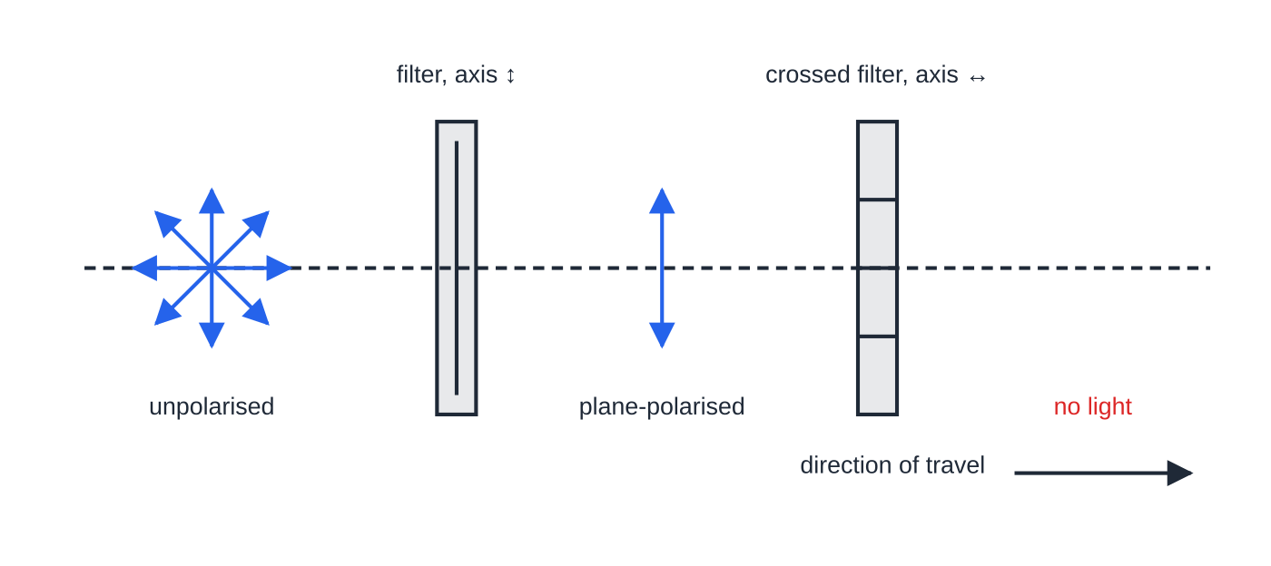
What is plane polarisation, and what is it used for? (continued)
Section 6 of 12
Microwaves from a transmitter horn are already plane-polarised: turning the receiver through 90° about the beam makes the signal fall to a minimum.
Uses of polarisation
Sunglasses: light reflected from water, wet roads and glass is partly plane-polarised, mostly in a horizontal plane. Polarising sunglasses with vertical transmission axes absorb much of this glare while passing other light.
Unpolarised light has oscillations in every direction perpendicular to its travel. The first filter passes only the vertical oscillations; a second filter with its axis horizontal (crossed) blocks everything.
Notes:
What is plane polarisation, and what is it used for?. Full notes: https://examinerprep.com/notes/edexcel-ial-physics/intensity-refraction-and-polarisation/

Slide 28
What is plane polarisation, and what is it used for? (continued)
Section 6 of 12
Stress analysis: a transparent plastic model of a part is placed between crossed polarisers. Stressed plastic rotates the plane of polarisation by different amounts for different colours, so coloured fringes appear; closely spaced fringes show where the stress is concentrated.
Displays and aerials: liquid-crystal displays use polarising filters, and a TV or radio aerial must be lined up with the plane of polarisation of the transmitted waves for the best signal.
Common error
Defining polarisation as "the wave vibrates in one direction". Say oscillations in one plane only, and that the plane includes the direction of travel.
Notes:
What is plane polarisation, and what is it used for?. Full notes: https://examinerprep.com/notes/edexcel-ial-physics/intensity-refraction-and-polarisation/

Slide 29
How does the pulse-echo technique locate objects?
Section 7 of 12
A short pulse is sent out; part of it reflects from each boundary or object it meets and returns as an echo to a detector next to the source. The time t between sending the pulse and receiving the echo is for the journey there and back, so the distance to the reflector is
d = vt/2
This is not in the formulae list: derive it from the fact that the pulse goes there and back. Ultrasound scans use frequencies of a few MHz in the body; sonar uses sound or ultrasound in water to find the sea bed, fish or submarines; radar uses radio waves or microwaves, travelling at the speed of light, to find aircraft and ships. An echo trace (an A-scan) plots the detected signal against time: each spike is a boundary, and its delay gives the depth. Echoes get weaker with depth, because each boundary reflects only part of the pulse and the medium absorbs energy.
Notes:
How does the pulse-echo technique locate objects?. Full notes: https://examinerprep.com/notes/edexcel-ial-physics/intensity-refraction-and-polarisation/

Slide 30
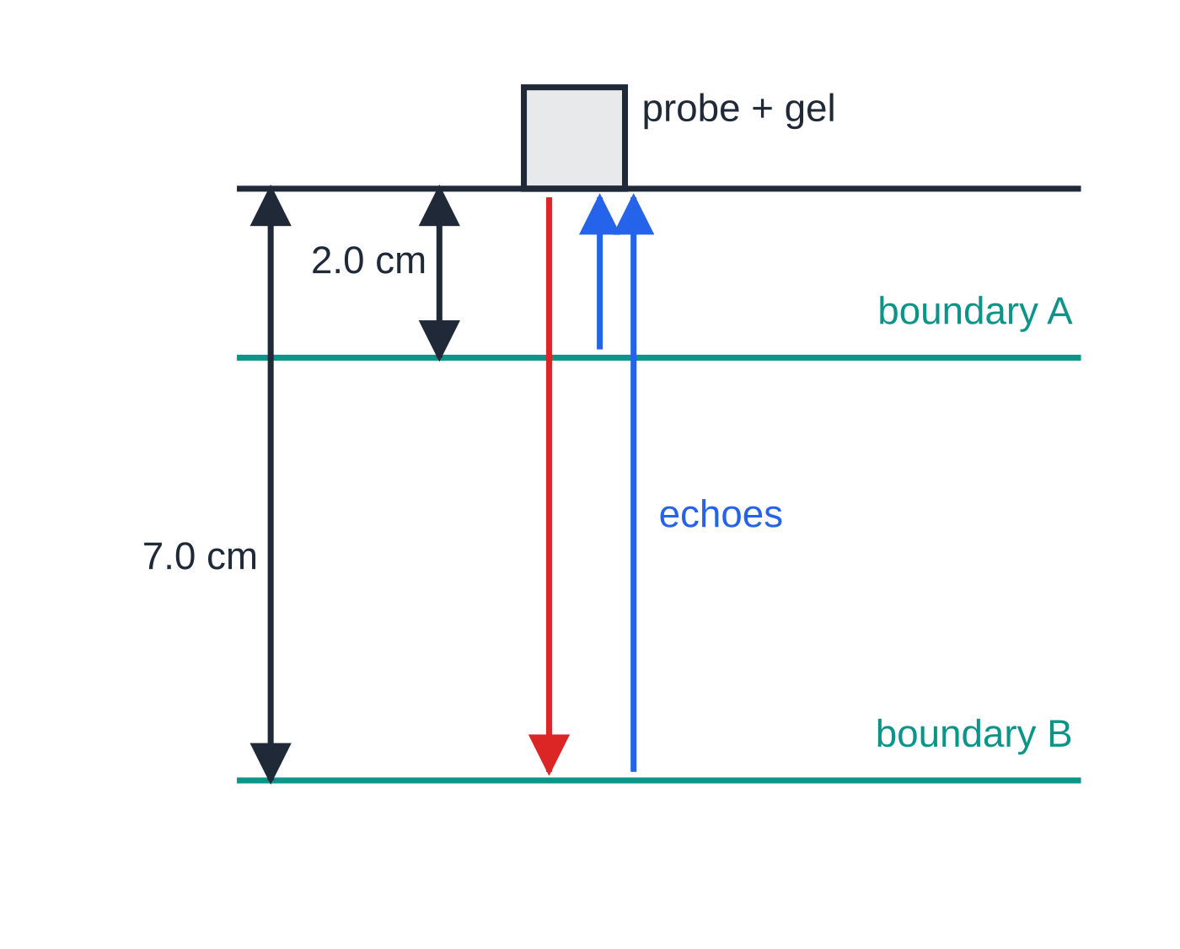
How does the pulse-echo technique locate objects? (continued)
Section 7 of 12
What limits the detail?
Wavelength: a feature much smaller than the wavelength does not give a clear reflection, because the wave diffracts round it. A shorter wavelength, from a higher frequency, shows finer detail.
Pulse duration: a pulse of duration τ is vτ long. Two reflectors closer together than vτ/2 along the beam send back echoes that overlap and look like one. Shorter pulses separate closer boundaries.
Higher frequency also lets each pulse contain the same number of cycles in a shorter time, but high frequencies are absorbed more, so they cannot reach as deep.
The probe sends a pulse down (red); part reflects at each boundary and returns as an echo (blue). The deeper boundary B returns a later, weaker echo.
Notes:
How does the pulse-echo technique locate objects?. Full notes: https://examinerprep.com/notes/edexcel-ial-physics/intensity-refraction-and-polarisation/

Slide 31
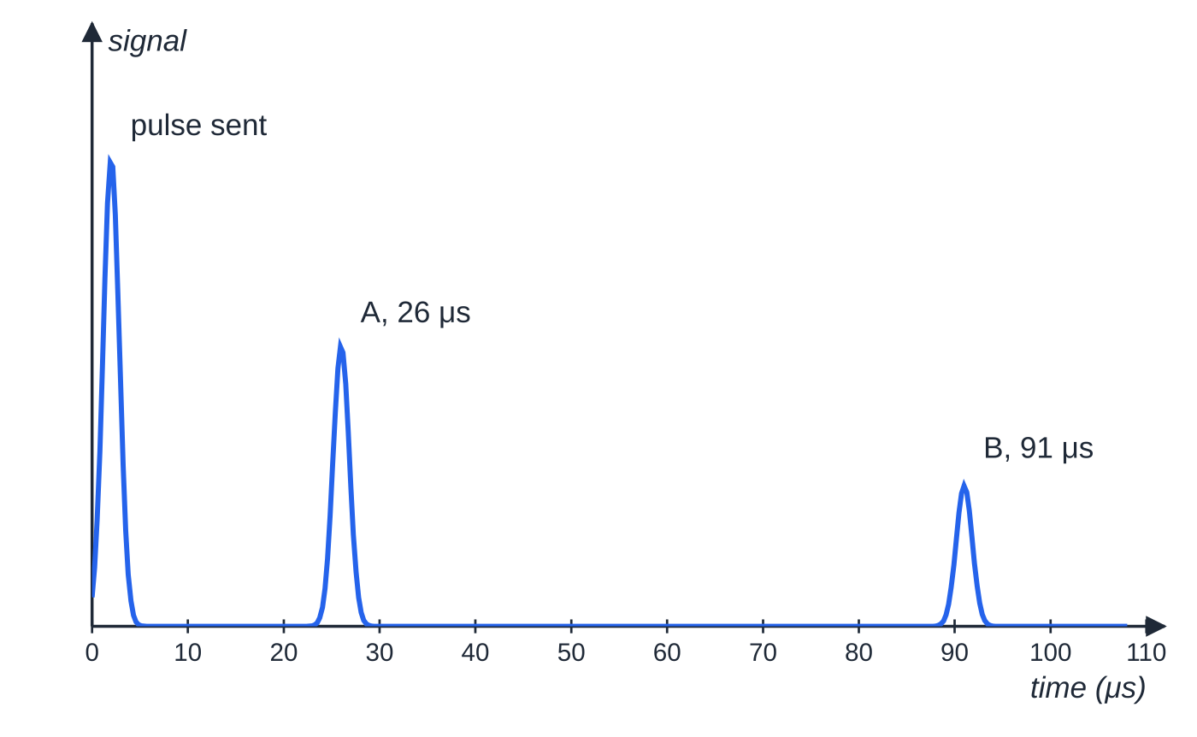
How does the pulse-echo technique locate objects? (continued)
Section 7 of 12
An echo trace drawn from t = 2d/v for boundaries at 2.0 cm and 7.0 cm in soft tissue (v = 1540 m s⁻¹). With 1.4 μs pulses, spikes from boundaries closer than about 1.1 mm would merge.
Notes:
How does the pulse-echo technique locate objects?. Full notes: https://examinerprep.com/notes/edexcel-ial-physics/intensity-refraction-and-polarisation/

Slide 32
How does the pulse-echo technique locate objects? (continued)
Section 7 of 12 · Worked example 7 · Hard · Calculate
WORKED EXAMPLE · QUESTION
The trace above comes from a 3.5 MHz ultrasound probe on the skin. The speed of ultrasound in soft tissue is 1540 m s⁻¹, and each pulse lasts 1.4 μs. (a) Calculate the depths of boundaries A and B and the distance between them. (b) Calculate the wavelength of the ultrasound in tissue. (c) Calculate the smallest separation of two boundaries, along the beam, whose echoes do not overlap.
SOLUTION
(a) The echo time is for there and back, so halve it: d_A = 1540 ×26 ×10⁻⁶ ÷2 = 2.0 cm and d_B = 1540 ×91 ×10⁻⁶ ÷2 = 7.0 cm. Separation = 7.0 - 2.0 = 5.0 cm.
(b) λ= v/f = 1540 ÷3.5 ×10⁶ = 0.44 mm.
(c) Pulse length in tissue = 1540 ×1.4 ×10⁻⁶ = 2.16 mm; halve it for the round trip: 1.1 mm.
The echo from B is weaker: some of the pulse was reflected at A, and the tissue absorbs energy on the longer path.
Notes:
How does the pulse-echo technique locate objects?: Worked example 7. Full notes: https://examinerprep.com/notes/edexcel-ial-physics/intensity-refraction-and-polarisation/

Slide 33
Exam tips for 2.3
Section 8 of 12
Exam tip 1 — angles from the normal
Every angle in Snell's law and in the critical-angle condition is measured from the normal. If a question gives the angle to the surface, subtract it from 90° first. Write n₁ sin θ₁ = n₂ sin θ₂ with symbols, label media 1 and 2, and sense-check: going into a higher n, the angle must get smaller.
Exam tip 2 — two conditions for total internal reflection
State both: travelling towards a lower refractive index, and an angle of incidence greater than the critical angle. Calculate C and quote it in the comparison.
Exam tip 3 — frequency stays, wavelength changes
At a boundary the frequency is fixed by the source. Find the new speed from n = c/v, then the new wavelength from λ= v/f, or divide the vacuum wavelength by n.
Notes:
Exam tips for 2.3. Full notes: https://examinerprep.com/notes/edexcel-ial-physics/intensity-refraction-and-polarisation/

Slide 34
Exam tips for 2.3 (continued)
Section 8 of 12
Exam tip 4 — inverse-square by ratio, echoes with a 2
For a point source, compare two distances with I₂/I₁ = (r₁/r₂)²; there is no need to know the power. In every echo calculation write "time there and back, so distance = vt/2" as a line of working.
Exam tip 5 — two separate ideas for detail
When asked what limits the detail in a pulse-echo image, give both the wavelength (features smaller than it are not resolved) and the pulse duration (boundaries closer than vτ/2 give overlapping echoes). In the glass-block practical, say which quantity goes on which axis: with sin i on the y-axis the gradient is n.
Notes:
Exam tips for 2.3. Full notes: https://examinerprep.com/notes/edexcel-ial-physics/intensity-refraction-and-polarisation/

Slide 35
Common misconceptions
Section 9 of 12
Misconception | Why it is wrong | Correct idea
Doubling the distance from a source halves the intensity. | The power spreads over a sphere whose area grows as r². | Doubling the distance quarters the intensity (point source, no absorption).
The frequency of light changes when it enters glass. | Frequency is set by the source; every wavefront that arrives must leave. | Speed and wavelength change; frequency stays the same.
Light bends towards the normal whenever it crosses a boundary. | The direction depends on whether it speeds up or slows down. | Towards the normal into higher n; away from the normal into lower n.
Total internal reflection can happen when light enters glass from air. | Going into a higher n, sin θ₂ is always less than 1, so a refracted ray always exists. | TIR needs travel towards a lower refractive index and an angle above C.
Below the critical angle all the light is transmitted. | Every boundary reflects part of the wave. | Below C there is refraction plus a weak partial reflection.
Notes:
Common misconceptions. Full notes: https://examinerprep.com/notes/edexcel-ial-physics/intensity-refraction-and-polarisation/

Slide 36
Common misconceptions (continued)
Section 9 of 12
Misconception | Why it is wrong | Correct idea
Sound can be polarised with the right filter. | Its oscillations are along the direction of travel, so there is no plane to select. | Only transverse waves can be polarised.
Notes:
Common misconceptions. Full notes: https://examinerprep.com/notes/edexcel-ial-physics/intensity-refraction-and-polarisation/

Slide 37
How this topic connects
Section 10 of 12
1 Progressive waves and 2.4 Diffraction
v = fλ turns a change of speed at a boundary into a change of wavelength, and the transverse–longitudinal distinction is exactly what polarisation tests. Diffraction (2.4) is why the wavelength limits the detail of an ultrasound or sonar image.
5 Photons and the photoelectric effect
Intensity reappears in the photoelectric effect: a more intense beam of the same frequency delivers more photons per second, not more energetic ones.
Unit 5 astrophysics
The flux from a star, F = L/4πd², is the same inverse-square law, used to find stellar distances and luminosities.
Notes:
How this topic connects. Full notes: https://examinerprep.com/notes/edexcel-ial-physics/intensity-refraction-and-polarisation/

Slide 38
Key equations
Section 11 of 12
Equation | Use | In the formulae list?
I = P/A | intensity from power and area; I in W m⁻², P in W, A in m² | Yes
n = c/v | refractive index from speeds; no unit | Yes
n₁ sin θ₁ = n₂ sin θ₂ | refraction at a boundary; angles from the normal | Yes
sin C = 1/n | critical angle, material to air | Yes
v = fλ | wavelength change at a boundary (earlier page) | Yes
A = 4πr², so I = P/4πr² | point source radiating in all directions | No — learn the sphere area
sin C = n₂/n₁ | critical angle between two materials | No — derive it: put θ₂ = 90° in Snell's law
d = vt/2 | pulse-echo distance | No — derive it: the pulse goes there and back
Notes:
Key equations. Full notes: https://examinerprep.com/notes/edexcel-ial-physics/intensity-refraction-and-polarisation/

Slide 39
Check your understanding
Section 12 of 12
1. The intensity 2.0 m from a small lamp is 8.0 W m⁻². Calculate the intensity at 4.0 m and at 6.0 m.
2. Light travels at 2.26 × 10⁸ m s⁻¹ in a liquid. Calculate the refractive index of the liquid.
3. Calculate the critical angle for light going from glass of refractive index 1.60 into air.
4. Explain why sound waves cannot be polarised but light waves can.
5. A ship's sonar pulse returns from the sea bed 0.20 s after it is sent. Sound travels at 1500 m s⁻¹ in sea water. Calculate the depth.
6. Light in glass (n = 1.52) meets a boundary with water (n = 1.33) at 65° to the normal. Does total internal reflection occur?
Notes:
Check your understanding: questions. Full notes: https://examinerprep.com/notes/edexcel-ial-physics/intensity-refraction-and-polarisation/

Slide 40
Check your understanding · answers
Section 12 of 12
1. At 4.0 m: 8.0 ×(2.0/4.0)² = 2.0 W m⁻². At 6.0 m: 8.0 ×(2.0/6.0)² = 0.89 W m⁻².
2. n = c/v = 3.00 ×10⁸ ÷2.26 ×10⁸ = 1.33.
3. sin C = 1/1.60 = 0.625, so C = 38.7°.
4. Sound is longitudinal: its oscillations are along the direction of travel, so there is no plane to select. Light is transverse, with oscillations perpendicular to its direction of travel that can be restricted to one plane.
5. d = vt/2 = 1500 ×0.20 ÷2 = 150 m.
6. sin C = 1.33 ÷1.52 = 0.875, so C = 61.0°. The light travels towards a lower refractive index and 65° > 61.0°, so yes, total internal reflection occurs.
Notes:
Check your understanding: answers. Full notes: https://examinerprep.com/notes/edexcel-ial-physics/intensity-refraction-and-polarisation/

Slide 41
Practice questions
5 original exam-style questions. Answers at the end of the deck.

Slide 42
Question 1
1 mark
A small lamp emits light with a power of 12 W equally in all directions.
What is the intensity of the light 4.0 m from the lamp?
A 0.060 W m⁻²
B 0.12 W m⁻²
C 0.24 W m⁻²
D 0.75 W m⁻²
Notes:
Online with the full mark scheme: https://examinerprep.com/ial-physics-2-3-intensity-refraction-and-polarisation-questions#IALP-U2-3-A-02

Slide 43
Question 2
1 mark
A radioactive source emits gamma radiation equally in all directions. A detector 3.0 m from the source measures an intensity I. Absorption in air is negligible.
What intensity is measured when the detector is moved to 7.5 m from the source?
A 0.16I
B 0.40I
C 2.5I
D 6.3I
Notes:
Online with the full mark scheme: https://examinerprep.com/ial-physics-2-3-intensity-refraction-and-polarisation-questions#IALP-U2-3-A-03

Slide 44
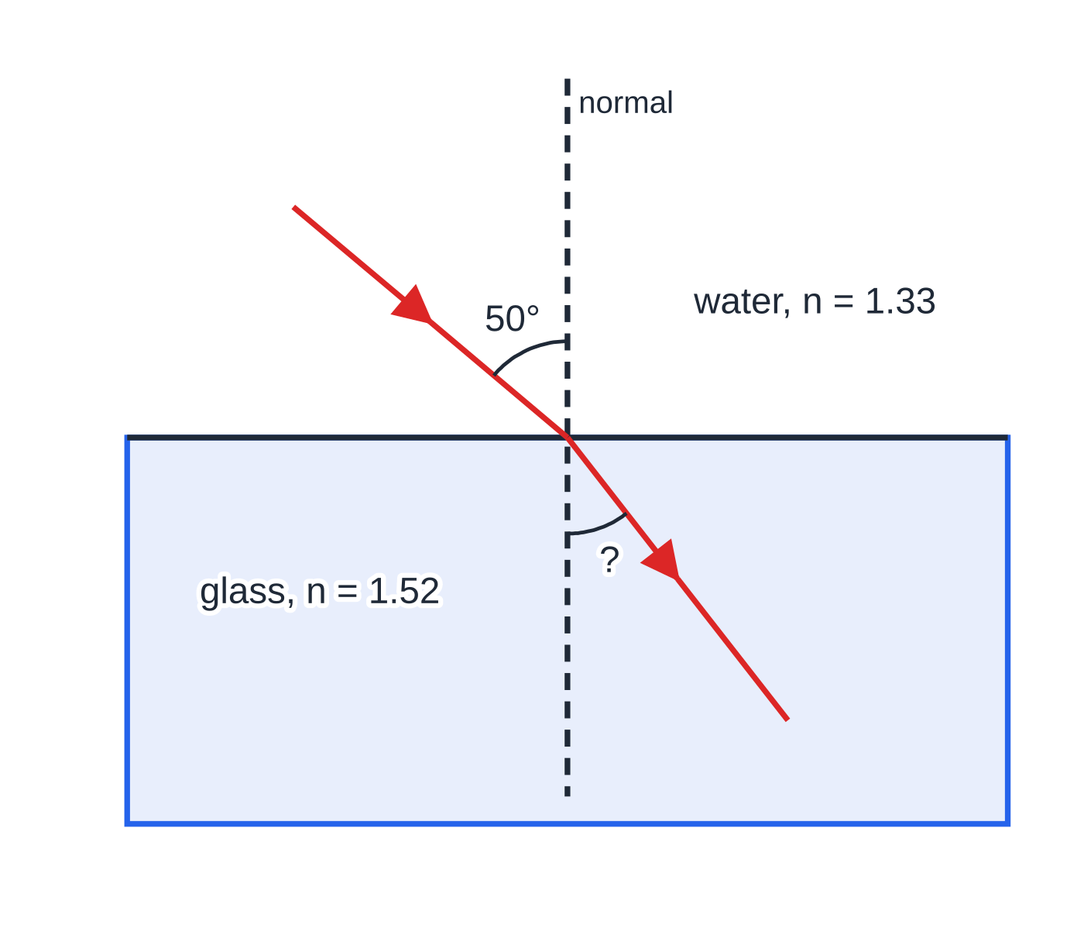
Question 3
1 mark
Light travelling in water strikes the flat glass base of a water-filled dish. The angle of incidence in the water is 50°. The refractive index of water is 1.33 and that of the glass is 1.52.
What is the angle of refraction in the glass?
Figure: ray passing from water into glass (not to scale)
A 30.3°
B 42.1°
C 47.9°
D 61.1°
Notes:
Online with the full mark scheme: https://examinerprep.com/ial-physics-2-3-intensity-refraction-and-polarisation-questions#IALP-U2-3-A-05

Slide 45
Question 4
4 marks
Sunlight of intensity 750 W m⁻² falls at right angles on a flat solar panel of area 1.6 m².
(a) State what is meant by the intensity of a wave. [1]
(b) Calculate the power of the sunlight falling on the panel. [2]
(c) The panel transfers 21% of this power to electrical energy. Calculate the electrical power output. [1]
Notes:
Online with the full mark scheme: https://examinerprep.com/ial-physics-2-3-intensity-refraction-and-polarisation-questions#IALP-U2-3-B-01

Slide 46
Question 5
6 marks
An antenna on a mast emits radio waves with a total power of 20 W. Assume that it radiates equally in all directions and that there is no absorption.
(a) Show that the intensity 50 m from the antenna is about 6.4 × 10⁻⁴ W m⁻². [2]
(b) Calculate the distance from the antenna at which the intensity is 1.0 × 10⁻⁴ W m⁻². [2]
(c) A student says that at 100 m the intensity will be half of its value at 50 m. Explain why this is wrong, and state the correct intensity at 100 m. [2]
Notes:
Online with the full mark scheme: https://examinerprep.com/ial-physics-2-3-intensity-refraction-and-polarisation-questions#IALP-U2-3-B-02

Slide 47
Answers

Slide 48
Question 1 · answer
Answer A
The power spreads over a sphere of area 4πr² = 4π × 4.0² = 201 m². I = P/A = 12 ÷ 201 = 0.060 W m⁻² (0.0597).
Notes:
Full mark scheme: https://examinerprep.com/ial-physics-2-3-intensity-refraction-and-polarisation-questions#IALP-U2-3-A-02

Slide 49
Question 2 · answer
Answer A
For a point source I ∝ 1/r², so the new intensity is I × (3.0/7.5)² = I × 0.40² = 0.16I.
Notes:
Full mark scheme: https://examinerprep.com/ial-physics-2-3-intensity-refraction-and-polarisation-questions#IALP-U2-3-A-03

Slide 50
Question 3 · answer
Answer B
n₁ sin θ₁ = n₂ sin θ₂: sin θ₂ = 1.33 × sin 50° ÷ 1.52 = 0.670, so θ₂ = 42.1°. It is smaller than 50° because the light enters a medium of higher refractive index.
Notes:
Full mark scheme: https://examinerprep.com/ial-physics-2-3-intensity-refraction-and-polarisation-questions#IALP-U2-3-A-05

Slide 51
Question 4 · answer
Mark scheme
power per unit area, on an area perpendicular to the direction the wave travels
P = IA = 750 × 1.6
= 1.2 × 10³ W
0.21 × 1200 = 250 W (252 W) (allow error carried forward)
Notes:
Full mark scheme: https://examinerprep.com/ial-physics-2-3-intensity-refraction-and-polarisation-questions#IALP-U2-3-B-01

Slide 52
Question 5 · answer
Mark scheme
area = 4π × 50² = 3.14 × 10⁴ m²
I = 20 ÷ 3.14 × 10⁴ = 6.37 × 10⁻⁴ W m⁻²
r = √(P ÷ 4πI) = √(20 ÷ (4π × 1.0 × 10⁻⁴))
= 1.3 × 10² m (126 m)
the power spreads over a sphere whose area is proportional to r², so I ∝ 1/r²
doubling the distance quarters the intensity: 1.6 × 10⁻⁴ W m⁻²
Notes:
Full mark scheme: https://examinerprep.com/ial-physics-2-3-intensity-refraction-and-polarisation-questions#IALP-U2-3-B-02

Slide 53
Keep practising
Notes for this topic
Questions on this topic
Build a printable test
ExaminerPrep is an independent tutoring service. It has been developed independently from and is not endorsed by the International Baccalaureate Organization. "International Baccalaureate", "IB" and "IB Diploma Programme" are registered trademarks of the IBO, used here for descriptive purposes only.
Pearson Edexcel and Cambridge are trademarks of their owners; ExaminerPrep is not affiliated with any exam board.

