Slide 1
EP
EDEXCEL IAL PHYSICS
5.2 Internal energy and the ideal gas
The full notes page in 11 sections · practice questions with answers · simulations
ExaminerPrep is an independent tutoring service. It has been developed independently from and is not endorsed by the International Baccalaureate Organization. "International Baccalaureate", "IB" and "IB Diploma Programme" are registered trademarks of the IBO, used here for descriptive purposes only.
Pearson Edexcel and Cambridge are trademarks of their owners; ExaminerPrep is not affiliated with any exam board.
Notes:
5.2 Internal energy and the ideal gas. Notes for this topic: https://examinerprep.com/notes/edexcel-ial-physics/internal-energy-and-the-ideal-gas/

Slide 2
What this page covers
Overview
Internal energy as the random kinetic and potential energies of the molecules
Absolute zero, the kelvin scale and the link between temperature and mean molecular kinetic energy
The ideal gas equation pV = NkT, with N the number of molecules
Boyle's law, the pressure law and Charles's law as special cases, and their graphs
Core Practical 14: how the pressure of a fixed mass of gas depends on its volume at constant temperature
The kinetic theory assumptions and the derivation of ½m⟨c²⟩= (3/2)kT
Root-mean-square speed and how it depends on temperature and molecular mass
Notes:
What this page covers. Full notes: https://examinerprep.com/notes/edexcel-ial-physics/internal-energy-and-the-ideal-gas/

Slide 3
In one minute
Key points
1. A gas obeys pV = NkT from outside and is a huge number of randomly moving molecules from inside, and putting the two views together shows that absolute temperature measures the mean kinetic energy of the molecules.
2. Internal energy is the sum of the randomly distributed kinetic and potential energies of all the molecules; in an ideal gas it is all kinetic.
3. Always use kelvin: T/K = θ/°C + 273. At absolute zero the molecules would have their minimum possible energy.
4. ½m⟨c²⟩= (3/2)kT: mean kinetic energy depends on T only, not on the type of gas.
5. Fix two of N, T, p, V and you get a gas law: p ∝1/V (Boyle), p ∝T (pressure law), V ∝T (Charles).
6. Kinetic theory gives pV = ⅓Nm⟨c²⟩; comparing with pV = NkT gives cᵣₘₛ = √(3kT/m).
Notes:
In one minute. Full notes: https://examinerprep.com/notes/edexcel-ial-physics/internal-energy-and-the-ideal-gas/

Slide 4
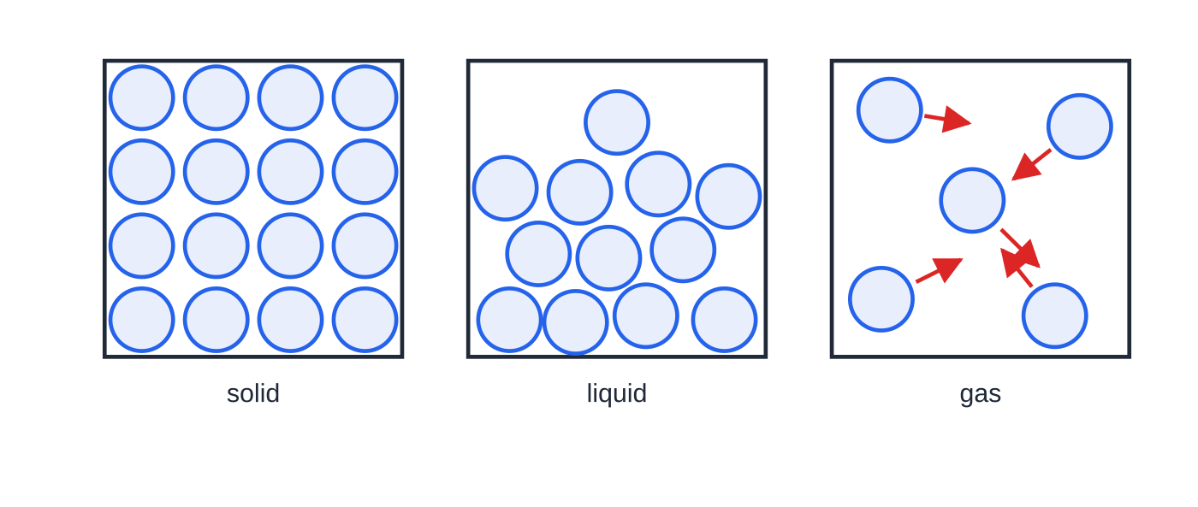
What is internal energy?
Section 1 of 11
Internal energy of a body: the sum of the randomly distributed kinetic and potential energies of all its molecules.
The kinetic part comes from the random motion of the molecules: vibration in a solid, vibration and sliding past each other in a liquid, free flight in a gas. The potential part comes from the forces between molecules; pulling molecules further apart against attractive forces increases it.
Solid, liquid and gas. Going from left to right the molecules are further apart (more potential energy); in a gas they fly freely and only interact during collisions.
Notes:
What is internal energy?. Full notes: https://examinerprep.com/notes/edexcel-ial-physics/internal-energy-and-the-ideal-gas/

Slide 5
What is internal energy? (continued)
Section 1 of 11
"Randomly distributed" matters: at any instant some molecules are fast and some slow, and collisions keep swapping energy between them. Only the total and the average are fixed by the state of the body.
Heating during a change of state (melting, boiling) increases the potential energy of the molecules at constant temperature; heating without a change of state increases mainly their kinetic energy, so the temperature rises.
An ideal gas has no forces between molecules except during collisions, so no potential energy: its internal energy is the total random kinetic energy of its molecules.
The kinetic energy of the body moving as a whole, or its gravitational potential energy, is not internal energy; only random, molecular-scale energies count.
Notes:
What is internal energy?. Full notes: https://examinerprep.com/notes/edexcel-ial-physics/internal-energy-and-the-ideal-gas/

Slide 6
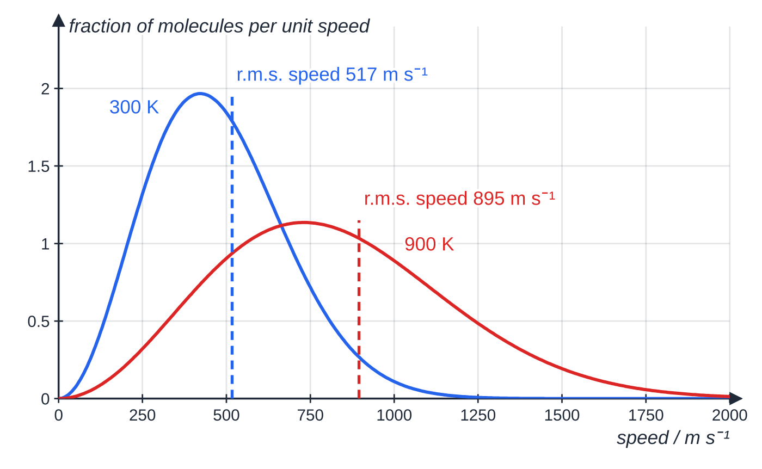
What is internal energy? (continued)
Section 1 of 11
Spread of molecular speeds in nitrogen (the shape itself is not required). Tripling the temperature from 300 K to 900 K raises the r.m.s. speed from 517 to 895 m s⁻¹, a factor of √3.
Notes:
What is internal energy?. Full notes: https://examinerprep.com/notes/edexcel-ial-physics/internal-energy-and-the-ideal-gas/

Slide 7
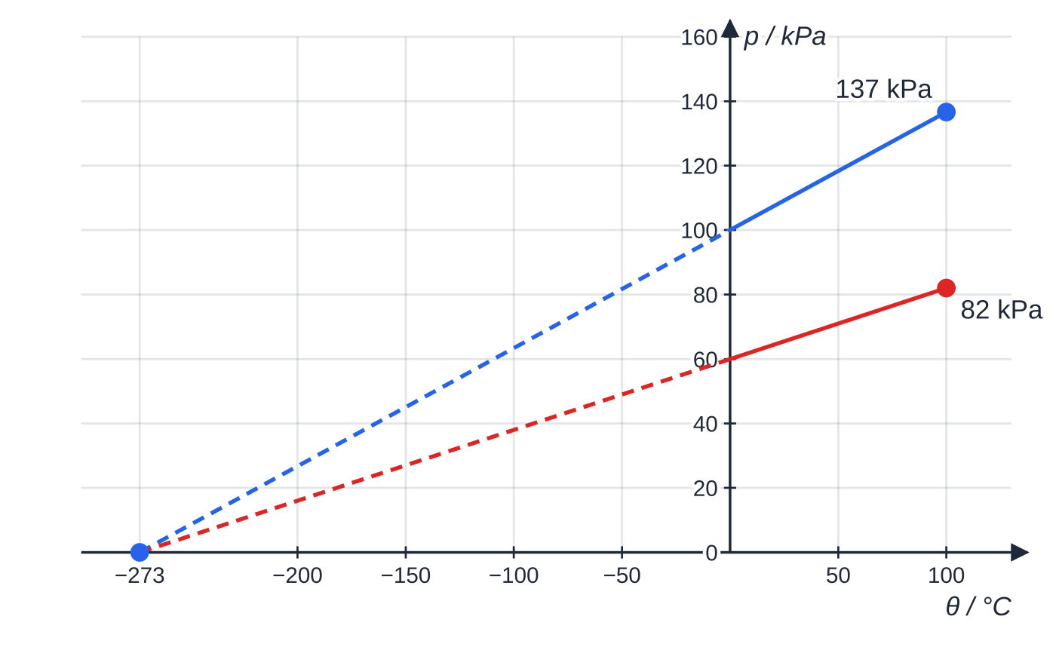
What is absolute zero, and how is temperature linked to molecular kinetic energy?
Section 2 of 11
Measure the pressure of a fixed volume of gas at several temperatures and plot p against θ in °C: the graph is a straight line. Extend it backwards and it reaches p = 0 at −273 °C, for every gas and every starting pressure.
Absolute zero (0 K, −273 °C): the lowest possible temperature, at which the molecules have their minimum possible energy (in the kinetic model, zero kinetic energy).
Two gas samples at constant volume, 100 kPa and 60 kPa at 0 °C, heated to 100 °C (137 kPa and 82 kPa). Both lines extrapolate to zero pressure at −273 °C.
Notes:
What is absolute zero, and how is temperature linked to molecular kinetic energy?. Full notes: https://examinerprep.com/notes/edexcel-ial-physics/internal-energy-and-the-ideal-gas/

Slide 8
What is absolute zero, and how is temperature linked to molecular kinetic energy? (continued)
Section 2 of 11
The kelvin (absolute) scale starts at absolute zero and has degrees the same size as Celsius degrees:
T/K = θ/°C + 273
This is not in the formulae list (learn it). A temperature difference is the same in K and °C; a temperature ratio is only meaningful in K.
The mean kinetic energy of the molecules is proportional to the absolute temperature: double T in kelvin and you double it (the kinetic theory section shows why).
Only kelvin works: 10 °C to 20 °C is 283 K to 293 K, a 3.5% rise, not a doubling.
At the same temperature, molecules of different gases have the same mean kinetic energy; heavier ones simply move more slowly.
Notes:
What is absolute zero, and how is temperature linked to molecular kinetic energy?. Full notes: https://examinerprep.com/notes/edexcel-ial-physics/internal-energy-and-the-ideal-gas/

Slide 9
What is absolute zero, and how is temperature linked to molecular kinetic energy? (continued)
Section 2 of 11 · Worked example 1 · Easy · Calculate
WORKED EXAMPLE · QUESTION
A sample of gas is heated from 27 °C to 327 °C. (a) Calculate the ratio of the mean kinetic energy of the molecules at 327 °C to that at 27 °C. (b) Calculate the Celsius temperature at which the mean kinetic energy would be half its value at 27 °C.
SOLUTION
(a) Convert: 27 + 273 = 300 K and 327 + 273 = 600 K. Mean kinetic energy ∝ T, so the ratio is 600 ÷ 300: 2.0 (not 327 ÷ 27 = 12.1).
(b) Half the mean kinetic energy needs half the kelvin temperature: T = 300 ÷2 = 150 K, so θ= 150 - 273: −123 °C.
Notes:
What is absolute zero, and how is temperature linked to molecular kinetic energy?: Worked example 1. Full notes: https://examinerprep.com/notes/edexcel-ial-physics/internal-energy-and-the-ideal-gas/

Slide 10
What is the ideal gas equation?
Section 3 of 11
pV = NkT
p is pressure (Pa), V volume (m³), N the number of molecules (no unit), k the Boltzmann constant, 1.38 × 10⁻²³ J K⁻¹, and T the absolute temperature (K). The equation is in the formulae list and k is on the data sheet. It holds for an ideal gas; real gases behave like this at low pressures and at temperatures well above those at which they liquefy.
N is a number of molecules, typically 10²⁰ to 10²⁷, not an amount in moles. If you are given the Avogadro constant N_A (6.02 × 10²³ mol⁻¹) and an amount n in moles, use N = nN_A.
Units check: Pa m³ = N m⁻² × m³ = N m = J, and kT is J K⁻¹ × K = J. So pV is an energy.
Convert first: cm³ → m³ (× 10⁻⁶), litres → m³ (× 10⁻³), kPa → Pa, °C → K.
Use the absolute pressure of the gas, not a tyre-gauge reading, which shows pressure above atmospheric.
Notes:
What is the ideal gas equation?. Full notes: https://examinerprep.com/notes/edexcel-ial-physics/internal-energy-and-the-ideal-gas/

Slide 11
What is the ideal gas equation? (continued)
Section 3 of 11 · Worked example 2 · Medium · Calculate
WORKED EXAMPLE · QUESTION
A classroom measures 8.0 m × 6.0 m × 3.0 m. The air is at 1.01 × 10⁵ Pa and 22 °C; treat it as an ideal gas. (a) Calculate the number of molecules in the room. (b) The average mass of an air molecule is 29 u. Calculate the mass of air in the room.
SOLUTION
(a) V = 8.0 ×6.0 ×3.0 = 144 m³ and T = 22 + 273 = 295 K. N = pV/kT = (1.01 ×10⁵ ×144)/(1.38 ×10⁻²³ ×295): N = 3.57 ×10²⁷.
(b) Mass = number × mass of one molecule (1 u = 1.66 × 10⁻²⁷ kg): 3.57 ×10²⁷ ×29 ×1.66 ×10⁻²⁷: 172 kg.
Given N_A = 6.02 ×10²³ mol⁻¹, the amount would be N/N_A = 5930 mol.
Notes:
What is the ideal gas equation?: Worked example 2. Full notes: https://examinerprep.com/notes/edexcel-ial-physics/internal-energy-and-the-ideal-gas/

Slide 12
How do the three gas laws follow from pV = NkT?
Section 4 of 11
For a fixed mass of gas N is constant, so pV/T = Nk is constant. Hold one more quantity constant and a simpler law drops out.
Law | Held constant | Relationship | Straight-line graph
Boyle's law | N and T | p ∝1/V, so p₁V₁ = p₂V₂ | p against 1/V, through the origin
Pressure law | N and V | p ∝T, so p₁/T₁ = p₂/T₂ | p against T (in K), through the origin
Charles's law | N and p | V ∝T, so V₁/T₁ = V₂/T₂ | V against T (in K), through the origin
Notes:
How do the three gas laws follow from pV = NkT?. Full notes: https://examinerprep.com/notes/edexcel-ial-physics/internal-energy-and-the-ideal-gas/

Slide 13
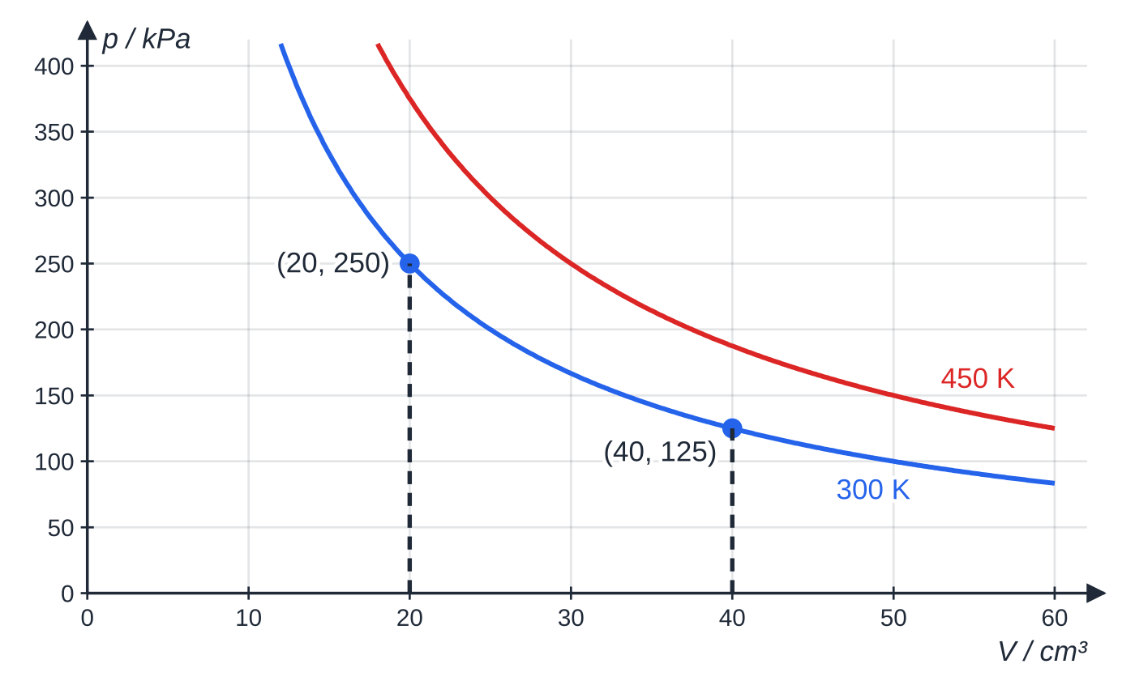
How do the three gas laws follow from pV = NkT? (continued)
Section 4 of 11
A p–V curve cannot show proportionality by eye, so replot as p against 1/V. Since p = NkT ×(1/V), the graph is a straight line through the origin with gradient NkT; a hotter isotherm is a steeper line.
Boyle's law for a fixed mass of gas with NkT = 5.0 J at 300 K: doubling the volume from 20 cm³ to 40 cm³ halves the pressure from 250 kPa to 125 kPa. Each curve is an isotherm.
Notes:
How do the three gas laws follow from pV = NkT?. Full notes: https://examinerprep.com/notes/edexcel-ial-physics/internal-energy-and-the-ideal-gas/

Slide 14
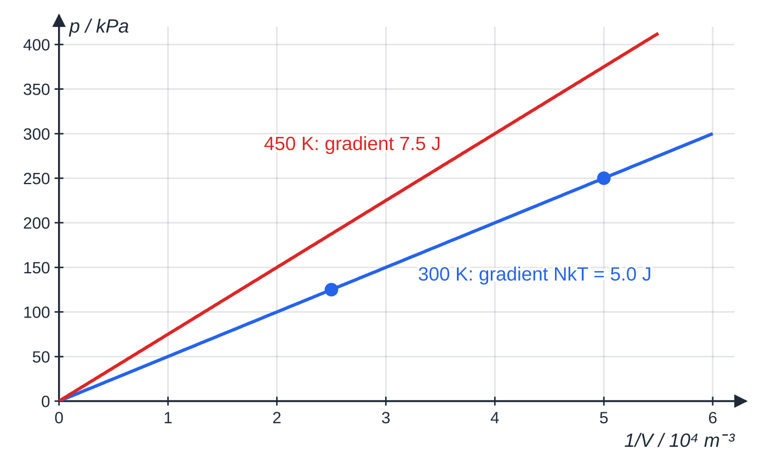
How do the three gas laws follow from pV = NkT? (continued)
Section 4 of 11
The same data as p against 1/V: straight lines through the origin, gradient NkT = 5.0 J at 300 K and 7.5 J at 450 K.
Notes:
How do the three gas laws follow from pV = NkT?. Full notes: https://examinerprep.com/notes/edexcel-ial-physics/internal-energy-and-the-ideal-gas/

Slide 15
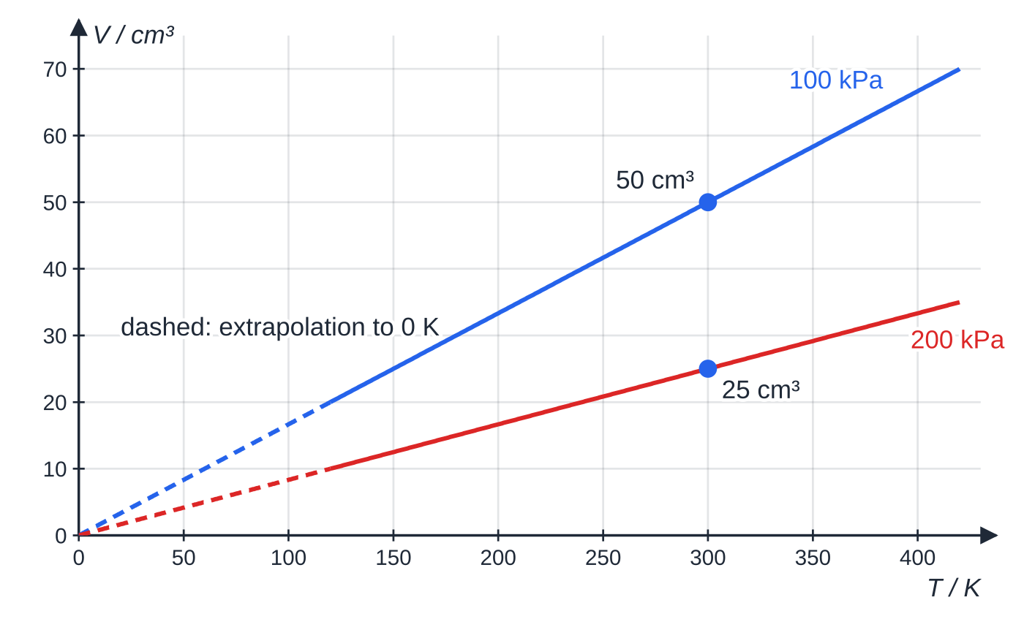
How do the three gas laws follow from pV = NkT? (continued)
Section 4 of 11
Charles's law for the same gas: 50 cm³ at 300 K at 100 kPa, 25 cm³ at 200 kPa. Both lines extrapolate to zero volume at 0 K, though every real gas liquefies long before this.
Notes:
How do the three gas laws follow from pV = NkT?. Full notes: https://examinerprep.com/notes/edexcel-ial-physics/internal-energy-and-the-ideal-gas/

Slide 16
How do the three gas laws follow from pV = NkT? (continued)
Section 4 of 11 · Worked example 3 · Medium · Calculate
WORKED EXAMPLE · QUESTION
A car tyre contains 0.025 m³ of air at an absolute pressure of 3.10 × 10⁵ Pa and 7 °C. After a long drive the air is at 37 °C; the volume does not change. (a) Calculate the new pressure. (b) The driver lets air out until the pressure is back to 3.10 × 10⁵ Pa, still at 37 °C. Calculate the fraction of the molecules let out, and the number this is.
SOLUTION
(a) Fixed N and V, so p/T is constant, in kelvin: p₂ = 3.10 ×10⁵ ×(310/280): 3.43 ×10⁵ Pa.
(b) At fixed V and T, N ∝p: fraction remaining = 3.10 ÷3.432 = 0.903, so 9.7% let out. Original number: N = (3.10 ×10⁵ ×0.025)/(1.38 ×10⁻²³ ×280) = 2.01 ×10²⁴, so let out 0.0968 ×2.01 ×10²⁴: 1.9 ×10²³ molecules.
Notes:
How do the three gas laws follow from pV = NkT?: Worked example 3. Full notes: https://examinerprep.com/notes/edexcel-ial-physics/internal-energy-and-the-ideal-gas/

Slide 17
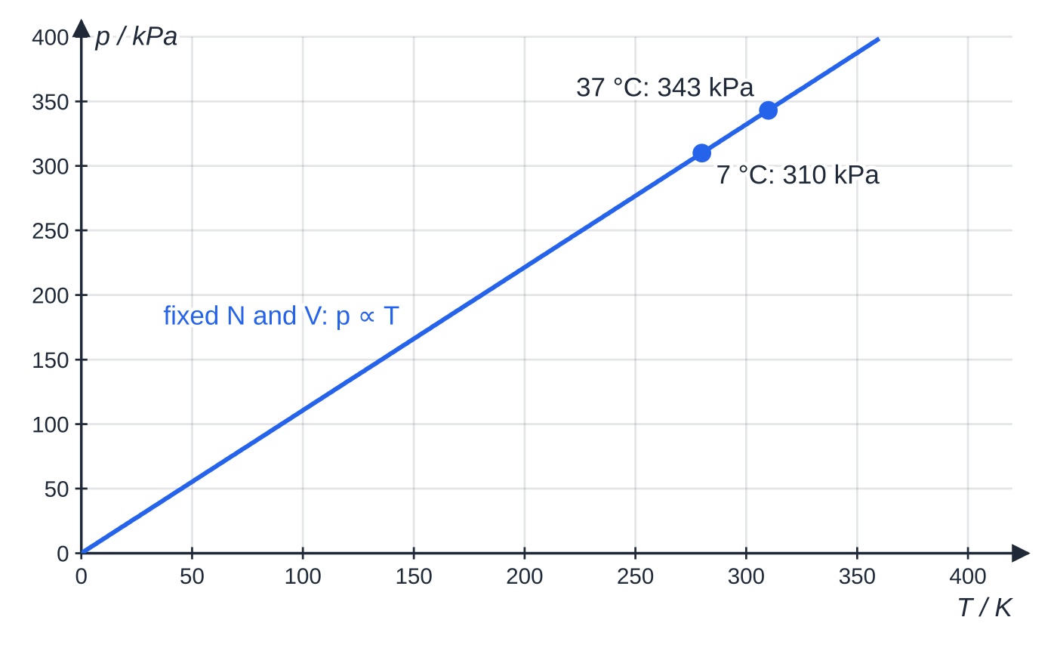
How do the three gas laws follow from pV = NkT? (continued)
Section 4 of 11
Common error
Using °C in a gas-law ratio: 3.10 × 10⁵ × 37 ÷ 7 would give a pressure more than five times larger. Only the kelvin scale starts where pressure and molecular kinetic energy would be zero.
The tyre in Worked example 3: at fixed N and V, p ∝ T in kelvin, so 280 K → 310 K raises 310 kPa to 343 kPa.
Notes:
How do the three gas laws follow from pV = NkT?. Full notes: https://examinerprep.com/notes/edexcel-ial-physics/internal-energy-and-the-ideal-gas/

Slide 18
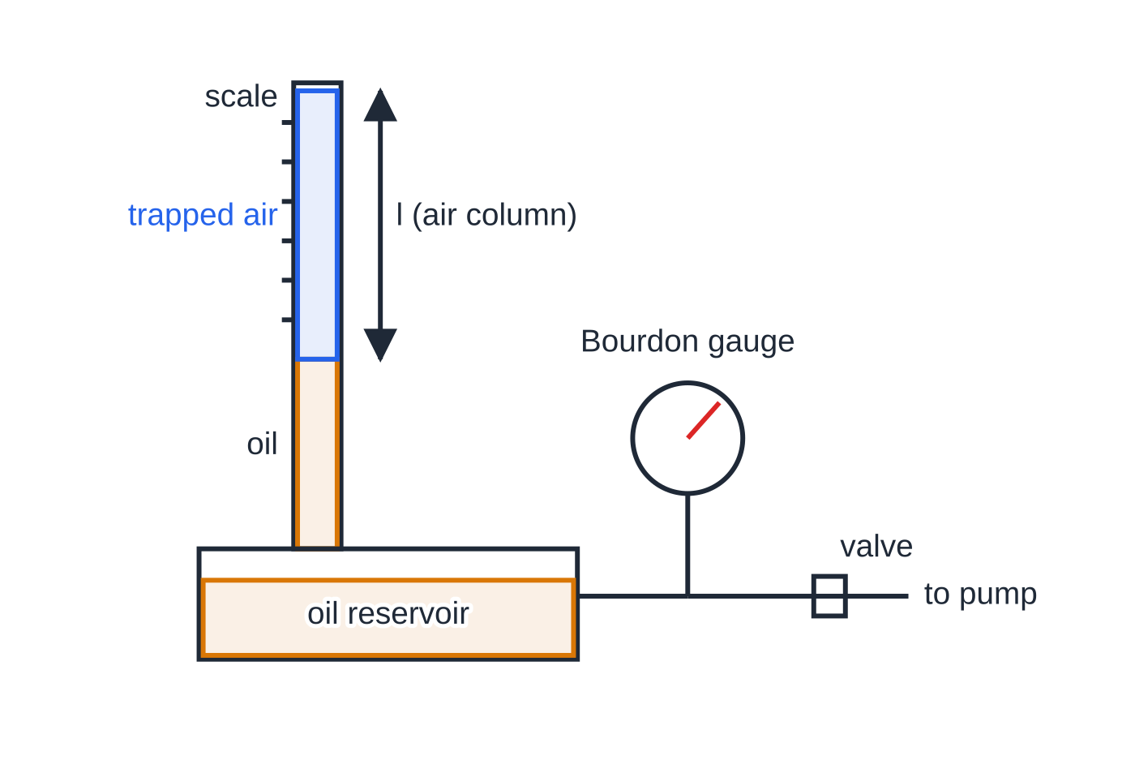
How do you investigate how the pressure of a gas depends on its volume?
Section 5 of 11
This is Core Practical 14. A fixed mass of air is trapped and compressed in steps at constant temperature, and its pressure recorded at each volume.
Measure the tube's internal diameter d (or use the value given), so V = πd²/4 l. The area is constant, so V ∝l and the length alone tests the relationship.
Record l and p at atmospheric pressure, then pump to raise the pressure in steps, closing the valve each time.
Compressing a gas warms it: wait about a minute after each change so the air returns to room temperature, then read the length (eye level with the oil, to avoid parallax) and the pressure.
One common arrangement: air trapped above oil in a sealed glass tube of uniform bore. Pumping air into the reservoir pushes oil up the tube; the Bourdon gauge reads the pressure. Volume = column length × cross-sectional area.
Notes:
How do you investigate how the pressure of a gas depends on its volume?. Full notes: https://examinerprep.com/notes/edexcel-ial-physics/internal-energy-and-the-ideal-gas/

Slide 19
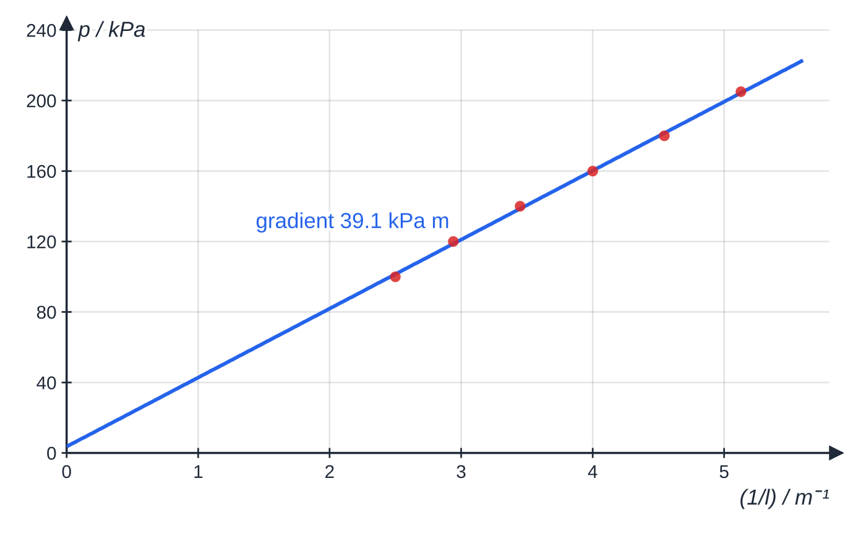
How do you investigate how the pressure of a gas depends on its volume? (continued)
Section 5 of 11
Take 6–8 readings across the gauge's range; repeat while releasing the pressure and average.
Plot p against 1/l (or 1/V): a straight line through the origin shows p ∝1/V at constant temperature.
Safety: eye protection, and stay within the working pressure of gauge and tube, since a glass tube under pressure can shatter.
Six readings (pressure to the nearest 5 kPa) as p against 1/l. The best-fit line has gradient 39.1 kPa m and intercept 3.6 kPa, close to zero given the gauge resolution.
Notes:
How do you investigate how the pressure of a gas depends on its volume?. Full notes: https://examinerprep.com/notes/edexcel-ial-physics/internal-energy-and-the-ideal-gas/

Slide 20
How do you investigate how the pressure of a gas depends on its volume? (continued)
Section 5 of 11 · Worked example 4 · Hard · Analyse
WORKED EXAMPLE · QUESTION
The results plotted above were taken at 20 °C in a tube of internal diameter 1.20 cm.
l / cm | 40.0 | 34.0 | 29.0 | 25.0 | 22.0 | 19.5
p / kPa | 100 | 120 | 140 | 160 | 180 | 205
pl / kPa m | 40.0 | 40.8 | 40.6 | 40.0 | 39.6 | 40.0
(a) Explain how the data support Boyle's law. (b) Use the gradient, 39.1 kPa m, to calculate the number of air molecules trapped. (c) The diameter is known to ± 0.02 cm, the gradient to ± 3.0% and the temperature to ± 1 K. Calculate the percentage uncertainty in N.
SOLUTION
(a) The products pl all lie between 39.6 and 40.8 kPa m, constant within about 2%, so p ∝1/l ∝1/V (and the graph is a straight line through the origin).
Notes:
How do you investigate how the pressure of a gas depends on its volume?: Worked example 4. Full notes: https://examinerprep.com/notes/edexcel-ial-physics/internal-energy-and-the-ideal-gas/

Slide 21
How do you investigate how the pressure of a gas depends on its volume? (continued)
Section 5 of 11 · Worked example 4 · Hard · Analyse (continued)
(b) Gradient = pl = pV/A = NkT/A, so N = gradient ×A/kT. A = π(0.60 ×10⁻²)² = 1.131 ×10⁻⁴ m², T = 293 K: N = (39.1 ×10³ ×1.131 ×10⁻⁴)/(1.38 ×10⁻²³ ×293): 1.09 ×10²¹.
(c) The diameter is squared, so its percentage counts twice: 0.02 ÷ 1.20 = 1.7%, so 3.3% for A; T: 1 ÷ 293 = 0.34%. Total 3.3 + 3.0 + 0.34: 6.7%, N = (1.09 ±0.07) ×10²¹.
Notes:
How do you investigate how the pressure of a gas depends on its volume?: Worked example 4. Full notes: https://examinerprep.com/notes/edexcel-ial-physics/internal-energy-and-the-ideal-gas/

Slide 22
How do you investigate how the pressure of a gas depends on its volume? (continued)
Section 5 of 11
Exam tip — straighten the graph
p against V is a curve. Plot p against 1/V and look for a straight line through the origin, or show that pV is the same for every reading.
Notes:
How do you investigate how the pressure of a gas depends on its volume?. Full notes: https://examinerprep.com/notes/edexcel-ial-physics/internal-energy-and-the-ideal-gas/

Slide 23
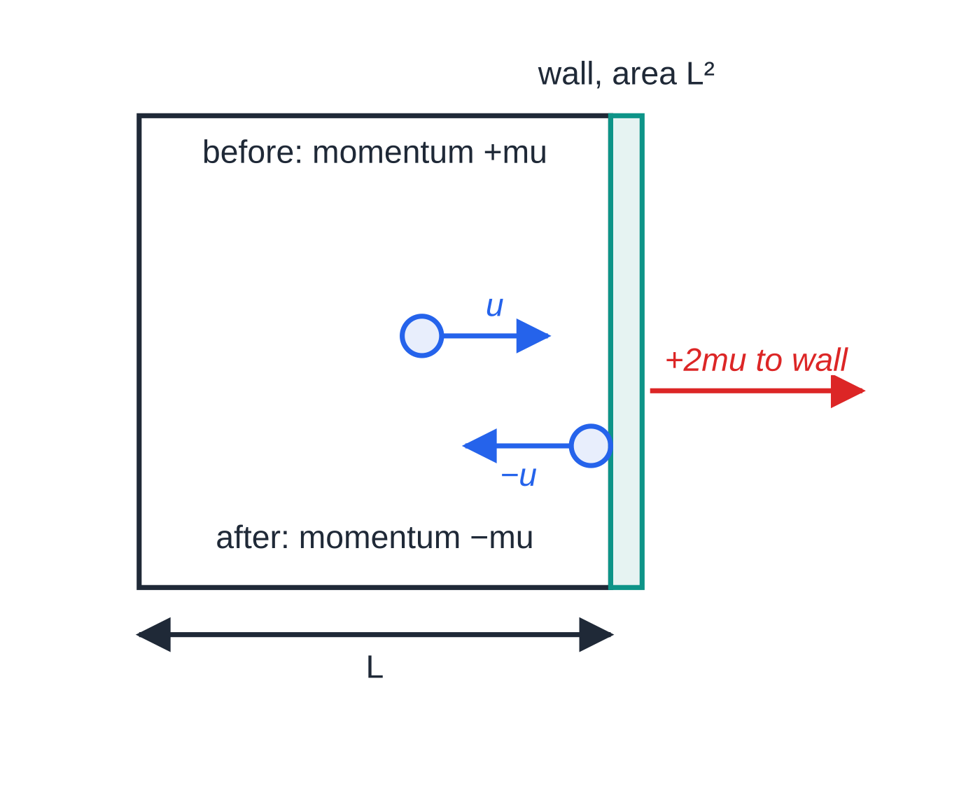
How does kinetic theory lead to ½m⟨c²⟩ = 3/2 kT?
Section 6 of 11
The assumptions of the kinetic model
A gas is a very large number of identical molecules in random motion.
The volume of the molecules is negligible compared with the volume of the container.
There are no forces between molecules except during collisions.
Collisions with each other and with the walls are elastic (no loss of kinetic energy).
The duration of a collision is negligible compared with the time between collisions.
One molecule in a cube of side L. Only the velocity component u at right angles to the shaded wall matters for that wall. Each collision reverses it: the molecule's momentum changes by −2mu and the wall receives +2mu (red arrow drawn twice as long).
Notes:
How does kinetic theory lead to ½m⟨c²⟩ = 3/2 kT?. Full notes: https://examinerprep.com/notes/edexcel-ial-physics/internal-energy-and-the-ideal-gas/

Slide 24
How does kinetic theory lead to ½m⟨c²⟩ = 3/2 kT? (continued)
Section 6 of 11
The derivation, step by step
1. Change of momentum of one molecule hitting the wall: mu - (-mu) = 2mu, given to the wall.
2. It crosses the box and back, distance 2L, before hitting the same wall again: time between hits = 2L/u.
3. Average force on the wall = rate of change of momentum: 2mu ÷(2L/u) = mu²/L.
4. For N molecules use the mean of u²: force = Nm⟨u²⟩/L, and pressure = force ÷ area L² = Nm⟨u²⟩/V.
5. The motion is random, so ⟨u²⟩= ⟨v²⟩= ⟨w²⟩, and since c² = u² + v² + w², ⟨u²⟩= ⅓⟨c²⟩.
6. So pV = ⅓Nm⟨c²⟩, or p = ⅓ρ⟨c²⟩ since the density ρ= Nm/V.
7. Compare with pV = NkT: ⅓Nm⟨c²⟩= NkT, so m⟨c²⟩= 3kT.
½m⟨c²⟩= (3/2)kT
Notes:
How does kinetic theory lead to ½m⟨c²⟩ = 3/2 kT?. Full notes: https://examinerprep.com/notes/edexcel-ial-physics/internal-energy-and-the-ideal-gas/

Slide 25
How does kinetic theory lead to ½m⟨c²⟩ = 3/2 kT? (continued)
Section 6 of 11
m is the mass of one molecule (kg), ⟨c²⟩ the mean square speed (m² s⁻²). The equation is in the formulae list, but the derivation is not supplied: learn its steps. Consequences: mean kinetic energy ∝ T; the internal energy of an ideal gas is N ×(3/2)kT; and cᵣₘₛ = √(⟨c²⟩) = √(3kT/m).
Root-mean-square speed
⟨c²⟩ is the mean of the squares of the speeds; its square root is the r.m.s. speed. Order matters: square each speed, take the mean, then the square root. The r.m.s. speed is always at least as big as the ordinary mean speed. cᵣₘₛ ∝√T for a given gas and ∝1/√m at a given temperature, so hydrogen and helium move much faster than nitrogen at the same temperature.
Notes:
How does kinetic theory lead to ½m⟨c²⟩ = 3/2 kT?. Full notes: https://examinerprep.com/notes/edexcel-ial-physics/internal-energy-and-the-ideal-gas/

Slide 26
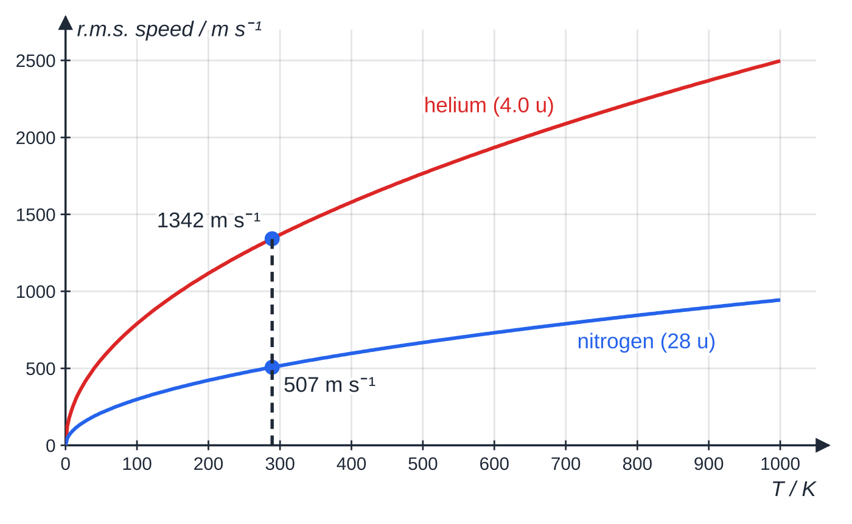
How does kinetic theory lead to ½m⟨c²⟩ = 3/2 kT? (continued)
Section 6 of 11
r.m.s. speed against temperature, from c(rms) = √(3kT/m). At 289 K helium atoms average 1342 m s⁻¹ and nitrogen molecules 507 m s⁻¹, in the ratio √(28/4.0).
Notes:
How does kinetic theory lead to ½m⟨c²⟩ = 3/2 kT?. Full notes: https://examinerprep.com/notes/edexcel-ial-physics/internal-energy-and-the-ideal-gas/

Slide 27
How does kinetic theory lead to ½m⟨c²⟩ = 3/2 kT? (continued)
Section 6 of 11 · Worked example 5 · Easy · Calculate
WORKED EXAMPLE · QUESTION
Five molecules have speeds of 200, 400, 500, 600 and 800 m s⁻¹. Calculate their mean speed and their r.m.s. speed.
SOLUTION
Mean: (200 + 400 + 500 + 600 + 800) ÷5: 500 m s⁻¹.
⟨c²⟩= (200² + 400² + 500² + 600² + 800²) ÷5 = 290 000 m² s⁻², so cᵣₘₛ = √(290 000): 539 m s⁻¹, larger than the mean because squaring weights the fast molecules more.
Notes:
How does kinetic theory lead to ½m⟨c²⟩ = 3/2 kT?: Worked example 5. Full notes: https://examinerprep.com/notes/edexcel-ial-physics/internal-energy-and-the-ideal-gas/

Slide 28
How does kinetic theory lead to ½m⟨c²⟩ = 3/2 kT? (continued)
Section 6 of 11 · Worked example 6 · Medium · Calculate
WORKED EXAMPLE · QUESTION
A nitrogen molecule has a mass of 28 u (1 u = 1.66 × 10⁻²⁷ kg). The air is at 20 °C. (a) Calculate the mean kinetic energy of a nitrogen molecule. (b) Calculate the r.m.s. speed. (c) Calculate the Celsius temperature at which the r.m.s. speed would be twice as large.
SOLUTION
(a) (3/2)kT = 1.5 ×1.38 ×10⁻²³ ×293: 6.07 ×10⁻²¹ J.
(b) m = 28 ×1.66 ×10⁻²⁷ = 4.65 ×10⁻²⁶ kg; cᵣₘₛ = √((3 ×1.38 ×10⁻²³ ×293)/(4.65 ×10⁻²⁶)): 511 m s⁻¹.
(c) cᵣₘₛ ∝√T, so doubling it needs four times the kelvin temperature: T = 4 ×293 = 1172 K: 899 °C.
Notes:
How does kinetic theory lead to ½m⟨c²⟩ = 3/2 kT?: Worked example 6. Full notes: https://examinerprep.com/notes/edexcel-ial-physics/internal-energy-and-the-ideal-gas/

Slide 29
How does kinetic theory lead to ½m⟨c²⟩ = 3/2 kT? (continued)
Section 6 of 11 · Worked example 7 · Hard · Show that
WORKED EXAMPLE · QUESTION
A cylinder contains helium at 1.2 × 10⁵ Pa and a density of 0.20 kg m⁻³. The mass of a helium atom is 4.0 u. (a) Show that the r.m.s. speed is about 1.3 × 10³ m s⁻¹. (b) Calculate the temperature of the helium. (c) Nitrogen (28 u) at the same temperature is in a second cylinder. Calculate its r.m.s. speed.
SOLUTION
(a) p = ⅓ρ⟨c²⟩, so cᵣₘₛ = √(3p/ρ) = √(3 ×1.2 ×10⁵ ÷0.20) = √(1.80 ×10⁶): 1342 m s⁻¹ ≈ 1.3 × 10³ m s⁻¹.
(b) T = m⟨c²⟩/3k = (4.0 ×1.66 ×10⁻²⁷ ×1.80 ×10⁶)/(3 ×1.38 ×10⁻²³): 289 K.
(c) Same T, same mean kinetic energy, so cᵣₘₛ ∝1/√m: 1342 ×√(4.0/28) = 1342 ×0.378: 507 m s⁻¹.
Check: p = ρkT/m = 0.20 ×1.38 ×10⁻²³ ×289 ÷6.64 ×10⁻²⁷ = 1.20 ×10⁵ Pa, consistent with the data.
Notes:
How does kinetic theory lead to ½m⟨c²⟩ = 3/2 kT?: Worked example 7. Full notes: https://examinerprep.com/notes/edexcel-ial-physics/internal-energy-and-the-ideal-gas/

Slide 30
How does kinetic theory lead to ½m⟨c²⟩ = 3/2 kT? (continued)
Section 6 of 11
Common error
Using the molar mass (4.0 or 0.0040) for m. In ½m⟨c²⟩= (3/2)kT and √(3kT/m), m is the mass of one molecule in kg: 4.0 u = 4.0 × 1.66 × 10⁻²⁷ kg.
Notes:
How does kinetic theory lead to ½m⟨c²⟩ = 3/2 kT?. Full notes: https://examinerprep.com/notes/edexcel-ial-physics/internal-energy-and-the-ideal-gas/

Slide 31
Exam tips for 5.2
Section 7 of 11
Exam tip 1 — convert to kelvin before anything else
Every gas-law ratio and every use of pV = NkT or ½m⟨c²⟩= (3/2)kT needs T in kelvin. Write the conversion as a separate line so it earns credit even if a later step slips.
Exam tip 2 — N is a number of molecules
Given moles and N_A, multiply first. Given a mass of gas, divide by the mass of one molecule.
Exam tip 3 — the mean kinetic energy depends only on T
Two gases at the same temperature have the same mean molecular kinetic energy; their r.m.s. speeds are in the ratio √(m₂/m₁). Use ratios rather than recalculating.
Notes:
Exam tips for 5.2. Full notes: https://examinerprep.com/notes/edexcel-ial-physics/internal-energy-and-the-ideal-gas/

Slide 32
Exam tips for 5.2 (continued)
Section 7 of 11
Exam tip 4 — learn the derivation as numbered steps
Change of momentum 2mu → time between collisions 2L/u → force mu²/L → sum over N molecules and divide by area → ⟨u²⟩= ⅓⟨c²⟩ → compare with pV = NkT. State which assumption you use at each step.
Exam tip 5 — explain pressure changes with molecules
Pressure rises when molecules hit the walls more often or with more momentum. Smaller volume at constant T: same speeds, more frequent collisions. Higher T at constant volume: faster molecules, so more frequent collisions and a larger momentum change per collision.
Notes:
Exam tips for 5.2. Full notes: https://examinerprep.com/notes/edexcel-ial-physics/internal-energy-and-the-ideal-gas/

Slide 33
Common misconceptions
Section 8 of 11
Misconception | Why it is wrong | Correct idea
Doubling the temperature from 20 °C to 40 °C doubles the mean kinetic energy. | The Celsius zero is not where molecular kinetic energy is zero. | Mean kinetic energy ∝ T in kelvin: 293 K → 313 K is a 7% rise.
Temperature measures the total internal energy of a body. | A large cool lake holds far more internal energy than a hot spark. | Temperature measures the mean kinetic energy per molecule.
When ice melts at 0 °C its internal energy does not change. | Energy is supplied while the temperature stays constant. | The molecular potential energy increases; the kinetic energy stays the same.
Heavier molecules have more kinetic energy at the same temperature. | Mean kinetic energy is (3/2)kT, which contains no mass. | Same mean kinetic energy; heavier molecules have a lower r.m.s. speed.
Gas pressure is caused by molecules colliding with each other. | Collisions between molecules exert no net force on the container. | Pressure is the rate of change of momentum of molecules hitting the walls, per unit area.
Notes:
Common misconceptions. Full notes: https://examinerprep.com/notes/edexcel-ial-physics/internal-energy-and-the-ideal-gas/

Slide 34
Common misconceptions (continued)
Section 8 of 11
Misconception | Why it is wrong | Correct idea
The r.m.s. speed is just the average speed. | Squaring before averaging gives fast molecules more weight. | cᵣₘₛ = √(⟨c²⟩) is greater than or equal to the mean speed.
Notes:
Common misconceptions. Full notes: https://examinerprep.com/notes/edexcel-ial-physics/internal-energy-and-the-ideal-gas/

Slide 35
How this topic connects
Section 9 of 11
1 Specific heat capacity and specific latent heat
Energy supplied to a body raises either the molecular kinetic energy (temperature rises, ΔE = mcΔθ) or the molecular potential energy (change of state, ΔE = LΔm): the two parts of internal energy.
Momentum (Unit 1) and 5.3 Binding energy, fission and fusion
The derivation is Newton's second law as rate of change of momentum, applied to molecules bouncing elastically off a wall. Nuclei fuse only if they approach very closely, which needs a large kinetic energy; since mean kinetic energy ∝ T, fusion needs temperatures of millions of kelvin.
Practical skills (Unit 6)
Core Practical 14 is a common context for planning, graph plotting and combining percentage uncertainties in the practical skills paper.
Notes:
How this topic connects. Full notes: https://examinerprep.com/notes/edexcel-ial-physics/internal-energy-and-the-ideal-gas/

Slide 36
Key equations
Section 10 of 11
Equation | Use | In the formulae list?
T/K = θ/°C + 273 | convert to the absolute temperature scale | no — learn it
pV = NkT | any calculation on an ideal gas; N = number of molecules (p in Pa, V in m³, k = 1.38 × 10⁻²³ J K⁻¹) | yes
p₁V₁/T₁ = p₂V₂/T₂ | a fixed mass of gas changing state (Boyle, pressure law, Charles as special cases) | no — derive it from pV = NkT with N constant
p = F/A | pressure on a wall in the kinetic theory derivation | no — learn it
pV = ⅓Nm⟨c²⟩ and p = ⅓ρ⟨c²⟩ | pressure from molecular motion | no — derive it
½m⟨c²⟩= (3/2)kT | mean kinetic energy of a molecule at temperature T | yes
cᵣₘₛ = √(3kT/m) | r.m.s. speed of the molecules of a gas | no — derive it from ½m⟨c²⟩ = 3/2kT
Notes:
Key equations. Full notes: https://examinerprep.com/notes/edexcel-ial-physics/internal-energy-and-the-ideal-gas/

Slide 37
Check your understanding
Section 11 of 11
1. Water at 100 °C turns to steam at 100 °C. State what happens to the mean kinetic energy and the potential energy of its molecules, and to its internal energy.
2. Calculate the ratio of the mean kinetic energy of air molecules at 20 °C to that at −40 °C.
3. A fixed mass of gas is compressed slowly to half its volume at constant temperature. State and explain what happens to its pressure.
4. A balloon holds 2.0 litres of gas at 300 K. It is heated to 450 K at constant pressure. Calculate the new volume.
5. By what factor does the r.m.s. speed of the molecules of a gas change when its temperature rises from 300 K to 1200 K?
6. Calculate the total internal energy of the 1.09 × 10²¹ air molecules in Worked example 4, treating the air as an ideal gas at 293 K.
Notes:
Check your understanding: questions. Full notes: https://examinerprep.com/notes/edexcel-ial-physics/internal-energy-and-the-ideal-gas/

Slide 38
Check your understanding · answers
Section 11 of 11
1. Mean kinetic energy unchanged (same temperature). Potential energy increases, because the molecules are separated against the attractive forces between them. So the internal energy increases.
2. 20 °C = 293 K and −40 °C = 233 K, so the ratio is 293 ÷ 233 = 1.26.
3. The pressure doubles (Boyle's law). The molecules have the same speeds, but in half the volume they hit each unit area of the walls twice as often, so the rate of change of momentum per unit area doubles.
4. V ∝T, so V = 2.0 ×450 ÷300 = 3.0 litres.
5. cᵣₘₛ ∝√T and T is multiplied by 4, so the r.m.s. speed doubles (factor 2).
6. U = N ×(3/2)kT = 1.09 ×10²¹ ×1.5 ×1.38 ×10⁻²³ ×293 = 6.61 J.
Notes:
Check your understanding: answers. Full notes: https://examinerprep.com/notes/edexcel-ial-physics/internal-energy-and-the-ideal-gas/

Slide 39
Practice questions
5 original exam-style questions. Answers at the end of the deck.

Slide 40
Question 1
1 mark
Which statement about the internal energy of a fixed mass of an ideal gas is correct?
A It is the total kinetic energy of the random motion of the molecules.
B It includes the kinetic energy of the container if the container is moving.
C It includes the potential energy due to the attractive forces between the molecules.
D It is proportional to the temperature of the gas in degrees Celsius.
Notes:
Online with the full mark scheme: https://examinerprep.com/ial-physics-5-2-internal-energy-and-the-ideal-gas-questions#IALP-U5-2-A-01

Slide 41
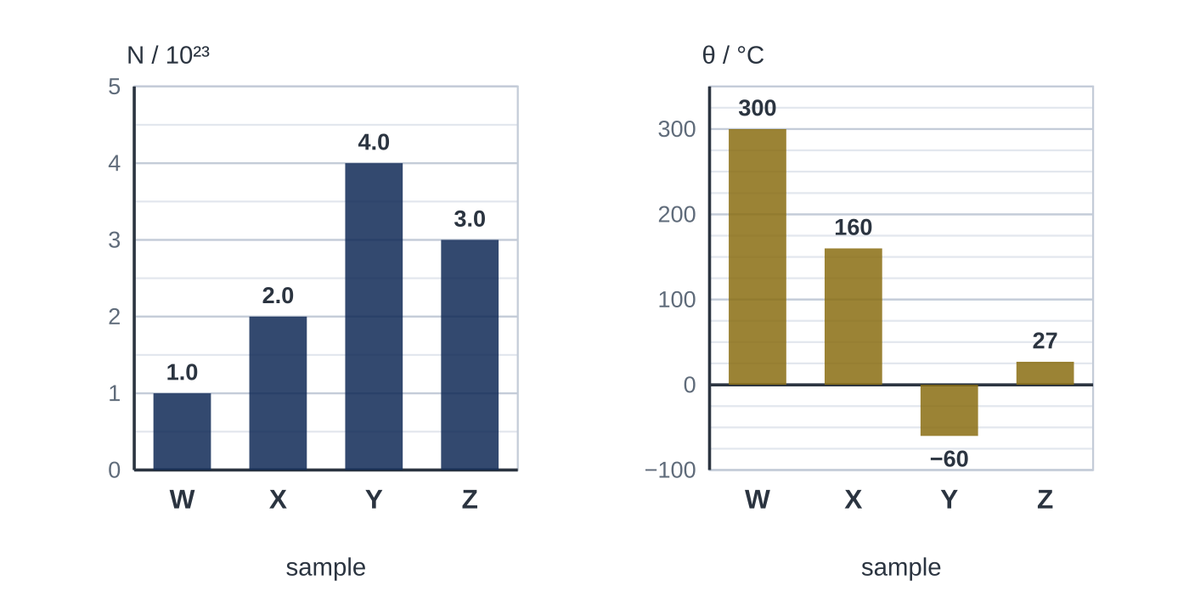
Question 2
1 mark
The bar charts show the number of molecules N and the Celsius temperature θ of four samples, W, X, Y and Z, of the same ideal gas.
Which sample has the greatest internal energy?
A W
B X
C Y
D Z
Notes:
Online with the full mark scheme: https://examinerprep.com/ial-physics-5-2-internal-energy-and-the-ideal-gas-questions#IALP-U5-2-FA-01

Slide 42
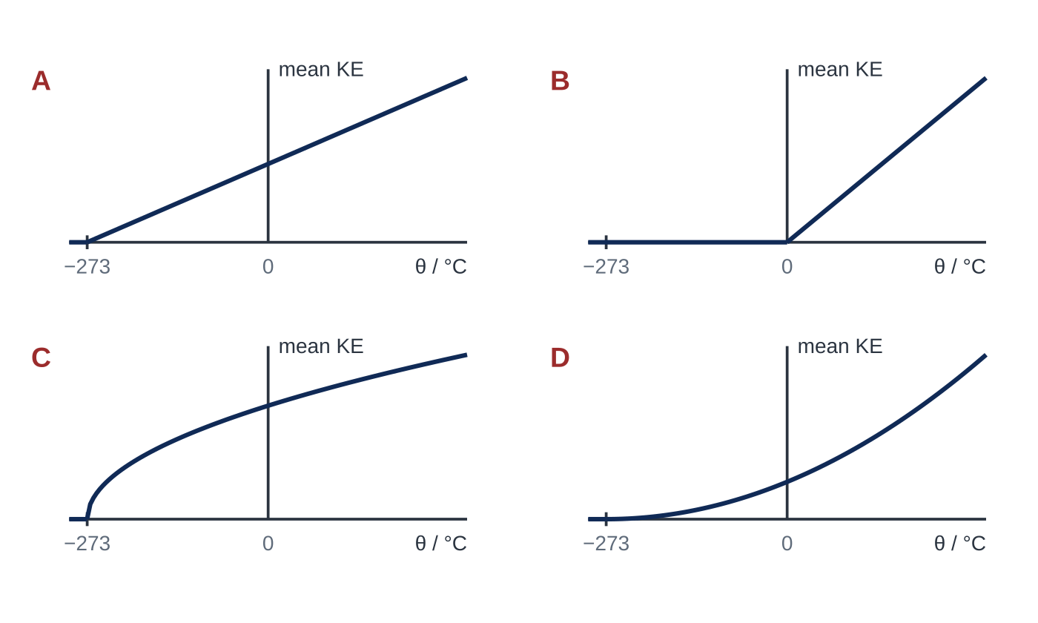
Question 3
1 mark
Which graph shows how the mean kinetic energy of the molecules of an ideal gas varies with the Celsius temperature θ of the gas?
A graph A
B graph B
C graph C
D graph D
Notes:
Online with the full mark scheme: https://examinerprep.com/ial-physics-5-2-internal-energy-and-the-ideal-gas-questions#IALP-U5-2-FA-02

Slide 43
Question 4
4 marks
A sealed plastic bottle of air is carried in a moving car from the coast to a mountain village. The temperature of the air in the bottle stays the same throughout. Treat the air as an ideal gas.
(a) State what is meant by the internal energy of a body. [2]
(b) Explain why the internal energy of the air in the bottle does not change during the journey. [2]
Notes:
Online with the full mark scheme: https://examinerprep.com/ial-physics-5-2-internal-energy-and-the-ideal-gas-questions#IALP-U5-2-B-01

Slide 44
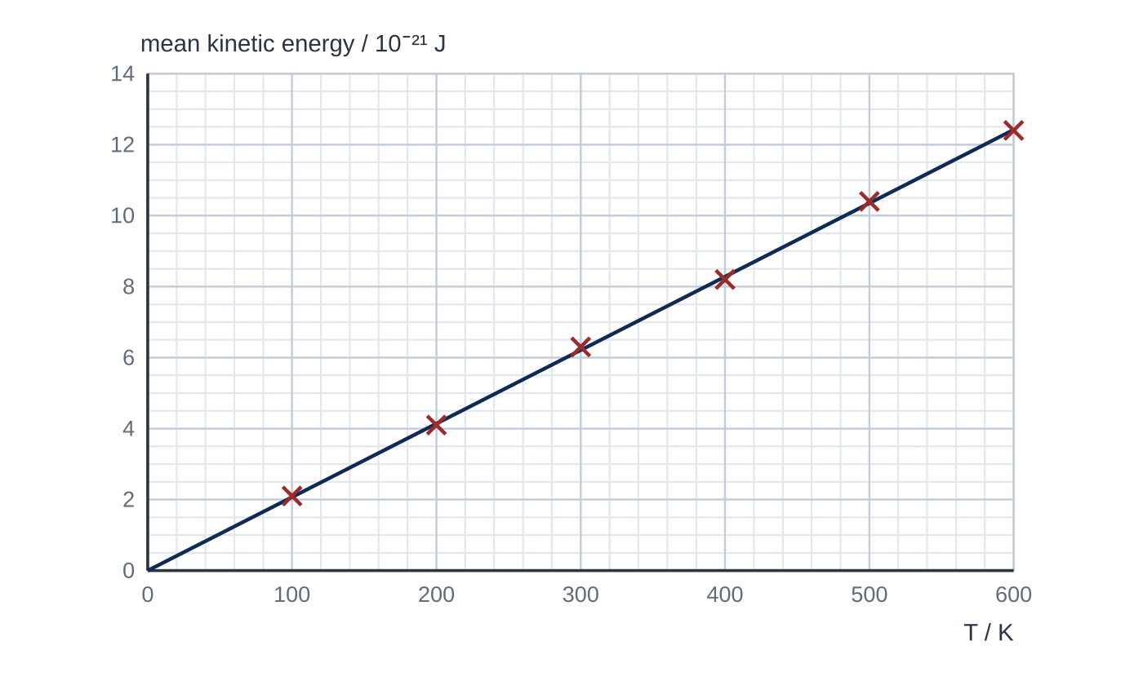
Question 5
7 marks
A computer model of an ideal gas calculates the mean kinetic energy of the molecules at different kelvin temperatures. Figure 1 shows the results with a line of best fit.
(a) Determine the gradient of the line. [2]
(b) The model uses ½m⟨c²⟩ = ³/₂kT. Use your gradient to find the value of the Boltzmann constant k in the model. [1]
(c) Explain why the internal energy of the model gas is equal to the number of molecules multiplied by the mean kinetic energy of a molecule. [1]
(d) The model contains 2.0 × 10²² molecules. Use Figure 1 to calculate the internal energy of the model gas at 400 K. [2]
(e) Each model molecule has a mass of 6.6 × 10⁻²⁷ kg. Calculate the r.m.s. speed of the molecules at 400 K. [1]
Notes:
Online with the full mark scheme: https://examinerprep.com/ial-physics-5-2-internal-energy-and-the-ideal-gas-questions#IALP-U5-2-FB-08

Slide 45
Answers

Slide 46
Question 1 · answer
Answer A
In an ideal gas there are no forces between the molecules except during collisions, so the molecules have no potential energy. The internal energy is the total random kinetic energy of the molecules, which is proportional to the absolute (kelvin) temperature.
Notes:
Full mark scheme: https://examinerprep.com/ial-physics-5-2-internal-energy-and-the-ideal-gas-questions#IALP-U5-2-A-01

Slide 47
Question 2 · answer
Answer D
For an ideal gas the internal energy is the total random kinetic energy of the molecules, N × ³/₂kT, so it is proportional to NT with T in kelvin. NT (in units of 10²³ K): W 1.0 × 573 = 573; X 2.0 × 433 = 866; Y 4.0 × 213 = 852; Z 3.0 × 300 = 900. The greatest is Z.
Notes:
Full mark scheme: https://examinerprep.com/ial-physics-5-2-internal-energy-and-the-ideal-gas-questions#IALP-U5-2-FA-01

Slide 48
Question 3 · answer
Answer A
½m⟨c²⟩ = ³/₂kT, so the mean kinetic energy is proportional to the kelvin temperature T = θ + 273. Against θ this is a straight line that reaches zero at θ = −273 °C (absolute zero): graph A.
Notes:
Full mark scheme: https://examinerprep.com/ial-physics-5-2-internal-energy-and-the-ideal-gas-questions#IALP-U5-2-FA-02

Slide 49
Question 4 · answer
Mark scheme
the sum of the kinetic and potential energies of the molecules
which are randomly distributed among the molecules
an ideal gas has no forces between its molecules, so no molecular potential energy; its internal energy is the total random kinetic energy, which depends only on the temperature
the kinetic and gravitational potential energy of the bottle as a whole are not part of internal energy, and the temperature is unchanged
Notes:
Full mark scheme: https://examinerprep.com/ial-physics-5-2-internal-energy-and-the-ideal-gas-questions#IALP-U5-2-B-01

Slide 50
Question 5 · answer
Mark scheme
uses a large triangle, e.g. from (0, 0) to (580 K, 12.0 × 10⁻²¹ J)
gradient = 12.0 × 10⁻²¹ ÷ 580 = 2.07 × 10⁻²³ J K⁻¹ (allow 2.03 to 2.11 × 10⁻²³ J K⁻¹)
gradient = ³/₂k, so k = ⅔ × 2.07 × 10⁻²³ = 1.38 × 10⁻²³ J K⁻¹ (allow 1.35 to 1.41 × 10⁻²³, consistent with the gradient)
in an ideal gas there are no forces between the molecules (except in collisions), so they have no potential energy and the internal energy is the total random kinetic energy
mean kinetic energy at 400 K = 8.3 × 10⁻²¹ J (allow 8.2 to 8.4)
U = 2.0 × 10²² × 8.3 × 10⁻²¹ = 1.7 × 10² J (166 J; allow 164 to 168 J)
⟨c²⟩ = 2 × 8.3 × 10⁻²¹ ÷ 6.6 × 10⁻²⁷, so cᵣₘₛ = 1.6 × 10³ m s⁻¹
Notes:
Full mark scheme: https://examinerprep.com/ial-physics-5-2-internal-energy-and-the-ideal-gas-questions#IALP-U5-2-FB-08

Slide 51
Keep practising
Notes for this topic
Questions on this topic
Build a printable test
ExaminerPrep is an independent tutoring service. It has been developed independently from and is not endorsed by the International Baccalaureate Organization. "International Baccalaureate", "IB" and "IB Diploma Programme" are registered trademarks of the IBO, used here for descriptive purposes only.
Pearson Edexcel and Cambridge are trademarks of their owners; ExaminerPrep is not affiliated with any exam board.

