Slide 1
EP
EDEXCEL IAL PHYSICS
4.5 Magnetic fields and forces
The full notes page in 11 sections · practice questions with answers · simulations
ExaminerPrep is an independent tutoring service. It has been developed independently from and is not endorsed by the International Baccalaureate Organization. "International Baccalaureate", "IB" and "IB Diploma Programme" are registered trademarks of the IBO, used here for descriptive purposes only.
Pearson Edexcel and Cambridge are trademarks of their owners; ExaminerPrep is not affiliated with any exam board.
Notes:
4.5 Magnetic fields and forces. Notes for this topic: https://examinerprep.com/notes/edexcel-ial-physics/magnetic-fields-and-forces/

Slide 2
What this page covers
Overview
Field patterns of a long straight wire, a flat coil and a solenoid, and the right-hand grip rule
Magnetic flux density B and its unit, the tesla
Magnetic flux φ= BA and flux linkage Nφ, including a coil at an angle to the field
The force on a current-carrying conductor, F = BIlsin θ, and Fleming's left-hand rule
Measuring B with a current balance, including the uncertainty
The force on a moving charge, F = Bqvsin θ, for positive and negative charges
Circular paths in a uniform field and r = p/BQ; selecting one speed with crossed fields
Notes:
What this page covers. Full notes: https://examinerprep.com/notes/edexcel-ial-physics/magnetic-fields-and-forces/

Slide 3
In one minute
Key points
1. A magnetic field is produced by moving charge and exerts a sideways force on moving charge, F = BIlsin θ on a wire and F = Bqvsin θ on a single charge, with the direction given by Fleming's left-hand rule.
2. Field lines run from N to S and never cross; closer lines mean a stronger field. The right-hand grip rule gives the direction of the field around a current.
3. Magnetic flux density B is the force per unit current per unit length on a wire at right angles to the field: 1 T = 1 N A⁻¹ m⁻¹.
4. Flux φ= BA (area at right angles to B) is in webers; flux linkage Nφ is in Wb turns.
5. Fleming's left-hand rule: First finger = Field, seCond finger = Current (conventional), thuMb = Motion (force). For a negative charge, point the second finger against its velocity.
6. The magnetic force on a charge is always at right angles to its velocity, so it does no work: in a uniform field the charge moves in a circle at constant speed with r = p/BQ.
Notes:
In one minute. Full notes: https://examinerprep.com/notes/edexcel-ial-physics/magnetic-fields-and-forces/

Slide 4
What does a magnetic field look like around a wire, a coil and a solenoid?
Section 1 of 11
A magnetic field is a region in which a moving charge, a current-carrying conductor or a magnetic material experiences a force. Field lines show the direction a free north pole would be pushed: out of N, into S. They never cross, and closer lines mean a stronger field.
Every current produces a magnetic field. Right-hand grip rule: grip the wire with your right hand, thumb along the conventional current; your fingers curl the way the field lines go. × means into the page (an arrow's tail) and • means out of the page (an arrow's point).
Notes:
What does a magnetic field look like around a wire, a coil and a solenoid?. Full notes: https://examinerprep.com/notes/edexcel-ial-physics/magnetic-fields-and-forces/

Slide 5
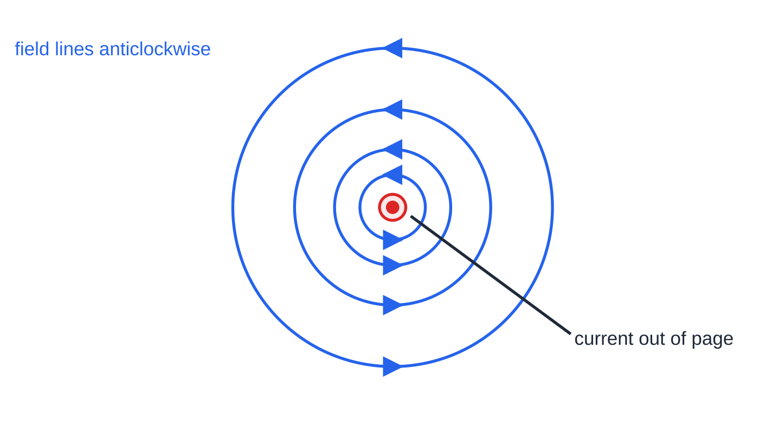
What does a magnetic field look like around a wire, a coil and a solenoid? (continued)
Section 1 of 11
Bending the wire into a loop makes every part of it send field the same way through the middle. Many loops in a solenoid give a strong, nearly uniform field inside and a bar-magnet pattern outside.
Field of a long straight wire carrying current out of the page: concentric circles, anticlockwise by the right-hand grip rule. The circles get further apart with distance because the field gets weaker further from the wire.
Notes:
What does a magnetic field look like around a wire, a coil and a solenoid?. Full notes: https://examinerprep.com/notes/edexcel-ial-physics/magnetic-fields-and-forces/

Slide 6
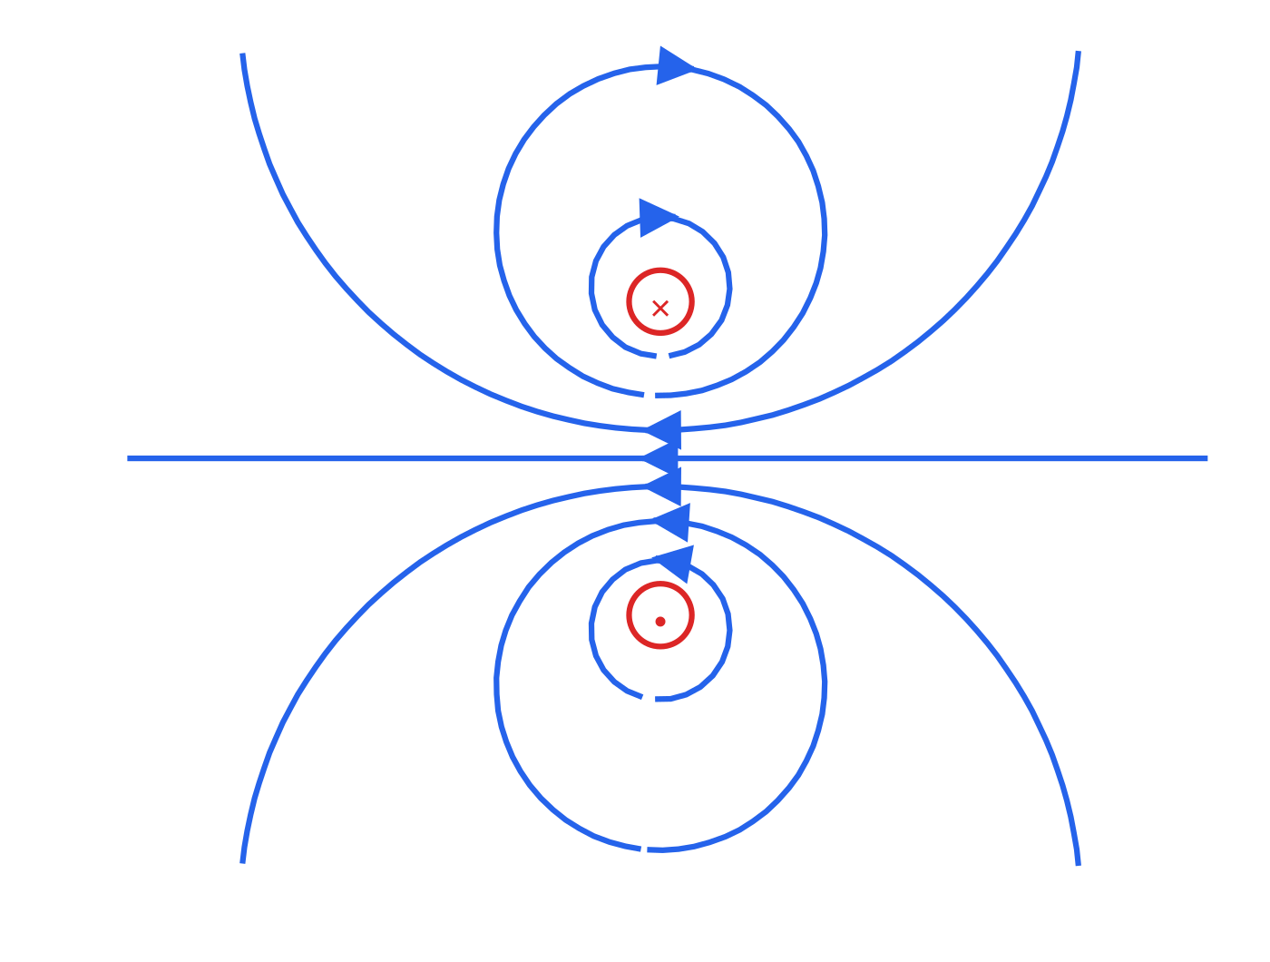
What does a magnetic field look like around a wire, a coil and a solenoid? (continued)
Section 1 of 11
Cross-section through a flat coil: current into the page at the top (×) and out at the bottom (•). Each side has its own circular field, and near the centre the lines run straight along the axis (to the left here).
Notes:
What does a magnetic field look like around a wire, a coil and a solenoid?. Full notes: https://examinerprep.com/notes/edexcel-ial-physics/magnetic-fields-and-forces/

Slide 7
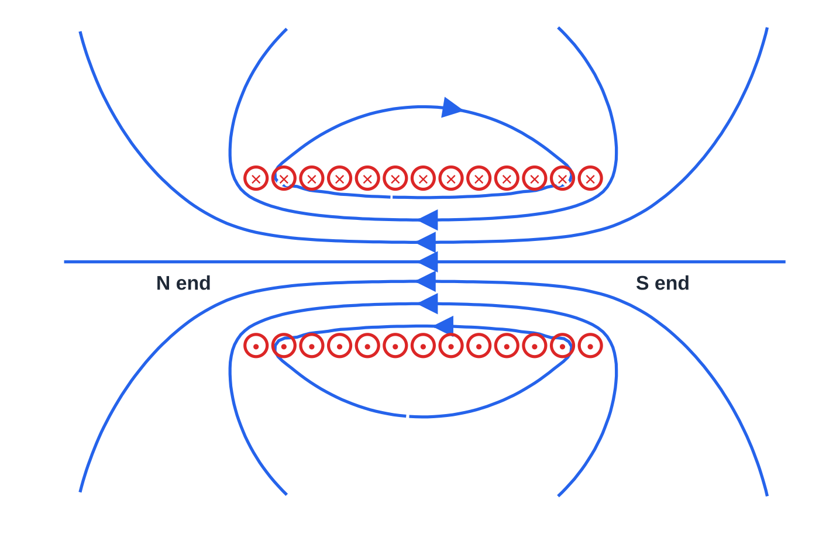
What does a magnetic field look like around a wire, a coil and a solenoid? (continued)
Section 1 of 11
Field lines calculated for a cross-section through a solenoid with the same current directions. Inside, the lines are parallel and evenly spaced (uniform field, pointing left). Outside, the lines leave the left end and return to the right end, so the left end acts as the N pole.
Notes:
What does a magnetic field look like around a wire, a coil and a solenoid?. Full notes: https://examinerprep.com/notes/edexcel-ial-physics/magnetic-fields-and-forces/

Slide 8
What does a magnetic field look like around a wire, a coil and a solenoid? (continued)
Section 1 of 11
Source | Field pattern | Which way?
Long straight wire | concentric circles round the wire, further apart with distance | right-hand grip: thumb along the current
Flat circular coil | lines loop round each side of the coil; near the centre they are nearly straight and run along the axis | curl right-hand fingers with the current; the thumb points along the field through the coil
Solenoid | strong, uniform field inside (parallel, evenly spaced lines); outside like a bar magnet | same rule; the thumb points to the N end
Exam tip — Drawing a uniform field
When you sketch a uniform field, inside a solenoid or between flat poles, draw parallel, equally spaced lines with arrows. Anything else says the field is not uniform.
Notes:
What does a magnetic field look like around a wire, a coil and a solenoid?. Full notes: https://examinerprep.com/notes/edexcel-ial-physics/magnetic-fields-and-forces/

Slide 9
What are magnetic flux density, flux and flux linkage?
Section 2 of 11
Magnetic flux density B is the force per unit current per unit length on a conductor placed at right angles to the field. Rearranging F = BIl for a wire at 90° to the field gives B = F/Il, so 1 tesla (T) = 1 N A⁻¹ m⁻¹.
Typical values: a fridge magnet is about 5 mT near its surface, a strong laboratory magnet 0.1–1 T, and the Earth's field about 50 µT. B is a vector: its direction is the direction of the field lines, and the density of the lines represents its size.
Flux measures how much field passes through an area, like the number of field lines threading it. Flux linkage counts every turn of a coil: N turns each enclosing φ link Nφ.
Magnetic flux and flux linkage
φ= BA flux linkage = Nφ φ magnetic flux (Wb), B flux density (T), A area
Notes:
What are magnetic flux density, flux and flux linkage?. Full notes: https://examinerprep.com/notes/edexcel-ial-physics/magnetic-fields-and-forces/

Slide 10
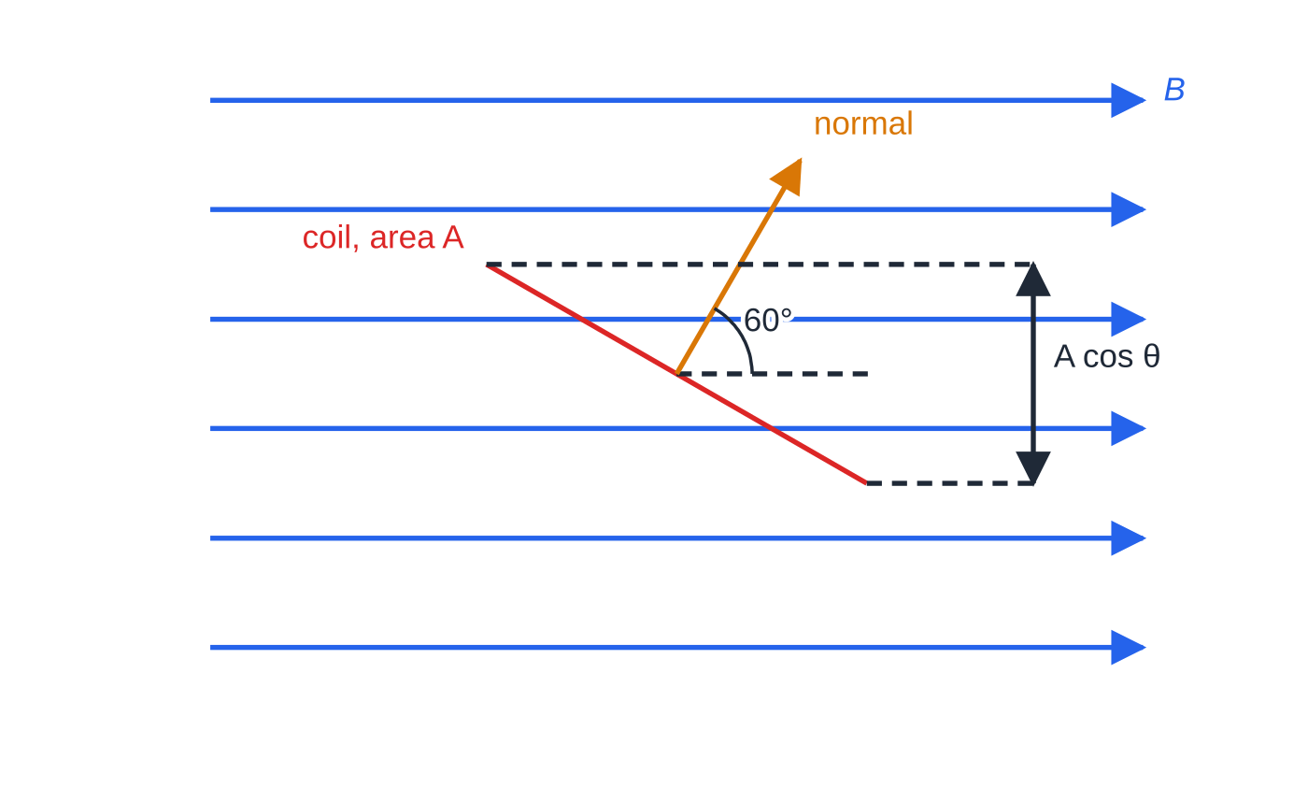
What are magnetic flux density, flux and flux linkage? (continued)
Section 2 of 11
at right angles to the field (m²), N number of turns. 1 weber (Wb) = 1 T m². Flux linkage is in Wb turns (sometimes written just Wb). In the formulae list.
If the coil is tilted, only the component of its area at right angles to the field counts. With θ the angle between the field and the normal to the coil, φ= BAcos θ: maximum when the coil faces the field (θ= 0°), zero when its plane is parallel to the field (θ= 90°).
A coil seen edge-on, with its normal at 60° to the field. Its projection at right angles to the field is A cos 60° = 0.50 A, so only half as much flux threads it as when it faces the field.
Notes:
What are magnetic flux density, flux and flux linkage?. Full notes: https://examinerprep.com/notes/edexcel-ial-physics/magnetic-fields-and-forces/

Slide 11
What are magnetic flux density, flux and flux linkage? (continued)
Section 2 of 11 · Worked example 1 · Medium · Calculate
WORKED EXAMPLE · QUESTION
A square coil of side 4.0 cm has 250 turns. It is placed with its plane at right angles to a uniform field of flux density 0.15 T. Calculate (a) the flux through the coil, (b) the flux linkage, and (c) the flux linkage after the coil is rotated so that its normal makes an angle of 60° with the field.
SOLUTION
(a) Area in m²: A = 0.040² = 1.6×10⁻³ m², so φ= BA = 0.15 ×1.6×10⁻³ = 2.4 × 10⁻⁴ Wb
(b) Nφ= 250 ×2.4×10⁻⁴ = 0.060 Wb turns
(c) Only the component of the area at right angles to the field counts: Nφ= NBAcos 60° = 0.060 ×0.50 = 0.030 Wb turns
Common slip: forgetting to convert 4.0 cm to 0.040 m before squaring, which makes the area 10⁴ times too big.
Notes:
What are magnetic flux density, flux and flux linkage?: Worked example 1. Full notes: https://examinerprep.com/notes/edexcel-ial-physics/magnetic-fields-and-forces/

Slide 12
What force acts on a current-carrying wire in a magnetic field?
Section 3 of 11
A wire carrying a current across a magnetic field feels a force (the motor effect), at right angles to both the wire and the field: largest at 90°, zero when the wire is parallel to the field.
Force on a current-carrying conductor
F = BIlsin θ F force (N), B flux density (T), I current (A), l length of wire
inside the field (m), θ angle between the wire (current) and the field. In the formulae list. lsin θ is the component of the wire at right angles to the field: only that component feels a force. For a coil of N turns, the force on each side is N times the force on one wire.
Fleming's left-hand rule
Hold the thumb and first two fingers of your left hand at right angles to each other. The First finger points along the Field (N to S), the seCond finger along the Current (conventional, + to −), and the thuMb gives the Motion, that is the direction of the force.
Notes:
What force acts on a current-carrying wire in a magnetic field?. Full notes: https://examinerprep.com/notes/edexcel-ial-physics/magnetic-fields-and-forces/

Slide 13
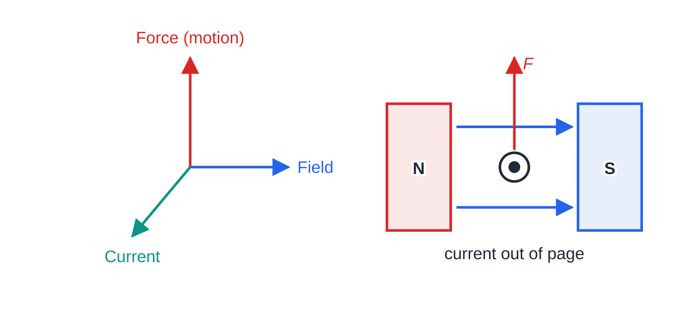
What force acts on a current-carrying wire in a magnetic field? (continued)
Section 3 of 11
If the wire is not at 90° to the field, use the component of the current at right angles to the field.
Why is there a force? The combined field
The wire's own circular field adds to the magnet's field on one side of the wire and opposes it on the other. The wire is pushed from the region of strong combined field towards the region of weak field, which is exactly the direction Fleming's rule gives.
Fleming's left-hand rule as three perpendicular arrows (left), and applied to a wire between two poles (right): field from N to S, current out of the page, force upwards.
Notes:
What force acts on a current-carrying wire in a magnetic field?. Full notes: https://examinerprep.com/notes/edexcel-ial-physics/magnetic-fields-and-forces/

Slide 14
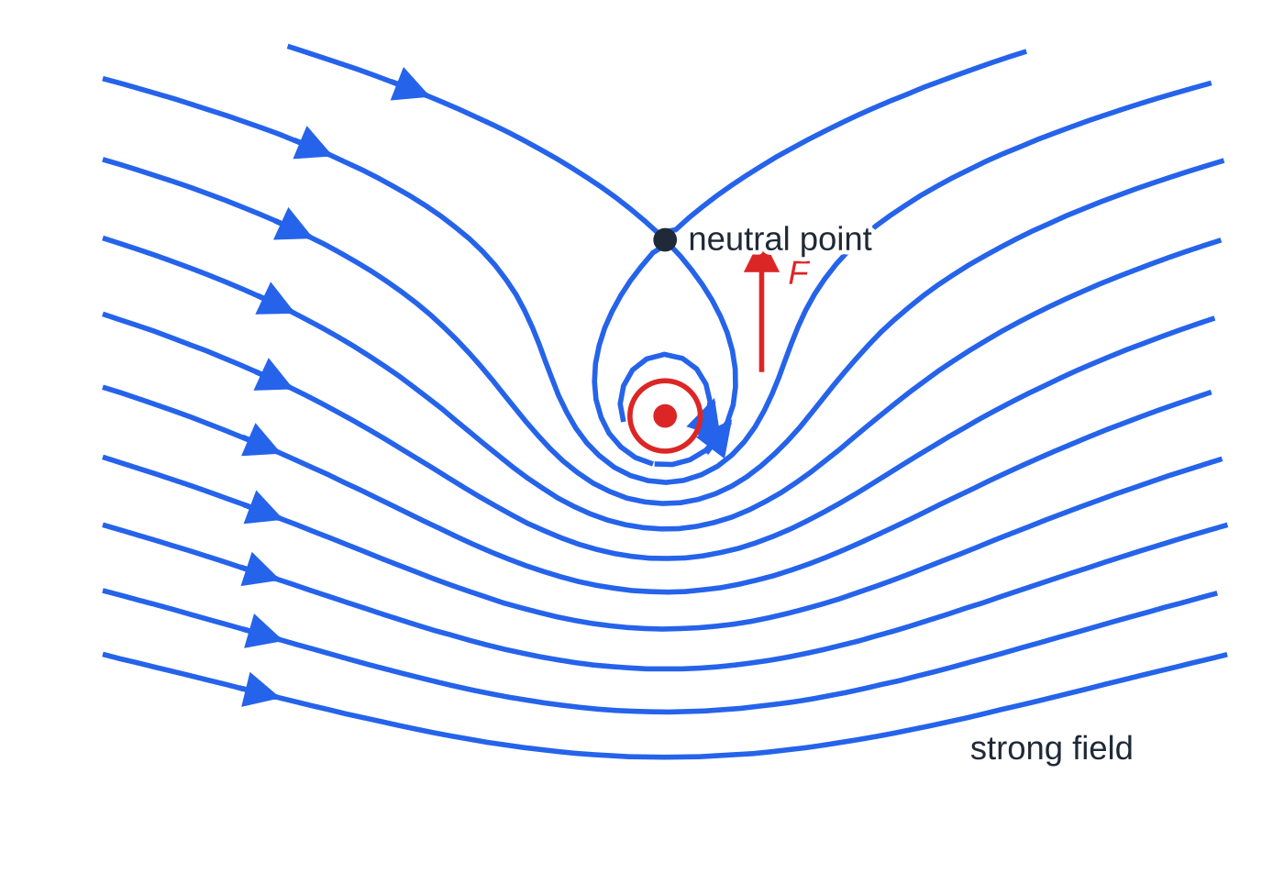
What force acts on a current-carrying wire in a magnetic field? (continued)
Section 3 of 11
Field lines of a uniform field (left to right) plus the field of a wire carrying current out of the page, calculated by adding the two fields. The crowded lines below and the sparse lines above (with a neutral point) show the wire being pushed upwards.
Notes:
What force acts on a current-carrying wire in a magnetic field?. Full notes: https://examinerprep.com/notes/edexcel-ial-physics/magnetic-fields-and-forces/

Slide 15
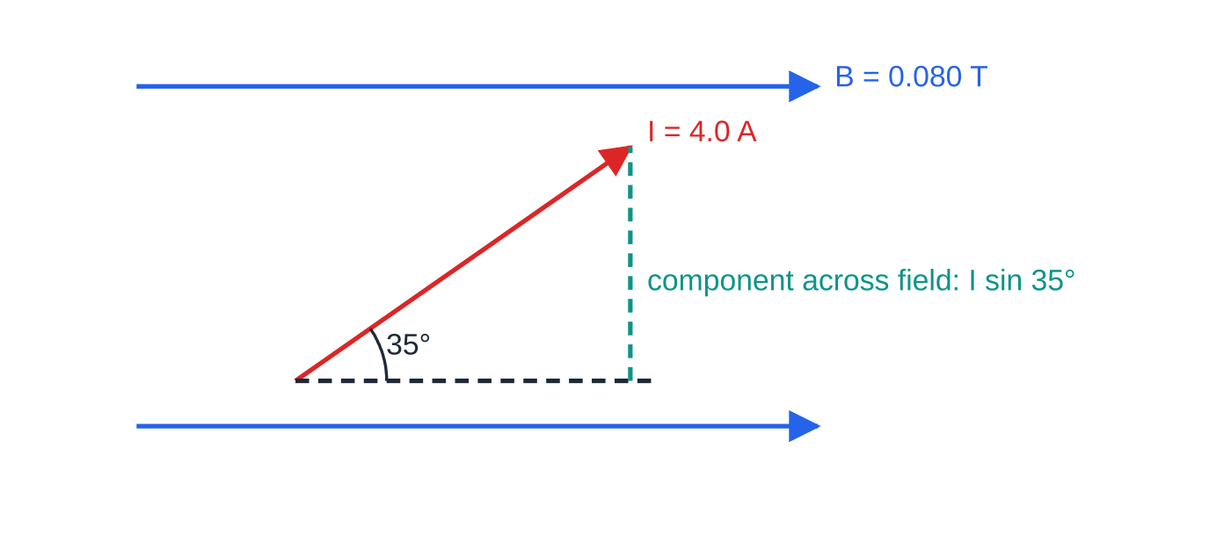
What force acts on a current-carrying wire in a magnetic field? (continued)
Section 3 of 11 · Worked example 2 · Medium · Calculate
WORKED EXAMPLE · QUESTION
A straight wire lies in the plane of the page and carries a current of 4.0 A. A 0.30 m length of it is in a uniform field of flux density 0.080 T, directed to the right across the page. The wire points up and to the right, at 35° to the field. Calculate the force on the wire and state its direction.
SOLUTION
Use θ = the angle between the wire and the field: F = BIlsin θ= 0.080 ×4.0 ×0.30 ×sin 35° = 0.055 N (0.0551 N)
Only the component of the current across the field (up the page) produces a force.
Notes:
What force acts on a current-carrying wire in a magnetic field?: Worked example 2. Full notes: https://examinerprep.com/notes/edexcel-ial-physics/magnetic-fields-and-forces/

Slide 16
What force acts on a current-carrying wire in a magnetic field? (continued)
Section 3 of 11 · Worked example 2 · Medium · Calculate (continued)
Direction: field to the right, component of the current up the page, so by Fleming's rule the force is into the page.
At 90° the force would be the maximum, 0.096 N; parallel to the field it would be zero.
Notes:
What force acts on a current-carrying wire in a magnetic field?: Worked example 2. Full notes: https://examinerprep.com/notes/edexcel-ial-physics/magnetic-fields-and-forces/

Slide 17
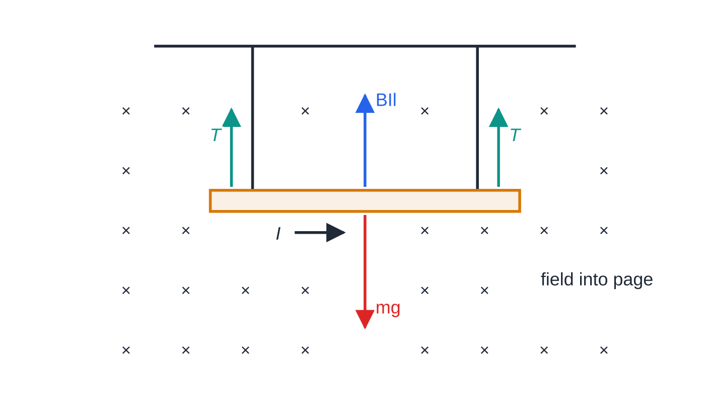
What force acts on a current-carrying wire in a magnetic field? (continued)
Section 3 of 11 · Worked example 3 · Hard · Calculate
WORKED EXAMPLE · QUESTION
A horizontal copper rod of mass 18 g hangs from two light, flexible leads. A 0.12 m length of the rod is in a horizontal magnetic field of flux density 0.30 T at right angles to the rod. (a) Calculate the current that makes the tension in the leads zero. (b) The current is reduced to 3.0 A. Calculate the tension in each lead.
SOLUTION
(a) Tension is zero when the upward magnetic force equals the weight:
Forces on the rod: weight down, magnetic force BIl up, and a tension T in each lead. With the field into the page, the current must flow to the right for the magnetic force to be upwards.
Notes:
What force acts on a current-carrying wire in a magnetic field?: Worked example 3. Full notes: https://examinerprep.com/notes/edexcel-ial-physics/magnetic-fields-and-forces/

Slide 18
What force acts on a current-carrying wire in a magnetic field? (continued)
Section 3 of 11 · Worked example 3 · Hard · Calculate (continued)
BIl = mg, so I = mg/Bl = (0.018 ×9.81) ÷(0.30 ×0.12) = 4.9 A (4.91 A)
(b) Magnetic force at 3.0 A: F = 0.30 ×3.0 ×0.12 = 0.108 N. The leads support the rest of the weight, shared equally: 2T = 0.1766 - 0.108 = 0.0686 N, so each lead has T = 0.034 N
Reverse either the current or the field and the magnetic force points down: the leads become tighter, not slacker.
Notes:
What force acts on a current-carrying wire in a magnetic field?: Worked example 3. Full notes: https://examinerprep.com/notes/edexcel-ial-physics/magnetic-fields-and-forces/

Slide 19
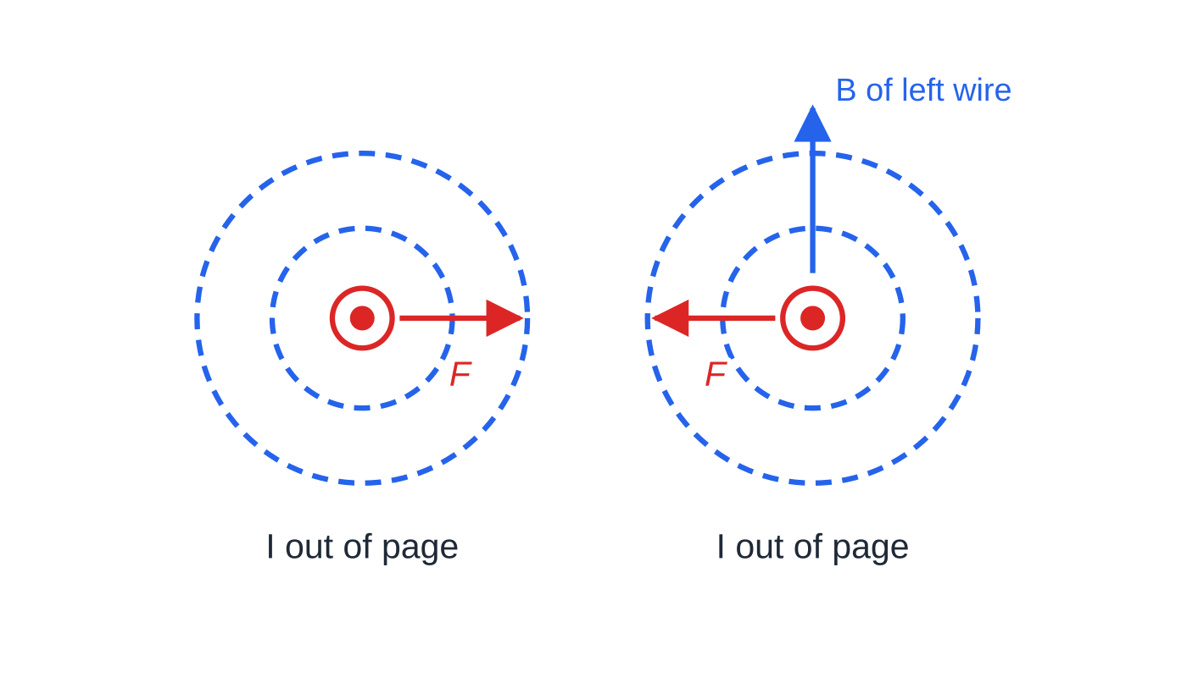
What force acts on a current-carrying wire in a magnetic field? (continued)
Section 3 of 11
In a motor, the forces on opposite sides of a coil form a couple that turns it; in a loudspeaker, an alternating current makes the force on the coil reverse, so the cone vibrates. Two parallel wires each sit in the other's field: currents in the same direction attract, in opposite directions repel.
Two wires both carrying current out of the page. The field of the left wire points up the page at the right wire, so the force on the right wire is to the left; by Newton's third law the left wire is pulled to the right.
Notes:
What force acts on a current-carrying wire in a magnetic field?. Full notes: https://examinerprep.com/notes/edexcel-ial-physics/magnetic-fields-and-forces/

Slide 20
What force acts on a current-carrying wire in a magnetic field? (continued)
Section 3 of 11
Common error — Right hand for the force
The right-hand grip rule gives the direction of the field made by a current; Fleming's left-hand rule gives the force on a current in a field. And θ in F = BIlsin θ is measured between the wire and the field, not between the wire and the force.
Notes:
What force acts on a current-carrying wire in a magnetic field?. Full notes: https://examinerprep.com/notes/edexcel-ial-physics/magnetic-fields-and-forces/

Slide 21
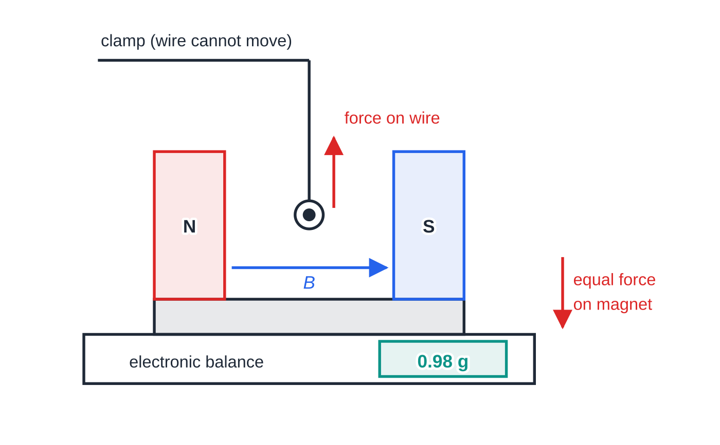
How can a current balance measure the flux density?
Section 4 of 11
Set-up. A magnet with its poles facing, so that the field between them is close to uniform, stands on an electronic balance. A stiff straight wire, clamped from above so that it cannot move, passes between the poles at right angles to the field.
Newton's third law. If the field pushes the wire up, the wire pushes the magnet down with an equal force, so the balance reading increases by Δm, and F = Δm g with Δm in kg.
Method. Tare the balance with no current and measure Δm for a range of currents.
Current balance. The clamped wire (current out of the page) is pushed up by the field, so the magnet is pushed down with an equal force and the balance reading rises. The reading shown is for 3.00 A.
Notes:
How can a current balance measure the flux density?. Full notes: https://examinerprep.com/notes/edexcel-ial-physics/magnetic-fields-and-forces/

Slide 22
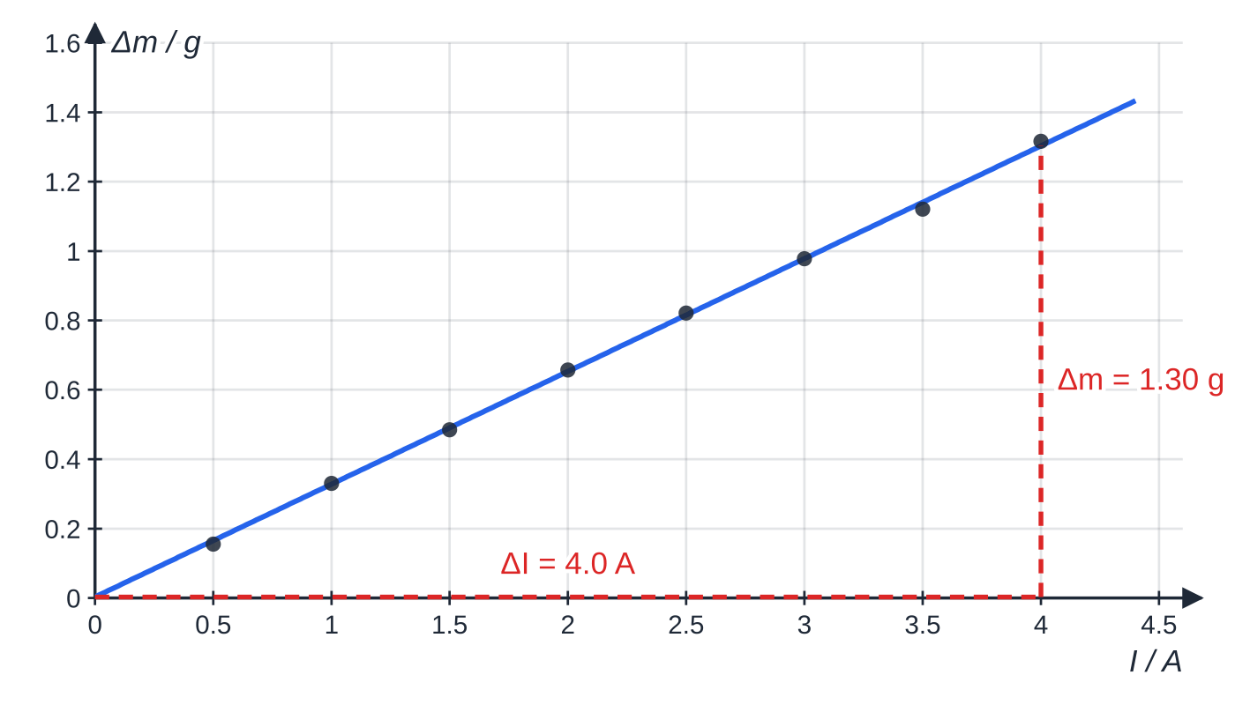
How can a current balance measure the flux density? (continued)
Section 4 of 11
Reverse the current, repeat and average the sizes of the two readings: this cancels changes that do not reverse with the current, such as convection from the warm wire or zero drift.
Analysis. F = BIl, so a graph of Δm against I is a straight line through the origin with gradient Bl/g. So B = gradient × g/l, where l is the length of wire inside the field, roughly the width of the pole faces, measured with a ruler or calipers.
Specimen results (l = 5.0 cm). The line passes through the origin: the force is proportional to the current. The large triangle gives the gradient, 1.30 g ÷ 4.0 A.
Notes:
How can a current balance measure the flux density?. Full notes: https://examinerprep.com/notes/edexcel-ial-physics/magnetic-fields-and-forces/

Slide 23
How can a current balance measure the flux density? (continued)
Section 4 of 11 · Worked example 4 · Hard · Determine
WORKED EXAMPLE · QUESTION
Use the graph above to determine the flux density between the poles. The length of wire in the field is 5.0 ± 0.1 cm, and the steepest and least steep acceptable lines differ from the best line by ±3%. Determine the percentage uncertainty in B and give the result with its absolute uncertainty.
SOLUTION
Gradient from a large triangle: 1.30 g ÷ 4.0 A = 0.325 g A⁻¹ = 0.325 × 10⁻³ kg A⁻¹.
Convert mass to force: gradient × g = F/I = Bl, so Bl = 0.325×10⁻³ ×9.81 = 3.19×10⁻³ N A⁻¹.
B = 3.19×10⁻³ ÷0.050 = 0.064 T (0.0638 T)
B = gradient × g ÷l, so add the percentage uncertainties: % in l = 0.1 ÷ 5.0 × 100 = 2.0%, % in B = 3% + 2% = 5%, so B = 0.064 ± 0.003 T
The intercept is 0.003 g, effectively zero: evidence that the zeroing worked and that there is no systematic error in the balance.
Notes:
How can a current balance measure the flux density?: Worked example 4. Full notes: https://examinerprep.com/notes/edexcel-ial-physics/magnetic-fields-and-forces/

Slide 24
How can a current balance measure the flux density? (continued)
Section 4 of 11
Exam tip — Grams to newtons
The balance reads in grams but the physics needs newtons. Convert g → kg, then multiply by 9.81. Skip the conversion and B is 1000 times too big; skip g and it is about 10 times too small.
Notes:
How can a current balance measure the flux density?. Full notes: https://examinerprep.com/notes/edexcel-ial-physics/magnetic-fields-and-forces/

Slide 25
What force acts on a charged particle moving through a magnetic field?
Section 5 of 11
A current is moving charge, so each charge carrier in a wire feels part of the force BIl. The same force acts on a charge moving through empty space, at right angles to both the velocity and the field, and zero for a charge at rest or moving parallel to the field.
Direction. Use Fleming's left-hand rule with the second finger along the conventional current: along the velocity for a positive charge, and opposite to the velocity for a negative charge such as an electron.
Force on a moving charge
F = Bqvsin θ F force (N), B flux density (T), q charge (C), v speed (m s⁻¹), θ angle between the velocity and the field. In the formulae list. It follows from F = BIl: a charge q crossing a length l in time t = l/v is a current I = q/t = qv/l, so BIl = Bqv.
Notes:
What force acts on a charged particle moving through a magnetic field?. Full notes: https://examinerprep.com/notes/edexcel-ial-physics/magnetic-fields-and-forces/

Slide 26
What force acts on a charged particle moving through a magnetic field? (continued)
Section 5 of 11 · Worked example 5 · Medium · Calculate
WORKED EXAMPLE · QUESTION
An electron moves to the right across the page at 3.0 × 10⁷ m s⁻¹ through a uniform field of 2.0 mT directed out of the page. (a) Calculate the size of the force on the electron and its acceleration. (b) State the direction of the force.
SOLUTION
(a) Velocity at 90° to the field, so sin θ= 1: F = Bqv = 2.0×10⁻³ ×1.60×10⁻¹⁹ ×3.0×10⁷ = 9.6 × 10⁻¹⁵ N. Then a = F/m = 9.6×10⁻¹⁵ ÷9.11×10⁻³¹ = 1.1 × 10¹⁶ m s⁻²
(b) An electron moving right is a conventional current to the left; with the field out of the page, Fleming's rule gives a force up the page, at right angles to the velocity.
The weight of the electron, about 9 × 10⁻³⁰ N, is smaller by a factor of more than 10¹⁴, so gravity is always ignored for beams of particles.
Notes:
What force acts on a charged particle moving through a magnetic field?: Worked example 5. Full notes: https://examinerprep.com/notes/edexcel-ial-physics/magnetic-fields-and-forces/

Slide 27
What force acts on a charged particle moving through a magnetic field? (continued)
Section 5 of 11
Common error — Electrons and the second finger
Pointing the second finger along the electron's velocity. Fleming's rule uses conventional current; for an electron, or any negative charge, the current is the opposite way to its motion, so the force is the opposite way to the one a proton would feel.
Notes:
What force acts on a charged particle moving through a magnetic field?. Full notes: https://examinerprep.com/notes/edexcel-ial-physics/magnetic-fields-and-forces/

Slide 28
Why do charged particles move in circles in a uniform field?
Section 6 of 11
The magnetic force is always at right angles to the velocity, so it does no work and the speed stays constant. A constant-size force always perpendicular to the velocity gives uniform circular motion: the magnetic force provides the centripetal force.
Radius of the circular path
Bqv = mv²/r ⇒ r = mv/BQ = p/BQ r radius (m), p = mv momentum (kg m s⁻¹), B flux density (T), Q charge (C). r = p/BQ is in the formulae list, but be ready to show how it follows from Bqv = mv²/r (No — derive it); this step is often asked for.
Bigger momentum gives a bigger circle; a stronger field or a bigger charge gives a tighter circle. Opposite charges curve opposite ways.
Notes:
Why do charged particles move in circles in a uniform field?. Full notes: https://examinerprep.com/notes/edexcel-ial-physics/magnetic-fields-and-forces/

Slide 29
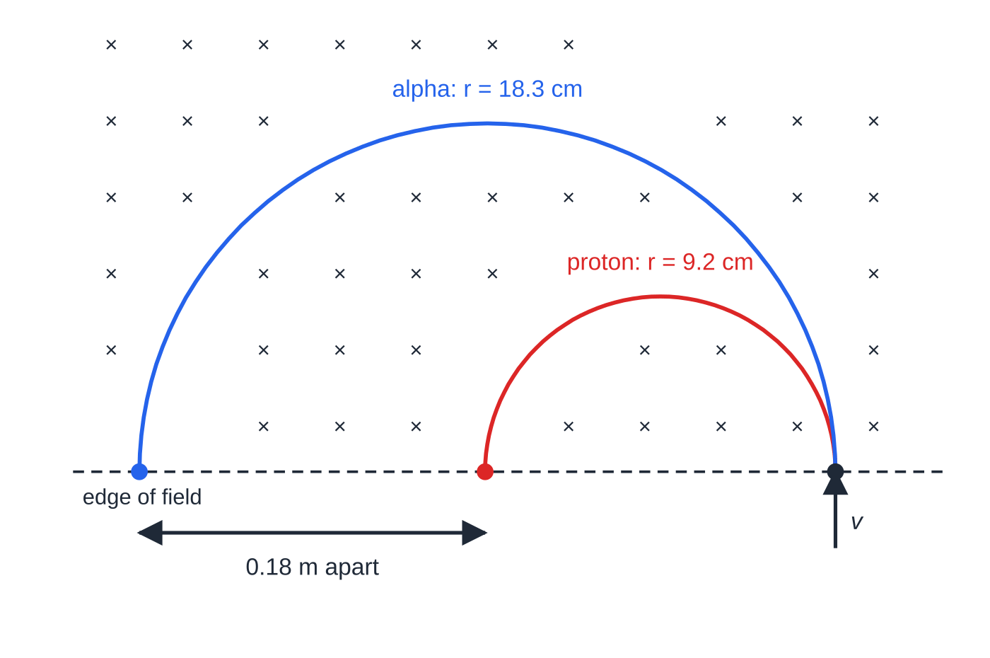
Why do charged particles move in circles in a uniform field? (continued)
Section 6 of 11
A proton and an alpha particle entering a field of 0.25 T (into the page) at 2.2 × 10⁶ m s⁻¹, drawn to scale. The alpha particle has four times the mass but only twice the charge, so its radius is about twice as large.
Notes:
Why do charged particles move in circles in a uniform field?. Full notes: https://examinerprep.com/notes/edexcel-ial-physics/magnetic-fields-and-forces/

Slide 30
Why do charged particles move in circles in a uniform field? (continued)
Section 6 of 11 · Worked example 6 · Medium · Calculate
WORKED EXAMPLE · QUESTION
A proton and an alpha particle enter a uniform field of flux density 0.25 T at right angles to it, both at 2.2 × 10⁶ m s⁻¹. The mass of an alpha particle is 6.64 × 10⁻²⁷ kg and its charge is +2e. (a) Calculate the radius of each path. (b) Both enter at the same point and leave the field after a semicircle. Calculate the distance between their exit points.
SOLUTION
(a) Proton: r = mv/BQ = (1.67×10⁻²⁷ ×2.2×10⁶) ÷(0.25 ×1.60×10⁻¹⁹) = 0.092 m (9.19 cm). Alpha: r = (6.64×10⁻²⁷ ×2.2×10⁶) ÷(0.25 ×3.20×10⁻¹⁹) = 0.18 m (0.1826 m)
(b) Each exits one diameter from the entry point: 2 ×0.1826 - 2 ×0.0919 = 0.18 m
Ratio check without numbers: r ∝m/Q at the same speed, and 4m/2e is twice m/e, so the alpha particle's radius is about twice the proton's (1.99 times with these masses).
Notes:
Why do charged particles move in circles in a uniform field?: Worked example 6. Full notes: https://examinerprep.com/notes/edexcel-ial-physics/magnetic-fields-and-forces/

Slide 31
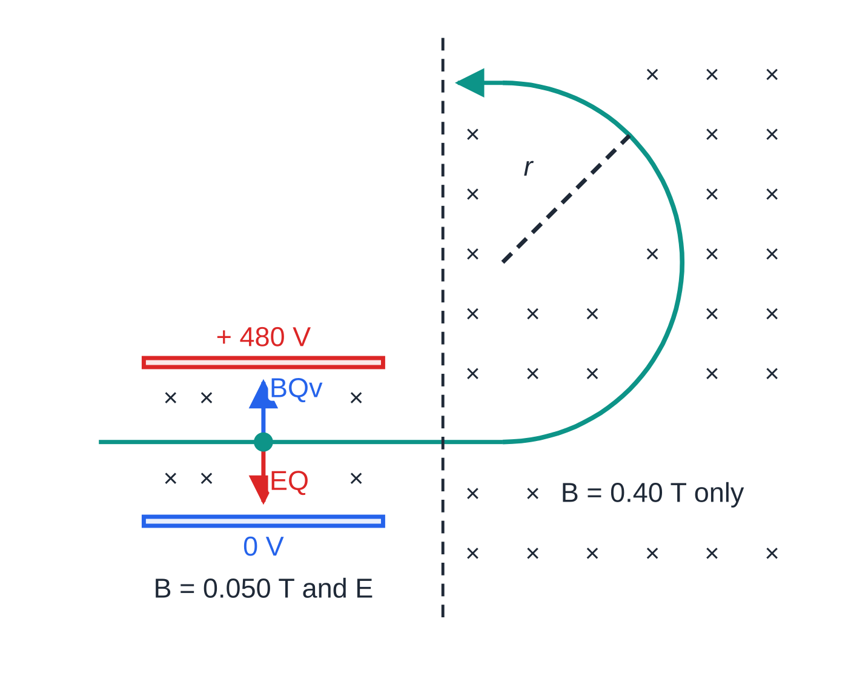
Why do charged particles move in circles in a uniform field? (continued)
Section 6 of 11 · Worked example 7 · Hard · Calculate
WORKED EXAMPLE · QUESTION
Singly charged positive ions pass between two parallel plates 8.0 mm apart with a p.d. of 480 V across them. A magnetic field of 0.050 T, at right angles to both the electric field and the ions' velocity, acts in the same region. Only ions for which the electric and magnetic forces cancel travel straight through. These ions, of mass 1.15 × 10⁻²⁶ kg, then enter a region where there is only a magnetic field of 0.40 T. (a) Calculate the speed of the ions that pass straight through. (b) Calculate the radius of their path in the 0.40 T field.
Crossed fields select one speed: the electric force EQ (down) balances the magnetic force BQv (up). In the second region the magnetic force alone bends the beam into a semicircle (not to scale).
Notes:
Why do charged particles move in circles in a uniform field?: Worked example 7. Full notes: https://examinerprep.com/notes/edexcel-ial-physics/magnetic-fields-and-forces/

Slide 32
Why do charged particles move in circles in a uniform field? (continued)
Section 6 of 11 · Worked example 7 · Hard · Calculate (continued)
SOLUTION
(a) Electric field between the plates (4.3): E = V/d = 480 ÷8.0×10⁻³ = 6.0×10⁴ V m⁻¹. The forces balance, EQ = BQv, so the charge cancels: v = E/B = 6.0×10⁴ ÷0.050 = 1.2 × 10⁶ m s⁻¹
(b) r = mv/BQ = (1.15×10⁻²⁶ ×1.2×10⁶) ÷(0.40 ×1.60×10⁻¹⁹) = 0.22 m (0.216 m)
Faster ions feel a bigger magnetic force and are deflected one way; slower ions are deflected the other way by the unchanged electric force. Only one speed gets through, whatever the charge or mass.
Notes:
Why do charged particles move in circles in a uniform field?: Worked example 7. Full notes: https://examinerprep.com/notes/edexcel-ial-physics/magnetic-fields-and-forces/

Slide 33
Why do charged particles move in circles in a uniform field? (continued)
Section 6 of 11
A velocity component along the field is unaffected, so the particle spirals (a helix) along the lines. A particle losing energy in a detector has decreasing momentum, so its track spirals inwards, showing which way it travelled.
Exam tip — "Show that r = p/BQ"
Write two lines: the magnetic force provides the centripetal force, BQv = mv²/r; cancel one v and rearrange to r = mv/BQ = p/BQ. Say why it is a circle: the force is always perpendicular to the velocity, so the speed is constant.
Notes:
Why do charged particles move in circles in a uniform field?. Full notes: https://examinerprep.com/notes/edexcel-ial-physics/magnetic-fields-and-forces/

Slide 34
Exam tips for 4.5
Section 7 of 11
Exam tip 1 — Define B in words
Flux density is the force per unit current per unit length on a conductor at right angles to the field. Leaving out "at right angles" makes the definition incomplete, because the force depends on the angle.
Exam tip 2 — Name the angle
In F = BIlsin θ and F = Bqvsin θ, θ is between the field and the current or velocity. In φ= BAcos θ, θ is between the field and the normal to the coil. Sketch the angle before you choose sin or cos.
Exam tip 3 — The right rule for each direction
Grip rule (right hand) for the field a current makes; left-hand rule for the force on a current. For electrons, reverse the second finger. State a direction in the words the question uses: "into the page", "towards the top of the page", "vertically upwards".
Notes:
Exam tips for 4.5. Full notes: https://examinerprep.com/notes/edexcel-ial-physics/magnetic-fields-and-forces/

Slide 35
Exam tips for 4.5 (continued)
Section 7 of 11
Exam tip 4 — No work, constant speed
Why does a charged particle's speed not change in a magnetic field? The force is perpendicular to the velocity, so no work is done on the particle and its kinetic energy stays constant. "The field is uniform" is not the reason.
Exam tip 5 — Units and prefixes
mT → × 10⁻³, µT → × 10⁻⁶, cm² → × 10⁻⁴ m², mm² → × 10⁻⁶ m². Convert before you substitute, and give flux in Wb, flux linkage in Wb turns and B in T.
Notes:
Exam tips for 4.5. Full notes: https://examinerprep.com/notes/edexcel-ial-physics/magnetic-fields-and-forces/

Slide 36
Common misconceptions
Section 8 of 11
Misconception | Why it is wrong | Correct idea
The magnetic force on a wire acts along the field lines, like the force on a pole. | The force on a current is a sideways force. | It is at right angles to both the field and the current (Fleming's left-hand rule).
A magnetic field speeds up the charged particles moving through it. | The force is always perpendicular to the velocity, so it does no work. | The field changes the direction of motion only; the speed and kinetic energy stay constant.
A stationary charge in a magnetic field feels a force. | F = Bqvsin θ is zero when v = 0. | Only moving charges (or currents) feel a magnetic force; a stationary charge feels only electric forces.
Flux and flux density are the same thing. | They have different units, Wb and T. | Flux density B is flux per unit area; flux φ= BA depends on the area too.
Notes:
Common misconceptions. Full notes: https://examinerprep.com/notes/edexcel-ial-physics/magnetic-fields-and-forces/

Slide 37
Common misconceptions (continued)
Section 8 of 11
Misconception | Why it is wrong | Correct idea
A coil has the most flux through it when its plane is along the field. | Then no field lines pass through the coil. | Flux is greatest when the plane of the coil is at right angles to the field (normal along the field), and zero when the plane is parallel to it.
Electrons and protons moving the same way are pushed the same way. | Their charges have opposite signs. | The forces are in opposite directions, so their paths curve opposite ways.
Notes:
Common misconceptions. Full notes: https://examinerprep.com/notes/edexcel-ial-physics/magnetic-fields-and-forces/

Slide 38
How this topic connects
Section 9 of 11
2 Circular motion and 4.3 Electric fields
The magnetic force Bqv plays the role of the centripetal force mv²/r, which is how r = p/BQ is derived. Compare the two fields: an electric force EQ acts on any charge, along the field lines, and can do work; a magnetic force acts only on moving charge, sideways, and does no work. Balancing them selects a single speed.
6 Electromagnetic induction
Flux φ= BA and flux linkage Nφ, defined here, are exactly what must change to induce an e.m.f.
7 Atomic structure and particle accelerators
Cyclotrons bend particles round with a magnetic field, and detectors find momentum from the radius of curvature of a track using r = p/BQ.
Notes:
How this topic connects. Full notes: https://examinerprep.com/notes/edexcel-ial-physics/magnetic-fields-and-forces/

Slide 39
Key equations
Section 10 of 11
Equation | Use | In the formulae list?
φ= BA | flux (Wb) through an area at right angles to the field | Yes
flux linkage = Nφ | flux linked by a coil of N turns (Wb turns) | Yes
φ= BAcos θ | coil whose normal is at θ to the field | No — learn it (component of the area)
F = BIlsin θ | force (N) on a current-carrying conductor | Yes
B = F/Il | definition of flux density; 1 T = 1 N A⁻¹ m⁻¹ | No — rearrange F = BIl
F = Bqvsin θ | force (N) on a moving charge | Yes
r = p/BQ | radius (m) of a charged particle's circular path | Yes
Bqv = mv²/r | starting point for the radius | No — derive it (magnetic force = centripetal force)
v = E/B | speed (m s⁻¹) passing undeflected through crossed fields | No — derive it from EQ = BQv
Notes:
Key equations. Full notes: https://examinerprep.com/notes/edexcel-ial-physics/magnetic-fields-and-forces/

Slide 40
Check your understanding
Section 11 of 11
1. A beam of protons travels parallel to the field lines of a uniform magnetic field. What force does the field exert on them, and why?
2. A coil of 500 turns and area 2.0 cm² is placed with its plane at right angles to a field of 0.30 T. Calculate the flux linkage.
3. A 0.25 m length of wire carrying 6.0 A lies at right angles to a field of 0.12 T. Calculate the force on it. What is the force if the wire is turned to lie along the field?
4. A proton moves up the page through a field directed into the page. In which direction is the force on it? What would change for an electron?
5. An electron moves at 5.0 × 10⁶ m s⁻¹ at right angles to a field of 1.0 mT. Calculate the radius of its path, and explain why its speed does not change.
6. Two long parallel wires carry currents in opposite directions. Explain whether they attract or repel.
Notes:
Check your understanding: questions. Full notes: https://examinerprep.com/notes/edexcel-ial-physics/magnetic-fields-and-forces/

Slide 41
Check your understanding · answers
Section 11 of 11
1. None. F = Bqvsin θ with θ= 0, so sin θ= 0: there is no component of the velocity across the field.
2. Nφ= NBA = 500 ×0.30 ×2.0×10⁻⁴ = 0.030 Wb turns.
3. F = 0.12 ×6.0 ×0.25 = 0.18 N. Along the field, sin 0° = 0, so the force is zero.
4. Fleming's left-hand rule (field into the page, current up the page) gives a force towards the left of the page. An electron moving the same way is equivalent to a current down the page, so the force on it is towards the right.
5. r = mv/BQ = (9.11×10⁻³¹ ×5.0×10⁶) ÷(1.0×10⁻³ ×1.60×10⁻¹⁹) = 0.028 m (2.8 cm). The force is always perpendicular to the velocity, so it does no work and the kinetic energy is constant.
6. Each wire is in the field of the other. Applying the grip rule to one wire and then the left-hand rule to the other shows the force on each wire points away from the other, so they repel. (Currents in the same direction attract.)
Notes:
Check your understanding: answers. Full notes: https://examinerprep.com/notes/edexcel-ial-physics/magnetic-fields-and-forces/

Slide 42
Practice questions
5 original exam-style questions. Answers at the end of the deck.

Slide 43
Question 1
1 mark
Which of the following is equivalent to the tesla, the unit of magnetic flux density?
A N A m
B Wb m²
C N A m⁻¹
D N A⁻¹ m⁻¹
Notes:
Online with the full mark scheme: https://examinerprep.com/ial-physics-4-5-magnetic-fields-and-forces-questions#IALP-U4-5-A-01

Slide 44
Question 2
1 mark
A flat circular coil of diameter 4.0 cm has 150 turns. It is placed with its plane at right angles to a uniform magnetic field of flux density 0.12 T.
What is the flux linkage of the coil?
A 1.5 × 10⁻⁴ Wb turns
B 7.2 × 10⁻³ Wb turns
C 2.3 × 10⁻² Wb turns
D 9.0 × 10⁻² Wb turns
Notes:
Online with the full mark scheme: https://examinerprep.com/ial-physics-4-5-magnetic-fields-and-forces-questions#IALP-U4-5-A-02

Slide 45
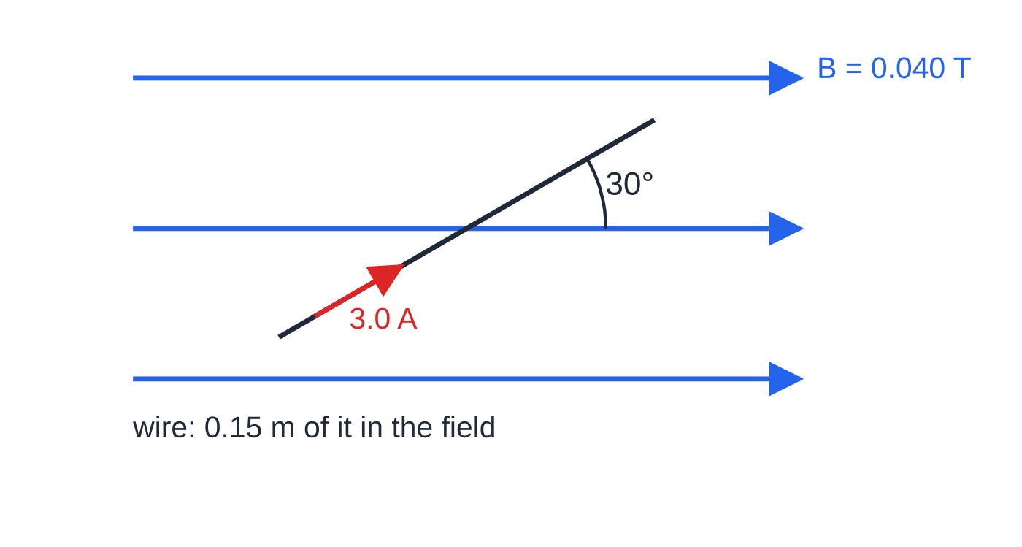
Question 3
1 mark
A straight wire carries a current of 3.0 A. A 0.15 m length of the wire lies in a uniform magnetic field of flux density 0.040 T, at an angle of 30° to the field lines.
What is the size of the force on the wire?
Figure: the wire in the field (not to scale)
A 0.0090 N
B 0.016 N
C 0.018 N
D 0.40 N
Notes:
Online with the full mark scheme: https://examinerprep.com/ial-physics-4-5-magnetic-fields-and-forces-questions#IALP-U4-5-A-03

Slide 46
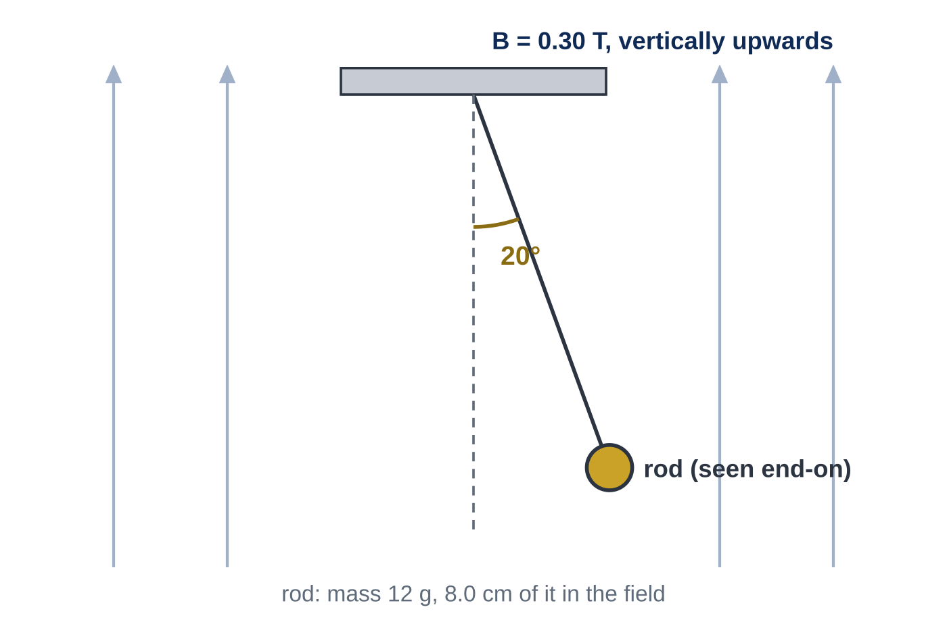
Question 4
7 marks
A horizontal metal rod of mass 12 g hangs from two light, flexible threads in a uniform vertical magnetic field of flux density 0.30 T. 8.0 cm of the rod is in the field. When there is a current in the rod, it moves sideways and comes to rest with the threads at 20° to the vertical. The figure shows the arrangement seen along the rod.
(a) Name the forces acting on the rod in its new position and explain why the magnetic force on the rod is horizontal. [2]
(b) Calculate the current in the rod. [2]
(c) State the direction of the current in the rod. [1]
(d) The current is doubled. Calculate the new angle between the threads and the vertical. [2]
Notes:
Online with the full mark scheme: https://examinerprep.com/ial-physics-4-5-magnetic-fields-and-forces-questions#IALP-U4-5-FB-09

Slide 47
Question 5
4 marks
A small rectangular search coil measures 1.2 cm × 2.5 cm and has 400 turns. It is held between the poles of an electromagnet with its plane at right angles to a uniform field of flux density 0.36 T.
(a) Calculate the magnetic flux through one turn of the coil. [2]
(b) Calculate the flux linkage of the coil. [1]
(c) The coil is rotated through 90° so that its plane is parallel to the field. State the new flux linkage. [1]
Notes:
Online with the full mark scheme: https://examinerprep.com/ial-physics-4-5-magnetic-fields-and-forces-questions#IALP-U4-5-B-01

Slide 48
Answers

Slide 49
Question 1 · answer
Answer D
From F = BIl for a wire at right angles to the field, B = F/Il, so 1 T = 1 N ÷ (1 A × 1 m) = 1 N A⁻¹ m⁻¹. (It is also 1 Wb m⁻², flux per unit area.)
Notes:
Full mark scheme: https://examinerprep.com/ial-physics-4-5-magnetic-fields-and-forces-questions#IALP-U4-5-A-01

Slide 50
Question 2 · answer
Answer C
Radius = 0.020 m, so A = π × 0.020² = 1.26 × 10⁻³ m². Nφ = NBA = 150 × 0.12 × 1.26 × 10⁻³ = 2.3 × 10⁻² Wb turns (0.0226).
Notes:
Full mark scheme: https://examinerprep.com/ial-physics-4-5-magnetic-fields-and-forces-questions#IALP-U4-5-A-02

Slide 51
Question 3 · answer
Answer A
F = BIl sin θ = 0.040 × 3.0 × 0.15 × sin 30° = 0.0090 N.
Notes:
Full mark scheme: https://examinerprep.com/ial-physics-4-5-magnetic-fields-and-forces-questions#IALP-U4-5-A-03

Slide 52
Question 4 · answer
Mark scheme
weight (down), tension (along the threads) and the magnetic force
the magnetic force is at right angles to both the field (vertical) and the current (along the horizontal rod), so it is horizontal
horizontal and vertical balance give tan 20° = BIl/mg, so I = (0.012 × 9.81 × tan 20°) ÷ (0.30 × 0.080)
= 1.8 A (1.79 A)
into the page (force to the right, field upwards, Fleming's left-hand rule)
tan θ = 2 × tan 20° = 0.728
θ = 36° (not 40°: the angle does not double)
Notes:
Full mark scheme: https://examinerprep.com/ial-physics-4-5-magnetic-fields-and-forces-questions#IALP-U4-5-FB-09

Slide 53
Question 5 · answer
Mark scheme
A = 0.012 × 0.025 = 3.0 × 10⁻⁴ m²
φ = BA = 0.36 × 3.0 × 10⁻⁴ = 1.1 × 10⁻⁴ Wb (1.08 × 10⁻⁴ Wb)
Nφ = 400 × 1.08 × 10⁻⁴ = 0.043 Wb turns (allow error carried forward)
zero — no field lines pass through the coil
Notes:
Full mark scheme: https://examinerprep.com/ial-physics-4-5-magnetic-fields-and-forces-questions#IALP-U4-5-B-01

Slide 54
Keep practising
Notes for this topic
Questions on this topic
Build a printable test
ExaminerPrep is an independent tutoring service. It has been developed independently from and is not endorsed by the International Baccalaureate Organization. "International Baccalaureate", "IB" and "IB Diploma Programme" are registered trademarks of the IBO, used here for descriptive purposes only.
Pearson Edexcel and Cambridge are trademarks of their owners; ExaminerPrep is not affiliated with any exam board.

