Slide 1
EP
EDEXCEL IAL PHYSICS
3.2 Measurements, uncertainties and graphs (AS)
The full notes page in 14 sections · practice questions with answers · simulations
ExaminerPrep is an independent tutoring service. It has been developed independently from and is not endorsed by the International Baccalaureate Organization. "International Baccalaureate", "IB" and "IB Diploma Programme" are registered trademarks of the IBO, used here for descriptive purposes only.
Pearson Edexcel and Cambridge are trademarks of their owners; ExaminerPrep is not affiliated with any exam board.
Notes:
3.2 Measurements, uncertainties and graphs (AS). Notes for this topic: https://examinerprep.com/notes/edexcel-ial-physics/measurements-uncertainties-and-graphs-as/

Slide 2
What this page covers
Overview
Choosing the number and range of readings, and when to repeat
Significant figures in recorded data and in calculated results
Uncertainty of a single reading (half the resolution) and of repeated readings (half the range)
Percentage uncertainty of a single measured quantity
Random and systematic errors, including zero error
Spotting, checking and dealing with an anomalous reading
Plotting graphs with sensible scales, best-fit lines, gradients from a large triangle, and intercepts
Linearising equations into the form y = mx + c (for example T² against l, v² against s, R against l)
Evaluating a method and suggesting specific improvements
Notes:
What this page covers. Full notes: https://examinerprep.com/notes/edexcel-ial-physics/measurements-uncertainties-and-graphs-as/

Slide 3
In one minute
Key points
1. Good practical work means taking at least 6 well-spread readings, recording them to the instrument's resolution, estimating how uncertain they are, and turning them into a straight-line graph whose gradient and intercept give a physical quantity.
2. Record every reading of one quantity to the same number of decimal places, set by the resolution. Give calculated results to the same number of significant figures as the least precise data (or one more).
3. Uncertainty of a single reading = half the resolution; of a set of repeats = half the range. Percentage uncertainty = uncertainty ÷ value × 100%.
4. Random errors scatter readings either side of the true value and are reduced by repeating and averaging. Systematic errors shift every reading the same way (for example a zero error) and are not reduced by repeating.
5. On a graph, label axes quantity / unit, choose scales so the points cover more than half the grid in each direction, draw one best-fit line, and find the gradient from a large triangle on the line.
Notes:
In one minute. Full notes: https://examinerprep.com/notes/edexcel-ial-physics/measurements-uncertainties-and-graphs-as/

Slide 4
In one minute (continued)
Key points
6. To test an equation, rearrange it into y = mx + c: the gradient and the intercept then give the physical constants.
Notes:
In one minute. Full notes: https://examinerprep.com/notes/edexcel-ial-physics/measurements-uncertainties-and-graphs-as/

Slide 5
How many readings should you take, and over what range?
Section 1 of 14
To see how one quantity depends on another, you change the independent variable in steps and measure the dependent variable, keeping the control variables fixed. Four decisions follow.
Number. For a graph, take at least 6 different values of the independent variable. With fewer points it is hard to judge whether the relationship really is a straight line, and one bad point has too much influence on the line.
Range. Spread the values over the widest range the apparatus safely allows, for example lengths of wire from 0.100 m to 0.900 m rather than 0.400 m to 0.600 m. A wide range shows the trend clearly and makes the gradient more reliable.
Spacing. Space the values roughly evenly. If the graph is expected to curve, take extra readings where it changes most quickly.
Repeats. Repeat each reading (often 3 times, more for hand timings) and calculate a mean. Repeats reduce random error, reveal anomalies and give an uncertainty from the spread.
Notes:
How many readings should you take, and over what range?. Full notes: https://examinerprep.com/notes/edexcel-ial-physics/measurements-uncertainties-and-graphs-as/

Slide 6
How many readings should you take, and over what range? (continued)
Section 1 of 14
They are pointless when a reading cannot change (a fixed length measured with the same ruler); then just check it once more.
For anything short and repetitive, time many cycles (10 or 20 oscillations) and divide. The reaction-time error is shared over all the cycles, so the percentage uncertainty in the period is much smaller.
Recording a results table
Every column heading has a quantity and its unit, separated by a solidus: l / m, t / s, T² / s². The cells then hold pure numbers, with no units.
Independent variable first, then the dependent variable, repeats, mean and processed values (T², 1/l).
All raw readings of one quantity have the same number of decimal places, matching the resolution of the instrument: 0.100, 0.200, 0.300 m, not 0.1, 0.2, 0.3 m.
Notes:
How many readings should you take, and over what range?. Full notes: https://examinerprep.com/notes/edexcel-ial-physics/measurements-uncertainties-and-graphs-as/

Slide 7
How many significant figures should you use?
Section 2 of 14
The figures you write are a claim about how precisely you know a value.
Recorded data: write down exactly what the instrument shows, to its resolution. A metre rule with a millimetre scale gives 0.452 m, not 0.45 m and not 0.4520 m. A reading of 2.5 cm on calipers that read to 0.01 cm should be written 2.50 cm: the final zero is information.
Calculated results: give the answer to the same number of significant figures as the least precise piece of data used (one more is usually acceptable). Keep extra figures in the working and round only at the end.
Means: give a mean to the same number of decimal places as the readings it came from.
Processed columns (such as T² or 1/l) are given to the same number of significant figures as the raw data, or one more.
Notes:
How many significant figures should you use?. Full notes: https://examinerprep.com/notes/edexcel-ial-physics/measurements-uncertainties-and-graphs-as/

Slide 8
How many significant figures should you use? (continued)
Section 2 of 14 · Worked example 1 · Easy · Identify, calculate
WORKED EXAMPLE · QUESTION
A student measures a rectangular block of plastic. Its mass, on a balance reading to 0.1 g, is 86.4 g. Its sides, measured with calipers reading to 0.01 cm, are recorded as 4.02 cm, 2.5 cm and 3.15 cm. (a) Identify the reading that has been recorded incorrectly. (b) The middle side is in fact 2.51 cm. Calculate the density of the plastic to an appropriate number of significant figures.
SOLUTION
(a) Every reading from the calipers should have two decimal places. "2.5 cm" hides the resolution of the instrument and should have been written 2.50 cm (or here 2.51 cm). The 2.5 cm reading
(b) Keep extra figures in the working: V = 4.02 ×2.51 ×3.15 = 31.78 cm³, so ρ= (86.4/31.78) = 2.7183… g cm⁻³.
Every measurement has 3 significant figures, so the answer has 3: ρ= 2.72 g cm⁻³ = 2.72 ×10³ kg m⁻³
Notes:
How many significant figures should you use?: Worked example 1. Full notes: https://examinerprep.com/notes/edexcel-ial-physics/measurements-uncertainties-and-graphs-as/

Slide 9
How many significant figures should you use? (continued)
Section 2 of 14 · Worked example 1 · Easy · Identify, calculate (continued)
Writing all the calculator digits (2.7183377) would claim a precision that the measurements cannot support.
Notes:
How many significant figures should you use?: Worked example 1. Full notes: https://examinerprep.com/notes/edexcel-ial-physics/measurements-uncertainties-and-graphs-as/

Slide 10
How do you estimate the uncertainty in a measurement?
Section 3 of 14
The uncertainty of a measurement is the interval either side of the recorded value within which the true value is expected to lie. The resolution of an instrument is the smallest change in the quantity it can show: 1 mm for a millimetre scale, 0.01 V for a meter that displays two decimal places.
Single reading: uncertainty = half the resolution. A reading of 47 mm on a millimetre scale is 47 mm ± 0.5 mm; 1.84 V on a meter with resolution 0.01 V is 1.84 V ± 0.005 V.
Repeated readings: uncertainty = half the range = (largest − smallest) ÷ 2, after removing any anomaly.
If half the range is smaller than half the resolution (all repeats identical, say), quote half the resolution. For hand timings, reaction time (a few tenths of a second) dwarfs the 0.01 s resolution of a stopwatch, so use the spread of repeats.
Notes:
How do you estimate the uncertainty in a measurement?. Full notes: https://examinerprep.com/notes/edexcel-ial-physics/measurements-uncertainties-and-graphs-as/

Slide 11
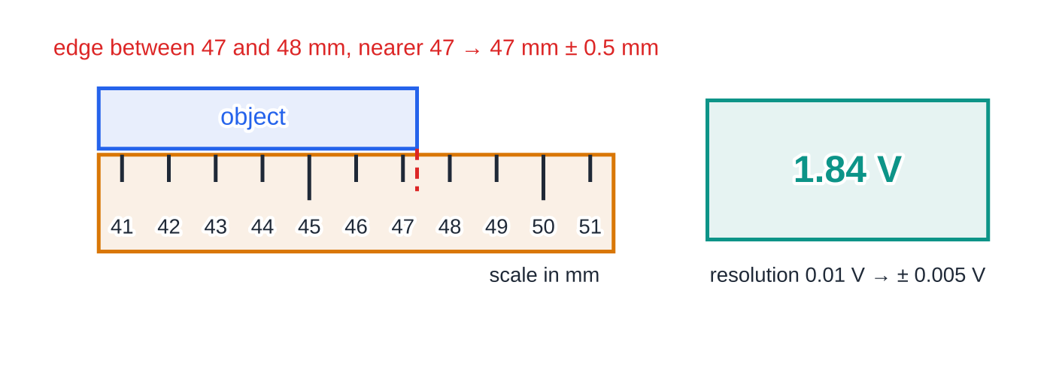
How do you estimate the uncertainty in a measurement? (continued)
Section 3 of 14
Percentage uncertainty
To compare measurements of different sizes, express the uncertainty as a fraction of the value:
percentage uncertainty = uncertainty/(measured value) ×100%
Resolution sets the uncertainty of a single reading. The edge of the object lies between the 47 mm and 48 mm marks, nearer 47 mm, so it is recorded as 47 mm ± 0.5 mm. The meter shows two decimal places, so its reading carries ± 0.005 V.
Use the same unit for both; the answer has no unit. It is not in the formulae list, so learn it with "half the resolution" and "half the range".
Notes:
How do you estimate the uncertainty in a measurement?. Full notes: https://examinerprep.com/notes/edexcel-ial-physics/measurements-uncertainties-and-graphs-as/

Slide 12
How do you estimate the uncertainty in a measurement? (continued)
Section 3 of 14
For example, 47 mm ± 0.5 mm is a 1.1% uncertainty, while 1.84 V ± 0.005 V is only 0.27%. The same absolute uncertainty is a larger percentage of a small reading, so make measured quantities as large as practical. At AS you find the percentage uncertainty of one quantity at a time; combining them is a Unit 6 skill.
Notes:
How do you estimate the uncertainty in a measurement?. Full notes: https://examinerprep.com/notes/edexcel-ial-physics/measurements-uncertainties-and-graphs-as/

Slide 13
How do you estimate the uncertainty in a measurement? (continued)
Section 3 of 14 · Worked example 2 · Medium · Calculate, state
WORKED EXAMPLE · QUESTION
A student times 10 oscillations of a mass on a spring four times: 8.42 s, 8.61 s, 8.37 s, 8.55 s. (a) Calculate the mean time for 10 oscillations, its uncertainty and its percentage uncertainty. (b) State the period with its uncertainty.
SOLUTION
(a) Mean = (8.42 + 8.61 + 8.37 + 8.55)/4 = 8.4875 s, which is given to the same number of decimal places as the readings: 8.49 s.
Uncertainty = half the range = (8.61 - 8.37)/2 = 0.12 s. Percentage uncertainty = (0.12/8.49) ×100% = 1.4%.
10T = 8.49 s ± 0.12 s (1.4%)
(b) Divide both the time and its uncertainty by the exact number 10. The percentage uncertainty is unchanged. T = 0.849 s ± 0.012 s (1.4%)
Notes:
How do you estimate the uncertainty in a measurement?: Worked example 2. Full notes: https://examinerprep.com/notes/edexcel-ial-physics/measurements-uncertainties-and-graphs-as/

Slide 14
How do you estimate the uncertainty in a measurement? (continued)
Section 3 of 14 · Worked example 2 · Medium · Calculate, state (continued)
If the student had timed a single oscillation with the same spread of ± 0.12 s, the percentage uncertainty would have been about 14%, ten times larger.
Notes:
How do you estimate the uncertainty in a measurement?: Worked example 2. Full notes: https://examinerprep.com/notes/edexcel-ial-physics/measurements-uncertainties-and-graphs-as/

Slide 15
What are random and systematic errors, and what is a zero error?
Section 4 of 14
An error is the difference between a measured value and the true value. The two kinds are fixed in different ways.
Random error makes repeated readings scatter unpredictably either side of the true value. Sources include reaction time, judging when a swinging pendulum passes a point, small fluctuations in conditions and reading a scale between marks. Reduce it by repeating and averaging, by timing many cycles, or by using a data logger or light gates.
Systematic error shifts every reading in the same direction by the same amount (or the same fraction). Sources include a zero error, a wrongly calibrated instrument, reading a scale from the same wrong angle every time (parallax) and measuring a pendulum length to the wrong point. Repeating does not reduce it: you must find and remove its cause, or correct the readings.
Notes:
What are random and systematic errors, and what is a zero error?. Full notes: https://examinerprep.com/notes/edexcel-ial-physics/measurements-uncertainties-and-graphs-as/

Slide 16
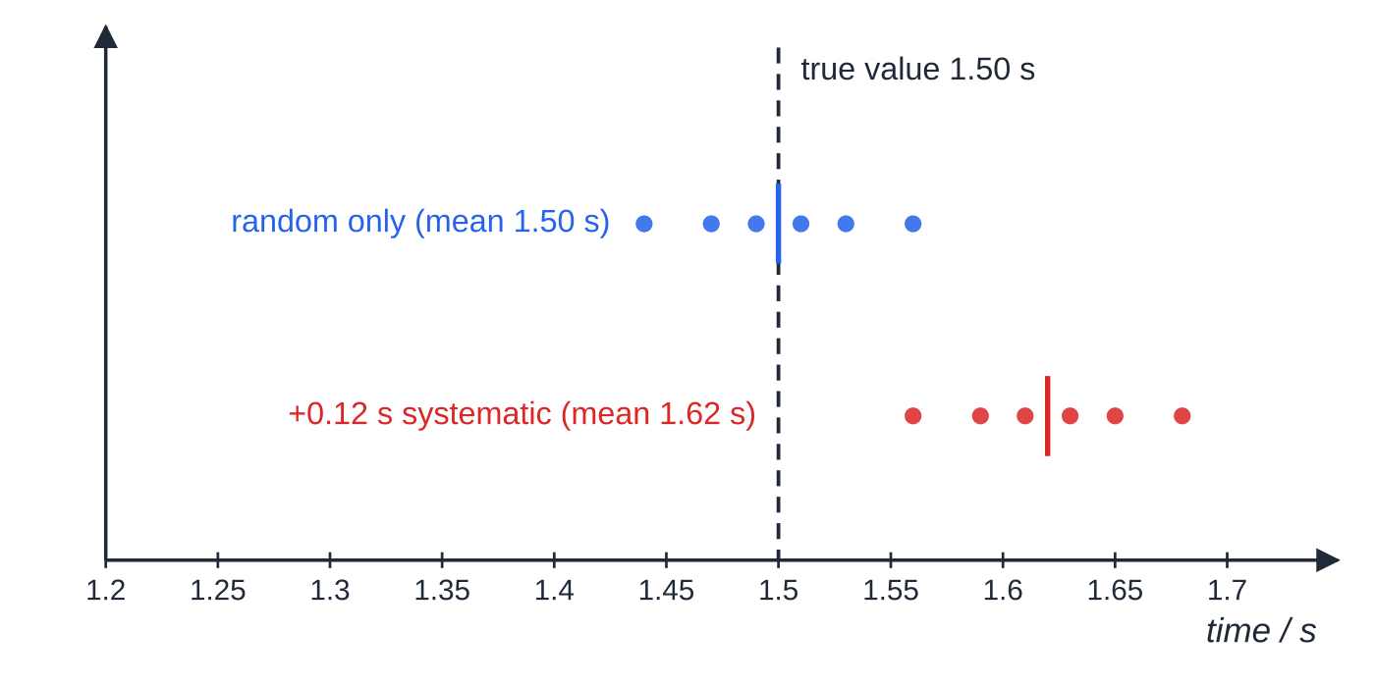
What are random and systematic errors, and what is a zero error? (continued)
Section 4 of 14
A zero error is when an instrument does not read zero when the true value is zero: a newtonmeter showing 0.15 N with nothing hanging, a micrometer that reads 0.02 mm when closed. Check the zero before you start, then subtract (or add) the zero reading from every reading.
On a graph, a systematic error that adds the same amount to every value of y moves the whole line up or down. The intercept changes but the gradient does not, so a gradient method cancels this kind of error.
Six repeated timings of an interval whose true value is 1.50 s. Random error spreads the readings either side of the true value, and their mean is close to it. A systematic error moves every reading, and so the mean, the same way (here by +0.12 s), and repeating does not fix it.
Notes:
What are random and systematic errors, and what is a zero error?. Full notes: https://examinerprep.com/notes/edexcel-ial-physics/measurements-uncertainties-and-graphs-as/

Slide 17
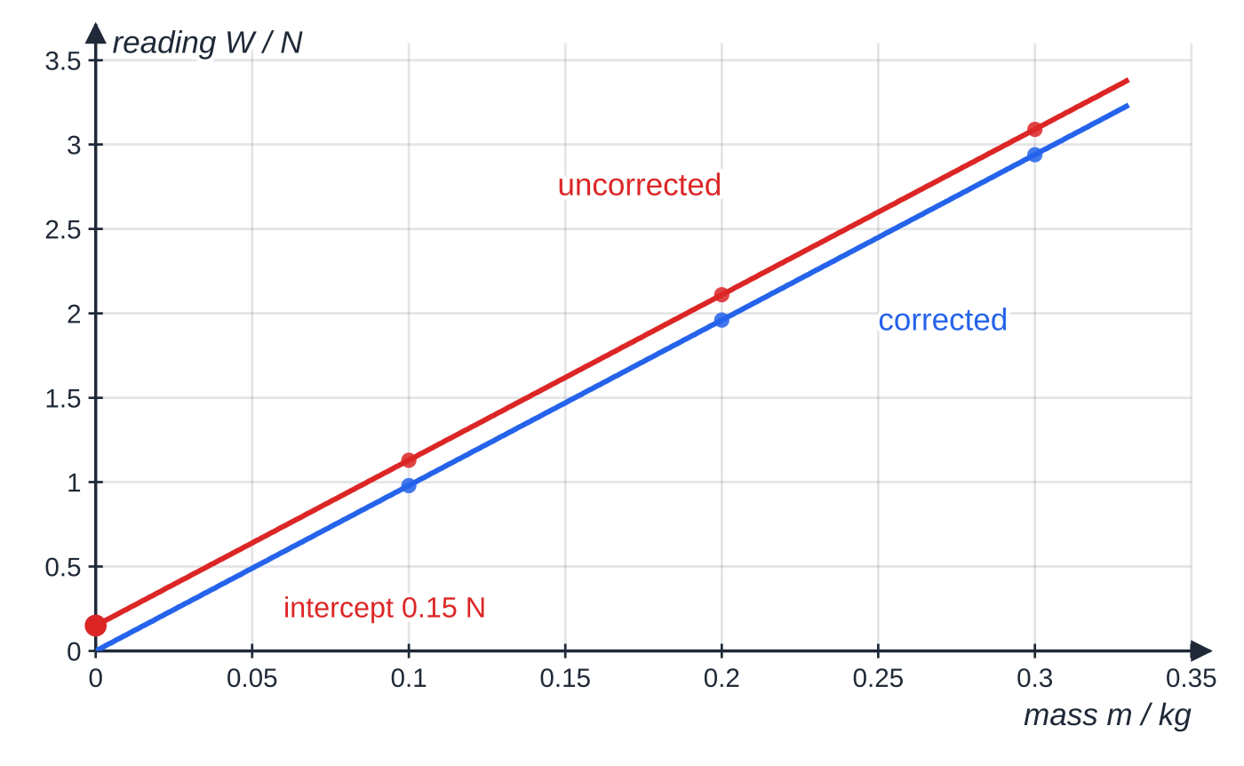
What are random and systematic errors, and what is a zero error? (continued)
Section 4 of 14 · Worked example 3 · Medium · State, show that
WORKED EXAMPLE · QUESTION
Before use, a newtonmeter reads 0.15 N with nothing attached. A student hangs masses of 0.100 kg, 0.200 kg and 0.300 kg from it and records 1.13 N, 2.11 N and 3.09 N. (a) State the type of error and correct the readings. (b) Show that the gradient of a graph of reading against mass is the same with or without the correction, and state what the gradient represents.
Worked example 3. The zero error adds 0.15 N to every reading, so the red line is the blue line moved up by 0.15 N. Both lines have the same gradient, 9.8 N kg⁻¹; only the intercept is different.
Notes:
What are random and systematic errors, and what is a zero error?: Worked example 3. Full notes: https://examinerprep.com/notes/edexcel-ial-physics/measurements-uncertainties-and-graphs-as/

Slide 18
What are random and systematic errors, and what is a zero error? (continued)
Section 4 of 14 · Worked example 3 · Medium · State, show that (continued)
SOLUTION
(a) Every reading is too large by the same amount, so this is a systematic (zero) error. Corrected readings: 1.13 − 0.15 = 0.98 N, 2.11 − 0.15 = 1.96 N and 3.09 − 0.15 = 2.94 N.
(b) Uncorrected, using the first and last points: gradient = (3.09 - 1.13)/(0.300 - 0.100) = (1.96/0.200) = 9.8 N kg⁻¹.
Corrected: every value has dropped by 0.15 N, so the differences are unchanged: (2.94 - 0.98)/0.200 = 9.8 N kg⁻¹. Both gradients are 9.8 N kg⁻¹, which is g; only the intercept (0.15 N) differs.
Dividing a single uncorrected reading by its mass gives 3.09 ÷ 0.300 = 10.3 N kg⁻¹: the zero error has then fed straight into the answer.
Notes:
What are random and systematic errors, and what is a zero error?: Worked example 3. Full notes: https://examinerprep.com/notes/edexcel-ial-physics/measurements-uncertainties-and-graphs-as/

Slide 19
How do you spot and deal with an anomalous reading?
Section 5 of 14
An anomalous reading (an anomaly) is one that does not fit the pattern of the others: a repeat that differs from the rest by much more than their spread, or a point well off the best-fit line.
Check it. If the apparatus is still set up, repeat the measurement for that value. If the new reading fits, it replaces the anomaly.
If it cannot be repeated, leave it out of the mean or the best-fit line, but keep it in the table, ring it on the graph and say why it was excluded.
Suggest a cause where you can: misreading a scale, counting one oscillation too many, a loose connection, a kink in a wire.
Do not discard readings just because they are inconvenient. A point is anomalous only if it is clearly out of line with the others.
Notes:
How do you spot and deal with an anomalous reading?. Full notes: https://examinerprep.com/notes/edexcel-ial-physics/measurements-uncertainties-and-graphs-as/

Slide 20
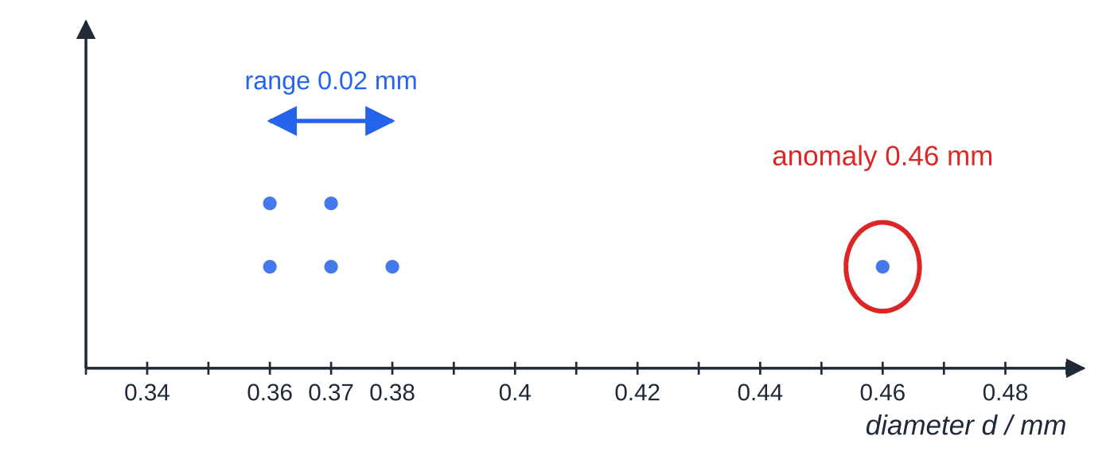
How do you spot and deal with an anomalous reading? (continued)
Section 5 of 14 · Worked example 4 · Medium · Identify, calculate
WORKED EXAMPLE · QUESTION
A student measures the diameter of a wire at six places with a micrometer of resolution 0.01 mm: 0.37, 0.36, 0.38, 0.46, 0.37, 0.36 (all in mm). Identify the anomaly, then calculate the mean diameter, its uncertainty and its percentage uncertainty.
SOLUTION
Anomaly: 0.46 mm differs from the rest by about 0.1 mm, while the others lie within 0.02 mm of each other. Exclude 0.46 mm (and re-measure at that point if possible).
Mean of the remaining five:
Worked example 4. Five of the six diameters lie within 0.02 mm of each other; 0.46 mm is far outside that spread, so it is ringed, left out of the mean and, if possible, measured again.
Notes:
How do you spot and deal with an anomalous reading?: Worked example 4. Full notes: https://examinerprep.com/notes/edexcel-ial-physics/measurements-uncertainties-and-graphs-as/

Slide 21
How do you spot and deal with an anomalous reading? (continued)
Section 5 of 14 · Worked example 4 · Medium · Identify, calculate (continued)
(0.37 + 0.36 + 0.38 + 0.37 + 0.36)/5 = 0.368 mm ≈ 0.37 mm
Uncertainty: half the range = (0.38 - 0.36)/2 = 0.01 mm. This is larger than half the resolution (0.005 mm), so use it: ± 0.01 mm
Percentage uncertainty: (0.01/0.368) ×100% = 2.7%
Including the anomaly would raise the mean to 0.38 mm and make the half-range five times larger (± 0.05 mm instead of ± 0.01 mm). One bad reading would spoil the whole result.
Notes:
How do you spot and deal with an anomalous reading?: Worked example 4. Full notes: https://examinerprep.com/notes/edexcel-ial-physics/measurements-uncertainties-and-graphs-as/

Slide 22
How do you plot a good graph?
Section 6 of 14
Follow the same routine every time.
Axes: independent variable on the x-axis, dependent variable on the y-axis, unless the question tells you which graph to plot. Then plot exactly that.
Labels: label each axis quantity / unit, the same as the table headings.
Scales: choose scales so the plotted points occupy more than half the grid in each direction. Use convenient steps of 1, 2 or 5 units (or 10, 20, 50 …) per large square, never 3 or 7, which make plotting and reading off slow and error-prone. The origin need not be included unless you need the intercept.
Plotting: mark each point with a small, neat cross, accurate to within half a small square.
Best-fit line: one thin straight line (or smooth curve) with the points scattered evenly either side along its length. Do not join the dots, and do not force the line through the origin or through the first point unless the physics demands it.
Notes:
How do you plot a good graph?. Full notes: https://examinerprep.com/notes/edexcel-ial-physics/measurements-uncertainties-and-graphs-as/

Slide 23
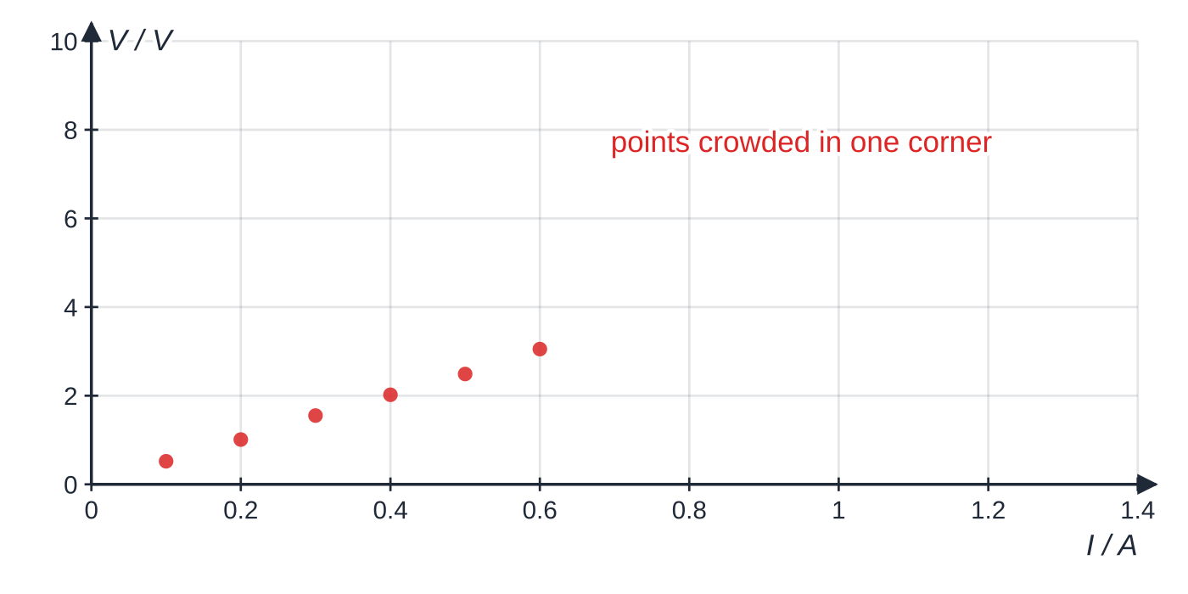
How do you plot a good graph? (continued)
Section 6 of 14
A poor choice of scale. The six points spread over only 0.50 A of a 1.4 A axis (36%) and 2.5 V of a 10 V axis (25%), so they are hard to plot precisely and the gradient is hard to read.
Notes:
How do you plot a good graph?. Full notes: https://examinerprep.com/notes/edexcel-ial-physics/measurements-uncertainties-and-graphs-as/

Slide 24
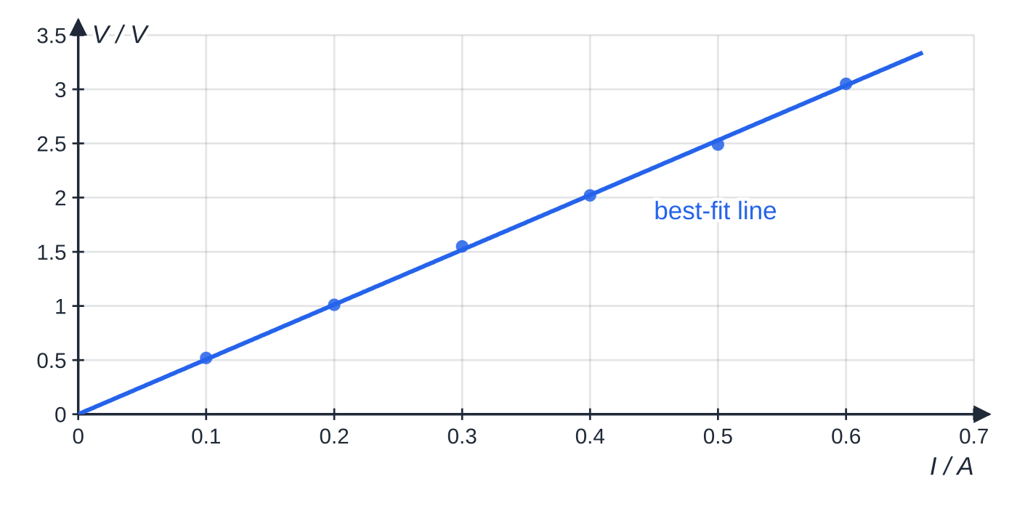
How do you plot a good graph? (continued)
Section 6 of 14
Common error — an easy-to-draw but hard-to-read scale
Choosing 3 N per large square, or letting the points fill only a corner of the grid, makes plotting slow and the gradient imprecise. Check: do the points fill more than half the grid in both directions, and can every value be read without a calculator?
The same six readings on a sensible scale: 0.1 A and 0.5 V per large square, and the points spread over most of the grid in both directions. The single thin best-fit line has points on both sides of it.
Notes:
How do you plot a good graph?. Full notes: https://examinerprep.com/notes/edexcel-ial-physics/measurements-uncertainties-and-graphs-as/

Slide 25
How do you find a gradient and an intercept?
Section 7 of 14
For a straight best-fit line, the gradient is found from two points on the line:
gradient = Δy/Δx = (y₂ - y₁)/(x₂ - x₁)
where (x₁, y₁) and (x₂, y₂) are read from the best-fit line. This is not in the formulae list, so learn it, and remember that the gradient has units: (unit of y) ÷ (unit of x).
Draw a large triangle: its hypotenuse should cover more than half of the drawn line. A small triangle magnifies the effect of reading errors.
Use points on the line, ideally where it crosses grid lines, not data points (unless a data point lies exactly on the line).
Show the triangle on the graph and write the two coordinate pairs in your working.
Give the gradient with a unit and to a sensible number of significant figures (2 or 3).
Notes:
How do you find a gradient and an intercept?. Full notes: https://examinerprep.com/notes/edexcel-ial-physics/measurements-uncertainties-and-graphs-as/

Slide 26
How do you find a gradient and an intercept? (continued)
Section 7 of 14
The intercept is the value of y where the line crosses the y-axis at x = 0. If the x-axis does not start at zero, you cannot read it directly; calculate it from c = y - mx using any point on the line and the gradient you found.
Notes:
How do you find a gradient and an intercept?. Full notes: https://examinerprep.com/notes/edexcel-ial-physics/measurements-uncertainties-and-graphs-as/

Slide 27
How do you find a gradient and an intercept? (continued)
Section 7 of 14 · Worked example 5 · Hard · Identify, determine, explain
WORKED EXAMPLE · QUESTION
A student measures the resistance R of different lengths l of a wire of diameter 0.315 mm, using an ohmmeter connected with crocodile clips.
l / m | 0.100 | 0.200 | 0.300 | 0.400 | 0.500 | 0.600 | 0.700 | 0.800 | 0.900
R / Ω | 1.06 | 1.62 | 2.34 | 2.90 | 3.58 | 4.79 | 4.75 | 5.45 | 6.03
(a) Identify the anomaly. (b) Use the graph to find the gradient. (c) Explain what the intercept shows. (d) Use R = ρl / A to determine the resistivity of the metal.
Notes:
How do you find a gradient and an intercept?: Worked example 5. Full notes: https://examinerprep.com/notes/edexcel-ial-physics/measurements-uncertainties-and-graphs-as/

Slide 28
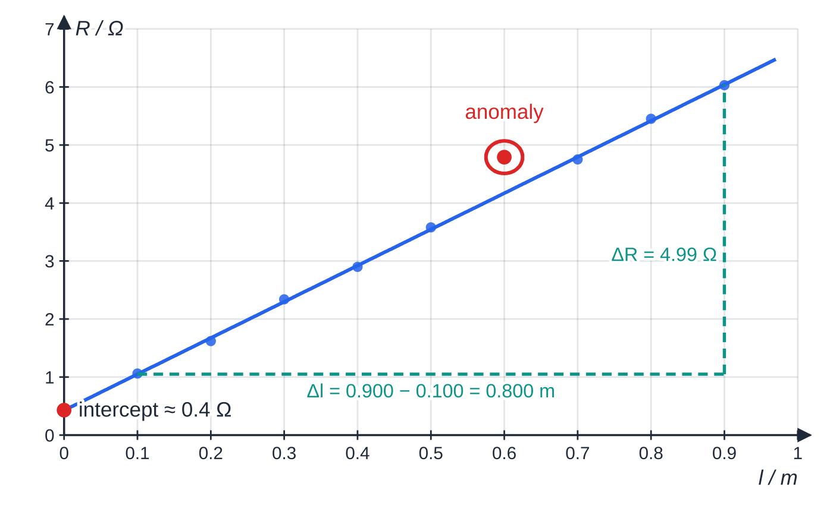
How do you find a gradient and an intercept? (continued)
Section 7 of 14 · Worked example 5 · Hard · Identify, determine, explain (continued)
SOLUTION
(a) Compare each point with the line through the others. At 0.600 m the line gives about 4.2 Ω, but 4.79 Ω was recorded; it is even larger than the 0.700 m reading. The 0.600 m reading is anomalous.
(b) Large triangle from 0.100 m to 0.900 m, values read from the line: gradient = (6.04 - 1.05)/(0.900 - 0.100) = (4.99/0.800) = 6.24 Ω m⁻¹
(c) The line does not pass through the origin: the intercept is about 0.4 Ω.
Resistance against length for the wire in worked example 5. The best-fit line ignores the ringed anomaly at 0.600 m. The large triangle spans 0.800 m of the line, and the line meets the R-axis at about 0.4 Ω, not at the origin.
Notes:
How do you find a gradient and an intercept?: Worked example 5. Full notes: https://examinerprep.com/notes/edexcel-ial-physics/measurements-uncertainties-and-graphs-as/

Slide 29
How do you find a gradient and an intercept? (continued)
Section 7 of 14 · Worked example 5 · Hard · Identify, determine, explain (continued)
This is a systematic error: the resistance of the clips, leads and contacts (or a zero error of the ohmmeter) is added to every reading.
(d) R = (ρ/A) l, so gradient = ρ/ A and ρ= gradient ×A. Area A = πd²/4 = (π(0.315 ×10⁻³)²)/4 = 7.79 ×10⁻⁸ m².
ρ= 6.24 ×7.79 ×10⁻⁸ = 4.86 ×10⁻⁷ Ω m
Using the gradient rather than a single R/l value removes the systematic contact resistance from the result.
Notes:
How do you find a gradient and an intercept?: Worked example 5. Full notes: https://examinerprep.com/notes/edexcel-ial-physics/measurements-uncertainties-and-graphs-as/

Slide 30
How do you turn an equation into a straight-line graph?
Section 8 of 14
Your eye can judge a straight line but not whether a curve is a parabola or a square root, and a line gives a gradient and an intercept to turn into constants. So rearrange the equation into the form
y = mx + c
Whatever multiplies the variable on the x-axis is the gradient; the constant term is the intercept. The axes can carry processed values (T², v², 1/l). If the points lie on a straight line, the data support the relationship; if the line should pass through the origin, check that it does.
Equation | Plot y | against x | Gradient | Intercept
R = ρl / A (+ contact resistance) | R | l | ρ/ A | contact resistance (ideally 0)
T = 2π√(l/g) | T² | l | 4π² / g | 0
v² = u² + 2as | v² | s | 2a | u²
Notes:
How do you turn an equation into a straight-line graph?. Full notes: https://examinerprep.com/notes/edexcel-ial-physics/measurements-uncertainties-and-graphs-as/

Slide 31
How do you turn an equation into a straight-line graph? (continued)
Section 8 of 14
Equation | Plot y | against x | Gradient | Intercept
s = ½at² (from rest) | s | t² | ½a | 0
V = ε- Ir | V | I | −r | ε
f = v / 2l (string fundamental) | f | 1/l | v/2 | 0
Notes:
How do you turn an equation into a straight-line graph?. Full notes: https://examinerprep.com/notes/edexcel-ial-physics/measurements-uncertainties-and-graphs-as/

Slide 32
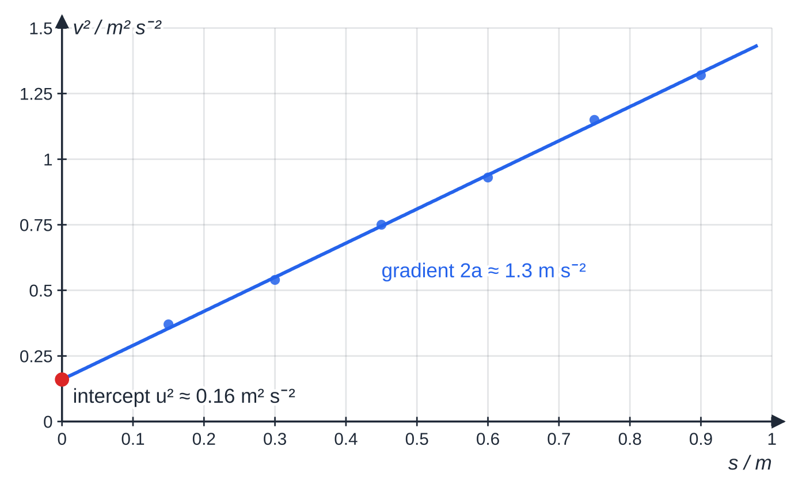
How do you turn an equation into a straight-line graph? (continued)
Section 8 of 14
For a pendulum, T against l is a curve; squaring gives T² = (4π²/g) l, a straight line through the origin.
A trolley passes the first light gate already moving, so v² = u² + 2as gives a straight line that does not pass through the origin. Gradient 2a ≈ 1.3 m s⁻², so a ≈ 0.65 m s⁻²; intercept u² ≈ 0.16 m² s⁻², so u ≈ 0.40 m s⁻¹.
Notes:
How do you turn an equation into a straight-line graph?. Full notes: https://examinerprep.com/notes/edexcel-ial-physics/measurements-uncertainties-and-graphs-as/

Slide 33
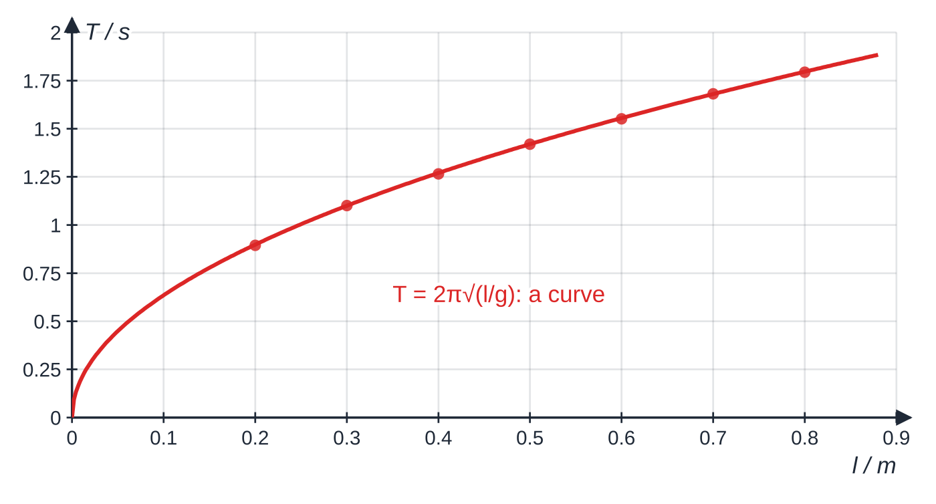
How do you turn an equation into a straight-line graph? (continued)
Section 8 of 14
Plotting T against l for the pendulum data gives a curve. It is hard to tell by eye whether it really follows a square-root law, and there is no gradient to read.
Notes:
How do you turn an equation into a straight-line graph?. Full notes: https://examinerprep.com/notes/edexcel-ial-physics/measurements-uncertainties-and-graphs-as/

Slide 34
How do you turn an equation into a straight-line graph? (continued)
Section 8 of 14 · Worked example 6 · Hard · Explain, determine
WORKED EXAMPLE · QUESTION
A student times 20 oscillations of a simple pendulum for seven lengths l, measured from the point of suspension to the centre of the bob. The period is given by T = 2π√(l/g).
l / m | 20T / s | T / s | T² / s²
0.200 | 17.88 | 0.894 | 0.799
0.300 | 22.02 | 1.101 | 1.21
0.400 | 25.30 | 1.265 | 1.60
0.500 | 28.40 | 1.420 | 2.02
0.600 | 31.02 | 1.551 | 2.41
0.700 | 33.62 | 1.681 | 2.83
0.800 | 35.86 | 1.793 | 3.21
Notes:
How do you turn an equation into a straight-line graph?: Worked example 6. Full notes: https://examinerprep.com/notes/edexcel-ial-physics/measurements-uncertainties-and-graphs-as/

Slide 35
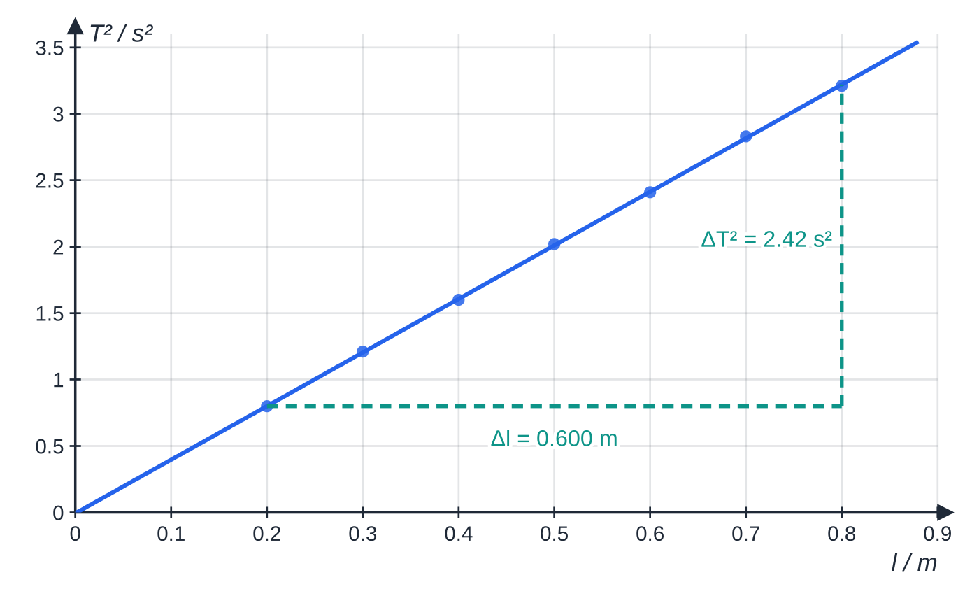
How do you turn an equation into a straight-line graph? (continued)
Section 8 of 14 · Worked example 6 · Hard · Explain, determine (continued)
(a) Explain why a graph of T² against l is plotted. (b) Use the graph to determine g. (c) Explain the effect on the graph and on g if every length had been measured to the top of the bob instead.
SOLUTION
(a) Square both sides: T² = (4π²/g) l. Compared with y = mx + c, y is T², x is l, the gradient is 4π²/g and the intercept is 0. A straight line through the origin tests the equation, and g comes from the gradient.
The same data plotted as T² against l (worked example 6). The points now lie on a straight line through the origin, as T² = (4π²/g)l predicts. The triangle spans 0.600 m of the line.
Notes:
How do you turn an equation into a straight-line graph?: Worked example 6. Full notes: https://examinerprep.com/notes/edexcel-ial-physics/measurements-uncertainties-and-graphs-as/

Slide 36
How do you turn an equation into a straight-line graph? (continued)
Section 8 of 14 · Worked example 6 · Hard · Explain, determine (continued)
(b) Large triangle from l = 0.200 m to 0.800 m, read from the line: gradient = (3.22 - 0.80)/0.600 = 4.03 s² m⁻¹.
Rearrange gradient = 4π²/g: g = 4π²/4.033 = 9.79 m s⁻²
(c) Every l would be too small by the bob's radius, a systematic error. The line shifts sideways and no longer passes through the origin, but the gradient, and so g, is unchanged.
Notes:
How do you turn an equation into a straight-line graph?: Worked example 6. Full notes: https://examinerprep.com/notes/edexcel-ial-physics/measurements-uncertainties-and-graphs-as/

Slide 37
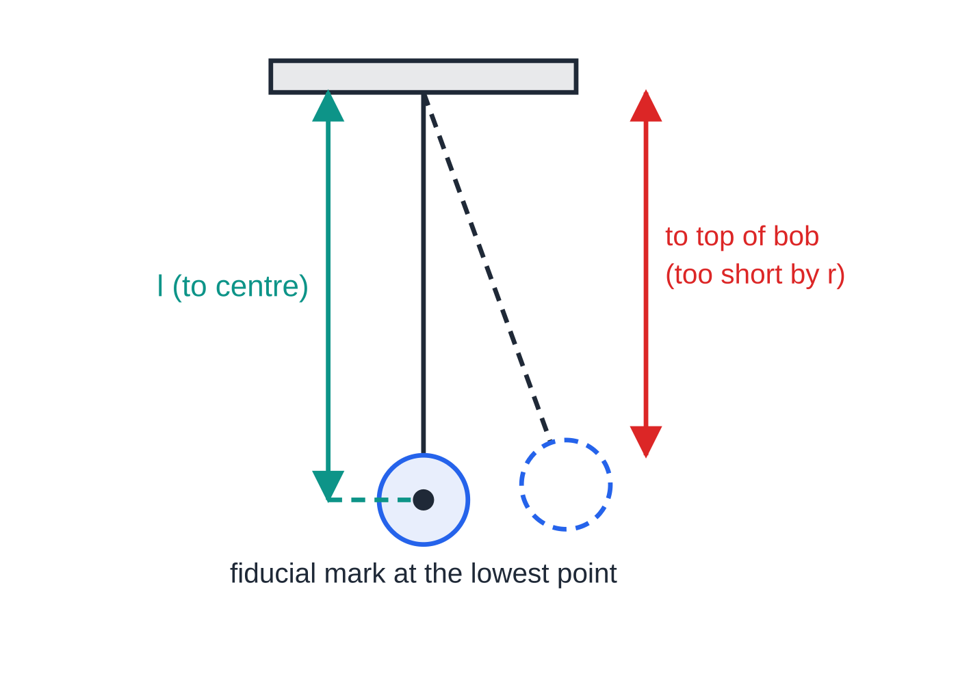
How do you turn an equation into a straight-line graph? (continued)
Section 8 of 14
Exam tip — explaining a choice of graph
Write the rearranged equation, then state which quantity is y, which is x, and what the gradient (and intercept) represent. "It gives a straight line" alone does not explain how you get the constant.
A simple pendulum. The length l in T = 2π√(l/g) runs from the point of suspension to the centre of mass of the bob. Measuring only to the top of the bob makes every length too short by the bob's radius r, a systematic error.
Notes:
How do you turn an equation into a straight-line graph?. Full notes: https://examinerprep.com/notes/edexcel-ial-physics/measurements-uncertainties-and-graphs-as/

Slide 38
How do you evaluate an experiment and suggest improvements?
Section 9 of 14
Improvements must target the real weakness and be specific enough to carry out.
Find the biggest source of uncertainty, usually the measurement with the largest percentage uncertainty, and aim your improvement at it.
Be specific. Not "be more careful" or "use better equipment", but "use light gates connected to a data logger to remove reaction time", "time 20 oscillations instead of 5", or "measure the diameter with a micrometer instead of a ruler".
Random errors: more repeats, more cycles, larger measured quantities (smaller percentage uncertainty), more readings over a wider range.
Systematic errors: check and correct zero errors, view scales at eye level to avoid parallax, use a fiducial mark, measure to the correct point (for example the centre of the bob).
Comparing with an accepted value: state whether your result is close to it. A result that is consistently too high or too low points to a systematic error rather than a random one.
Notes:
How do you evaluate an experiment and suggest improvements?. Full notes: https://examinerprep.com/notes/edexcel-ial-physics/measurements-uncertainties-and-graphs-as/

Slide 39
Exam tips for 3.2
Section 10 of 14
Exam tip 1 — headings and decimal places
Check every table you write: quantity / unit in each heading, no units in the cells, and every reading of one quantity to the same number of decimal places as the instrument's resolution.
Exam tip 2 — the big triangle
For a gradient, draw a triangle covering more than half the line, read both corners from the line itself, and show the values you read. Then give the gradient with its unit.
Exam tip 3 — round at the end
Carry at least one extra figure through a calculation, then give the final answer to the number of significant figures of the least precise data (2 or 3 in most questions). A long string of calculator digits is not "more accurate".
Notes:
Exam tips for 3.2. Full notes: https://examinerprep.com/notes/edexcel-ial-physics/measurements-uncertainties-and-graphs-as/

Slide 40
Exam tips for 3.2 (continued)
Section 10 of 14
Exam tip 4 — which uncertainty?
One reading: half the resolution. Several repeats: half the range, with any anomaly removed. If both are available, quote the larger, and show the calculation that produced it.
Exam tip 5 — say "systematic" or "random"
When explaining an error, name its type and its effect: a zero error is systematic, makes every reading too large (or too small) by the same amount, and changes the intercept of a graph but not its gradient.
Notes:
Exam tips for 3.2. Full notes: https://examinerprep.com/notes/edexcel-ial-physics/measurements-uncertainties-and-graphs-as/

Slide 41
Common misconceptions
Section 11 of 14
Misconception | Why it is wrong | Correct idea
More decimal places in an answer make it more accurate. | A result cannot be more precise than the data it came from. | Give results to the s.f. of the least precise data (or one more).
Repeating readings removes all errors. | A systematic error shifts every repeat by the same amount, so the mean is still wrong. | Repeats reduce random error; systematic error needs its cause removed or a correction.
A stopwatch reading to 0.01 s gives timings with an uncertainty of 0.005 s. | Human reaction time varies by far more than 0.01 s. | Use half the range of repeated timings.
The best-fit line must pass through the origin. | Systematic errors and the physics (for example v² = u² + 2as) can give a non-zero intercept. | Draw the line that best fits the points, then interpret the intercept.
The gradient can be found from any two data points. | Individual points carry random error; two close points magnify it. | Use a large triangle on the best-fit line.
Notes:
Common misconceptions. Full notes: https://examinerprep.com/notes/edexcel-ial-physics/measurements-uncertainties-and-graphs-as/

Slide 42
Common misconceptions (continued)
Section 11 of 14
Misconception | Why it is wrong | Correct idea
An anomaly should be included because it is "real data". | A reading far outside the pattern usually comes from a mistake, and it distorts the mean or the line. | Repeat it if possible; otherwise exclude it, ring it and say why.
Notes:
Common misconceptions. Full notes: https://examinerprep.com/notes/edexcel-ial-physics/measurements-uncertainties-and-graphs-as/

Slide 43
How this topic connects
Section 12 of 14
1 Planning experiments and measuring instruments
Resolution, zero error and parallax start with choosing and reading the instrument. This page takes those readings forward into uncertainties and graphs.
3 The AS core practicals
Every core practical (free fall, Young modulus, resistivity, internal resistance and the rest) ends with a table, a linearised graph and an evaluation using exactly these skills.
Units 1 and 2, and Unit 6
The equations being linearised come from mechanics (v² = u² + 2as), materials and electricity (R = ρl / A, V = ε- Ir) and waves (f = v/2l). Practical skills at A2 (Unit 6) build on this page with combined percentage uncertainties, maximum and minimum gradient lines, and logarithmic graphs.
Notes:
How this topic connects. Full notes: https://examinerprep.com/notes/edexcel-ial-physics/measurements-uncertainties-and-graphs-as/

Slide 44
Key equations
Section 13 of 14
Equation | Use | In the formulae list?
uncertainty = ½ × resolution | single reading | No — learn it
uncertainty = ½ × (largest − smallest) | set of repeated readings | No — learn it
percentage uncertainty = (uncertainty ÷ value) × 100% | comparing uncertainties of different measurements | No — learn it
gradient = Δy / Δx; c = y - mx | straight-line graphs | No — learn it
v² = u² + 2as | linearised: v² against s | Yes
R = ρl / A | linearised: R against l | Yes
T = 2π√(l/g) | linearised: T² against l | No at AS — given in the question when needed
Notes:
Key equations. Full notes: https://examinerprep.com/notes/edexcel-ial-physics/measurements-uncertainties-and-graphs-as/

Slide 45
Check your understanding
Section 14 of 14
1. A digital stopwatch reads to 0.01 s. Why is the uncertainty in a hand timing much larger than 0.005 s, and how should you estimate it?
2. A thermometer with 1 °C divisions reads 23 °C. State the uncertainty and the percentage uncertainty.
3. Repeat readings of a length are 12.4, 12.6, 12.5, 13.9 and 12.5 cm. Give the mean and its uncertainty.
4. Which graph would you plot to find a and u from v² = u² + 2as, and how?
5. Classify each as random or systematic: (a) a balance that reads 0.3 g with nothing on it; (b) variation in judging when a pendulum passes its lowest point; (c) always reading a meniscus from slightly above.
Notes:
Check your understanding: questions. Full notes: https://examinerprep.com/notes/edexcel-ial-physics/measurements-uncertainties-and-graphs-as/

Slide 46
Check your understanding · answers
Section 14 of 14
1. Human reaction time in starting and stopping the watch varies by tenths of a second, far more than the resolution. Repeat the timing and use half the range of the repeats.
2. ± 0.5 °C (half the resolution). Percentage uncertainty = (0.5/23) ×100% = 2.2%.
3. 13.9 cm is anomalous and is excluded. Mean = (12.4 + 12.6 + 12.5 + 12.5)/4 = 12.5 cm; uncertainty = (12.6 - 12.4)/2 = ±0.1 cm.
4. v² on the y-axis against s on the x-axis. Gradient = 2a, so a = gradient ÷ 2; intercept = u², so u = √intercept.
5. (a) Systematic (zero error). (b) Random. (c) Systematic (parallax in the same direction every time).
Notes:
Check your understanding: answers. Full notes: https://examinerprep.com/notes/edexcel-ial-physics/measurements-uncertainties-and-graphs-as/

Slide 47
Practice questions
2 original exam-style questions. Answers at the end of the deck.

Slide 48
Question 1
5 marks
A student releases a marble from rest at the top of a grooved ramp and uses a digital stopwatch, reading to 0.01 s, to time how long it takes to reach the bottom. Her four timings are:
(a) Calculate the mean time. [1]
(b) Calculate the uncertainty in the mean time. [1]
(c) Calculate the percentage uncertainty in the mean time. [1]
(d) Explain why the uncertainty in the time is not ± 0.005 s, even though the stopwatch reads to 0.01 s. [2]
t / s
1.62
1.58
1.71
1.60
Notes:
Online with the full mark scheme: https://examinerprep.com/ial-physics-3-2-measurements-uncertainties-and-graphs-as-questions#IALP-U3-2-B-01

Slide 49
Question 2
4 marks
A student measures the current in a fixed resistor for different potential differences. The voltmeter reads to 0.01 V and the milliammeter to 0.1 mA. His table of results is:
(a) Identify the value that has been recorded incorrectly and explain your answer. [2]
(b) Calculate the resistance of the resistor using the readings for 2.00 V. Give your answer to an appropriate number of significant figures. [2]
V / V | I / mA
0.50 | 21.3
1.00 | 42.4
1.5 | 63.9
2.00 | 85.1
2.50 | 106.2
Notes:
Online with the full mark scheme: https://examinerprep.com/ial-physics-3-2-measurements-uncertainties-and-graphs-as-questions#IALP-U3-2-B-02

Slide 50
Answers

Slide 51
Question 1 · answer
Mark scheme
(1.62 + 1.58 + 1.71 + 1.60) ÷ 4 = 1.63 s (1.6275 s)
half the range = (1.71 − 1.58) ÷ 2 = ± 0.065 s (allow ± 0.07 s)
0.065 ÷ 1.63 × 100 = 4.0% (allow 4.3% from 0.07 s; allow error carried forward)
the student's reaction time in starting and stopping the stopwatch varies from one timing to the next
this spread (about 0.1 s) is much larger than the resolution, so half the range of the repeats is the realistic uncertainty
Notes:
Full mark scheme: https://examinerprep.com/ial-physics-3-2-measurements-uncertainties-and-graphs-as-questions#IALP-U3-2-B-01

Slide 52
Question 2 · answer
Mark scheme
the potential difference “1.5”
all readings from the voltmeter should be given to two decimal places, matching its resolution of 0.01 V, so it should be written 1.50 V
R = V/I = 2.00 ÷ 0.0851 (current converted to amperes)
= 23.5 Ω (3 s.f., as the data are 3 s.f.)
Notes:
Full mark scheme: https://examinerprep.com/ial-physics-3-2-measurements-uncertainties-and-graphs-as-questions#IALP-U3-2-B-02

Slide 53
Keep practising
Notes for this topic
Questions on this topic
Build a printable test
ExaminerPrep is an independent tutoring service. It has been developed independently from and is not endorsed by the International Baccalaureate Organization. "International Baccalaureate", "IB" and "IB Diploma Programme" are registered trademarks of the IBO, used here for descriptive purposes only.
Pearson Edexcel and Cambridge are trademarks of their owners; ExaminerPrep is not affiliated with any exam board.

