Slide 1
EP
EDEXCEL IAL PHYSICS
1.4 Moments and centre of gravity
The full notes page in 14 sections · practice questions with answers · simulations
ExaminerPrep is an independent tutoring service. It has been developed independently from and is not endorsed by the International Baccalaureate Organization. "International Baccalaureate", "IB" and "IB Diploma Programme" are registered trademarks of the IBO, used here for descriptive purposes only.
Pearson Edexcel and Cambridge are trademarks of their owners; ExaminerPrep is not affiliated with any exam board.
Notes:
1.4 Moments and centre of gravity. Notes for this topic: https://examinerprep.com/notes/edexcel-ial-physics/moments-and-centre-of-gravity/

Slide 2
What this page covers
Overview
The moment of a force about a pivot, using the perpendicular distance to the line of action
Moments of forces that act at an angle
The principle of moments and the two conditions for a body in equilibrium
Centre of gravity, and free-body diagrams of beams and planks with the weight drawn at the centre of gravity
Beams on two supports, see-saws and levers, cranes, and a beam held by a cable at an angle
Finding the centre of gravity of a rod or a flat sheet (lamina) by balancing and by suspension
Stability and toppling, explained with moments
Notes:
What this page covers. Full notes: https://examinerprep.com/notes/edexcel-ial-physics/moments-and-centre-of-gravity/

Slide 3
In one minute
Key points
1. A force can make a body turn as well as move: its turning effect, the moment, is force × perpendicular distance from the pivot to the line of action, measured in N m.
2. For a force at angle θ to a lever of length r: moment = Frsin θ — use the perpendicular component of the force, or the perpendicular distance.
3. Principle of moments: for a body in equilibrium, the sum of clockwise moments about any point = the sum of anticlockwise moments about that point.
4. Equilibrium also needs zero resultant force: upward forces = downward forces.
5. The centre of gravity is the point where the whole weight can be taken to act. For a uniform beam it is at the midpoint.
6. Take moments about the point where an unknown force acts — that force then has no moment and drops out.
7. An object topples when the line of action of its weight passes outside its base.
Notes:
In one minute. Full notes: https://examinerprep.com/notes/edexcel-ial-physics/moments-and-centre-of-gravity/

Slide 4
What is the moment of a force?
Section 1 of 14
Moment of a force about a point:
force × perpendicular distance from the point to the line of action of the force.
moment = Fx
F = force (N) · x = perpendicular distance from the pivot (axis) to the line of action of the force (m) · moment in newton metres, N m. Supplied in the formulae list.
The line of action is the straight line through the point of application, along the direction of the force, extended as far as you need in both directions.
A moment measures the turning effect of a force. It has a sense of rotation: clockwise or anticlockwise about the chosen point.
A force whose line of action passes through the pivot has zero moment about it, however large the force.
Notes:
What is the moment of a force?. Full notes: https://examinerprep.com/notes/edexcel-ial-physics/moments-and-centre-of-gravity/

Slide 5
What is the moment of a force? (continued)
Section 1 of 14
The same force has a larger moment further from the pivot — hence door handles far from hinges and long spanners.
Moments are taken about a stated point. The value depends on which point you choose.
Common error
Writing the unit of moment as N m⁻¹ or J. A moment is a force multiplied by a distance, so the unit is N m. Although work also has units of N m, a moment is not an energy and is never written in joules.
Notes:
What is the moment of a force?. Full notes: https://examinerprep.com/notes/edexcel-ial-physics/moments-and-centre-of-gravity/

Slide 6
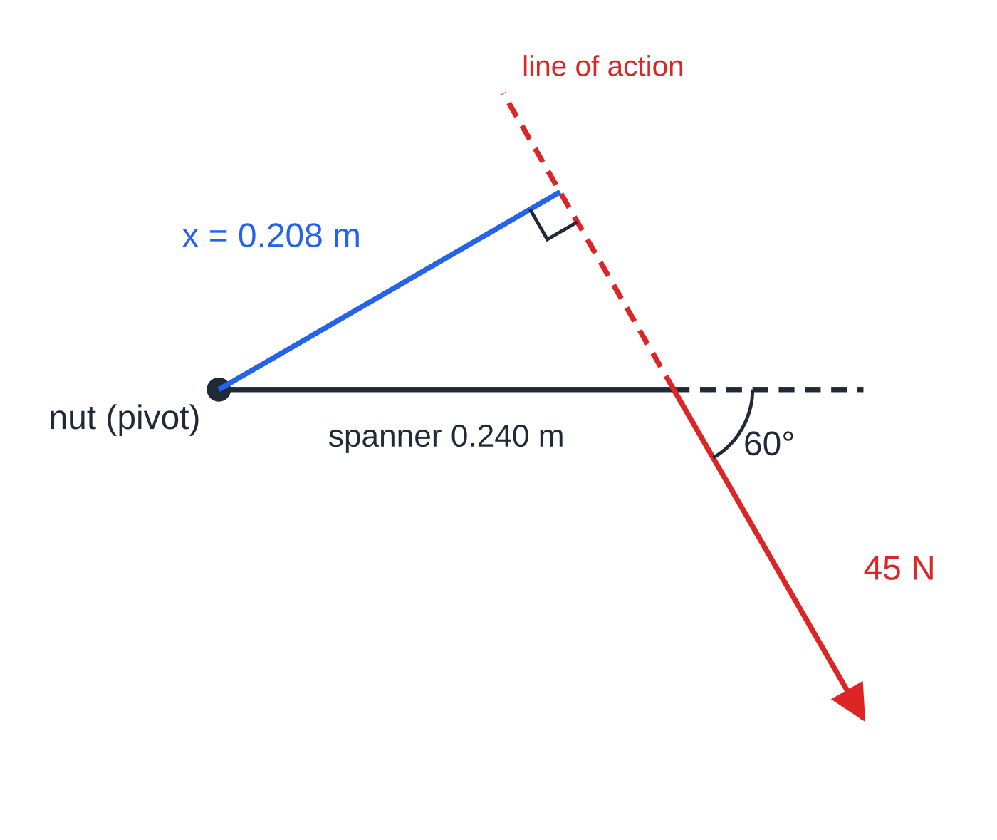
How do you find the moment of a force at an angle?
Section 2 of 14
Only the perpendicular distance to the line of action counts. When a force is not at 90° to the lever, that distance is shorter than the length of the lever. For a force F applied at distance r from the pivot, at angle θ to the lever, there are two equivalent methods:
Perpendicular distance: x = rsin θ, so moment = F ×rsin θ.
Perpendicular component: resolve F; the component Fsin θ is at 90° to the lever and has moment (Fsin θ) ×r. The component Fcos θ acts along the lever, through the pivot, so its moment is zero.
Both give Frsin θ. The moment is largest when the force is at 90° to the lever (sin 90° = 1).
Drawn to scale. The perpendicular from the pivot meets the extended line of action at a right angle; its length, 0.208 m, is 0.240 sin 60°.
Notes:
How do you find the moment of a force at an angle?. Full notes: https://examinerprep.com/notes/edexcel-ial-physics/moments-and-centre-of-gravity/

Slide 7
How do you find the moment of a force at an angle? (continued)
Section 2 of 14 · Worked example 1 · Easy · Calculate
WORKED EXAMPLE · QUESTION
A mechanic pulls on the end of a spanner 0.240 m long with a force of 45 N. Calculate the moment about the centre of the nut (a) when the force is at 90° to the spanner and (b) when the same force is at 60° to the spanner, as in the figure.
SOLUTION
(a) The force is perpendicular, so the distance is the full length: moment = 45 ×0.240 = 10.8 N m
(b) Perpendicular distance to the line of action: x = 0.240 ×sin 60° = 0.208 m. Moment = 45 ×0.2078 = 9.35 N m
Check with the component method: 45sin 60° = 39.0 N at 90° to the spanner, and 38.97 ×0.240 = 9.35 N m.
Notes:
How do you find the moment of a force at an angle?: Worked example 1. Full notes: https://examinerprep.com/notes/edexcel-ial-physics/moments-and-centre-of-gravity/

Slide 8
How do you find the moment of a force at an angle? (continued)
Section 2 of 14
Exam tip
Before choosing sin or cos, sketch the force, the lever and the angle. The part you want is the one perpendicular to the lever. If the angle is given between the force and the normal to the lever instead, the cosine is needed.
Notes:
How do you find the moment of a force at an angle?. Full notes: https://examinerprep.com/notes/edexcel-ial-physics/moments-and-centre-of-gravity/

Slide 9
What is the principle of moments?
Section 3 of 14
Principle of moments: for a body in equilibrium, the sum of the clockwise moments about any point equals the sum of the anticlockwise moments about the same point.
Conditions for equilibrium of an extended body
ΣF = 0 and Σ clockwise moments = Σ anticlockwise moments
Zero resultant force: no linear acceleration (forces up = forces down, forces left = forces right). Zero resultant moment about any point: no turning. The principle of moments is not printed in the formulae list — learn it.
A body in equilibrium is at rest or moving at constant velocity without starting to rotate. Both conditions must hold at the same time.
Notes:
What is the principle of moments?. Full notes: https://examinerprep.com/notes/edexcel-ial-physics/moments-and-centre-of-gravity/

Slide 10
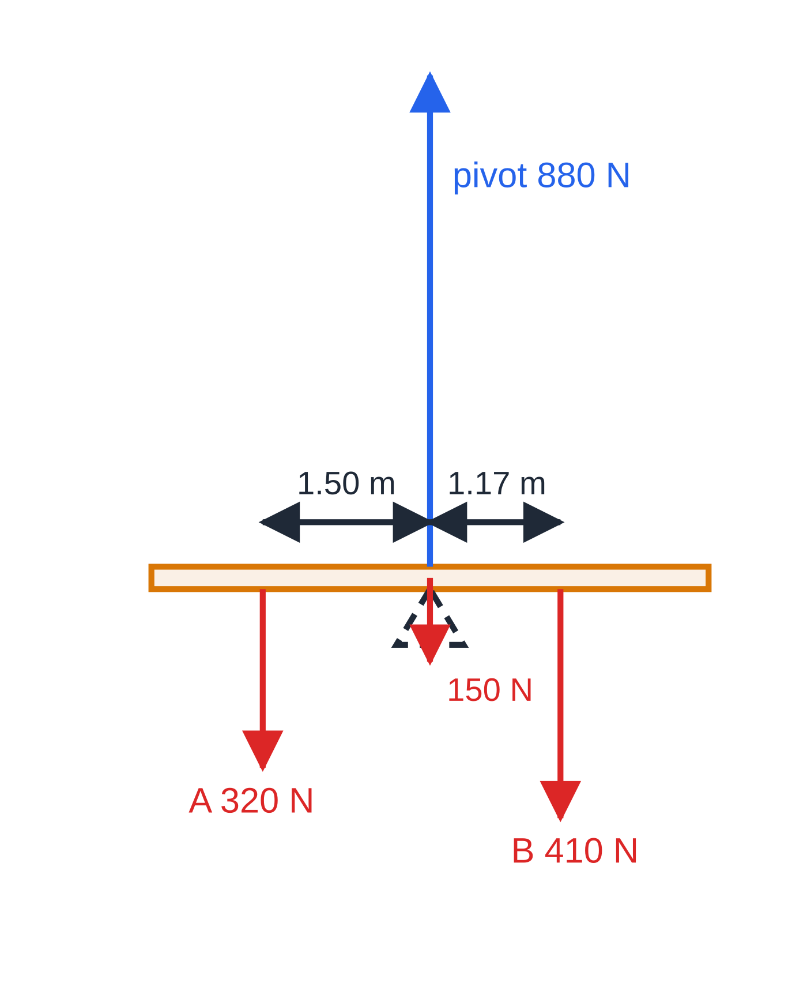
What is the principle of moments? (continued)
Section 3 of 14
A reliable method
1. Draw a free-body diagram: every force on the body, at the point where it acts.
2. Choose a point to take moments about — usually where an unknown force acts.
3. For each force, write force × perpendicular distance and label it clockwise or anticlockwise.
4. Equate the totals, solve, then use "up = down" for any remaining unknown force.
Free-body diagram of the see-saw in worked example 2, with forces and distances to scale. The plank's weight and the pivot force act through the pivot, so they have no moment about it.
Notes:
What is the principle of moments?. Full notes: https://examinerprep.com/notes/edexcel-ial-physics/moments-and-centre-of-gravity/

Slide 11
What is the principle of moments? (continued)
Section 3 of 14 · Worked example 2 · Easy · Calculate
WORKED EXAMPLE · QUESTION
A uniform see-saw is pivoted at its centre. Its weight is 150 N. Child A, of weight 320 N, sits 1.50 m to the left of the pivot. Child B, of weight 410 N, sits on the right. Calculate (a) how far from the pivot child B must sit for the see-saw to balance horizontally and (b) the force from the pivot on the see-saw.
SOLUTION
(a) Moments about the pivot, clockwise = anticlockwise: 410 ×x = 320 ×1.50, so x = 480 ÷410 = 1.17 m
(b) Resultant force is zero, so up = down: pivot force = 320 + 410 + 150 = 880 N upwards
The products of force and distance balance, not the forces.
Notes:
What is the principle of moments?: Worked example 2. Full notes: https://examinerprep.com/notes/edexcel-ial-physics/moments-and-centre-of-gravity/

Slide 12
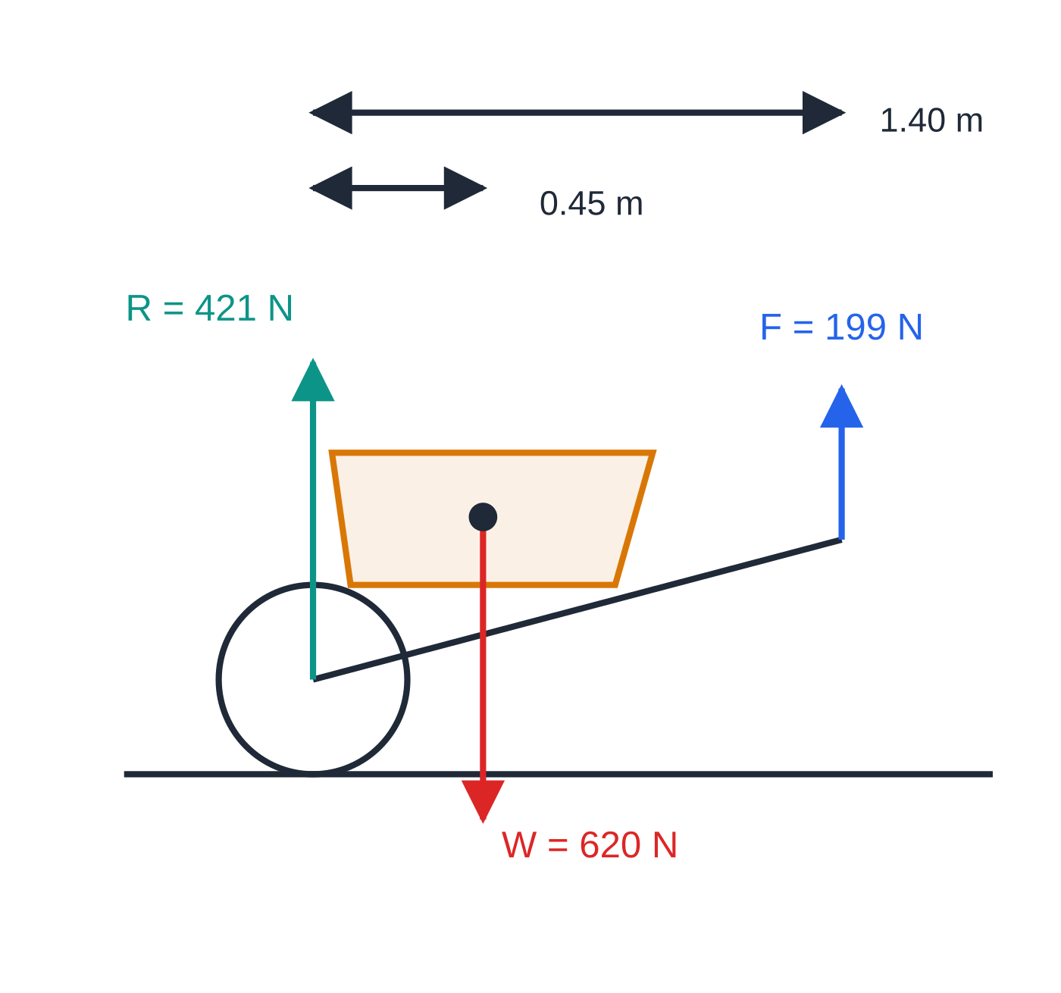
What is the principle of moments? (continued)
Section 3 of 14
Levers
A lever uses a small force at a large distance from the pivot to balance a large force close to it. The pivot need not be between the two forces: in a wheelbarrow the wheel is the pivot and both the load and the lift are on the same side of it.
A wheelbarrow as a lever with the pivot at the axle. Load and lift are on the same side of the pivot; distances are horizontal, and forces are roughly to scale (1 unit = 775 N).
Notes:
What is the principle of moments?. Full notes: https://examinerprep.com/notes/edexcel-ial-physics/moments-and-centre-of-gravity/

Slide 13
What is the principle of moments? (continued)
Section 3 of 14 · Worked example 3 · Medium · Calculate
WORKED EXAMPLE · QUESTION
A loaded wheelbarrow has a total weight of 620 N. Its centre of gravity is 0.45 m horizontally from the axle of the wheel. The gardener holds the handles 1.40 m horizontally from the axle and lifts vertically so the barrow is just off the ground at the back. Calculate the upward force the gardener applies and the force of the ground on the wheel.
SOLUTION
Step 1 Moments about the axle (the ground force on the wheel acts there): F ×1.40 = 620 ×0.45, so F = 199 N
Step 2 Up = down for the wheel force: R = 620 - 199.3 = 421 N
The handles are about three times as far from the axle as G, so the gardener lifts less than a third of the weight.
Notes:
What is the principle of moments?: Worked example 3. Full notes: https://examinerprep.com/notes/edexcel-ial-physics/moments-and-centre-of-gravity/

Slide 14
What is the centre of gravity?
Section 4 of 14
Centre of gravity: the single point at which the whole weight of the body can be considered to act.
Every small part of a body has weight; at G one force — the total weight — has the same turning effect as all those small weights together.
A body is uniform when its mass is evenly spread. The centre of gravity of a uniform rod, beam or plank is at its midpoint; for a uniform rectangular sheet it is where the diagonals cross.
For a non-uniform body (a cricket bat, a tree trunk, a loaded van) the centre of gravity is nearer the heavier end, and it is often found by experiment.
The centre of gravity need not lie inside the material — for a ring or a boomerang it is in the space between.
In a uniform gravitational field the centre of gravity is at the same point as the centre of mass.
Notes:
What is the centre of gravity?. Full notes: https://examinerprep.com/notes/edexcel-ial-physics/moments-and-centre-of-gravity/

Slide 15
What is the centre of gravity? (continued)
Section 4 of 14
Free-body diagrams of beams and planks
Draw the body as a simple shape with the weight as one arrow down from the centre of gravity, and each contact force, labelled, where the contact is. Show only forces on the body, and mark the distances between the lines of action.
Common error
Leaving out the weight of the beam itself, or drawing it at one end. Unless a beam is described as "light" (negligible weight), it has weight, and for a uniform beam that weight acts at the midpoint.
Notes:
What is the centre of gravity?. Full notes: https://examinerprep.com/notes/edexcel-ial-physics/moments-and-centre-of-gravity/

Slide 16
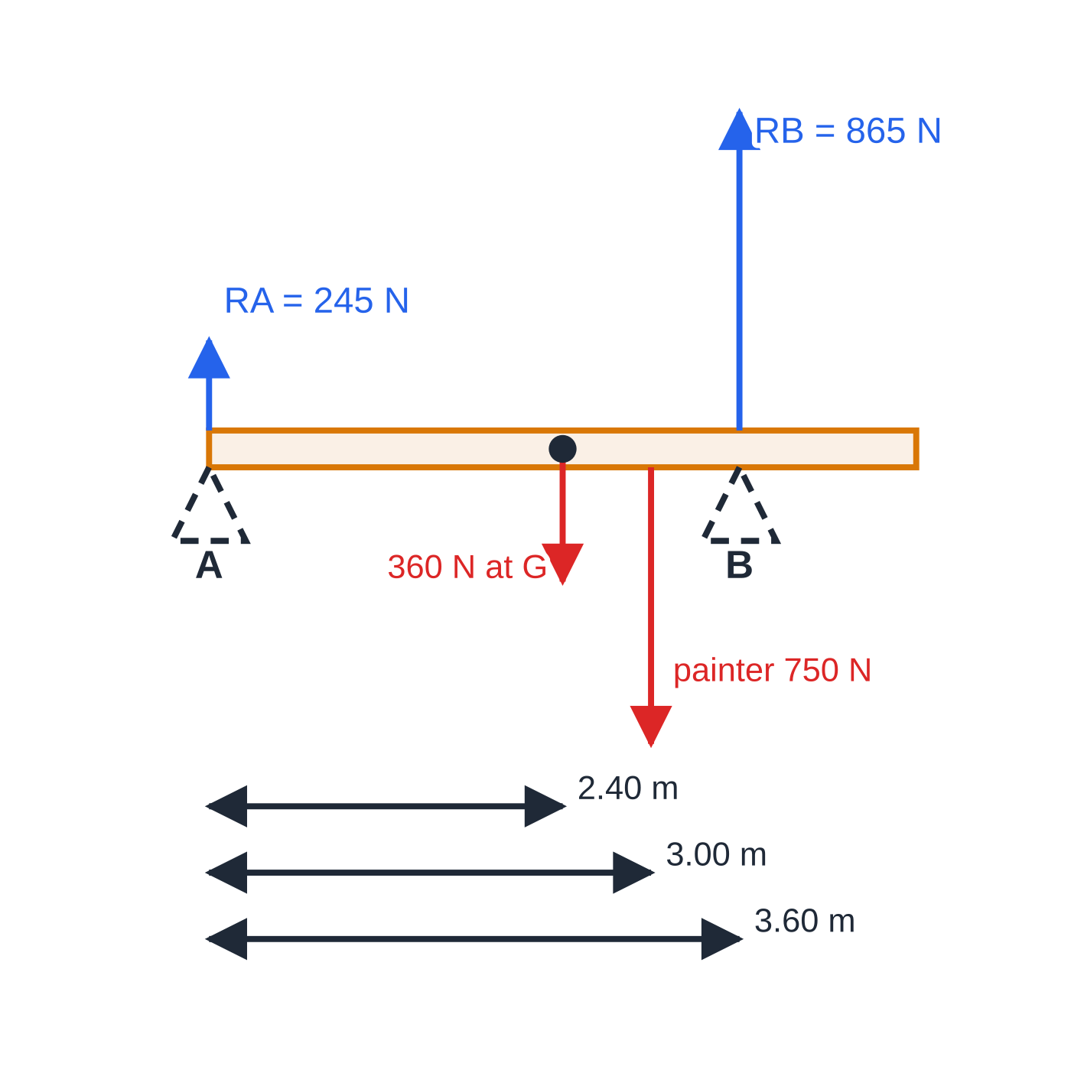
How do you find the support forces on a beam?
Section 5 of 14
With two supports there are two unknown forces. Take moments about one support: its force has no moment there, so the equation has one unknown. Then use up = down for the other support force — or take moments about the second support as an independent check. The support nearer to a heavy load carries the larger force.
Free-body diagram for worked example 4, forces and distances to scale. The weight of the uniform plank acts at its midpoint G, 2.40 m from A; the trestle nearer the painter carries most of the load.
Notes:
How do you find the support forces on a beam?. Full notes: https://examinerprep.com/notes/edexcel-ial-physics/moments-and-centre-of-gravity/

Slide 17
How do you find the support forces on a beam? (continued)
Section 5 of 14 · Worked example 4 · Hard · Determine
WORKED EXAMPLE · QUESTION
A uniform plank of length 4.80 m and weight 360 N rests on two trestles: A at one end and B 3.60 m from A, so 1.20 m of the plank overhangs beyond B. A painter of weight 750 N stands 3.00 m from A. (a) Calculate the forces on the plank from the trestles A and B. (b) The painter walks towards the overhanging end. Determine how far beyond B he can stand before the plank starts to tip.
SOLUTION
(a) Moments about A to remove R_A: anticlockwise R_B ×3.60 = clockwise 360 ×2.40 + 750 ×3.00 = 864 + 2250. So R_B = 3114 ÷3.60 = 865 N. Up = down: R_A = 360 + 750 - 865 = 245 N
(b) On the point of tipping the plank lifts off A, so R_A = 0. Moments about B: 750 ×d = 360 ×(3.60 - 2.40), so d = 432 ÷750 = 0.58 m beyond B
He can reach about halfway along the 1.20 m overhang.
Notes:
How do you find the support forces on a beam?: Worked example 4. Full notes: https://examinerprep.com/notes/edexcel-ial-physics/moments-and-centre-of-gravity/

Slide 18
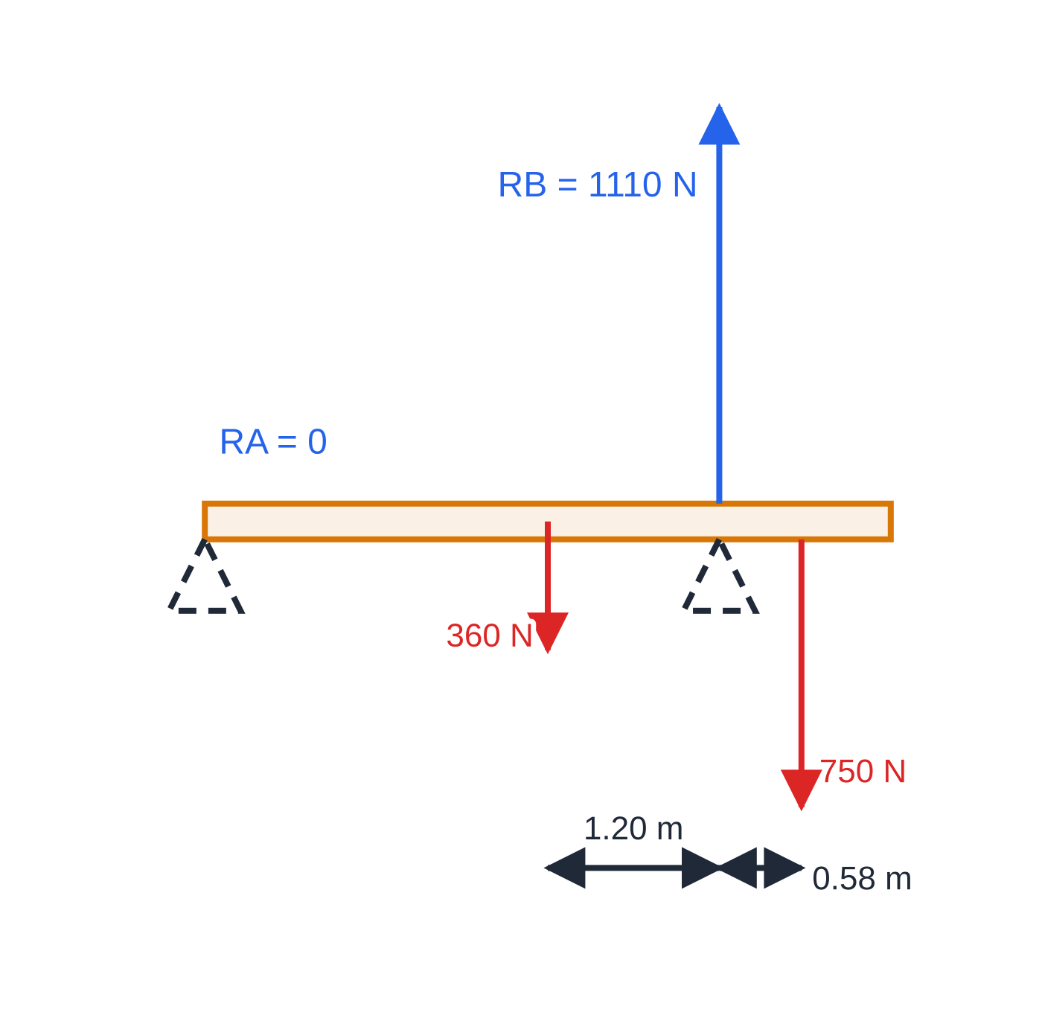
How do you find the support forces on a beam? (continued)
Section 5 of 14
Exam tip
"On the point of tipping" or "just about to lift off" means the force at the other support has fallen to zero. Write that down, then take moments about the support it tips over.
On the point of tipping: the plank is just lifting off A, so all the weight (1110 N) is carried by B, and the moments of the two weights about B balance.
Notes:
How do you find the support forces on a beam?. Full notes: https://examinerprep.com/notes/edexcel-ial-physics/moments-and-centre-of-gravity/

Slide 19
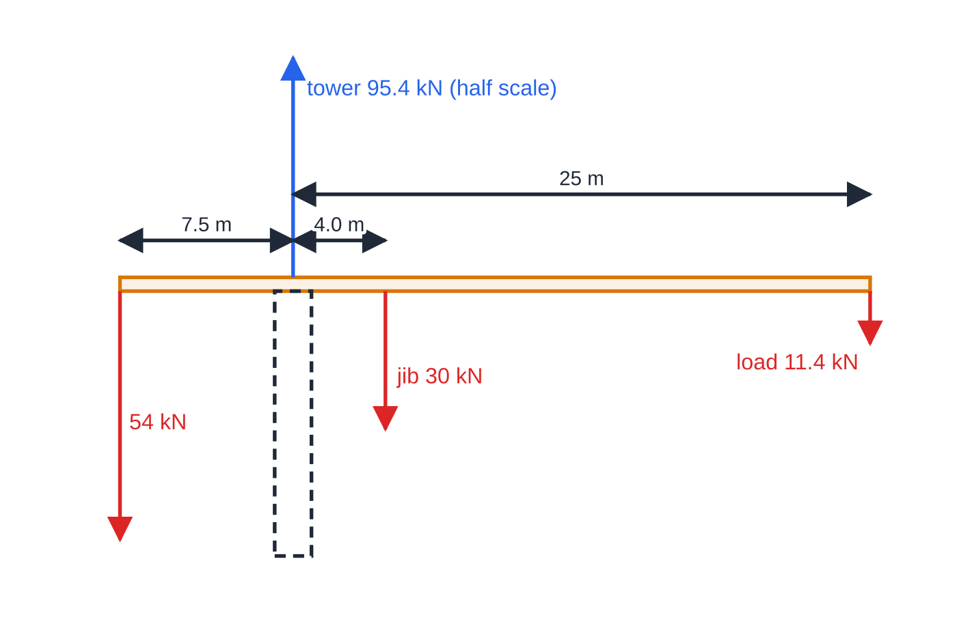
How do moments keep a crane balanced?
Section 6 of 14
A tower crane's long arm (the jib) carries the load, balanced by a heavy counterweight on a shorter arm on the other side of the tower, so the resultant moment about the tower is small. The further out the load, the smaller the load the crane can safely lift. The tower still has to support the total weight: moments cancel, but forces add.
Forces on the jib in worked example 5 (counterweight 54 kN on the left), with distances and downward forces to scale. The upward tower force is drawn at half the force scale so that it fits; the dashed tower is not part of the free body.
Notes:
How do moments keep a crane balanced?. Full notes: https://examinerprep.com/notes/edexcel-ial-physics/moments-and-centre-of-gravity/

Slide 20
How do moments keep a crane balanced? (continued)
Section 6 of 14 · Worked example 5 · Medium · Calculate
WORKED EXAMPLE · QUESTION
The jib of a tower crane has a counterweight of 54 kN acting 7.5 m from the axis of the tower. The weight of the jib is 30 kN, acting 4.0 m from the axis on the load side. The load hangs 25 m from the axis. Calculate (a) the load for which the resultant moment about the tower axis is zero and (b) the vertical force from the tower on the jib with this load.
SOLUTION
(a) Moments about the tower axis: anticlockwise 54 ×7.5 = 405 kN m; clockwise 30 ×4.0 + L ×25 = 120 + 25L. So L = (405 - 120) ÷25 = 11.4 kN
(b) Up = down: N = 54 + 30 + 11.4 = 95.4 kN
Without a load the resultant moment is 285 kN m anticlockwise — a crane is designed for a range of moments either way.
Notes:
How do moments keep a crane balanced?: Worked example 5. Full notes: https://examinerprep.com/notes/edexcel-ial-physics/moments-and-centre-of-gravity/

Slide 21
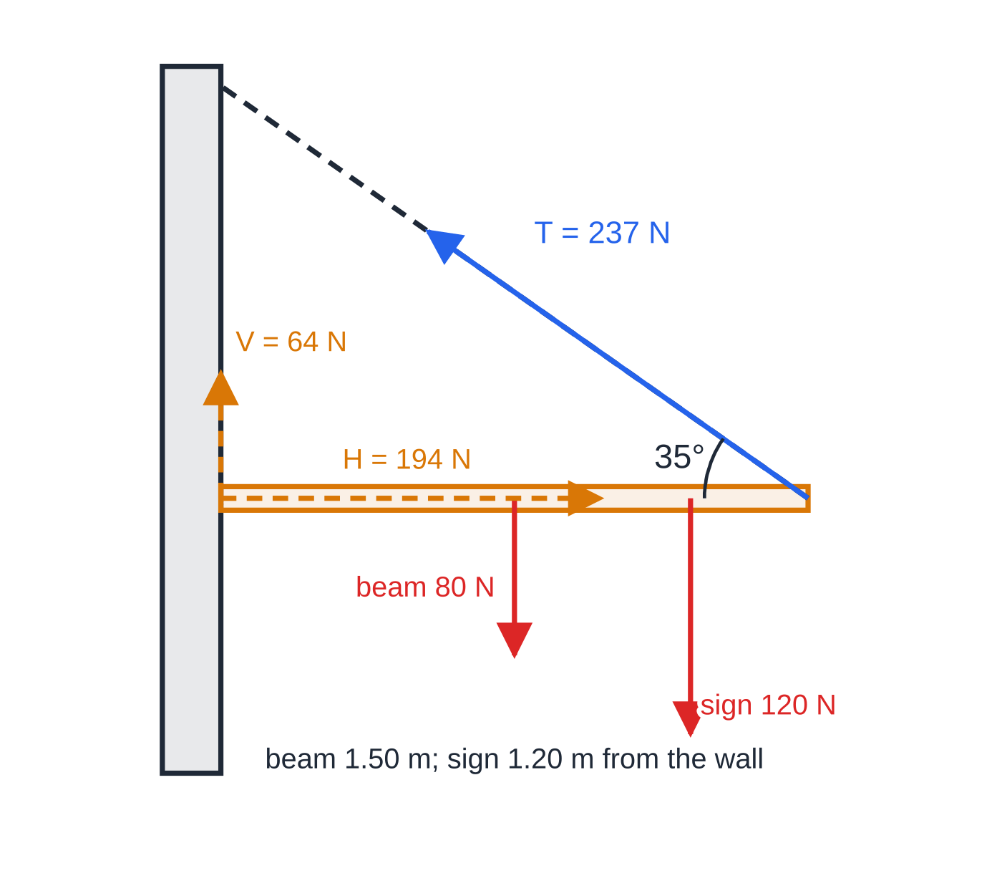
How do you solve a beam held by a cable at an angle?
Section 7 of 14
A beam hinged to a wall and held by a cable (signs, shelves, drawbridges) has three unknowns: the tension and two components of the hinge force.
Take moments about the hinge first. The hinge force has no moment there, so the tension is the only unknown.
The moment of the tension uses its component perpendicular to the beam, Tsin θ, where θ is the angle between the cable and the beam.
Then resolve: horizontal forces balance (the hinge pushes outwards against Tcos θ), and vertical forces balance.
Free-body diagram for worked example 6, forces and distances to scale. The amber dashed arrows are the components of the hinge force: the wall pushes the beam outwards and slightly upwards. The dashed line shows where the cable runs.
Notes:
How do you solve a beam held by a cable at an angle?. Full notes: https://examinerprep.com/notes/edexcel-ial-physics/moments-and-centre-of-gravity/

Slide 22
How do you solve a beam held by a cable at an angle? (continued)
Section 7 of 14 · Worked example 6 · Hard · Determine
WORKED EXAMPLE · QUESTION
A uniform horizontal beam of length 1.50 m and weight 80 N is hinged to a wall at one end. A sign of weight 120 N hangs from the beam 1.20 m from the wall. A cable from the far end of the beam to a point higher up the wall makes an angle of 35° with the beam. (a) Calculate the tension in the cable. (b) Determine the magnitude and direction of the force from the hinge on the beam.
SOLUTION
(a) Moments about the hinge: Tsin 35° ×1.50 = 80 ×0.75 + 120 ×1.20 = 204 N m. So T = 204/(1.50 ×sin 35°) = 237 N
(b) Horizontal forces balance: H = Tcos 35° = 237.1 ×cos 35° = 194 N, away from the wall. Vertical forces balance: V = 80 + 120 - Tsin 35° = 200 - 136 = 64 N, upwards. Combine: R = √(194² + 64²) = 205 N at tan⁻¹(64 ÷194) = 18°. 205 N at 18° above the horizontal
Notes:
How do you solve a beam held by a cable at an angle?: Worked example 6. Full notes: https://examinerprep.com/notes/edexcel-ial-physics/moments-and-centre-of-gravity/

Slide 23
How do you solve a beam held by a cable at an angle? (continued)
Section 7 of 14
Common error
Multiplying the whole tension by the length of the beam. The cable is not at 90° to the beam, so either use the perpendicular component Tsin θ, or multiply T by the perpendicular distance from the hinge to the cable, Lsin θ. Both give the same moment.
Notes:
How do you solve a beam held by a cable at an angle?. Full notes: https://examinerprep.com/notes/edexcel-ial-physics/moments-and-centre-of-gravity/

Slide 24
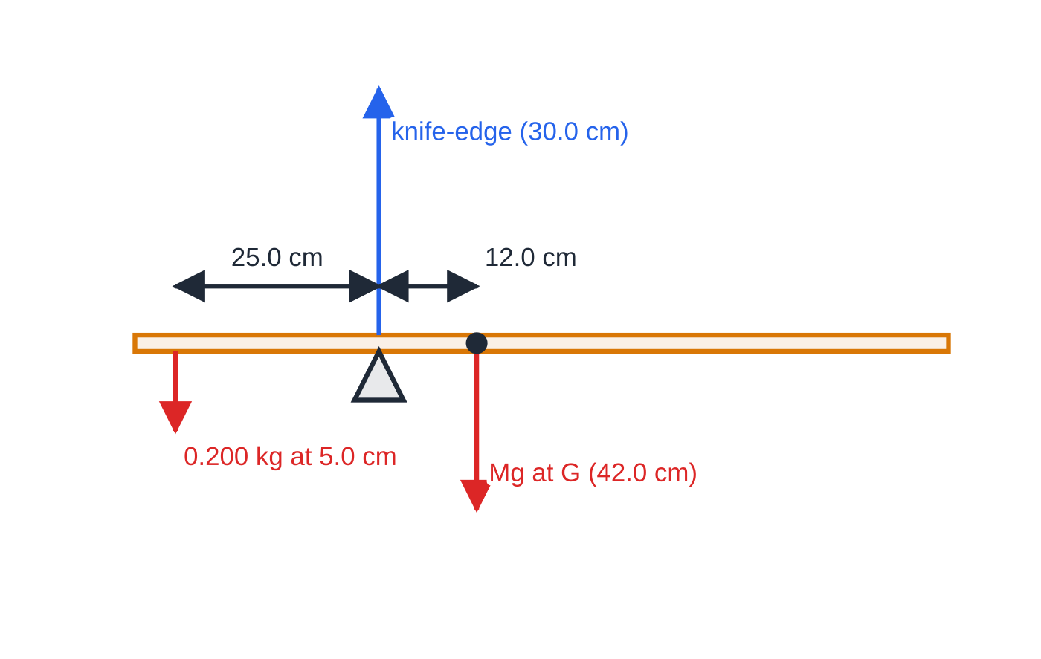
How do you find a centre of gravity by experiment?
Section 8 of 14
A rod or beam — balancing
Balance the rod on a knife-edge (or a narrow pencil) and move it until it stays horizontal. The centre of gravity is directly above the knife-edge, because the only force with a moment about that point would be the weight. Repeat a few times, approaching the balance point from both sides, and take the mean position. Hanging a known mass from the rod and balancing again gives the rod's mass by moments.
The rod of worked example 7 balanced with a 200 g mass hung near one end. The rod's own weight acts at its centre of gravity, found earlier at the 42.0 cm mark.
Notes:
How do you find a centre of gravity by experiment?. Full notes: https://examinerprep.com/notes/edexcel-ial-physics/moments-and-centre-of-gravity/

Slide 25
How do you find a centre of gravity by experiment? (continued)
Section 8 of 14 · Worked example 7 · Medium · Determine
WORKED EXAMPLE · QUESTION
A non-uniform rod balances on its own on a knife-edge at the 42.0 cm mark of its scale. A 200 g mass is hung at the 5.0 cm mark, and the rod now balances with the knife-edge at the 30.0 cm mark. Determine the mass of the rod.
SOLUTION
Step 1 The rod's weight acts at its centre of gravity, the 42.0 cm mark. Distances from the new pivot: hung mass 30.0 - 5.0 = 25.0 cm; centre of gravity 42.0 - 30.0 = 12.0 cm.
Step 2 Principle of moments (g cancels on both sides): Mg ×0.120 = 0.200g ×0.250, so M = 0.0500 ÷0.120 = 0.417 kg
Each distance is the difference of two readings, so its uncertainty is the sum of two reading uncertainties — keep both distances large.
Notes:
How do you find a centre of gravity by experiment?: Worked example 7. Full notes: https://examinerprep.com/notes/edexcel-ial-physics/moments-and-centre-of-gravity/

Slide 26
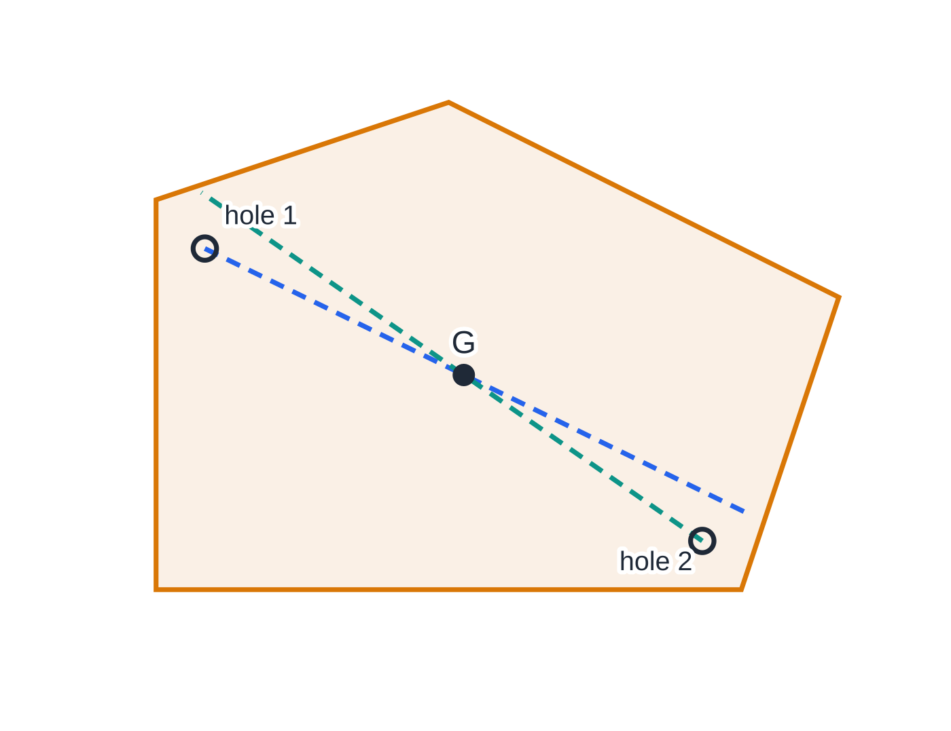
How do you find a centre of gravity by experiment? (continued)
Section 8 of 14
A flat sheet (lamina) — suspension
1. Make two or three small holes near the edge of the card, well apart.
2. Hang the card from a pin through one hole so that it can swing freely. Hang a plumb line (a thread with a small weight) from the same pin.
3. When the card is at rest, mark the plumb line on the card with two well-separated dots, then join them with a ruler.
4. Repeat from a second hole. The centre of gravity is where the lines cross. A line from a third hole should pass through the same point — a useful check.
Plumb lines marked from two holes, shown with the card laid flat. When the card hangs at rest the weight has no moment about the pin, so G lies on the vertical line through the pin; two such lines fix G (here the centroid of the outline, computed).
Notes:
How do you find a centre of gravity by experiment?. Full notes: https://examinerprep.com/notes/edexcel-ial-physics/moments-and-centre-of-gravity/

Slide 27
How do you find a centre of gravity by experiment? (continued)
Section 8 of 14
Exam tip
When asked to explain why the method works, link it to moments: at rest the resultant moment about the pin is zero, so the line of action of the weight must pass through the pin — that is, G is vertically below it.
Notes:
How do you find a centre of gravity by experiment?. Full notes: https://examinerprep.com/notes/edexcel-ial-physics/moments-and-centre-of-gravity/

Slide 28
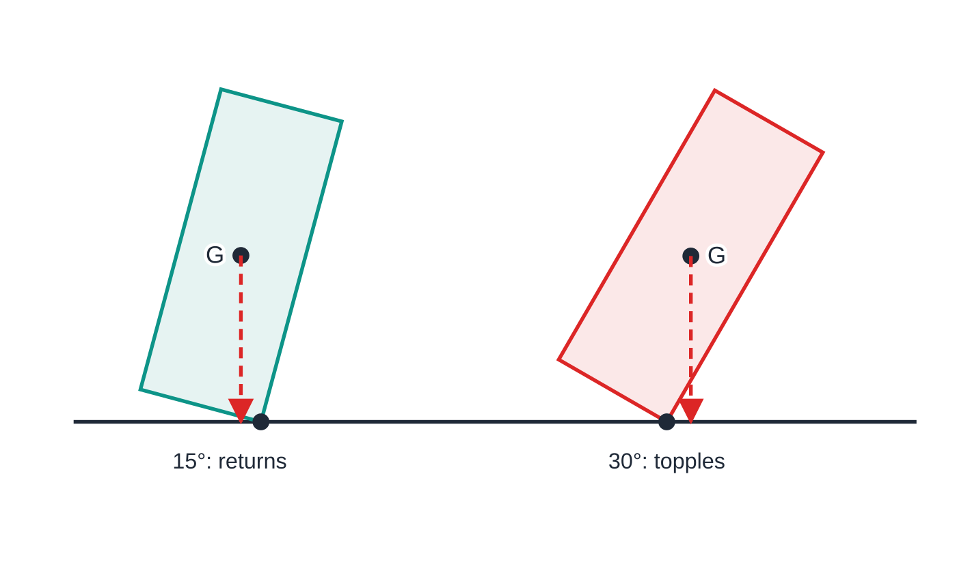
Why do objects topple?
Section 9 of 14
When an object is tilted, it pivots about one edge of its base. Its weight, acting at G, now has a moment about that edge. If the vertical line through G still falls inside the base, the moment of the weight turns the object back: it is stable. If the vertical line through G falls outside the base, the moment turns it further over: it topples.
An object is more stable — it can be tilted further before toppling — when its centre of gravity is low and its base is wide.
The same block, 0.40 m wide and 1.00 m tall, tilted about its corner (dot). At 15° the weight's line of action falls inside the base and turns the block back; at 30° it falls outside the corner and turns it over. The changeover is at tan⁻¹(0.20/0.50) = 21.8°.
Notes:
Why do objects topple?. Full notes: https://examinerprep.com/notes/edexcel-ial-physics/moments-and-centre-of-gravity/

Slide 29
Why do objects topple? (continued)
Section 9 of 14
Racing cars are low and wide; a lorry with a high load is easier to tip; a desk lamp has a heavy, wide base.
Common error
Saying an object topples "because its weight is too big". A heavier object with the same shape topples at exactly the same angle: what matters is where the line of action of the weight falls compared with the edge of the base.
Notes:
Why do objects topple?. Full notes: https://examinerprep.com/notes/edexcel-ial-physics/moments-and-centre-of-gravity/

Slide 30
Exam tips for 1.4
Section 10 of 14
Exam tip 1 — choose the pivot to remove an unknown
You may take moments about any point. Pick the point where the force you do not know (and do not want yet) acts. It then has zero moment and disappears from the equation.
Exam tip 2 — the word "perpendicular" matters
When defining a moment, write "force × perpendicular distance from the pivot to the line of action of the force". "Force × distance" on its own is incomplete.
Exam tip 3 — label every moment
Write each term as force × distance with "clockwise" or "anticlockwise" beside it before you add anything up. A visible substitution keeps later credit available even after an arithmetic slip.
Notes:
Exam tips for 1.4. Full notes: https://examinerprep.com/notes/edexcel-ial-physics/moments-and-centre-of-gravity/

Slide 31
Exam tips for 1.4 (continued)
Section 10 of 14
Exam tip 4 — two conditions, two kinds of equation
Moments give one equation; resolving vertically and horizontally gives more. In a "determine the force at the hinge" question you will usually need all three.
Exam tip 5 — read the description of the beam
"Light" means ignore its weight. "Uniform" means its weight acts at the midpoint. If neither word is used and a weight is given, you need to be told — or work out — where it acts.
Notes:
Exam tips for 1.4. Full notes: https://examinerprep.com/notes/edexcel-ial-physics/moments-and-centre-of-gravity/

Slide 32
Common misconceptions
Section 11 of 14
Misconception | Why it is wrong | Correct idea
Moment = force × distance from the pivot to where the force is applied. | Only the distance at right angles to the line of action matters. | Use the perpendicular distance, or the perpendicular component of the force.
If the moments balance, the body is in equilibrium. | A resultant force could still accelerate it. | Equilibrium needs zero resultant moment and zero resultant force.
The two supports of a beam always share the load equally. | Each support force depends on how far the loads are from it. | The support nearer a load carries more of it; find the forces by moments.
The pivot force on a balanced see-saw is zero. | Balanced moments say nothing about the vertical forces. | The pivot pushes up with the total weight it supports.
The centre of gravity is always at the centre of the object. | That is only true for uniform, symmetrical bodies. | For non-uniform bodies G is nearer the heavier part and may lie outside the material.
Notes:
Common misconceptions. Full notes: https://examinerprep.com/notes/edexcel-ial-physics/moments-and-centre-of-gravity/

Slide 33
Common misconceptions (continued)
Section 11 of 14
Misconception | Why it is wrong | Correct idea
A heavier object is harder to topple. | Toppling depends on where the weight acts, not on its size. | A low G and a wide base make an object more stable.
Notes:
Common misconceptions. Full notes: https://examinerprep.com/notes/edexcel-ial-physics/moments-and-centre-of-gravity/

Slide 34
How this topic connects
Section 12 of 14
2 Forces and Newton's laws
The "zero resultant force" half of equilibrium is Newton's first law; resolving forces into perpendicular components is the same skill used for slopes and for vectors.
Materials (Unit 1) and practical skills (Unit 3)
Moments give the tension in a wire or the force on a spring that supports a beam; from that force you can find the extension using Hooke's law or the Young modulus. Balancing experiments are also good practice in handling uncertainty.
Magnetic fields (Unit 4)
The forces on the two sides of a current-carrying coil in a magnetic field are equal and opposite but act along different lines, so together they produce a turning effect — the basis of an electric motor.
Notes:
How this topic connects. Full notes: https://examinerprep.com/notes/edexcel-ial-physics/moments-and-centre-of-gravity/

Slide 35
Key equations
Section 13 of 14
Equation | Use | In the formulae list?
moment = Fx | turning effect of a force; x perpendicular to the line of action | Yes
moment = Frsin θ | force at angle θ to a lever of length r | No — derive it from Fx with x = rsin θ
Σ clockwise moments = Σ anticlockwise moments | principle of moments, body in equilibrium | No — learn it
ΣF = 0 (up = down, left = right) | second condition for equilibrium | No — learn it
W = mg | weight acting at the centre of gravity | Yes
Notes:
Key equations. Full notes: https://examinerprep.com/notes/edexcel-ial-physics/moments-and-centre-of-gravity/

Slide 36
Check your understanding
Section 14 of 14
1. A force of 25 N, at 90° to a door, is applied 0.80 m from the hinges. Calculate its moment about the hinges. What force at 0.20 m from the hinges would have the same moment?
2. A 60 N force acts on the end of a 0.50 m lever at 30° to the lever. Calculate its moment about the pivot.
3. State the two conditions for an extended body to be in equilibrium.
4. A uniform pole 2.0 m long, weight 40 N, rests on supports at its two ends. A 100 N load hangs 0.50 m from the left end. Find the two support forces.
5. Explain why a racing car is built with a low centre of gravity and a wide wheelbase.
Notes:
Check your understanding: questions. Full notes: https://examinerprep.com/notes/edexcel-ial-physics/moments-and-centre-of-gravity/

Slide 37
Check your understanding · answers
Section 14 of 14
1. 25 ×0.80 = 20 N m. Same moment at 0.20 m: 20 ÷0.20 = 100 N — four times the force at a quarter of the distance.
2. Perpendicular distance = 0.50sin 30° = 0.25 m; moment = 60 ×0.25 = 15 N m.
3. The resultant force on it is zero, and the resultant moment about any point is zero (sum of clockwise moments = sum of anticlockwise moments).
4. Moments about the right end: R_L ×2.0 = 40 ×1.0 + 100 ×1.50, so R_L = 95 N. Up = down: R_R = 140 - 95 = 45 N.
5. When the car tilts, it pivots about the outer wheels. A low G and a wide base mean the car must tilt much further before the vertical line through G passes outside the wheels, so the moment of the weight keeps turning it back for longer: it is harder to tip over.
Notes:
Check your understanding: answers. Full notes: https://examinerprep.com/notes/edexcel-ial-physics/moments-and-centre-of-gravity/

Slide 38
Practice questions
5 original exam-style questions. Answers at the end of the deck.

Slide 39
Question 1
1 mark
Which statement describes the centre of gravity of a body?
A the point about which the body always rotates
B the point halfway between the top and the bottom of the body
C the point where the body touches the ground
D the point at which the whole weight of the body can be taken to act
Notes:
Online with the full mark scheme: https://examinerprep.com/ial-physics-1-4-moments-and-centre-of-gravity-questions#IALP-U1-4-A-04

Slide 40
Question 2
1 mark
A double-decker bus is tilted sideways on a test platform. Which change would allow the bus to be tilted to a larger angle before it topples?
A lowering the centre of gravity and increasing the distance between the wheels
B carrying heavy luggage on the upper deck
C raising the centre of gravity and keeping the wheels in the same place
D increasing the mass of the bus without changing the position of its centre of gravity
Notes:
Online with the full mark scheme: https://examinerprep.com/ial-physics-1-4-moments-and-centre-of-gravity-questions#IALP-U1-4-A-08

Slide 41
Question 3
1 mark
A student finds the centre of gravity of an irregular sheet of card. She hangs the card from a pin through a small hole and marks the line of a plumb line hung from the same pin.
Why does the centre of gravity lie on this line?
A the plumb line pulls the centre of gravity towards it
B the weight of the card acts at the hole
C the card is uniform, so the centre of gravity is at its middle
D when the card is at rest, its weight has no moment about the pin
Notes:
Online with the full mark scheme: https://examinerprep.com/ial-physics-1-4-moments-and-centre-of-gravity-questions#IALP-U1-4-A-09

Slide 42
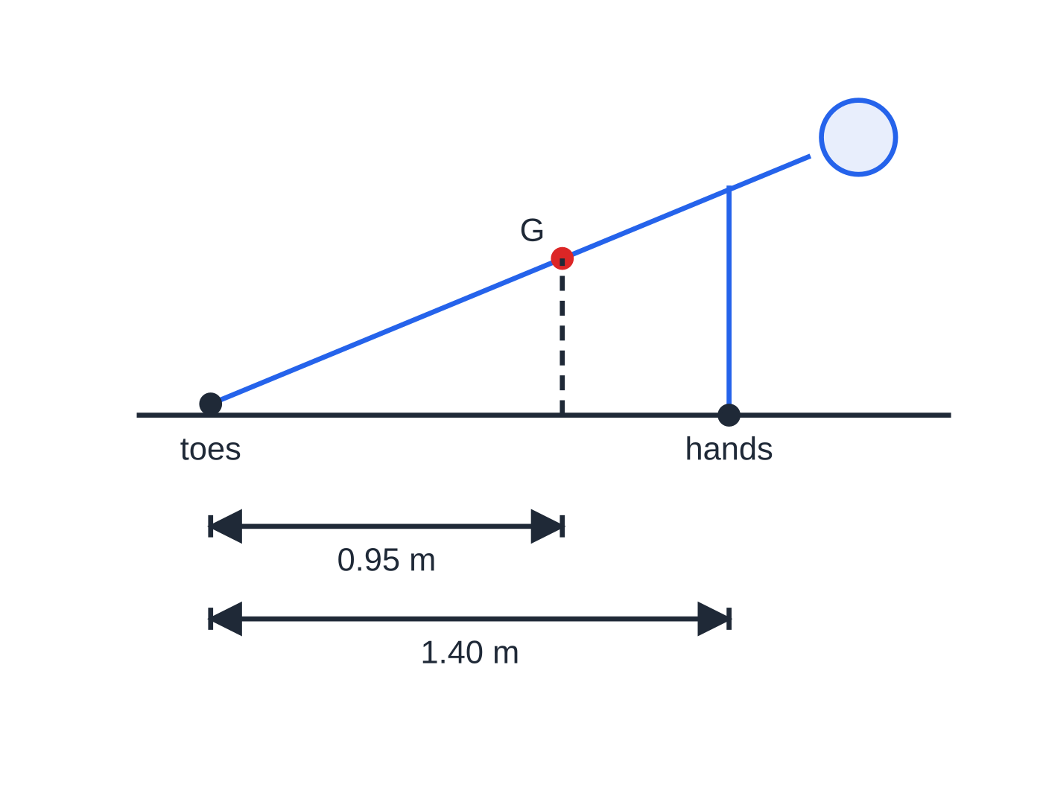
Question 4
5 marks
A person holds a push-up position with a straight, rigid body. Her weight is 680 N, and her centre of gravity is 0.95 m horizontally from her toes. Her hands are 1.40 m horizontally from her toes. Treat all the forces as vertical.
Figure: the push-up position; G is her centre of gravity (not to scale)
(a) State the forces acting on her body, giving the direction of each and where it acts. [2]
(b) Calculate the force from the floor on her hands. [2]
(c) Calculate the force from the floor on her toes. [1]
Notes:
Online with the full mark scheme: https://examinerprep.com/ial-physics-1-4-moments-and-centre-of-gravity-questions#IALP-U1-4-B-02

Slide 43
Question 5
6 marks
A student has cut a flat, irregular shape from a sheet of thin plywood. She wants to find its centre of gravity by experiment. She has a clamp and stand, a pin, thread, a small mass and a pencil.
(a) Describe how she should find the centre of gravity of the shape. [4]
(b) Explain why the centre of gravity lies on each line she draws. [1]
(c) Suggest how she could check her result. [1]
Notes:
Online with the full mark scheme: https://examinerprep.com/ial-physics-1-4-moments-and-centre-of-gravity-questions#IALP-U1-4-B-04

Slide 44
Answers

Slide 45
Question 1 · answer
Answer D
The centre of gravity is the single point at which the whole weight can be considered to act. It is at the geometric centre only for a uniform, symmetrical body.
Notes:
Full mark scheme: https://examinerprep.com/ial-physics-1-4-moments-and-centre-of-gravity-questions#IALP-U1-4-A-04

Slide 46
Question 2 · answer
Answer A
The bus topples when the vertical line through its centre of gravity passes outside the wheels on the lower side. A lower centre of gravity and a wider base mean it must tilt further before that happens.
Notes:
Full mark scheme: https://examinerprep.com/ial-physics-1-4-moments-and-centre-of-gravity-questions#IALP-U1-4-A-08

Slide 47
Question 3 · answer
Answer D
At rest the resultant moment about the pin is zero, so the line of action of the weight passes through the pin: the centre of gravity is vertically below it, on the plumb line.
Notes:
Full mark scheme: https://examinerprep.com/ial-physics-1-4-moments-and-centre-of-gravity-questions#IALP-U1-4-A-09

Slide 48
Question 4 · answer
Mark scheme
weight, 680 N downwards, acting at her centre of gravity
upward contact forces from the floor at her hands and at her toes
moments about the toes: F × 1.40 = 680 × 0.95
F = 461 N
680 − 461 = 219 N (allow error carried forward)
Notes:
Full mark scheme: https://examinerprep.com/ial-physics-1-4-moments-and-centre-of-gravity-questions#IALP-U1-4-B-02

Slide 49
Question 5 · answer
Mark scheme
make a small hole near the edge and hang the shape from the pin so that it can swing freely
hang a plumb line (thread with the mass) from the pin and, when everything is at rest, mark the line of the thread on the shape
repeat with a second hole well away from the first
the centre of gravity is where the two lines cross
at rest the resultant moment about the pin is zero, so the line of action of the weight passes through the pin / G is vertically below the pin
hang the shape from a third hole: the new line should pass through the same point / balance the shape on a point placed under G
Notes:
Full mark scheme: https://examinerprep.com/ial-physics-1-4-moments-and-centre-of-gravity-questions#IALP-U1-4-B-04

Slide 50
Keep practising
Notes for this topic
Questions on this topic
Build a printable test
ExaminerPrep is an independent tutoring service. It has been developed independently from and is not endorsed by the International Baccalaureate Organization. "International Baccalaureate", "IB" and "IB Diploma Programme" are registered trademarks of the IBO, used here for descriptive purposes only.
Pearson Edexcel and Cambridge are trademarks of their owners; ExaminerPrep is not affiliated with any exam board.

