Slide 1
EP
EDEXCEL IAL PHYSICS
1.3 Momentum
The full notes page in 12 sections · practice questions with answers · simulations
ExaminerPrep is an independent tutoring service. It has been developed independently from and is not endorsed by the International Baccalaureate Organization. "International Baccalaureate", "IB" and "IB Diploma Programme" are registered trademarks of the IBO, used here for descriptive purposes only.
Pearson Edexcel and Cambridge are trademarks of their owners; ExaminerPrep is not affiliated with any exam board.
Notes:
1.3 Momentum. Notes for this topic: https://examinerprep.com/notes/edexcel-ial-physics/momentum/

Slide 2
What this page covers
Overview
Momentum p = mv: a vector quantity, its unit and its sign in one dimension
Change of momentum, including a body that rebounds
The principle of conservation of linear momentum and the condition for it to apply
How Newton's second and third laws lead to conservation of momentum
Collisions in one dimension where bodies join together or move apart
Explosions and recoil from rest, and separation of bodies that are already moving
Testing conservation of momentum with gliders, light gates and a data logger
Notes:
What this page covers. Full notes: https://examinerprep.com/notes/edexcel-ial-physics/momentum/

Slide 3
In one minute
Key points
1. Momentum is mass × velocity, p = mv, and the total momentum of a system stays constant if no resultant external force acts on it — one rule that solves every one-dimensional collision, explosion and recoil problem.
2. Momentum is a vector; its unit is kg m s⁻¹ (the same as N s).
3. In one dimension, choose a positive direction: momentum in the other direction is negative.
4. Newton's third law: two bodies push each other with equal and opposite forces for the same time, so their momentum changes are equal and opposite.
5. Collision method: positive direction → total momentum before → total momentum after → equate → interpret the sign.
6. Explosion from rest: total momentum is zero before, so the fragments have equal and opposite momenta after.
Notes:
In one minute. Full notes: https://examinerprep.com/notes/edexcel-ial-physics/momentum/

Slide 4
What is momentum?
Section 1 of 12
A lorry and a bicycle moving at the same speed are not equally hard to stop, and neither are a bullet and a thrown pebble of the same mass. Momentum is the quantity that combines both ingredients — how much mass is moving and how fast — into one number with a direction.
Momentum:
the product of a body's mass and its velocity.
p = mv
p = momentum (kg m s⁻¹) · m = mass (kg) · v = velocity (m s⁻¹). Supplied in the formulae list. Momentum has the same direction as the velocity, because mass is a positive scalar.
Vector: momentum has magnitude and direction. In one dimension, the direction is carried by a sign once you have chosen which way is positive.
Notes:
What is momentum?. Full notes: https://examinerprep.com/notes/edexcel-ial-physics/momentum/

Slide 5
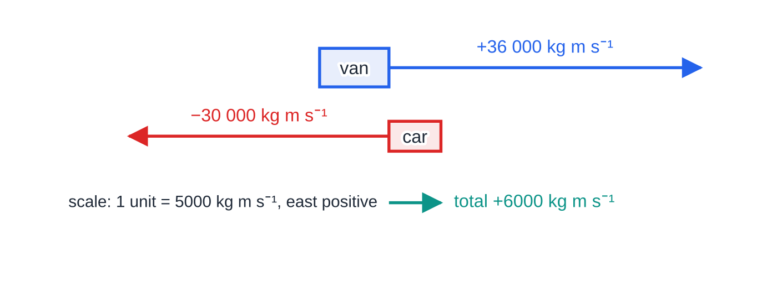
What is momentum? (continued)
Section 1 of 12
Unit: kg m s⁻¹. This is the same as N s, because 1 N = 1 kg m s⁻².
A slow, massive body can have more momentum than a fast, light one — it is the product that matters.
Momentum arrows drawn to scale, taking east as positive. The van's momentum is larger than the car's, so the total is 6000 kg m s⁻¹ east.
Notes:
What is momentum?. Full notes: https://examinerprep.com/notes/edexcel-ial-physics/momentum/

Slide 6
What is momentum? (continued)
Section 1 of 12 · Worked example 1 · Easy · Calculate
WORKED EXAMPLE · QUESTION
A delivery van of mass 2400 kg travels east at 15 m s⁻¹. A car of mass 1200 kg travels west at 25 m s⁻¹ on the other side of the road. Calculate the momentum of each vehicle and the total momentum of the two vehicles.
SOLUTION
Step 1 Choose east as positive, so the car's velocity is −25 m s⁻¹. Van: 2400 ×15 = +36 000 kg m s⁻¹; car: 1200 ×(-25) = -30 000 kg m s⁻¹.
Step 2 Add the momenta, keeping their signs: 36 000 + (-30 000) = +6000 kg m s⁻¹, i.e. 6000 kg m s⁻¹ east
Adding the magnitudes (66 000 kg m s⁻¹) ignores the directions and is wrong.
Notes:
What is momentum?: Worked example 1. Full notes: https://examinerprep.com/notes/edexcel-ial-physics/momentum/

Slide 7
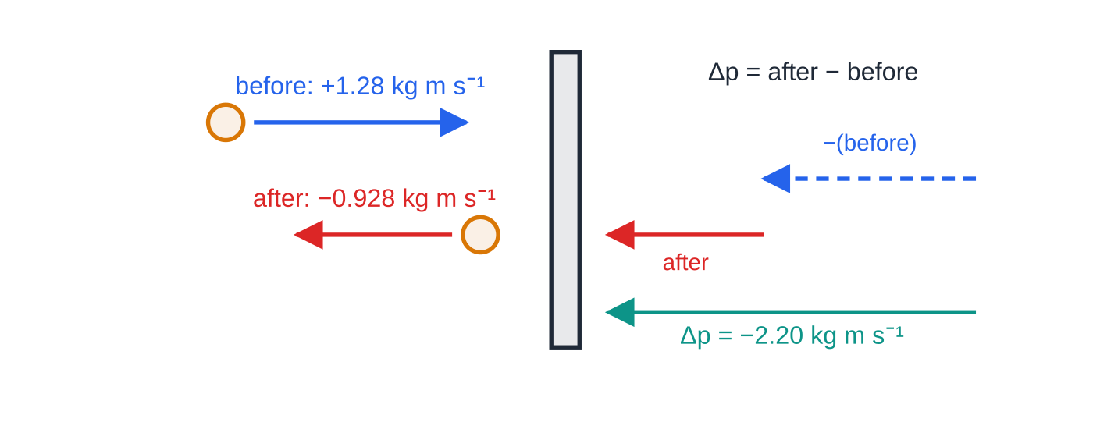
How do you find a change in momentum?
Section 2 of 12
Change in momentum is final momentum minus initial momentum:
Δp = mv - mu
Because momentum is a vector, a body that reverses direction has a change in momentum larger than either momentum on its own: it must first lose all its momentum and then gain momentum the other way. Always substitute the velocities with their signs.
A tennis ball rebounding from a wall (towards the wall positive). Subtracting the initial momentum means adding an arrow pointing the other way, so the change in momentum (2.20 kg m s⁻¹ away from the wall) is bigger than either momentum alone.
Notes:
How do you find a change in momentum?. Full notes: https://examinerprep.com/notes/edexcel-ial-physics/momentum/

Slide 8
How do you find a change in momentum? (continued)
Section 2 of 12 · Worked example 2 · Medium · Calculate
WORKED EXAMPLE · QUESTION
A tennis ball of mass 0.058 kg travels horizontally at 22 m s⁻¹ towards a wall and rebounds along the same line at 16 m s⁻¹. Calculate the change in momentum of the ball.
SOLUTION
Step 1 Take towards the wall as positive: u = +22 m s⁻¹, v = -16 m s⁻¹. So mu = +1.28 kg m s⁻¹ and mv = -0.928 kg m s⁻¹.
Step 2 Final minus initial: Δp = -0.928 - 1.28 = -2.20 kg m s⁻¹, i.e. 2.2 kg m s⁻¹ away from the wall
Notes:
How do you find a change in momentum?: Worked example 2. Full notes: https://examinerprep.com/notes/edexcel-ial-physics/momentum/

Slide 9
How do you find a change in momentum? (continued)
Section 2 of 12
Common error
Subtracting the speeds: 0.058 ×(22 - 16) = 0.35 kg m s⁻¹. That treats the rebound as if the ball were still moving towards the wall. A reversal of direction means the two momenta have opposite signs, so their difference is large.
Notes:
How do you find a change in momentum?. Full notes: https://examinerprep.com/notes/edexcel-ial-physics/momentum/

Slide 10
What is the principle of conservation of linear momentum?
Section 3 of 12
The principle of conservation of linear momentum: the total momentum of a system of interacting bodies stays constant, provided no resultant external force acts on the system.
A system is the group of bodies you choose to consider, for example two colliding trolleys.
Internal forces — forces the bodies exert on each other — cannot change the total momentum.
External forces come from outside the system (friction from the ground, air resistance, a push from a hand). If they do not balance, the total momentum changes.
In many collisions the external forces are small compared with the large internal forces during the brief contact, so momentum is conserved to a good approximation.
For two bodies in one dimension the principle becomes
m₁u₁ + m₂u₂ = m₁v₁ + m₂v₂
Notes:
What is the principle of conservation of linear momentum?. Full notes: https://examinerprep.com/notes/edexcel-ial-physics/momentum/

Slide 11
What is the principle of conservation of linear momentum? (continued)
Section 3 of 12
Exam tip
When asked to state the principle, give both parts: total momentum is constant (or total before = total after) and the condition — no resultant external force. "Momentum is always conserved" on its own is incomplete.
Notes:
What is the principle of conservation of linear momentum?. Full notes: https://examinerprep.com/notes/edexcel-ial-physics/momentum/

Slide 12
How do Newton's laws lead to conservation of momentum?
Section 4 of 12
Conservation of momentum is not a separate law to memorise; it follows from Newton's laws in four steps.
1. Newton's second law can be written in terms of momentum: the resultant force on a body equals its rate of change of momentum, F = Δp/Δt. For constant mass, Δp/Δt = mΔv/Δt = ma.
2. Newton's third law: when body A pushes body B, B pushes A with a force of equal size in the opposite direction.
3. The two forces act for exactly the same time Δt — the time the bodies are in contact.
4. So Δp_B = FΔt and Δp_A = -FΔt: the changes in momentum are equal and opposite. Adding them gives zero — the total momentum does not change. Momentum is transferred from one body to the other, not created or destroyed.
Notes:
How do Newton's laws lead to conservation of momentum?. Full notes: https://examinerprep.com/notes/edexcel-ial-physics/momentum/

Slide 13
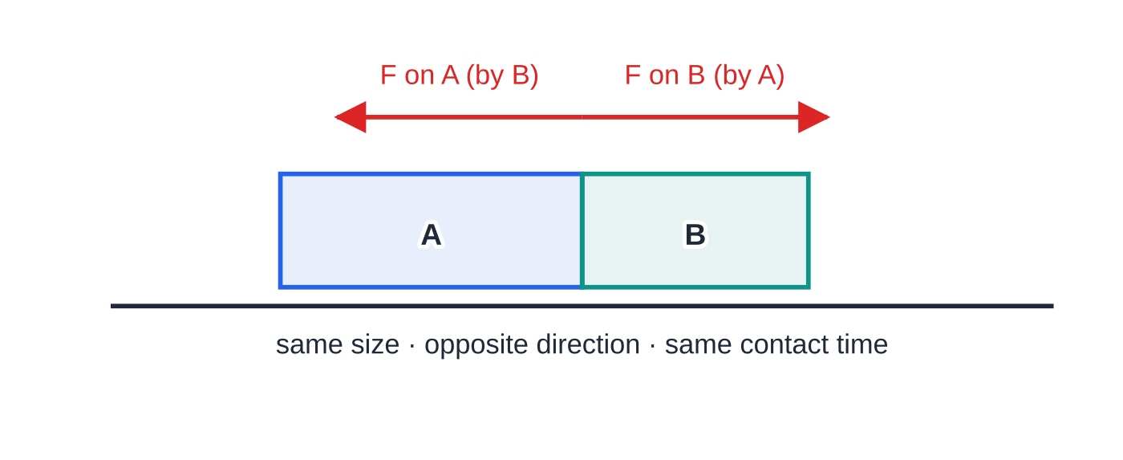
How do Newton's laws lead to conservation of momentum? (continued)
Section 4 of 12
During the contact each trolley pushes the other. The two forces are equal in size, opposite in direction and act for the same time, so the trolleys gain equal and opposite momentum.
Notes:
How do Newton's laws lead to conservation of momentum?. Full notes: https://examinerprep.com/notes/edexcel-ial-physics/momentum/

Slide 14
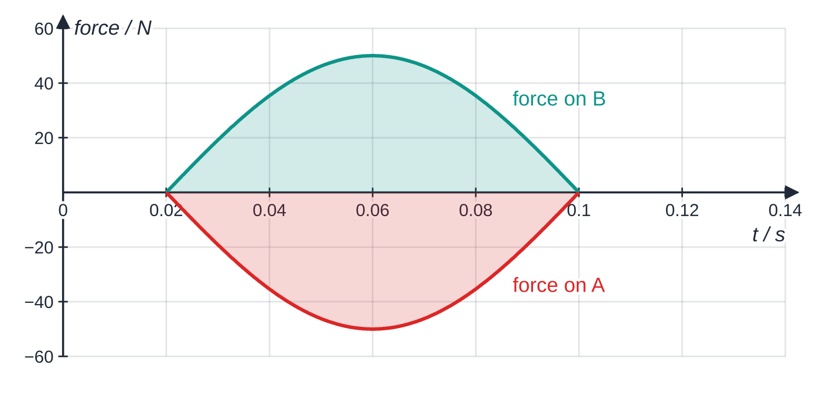
How do Newton's laws lead to conservation of momentum? (continued)
Section 4 of 12
A sketch of how the two forces vary during a contact lasting 0.08 s. At every instant they are equal and opposite, so the areas (force × time, the change in momentum) are equal in size and opposite in sign.
Notes:
How do Newton's laws lead to conservation of momentum?. Full notes: https://examinerprep.com/notes/edexcel-ial-physics/momentum/

Slide 15
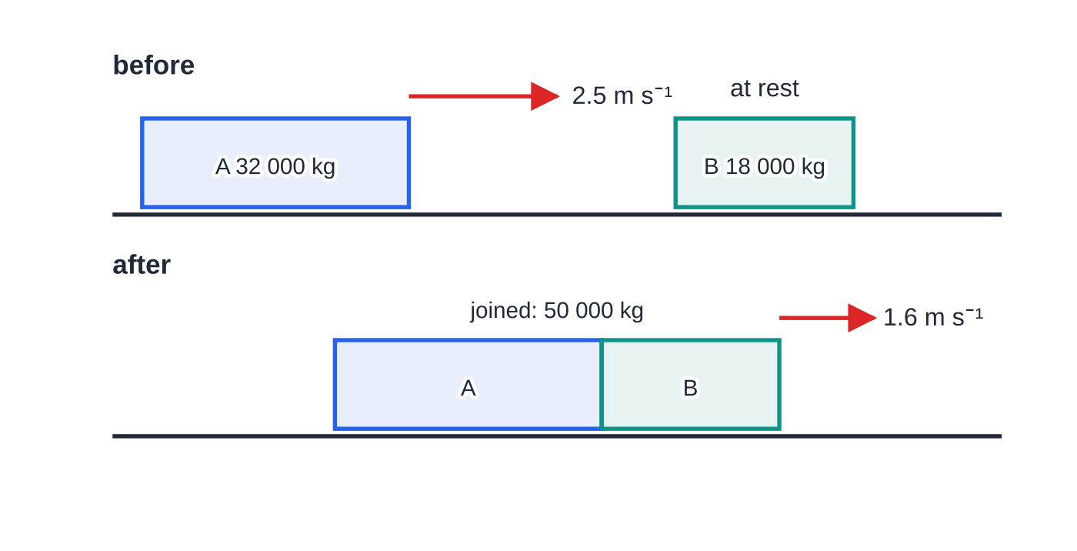
How do Newton's laws lead to conservation of momentum? (continued)
Section 4 of 12 · Worked example 3 · Medium · Show that
WORKED EXAMPLE · QUESTION
A railway wagon A of mass 32 000 kg rolls at 2.5 m s⁻¹ along a level track and hits a stationary wagon B of mass 18 000 kg. The wagons couple together. Friction is negligible. (a) Calculate the velocity of the wagons just after coupling. (b) Show that the change in momentum of A is equal and opposite to the change in momentum of B.
SOLUTION
(a) Total momentum before (direction of A positive): 32 000 ×2.5 + 18 000 ×0 = 80 000 kg m s⁻¹.
Before and after the wagons couple. Velocity arrows are to scale: the joined wagons move off more slowly because the same momentum is now shared by a larger mass.
Notes:
How do Newton's laws lead to conservation of momentum?: Worked example 3. Full notes: https://examinerprep.com/notes/edexcel-ial-physics/momentum/

Slide 16
How do Newton's laws lead to conservation of momentum? (continued)
Section 4 of 12 · Worked example 3 · Medium · Show that (continued)
After coupling the total mass is 50 000 kg: 80 000 = 50 000 v, so v = 1.6 m s⁻¹ in the original direction
(b) A: 32 000 ×(1.6 - 2.5) = -28 800 kg m s⁻¹. B: 18 000 ×(1.6 - 0) = +28 800 kg m s⁻¹. Equal size, opposite sign — exactly what Newton's third law predicts.
Notes:
How do Newton's laws lead to conservation of momentum?: Worked example 3. Full notes: https://examinerprep.com/notes/edexcel-ial-physics/momentum/

Slide 17
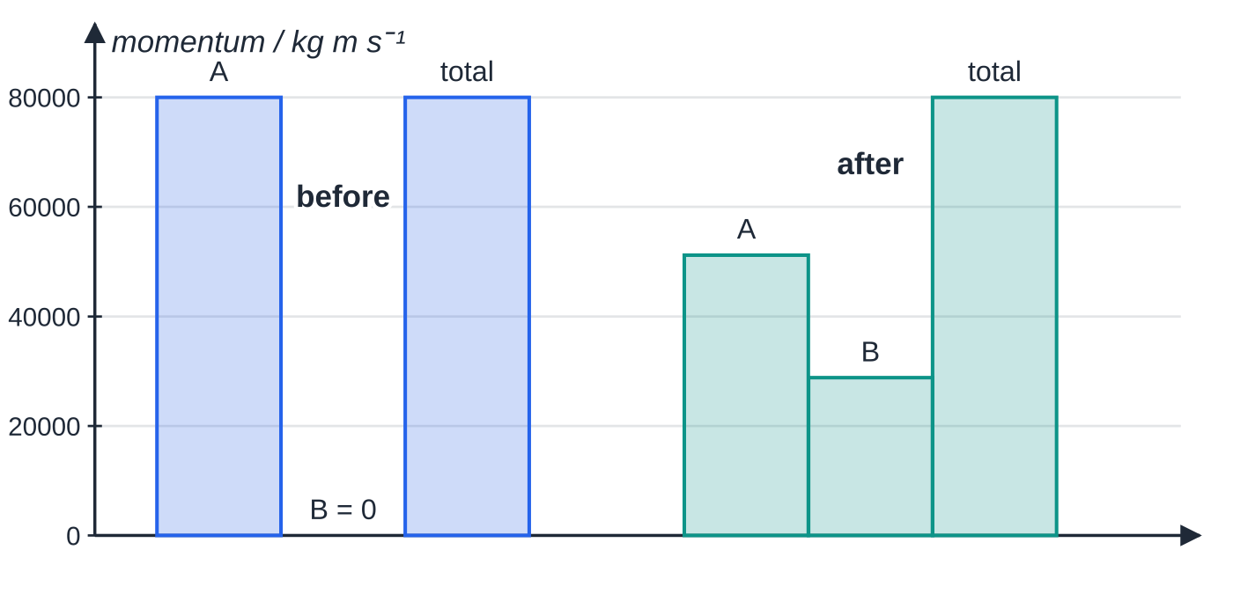
How do Newton's laws lead to conservation of momentum? (continued)
Section 4 of 12
Common error
Thinking the heavier wagon exerts the bigger force. The forces are always equal and opposite. The lighter body has the larger change in velocity because the same change in momentum is shared over a smaller mass.
Momentum of each wagon before and after coupling. A loses 28 800 kg m s⁻¹ (80 000 → 51 200), B gains 28 800 kg m s⁻¹, and the total stays at 80 000 kg m s⁻¹.
Notes:
How do Newton's laws lead to conservation of momentum?. Full notes: https://examinerprep.com/notes/edexcel-ial-physics/momentum/

Slide 18
How do you solve a collision problem?
Section 5 of 12
A reliable method
1. Sketch the bodies before and after, with an arrow for each velocity.
2. Write the positive direction ("taking right as positive") and give every velocity its sign.
3. Write total momentum before = total momentum after as an equation.
4. Solve for the unknown. A negative answer means the body moves in the negative direction — say so in words.
Type of event | Before | After | Equation
Bodies join | two velocities | one common velocity | m₁u₁ + m₂u₂ = (m₁ + m₂)v
Bodies move apart after a collision | two velocities | two velocities | m₁u₁ + m₂u₂ = m₁v₁ + m₂v₂
Explosion from rest | total momentum zero | two velocities, opposite signs | 0 = m₁v₁ + m₂v₂
Notes:
How do you solve a collision problem?. Full notes: https://examinerprep.com/notes/edexcel-ial-physics/momentum/

Slide 19
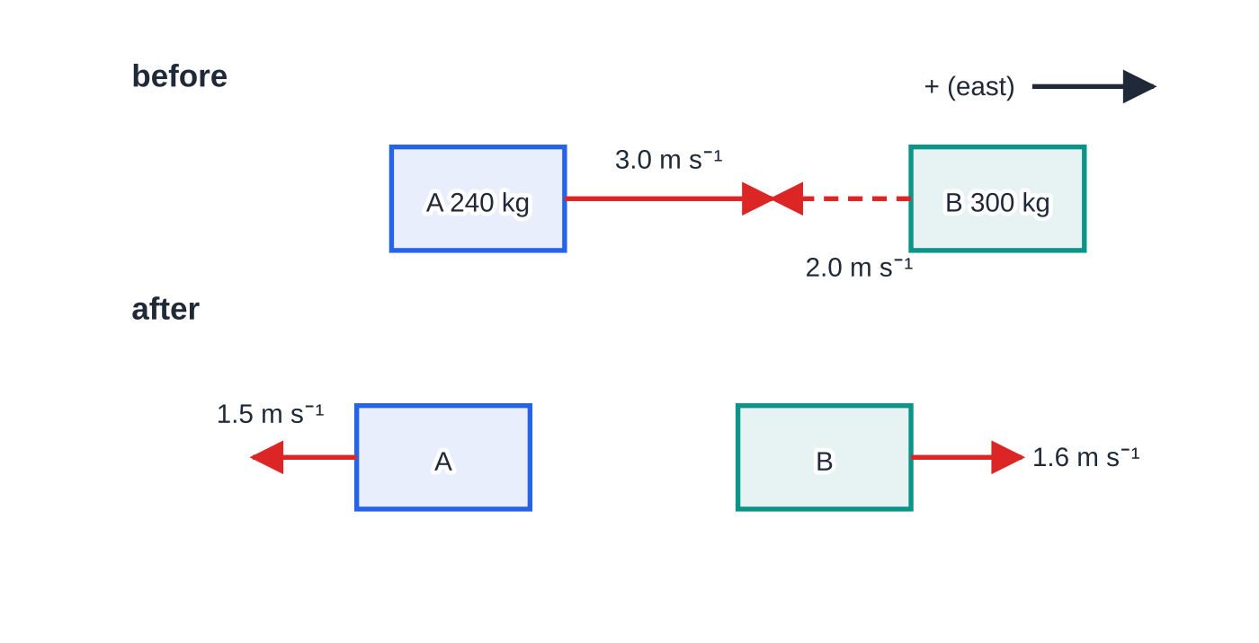
How do you solve a collision problem? (continued)
Section 5 of 12
Before and after a head-on collision between two bumper cars, east positive, velocity arrows to scale. The arrow for B after the collision is drawn at the 1.6 m s⁻¹ found in worked example 4: both cars have reversed.
Notes:
How do you solve a collision problem?. Full notes: https://examinerprep.com/notes/edexcel-ial-physics/momentum/

Slide 20
How do you solve a collision problem? (continued)
Section 5 of 12 · Worked example 4 · Medium · Determine
WORKED EXAMPLE · QUESTION
At a fairground, bumper car A (total mass 240 kg) moves east at 3.0 m s⁻¹ and collides head-on with bumper car B (total mass 300 kg) moving west at 2.0 m s⁻¹. After the collision A moves west at 1.5 m s⁻¹. Determine the velocity of B after the collision.
SOLUTION
Step 1 East positive. Total momentum before: 240 ×3.0 + 300 ×(-2.0) = 720 - 600 = +120 kg m s⁻¹
Step 2 Total momentum after, with A moving west: 240 ×(-1.5) + 300v_B = -360 + 300v_B
Step 3 Equate and solve: -360 + 300v_B = 120, so v_B = 480 ÷300 = 1.6 m s⁻¹ east
Both cars have reversed direction. The positive answer tells you B now moves east.
Notes:
How do you solve a collision problem?: Worked example 4. Full notes: https://examinerprep.com/notes/edexcel-ial-physics/momentum/

Slide 21
How do you solve a collision problem? (continued)
Section 5 of 12
Exam tip
Momentum is conserved in this collision, but kinetic energy is not: it falls from 1680 J to 654 J, the rest being transferred to thermal energy and sound. Do not try to use kinetic energy to solve a collision unless the question tells you it is conserved.
Notes:
How do you solve a collision problem?. Full notes: https://examinerprep.com/notes/edexcel-ial-physics/momentum/

Slide 22
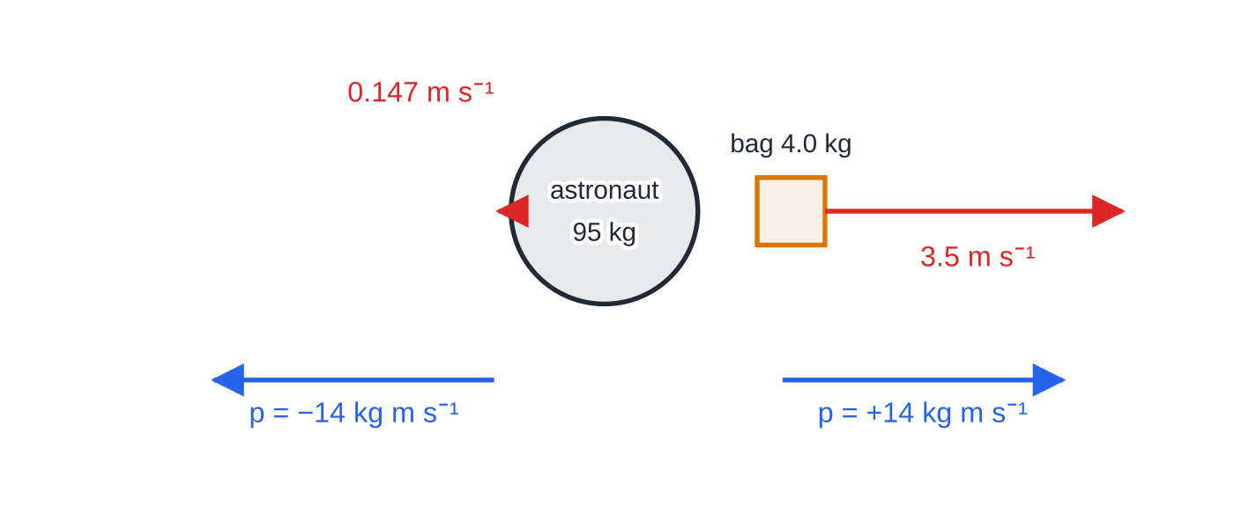
How do you handle explosions and recoil?
Section 6 of 12
In an explosion or a push-off, internal forces drive the bodies apart. Energy stored in a spring, a chemical or the muscles becomes kinetic energy, but the momentum of the system is unchanged.
From rest: total momentum is zero before, so after the event m₁v₁ = -m₂v₂ — equal magnitudes, opposite directions.
The recoil speed of the heavier body is smaller in the ratio of the masses: v₁/v₂ = -m₂/m₁.
From a moving start: the total before is (m₁ + m₂)u, not zero.
An astronaut floating at rest throws a tool bag. The velocities are very different (3.5 m s⁻¹ and 0.147 m s⁻¹), but the momenta (blue arrows) are equal in size and opposite in direction, so the total is still zero.
Notes:
How do you handle explosions and recoil?. Full notes: https://examinerprep.com/notes/edexcel-ial-physics/momentum/

Slide 23
How do you handle explosions and recoil? (continued)
Section 6 of 12 · Worked example 5 · Easy · Calculate
WORKED EXAMPLE · QUESTION
An astronaut of mass 95 kg (including her suit) floats at rest outside a space station. She throws a 4.0 kg tool bag directly away from her at 3.5 m s⁻¹. Calculate her velocity after the throw.
SOLUTION
Step 1 Total momentum before is zero. Take the bag's direction as positive: 0 = 4.0 ×3.5 + 95v
Step 2 Solve: v = -14 ÷95 = -0.147 m s⁻¹, so 0.147 m s⁻¹ in the opposite direction to the bag
Notes:
How do you handle explosions and recoil?: Worked example 5. Full notes: https://examinerprep.com/notes/edexcel-ial-physics/momentum/

Slide 24
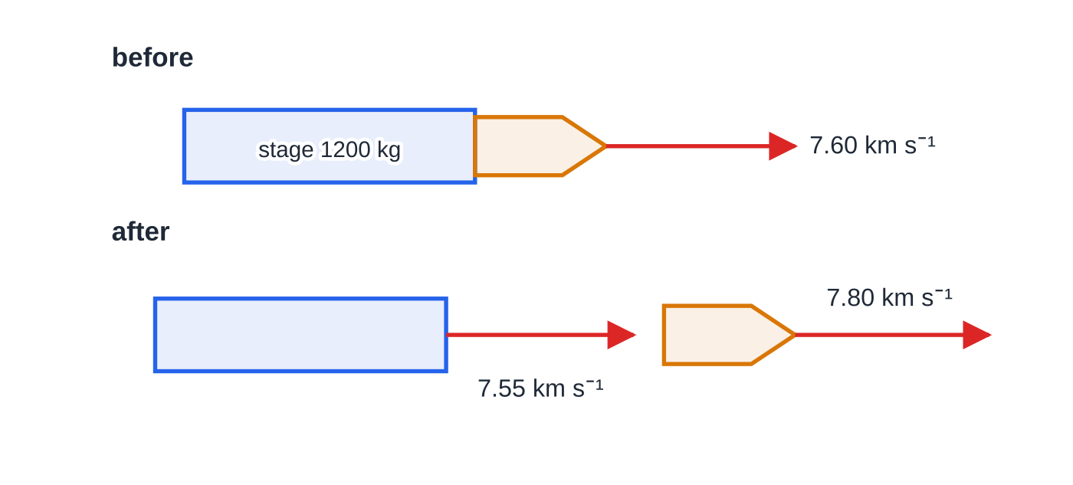
How do you handle explosions and recoil? (continued)
Section 6 of 12 · Worked example 6 · Hard · Calculate
WORKED EXAMPLE · QUESTION
A rocket stage of mass 1200 kg and a satellite of mass 300 kg move together along a straight line at 7.60 km s⁻¹. Springs push them apart. Afterwards the satellite moves at 7.80 km s⁻¹ in the original direction. Treat the motion as one-dimensional and ignore external forces during the separation. (a) Calculate the velocity of the rocket stage after the separation. (b) Show that the changes in momentum of the two bodies are equal and opposite.
A satellite separating from its rocket stage. The springs push the satellite forwards and the stage backwards, but "backwards" only slows the stage from 7.60 to 7.55 km s⁻¹ — both keep moving in the original direction.
Notes:
How do you handle explosions and recoil?: Worked example 6. Full notes: https://examinerprep.com/notes/edexcel-ial-physics/momentum/

Slide 25
How do you handle explosions and recoil? (continued)
Section 6 of 12 · Worked example 6 · Hard · Calculate (continued)
SOLUTION
(a) Total momentum before (original direction positive; working in kg km s⁻¹): 1500 ×7.60 = 11 400 kg km s⁻¹. After: 300 ×7.80 + 1200v = 11 400, so v = (11 400 - 2340)/1200 = 7.55 km s⁻¹ in the original direction
(b) In kg m s⁻¹: satellite 300 ×(7800 - 7600) = +6.0 ×10⁴; stage 1200 ×(7550 - 7600) = -6.0 ×10⁴. Equal and opposite.
The stage is not pushed backwards — it simply moves forwards a little more slowly. An explosion from a moving start need not reverse either body.
Notes:
How do you handle explosions and recoil?: Worked example 6. Full notes: https://examinerprep.com/notes/edexcel-ial-physics/momentum/

Slide 26
How do you handle explosions and recoil? (continued)
Section 6 of 12
Common error
Setting the total momentum before to zero when the bodies were already moving. Zero is correct only for an explosion from rest.
Notes:
How do you handle explosions and recoil?. Full notes: https://examinerprep.com/notes/edexcel-ial-physics/momentum/

Slide 27
How can you test conservation of momentum in the laboratory?
Section 7 of 12
Apparatus: two gliders on a level air track (or two trolleys on a runway tilted just enough to compensate for friction). Each carries a card of measured length; light gates connected to a data logger time the cards.
Velocity from a light gate: v = card length ÷ time for the card to pass through the beam.
Masses from a top-pan balance, including the card and any pads.
Collisions to try: Velcro or a pin and plasticine makes the gliders stick; magnets or a spring makes them move apart; a spring-loaded plunger released between two gliders at rest gives an explosion.
Checks: a single glider given a gentle push should pass both gates in the same time — this shows the track is level and friction is negligible.
Repeat each collision several times and compare total momentum before and after.
Notes:
How can you test conservation of momentum in the laboratory?. Full notes: https://examinerprep.com/notes/edexcel-ial-physics/momentum/

Slide 28
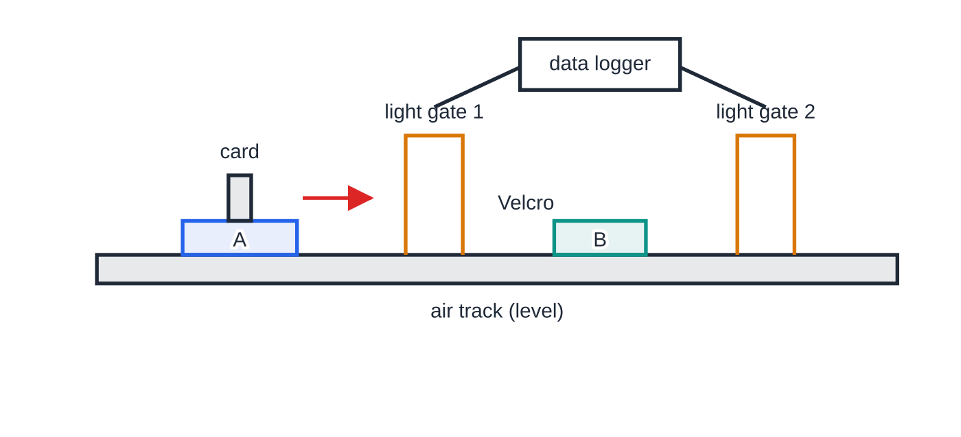
How can you test conservation of momentum in the laboratory? (continued)
Section 7 of 12
Air-track arrangement for a collision in which the gliders stick together. Light gate 1 times glider A's card before the collision; light gate 2 times the joined gliders afterwards.
Notes:
How can you test conservation of momentum in the laboratory?. Full notes: https://examinerprep.com/notes/edexcel-ial-physics/momentum/

Slide 29
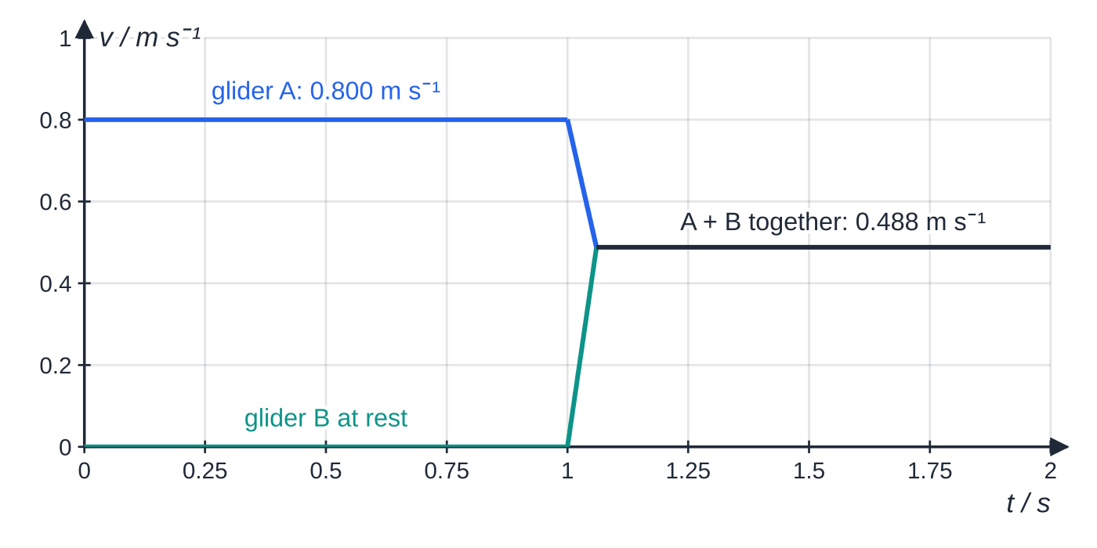
How can you test conservation of momentum in the laboratory? (continued)
Section 7 of 12
A data-logger velocity–time trace for the same collision. Glider A slows and glider B speeds up during the brief contact; afterwards they share one velocity.
Notes:
How can you test conservation of momentum in the laboratory?. Full notes: https://examinerprep.com/notes/edexcel-ial-physics/momentum/

Slide 30
How can you test conservation of momentum in the laboratory? (continued)
Section 7 of 12 · Worked example 7 · Hard · Calculate
WORKED EXAMPLE · QUESTION
Glider A (mass 0.250 kg) carries a card of length 0.100 m. It passes light gate 1 in 0.125 s, then collides with and sticks to glider B (mass 0.150 kg), which was at rest. The joined gliders pass light gate 2 in 0.205 s. (a) Calculate the total momentum before and after the collision. (b) Calculate the percentage difference and suggest a reason why the momentum after is smaller.
SOLUTION
Step 1 Velocities from the light gates: u = 0.100 ÷0.125 = 0.800 m s⁻¹; v = 0.100 ÷0.205 = 0.488 m s⁻¹
(a) Before: 0.250 ×0.800 = 0.200 kg m s⁻¹. After: 0.400 ×0.488 = 0.195 kg m s⁻¹
(b) (0.200 - 0.195)/0.200 ×100 = 2.4%. A small external force — air resistance on the cards, or a track that slopes slightly upwards — acts between the gates and removes a little momentum from the system. A difference this small is consistent with conservation within experimental uncertainty.
Notes:
How can you test conservation of momentum in the laboratory?: Worked example 7. Full notes: https://examinerprep.com/notes/edexcel-ial-physics/momentum/

Slide 31
How can you test conservation of momentum in the laboratory? (continued)
Section 7 of 12
Exam tip
If asked how to improve the experiment, link each change to a source of error: a longer card reduces the percentage uncertainty in its length; placing the gates close to the collision point reduces the time over which friction can act; repeating and averaging reduces the effect of random errors in timing.
Notes:
How can you test conservation of momentum in the laboratory?. Full notes: https://examinerprep.com/notes/edexcel-ial-physics/momentum/

Slide 32
Exam tips for 1.3
Section 8 of 12
Exam tip 1 — define your positive direction
Write "taking right as positive" (or east, or the original direction) before any momentum equation. It costs one line and makes every sign that follows easy to check.
Exam tip 2 — write the conservation equation in full
Write total momentum before = total momentum after, with every term substituted, before you rearrange. A bare final answer gives nothing to follow if the arithmetic slips.
Exam tip 3 — interpret the sign
A velocity of −0.15 m s⁻¹ is not a finished answer. Translate it: "0.15 m s⁻¹ in the opposite direction to the bag".
Notes:
Exam tips for 1.3. Full notes: https://examinerprep.com/notes/edexcel-ial-physics/momentum/

Slide 33
Exam tips for 1.3 (continued)
Section 8 of 12
Exam tip 4 — explaining with Newton's laws
For an "explain" question about why momentum is conserved, use three linked steps: the forces on the two bodies are equal and opposite (third law); they act for the same time; so the changes in momentum are equal and opposite and the total is unchanged.
Exam tip 5 — units and significant figures
Give momentum in kg m s⁻¹ (N s is equivalent). Keep unrounded intermediate values in your calculator, and give the final answer to the number of significant figures in the least precise data.
Notes:
Exam tips for 1.3. Full notes: https://examinerprep.com/notes/edexcel-ial-physics/momentum/

Slide 34
Common misconceptions
Section 9 of 12
Misconception | Why it is wrong | Correct idea
Each body keeps its own momentum in a collision. | The bodies push on each other, so each one's momentum changes. | Only the total momentum of the system is conserved.
Momentum can be added like a scalar. | Momentum has a direction; opposite momenta partly cancel. | Add momenta with signs (in one dimension).
The heavier body exerts the larger force in a collision. | Newton's third law makes the forces equal and opposite. | Equal forces, equal and opposite Δp; the lighter body has the larger Δv.
If momentum is conserved, kinetic energy must be too. | Kinetic energy is often transferred to thermal energy, sound or deformation. | Momentum is conserved whenever there is no resultant external force; kinetic energy usually is not.
An explosion creates momentum. | The fragments move in opposite directions. | From rest, the momenta are equal and opposite and the total stays zero.
Notes:
Common misconceptions. Full notes: https://examinerprep.com/notes/edexcel-ial-physics/momentum/

Slide 35
Common misconceptions (continued)
Section 9 of 12
Misconception | Why it is wrong | Correct idea
A ball bouncing off a wall breaks the conservation law. | The wall and the Earth are part of the system and receive an equal and opposite change of momentum. | The Earth's mass is so large that its change in velocity is far too small to notice.
Notes:
Common misconceptions. Full notes: https://examinerprep.com/notes/edexcel-ial-physics/momentum/

Slide 36
How this topic connects
Section 10 of 12
2 Forces and Newton's laws
Conservation of momentum is Newton's third law applied over the time of an interaction; F = ma is the constant-mass form of "force = rate of change of momentum".
5 Work and energy
Momentum and kinetic energy are different quantities: momentum is conserved in every collision with no resultant external force, while kinetic energy is usually partly transferred to other stores.
Further momentum and nuclear physics (Units 4 and 5)
Impulse, collisions in two dimensions and the difference between elastic and inelastic collisions build directly on the one-dimensional method on this page. A nucleus that emits an alpha particle recoils exactly like the astronaut in worked example 5, and conservation of momentum is used to analyse particle collisions and decays.
Notes:
How this topic connects. Full notes: https://examinerprep.com/notes/edexcel-ial-physics/momentum/

Slide 37
Key equations
Section 11 of 12
Equation | Use | In the formulae list?
p = mv | momentum of a body | Yes
Δp = mv - mu | change of momentum (signs!) | No — derive it from p = mv
m₁u₁ + m₂u₂ = m₁v₁ + m₂v₂ | collision in one dimension, no resultant external force | No — learn the principle
m₁u₁ + m₂u₂ = (m₁ + m₂)v | bodies stick together | No — derive it
0 = m₁v₁ + m₂v₂ | explosion or push-off from rest | No — derive it
F = Δp/Δt | link to Newton's second law (idea only on this page) | No — calculations with it come in Unit 4
v = card length ÷ time | velocity from a light gate | No — learn it
Notes:
Key equations. Full notes: https://examinerprep.com/notes/edexcel-ial-physics/momentum/

Slide 38
Check your understanding
Section 12 of 12
1. Show that the units kg m s⁻¹ and N s are equivalent.
2. Calculate the momentum of a 0.16 kg cricket ball moving at 30 m s⁻¹.
3. A 1.2 kg trolley moving at 0.50 m s⁻¹ hits a stationary 0.80 kg trolley and they stick together. Find their common velocity.
4. Two ice skaters stand at rest facing each other. The 50 kg skater pushes the 70 kg skater, who moves off at 1.5 m s⁻¹. Find the velocity of the 50 kg skater.
5. Explain why a small rowing boat moves backwards when a person jumps forwards from it onto a jetty.
Notes:
Check your understanding: questions. Full notes: https://examinerprep.com/notes/edexcel-ial-physics/momentum/

Slide 39
Check your understanding · answers
Section 12 of 12
1. 1 N = 1 kg m s⁻², so 1 N s = 1 kg m s⁻² ×s = 1 kg m s⁻¹.
2. p = 0.16 ×30 = 4.8 kg m s⁻¹, in the direction of the ball's velocity.
3. 1.2 ×0.50 = (1.2 + 0.80)v, so v = 0.60 ÷2.0 = 0.30 m s⁻¹ in the original direction.
4. 0 = 70 ×1.5 + 50v, so v = -105 ÷50 = -2.1 m s⁻¹: 2.1 m s⁻¹ in the opposite direction.
5. The person pushes the boat backwards and the boat pushes the person forwards with an equal and opposite force for the same time (Newton's third law). The total momentum was zero before, so the boat gains backward momentum equal in size to the person's forward momentum.
Notes:
Check your understanding: answers. Full notes: https://examinerprep.com/notes/edexcel-ial-physics/momentum/

Slide 40
Practice questions
5 original exam-style questions. Answers at the end of the deck.

Slide 41
Question 1
1 mark
Which of the following is a correct unit for momentum?
A kg m s⁻¹
B kg m s⁻²
C kg m² s⁻²
D N s⁻¹
Notes:
Online with the full mark scheme: https://examinerprep.com/ial-physics-1-3-momentum-questions#IALP-U1-3-A-01

Slide 42
Question 2
1 mark
A cyclist and her bicycle have a combined mass of 85 kg. They travel along a straight road at 7.2 m s⁻¹.
What is their momentum?
A 12 kg m s⁻¹
B 310 kg m s⁻¹
C 610 kg m s⁻¹
D 2200 kg m s⁻¹
Notes:
Online with the full mark scheme: https://examinerprep.com/ial-physics-1-3-momentum-questions#IALP-U1-3-A-02

Slide 43
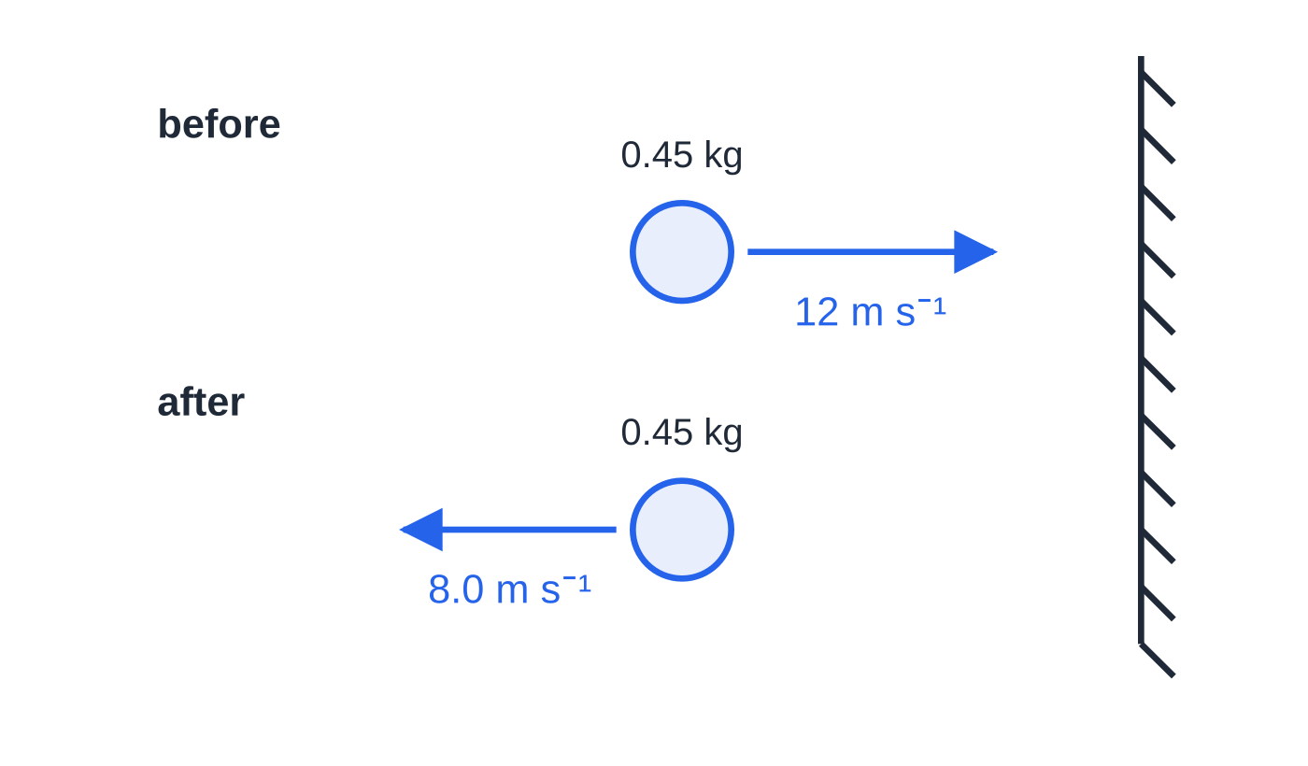
Question 3
1 mark
A football of mass 0.45 kg moves horizontally at 12 m s⁻¹ towards a wall. It rebounds along the same line at 8.0 m s⁻¹.
What is the magnitude of the change in momentum of the ball?
Figure: the ball before and after it rebounds from the wall (not to scale)
A 1.8 kg m s⁻¹
B 3.6 kg m s⁻¹
C 5.4 kg m s⁻¹
D 9.0 kg m s⁻¹
Notes:
Online with the full mark scheme: https://examinerprep.com/ial-physics-1-3-momentum-questions#IALP-U1-3-A-03

Slide 44
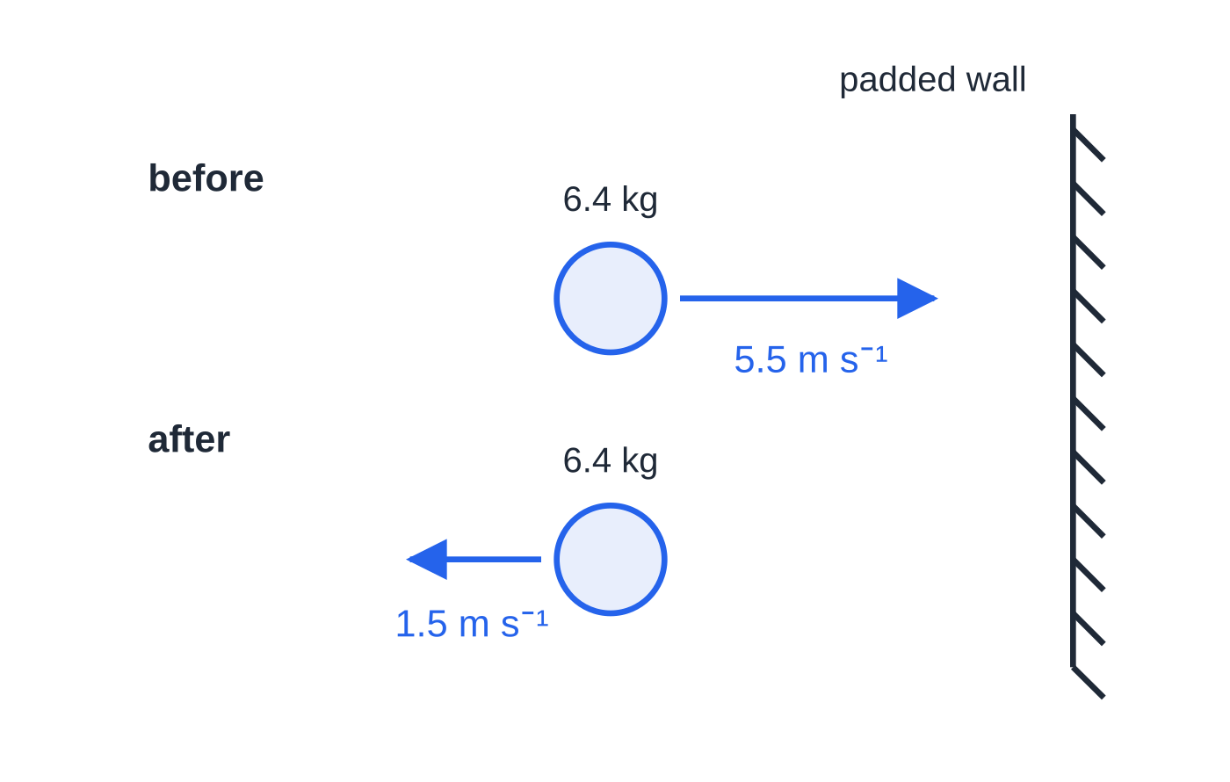
Question 4
4 marks
A bowling ball of mass 6.4 kg rolls in a straight line along a lane at 5.5 m s⁻¹. It strikes the padded back wall of the lane head-on and rebounds along the same line at 1.5 m s⁻¹.
Figure: the bowling ball before and after it rebounds (not to scale)
(a) Calculate the momentum of the ball before it reaches the wall. [2]
(b) Calculate the magnitude of the change in momentum of the ball. [2]
Notes:
Online with the full mark scheme: https://examinerprep.com/ial-physics-1-3-momentum-questions#IALP-U1-3-B-01

Slide 45
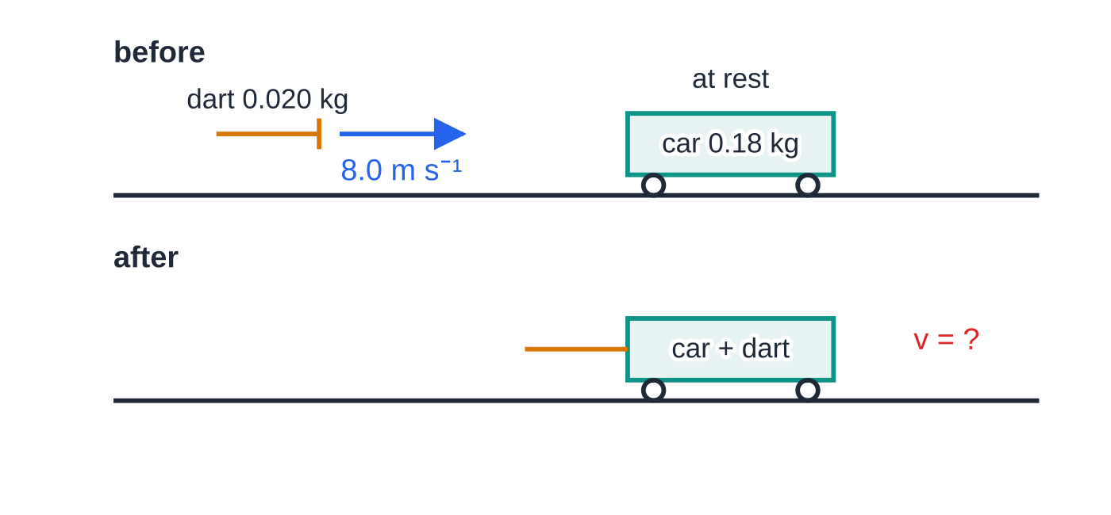
Question 5
4 marks
A toy dart of mass 0.020 kg travels horizontally at 8.0 m s⁻¹. It hits a toy car of mass 0.18 kg that is at rest on a smooth floor, and its sucker sticks to the car.
Figure: the dart and toy car before and after the dart sticks (not to scale)
(a) State the principle of conservation of linear momentum. [2]
(b) Calculate the velocity of the car and dart just after the dart sticks. [2]
Notes:
Online with the full mark scheme: https://examinerprep.com/ial-physics-1-3-momentum-questions#IALP-U1-3-B-02

Slide 46
Answers

Slide 47
Question 1 · answer
Answer A
Momentum = mass × velocity, so its unit is kg × m s⁻¹ = kg m s⁻¹ (equivalent to N s).
Notes:
Full mark scheme: https://examinerprep.com/ial-physics-1-3-momentum-questions#IALP-U1-3-A-01

Slide 48
Question 2 · answer
Answer C
p = mv = 85 × 7.2 = 610 kg m s⁻¹ (612).
Notes:
Full mark scheme: https://examinerprep.com/ial-physics-1-3-momentum-questions#IALP-U1-3-A-02

Slide 49
Question 3 · answer
Answer D
Taking towards the wall as positive: Δp = 0.45 × (−8.0) − 0.45 × 12 = −9.0 kg m s⁻¹. Magnitude 9.0 kg m s⁻¹.
Notes:
Full mark scheme: https://examinerprep.com/ial-physics-1-3-momentum-questions#IALP-U1-3-A-03

Slide 50
Question 4 · answer
Mark scheme
p = mv = 6.4 × 5.5
= 35 kg m s⁻¹ (35.2)
towards the wall positive: Δp = 6.4 × (−1.5) − 6.4 × 5.5
magnitude = 45 kg m s⁻¹ (44.8)
Notes:
Full mark scheme: https://examinerprep.com/ial-physics-1-3-momentum-questions#IALP-U1-3-B-01

Slide 51
Question 5 · answer
Mark scheme
the total momentum of a system stays constant / total momentum before = total momentum after
provided no resultant external force acts on the system
0.020 × 8.0 = (0.020 + 0.18)v
v = 0.80 m s⁻¹ in the dart's original direction
Notes:
Full mark scheme: https://examinerprep.com/ial-physics-1-3-momentum-questions#IALP-U1-3-B-02

Slide 52
Keep practising
Notes for this topic
Questions on this topic
Build a printable test
ExaminerPrep is an independent tutoring service. It has been developed independently from and is not endorsed by the International Baccalaureate Organization. "International Baccalaureate", "IB" and "IB Diploma Programme" are registered trademarks of the IBO, used here for descriptive purposes only.
Pearson Edexcel and Cambridge are trademarks of their owners; ExaminerPrep is not affiliated with any exam board.

