Slide 1
EP
EDEXCEL IAL PHYSICS
1.1 Motion, vectors and projectiles
The full notes page in 13 sections · practice questions with answers · simulations
ExaminerPrep is an independent tutoring service. It has been developed independently from and is not endorsed by the International Baccalaureate Organization. "International Baccalaureate", "IB" and "IB Diploma Programme" are registered trademarks of the IBO, used here for descriptive purposes only.
Pearson Edexcel and Cambridge are trademarks of their owners; ExaminerPrep is not affiliated with any exam board.
Notes:
1.1 Motion, vectors and projectiles. Notes for this topic: https://examinerprep.com/notes/edexcel-ial-physics/motion-vectors-and-projectiles/

Slide 2
What this page covers
Overview
Scalar and vector quantities, with examples, and how vectors are written
Resolving a vector into two perpendicular components, by drawing and by calculation
Adding two vectors: by scale drawing at any angle, by calculation at right angles
Distance, displacement, speed, velocity and acceleration
Displacement–time, velocity–time and acceleration–time graphs, including non-uniform acceleration
The four equations of uniformly accelerated motion in one dimension
Projectiles: independent horizontal and vertical motion
Core Practical 1: determining the acceleration of a freely falling object
Notes:
What this page covers. Full notes: https://examinerprep.com/notes/edexcel-ial-physics/motion-vectors-and-projectiles/

Slide 3
In one minute
Key points
1. This topic gives you the tools to describe motion before asking what causes it: vectors and how to combine them, motion graphs, the four equations for constant acceleration, and projectiles treated as two independent straight-line motions.
2. A vector has magnitude and direction; a scalar has magnitude only. Displacement, velocity, acceleration and force are vectors.
3. A vector F at angle θ to the horizontal has components Fcos θ (horizontal) and Fsin θ (vertical).
4. Gradient of s–t = velocity. Gradient of v–t = acceleration; area under v–t = displacement. Area under a–t = change in velocity.
5. The four equations of motion apply only when the acceleration is uniform.
6. A projectile's horizontal and vertical motions are independent and share only the time.
7. Free fall: g = 9.81 m s⁻². Plot h against t²; the gradient is g/2.
Notes:
In one minute. Full notes: https://examinerprep.com/notes/edexcel-ial-physics/motion-vectors-and-projectiles/

Slide 4
What is the difference between a scalar and a vector?
Section 1 of 13
"2 km" tells you how far someone walked, but not where they ended up: for that you also need "north-east of the station". Physics separates quantities into these two kinds, because they combine in different ways. Two scalars simply add; two vectors add in a way that depends on the angle between them.
Scalar: a quantity with magnitude only.
Vector: a quantity with both magnitude and direction.
Scalars | Vectors
distance, speed | displacement, velocity
mass, time, temperature | acceleration, force (including weight)
energy, work, power | momentum, gravitational field strength
Notes:
What is the difference between a scalar and a vector?. Full notes: https://examinerprep.com/notes/edexcel-ial-physics/motion-vectors-and-projectiles/

Slide 5
What is the difference between a scalar and a vector? (continued)
Section 1 of 13
Scalars | Vectors
density, volume, pressure | electric field strength
Vector notation. In print a vector is shown in bold (F) or with an arrow above the symbol; when you write by hand, underline it. The plain italic symbol F means the magnitude only. In one dimension a vector's direction is carried by its sign, once you have chosen which direction is positive. Two vectors are equal only if both their magnitudes and their directions are equal: a velocity of 5 m s⁻¹ east is not the same as 5 m s⁻¹ west.
The difference shows up as soon as a journey is not a straight line. In the figure a student walks 400 m east and then 300 m north. The distance walked is 700 m, but the displacement — the straight line from start to finish — is only 500 m, at 36.9° north of east.
Notes:
What is the difference between a scalar and a vector?. Full notes: https://examinerprep.com/notes/edexcel-ial-physics/motion-vectors-and-projectiles/

Slide 6
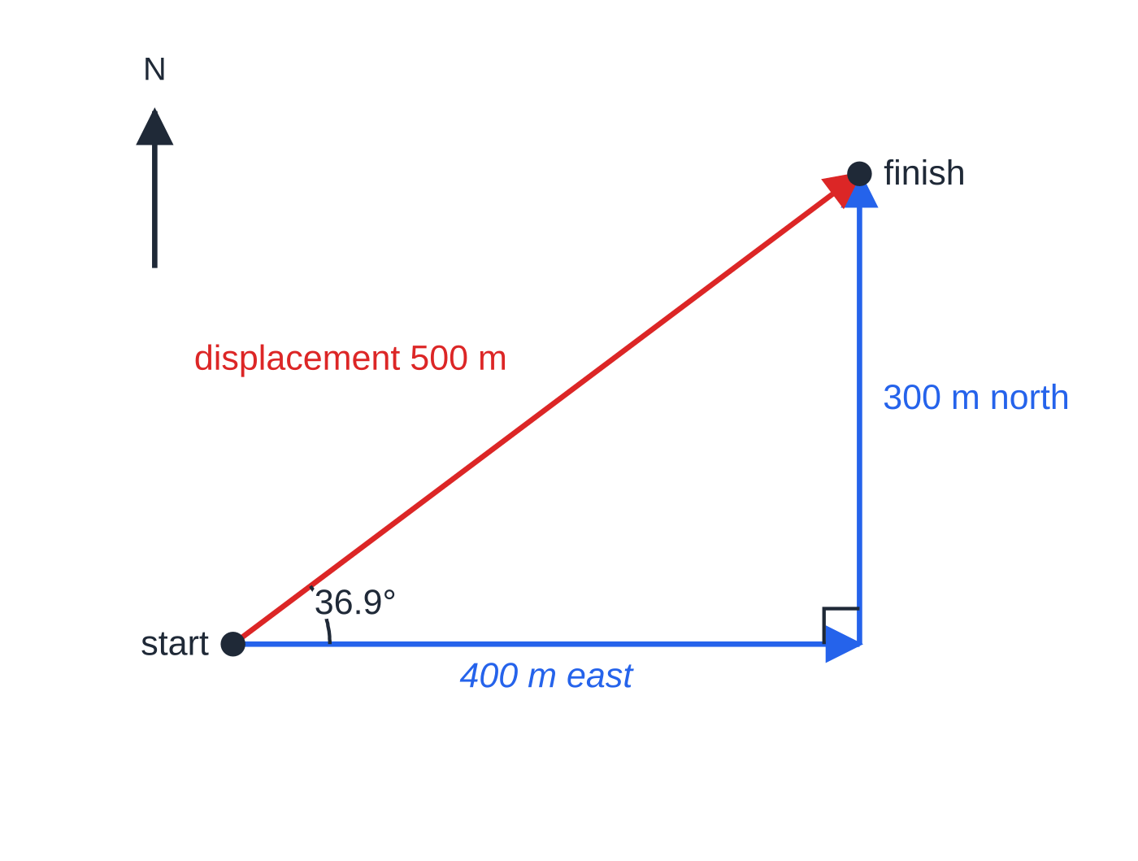
What is the difference between a scalar and a vector? (continued)
Section 1 of 13
Common error
Calling energy or work a vector because a force is involved. Work is the product of a force and a displacement along its line, and the result is a scalar — it has no direction.
Distance is the length of the path (400 m + 300 m = 700 m, a scalar). Displacement is the straight line from start to finish with a direction (500 m at 36.9° north of east, a vector).
Notes:
What is the difference between a scalar and a vector?. Full notes: https://examinerprep.com/notes/edexcel-ial-physics/motion-vectors-and-projectiles/

Slide 7
How do you resolve a vector into components?
Section 2 of 13
Resolving is the reverse of adding. Instead of combining two vectors into one, you replace one vector by two vectors at right angles that have the same combined effect. This is useful because perpendicular directions are independent: what happens horizontally does not affect what happens vertically.
For a vector of magnitude F at angle θ to the horizontal:
Fₕ = Fcos θ Fᵥ = Fsin θ
The component next to the angle uses cos; the component opposite the angle uses sin.
You can also resolve by drawing: draw the vector to scale, drop perpendiculars to the two axes and measure the lengths, converting back with your scale. The drawing shows why the rule works: the vector is the hypotenuse of a right-angled triangle whose other two sides are the components.
Notes:
How do you resolve a vector into components?. Full notes: https://examinerprep.com/notes/edexcel-ial-physics/motion-vectors-and-projectiles/

Slide 8
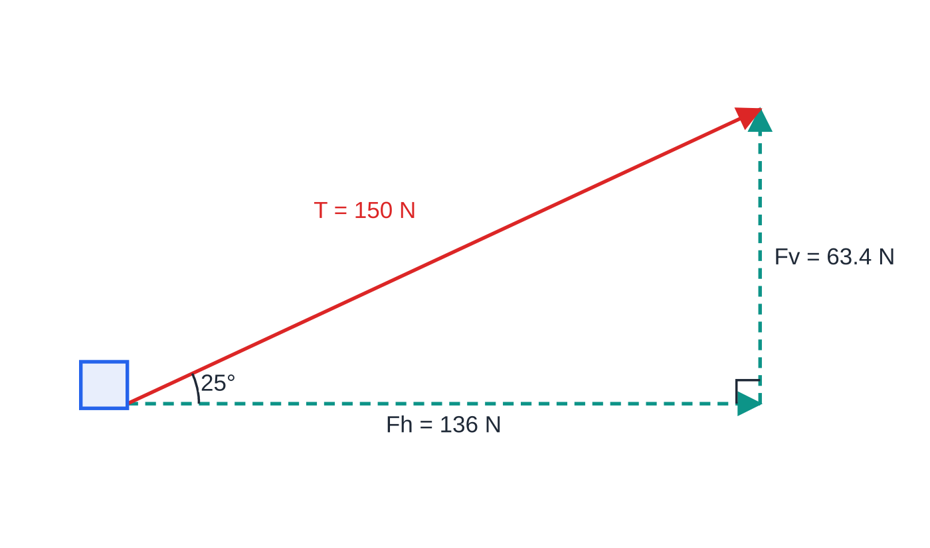
How do you resolve a vector into components? (continued)
Section 2 of 13
A pull of 150 N at 25° above the horizontal does the same job as 136 N horizontally plus 63.4 N vertically. The two dashed components rebuild the original vector tip to tail.
Notes:
How do you resolve a vector into components?. Full notes: https://examinerprep.com/notes/edexcel-ial-physics/motion-vectors-and-projectiles/

Slide 9
How do you resolve a vector into components? (continued)
Section 2 of 13 · Worked example 1 · Easy · Calculate
WORKED EXAMPLE · QUESTION
A child pulls a sledge with a rope that makes an angle of 25° with the horizontal ground. The tension in the rope is 150 N. Calculate the horizontal and vertical components of the pull.
SOLUTION
Step 1 The horizontal component is next to the 25° angle: Fₕ = 150cos 25° = 136 N
Step 2 The vertical component is opposite the angle: Fᵥ = 150sin 25° = 63.4 N
Check: √(136² + 63.4²) = 150 N — the components rebuild the original vector.
Notes:
How do you resolve a vector into components?: Worked example 1. Full notes: https://examinerprep.com/notes/edexcel-ial-physics/motion-vectors-and-projectiles/

Slide 10
How do you resolve a vector into components? (continued)
Section 2 of 13
Exam tip
Mark the angle on your own sketch before choosing sin or cos. If the angle is given from the vertical, the roles swap: the vertical component becomes Fcos θ and the horizontal one Fsin θ.
Notes:
How do you resolve a vector into components?. Full notes: https://examinerprep.com/notes/edexcel-ial-physics/motion-vectors-and-projectiles/

Slide 11
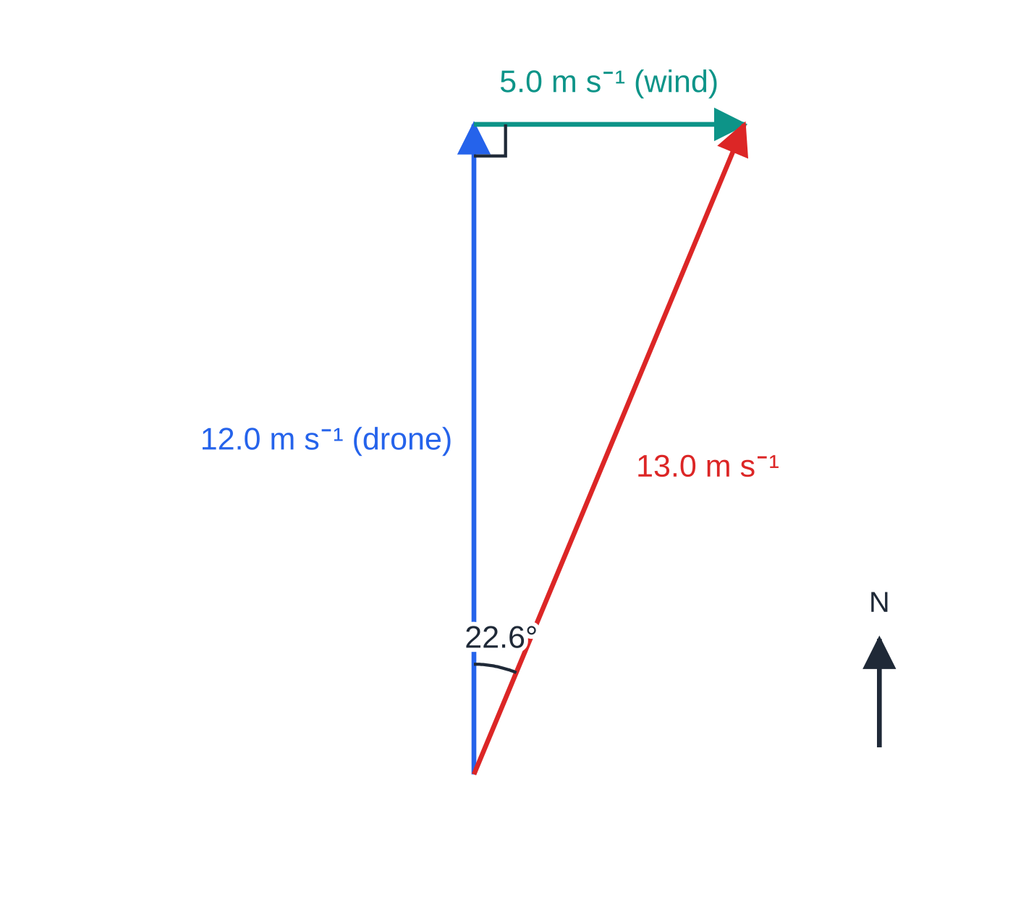
How do you add two vectors?
Section 3 of 13
Two vectors at right angles — by calculation
To add vectors, place them tip to tail: draw the second vector starting where the first one ends. The resultant runs from the start of the first to the tip of the second. When the two vectors are perpendicular the triangle has a right angle, so the magnitude comes from Pythagoras and the direction from tan⁻¹, measured from a reference direction that you must state.
Tip to tail: the drone's own velocity and the wind velocity add to a resultant of 13.0 m s⁻¹ at 22.6° east of north.
Notes:
How do you add two vectors?. Full notes: https://examinerprep.com/notes/edexcel-ial-physics/motion-vectors-and-projectiles/

Slide 12
How do you add two vectors? (continued)
Section 3 of 13 · Worked example 2 · Medium · Determine
WORKED EXAMPLE · QUESTION
A survey drone flies due north at 12.0 m s⁻¹ relative to the air. A wind blows due east at 5.0 m s⁻¹. Determine the velocity of the drone relative to the ground.
SOLUTION
Step 1 The two velocities are perpendicular, so use Pythagoras: v = √(12.0² + 5.0²) = 13.0 m s⁻¹
Step 2 Direction from north: θ= tan⁻¹(5.0 ÷12.0) = 22.6°
Velocity = 13.0 m s⁻¹ at 22.6° east of north. A velocity is a vector, so the answer is incomplete without the direction.
Notes:
How do you add two vectors?: Worked example 2. Full notes: https://examinerprep.com/notes/edexcel-ial-physics/motion-vectors-and-projectiles/

Slide 13
How do you add two vectors? (continued)
Section 3 of 13
Two vectors at any angle — by scale drawing
When the angle between the vectors is not 90°, the triangle has no right angle and Pythagoras does not apply. At AS you add such vectors by an accurate scale drawing:
Choose a scale and write it down (for example 1 cm = 5 N).
Draw the first vector to scale; draw the second from its tip at the correct angle — or draw both from one point and complete the parallelogram.
Measure the resultant with a ruler and its angle with a protractor; convert back using the scale.
Notes:
How do you add two vectors?. Full notes: https://examinerprep.com/notes/edexcel-ial-physics/motion-vectors-and-projectiles/

Slide 14
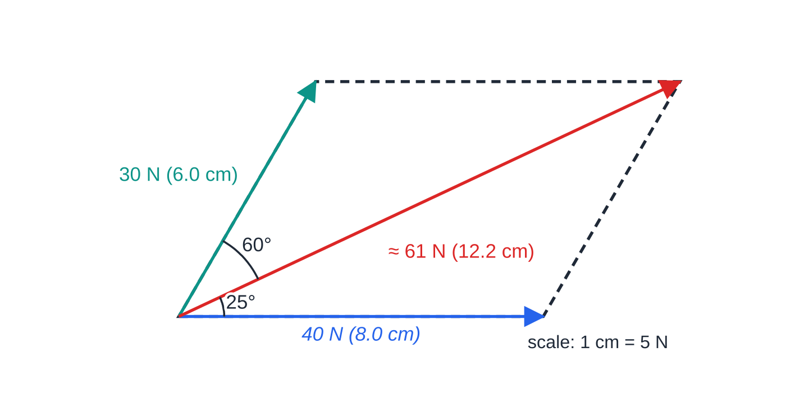
How do you add two vectors? (continued)
Section 3 of 13
Parallelogram of forces drawn to scale: 40 N and 30 N with 60° between them give a resultant of about 61 N at 25° to the 40 N force. The diagonal from the common starting point is the resultant.
Notes:
How do you add two vectors?. Full notes: https://examinerprep.com/notes/edexcel-ial-physics/motion-vectors-and-projectiles/

Slide 15
How do you add two vectors? (continued)
Section 3 of 13 · Worked example 3 · Medium · Find
WORKED EXAMPLE · QUESTION
Two ropes pull a crate across a smooth floor. One rope pulls with 40 N; the other pulls with 30 N at 60° to the first. Find the resultant force by scale drawing.
SOLUTION
Step 1 Choose a scale — 1 cm = 5 N — and draw the 40 N force as an 8.0 cm line.
Step 2 From the same point draw the 30 N force as a 6.0 cm line at 60°, then complete the parallelogram.
Step 3 Measure the diagonal and its angle: diagonal ≈ 12.2 cm, so the resultant is ≈ 61 N at about 25° to the 40 N force.
A careful drawing is accurate to about ±1 mm and ±1°, so quote the result to 2 s.f.
Notes:
How do you add two vectors?: Worked example 3. Full notes: https://examinerprep.com/notes/edexcel-ial-physics/motion-vectors-and-projectiles/

Slide 16
How do you add two vectors? (continued)
Section 3 of 13
Common error
Using Pythagoras when the two vectors are not at 90°. Pythagoras would give √(40² + 30²) = 50 N here, well below the true 61 N. At angles other than 90°, draw to scale or resolve both vectors into components first, add the components, then recombine.
Notes:
How do you add two vectors?. Full notes: https://examinerprep.com/notes/edexcel-ial-physics/motion-vectors-and-projectiles/

Slide 17
Which quantities describe motion?
Section 4 of 13
Each vector quantity of motion has a scalar partner that drops the direction. The difference matters when something turns round: a ball thrown up and caught has travelled a distance of twice its height but has zero displacement, and its average velocity over the flight is zero even though its average speed is not.
Quantity | Meaning | SI unit | Type
Distance | total length of path travelled | m | scalar
Displacement s | distance in a stated direction from the starting point | m | vector
Speed | rate of change of distance | m s⁻¹ | scalar
Velocity v | rate of change of displacement | m s⁻¹ | vector
Acceleration a | rate of change of velocity | m s⁻² | vector
Notes:
Which quantities describe motion?. Full notes: https://examinerprep.com/notes/edexcel-ial-physics/motion-vectors-and-projectiles/

Slide 18
Which quantities describe motion? (continued)
Section 4 of 13
Average velocity and average acceleration
v = Δs/Δt a = Δv/Δt
An average value covers a whole interval. An instantaneous value is the gradient of the tangent to the graph at one instant. They are equal only when the gradient is constant.
Notes:
Which quantities describe motion?. Full notes: https://examinerprep.com/notes/edexcel-ial-physics/motion-vectors-and-projectiles/

Slide 19
What do motion graphs tell you?
Section 5 of 13
Almost every motion-graph question comes down to two operations: the gradient (how fast the plotted quantity changes) and the area under the line (the plotted quantity multiplied by time).
Graph | Gradient gives | Area under the line gives
displacement–time | velocity | no useful quantity
velocity–time | acceleration | displacement
acceleration–time | no useful quantity at this level | change in velocity
The reason is the definitions. Velocity is Δs / Δt, which is exactly the gradient of an s–t graph. Rearranging gives Δs = vΔt: a thin strip under a v–t graph has height v and width Δt, so its area is the small displacement, and adding all the strips gives the total. The same argument with a and v explains the a–t graph. The three graphs below describe one tram journey between two stops.
Notes:
What do motion graphs tell you?. Full notes: https://examinerprep.com/notes/edexcel-ial-physics/motion-vectors-and-projectiles/

Slide 20
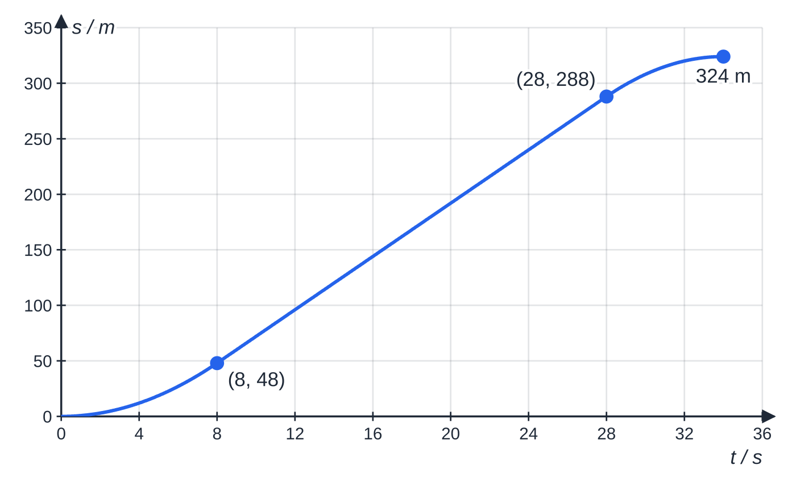
What do motion graphs tell you? (continued)
Section 5 of 13
Displacement–time: a curve getting steeper while the tram speeds up, a straight line (constant gradient = 12.0 m s⁻¹) while it cruises, and a curve levelling off to zero gradient as it stops.
Notes:
What do motion graphs tell you?. Full notes: https://examinerprep.com/notes/edexcel-ial-physics/motion-vectors-and-projectiles/

Slide 21
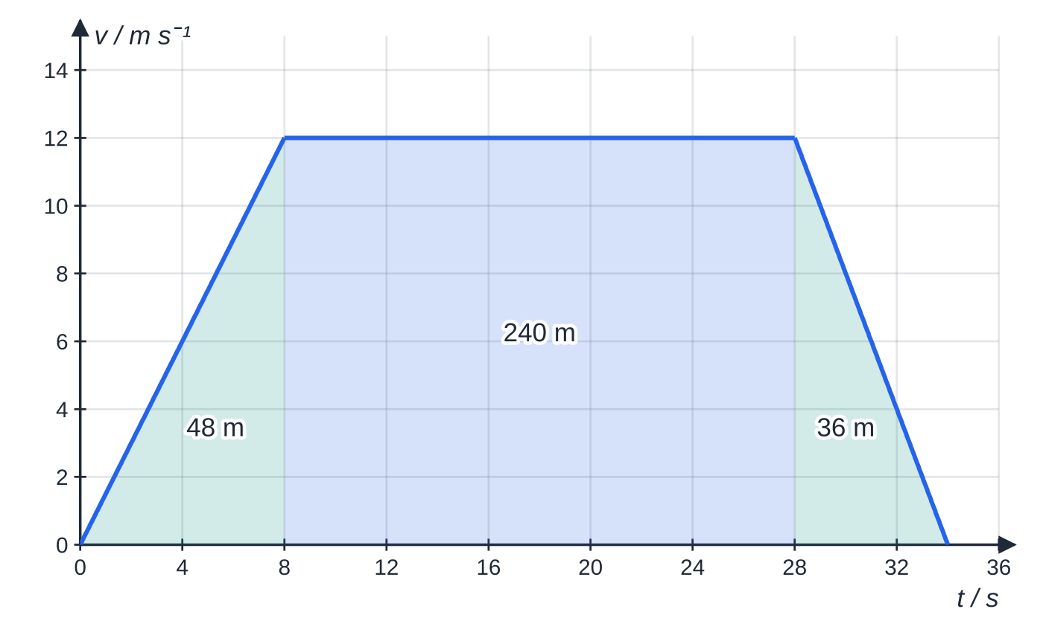
What do motion graphs tell you? (continued)
Section 5 of 13
Velocity–time: the gradients give the accelerations (1.5, 0 and −2.0 m s⁻²) and the shaded area is the 324 m travelled.
Notes:
What do motion graphs tell you?. Full notes: https://examinerprep.com/notes/edexcel-ial-physics/motion-vectors-and-projectiles/

Slide 22
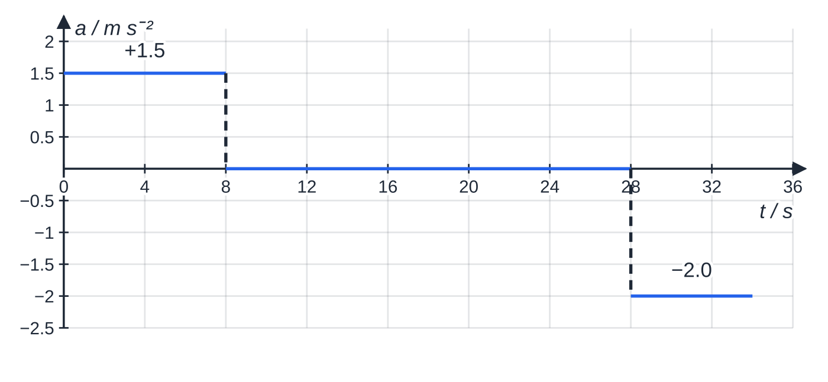
What do motion graphs tell you? (continued)
Section 5 of 13
Acceleration–time: uniform acceleration is a horizontal line. Area of the first block = 1.5 × 8.0 = +12.0 m s⁻¹, the gain in velocity; the last block, −2.0 × 6.0 = −12.0 m s⁻¹, removes it again.
Notes:
What do motion graphs tell you?. Full notes: https://examinerprep.com/notes/edexcel-ial-physics/motion-vectors-and-projectiles/

Slide 23
What do motion graphs tell you? (continued)
Section 5 of 13 · Worked example 4 · Medium · Determine
WORKED EXAMPLE · QUESTION
A tram accelerates uniformly from rest to 12.0 m s⁻¹ in 8.0 s, travels at constant velocity for 20.0 s, then decelerates uniformly to rest in 6.0 s (the velocity–time graph above). Determine (a) the acceleration in each stage, (b) the distance between the stops and (c) the average speed.
SOLUTION
(a) Acceleration = gradient of each straight section: a₁ = 12.0 ÷8.0 = 1.5 m s⁻², a₂ = 0, a₃ = -12.0 ÷6.0 = -2.0 m s⁻². 1.5 m s⁻², 0, −2.0 m s⁻²
(b) Distance = area under the v–t graph (a trapezium): ½ ×8.0 ×12.0 + 20.0 ×12.0 + ½ ×6.0 ×12.0 = 48 + 240 + 36 = 324 m
(c) Average speed = total distance ÷ total time = 324 ÷34.0 = 9.53 m s⁻¹
Notes:
What do motion graphs tell you?: Worked example 4. Full notes: https://examinerprep.com/notes/edexcel-ial-physics/motion-vectors-and-projectiles/

Slide 24
What do motion graphs tell you? (continued)
Section 5 of 13
Non-uniform acceleration
Real vehicles rarely accelerate uniformly. A curved v–t graph means the acceleration is changing. To find the acceleration at one instant, draw the tangent to the curve at that time and find its gradient with a large triangle. The displacement is still the area under the curve, found by counting squares or splitting the area into thin strips; the equations of motion cannot be used, because they assume a straight v–t line. An a–t graph that is not horizontal shows non-uniform acceleration; the area under it still gives the change in velocity.
Notes:
What do motion graphs tell you?. Full notes: https://examinerprep.com/notes/edexcel-ial-physics/motion-vectors-and-projectiles/

Slide 25
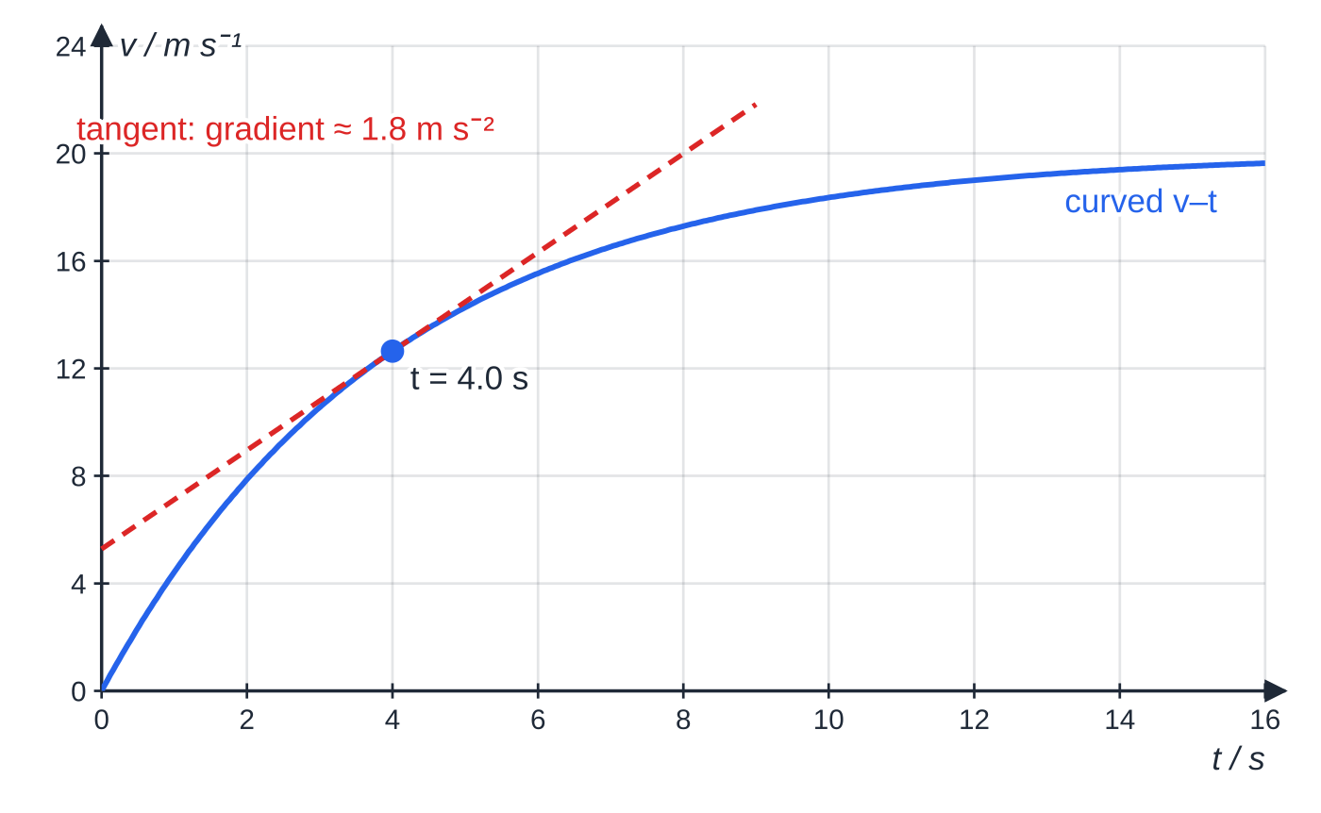
What do motion graphs tell you? (continued)
Section 5 of 13
Areas below the time axis
Velocity below the axis means motion in the negative direction, so area below the axis counts as negative displacement. Displacement = area above − area below; distance = area above + area below.
A car whose acceleration decreases as it approaches its top speed. The gradient of the tangent at t = 4.0 s gives the instantaneous acceleration there, about 1.8 m s⁻²; the gradient keeps falling as the curve flattens.
Notes:
What do motion graphs tell you?. Full notes: https://examinerprep.com/notes/edexcel-ial-physics/motion-vectors-and-projectiles/

Slide 26
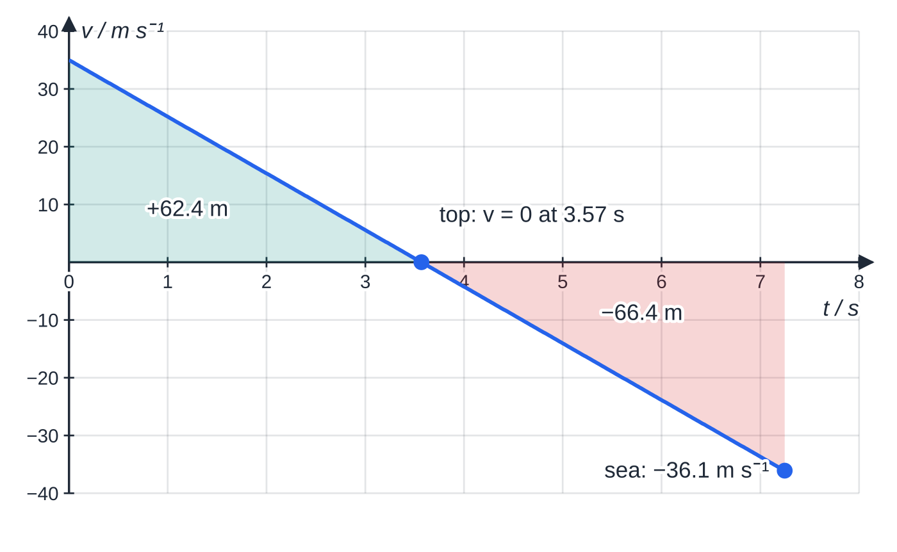
What do motion graphs tell you? (continued)
Section 5 of 13
Common error
Reading the point where a v–t line crosses the time axis as "the object stops and stays at rest". It is momentarily at rest and then moves in the opposite direction; the gradient — the acceleration — has not changed.
Velocity–time graph for a flare fired straight up (upwards positive). The area above the axis is the height gained; the area below is the distance fallen. The gradient is −9.81 m s⁻² throughout, including at the top.
Notes:
What do motion graphs tell you?. Full notes: https://examinerprep.com/notes/edexcel-ial-physics/motion-vectors-and-projectiles/

Slide 27
What are the equations of uniformly accelerated motion?
Section 6 of 13
When the acceleration is constant, the v–t graph is a straight line, and its gradient and area can be written as algebra. The gradient gives a = (v-u)/t, which rearranges to the first equation. The area is a trapezium, s = ½(u+v)t. Eliminating v or t between these two gives the other two. Each equation leaves out one of the five quantities, which is how you choose between them.
The four equations of motion
(constant acceleration in a straight line)
v = u + at s = ((u+v)t)/2
s = ut + ½ at² v² = u² + 2as
s = displacement (m) · u = initial velocity (m s⁻¹) · v = final velocity (m s⁻¹) · a = acceleration (m s⁻²), constant · t = time (s). All four are supplied in the formulae list in the exam.
Notes:
What are the equations of uniformly accelerated motion?. Full notes: https://examinerprep.com/notes/edexcel-ial-physics/motion-vectors-and-projectiles/

Slide 28
What are the equations of uniformly accelerated motion? (continued)
Section 6 of 13
A reliable method
1. Write the positive direction first ("taking upwards as positive").
2. List s, u, v, a, t with signs; mark the one you want and the one you neither know nor need.
3. Choose the equation that leaves out the unneeded quantity; rearrange, then substitute.
4. Interpret the sign of the answer.
Notes:
What are the equations of uniformly accelerated motion?. Full notes: https://examinerprep.com/notes/edexcel-ial-physics/motion-vectors-and-projectiles/

Slide 29
What are the equations of uniformly accelerated motion? (continued)
Section 6 of 13 · Worked example 5 · Hard · Calculate
WORKED EXAMPLE · QUESTION
A distress flare is fired vertically upwards at 35.0 m s⁻¹ from the deck of a boat 4.0 m above the sea. Air resistance is negligible; g = 9.81 m s⁻². Calculate (a) the maximum height of the flare above the deck and (b) the time until it lands in the sea.
SOLUTION
Step 1 Upwards positive: u = +35.0 m s⁻¹, a = -9.81 m s⁻².
(a) At the top v = 0; t is not needed, so use v² = u² + 2as: 0 = 35.0² - 2 ×9.81 ×s, so s = 62.4 m
(b) The sea is 4.0 m below the deck, so s = -4.0 m. Find the landing velocity first: v² = 35.0² + 2(-9.81)(-4.0) = 1303, so v = -36.1 m s⁻¹ (moving down). Then v = u + at gives t = (-36.1 - 35.0)/(-9.81) = 7.25 s
Notes:
What are the equations of uniformly accelerated motion?: Worked example 5. Full notes: https://examinerprep.com/notes/edexcel-ial-physics/motion-vectors-and-projectiles/

Slide 30
What are the equations of uniformly accelerated motion? (continued)
Section 6 of 13
Exam tip
Finding v first and then t from v = u + at avoids solving a quadratic. Keep the unrounded value of v in your calculator for the second step and round only the final answer.
Notes:
What are the equations of uniformly accelerated motion?. Full notes: https://examinerprep.com/notes/edexcel-ial-physics/motion-vectors-and-projectiles/

Slide 31
How do you analyse a projectile?
Section 7 of 13
A projectile is any object moving freely under gravity after launch, such as a thrown ball or a long-jumper in the air. Air resistance is taken as negligible unless the question says otherwise. The key idea is that its horizontal and vertical motions are independent, because gravity acts only vertically:
Horizontal: no force, so the horizontal velocity u_H = ucos θ stays constant.
Vertical: constant acceleration g = 9.81 m s⁻² downwards, starting from u_V = usin θ.
Time is the link — work it out from one direction and use it in the other.
At the highest point the vertical velocity is zero, but the horizontal velocity is unchanged.
Notes:
How do you analyse a projectile?. Full notes: https://examinerprep.com/notes/edexcel-ial-physics/motion-vectors-and-projectiles/

Slide 32
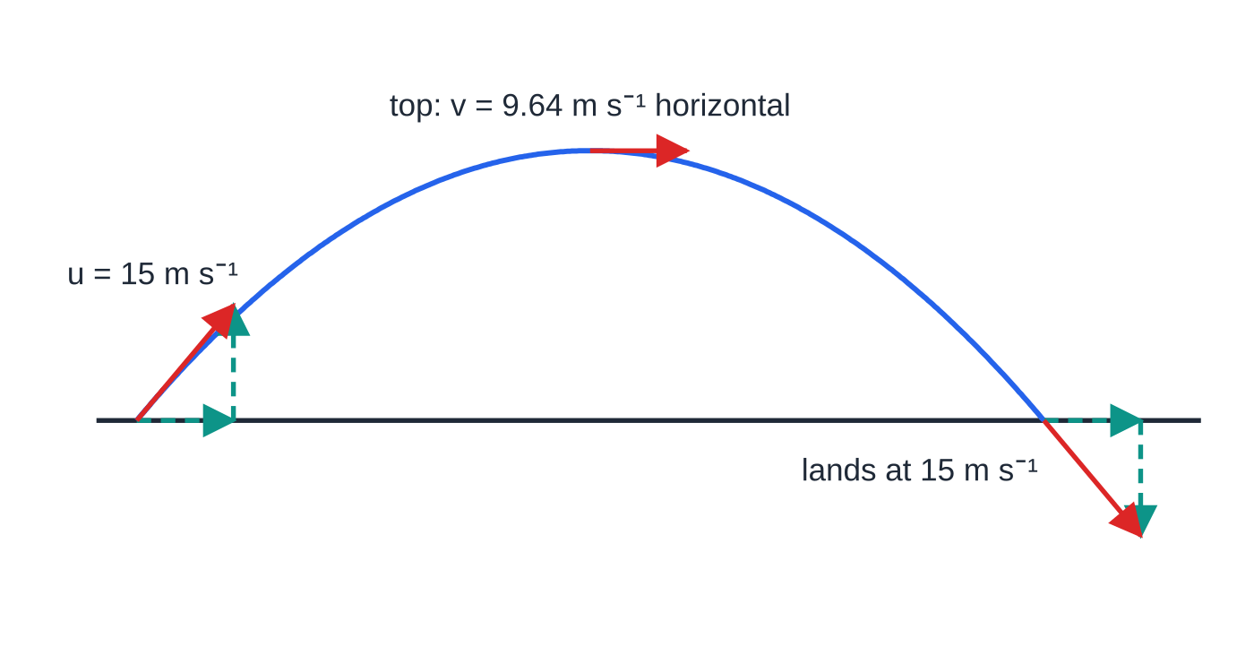
How do you analyse a projectile? (continued)
Section 7 of 13
A neat consequence of independence: a ball dropped and a ball thrown horizontally from the same height at the same moment land together. The horizontal velocity carries the second ball sideways, but it does nothing to its vertical motion.
A ball launched at 15 m s⁻¹, 50° above level ground. The dashed horizontal component (9.64 m s⁻¹) is the same at launch, at the top and at landing; only the vertical component changes, from +11.5 m s⁻¹ through zero to −11.5 m s⁻¹.
Notes:
How do you analyse a projectile?. Full notes: https://examinerprep.com/notes/edexcel-ial-physics/motion-vectors-and-projectiles/

Slide 33
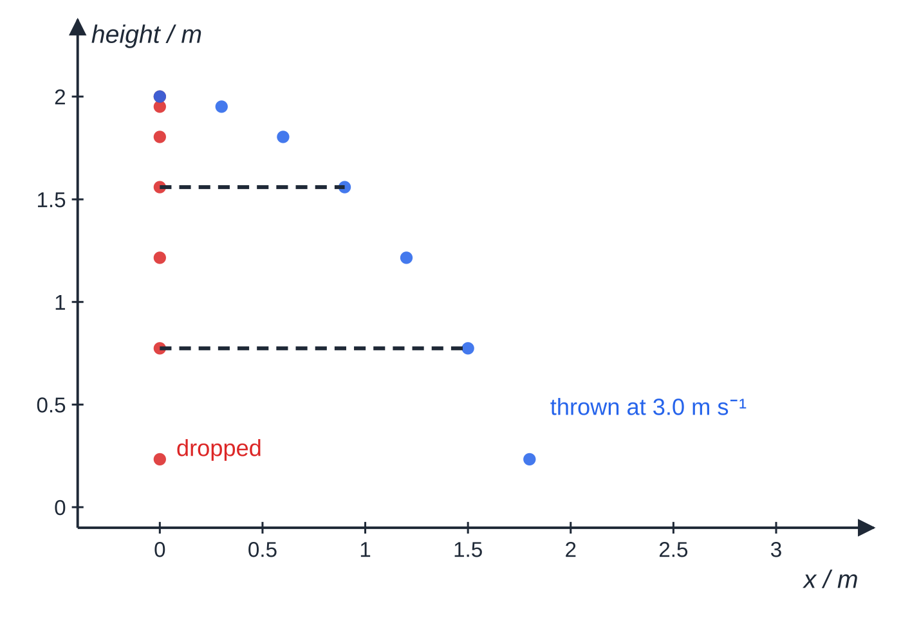
How do you analyse a projectile? (continued)
Section 7 of 13
Positions every 0.10 s for a ball dropped from 2.0 m and a ball thrown horizontally at 3.0 m s⁻¹ from the same height. At every instant both are at the same height (dashed lines): equal horizontal steps, identical vertical falls.
Notes:
How do you analyse a projectile?. Full notes: https://examinerprep.com/notes/edexcel-ial-physics/motion-vectors-and-projectiles/

Slide 34
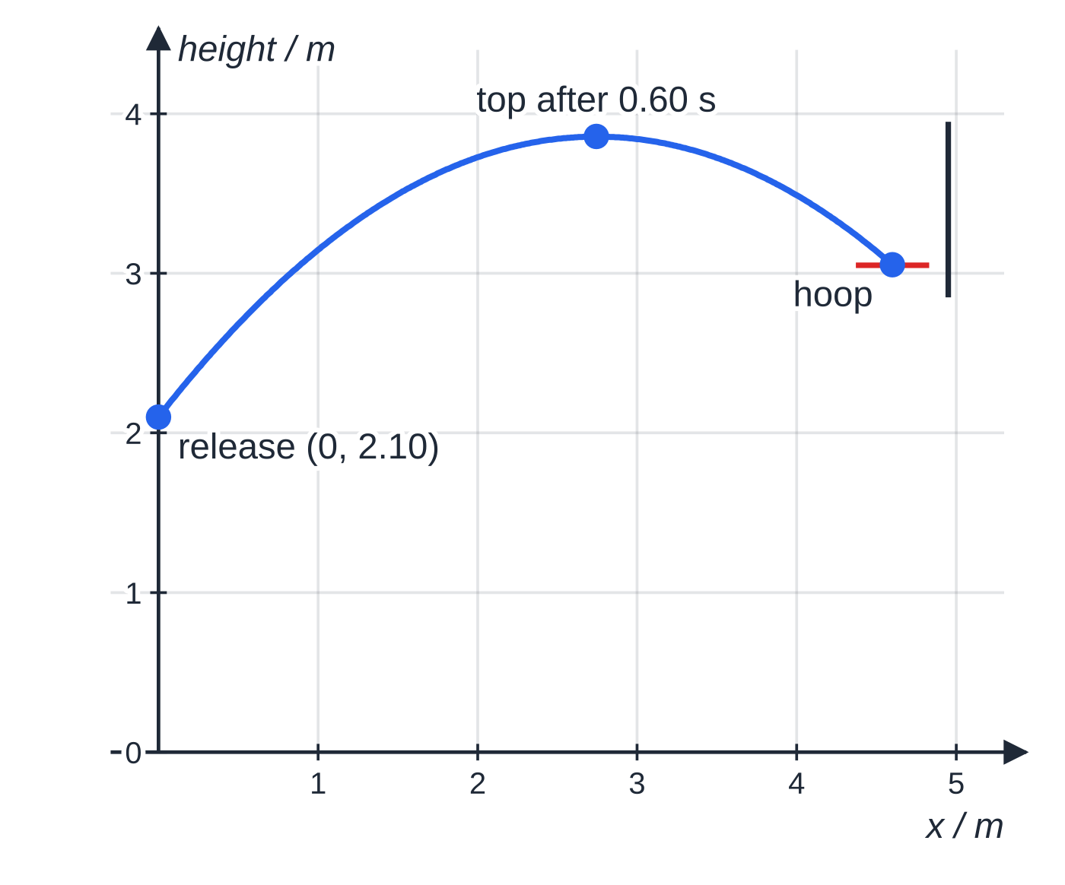
How do you analyse a projectile? (continued)
Section 7 of 13 · Worked example 6 · Hard · Show that
WORKED EXAMPLE · QUESTION
A player releases a basketball 2.10 m above the floor at 7.45 m s⁻¹ and 52° above the horizontal. The hoop is 3.05 m above the floor, 4.60 m horizontally from the point of release. Air resistance is negligible. (a) Calculate the time taken for the ball to travel 4.60 m horizontally. (b) Show that the ball is at the height of the hoop at this time. (c) State and explain whether the ball is rising or falling as it reaches the hoop.
SOLUTION
Step 1 Resolve the launch velocity: u_H = 7.45cos 52° = 4.59 m s⁻¹, u_V = 7.45sin 52° = 5.87 m s⁻¹.
The basketball of worked example 6, drawn to scale. It passes the highest point after 0.60 s and is already falling when it reaches the hoop at 1.00 s.
Notes:
How do you analyse a projectile?: Worked example 6. Full notes: https://examinerprep.com/notes/edexcel-ial-physics/motion-vectors-and-projectiles/

Slide 35
How do you analyse a projectile? (continued)
Section 7 of 13 · Worked example 6 · Hard · Show that (continued)
(a) Horizontal velocity is constant: t = 4.60 ÷4.587 = 1.00 s (1.003 s — keep this value).
(b) Vertical displacement in this time (upwards positive): s = 5.871 ×1.003 - ½ ×9.81 ×1.003² = 0.954 m. Height = 2.10 + 0.954 = 3.054 m ≈ 3.05 m, the height of the hoop.
(c) Vertical velocity at the hoop: v_V = 5.871 - 9.81 ×1.003 = -3.97 m s⁻¹. It is negative, so the ball is falling.
Notes:
How do you analyse a projectile?: Worked example 6. Full notes: https://examinerprep.com/notes/edexcel-ial-physics/motion-vectors-and-projectiles/

Slide 36
How do you analyse a projectile? (continued)
Section 7 of 13
Exam tip
In a "show that" question the value is given, so the credit is for the working. Show the substitution and give your result to one more significant figure than the value quoted — here 3.054 m, not just 3.05 m.
Notes:
How do you analyse a projectile?. Full notes: https://examinerprep.com/notes/edexcel-ial-physics/motion-vectors-and-projectiles/

Slide 37
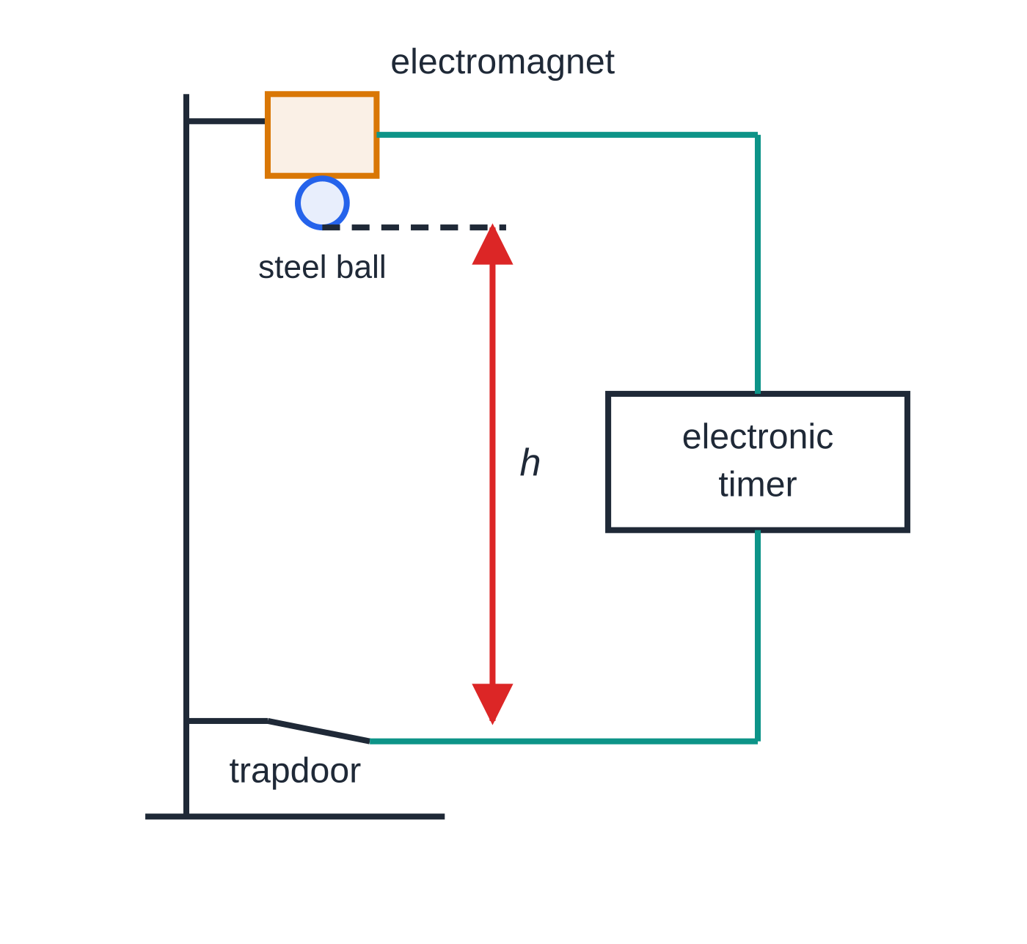
Core Practical 1: how do you measure g?
Section 8 of 13
The idea is simple: a body released from rest falls a height h in time t, with h = ½ gt² (this is s = ut + ½at² with u = 0). Comparing with y = mx, a graph of h against t² is a straight line through the origin with gradient g/2.
Method: a small steel ball is held by an electromagnet; switching off the magnet releases the ball and starts an electronic timer; the ball falls through a trapdoor or a light gate that stops the timer.
Measure: h from the bottom of the ball to the trapdoor with a metre rule, kept vertical with a set square; repeat each timing several times and take a mean.
Range: at least five or six heights spread over the widest practical range, so the line is well defined.
One arrangement: switching off the electromagnet releases the ball and starts the timer; the ball hitting the trapdoor stops it. The height h is measured from the bottom of the ball to the trapdoor.
Notes:
Core Practical 1: how do you measure g?. Full notes: https://examinerprep.com/notes/edexcel-ial-physics/motion-vectors-and-projectiles/

Slide 38
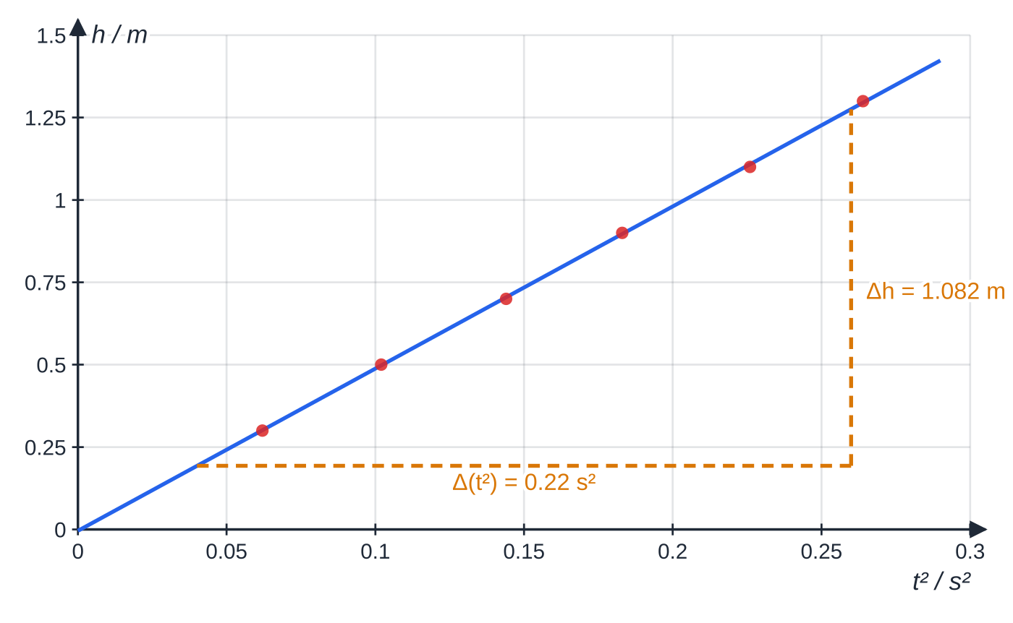
Core Practical 1: how do you measure g? (continued)
Section 8 of 13
Why electronic timing: human reaction time (about 0.2 s) is comparable to the fall times themselves.
Specimen results: h against t² is a straight line through (very nearly) the origin. The gradient triangle spans most of the line, which keeps the reading error small.
Notes:
Core Practical 1: how do you measure g?. Full notes: https://examinerprep.com/notes/edexcel-ial-physics/motion-vectors-and-projectiles/

Slide 39
Core Practical 1: how do you measure g? (continued)
Section 8 of 13 · Worked example 7 · Medium · Determine
WORKED EXAMPLE · QUESTION
Use the graph above to determine g.
SOLUTION
Step 1 Gradient from a large triangle drawn on the line: gradient = (1.275 - 0.193)/(0.26 - 0.04) = 4.92 m s⁻²
Step 2 Gradient = g/2, so g = 2 ×4.92 = 9.84 m s⁻², within 0.3% of 9.81 m s⁻².
Notes:
Core Practical 1: how do you measure g?: Worked example 7. Full notes: https://examinerprep.com/notes/edexcel-ial-physics/motion-vectors-and-projectiles/

Slide 40
Core Practical 1: how do you measure g? (continued)
Section 8 of 13
Exam tip
A systematic error that adds the same amount to every reading of h — for example measuring from the top of the ball instead of the bottom — moves the line up without changing its gradient. It shows up as an intercept, and the value of g from the gradient is unaffected. This is a good reason to use a graph rather than a single measurement.
Notes:
Core Practical 1: how do you measure g?. Full notes: https://examinerprep.com/notes/edexcel-ial-physics/motion-vectors-and-projectiles/

Slide 41
Exam tips for 1.1
Section 9 of 13
Exam tip 1 — directions are part of the answer
For any vector answer — displacement, velocity, acceleration, a resultant force — state the direction: a sign with the positive direction defined, an angle from a named reference, or a compass direction.
Exam tip 2 — use the data you are given
Take g = 9.81 m s⁻² from the data list, not 10 m s⁻². Give final answers to the number of significant figures in the least precise data, usually 2 or 3.
Exam tip 3 — gradients need a large triangle
For a gradient, draw a triangle that covers at least half of the line and read its corners from the line, not from the data points. Show the triangle on the graph.
Notes:
Exam tips for 1.1. Full notes: https://examinerprep.com/notes/edexcel-ial-physics/motion-vectors-and-projectiles/

Slide 42
Exam tips for 1.1 (continued)
Section 9 of 13
Exam tip 4 — keep working visible
If an early answer is wrong but you use it correctly later, the later steps can still earn credit — but only when the substitution can be seen. A bare number gives nothing to follow.
Exam tip 5 — read the command word
State needs a short answer; calculate needs a numerical answer with working; show that needs every step and one extra significant figure; explain needs a reason linked to physics, not a restatement.
Notes:
Exam tips for 1.1. Full notes: https://examinerprep.com/notes/edexcel-ial-physics/motion-vectors-and-projectiles/

Slide 43
Common misconceptions
Section 10 of 13
Misconception | Why it is wrong | Correct idea
At the top of its flight a projectile has zero velocity. | Only the vertical component is zero; the horizontal component is unchanged. | Velocity at the top = ucos θ, horizontal.
At the top of its flight the acceleration is zero. | The weight still acts. | The acceleration is 9.81 m s⁻² downwards at every point.
A ball thrown horizontally stays in the air longer than one dropped from the same height. | The horizontal velocity does not affect the vertical motion. | Both land at the same time.
Two vectors always add by Pythagoras. | Pythagoras works only for a right-angled triangle. | At other angles, draw to scale or add components.
Negative acceleration means slowing down. | The sign depends on the chosen positive direction. | A body slows down when v and a have opposite signs.
Notes:
Common misconceptions. Full notes: https://examinerprep.com/notes/edexcel-ial-physics/motion-vectors-and-projectiles/

Slide 44
Common misconceptions (continued)
Section 10 of 13
Misconception | Why it is wrong | Correct idea
The equations of motion work for any motion. | They are derived for a straight-line v–t graph. | Use them only for uniform acceleration; otherwise use the graph.
Notes:
Common misconceptions. Full notes: https://examinerprep.com/notes/edexcel-ial-physics/motion-vectors-and-projectiles/

Slide 45
How this topic connects
Section 11 of 13
2 Forces and Newton's laws
Resolving vectors is the main tool for forces on slopes and in equilibrium, and a constant resultant force gives the constant acceleration these equations need.
5 Work and energy
For a speed at a given height, conservation of energy gives the answer without the time: v² = u² + 2gh for a fall through h, whatever the launch angle.
Charged particles in fields (Unit 4) and practical skills (Unit 3)
A charge moving across a uniform electric field follows a parabola for the same reason a projectile does: constant velocity in one direction, constant acceleration at right angles to it. And linearising h = ½gt² by plotting h against t² is the pattern for many practical questions: choose axes that give a straight line, then read the constant from the gradient.
Notes:
How this topic connects. Full notes: https://examinerprep.com/notes/edexcel-ial-physics/motion-vectors-and-projectiles/

Slide 46
Key equations
Section 12 of 13
Equation | Use | In the formulae list?
v = u + at | constant a; s not needed | Yes
s = ((u+v)t)/2 | constant a; a not needed | Yes
s = ut + ½ at² | constant a; v not needed | Yes
v² = u² + 2as | constant a; t not needed | Yes
Fₕ = Fcos θ, Fᵥ = Fsin θ | resolving a vector | No — trigonometry, learn it
R = √(A² + B²), θ= tan⁻¹(B/A) | adding perpendicular vectors | No — trigonometry, learn it
h = ½ gt² | free fall from rest (Core Practical 1) | No — it is s = ut + ½at² with u = 0
Notes:
Key equations. Full notes: https://examinerprep.com/notes/edexcel-ial-physics/motion-vectors-and-projectiles/

Slide 47
Check your understanding
Section 13 of 13
1. Sort into scalars and vectors: momentum, speed, weight, energy, displacement.
2. A force of 80 N acts at 30° to the vertical. Calculate its horizontal and vertical components.
3. A swimmer crosses a river at 1.2 m s⁻¹ straight across, while the current flows at 0.90 m s⁻¹. Find the resultant velocity.
4. A cyclist accelerates uniformly from 3.0 m s⁻¹ to 9.0 m s⁻¹ over 48 m. Calculate the acceleration.
5. A stone is thrown horizontally at 6.0 m s⁻¹ from a wall 1.8 m high. How far from the wall does it land?
6. On a velocity–time graph a line crosses the time axis with a constant negative gradient. Describe the motion at that instant.
Notes:
Check your understanding: questions. Full notes: https://examinerprep.com/notes/edexcel-ial-physics/motion-vectors-and-projectiles/

Slide 48
Check your understanding · answers
Section 13 of 13
1. Vectors: momentum, weight, displacement. Scalars: speed, energy.
2. The angle is from the vertical, so vertical = 80cos 30° = 69 N and horizontal = 80sin 30° = 40 N.
3. √(1.2² + 0.90²) = 1.5 m s⁻¹, at tan⁻¹(0.90/1.2) = 37° downstream from the straight-across direction: 1.5 m s⁻¹ at 37° downstream.
4. v² = u² + 2as, so a = (9.0² - 3.0²)/(2 ×48) = (72/96) = 0.75 m s⁻².
5. Vertical motion starts from zero: t = √(2 ×1.8 ÷9.81) = 0.61 s. Horizontal distance = 6.0 ×0.606 = 3.6 m.
6. The object is momentarily at rest and reversing direction. Its acceleration (the gradient) is unchanged and non-zero, so it does not stay at rest — like the flare at the top of its flight.
Notes:
Check your understanding: answers. Full notes: https://examinerprep.com/notes/edexcel-ial-physics/motion-vectors-and-projectiles/

Slide 49
Practice questions
4 original exam-style questions. Answers at the end of the deck.

Slide 50
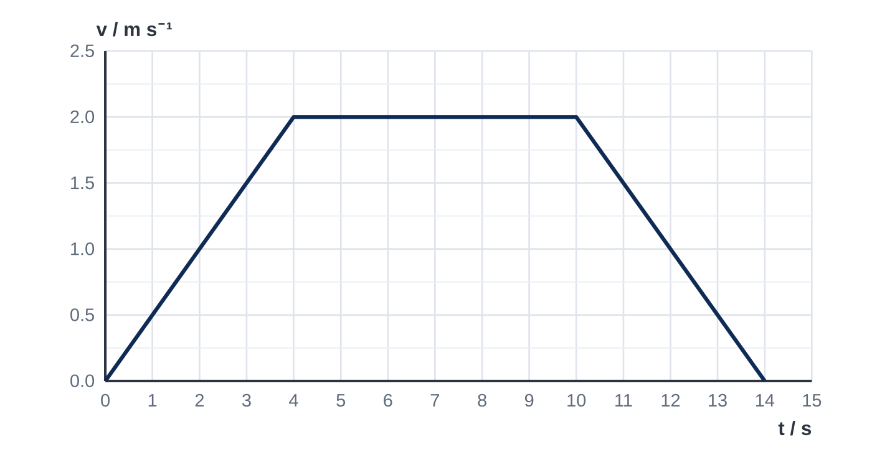
Question 1
1 mark
The velocity–time graph shows the motion of a lift as it travels upwards from one floor to another.
What is the distance travelled by the lift?
A 8.0 m
B 12 m
C 16 m
D 20 m
Notes:
Online with the full mark scheme: https://examinerprep.com/ial-physics-1-1-motion-vectors-and-projectiles-questions#IALP-U1-1-FA-01

Slide 51
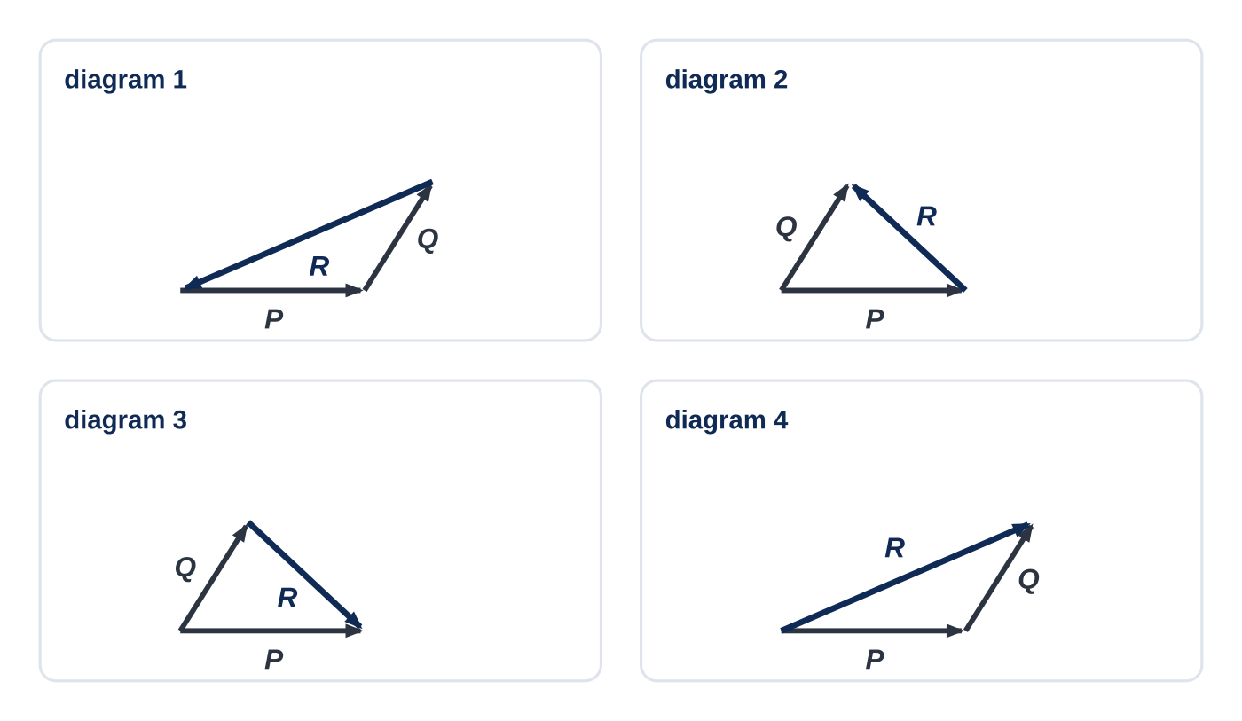
Question 2
1 mark
The diagrams show the same two vectors P and Q in each case, together with a third vector R.
In which diagram is R = P + Q?
A diagram 1
B diagram 2
C diagram 3
D diagram 4
Notes:
Online with the full mark scheme: https://examinerprep.com/ial-physics-1-1-motion-vectors-and-projectiles-questions#IALP-U1-1-FA-02

Slide 52
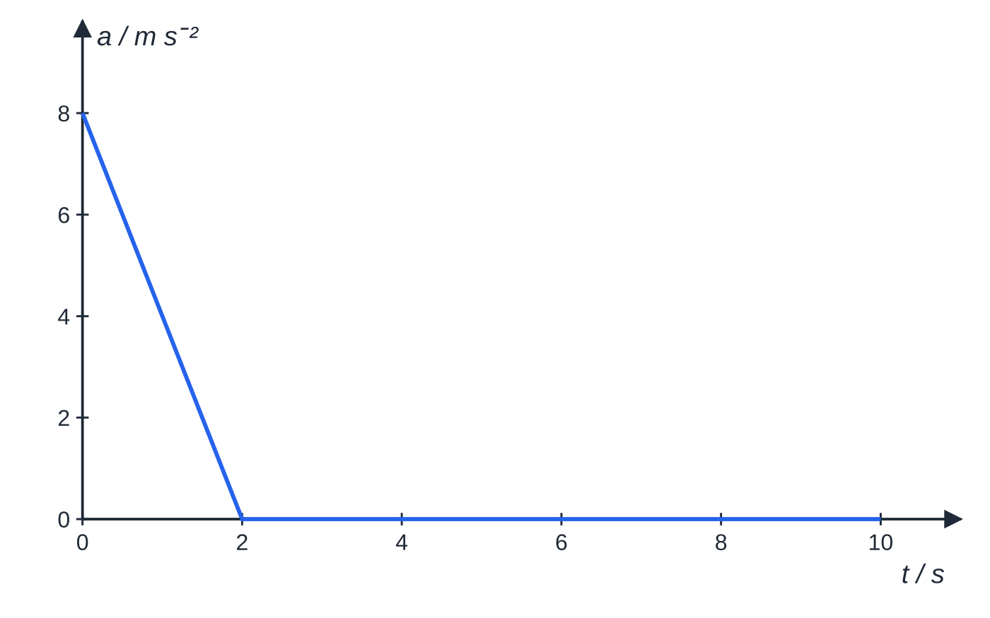
Question 3
5 marks
A sprinter starts from rest. Her acceleration decreases uniformly from 8.0 m s⁻² at t = 0 to zero at t = 2.0 s. After t = 2.0 s she runs at constant velocity.
Figure: acceleration–time graph for the sprinter
(a) State what is represented by the area under an acceleration–time graph. [1]
(b) Determine her velocity at t = 2.0 s. [2]
(c) Explain why the equations of uniformly accelerated motion cannot be used for the first 2.0 s. [1]
(d) Calculate the distance she runs between t = 2.0 s and t = 10.0 s. [1]
Notes:
Online with the full mark scheme: https://examinerprep.com/ial-physics-1-1-motion-vectors-and-projectiles-questions#IALP-U1-1-B-04

Slide 53
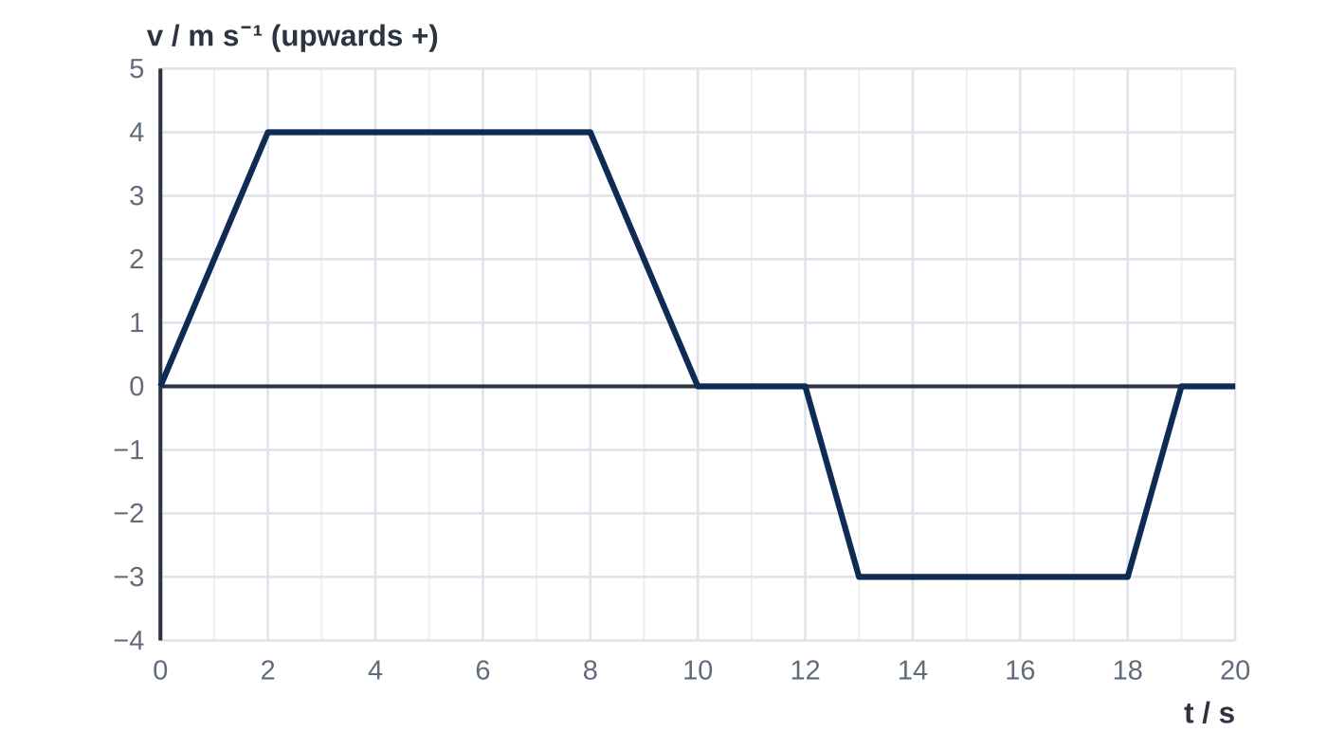
Question 4
7 marks
A drone takes off vertically from the ground. The graph shows how its vertical velocity varies with time, with upwards taken as positive.
(a) Calculate the acceleration of the drone between t = 0 and t = 2.0 s. [1]
(b) Describe the motion of the drone between t = 10 s and t = 12 s. [1]
(c) Determine the maximum height of the drone above the ground. [2]
(d) Determine the height of the drone above the ground at t = 19 s. [2]
(e) Calculate the average velocity of the drone for the first 19 s. [1]
Notes:
Online with the full mark scheme: https://examinerprep.com/ial-physics-1-1-motion-vectors-and-projectiles-questions#IALP-U1-1-FB-03

Slide 54
Answers

Slide 55
Question 1 · answer
Answer D
Distance = area under the graph = ½ × 4 × 2.0 + 6 × 2.0 + ½ × 4 × 2.0 = 4 + 12 + 4 = 20 m.
Notes:
Full mark scheme: https://examinerprep.com/ial-physics-1-1-motion-vectors-and-projectiles-questions#IALP-U1-1-FA-01

Slide 56
Question 2 · answer
Answer D
To add vectors, draw them tip to tail; the resultant runs from the tail of the first to the tip of the last. Only diagram 4 does this. In diagram 1 the arrow on R is reversed, so P + Q + R = 0. Diagrams 2 and 3 show the differences Q − P and P − Q.
Notes:
Full mark scheme: https://examinerprep.com/ial-physics-1-1-motion-vectors-and-projectiles-questions#IALP-U1-1-FA-02

Slide 57
Question 3 · answer
Mark scheme
change in velocity
area of triangle = ½ × 2.0 × 8.0
= 8.0 m s⁻¹ (starting from rest)
the acceleration is not constant / it changes with time
8.0 × 8.0 = 64 m (allow error carried forward from (b))
Notes:
Full mark scheme: https://examinerprep.com/ial-physics-1-1-motion-vectors-and-projectiles-questions#IALP-U1-1-B-04

Slide 58
Question 4 · answer
Mark scheme
4.0 ÷ 2.0 = 2.0 m s⁻²
velocity is zero, so the drone is at rest / hovering at a fixed height
area under the graph from 0 to 10 s = ½ × 2 × 4.0 + 6 × 4.0 + ½ × 2 × 4.0
= 32 m
area below the axis from 12 s to 19 s = ½ × 1 × 3.0 + 5 × 3.0 + ½ × 1 × 3.0 = 18 m
height = 32 − 18 = 14 m
14 ÷ 19 = 0.74 m s⁻¹ upwards
Notes:
Full mark scheme: https://examinerprep.com/ial-physics-1-1-motion-vectors-and-projectiles-questions#IALP-U1-1-FB-03

Slide 59
Keep practising
Notes for this topic
Questions on this topic
Build a printable test
ExaminerPrep is an independent tutoring service. It has been developed independently from and is not endorsed by the International Baccalaureate Organization. "International Baccalaureate", "IB" and "IB Diploma Programme" are registered trademarks of the IBO, used here for descriptive purposes only.
Pearson Edexcel and Cambridge are trademarks of their owners; ExaminerPrep is not affiliated with any exam board.

