Slide 1
EP
EDEXCEL IAL PHYSICS
2.5 Photons, the photoelectric effect and line spectra
The full notes page in 12 sections · practice questions with answers · simulations
ExaminerPrep is an independent tutoring service. It has been developed independently from and is not endorsed by the International Baccalaureate Organization. "International Baccalaureate", "IB" and "IB Diploma Programme" are registered trademarks of the IBO, used here for descriptive purposes only.
Pearson Edexcel and Cambridge are trademarks of their owners; ExaminerPrep is not affiliated with any exam board.
Notes:
2.5 Photons, the photoelectric effect and line spectra. Notes for this topic: https://examinerprep.com/notes/edexcel-ial-physics/photons-the-photoelectric-effect-and-line-spectra/

Slide 2
What this page covers
Overview
The wave model and the photon model of electromagnetic radiation, and how scientists moved from one to the other
Photon energy, E = hf, and the electronvolt
The photoelectric effect: threshold frequency, work function and Einstein's equation hf = φ+ ½ mv²ₘₐₓ
Stopping potential as a way to measure the maximum kinetic energy of photoelectrons
Why the photoelectric effect is evidence for photons, and where the wave model fails
Emission and absorption line spectra, discrete energy levels, hf = E₁ - E₂ and energy level diagrams in eV
Notes:
What this page covers. Full notes: https://examinerprep.com/notes/edexcel-ial-physics/photons-the-photoelectric-effect-and-line-spectra/

Slide 3
In one minute
Key points
1
Light travels as a wave (diffraction, interference) but is emitted and absorbed in photons, packets of energy E = hf = hc/λ.
4
Below the threshold frequency f₀ = φ/h no electrons are emitted, however bright the light. Brighter light above f₀ gives more electrons, not faster ones.
2
1 eV is the energy transferred when an electron moves through a p.d. of 1 V, 1.60 ×10⁻¹⁹ J.
5
Electrons in atoms occupy discrete energy levels. A transition emits or absorbs one photon with hf = E₁ - E₂, so each element has its own line spectrum.
3
One photon gives all its energy to one electron. If hf is at least the work function φ, the electron can escape: hf = φ+ ½ mv²ₘₐₓ.
Notes:
In one minute: the key points of this topic.

Slide 4
How did the wave and photon models of light develop?
Section 1 of 12
A model is a simplified picture that explains observations and makes testable predictions. Light has had two, and the scientific community changed its mind as new evidence arrived.
When | Idea or evidence | Which model it supported
late 1600s | Newton pictures light as a stream of tiny "corpuscles"; Huygens describes light as a wave spreading from each point on a wavefront | both proposed; Newton's reputation keeps the particle view dominant for a century
1801 | Young's double-slit experiment shows interference fringes | wave: particles cannot cancel each other out
1860s | Maxwell shows that light is an electromagnetic wave travelling at 3.00 ×10⁸ m s⁻¹ | wave
1887–1902 | Hertz notices that ultraviolet light helps sparks jump; later work shows light ejects electrons from metals only above a threshold frequency | a puzzle the wave model cannot explain
Notes:
How did the wave and photon models of light develop?. Full notes: https://examinerprep.com/notes/edexcel-ial-physics/photons-the-photoelectric-effect-and-line-spectra/

Slide 5
How did the wave and photon models of light develop? (continued)
Section 1 of 12
When | Idea or evidence | Which model it supported
1900 | Planck explains the spectrum of hot objects by assuming energy is emitted in packets hf | the first quantum idea
1905 | Einstein proposes that light itself travels as quanta (photons) and explains the photoelectric effect | photon
1916 | Millikan's careful measurements confirm Einstein's equation and give a value of h | photon: accepted after the prediction was tested
Notes:
How did the wave and photon models of light develop?. Full notes: https://examinerprep.com/notes/edexcel-ial-physics/photons-the-photoelectric-effect-and-line-spectra/

Slide 6
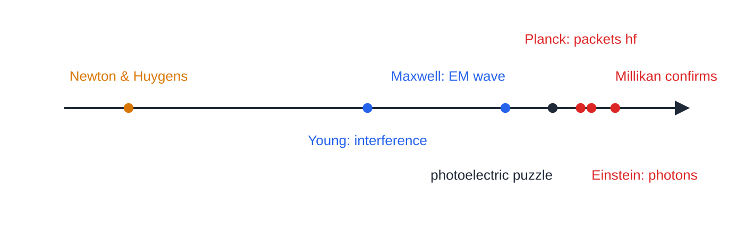
How did the wave and photon models of light develop? (continued)
Section 1 of 12
Today neither model alone is complete. Light shows wave behaviour as it travels (diffraction, interference, polarisation) and particle behaviour when it interacts with matter (photoelectric effect, line spectra): wave–particle duality. The history shows how science works: a model is kept while it explains the evidence, and replaced or extended when new, reproducible evidence contradicts it.
Timeline of the models of light: blue points supported the wave model, red points the photon model. The photoelectric puzzle (black) is the evidence the wave model could not explain.
Notes:
How did the wave and photon models of light develop?. Full notes: https://examinerprep.com/notes/edexcel-ial-physics/photons-the-photoelectric-effect-and-line-spectra/

Slide 7
What is a photon, and how much energy does it carry?
Section 2 of 12
A photon is a quantum (discrete packet) of electromagnetic radiation, with energy proportional to its frequency: E = hf.
Here E is the photon energy (J), h the Planck constant, 6.63 ×10⁻³⁴ J s, and f the frequency (Hz). E = hf is in the formulae list, and so is c = fλ. Combining them gives E = hc/λ, which is not given, so derive it.
Higher frequency (shorter wavelength) means more energy per photon: an ultraviolet photon carries more energy than a red one.
The intensity of a beam depends on how many photons arrive per second, not on the energy of each one.
For a beam of power P: number of photons per second = P ÷hf.
Notes:
What is a photon, and how much energy does it carry?. Full notes: https://examinerprep.com/notes/edexcel-ial-physics/photons-the-photoelectric-effect-and-line-spectra/

Slide 8
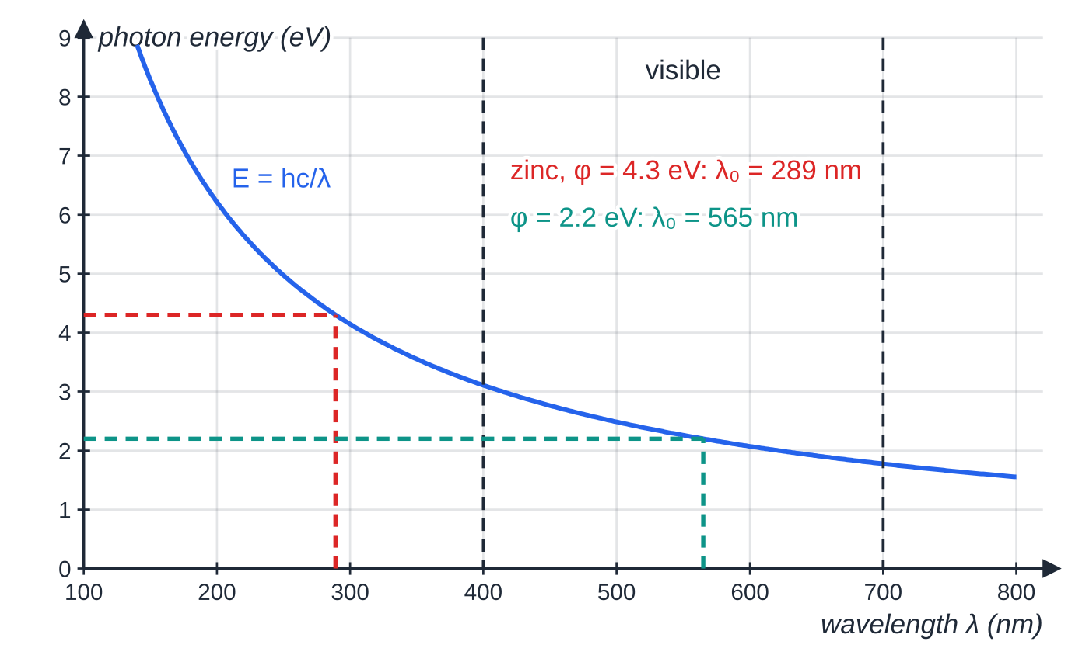
What is a photon, and how much energy does it carry? (continued)
Section 2 of 12
Photon energy against wavelength. Visible photons carry roughly 1.8–3.1 eV. A metal with a work function of 4.3 eV needs photons shorter than 289 nm (ultraviolet); one with 2.2 eV responds to light shorter than 565 nm. λ₀ is the threshold wavelength.
Notes:
What is a photon, and how much energy does it carry?. Full notes: https://examinerprep.com/notes/edexcel-ial-physics/photons-the-photoelectric-effect-and-line-spectra/

Slide 9
What is a photon, and how much energy does it carry? (continued)
Section 2 of 12 · Worked example 1 · Easy · Calculate
WORKED EXAMPLE · QUESTION
A green laser pointer emits light of wavelength 532 nm with an output power of 5.0 mW. (a) Calculate the frequency of the light. (b) Calculate the energy of one photon. (c) Calculate the number of photons emitted each second.
SOLUTION
(a) f = c/λ= 3.00 ×10⁸ ÷532 ×10⁻⁹ = 5.64 × 10¹⁴ Hz.
(b) E = hf = 6.63 ×10⁻³⁴ ×5.64 ×10¹⁴ = 3.74 × 10⁻¹⁹ J.
(c) Energy per second ÷ energy per photon: N = 5.0 ×10⁻³ ÷3.74 ×10⁻¹⁹ = 1.3 × 10¹⁶ s⁻¹ (1.34 × 10¹⁶ s⁻¹).
Even a weak beam carries an enormous number of photons each second, which is why light usually looks continuous.
Notes:
What is a photon, and how much energy does it carry?: Worked example 1. Full notes: https://examinerprep.com/notes/edexcel-ial-physics/photons-the-photoelectric-effect-and-line-spectra/

Slide 10
What is the electronvolt?
Section 3 of 12
The electronvolt (eV) is the energy transferred when an electron moves through a potential difference of 1 volt.
From W = QV: 1 eV = 1.60 ×10⁻¹⁹ C ×1 V = 1.60 ×10⁻¹⁹ J. To go from eV to J, multiply by 1.60 ×10⁻¹⁹; from J to eV, divide. An electron accelerated from rest through a p.d. V gains kinetic energy eV: through 1500 V it gains 1500 eV. The eV is a convenient size for photon energies, work functions and atomic energy levels, which are all a few eV; 1 keV = 10³ eV and 1 MeV = 10⁶ eV.
Notes:
What is the electronvolt?. Full notes: https://examinerprep.com/notes/edexcel-ial-physics/photons-the-photoelectric-effect-and-line-spectra/

Slide 11
What is the electronvolt? (continued)
Section 3 of 12 · Worked example 2 · Easy · Calculate
WORKED EXAMPLE · QUESTION
(a) Express the photon energy from worked example 1 in electronvolts. (b) An electron is accelerated from rest through a potential difference of 1500 V. Calculate its kinetic energy in joules and its final speed. Mass of electron = 9.11 ×10⁻³¹ kg.
SOLUTION
(a) 3.74 ×10⁻¹⁹ ÷1.60 ×10⁻¹⁹ = 2.34 eV.
(b) Eₖ = 1500 eV = 1500 ×1.60 ×10⁻¹⁹ = 2.4 ×10⁻¹⁶ J. From Eₖ = ½ mv²: v = √(2 ×2.4 ×10⁻¹⁶ ÷9.11 ×10⁻³¹) = 2.4 × 10⁻¹⁶ J; 2.30 × 10⁷ m s⁻¹.
Notes:
What is the electronvolt?: Worked example 2. Full notes: https://examinerprep.com/notes/edexcel-ial-physics/photons-the-photoelectric-effect-and-line-spectra/

Slide 12
What is the electronvolt? (continued)
Section 3 of 12
Common error
Putting an energy in eV straight into ½ mv² or E = hf. Whenever h, a mass in kg or a speed in m s⁻¹ appears in the same equation, the energy must be in joules.
Notes:
What is the electronvolt?. Full notes: https://examinerprep.com/notes/edexcel-ial-physics/photons-the-photoelectric-effect-and-line-spectra/

Slide 13
What is the photoelectric effect?
Section 4 of 12
The photoelectric effect is the emission of electrons from the surface of a metal when electromagnetic radiation of high enough frequency falls on it. The emitted electrons are called photoelectrons.
A classic demonstration: a clean zinc plate on a negatively charged electroscope discharges at once in ultraviolet light, but not at all in bright visible light. One photon interacts with one electron and gives it all its energy, hf; the photon ceases to exist. The electron needs a minimum energy to escape the attraction of the metal's positive ions.
The work function φ of a metal is the minimum energy needed to remove an electron from the surface of the metal.
The threshold frequency f₀ is the minimum frequency of radiation that will release electrons from the surface of a metal.
Notes:
What is the photoelectric effect?. Full notes: https://examinerprep.com/notes/edexcel-ial-physics/photons-the-photoelectric-effect-and-line-spectra/

Slide 14
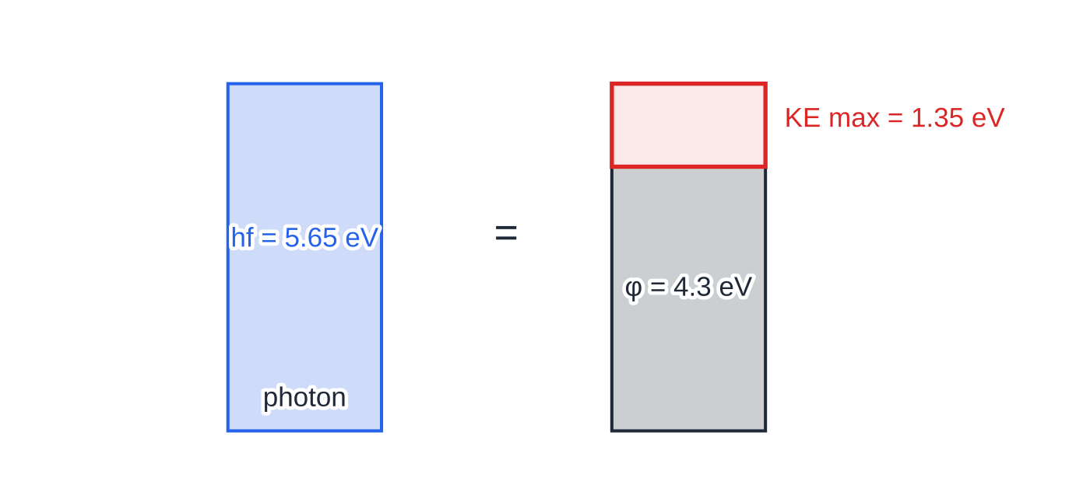
What is the photoelectric effect? (continued)
Section 4 of 12
hf = φ+ ½ mv²ₘₐₓ
Einstein's photoelectric equation is in the formulae list. It is an energy balance: photon energy in = energy to escape + kinetic energy left over. It says "max" because electrons from below the surface lose some energy on the way out; only those at the surface leave with all of hf - φ. At threshold, hf₀ = φ, so f₀ = φ/h; derive this, as it is not given.
The energy balance of worked example 3: a 220 nm photon (5.65 eV) on zinc spends 4.3 eV escaping and leaves the fastest electron with 1.35 eV of kinetic energy.
Notes:
What is the photoelectric effect?. Full notes: https://examinerprep.com/notes/edexcel-ial-physics/photons-the-photoelectric-effect-and-line-spectra/

Slide 15
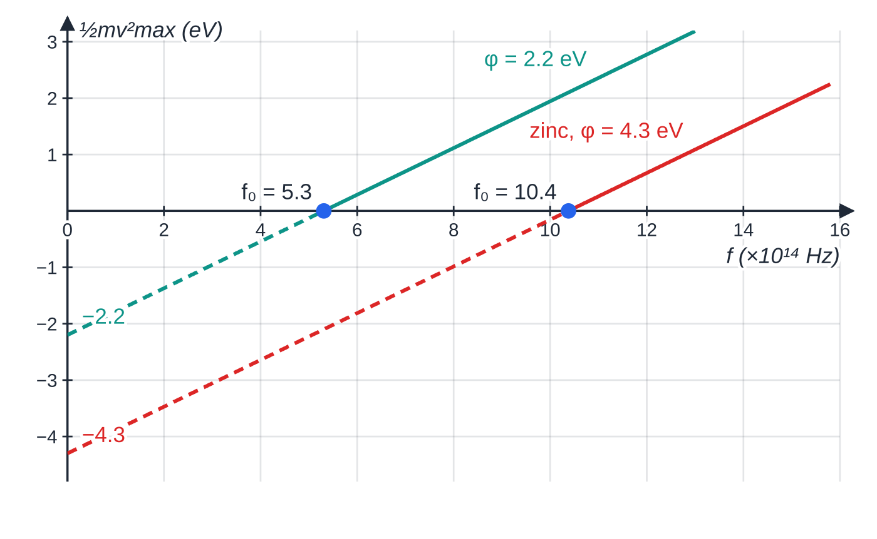
What is the photoelectric effect? (continued)
Section 4 of 12
A graph of ½ mv²ₘₐₓ against f is a straight line: the gradient is h for every metal, the f-intercept is f₀, and the line extrapolates to -φ on the energy axis.
Maximum kinetic energy against frequency for two metals. The lines are parallel (gradient h). Below f₀ no electrons are emitted, so the dashed parts are extrapolations to −φ, not measurements.
Notes:
What is the photoelectric effect?. Full notes: https://examinerprep.com/notes/edexcel-ial-physics/photons-the-photoelectric-effect-and-line-spectra/

Slide 16
What is the photoelectric effect? (continued)
Section 4 of 12 · Worked example 3 · Medium · Calculate
WORKED EXAMPLE · QUESTION
Ultraviolet radiation of wavelength 220 nm falls on a clean zinc surface. The work function of zinc is 4.3 eV. Mass of electron = 9.11 ×10⁻³¹ kg. (a) Calculate the photon energy in eV. (b) Calculate the maximum speed of the photoelectrons. (c) Calculate the threshold frequency for zinc.
SOLUTION
(a) E = hc/λ= 6.63 ×10⁻³⁴ ×3.00 ×10⁸ ÷220 ×10⁻⁹ = 9.04 ×10⁻¹⁹ J = 5.65 eV.
(b) Maximum kinetic energy = 5.65 - 4.3 = 1.35 eV = 1.35 ×1.60 ×10⁻¹⁹ = 2.16 ×10⁻¹⁹ J. Then vₘₐₓ = √(2 ×2.16 ×10⁻¹⁹ ÷9.11 ×10⁻³¹) = 6.9 × 10⁵ m s⁻¹ (6.89 × 10⁵ m s⁻¹).
(c) f₀ = φ/h = 4.3 ×1.60 ×10⁻¹⁹ ÷6.63 ×10⁻³⁴ = 1.0 × 10¹⁵ Hz (1.04 × 10¹⁵ Hz).
The work function is given to 2 s.f., so the speed and frequency are given to 2 s.f.
Notes:
What is the photoelectric effect?: Worked example 3. Full notes: https://examinerprep.com/notes/edexcel-ial-physics/photons-the-photoelectric-effect-and-line-spectra/

Slide 17
What is the photoelectric effect? (continued)
Section 4 of 12
Common error
Subtracting 4.3 (eV) from 9.04 ×10⁻¹⁹ (J). Decide on one energy unit before you subtract: convert hf to eV, or convert φ to joules.
Notes:
What is the photoelectric effect?. Full notes: https://examinerprep.com/notes/edexcel-ial-physics/photons-the-photoelectric-effect-and-line-spectra/

Slide 18
How do you measure the maximum kinetic energy of photoelectrons?
Section 5 of 12
Light falls on the metal cathode of a vacuum photocell; photoelectrons cross to the anode and a sensitive ammeter registers a photocurrent. Now make the anode negative relative to the cathode. Electrons are repelled and must do work against the field to reach it, so only those with enough kinetic energy arrive. Increase this reverse p.d. until the current just falls to zero. That p.d. is the stopping potential Vₛ: even the fastest electrons are just turned back, so
eVₛ = ½ mv²ₘₐₓ
A stopping potential of 1.35 V means a maximum kinetic energy of 1.35 eV. This relation is not in the formulae list; learn it.
Notes:
How do you measure the maximum kinetic energy of photoelectrons?. Full notes: https://examinerprep.com/notes/edexcel-ial-physics/photons-the-photoelectric-effect-and-line-spectra/

Slide 19
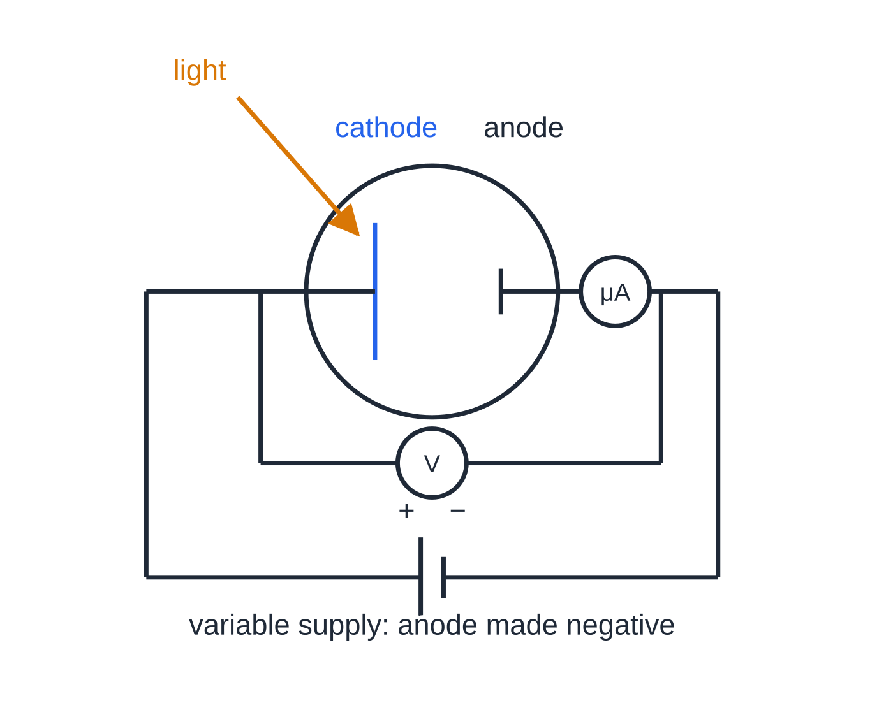
How do you measure the maximum kinetic energy of photoelectrons? (continued)
Section 5 of 12
Circuit for measuring stopping potential. The supply makes the anode negative; the voltmeter reads the reverse p.d. across the photocell and the microammeter shows when the photocurrent reaches zero.
Notes:
How do you measure the maximum kinetic energy of photoelectrons?. Full notes: https://examinerprep.com/notes/edexcel-ial-physics/photons-the-photoelectric-effect-and-line-spectra/

Slide 20
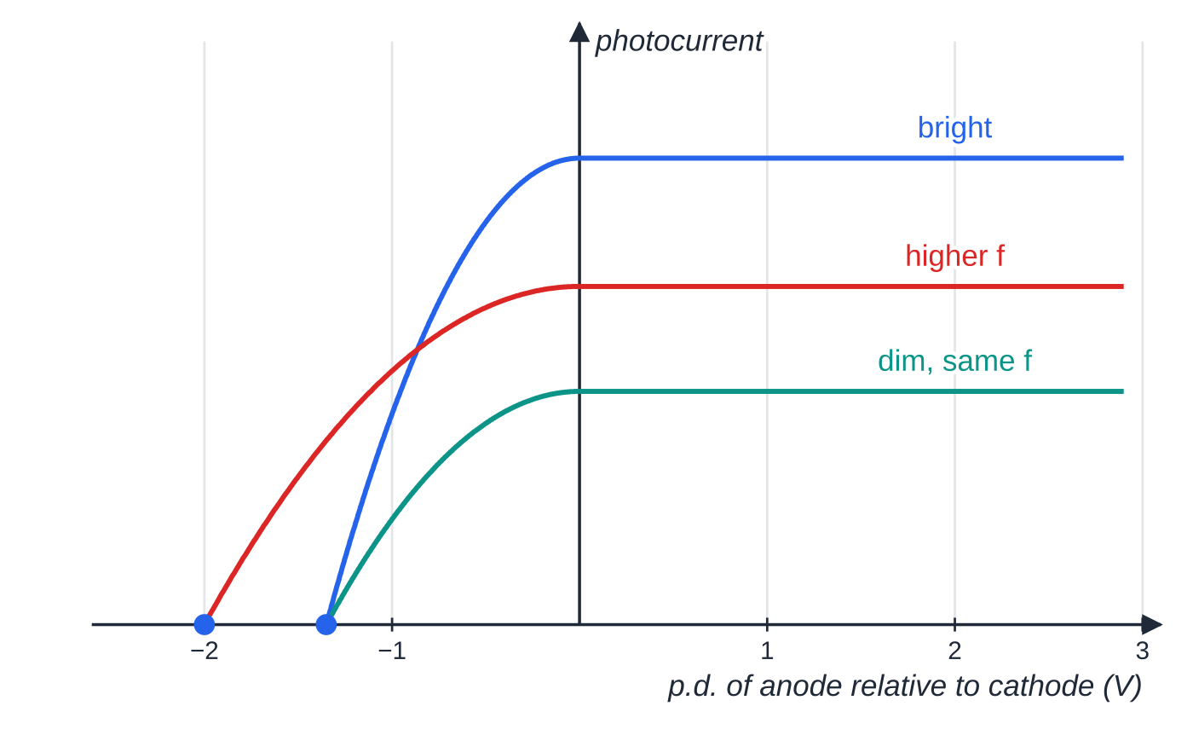
How do you measure the maximum kinetic energy of photoelectrons? (continued)
Section 5 of 12
Combining eVₛ = ½ mv²ₘₐₓ with Einstein's equation gives eVₛ = hf - φ, so Vₛ = (h/e)f - φ/e. A graph of Vₛ against f is a straight line of gradient h/e, a way to measure the Planck constant.
Photocurrent against p.d. (shape from a simple model). Bright and dim light of the same frequency have the same stopping potential (current zero at −1.35 V) but different saturation currents; a higher frequency gives a larger stopping potential (zero at −2.0 V).
Notes:
How do you measure the maximum kinetic energy of photoelectrons?. Full notes: https://examinerprep.com/notes/edexcel-ial-physics/photons-the-photoelectric-effect-and-line-spectra/

Slide 21
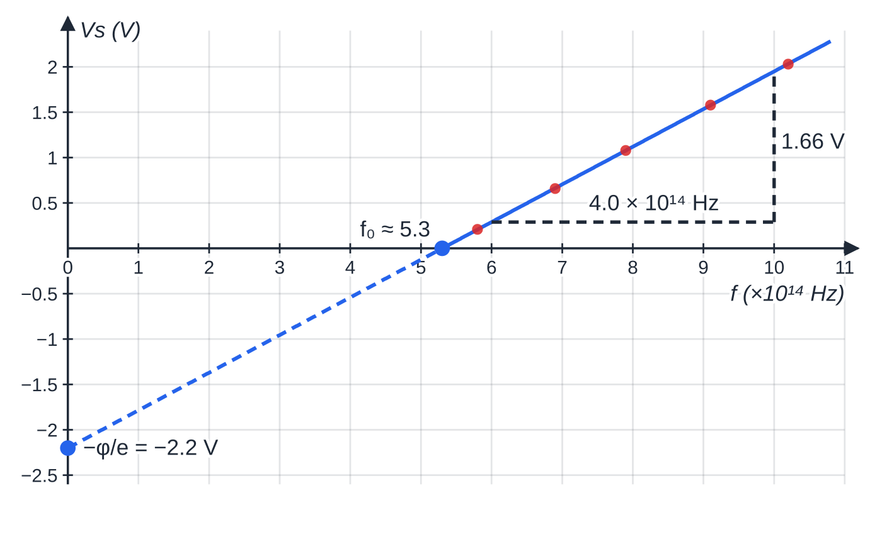
How do you measure the maximum kinetic energy of photoelectrons? (continued)
Section 5 of 12
Data from worked example 4 with the best-fit line. The gradient triangle spans 4.0 × 10¹⁴ Hz and 1.66 V; the line meets the frequency axis at the threshold frequency and extrapolates to −φ/e.
Notes:
How do you measure the maximum kinetic energy of photoelectrons?. Full notes: https://examinerprep.com/notes/edexcel-ial-physics/photons-the-photoelectric-effect-and-line-spectra/

Slide 22
How do you measure the maximum kinetic energy of photoelectrons? (continued)
Section 5 of 12 · Worked example 4 · Hard · Determine
WORKED EXAMPLE · QUESTION
A student shines light of five different frequencies on the same photocell and measures the stopping potential each time.
f / 10¹⁴ Hz | 5.8 | 6.9 | 7.9 | 9.1 | 10.2
Vs / V | 0.21 | 0.66 | 1.08 | 1.58 | 2.03
(a) Use the graph above to determine a value for the Planck constant. (b) Determine the work function of the cathode, in eV.
SOLUTION
(a) Gradient of the best-fit line, from a large triangle: 1.66 V ÷4.0 ×10¹⁴ Hz = 4.15 ×10⁻¹⁵ V s. Gradient = h/e, so h = 1.60 ×10⁻¹⁹ ×4.15 ×10⁻¹⁵ = 6.64 × 10⁻³⁴ J s.
(b) From the f-intercept, f₀ ≈5.3 ×10¹⁴ Hz. φ= hf₀ = 6.64 ×10⁻³⁴ ×5.3 ×10¹⁴ = 3.5 ×10⁻¹⁹ J = 2.2 eV.
Notes:
How do you measure the maximum kinetic energy of photoelectrons?: Worked example 4. Full notes: https://examinerprep.com/notes/edexcel-ial-physics/photons-the-photoelectric-effect-and-line-spectra/

Slide 23
How do you measure the maximum kinetic energy of photoelectrons? (continued)
Section 5 of 12 · Worked example 4 · Hard · Determine (continued)
Use points on your best-fit line, not individual data points, for the gradient. Equivalent method: the line extrapolates to -φ/e = -2.2 V at f = 0.
Notes:
How do you measure the maximum kinetic energy of photoelectrons?: Worked example 4. Full notes: https://examinerprep.com/notes/edexcel-ial-physics/photons-the-photoelectric-effect-and-line-spectra/

Slide 24
How do you measure the maximum kinetic energy of photoelectrons? (continued)
Section 5 of 12
Common error
Saying the gradient of Vₛ against f is h. It is h/e, because the vertical axis is a p.d., not an energy. If the graph is of maximum kinetic energy in joules against f, then the gradient is h.
Notes:
How do you measure the maximum kinetic energy of photoelectrons?. Full notes: https://examinerprep.com/notes/edexcel-ial-physics/photons-the-photoelectric-effect-and-line-spectra/

Slide 25
Why is the photoelectric effect evidence for photons?
Section 6 of 12
In the wave model, the energy of a light wave is spread continuously across the wavefront and grows with intensity, so electrons could soak up energy gradually until they had enough to escape. The observations contradict this.
Observation | Wave model predicts | Photon model explains
Below a threshold frequency no electrons are emitted, however intense the light. | Any frequency should work if the light is bright enough or shines for long enough. | Each electron absorbs one photon. If hf < φ, no single photon has enough energy; more photons only means more electrons that each fail to escape.
Emission begins instantly, even in very dim light (above f₀). | In dim light an electron would need time to build up enough energy. | One photon delivers hf to one electron at once.
The maximum kinetic energy depends on frequency, not intensity. | Brighter light carries more energy, so electrons should leave faster. | ½ mv²ₘₐₓ = hf - φ depends only on f. Intensity sets the number of photons per second.
Notes:
Why is the photoelectric effect evidence for photons?. Full notes: https://examinerprep.com/notes/edexcel-ial-physics/photons-the-photoelectric-effect-and-line-spectra/

Slide 26
Why is the photoelectric effect evidence for photons? (continued)
Section 6 of 12
Observation | Wave model predicts | Photon model explains
Photocurrent is proportional to intensity (above f₀). | Consistent, but cannot explain the rows above. | More photons per second → more photoelectrons per second.
Notes:
Why is the photoelectric effect evidence for photons?. Full notes: https://examinerprep.com/notes/edexcel-ial-physics/photons-the-photoelectric-effect-and-line-spectra/

Slide 27
Why is the photoelectric effect evidence for photons? (continued)
Section 6 of 12 · Worked example 5 · Hard · Explain
WORKED EXAMPLE · QUESTION
Explain how observations of the photoelectric effect support a particle (photon) model of light rather than a wave model. Refer to threshold frequency, the time before emission begins and the energy of the emitted electrons.
SOLUTION
A full answer links each observation to the model:
Light consists of photons, each of energy E = hf; one photon is absorbed by one electron.
An electron needs at least the work function φ to escape, so emission needs hf ≥φ: below f₀ = φ/h there is no emission, whatever the intensity. In the wave model energy could build up, so any frequency should eventually work; this is not observed.
Emission is instantaneous because each photon delivers its energy in a single interaction; the wave model predicts a delay in dim light.
Notes:
Why is the photoelectric effect evidence for photons?: Worked example 5. Full notes: https://examinerprep.com/notes/edexcel-ial-physics/photons-the-photoelectric-effect-and-line-spectra/

Slide 28
Why is the photoelectric effect evidence for photons? (continued)
Section 6 of 12 · Worked example 5 · Hard · Explain (continued)
The maximum kinetic energy is hf - φ, so it rises with frequency and does not depend on intensity. Greater intensity means more photons per second, so more electrons per second, not faster ones; the wave model predicts faster electrons in brighter light.
Threshold, instant emission and frequency-dependent energy all need one-photon-one-electron energy packets.
Notes:
Why is the photoelectric effect evidence for photons?: Worked example 5. Full notes: https://examinerprep.com/notes/edexcel-ial-physics/photons-the-photoelectric-effect-and-line-spectra/

Slide 29
What are line spectra, and what do they tell us about atoms?
Section 7 of 12
Electrons in an atom can only have certain discrete energies, called energy levels. The lowest is the ground state; higher ones are excited states.
Levels are given negative values: zero is the energy of an electron that has just escaped (ionisation). The ground state value, without its sign, is the ionisation energy.
Emission: an excited electron drops to a lower level and emits one photon carrying the energy difference. In a gas discharge tube, electrons accelerated by the p.d. collide with atoms and excite them; the atoms then de-excite.
Absorption: an electron absorbs a photon only if the photon energy exactly equals the difference between its level and a higher one. Other photons pass straight through.
Because the levels are discrete, only certain photon energies, and so only certain frequencies, are involved. Each element has its own set of levels, so its line spectrum identifies it.
Notes:
What are line spectra, and what do they tell us about atoms?. Full notes: https://examinerprep.com/notes/edexcel-ial-physics/photons-the-photoelectric-effect-and-line-spectra/

Slide 30
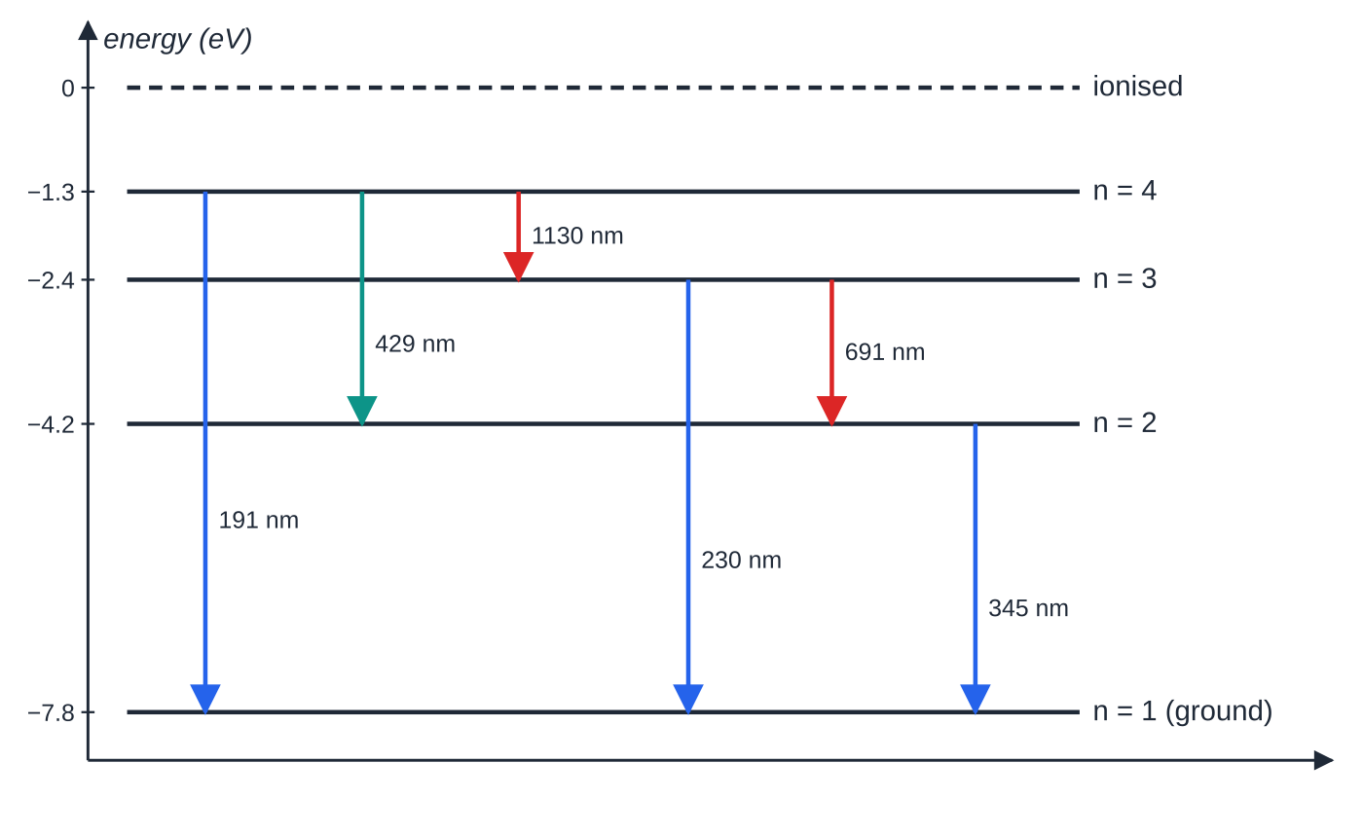
What are line spectra, and what do they tell us about atoms? (continued)
Section 7 of 12
hf = E₁ - E₂
Here E₁ is the energy of the higher level and E₂ of the lower level (J), and f the photon frequency (Hz). This is not in the formulae list, so learn it; it is E = hf applied to the gap between two levels. Diagrams are usually in eV: convert the difference to joules before using h.
Emission and absorption spectra
An emission line spectrum is bright coloured lines on a dark background, from a hot, low-pressure gas.
Energy level diagram (to scale) for an atom with four bound levels. An electron in n = 4 can reach the ground state by several routes, so six different photon energies are possible, with wavelengths from λ = hc/ΔE running from 191 nm (6.50 eV) to 1130 nm (1.10 eV).
Notes:
What are line spectra, and what do they tell us about atoms?. Full notes: https://examinerprep.com/notes/edexcel-ial-physics/photons-the-photoelectric-effect-and-line-spectra/

Slide 31
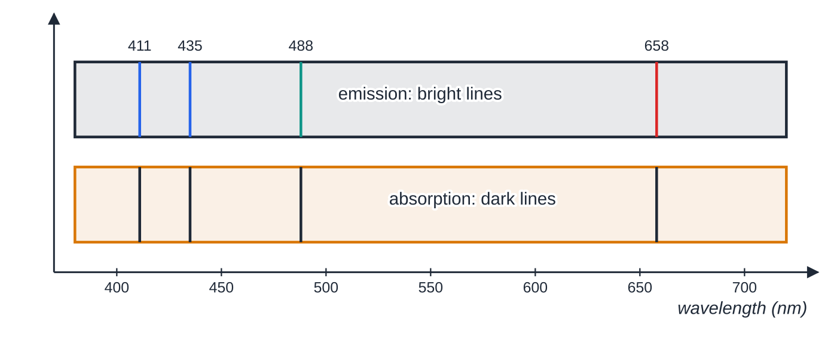
What are line spectra, and what do they tell us about atoms? (continued)
Section 7 of 12
An absorption line spectrum is dark lines across a continuous spectrum, seen when white light passes through a cooler gas. The atoms absorb exactly the photon energies that match their level differences, then re-emit in random directions, so less light at those wavelengths continues towards the observer. The dark lines of an element are at the same wavelengths as some of its bright emission lines, because the same energy gaps are involved.
The visible lines of hydrogen, calculated from levels Eₙ = −13.6 eV/n² for transitions down to (emission) or up from (absorption) n = 2. Measured values are within about 2 nm of these; the small differences come from rounding the constants.
Notes:
What are line spectra, and what do they tell us about atoms?. Full notes: https://examinerprep.com/notes/edexcel-ial-physics/photons-the-photoelectric-effect-and-line-spectra/

Slide 32
What are line spectra, and what do they tell us about atoms? (continued)
Section 7 of 12 · Worked example 6 · Hard · Calculate
WORKED EXAMPLE · QUESTION
The energy level diagram above has levels at −7.80 eV (n = 1), −4.20 eV (n = 2), −2.40 eV (n = 3) and −1.30 eV (n = 4). (a) State the ionisation energy of the atom in joules. (b) Calculate the frequency of the highest-energy photon that can be emitted. (c) Show that the longest wavelength emitted lies in the infrared. (d) A photon of energy 5.00 eV and, separately, a free electron with 5.00 eV of kinetic energy meet atoms in the ground state. Explain what can happen in each case.
SOLUTION
(a) Energy to lift an electron from the ground state to 0 eV: 7.80 ×1.60 ×10⁻¹⁹ = 1.25 × 10⁻¹⁸ J.
(b) Largest gap, n = 4 → n = 1: ΔE = -1.30 - (-7.80) = 6.50 eV, so f = 6.50 ×1.60 ×10⁻¹⁹ ÷6.63 ×10⁻³⁴ = 1.57 × 10¹⁵ Hz.
(c) Longest wavelength = smallest gap, n = 4 → n = 3: λ= 6.63 ×10⁻³⁴ ×3.00 ×10⁸ ÷(1.10 ×1.60 ×10⁻¹⁹) = 1.13 × 10⁻⁶ m, longer than about 7 ×10⁻⁷ m, so infrared.
Notes:
What are line spectra, and what do they tell us about atoms?: Worked example 6. Full notes: https://examinerprep.com/notes/edexcel-ial-physics/photons-the-photoelectric-effect-and-line-spectra/

Slide 33
What are line spectra, and what do they tell us about atoms? (continued)
Section 7 of 12 · Worked example 6 · Hard · Calculate (continued)
(d) Photon: all or nothing. No gap from the ground state equals 5.00 eV (they are 3.60, 5.40 and 6.50 eV), so the photon is not absorbed. Electron: it can give up part of its energy, so it can excite an atom to n = 2 (3.60 eV) and carry on with 1.40 eV; it cannot reach n = 3 (5.40 eV).
Notes:
What are line spectra, and what do they tell us about atoms?: Worked example 6. Full notes: https://examinerprep.com/notes/edexcel-ial-physics/photons-the-photoelectric-effect-and-line-spectra/

Slide 34
What are line spectra, and what do they tell us about atoms? (continued)
Section 7 of 12
Common error
Using one level's value instead of the difference, or adding the two negative values. The photon energy is always the gap: subtract the lower (more negative) level from the higher one, so the answer is positive.
Notes:
What are line spectra, and what do they tell us about atoms?. Full notes: https://examinerprep.com/notes/edexcel-ial-physics/photons-the-photoelectric-effect-and-line-spectra/

Slide 35
Exam tips for 2.5
Section 8 of 12
Exam tip 1 — convert nm and eV first
Wavelengths in nm need ×10⁻⁹; energies in eV need ×1.60 ×10⁻¹⁹ before they meet h, c or a mass. Write the conversion as a separate line so it is visible.
Exam tip 2 — energy balance in words, and the word "maximum"
Write "photon energy = work function + maximum kinetic energy" before substituting. Always say maximum kinetic energy: photoelectrons leave with a range of energies, because those below the surface lose energy on the way out.
Notes:
Exam tips for 2.5. Full notes: https://examinerprep.com/notes/edexcel-ial-physics/photons-the-photoelectric-effect-and-line-spectra/

Slide 36
Exam tips for 2.5 (continued)
Section 8 of 12
Exam tip 3 — intensity versus frequency
Frequency controls the energy of each photon, and so whether emission happens and the maximum kinetic energy. Intensity controls the number of photons per second, and so the number of electrons per second (the current).
Exam tip 4 — extended explanations
Pair each observation with its explanation, and say what the wave model would have predicted. Use the words one photon, one electron, work function and intensity = number of photons per second.
Exam tip 5 — counting lines
From the n-th level, the number of different photon energies possible is n(n - 1)/2: six from n = 4. Check by drawing every downward arrow between pairs of levels.
Notes:
Exam tips for 2.5. Full notes: https://examinerprep.com/notes/edexcel-ial-physics/photons-the-photoelectric-effect-and-line-spectra/

Slide 37
Common misconceptions
Section 9 of 12
Misconception | Why it is wrong | Correct idea
Brighter light gives photoelectrons more kinetic energy. | Intensity changes the number of photons, not the energy of each. | Brighter light (above f₀) gives more electrons per second; ½ mv²ₘₐₓ depends only on f.
Very bright red light will eventually release electrons from zinc. | Each red photon has less energy than the work function, and electrons cannot store energy from several photons. | Below f₀ there is no emission at any intensity.
All photoelectrons leave with the same kinetic energy. | Electrons below the surface lose energy escaping. | hf - φ is the maximum kinetic energy.
The work function is the energy of the photon. | It is a property of the metal surface. | The work function is the minimum energy to remove an electron from the metal.
Notes:
Common misconceptions. Full notes: https://examinerprep.com/notes/edexcel-ial-physics/photons-the-photoelectric-effect-and-line-spectra/

Slide 38
Common misconceptions (continued)
Section 9 of 12
Misconception | Why it is wrong | Correct idea
An atom absorbs any photon with more energy than the gap. | A photon is absorbed whole or not at all. | Only photons whose energy exactly matches a gap are absorbed (a free electron can give up part of its energy).
Dark lines in an absorption spectrum mean the light there is completely removed. | Absorbed energy is re-emitted, but in all directions. | Those wavelengths are much fainter in the direction of the original beam, so the lines look dark by contrast.
Notes:
Common misconceptions. Full notes: https://examinerprep.com/notes/edexcel-ial-physics/photons-the-photoelectric-effect-and-line-spectra/

Slide 39
How this topic connects
Section 10 of 12
1–2.4 Waves
c = fλ links the wavelength in a spectrum to the photon frequency; diffraction and interference are the evidence for the wave model, and a diffraction grating (2.4) is how line spectra are measured precisely.
6 onwards: electric circuits
The electronvolt comes from W = QV; the stopping potential is the p.d. that does enough work on an electron to remove all its kinetic energy.
Units 4 and 5
Particles accelerated through a p.d. gain energy eV, and particle energies are quoted in MeV and GeV (Unit 4). Absorption lines in starlight identify the elements in stars, and black-body radiation, the problem that started the quantum idea, is used to find stellar temperatures (Unit 5).
Notes:
How this topic connects. Full notes: https://examinerprep.com/notes/edexcel-ial-physics/photons-the-photoelectric-effect-and-line-spectra/

Slide 40
Key equations
Section 11 of 12
Equation | Use | In the formulae list?
E = hf | energy of one photon; E in J, f in Hz | Yes
c = fλ | frequency from wavelength | Yes
E = hc/λ | photon energy from wavelength | No — derive it from the two above
1 eV = 1.60 ×10⁻¹⁹ J | converting energies; Eₖ = eV after acceleration through V | No — learn it (e is on the data list)
hf = φ+ ½ mv²ₘₐₓ | photoelectric effect: energy balance for one photon and one electron | Yes
f₀ = φ/h | threshold frequency | No — derive it (set ½mv²max = 0)
eVₛ = ½ mv²ₘₐₓ | maximum kinetic energy from stopping potential | No — learn it
Notes:
Key equations. Full notes: https://examinerprep.com/notes/edexcel-ial-physics/photons-the-photoelectric-effect-and-line-spectra/

Slide 41
Key equations (continued)
Section 11 of 12
Equation | Use | In the formulae list?
hf = E₁ - E₂ | photon emitted or absorbed in a transition between energy levels | No — learn it (it is E = hf for the gap)
number of photons per second = P/hf | photon rate in a beam of power P | No — derive it
Notes:
Key equations. Full notes: https://examinerprep.com/notes/edexcel-ial-physics/photons-the-photoelectric-effect-and-line-spectra/

Slide 42
Check your understanding
Section 12 of 12
1. Define the work function of a metal.
2. Calculate the energy, in eV, of a photon of frequency 1.0 × 10¹⁵ Hz.
3. Light below the threshold frequency falls on a metal. Its intensity is doubled. What happens?
4. The stopping potential for a photocell is 0.80 V. What is the maximum kinetic energy of the photoelectrons in joules?
5. Why do the dark lines in the absorption spectrum of a gas appear at the same wavelengths as bright lines in its emission spectrum?
6. Light of wavelength 450 nm falls on a metal of work function 2.2 eV. Calculate the stopping potential.
Notes:
Check your understanding: questions. Full notes: https://examinerprep.com/notes/edexcel-ial-physics/photons-the-photoelectric-effect-and-line-spectra/

Slide 43
Check your understanding · answers
Section 12 of 12
1. The minimum energy needed to remove an electron from the surface of the metal.
2. E = 6.63 ×10⁻³⁴ ×1.0 ×10¹⁵ = 6.63 ×10⁻¹⁹ J; ÷1.60 ×10⁻¹⁹ = 4.14 eV.
3. Still no electrons are emitted. Doubling the intensity doubles the number of photons per second, but each photon still has less energy than the work function, and an electron absorbs only one photon.
4. ½ mv²ₘₐₓ = eVₛ = 1.60 ×10⁻¹⁹ ×0.80 = 1.28 × 10⁻¹⁹ J (0.80 eV).
5. Both involve the same pairs of energy levels. A photon is absorbed only if its energy equals a gap E₁ - E₂, and a photon of exactly that energy is emitted when an electron drops back across the same gap, so the frequencies are the same.
6. E = hc/λ= 6.63 ×10⁻³⁴ ×3.00 ×10⁸ ÷450 ×10⁻⁹ = 4.42 ×10⁻¹⁹ J = 2.76 eV. Maximum kinetic energy = 2.76 - 2.2 = 0.56 eV, so Vs = 0.56 V.
Notes:
Check your understanding: answers. Full notes: https://examinerprep.com/notes/edexcel-ial-physics/photons-the-photoelectric-effect-and-line-spectra/

Slide 44
Practice questions
5 original exam-style questions. Answers at the end of the deck.

Slide 45
Question 1
1 mark
Monochromatic light above the threshold frequency falls on a metal surface and photoelectrons are emitted. The intensity of the light is doubled without changing its frequency.
Which row describes the effect on the photoelectrons?
A maximum kinetic energy unchanged; number emitted per second unchanged
B maximum kinetic energy unchanged; number emitted per second doubled
C maximum kinetic energy doubled; number emitted per second unchanged
D maximum kinetic energy doubled; number emitted per second doubled
Notes:
Online with the full mark scheme: https://examinerprep.com/ial-physics-2-5-photons-the-photoelectric-effect-and-line-spectra-questions#IALP-U2-5-A-07

Slide 46
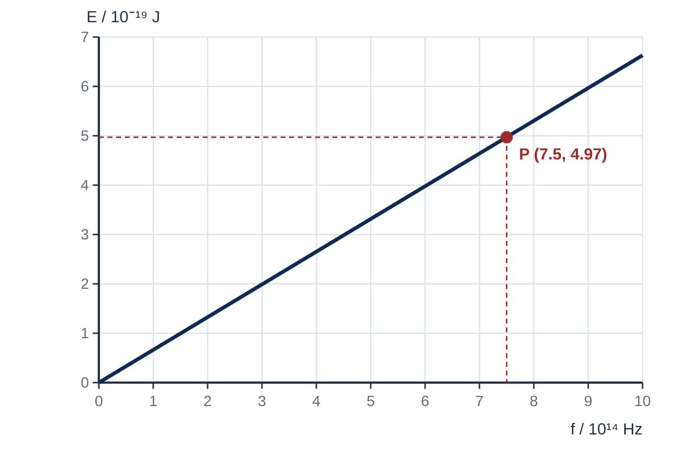
Question 2
1 mark
The graph shows how the energy E of a photon depends on its frequency f. Point P lies on the line.
What value of the Planck constant does the graph give?
A 6.6 × 10⁻³⁴ J s
B 6.6 × 10⁻²⁰ J s
C 0.66 J s
D 1.5 × 10³³ J s
Notes:
Online with the full mark scheme: https://examinerprep.com/ial-physics-2-5-photons-the-photoelectric-effect-and-line-spectra-questions#IALP-U2-5-FA-02

Slide 47
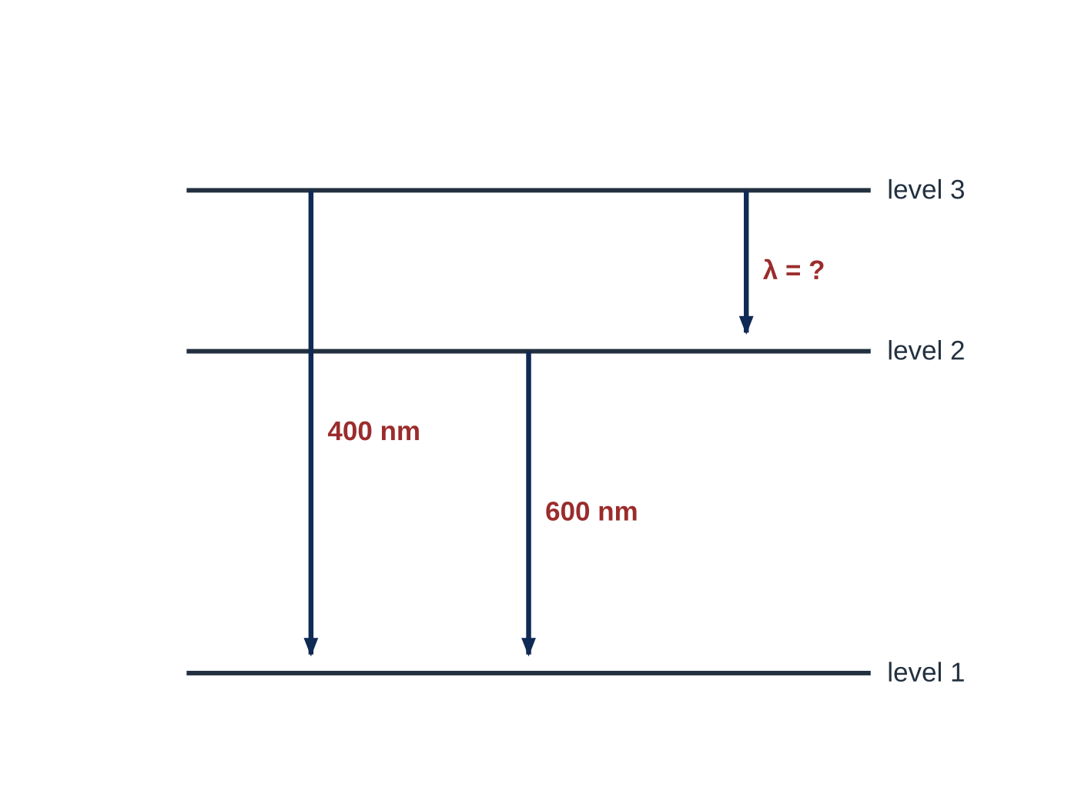
Question 3
1 mark
The diagram shows three energy levels of an atom. The photons emitted in two of the transitions have the wavelengths shown.
What is the wavelength of the photon emitted in the transition from level 3 to level 2?
A 200 nm
B 240 nm
C 1000 nm
D 1200 nm
Notes:
Online with the full mark scheme: https://examinerprep.com/ial-physics-2-5-photons-the-photoelectric-effect-and-line-spectra-questions#IALP-U2-5-FA-09

Slide 48
Question 4
8 marks
A student uses a vacuum photocell and a set of filters to investigate the photoelectric effect. For each frequency f of light, the student increases the reverse potential difference across the photocell until the photocurrent is zero, and records this stopping potential Vₛ.
f / 10¹⁴ Hz: 5.5, 6.5, 7.5, 8.5, 9.5
Vₛ / V: 0.36, 0.81, 1.20, 1.63, 2.03
(a) Explain why the photocurrent falls to zero when the reverse potential difference reaches Vₛ. [1]
(b) Plot a graph of Vₛ against f and use it to determine a value for the Planck constant. [3]
(c) Determine the work function of the metal in eV. [2]
(d) Determine the threshold frequency. [1]
(e) The voltmeter has a resolution of 0.01 V. Calculate the percentage uncertainty in the smallest reading of Vₛ. [1]
Notes:
Online with the full mark scheme: https://examinerprep.com/ial-physics-2-5-photons-the-photoelectric-effect-and-line-spectra-questions#IALP-U2-5-B-05

Slide 49
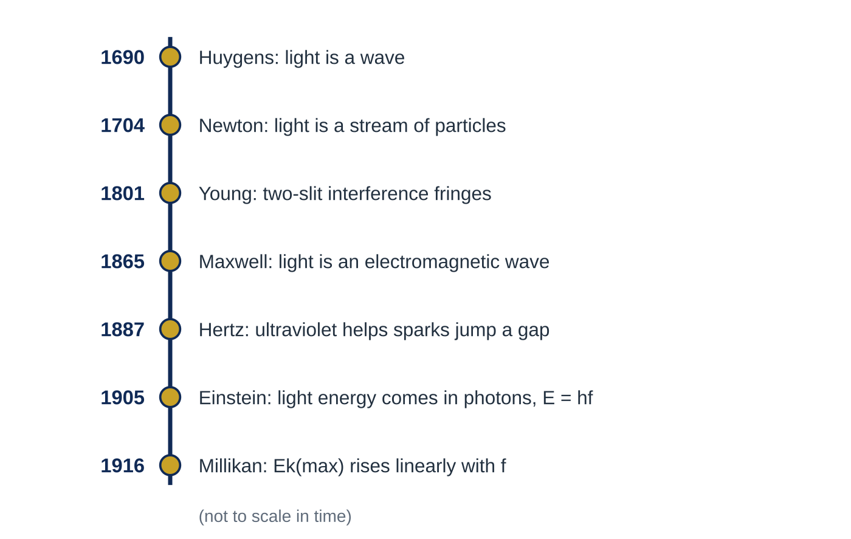
Question 5
6 marks
The timeline in Figure 1 shows some of the steps in the development of models of light.
(a) Identify the observation on the timeline that led scientists to prefer a wave model to Newton’s particle model, and explain why it did so. [2]
(b) Explain how Maxwell’s work in 1865 strengthened the wave model. [1]
(c) Hertz’s observation in 1887 was an early sign of the photoelectric effect. Explain why Einstein needed a photon model to account for the photoelectric effect. [2]
(d) Suggest why Millikan’s results in 1916 were important for the photon model. [1]
Notes:
Online with the full mark scheme: https://examinerprep.com/ial-physics-2-5-photons-the-photoelectric-effect-and-line-spectra-questions#IALP-U2-5-FB-06

Slide 50
Answers

Slide 51
Question 1 · answer
Answer B
Doubling the intensity doubles the number of photons arriving per second, so twice as many electrons are emitted each second. Each photon still has energy hf, so the maximum kinetic energy hf − φ is unchanged, with the number per second doubled.
Notes:
Full mark scheme: https://examinerprep.com/ial-physics-2-5-photons-the-photoelectric-effect-and-line-spectra-questions#IALP-U2-5-A-07

Slide 52
Question 2 · answer
Answer A
E = hf, so h is the gradient. Using P: h = 4.97 × 10⁻¹⁹ ÷ 7.5 × 10¹⁴ = 6.6 × 10⁻³⁴ J s.
Notes:
Full mark scheme: https://examinerprep.com/ial-physics-2-5-photons-the-photoelectric-effect-and-line-spectra-questions#IALP-U2-5-FA-02

Slide 53
Question 3 · answer
Answer D
Energies add: E_(3→1) = E_(3→2) + E_(2→1), and E = hc/λ, so 1/λ = 1/400 − 1/600 = 1/1200. λ = 1200 nm (infrared).
Notes:
Full mark scheme: https://examinerprep.com/ial-physics-2-5-photons-the-photoelectric-effect-and-line-spectra-questions#IALP-U2-5-FA-09

Slide 54
Question 4 · answer
Mark scheme
the work done against the field, eVₛ, equals the maximum kinetic energy of the photoelectrons, so even the fastest electrons are stopped before reaching the anode
points plotted correctly and a straight best-fit line drawn
gradient from a large triangle ≈ 4.2 × 10⁻¹⁵ V s (accept 4.0–4.4 × 10⁻¹⁵)
h = e × gradient = 6.7 × 10⁻³⁴ J s (accept 6.4–7.0 × 10⁻³⁴ J s)
use a point on the line in eVₛ = hf − φ, or extrapolate to −φ/e on the Vₛ axis
φ = 1.9 eV (accept 1.8–2.0 eV)
intercept on the f axis: f₀ = 4.6 × 10¹⁴ Hz (accept 4.4–4.8 × 10¹⁴ Hz)
uncertainty = half the resolution = 0.005 V; 0.005 ÷ 0.36 × 100 = 1.4% (allow 0.01 ÷ 0.36 × 100 = 2.8% if the full resolution is taken as the uncertainty)
Notes:
Full mark scheme: https://examinerprep.com/ial-physics-2-5-photons-the-photoelectric-effect-and-line-spectra-questions#IALP-U2-5-B-05

Slide 55
Question 5 · answer
Mark scheme
Young’s two-slit interference fringes (1801)
dark fringes need waves to superpose and cancel (arrive in antiphase); streams of particles cannot cancel each other
his theory predicted electromagnetic waves travelling at a speed equal to the measured speed of light, so light was identified as an electromagnetic wave
in the wave model energy is spread continuously over the wave, so any frequency should eventually release electrons and brighter light should give faster electrons, which is not observed
Einstein proposed energy arrives in photons of E = hf, each absorbed by one electron, so emission needs hf ≥ φ (a threshold frequency)
they tested a prediction of the model: maximum kinetic energy = hf − φ gives a straight line of gradient h, so the results supported (gave evidence for) the photon model
Notes:
Full mark scheme: https://examinerprep.com/ial-physics-2-5-photons-the-photoelectric-effect-and-line-spectra-questions#IALP-U2-5-FB-06

Slide 56
Keep practising
Notes for this topic
Questions on this topic
Build a printable test
ExaminerPrep is an independent tutoring service. It has been developed independently from and is not endorsed by the International Baccalaureate Organization. "International Baccalaureate", "IB" and "IB Diploma Programme" are registered trademarks of the IBO, used here for descriptive purposes only.
Pearson Edexcel and Cambridge are trademarks of their owners; ExaminerPrep is not affiliated with any exam board.

