Slide 1
EP
EDEXCEL IAL PHYSICS
6.1 Planning and evaluating experiments (A2)
The full notes page in 13 sections · practice questions with answers · simulations
ExaminerPrep is an independent tutoring service. It has been developed independently from and is not endorsed by the International Baccalaureate Organization. "International Baccalaureate", "IB" and "IB Diploma Programme" are registered trademarks of the IBO, used here for descriptive purposes only.
Pearson Edexcel and Cambridge are trademarks of their owners; ExaminerPrep is not affiliated with any exam board.
Notes:
6.1 Planning and evaluating experiments (A2). Notes for this topic: https://examinerprep.com/notes/edexcel-ial-physics/planning-and-evaluating-experiments-a2/

Slide 2
What this page covers
Overview
What an A2 planning or evaluation question asks for
Specifying apparatus: range, resolution and the relevant dimension (for example a pendulum length measured to the centre of the bob)
When to use a data logger, and how to choose its sampling rate
Calibration and zero checks, including background count and fixed-point calibration
Techniques that improve a measurement: set squares, fiducial marks, data loggers, video
Control variables, repeats, and the number and range of readings; how the data will be used
Safety with radioactive sources, high voltages, hot liquids and charged capacitors
Recording results, anomalous readings, and the words precision, accuracy, resolution and sensitivity
Notes:
What this page covers. Full notes: https://examinerprep.com/notes/edexcel-ial-physics/planning-and-evaluating-experiments-a2/

Slide 3
In one minute
Key points
1. A good A2 plan specifies every instrument with its range and resolution and says exactly which dimension is measured and where from, such as "to the centre of the bob" or "from the front of the source holder to the window of the tube".
2. Use a data logger when the event is too fast (or too slow) for hand timing; choose a sampling rate that gives many readings within each time constant or cycle.
3. Check zeros and calibrate against known values; subtract the background count from every count rate.
4. Plan at least six values over the widest sensible range, spaced evenly in the quantity you will plot; repeat where readings scatter, count for longer where they are random.
5. Safety must name the hazard of this experiment: tongs and distance for sources, current-limited supplies for high voltages, stable mounting and care with hot liquids.
Notes:
In one minute. Full notes: https://examinerprep.com/notes/edexcel-ial-physics/planning-and-evaluating-experiments-a2/

Slide 4
In one minute (continued)
Key points
6. Precise = little spread; accurate = close to the true value; sensitive = large output change per unit input change; resolution = smallest change shown.
Notes:
In one minute. Full notes: https://examinerprep.com/notes/edexcel-ial-physics/planning-and-evaluating-experiments-a2/

Slide 5
What does an A2 planning question ask you to do?
Section 1 of 13
Unit 6 asks the same planning questions as Unit 3, but with experiments from Units 4 and 5 and sharper detail. The paper is written, but every question is about a real experiment, often one you have not done: write a plan, criticise one, process readings or evaluate a result.
Part of the plan | What A2 detail looks like
Apparatus | instrument, range and resolution, and the exact dimension measured: "metre rule (1 mm) from the bottom of the clamp blocks to the top of the bob, plus half the bob diameter from a vernier caliper (0.1 mm)"
Calibration and zero | background count measured and subtracted; balance tared; Hall probe zeroed away from magnets; thermometer checked at fixed points
Technique | set squares, fiducial marks, many cycles timed, data-logger sampling rate, eye level with the scale
Variables | independent, dependent, and each control variable with how it is kept constant
Notes:
What does an A2 planning question ask you to do?. Full notes: https://examinerprep.com/notes/edexcel-ial-physics/planning-and-evaluating-experiments-a2/

Slide 6
What does an A2 planning question ask you to do? (continued)
Section 1 of 13
Part of the plan | What A2 detail looks like
Readings | how many values, over what range, how spaced; repeats or longer counts
Safety | the specific hazard (radioactive source, high voltage, hot liquid) and the precaution that deals with it
Use of the data | what is plotted against what, the expected shape, and what the gradient or intercept gives
Exam tip — detail that belongs to this experiment
Plans gain credit for detail that could only belong to this experiment. Before writing, ask: what is hard to measure here, what could change by accident, and what could hurt someone? Answer those three and most of the plan writes itself.
Notes:
What does an A2 planning question ask you to do?. Full notes: https://examinerprep.com/notes/edexcel-ial-physics/planning-and-evaluating-experiments-a2/

Slide 7
How do you choose apparatus, and when do you need a data logger?
Section 2 of 13
Choose each instrument so its range covers all the readings and its resolution is small compared with the smallest reading.
Instrument | Typical resolution / setting | Use in A2 experiments
data logger with voltage, current, temperature, light-gate or pressure sensor | sampling rate chosen by you, e.g. 50 or 1000 samples per second | fast or slow changes: capacitor discharge, cooling, collisions, induced e.m.f.
oscilloscope | time-base (e.g. 1 ms per division) and Y-gain (e.g. 0.5 V per division) | rapidly changing p.d.s; periods of short cycles
Geiger–Müller tube and counter (or ratemeter) | counts in a set time | count rates from radioactive sources; background count
Hall probe and meter | e.g. 0.01 mT | magnetic flux density near magnets and coils
Notes:
How do you choose apparatus, and when do you need a data logger?. Full notes: https://examinerprep.com/notes/edexcel-ial-physics/planning-and-evaluating-experiments-a2/

Slide 8
How do you choose apparatus, and when do you need a data logger? (continued)
Section 2 of 13
Instrument | Typical resolution / setting | Use in A2 experiments
thermometer or temperature probe | 0.5 °C (liquid in glass) or 0.1 °C (digital) | gas laws, specific heat capacity, cooling
top-pan balance | 0.01 g | masses; small forces such as the force on a current-carrying wire
travelling microscope | 0.01 mm | very small distances that cannot be touched, e.g. a capillary bead or ring spacing
Use a data logger when the change is over in a second or two, when many readings are needed at precise times, when two quantities must be read at the same instant, or when a slow change needs readings over a long time.
Sampling rate: choose it so there are many readings, at least 10 to 20, within each time constant, period or event. Too slow a rate misses the peak of a short pulse.
Notes:
How do you choose apparatus, and when do you need a data logger?. Full notes: https://examinerprep.com/notes/edexcel-ial-physics/planning-and-evaluating-experiments-a2/

Slide 9
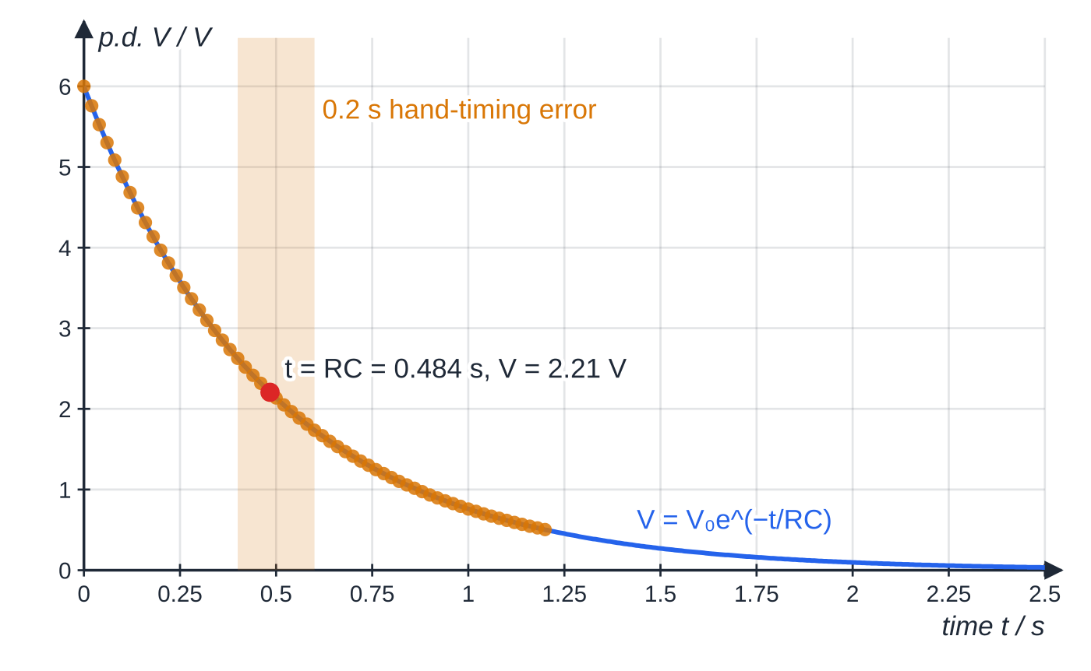
How do you choose apparatus, and when do you need a data logger? (continued)
Section 2 of 13
A data logger removes reaction time, but its sensor still needs a suitable range and resolution, and zeroing or calibration.
A 220 µF capacitor (6.00 V) discharging through 2.2 kΩ. The time constant is 0.484 s, so the p.d. falls to 2.21 V in under half a second. The shaded band is a 0.2 s hand-timing error; the gold dots are data-logger samples every 0.020 s.
Notes:
How do you choose apparatus, and when do you need a data logger?. Full notes: https://examinerprep.com/notes/edexcel-ial-physics/planning-and-evaluating-experiments-a2/

Slide 10
How do you choose apparatus, and when do you need a data logger? (continued)
Section 2 of 13 · Worked example 1 · Medium · Calculate, explain, suggest
WORKED EXAMPLE · QUESTION
A student plans to measure how the p.d. across a 220 µF capacitor, charged to 6.00 V, changes as it discharges through a 2.2 kΩ resistor. She intends to read a voltmeter every few seconds while timing with a stopwatch. (a) Calculate the time constant. (b) Explain why her method is unsuitable. (c) Suggest suitable apparatus and settings.
SOLUTION
(a) RC=2.2×10³×220×10⁻⁶= 0.484 s
(b) A reaction-time error of about 0.2 s is 0.2÷0.484×100=41% of the time constant, and the discharge is nearly complete in about 5RC=2.42 s, so there is no time to read the meter more than once or twice.
(c) A data logger with a voltage sensor across the capacitor, sampling at 50 readings per second (every 0.020 s): about 24 readings in each time constant and about 121 over 5RC.
Alternatively, use a 100 kΩ resistor: RC=22 s and the 0.2 s error is under 1%.
Notes:
How do you choose apparatus, and when do you need a data logger?: Worked example 1. Full notes: https://examinerprep.com/notes/edexcel-ial-physics/planning-and-evaluating-experiments-a2/

Slide 11
How do you choose apparatus, and when do you need a data logger? (continued)
Section 2 of 13 · Worked example 1 · Medium · Calculate, explain, suggest (continued)
Changing the apparatus to suit the instrument is a good planning answer too.
Notes:
How do you choose apparatus, and when do you need a data logger?: Worked example 1. Full notes: https://examinerprep.com/notes/edexcel-ial-physics/planning-and-evaluating-experiments-a2/

Slide 12
What is a "relevant dimension", and which techniques make it reliable?
Section 3 of 13
Many equations contain a length measured between particular points; saying which points is part of specifying the apparatus.
Quantity in the equation | What you actually measure
length l of a simple pendulum | from the point of suspension to the centre of mass of the bob: string length + half the bob diameter
radius r of a whirled object | from the axis of rotation to the centre of the object
length of a solenoid (turns per metre) | the length of the winding, not of the tube it is wound on
distance from a radioactive source to a detector | a measured distance plus an unknown offset (the source sits inside its holder), handled with a graph, as in Worked example 4
separation of capacitor plates | the gap between the inner faces, set with spacers of known thickness and checked at several points
Notes:
What is a "relevant dimension", and which techniques make it reliable?. Full notes: https://examinerprep.com/notes/edexcel-ial-physics/planning-and-evaluating-experiments-a2/

Slide 13
What is a "relevant dimension", and which techniques make it reliable? (continued)
Section 3 of 13
Techniques and extra apparatus worth naming
Set square: stand it on the bench against a rule to make the rule vertical, or line up the bottom of a bob or pointer with the scale.
Fiducial mark: a pin, or a line drawn with a marker pen, at the centre of an oscillation, where the object moves fastest and its passing is sharpest. Count passes in the same direction and start the stopwatch on "zero".
Many cycles: time 10 or 20 oscillations so the reaction-time error is a small fraction of the total.
Small amplitudes for pendulums and springs (under about 10°) so the motion is simple harmonic and the period does not depend on amplitude.
Data logger, light gates or video against a scale remove reaction time.
Clamp blocks at the top of a pendulum give a fixed, sharply defined point of suspension.
Notes:
What is a "relevant dimension", and which techniques make it reliable?. Full notes: https://examinerprep.com/notes/edexcel-ial-physics/planning-and-evaluating-experiments-a2/

Slide 14
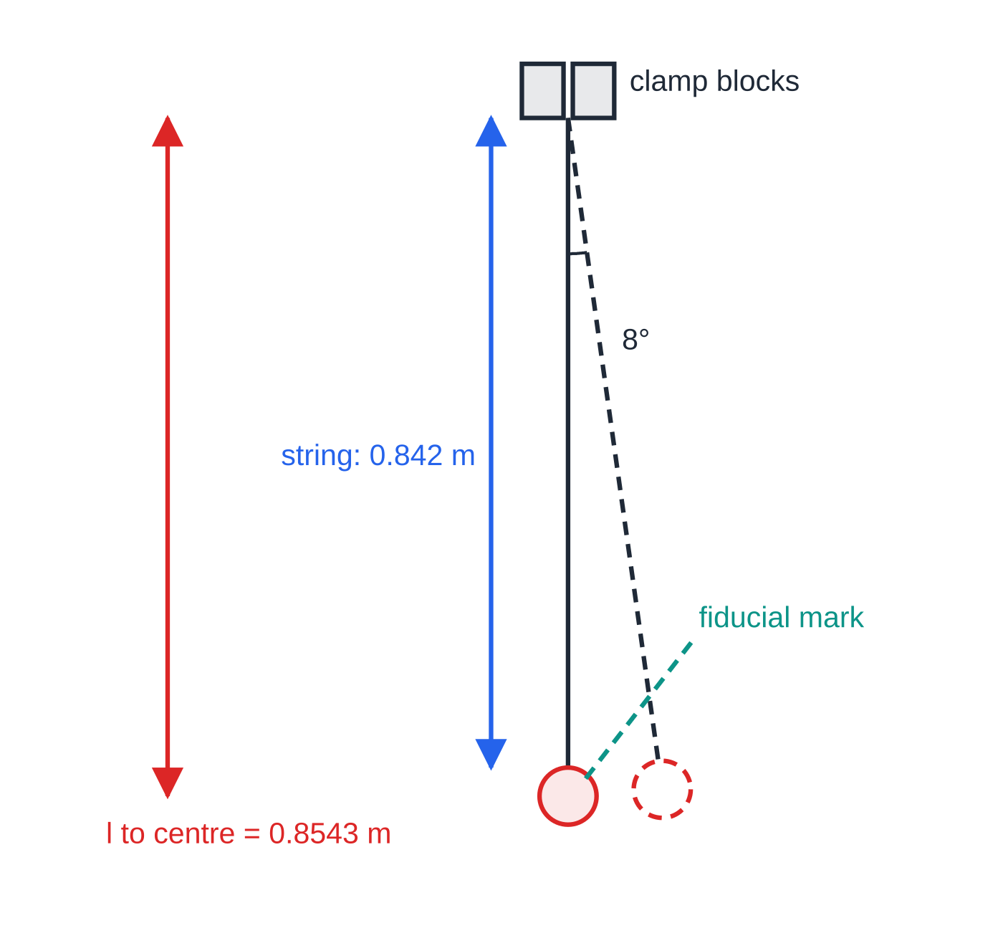
What is a "relevant dimension", and which techniques make it reliable? (continued)
Section 3 of 13
The string (pivot to top of bob) is drawn to scale at 0.842 m; the bob is drawn three times too large so it can be seen. The length in T = 2π√(l/g) is to the centre of the bob: 0.842 + 12.3 × 10⁻³ = 0.8543 m. The dashed position is at 8°.
Notes:
What is a "relevant dimension", and which techniques make it reliable?. Full notes: https://examinerprep.com/notes/edexcel-ial-physics/planning-and-evaluating-experiments-a2/

Slide 15
What is a "relevant dimension", and which techniques make it reliable? (continued)
Section 3 of 13 · Worked example 2 · Medium · Determine, compare
WORKED EXAMPLE · QUESTION
A student measures the string of a pendulum from the bottom of the clamp blocks to the top of the bob as 0.842 m, and the bob diameter with a vernier caliper as 24.6 mm. Three timings of 20 oscillations give 37.0 s, 37.2 s and 37.1 s. (a) Determine g. (b) A second student uses 0.842 m as the length. Compare the error this causes with the uncertainty from the timing.
SOLUTION
(a) Relevant length: l=0.842+0.0123=0.8543 m. Mean of 20 oscillations = 37.1 s, so T=37.1÷20=1.855 s. Rearrange T=2π√(l/g): g=4π²l/T²=4π²×0.8543÷1.855²= 9.80 m s⁻²
(b) Leaving out the radius makes l 0.0123÷0.8543×100=1.4% too small, giving g=9.66 m s⁻²: every reading would be low by the same proportion, a systematic error. The timing half-range, 0.1 s on 37.1 s, is 0.27% in T, so about 0.5% in g (T is squared). The missing radius is bigger than the timing uncertainty. (Combining percentage uncertainties for powers and products is on 6.2.)
Notes:
What is a "relevant dimension", and which techniques make it reliable?: Worked example 2. Full notes: https://examinerprep.com/notes/edexcel-ial-physics/planning-and-evaluating-experiments-a2/

Slide 16
How do you calibrate and check instruments at A2?
Section 4 of 13
Zero checks: tare a balance with the apparatus in place; zero a Hall probe away from magnets and currents; check a sensor reads zero with no input; close the jaws of a caliper.
Background count: with the source locked away, count for a long time (several minutes) and work out the background count rate. Subtract it from every count rate before analysing.
Calibration compares an instrument with known values. Two fixed points give a straight calibration line: melting ice (0 °C) and steam above boiling water (100 °C at standard pressure) for a thermometer; a known field inside a long solenoid for a Hall probe; known masses for a force sensor.
A zero error moves every reading by the same amount and cancels when you take a difference. A scale (gradient) error changes readings in proportion and does not cancel in a difference; it must be corrected using the calibration line.
Notes:
How do you calibrate and check instruments at A2?. Full notes: https://examinerprep.com/notes/edexcel-ial-physics/planning-and-evaluating-experiments-a2/

Slide 17
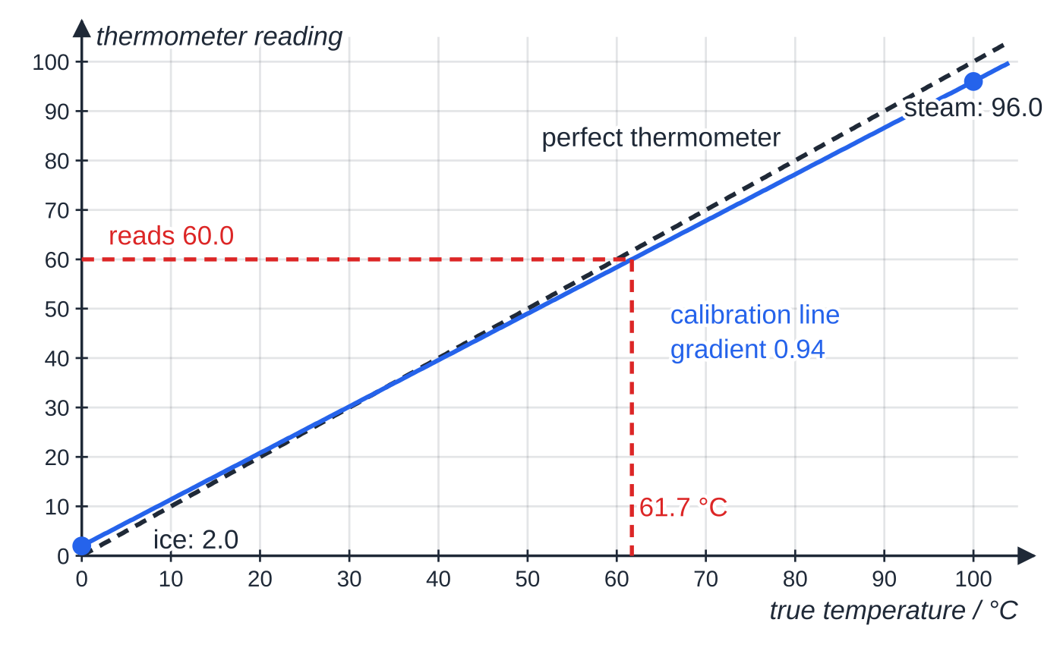
How do you calibrate and check instruments at A2? (continued)
Section 4 of 13
A thermometer reads 2.0 in melting ice and 96.0 in steam. Assuming it responds linearly, the calibration line has gradient 0.94; a reading of 60.0 means a true temperature of 61.7 °C.
Notes:
How do you calibrate and check instruments at A2?. Full notes: https://examinerprep.com/notes/edexcel-ial-physics/planning-and-evaluating-experiments-a2/

Slide 18
How do you calibrate and check instruments at A2? (continued)
Section 4 of 13 · Worked example 3 · Medium · Determine
WORKED EXAMPLE · QUESTION
A thermometer reads 2.0 °C in melting ice and 96.0 °C in steam at standard pressure. During an experiment it reads 20.0 °C at the start and 60.0 °C at the end. (a) Determine the true final temperature. (b) Determine the true temperature rise and the percentage error if the readings were used uncorrected.
SOLUTION
(a) Gradient of the calibration line: (96.0-2.0)÷(100-0)=0.94 (reading per °C). Invert: true = (reading − 2.0) ÷ 0.94, so (60.0-2.0)÷0.94= 61.7 °C
(b) True start: (20.0-2.0)÷0.94=19.1 °C, so the rise is 58.0÷0.94-18.0÷0.94= 42.6 °C. The uncorrected rise is 40.0 °C: (42.6-40.0)÷42.6×100= 6% too small. The offset of 2.0 cancels in the difference, but the scale error does not.
Notes:
How do you calibrate and check instruments at A2?: Worked example 3. Full notes: https://examinerprep.com/notes/edexcel-ial-physics/planning-and-evaluating-experiments-a2/

Slide 19
How do you plan for safety in A2 experiments?
Section 5 of 13
A safety answer names the hazard in this experiment and the precaution that deals with it.
Hazard | Where it appears | Precautions
ionising radiation from a sealed source | count rates, inverse-square law, absorption | handle the source only with long tongs, holding it at arm's length and pointing it away from people; keep the time out of its lead-lined box short; work at the largest practical distance; return it to the box and store it securely straight after use
high voltage | electron beam tubes, deflection plates (kV supplies) | use a current-limited supply; make and change connections only with the supply switched off; use fully shrouded leads; never touch terminals while it is on
glass vacuum tube | electron beam and deflection tubes | handle gently, do not knock; the tube could implode
Notes:
How do you plan for safety in A2 experiments?. Full notes: https://examinerprep.com/notes/edexcel-ial-physics/planning-and-evaluating-experiments-a2/

Slide 20
How do you plan for safety in A2 experiments? (continued)
Section 5 of 13
Hazard | Where it appears | Precautions
hot liquids and surfaces | water baths for gas laws, specific heat capacity, cooling curves, thermistor calibration | stand the beaker on a heat-proof mat in a stable clamp; do not carry beakers of hot water; let water cool before emptying; keep electrical leads away from the water
stored charge | large capacitors at more than a few volts | discharge through a resistor before handling; observe polarity of electrolytic capacitors
moving or whirling masses | circular motion, oscillating trolleys, swinging pendulums | safety goggles; clear space; secure the load to the string; use small masses
Common error — gloves for a gamma source
Writing "wear gloves" or "wear a lab coat" for a gamma source. Neither stops gamma rays. The precautions that work are distance (tongs), short exposure time and shielding (the lead-lined box).
Notes:
How do you plan for safety in A2 experiments?. Full notes: https://examinerprep.com/notes/edexcel-ial-physics/planning-and-evaluating-experiments-a2/

Slide 21
How many readings, over what range, and how will the data be used?
Section 6 of 13
Number: at least six (better seven or eight) values, so the shape is clear and an odd point stands out.
Range: as wide as the apparatus and safety allow. For a decay or discharge, cover at least two or three time constants or half-lives.
Spacing: aim for points spread evenly along the axis you will plot. If you plot 1/d², readings evenly spaced in d crowd together at the small-1/d² end of the axis, so take more readings at small d, where the quantity changes fastest.
Repeats: repeat where readings scatter (hand timing, rebound heights); for random processes such as radioactive decay, count for longer so each count contains several hundred events.
Control variables: name each one, say why it matters and how it is fixed: "same source and same GM tube, at the same voltage setting, throughout".
Use of the data: rearrange into a straight-line form; say what is plotted, the expected shape, and what the gradient and intercept give.
Notes:
How many readings, over what range, and how will the data be used?. Full notes: https://examinerprep.com/notes/edexcel-ial-physics/planning-and-evaluating-experiments-a2/

Slide 22
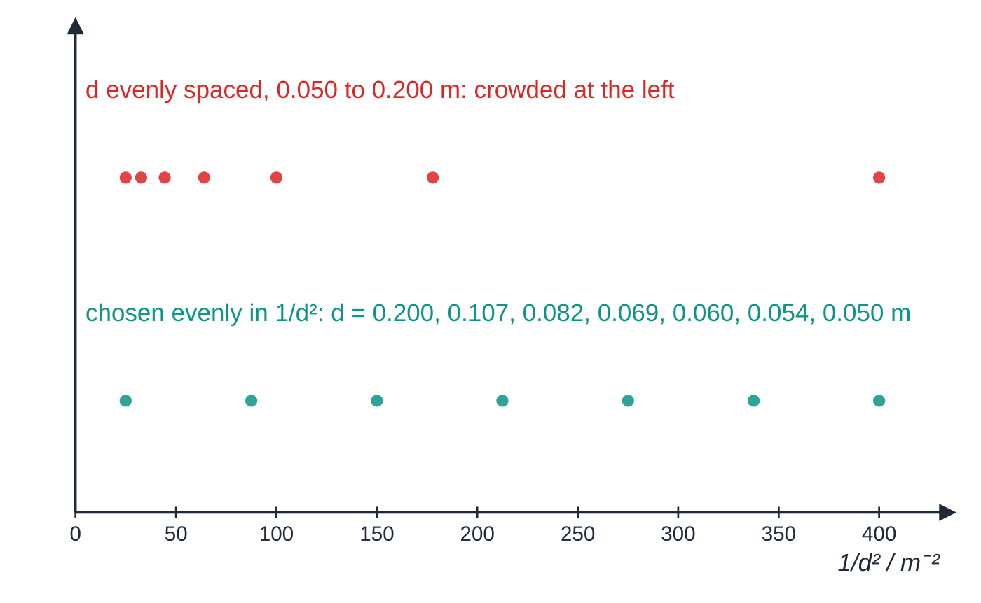
How many readings, over what range, and how will the data be used? (continued)
Section 6 of 13
Seven readings on a 1/d² axis. Evenly spaced distances (top) leave most of the axis empty; spacing evenly along the plotted axis (bottom) means more readings at small d.
Notes:
How many readings, over what range, and how will the data be used?. Full notes: https://examinerprep.com/notes/edexcel-ial-physics/planning-and-evaluating-experiments-a2/

Slide 23
How many readings, over what range, and how will the data be used? (continued)
Section 6 of 13
Relationship (A2 context) | Plot | Result from
T=2π√(l/g) | T² against l | gradient = 4π²/g
F=BIl (wire in a field, on a balance) | reading change Δm against I | gradient = Bl/g
p∝(θ+273) at constant volume | p against θ/°C | intercept on the θ axis ≈ −273 °C
C=k/(d+d₀)² (gamma count rate) | C^(-1/2) against d | gradient = 1/√k; intercept on the d axis = -d₀
V=V₀e^(-t/RC) | ln V against t (see 6.2) | gradient = -1/RC
Notes:
How many readings, over what range, and how will the data be used?. Full notes: https://examinerprep.com/notes/edexcel-ial-physics/planning-and-evaluating-experiments-a2/

Slide 24
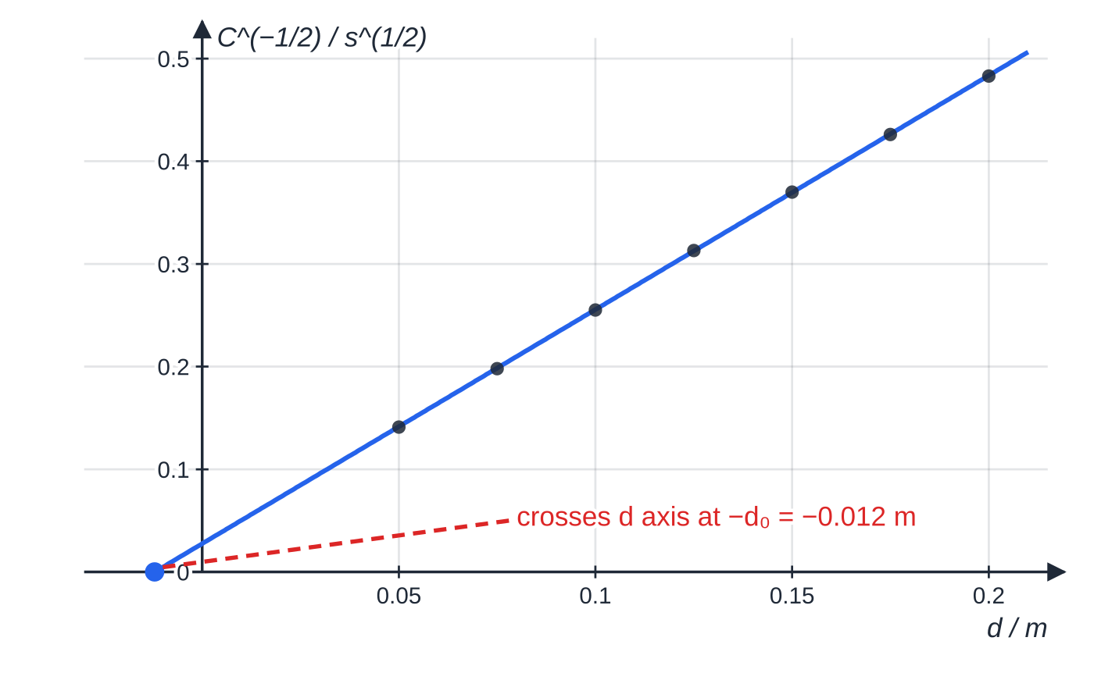
How many readings, over what range, and how will the data be used? (continued)
Section 6 of 13 · Worked example 4 · Hard · Plan, determine
WORKED EXAMPLE · QUESTION
A sealed gamma source sits a few millimetres inside its holder, so the true source-to-detector distance is d+d₀, where d is the distance measured from the front of the holder to the window of a GM tube and d₀ is unknown. Theory predicts a corrected count rate C=k/(d+d₀)². (a) Plan an experiment to test this relationship and find d₀. (b) Use the graph below to determine d₀.
SOLUTION
(a) Background: with the source in its box, count for 300 s: here 108 counts → 0.36 s⁻¹, subtracted from every count rate.
Specimen results: corrected count rates at seven distances from 0.050 m to 0.200 m, plotted as C^(−1/2) against d. The straight line confirms an inverse-square law; extended back, it crosses the d axis at −0.012 m, the hidden offset d₀.
Notes:
How many readings, over what range, and how will the data be used?: Worked example 4. Full notes: https://examinerprep.com/notes/edexcel-ial-physics/planning-and-evaluating-experiments-a2/

Slide 25
How many readings, over what range, and how will the data be used? (continued)
Section 6 of 13 · Worked example 4 · Hard · Plan, determine (continued)
Measurements and technique: clamp the source holder and the tube on a line along a bench rule (1 mm); vary d from 0.050 m to 0.200 m in seven steps, using a set square to line up the front of the holder and the tube window with the rule; count for 100 s at each distance so every count is several hundred or more.
Controls and safety: same source, tube and counter voltage; nothing moved between source and tube. Source handled with tongs, pointed away from people, returned to its lead-lined box as soon as the readings are complete.
Use of the data: rearrange to C^(-1/2)=(d+d₀)/√k. Plot C^(-1/2) against d: a straight line confirms the law; it crosses the d axis at -d₀, and d₀ = y-intercept ÷ gradient.
(b) At d=0: 0.0275 s^½; at d=0.200 m: 0.483 s^½. Gradient =(0.483-0.0275)÷0.200=2.28 s^(1/2) m⁻¹. d₀=0.0275÷2.28= 0.012 m (about 12 mm)
The graph turns a systematic error you cannot measure directly into an intercept you can read.
Notes:
How many readings, over what range, and how will the data be used?: Worked example 4. Full notes: https://examinerprep.com/notes/edexcel-ial-physics/planning-and-evaluating-experiments-a2/

Slide 26
How many readings, over what range, and how will the data be used? (continued)
Section 6 of 13 · Worked example 4 · Hard · Plan, determine (continued)
That is why a plan should say how the data will be used, not just which readings to take.
Notes:
How many readings, over what range, and how will the data be used?: Worked example 4. Full notes: https://examinerprep.com/notes/edexcel-ial-physics/planning-and-evaluating-experiments-a2/

Slide 27
How should results be recorded, and what about anomalies?
Section 7 of 13
Every column heading is quantity / unit, for example d / m or C / s⁻¹. Units go in the heading, not after each value.
Raw readings are recorded to the resolution of the instrument and to the same number of decimal places down a column: 0.050, 0.075, 0.100 m, never 0.05, 0.075, 0.1.
A calculated column has the same number of significant figures as the least precise raw data used, or one more.
The unit of a derived quantity is worked out, not guessed: the unit of T² is s²; of a count rate, s⁻¹; of C^(-1/2), s^½.
Put repeats and the mean in the same table, so an anomalous repeat can be seen.
Notes:
How should results be recorded, and what about anomalies?. Full notes: https://examinerprep.com/notes/edexcel-ial-physics/planning-and-evaluating-experiments-a2/

Slide 28
How should results be recorded, and what about anomalies? (continued)
Section 7 of 13 · Worked example 5 · Medium · Identify, correct
WORKED EXAMPLE · QUESTION
A student records the first four rows of the experiment in Worked example 4 like this (background 0.36 s⁻¹):
Distance | Counts in 100 s | Count rate / s | Corrected rate
0.05 | 5036 | 50.36 | 50.0
0.075 | 2575 | 25.75 | 25.39
0.1 | 1568 | 15.68 | 15.32
0.125 | 1060 | 10.6 | 10.24
Identify the faults and write out a corrected table, adding a column for C^(-1/2).
Notes:
How should results be recorded, and what about anomalies?: Worked example 5. Full notes: https://examinerprep.com/notes/edexcel-ial-physics/planning-and-evaluating-experiments-a2/

Slide 29
How should results be recorded, and what about anomalies? (continued)
Section 7 of 13 · Worked example 5 · Medium · Identify, correct (continued)
SOLUTION
Headings: "Distance" has no unit → d / m; "Count rate / s" has the wrong unit → / s⁻¹; "Corrected rate" has no unit → C / s⁻¹.
Decimal places: distances measured to 1 mm must all show three decimal places; 10.6 should be 10.60 and 50.0 should be 50.00, to match the rest of their columns.
d / m | counts in 100 s | count rate / s⁻¹ | C / s⁻¹ | C^(−1/2) / s^½
0.050 | 5036 | 50.36 | 50.00 | 0.141
0.075 | 2575 | 25.75 | 25.39 | 0.198
0.100 | 1568 | 15.68 | 15.32 | 0.255
0.125 | 1060 | 10.60 | 10.24 | 0.313
0.150 | 768 | 7.68 | 7.32 | 0.370
Notes:
How should results be recorded, and what about anomalies?: Worked example 5. Full notes: https://examinerprep.com/notes/edexcel-ial-physics/planning-and-evaluating-experiments-a2/

Slide 30
How should results be recorded, and what about anomalies? (continued)
Section 7 of 13 · Worked example 5 · Medium · Identify, correct (continued)
d / m | counts in 100 s | count rate / s⁻¹ | C / s⁻¹ | C^(−1/2) / s^½
0.175 | 586 | 5.86 | 5.50 | 0.426
0.200 | 464 | 4.64 | 4.28 | 0.483
Notes:
How should results be recorded, and what about anomalies?: Worked example 5. Full notes: https://examinerprep.com/notes/edexcel-ial-physics/planning-and-evaluating-experiments-a2/

Slide 31
How should results be recorded, and what about anomalies? (continued)
Section 7 of 13
Anomalous readings
An anomalous reading is one that does not fit the pattern of the others: a repeat far from the other repeats, or a point well off the best-fit line.
Spot it while the experiment is running (plot as you go, compare repeats) so it can be measured again. If it cannot be repeated, leave it out of the mean and the best-fit line, but keep it in the table, marked, with the reason.
Suggest a physical cause where you can: a balance not re-zeroed, a wire that had warmed up, a timing started late, a source moved.
Do not call a point anomalous just because it is inconvenient. A curve in the data is a result, not an anomaly.
Notes:
How should results be recorded, and what about anomalies?. Full notes: https://examinerprep.com/notes/edexcel-ial-physics/planning-and-evaluating-experiments-a2/

Slide 32
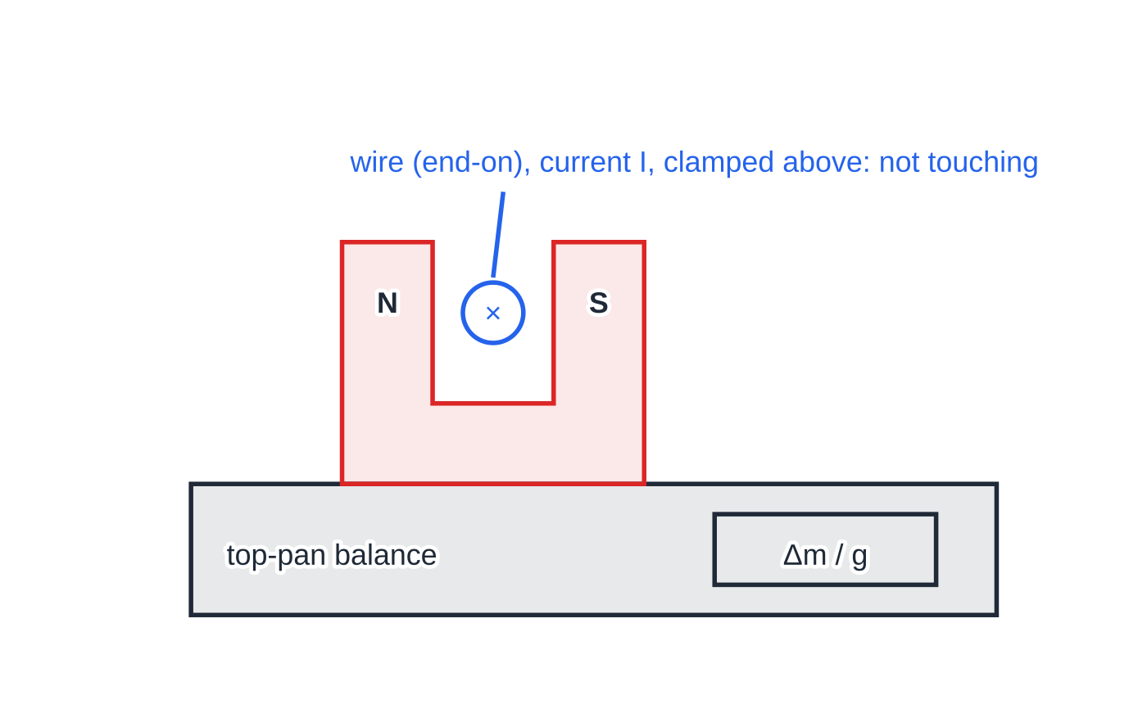
How should results be recorded, and what about anomalies? (continued)
Section 7 of 13
A wire carrying current I passes between the poles of a magnet resting on a top-pan balance. The magnet is pushed down (or up) by the reaction to the force on the wire, by Newton's third law, so the balance reading changes by Δm.
Notes:
How should results be recorded, and what about anomalies?. Full notes: https://examinerprep.com/notes/edexcel-ial-physics/planning-and-evaluating-experiments-a2/

Slide 33
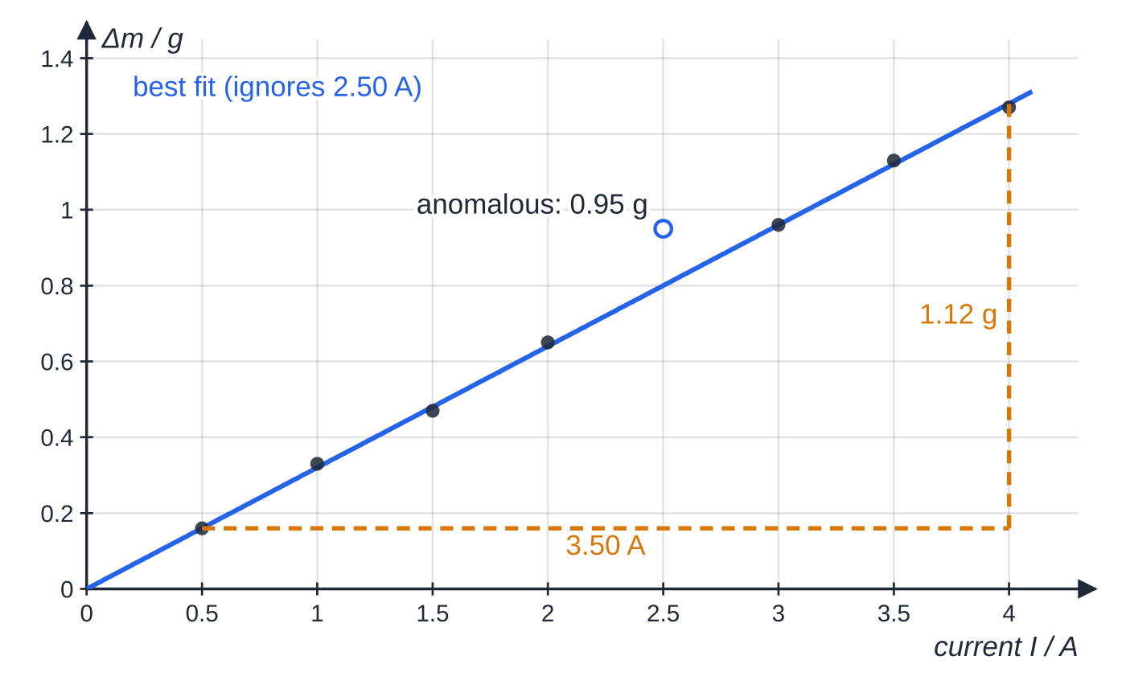
How should results be recorded, and what about anomalies? (continued)
Section 7 of 13
Recorded values: 0.16, 0.33, 0.47, 0.65, 0.95, 0.96, 1.13, 1.27 g for I = 0.50 A to 4.00 A in steps of 0.50 A. The point at 2.50 A is anomalous; the best-fit line ignores it.
Notes:
How should results be recorded, and what about anomalies?. Full notes: https://examinerprep.com/notes/edexcel-ial-physics/planning-and-evaluating-experiments-a2/

Slide 34
How should results be recorded, and what about anomalies? (continued)
Section 7 of 13 · Worked example 6 · Hard · Identify, determine, explain
WORKED EXAMPLE · QUESTION
In the experiment in the figures, the length of wire in the field is 45.0 mm. The balance has a resolution of 0.01 g. (a) Identify the anomalous reading and describe what the student should do. (b) Use the graph to determine the magnetic flux density B. (c) Explain why the smallest current gives the least reliable point.
SOLUTION
(a) I=2.50 A, Δm=0.95 g: the line predicts about 0.80 g. Re-zero the balance and repeat the reading at 2.50 A; if the repeat lies on the line, use it. If not, exclude 0.95 g from the line and note it in the table.
(b) Gradient from a large triangle: (1.28-0.16) g÷(4.00-0.50) A=0.32 g A⁻¹=3.2×10⁻⁴ kg A⁻¹. Since Δm g=BIl, gradient =Bl/g, so B=3.2×10⁻⁴×9.81÷0.0450= 0.070 T
(c) ±0.005 g on 0.16 g is 3.1%, but on 1.27 g only 0.39%: small readings carry the largest percentage uncertainty.
Notes:
How should results be recorded, and what about anomalies?: Worked example 6. Full notes: https://examinerprep.com/notes/edexcel-ial-physics/planning-and-evaluating-experiments-a2/

Slide 35
What do precision, accuracy and sensitivity mean, and how do you improve an experiment?
Section 8 of 13
Accuracy describes how close a measurement or result is to the true value. Precision describes how closely repeated measurements agree with each other: a precise set has very little spread about its mean. The sensitivity of an instrument is the change in its reading (output) for each unit change in the quantity being measured (input). Resolution is different again: the smallest change the instrument can show.
A set of results can be precise but inaccurate (a systematic error moves them all the same way), or accurate on average but imprecise (large random scatter).
Random errors limit precision; systematic errors limit accuracy. Repeating improves the mean of a scattered set, but it cannot fix a systematic error.
"More accurate" does not mean "more decimal places", and many significant figures do not make a value "precise".
Notes:
What do precision, accuracy and sensitivity mean, and how do you improve an experiment?. Full notes: https://examinerprep.com/notes/edexcel-ial-physics/planning-and-evaluating-experiments-a2/

Slide 36
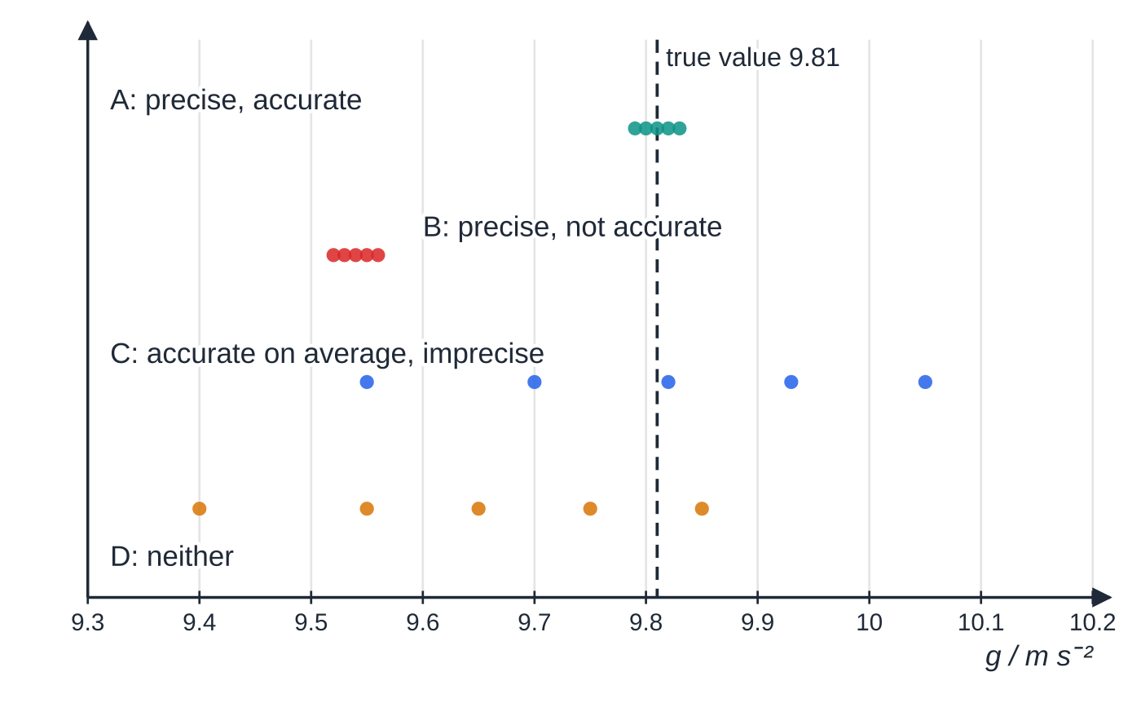
What do precision, accuracy and sensitivity mean, and how do you improve an experiment? (continued)
Section 8 of 13
Four sets of five repeat values of g. Means: A 9.81, B 9.54, C 9.81, D 9.64 m s⁻². Set B is as precise as set A, but a systematic error has moved every value; set C is accurate on average but imprecise.
Notes:
What do precision, accuracy and sensitivity mean, and how do you improve an experiment?. Full notes: https://examinerprep.com/notes/edexcel-ial-physics/planning-and-evaluating-experiments-a2/

Slide 37
What do precision, accuracy and sensitivity mean, and how do you improve an experiment? (continued)
Section 8 of 13 · Worked example 7 · Medium · Calculate, comment
WORKED EXAMPLE · QUESTION
A temperature sensor gives an output p.d. that falls as the temperature rises: 3.92 V at 10 °C, 3.40 V at 20 °C, 1.78 V at 50 °C and 1.36 V at 60 °C. Its output is read with a voltmeter of resolution 0.01 V. (a) Calculate the sensitivity between 10 °C and 20 °C and between 50 °C and 60 °C. (b) Determine the smallest temperature change the system can detect in each range. (c) A student says the sensor is "more accurate at low temperatures". Comment.
SOLUTION
(a) Sensitivity = change in output ÷ change in input: (3.92-3.40)÷10= 0.052 V K⁻¹ (52 mV K⁻¹); (1.78-1.36)÷10= 0.042 V K⁻¹ (42 mV K⁻¹).
(b) Smallest detectable change = resolution ÷ sensitivity: 0.01÷0.052= 0.19 K; 0.01÷0.042= 0.24 K.
(c) The sensor is more sensitive at low temperatures, so it can detect smaller changes there;
Notes:
What do precision, accuracy and sensitivity mean, and how do you improve an experiment?: Worked example 7. Full notes: https://examinerprep.com/notes/edexcel-ial-physics/planning-and-evaluating-experiments-a2/

Slide 38
What do precision, accuracy and sensitivity mean, and how do you improve an experiment? (continued)
Section 8 of 13 · Worked example 7 · Medium · Calculate, comment (continued)
whether its readings are accurate depends on how well it has been calibrated against known temperatures, not on its sensitivity.
Notes:
What do precision, accuracy and sensitivity mean, and how do you improve an experiment?: Worked example 7. Full notes: https://examinerprep.com/notes/edexcel-ial-physics/planning-and-evaluating-experiments-a2/

Slide 39
What do precision, accuracy and sensitivity mean, and how do you improve an experiment? (continued)
Section 8 of 13
Evaluating and improving
Find the largest source of uncertainty by comparing percentage uncertainties (a squared quantity counts twice; see 6.2), and look for systematic errors: a non-zero intercept where theory says zero, results all on one side of the accepted value, a hidden offset such as d₀.
Suggest a specific improvement tied to that source and say what it improves; comment in context: does the result agree with the accepted value within its uncertainty, and do the assumptions hold (small amplitude, point source, constant temperature)?
Problem | Improvement | What it improves
reaction time in hand timing | light gate or data logger; or time many cycles past a fiducial mark | precision of times
rule not vertical, pointer not level with scale | set square against the rule; eye level with the pointer | accuracy of lengths (removes a systematic error)
Notes:
What do precision, accuracy and sensitivity mean, and how do you improve an experiment?. Full notes: https://examinerprep.com/notes/edexcel-ial-physics/planning-and-evaluating-experiments-a2/

Slide 40
What do precision, accuracy and sensitivity mean, and how do you improve an experiment? (continued)
Section 8 of 13
Problem | Improvement | What it improves
heat lost to the surroundings | insulate (lagging, lid); start below room temperature and finish the same amount above it | accuracy of thermal results
random counts from a source | count for longer; repeat counts and average | precision of count rates
very small readings | increase the range (bigger current, longer length) within safe limits; use an instrument with finer resolution | percentage uncertainty
wire or resistor warming up | small currents; switch off between readings | keeps a control variable (temperature) constant
Notes:
What do precision, accuracy and sensitivity mean, and how do you improve an experiment?. Full notes: https://examinerprep.com/notes/edexcel-ial-physics/planning-and-evaluating-experiments-a2/

Slide 41
What do precision, accuracy and sensitivity mean, and how do you improve an experiment? (continued)
Section 8 of 13
Exam tip — specific, justified improvements
An improvement earns credit when it is specific and justified: "use a data logger sampling at 50 Hz, because the p.d. halves in about 0.3 s, far too quickly to read by hand". "Use better equipment" or "be more careful" earn nothing.
Notes:
What do precision, accuracy and sensitivity mean, and how do you improve an experiment?. Full notes: https://examinerprep.com/notes/edexcel-ial-physics/planning-and-evaluating-experiments-a2/

Slide 42
Exam tips for 6.1
Section 9 of 13
Exam tip 1 — specify, do not just name
"Metre rule" is a name. "Metre rule, resolution 1 mm, from the bottom of the clamp blocks to the top of the bob, plus half the diameter from a vernier" is a specification.
Exam tip 2 — justify a data logger with numbers
Compare the time scale of the change (a time constant, a period, a pulse length) with a reaction time of about 0.2 s, and state a sampling rate that gives many readings within that time.
Exam tip 3 — background first, then everything else
Any plan with a radioactive source should measure the background count rate over several minutes and subtract it from every count rate before plotting.
Notes:
Exam tips for 6.1. Full notes: https://examinerprep.com/notes/edexcel-ial-physics/planning-and-evaluating-experiments-a2/

Slide 43
Exam tips for 6.1 (continued)
Section 9 of 13
Exam tip 4 — say how the graph gives the answer
End every plan with the graph: what goes on each axis, the expected shape, and which feature (gradient, intercept on either axis) gives the quantity asked for.
Notes:
Exam tips for 6.1. Full notes: https://examinerprep.com/notes/edexcel-ial-physics/planning-and-evaluating-experiments-a2/

Slide 44
Common misconceptions
Section 10 of 13
Misconception | Why it is wrong | Correct idea
A precise result must be accurate. | A systematic error can move every reading by the same amount while their spread stays tiny. | Precision is about spread; accuracy is about closeness to the true value. Check both.
More significant figures make a value more precise. | Digits beyond the resolution of the instrument carry no information. | Record to the resolution; precision comes from the spread of repeats.
Sensitivity and resolution are the same thing. | Sensitivity is output change per unit input; resolution is the smallest change the display can show. | Smallest detectable input change = resolution ÷ sensitivity.
A data logger makes any measurement accurate. | It removes reaction time, but its sensor can still have a zero error or poor calibration, and too low a sampling rate misses fast changes. | Zero and calibrate the sensor; choose a suitable sampling rate.
Notes:
Common misconceptions. Full notes: https://examinerprep.com/notes/edexcel-ial-physics/planning-and-evaluating-experiments-a2/

Slide 45
Common misconceptions (continued)
Section 10 of 13
Misconception | Why it is wrong | Correct idea
An anomalous reading should be rubbed out. | It may reveal a real problem, and removing it hides the evidence. | Repeat it if possible; otherwise keep it in the table, marked, and leave it out of the line and the mean.
Notes:
Common misconceptions. Full notes: https://examinerprep.com/notes/edexcel-ial-physics/planning-and-evaluating-experiments-a2/

Slide 46
How this topic connects
Section 11 of 13
2 Uncertainties and logarithmic graphs, 6.3 A2 core practicals
After the readings: combining uncertainties, error bars, worst-fit lines and log graphs. Every A2 core practical uses the planning skills on this page.
1 Planning at IAS
Verniers, micrometers, zero errors, parallax and the basic plan checklist.
Units 4 and 5
The physics behind the contexts: F=BIl and capacitor discharge (Unit 4); simple harmonic motion, gas laws, thermal energy and radioactivity (Unit 5).
Notes:
How this topic connects. Full notes: https://examinerprep.com/notes/edexcel-ial-physics/planning-and-evaluating-experiments-a2/

Slide 47
Key equations
Section 12 of 13
Equation | Use | In the formulae list?
corrected count rate = count rate − background count rate | every radioactivity experiment | no — learn it
sensitivity = Δ(output) ÷ Δ(input) | comparing sensors and instruments | no — learn it
smallest detectable change = resolution ÷ sensitivity | a sensor read by a meter | no — derive it
percentage uncertainty = (uncertainty ÷ value) × 100% | finding the biggest source of uncertainty | no — learn it
T=2π√(l/g) | pendulum; l to the centre of the bob | yes
V=V₀e^(-t/RC) | judging the time scale of a discharge | yes
F=BIlsin θ | current balance | yes
Notes:
Key equations. Full notes: https://examinerprep.com/notes/edexcel-ial-physics/planning-and-evaluating-experiments-a2/

Slide 48
Check your understanding
Section 13 of 13
1. A 470 µF capacitor discharges through 47 kΩ. Is a stopwatch suitable for timing the discharge?
2. A GM counter records 4.40 counts per second near a source; the background is 0.20 s⁻¹. What count rate is due to the source?
3. A sensor's output changes by 25 mV for each kelvin. It is read with a voltmeter of resolution 0.01 V. What is the smallest temperature change it can detect?
4. Five values of the speed of sound are 331, 332, 331, 330, 332 m s⁻¹; the accepted value at that temperature is 343 m s⁻¹. Describe the results.
5. Why is a fiducial mark placed at the centre of an oscillation rather than at one end?
Notes:
Check your understanding: questions. Full notes: https://examinerprep.com/notes/edexcel-ial-physics/planning-and-evaluating-experiments-a2/

Slide 49
Check your understanding · answers
Section 13 of 13
1. RC=470×10⁻⁶×47×10³=22.1 s. A 0.2 s reaction time is under 1% of this, so hand timing with readings every 5 or 10 s is reasonable.
2. 4.40-0.20= 4.20 s⁻¹. Always subtract the background before analysing.
3. 0.01 V÷0.025 V K⁻¹= 0.40 K.
4. Precise (spread only ±1 m s⁻¹) but not accurate (about 12 m s⁻¹ low): there is a systematic error, which repeating will not remove.
5. The object moves fastest at the centre, so the instant it passes is sharply defined; at the ends it is momentarily at rest and the turning point is hard to judge.
Notes:
Check your understanding: answers. Full notes: https://examinerprep.com/notes/edexcel-ial-physics/planning-and-evaluating-experiments-a2/

Slide 50
Practice questions
2 original exam-style questions. Answers at the end of the deck.

Slide 51
Question 1
6 marks
A student investigates the deflection of an electron beam passing between two parallel metal plates inside an evacuated glass tube. Electrons leave a heated filament and are accelerated through a potential difference of 3.0 kV. A separate supply of several hundred volts is connected across the plates.
(a) Identify two hazards in this experiment and describe a precaution for each. [4]
(b) Calculate the speed of the electrons as they leave the accelerating region. Use e = 1.60 × 10⁻¹⁹ C and mₑ = 9.11 × 10⁻³¹ kg. [2]
Notes:
Online with the full mark scheme: https://examinerprep.com/ial-physics-6-1-planning-and-evaluating-experiments-a2-questions#IALP-U6-1-B-01

Slide 52
Question 2
5 marks
A 470 µF capacitor, charged to 9.00 V, discharges through a 100 kΩ resistor. A student reads a digital voltmeter (resolution 0.01 V) every 10 s, timing with a stopwatch, and calculates the charge Q = CV. Her table is:
(a) Identify three faults in the table and state how each should be corrected. [3]
(b) Calculate the missing value of charge at t = 40 s, in mC. [1]
(c) Explain why a stopwatch is a suitable timer for this experiment. [1]
Time | p.d. / V | Q / C
0 | 9.00 | 4.23
10 | 7.3 | 3.42
20.0 | 5.88 | 2.76
30 | 4.75 | 2.23
40 | 3.84
Notes:
Online with the full mark scheme: https://examinerprep.com/ial-physics-6-1-planning-and-evaluating-experiments-a2-questions#IALP-U6-1-B-02

Slide 53
Answers

Slide 54
Question 1 · answer
Mark scheme
high voltage / risk of electric shock from the kV supplies
use a current-limited supply; make and change connections only with the supplies switched off; use fully shrouded leads
the evacuated glass tube could implode if knocked
handle the tube gently by its base, clamp it securely in its stand / use a safety screen
also accept as a hazard/precaution pair: the hot filament and tube neck — allow them to cool before touching
eV = ½mₑv², so v = √(2 × 1.60 × 10⁻¹⁹ × 3.0 × 10³ ÷ 9.11 × 10⁻³¹)
= 3.2 × 10⁷ m s⁻¹
Notes:
Full mark scheme: https://examinerprep.com/ial-physics-6-1-planning-and-evaluating-experiments-a2-questions#IALP-U6-1-B-01

Slide 55
Question 2 · answer
Mark scheme
the time column has no unit: heading should be t / s, and 20.0 should be written 20 like the other set times
7.3 is not recorded to the resolution of the voltmeter: it should be 7.28 (two decimal places, like the others)
the charge values are in mC, not C: heading should be Q / mC
470 × 10⁻⁶ × 3.84 = 1.80 × 10⁻³ C = 1.80 mC
the time constant RC = 100 × 10³ × 470 × 10⁻⁶ = 47 s, so a reaction-time error of about 0.2 s is well under 1% of the time scale of the discharge
Notes:
Full mark scheme: https://examinerprep.com/ial-physics-6-1-planning-and-evaluating-experiments-a2-questions#IALP-U6-1-B-02

Slide 56
Keep practising
Notes for this topic
Questions on this topic
Build a printable test
ExaminerPrep is an independent tutoring service. It has been developed independently from and is not endorsed by the International Baccalaureate Organization. "International Baccalaureate", "IB" and "IB Diploma Programme" are registered trademarks of the IBO, used here for descriptive purposes only.
Pearson Edexcel and Cambridge are trademarks of their owners; ExaminerPrep is not affiliated with any exam board.

