Slide 1
EP
EDEXCEL IAL PHYSICS
3.1 Planning experiments and measuring instruments
The full notes page in 13 sections · practice questions with answers · simulations
ExaminerPrep is an independent tutoring service. It has been developed independently from and is not endorsed by the International Baccalaureate Organization. "International Baccalaureate", "IB" and "IB Diploma Programme" are registered trademarks of the IBO, used here for descriptive purposes only.
Pearson Edexcel and Cambridge are trademarks of their owners; ExaminerPrep is not affiliated with any exam board.
Notes:
3.1 Planning experiments and measuring instruments. Notes for this topic: https://examinerprep.com/notes/edexcel-ial-physics/planning-experiments-and-measuring-instruments/

Slide 2
What this page covers
Overview
What a complete plan contains, and how to set it out
Choosing apparatus by range and resolution, and judging it with percentage uncertainty
Reading vernier calipers (0.1 mm) and micrometer screw gauges (0.01 mm), including zero errors
Measuring techniques: avoiding parallax, set squares, fiducial marks, timing many oscillations, repeating and averaging
Variables, repeats, hazards and precautions
Choosing the graph that tests a relationship and gives the quantity you want
Reducing uncertainty and commenting on the physics
Notes:
What this page covers. Full notes: https://examinerprep.com/notes/edexcel-ial-physics/planning-experiments-and-measuring-instruments/

Slide 3
In one minute
Key points
1. A plan names every instrument with its resolution, says what is varied, what is measured and what is kept constant, and ends with the graph and how the result comes from it.
2. Choose the instrument whose resolution makes the percentage uncertainty small: uncertainty ≈ half the resolution.
3. Vernier caliper: main scale (mm) + the vernier line that lines up × 0.1 mm. Micrometer: sleeve (to 0.5 mm) + thimble × 0.01 mm.
4. Corrected reading = reading − zero error. A zero error is systematic: repeating does not remove it.
5. Linearise the relationship so the graph is a straight line; the constant you want is in the gradient or intercept.
Notes:
In one minute. Full notes: https://examinerprep.com/notes/edexcel-ial-physics/planning-experiments-and-measuring-instruments/

Slide 4
What does a planning question ask you to do?
Section 1 of 13
A planning question describes an aim, such as "investigate how the deflection of a strip depends on its length", and asks how you would do it. Every good plan answers the same short list of questions.
Part of the plan | What to write
Variables | the independent variable (what you change), the dependent variable (what you measure) and every control variable (what you keep the same, and how)
Apparatus | each instrument with its resolution, and why it suits the size of the quantity
Method | numbered steps: what you set, what you read, where you read it from
Technique | how you avoid parallax, keep things vertical, reduce timing errors, check zero
Range and repeats | how many values of the independent variable, over what range, and whether repeats are useful
Safety | the real hazard in this experiment and a precaution that deals with it
Notes:
What does a planning question ask you to do?. Full notes: https://examinerprep.com/notes/edexcel-ial-physics/planning-experiments-and-measuring-instruments/

Slide 5
What does a planning question ask you to do? (continued)
Section 1 of 13
Part of the plan | What to write
Analysis | what you plot against what, why it should be a straight line, and how the result comes from the gradient or intercept
Notes:
What does a planning question ask you to do?. Full notes: https://examinerprep.com/notes/edexcel-ial-physics/planning-experiments-and-measuring-instruments/

Slide 6
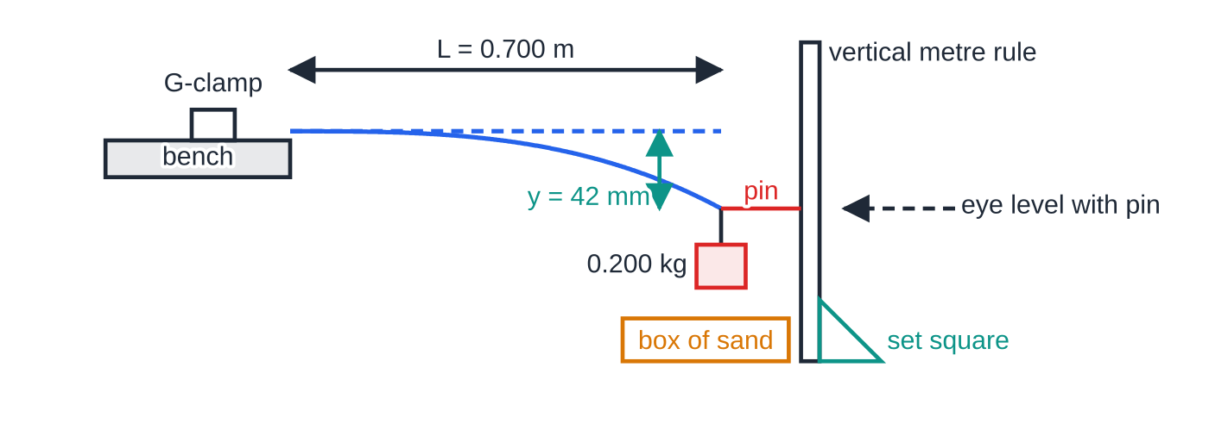
What does a planning question ask you to do? (continued)
Section 1 of 13
Exam tip
Write specific detail, not general advice. "Measure carefully" tells the reader nothing; "read the position of the pin against a vertical metre rule (resolution 1 mm) with the eye level with the pin" is a step someone could follow.
A planning context: a strip clamped to a bench with a 0.200 kg load at its free end. With L = 0.700 m the end drops y = 42 mm (deflection drawn three times larger for clarity). A pin on the end, a vertical rule checked with a set square and an eye level with the pin give a reliable reading of y.
Notes:
What does a planning question ask you to do?. Full notes: https://examinerprep.com/notes/edexcel-ial-physics/planning-experiments-and-measuring-instruments/

Slide 7
How do you choose the right instrument?
Section 2 of 13
Range is the largest (and smallest) value the instrument can measure; it must cover every reading you expect. Resolution is the smallest change the instrument can show: one scale division, or the last digit on a digital display. At IAS level, take the uncertainty in a single reading as half the resolution, and judge an instrument by the percentage uncertainty it gives for the size of quantity you are measuring.
Instrument | Typical resolution | Good for
metre rule | 1 mm | lengths from about 10 cm to 1 m: heights, lengths of wire or string
vernier caliper | 0.1 mm | a few mm to about 15 cm: diameters of tubes, rods and balls; internal diameters; depths
micrometer screw gauge | 0.01 mm | below about 25 mm: wire diameters, sheet thickness, small balls
Notes:
How do you choose the right instrument?. Full notes: https://examinerprep.com/notes/edexcel-ial-physics/planning-experiments-and-measuring-instruments/

Slide 8
How do you choose the right instrument? (continued)
Section 2 of 13
Instrument | Typical resolution | Good for
digital stopwatch (hand-operated) | 0.01 s | times of several seconds; reaction time (about 0.2 s) matters more than the resolution
light gate and timer / data logger | 0.001 s or better | short times and speeds
top-pan balance | 0.01 g or 0.1 g | masses of small objects
protractor | 1° | angles of rays, slopes and strings
digital multimeter | last digit, e.g. 0.01 V or 0.001 A | current and p.d.; choose the range with the smallest full-scale value that still fits the reading
Notes:
How do you choose the right instrument?. Full notes: https://examinerprep.com/notes/edexcel-ial-physics/planning-experiments-and-measuring-instruments/

Slide 9
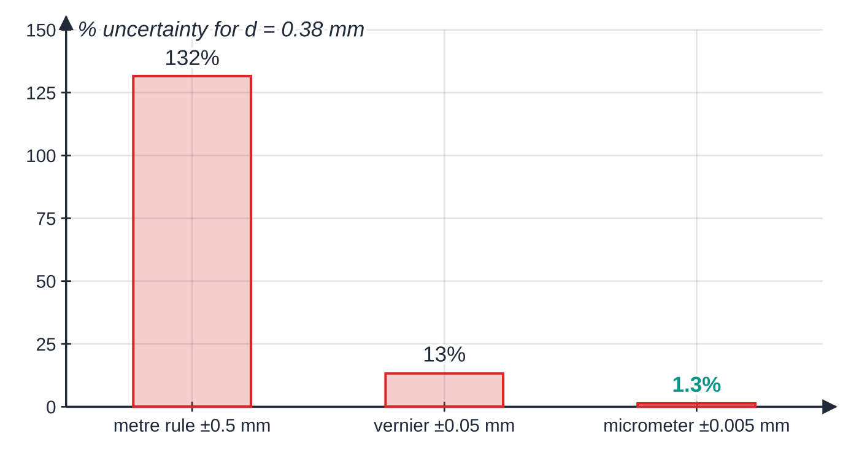
How do you choose the right instrument? (continued)
Section 2 of 13 · Worked example 1 · Easy · Justify
WORKED EXAMPLE · QUESTION
A student needs the diameter of a copper wire, which is about 0.38 mm. She has a metre rule, a vernier caliper and a micrometer screw gauge. Use percentage uncertainties to justify the choice of instrument.
SOLUTION
Half the resolution: metre rule ±0.5 mm, vernier ±0.05 mm, micrometer ±0.005 mm. Percentage uncertainty = uncertainty ÷ reading × 100%:
Half the resolution of each instrument as a percentage of 0.38 mm. Only the micrometer gives a useful result; its bar is barely visible on the same scale.
Notes:
How do you choose the right instrument?: Worked example 1. Full notes: https://examinerprep.com/notes/edexcel-ial-physics/planning-experiments-and-measuring-instruments/

Slide 10
How do you choose the right instrument? (continued)
Section 2 of 13 · Worked example 1 · Easy · Justify (continued)
0.5/0.38 ×100 = 132%, 0.05/0.38 ×100 = 13%, 0.005/0.38 ×100 = 1.3%.
Micrometer screw gauge: the only instrument giving a percentage uncertainty of a few per cent or less.
Notes:
How do you choose the right instrument?: Worked example 1. Full notes: https://examinerprep.com/notes/edexcel-ial-physics/planning-experiments-and-measuring-instruments/

Slide 11
How do you choose the right instrument? (continued)
Section 2 of 13
Common error
Choosing an instrument because it is "more accurate" without saying why. The reason is that its resolution is small compared with the quantity, so the percentage uncertainty is small. Quote the resolution with a unit.
Notes:
How do you choose the right instrument?. Full notes: https://examinerprep.com/notes/edexcel-ial-physics/planning-experiments-and-measuring-instruments/

Slide 12
How do you read a vernier caliper and a micrometer?
Section 3 of 13
Vernier caliper (0.1 mm)
The main scale is marked in millimetres. The sliding vernier scale has 10 divisions that together span 9 mm, so each vernier division is 0.9 mm long, 0.1 mm shorter than a main-scale division.
1. Read the main scale at the vernier zero: the whole number of millimetres to its left.
2. Find the vernier line that lines up best with any main-scale line. Its number gives the tenths of a millimetre.
3. Reading = main-scale millimetres + (number of the coinciding vernier line × 0.1 mm). Record it to 0.1 mm, for example 23.4 mm, never as 23.40 mm.
Close the jaws first: if the vernier zero does not line up with the main zero, there is a zero error. Outside jaws measure external diameters, inside jaws internal diameters, the tail depths. Close gently: squeezing a soft object makes it read small.
Notes:
How do you read a vernier caliper and a micrometer?. Full notes: https://examinerprep.com/notes/edexcel-ial-physics/planning-experiments-and-measuring-instruments/

Slide 13
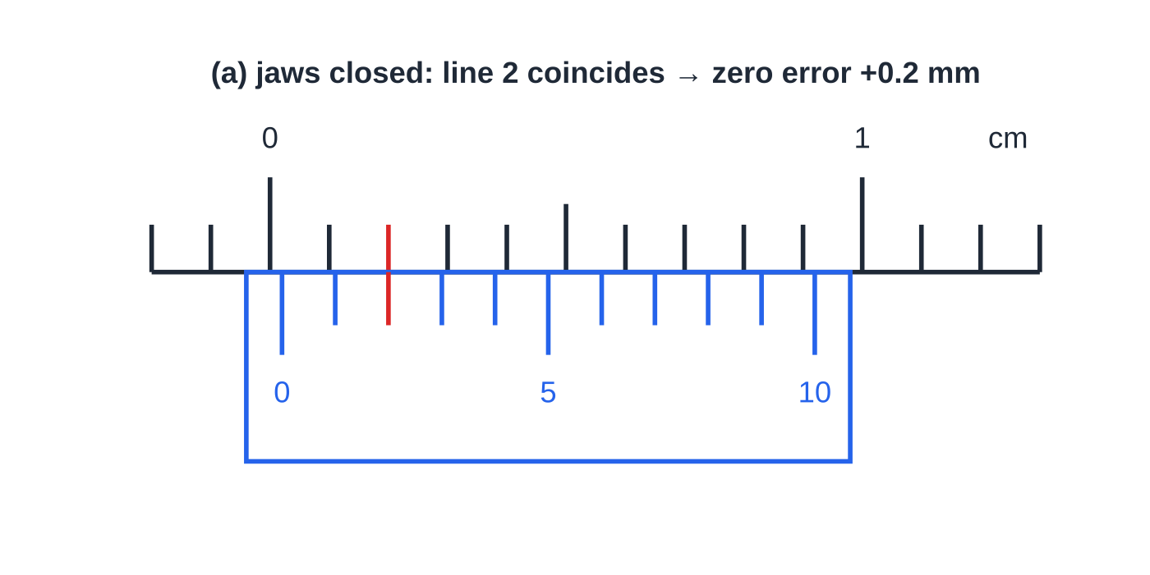
How do you read a vernier caliper and a micrometer? (continued)
Section 3 of 13
(a) Jaws closed: the vernier zero sits just past the main zero and vernier line 2 lines up, so the zero error is +0.2 mm.
Notes:
How do you read a vernier caliper and a micrometer?. Full notes: https://examinerprep.com/notes/edexcel-ial-physics/planning-experiments-and-measuring-instruments/

Slide 14
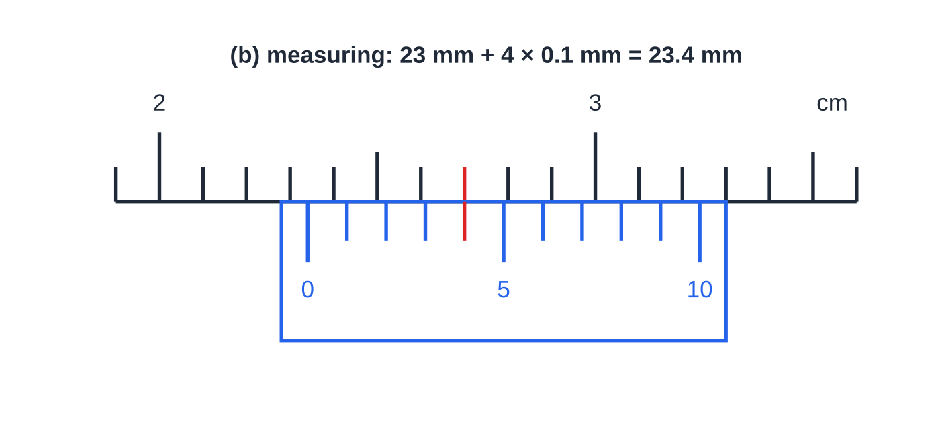
How do you read a vernier caliper and a micrometer? (continued)
Section 3 of 13
(b) The vernier zero is just past 23 mm and vernier line 4 lines up with a main-scale line (the 27 mm line): the reading is 23.4 mm.
Notes:
How do you read a vernier caliper and a micrometer?. Full notes: https://examinerprep.com/notes/edexcel-ial-physics/planning-experiments-and-measuring-instruments/

Slide 15
How do you read a vernier caliper and a micrometer? (continued)
Section 3 of 13 · Worked example 2 · Medium · Determine
WORKED EXAMPLE · QUESTION
The scales above show a vernier caliper with its jaws closed (a) and measuring the outside diameter of a plastic pipe (b). Determine the diameter of the pipe and its percentage uncertainty.
SOLUTION
Read (b): main scale 23 mm, vernier line 4 coincides, so reading = 23 + 4 ×0.1 = 23.4 mm. Zero error from (a): +0.2 mm, so diameter = 23.4 - 0.2 = 23.2 mm. Uncertainty = half the resolution = 0.05 mm, so 0.05/23.2 ×100 = 0.22%.
Notes:
How do you read a vernier caliper and a micrometer?: Worked example 2. Full notes: https://examinerprep.com/notes/edexcel-ial-physics/planning-experiments-and-measuring-instruments/

Slide 16
How do you read a vernier caliper and a micrometer? (continued)
Section 3 of 13
Common error
Reading the vernier line that sits under the main-scale value instead of the one that lines up with a main-scale line. In (b), vernier line 4 lines up with the 27 mm line: a different main-scale line from the 23 mm you read first, and that is exactly how a vernier works.
Micrometer screw gauge (0.01 mm)
The sleeve has a horizontal datum line with millimetre marks above it and half-millimetre marks below it. The thimble is a screw with a pitch of 0.50 mm: one full turn moves the spindle 0.50 mm. Its edge carries 50 divisions, so each division is 0.50/50 = 0.01 mm.
Reading = the last mark visible on the sleeve (to 0.5 mm) + (thimble division on the datum line × 0.01 mm). Record to 0.01 mm.
Notes:
How do you read a vernier caliper and a micrometer?. Full notes: https://examinerprep.com/notes/edexcel-ial-physics/planning-experiments-and-measuring-instruments/

Slide 17
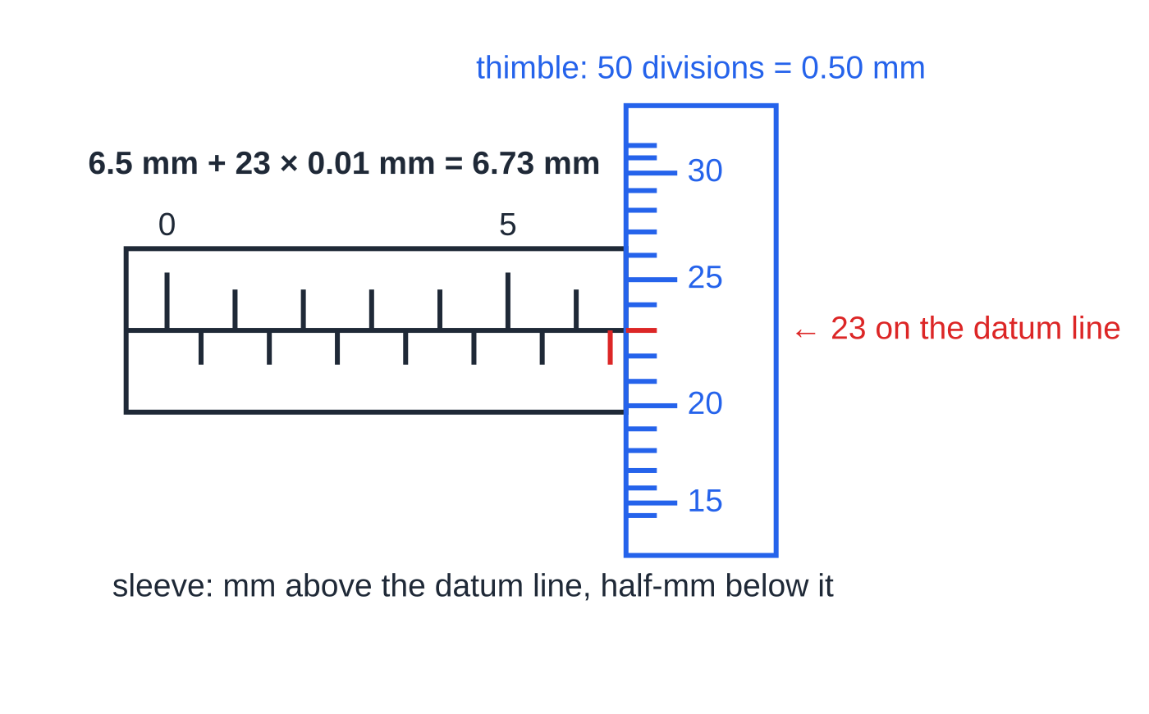
How do you read a vernier caliper and a micrometer? (continued)
Section 3 of 13
Turn the ratchet, not the thimble, to close on the object: the ratchet slips at the same gentle force every time, so soft wires are not squashed and readings are consistent.
Check the zero with the anvil and spindle closed (and clean) before measuring.
The half-millimetre mark after 6 mm is visible, so the sleeve gives 6.5 mm; thimble division 23 is on the datum line, adding 0.23 mm. The thimble lines are drawn as they appear on a cylinder: closer together away from the datum line.
Notes:
How do you read a vernier caliper and a micrometer?. Full notes: https://examinerprep.com/notes/edexcel-ial-physics/planning-experiments-and-measuring-instruments/

Slide 18
How do you read a vernier caliper and a micrometer? (continued)
Section 3 of 13 · Worked example 3 · Medium · State, Determine
WORKED EXAMPLE · QUESTION
The micrometer above is measuring the diameter of a steel ball bearing. With the anvil and spindle closed, the datum line lies 2 divisions below the zero on the thimble, so the instrument reads −0.02 mm. (a) State the reading shown. (b) Determine the diameter of the ball bearing. (c) Calculate the percentage uncertainty in the diameter.
SOLUTION
(a) 6.5 + 23 ×0.01 = 6.73 mm.
(b) Corrected reading = reading − zero error: 6.73 - (-0.02) = 6.75 mm. A negative zero error makes every reading too small, so it is added back.
(c) Uncertainty = 0.005 mm, so 0.005/6.75 ×100 = 0.074%.
Notes:
How do you read a vernier caliper and a micrometer?: Worked example 3. Full notes: https://examinerprep.com/notes/edexcel-ial-physics/planning-experiments-and-measuring-instruments/

Slide 19
How do you read a vernier caliper and a micrometer? (continued)
Section 3 of 13
Exam tip
The commonest slip is missing the half-millimetre mark: if a mark below the datum line is visible after the last whole millimetre, add 0.50 mm before adding the thimble reading. A thimble reading can never exceed 0.49 mm.
Notes:
How do you read a vernier caliper and a micrometer?. Full notes: https://examinerprep.com/notes/edexcel-ial-physics/planning-experiments-and-measuring-instruments/

Slide 20
What are zero errors and calibration?
Section 4 of 13
Zero error: a non-zero reading shown by an instrument when the true value is zero.
A zero error adds (or removes) the same amount from every reading: it is a systematic error. Repeating and averaging cannot remove it, so you must correct for it: corrected reading = reading − zero error.
Checking zero before use: close the jaws of a caliper or micrometer; switch on a meter with no current or p.d. and check it reads zero; tare (zero) a balance with the empty container on it; check the end of a metre rule is not worn, or measure from the 10.0 cm mark and subtract.
Calibration means checking an instrument against known values and correcting for any difference: for example hanging known masses on a newton meter, or placing a thermometer in melting ice (0 °C) and in steam above boiling water (about 100 °C).
Notes:
What are zero errors and calibration?. Full notes: https://examinerprep.com/notes/edexcel-ial-physics/planning-experiments-and-measuring-instruments/

Slide 21
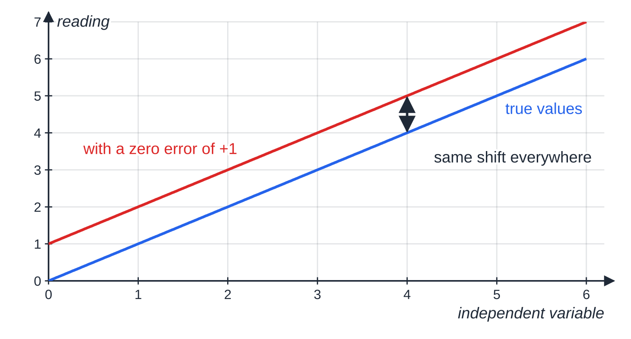
What are zero errors and calibration? (continued)
Section 4 of 13
Common error
Adding a positive zero error instead of subtracting it: a +0.2 mm zero error makes every reading 0.2 mm too big, so take 0.2 mm away.
On a graph, a zero error moves the whole line up or down: it changes the intercept but not the gradient. This is one reason to take a result from a gradient.
Notes:
What are zero errors and calibration?. Full notes: https://examinerprep.com/notes/edexcel-ial-physics/planning-experiments-and-measuring-instruments/

Slide 22
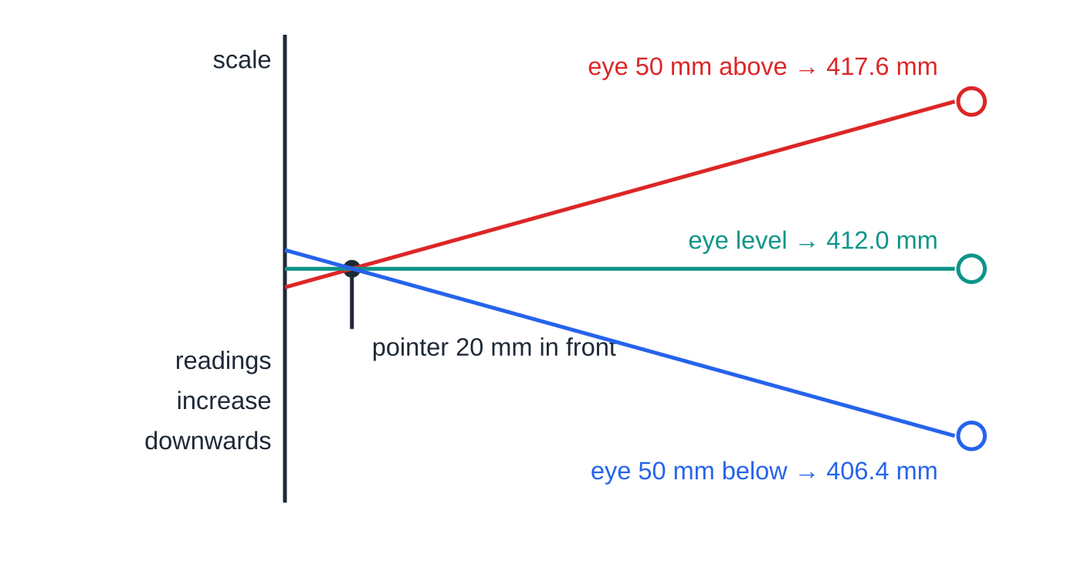
Which techniques make a measurement trustworthy?
Section 5 of 13
Avoiding parallax
Parallax error occurs when a pointer (or meniscus) is not touching the scale and the eye is not level with it. Put the eye at the same level as the pointer, perpendicular to the scale; move the scale as close to the pointer as possible; for meters, use one with a mirror behind the pointer and line the pointer up with its image.
Drawn to scale: a pointer 20 mm in front of a scale, viewed from 200 mm away. Level, the reading is 412.0 mm. An eye 50 mm too high reads 417.6 mm; 50 mm too low reads 406.4 mm.
Notes:
Which techniques make a measurement trustworthy?. Full notes: https://examinerprep.com/notes/edexcel-ial-physics/planning-experiments-and-measuring-instruments/

Slide 23
Which techniques make a measurement trustworthy? (continued)
Section 5 of 13 · Worked example 4 · Medium · Calculate, Suggest
WORKED EXAMPLE · QUESTION
A spring hangs beside a vertical metre rule, with readings increasing downwards. A pointer on the bottom of the spring is 20 mm in front of the rule. A student's eye is 200 mm from the rule and 50 mm above the pointer when she reads the stretched position. The unstretched reading was 350.0 mm and the true stretched reading is 412.0 mm. (a) Calculate the reading she obtains. (b) Calculate the percentage error this causes in the extension. (c) Suggest two ways to avoid it.
SOLUTION
(a) Similar triangles: the line of sight drops 50 mm over 180 mm, so over a further 20 mm it drops 50 ×20/180 = 5.6 mm. Reading = 412.0 + 5.6 = 417.6 mm.
(b) True extension = 412.0 - 350.0 = 62 mm, so 5.6/62 ×100 = 9%, far larger than the 0.5 mm reading uncertainty.
Notes:
Which techniques make a measurement trustworthy?: Worked example 4. Full notes: https://examinerprep.com/notes/edexcel-ial-physics/planning-experiments-and-measuring-instruments/

Slide 24
Which techniques make a measurement trustworthy? (continued)
Section 5 of 13 · Worked example 4 · Medium · Calculate, Suggest (continued)
(c) Eye level with the pointer, looking perpendicular to the rule; move the rule (or pointer) so they almost touch.
Notes:
Which techniques make a measurement trustworthy?: Worked example 4. Full notes: https://examinerprep.com/notes/edexcel-ial-physics/planning-experiments-and-measuring-instruments/

Slide 25
Which techniques make a measurement trustworthy? (continued)
Section 5 of 13
Other techniques worth naming
Set square: stand it on the bench against a metre rule to check the rule is vertical, or use it to line up the bottom of an object with the scale. A spirit level does the same job for horizontal surfaces.
Fiducial mark: a fixed reference line or pin at the centre of an oscillation (where the object moves fastest), so each pass is timed at the same, sharply defined point.
Time many cycles: time 10 or 20 oscillations and divide. The reaction-time error happens once at the start and once at the end, so it is shared across all the cycles.
Several places and directions: measure a wire's diameter at several points, turning the micrometer through 90° each time, and take the mean.
Electronic timing (light gates) removes reaction time for short events.
Notes:
Which techniques make a measurement trustworthy?. Full notes: https://examinerprep.com/notes/edexcel-ial-physics/planning-experiments-and-measuring-instruments/

Slide 26
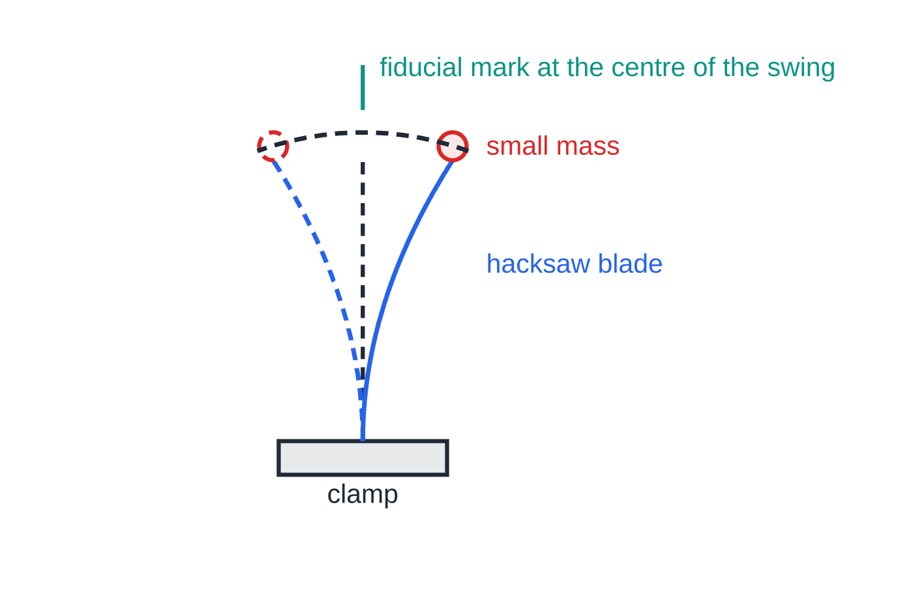
Which techniques make a measurement trustworthy? (continued)
Section 5 of 13
A vertical hacksaw blade with a small mass on top. The fiducial mark sits at the centre of the swing, where the blade moves fastest, so each pass is timed at a sharply defined instant.
Notes:
Which techniques make a measurement trustworthy?. Full notes: https://examinerprep.com/notes/edexcel-ial-physics/planning-experiments-and-measuring-instruments/

Slide 27
Which techniques make a measurement trustworthy? (continued)
Section 5 of 13 · Worked example 5 · Medium · Calculate, Explain
WORKED EXAMPLE · QUESTION
A hacksaw blade is clamped vertically with a small mass on its top and set vibrating. A student times single oscillations three times: 0.40 s, 0.47 s, 0.37 s. He then times 20 oscillations three times: 8.46 s, 8.31 s, 8.55 s. (a) Calculate the period and its percentage uncertainty from each set. (b) Explain why timing 20 oscillations is better. (c) Suggest one further improvement.
SOLUTION
(a) Single oscillations: mean = 0.41 s; uncertainty = half the range = (0.47 - 0.37)/2 = 0.05 s; percentage = 0.05/0.413 ×100 = 12%. Twenty oscillations: mean = 8.44 s; uncertainty = (8.55 - 8.31)/2 = 0.12 s; percentage = 0.12/8.44 ×100 = 1.4%; period = 8.44/20 = 0.422 s (1.4%).
(b) The reaction-time error at start and stop is about the same, but it is now spread over a time 20 times longer, so it is a much smaller fraction of the total and the percentage uncertainty falls sharply (1.4% instead of 12%).
Notes:
Which techniques make a measurement trustworthy?: Worked example 5. Full notes: https://examinerprep.com/notes/edexcel-ial-physics/planning-experiments-and-measuring-instruments/

Slide 28
Which techniques make a measurement trustworthy? (continued)
Section 5 of 13 · Worked example 5 · Medium · Calculate, Explain (continued)
(c) A fiducial mark at the centre of the swing; start the count at "zero" as the blade passes it.
Notes:
Which techniques make a measurement trustworthy?: Worked example 5. Full notes: https://examinerprep.com/notes/edexcel-ial-physics/planning-experiments-and-measuring-instruments/

Slide 29
How do you handle variables, repeats and safety?
Section 6 of 13
Variable | Meaning | In the cantilever experiment
independent | the one you deliberately change | length L beyond the bench edge
dependent | the one you measure as a result | end deflection y
control | everything else that could affect the result, kept constant | same load, same strip (width and thickness), load hung at the same distance from the free end, same clamp position
For each control variable say how it is kept constant ("use the same 0.200 kg mass throughout"), not just that it is: "fair test" alone is not an answer.
Range and number of readings: at least five or six values of the independent variable, spread across the widest range the apparatus allows, so the shape of the graph is clear.
Repeats are useful when readings scatter randomly: timing by hand, rebound heights, readings that drift. Repeat, check for an anomaly, and take the mean.
Notes:
How do you handle variables, repeats and safety?. Full notes: https://examinerprep.com/notes/edexcel-ial-physics/planning-experiments-and-measuring-instruments/

Slide 30
How do you handle variables, repeats and safety? (continued)
Section 6 of 13
Repeats are not useful when the reading cannot change (a steady digital display, a fixed length), or when the measurement changes the object (a wire stretched beyond its elastic limit, a sample that is destroyed). Then say why, and take readings at more values instead.
For safety, give a hazard that belongs to this experiment and a precaution that deals with it; "wear goggles" only when something could hit the eyes.
Hazard | Where it appears | Precaution
falling masses | loaded strips, springs, wires under tension | box of sand or foam under the load; keep feet clear; clamp the stand to the bench
wire or string snapping and whipping | stretching wires, tensioned strings | safety goggles; cover the wire; stand to one side of it, not in line with it
hot components | resistance wire, filament lamps carrying large currents | keep currents small; switch off between readings; let parts cool before touching
Notes:
How do you handle variables, repeats and safety?. Full notes: https://examinerprep.com/notes/edexcel-ial-physics/planning-experiments-and-measuring-instruments/

Slide 31
How do you handle variables, repeats and safety? (continued)
Section 6 of 13
Hazard | Where it appears | Precaution
laser light | diffraction and refraction experiments | low-power laser; never look along the beam; keep beam below eye level; remove reflective objects
water near electrical equipment | ripple tanks, heating experiments | keep supplies away from water; use low-voltage supplies; mop spills at once
a tall stand toppling | long pendulums, drop experiments from height | clamp the base or add a counterweight
Notes:
How do you handle variables, repeats and safety?. Full notes: https://examinerprep.com/notes/edexcel-ial-physics/planning-experiments-and-measuring-instruments/

Slide 32
How will the data be used?
Section 7 of 13
Rearrange the equation linking the variables into the form y = mx + c and plot the y-quantity against the x-quantity. State the expected shape ("a straight line through the origin" confirms a proportional relationship) and what the gradient or intercept equals.
Relationship | Plot | Gradient
y = 4WL³/Ebd³ (cantilever) | y against L³ | 4W/Ebd³
v² = u² + 2as | v² against s | 2a (intercept u²)
R = ρl/A | R against l | ρ/A
I = P/4πr² | I against 1/r² | P/4π
Notes:
How will the data be used?. Full notes: https://examinerprep.com/notes/edexcel-ial-physics/planning-experiments-and-measuring-instruments/

Slide 33
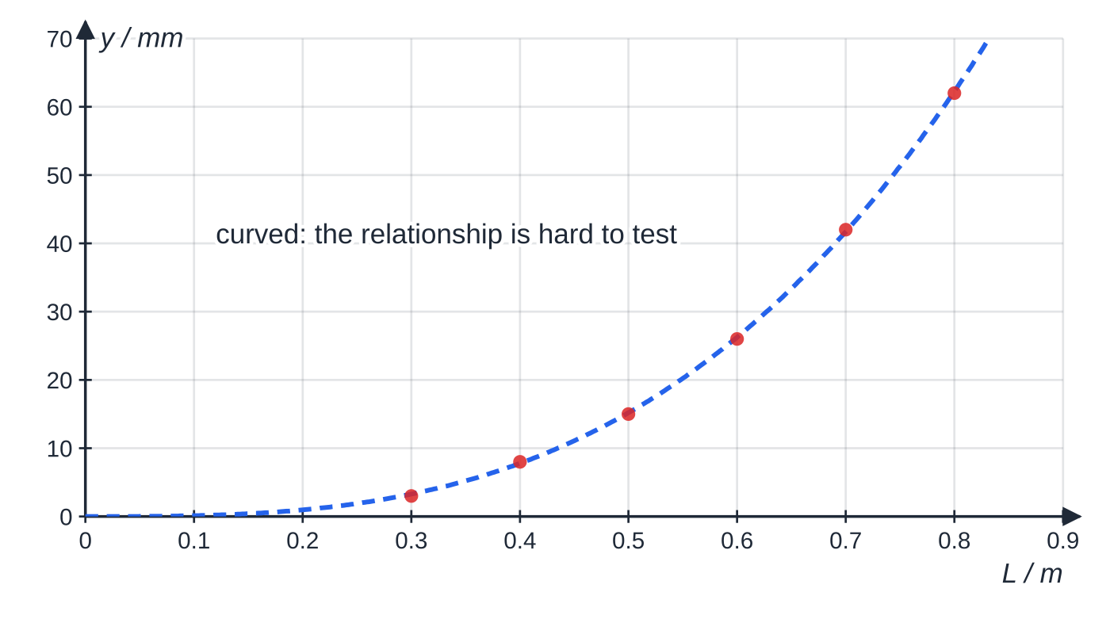
How will the data be used? (continued)
Section 7 of 13
Specimen results for the cantilever: y = 3, 8, 15, 26, 42, 62 mm for L = 0.300 m to 0.800 m in steps of 0.100 m. Plotted directly, the points lie on a curve, and you cannot tell by eye whether it is a cube law.
Notes:
How will the data be used?. Full notes: https://examinerprep.com/notes/edexcel-ial-physics/planning-experiments-and-measuring-instruments/

Slide 34
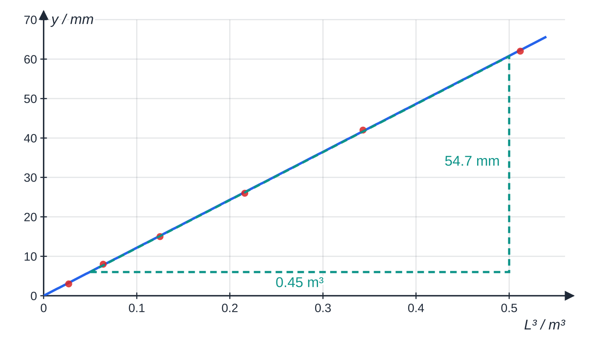
How will the data be used? (continued)
Section 7 of 13
The same data plotted as y against L³ lie on a straight line through the origin, so y ∝ L³. The gradient triangle runs from (0.05 m³, 6.0 mm) to (0.50 m³, 60.7 mm).
Notes:
How will the data be used?. Full notes: https://examinerprep.com/notes/edexcel-ial-physics/planning-experiments-and-measuring-instruments/

Slide 35
How will the data be used? (continued)
Section 7 of 13 · Worked example 6 · Hard · Plan, Determine
WORKED EXAMPLE · QUESTION
A wooden strip 25.0 mm wide and 6.0 mm thick is clamped to a bench, as in the first figure. A load of weight W = 0.200 ×9.81 = 1.96 N hangs from its free end. Theory predicts y = 4WL³/Ebd³, where L is the length beyond the bench, b the width, d the thickness and E the Young modulus of the wood. (a) Write a plan to test the relationship and find E. (b) Use the graph above to determine E.
SOLUTION
(a) Variables: vary L; measure y; keep W, the strip and the load position fixed. Measurements: L with a metre rule (1 mm) from the bench edge to the hanger; y as the change in the pin's position on a vertical metre rule, unloaded then loaded; b with a vernier (0.1 mm) and d with a micrometer (0.01 mm), each at several places, averaged. Technique and safety: rule checked vertical with a set square; eye level with the pin; six lengths from 0.300 m to 0.800 m; box of sand under the load. Analysis: plot y against L³: a straight line through the origin confirms the relationship; gradient = 4W/(Ebd³).
(b) Gradient = (60.7 - 6.0) mm ÷ (0.50 - 0.05) m³ = 122 mm m⁻³ = 0.122 m m⁻³.
Notes:
How will the data be used?: Worked example 6. Full notes: https://examinerprep.com/notes/edexcel-ial-physics/planning-experiments-and-measuring-instruments/

Slide 36
How will the data be used? (continued)
Section 7 of 13 · Worked example 6 · Hard · Plan, Determine (continued)
Then E = (4 ×1.96)/(0.0250 ×0.0060³ ×0.122), so E = 1.2 ×10¹⁰ Pa.
Note the unit conversion: y was in mm, so divide the gradient by 1000 before using it in SI units.
Notes:
How will the data be used?: Worked example 6. Full notes: https://examinerprep.com/notes/edexcel-ial-physics/planning-experiments-and-measuring-instruments/

Slide 37
How do you reduce uncertainty and comment on the physics?
Section 8 of 13
Find the biggest source of uncertainty: the measurement with the largest percentage uncertainty. In the cantilever data the smallest deflection, 3 mm, read to ±0.5 mm, is uncertain by 17%, far more than any length.
Reduce it by making the quantity bigger (longer lengths or heavier loads, within the elastic limit), by choosing an instrument with a finer resolution (a travelling microscope or a vernier for small deflections), or by measuring many units at once (20 oscillations; the thickness of 10 sheets).
Systematic errors (zero errors, a rule that is not vertical, a thermometer that reads high) shift every reading the same way. Remove them by checking zero, calibrating and using good technique; repeats do not help.
Random errors scatter readings either side of the true value. Reduce their effect by repeating and averaging and by plotting a graph.
Commenting on the physics: link the result to its context. Is the value sensible for the material? Would the relationship still hold for very large deflections (no: the theory assumes small ones)?
Notes:
How do you reduce uncertainty and comment on the physics?. Full notes: https://examinerprep.com/notes/edexcel-ial-physics/planning-experiments-and-measuring-instruments/

Slide 38
How do you reduce uncertainty and comment on the physics? (continued)
Section 8 of 13
What does the result mean for a real use, such as a shelf or a diving board?
Exam tip
When asked to "suggest an improvement", tie it to a named source of uncertainty and say what it changes: "use a travelling microscope to measure y, because the deflections are only a few millimetres and ±0.5 mm is a large percentage of them".
Notes:
How do you reduce uncertainty and comment on the physics?. Full notes: https://examinerprep.com/notes/edexcel-ial-physics/planning-experiments-and-measuring-instruments/

Slide 39
Exam tips for 3.1
Section 9 of 13
Exam tip 1 — name the instrument and its resolution
Every quantity in a plan needs an instrument, and every instrument needs a resolution with a unit: "micrometer screw gauge, resolution 0.01 mm".
Exam tip 2 — number your method, end with the graph
Short numbered steps show that each measurement, control and repeat is covered. The last step states what is plotted against what, the expected shape, and what the gradient or intercept equals: a plan without analysis cannot give a result.
Exam tip 3 — make safety specific
Give one real hazard of this experiment and a precaution that removes it. If the risk is genuinely low, say so briefly and give the one sensible precaution.
Notes:
Exam tips for 3.1. Full notes: https://examinerprep.com/notes/edexcel-ial-physics/planning-experiments-and-measuring-instruments/

Slide 40
Exam tips for 3.1 (continued)
Section 9 of 13
Exam tip 4 — read the command word
State needs a short answer; describe needs the steps; explain needs a reason linked to physics; suggest means apply what you know to an unfamiliar situation; justify a choice by comparing percentage uncertainties.
Notes:
Exam tips for 3.1. Full notes: https://examinerprep.com/notes/edexcel-ial-physics/planning-experiments-and-measuring-instruments/

Slide 41
Common misconceptions
Section 10 of 13
Misconception | Why it is wrong | Correct idea
Repeating readings removes a zero error. | A zero error shifts every reading by the same amount, so the mean is shifted too. | Correct each reading (reading − zero error) or take the result from a gradient.
A more expensive instrument is always the better choice. | What matters is resolution compared with the size of the quantity, and range. | Choose the instrument that gives a small percentage uncertainty and covers the range.
A vernier reading can be written as 23.40 mm. | The vernier resolves 0.1 mm; the extra zero claims a precision it does not have. | Record vernier readings to 0.1 mm and micrometer readings to 0.01 mm.
Timing one oscillation many times is as good as timing many oscillations once. | Each single timing still carries the full reaction-time error on a short time. | Time 10–20 oscillations so the error is a small fraction of the total.
"Keep it a fair test" is enough for the control variables. | It names no variable and no method. | Name each control variable and how it is kept constant.
Notes:
Common misconceptions. Full notes: https://examinerprep.com/notes/edexcel-ial-physics/planning-experiments-and-measuring-instruments/

Slide 42
Common misconceptions (continued)
Section 10 of 13
Misconception | Why it is wrong | Correct idea
Parallax is a random error. | If the eye is always too high, every reading shifts the same way. | Parallax can be systematic; avoid it by keeping the eye level and perpendicular to the scale.
Notes:
Common misconceptions. Full notes: https://examinerprep.com/notes/edexcel-ial-physics/planning-experiments-and-measuring-instruments/

Slide 43
How this topic connects
Section 11 of 13
2 Uncertainties and graphs; 3.3 Core practicals
Page 3.2 covers recording, plotting and evaluating the readings (significant figures, half-range uncertainties, best-fit lines, gradients). Every core practical uses the instruments and techniques on this page.
Materials (Unit 1)
The Young modulus and Hooke's law supply many planning contexts; measuring a wire's diameter with a micrometer is the key step in finding stress.
1 Planning at A2
The same planning skills return with A2 physics, together with combined uncertainties, precision, accuracy and sensitivity.
Notes:
How this topic connects. Full notes: https://examinerprep.com/notes/edexcel-ial-physics/planning-experiments-and-measuring-instruments/

Slide 44
Key equations
Section 12 of 13
Equation | Use | In the formulae list?
uncertainty of one reading = ½ × resolution | single readings at IAS | No — learn it
percentage uncertainty = (uncertainty ÷ value) × 100% | comparing instruments; finding the biggest source of uncertainty | No — learn it
vernier reading = main-scale mm + n × 0.1 mm | vernier caliper, n = coinciding vernier line | No — learn it
micrometer reading = sleeve (to 0.5 mm) + n × 0.01 mm | micrometer, n = thimble division on the datum line | No — learn it
corrected reading = reading − zero error | any instrument with a zero error (keep the sign of the zero error) | No — learn it
period = (time for N oscillations) ÷ N | timing many cycles | No — derive it
Notes:
Key equations. Full notes: https://examinerprep.com/notes/edexcel-ial-physics/planning-experiments-and-measuring-instruments/

Slide 45
Check your understanding
Section 13 of 13
1. On a vernier caliper the vernier zero is just past the 41 mm mark and vernier line 6 lines up with a main-scale line. What is the reading?
2. A micrometer sleeve shows the 3 mm mark and the half-millimetre mark after it; thimble division 12 is on the datum line. What is the reading?
3. An ammeter reads 0.02 A before the circuit is switched on. It then reads 0.46 A. What is the current?
4. Why should the diameter of a wire be measured at several points and in two perpendicular directions?
5. A trolley is released from rest on a ramp and a light gate measures its speed v after it has rolled a distance s. Which graph gives the acceleration, and how?
Notes:
Check your understanding: questions. Full notes: https://examinerprep.com/notes/edexcel-ial-physics/planning-experiments-and-measuring-instruments/

Slide 46
Check your understanding · answers
Section 13 of 13
1. 41 + 6 ×0.1 = 41.6 mm. (Vernier line 6 lines up with the 47 mm line: 41.6 + 6 ×0.9 = 47.0.)
2. 3.5 + 12 ×0.01 = 3.62 mm.
3. The zero error is +0.02 A, so the current is 0.46 - 0.02 = 0.44 A. Better still, zero the meter before use.
4. The wire may not be uniform along its length or perfectly circular; the mean of several readings is a better estimate, and the spread shows how variable it is.
5. From rest, v² = 2as. Vary s and plot v² against s: a straight line through the origin with gradient 2a, so a = gradient ÷ 2.
Notes:
Check your understanding: answers. Full notes: https://examinerprep.com/notes/edexcel-ial-physics/planning-experiments-and-measuring-instruments/

Slide 47
Practice questions
2 original exam-style questions. Answers at the end of the deck.

Slide 48
Question 1
9 marks
The speed v of a long, low wave pulse in shallow water of depth d is predicted to be v = √(gd). A student has a rectangular plastic tray 0.600 m long, a supply of water and any standard laboratory equipment.
(a) Plan an experiment to test this relationship and to determine a value for g. Your plan should include the measurements, the instruments, the control of variables, a safety point and how the results are analysed. [6]
(b) At a depth of 12 mm, the pulse travels four lengths of the tray in 7.0 s. Calculate the speed of the pulse and hence a value for g. [3]
Notes:
Online with the full mark scheme: https://examinerprep.com/ial-physics-3-1-planning-experiments-and-measuring-instruments-questions#IALP-U3-1-B-10

Slide 49
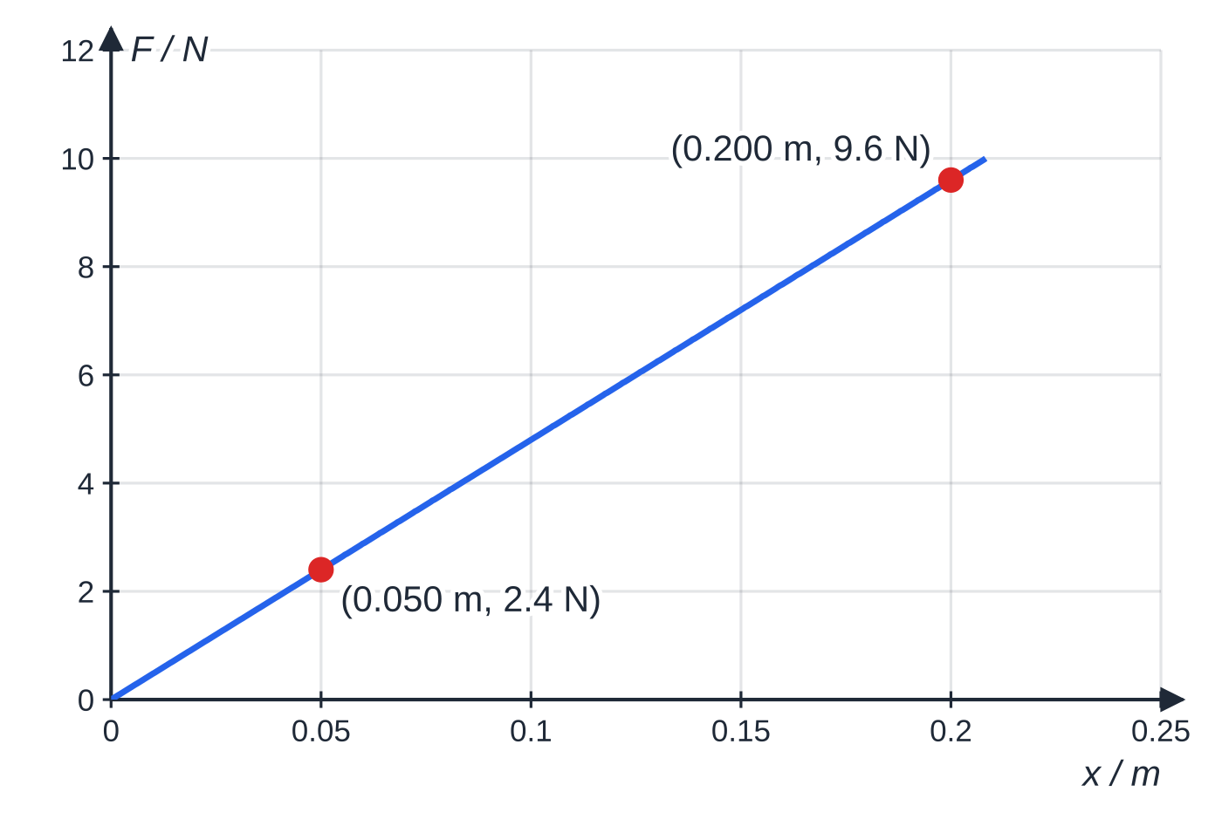
Question 2
7 marks
A toy company wants to know the stiffness of the elastic cord used in a foam-rocket launcher. A student hangs a 0.300 m length of the cord from a clamp and adds loads from 2.0 N to 10.0 N in steps of 2.0 N, measuring the extension each time. His graph of load F against extension x is a straight line through the origin, passing through the points (0.050 m, 2.4 N) and (0.200 m, 9.6 N).
Figure: the student's graph of load against extension
(a) Describe how the student could measure each extension accurately. [2]
(b) Determine the stiffness of the cord from the graph. [2]
(c) State one variable, other than the load, that should be kept constant, and explain why. [1]
(d) In the launcher the cord is stretched by 0.35 m. Discuss whether the company can use the student's value of stiffness to find the force at this extension. [2]
Notes:
Online with the full mark scheme: https://examinerprep.com/ial-physics-3-1-planning-experiments-and-measuring-instruments-questions#IALP-U3-1-B-14

Slide 50
Answers

Slide 51
Question 1 · answer
Mark scheme
Indicative content, one mark each:
vary the depth d over at least five values (e.g. 5 mm to 30 mm); measure the depth with a ruler/vernier depth gauge at several places in the tray and average
make a single pulse by quickly lifting and lowering one end of the tray (or dipping a ruler), the same way each time
time the pulse over several lengths of the tray (there and back) with a stopwatch, or film it with a video camera against a scale; v = total distance ÷ time
repeat each timing and take the mean; keep the tray level (check with a spirit level) and the water at the same temperature
plot v² against d: a straight line through the origin confirms the relationship, and the gradient = g
safety: mop up spills at once so nobody slips, and keep electrical equipment away from the water
v = 4 × 0.600 ÷ 7.0 = 0.343 m s⁻¹
Notes:
Full mark scheme: https://examinerprep.com/ial-physics-3-1-planning-experiments-and-measuring-instruments-questions#IALP-U3-1-B-10

Slide 52
Question 2 · answer
Mark scheme
fix a pointer / horizontal pin to the bottom of the cord and read it against a vertical metre rule, checked vertical with a set square
eye level with the pointer; extension = loaded reading − unloaded reading
gradient = (9.6 − 2.4) ÷ (0.200 − 0.050)
= 48 N m⁻¹
the original length of the cord (use the same 0.300 m piece), because a longer cord extends more for the same load / the temperature, because the stiffness of rubber depends on temperature
0.35 m is outside the range tested (the largest load, 10.0 N, gives only 10.0 ÷ 48 = 0.21 m), so the result would be an extrapolation
the cord may stop obeying Hooke's law at larger extensions, so the force should be measured over the full working range before relying on it
Notes:
Full mark scheme: https://examinerprep.com/ial-physics-3-1-planning-experiments-and-measuring-instruments-questions#IALP-U3-1-B-14

Slide 53
Keep practising
Notes for this topic
Questions on this topic
Build a printable test
ExaminerPrep is an independent tutoring service. It has been developed independently from and is not endorsed by the International Baccalaureate Organization. "International Baccalaureate", "IB" and "IB Diploma Programme" are registered trademarks of the IBO, used here for descriptive purposes only.
Pearson Edexcel and Cambridge are trademarks of their owners; ExaminerPrep is not affiliated with any exam board.

