Slide 1
EP
EDEXCEL IAL PHYSICS
1.6 Power and efficiency
The full notes page in 11 sections · practice questions with answers · simulations
ExaminerPrep is an independent tutoring service. It has been developed independently from and is not endorsed by the International Baccalaureate Organization. "International Baccalaureate", "IB" and "IB Diploma Programme" are registered trademarks of the IBO, used here for descriptive purposes only.
Pearson Edexcel and Cambridge are trademarks of their owners; ExaminerPrep is not affiliated with any exam board.
Notes:
1.6 Power and efficiency. Notes for this topic: https://examinerprep.com/notes/edexcel-ial-physics/power-and-efficiency/

Slide 2
What this page covers
Overview
Power as the rate of doing work or transferring energy, and the watt
Reading power from an energy–time graph and energy from a power–time graph
The power needed to lift a load with a crane, motor or lift
Converting between kilowatt-hours and joules
Deriving P = Fv and using it for vehicles at constant speed, on the level and on slopes
Efficiency from energies or from powers, as a ratio or a percentage
Sankey diagrams drawn to scale
Estimating the power of a person running upstairs, with uncertainties
Notes:
What this page covers. Full notes: https://examinerprep.com/notes/edexcel-ial-physics/power-and-efficiency/

Slide 3
In one minute
Key points
1
Power is the rate of doing work or transferring energy, P = E/t = W/t, measured in watts, where 1 W = 1 J s⁻¹.
4
At constant speed the driving force equals the resistive force, so the power needed is (resistive force) × (speed).
2
Lifting a mass m through a height Δh in a time t needs a useful power of mgΔh/t.
5
1 kWh is the energy transferred by 1 kW in 1 hour, which is 3.6 × 10⁶ J. It is a unit of energy, not power.
3
A force F moving its point of application at velocity v does work at a rate P = Fv.
6
Efficiency = useful output ÷ total input (both energies or both powers); it is always less than 1 (100%).
Notes:
In one minute: the key points of this topic.

Slide 4
What is power?
Section 1 of 11
Work and energy tell you how much has been transferred. They say nothing about how quickly. A small electric motor and a large one can both lift the same load to the same height, and both do exactly the same work on it, but one finishes in a fraction of the time. The quantity that captures "how fast" is power.
Power
is the rate of doing work, or the rate of transferring energy:
P = E/t P = W/t
where P is power (W), E is the energy transferred (J), W is the work done (J) and t is the time taken (s).
If E or W is the total for a whole interval, these equations give the average power over that interval.
Notes:
What is power?. Full notes: https://examinerprep.com/notes/edexcel-ial-physics/power-and-efficiency/

Slide 5
What is power? (continued)
Section 1 of 11
A car accelerating hard, then cruising, then braking has a power output that changes from moment to moment, and E/t smooths all of that into one number.
The watt. 1 W = 1 J s⁻¹. In SI base units a joule is kg m² s⁻², so 1 W = 1 kg m² s⁻³.
Power is a scalar, like the work and energy it is built from. It has no direction.
Large powers are given in kW (10³ W), MW (10⁶ W) or GW (10⁹ W). A kettle is about 2–3 kW, a family car engine tens of kW, a large power station about 1–2 GW.
Graphs make the definition visual. If you plot the energy transferred against time, the gradient of the line is ΔE/Δt, which is the power. A steeper line means a more powerful machine.
Notes:
What is power?. Full notes: https://examinerprep.com/notes/edexcel-ial-physics/power-and-efficiency/

Slide 6
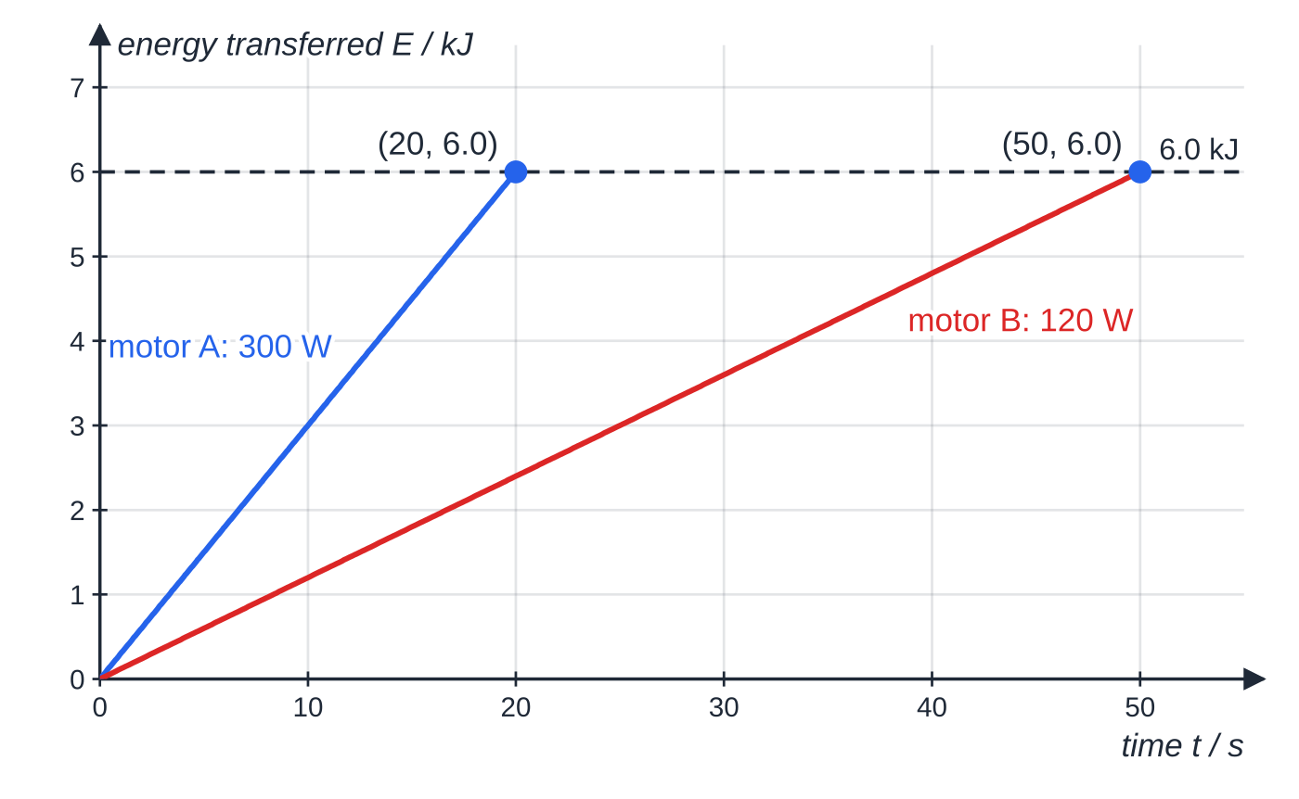
What is power? (continued)
Section 1 of 11
The reverse is just as useful. On a graph of power against time, a thin strip of width Δt and height P has area P Δt = ΔE. Adding up all the strips, the area under a power–time graph is the energy transferred. This works even when the power changes, which is where the simple formula E = Pt would fail.
Two motors raise the same load, so each transfers 6.0 kJ. Motor A takes 20 s and motor B takes 50 s. The gradient of each line is the power: 6000 ÷ 20 = 300 W and 6000 ÷ 50 = 120 W.
Notes:
What is power?. Full notes: https://examinerprep.com/notes/edexcel-ial-physics/power-and-efficiency/

Slide 7
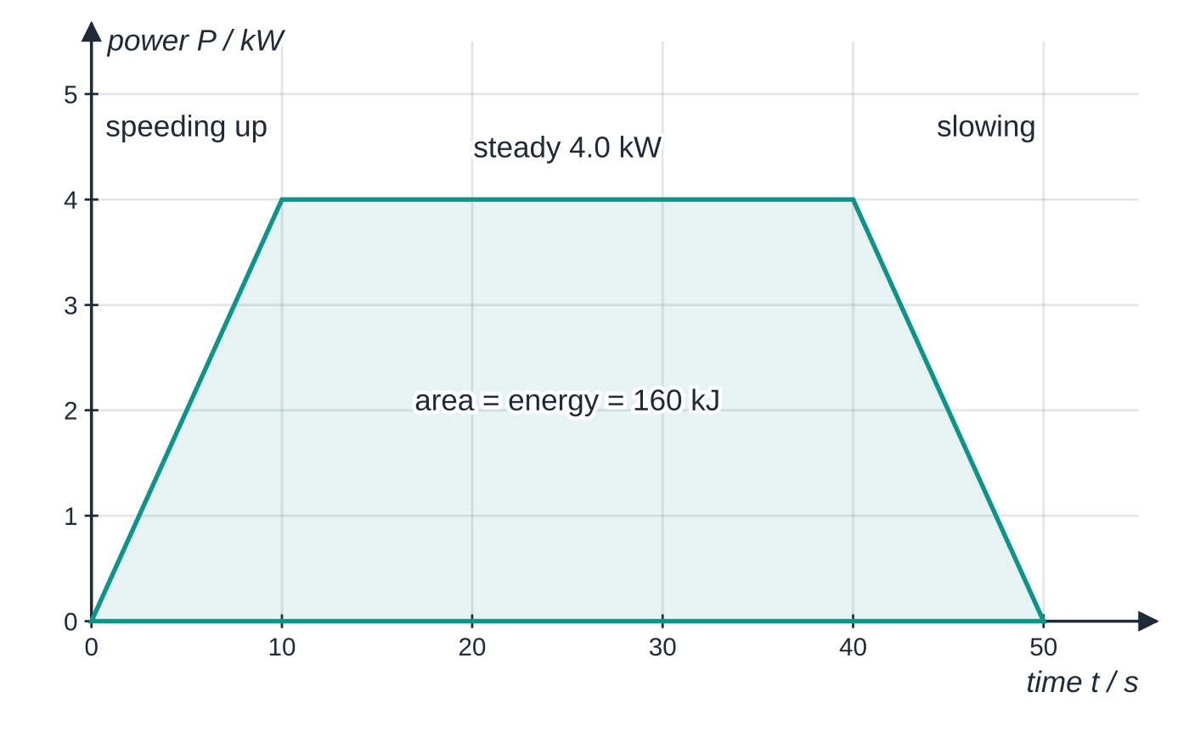
What is power? (continued)
Section 1 of 11
Common error
Treating "more powerful" as "transfers more energy". Both motors in the first graph end with the same 6.0 kJ. Power is about the rate; the total energy also depends on how long the machine runs, E = Pt.
A winch motor's power rises to 4.0 kW, stays there for 30 s, then falls back to zero. The shaded area is two triangles (20 kJ each) plus a rectangle (4.0 kW × 30 s = 120 kJ), so the motor transfers 160 kJ in total.
Notes:
What is power?. Full notes: https://examinerprep.com/notes/edexcel-ial-physics/power-and-efficiency/

Slide 8
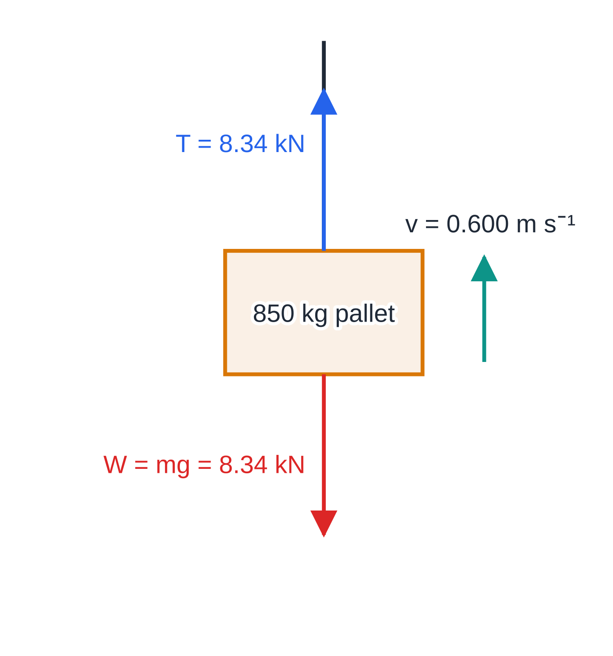
How do you find the power needed to lift a load?
Section 2 of 11
Lifting is the most common power calculation, because the useful energy is easy to find. Raising a mass m through a height Δh increases its gravitational potential energy by mgΔh. Divide by the time taken and you have the useful power:
P = mgΔh/t
When the load rises at constant velocity there is no resultant force on it (Newton's first law), so the tension in the cable equals the weight, T = mg. Also Δh/t is then simply the speed v. Putting these together gives a short cut, P = mgv, which you will see derived properly in the P = Fv section below.
Free-body diagram of the crane's load rising at a steady 0.600 m s⁻¹. The upward tension and the weight are equal, 8.34 kN each, so the load does not accelerate. Only the tension does work on it at the rate the crane must supply.
Notes:
How do you find the power needed to lift a load?. Full notes: https://examinerprep.com/notes/edexcel-ial-physics/power-and-efficiency/

Slide 9
How do you find the power needed to lift a load? (continued)
Section 2 of 11
The motor must supply more than this useful power, because some energy is always wasted, mostly by friction in gears and bearings and as thermal energy in the motor windings. The link between the two is efficiency, which comes later on this page.
Notes:
How do you find the power needed to lift a load?. Full notes: https://examinerprep.com/notes/edexcel-ial-physics/power-and-efficiency/

Slide 10
How do you find the power needed to lift a load? (continued)
Section 2 of 11 · Worked example 1 · Easy · Calculate
WORKED EXAMPLE · QUESTION
A crane lifts a pallet of bricks of mass 850 kg through a height of 18.0 m at constant speed in 30.0 s. Take g = 9.81 N kg⁻¹. Calculate (a) the work done on the pallet by the crane cable and (b) the useful power output of the crane.
SOLUTION
At constant speed the tension equals the weight: T = mg = 850 ×9.81 = 8338.5 N.
(a) Work done = force × distance moved in the direction of the force: W = 8338.5 ×18.0 = 150 093 J, so W = 1.50 × 10⁵ J.
(b) P = W/t = 150 093 ÷30.0 = 5003 W, so P = 5.00 kW.
Check with P = Fv: v = 18.0 ÷30.0 = 0.600 m s⁻¹ and 8338.5 ×0.600 = 5003 W, the same answer.
Notes:
How do you find the power needed to lift a load?: Worked example 1. Full notes: https://examinerprep.com/notes/edexcel-ial-physics/power-and-efficiency/

Slide 11
How do you convert between kilowatt-hours and joules?
Section 3 of 11
The joule is a very small amount of energy on a household scale. A kettle boiling for three minutes transfers about half a million joules, and a home uses tens of millions of joules a day. Energy suppliers therefore use a bigger unit.
One kilowatt-hour
is the energy transferred by a power of 1 kW in a time of 1 hour:
1 kWh = 1000 W ×3600 s = 3.6 ×10⁶ J
kWh → J: multiply by 3.6 × 10⁶. J → kWh: divide by 3.6 × 10⁶.
Energy in kWh = power in kW × time in hours. If you keep the units matched like this, no conversion is needed at all.
The name contains "watt", but kW × h is power × time, which is energy.
Notes:
How do you convert between kilowatt-hours and joules?. Full notes: https://examinerprep.com/notes/edexcel-ial-physics/power-and-efficiency/

Slide 12
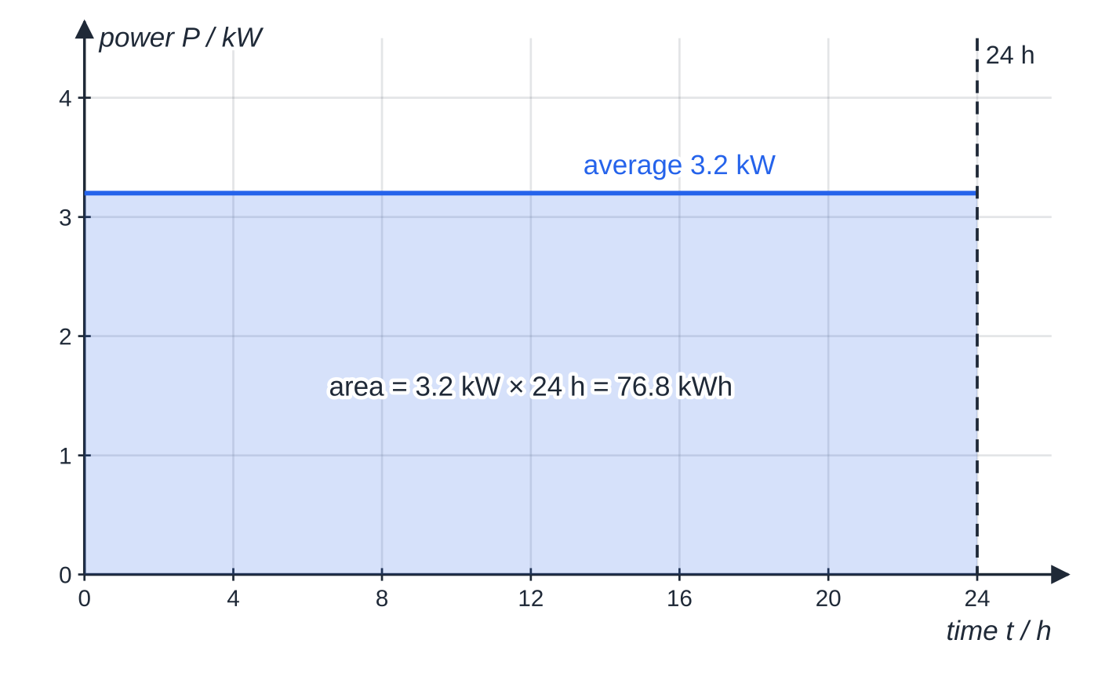
How do you convert between kilowatt-hours and joules? (continued)
Section 3 of 11
Using the average power of the wind turbine in worked example 2, the area under the power–time graph over one day is 76.8 kWh, which is 2.76 × 10⁸ J.
Notes:
How do you convert between kilowatt-hours and joules?. Full notes: https://examinerprep.com/notes/edexcel-ial-physics/power-and-efficiency/

Slide 13
How do you convert between kilowatt-hours and joules? (continued)
Section 3 of 11 · Worked example 2 · Medium · Calculate
WORKED EXAMPLE · QUESTION
A small wind turbine on a farm has an average useful power output of 3.2 kW over one day. (a) Calculate the energy it supplies in one day, in kWh and in J. (b) A household uses 9.5 kWh per day. How many such households could the turbine supply on this day?
SOLUTION
(a) Power in kW × time in hours gives kWh directly: E = 3.2 ×24 = 76.8 kWh, so E ≈ 77 kWh.
Convert with 1 kWh = 3.6 × 10⁶ J: E = 76.8 ×3.6 ×10⁶ = 2.765 ×10⁸ J, so E = 2.8 × 10⁸ J.
Check in SI units: 3200 W ×(24 ×3600 s) = 2.765 ×10⁸ J.
(b) 76.8 ÷9.5 = 8.08. Round down, because a household cannot be part-supplied: 8 households.
Notes:
How do you convert between kilowatt-hours and joules?: Worked example 2. Full notes: https://examinerprep.com/notes/edexcel-ial-physics/power-and-efficiency/

Slide 14
How do you convert between kilowatt-hours and joules? (continued)
Section 3 of 11
Common error
Calling the kilowatt-hour a unit of power because it contains "kilowatt". Another trap is converting only half the way: multiplying by 1000 alone, or by 3600 alone, gives an answer that is wrong by a factor of 3600 or 1000.
Notes:
How do you convert between kilowatt-hours and joules?. Full notes: https://examinerprep.com/notes/edexcel-ial-physics/power-and-efficiency/

Slide 15
Where does P = Fv come from, and when do you use it?
Section 4 of 11
Many power questions give you a force and a speed rather than an energy and a time. You can link them in two lines. Suppose a constant force F moves its point of application a distance Δs in its own direction, at constant velocity v, in a time Δt. Then
P = W/Δt = F Δs/Δt = F ×Δs/Δt = Fv
Here F is the force doing the work (N) and v is the velocity in the direction of that force (m s⁻¹). This equation is not given to you, so be ready to derive it from W = FΔs and P = W/t. If the velocity is changing, Fv gives the power at the instant when the velocity is v.
Vehicles at constant speed
A car cruising on a level motorway is not accelerating, so by Newton's first law the resultant force on it is zero. The forward driving force from the road on the tyres must exactly balance the total resistive force (air resistance plus rolling resistance and friction in moving parts).
Notes:
Where does P = Fv come from, and when do you use it?. Full notes: https://examinerprep.com/notes/edexcel-ial-physics/power-and-efficiency/

Slide 16
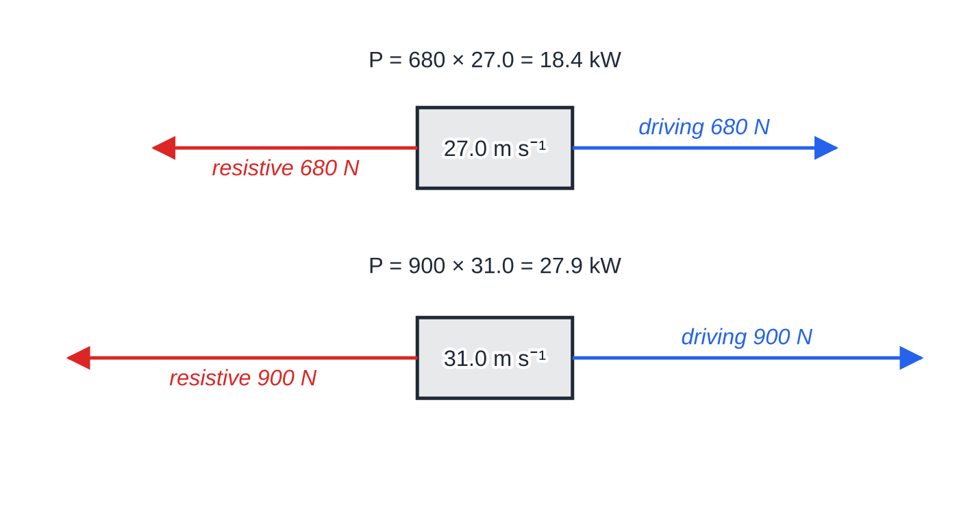
Where does P = Fv come from, and when do you use it? (continued)
Section 4 of 11
The engine still has to work hard, because the resistive forces are always there, taking energy away to the surroundings.
So the useful power from the engine is (resistive force) × (speed). Resistive forces grow with speed, mainly because air resistance rises steeply, so the power needed grows faster than the speed.
A vehicle reaches its top speed when the power needed to overcome resistance equals the maximum useful power the engine can deliver.
Horizontal forces on the car of worked example 3, drawn to scale. At each constant speed the driving force balances the resistive force. A 15% rise in speed needs a 52% rise in power, because the resistive force also rises.
Notes:
Where does P = Fv come from, and when do you use it?. Full notes: https://examinerprep.com/notes/edexcel-ial-physics/power-and-efficiency/

Slide 17
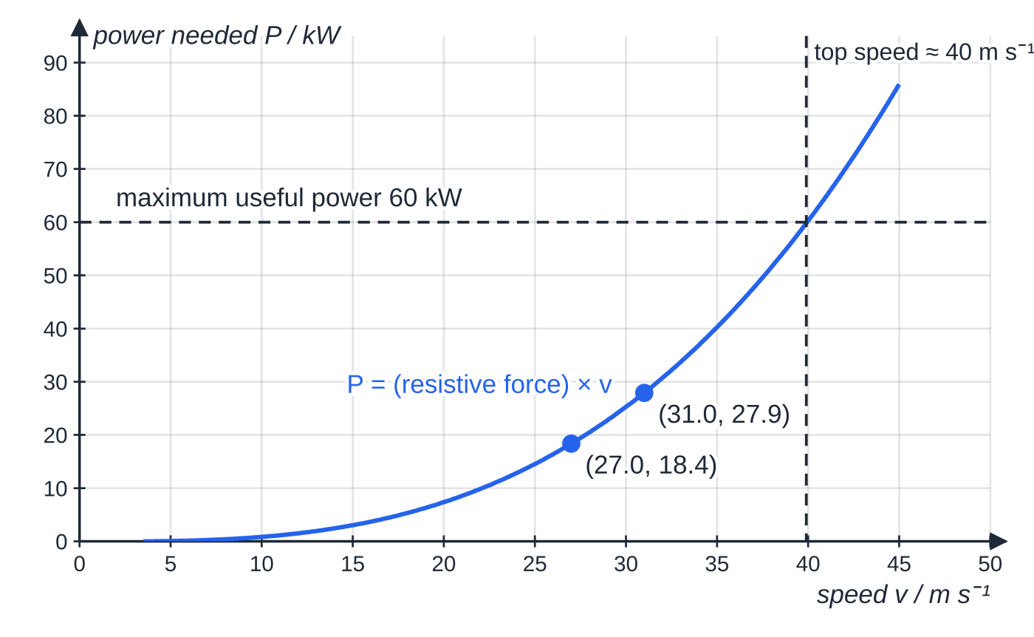
Where does P = Fv come from, and when do you use it? (continued)
Section 4 of 11
Beyond that speed the driving force available, P_(max)/v, is smaller than the resistive force, so the car would decelerate back down.
A model of the power needed by the car in worked example 3, using a resistive force that rises with the square of the speed and passes through both data points. If the engine can deliver at most 60 kW of useful power, the curve reaches that value at about 40 m s⁻¹: the top speed on level ground.
Notes:
Where does P = Fv come from, and when do you use it?. Full notes: https://examinerprep.com/notes/edexcel-ial-physics/power-and-efficiency/

Slide 18
Where does P = Fv come from, and when do you use it? (continued)
Section 4 of 11 · Worked example 3 · Medium · Calculate, compare
WORKED EXAMPLE · QUESTION
A car travels along a level road at a constant 27.0 m s⁻¹. The total resistive force on it is 680 N. When it travels at a constant 31.0 m s⁻¹ the resistive force is 900 N. (a) Calculate the useful power output of the engine at each speed. (b) Compare the percentage increases in speed and in power. (c) Calculate the work done against resistive forces per kilometre at each speed.
SOLUTION
(a) Constant speed, so driving force = resistive force; then P = Fv.
P = 680 ×27.0 = 18 360 W → 18.4 kW; P = 900 ×31.0 = 27 900 W → 27.9 kW.
(b) Speed: (31.0 - 27.0) ÷27.0 = 0.148 → 15%. Power: (27 900 - 18 360) ÷18 360 = 0.520 → 52%. The power rises more than three times as fast as the speed.
(c) Work = force × distance, with 1 km = 1000 m: 680 ×1000 → 6.8 × 10⁵ J; 900 ×1000 → 9.0 × 10⁵ J.
Notes:
Where does P = Fv come from, and when do you use it?: Worked example 3. Full notes: https://examinerprep.com/notes/edexcel-ial-physics/power-and-efficiency/

Slide 19
Where does P = Fv come from, and when do you use it? (continued)
Section 4 of 11 · Worked example 3 · Medium · Calculate, compare (continued)
Driving faster needs more power and more energy for every kilometre, because the resistive force is larger.
Notes:
Where does P = Fv come from, and when do you use it?: Worked example 3. Full notes: https://examinerprep.com/notes/edexcel-ial-physics/power-and-efficiency/

Slide 20
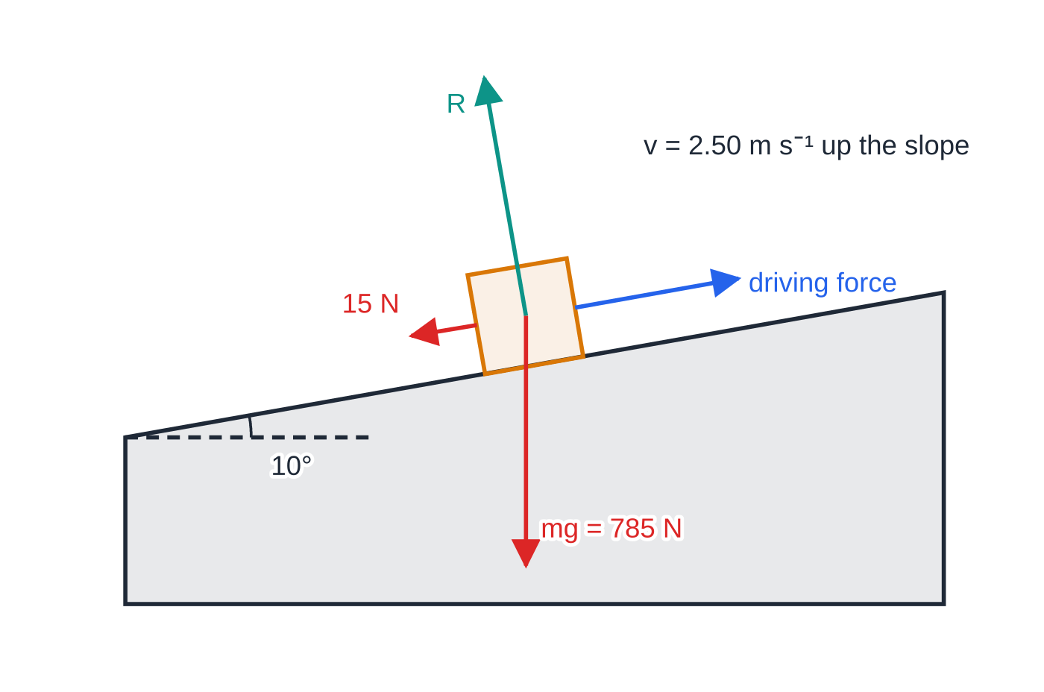
Where does P = Fv come from, and when do you use it? (continued)
Section 4 of 11
Vehicles on a slope
Going uphill at constant speed, the driving force must balance the resistive force and the component of the weight down the slope, mgsin θ. The extra power mgsin θ×v is the rate at which the vehicle gains gravitational potential energy, since vsin θ is its vertical speed.
Forces on a cyclist (with bike) of mass 80 kg riding up a 10° slope at constant speed, not to scale. Along the slope the driving force balances the 15 N resistive force plus the weight component mg sin 10° = 136 N.
Notes:
Where does P = Fv come from, and when do you use it?. Full notes: https://examinerprep.com/notes/edexcel-ial-physics/power-and-efficiency/

Slide 21
Where does P = Fv come from, and when do you use it? (continued)
Section 4 of 11 · Worked example 4 · Hard · Calculate
WORKED EXAMPLE · QUESTION
A cyclist and bike of total mass 80 kg ride up a straight slope inclined at 10° to the horizontal at a constant 2.50 m s⁻¹. The total resistive force is 15 N. (a) Calculate the useful power the cyclist must supply. (b) What fraction of this power goes into gravitational potential energy?
SOLUTION
(a) Weight component down the slope: mgsin θ= 80 ×9.81 ×sin 10° = 136.3 N.
Constant speed, so driving force = 136.3 + 15 = 151.3 N.
P = Fv = 151.3 ×2.50 = 378 W → P = 378 W.
(b) Rate of gain of GPE = mgsin θ×v = 136.3 ×2.50 = 341 W. Fraction = 341 ÷378 = 0.90 → about 90%. On a steep hill at low speed, nearly all the effort goes into climbing.
Notes:
Where does P = Fv come from, and when do you use it?: Worked example 4. Full notes: https://examinerprep.com/notes/edexcel-ial-physics/power-and-efficiency/

Slide 22
What is efficiency, and how do you show it on a Sankey diagram?
Section 5 of 11
No real machine transfers all of its input energy into the form you want. A lift motor raises the car, but it also warms its own windings, heats the gearbox through friction and makes some noise. Efficiency measures what fraction of the input actually does the job.
efficiency = (useful energy output)/(total energy input) efficiency = (useful power output)/(total power input)
Give efficiency as a ratio (for example 0.77) or a percentage (77%). It has no unit and is always less than 1 (100%).
Useful output is the energy transferred in the form you want. For a lift it is the gain in gravitational potential energy; for a car at steady speed it is the work done against resistive forces.
The rest is wasted, usually dissipated as thermal energy in the surroundings (and some sound). Energy is conserved, so input = useful + wasted.
Notes:
What is efficiency, and how do you show it on a Sankey diagram?. Full notes: https://examinerprep.com/notes/edexcel-ial-physics/power-and-efficiency/

Slide 23
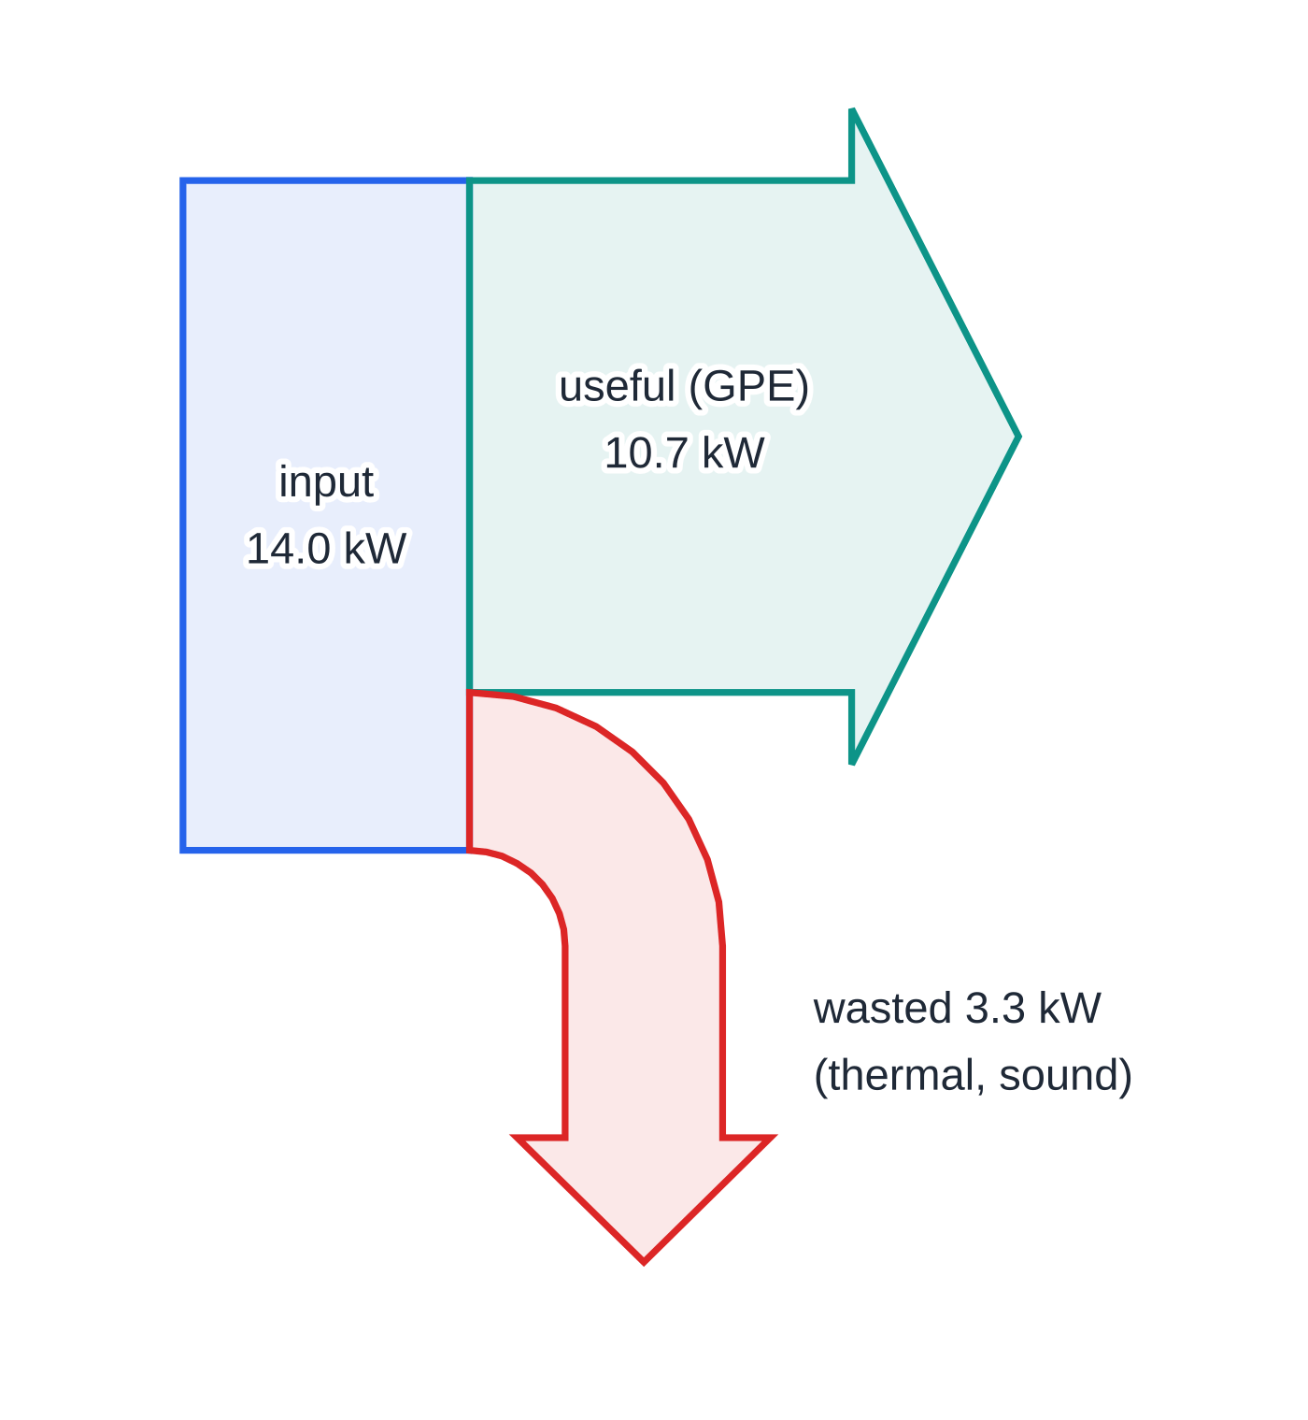
What is efficiency, and how do you show it on a Sankey diagram? (continued)
Section 5 of 11
Use the power form when you are given rates, and the energy form when you are given amounts. Never divide a power by an energy.
Sankey diagrams
A Sankey diagram shows energy (or power) flows as arrows whose widths are proportional to the amounts. The input enters on the left, the useful output carries straight on, and wasted output bends away, conventionally downwards. Because energy is conserved, the widths of the output arrows add up to the width of the input arrow. A diagram drawn to scale lets you read the efficiency straight off the page by comparing widths.
Sankey diagram for the lift motor in worked example 5, drawn to scale: 14.0 kW in, 10.7 kW useful, 3.3 kW wasted. The two output widths add up to the input width, and the useful arrow is about three-quarters of the input: an efficiency of 77%.
Notes:
What is efficiency, and how do you show it on a Sankey diagram?. Full notes: https://examinerprep.com/notes/edexcel-ial-physics/power-and-efficiency/

Slide 24
What is efficiency, and how do you show it on a Sankey diagram? (continued)
Section 5 of 11 · Worked example 5 · Medium · Calculate
WORKED EXAMPLE · QUESTION
A lift car and its passengers have a total mass of 1150 kg. The lift rises at a constant 0.95 m s⁻¹. The input power to the lift motor is 14.0 kW. Ignore any counterweight. (a) Calculate the efficiency of the lift system. (b) Calculate the energy wasted while the lift rises 24 m.
SOLUTION
Useful output power: constant speed, so F = mg and P = mgv = 1150 ×9.81 ×0.95 = 10 717 W.
(a) Efficiency = 10 717 ÷14 000 = 0.766 → 77%.
(b) Wasted power = 14 000 - 10 717 = 3283 W. Time to rise 24 m: t = 24 ÷0.95 = 25.3 s.
Energy = power × time: E_wasted = 3283 ×25.3 → 8.3 × 10⁴ J.
Notes:
What is efficiency, and how do you show it on a Sankey diagram?: Worked example 5. Full notes: https://examinerprep.com/notes/edexcel-ial-physics/power-and-efficiency/

Slide 25
What is efficiency, and how do you show it on a Sankey diagram? (continued)
Section 5 of 11
Common error
Writing the efficiency upside down (input ÷ output), giving an answer above 1. If your efficiency comes out at more than 100%, the ratio is inverted or a useful output has been overestimated. Check before you move on.
Notes:
What is efficiency, and how do you show it on a Sankey diagram?. Full notes: https://examinerprep.com/notes/edexcel-ial-physics/power-and-efficiency/

Slide 26
How can you estimate the power of a person running upstairs?
Section 6 of 11
This is a classic practical. Running up a flight of stairs raises your body through a vertical height h, so the useful power you develop is the rate of gain of gravitational potential energy, P = mgh/t. You need three measurements.
Mass m: bathroom scales, with a resolution of 0.5 kg or 0.1 kg.
Height h: measure the rise of one step with a metre rule (mm scale) and multiply by the number of steps. Check that several steps are equal, or measure the total height directly with a tape measure.
Time t: a stopwatch started as the runner sets off from the bottom step and stopped as they reach the top. Repeat several times and take the mean.
Only the vertical height matters. The horizontal distance along the treads does not change the gravitational potential energy. For safety, use dry stairs, sensible footwear and a staircase with a handrail, with nobody else on the stairs.
Notes:
How can you estimate the power of a person running upstairs?. Full notes: https://examinerprep.com/notes/edexcel-ial-physics/power-and-efficiency/

Slide 27
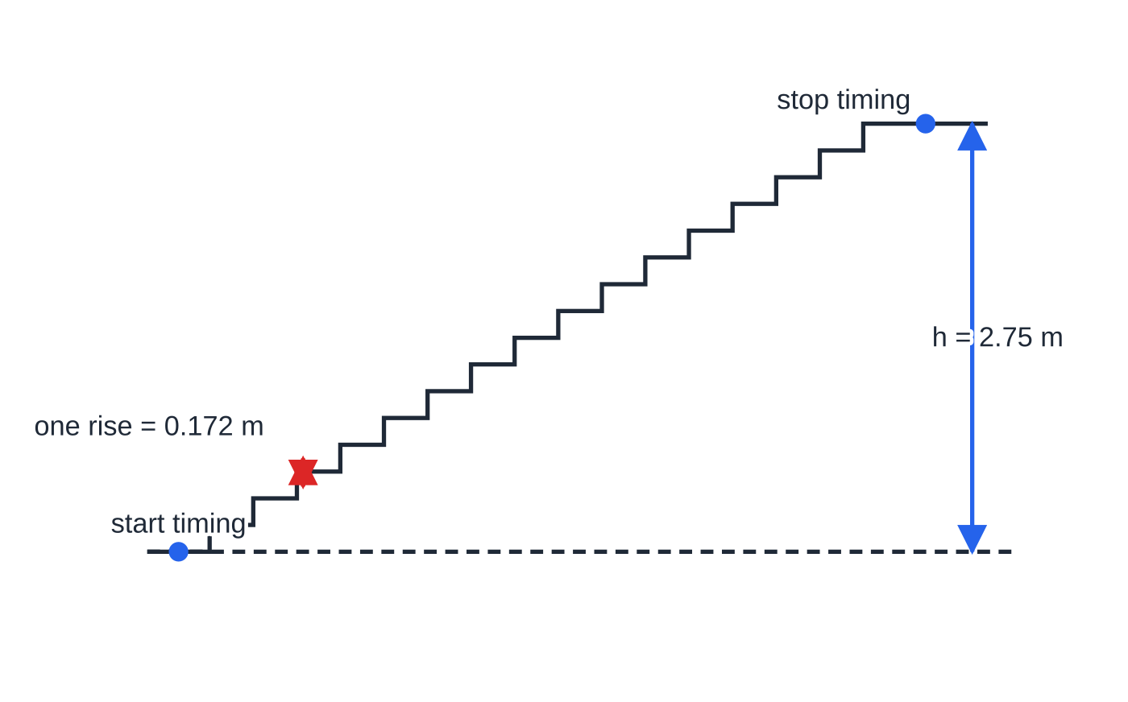
How can you estimate the power of a person running upstairs? (continued)
Section 6 of 11
The staircase of worked example 6, drawn to scale: 16 steps of rise 0.172 m give a vertical height of 2.75 m. The horizontal length of the stairs plays no part in the calculation.
Notes:
How can you estimate the power of a person running upstairs?. Full notes: https://examinerprep.com/notes/edexcel-ial-physics/power-and-efficiency/

Slide 28
How can you estimate the power of a person running upstairs? (continued)
Section 6 of 11 · Worked example 6 · Hard · Determine
WORKED EXAMPLE · QUESTION
A student of mass (58.0 ± 0.5) kg runs up a staircase of 16 steps. The rise of one step is (0.172 ± 0.001) m. Five timings are 3.71 s, 3.52 s, 3.64 s, 3.58 s and 3.65 s. Determine the student's useful power output, and identify the measurement with the largest percentage uncertainty.
SOLUTION
Height: h = 16 ×0.172 = 2.752 m. Multiplying by an exact 16 multiplies the uncertainty by 16: ±0.016 m.
Mean time: t = 18.10 ÷5 = 3.62 s; uncertainty = half the range = (3.71 - 3.52) ÷2 = ±0.095 s ≈±0.10 s.
Power: P = (58.0 ×9.81 ×2.752)/3.62 = 433 W → P ≈ 430 W.
Percentage uncertainties: mass 0.5/58.0 = 0.86%; height 0.016/2.752 = 0.58%; time 0.095/3.62 = 2.6%. The time has by far the largest percentage uncertainty (2.6%), so more repeats, or light gates at the bottom and top of the stairs, would improve the result most.
Combining the separate percentage uncertainties into one for P is a Unit 6 (A2) skill.
Notes:
How can you estimate the power of a person running upstairs?: Worked example 6. Full notes: https://examinerprep.com/notes/edexcel-ial-physics/power-and-efficiency/

Slide 29
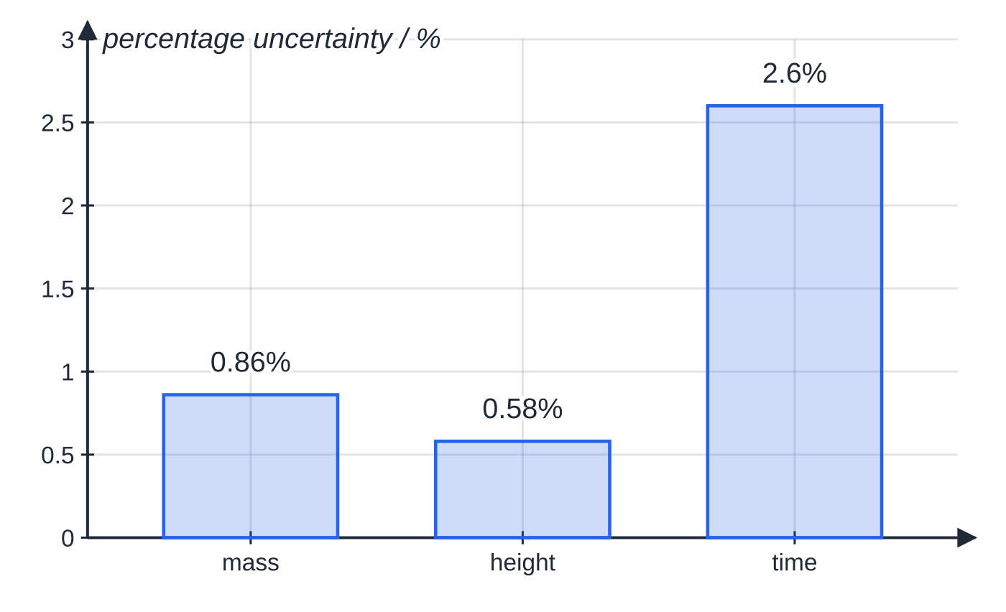
How can you estimate the power of a person running upstairs? (continued)
Section 6 of 11
Exam tip
This method finds only the rate of gain of gravitational potential energy. The person's real power output is larger: they also gain kinetic energy, and their muscles waste much of the chemical energy as thermal energy. Say so if asked why the value is an underestimate.
Percentage uncertainties of the three measurements in worked example 6. The timing dominates, so improving the timing is the most effective way to improve the result.
Notes:
How can you estimate the power of a person running upstairs?. Full notes: https://examinerprep.com/notes/edexcel-ial-physics/power-and-efficiency/

Slide 30
Exam tips for 1.6
Section 7 of 11
Exam tip 1 — convert to base units first
Before you substitute, convert kW to W, minutes and hours to seconds, and kWh to J (× 3.6 × 10⁶). A power in kW with a time in minutes gives a number that is neither joules nor kWh.
Exam tip 2 — "constant speed" is a force clue
Constant speed or constant velocity means zero resultant force. For a vehicle, driving force = resistive force; for a lifted load, tension = weight. Write that line of working, then use P = Fv. The F in P = Fv is the force doing the work, not the resultant force.
Exam tip 3 — say which output is useful
Before calculating an efficiency, decide what the device is for. For a winch it is the gain in gravitational potential energy; for a car at steady speed it is the work done against resistive forces.
Notes:
Exam tips for 1.6. Full notes: https://examinerprep.com/notes/edexcel-ial-physics/power-and-efficiency/

Slide 31
Exam tips for 1.6 (continued)
Section 7 of 11
Exam tip 4 — ratio or percentage, not both
0.77 and 77% are both correct; "0.77%" is not. Match the form the question asks for, and sense-check that the answer is below 1 (100%).
Exam tip 5 — derive P = Fv in two lines
If asked to show that P = Fv, write P = W/t = FΔs/t, then state that Δs/t = v for constant velocity. Each step is a separate statement.
Notes:
Exam tips for 1.6. Full notes: https://examinerprep.com/notes/edexcel-ial-physics/power-and-efficiency/

Slide 32
Common misconceptions
Section 8 of 11
Misconception | Why it is wrong | Correct idea
A more powerful machine always transfers more energy. | Energy = power × time; a weaker machine running for longer can transfer more. | Power is the rate of energy transfer.
The kilowatt-hour is a unit of power. | kW × h is power × time. | The kWh is a unit of energy: 1 kWh = 3.6 × 10⁶ J.
At constant speed no force is needed, so no power is needed. | Resistive forces still act and must be balanced. | Power = driving force × speed, with driving force = resistive force.
In P = Fv, F is the resultant force. | At constant velocity the resultant force is zero, which would give zero power. | F is the force doing the work, for example the driving force.
A very good machine can be more than 100% efficient. | Output energy cannot exceed input energy (conservation of energy). | Efficiency is always less than 1; some energy is always dissipated.
Notes:
Common misconceptions. Full notes: https://examinerprep.com/notes/edexcel-ial-physics/power-and-efficiency/

Slide 33
Common misconceptions (continued)
Section 8 of 11
Misconception | Why it is wrong | Correct idea
Wasted energy is destroyed. | Energy cannot be destroyed. | Wasted energy is transferred to the surroundings, mostly as thermal energy.
Notes:
Common misconceptions. Full notes: https://examinerprep.com/notes/edexcel-ial-physics/power-and-efficiency/

Slide 34
How this topic connects
Section 9 of 11
5 Work and energy
Power is built on work done, W = FΔs, and on the energy stores mgΔh and ½mv². Most power questions start by finding one of these.
2 Forces and Newton's laws
"Constant velocity, so the forces balance" is the step that turns a power question into P = (resistive force) ×v. On a slope the weight component along the slope joins the resistive force.
Electric circuits (Unit 2) and thermal physics (Unit 5)
Electrical power P = VI is often the input power to a motor; the efficiency equation links it to the mechanical output power on this page. Wasted power heats the device and its surroundings, and with specific heat capacity you can calculate the temperature rise it causes.
Notes:
How this topic connects. Full notes: https://examinerprep.com/notes/edexcel-ial-physics/power-and-efficiency/

Slide 35
Key equations
Section 10 of 11
Equation | Use | In the formulae list?
P = E/t | power from energy transferred; P in W, E in J, t in s | yes
P = W/t | power from work done; W in J | yes
efficiency = useful energy output ÷ total energy input | efficiency from energies (no unit) | yes
efficiency = useful power output ÷ total power input | efficiency from powers (no unit) | yes
W = FΔs | work done by a force (1.5); F in N, Δs in m | yes
P = Fv | power of a force moving at velocity v (m s⁻¹) | no — derive it from W = FΔs
P = mgv | lifting at constant speed | no — derive it: P = Fv with F = mg
Notes:
Key equations. Full notes: https://examinerprep.com/notes/edexcel-ial-physics/power-and-efficiency/

Slide 36
Key equations (continued)
Section 10 of 11
Equation | Use | In the formulae list?
1 kWh = 3.6 × 10⁶ J | energy unit conversion | no — learn it (1000 W × 3600 s)
Notes:
Key equations. Full notes: https://examinerprep.com/notes/edexcel-ial-physics/power-and-efficiency/

Slide 37
Check your understanding
Section 11 of 11
1. Show that the watt is equivalent to kg m² s⁻³.
2. A 1.2 kW pump runs for 15 minutes. Calculate the energy it transfers in J and in kWh.
3. A barge is towed at a constant 5.0 m s⁻¹; the water exerts a resistive force of 2.4 kN. Calculate the power of the towing force.
4. A motor is 40% efficient and gives a useful output power of 300 W. Calculate the input power and the wasted power.
5. A car's engine can deliver a maximum useful power of 45 kW. At its top speed on level ground the resistive force is 1.25 kN. Calculate the top speed.
6. Explain why mgh/t underestimates the power output of a person running upstairs.
Notes:
Check your understanding: questions. Full notes: https://examinerprep.com/notes/edexcel-ial-physics/power-and-efficiency/

Slide 38
Check your understanding · answers
Section 11 of 11
1. 1 W = 1 J s⁻¹. 1 J = 1 N m = 1 kg m s⁻² × m = 1 kg m² s⁻². Dividing by s gives kg m² s⁻³.
2. 1200 ×15 ×60 = 1.08 ×10⁶ J. In kWh: 1.2 ×0.25 = 0.30 kWh. Check: 0.30 ×3.6×10⁶ = 1.08×10⁶ J.
3. Constant velocity, so towing force = 2.4 kN. P = Fv = 2400 ×5.0 = 12 000 W = 12 kW.
4. Input = 300 ÷0.40 = 750 W; wasted = 750 - 300 = 450 W.
5. At top speed the driving force equals the resistive force, so v = P/F = 45 000 ÷1250 = 36 m s⁻¹.
6. It counts only the gain in gravitational potential energy. The person also gains kinetic energy, and their muscles dissipate much of the chemical energy they use as thermal energy, so their total power output is larger.
Notes:
Check your understanding: answers. Full notes: https://examinerprep.com/notes/edexcel-ial-physics/power-and-efficiency/

Slide 39
Practice questions
5 original exam-style questions. Answers at the end of the deck.

Slide 40
Question 1
1 mark
A small pump in a village well raises 45 kg of water through a vertical height of 8.0 m every minute. The input power to the pump is 95 W. g = 9.81 N kg⁻¹.
What is the efficiency of the pump?
A 6.3%
B 38%
C 62%
D 160%
Notes:
Online with the full mark scheme: https://examinerprep.com/ial-physics-1-6-power-and-efficiency-questions#IALP-U1-6-A-05

Slide 41
Question 2
1 mark
An outboard engine on a small boat has an efficiency of 0.32. Its useful output power is 18 kW.
At what rate does the engine waste energy?
A 12 kW
B 38 kW
C 56 kW
D 74 kW
Notes:
Online with the full mark scheme: https://examinerprep.com/ial-physics-1-6-power-and-efficiency-questions#IALP-U1-6-A-06

Slide 42
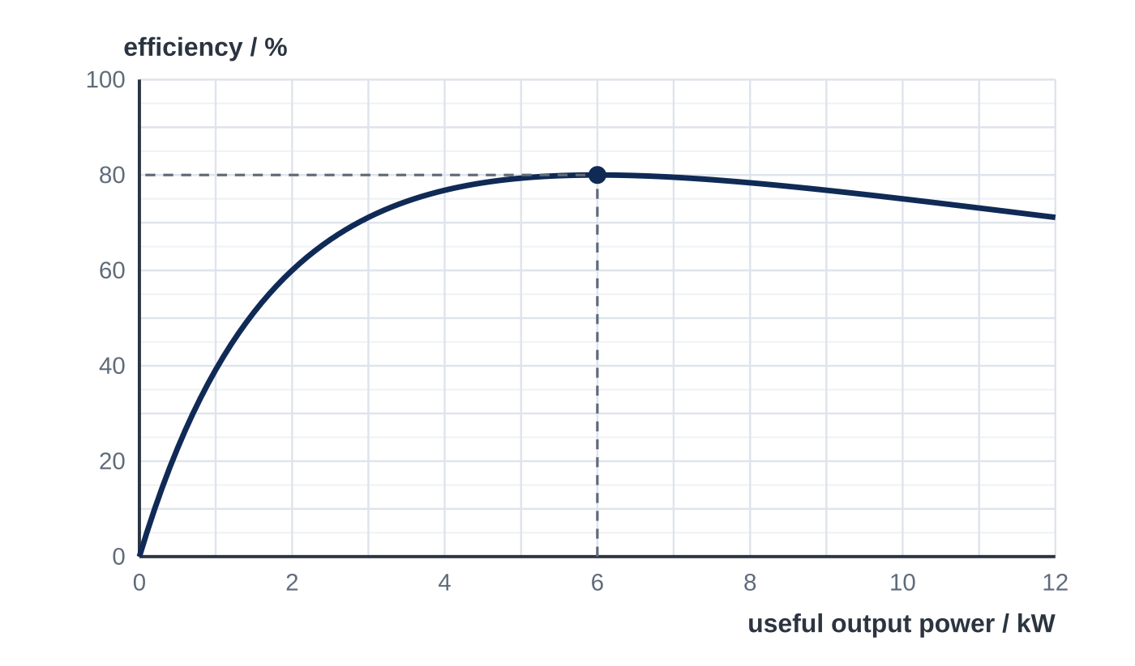
Question 3
1 mark
The graph shows how the efficiency of an electric motor varies with its useful output power. The motor is operated at a useful output power of 6.0 kW.
At what rate is energy wasted in the motor?
A 1.5 kW
B 4.8 kW
C 7.5 kW
D 14 kW
Notes:
Online with the full mark scheme: https://examinerprep.com/ial-physics-1-6-power-and-efficiency-questions#IALP-U1-6-FA-05

Slide 43
Question 4
6 marks
A student investigates how the efficiency of a small motor depends on the load it lifts. The input power to the motor is kept constant at 3.20 W, measured with a power meter. The motor winds up a string to raise a mass through 0.800 m at constant speed, and she times each lift. g = 9.81 N kg⁻¹.
Results: 0.100 kg — 2.60 s; 0.200 kg — 3.40 s; 0.300 kg — 4.60 s; 0.400 kg — 7.00 s.
(a) Calculate the efficiency of the motor when it lifts the 0.300 kg mass. [3]
(b) The efficiencies for the 0.100 kg, 0.200 kg and 0.400 kg masses are 9.4%, 14.4% and 14.0%. Describe how the efficiency varies with the load, and estimate the load at which it is greatest. [2]
(c) Suggest one improvement to the method that would locate the load for maximum efficiency more precisely. [1]
Notes:
Online with the full mark scheme: https://examinerprep.com/ial-physics-1-6-power-and-efficiency-questions#IALP-U1-6-B-07

Slide 44
Question 5
6 marks
In a hydroelectric power station, water flows through the turbines at a rate of 85 m³ s⁻¹ after falling through a vertical height of 120 m. The density of water is 1000 kg m⁻³. The overall efficiency of the station is 0.88. g = 9.81 N kg⁻¹.
(a) Calculate the mass of water passing through the turbines each second. [1]
(b) Calculate the rate at which the water loses gravitational potential energy. [2]
(c) Calculate the useful output power of the station. [1]
(d) Calculate the useful energy output of the station in one day, in kWh. [2]
Notes:
Online with the full mark scheme: https://examinerprep.com/ial-physics-1-6-power-and-efficiency-questions#IALP-U1-6-B-08

Slide 45
Answers

Slide 46
Question 1 · answer
Answer C
Useful energy per minute = 45 × 9.81 × 8.0 = 3532 J, so useful power = 3532 ÷ 60 = 58.9 W. Efficiency = 58.9 ÷ 95 = 0.62 = 62%.
Notes:
Full mark scheme: https://examinerprep.com/ial-physics-1-6-power-and-efficiency-questions#IALP-U1-6-A-05

Slide 47
Question 2 · answer
Answer B
Input power = useful ÷ efficiency = 18 ÷ 0.32 = 56.25 kW. Wasted power = 56.25 − 18 = 38 kW.
Notes:
Full mark scheme: https://examinerprep.com/ial-physics-1-6-power-and-efficiency-questions#IALP-U1-6-A-06

Slide 48
Question 3 · answer
Answer A
From the graph the efficiency at 6.0 kW is 80% (0.80). Input power = 6.0 ÷ 0.80 = 7.5 kW. Wasted power = 7.5 − 6.0 = 1.5 kW.
Notes:
Full mark scheme: https://examinerprep.com/ial-physics-1-6-power-and-efficiency-questions#IALP-U1-6-FA-05

Slide 49
Question 4 · answer
Mark scheme
useful energy = 0.300 × 9.81 × 0.800 = 2.354 J
useful power = 2.354 ÷ 4.60 = 0.512 W
efficiency = 0.512 ÷ 3.20 = 0.160 / 16.0%
efficiency increases with load and then decreases
greatest at a load of about 0.3 kg (between 0.2 kg and 0.4 kg)
take more readings at loads between 0.2 kg and 0.4 kg / use a greater lifting height or light gates so that the percentage uncertainty in each time is smaller / repeat each timing and use the mean
Notes:
Full mark scheme: https://examinerprep.com/ial-physics-1-6-power-and-efficiency-questions#IALP-U1-6-B-07

Slide 50
Question 5 · answer
Mark scheme
85 × 1000 = 8.5 × 10⁴ kg
energy lost per second = mgΔh for one second's mass of water: 8.5 × 10⁴ × 9.81 × 120
= 1.0 × 10⁸ W (1.0006 × 10⁸ W)
0.88 × 1.0006 × 10⁸ = 8.8 × 10⁷ W (88 MW)
8.805 × 10⁴ kW × 24 h
= 2.1 × 10⁶ kWh (allow error carried forward)
Notes:
Full mark scheme: https://examinerprep.com/ial-physics-1-6-power-and-efficiency-questions#IALP-U1-6-B-08

Slide 51
Keep practising
Notes for this topic
Questions on this topic
Build a printable test
ExaminerPrep is an independent tutoring service. It has been developed independently from and is not endorsed by the International Baccalaureate Organization. "International Baccalaureate", "IB" and "IB Diploma Programme" are registered trademarks of the IBO, used here for descriptive purposes only.
Pearson Edexcel and Cambridge are trademarks of their owners; ExaminerPrep is not affiliated with any exam board.

