Slide 1
EP
EDEXCEL IAL PHYSICS
2.1 Progressive waves
The full notes page in 11 sections · practice questions with answers · simulations
ExaminerPrep is an independent tutoring service. It has been developed independently from and is not endorsed by the International Baccalaureate Organization. "International Baccalaureate", "IB" and "IB Diploma Programme" are registered trademarks of the IBO, used here for descriptive purposes only.
Pearson Edexcel and Cambridge are trademarks of their owners; ExaminerPrep is not affiliated with any exam board.
Notes:
2.1 Progressive waves. Notes for this topic: https://examinerprep.com/notes/edexcel-ial-physics/progressive-waves/

Slide 2
What this page covers
Overview
What a progressive wave is: energy transferred, no net transfer of material
Transverse and longitudinal waves, with examples
Amplitude, wavelength, frequency, period and wave speed
Using and justifying v = fλ
Longitudinal waves in terms of molecule displacement and pressure
Displacement–distance and displacement–time graphs, and phase along a wave
Core practical: the speed of sound in air with a two-beam oscilloscope
Notes:
What this page covers. Full notes: https://examinerprep.com/notes/edexcel-ial-physics/progressive-waves/

Slide 3
In one minute
Key points
1
A progressive wave transfers energy through a medium (or through space) without any net transfer of the medium itself.
4
In one period the wave moves one wavelength, so v = fλ. The source sets f; the medium sets v.
2
Transverse: particles oscillate at right angles to the direction of energy transfer. Longitudinal: particles oscillate parallel to it, forming compressions and rarefactions.
5
A displacement–distance graph is a snapshot and shows λ; a displacement–time graph follows one point and shows T.
3
Amplitude A is the maximum displacement from equilibrium; wavelength λ is the distance between neighbouring points oscillating in phase; f = 1/T.
6
Points a distance Δx apart differ in phase by 360°×Δx/λ; points one wavelength apart are in phase.
Notes:
In one minute: the key points of this topic.

Slide 4
What is a progressive wave, and how do transverse and longitudinal waves differ?
Section 1 of 11
Drop a stone into a pond and ripples spread out, yet a cork floating on the surface only bobs up and down as they pass; it is not carried to the bank. Something travels outwards, but it is not the water. That "something" is energy, and the travelling disturbance that carries it is a wave.
A progressive wave is a disturbance that travels through a medium, transferring energy from one place to another without a net transfer of the medium.
Each particle of the medium oscillates about a fixed equilibrium position and passes the disturbance on to its neighbour a little later in time. Electromagnetic waves need no medium at all: what oscillates there is an electric and a magnetic field.
In a transverse wave the oscillations are perpendicular to the direction in which the wave transfers energy. In a longitudinal wave the oscillations are parallel to the direction in which the wave transfers energy.
Notes:
What is a progressive wave, and how do transverse and longitudinal waves differ?. Full notes: https://examinerprep.com/notes/edexcel-ial-physics/progressive-waves/

Slide 5
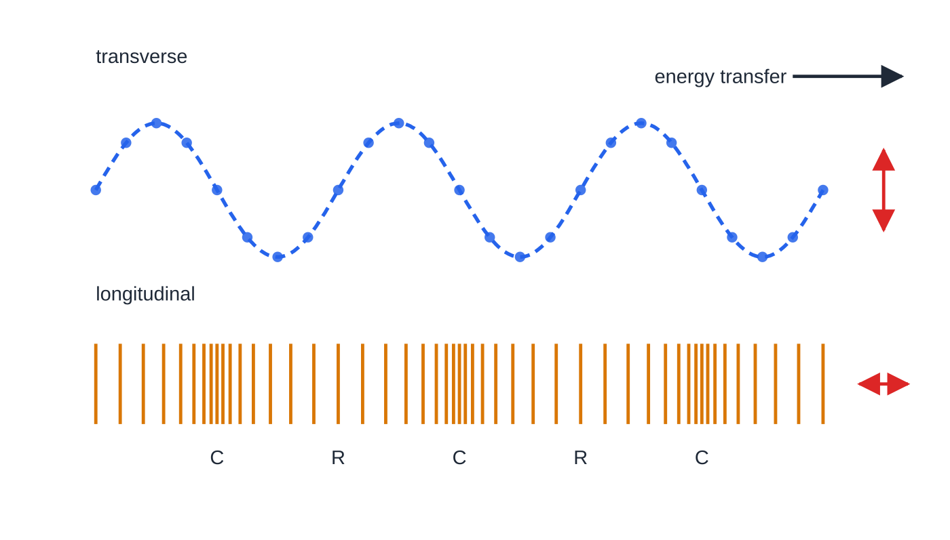
What is a progressive wave, and how do transverse and longitudinal waves differ? (continued)
Section 1 of 11
Transverse examples: waves on a stretched string or rope, all electromagnetic waves (light, radio, X-rays), the S-waves of an earthquake.
Longitudinal examples: sound and ultrasound in any medium, a push–pull pulse along a slinky spring, the P-waves of an earthquake.
Surface water waves are a mixture (water particles move in loops), but are usually modelled as transverse.
Two directions of oscillation (red double arrows). In the transverse wave each particle moves only up and down; in the longitudinal wave each moves only back and forth, crowding together at compressions (C) and spreading out at rarefactions (R).
Notes:
What is a progressive wave, and how do transverse and longitudinal waves differ?. Full notes: https://examinerprep.com/notes/edexcel-ial-physics/progressive-waves/

Slide 6
What is a progressive wave, and how do transverse and longitudinal waves differ? (continued)
Section 1 of 11
Common error
Defining a transverse wave as one where "the wave moves up and down". The particles (or fields) oscillate; the wave travels forwards. A full definition names both the direction of oscillation and the direction of energy transfer.
Notes:
What is a progressive wave, and how do transverse and longitudinal waves differ?. Full notes: https://examinerprep.com/notes/edexcel-ial-physics/progressive-waves/

Slide 7
What do amplitude, wavelength, frequency and period mean?
Section 2 of 11
Quantity | Meaning | Unit
displacement x or d | distance and direction of a particle from its equilibrium position | m
amplitude A | the maximum displacement from the equilibrium position | m
wavelength λ | the distance between two neighbouring points oscillating in phase, e.g. crest to crest or compression to compression | m
period T | the time for one complete oscillation of a particle | s
frequency f | the number of complete oscillations per unit time | Hz = s⁻¹
wave speed v | the distance travelled by the wave (by a crest, say) per unit time | m s⁻¹
Notes:
What do amplitude, wavelength, frequency and period mean?. Full notes: https://examinerprep.com/notes/edexcel-ial-physics/progressive-waves/

Slide 8
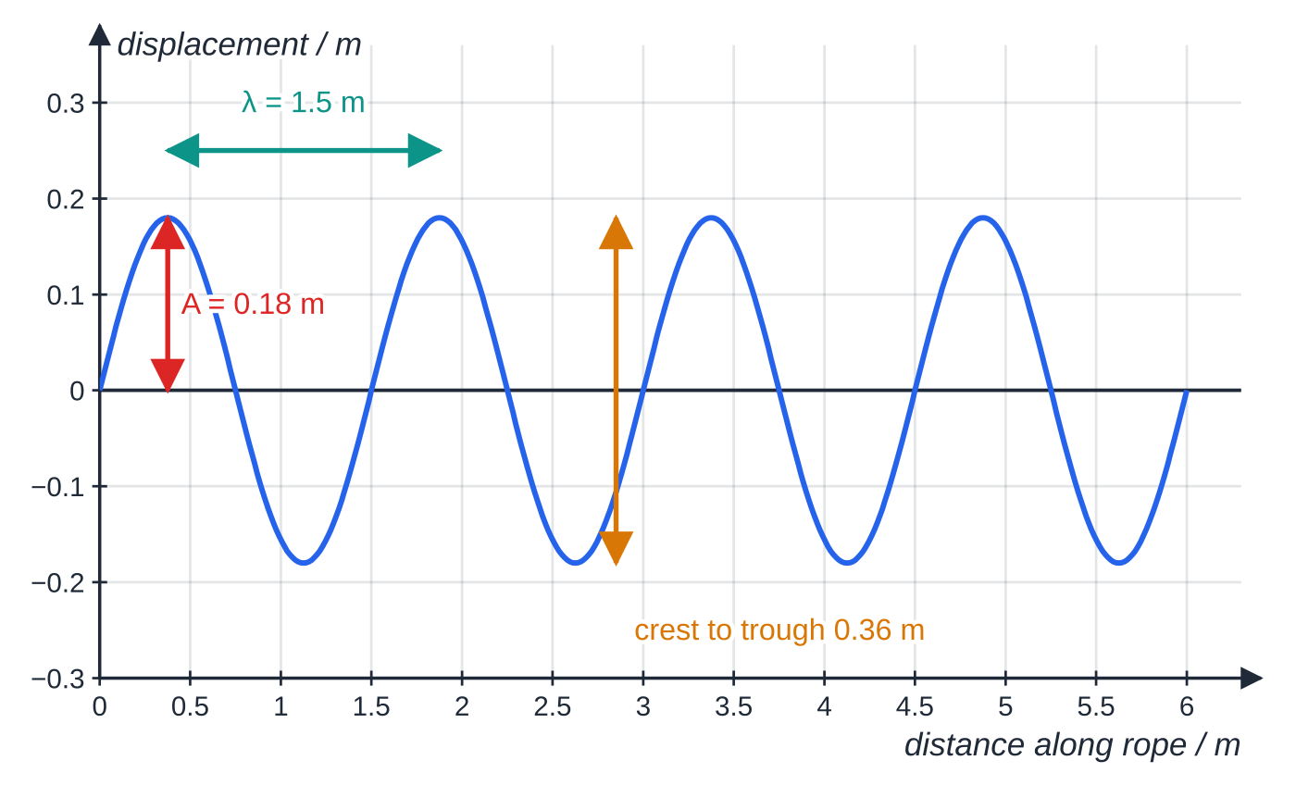
What do amplitude, wavelength, frequency and period mean? (continued)
Section 2 of 11
f = 1/T
f = frequency (Hz), T = period (s). Not in the formulae list: learn it. It follows from the definitions, since f oscillations happen each second, each lasting T.
Displacement–distance graph for the rope in worked example 1. The amplitude is measured from the equilibrium line, not from crest to trough; the wavelength is crest to crest.
Notes:
What do amplitude, wavelength, frequency and period mean?. Full notes: https://examinerprep.com/notes/edexcel-ial-physics/progressive-waves/

Slide 9
What do amplitude, wavelength, frequency and period mean? (continued)
Section 2 of 11 · Worked example 1 · Easy · Determine
WORKED EXAMPLE · QUESTION
A student shakes one end of a long rope. A photograph shows that the vertical distance from a crest to a trough is 0.36 m and that exactly four complete wavelengths fit along 6.0 m of rope. A marked point on the rope makes 15 complete oscillations in 10.0 s. Determine the amplitude, the wavelength, the frequency and the period of the wave.
SOLUTION
Amplitude is half the crest-to-trough height: A = 0.36÷2 → A = 0.18 m.
Wavelength = length ÷ number of wavelengths: λ= 6.0÷4 → λ = 1.5 m.
Frequency = oscillations ÷ time: f = 15÷10.0 → f = 1.5 Hz; period T = 1÷1.5 → T = 0.667 s.
Notes:
What do amplitude, wavelength, frequency and period mean?: Worked example 1. Full notes: https://examinerprep.com/notes/edexcel-ial-physics/progressive-waves/

Slide 10
Where does v = fλ come from, and how do you use it?
Section 3 of 11
The wave equation: v = fλ
v = wave speed (m s⁻¹), f = frequency (Hz), λ = wavelength (m).
Why it is true: in one period T the source makes one oscillation and the wave moves forward one wavelength, so v = λ/T = fλ. The argument uses nothing about the kind of wave, so it holds for every kind of wave.
The frequency is set by the source and does not change when the wave moves into a new medium.
The speed is set by the medium (its stiffness, density, tension, temperature …). In one medium, all frequencies of sound travel at the same speed.
So in a given medium, doubling f halves λ; moving into a medium where v is larger makes λ larger in the same ratio.
Watch the prefixes: kHz = 10³ Hz, MHz = 10⁶ Hz, GHz = 10⁹ Hz; mm, μm and nm for wavelengths.
Notes:
Where does v = fλ come from, and how do you use it?. Full notes: https://examinerprep.com/notes/edexcel-ial-physics/progressive-waves/

Slide 11
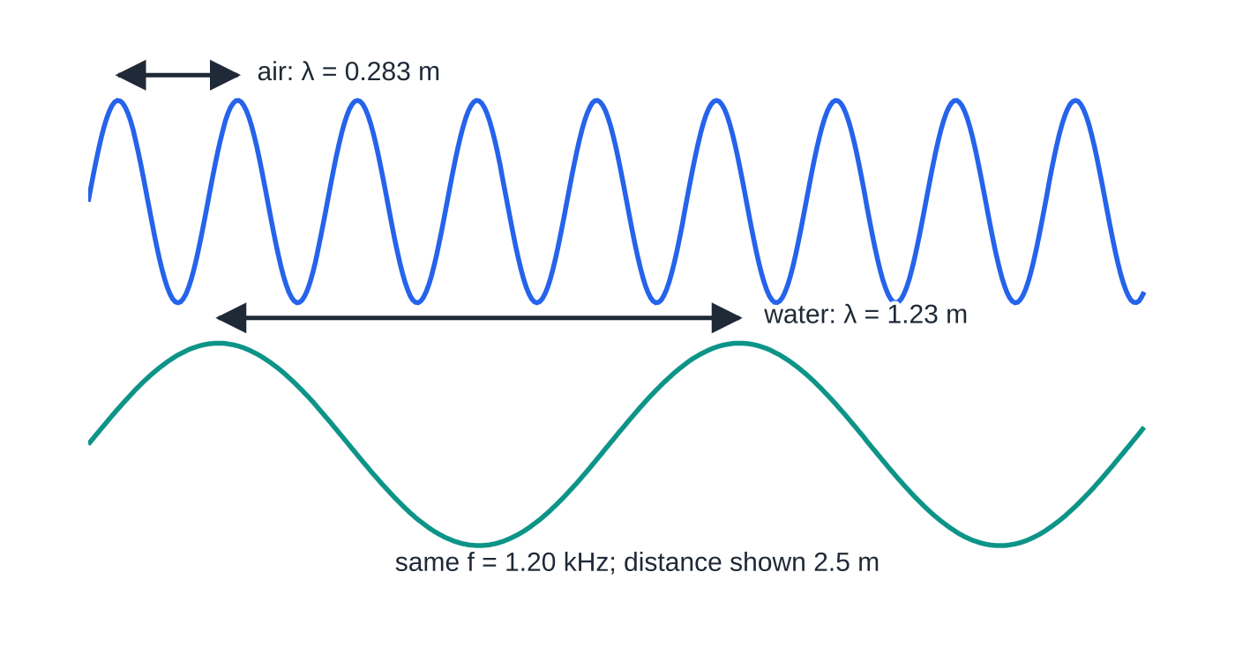
Where does v = fλ come from, and how do you use it? (continued)
Section 3 of 11
The same 1.20 kHz note in air (340 m s⁻¹) and in water (1480 m s⁻¹), drawn to the same distance scale. The frequency is fixed by the loudspeaker, so the wavelength grows in proportion to the speed.
Notes:
Where does v = fλ come from, and how do you use it?. Full notes: https://examinerprep.com/notes/edexcel-ial-physics/progressive-waves/

Slide 12
Where does v = fλ come from, and how do you use it? (continued)
Section 3 of 11 · Worked example 2 · Easy · Calculate
WORKED EXAMPLE · QUESTION
A loudspeaker at the side of a swimming pool plays a steady note of frequency 1.20 kHz. The speed of sound is 340 m s⁻¹ in air and 1480 m s⁻¹ in water. Calculate the wavelength of the sound in the air and in the water.
SOLUTION
Rearrange: λ= v/f, with f = 1200 Hz.
In air: λ= 340÷1200 → λ = 0.283 m. In water (same frequency, larger speed): λ= 1480÷1200 → λ = 1.23 m.
The wavelength rises by the same factor as the speed, 4.35, because f is fixed by the loudspeaker.
Notes:
Where does v = fλ come from, and how do you use it?: Worked example 2. Full notes: https://examinerprep.com/notes/edexcel-ial-physics/progressive-waves/

Slide 13
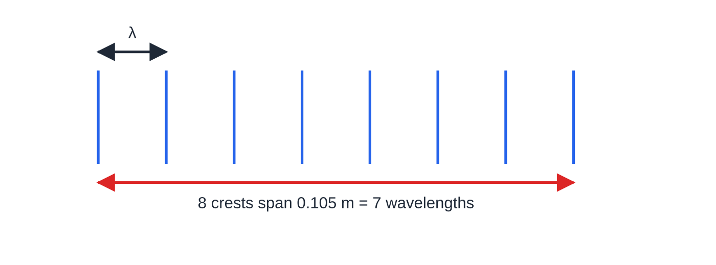
Where does v = fλ come from, and how do you use it? (continued)
Section 3 of 11
Eight bright lines (crests) on the ripple-tank photograph of worked example 3. Eight crests enclose seven gaps, so the distance is seven wavelengths, not eight.
Notes:
Where does v = fλ come from, and how do you use it?. Full notes: https://examinerprep.com/notes/edexcel-ial-physics/progressive-waves/

Slide 14
Where does v = fλ come from, and how do you use it? (continued)
Section 3 of 11 · Worked example 3 · Medium · Calculate
WORKED EXAMPLE · QUESTION
A vibrating bar dips into a ripple tank at 12 Hz. On a photograph, eight successive bright lines (wave crests) span a distance of 0.105 m. (a) Calculate the speed of the ripples. (b) Calculate the time for a crest to cross the 0.45 m width of the tank.
SOLUTION
(a) Eight crests enclose seven gaps: λ= 0.105÷7 = 0.0150 m = 15.0 mm. Then v = fλ= 12×0.0150 → v = 0.180 m s⁻¹.
(b) The wave moves at constant speed: t = 0.45÷0.180 → t = 2.5 s.
Dividing by 8 instead of 7 gives λ= 13.1 mm and v = 0.158 m s⁻¹, which is 12.5% too small.
Notes:
Where does v = fλ come from, and how do you use it?: Worked example 3. Full notes: https://examinerprep.com/notes/edexcel-ial-physics/progressive-waves/

Slide 15
Where does v = fλ come from, and how do you use it? (continued)
Section 3 of 11
Exam tip
When you are told how many crests, compressions or bright lines fit in a distance, count the gaps: n crests in a row span (n - 1) wavelengths. Sketching three or four crests settles it in seconds.
Notes:
Where does v = fλ come from, and how do you use it?. Full notes: https://examinerprep.com/notes/edexcel-ial-physics/progressive-waves/

Slide 16
How do you describe a longitudinal wave using displacement and pressure?
Section 4 of 11
In a sound wave each air molecule is displaced along the direction of travel. Take displacement to the right (the direction of travel) as positive.
A compression is where molecules are closest together: the molecules just behind it are displaced forwards and those just in front are displaced backwards, so they crowd in. Pressure and density are above the undisturbed value.
A rarefaction is where molecules are furthest apart; pressure and density are below the undisturbed value.
At the centre of a compression or a rarefaction the displacement itself is zero; the molecules with the largest displacement sit halfway between them, where the pressure is normal.
So the pressure variation is a quarter of a wavelength out of step with the displacement graph.
The wavelength is the distance from one compression to the next (or rarefaction to rarefaction); a compression and the nearest rarefaction are λ/2 apart.
Notes:
How do you describe a longitudinal wave using displacement and pressure?. Full notes: https://examinerprep.com/notes/edexcel-ial-physics/progressive-waves/

Slide 17
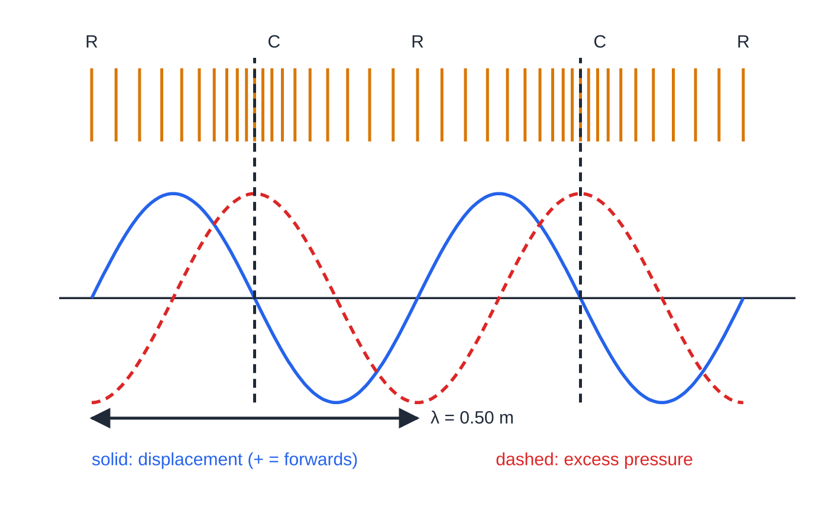
How do you describe a longitudinal wave using displacement and pressure? (continued)
Section 4 of 11
One sound wave (λ = 0.50 m) at one instant, three ways: molecule positions (top), displacement and excess pressure (graph). At a compression C the displacement is zero but the excess pressure is greatest; the displacement is greatest where the pressure is normal.
Notes:
How do you describe a longitudinal wave using displacement and pressure?. Full notes: https://examinerprep.com/notes/edexcel-ial-physics/progressive-waves/

Slide 18
How do you describe a longitudinal wave using displacement and pressure? (continued)
Section 4 of 11 · Worked example 4 · Medium · Calculate, state
WORKED EXAMPLE · QUESTION
A tuning fork produces a sound of frequency 680 Hz in air, where the speed of sound is 340 m s⁻¹. (a) Calculate the distance between neighbouring compressions. (b) State the distance from a compression to the nearest rarefaction. (c) Calculate the time between successive compressions reaching a listener's ear. (d) State how far an air molecule travels along with the wave in one second.
SOLUTION
(a) Compression to compression is one wavelength: λ= 340÷680 → 0.500 m.
(b) Compression to rarefaction is half a wavelength → 0.250 m.
(c) Successive compressions arrive one period apart: T = 1÷680 → 1.47 ms.
(d) Molecules only oscillate about their equilibrium positions → no net distance; each vibrates 680 times a second about a fixed position.
Notes:
How do you describe a longitudinal wave using displacement and pressure?: Worked example 4. Full notes: https://examinerprep.com/notes/edexcel-ial-physics/progressive-waves/

Slide 19
How do you describe a longitudinal wave using displacement and pressure? (continued)
Section 4 of 11
Common error
Saying that at a compression the molecules have their maximum displacement. A compression is where neighbouring molecules have moved towards it from both sides; the molecule at its centre has zero displacement at that instant.
Notes:
How do you describe a longitudinal wave using displacement and pressure?. Full notes: https://examinerprep.com/notes/edexcel-ial-physics/progressive-waves/

Slide 20
How do you read displacement–distance and displacement–time graphs?
Section 5 of 11
 | Displacement–distance graph | Displacement–time graph
What it shows | a snapshot of every point along the wave at one instant | the history of one point over time
Horizontal repeat length | the wavelength λ | the period T
Peak height | the amplitude A | the amplitude A
For a longitudinal wave | positive displacement means moved forwards along the direction of travel, not "up" | the same convention, for one molecule
To find the wave speed you usually need both: λ from the distance graph and T (so f) from the time graph, then v = λ/T.
A snapshot taken a little later has the same shape, shifted a distance vΔt in the direction of travel: a quarter of a wavelength after a quarter of a period.
Notes:
How do you read displacement–distance and displacement–time graphs?. Full notes: https://examinerprep.com/notes/edexcel-ial-physics/progressive-waves/

Slide 21
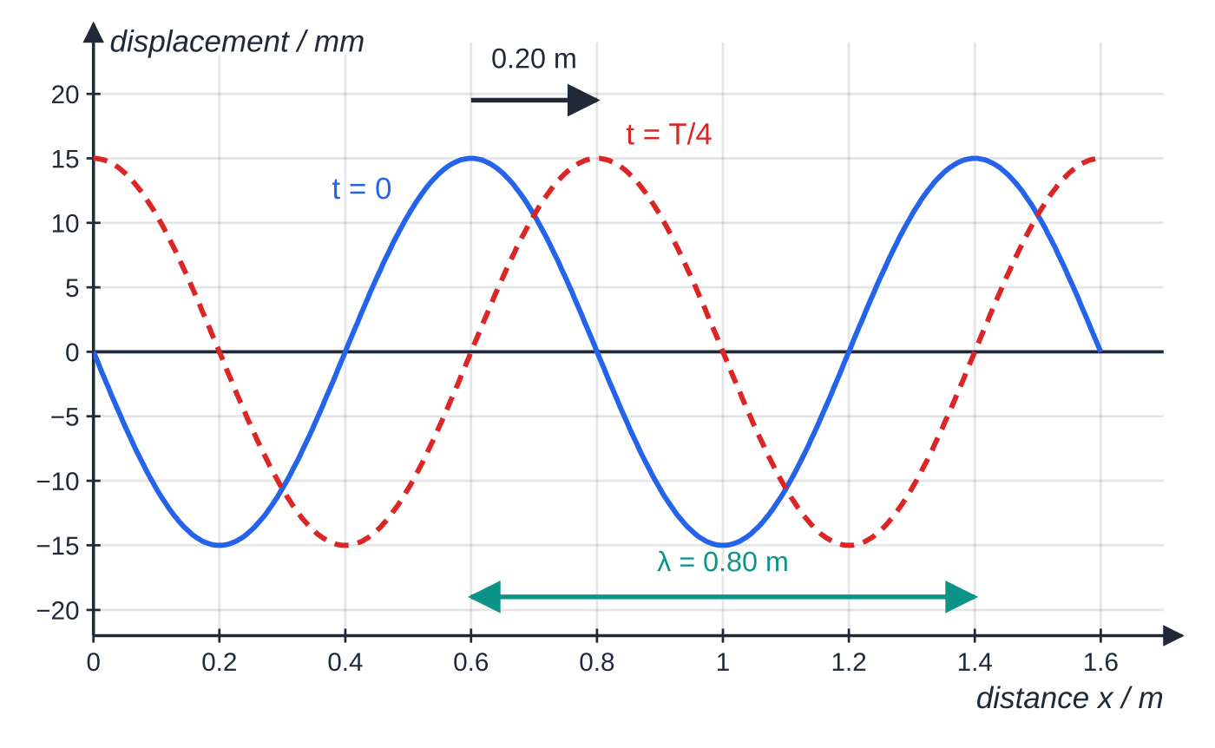
How do you read displacement–distance and displacement–time graphs? (continued)
Section 5 of 11
To find which way a particle is moving, imagine the shifted snapshot and see whether that point's displacement has gone up or down.
Displacement–distance graph for the wave of worked example 5 at t = 0 (solid) and a quarter period later (dashed): the crest has moved 0.20 m to the right, the direction of travel. The wavelength is read from this graph.
Notes:
How do you read displacement–distance and displacement–time graphs?. Full notes: https://examinerprep.com/notes/edexcel-ial-physics/progressive-waves/

Slide 22
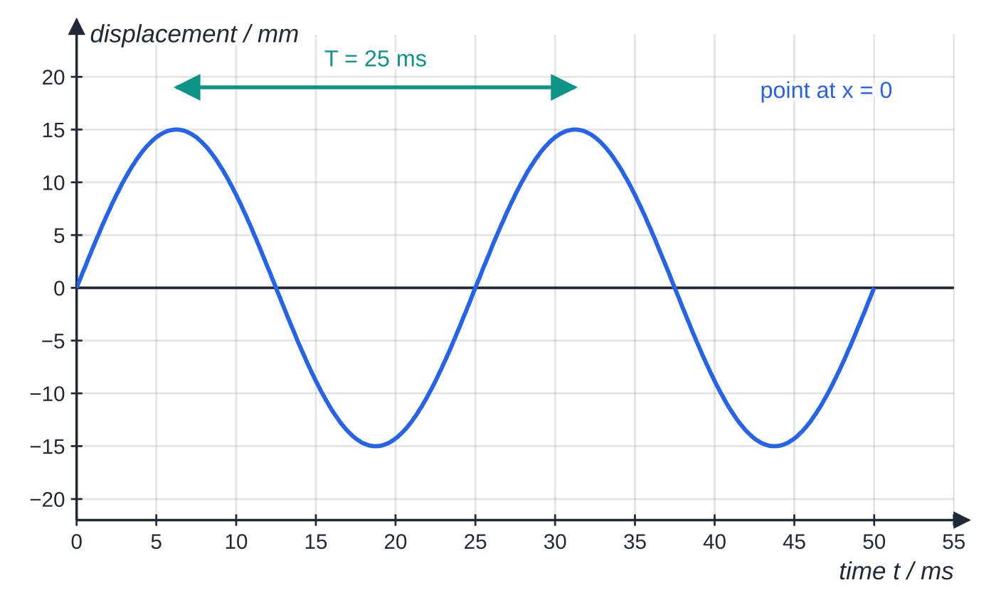
How do you read displacement–distance and displacement–time graphs? (continued)
Section 5 of 11
Phase along a wave
Phase describes where a point is in its cycle of oscillation. One complete cycle is 360° or 2π rad. Moving one wavelength along a progressive wave takes you through one whole cycle, so two points a distance Δx apart have a phase difference
Δφ= 360°×Δx/λ Δφ= 2π×Δx/λ
Not in the formulae list: learn it from "one wavelength ↔ one full cycle (360° or 2π rad)".
Displacement–time graph for the particle at x = 0 in the same wave. Its repeat length is the period, 25 ms. Just after t = 0 the displacement becomes positive, so the particle is moving upwards.
Notes:
How do you read displacement–distance and displacement–time graphs?. Full notes: https://examinerprep.com/notes/edexcel-ial-physics/progressive-waves/

Slide 23
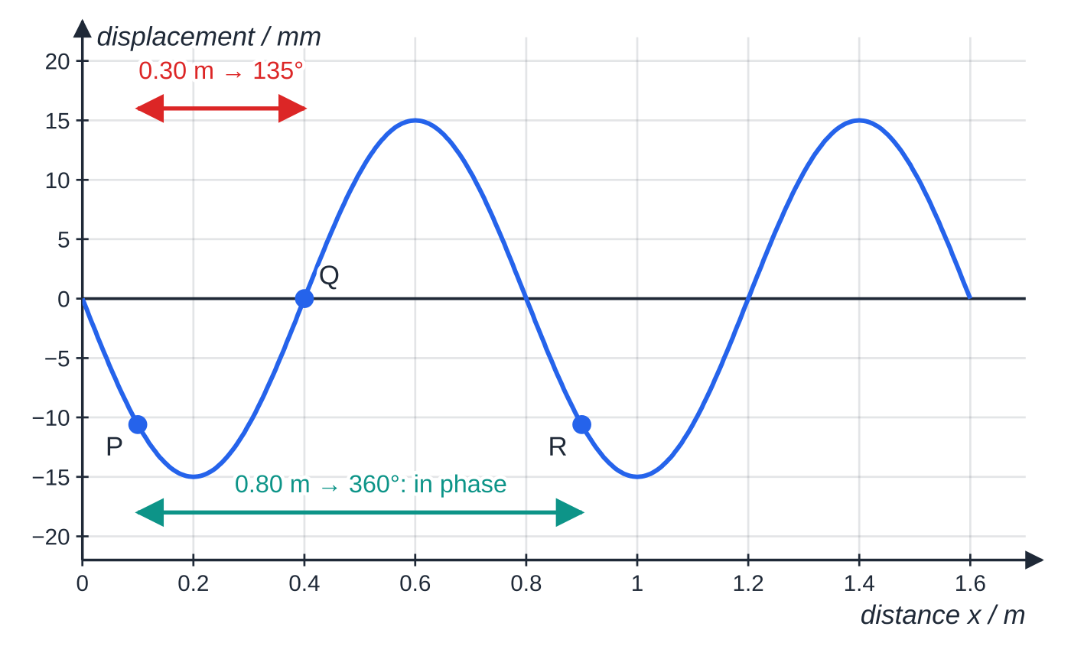
How do you read displacement–distance and displacement–time graphs? (continued)
Section 5 of 11
Points λ, 2λ, 3λ … apart are in phase; points λ/2, 3λ/2 … apart are in antiphase (180°, π rad).
In a progressive wave every point within one wavelength has a different phase, and all have the same amplitude.
The link between phase difference and path difference for two separate sources is in 2.2.
Phase along the wave of worked example 5 (λ = 0.80 m). P and Q, 0.30 m apart, differ in phase by 135°. R is one wavelength from P and moves exactly in step with it.
Notes:
How do you read displacement–distance and displacement–time graphs?. Full notes: https://examinerprep.com/notes/edexcel-ial-physics/progressive-waves/

Slide 24
How do you read displacement–distance and displacement–time graphs? (continued)
Section 5 of 11 · Worked example 5 · Hard · Calculate, state
WORKED EXAMPLE · QUESTION
The graphs above show a transverse wave on a long stretched spring travelling in the +x direction. The displacement–distance graph has crests 0.80 m apart; the displacement–time graph for the point at x = 0 has crests 25 ms apart. (a) Calculate the speed of the wave. (b) Calculate the phase difference between points P (x = 0.10 m) and Q (x = 0.40 m), in degrees and in radians. (c) State the direction in which the point at x = 0 is moving at t = 0. (d) Calculate the time for a crest to travel 2.0 m along the spring.
SOLUTION
(a) λ from the distance graph, T from the time graph: f = 1÷0.025 = 40 Hz, v = 40×0.80 → v = 32 m s⁻¹.
(b) Δx = 0.30 m: Δφ= 360°×0.30÷0.80 → 135° = 3π/4 rad = 2.36 rad.
(c) Just after t = 0 the time graph becomes positive → moving upwards (in the +d direction).
Notes:
How do you read displacement–distance and displacement–time graphs?: Worked example 5. Full notes: https://examinerprep.com/notes/edexcel-ial-physics/progressive-waves/

Slide 25
How do you read displacement–distance and displacement–time graphs? (continued)
Section 5 of 11 · Worked example 5 · Hard · Calculate, state (continued)
Check with the snapshot: shifting the solid curve a little to the right (towards the dashed curve) raises the point at x = 0.
(d) A crest moves at the wave speed: t = 2.0÷32 → t = 0.0625 s (62.5 ms).
Notes:
How do you read displacement–distance and displacement–time graphs?: Worked example 5. Full notes: https://examinerprep.com/notes/edexcel-ial-physics/progressive-waves/

Slide 26
How do you read displacement–distance and displacement–time graphs? (continued)
Section 5 of 11
Exam tip
Before reading any value off a wave graph, read the horizontal axis label. A repeat length in metres is a wavelength; a repeat length in seconds is a period. Reading 0.80 as a period, or 25 ms as a wavelength, gives a speed with no meaning.
Notes:
How do you read displacement–distance and displacement–time graphs?. Full notes: https://examinerprep.com/notes/edexcel-ial-physics/progressive-waves/

Slide 27
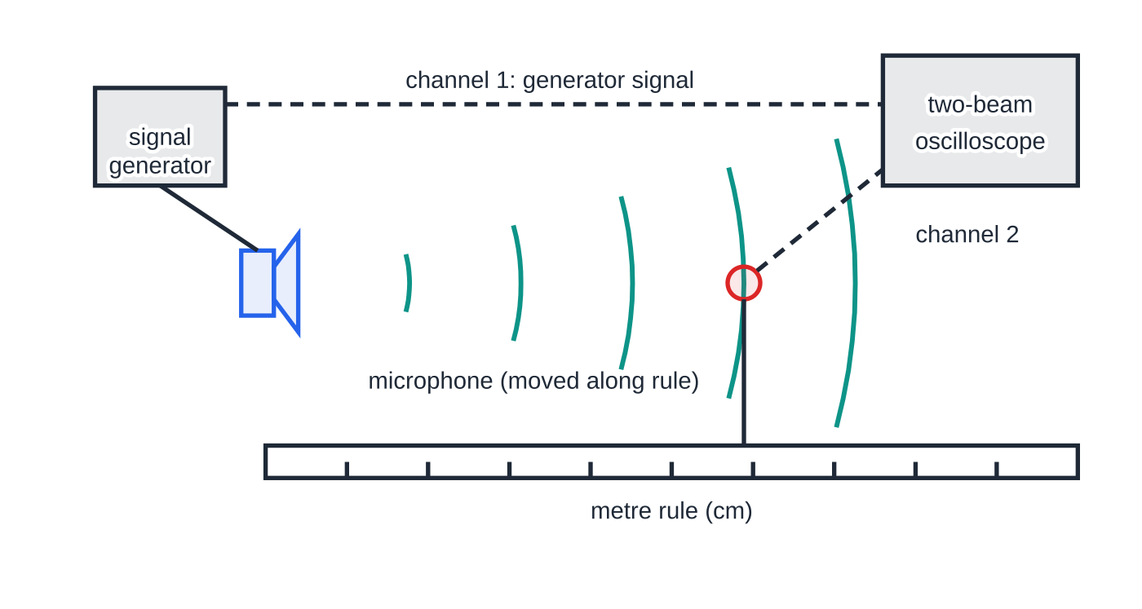
How do you measure the speed of sound with an oscilloscope?
Section 6 of 11
This is a core practical. The oscilloscope compares the phase of the sound arriving at a microphone with the phase of the signal driving the loudspeaker. Moving the microphone one wavelength further away brings the two traces back into step, so the distance moved between "in-phase" positions is the wavelength. With the frequency known, v = fλ.
The arrangement, with wavefronts drawn one wavelength (13.7 cm at 2.50 kHz) apart to the scale of the rule. The generator signal goes to channel 1 and the microphone signal to channel 2.
Notes:
How do you measure the speed of sound with an oscilloscope?. Full notes: https://examinerprep.com/notes/edexcel-ial-physics/progressive-waves/

Slide 28
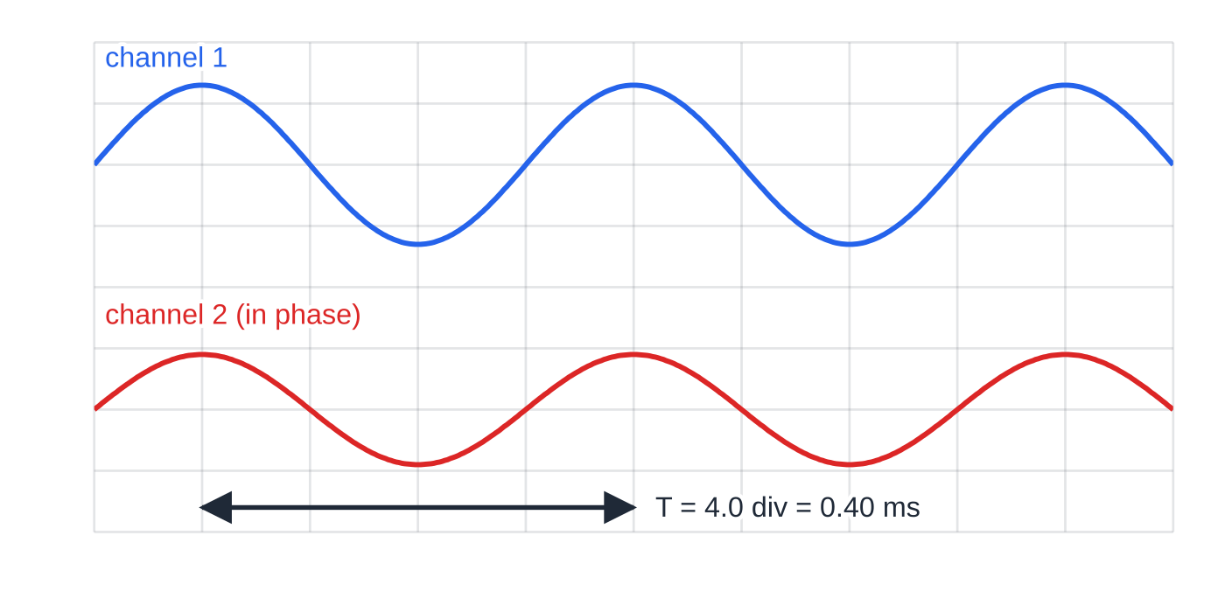
How do you measure the speed of sound with an oscilloscope? (continued)
Section 6 of 11
The screen with the microphone at an in-phase position: the peaks of the two traces line up. At 0.10 ms per division one period of the 2.50 kHz signal is 4.0 divisions.
Notes:
How do you measure the speed of sound with an oscilloscope?. Full notes: https://examinerprep.com/notes/edexcel-ial-physics/progressive-waves/

Slide 29
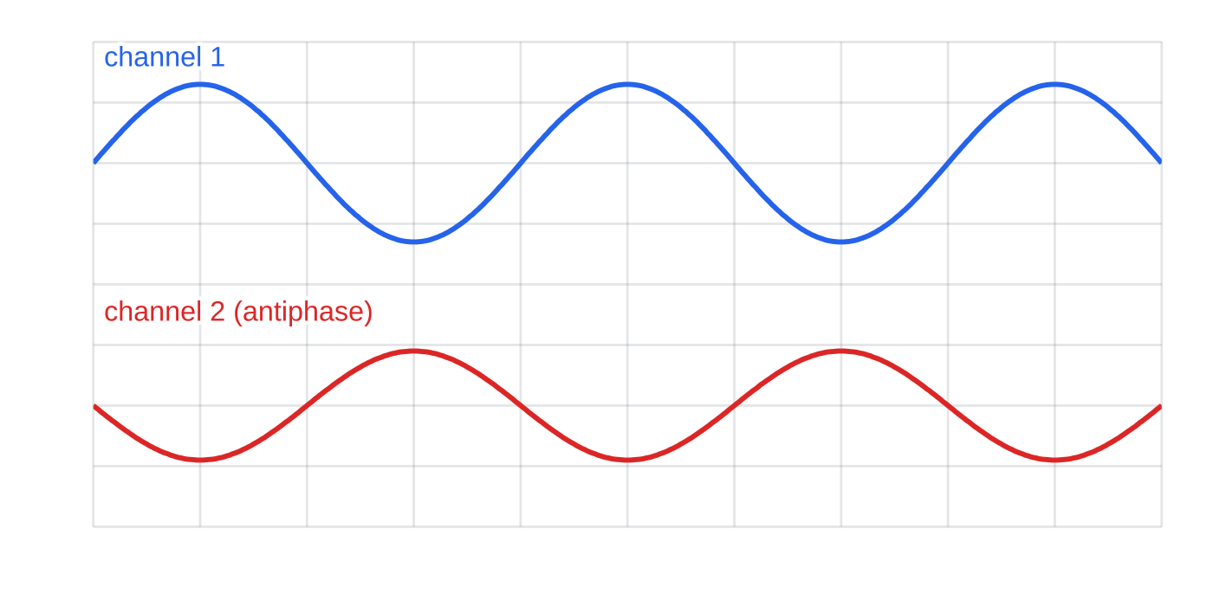
How do you measure the speed of sound with an oscilloscope? (continued)
Section 6 of 11
Method in outline
Connect a signal generator to a loudspeaker and also to channel 1 of a two-beam oscilloscope; connect a microphone to channel 2.
Set a frequency of a few kilohertz, so that the wavelength (around 10 cm) is short enough for several to fit along a metre rule; read f from the generator (or from the period on the screen).
Place the microphone on the axis of the loudspeaker, next to a metre rule fixed to the bench.
Half a wavelength (6.9 cm) further on, the traces are in antiphase: each peak of one lines up with a trough of the other. In-phase and antiphase positions alternate every λ/2.
Notes:
How do you measure the speed of sound with an oscilloscope?. Full notes: https://examinerprep.com/notes/edexcel-ial-physics/progressive-waves/

Slide 30
How do you measure the speed of sound with an oscilloscope? (continued)
Section 6 of 11
Adjust the time-base and channel gains so that both traces show a few cycles.
Move the microphone until the two traces are in phase (peaks line up) and record its position on the rule.
Move it slowly away, counting each time the traces come back into phase, through several (say 6–10) wavelengths. Record the final position.
Wavelength = distance moved ÷ number of times the traces came back into phase (the number of wavelengths, not counting the starting position). Repeat the run, take a mean, then v = fλ.
Getting a good result
Many wavelengths: judging exactly where the traces line up is uncertain by several millimetres; spreading that over 6 wavelengths makes the percentage uncertainty about six times smaller.
Antiphase is sharper to spot on some screens: in-phase and antiphase positions alternate every λ/2, so you can count either, as long as you know which.
Notes:
How do you measure the speed of sound with an oscilloscope?. Full notes: https://examinerprep.com/notes/edexcel-ial-physics/progressive-waves/

Slide 31
How do you measure the speed of sound with an oscilloscope? (continued)
Section 6 of 11
Reduce reflections from the bench and walls (soft material on the bench, other objects moved away), which can distort the microphone trace.
Alternatively, record each in-phase position, plot position against the number of wavelengths and take the gradient as λ; an unknown zero (where inside the loudspeaker the sound "starts") then only shifts the intercept.
Safety: keep the volume low, especially at higher frequencies.
Notes:
How do you measure the speed of sound with an oscilloscope?. Full notes: https://examinerprep.com/notes/edexcel-ial-physics/progressive-waves/

Slide 32
How do you measure the speed of sound with an oscilloscope? (continued)
Section 6 of 11 · Worked example 6 · Hard · Determine
WORKED EXAMPLE · QUESTION
The signal generator is set to 2.50 kHz. In three runs, a student starts with the traces in phase and moves the microphone away until they have come back into phase six times (six wavelengths). The distances moved are 82.3 cm, 81.8 cm and 82.9 cm. Determine the speed of sound and its percentage uncertainty, assuming the frequency is exact.
SOLUTION
Mean distance = (82.3 + 81.8 + 82.9)÷3 = 82.3 cm; uncertainty (half the range) = (82.9 - 81.8)÷2 = ±0.55 cm.
Six wavelengths in the mean distance: λ= 82.33÷6 = 13.72 cm = 0.1372 m.
v = fλ= 2500×0.1372 → v = 343 m s⁻¹.
The percentage uncertainty in the distance carries straight through to v: 0.55÷82.3×100 = 0.67% → v = (343 ± 2) m s⁻¹.
Notes:
How do you measure the speed of sound with an oscilloscope?: Worked example 6. Full notes: https://examinerprep.com/notes/edexcel-ial-physics/progressive-waves/

Slide 33
How do you measure the speed of sound with an oscilloscope? (continued)
Section 6 of 11 · Worked example 6 · Hard · Determine (continued)
Judging a single wavelength of 13.7 cm to ± 0.5 cm would give 3.6%, which is the reason for measuring over many wavelengths.
Notes:
How do you measure the speed of sound with an oscilloscope?: Worked example 6. Full notes: https://examinerprep.com/notes/edexcel-ial-physics/progressive-waves/

Slide 34
How do you measure the speed of sound with an oscilloscope? (continued)
Section 6 of 11
Common error
Taking the distance between an in-phase position and the next antiphase position as the wavelength. That distance is only λ/2, and the speed comes out half its true value.
Notes:
How do you measure the speed of sound with an oscilloscope?. Full notes: https://examinerprep.com/notes/edexcel-ial-physics/progressive-waves/

Slide 35
Exam tips for 2.1
Section 7 of 11
Exam tip 1 — definitions with two directions
For transverse and longitudinal waves, name what oscillates and compare its direction with the direction of energy transfer (or of wave travel): "perpendicular to" or "parallel to".
Exam tip 2 — prefixes first
Convert kHz, MHz and GHz to Hz, and mm, cm or nm to m, before using v = fλ. Then sense-check: sound in air is a few hundred m s⁻¹; light in a vacuum is 3.00 × 10⁸ m s⁻¹.
Exam tip 3 — gaps, not crests
n crests (or compressions, or in-phase positions) in a row span n - 1 wavelengths. "The microphone was moved through six wavelengths" is different from "six in-phase positions were seen".
Notes:
Exam tips for 2.1. Full notes: https://examinerprep.com/notes/edexcel-ial-physics/progressive-waves/

Slide 36
Exam tips for 2.1 (continued)
Section 7 of 11
Exam tip 4 — which graph is it?
Distance on the horizontal axis gives λ; time gives T. Write "from the graph, λ = …" or "T = …" as a line of working, so the reading is clear even if a later step slips.
Exam tip 5 — phase as a fraction of a wavelength
Find Δx/λ first, then multiply by 360° or 2π. Give the unit (degrees or rad) every time; "135" alone is ambiguous.
Notes:
Exam tips for 2.1. Full notes: https://examinerprep.com/notes/edexcel-ial-physics/progressive-waves/

Slide 37
Common misconceptions
Section 8 of 11
Misconception | Why it is wrong | Correct idea
A wave carries the medium along with it. | A floating cork bobs in place as ripples pass under it. | A progressive wave transfers energy; each particle only oscillates about a fixed position.
Amplitude is the height from crest to trough. | Crest to trough is two amplitudes. | Amplitude is the maximum displacement from the equilibrium position.
A higher frequency sound travels faster. | In one medium all frequencies of sound arrive together, or music would be scrambled at a distance. | The medium sets v; a higher f just means a shorter λ.
The frequency changes when a wave enters a new medium. | The oscillations at the boundary must match on both sides, one for one. | Frequency is set by the source; v and λ change together.
At a compression the molecules have their largest displacement. | Molecules on either side are displaced towards the compression; the one at its centre is at its equilibrium position. | At a compression the displacement is zero and the pressure is greatest.
Notes:
Common misconceptions. Full notes: https://examinerprep.com/notes/edexcel-ial-physics/progressive-waves/

Slide 38
Common misconceptions (continued)
Section 8 of 11
Misconception | Why it is wrong | Correct idea
A displacement–time graph shows the wavelength. | Its horizontal axis is time, so its repeat length is a time. | A displacement–time graph gives the period; a displacement–distance graph gives the wavelength.
Notes:
Common misconceptions. Full notes: https://examinerprep.com/notes/edexcel-ial-physics/progressive-waves/

Slide 39
How this topic connects
Section 9 of 11
2 Superposition and stationary waves
Phase difference is the key to interference; two progressive waves travelling in opposite directions build a stationary wave, and the speed of a wave on a string sets its harmonics.
3 Intensity, refraction and polarisation
Refraction is a change of speed at constant frequency, exactly the v = fλ reasoning above; only transverse waves can be polarised, which is evidence that light is transverse.
5 Photons, and oscillations (Unit 5)
For electromagnetic waves c = fλ, and the frequency fixes each photon's energy through E = hf. Each particle of a wave carrying a pure tone performs simple harmonic motion; the sine-shaped graphs on this page are the same functions.
Notes:
How this topic connects. Full notes: https://examinerprep.com/notes/edexcel-ial-physics/progressive-waves/

Slide 40
Key equations
Section 10 of 11
Equation | Use | In the formulae list?
v = fλ | wave speed (m s⁻¹) from frequency (Hz) and wavelength (m) | yes
f = 1/T | frequency from period (e.g. from a displacement–time graph or an oscilloscope) | no — learn it
v = λ/T | wave speed straight from the two graphs | no — derive it from v = fλ and f = 1/T
Δφ= 360°×Δx/λ= 2πΔx/λ | phase difference between two points on a wave | no — learn it
λ = distance ÷ number of wavelengths | wavelength from several crests or in-phase positions | no — learn it (count the gaps)
Notes:
Key equations. Full notes: https://examinerprep.com/notes/edexcel-ial-physics/progressive-waves/

Slide 41
Check your understanding
Section 11 of 11
1. A displacement–time graph for one point on a wave repeats every 4.0 ms. Calculate the frequency.
2. A radio station broadcasts at 95.0 MHz. Calculate the wavelength of its radio waves.
3. Describe the motion of the air molecules as a sound wave passes, and say where the pressure is greatest.
4. Two points on a progressive wave of wavelength 0.48 m are 0.12 m apart. Calculate their phase difference.
5. In the speed-of-sound practical, why is the microphone moved through several in-phase positions rather than one?
6. Ultrasound of frequency 2.0 MHz travels through soft tissue at 1540 m s⁻¹. Calculate its wavelength.
Notes:
Check your understanding: questions. Full notes: https://examinerprep.com/notes/edexcel-ial-physics/progressive-waves/

Slide 42
Check your understanding · answers
Section 11 of 11
1. f = 1/T = 1÷4.0×10⁻³ = 250 Hz.
2. λ= c/f = 3.00×10⁸÷95.0×10⁶ = 3.16 m.
3. Each molecule oscillates back and forth about a fixed position, parallel to the direction the sound travels. Where neighbouring molecules have moved towards each other there is a compression, with pressure (and density) above normal; the pressure is greatest at the centre of a compression.
4. Δφ= 360°×0.12÷0.48 = 90° (π/2 rad).
5. The position at which the traces line up can only be judged to within a few millimetres. Measuring the distance for many wavelengths and dividing makes this uncertainty a much smaller percentage of the measured distance.
6. λ= v/f = 1540÷2.0×10⁶ = 7.7×10⁻⁴ m = 0.77 mm.
Notes:
Check your understanding: answers. Full notes: https://examinerprep.com/notes/edexcel-ial-physics/progressive-waves/

Slide 43
Practice questions
5 original exam-style questions. Answers at the end of the deck.

Slide 44
Question 1
1 mark
Which of the following is the wavelength of a progressive wave?
A the maximum displacement of a particle from its equilibrium position
B the distance travelled by the wave in one second
C the distance between a crest and the neighbouring trough
D the distance between two neighbouring points that oscillate in phase
Notes:
Online with the full mark scheme: https://examinerprep.com/ial-physics-2-1-progressive-waves-questions#IALP-U2-1-A-01

Slide 45
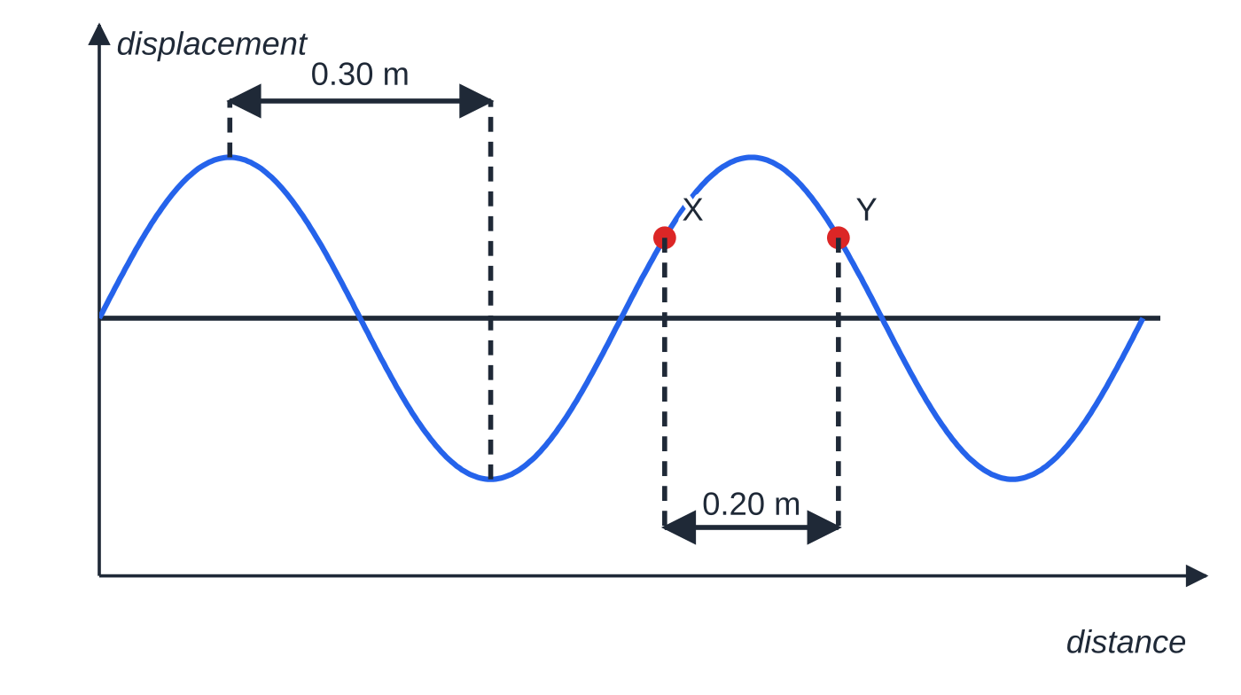
Question 2
1 mark
On a displacement–distance graph of a progressive wave, the horizontal distance between a crest and the neighbouring trough is 0.30 m. Points X and Y on the wave are 0.20 m apart.
What is the phase difference between the oscillations of X and Y?
Figure: displacement–distance graph of the wave, with crest-to-trough distance and points X and Y
A 0.33 rad
B 1.0 rad
C 2.1 rad
D 4.2 rad
Notes:
Online with the full mark scheme: https://examinerprep.com/ial-physics-2-1-progressive-waves-questions#IALP-U2-1-A-06

Slide 46
Question 3
1 mark
A transverse progressive wave travels along a rope. At one instant a particular point on the rope is at a crest.
Which statement about that point at this instant is correct?
A Its displacement is zero and it is moving at its greatest speed.
B It is moving in the direction in which the wave travels.
C It is moving along the rope at the wave speed.
D It is momentarily at rest at its maximum displacement.
Notes:
Online with the full mark scheme: https://examinerprep.com/ial-physics-2-1-progressive-waves-questions#IALP-U2-1-A-09

Slide 47
Question 4
5 marks
Waves can be classified as transverse or longitudinal.
(a) Explain the difference between a transverse wave and a longitudinal wave. [2]
(b) Give one example of each type of wave. [2]
(c) State what is transferred from place to place by a progressive wave. [1]
Notes:
Online with the full mark scheme: https://examinerprep.com/ial-physics-2-1-progressive-waves-questions#IALP-U2-1-B-02

Slide 48
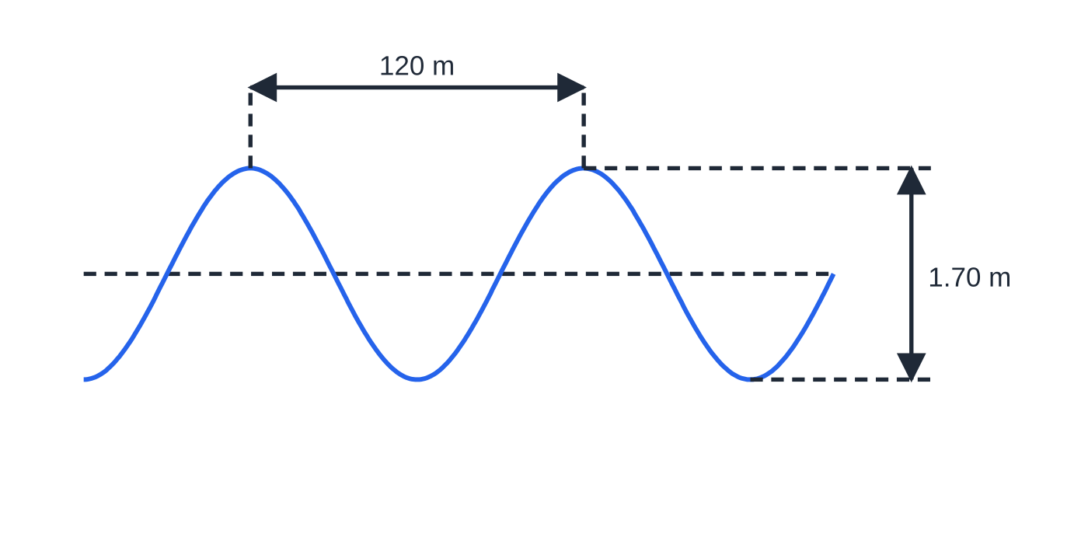
Question 5
6 marks
A data buoy floats on the open ocean. Its height above the sea bed is recorded and shows that it rises a total of 1.70 m from its lowest to its highest position, and that successive crests of the ocean swell pass the buoy every 9.0 s. Aerial photographs show that the crests are 120 m apart. The swell may be treated as a progressive transverse wave.
Figure: profile of the ocean swell (not to scale)
(a) State the amplitude of the swell. [1]
(b) Calculate the frequency of the swell. [1]
(c) Calculate the speed of the swell. [2]
(d) A storm far away produced the swell. Calculate the time for a crest to travel 2.0 km towards the buoy. [2]
Notes:
Online with the full mark scheme: https://examinerprep.com/ial-physics-2-1-progressive-waves-questions#IALP-U2-1-B-03

Slide 49
Answers

Slide 50
Question 1 · answer
Answer D
The wavelength is the distance between two neighbouring points oscillating in phase — for example crest to crest, or compression to compression.
Notes:
Full mark scheme: https://examinerprep.com/ial-physics-2-1-progressive-waves-questions#IALP-U2-1-A-01

Slide 51
Question 2 · answer
Answer C
Crest to neighbouring trough is half a wavelength, so λ = 0.60 m. Δφ = 2π × 0.20 ÷ 0.60 = 2π/3 = 2.1 rad.
Notes:
Full mark scheme: https://examinerprep.com/ial-physics-2-1-progressive-waves-questions#IALP-U2-1-A-06

Slide 52
Question 3 · answer
Answer D
Each point oscillates at right angles to the rope. At a crest it has its maximum displacement and is momentarily at rest before moving back towards equilibrium. It never travels along the rope.
Notes:
Full mark scheme: https://examinerprep.com/ial-physics-2-1-progressive-waves-questions#IALP-U2-1-A-09

Slide 53
Question 4 · answer
Mark scheme
transverse: the oscillations are perpendicular to the direction of energy transfer / of wave travel
longitudinal: the oscillations are parallel to the direction of energy transfer / of wave travel
transverse: any electromagnetic wave (light, radio, microwaves …) / a wave on a string / S-wave
longitudinal: sound / ultrasound / P-wave / push–pull wave on a slinky
energy (and information), with no net transfer of the medium
Notes:
Full mark scheme: https://examinerprep.com/ial-physics-2-1-progressive-waves-questions#IALP-U2-1-B-02

Slide 54
Question 5 · answer
Mark scheme
1.70 ÷ 2 = 0.85 m
f = 1/T = 1 ÷ 9.0 = 0.11 Hz (0.111 Hz)
v = fλ (or λ/T) = 120 ÷ 9.0
= 13 m s⁻¹ (13.3 m s⁻¹)
t = distance ÷ speed = 2000 ÷ 13.3
= 150 s (allow error carried forward)
Notes:
Full mark scheme: https://examinerprep.com/ial-physics-2-1-progressive-waves-questions#IALP-U2-1-B-03

Slide 55
Keep practising
Notes for this topic
Questions on this topic
Build a printable test
ExaminerPrep is an independent tutoring service. It has been developed independently from and is not endorsed by the International Baccalaureate Organization. "International Baccalaureate", "IB" and "IB Diploma Programme" are registered trademarks of the IBO, used here for descriptive purposes only.
Pearson Edexcel and Cambridge are trademarks of their owners; ExaminerPrep is not affiliated with any exam board.

