Slide 1
EP
EDEXCEL IAL PHYSICS
5.4 Radioactive decay
The full notes page in 13 sections · practice questions with answers · simulations
ExaminerPrep is an independent tutoring service. It has been developed independently from and is not endorsed by the International Baccalaureate Organization. "International Baccalaureate", "IB" and "IB Diploma Programme" are registered trademarks of the IBO, used here for descriptive purposes only.
Pearson Edexcel and Cambridge are trademarks of their owners; ExaminerPrep is not affiliated with any exam board.
Notes:
5.4 Radioactive decay. Notes for this topic: https://examinerprep.com/notes/edexcel-ial-physics/radioactive-decay/

Slide 2
What this page covers
Overview
Background radiation: sources and how to correct a count rate for it
The nature, ionising ability, penetration and range of alpha, beta and gamma radiation
Nuclear equations for α, β⁻, β⁺ and γ emission
The spontaneous and random nature of decay, activity and the decay constant
Half-life, A = λN, N = N₀e^(-λt), λ= ln 2/t_(1/2) and the log forms
Carbon dating and medical tracers as contexts
Core Practical 15: the absorption of gamma radiation by lead
Notes:
What this page covers. Full notes: https://examinerprep.com/notes/edexcel-ial-physics/radioactive-decay/

Slide 3
In one minute
Key points
1. Every calculation on this page comes from one statement, that each unstable nucleus has the same constant probability of decaying per second, which gives A = λN, a constant half-life and exponential decay.
2. Always subtract the background count rate (measured with the source removed) before using a count rate.
3. Alpha: strongly ionising, a few cm of air, stopped by paper. Beta: moderately ionising, stopped by a few mm of aluminium. Gamma: weakly ionising, only reduced by several cm of lead.
4. In every nuclear equation nucleon numbers and proton numbers balance. α: A − 4, Z − 2. β⁻: Z + 1. β⁺: Z − 1. γ: no change.
5. Decay is random (no way to tell which nucleus decays next) and spontaneous (unaffected by temperature, pressure or chemistry).
6. N = N₀e^(-λt) with t_(1/2) = ln 2/λ; a graph of ln A against t is a straight line of gradient -λ.
Notes:
In one minute. Full notes: https://examinerprep.com/notes/edexcel-ial-physics/radioactive-decay/

Slide 4
What is background radiation, and how do you correct for it?
Section 1 of 13
Background radiation: the ionising radiation present all the time, from natural and artificial sources, when no deliberately introduced source is nearby.
Natural sources: radon gas from rocks and soil (often the largest single contribution indoors), rocks and building materials such as granite, cosmic rays, and radioactive isotopes in food, drink and our bodies (potassium-40, carbon-14). Artificial sources: medical X-rays and treatments, and small contributions from past weapons tests and the nuclear industry.
A Geiger–Müller (GM) tube counts background events as well as those from your source. The background fluctuates randomly too, so measure it for several minutes and use the mean rate. Then
corrected count rate = measured count rate - background count rate
Not in the formulae list (learn it). Both rates must be in the same unit (s⁻¹ or min⁻¹).
Notes:
What is background radiation, and how do you correct for it?. Full notes: https://examinerprep.com/notes/edexcel-ial-physics/radioactive-decay/

Slide 5
What is background radiation, and how do you correct for it? (continued)
Section 1 of 13
Correct every reading before you halve it, plot it or take its log; it matters most when the source count rate is small.
Notes:
What is background radiation, and how do you correct for it?. Full notes: https://examinerprep.com/notes/edexcel-ial-physics/radioactive-decay/

Slide 6
What is background radiation, and how do you correct for it? (continued)
Section 1 of 13 · Worked example 1 · Easy · Calculate
WORKED EXAMPLE · QUESTION
With no source present, a GM tube records 486 counts in 20.0 minutes. With a source in front of the tube, 1840 counts are recorded in 2.00 minutes. (a) Calculate the corrected count rate due to the source, in s⁻¹. (b) Explain why the background was measured for much longer.
SOLUTION
(a) Background = 486 ÷20.0 = 24.3 min⁻¹; with source = 1840 ÷2.00 = 920 min⁻¹. Corrected: 920 - 24.3 = 896 min⁻¹: 14.9 s⁻¹.
(b) Background counts fluctuate randomly; a longer count averages out the fluctuations and gives a more reliable mean rate.
Notes:
What is background radiation, and how do you correct for it?: Worked example 1. Full notes: https://examinerprep.com/notes/edexcel-ial-physics/radioactive-decay/

Slide 7
What are alpha, beta and gamma radiation?
Section 2 of 13
Unstable nuclei become more stable by emitting radiation. What each kind is decides how strongly it ionises and how far it travels.
Radiation | What it is | Charge | Ionising | Range in air | Absorbed by
alpha, α | helium nucleus: 2 protons + 2 neutrons | +2e | strong | a few cm | a sheet of paper, or the outer layer of skin
beta-minus, β⁻ | high-speed electron created in the nucleus | −e | moderate | up to about 1 m (varies with energy) | a few mm of aluminium
beta-plus, β⁺ | positron (antielectron) created in the nucleus | +e | moderate | very short: it meets an electron and annihilates into two gamma photons | —
Notes:
What are alpha, beta and gamma radiation?. Full notes: https://examinerprep.com/notes/edexcel-ial-physics/radioactive-decay/

Slide 8
What are alpha, beta and gamma radiation? (continued)
Section 2 of 13
Radiation | What it is | Charge | Ionising | Range in air | Absorbed by
gamma, γ | high-frequency electromagnetic radiation: photons | 0 | weak | no fixed range; intensity falls roughly as 1/r² | reduced, never stopped completely, by several cm of lead or about a metre of concrete
Notes:
What are alpha, beta and gamma radiation?. Full notes: https://examinerprep.com/notes/edexcel-ial-physics/radioactive-decay/

Slide 9
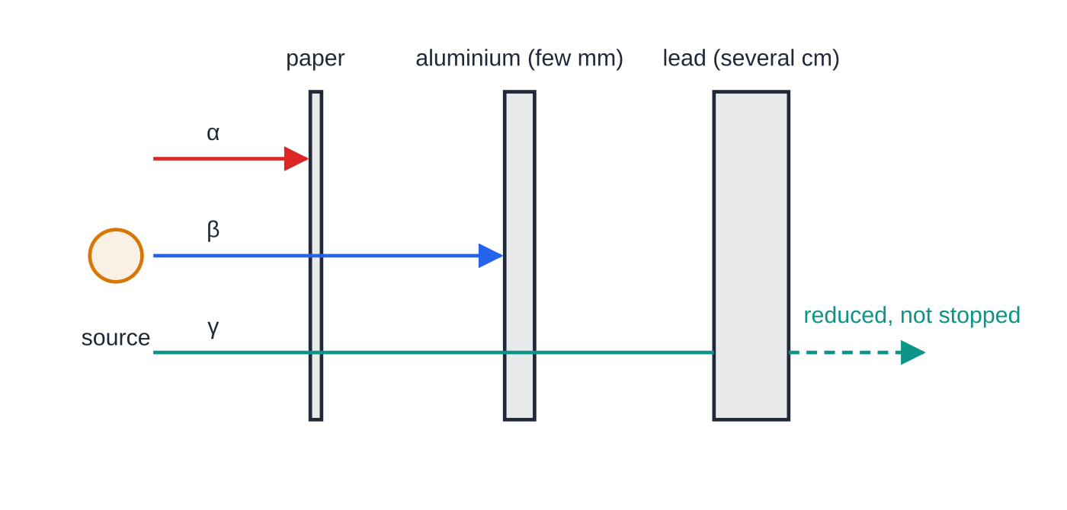
What are alpha, beta and gamma radiation? (continued)
Section 2 of 13
Ionising vs penetrating: each ionisation takes energy. An α particle (large charge, slow, massive) ionises thousands of atoms per mm of air and runs out of energy within a few cm; an uncharged γ photon interacts only occasionally, so it travels much further.
Hazard: outside the body α cannot reach living cells, so β and γ are the concern. Inside the body an α source is the most dangerous, because all its energy is deposited in a small volume of tissue.
What stops each type of radiation (schematic, not to scale). Gamma is weakened by lead but some always gets through.
Notes:
What are alpha, beta and gamma radiation?. Full notes: https://examinerprep.com/notes/edexcel-ial-physics/radioactive-decay/

Slide 10
What are alpha, beta and gamma radiation? (continued)
Section 2 of 13
Identifying a source: add absorbers between it and a detector. A large drop with paper means α; a further drop with a few mm of aluminium means β; what remains is γ.
Common error
Saying a β⁻ particle is one of the atom's orbiting electrons. It is created in the nucleus at the moment of decay, when a neutron changes into a proton.
Notes:
What are alpha, beta and gamma radiation?. Full notes: https://examinerprep.com/notes/edexcel-ial-physics/radioactive-decay/

Slide 11
How do you write a nuclear equation?
Section 3 of 13
A nuclide is written ᴬ_ZX: A is the nucleon (mass) number, Z the proton (atomic) number. In every nuclear equation the total nucleon number and the total proton number (charge) are the same on both sides.
Decay | General equation | What happens in the nucleus | Change
α | ᴬ_ZX →ᴬ⁻⁴_(Z-2)Y + ⁴₂α | 2 protons and 2 neutrons leave together | A − 4, Z − 2
β⁻ | ᴬ_ZX →ᴬ_(Z+1)Y + ⁰₋₁β+ ν̄ₑ | a neutron becomes a proton; an electron and an electron antineutrino are emitted | A same, Z + 1
β⁺ | ᴬ_ZX →ᴬ_(Z-1)Y + ⁰₊₁β+ νₑ | a proton becomes a neutron; a positron and an electron neutrino are emitted | A same, Z − 1
γ | ᴬ_ZX* →ᴬ_ZX + γ | an excited nucleus drops to a lower energy state and emits a photon; often follows α or β decay | no change
Notes:
How do you write a nuclear equation?. Full notes: https://examinerprep.com/notes/edexcel-ial-physics/radioactive-decay/

Slide 12
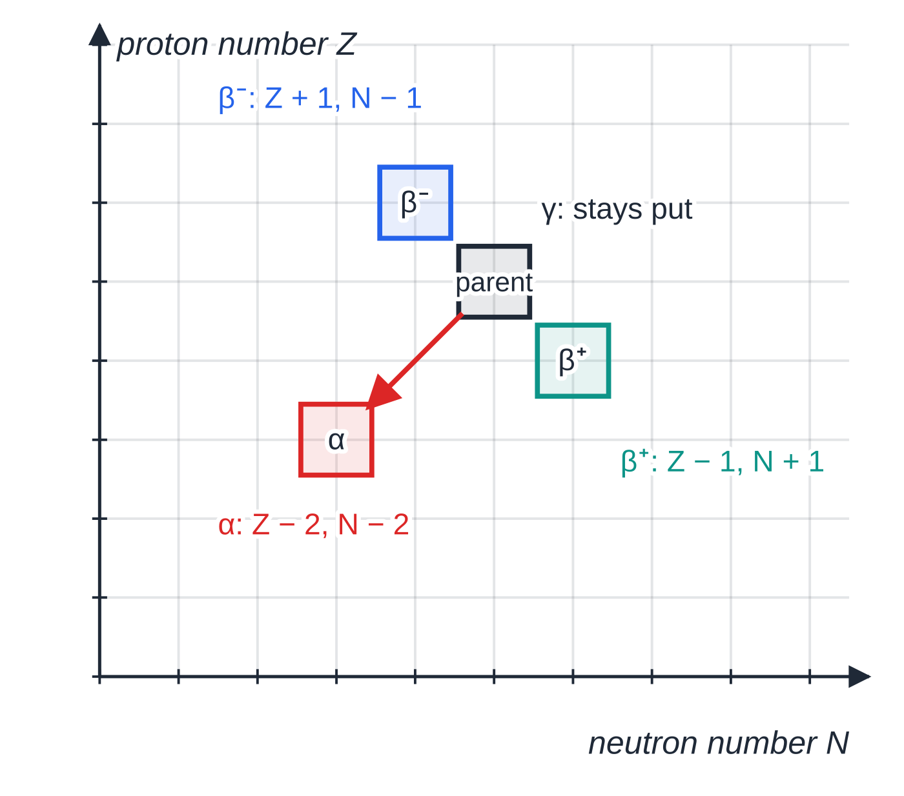
How do you write a nuclear equation? (continued)
Section 3 of 13
The (anti)neutrino has no charge and almost no mass, so it does not affect the balance, but include it: it is needed to conserve energy, momentum and lepton number, and it explains why β particles from one isotope have a range of energies.
Each decay as a step on a chart of proton number against neutron number: α is a diagonal step of two squares, β⁻ and β⁺ single steps in opposite directions, and γ does not move the nucleus.
Notes:
How do you write a nuclear equation?. Full notes: https://examinerprep.com/notes/edexcel-ial-physics/radioactive-decay/

Slide 13
How do you write a nuclear equation? (continued)
Section 3 of 13 · Worked example 2 · Medium · Write
WORKED EXAMPLE · QUESTION
(a) Polonium-210 (²¹⁰₈₄Po) is an α emitter. (b) Strontium-90 (⁹⁰₃₈Sr) is a β⁻ emitter. (c) Fluorine-18 (¹⁸₉F) is a β⁺ emitter. Write each decay equation. (d) Thorium-232 (²³²₉₀Th) decays through α and β⁻ emissions to stable lead-208 (²⁰⁸₈₂Pb). How many of each are emitted?
SOLUTION
(a) ²¹⁰₈₄Po →²⁰⁶₈₂Pb + ⁴₂α
(b) Element 39 is yttrium: ⁹⁰₃₈Sr →⁹⁰₃₉Y + ⁰₋₁β+ ν̄ₑ
(c) Element 8 is oxygen: ¹⁸₉F →¹⁸₈O + ⁰₊₁β+ νₑ
(d) Only α changes A: fall in A = 232 − 208 = 24, so 6 α decays, which alone would take Z to 90 − 12 = 78. Each β⁻ raises Z by 1: 82 − 78 = 4. 6 α and 4 β⁻.
Notes:
How do you write a nuclear equation?: Worked example 2. Full notes: https://examinerprep.com/notes/edexcel-ial-physics/radioactive-decay/

Slide 14
How do you write a nuclear equation? (continued)
Section 3 of 13
Exam tip — check the sums
After writing a nuclear equation, add the top numbers and the bottom numbers on each side. Write β⁻ as ⁰₋₁β and β⁺ as ⁰₊₁β so the charge balance is visible.
Notes:
How do you write a nuclear equation?. Full notes: https://examinerprep.com/notes/edexcel-ial-physics/radioactive-decay/

Slide 15
What does it mean that decay is random and spontaneous?
Section 4 of 13
Random: it is impossible to predict which nucleus will decay next, or when a particular nucleus will decay. Every nucleus of the same isotope has the same probability of decaying in the next second, however long it has existed.
Spontaneous: decay is not triggered by anything outside the nucleus; its rate is unaffected by temperature, pressure, chemical combination or physical state.
Evidence of randomness: repeated equal-time counts from a long-lived source scatter about a mean.
Decay constant λ: the probability per unit time that an individual nucleus will decay. Activity A: the number of nuclei that decay per unit time; unit the becquerel, 1 Bq = 1 decay per second.
If each of N nuclei has probability λΔt of decaying in a short time Δt, the expected number decaying is λNΔt: the rate of decay is proportional to the number left.
Notes:
What does it mean that decay is random and spontaneous?. Full notes: https://examinerprep.com/notes/edexcel-ial-physics/radioactive-decay/

Slide 16
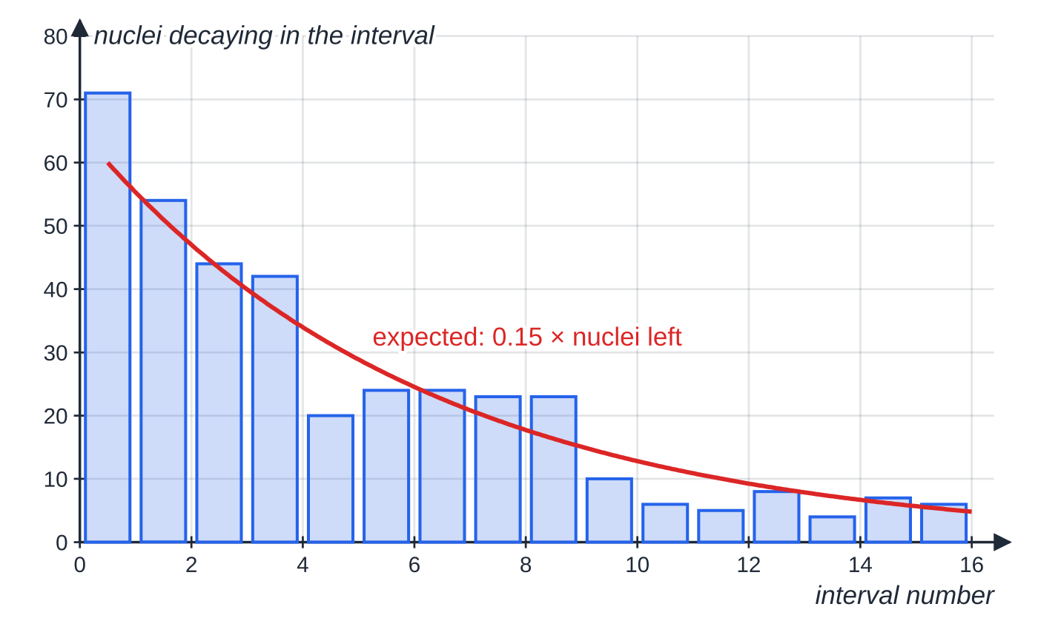
What does it mean that decay is random and spontaneous? (continued)
Section 4 of 13
For large N the fluctuations average out and the sample follows a smooth exponential; for a few nuclei the pattern is ragged. A detector catches only a fraction of the emissions, so the count rate is smaller than the activity but proportional to it for a fixed arrangement.
A computer simulation (fixed random seed) of 400 nuclei, each with a 15% chance of decaying in every interval. The bars scatter randomly about the expected value, which falls exponentially as nuclei are used up.
Notes:
What does it mean that decay is random and spontaneous?. Full notes: https://examinerprep.com/notes/edexcel-ial-physics/radioactive-decay/

Slide 17
What is half-life, and how do you use the decay equations?
Section 5 of 13
Half-life t_(1/2): the average time taken for the number of undecayed nuclei of an isotope (and so its activity) to halve.
A = λN dN/dt = -λN
Both are in the formulae list; the minus sign shows that N decreases. With A in Bq, λ must be in s⁻¹, so convert a half-life in hours, days or years to seconds first.
N = N₀e^(-λt) A = A₀e^(-λt) λ= ln 2/(t_(1/2))
These are in the formulae list. Put N = N₀/2 at t = t_(1/2): ½ = e^(-λt_(1/2)), so λt_(1/2) = ln 2. After n half-lives the fraction left is (½)ⁿ (not in the list: learn it). The same equations work for N, A, the corrected count rate and the mass of isotope left, since all are proportional to N.
Notes:
What is half-life, and how do you use the decay equations?. Full notes: https://examinerprep.com/notes/edexcel-ial-physics/radioactive-decay/

Slide 18
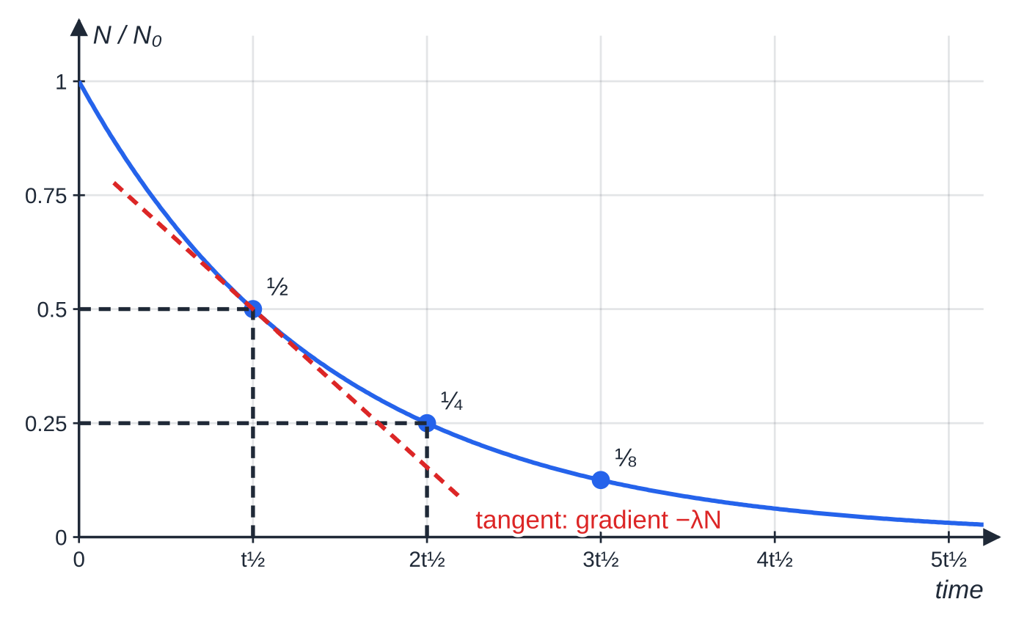
What is half-life, and how do you use the decay equations? (continued)
Section 5 of 13
To find a half-life from a graph, read the time for the activity to fall from any value to half of it; repeat from two or three starting points and average.
Exponential decay. Each half-life halves what is left, wherever you start. The tangent at one half-life has gradient −λN = −0.347N₀ per half-life: the steeper the curve, the higher the activity.
Notes:
What is half-life, and how do you use the decay equations?. Full notes: https://examinerprep.com/notes/edexcel-ial-physics/radioactive-decay/

Slide 19
What is half-life, and how do you use the decay equations? (continued)
Section 5 of 13 · Worked example 3 · Medium · Calculate
WORKED EXAMPLE · QUESTION
A patient is injected with technetium-99m, a gamma emitter with a half-life of 6.0 hours; the activity at injection is 400 MBq. (a) Calculate the decay constant in s⁻¹. (b) Calculate the number of nuclei injected. (c) Calculate the activity 24 hours later. (d) Calculate the time for the activity to fall to 1.0 MBq.
SOLUTION
(a) λ= 0.693 ÷(6.0 ×3600): 3.21 ×10⁻⁵ s⁻¹.
(b) N = A/λ= 4.00 ×10⁸ ÷3.21 ×10⁻⁵: 1.2 ×10¹³ (1.25 × 10¹³).
(c) 24 h is exactly 4 half-lives: 400 ×(½)⁴: 25 MBq.
(d) t = ln(A₀/A)/λ= ln(400 ÷1.0) ÷3.21 ×10⁻⁵ = 1.87 ×10⁵ s: 52 hours. Shortcut: t = t_(1/2) ×ln(A₀/A)/ln 2 = 6.0 ×8.64 h.
Notes:
What is half-life, and how do you use the decay equations?: Worked example 3. Full notes: https://examinerprep.com/notes/edexcel-ial-physics/radioactive-decay/

Slide 20
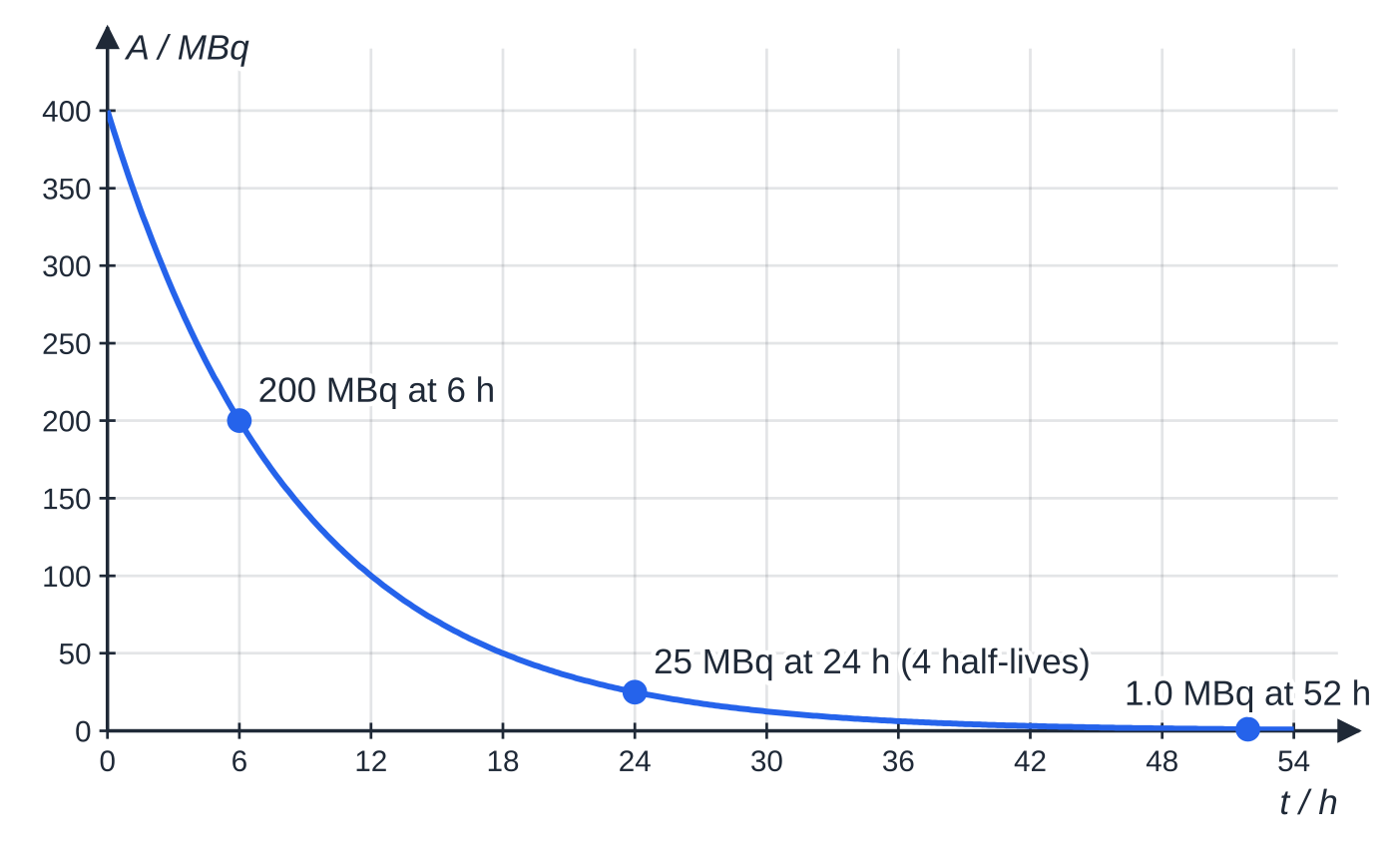
What is half-life, and how do you use the decay equations? (continued)
Section 5 of 13
Activity of the technetium-99m dose: 400 MBq halves every 6.0 h, to 25 MBq after 24 h and 1.0 MBq after about 52 h.
Notes:
What is half-life, and how do you use the decay equations?. Full notes: https://examinerprep.com/notes/edexcel-ial-physics/radioactive-decay/

Slide 21
What is half-life, and how do you use the decay equations? (continued)
Section 5 of 13 · Worked example 4 · Medium · Calculate
WORKED EXAMPLE · QUESTION
A sample contains 2.0 µg of iodine-131 (atom mass 131 u, half-life 8.0 days; 1 u = 1.66 × 10⁻²⁷ kg). (a) Calculate the activity. (b) Calculate how long it takes for the activity to fall to 5.0% of this value.
SOLUTION
(a) N = 2.0 ×10⁻⁹ ÷(131 ×1.66 ×10⁻²⁷) = 9.20 ×10¹⁵; λ= 0.693 ÷(8.0 ×24 ×3600) = 1.00 ×10⁻⁶ s⁻¹; A = λN: 9.2 ×10⁹ Bq (mass given to 2 s.f.).
(b) t = t_(1/2) ×ln(1/0.050)/ln 2 = 8.0 ×ln 20 ÷0.693: 35 days.
Notes:
What is half-life, and how do you use the decay equations?: Worked example 4. Full notes: https://examinerprep.com/notes/edexcel-ial-physics/radioactive-decay/

Slide 22
What is half-life, and how do you use the decay equations? (continued)
Section 5 of 13
Common error
Using a half-life in days or years in A = λN. The becquerel is decays per second, so λ must be in s⁻¹. In N = N₀e^(-λt) any time unit works, as long as λ and t share it. Remember µg → kg is × 10⁻⁹.
Notes:
What is half-life, and how do you use the decay equations?. Full notes: https://examinerprep.com/notes/edexcel-ial-physics/radioactive-decay/

Slide 23
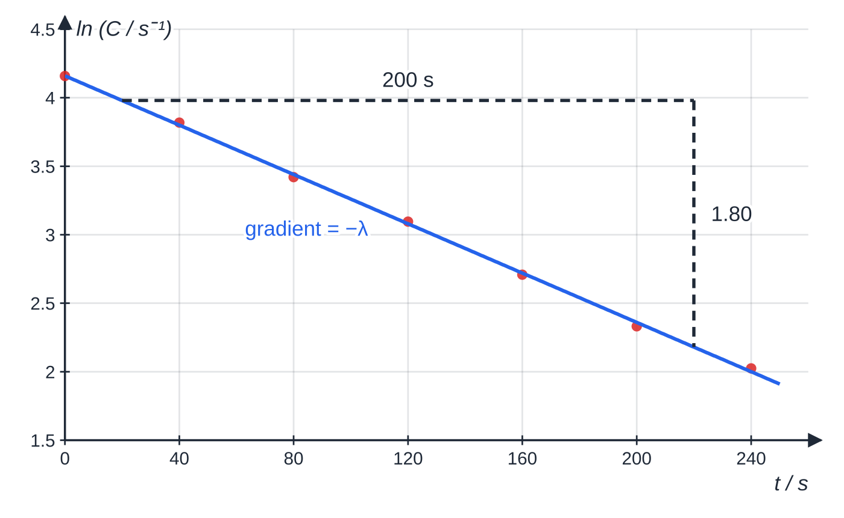
How do you find the decay constant from a log graph?
Section 6 of 13
An exponential curve is hard to judge by eye. Taking natural logs turns it into a straight line:
ln N = ln N₀ - λt ln A = ln A₀ - λt
These are in the formulae list too (they are the natural logs of the exponential forms). Compared with y = mx + c, plot ln A (or ln C) against t: gradient = -λ, intercept = ln A₀. A straight line confirms exponential decay. Label the axis ln (C / s⁻¹), since a log has no unit.
Data of Worked example 5 with the best-fit line. The triangle spans 200 s and the line falls by 1.80, so λ = 9.0 × 10⁻³ s⁻¹.
Notes:
How do you find the decay constant from a log graph?. Full notes: https://examinerprep.com/notes/edexcel-ial-physics/radioactive-decay/

Slide 24
How do you find the decay constant from a log graph? (continued)
Section 6 of 13 · Worked example 5 · Medium · Determine
WORKED EXAMPLE · QUESTION
Corrected count rates from a short-lived sample, every 40 s:
t / s | 0 | 40 | 80 | 120 | 160 | 200 | 240
C / s⁻¹ | 64.0 | 45.5 | 30.6 | 22.1 | 15.0 | 10.3 | 7.57
ln (C / s⁻¹) | 4.16 | 3.82 | 3.42 | 3.10 | 2.71 | 2.33 | 2.02
(a) Explain why ln C against t should be a straight line. (b) Use the graph to determine the decay constant and half-life. (c) Determine the initial count rate.
SOLUTION
(a) Taking logs of C = C₀e^(-λt) gives ln C = -λt + ln C₀, the form y = mx + c with constant m = -λ.
(b) Gradient = -1.80 ÷200 = -9.0 ×10⁻³ s⁻¹, so λ= 9.0 ×10⁻³ s⁻¹; t_(1/2) = 0.693 ÷9.0 ×10⁻³: 77 s.
(c) Intercept ln C₀ = 4.16, so C₀ = e^(4.16): 64 s⁻¹.
Notes:
How do you find the decay constant from a log graph?: Worked example 5. Full notes: https://examinerprep.com/notes/edexcel-ial-physics/radioactive-decay/

Slide 25
How do you find the decay constant from a log graph? (continued)
Section 6 of 13 · Worked example 5 · Medium · Determine (continued)
Check: the table halves from 64.0 to about 32 s⁻¹ in about 80 s, consistent with 77 s.
Notes:
How do you find the decay constant from a log graph?: Worked example 5. Full notes: https://examinerprep.com/notes/edexcel-ial-physics/radioactive-decay/

Slide 26
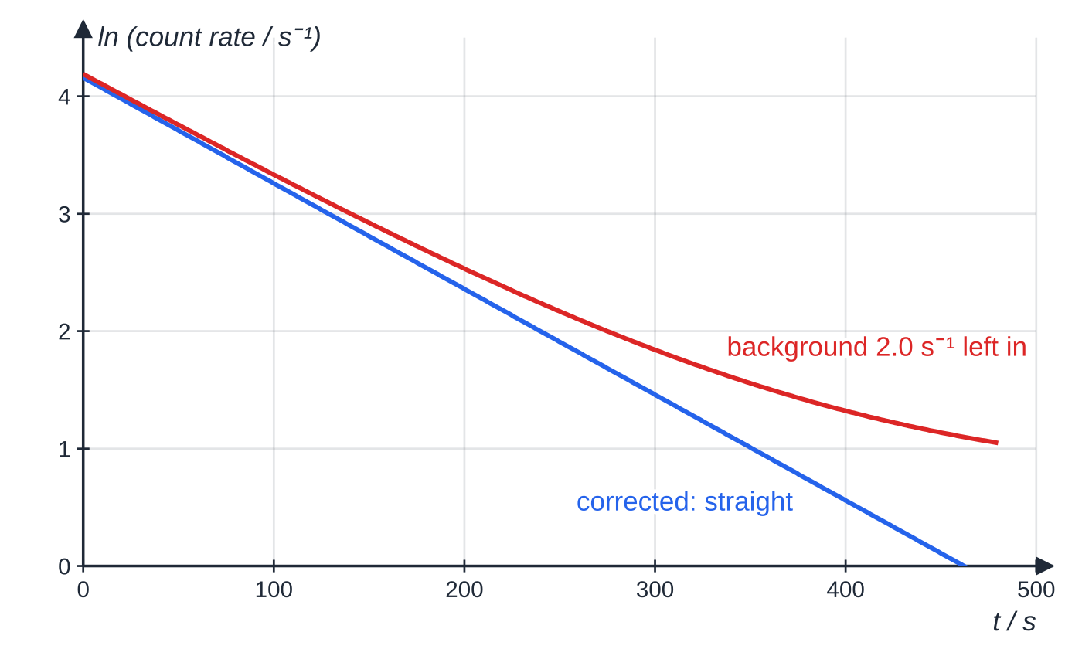
How do you find the decay constant from a log graph? (continued)
Section 6 of 13
Common error
Taking ln of the measured count rate before subtracting background. The background does not decay or get absorbed, so leaving it in makes the ln graph curve upwards at long times (or large thicknesses) and gives a gradient that is too shallow.
The same decay with and without a background of 2.0 s⁻¹ subtracted: left in, the background bends the line upwards.
Notes:
How do you find the decay constant from a log graph?. Full notes: https://examinerprep.com/notes/edexcel-ial-physics/radioactive-decay/

Slide 27
How are carbon dating and medical tracers based on decay?
Section 7 of 13
Carbon dating
Cosmic rays produce carbon-14 in the upper atmosphere (β⁻, half-life 5730 years), which mixes into atmospheric carbon dioxide. Living things keep exchanging carbon with their surroundings, so the activity per gram of their carbon stays steady. After death no new carbon-14 is taken in and the activity per gram falls exponentially; comparing an old sample with living material gives the time since death.
Limitations: it assumes past atmospheric carbon-14 levels were the same (in practice corrected with samples of known age); very old samples have so little activity that background and random fluctuations swamp it, limiting the method to roughly 50 000 years; contamination with modern carbon gives wrong ages.
Notes:
How are carbon dating and medical tracers based on decay?. Full notes: https://examinerprep.com/notes/edexcel-ial-physics/radioactive-decay/

Slide 28
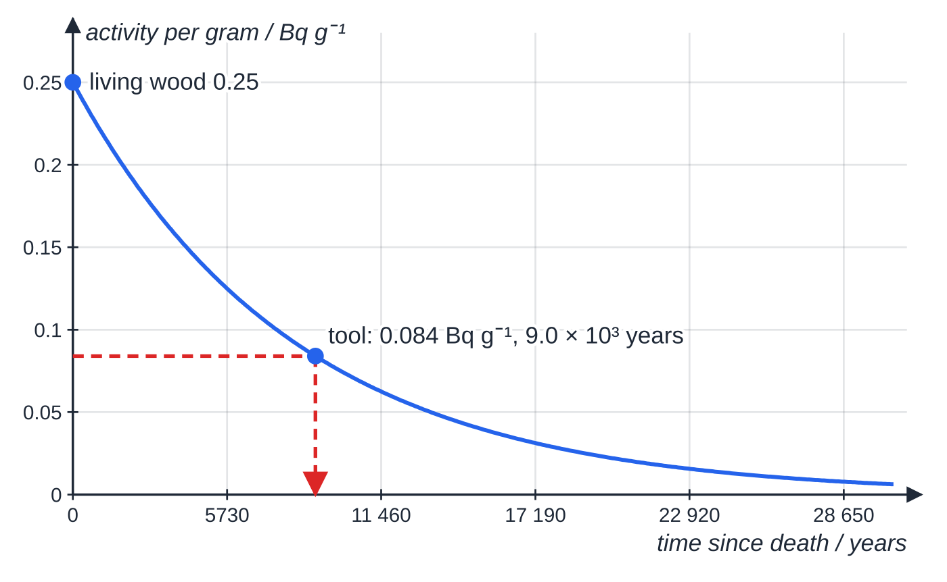
How are carbon dating and medical tracers based on decay? (continued)
Section 7 of 13
Activity per gram of carbon after death, falling from 0.25 Bq g⁻¹ with a half-life of 5730 years. The tool of Worked example 6 reads 0.084 Bq g⁻¹.
Notes:
How are carbon dating and medical tracers based on decay?. Full notes: https://examinerprep.com/notes/edexcel-ial-physics/radioactive-decay/

Slide 29
How are carbon dating and medical tracers based on decay? (continued)
Section 7 of 13 · Worked example 6 · Medium · Calculate and explain
WORKED EXAMPLE · QUESTION
Carbon from living wood has an activity of 0.25 Bq per gram; carbon from a wooden tool has 0.084 Bq per gram. Half-life of carbon-14 = 5730 years. (a) Calculate the age of the tool. (b) The sample contains 5.0 g of carbon. Explain why measuring its activity accurately is difficult.
SOLUTION
(a) λ= 0.693 ÷5730 = 1.21 ×10⁻⁴ year⁻¹ (no need for seconds). t = ln(0.25 ÷0.084) ÷1.21 ×10⁻⁴ = 1.091 ÷1.21 ×10⁻⁴: 9.0 ×10³ years.
(b) Activity = 5.0 ×0.084 = 0.42 Bq: fewer than one count per second even if every emission were detected, no more than a typical background rate. The corrected count is small with a large random uncertainty, so long counting times and shielding are needed.
Notes:
How are carbon dating and medical tracers based on decay?: Worked example 6. Full notes: https://examinerprep.com/notes/edexcel-ial-physics/radioactive-decay/

Slide 30
How are carbon dating and medical tracers based on decay? (continued)
Section 7 of 13
Medical tracers
A tracer is a radioactive isotope attached to a chemical the body takes to the organ of interest; a camera outside the body builds an image from the radiation.
Gamma emitter: γ leaves the body and, being weakly ionising, does least damage on the way. An α emitter would be absorbed inside and do most harm.
Half-life of a few hours: long enough to reach the organ and complete the scan, short enough that the activity soon becomes negligible. Technetium-99m (6.0 h) is the standard example.
The daughter should be stable or very long-lived and the chemical non-toxic. Positron emitters such as fluorine-18 are used in PET scans: the two gamma photons from each annihilation travel in opposite directions and locate the source.
Notes:
How are carbon dating and medical tracers based on decay?. Full notes: https://examinerprep.com/notes/edexcel-ial-physics/radioactive-decay/

Slide 31
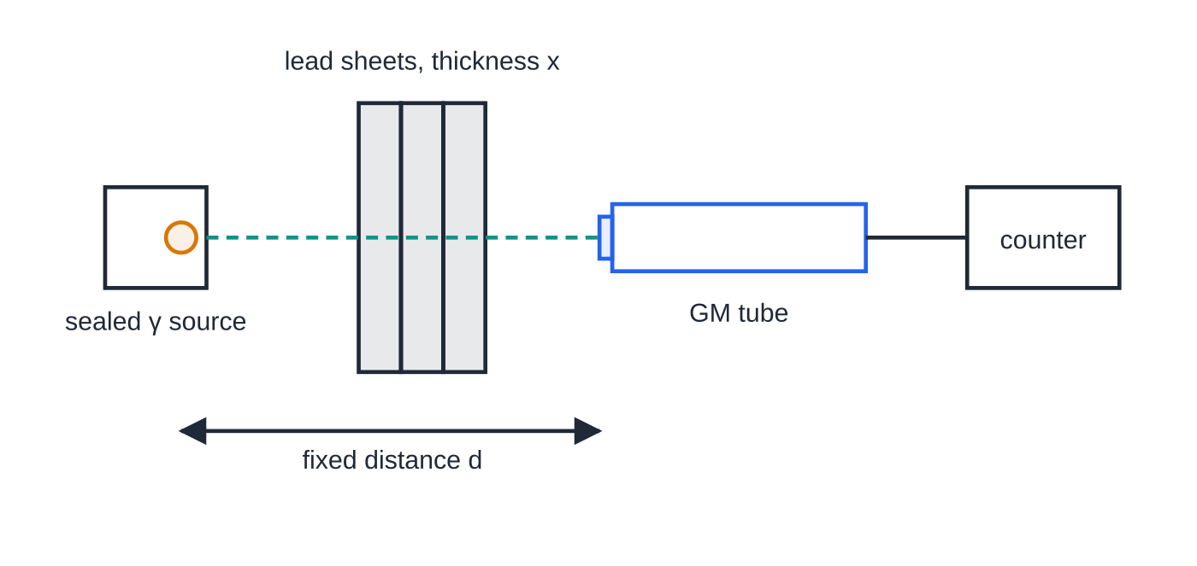
How do you investigate the absorption of gamma radiation by lead?
Section 8 of 13
Core Practical 15 finds how the gamma count rate through lead depends on the thickness of lead.
With the source locked away, record the background over several minutes (e.g. 10 min).
Clamp the GM tube and set the sealed source a fixed distance d from its window. Record the count over a fixed time (e.g. 100 s) with no lead.
Measure each sheet's thickness with a micrometer at several points and average.
Arrangement for gamma absorption. The source–tube distance is fixed so that only the lead thickness changes.
Notes:
How do you investigate the absorption of gamma radiation by lead?. Full notes: https://examinerprep.com/notes/edexcel-ial-physics/radioactive-decay/

Slide 32
How do you investigate the absorption of gamma radiation by lead? (continued)
Section 8 of 13
Add sheets one at a time, recording the count for each total thickness x; repeat and average.
Correct every count rate for background, then plot ln C against x.
Control variables: same source, distance (gamma intensity also falls with distance), counting time and GM tube settings. Longer counts give more reliable rates; steepest and least steep acceptable lines give the gradient's uncertainty.
Safety: handle the source with tongs, pointing away from people, and return it to its lead-lined box promptly; keep exposure short and distant; lead is toxic, so wear gloves or wash hands.
If each millimetre of lead absorbs the same fraction of the photons reaching it, the corrected count rate falls exponentially: C = C₀e^(-μx), with μ a constant for lead and this gamma energy. It is the same mathematics as decay with time: ln C against x has gradient -μ, and the half-thickness ln 2/μ plays the part of the half-life.
Notes:
How do you investigate the absorption of gamma radiation by lead?. Full notes: https://examinerprep.com/notes/edexcel-ial-physics/radioactive-decay/

Slide 33
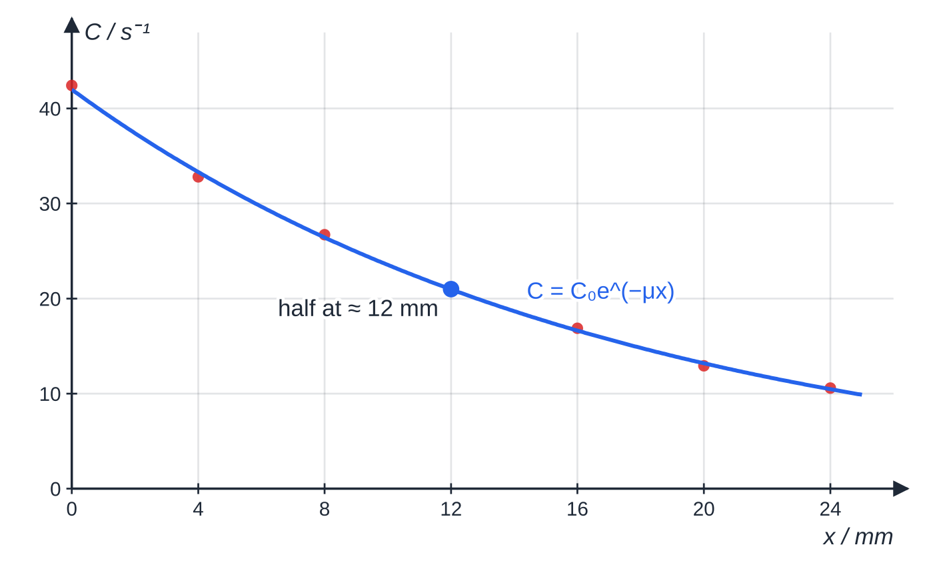
How do you investigate the absorption of gamma radiation by lead? (continued)
Section 8 of 13
Results of Worked example 7: corrected count rate against lead thickness with the exponential best fit.
Notes:
How do you investigate the absorption of gamma radiation by lead?. Full notes: https://examinerprep.com/notes/edexcel-ial-physics/radioactive-decay/

Slide 34
How do you investigate the absorption of gamma radiation by lead? (continued)
Section 8 of 13 · Worked example 7 · Hard · Analyse
WORKED EXAMPLE · QUESTION
Background = 0.45 s⁻¹; counts taken for 100 s at each thickness.
x / mm | counts in 100 s | C / s⁻¹ | ln (C / s⁻¹)
0 | 4287 | 42.4 | 3.75
4 | 3325 | 32.8 | 3.49
8 | 2718 | 26.7 | 3.29
12 | 2122 | 20.8 | 3.03
16 | 1733 | 16.9 | 2.83
20 | 1337 | 12.9 | 2.56
24 | 1104 | 10.6 | 2.36
Notes:
How do you investigate the absorption of gamma radiation by lead?: Worked example 7. Full notes: https://examinerprep.com/notes/edexcel-ial-physics/radioactive-decay/

Slide 35
How do you investigate the absorption of gamma radiation by lead? (continued)
Section 8 of 13 · Worked example 7 · Hard · Analyse (continued)
(a) Show how C for 12 mm was calculated. (b) Use the ln graph to determine μ. (c) Calculate the thickness that halves the count rate. (d) Estimate the thickness needed to reduce C to 1.0% of its value with no lead.
SOLUTION
(a) C = 2122 ÷100 - 0.45: 20.8 s⁻¹.
(b) Gradient = -1.16 ÷20 = -0.058 mm⁻¹, so μ= 0.058 mm⁻¹.
(c) x_(1/2) = 0.693 ÷0.058: 12 mm.
(d) x = ln(100)/μ= 4.61 ÷0.058: 79 mm (about 8 cm). The table agrees: every 12 mm roughly halves C (42.4 → 20.8 → 10.6 s⁻¹).
Notes:
How do you investigate the absorption of gamma radiation by lead?: Worked example 7. Full notes: https://examinerprep.com/notes/edexcel-ial-physics/radioactive-decay/

Slide 36
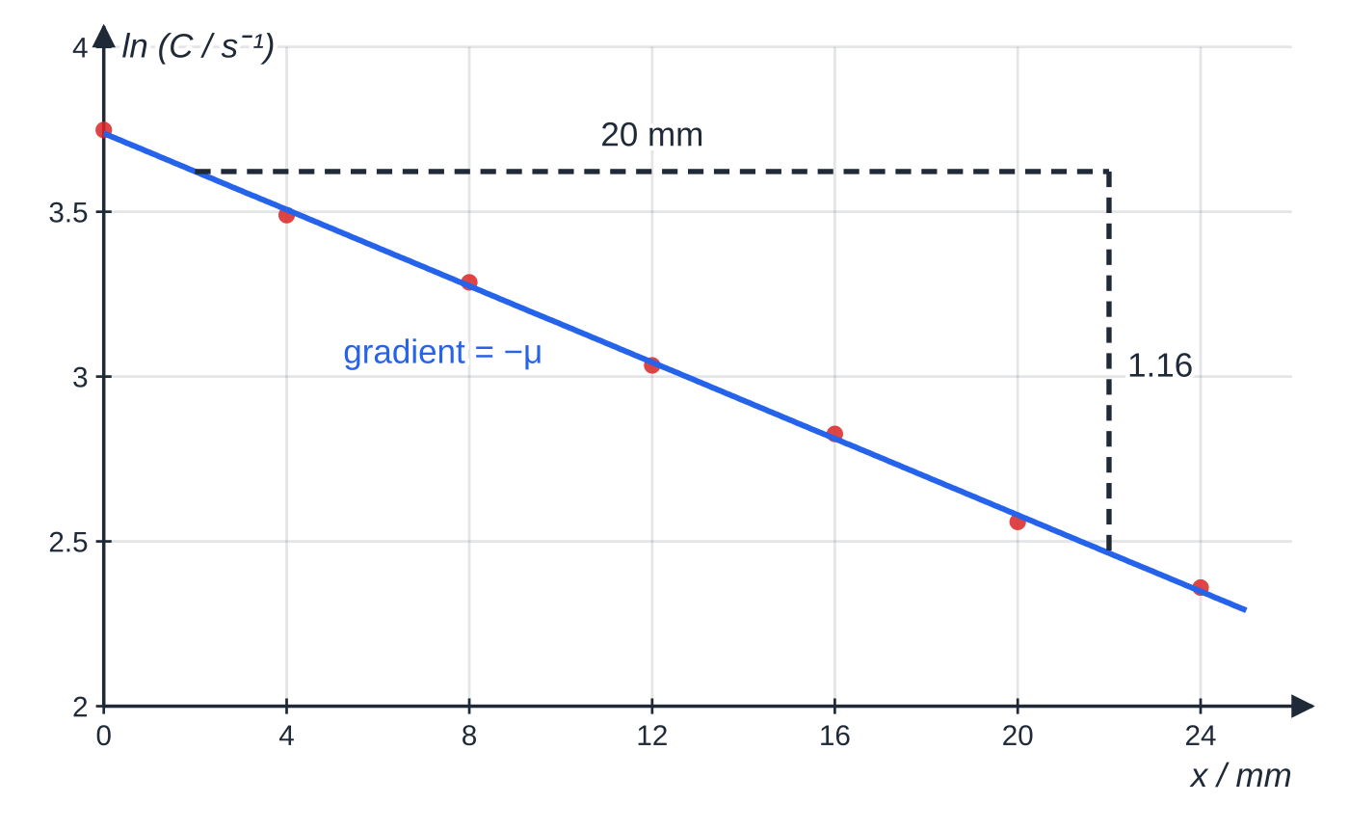
How do you investigate the absorption of gamma radiation by lead? (continued)
Section 8 of 13
ln C against x is a straight line, confirming exponential absorption; the triangle spans 20 mm and falls by 1.16.
Notes:
How do you investigate the absorption of gamma radiation by lead?. Full notes: https://examinerprep.com/notes/edexcel-ial-physics/radioactive-decay/

Slide 37
Exam tips for 5.4
Section 9 of 13
Exam tip 1 — background first
Make "subtract background" your first line whenever a count rate appears, with both rates in the same unit.
Exam tip 2 — seconds for becquerels
In A = λN, convert the half-life to seconds. In A = A₀e^(-λt) you may stay in hours, days or years, provided λ and t share the unit.
Exam tip 3 — whole numbers of half-lives
For a whole number of half-lives, halve repeatedly; otherwise use the exponential. Check your answer lies between the values for the whole numbers either side.
Notes:
Exam tips for 5.4. Full notes: https://examinerprep.com/notes/edexcel-ial-physics/radioactive-decay/

Slide 38
Exam tips for 5.4 (continued)
Section 9 of 13
Exam tip 4 — describe randomness precisely
"Random": you cannot predict which nucleus will decay or when, but each has a constant probability per unit time. "Spontaneous": unaffected by external conditions. Do not swap them.
Exam tip 5 — log-graph gradients
Use a triangle covering more than half the line, quote the gradient with its sign, then say λ = −gradient. Scatter about the line is expected, because decay is random.
Notes:
Exam tips for 5.4. Full notes: https://examinerprep.com/notes/edexcel-ial-physics/radioactive-decay/

Slide 39
Common misconceptions
Section 10 of 13
Misconception | Why it is wrong | Correct idea
After two half-lives the sample has completely decayed. | Each half-life halves what is left. | After two half-lives ¼ remains, after three ⅛, and so on.
Heating a radioactive source makes it decay faster. | Decay is nuclear, unaffected by the energies of heating or chemical change. | Decay is spontaneous: λ and the half-life are fixed for each isotope.
A nucleus that has existed for a long time is "due" to decay. | Nuclei have no memory. | Every nucleus has the same probability of decaying per second, whatever its age.
The count rate equals the activity. | A detector catches only some emissions and also counts background. | Corrected count rate is proportional to activity for a fixed arrangement, but smaller.
Gamma emission turns the nucleus into a different element. | A photon has no charge and no nucleons. | Gamma emission leaves A and Z unchanged; the nucleus just loses energy.
Notes:
Common misconceptions. Full notes: https://examinerprep.com/notes/edexcel-ial-physics/radioactive-decay/

Slide 40
Common misconceptions (continued)
Section 10 of 13
Misconception | Why it is wrong | Correct idea
Alpha is the most dangerous radiation in every situation. | Outside the body, α is stopped by the dead outer layer of skin. | α is most dangerous inside the body; outside, β and γ are the bigger hazards.
Notes:
Common misconceptions. Full notes: https://examinerprep.com/notes/edexcel-ial-physics/radioactive-decay/

Slide 41
How this topic connects
Section 11 of 13
3 Binding energy, fission and fusion, and the standard model (Unit 4)
Why nuclei are unstable and the energy released in a decay come from mass deficit and ΔE = c²Δm. In β⁻ decay a down quark becomes an up quark (udd → uud); neutrinos conserve lepton number; a positron annihilates with an electron to give two gamma photons.
Capacitors (Unit 4)
Discharge follows the same mathematics: Q = Q₀e^(-t/RC), time to halve RCln 2, and ln Q against t is a straight line, just as t_(1/2) = ln 2/λ here.
Photons (Unit 2) and practical skills (Unit 6)
Gamma photon energies follow E = hf and are quoted in MeV; the log graphs, gradients and uncertainties of Core Practical 15 are exactly the skills assessed in practical work.
Notes:
How this topic connects. Full notes: https://examinerprep.com/notes/edexcel-ial-physics/radioactive-decay/

Slide 42
Key equations
Section 12 of 13
Equation | Use | In the formulae list?
corrected count rate = measured − background | removing background before any analysis | no — learn it
A = λN | activity from the number of nuclei (λ in s⁻¹ for Bq) | yes
dN/dt = -λN | rate of decay proportional to nuclei left | yes
λ= ln 2/t_(1/2) | decay constant from half-life and back | yes
N = N₀e^(-λt), A = A₀e^(-λt) | number or activity after any time | yes
ln N = ln N₀ - λt, ln A = ln A₀ - λt | straight-line graph: gradient −λ; solving for t | yes
fraction left = (½)ⁿ | after a whole number n of half-lives | no — learn it
N = mass of sample ÷ mass of one atom | number of nuclei from a mass (atom mass ≈ nucleon number × u) | no — derive it
Notes:
Key equations. Full notes: https://examinerprep.com/notes/edexcel-ial-physics/radioactive-decay/

Slide 43
Key equations (continued)
Section 12 of 13
Equation | Use | In the formulae list?
C = C₀e^(-μx) | gamma absorption in lead (Core Practical 15) | no — learn the shape; ln C against x has gradient −μ
Notes:
Key equations. Full notes: https://examinerprep.com/notes/edexcel-ial-physics/radioactive-decay/

Slide 44
Check your understanding
Section 13 of 13
1. What fraction of a radioactive isotope remains after three half-lives?
2. An isotope has a half-life of 30 minutes. Calculate its decay constant in s⁻¹.
3. A nucleus emits a β⁺ particle. What happens to its nucleon number and its proton number?
4. A source has an activity of 3.0 × 10⁵ Bq and a half-life of 2.5 days. What is its activity after 10 days?
5. Why does the count rate from a long-lived source vary from one 10 s count to the next?
Notes:
Check your understanding: questions. Full notes: https://examinerprep.com/notes/edexcel-ial-physics/radioactive-decay/

Slide 45
Check your understanding · answers
Section 13 of 13
1. (½)³ = ⅛ = 0.125 of the original nuclei.
2. λ= 0.693 ÷(30 ×60) = 3.85 ×10⁻⁴ s⁻¹.
3. The nucleon number is unchanged and the proton number decreases by 1: a proton has changed into a neutron, emitting a positron and an electron neutrino.
4. 10 days = 4 half-lives, so A = 3.0 ×10⁵ ×(½)⁴ = 1.9 ×10⁴ Bq (1.88 × 10⁴ Bq).
5. Decay is random: the number of nuclei decaying in each interval fluctuates about the mean, even though the probability of decay per nucleus is constant. The background fluctuates in the same way.
Notes:
Check your understanding: answers. Full notes: https://examinerprep.com/notes/edexcel-ial-physics/radioactive-decay/

Slide 46
Practice questions
5 original exam-style questions. Answers at the end of the deck.

Slide 47
Question 1
1 mark
Which statement about radioactive decay is correct?
A The half-life of an isotope can be shortened by heating the sample strongly.
B A nucleus that has existed for longer is more likely to decay in the next second.
C After two half-lives every nucleus of the original isotope has decayed.
D Each undecayed nucleus of an isotope has the same probability of decaying in the next second.
Notes:
Online with the full mark scheme: https://examinerprep.com/ial-physics-5-4-radioactive-decay-questions#IALP-U5-4-A-08

Slide 48
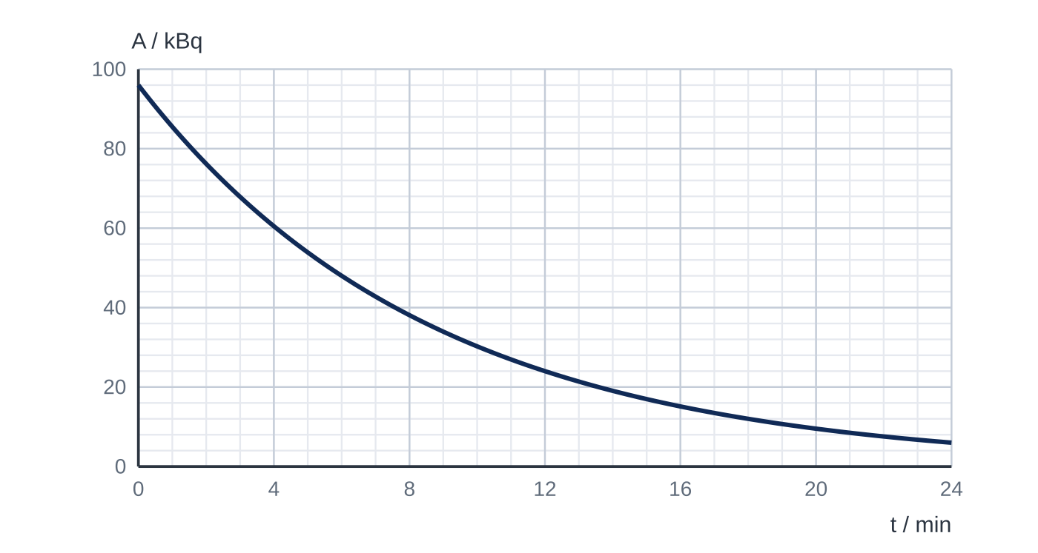
Question 2
1 mark
The graph shows how the activity A of a sample of a radioactive isotope varies with time t.
What is the decay constant of the isotope?
A 9.6 × 10⁻⁴ s⁻¹
B 1.9 × 10⁻³ s⁻¹
C 2.8 × 10⁻³ s⁻¹
D 1.2 × 10⁻¹ s⁻¹
Notes:
Online with the full mark scheme: https://examinerprep.com/ial-physics-5-4-radioactive-decay-questions#IALP-U5-4-FA-01

Slide 49
Question 3
1 mark
A sample contains 80 mg of a radioactive isotope with a half-life of 15 hours.
What mass of the isotope remains after 60 hours?
A 2.5 mg
B 5.0 mg
C 10 mg
D 20 mg
Notes:
Online with the full mark scheme: https://examinerprep.com/ial-physics-5-4-radioactive-decay-questions#IALP-U5-4-A-05

Slide 50
Question 4
6 marks
Radioactive decay is described as both random and spontaneous, yet a large sample of a radioactive isotope always has the same half-life.
(a) Explain what is meant by the random and spontaneous nature of radioactive decay, and explain how a large sample can nevertheless decay with a constant half-life. [6]
Notes:
Online with the full mark scheme: https://examinerprep.com/ial-physics-5-4-radioactive-decay-questions#IALP-U5-4-B-08

Slide 51
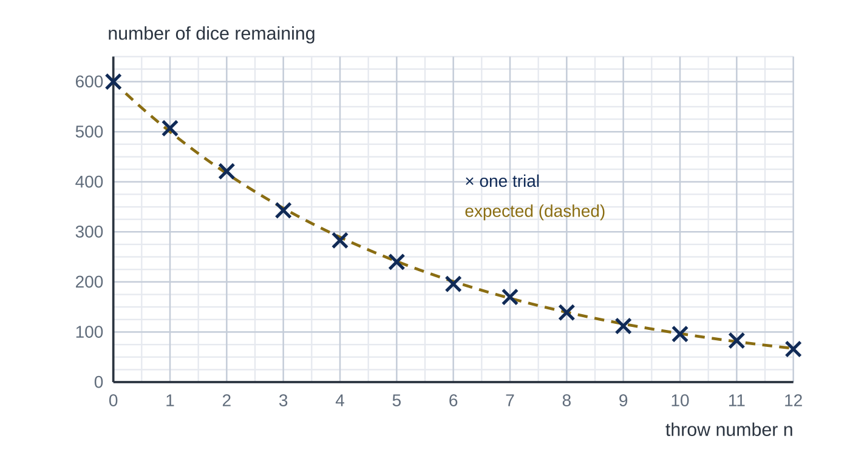
Question 5
5 marks
To model radioactive decay, a class throws 600 dice. After each throw, every die showing a six is removed and the rest are thrown again. Figure 1 shows the class's results (crosses) and the number expected (dashed curve).
(a) State the probability that a particular die is removed on any one throw, and state the quantity in radioactive decay that this probability represents. [1]
(b) Use the dashed curve to find the number of throws needed for the number of dice to halve. [1]
(c) Calculate the number of dice expected to remain after 10 throws. [1]
(d) Explain why the crosses do not lie exactly on the dashed curve. [1]
(e) Explain why, for a real radioactive sample, the scatter about the expected curve is much less noticeable than in this model. [1]
Notes:
Online with the full mark scheme: https://examinerprep.com/ial-physics-5-4-radioactive-decay-questions#IALP-U5-4-FB-05

Slide 52
Answers

Slide 53
Question 1 · answer
Answer D
Decay is random: every undecayed nucleus has the same constant probability per unit time of decaying (the decay constant λ). It is spontaneous, so heating has no effect, and nuclei do not “age”.
Notes:
Full mark scheme: https://examinerprep.com/ial-physics-5-4-radioactive-decay-questions#IALP-U5-4-A-08

Slide 54
Question 2 · answer
Answer B
The activity falls from 96 kBq to 48 kBq in 6.0 min, and from 48 kBq to 24 kBq in the next 6.0 min, so t_½ = 6.0 min = 360 s.
λ = ln 2 / t_½ = 0.693 ÷ 360 s = 1.9 × 10⁻³ s⁻¹.
Notes:
Full mark scheme: https://examinerprep.com/ial-physics-5-4-radioactive-decay-questions#IALP-U5-4-FA-01

Slide 55
Question 3 · answer
Answer B
60 h = 4 half-lives. 80 × (½)⁴ = 5.0 mg.
Notes:
Full mark scheme: https://examinerprep.com/ial-physics-5-4-radioactive-decay-questions#IALP-U5-4-A-05

Slide 56
Question 4 · answer
Mark scheme
Indicative content:
random: it is not possible to predict which nucleus will decay next or when a particular nucleus will decay
spontaneous: decay is not affected by external factors such as temperature, pressure or chemical state
each nucleus has the same constant probability of decaying per unit time, the decay constant λ
so the expected number decaying per second is proportional to the number left: dN/dt = −λN / A = λN
this gives exponential decay, N = N₀e^(−λt), in which the time to halve, ln 2/λ, is the same whatever the starting number
with very large numbers of nuclei the random fluctuations are tiny compared with the total, so the sample follows the law closely; small samples show visible scatter
Notes:
Full mark scheme: https://examinerprep.com/ial-physics-5-4-radioactive-decay-questions#IALP-U5-4-B-08

Slide 57
Question 5 · answer
Mark scheme
1/6, which represents the decay constant / probability that a nucleus decays per unit time
the curve reaches 300 at about 3.8 throws (allow 3.6–4.0)
600 × (5/6)¹⁰ = 97
whether a die shows a six is random, so the number removed in each throw varies about the expected value
a real sample contains a very large number of nuclei, so the random fluctuations are a tiny fraction of the number decaying
Notes:
Full mark scheme: https://examinerprep.com/ial-physics-5-4-radioactive-decay-questions#IALP-U5-4-FB-05

Slide 58
Keep practising
Notes for this topic
Questions on this topic
Build a printable test
ExaminerPrep is an independent tutoring service. It has been developed independently from and is not endorsed by the International Baccalaureate Organization. "International Baccalaureate", "IB" and "IB Diploma Programme" are registered trademarks of the IBO, used here for descriptive purposes only.
Pearson Edexcel and Cambridge are trademarks of their owners; ExaminerPrep is not affiliated with any exam board.

