Slide 1
EP
EDEXCEL IAL PHYSICS
2.10 Resistance, temperature and light
The full notes page in 11 sections · practice questions with answers · simulations
ExaminerPrep is an independent tutoring service. It has been developed independently from and is not endorsed by the International Baccalaureate Organization. "International Baccalaureate", "IB" and "IB Diploma Programme" are registered trademarks of the IBO, used here for descriptive purposes only.
Pearson Edexcel and Cambridge are trademarks of their owners; ExaminerPrep is not affiliated with any exam board.
Notes:
2.10 Resistance, temperature and light. Notes for this topic: https://examinerprep.com/notes/edexcel-ial-physics/resistance-temperature-and-light/

Slide 2
What this page covers
Overview
What limits the current in a conductor: the number of charge carriers and their drift velocity
Why the resistance of a metal increases with temperature (lattice vibrations)
Why a filament lamp has a curved current–potential difference graph
Why the resistance of an NTC thermistor decreases with temperature (more charge carriers)
Why the resistance of an LDR decreases as the light intensity increases
Reading and sketching resistance–temperature and resistance–light intensity graphs
Thermistors and LDRs as sensors in potential divider circuits
Notes:
What this page covers. Full notes: https://examinerprep.com/notes/edexcel-ial-physics/resistance-temperature-and-light/

Slide 3
In one minute
Key points
1. For a fixed potential difference the current is I = nqvA, so it depends on the number density of charge carriers n and on their drift velocity v, and the resistance R = V/I changes whenever nv changes.
2. Metal heated: n stays the same; the lattice ions vibrate with a larger amplitude, electrons collide with them more often, v falls, so I falls and R rises.
3. Filament lamp: more current → hotter filament → higher resistance, so the I–V graph bends towards the V axis.
4. NTC thermistor heated: many more charge carriers are released, so n rises steeply; this outweighs the small fall in v, so R falls.
5. LDR in brighter light: absorbed light releases more charge carriers, n rises, so R falls.
6. In a potential divider, the p.d. across a component rises when its share of the total resistance rises: that is how these components become temperature and light sensors.
Notes:
In one minute. Full notes: https://examinerprep.com/notes/edexcel-ial-physics/resistance-temperature-and-light/

Slide 4
What decides the resistance of a conductor at the atomic scale?
Section 1 of 11
One simple model, charge carriers moving through a vibrating lattice of ions, explains three different behaviours on this page: a metal's resistance rises when it is heated, a thermistor's falls, and an LDR's falls in brighter light. The model rests on one equation.
Current in terms of charge carriers: I = nqvA, where I is the current (A), n the number of charge carriers per unit volume (m⁻³), q the charge on each carrier (C), v the drift velocity (m s⁻¹) and A the cross-sectional area (m²). In the formulae list supplied in the exam; it is derived on page 2.6. The drift velocity is the small average velocity of the carriers along the conductor, superimposed on their much faster random motion.
A potential difference across a conductor creates an electric field that accelerates the free charge carriers (in a metal, the conduction electrons).
The carriers keep colliding with the lattice ions, losing the energy they gained. Each collision transfers energy to the lattice as vibration, which is why a current heats a conductor.
Notes:
What decides the resistance of a conductor at the atomic scale?. Full notes: https://examinerprep.com/notes/edexcel-ial-physics/resistance-temperature-and-light/

Slide 5
What decides the resistance of a conductor at the atomic scale? (continued)
Section 1 of 11
The collisions limit the drift velocity: more frequent collisions mean a smaller drift velocity for the same p.d.
For a given conductor and a fixed p.d., the current is set by n and v (q and A do not change). Since R = V/I, anything that reduces nv increases the resistance.
So every explanation on this page has the same skeleton: what happens to n? what happens to v? which effect wins? so what happens to I and R?
Notes:
What decides the resistance of a conductor at the atomic scale?. Full notes: https://examinerprep.com/notes/edexcel-ial-physics/resistance-temperature-and-light/

Slide 6
What decides the resistance of a conductor at the atomic scale? (continued)
Section 1 of 11 · Worked example 1 · Medium · Calculate, State
WORKED EXAMPLE · QUESTION
A copper wire of cross-sectional area 0.50 mm² has a resistance of 3.0 Ω and is connected to a constant 6.0 V supply. Copper has 8.5 ×10²⁸ conduction electrons per m³; e = 1.60 ×10⁻¹⁹ C. (a) Calculate the drift velocity of the electrons. (b) As the wire warms up, its resistance rises to 3.6 Ω. Calculate the new drift velocity and state why the number of electrons per m³ can be taken as unchanged.
SOLUTION
(a) I = 6.0/3.0 = 2.0 A and A = 0.50 ×10⁻⁶ m². Rearranging I = nqvA: v = 2.0/(8.5 ×10²⁸ ×1.60 ×10⁻¹⁹ ×0.50 ×10⁻⁶), so v = 2.9 ×10⁻⁴ m s⁻¹ (2.94 ×10⁻⁴ m s⁻¹).
(b) I = 6.0/3.6 = 1.67 A, so v = 1.667/(8.5 ×10²⁸ ×1.60 ×10⁻¹⁹ ×0.50 ×10⁻⁶), giving v = 2.5 ×10⁻⁴ m s⁻¹ (2.45 ×10⁻⁴ m s⁻¹). In a metal every atom already provides its conduction electrons; heating does not release significantly more. The whole change is in v: 0.833 of its original value, exactly 3.0/3.6.
Notes:
What decides the resistance of a conductor at the atomic scale?: Worked example 1. Full notes: https://examinerprep.com/notes/edexcel-ial-physics/resistance-temperature-and-light/

Slide 7
Why does the resistance of a metal increase with temperature?
Section 2 of 11
The lattice ions are always vibrating about fixed positions. Raising the temperature increases their kinetic energy, so they vibrate with a larger amplitude.
The conduction electrons therefore collide with the ions more often (the ions present a bigger "target"), so the electrons gain less drift velocity between collisions.
The number of conduction electrons per unit volume, n, is effectively unchanged by heating.
With n constant and v smaller, I = nqvA is smaller for the same p.d., so R = V/I is larger.
The effect is modest: for copper, the resistance rises by roughly 0.4% for each degree Celsius near room temperature.
Notes:
Why does the resistance of a metal increase with temperature?. Full notes: https://examinerprep.com/notes/edexcel-ial-physics/resistance-temperature-and-light/

Slide 8
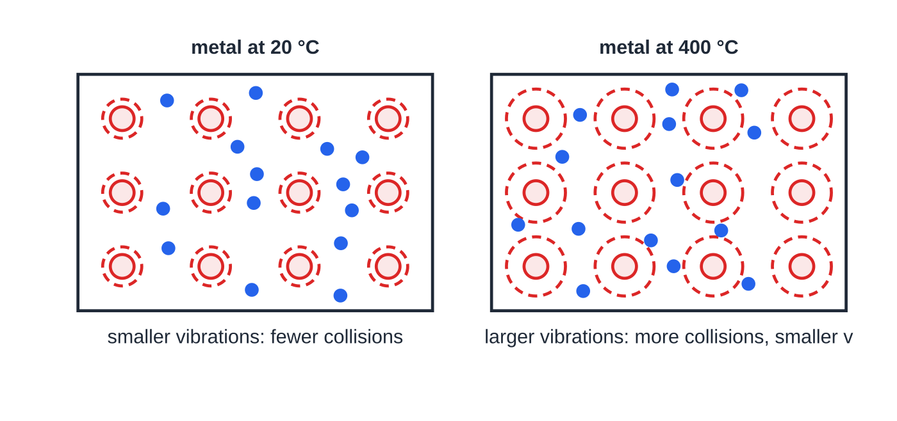
Why does the resistance of a metal increase with temperature? (continued)
Section 2 of 11
The resistance–temperature graph of a metal
Over everyday temperatures the graph of R against θ is very close to a straight line with a positive gradient and a positive intercept on the R axis at 0 °C. It is not proportional: doubling the Celsius temperature does not double the resistance. The same behaviour, at a much higher temperature, explains the filament lamp below.
Lattice model of a metal. The dashed envelopes show the vibration amplitude, drawn ∝ √T (kelvin), so the amplitude at 400 °C is 1.52 times that at 20 °C. The number of conduction electrons (14) is the same in both panels.
Notes:
Why does the resistance of a metal increase with temperature?. Full notes: https://examinerprep.com/notes/edexcel-ial-physics/resistance-temperature-and-light/

Slide 9
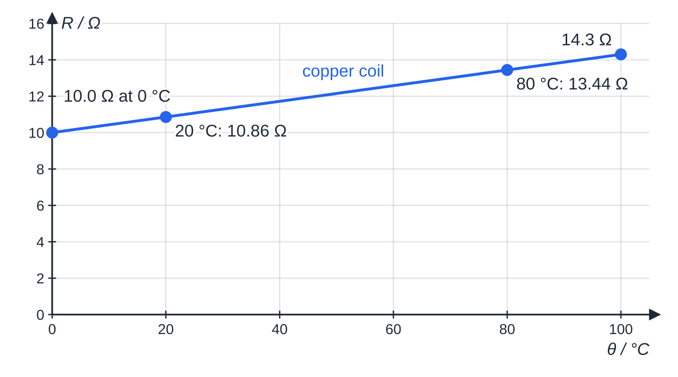
Why does the resistance of a metal increase with temperature? (continued)
Section 2 of 11
A copper coil: 10.0 Ω at 0 °C rising in a straight line to 14.3 Ω at 100 °C. The line does not pass through the origin.
Notes:
Why does the resistance of a metal increase with temperature?. Full notes: https://examinerprep.com/notes/edexcel-ial-physics/resistance-temperature-and-light/

Slide 10
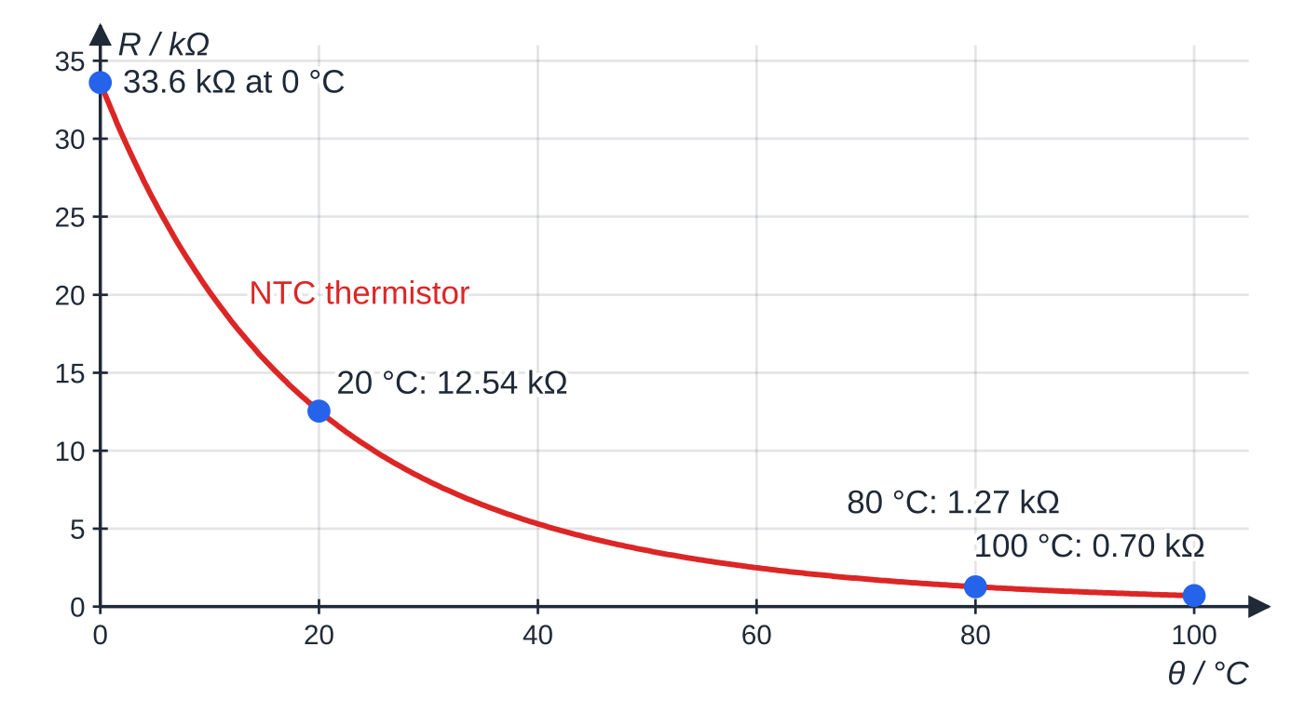
Why does the resistance of a metal increase with temperature? (continued)
Section 2 of 11
An NTC thermistor: 33.6 kΩ at 0 °C falling steeply, then levelling off at 0.70 kΩ at 100 °C. Note the unit, kΩ, is different from the copper graph.
Notes:
Why does the resistance of a metal increase with temperature?. Full notes: https://examinerprep.com/notes/edexcel-ial-physics/resistance-temperature-and-light/

Slide 11
Why does the resistance of a metal increase with temperature? (continued)
Section 2 of 11 · Worked example 2 · Medium · Calculate
WORKED EXAMPLE · QUESTION
Use the two graphs above. The copper coil and the thermistor are each connected in turn to a constant 5.0 V supply. (a) Calculate the percentage change in resistance of each component between 20 °C and 80 °C. (b) Calculate the current in each component at 20 °C and at 80 °C.
SOLUTION
(a) Coil: (13.44 - 10.86)/10.86, so +24%. Thermistor: (1.27 - 12.54)/12.54, so −90%.
(b) I = V/R; with R in kΩ the current comes out in mA. Coil: 5.0/10.86 = 0.460 A → 5.0/13.44 = 0.372 A. Thermistor: 5.0/12.54 = 0.399 mA → 5.0/1.27 = 3.94 mA. Coil 0.460 A → 0.372 A; thermistor 0.399 mA → 3.94 mA.
Heating cuts the coil's current by about a fifth but makes the thermistor's current about ten times larger: opposite directions, very different sizes.
Notes:
Why does the resistance of a metal increase with temperature?: Worked example 2. Full notes: https://examinerprep.com/notes/edexcel-ial-physics/resistance-temperature-and-light/

Slide 12
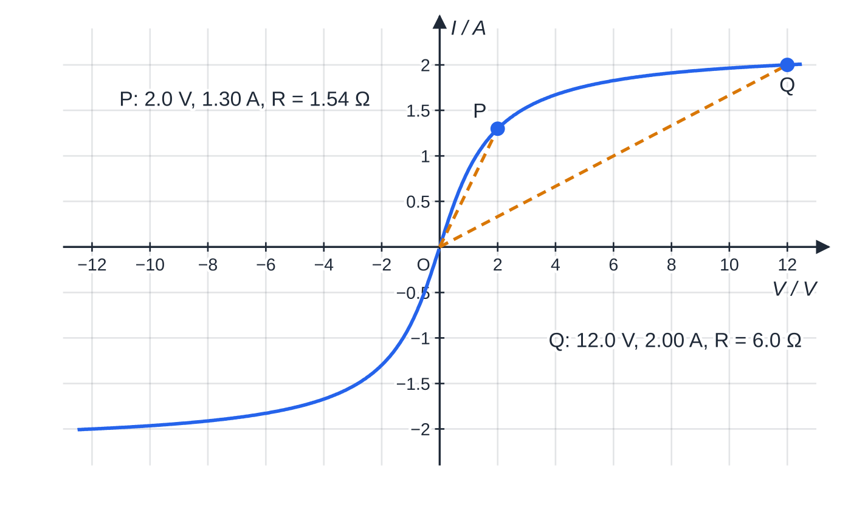
Why is the I–V graph of a filament lamp curved?
Section 3 of 11
A filament lamp is a thin metal (tungsten) wire. The current in it transfers energy to the lattice, so the filament's temperature depends on the current. As the p.d. is increased, the current increases, the filament gets hotter, the ions vibrate with larger amplitude, the electrons collide more often and the resistance increases. So each further volt produces a smaller increase in current: the I–V graph is steep near the origin and becomes less steep, curving towards the V axis. Reversing the p.d. reverses the current but heats the filament just as much, so the graph is symmetrical through the origin.
A 12.0 V, 2.00 A lamp, modelled with a filament resistance that rises in proportion to the power it dissipates (cold resistance 1.0 Ω). The dashed lines from the origin have gradients I/V = 1/R: the resistance is 1.54 Ω at 2.0 V and 6.0 Ω at 12.0 V.
Notes:
Why is the I–V graph of a filament lamp curved?. Full notes: https://examinerprep.com/notes/edexcel-ial-physics/resistance-temperature-and-light/

Slide 13
Why is the I–V graph of a filament lamp curved? (continued)
Section 3 of 11
The resistance at any point is V/I for that point: the gradient of the line from the origin, not the gradient of the curve.
Notes:
Why is the I–V graph of a filament lamp curved?. Full notes: https://examinerprep.com/notes/edexcel-ial-physics/resistance-temperature-and-light/

Slide 14
Why is the I–V graph of a filament lamp curved? (continued)
Section 3 of 11 · Worked example 3 · Medium · Calculate, Explain
WORKED EXAMPLE · QUESTION
The lamp in the graph above takes a current of 1.30 A at 2.0 V and 2.00 A at 12.0 V. (a) Calculate the resistance of the filament at each p.d. (b) Explain the difference.
SOLUTION
(a) R = V/I: 2.0/1.30 = 1.54 Ω and 12.0/2.00 = 6.0 Ω, about 3.9 times larger.
(b) At 12.0 V the current, and so the power dissipated (24 W), is much greater, so the filament is much hotter. Its ions vibrate with a larger amplitude, the electrons collide with them more often, the drift velocity per volt is smaller, so the resistance is higher.
Notes:
Why is the I–V graph of a filament lamp curved?: Worked example 3. Full notes: https://examinerprep.com/notes/edexcel-ial-physics/resistance-temperature-and-light/

Slide 15
Why is the I–V graph of a filament lamp curved? (continued)
Section 3 of 11
Common error
Finding the resistance from the gradient of the tangent to the I–V curve. Resistance is defined as R = V/I, so read one point and divide. For a lamp the tangent method gives a value that is far too large near the top of the curve.
Notes:
Why is the I–V graph of a filament lamp curved?. Full notes: https://examinerprep.com/notes/edexcel-ial-physics/resistance-temperature-and-light/

Slide 16
Why does the resistance of an NTC thermistor decrease with temperature?
Section 4 of 11
NTC thermistor: a semiconductor resistor whose resistance decreases as its temperature increases (negative temperature coefficient).
In a semiconductor, very few electrons are free to move at room temperature: n is small compared with a metal.
When the temperature rises, more electrons gain enough energy from the lattice vibrations to break free and become conduction electrons, so n increases greatly.
The ions also vibrate more, so the drift velocity at a given p.d. falls a little, the same effect as in a metal.
The increase in n is much larger than the fall in v, so nv and the current increase: the resistance decreases.
The R–θ graph is a curve falling steeply at low temperatures and levelling off at high temperatures.
Notes:
Why does the resistance of an NTC thermistor decrease with temperature?. Full notes: https://examinerprep.com/notes/edexcel-ial-physics/resistance-temperature-and-light/

Slide 17
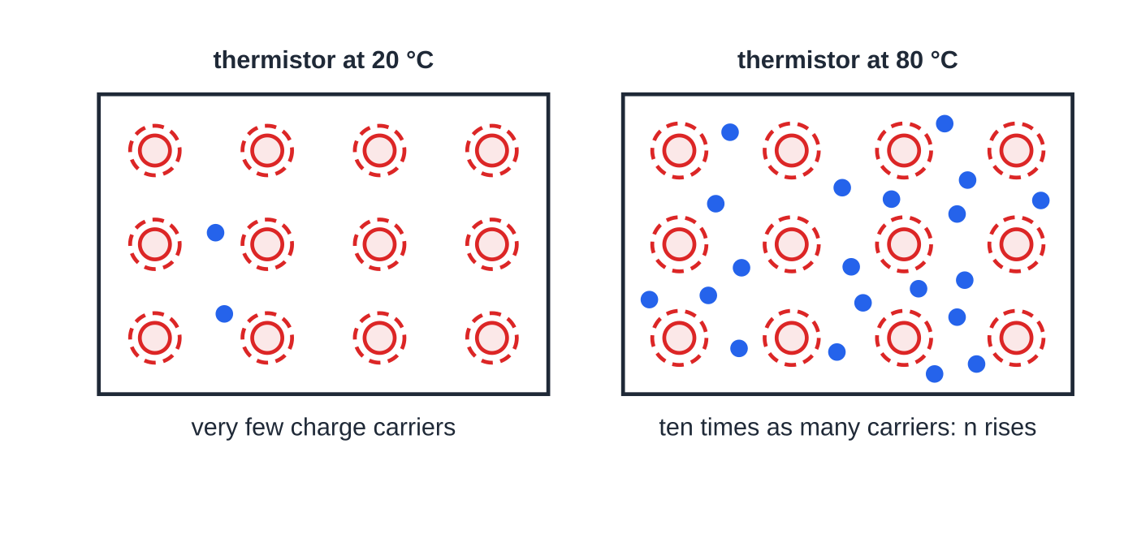
Why does the resistance of an NTC thermistor decrease with temperature? (continued)
Section 4 of 11
It never reaches zero.
Lattice model of an NTC thermistor. The number of conduction electrons drawn follows the thermistor's resistance ratio between 20 °C and 80 °C (2 → 20); the vibration amplitude grows only 10%.
Notes:
Why does the resistance of an NTC thermistor decrease with temperature?. Full notes: https://examinerprep.com/notes/edexcel-ial-physics/resistance-temperature-and-light/

Slide 18
Why does the resistance of an NTC thermistor decrease with temperature? (continued)
Section 4 of 11 · Worked example 4 · Hard · Explain (6 points)
WORKED EXAMPLE · QUESTION
Explain why, when the temperature rises, the resistance of a metal wire increases but the resistance of an NTC thermistor decreases. Refer to I = nqvA in your answer.
SOLUTION
Six linked points, in a clear order:
1. For a fixed p.d., the resistance depends on the current, I = nqvA, where n is the number of charge carriers per unit volume and v is their drift velocity.
2. When the temperature rises, the lattice ions vibrate with a larger amplitude.
3. The charge carriers collide with the ions more frequently, so their drift velocity decreases.
4. In the metal, n does not change significantly, so the current decreases and the resistance increases.
5. In the thermistor, the rise in temperature releases many more charge carriers, so n increases greatly.
Notes:
Why does the resistance of an NTC thermistor decrease with temperature?: Worked example 4. Full notes: https://examinerprep.com/notes/edexcel-ial-physics/resistance-temperature-and-light/

Slide 19
Why does the resistance of an NTC thermistor decrease with temperature? (continued)
Section 4 of 11 · Worked example 4 · Hard · Explain (6 points) (continued)
6. The increase in n outweighs the decrease in v, so the current increases and the resistance decreases.
Notes:
Why does the resistance of an NTC thermistor decrease with temperature?: Worked example 4. Full notes: https://examinerprep.com/notes/edexcel-ial-physics/resistance-temperature-and-light/

Slide 20
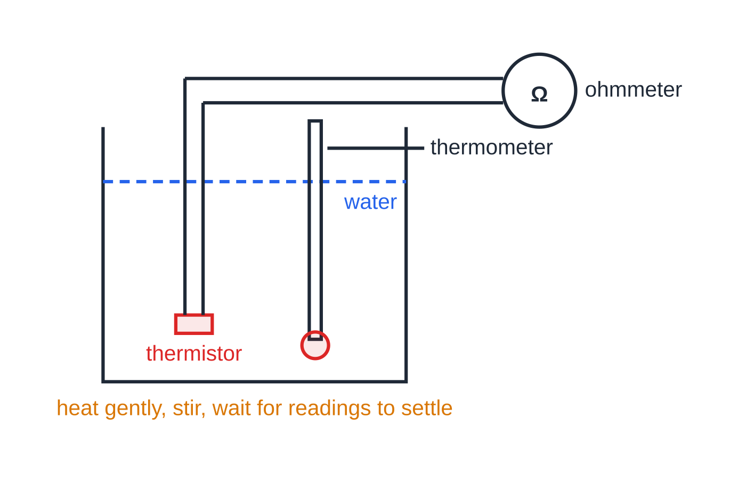
Why does the resistance of an NTC thermistor decrease with temperature? (continued)
Section 4 of 11
Measuring how resistance changes with temperature
Put the thermistor (or a coil of wire) in a beaker of water with a thermometer, with its leads kept out of the water or the component sealed in a thin tube.
Start with iced water; heat gently, stir, and wait for the reading to settle before recording the temperature and the resistance on an ohmmeter (or from V/I).
The thermistor (sealed, or with its leads kept dry) sits in a water bath next to the thermometer bulb, so both are at the same temperature when the reading is taken.
Notes:
Why does the resistance of an NTC thermistor decrease with temperature?. Full notes: https://examinerprep.com/notes/edexcel-ial-physics/resistance-temperature-and-light/

Slide 21
Why does the resistance of an NTC thermistor decrease with temperature? (continued)
Section 4 of 11
Take readings every 10 °C up to near boiling; repeat while the water cools and average the two sets.
Use a small current: a large current would heat the component itself, so it would be hotter than the water.
The uncertainty in a temperature reading is half the resolution of the thermometer (±0.5 °C for a 1 °C scale).
Common error
Writing "the thermistor's atoms vibrate less, so there are fewer collisions". The lattice vibrates more when hotter in every material. The thermistor's resistance falls because the number of charge carriers rises, and that effect is larger than the extra collisions.
Notes:
Why does the resistance of an NTC thermistor decrease with temperature?. Full notes: https://examinerprep.com/notes/edexcel-ial-physics/resistance-temperature-and-light/

Slide 22
Why does the resistance of an LDR decrease in brighter light?
Section 5 of 11
Light-dependent resistor (LDR): a semiconductor resistor whose resistance decreases as the intensity of the light falling on it increases.
In the dark the semiconductor has very few conduction electrons, so its resistance is high, of order 1 MΩ.
Light is absorbed by the semiconductor. The energy absorbed releases electrons, which become conduction electrons (charge carriers).
Greater light intensity → more energy absorbed per second → more charge carriers released → n increases.
The temperature, and so the drift velocity, is essentially unchanged, so by I = nqvA the current at a given p.d. increases and the resistance decreases.
The R–light intensity graph is a curve: a steep fall at low intensities, levelling off at high intensities.
Notes:
Why does the resistance of an LDR decrease in brighter light?. Full notes: https://examinerprep.com/notes/edexcel-ial-physics/resistance-temperature-and-light/

Slide 23
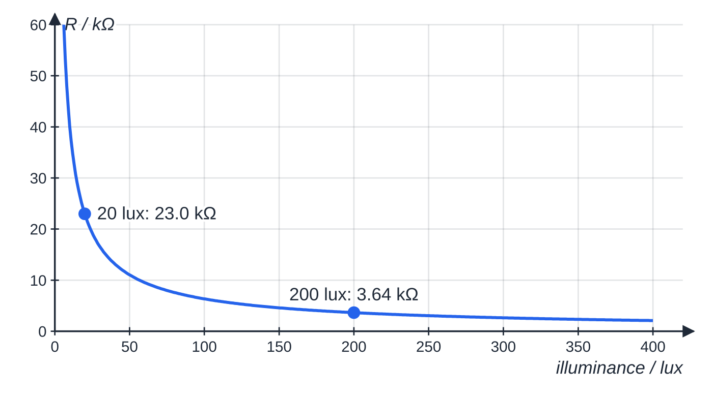
Why does the resistance of an LDR decrease in brighter light? (continued)
Section 5 of 11
Exam tip
For an LDR, the explanation is about n only: "more light, more charge carriers released, so lower resistance". Do not bring in lattice vibrations: the temperature of the LDR is not what changes.
A typical LDR, modelled as R = 40 kΩ × (illuminance ÷ 10 lux)^−0.8: 23.0 kΩ at 20 lux and 3.64 kΩ at 200 lux. In total darkness the same model gives over 1 MΩ.
Notes:
Why does the resistance of an LDR decrease in brighter light?. Full notes: https://examinerprep.com/notes/edexcel-ial-physics/resistance-temperature-and-light/

Slide 24
How are thermistors and LDRs used as sensors?
Section 6 of 11
Put the sensor in series with a fixed resistor across a supply: a potential divider. The current is the same in both, so each component's share of the supply p.d. is in proportion to its share of the total resistance. When the sensor's resistance changes, the output across the fixed resistor moves one way and the output across the sensor moves the other way.
Temperature sensor (fire alarm, heating control): thermistor on top, output across the fixed resistor. Hotter → thermistor resistance falls → its share falls → output rises.
Light sensor (street lamp switch): LDR at the bottom, output across the LDR. Darker → LDR resistance rises → its share rises → output rises.
Replacing the fixed resistor with a variable resistor lets you adjust the temperature or light level at which the output reaches a switching value.
Notes:
How are thermistors and LDRs used as sensors?. Full notes: https://examinerprep.com/notes/edexcel-ial-physics/resistance-temperature-and-light/

Slide 25
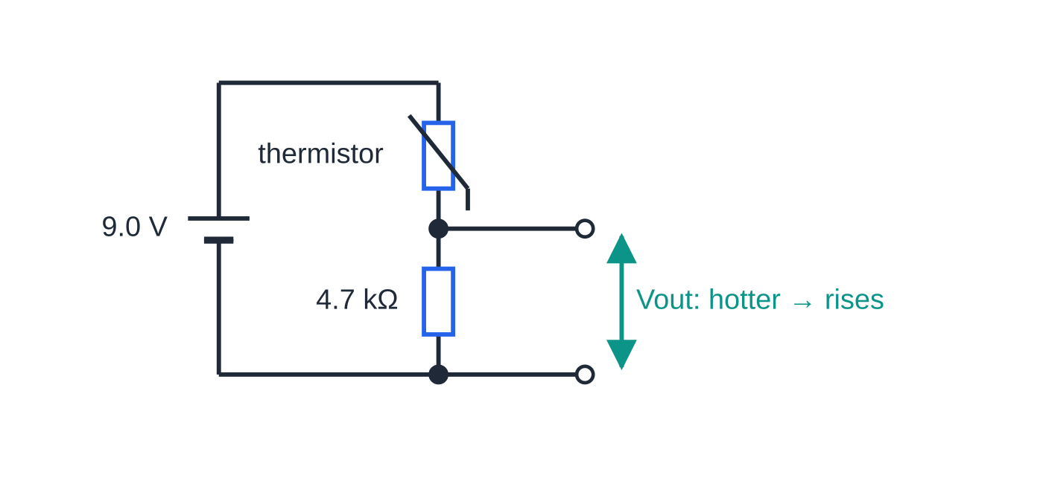
How are thermistors and LDRs used as sensors? (continued)
Section 6 of 11
Temperature sensor: thermistor on top, output across the 4.7 kΩ fixed resistor. Swapping the two components reverses the direction in which the output changes.
Notes:
How are thermistors and LDRs used as sensors?. Full notes: https://examinerprep.com/notes/edexcel-ial-physics/resistance-temperature-and-light/

Slide 26
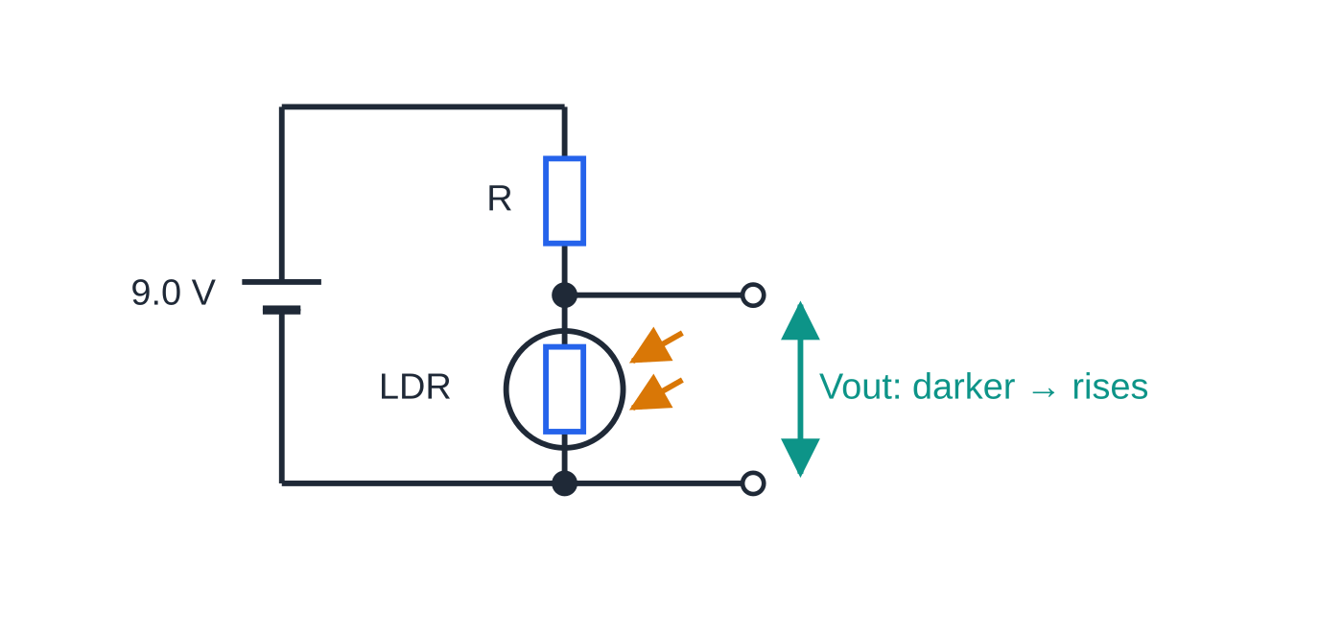
How are thermistors and LDRs used as sensors? (continued)
Section 6 of 11
Light sensor: fixed resistor R on top, output across the LDR, so the output rises as it gets darker.
Notes:
How are thermistors and LDRs used as sensors?. Full notes: https://examinerprep.com/notes/edexcel-ial-physics/resistance-temperature-and-light/

Slide 27
How are thermistors and LDRs used as sensors? (continued)
Section 6 of 11 · Worked example 5 · Medium · Calculate
WORKED EXAMPLE · QUESTION
In the temperature sensor above the supply is 9.0 V with negligible internal resistance and the fixed resistor is 4.7 kΩ. The thermistor's resistance is 12.54 kΩ at 20 °C and 2.49 kΩ at 60 °C. Calculate the output p.d. across the fixed resistor at 20 °C and at 60 °C, and the current at 60 °C.
SOLUTION
The fixed resistor's share of the total resistance sets its share of 9.0 V. 20 °C: Vₒᵤₜ = 9.0 ×4.7/(4.7 + 12.54), so 2.45 V. 60 °C: Vₒᵤₜ = 9.0 ×4.7/(4.7 + 2.49), so 5.88 V.
Current from the total resistance: I = 9.0/(7.19 ×10³) = 1.25 mA. Check: 1.252 mA × 4.7 kΩ = 5.88 V.
Notes:
How are thermistors and LDRs used as sensors?: Worked example 5. Full notes: https://examinerprep.com/notes/edexcel-ial-physics/resistance-temperature-and-light/

Slide 28
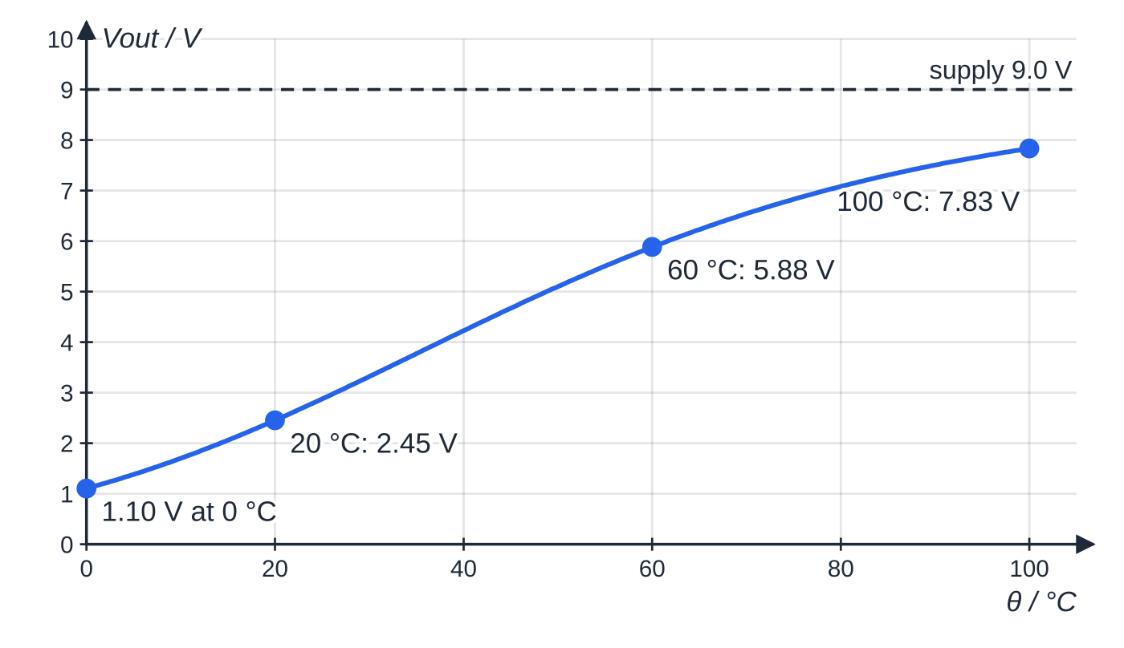
How are thermistors and LDRs used as sensors? (continued)
Section 6 of 11
Output of the temperature sensor against temperature, computed from the thermistor's R–θ curve. The output rises from 1.10 V at 0 °C to 7.83 V at 100 °C and is most sensitive in the middle of its range.
Notes:
How are thermistors and LDRs used as sensors?. Full notes: https://examinerprep.com/notes/edexcel-ial-physics/resistance-temperature-and-light/

Slide 29
How are thermistors and LDRs used as sensors? (continued)
Section 6 of 11 · Worked example 6 · Hard · Calculate
WORKED EXAMPLE · QUESTION
In the light sensor above the supply is 9.0 V. A switching circuit turns the street lamp on when the p.d. across the LDR reaches 6.0 V. The LDR's resistance is 23.0 kΩ at 20 lux and 3.64 kΩ at 200 lux. (a) Calculate the value of the fixed resistor R so that the lamp switches on when the illuminance falls to 20 lux. (b) Calculate the p.d. across the LDR at 200 lux and state whether the lamp is on.
SOLUTION
(a) At switching, 6.0 V across the LDR leaves 3.0 V across R, with the same current in both: R/23.0 = 3.0/6.0, so R = 11 kΩ (11.5 kΩ).
(b) V_LDR = 9.0 ×3.64/(3.64 + 11.5), so V_LDR = 2.2 V (2.16 V), below 6.0 V, so the lamp is off. The higher the light level, the lower the LDR's share, so a dusk switch has its output across the LDR.
Notes:
How are thermistors and LDRs used as sensors?: Worked example 6. Full notes: https://examinerprep.com/notes/edexcel-ial-physics/resistance-temperature-and-light/

Slide 30
How are thermistors and LDRs used as sensors? (continued)
Section 6 of 11
Exam tip
To decide which way an output moves, use ratios rather than a calculation: "the thermistor's resistance falls, so it takes a smaller share of the supply p.d., so the p.d. across the fixed resistor rises". Then add the reason the resistance changed if the question says "explain".
Notes:
How are thermistors and LDRs used as sensors?. Full notes: https://examinerprep.com/notes/edexcel-ial-physics/resistance-temperature-and-light/

Slide 31
Exam tips for 2.10
Section 7 of 11
Exam tip 1 — name the factor that changes
Each explanation needs you to say which of n and v changes, in which direction, and why. Metal: v falls (more collisions), n constant. Thermistor: n rises greatly. LDR: n rises with light intensity.
Exam tip 2 — write a chain, not a list
Six-point explanations reward a linked sequence: temperature rises → ions vibrate with larger amplitude → more frequent collisions → lower drift velocity → lower current for the same p.d. → higher resistance. Each arrow is a point.
Exam tip 3 — say "charge carriers" or "conduction electrons"
Say "the number of conduction electrons per unit volume increases", not "the electrons increase" or "the electrons get more energy". Precise wording shows which quantity in I = nqvA you mean.
Notes:
Exam tips for 2.10. Full notes: https://examinerprep.com/notes/edexcel-ial-physics/resistance-temperature-and-light/

Slide 32
Exam tips for 2.10 (continued)
Section 7 of 11
Exam tip 4 — sketch graphs with the right features
Metal R–θ: straight, rising, positive intercept. Thermistor and LDR: curves falling steeply then levelling off, never reaching zero. Lamp I–V: through the origin, symmetrical, gradient decreasing as |V| rises.
Exam tip 5 — check the direction of a sensor output
Before writing a final answer, ask: "as it gets hotter (or darker), does this component's share of the total resistance go up or down?" The p.d. across a component follows its share.
Notes:
Exam tips for 2.10. Full notes: https://examinerprep.com/notes/edexcel-ial-physics/resistance-temperature-and-light/

Slide 33
Common misconceptions
Section 8 of 11
Misconception | Why it is wrong | Correct idea
Heating a metal releases more free electrons, so it conducts better. | Metal atoms have already released their conduction electrons; heating adds almost none. | In a metal n is constant; more collisions lower v, so R rises.
Electrons "bump into each other" more when hot. | The resistance comes from collisions with the vibrating lattice ions. | Ions vibrate with larger amplitude, so electron–ion collisions are more frequent.
A thermistor's lattice vibrates less when it is hot. | All lattices vibrate more as temperature rises. | The rise in n outweighs the fall in v, so R falls.
A filament lamp obeys Ohm's law because it is a metal. | Ohm's law needs constant temperature; the filament heats up as the current rises. | The lamp's resistance rises with current, so its I–V graph curves.
The resistance of a lamp is the gradient of its I–V graph. | Resistance is defined as V/I at a point. | Use the line from the origin to the point: R = V/I.
Notes:
Common misconceptions. Full notes: https://examinerprep.com/notes/edexcel-ial-physics/resistance-temperature-and-light/

Slide 34
Common misconceptions (continued)
Section 8 of 11
Misconception | Why it is wrong | Correct idea
An LDR's resistance falls because light warms it up. | The heating is tiny; the effect works on cold components too. | Absorbed light releases charge carriers, so n increases.
Notes:
Common misconceptions. Full notes: https://examinerprep.com/notes/edexcel-ial-physics/resistance-temperature-and-light/

Slide 35
How this topic connects
Section 9 of 11
6 Current and drift velocity
I = nqvA is the equation behind every explanation here; that page derives it and compares metals, semiconductors and insulators by their values of n.
8 Resistivity and the potential divider
R = ρl/A: heating changes the resistivity of the material, not its dimensions, so the same model explains why ρ for a metal rises and ρ for a semiconductor falls with temperature. Thermistors and LDRs are almost always used in a potential divider, whose equation and use with variable resistors are covered there.
Waves and the particle nature of light (Unit 2)
Light arrives as photons, each carrying energy hf; this is why absorbing light can release charge carriers in an LDR, an idea that links to the photoelectric effect.
Notes:
How this topic connects. Full notes: https://examinerprep.com/notes/edexcel-ial-physics/resistance-temperature-and-light/

Slide 36
Key equations
Section 10 of 11
Equation | Use | In the formulae list?
I = nqvA | current from the number density and drift velocity of charge carriers (n in m⁻³, v in m s⁻¹) | Yes
R = V/I | resistance at any point on an I–V graph | Yes
V = IR for each resistor in series | p.d. across one component of a potential divider | Yes (as R = V/I)
Rₜₒₜₐₗ = R₁ + R₂ | total resistance of a sensor and fixed resistor in series | Yes
Vₒᵤₜ = Vᵢₙ ×Rₒᵤₜ/(R₁ + R₂) | output of a sensor potential divider | No — derive it from I = Vᵢₙ/(R₁ + R₂) and V = IR
resistance ∝ 1/(nv) for a given conductor and p.d. | deciding which way R changes | No — derive it from I = nqvA and R = V/I
Notes:
Key equations. Full notes: https://examinerprep.com/notes/edexcel-ial-physics/resistance-temperature-and-light/

Slide 37
Check your understanding
Section 11 of 11
1. A metal wire is cooled at constant p.d. State what happens to the number of conduction electrons per unit volume and to their drift velocity.
2. A lamp draws 0.12 A at 0.60 V and 0.50 A at 6.0 V. Calculate its resistance at each p.d. and explain the difference.
3. A thermistor is connected in series with an ammeter and a constant supply, then warmed with a hair dryer. What happens to the ammeter reading, and why?
4. An LDR and a 3.0 kΩ resistor are in series across 6.0 V. The output is across the fixed resistor. Calculate the output when the LDR is 1.5 kΩ (bright) and 9.0 kΩ (dim).
5. Why should only a small current pass through a thermistor while you measure how its resistance depends on the temperature of a water bath?
Notes:
Check your understanding: questions. Full notes: https://examinerprep.com/notes/edexcel-ial-physics/resistance-temperature-and-light/

Slide 38
Check your understanding · answers
Section 11 of 11
1. The number per unit volume stays (almost) the same. The ions vibrate with a smaller amplitude, so collisions are less frequent and the drift velocity increases; the current increases and the resistance decreases.
2. 0.60/0.12 = 5.0 Ω and 6.0/0.50 = 12 Ω. The larger current makes the filament hotter, so the ions vibrate more, collisions are more frequent and the resistance is higher.
3. It increases. More charge carriers are released in the warmer thermistor, so n rises greatly; this outweighs the small fall in drift velocity, so the resistance falls and the current rises.
4. Bright: 6.0 ×3.0/4.5 = 4.0 V. Dim: 6.0 ×3.0/12.0 = 1.5 V. This output is high in bright light and falls as it gets darker.
5. A large current would dissipate power in the thermistor and heat it above the water temperature, so the resistance recorded would belong to a higher temperature than the one read on the thermometer.
Notes:
Check your understanding: answers. Full notes: https://examinerprep.com/notes/edexcel-ial-physics/resistance-temperature-and-light/

Slide 39
Practice questions
5 original exam-style questions. Answers at the end of the deck.

Slide 40
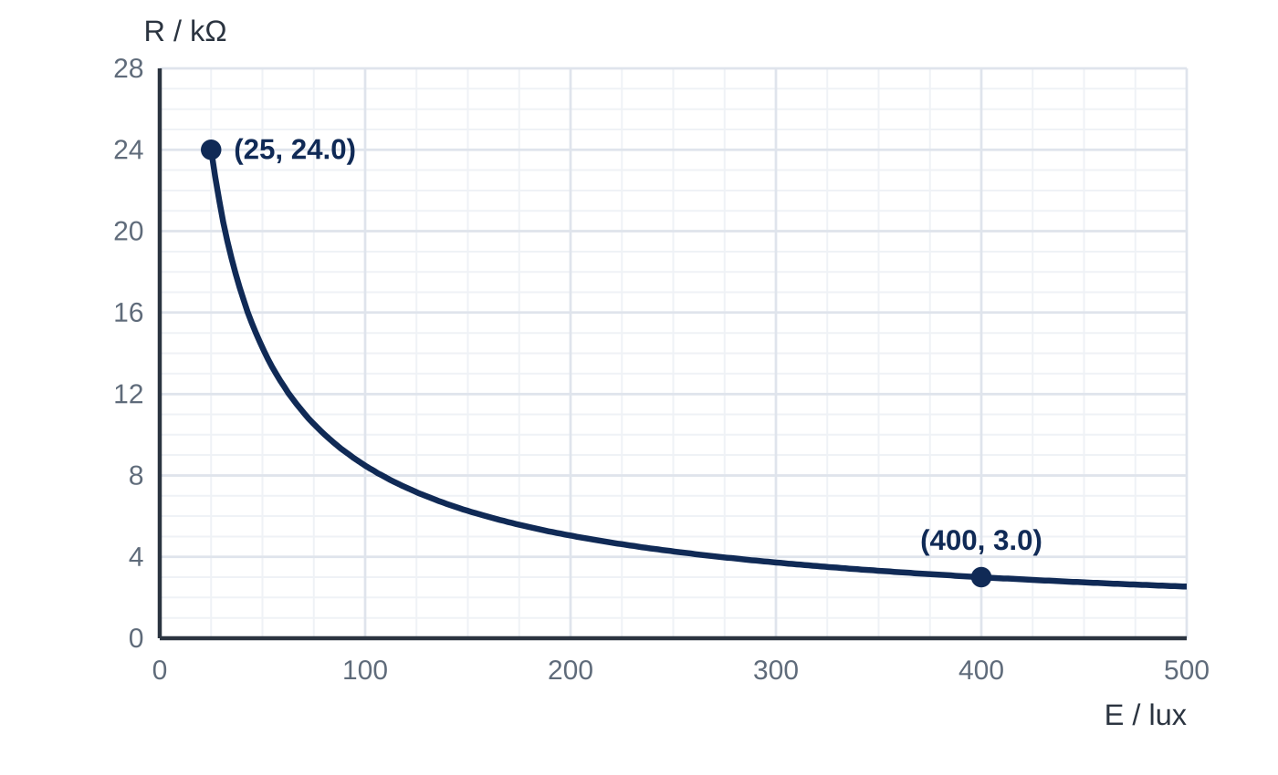
Question 1
1 mark
Figure 1 shows how the resistance R of an LDR varies with the illuminance E of the light falling on it. The LDR is moved from a place where the illuminance is 25 lux to a place where it is 400 lux. Its temperature does not change, so the drift velocity of the charge carriers for a given p.d. is unchanged.
By what factor does the number of charge carriers per unit volume in the LDR increase?
A 0.13
B 8.0
C 16
D 21
Notes:
Online with the full mark scheme: https://examinerprep.com/ial-physics-2-10-resistance-temperature-and-light-questions#IALP-U2-10-FA-06

Slide 41
Question 2
1 mark
The temperature of a metal wire increases while the potential difference across it is kept constant.
Which statement explains why the resistance of the wire increases?
A The lattice ions vibrate with a larger amplitude, so the conduction electrons collide with them more frequently.
B More conduction electrons are released from the metal atoms.
C The conduction electrons move faster at random, so their drift velocity increases.
D Some conduction electrons are captured by the lattice ions, so fewer are free to move.
Notes:
Online with the full mark scheme: https://examinerprep.com/ial-physics-2-10-resistance-temperature-and-light-questions#IALP-U2-10-A-01

Slide 42
Question 3
1 mark
The intensity of the light falling on a light-dependent resistor (LDR) increases.
Which row describes the changes in the number of charge carriers per unit volume in the LDR and in its resistance?
A number of charge carriers increases; resistance decreases
B number of charge carriers increases; resistance increases
C number of charge carriers decreases; resistance increases
D number of charge carriers unchanged; resistance decreases
Notes:
Online with the full mark scheme: https://examinerprep.com/ial-physics-2-10-resistance-temperature-and-light-questions#IALP-U2-10-A-02

Slide 43
Question 4
7 marks
A constant potential difference of 5.0 V is applied across an LDR. In dim light the current is 0.45 mA. When a lamp is switched on nearby, the current rises to 2.5 mA. The temperature of the LDR does not change significantly.
(a) Calculate the resistance of the LDR in dim light and when the lamp is on. [2]
(b) Explain, with reference to I = nqvA, why the current increases when the lamp is switched on. [4]
(c) Assuming the drift velocity of the charge carriers does not change, calculate the factor by which the number of charge carriers per unit volume increases. [1]
Notes:
Online with the full mark scheme: https://examinerprep.com/ial-physics-2-10-resistance-temperature-and-light-questions#IALP-U2-10-B-06

Slide 44
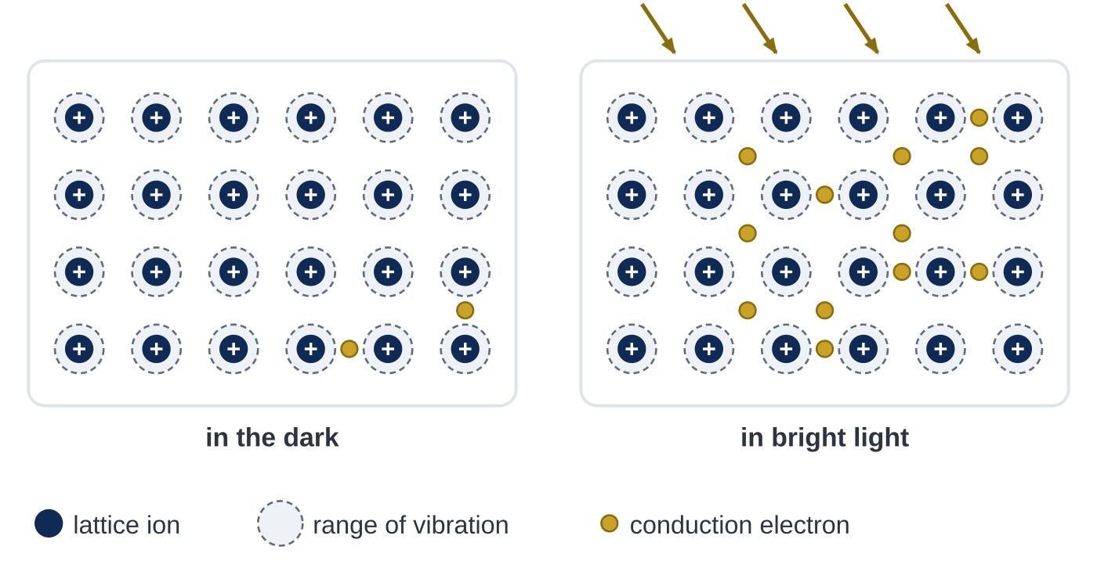
Question 5
5 marks
Figure 1 shows a simple model of the material of an LDR at the same temperature, first in the dark and then in bright light.
(a) Use Figure 1 to state which quantity in the equation I = nqvA is different in bright light, and the factor by which it changes. [2]
(b) Explain why the resistance of the LDR is smaller in bright light. Refer to Figure 1 in your answer. [3]
Notes:
Online with the full mark scheme: https://examinerprep.com/ial-physics-2-10-resistance-temperature-and-light-questions#IALP-U2-10-FB-02

Slide 45
Answers

Slide 46
Question 1 · answer
Answer B
For a given p.d., I = nqvA with q, v and A unchanged, so I ∝ n and R = V/I ∝ 1/n. From the graph the resistance falls from 24.0 kΩ to 3.0 kΩ, so n increases by 24.0 ÷ 3.0 = 8.0.
Notes:
Full mark scheme: https://examinerprep.com/ial-physics-2-10-resistance-temperature-and-light-questions#IALP-U2-10-FA-06

Slide 47
Question 2 · answer
Answer A
In a metal the number of conduction electrons per unit volume does not change significantly with temperature. The hotter lattice ions vibrate with a larger amplitude, so electron–ion collisions are more frequent, the drift velocity for a given p.d. falls, the current falls and the resistance rises.
Notes:
Full mark scheme: https://examinerprep.com/ial-physics-2-10-resistance-temperature-and-light-questions#IALP-U2-10-A-01

Slide 48
Question 3 · answer
Answer A
Energy absorbed from the light releases more electrons to act as charge carriers, so n increases. With more charge carriers the current at a given p.d. is larger, so the resistance decreases.
Notes:
Full mark scheme: https://examinerprep.com/ial-physics-2-10-resistance-temperature-and-light-questions#IALP-U2-10-A-02

Slide 49
Question 4 · answer
Mark scheme
5.0 ÷ 0.45 × 10⁻³ = 11 kΩ (11.1 kΩ)
5.0 ÷ 2.5 × 10⁻³ = 2.0 kΩ
the LDR absorbs more light energy (per second)
this releases more electrons, which become charge carriers
so the number of charge carriers per unit volume n increases
the temperature, so the drift velocity v (and q, A), are unchanged, so I = nqvA increases
n ∝ I, so 2.5 ÷ 0.45 = 5.6 (5.56)
Notes:
Full mark scheme: https://examinerprep.com/ial-physics-2-10-resistance-temperature-and-light-questions#IALP-U2-10-B-06

Slide 50
Question 5 · answer
Mark scheme
n, the number of charge carriers (conduction electrons) per unit volume
it increases by a factor of 6 (12 ÷ 2)
energy absorbed from the light releases more electrons to act as charge carriers, so n increases
the ions' range of vibration is the same in both diagrams because the temperature has not changed, so the drift velocity v for a given p.d. is unchanged
so I = nqvA is larger for the same p.d., and R = V/I is smaller
Notes:
Full mark scheme: https://examinerprep.com/ial-physics-2-10-resistance-temperature-and-light-questions#IALP-U2-10-FB-02

Slide 51
Keep practising
Notes for this topic
Questions on this topic
Build a printable test
ExaminerPrep is an independent tutoring service. It has been developed independently from and is not endorsed by the International Baccalaureate Organization. "International Baccalaureate", "IB" and "IB Diploma Programme" are registered trademarks of the IBO, used here for descriptive purposes only.
Pearson Edexcel and Cambridge are trademarks of their owners; ExaminerPrep is not affiliated with any exam board.

