Slide 1
EP
EDEXCEL IAL PHYSICS
2.8 Resistivity and the potential divider
The full notes page in 11 sections · practice questions with answers · simulations
ExaminerPrep is an independent tutoring service. It has been developed independently from and is not endorsed by the International Baccalaureate Organization. "International Baccalaureate", "IB" and "IB Diploma Programme" are registered trademarks of the IBO, used here for descriptive purposes only.
Pearson Edexcel and Cambridge are trademarks of their owners; ExaminerPrep is not affiliated with any exam board.
Notes:
2.8 Resistivity and the potential divider. Notes for this topic: https://examinerprep.com/notes/edexcel-ial-physics/resistivity-and-the-potential-divider/

Slide 2
What this page covers
Overview
Resistivity and the equation R = ρl/A; how resistance scales with length and diameter
Core practical: determining the resistivity of the metal of a wire from a graph of R against l
How the potential varies along a uniform wire that carries a current
Potential dividers: sharing a supply p.d. between resistors, and choosing a resistor for a given output
Potential dividers with a variable resistor, a thermistor or an LDR as sensor circuits
Why a voltmeter or other load of finite resistance lowers the output p.d.
Notes:
What this page covers. Full notes: https://examinerprep.com/notes/edexcel-ial-physics/resistivity-and-the-potential-divider/

Slide 3
In one minute
Key points
1
Resistivity ρ is a property of the material, R = ρl/A, with unit Ω m: a longer wire has more resistance and a thicker wire has less.
4
Along a uniform wire carrying a steady current, the potential changes linearly with distance.
2
For a round wire A = πd²/4, so halving the diameter makes the resistance four times larger.
5
In a potential divider the same current passes through each resistor, so the supply p.d. is shared in the ratio of the resistances: Vₒᵤₜ = R₂/(R₁ + R₂)Vᵢₙ.
3
To measure ρ: plot R against l; the gradient is ρ/A, and A comes from the micrometer diameter.
6
Replace one resistor with a thermistor or LDR and the output responds to temperature or light; a variable resistor sets the switching point.
Notes:
In one minute: the key points of this topic.

Slide 4
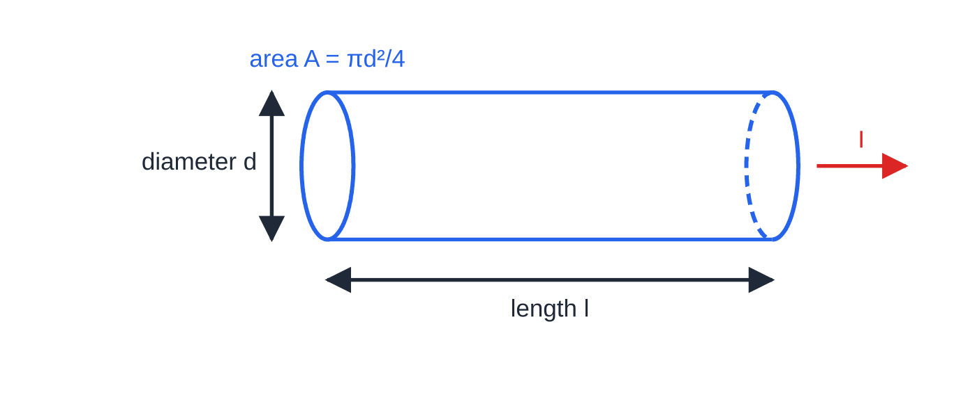
What is resistivity, and how does resistance depend on size?
Section 1 of 11
Two wires of the same metal can have very different resistances, because resistance depends on the shape of the piece as well as the material. A longer wire has more resistance: the charge carriers pass more ions on the way, so R ∝l. A thicker wire has less resistance: there are more parallel paths for the charge, so R ∝1/A. Resistivity is the constant of proportionality that is left. It depends only on the material (and its temperature), not on the shape of the sample.
The three quantities in R = ρl/A: the length l along which the current flows, and the cross-sectional area A, worked out from the measured diameter d.
Notes:
What is resistivity, and how does resistance depend on size?. Full notes: https://examinerprep.com/notes/edexcel-ial-physics/resistivity-and-the-potential-divider/

Slide 5
What is resistivity, and how does resistance depend on size? (continued)
Section 1 of 11
Resistance from resistivity: R = ρl/A, where R is the resistance (Ω), ρ the resistivity of the material (Ω m), l the length (m) and A the cross-sectional area (m²). In the formulae list supplied in the exam. It applies to a uniform conductor at constant temperature. Rearranged, ρ= RA/l, which gives the unit: Ω × m² ÷ m = Ω m.
Typical values (room temperature): copper 1.7 ×10⁻⁸ Ω m; aluminium 2.8 ×10⁻⁸ Ω m; constantan 4.9 ×10⁻⁷ Ω m; nichrome 1.1 ×10⁻⁶ Ω m; pure silicon about 10³ Ω m; glass above 10¹⁰ Ω m. Good conductors have tiny resistivities, insulators enormous ones, and semiconductors sit in between.
Round wires: A = πr² = πd²/4. Micrometers measure the diameter, so halve it before squaring.
Units: 1 mm = 10⁻³ m but 1 mm² = 10⁻⁶ m².
Notes:
What is resistivity, and how does resistance depend on size?. Full notes: https://examinerprep.com/notes/edexcel-ial-physics/resistivity-and-the-potential-divider/

Slide 6
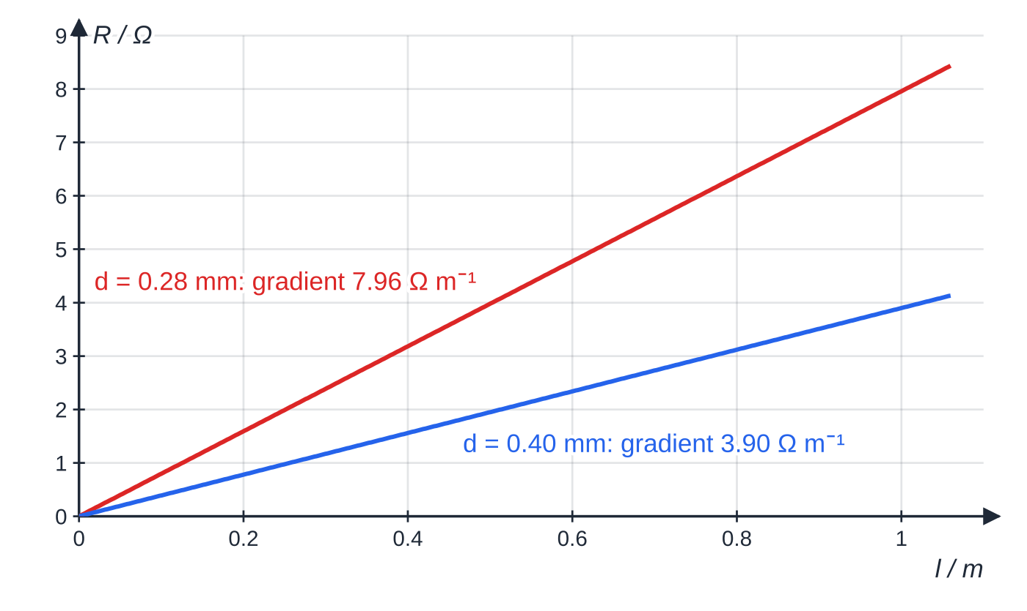
What is resistivity, and how does resistance depend on size? (continued)
Section 1 of 11
R against l for two constantan wires, plotted from R = ρl/A. Both lines pass through the origin. The thinner wire's gradient is 2.04 times larger, because (0.40 ÷ 0.28)² = 2.04.
Notes:
What is resistivity, and how does resistance depend on size?. Full notes: https://examinerprep.com/notes/edexcel-ial-physics/resistivity-and-the-potential-divider/

Slide 7
What is resistivity, and how does resistance depend on size? (continued)
Section 1 of 11 · Worked example 1 · Easy · Calculate
WORKED EXAMPLE · QUESTION
An extension lead is 25 m long. The current flows out along one copper core and back along the other. Each core has a cross-sectional area of 1.5 mm². The resistivity of copper is 1.7 ×10⁻⁸ Ω m. (a) Calculate the total resistance of the two cores. (b) Calculate the p.d. across the lead when it carries a current of 10 A.
SOLUTION
(a) Convert the area: A = 1.5 ×10⁻⁶ m². The current passes through 2 ×25 = 50 m of copper, so R = (1.7 ×10⁻⁸ ×50)/(1.5 ×10⁻⁶), giving R = 0.57 Ω (0.567 Ω).
(b) V = IR = 10 ×0.567 = 5.7 V. This p.d. is lost before the supply reaches the appliance, which is why long leads for high-current appliances use thicker cores.
Notes:
What is resistivity, and how does resistance depend on size?: Worked example 1. Full notes: https://examinerprep.com/notes/edexcel-ial-physics/resistivity-and-the-potential-divider/

Slide 8
What is resistivity, and how does resistance depend on size? (continued)
Section 1 of 11 · Worked example 2 · Medium · Calculate
WORKED EXAMPLE · QUESTION
A 2.0 m length of nichrome wire has a resistance of 14 Ω. (a) Calculate the resistance of a 0.50 m length of nichrome wire with half the diameter. (b) The original 2.0 m wire is drawn out uniformly until it is 3.0 m long. Its volume does not change. Calculate its new resistance.
SOLUTION
(a) Scale each factor separately: length × 0.25; diameter × ½, so area × ¼ and resistance × 4. R = 14 ×0.25 ×4 = 14 Ω.
(b) Volume Al is constant, so if l rises by a factor of 1.5 the area falls by a factor of 1.5. R = 14 ×1.5 ×1.5 = 31.5 Ω≈32 Ω. Stretching a wire increases its resistance twice over: it gets longer and thinner.
Notes:
What is resistivity, and how does resistance depend on size?: Worked example 2. Full notes: https://examinerprep.com/notes/edexcel-ial-physics/resistivity-and-the-potential-divider/

Slide 9
What is resistivity, and how does resistance depend on size? (continued)
Section 1 of 11
Common error
Using the diameter as if it were the radius in πr². The area comes out four times too big and the resistance (or resistivity) four times too small. Write A = π(d/2)² as a separate line of working.
Notes:
What is resistivity, and how does resistance depend on size?. Full notes: https://examinerprep.com/notes/edexcel-ial-physics/resistivity-and-the-potential-divider/

Slide 10
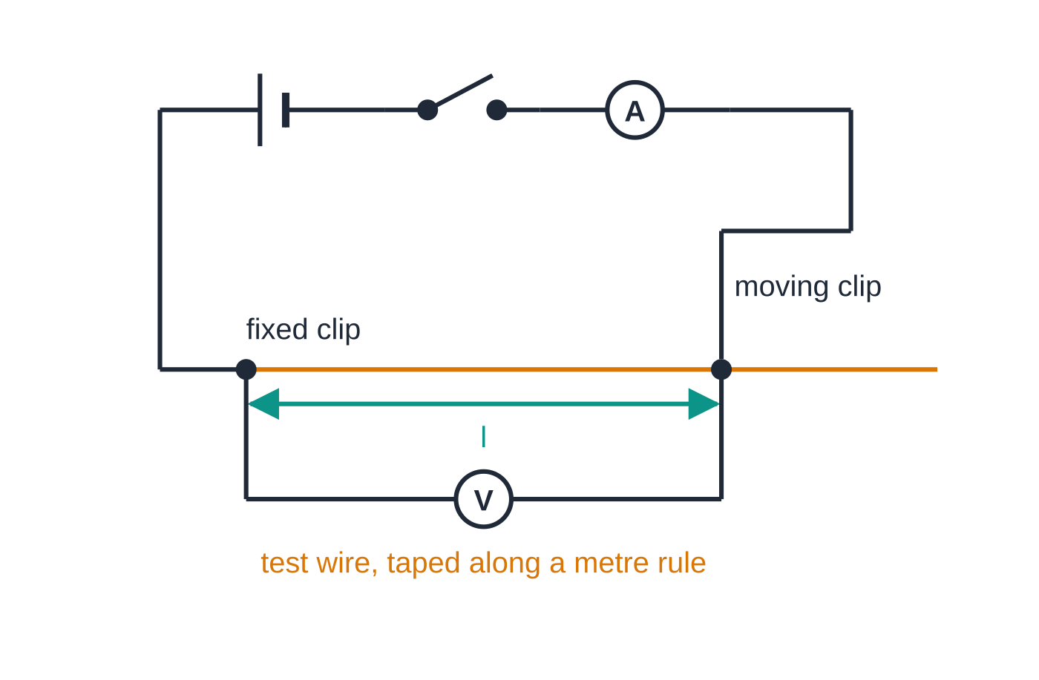
How do you determine the resistivity of the metal of a wire?
Section 2 of 11
This is a core practical. Measure the resistance of several different lengths of the same wire, plot R against l, and use the gradient together with the cross-sectional area.
Diameter: use a micrometer screw gauge (resolution 0.01 mm), checked for zero error when closed. Measure at several points along the wire, turning the micrometer through 90° at each point, and take the mean: the wire may be uneven or not perfectly round.
Set-up: tape the wire straight along a metre rule.
The ammeter measures the current through the wire; the voltmeter measures the p.d. across the length l between the two clips. R = V/I for each length.
Notes:
How do you determine the resistivity of the metal of a wire?. Full notes: https://examinerprep.com/notes/edexcel-ial-physics/resistivity-and-the-potential-divider/

Slide 11
How do you determine the resistivity of the metal of a wire? (continued)
Section 2 of 11
Connect it in series with a battery (or low-voltage supply), a switch and an ammeter, with one crocodile clip fixed at the zero mark and a second clip that can be moved along the wire.
Readings: connect a voltmeter across the length l between the clips. For each length (for example every 0.10 m from 0.10 m to 1.00 m) record V and I and calculate R = V/I.
Constant temperature: use a small current and switch off between readings. Resistivity rises with temperature, so a heated wire would give a wrong value.
Analysis: plot R (y-axis) against l (x-axis) and draw the line of best fit.
Safety: a short length of thin wire can become hot; avoid touching it while current flows.
Why the gradient gives the resistivity
Write the equation as R = (ρ/A) l and compare with y = mx: the gradient is ρ/A (not in the formulae list: derive it by rearranging R = ρl/A, which is). So ρ= gradient ×A. A small intercept, from the resistance of the clips and contacts or a zero error, does not change the gradient.
Notes:
How do you determine the resistivity of the metal of a wire?. Full notes: https://examinerprep.com/notes/edexcel-ial-physics/resistivity-and-the-potential-divider/

Slide 12
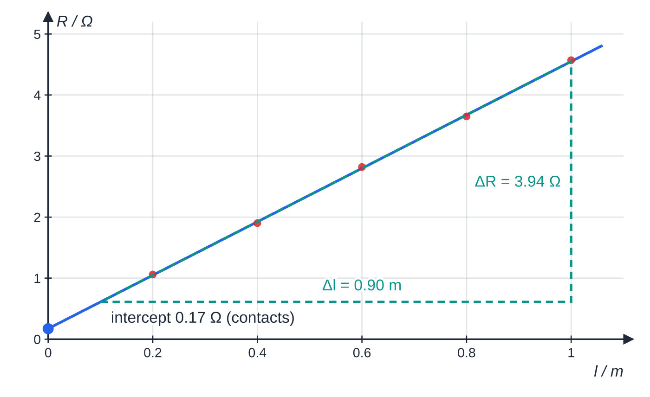
How do you determine the resistivity of the metal of a wire? (continued)
Section 2 of 11 · Worked example 3 · Hard · Determine
WORKED EXAMPLE · QUESTION
A student measures the diameter of a wire at five places: 0.37 mm, 0.38 mm, 0.38 mm, 0.37 mm, 0.38 mm. Her values of R for lengths 0.200 m to 1.000 m (in steps of 0.200 m) are 1.06 Ω, 1.90 Ω, 2.82 Ω, 3.65 Ω and 4.57 Ω. Her best-fit line passes through 0.61 Ω at 0.10 m and 4.55 Ω at 1.00 m. (a) Calculate the mean diameter and its percentage uncertainty. (b) Determine the resistivity of the metal.
The best-fit line does not quite pass through the origin: its intercept of 0.17 Ω is the extra resistance at the clips. The gradient triangle is drawn as large as the line allows.
Notes:
How do you determine the resistivity of the metal of a wire?: Worked example 3. Full notes: https://examinerprep.com/notes/edexcel-ial-physics/resistivity-and-the-potential-divider/

Slide 13
How do you determine the resistivity of the metal of a wire? (continued)
Section 2 of 11 · Worked example 3 · Hard · Determine (continued)
SOLUTION
(a) d = 1.88 / 5 = 0.376 mm. Uncertainty = half the range = (0.38 - 0.37)/2 = ±0.005 mm, so the percentage uncertainty = 0.005/0.376 ×100 = 1.3%.
(b) Area: A = π(0.376 ×10⁻³/2)² = 1.110 ×10⁻⁷ m². Gradient: (4.55 - 0.61)/(1.00 - 0.10) = 3.94/0.90 = 4.38 Ω m⁻¹. Then ρ= 4.38 ×1.110 ×10⁻⁷, so ρ= 4.9 ×10⁻⁷ Ω m (4.86 ×10⁻⁷ Ω m).
The diameter is the smallest quantity measured, so it usually has the largest percentage uncertainty, and it is squared in the area, so it is worth measuring carefully.
Notes:
How do you determine the resistivity of the metal of a wire?: Worked example 3. Full notes: https://examinerprep.com/notes/edexcel-ial-physics/resistivity-and-the-potential-divider/

Slide 14
How do you determine the resistivity of the metal of a wire? (continued)
Section 2 of 11
Exam tip
Explain why the graph method is better than a single reading: the gradient uses all the results, it shows up any anomalous point, and it is not affected by a constant extra resistance at the contacts, which only shifts the intercept.
Notes:
How do you determine the resistivity of the metal of a wire?. Full notes: https://examinerprep.com/notes/edexcel-ial-physics/resistivity-and-the-potential-divider/

Slide 15
How does the potential vary along a uniform wire?
Section 3 of 11
When a steady current I flows through a uniform wire (same material and cross-section all the way along), every centimetre has the same resistance. The p.d. across any section is IR, and R ∝ length, so the p.d. across a section is proportional to its length. Taking one end as 0 V, the potential rises linearly with distance towards the other end. The potential gradient (V m⁻¹) is the p.d. across the whole wire divided by its length. A sliding contact can therefore pick off any p.d. between zero and the full p.d. across the wire: a continuously variable potential divider.
Notes:
How does the potential vary along a uniform wire?. Full notes: https://examinerprep.com/notes/edexcel-ial-physics/resistivity-and-the-potential-divider/

Slide 16
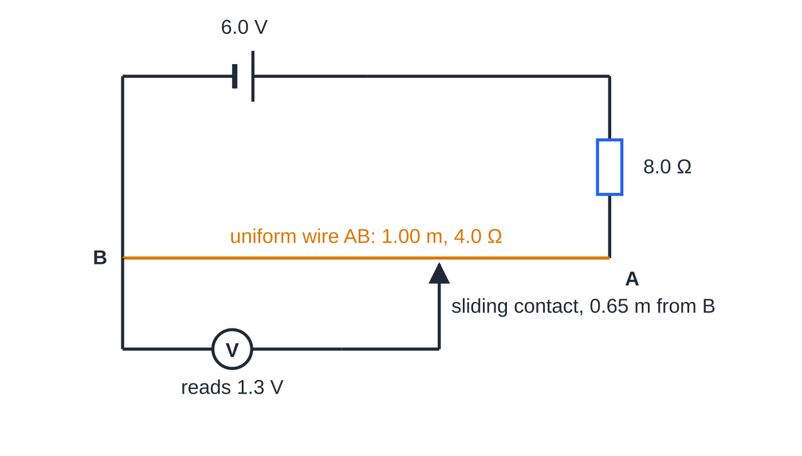
How does the potential vary along a uniform wire? (continued)
Section 3 of 11
The circuit of worked example 4. A 0.50 A current through the 4.0 Ω wire gives 2.0 V across it, and the voltmeter picks off part of that.
Notes:
How does the potential vary along a uniform wire?. Full notes: https://examinerprep.com/notes/edexcel-ial-physics/resistivity-and-the-potential-divider/

Slide 17
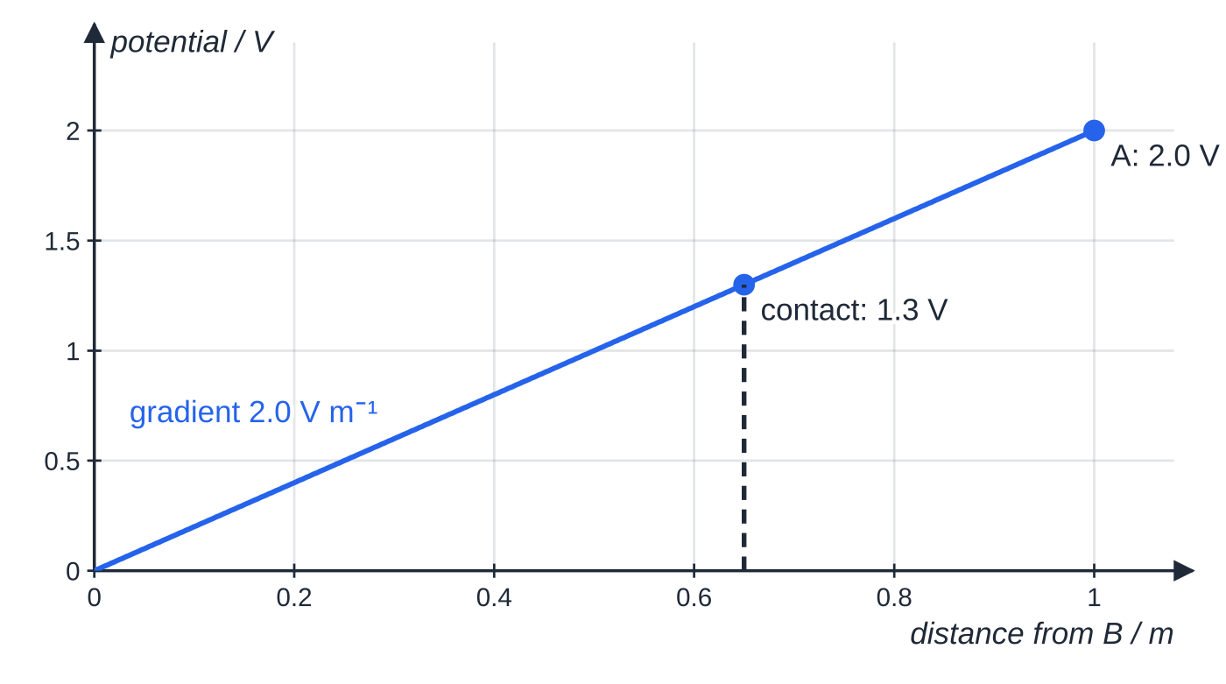
How does the potential vary along a uniform wire? (continued)
Section 3 of 11
With B at 0 V the potential rises in a straight line to 2.0 V at A; with the sliding contact 0.65 m from B the voltmeter reads 1.3 V.
Notes:
How does the potential vary along a uniform wire?. Full notes: https://examinerprep.com/notes/edexcel-ial-physics/resistivity-and-the-potential-divider/

Slide 18
How does the potential vary along a uniform wire? (continued)
Section 3 of 11 · Worked example 4 · Medium · Calculate
WORKED EXAMPLE · QUESTION
A uniform wire AB of length 1.00 m and resistance 4.0 Ω is connected in series with an 8.0 Ω resistor and a 6.0 V supply of negligible internal resistance. End B is connected to the negative terminal. (a) Calculate the p.d. across the wire. (b) Calculate the p.d. between two points on the wire 0.30 m and 0.85 m from B. (c) How far apart must two contacts be to pick off 0.50 V?
SOLUTION
(a) I = 6.0/(8.0 + 4.0) = 0.50 A, so V = 0.50 ×4.0 = 2.0 V.
(b) The potential gradient is 2.0/1.00 = 2.0 V m⁻¹ and the points are 0.55 m apart: V = 2.0 ×0.55 = 1.1 V.
(c) Distance = p.d. ÷ potential gradient: 0.50/2.0 = 0.25 m. Only the separation of the two points matters, not where they are on the wire.
Notes:
How does the potential vary along a uniform wire?: Worked example 4. Full notes: https://examinerprep.com/notes/edexcel-ial-physics/resistivity-and-the-potential-divider/

Slide 19
How does a potential divider share out a p.d.?
Section 4 of 11
A potential divider is two (or more) resistors in series across a supply, giving an output p.d. that is a chosen fraction of the supply p.d. The same current flows through each resistor, so each p.d. is proportional to its resistance and the larger resistor takes the larger share. The p.d.s add up to the supply p.d. (Kirchhoff's second law).
Potential divider: I = Vᵢₙ/(R₁ + R₂), so Vₒᵤₜ = IR₂ = R₂/(R₁ + R₂) ×Vᵢₙ, and V₁/V₂ = R₁/R₂. Vᵢₙ is the supply p.d. across both resistors, Vₒᵤₜ the p.d. across R₂. Not in the formulae list: derive it from V = IR and the series rule R = R₁ + R₂, both of which are. Valid when no current is drawn from the output, or the load's resistance is much larger than R₂.
Notes:
How does a potential divider share out a p.d.?. Full notes: https://examinerprep.com/notes/edexcel-ial-physics/resistivity-and-the-potential-divider/

Slide 20
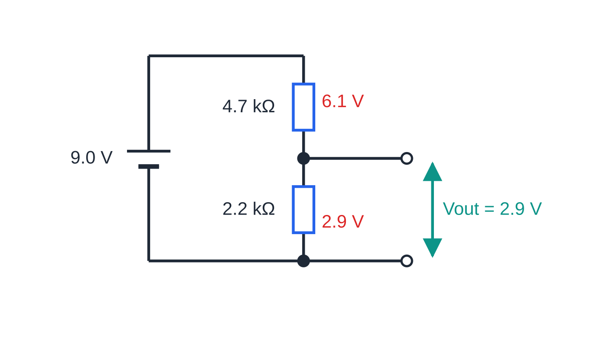
How does a potential divider share out a p.d.? (continued)
Section 4 of 11
The divider of worked example 5. The 9.0 V supply is shared in the ratio 4.7: 2.2, giving 6.1 V and 2.9 V, which add up to 9.0 V.
Notes:
How does a potential divider share out a p.d.?. Full notes: https://examinerprep.com/notes/edexcel-ial-physics/resistivity-and-the-potential-divider/

Slide 21
How does a potential divider share out a p.d.? (continued)
Section 4 of 11 · Worked example 5 · Medium · Calculate
WORKED EXAMPLE · QUESTION
A 4.7 kΩ resistor and a 2.2 kΩ resistor are connected in series across a 9.0 V supply of negligible internal resistance. The output is taken across the 2.2 kΩ resistor. (a) Calculate the output p.d. (b) The 4.7 kΩ resistor is replaced so that the output becomes 6.0 V. Calculate the resistance of the new resistor.
SOLUTION
(a) Vₒᵤₜ = 2.2/(4.7 + 2.2) ×9.0, so Vₒᵤₜ = 2.9 V (2.87 V).
(b) The other resistor must take 9.0 - 6.0 = 3.0 V, and p.d.s are in the ratio of resistances: R₁/2.2 = 3.0/6.0, so R₁ = 1.1 kΩ. Sense check: for the output to be the larger share, R₂ must be the larger resistance.
Notes:
How does a potential divider share out a p.d.?: Worked example 5. Full notes: https://examinerprep.com/notes/edexcel-ial-physics/resistivity-and-the-potential-divider/

Slide 22
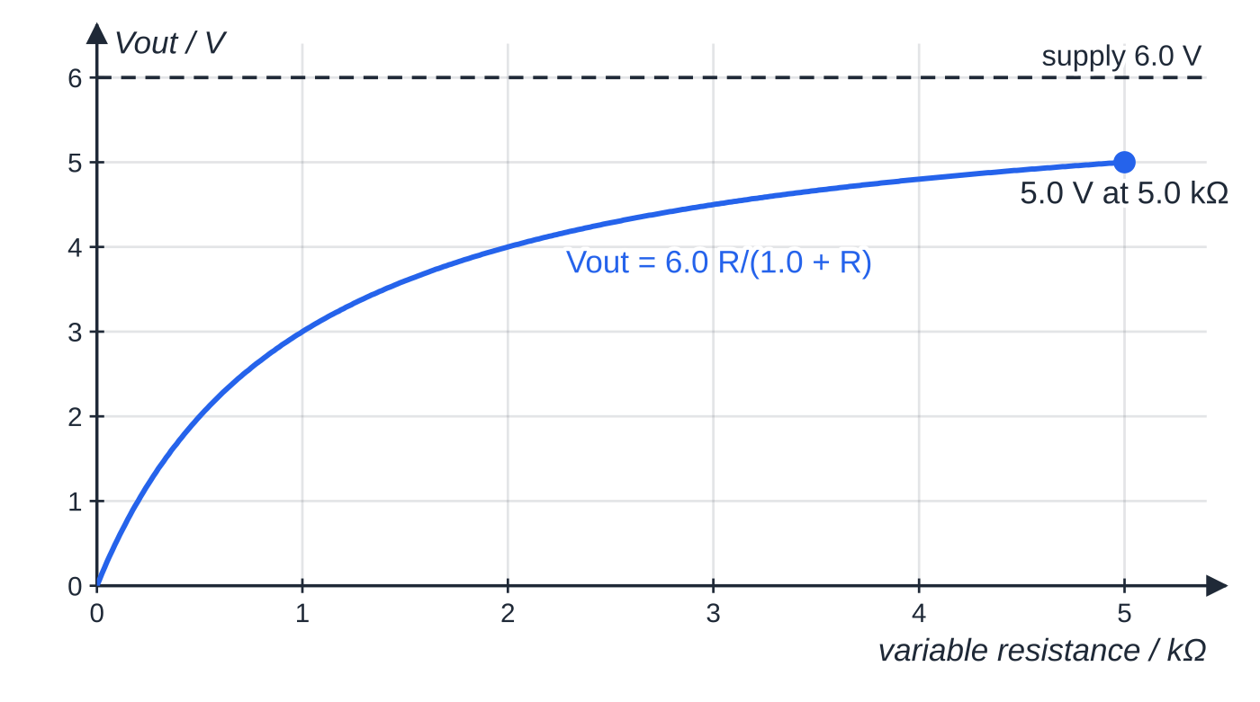
How does a potential divider share out a p.d.? (continued)
Section 4 of 11
Using a variable resistor
Replacing R₂ with a variable resistor makes the output adjustable. With a 1.0 kΩ fixed resistor and a 0–5.0 kΩ variable resistor on 6.0 V, the output across the variable resistor can be set anywhere from 0 to 6.0 ×5.0/6.0 = 5.0 V. A potentiometer (a resistance track with a sliding contact, like the wire above) gives the full range from 0 to Vᵢₙ.
Output across a 0–5.0 kΩ variable resistor in series with 1.0 kΩ on 6.0 V. The output rises quickly at first, then levels off below the supply p.d.: it never reaches 6.0 V.
Notes:
How does a potential divider share out a p.d.?. Full notes: https://examinerprep.com/notes/edexcel-ial-physics/resistivity-and-the-potential-divider/

Slide 23
How does a potential divider share out a p.d.? (continued)
Section 4 of 11
Common error
Writing Vₒᵤₜ = R₂/R₁ ×Vᵢₙ. The denominator is the total resistance R₁ + R₂. A quick check: the output can never be bigger than the supply.
Notes:
How does a potential divider share out a p.d.?. Full notes: https://examinerprep.com/notes/edexcel-ial-physics/resistivity-and-the-potential-divider/

Slide 24
How do sensor circuits use thermistors, LDRs and variable resistors?
Section 5 of 11
An NTC thermistor's resistance falls as its temperature rises. A light-dependent resistor's (LDR's) resistance falls as the light intensity on it rises (why, is on page 2.10). Put one of them in a potential divider and the output p.d. changes with temperature or light: a sensor circuit. The output can switch a lamp, heater, fan or alarm through a switching circuit when it passes a set value.
To decide which way the output goes, reason in three steps: (1) the sensor's resistance changes; (2) it therefore takes a larger or smaller share of the supply p.d.; (3) the other resistor takes the rest.
Sensor in the top position, output across the fixed resistor: sensor resistance falls → its share falls → Vₒᵤₜ rises.
Sensor in the bottom position, output across the sensor: sensor resistance falls → Vₒᵤₜ falls.
Swapping the two components reverses the response.
Notes:
How do sensor circuits use thermistors, LDRs and variable resistors?. Full notes: https://examinerprep.com/notes/edexcel-ial-physics/resistivity-and-the-potential-divider/

Slide 25
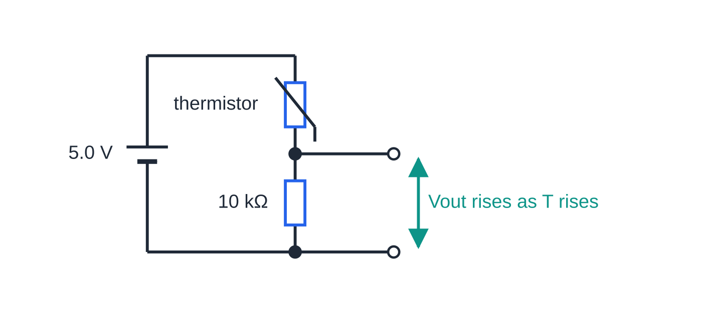
How do sensor circuits use thermistors, LDRs and variable resistors? (continued)
Section 5 of 11
A thermistor sensor on a 5.0 V supply, with the output taken across the fixed 10 kΩ resistor.
Notes:
How do sensor circuits use thermistors, LDRs and variable resistors?. Full notes: https://examinerprep.com/notes/edexcel-ial-physics/resistivity-and-the-potential-divider/

Slide 26
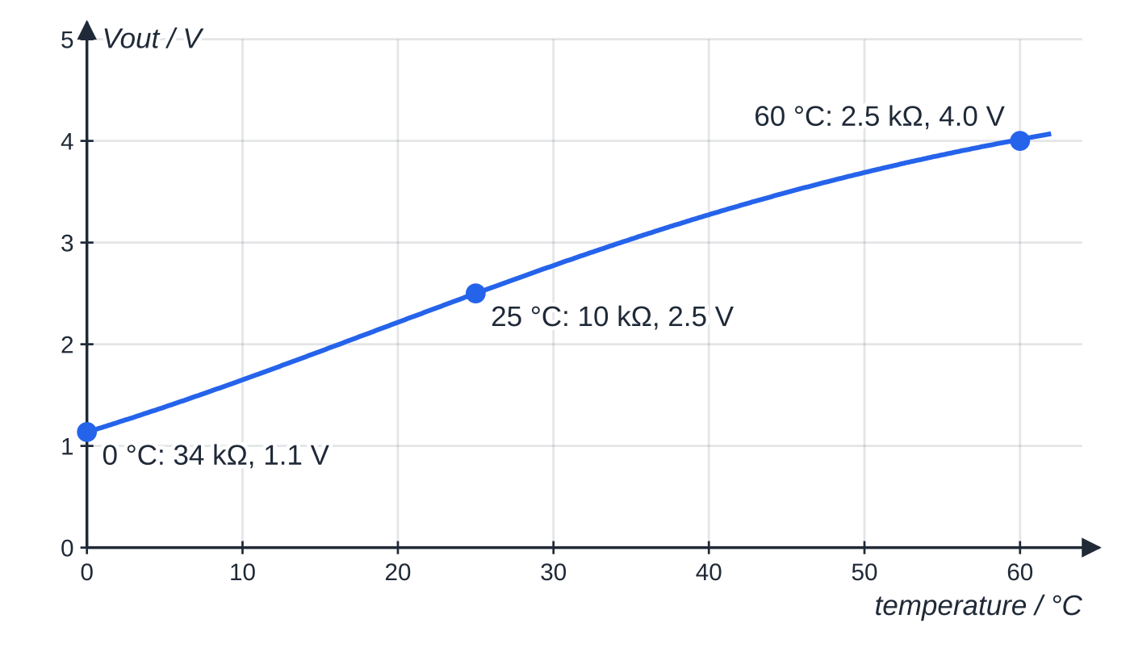
How do sensor circuits use thermistors, LDRs and variable resistors? (continued)
Section 5 of 11
Setting the switching point: make the fixed resistor a variable resistor. Adjusting it changes the temperature (or light level) at which the output reaches the switching value.
Sensitivity: the output changes most when the sensor's resistance is comparable to the other resistor's, so choose the fixed resistance close to the sensor resistance in the range you care about.
The thermistor's resistance falls from about 34 kΩ at 0 °C to 10 kΩ at 25 °C and 2.5 kΩ at 60 °C, so the output rises from 1.1 V to 2.5 V to 4.0 V. The curve is plotted from data for a typical thermistor.
Notes:
How do sensor circuits use thermistors, LDRs and variable resistors?. Full notes: https://examinerprep.com/notes/edexcel-ial-physics/resistivity-and-the-potential-divider/

Slide 27
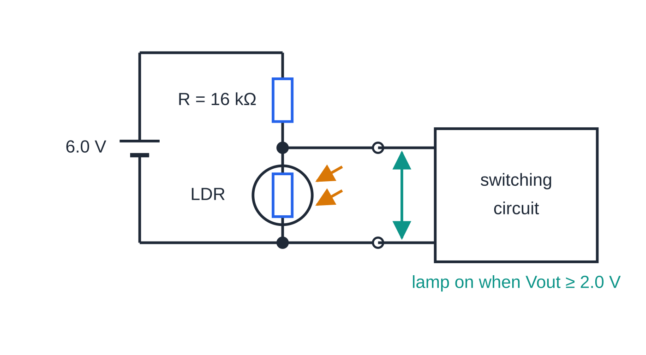
How do sensor circuits use thermistors, LDRs and variable resistors? (continued)
Section 5 of 11 · Worked example 6 · Medium · Explain, Calculate
WORKED EXAMPLE · QUESTION
A garden lamp should switch on at dusk. An LDR and a fixed resistor R are in series across a 6.0 V supply of negligible internal resistance, and the output is taken across the LDR. The switching circuit turns the lamp on when the output reaches 2.0 V. At dusk the LDR's resistance is 8.0 kΩ; in bright daylight it is 0.50 kΩ. (a) Explain why the output p.d. rises as it gets darker. (b) Calculate the value of R needed. (c) Calculate the output p.d. in bright daylight.
In darkness the LDR's resistance rises, it takes a larger share of the 6.0 V, and the output across it rises to the 2.0 V that switches the lamp on.
Notes:
How do sensor circuits use thermistors, LDRs and variable resistors?: Worked example 6. Full notes: https://examinerprep.com/notes/edexcel-ial-physics/resistivity-and-the-potential-divider/

Slide 28
How do sensor circuits use thermistors, LDRs and variable resistors? (continued)
Section 5 of 11 · Worked example 6 · Medium · Explain, Calculate (continued)
SOLUTION
(a) Less light → LDR resistance increases → the LDR takes a larger share of the 6.0 V (same current, p.d. ∝ resistance) → the output across the LDR rises.
(b) At switching, the LDR has 2.0 V and R has 6.0 - 2.0 = 4.0 V: R/8.0 = 4.0/2.0, so R = 16 kΩ.
(c) Vₒᵤₜ = 0.50/(16 + 0.50) ×6.0, so Vₒᵤₜ = 0.18 V, well below 2.0 V, so the lamp stays off. Using a variable resistor for R lets the user choose how dark it must be before the lamp comes on.
Notes:
How do sensor circuits use thermistors, LDRs and variable resistors?: Worked example 6. Full notes: https://examinerprep.com/notes/edexcel-ial-physics/resistivity-and-the-potential-divider/

Slide 29
How do sensor circuits use thermistors, LDRs and variable resistors? (continued)
Section 5 of 11
Exam tip
"Explain" questions on sensor circuits want the full chain: what changes in the surroundings, what happens to the sensor's resistance, what happens to its share of the p.d., and what happens to the output. Leaving out the middle step, the share of the p.d., leaves the explanation incomplete.
Notes:
How do sensor circuits use thermistors, LDRs and variable resistors?. Full notes: https://examinerprep.com/notes/edexcel-ial-physics/resistivity-and-the-potential-divider/

Slide 30
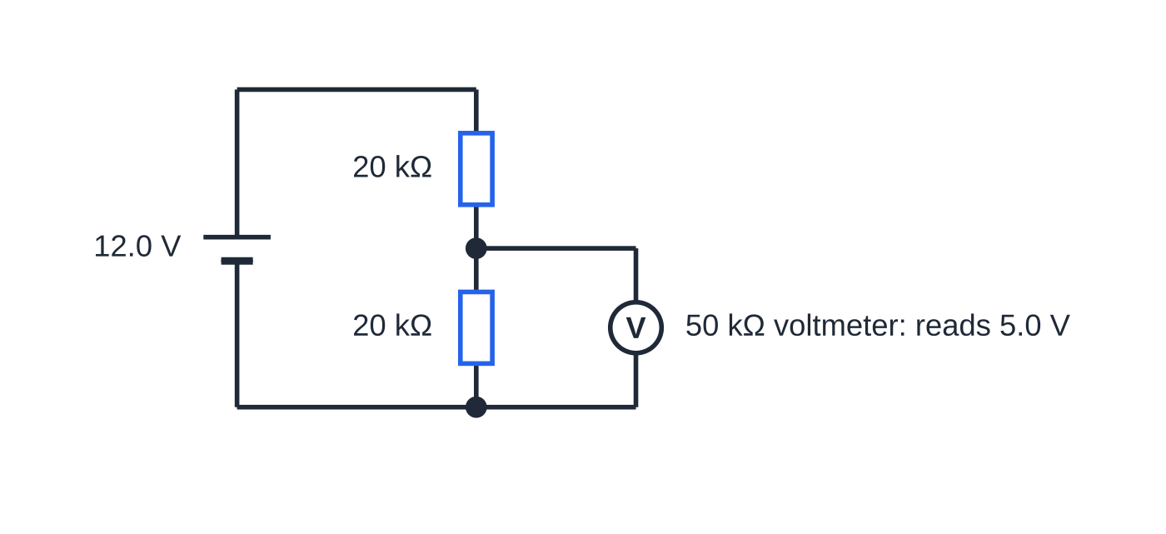
What happens when you connect a voltmeter or load to the output?
Section 6 of 11
Anything connected to the output (a voltmeter, a lamp, a switching circuit) is in parallel with R₂. The parallel combination has a lower resistance than R₂ alone, so it takes a smaller share of the supply and the output p.d. falls. The effect is small only if the load resistance is much larger than R₂. That is why an ideal voltmeter has infinite resistance, and why digital voltmeters (about 10 MΩ) are used to measure across large resistors.
A 50 kΩ voltmeter across one of two 20 kΩ resistors. The meter and resistor together make 14.3 kΩ, so the reading is 5.0 V instead of the 6.0 V that was there before the meter was connected.
Notes:
What happens when you connect a voltmeter or load to the output?. Full notes: https://examinerprep.com/notes/edexcel-ial-physics/resistivity-and-the-potential-divider/

Slide 31
What happens when you connect a voltmeter or load to the output? (continued)
Section 6 of 11 · Worked example 7 · Hard · Calculate
WORKED EXAMPLE · QUESTION
Two 20 kΩ resistors are in series across a 12.0 V supply of negligible internal resistance. A voltmeter of resistance 50 kΩ is connected across one of them. (a) State the p.d. across each resistor before the voltmeter is connected. (b) Calculate the voltmeter reading. (c) Calculate the reading with a 10 MΩ digital voltmeter instead.
SOLUTION
(a) Equal resistors share the supply equally: 6.0 V across each.
(b) 1/R = 1/20 + 1/50, so R = 14.3 kΩ. V = 14.3/(20 + 14.3) ×12.0, giving 5.0 V, 17% lower than the true 6.0 V.
(c) With 10 MΩ = 10 000 kΩ in parallel, R = 19.96 kΩ and V = 5.994 V, so V ≈6.0 V. A meter whose resistance is 500 times R₂ barely disturbs the divider; one only 2.5 times R₂ disturbs it badly.
Notes:
What happens when you connect a voltmeter or load to the output?: Worked example 7. Full notes: https://examinerprep.com/notes/edexcel-ial-physics/resistivity-and-the-potential-divider/

Slide 32
Exam tips for 2.8
Section 7 of 11
Exam tip 1 — convert areas properly
Convert the diameter to metres before squaring (0.38 mm = 0.38 ×10⁻³ m), or convert mm² with 10⁻⁶. Using 10⁻³ for an area is a factor of 1000 out.
Exam tip 2 — scaling: one factor at a time
For "twice the length and half the diameter" write the factors separately: × 2 for length, × 4 for area (½ squared, then inverted), so × 8 overall. Keep the material the same or the resistivity changes too.
Exam tip 3 — describe the practical in measurable detail
Name the instrument for each quantity (micrometer for diameter, metre rule for length, ammeter and voltmeter for R), say how you reduce uncertainty (repeat the diameter at several places and orientations, many lengths, graph), and how you keep the temperature constant (small current, switch off).
Notes:
Exam tips for 2.8. Full notes: https://examinerprep.com/notes/edexcel-ial-physics/resistivity-and-the-potential-divider/

Slide 33
Exam tips for 2.8 (continued)
Section 7 of 11
Exam tip 4 — check that p.d.s add up
After any potential divider calculation, add the p.d.s: they must equal the supply. It catches the common slip of calculating the p.d. across the wrong resistor.
Exam tip 5 — the load is in parallel
If a question mentions the resistance of a voltmeter or of a device connected to the output, combine it in parallel with the resistor it is across before using the divider equation.
Notes:
Exam tips for 2.8. Full notes: https://examinerprep.com/notes/edexcel-ial-physics/resistivity-and-the-potential-divider/

Slide 34
Common misconceptions
Section 8 of 11
Misconception | Why it is wrong | Correct idea
Resistivity and resistance are the same thing. | Two copper wires of different sizes have different resistances but the same resistivity. | Resistivity is a property of the material; resistance also depends on length and area.
Doubling the diameter halves the resistance. | Area depends on the diameter squared. | Doubling the diameter quarters the resistance.
The unit of resistivity is Ω m⁻¹. | From ρ= RA/l: Ω × m² ÷ m. | The unit is Ω m (ohm metre). Ω m⁻¹ is the unit of the gradient of an R–l graph.
The R–l line must go through the origin, so the experiment failed if it does not. | Contact resistance or a zero error adds a constant to every reading. | A constant offset moves the intercept but not the gradient, which is what gives ρ.
Current is "used up" along a wire, so the potential falls. | Current is the same at every point in a series circuit. | Energy per unit charge is transferred along the wire; the potential falls by IR for each section.
Notes:
Common misconceptions. Full notes: https://examinerprep.com/notes/edexcel-ial-physics/resistivity-and-the-potential-divider/

Slide 35
Common misconceptions (continued)
Section 8 of 11
Misconception | Why it is wrong | Correct idea
Connecting a voltmeter across a resistor does not change the circuit. | A real voltmeter has finite resistance in parallel with the resistor. | The combined resistance is lower, so the measured p.d. is lower; the effect is small only if the meter's resistance is much larger.
Notes:
Common misconceptions. Full notes: https://examinerprep.com/notes/edexcel-ial-physics/resistivity-and-the-potential-divider/

Slide 36
How this topic connects
Section 9 of 11
6 Current, p.d. and resistance
R = V/I defines resistance; this page explains how that resistance depends on the material and the dimensions, and uses V = IR in every divider calculation.
7 Series and parallel circuits
A potential divider is a series circuit; the loading effect of a voltmeter is a parallel combination.
9 E.m.f. and internal resistance, 2.10 Resistance, temperature and light, and Unit 3
A real cell is a potential divider between its internal and external resistance. Thermistor and LDR behaviour is explained on page 2.10 using I = nqvA. The planning, graph and uncertainty skills of the resistivity practical reappear in Unit 3.
Notes:
How this topic connects. Full notes: https://examinerprep.com/notes/edexcel-ial-physics/resistivity-and-the-potential-divider/

Slide 37
Key equations
Section 10 of 11
Equation | Use | In the formulae list?
R = ρl/A | resistance from resistivity and dimensions (ρ in Ω m, l in m, A in m²) | Yes
R = V/I | resistance from p.d. and current | Yes
R = R₁ + R₂ + … | resistors in series (the divider chain) | Yes
1/R = 1/R₁ + 1/R₂ + … | resistors in parallel (a load across the output) | Yes
A = πd²/4 | cross-sectional area of a round wire | No — learn it
gradient of R–l graph = ρ/A | resistivity practical | No — derive it from R = ρl/A
Vₒᵤₜ = R₂Vᵢₙ/(R₁ + R₂) | output of a potential divider | No — derive it from V = IR
V₁/V₂ = R₁/R₂ | ratio of p.d.s in series | No — derive it (same current)
Notes:
Key equations. Full notes: https://examinerprep.com/notes/edexcel-ial-physics/resistivity-and-the-potential-divider/

Slide 38
Check your understanding
Section 11 of 11
1. Show that the unit of resistivity is Ω m.
2. Wire Q is made of the same metal as wire P, with twice the length and twice the diameter. Compare their resistances.
3. In the resistivity practical, why is the diameter measured at several places and in different directions?
4. A 1.0 kΩ and a 2.0 kΩ resistor are in series across 6.0 V. Calculate the p.d. across each.
5. A thermistor is in the top position of a divider and the output is across the fixed resistor below it. What happens to the output as the temperature falls?
6. A uniform wire of resistance 6.0 Ω and length 1.20 m has 3.0 V across it. What length of it has a p.d. of 1.0 V across it?
Notes:
Check your understanding: questions. Full notes: https://examinerprep.com/notes/edexcel-ial-physics/resistivity-and-the-potential-divider/

Slide 39
Check your understanding · answers
Section 11 of 11
1. ρ= RA/l, so the unit is Ω × m² ÷ m = Ω m.
2. Length × 2, area × 4, so R_Q = (2/4)R_P = 0.5R_P: wire Q has half the resistance.
3. The wire may not be uniform or perfectly round. The mean of several readings gives a better value for the area, and the spread gives the uncertainty in the diameter.
4. The 6.0 V is shared in the ratio 1: 2, so 2.0 V across the 1.0 kΩ resistor and 4.0 V across the 2.0 kΩ resistor.
5. The thermistor's resistance increases, so it takes a larger share of the supply p.d. The fixed resistor's share, the output, falls.
6. Potential gradient = 3.0/1.20 = 2.5 V m⁻¹, so the length is 1.0/2.5 = 0.40 m (one third of the wire, as 1.0 V is one third of 3.0 V).
Notes:
Check your understanding: answers. Full notes: https://examinerprep.com/notes/edexcel-ial-physics/resistivity-and-the-potential-divider/

Slide 40
Practice questions
5 original exam-style questions. Answers at the end of the deck.

Slide 41
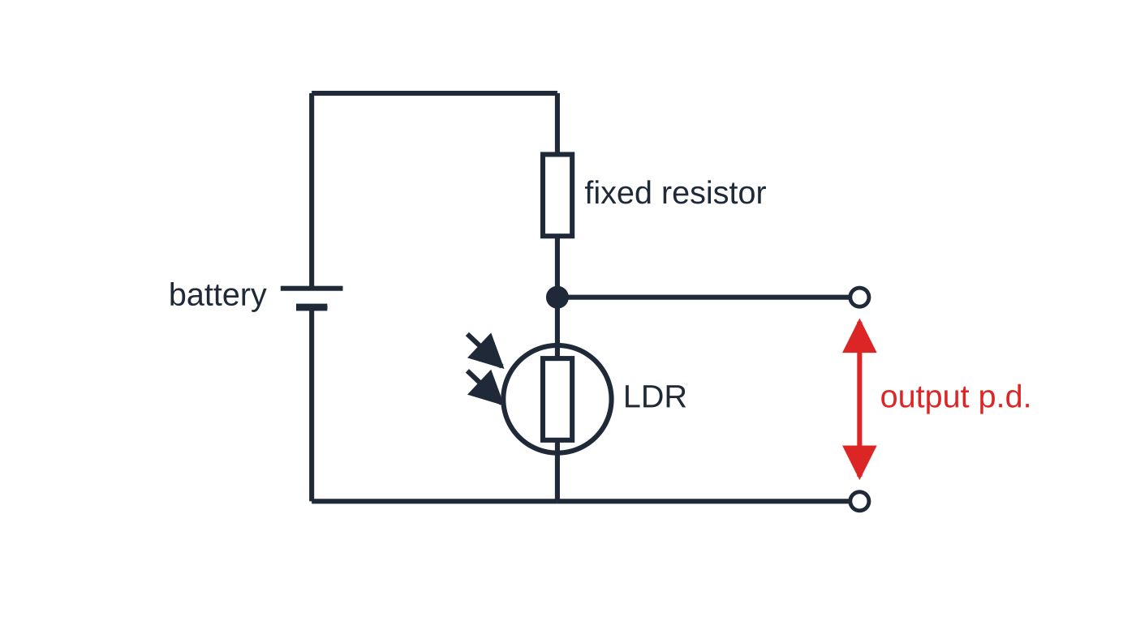
Question 1
1 mark
A fixed resistor and a light-dependent resistor (LDR) are connected in series across a battery. The output p.d. is taken across the LDR.
The light intensity on the LDR increases. Which statement is correct?
Figure: potential divider with the output taken across the LDR
A The output p.d. increases, because the LDR's resistance decreases and more current flows through it.
B The output p.d. stays the same, because the battery p.d. does not change.
C The output p.d. decreases, because the current in the circuit decreases.
D The output p.d. decreases, because the LDR's resistance decreases and it takes a smaller share of the battery p.d.
Notes:
Online with the full mark scheme: https://examinerprep.com/ial-physics-2-8-resistivity-and-the-potential-divider-questions#IALP-U2-8-A-08

Slide 42
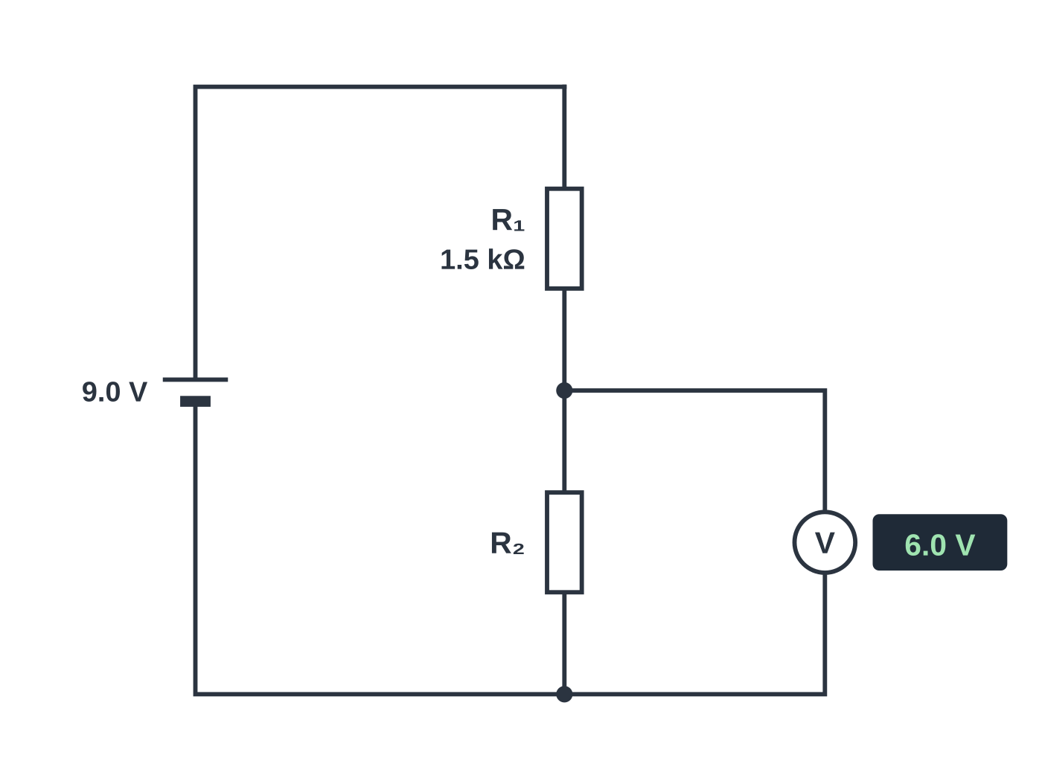
Question 2
1 mark
The figure shows a potential divider connected to a supply of negligible internal resistance. The voltmeter has a very high resistance.
What is the resistance of R₂?
A 0.75 kΩ
B 1.0 kΩ
C 3.0 kΩ
D 4.5 kΩ
Notes:
Online with the full mark scheme: https://examinerprep.com/ial-physics-2-8-resistivity-and-the-potential-divider-questions#IALP-U2-8-FA-07

Slide 43
Question 3
1 mark
Which of the following is the unit of resistivity?
A Ω m⁻²
B Ω m⁻¹
C Ω m
D Ω m²
Notes:
Online with the full mark scheme: https://examinerprep.com/ial-physics-2-8-resistivity-and-the-potential-divider-questions#IALP-U2-8-A-01

Slide 44
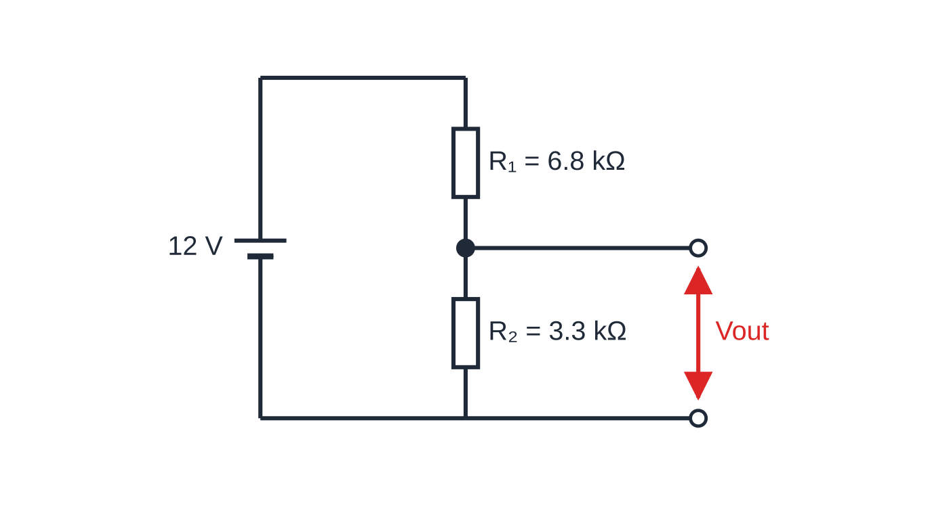
Question 4
4 marks
A potential divider is made from a 6.8 kΩ resistor R₁ and a 3.3 kΩ resistor R₂ connected in series across a 12 V supply of negligible internal resistance. The output p.d. Vₒᵤₜ is taken across R₂.
Figure: the potential divider, with V_out across R₂
(a) Show that Vₒᵤₜ = R₂Vᵢₙ/(R₁ + R₂), where Vᵢₙ is the supply p.d. [2]
(b) Calculate Vₒᵤₜ. [1]
(c) Calculate the p.d. across R₁. [1]
Notes:
Online with the full mark scheme: https://examinerprep.com/ial-physics-2-8-resistivity-and-the-potential-divider-questions#IALP-U2-8-B-07

Slide 45
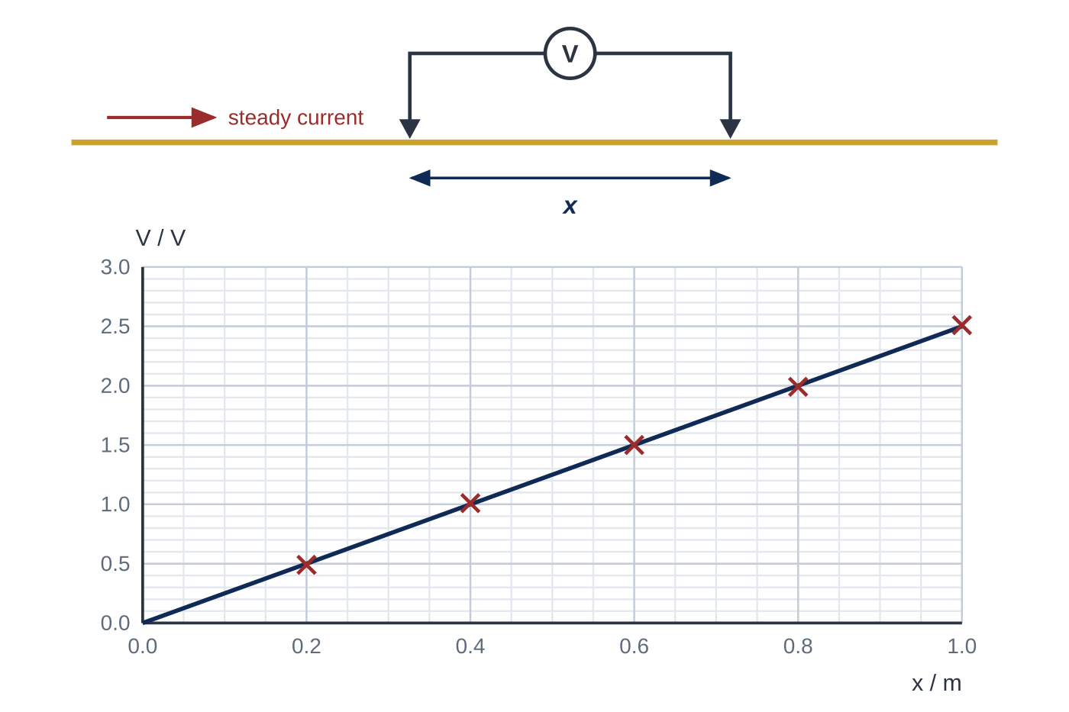
Question 5
5 marks
A steady current of 0.50 A passes along a long, uniform wire of diameter 0.40 mm. A voltmeter is connected between two contacts on the wire, a distance x apart. The graph shows how the voltmeter reading V varies with x.
(a) Determine the potential gradient along the wire. [1]
(b) Calculate the resistance of 1.0 m of the wire. [1]
(c) Calculate the resistivity of the metal of the wire. [2]
(d) Explain why the graph is a straight line through the origin. [1]
Notes:
Online with the full mark scheme: https://examinerprep.com/ial-physics-2-8-resistivity-and-the-potential-divider-questions#IALP-U2-8-FB-06

Slide 46
Answers

Slide 47
Question 1 · answer
Answer D
Brighter light lowers the LDR's resistance. The current is the same in both components, so each p.d. is proportional to its resistance: the LDR's share of the battery p.d. falls and the output decreases.
Notes:
Full mark scheme: https://examinerprep.com/ial-physics-2-8-resistivity-and-the-potential-divider-questions#IALP-U2-8-A-08

Slide 48
Question 2 · answer
Answer C
The p.d. across R₁ is 9.0 − 6.0 = 3.0 V. The same current passes through both resistors, so R₂/R₁ = 6.0/3.0 and R₂ = 2 × 1.5 = 3.0 kΩ.
Notes:
Full mark scheme: https://examinerprep.com/ial-physics-2-8-resistivity-and-the-potential-divider-questions#IALP-U2-8-FA-07

Slide 49
Question 3 · answer
Answer C
Rearranging R = ρl/A gives ρ = RA/l, with unit Ω × m² ÷ m = Ω m.
Notes:
Full mark scheme: https://examinerprep.com/ial-physics-2-8-resistivity-and-the-potential-divider-questions#IALP-U2-8-A-01

Slide 50
Question 4 · answer
Mark scheme
the same current flows through both resistors: I = Vᵢₙ/(R₁ + R₂)
Vₒᵤₜ = IR₂ = R₂Vᵢₙ/(R₁ + R₂)
3.3 ÷ 10.1 × 12 = 3.9 V (3.92 V)
12 − 3.92 = 8.1 V (allow 6.8 ÷ 10.1 × 12)
Notes:
Full mark scheme: https://examinerprep.com/ial-physics-2-8-resistivity-and-the-potential-divider-questions#IALP-U2-8-B-07

Slide 51
Question 5 · answer
Mark scheme
gradient of the line, e.g. 2.0 V ÷ 0.80 m = 2.5 V m⁻¹ (allow 2.4–2.6)
R = V/I = 2.5 ÷ 0.50 = 5.0 Ω (allow error carried forward)
A = π(0.20 × 10⁻³)² = 1.26 × 10⁻⁷ m²
ρ = RA/l = 5.0 × 1.26 × 10⁻⁷ ÷ 1.0 = 6.3 × 10⁻⁷ Ω m (allow error carried forward)
the wire is uniform and carries the same current everywhere, so every metre has the same resistance and the same p.d.: V ∝ x, with V = 0 when x = 0
Notes:
Full mark scheme: https://examinerprep.com/ial-physics-2-8-resistivity-and-the-potential-divider-questions#IALP-U2-8-FB-06

Slide 52
Keep practising
Notes for this topic
Questions on this topic
Build a printable test
ExaminerPrep is an independent tutoring service. It has been developed independently from and is not endorsed by the International Baccalaureate Organization. "International Baccalaureate", "IB" and "IB Diploma Programme" are registered trademarks of the IBO, used here for descriptive purposes only.
Pearson Edexcel and Cambridge are trademarks of their owners; ExaminerPrep is not affiliated with any exam board.

