Slide 1
EP
EDEXCEL IAL PHYSICS
2.7 Series and parallel circuits and I–V characteristics
The full notes page in 12 sections · practice questions with answers · simulations
ExaminerPrep is an independent tutoring service. It has been developed independently from and is not endorsed by the International Baccalaureate Organization. "International Baccalaureate", "IB" and "IB Diploma Programme" are registered trademarks of the IBO, used here for descriptive purposes only.
Pearson Edexcel and Cambridge are trademarks of their owners; ExaminerPrep is not affiliated with any exam board.
Notes:
2.7 Series and parallel circuits and I–V characteristics. Notes for this topic: https://examinerprep.com/notes/edexcel-ial-physics/series-and-parallel-circuits-and-i-v-characteristics/

Slide 2
What this page covers
Overview
Why the current into a junction equals the current out of it (conservation of charge, Kirchhoff's first law)
Why the p.d.s around a closed loop add up to the source p.d. (conservation of energy, Kirchhoff's second law)
Deriving and using R = R₁ + R₂ + R₃ and 1/R = 1/R₁ + 1/R₂ + 1/R₃
A reliable method for currents, p.d.s and resistances in combined series–parallel networks
Sketching, recognising and interpreting the I–V graphs of an ohmic conductor, a filament lamp, an NTC thermistor and a semiconductor diode
Finding resistance from an I–V graph correctly, and solving a circuit containing a non-ohmic component
The circuit and method for measuring an I–V characteristic
Notes:
What this page covers. Full notes: https://examinerprep.com/notes/edexcel-ial-physics/series-and-parallel-circuits-and-i-v-characteristics/

Slide 3
In one minute
Key points
1. Two conservation laws do almost all the work in circuit questions: charge is conserved, so current divides at junctions without being used up, and energy is conserved, so the p.d.s around any loop add up to what the source provides.
2. In a series loop the current is the same everywhere; parallel branches all have the same p.d.
3. Series: R = R₁ + R₂ + R₃, larger than any single resistor. Parallel: 1/R = 1/R₁ + 1/R₂ + 1/R₃, smaller than the smallest resistor.
4. I–V graphs: ohmic conductor, a straight line through the origin; filament lamp, gradient falls as it heats; NTC thermistor, gradient rises as it heats; diode, almost no current in reverse or below about 0.6 V, then a steep rise.
5. Resistance at any point is V/I using that point's coordinates, not the gradient.
Notes:
In one minute. Full notes: https://examinerprep.com/notes/edexcel-ial-physics/series-and-parallel-circuits-and-i-v-characteristics/

Slide 4
How is current shared at a junction?
Section 1 of 12
A junction is any point where three or more wires meet. Know the rule and the reason for it: "explain" questions ask for the reason.
Kirchhoff's first law: the sum of the currents into a junction equals the sum of the currents out of it. It is a consequence of conservation of charge.
Current is the rate of flow of charge, I = ΔQ/Δt. Charge cannot be created or destroyed, and in a steady circuit it does not pile up at a junction. So in every second, the charge arriving at a junction must equal the charge leaving it, and dividing both by the time gives exactly the statement about currents. In a series loop, with no junctions, the current is therefore the same at every point. A component transfers energy from the charge; it does not use up charge, so it does not use up current.
Notes:
How is current shared at a junction?. Full notes: https://examinerprep.com/notes/edexcel-ial-physics/series-and-parallel-circuits-and-i-v-characteristics/

Slide 5
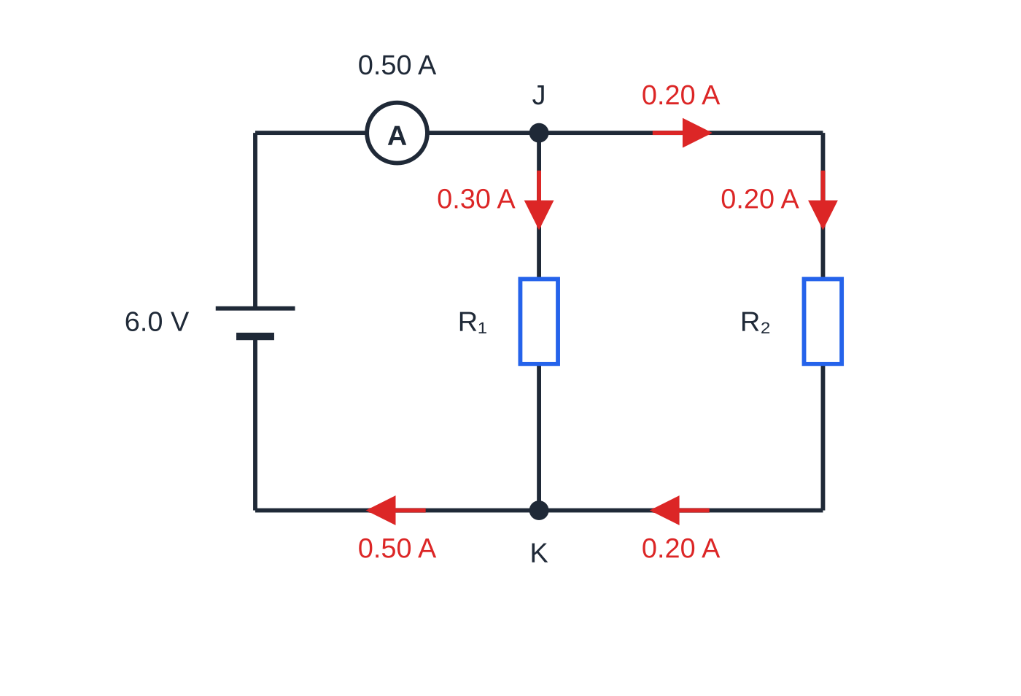
How is current shared at a junction? (continued)
Section 1 of 12
The smaller current flows through the branch with the larger resistance: both branches have the same p.d., so I = V/R gives more current to the smaller resistance.
At junction J the 0.50 A from the cell splits into 0.30 A through R₁ and 0.20 A towards R₂. At K the branch currents recombine to give 0.50 A again: nothing is lost, it is only shared.
Notes:
How is current shared at a junction?. Full notes: https://examinerprep.com/notes/edexcel-ial-physics/series-and-parallel-circuits-and-i-v-characteristics/

Slide 6
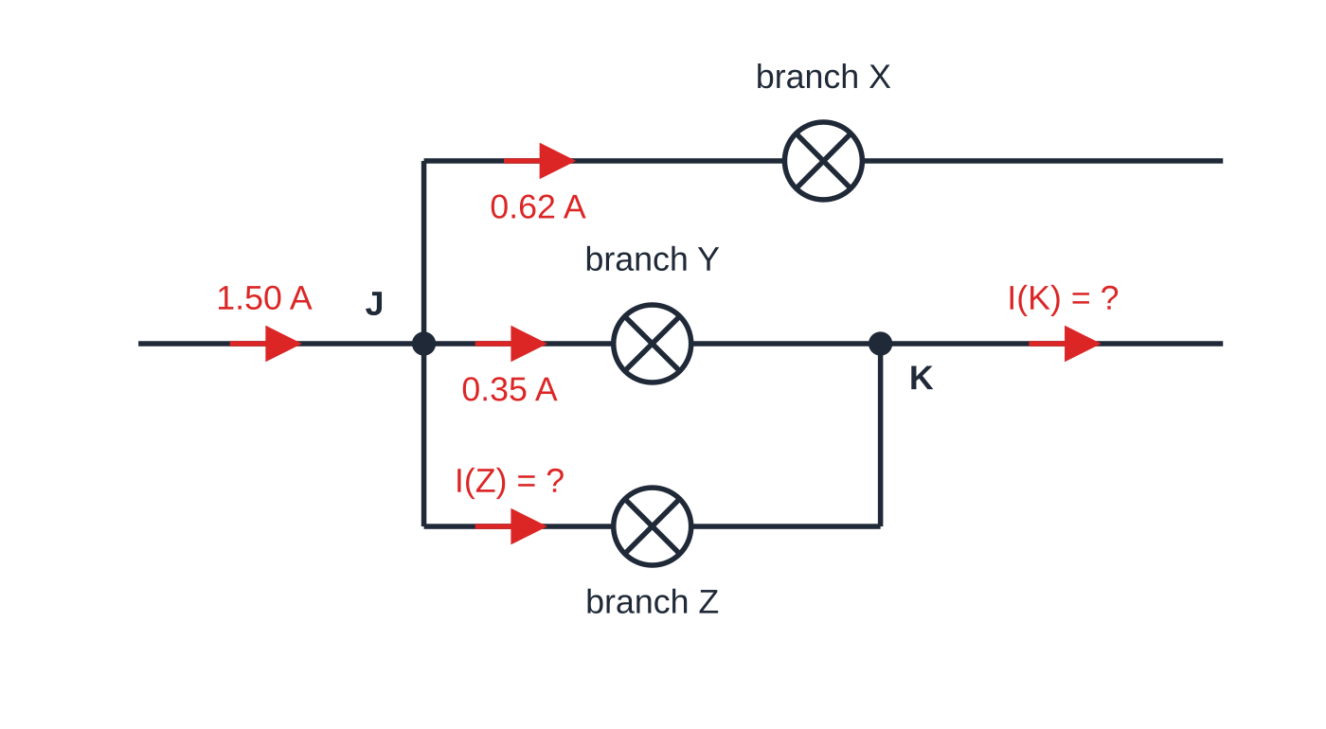
How is current shared at a junction? (continued)
Section 1 of 12 · Worked example 1 · Easy · Calculate
WORKED EXAMPLE · QUESTION
A current of 1.50 A enters junction J on a shop's lighting track. From J, branch X carries 0.62 A and branch Y carries 0.35 A; branch Z carries the rest. Further along, branches Y and Z rejoin at junction K. Calculate (a) the current in branch Z, (b) the current leaving K, and (c) the charge that flows through branch Z in 2.0 minutes.
SOLUTION
(a) Current in = current out at J: 1.50 = 0.62 + 0.35 + I_Z, so I_Z = 0.53 A.
(b) Current in = current out at K:
Label each junction and draw an arrow on every current before you calculate; the unknowns then become simple equations.
Notes:
How is current shared at a junction?: Worked example 1. Full notes: https://examinerprep.com/notes/edexcel-ial-physics/series-and-parallel-circuits-and-i-v-characteristics/

Slide 7
How is current shared at a junction? (continued)
Section 1 of 12 · Worked example 1 · Easy · Calculate (continued)
I_K = 0.35 + 0.53, so I_K = 0.88 A.
(c) Q = It with the time in seconds: Q = 0.53 ×120 = 63.6 C, so Q ≈64 C.
Check: X carries 0.62 A and 0.62 + 0.88 = 1.50 A, so all the current that left J is accounted for.
Notes:
How is current shared at a junction?: Worked example 1. Full notes: https://examinerprep.com/notes/edexcel-ial-physics/series-and-parallel-circuits-and-i-v-characteristics/

Slide 8
How is current shared at a junction? (continued)
Section 1 of 12
Common error
Saying the current is "used up" by a lamp or resistor, so it is smaller after the component. In a series loop the current is the same on both sides of every component. What decreases across a component is the potential, because the charge has transferred energy.
Notes:
How is current shared at a junction?. Full notes: https://examinerprep.com/notes/edexcel-ial-physics/series-and-parallel-circuits-and-i-v-characteristics/

Slide 9
How is potential difference shared around a circuit?
Section 2 of 12
Kirchhoff's second law: around any closed loop, the sum of the e.m.f.s equals the sum of the p.d.s. It is a consequence of conservation of energy.
P.d. is energy transferred per unit charge, V = W/Q. A coulomb gains energy in the source, transfers it in the components, and returns to its start with the energy it began with. Energy is conserved, so the energy transferred in the components must equal the energy supplied, and dividing by the charge turns energies into p.d.s. (With negligible internal resistance, e.m.f. = terminal p.d.; see page 2.9.)
Series: the p.d.s across the components add up to the supply p.d. Because the current is the same in each component, V = IR means the p.d. across each resistor is proportional to its resistance.
Parallel: every branch connects the same two points, so every branch has the same p.d. A coulomb passes through only one branch and transfers the same energy whichever branch it takes.
Notes:
How is potential difference shared around a circuit?. Full notes: https://examinerprep.com/notes/edexcel-ial-physics/series-and-parallel-circuits-and-i-v-characteristics/

Slide 10
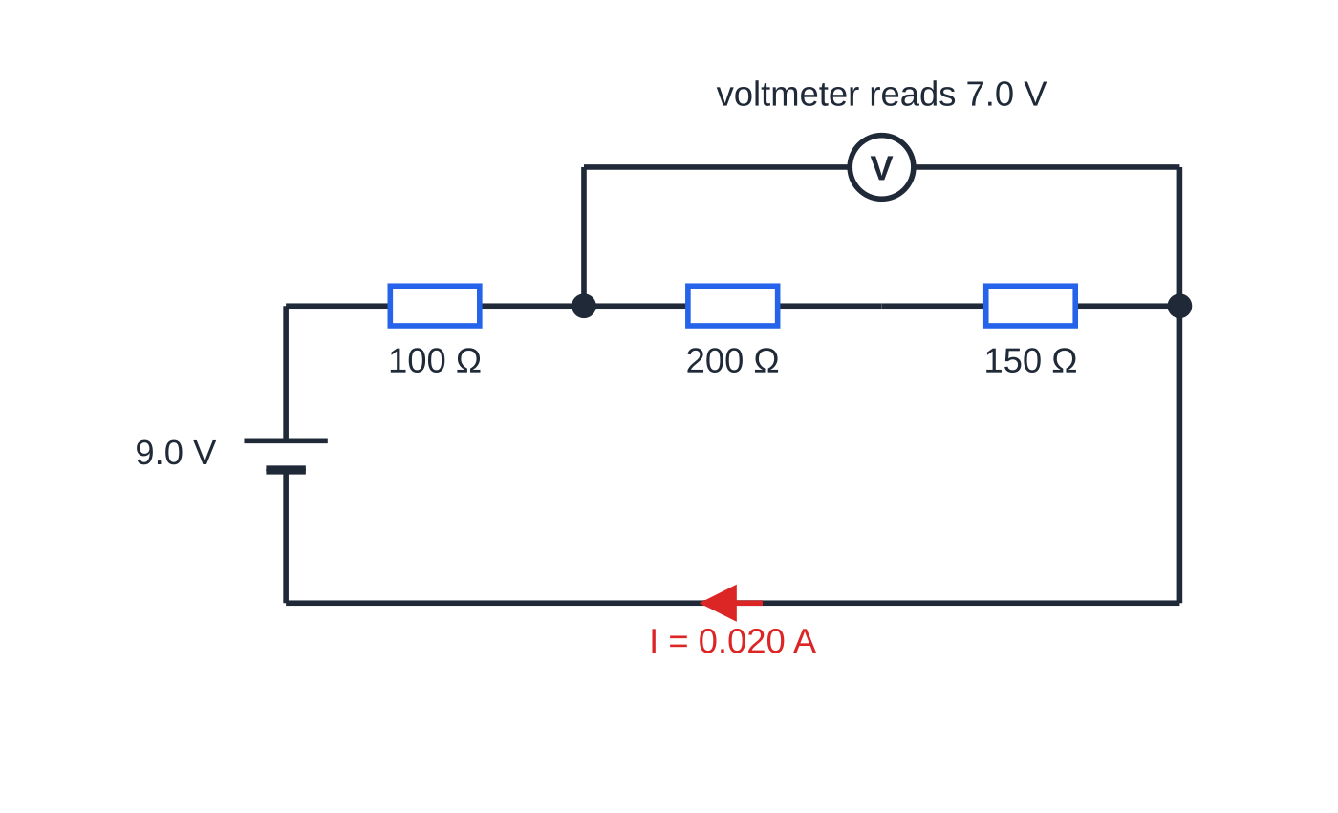
How is potential difference shared around a circuit? (continued)
Section 2 of 12
A graph of potential against position round the circuit makes the energy picture visible. Connecting wires have negligible resistance, so the potential along a wire is constant. Each resistor causes a drop, and the drops together use up the whole of the source p.d.
The series chain of worked example 2. One current flows through all three resistors; the voltmeter is connected across the 200 Ω and 150 Ω resistors together.
Notes:
How is potential difference shared around a circuit?. Full notes: https://examinerprep.com/notes/edexcel-ial-physics/series-and-parallel-circuits-and-i-v-characteristics/

Slide 11
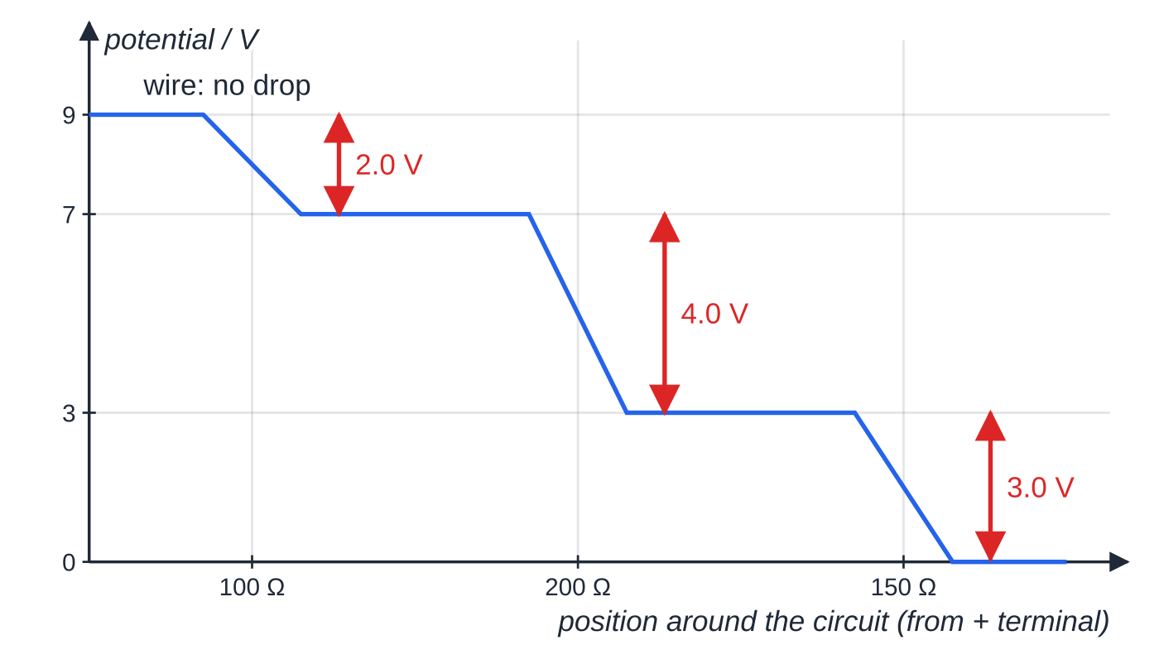
How is potential difference shared around a circuit? (continued)
Section 2 of 12
Potential around the series circuit, starting at the positive terminal. Flat sections are wires; each resistor takes a share of the 9.0 V in proportion to its resistance, and the three drops add up to 9.0 V.
Notes:
How is potential difference shared around a circuit?. Full notes: https://examinerprep.com/notes/edexcel-ial-physics/series-and-parallel-circuits-and-i-v-characteristics/

Slide 12
How is potential difference shared around a circuit? (continued)
Section 2 of 12 · Worked example 2 · Easy · Calculate
WORKED EXAMPLE · QUESTION
A 9.0 V battery of negligible internal resistance is connected in series with resistors of 100 Ω, 200 Ω and 150 Ω. Calculate (a) the current, (b) the p.d. across each resistor, and (c) the reading of an ideal voltmeter connected across the 200 Ω and 150 Ω resistors together.
SOLUTION
(a) Series total: R = 100 + 200 + 150 = 450 Ω. Then I = V/R = 9.0/450, so I = 0.020 A (20 mA).
(b) V = IR with the same current in each: 0.020 ×100 = 2.0 V, 0.020 ×200 = 4.0 V, 0.020 ×150 = 3.0 V, so 2.0 V, 4.0 V and 3.0 V.
Energy check: 2.0 + 4.0 + 3.0 = 9.0 V, the supply p.d.
(c) The voltmeter spans two resistors, so add their p.d.s: 4.0 + 3.0, giving 7.0 V.
Notes:
How is potential difference shared around a circuit?: Worked example 2. Full notes: https://examinerprep.com/notes/edexcel-ial-physics/series-and-parallel-circuits-and-i-v-characteristics/

Slide 13
How is potential difference shared around a circuit? (continued)
Section 2 of 12
Exam tip
In a series circuit you can share the supply p.d. in the ratio of the resistances without finding the current: the 200 Ω resistor has (200/450) of 9.0 V, which is 4.0 V. Use the current method when the question asks for the current anyway.
Notes:
How is potential difference shared around a circuit?. Full notes: https://examinerprep.com/notes/edexcel-ial-physics/series-and-parallel-circuits-and-i-v-characteristics/

Slide 14
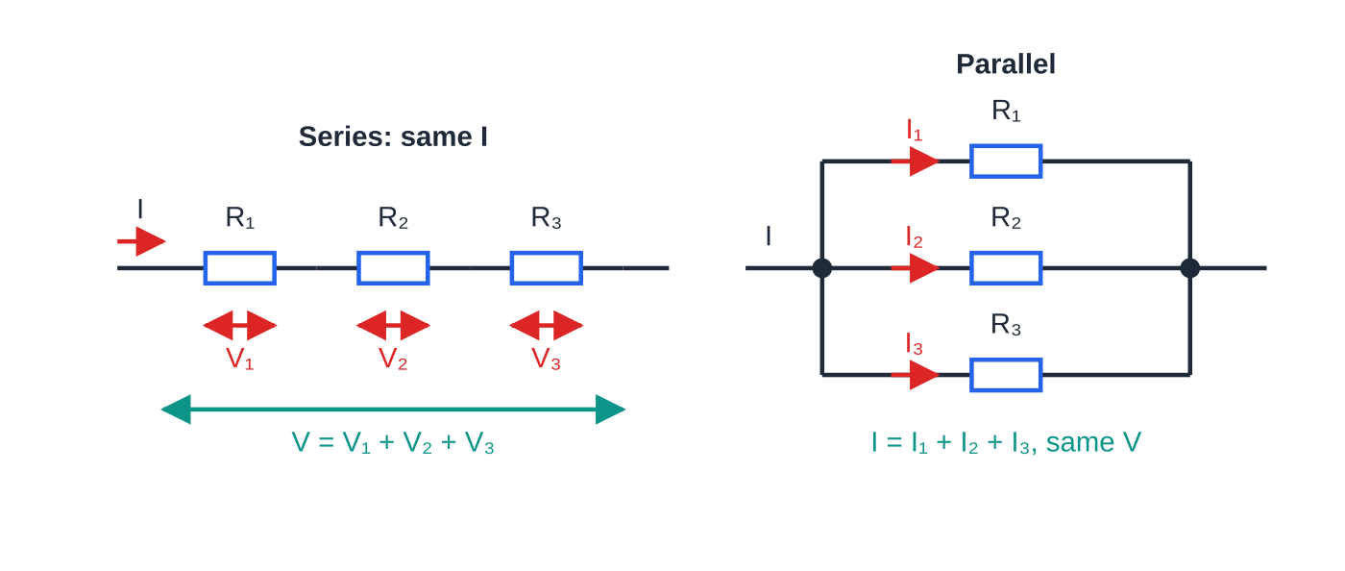
How do you derive the equations for resistors in series and in parallel?
Section 3 of 12
Both results come from combining the two conservation laws with V = IR. Learn the derivations as three short steps each; the final equations are in the formulae list, the derivations are not.
Resistors in series
1. The same current I passes through each resistor (conservation of charge).
2. The p.d.s add: V = V₁ + V₂ + V₃ (conservation of energy).
3. Write each p.d. as IR: IR = IR₁ + IR₂ + IR₃, then divide by I.
Series: one current, p.d.s add. Parallel: one p.d., currents add. Every resistor equation on this page comes from these two pictures.
Notes:
How do you derive the equations for resistors in series and in parallel?. Full notes: https://examinerprep.com/notes/edexcel-ial-physics/series-and-parallel-circuits-and-i-v-characteristics/

Slide 15
How do you derive the equations for resistors in series and in parallel? (continued)
Section 3 of 12
R = R₁ + R₂ + R₃
The total is always larger than the largest single resistor: every coulomb has to pass through all of them.
Resistors in parallel
1. The same p.d. V is across each resistor (conservation of energy: each branch joins the same two points).
2. The currents add: I = I₁ + I₂ + I₃ (conservation of charge at the junction).
3. Write each current as V/R: V/R = V/R₁ + V/R₂ + V/R₃, then divide by V.
1/R = 1/R₁ + 1/R₂ + 1/R₃
The total is always smaller than the smallest single resistor.
Notes:
How do you derive the equations for resistors in series and in parallel?. Full notes: https://examinerprep.com/notes/edexcel-ial-physics/series-and-parallel-circuits-and-i-v-characteristics/

Slide 16
How do you derive the equations for resistors in series and in parallel? (continued)
Section 3 of 12
Each extra branch is an extra path for charge, so for the same p.d. more current flows, and R = V/I falls.
Useful shortcut | Result | Note
Two resistors in parallel | R = R₁R₂/(R₁ + R₂) ("product over sum") | Not in the formulae list: derive it from the parallel equation. Works for two resistors only.
n identical resistors R₀ in series | nR₀ | From the series equation
n identical resistors R₀ in parallel | R₀/n | From the parallel equation
Branch currents in parallel | smaller R carries larger I | Same p.d. across every branch
Notes:
How do you derive the equations for resistors in series and in parallel?. Full notes: https://examinerprep.com/notes/edexcel-ial-physics/series-and-parallel-circuits-and-i-v-characteristics/

Slide 17
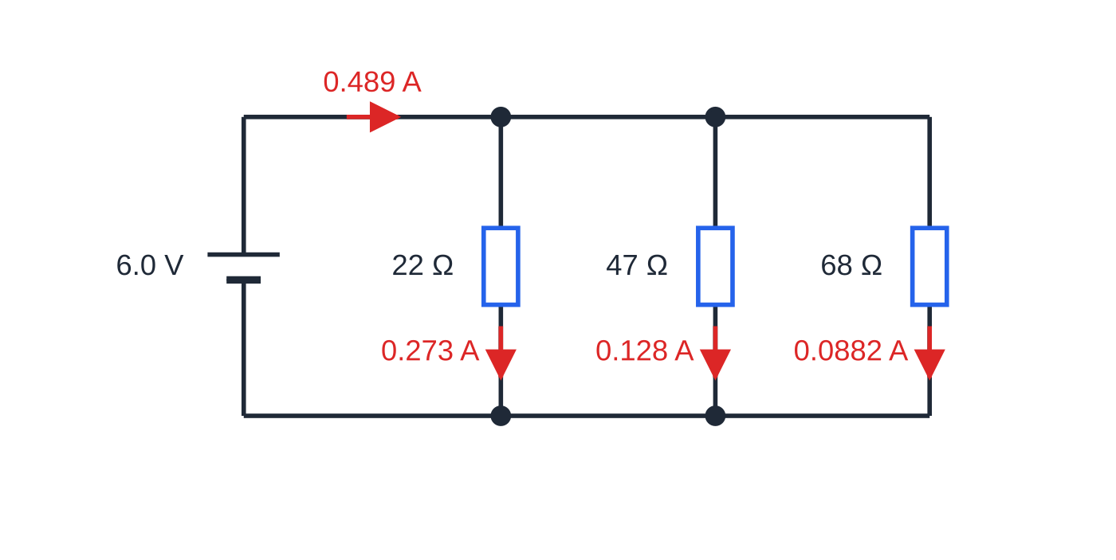
How do you derive the equations for resistors in series and in parallel? (continued)
Section 3 of 12 · Worked example 3 · Medium · Calculate
WORKED EXAMPLE · QUESTION
Resistors of 22 Ω, 47 Ω and 68 Ω are connected in parallel across a 6.0 V supply of negligible internal resistance. Calculate (a) the combined resistance and (b) the current in each resistor and the supply current.
SOLUTION
(a) Add the reciprocals, then invert: 1/R = (1/22) + (1/47) + (1/68) = 0.0814 Ω⁻¹, so R = 12 Ω (12.3 Ω).
(b) 6.0/22 = 0.273 A, 6.0/47 = 0.128 A, 6.0/68 = 0.0882 A. The supply current is the sum of the branch currents: I = 0.489 A.
Every branch has the full 6.0 V across it, so each branch current is simply 6.0 V divided by that branch's resistance.
Notes:
How do you derive the equations for resistors in series and in parallel?: Worked example 3. Full notes: https://examinerprep.com/notes/edexcel-ial-physics/series-and-parallel-circuits-and-i-v-characteristics/

Slide 18
How do you derive the equations for resistors in series and in parallel? (continued)
Section 3 of 12 · Worked example 3 · Medium · Calculate (continued)
Check: 6.0 / 12.28 = 0.489 A. And 12 Ω is less than the smallest resistor, 22 Ω, a quick sense check on any parallel answer.
Notes:
How do you derive the equations for resistors in series and in parallel?: Worked example 3. Full notes: https://examinerprep.com/notes/edexcel-ial-physics/series-and-parallel-circuits-and-i-v-characteristics/

Slide 19
How do you derive the equations for resistors in series and in parallel? (continued)
Section 3 of 12
Common error
Stopping after adding the reciprocals. 1/22 + 1/47 + 1/68 = 0.0814 is 1/R, in Ω⁻¹. Giving "0.081 Ω" as the resistance is wrong by a factor of more than 100, so always invert as the last step.
Notes:
How do you derive the equations for resistors in series and in parallel?. Full notes: https://examinerprep.com/notes/edexcel-ial-physics/series-and-parallel-circuits-and-i-v-characteristics/

Slide 20
How do you analyse a combined series–parallel network?
Section 4 of 12
Simplify inwards to a single resistance, find the supply current, then work back outwards. Use the same four steps every time:
1. Replace each parallel group with its single equivalent resistance.
2. Add the series resistances to get the total; find the supply current, I = V/Rₜₒₜₐₗ.
3. Work back out: the p.d. across each series part is I times its resistance, and these p.d.s add up to the supply p.d.
4. Each branch of a parallel group has the group's p.d.; branch current = that p.d. ÷ branch resistance. The branch currents add up to the current into the group.
Changing any one resistor changes every current and p.d. in the network, because the total resistance, and therefore the supply current, changes.
Notes:
How do you analyse a combined series–parallel network?. Full notes: https://examinerprep.com/notes/edexcel-ial-physics/series-and-parallel-circuits-and-i-v-characteristics/

Slide 21
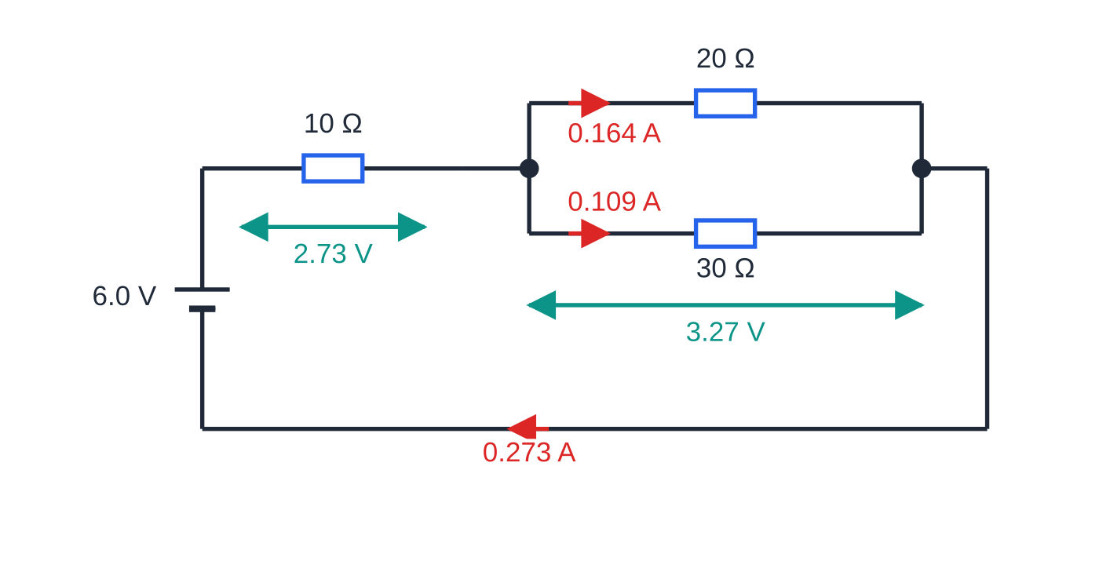
How do you analyse a combined series–parallel network? (continued)
Section 4 of 12
The network of worked example 4. The parallel pair is equivalent to 12 Ω, so the total is 22 Ω. The 2.73 V across the 10 Ω resistor and the 3.27 V across the pair add up to 6.0 V, and 0.164 A + 0.109 A = 0.273 A.
Notes:
How do you analyse a combined series–parallel network?. Full notes: https://examinerprep.com/notes/edexcel-ial-physics/series-and-parallel-circuits-and-i-v-characteristics/

Slide 22
How do you analyse a combined series–parallel network? (continued)
Section 4 of 12 · Worked example 4 · Medium · Calculate
WORKED EXAMPLE · QUESTION
A 6.0 V supply of negligible internal resistance is connected to a 10 Ω resistor in series with a parallel pair of resistors, 20 Ω and 30 Ω. Calculate (a) the total resistance, (b) the supply current, (c) the p.d. across the parallel pair and (d) the current in the 30 Ω resistor.
SOLUTION
(a) Parallel pair first: 1/Rₚ = (1/20) + (1/30) = (5/60), so Rₚ = 12 Ω. Then R = 10 + 12 = 22 Ω.
(b) I = 6.0/22 = 0.273 A.
(c) P.d. across the series resistor: V₁₀ = 0.2727 ×10 = 2.73 V. The rest of the 6.0 V is across the pair: Vₚ = 6.0 - 2.73 = 3.27 V.
(d) I₃₀ = 3.273/30 = 0.109 A.
Check: I₂₀ = 3.273/20 = 0.164 A, and 0.164 + 0.109 = 0.273 A.
Notes:
How do you analyse a combined series–parallel network?: Worked example 4. Full notes: https://examinerprep.com/notes/edexcel-ial-physics/series-and-parallel-circuits-and-i-v-characteristics/

Slide 23
How do you analyse a combined series–parallel network? (continued)
Section 4 of 12
A follow-up thought shows how the whole network responds. If the 30 Ω resistor were removed, the total would rise to 10 + 20 = 30 Ω, the supply current would fall to 6.0/30 = 0.20 A, and the p.d. across the 20 Ω resistor would rise to 0.20 ×20 = 4.0 V. Less p.d. is "lost" across the 10 Ω resistor because less current flows through it.
Exam tip
Carry at least one more significant figure than the answer needs through a multi-step network calculation (here 0.2727 A, not 0.27 A). Rounding early can move the final answer in its last figure.
Notes:
How do you analyse a combined series–parallel network?. Full notes: https://examinerprep.com/notes/edexcel-ial-physics/series-and-parallel-circuits-and-i-v-characteristics/

Slide 24
What do the I–V graphs of common components look like?
Section 5 of 12
An I–V characteristic is a graph of the current I through a component against the p.d. V across it. It includes negative values, obtained by reversing the connections, because some components behave differently in the two directions. A component is ohmic if I ∝V: its graph is a straight line through the origin. For a metal this needs constant temperature (Ohm's law, page 2.6).
On I–V axes a steeper line from the origin means a smaller resistance. Why the lamp and thermistor change resistance with temperature is explained on page 2.10.
Notes:
What do the I–V graphs of common components look like?. Full notes: https://examinerprep.com/notes/edexcel-ial-physics/series-and-parallel-circuits-and-i-v-characteristics/

Slide 25
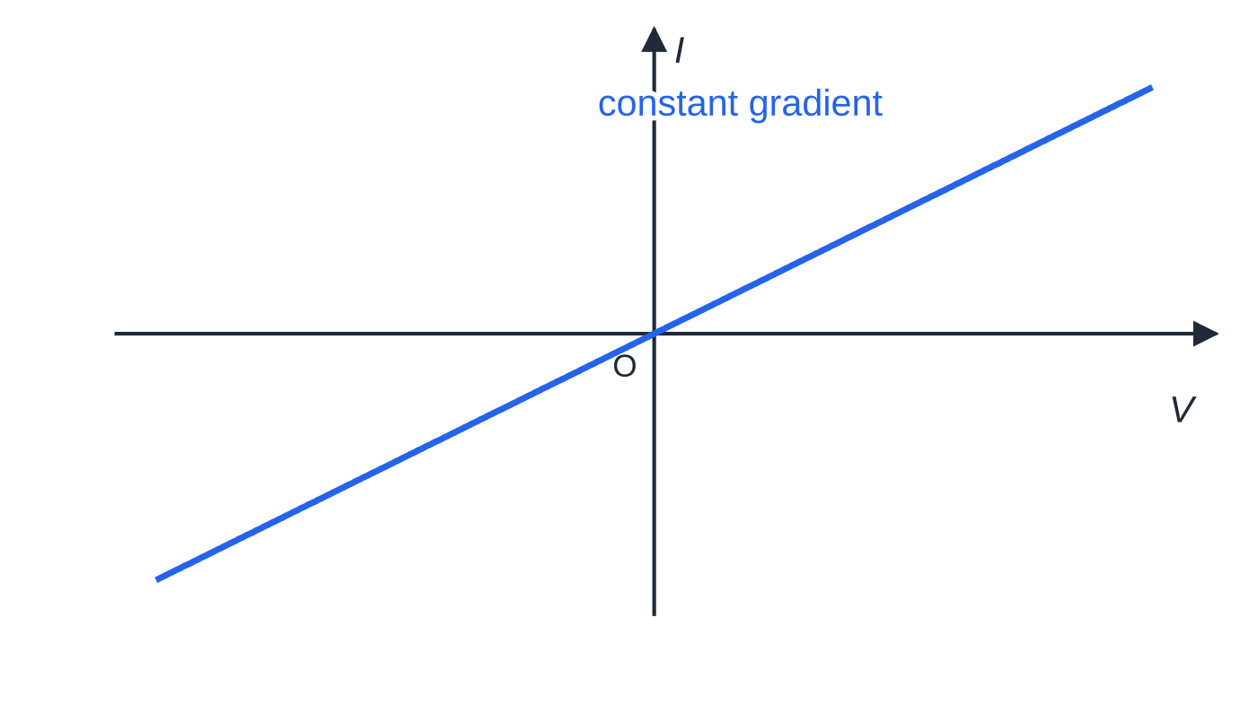
What do the I–V graphs of common components look like? (continued)
Section 5 of 12
Ohmic conductor (a resistor, or a metal wire at constant temperature): a straight line through the origin, the same in both directions. The resistance is constant.
Notes:
What do the I–V graphs of common components look like?. Full notes: https://examinerprep.com/notes/edexcel-ial-physics/series-and-parallel-circuits-and-i-v-characteristics/

Slide 26
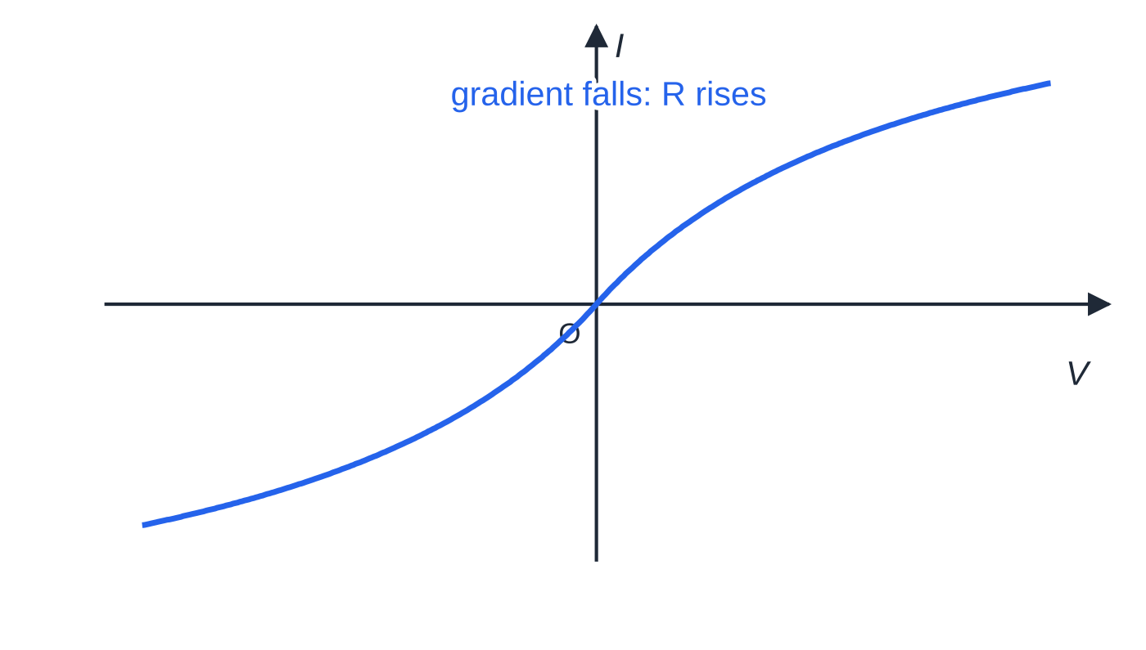
What do the I–V graphs of common components look like? (continued)
Section 5 of 12
Filament lamp: a curve through the origin whose gradient decreases as |V| increases, symmetrical about the origin. A larger current heats the metal filament, and the resistance of a metal rises with temperature.
Notes:
What do the I–V graphs of common components look like?. Full notes: https://examinerprep.com/notes/edexcel-ial-physics/series-and-parallel-circuits-and-i-v-characteristics/

Slide 27
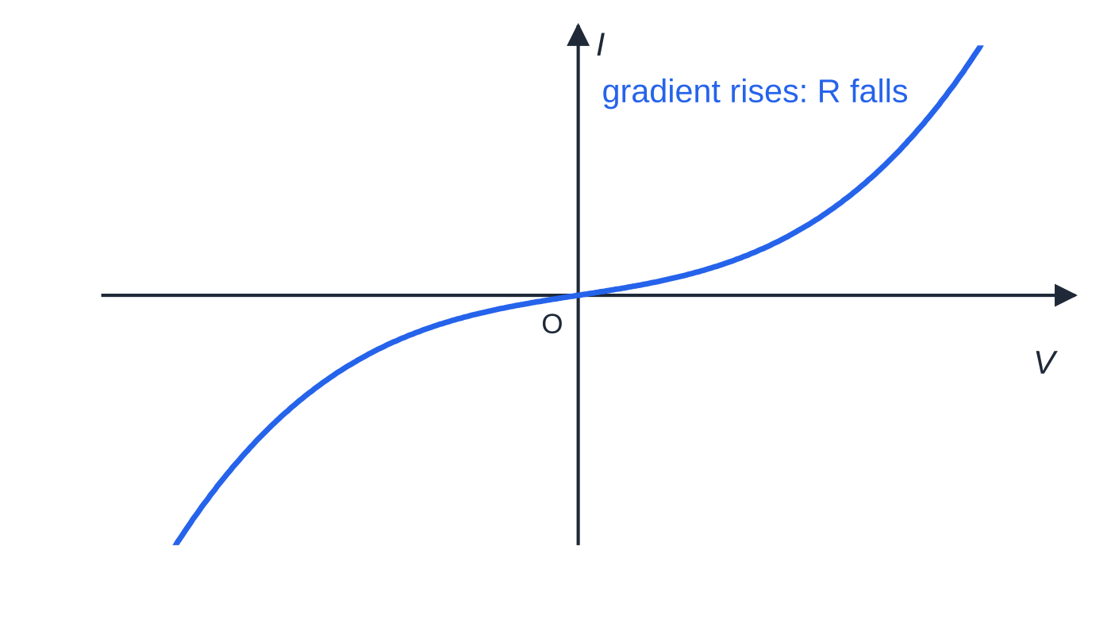
What do the I–V graphs of common components look like? (continued)
Section 5 of 12
NTC thermistor: a curve whose gradient increases as |V| increases, also symmetrical. The current heats the thermistor and its resistance falls.
Notes:
What do the I–V graphs of common components look like?. Full notes: https://examinerprep.com/notes/edexcel-ial-physics/series-and-parallel-circuits-and-i-v-characteristics/

Slide 28
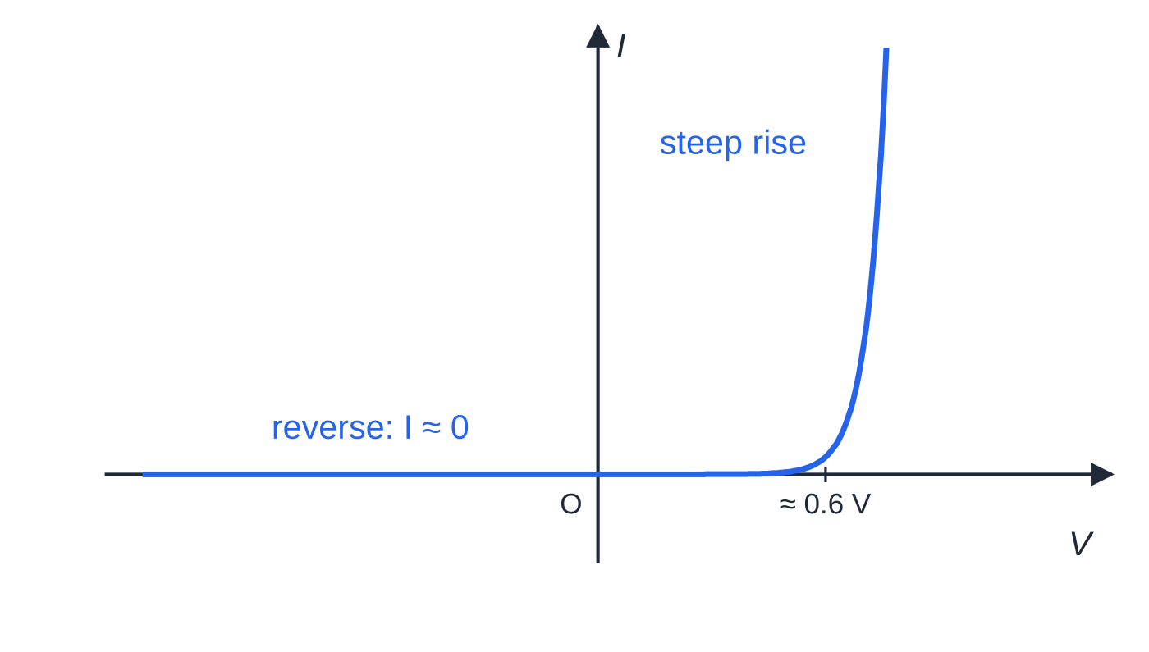
What do the I–V graphs of common components look like? (continued)
Section 5 of 12
Semiconductor diode: almost zero current in reverse; in the forward direction almost zero until about 0.6 V, then a steep rise. It conducts in one direction only.
Notes:
What do the I–V graphs of common components look like?. Full notes: https://examinerprep.com/notes/edexcel-ial-physics/series-and-parallel-circuits-and-i-v-characteristics/

Slide 29
What do the I–V graphs of common components look like? (continued)
Section 5 of 12
Component | Shape of the I–V graph | What it tells you
Ohmic conductor (resistor, metal wire at constant temperature) | Straight line through the origin, same in both directions | Constant resistance; R = V/I
Filament lamp | Curve through the origin, gradient decreasing as |V| increases; symmetrical | Resistance increases as the current heats the filament
NTC thermistor | Curve through the origin, gradient increasing as |V| increases; symmetrical | Resistance decreases as the current heats the thermistor
Semiconductor diode | Almost zero current in reverse; forward current almost zero until about 0.6 V, then a steep rise | Very high resistance in reverse, low resistance once it conducts
Notes:
What do the I–V graphs of common components look like?. Full notes: https://examinerprep.com/notes/edexcel-ial-physics/series-and-parallel-circuits-and-i-v-characteristics/

Slide 30
What do the I–V graphs of common components look like? (continued)
Section 5 of 12
Exam tip
When you sketch a characteristic, label the axes I and V, draw through the origin, and show both quadrants unless told otherwise. Make the lamp curve level off, the thermistor curve steepen, and the diode current stay on the axis until a small positive p.d.
Notes:
What do the I–V graphs of common components look like?. Full notes: https://examinerprep.com/notes/edexcel-ial-physics/series-and-parallel-circuits-and-i-v-characteristics/

Slide 31
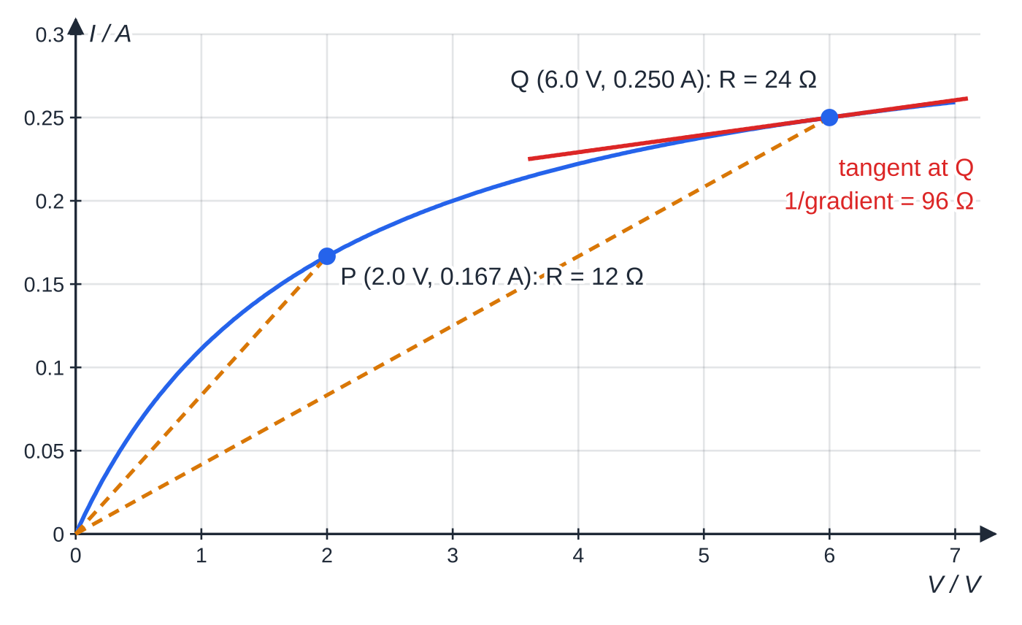
How do you read resistance from an I–V graph and solve non-ohmic circuits?
Section 6 of 12
Resistance is defined as R = V/I at a point. It does not mean the gradient, and it does not mean ΔV/ΔI between two points. The two methods agree only for a straight line through the origin.
A lamp rated 6.0 V. The dashed lines from the origin have gradients I/V = 1/R: 12 Ω at P and 24 Ω at Q. The tangent at Q is much flatter, and 1/(its gradient) = 96 Ω is not the resistance.
Notes:
How do you read resistance from an I–V graph and solve non-ohmic circuits?. Full notes: https://examinerprep.com/notes/edexcel-ial-physics/series-and-parallel-circuits-and-i-v-characteristics/

Slide 32
How do you read resistance from an I–V graph and solve non-ohmic circuits? (continued)
Section 6 of 12 · Worked example 5 · Medium · Determine, Explain
WORKED EXAMPLE · QUESTION
The graph above is the I–V characteristic of a lamp rated 6.0 V. (a) Determine the resistance of the lamp at 2.0 V and at 6.0 V. (b) A student calculates ΔV/ΔI between P and Q and calls it the resistance. Explain why this is wrong.
SOLUTION
(a) From the graph: at 2.0 V, I = 0.167 A; at 6.0 V, I = 0.250 A. Then R = V/I: 2.0/0.167 = 12 Ω and 6.0/0.250 = 24 Ω, so 12 Ω at 2.0 V and 24 Ω at 6.0 V.
(b) The student's value is ΔV/ΔI = 4.0/0.083 = 48 Ω. Resistance is defined as V/I at a point, not as the change in V over the change in I. The two agree only for a straight line through the origin; for the curved lamp graph, 48 Ω matches neither point.
Notes:
How do you read resistance from an I–V graph and solve non-ohmic circuits?: Worked example 5. Full notes: https://examinerprep.com/notes/edexcel-ial-physics/series-and-parallel-circuits-and-i-v-characteristics/

Slide 33
How do you read resistance from an I–V graph and solve non-ohmic circuits? (continued)
Section 6 of 12
With a lamp in a circuit you cannot share the p.d. in a ratio, because the lamp's resistance depends on the current through it. Write down both conditions and use the graph.
Notes:
How do you read resistance from an I–V graph and solve non-ohmic circuits?. Full notes: https://examinerprep.com/notes/edexcel-ial-physics/series-and-parallel-circuits-and-i-v-characteristics/

Slide 34
How do you read resistance from an I–V graph and solve non-ohmic circuits? (continued)
Section 6 of 12 · Worked example 6 · Hard · Determine
WORKED EXAMPLE · QUESTION
The same lamp is connected in series with a 16 Ω resistor across an 8.0 V supply of negligible internal resistance. Use the graph to determine the current and the p.d. across the lamp.
SOLUTION
Step 1. Series: the same current I passes through the lamp and the resistor. Energy: Vₗₐₘₚ + 16I = 8.0 V.
Step 2. The lamp is non-ohmic, so try currents and read Vₗₐₘₚ from the graph:
I / A | Vₗₐₘₚ from graph / V | 16I / V | total / V
0.20 | 3.00 | 3.20 | 6.20
0.22 | 3.88 | 3.52 | 7.40
0.23 | 4.45 | 3.68 | 8.13
Step 3. The total reaches 8.0 V between 0.22 A and 0.23 A, close to 0.23 A.
Notes:
How do you read resistance from an I–V graph and solve non-ohmic circuits?: Worked example 6. Full notes: https://examinerprep.com/notes/edexcel-ial-physics/series-and-parallel-circuits-and-i-v-characteristics/

Slide 35
How do you read resistance from an I–V graph and solve non-ohmic circuits? (continued)
Section 6 of 12 · Worked example 6 · Hard · Determine (continued)
So I ≈0.23 A (0.228 A) and Vₗₐₘₚ = 8.0 - 16 ×0.228, giving Vₗₐₘₚ ≈4.3 V (4.347 V).
The lamp's resistance settles at about 4.35/0.228 = 19 Ω. You could not have shared the 8.0 V in a ratio first, because that 19 Ω is only known at the end.
Notes:
How do you read resistance from an I–V graph and solve non-ohmic circuits?: Worked example 6. Full notes: https://examinerprep.com/notes/edexcel-ial-physics/series-and-parallel-circuits-and-i-v-characteristics/

Slide 36
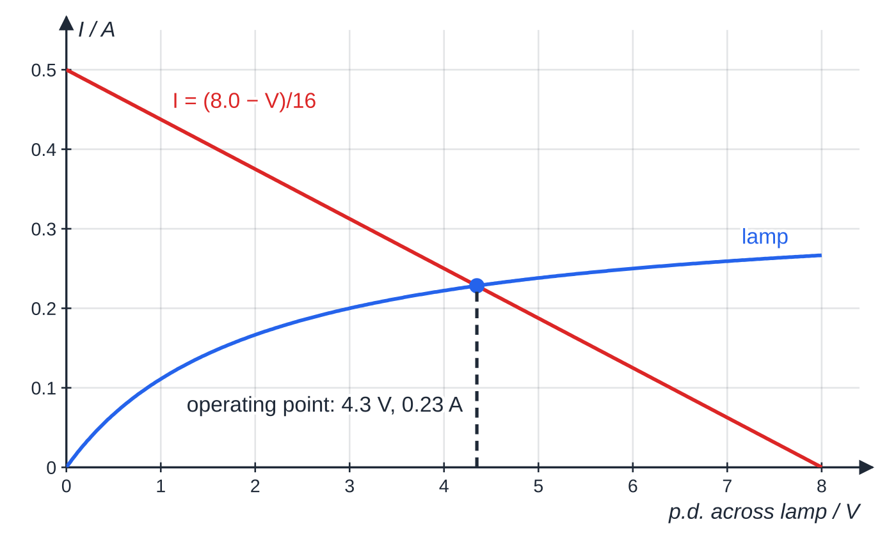
How do you read resistance from an I–V graph and solve non-ohmic circuits? (continued)
Section 6 of 12
The same answer can be found by drawing. Rearranged, the resistor condition is I = (8.0 - Vₗₐₘₚ)/16, a straight line on the lamp's I–V axes. Where it crosses the lamp curve, both conditions hold at once.
The straight line I = (8.0 − V)/16 shows every combination allowed by the 16 Ω resistor and the 8.0 V supply; the lamp curve shows every combination the lamp allows. They cross at about 4.3 V and 0.23 A.
Notes:
How do you read resistance from an I–V graph and solve non-ohmic circuits?. Full notes: https://examinerprep.com/notes/edexcel-ial-physics/series-and-parallel-circuits-and-i-v-characteristics/

Slide 37
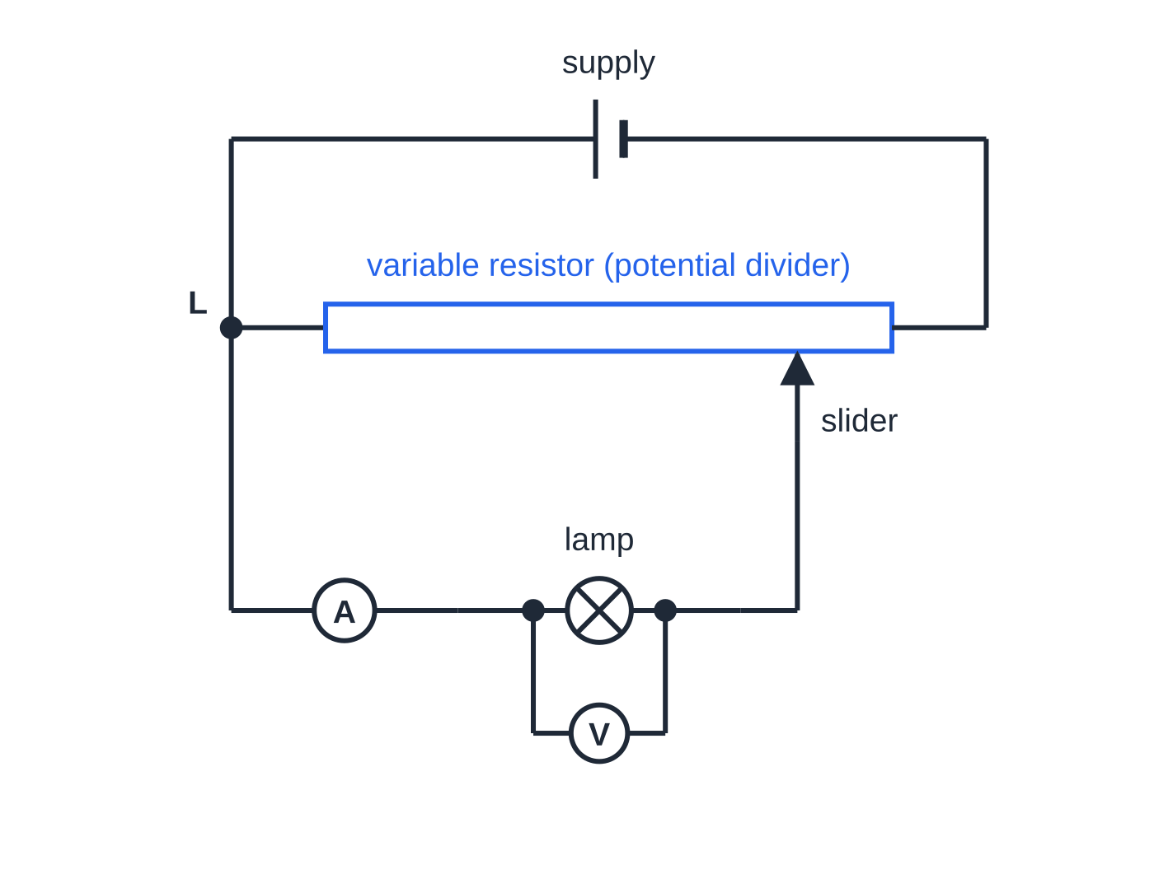
How do you measure an I–V characteristic?
Section 7 of 12
The ammeter goes in series with the component; the voltmeter goes in parallel with the component only.
Varying the p.d.: a variable resistor used as a potential divider (above) lets the p.d. start from zero. A variable resistor simply in series with the component is easier to set up, but the p.d. cannot fall to zero, so the region near the origin is missed.
Readings: record I for a range of V, in equal steps across the whole range; take extra readings where the graph curves most.
Negative values: reverse the connections to the component (or the supply) and repeat.
A variable resistor connected as a potential divider. The lamp's p.d. is taken between end L and the slider, so it can be set to any value from zero up to the supply p.d.
Notes:
How do you measure an I–V characteristic?. Full notes: https://examinerprep.com/notes/edexcel-ial-physics/series-and-parallel-circuits-and-i-v-characteristics/

Slide 38
How do you measure an I–V characteristic? (continued)
Section 7 of 12
Diode: add a protective resistor in series so the forward current cannot become large; use a milliammeter; take small steps between about 0.4 V and 0.8 V where the current rises steeply.
Lamp and thermistor: wait for each reading to settle, because the component needs time to reach a steady temperature. The lamp gets hot, so do not touch it.
Graph: plot I against V and draw a smooth curve (or straight line) of best fit through the points.
Exam tip
Asked why a potential divider is used, give the physics reason: it allows the p.d. across the component to be varied from zero, so the full characteristic can be plotted. "It is more accurate" is not a reason.
Notes:
How do you measure an I–V characteristic?. Full notes: https://examinerprep.com/notes/edexcel-ial-physics/series-and-parallel-circuits-and-i-v-characteristics/

Slide 39
Exam tips for 2.7
Section 8 of 12
Exam tip 1 — label the junctions
Put letters on junctions and arrows on currents before calculating. Writing "current in at J = current out at J" as an equation makes unknown currents straightforward and shows the physics.
Exam tip 2 — parallel first, then series
Reduce every parallel group to one resistor, add the series parts, find the supply current, then work back out to individual p.d.s and currents.
Exam tip 3 — two built-in checks
P.d.s around any loop must add up to the supply p.d.; branch currents must add up to the current into the group. A quick check on either catches most arithmetic slips.
Notes:
Exam tips for 2.7. Full notes: https://examinerprep.com/notes/edexcel-ial-physics/series-and-parallel-circuits-and-i-v-characteristics/

Slide 40
Exam tips for 2.7 (continued)
Section 8 of 12
Exam tip 4 — resistance from a graph
Read one point and divide: R = V/I. Watch the axes: if V is on the vertical axis the gradient has units of Ω, but it is still the resistance only for a straight line through the origin.
Exam tip 5 — say which conservation law
"Explain" questions on circuits expect the law by name: currents at junctions follow from conservation of charge; p.d.s around loops follow from conservation of energy.
Notes:
Exam tips for 2.7. Full notes: https://examinerprep.com/notes/edexcel-ial-physics/series-and-parallel-circuits-and-i-v-characteristics/

Slide 41
Common misconceptions
Section 9 of 12
Misconception | Why it is wrong | Correct idea
Current is used up as it passes through a component. | Charge is conserved; it cannot disappear inside a lamp or resistor. | The current is the same on both sides of a component in series; energy is transferred, not charge.
Parallel branches share the supply p.d. between them. | Each branch connects the same two points. | Every parallel branch has the same p.d.; it is the current that is shared.
Adding another resistor always increases the total resistance. | A resistor in parallel adds an extra path for charge. | In parallel the total falls and is less than the smallest resistor.
Resistance is the gradient of an I–V graph. | Resistance is defined as V/I. | Use the coordinates of the point; the gradient matches only for a straight line through the origin.
A filament lamp disobeys Ohm's law because it is not a metal conductor. | The filament is a metal; its temperature rises with current. | Ohm's law needs constant temperature; the lamp's resistance rises as it heats.
Notes:
Common misconceptions. Full notes: https://examinerprep.com/notes/edexcel-ial-physics/series-and-parallel-circuits-and-i-v-characteristics/

Slide 42
Common misconceptions (continued)
Section 9 of 12
Misconception | Why it is wrong | Correct idea
A diode has a fixed resistance. | V/I is enormous in reverse and small once it conducts. | A diode is non-ohmic: it conducts in one direction only, above about 0.6 V.
Notes:
Common misconceptions. Full notes: https://examinerprep.com/notes/edexcel-ial-physics/series-and-parallel-circuits-and-i-v-characteristics/

Slide 43
How this topic connects
Section 10 of 12
6 Current, p.d. and resistance
I = ΔQ/Δt, V = W/Q and R = V/I are the definitions that turn conservation of charge and energy into the rules on this page; power in each resistor follows from P = VI.
8 Resistivity and the potential divider
A potential divider is a series circuit sharing p.d. in the ratio of resistances: section 2 of this page applied to sensors with thermistors and LDRs.
9 E.m.f. and internal resistance
Kirchhoff's second law with the internal resistance included gives V = ε- Ir; the source's internal resistance is simply one more resistor in series.
Notes:
How this topic connects. Full notes: https://examinerprep.com/notes/edexcel-ial-physics/series-and-parallel-circuits-and-i-v-characteristics/

Slide 44
How this topic connects (continued)
Section 10 of 12
10 Resistance, temperature and light
Explains the shapes on this page: lattice vibrations raise a metal filament's resistance, while extra conduction electrons lower a thermistor's.
Notes:
How this topic connects. Full notes: https://examinerprep.com/notes/edexcel-ial-physics/series-and-parallel-circuits-and-i-v-characteristics/

Slide 45
Key equations
Section 11 of 12
Equation | Use | In the formulae list?
R = R₁ + R₂ + R₃ | resistors in series | Yes
1/R = 1/R₁ + 1/R₂ + 1/R₃ | resistors in parallel | Yes
R = V/I | resistance at any point on an I–V graph (R in Ω, V in V, I in A; page 2.6) | Yes
I = ΔQ/Δt | charge through a branch in a given time (Q in C, t in s; page 2.6) | Yes
ΣIᵢₙ = ΣIₒᵤₜ | currents at a junction (conservation of charge) | No — learn it
Σε= ΣIR around a loop | p.d.s around a loop (conservation of energy) | No — learn it
R = R₁R₂/(R₁ + R₂) | two resistors in parallel | No — derive it from the parallel equation
Notes:
Key equations. Full notes: https://examinerprep.com/notes/edexcel-ial-physics/series-and-parallel-circuits-and-i-v-characteristics/

Slide 46
Check your understanding
Section 12 of 12
1. Calculate the combined resistance of four 100 Ω resistors connected in parallel.
2. 2.0 A enters a junction with two outgoing wires. One carries 0.8 A. What does the other carry, and which conservation law did you use?
3. Two resistors in series are connected to a 9.0 V supply of negligible internal resistance. The p.d. across one is 3.5 V. What is the p.d. across the other, and which resistor is larger?
4. A 40 Ω resistor is connected in parallel with a 60 Ω resistor. Show that the combined resistance is less than 40 Ω, and explain why it must be.
5. A 6.0 Ω resistor is in series with two 12 Ω resistors in parallel, across a 12 V supply of negligible internal resistance. Find the current in each 12 Ω resistor.
6. Explain why a variable resistor connected as a potential divider is used, rather than one in series, when measuring the I–V characteristic of a lamp.
Notes:
Check your understanding: questions. Full notes: https://examinerprep.com/notes/edexcel-ial-physics/series-and-parallel-circuits-and-i-v-characteristics/

Slide 47
Check your understanding · answers
Section 12 of 12
1. 1/R = 4 ×1/100 = 0.040 Ω⁻¹, so R = 25 Ω. For identical resistors this is R₀/n = 100/4.
2. 2.0 - 0.8 = 1.2 A, using conservation of charge (Kirchhoff's first law).
3. 9.0 - 3.5 = 5.5 V (conservation of energy). The current is the same in both, so the resistor with 5.5 V across it has the larger resistance.
4. (40 ×60)/(40 + 60) = 24 Ω. Adding the 60 Ω branch gives charge an extra path, so for the same p.d. the total current is larger than through 40 Ω alone, and R = V/I is smaller.
5. Parallel pair: 12/2 = 6.0 Ω. Total = 6.0 + 6.0 = 12 Ω, so the supply current is 12/12 = 1.0 A. The pair is identical, so each 12 Ω resistor carries 0.50 A. Check: p.d. across the pair = 1.0 ×6.0 = 6.0 V, and 6.0/12 = 0.50 A.
6. The potential divider allows the p.d. across the lamp to be varied all the way from zero, so the whole curve, including the region near the origin, can be plotted. A series variable resistor cannot reduce the lamp's p.d. to zero.
Notes:
Check your understanding: answers. Full notes: https://examinerprep.com/notes/edexcel-ial-physics/series-and-parallel-circuits-and-i-v-characteristics/

Slide 48
Practice questions
5 original exam-style questions. Answers at the end of the deck.

Slide 49
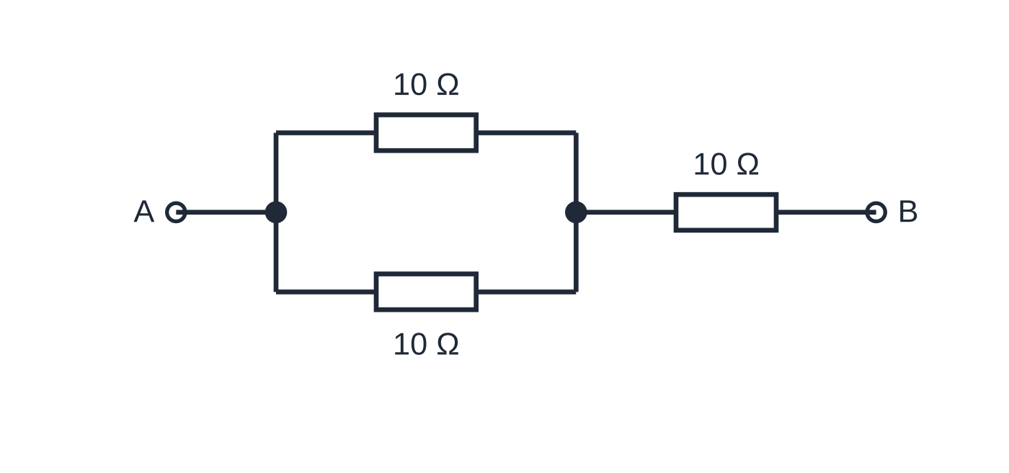
Question 1
1 mark
Three identical 10 Ω resistors are available. Two are connected in parallel, and this pair is connected in series with the third.
What is the total resistance?
Figure: two resistors in parallel, connected in series with the third
A 3.3 Ω
B 6.7 Ω
C 15 Ω
D 30 Ω
Notes:
Online with the full mark scheme: https://examinerprep.com/ial-physics-2-7-series-and-parallel-circuits-and-i-v-characteristics-questions#IALP-U2-7-A-07

Slide 50
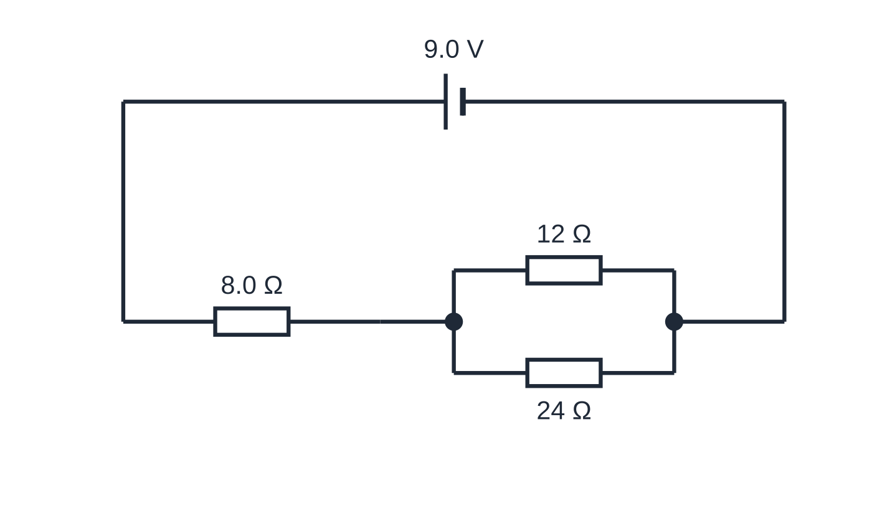
Question 2
1 mark
A 9.0 V supply of negligible internal resistance is connected to an 8.0 Ω resistor in series with a parallel pair of resistors of 12 Ω and 24 Ω.
What is the current in the 24 Ω resistor?
Figure: the circuit
A 0.19 A
B 0.28 A
C 0.38 A
D 0.56 A
Notes:
Online with the full mark scheme: https://examinerprep.com/ial-physics-2-7-series-and-parallel-circuits-and-i-v-characteristics-questions#IALP-U2-7-A-09

Slide 51
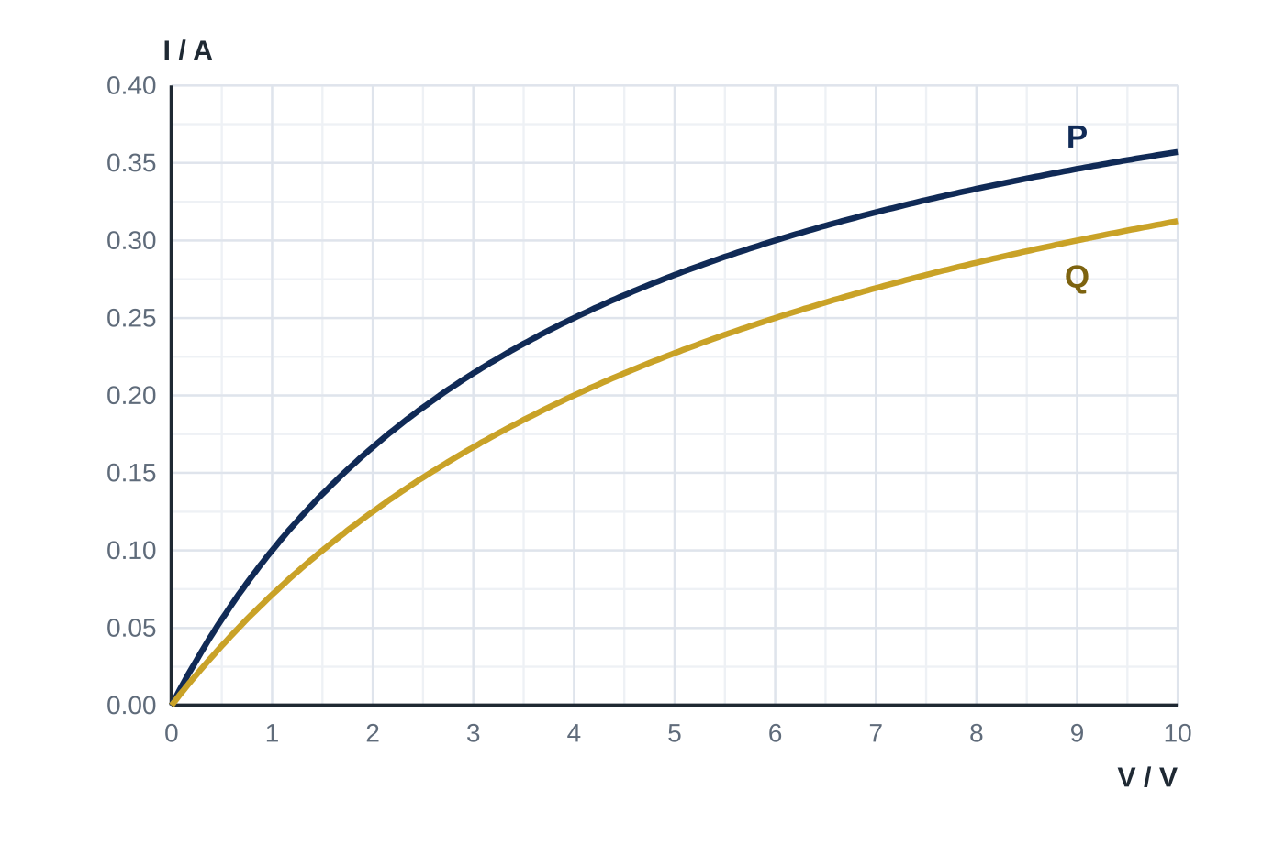
Question 3
1 mark
The graph shows the I–V characteristics of two filament lamps, P and Q. The lamps are connected in series with a 10.0 V supply of negligible internal resistance.
What is the power transferred in lamp Q?
A 1.0 W
B 1.1 W
C 1.4 W
D 1.5 W
Notes:
Online with the full mark scheme: https://examinerprep.com/ial-physics-2-7-series-and-parallel-circuits-and-i-v-characteristics-questions#IALP-U2-7-FA-09

Slide 52
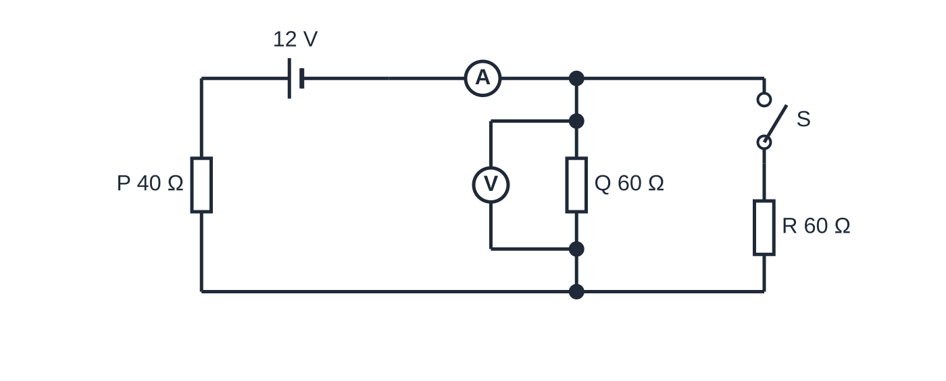
Question 4
6 marks
A 12 V supply of negligible internal resistance is connected in series with an ideal ammeter, a 40 Ω resistor P and a 60 Ω resistor Q. An ideal voltmeter is connected across Q. A switch S, when closed, connects a third resistor R of 60 Ω in parallel with Q. S is initially open.
Figure: the circuit, with switch S open
(a) Calculate the readings on the ammeter and on the voltmeter with S open. [2]
(b) S is closed. Calculate the new readings on the ammeter and on the voltmeter. [3]
(c) Explain why the voltmeter reading falls when S is closed, even though the current from the supply increases. [1]
Notes:
Online with the full mark scheme: https://examinerprep.com/ial-physics-2-7-series-and-parallel-circuits-and-i-v-characteristics-questions#IALP-U2-7-B-04

Slide 53
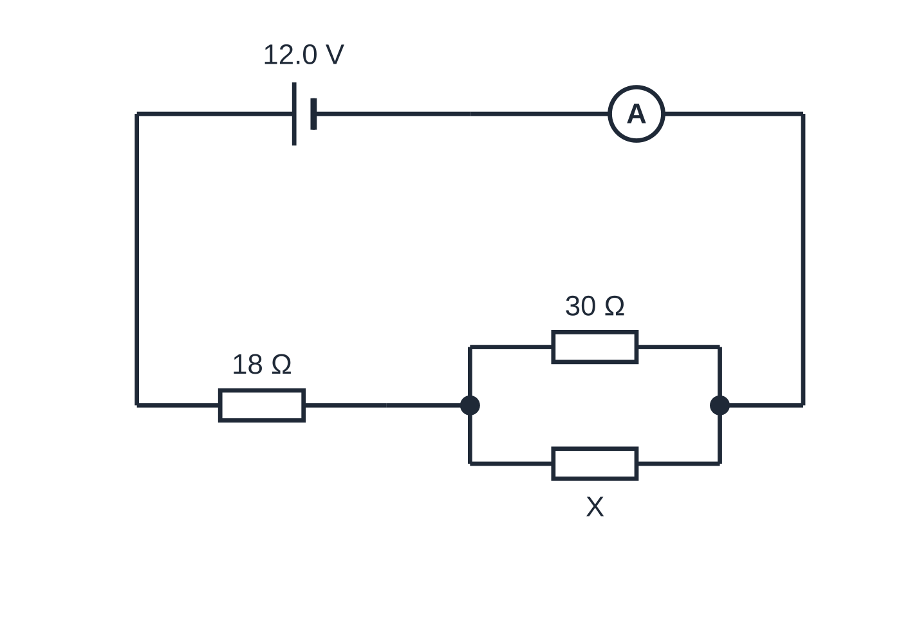
Question 5
7 marks
A 12.0 V supply of negligible internal resistance is connected in series with an ideal ammeter and an 18 Ω resistor. The rest of the circuit is a 30 Ω resistor in parallel with a resistor X of unknown resistance. The ammeter reads 0.50 A.
Figure: the circuit
(a) Calculate the p.d. across the 18 Ω resistor. [1]
(b) Determine the p.d. across the 30 Ω resistor, and name the conservation law you use. [2]
(c) Calculate the resistance of X. [3]
(d) Resistor X breaks, leaving a gap in its branch. Calculate the new ammeter reading. [1]
Notes:
Online with the full mark scheme: https://examinerprep.com/ial-physics-2-7-series-and-parallel-circuits-and-i-v-characteristics-questions#IALP-U2-7-B-07

Slide 54
Answers

Slide 55
Question 1 · answer
Answer C
Two 10 Ω in parallel = 10/2 = 5.0 Ω. In series with 10 Ω: 5.0 + 10 = 15 Ω.
Notes:
Full mark scheme: https://examinerprep.com/ial-physics-2-7-series-and-parallel-circuits-and-i-v-characteristics-questions#IALP-U2-7-A-07

Slide 56
Question 2 · answer
Answer A
Parallel pair: 12 × 24/(12 + 24) = 8.0 Ω, so the total is 16 Ω and the supply current is 9.0 ÷ 16 = 0.5625 A. P.d. across the pair = 0.5625 × 8.0 = 4.5 V, so the current in 24 Ω is 4.5 ÷ 24 = 0.19 A (0.1875 A).
Notes:
Full mark scheme: https://examinerprep.com/ial-physics-2-7-series-and-parallel-circuits-and-i-v-characteristics-questions#IALP-U2-7-A-09

Slide 57
Question 3 · answer
Answer D
The current is the same in both lamps and their p.d.s must add up to 10.0 V. At 0.25 A, P has 4.0 V and Q has 6.0 V: 4.0 + 6.0 = 10.0 V. Power in Q = 6.0 × 0.25 = 1.5 W.
Notes:
Full mark scheme: https://examinerprep.com/ial-physics-2-7-series-and-parallel-circuits-and-i-v-characteristics-questions#IALP-U2-7-FA-09

Slide 58
Question 4 · answer
Mark scheme
I = 12 ÷ (40 + 60) = 0.12 A
V = 0.12 × 60 = 7.2 V
Q and R in parallel = 30 Ω, so total resistance = 70 Ω
I = 12 ÷ 70 = 0.17 A (0.171 A)
V = 0.171 × 30 = 5.1 V (5.14 V) (allow error carried forward)
the larger current gives a larger p.d. across P, and the p.d.s across P and across Q must still add up to 12 V, so the p.d. across Q is smaller
Notes:
Full mark scheme: https://examinerprep.com/ial-physics-2-7-series-and-parallel-circuits-and-i-v-characteristics-questions#IALP-U2-7-B-04

Slide 59
Question 5 · answer
Mark scheme
0.50 × 18 = 9.0 V
12.0 − 9.0 = 3.0 V
conservation of energy: the p.d.s around the loop add up to the supply p.d.
current in 30 Ω = 3.0 ÷ 30 = 0.10 A
current in X = 0.50 − 0.10 = 0.40 A
X = 3.0 ÷ 0.40 = 7.5 Ω (allow error carried forward)
12.0 ÷ (18 + 30) = 0.25 A
Notes:
Full mark scheme: https://examinerprep.com/ial-physics-2-7-series-and-parallel-circuits-and-i-v-characteristics-questions#IALP-U2-7-B-07

Slide 60
Keep practising
Notes for this topic
Questions on this topic
Build a printable test
ExaminerPrep is an independent tutoring service. It has been developed independently from and is not endorsed by the International Baccalaureate Organization. "International Baccalaureate", "IB" and "IB Diploma Programme" are registered trademarks of the IBO, used here for descriptive purposes only.
Pearson Edexcel and Cambridge are trademarks of their owners; ExaminerPrep is not affiliated with any exam board.

