Slide 1
EP
EDEXCEL IAL PHYSICS
5.5 Simple harmonic motion
The full notes page in 13 sections · practice questions with answers · simulations
ExaminerPrep is an independent tutoring service. It has been developed independently from and is not endorsed by the International Baccalaureate Organization. "International Baccalaureate", "IB" and "IB Diploma Programme" are registered trademarks of the IBO, used here for descriptive purposes only.
Pearson Edexcel and Cambridge are trademarks of their owners; ExaminerPrep is not affiliated with any exam board.
Notes:
5.5 Simple harmonic motion. Notes for this topic: https://examinerprep.com/notes/edexcel-ial-physics/simple-harmonic-motion/

Slide 2
What this page covers
Overview
The condition for simple harmonic motion, F = -kx and a = -ω²x, and how to test whether a motion is SHM
Amplitude, period, frequency and angular frequency
x = Acos ωt, v = -Aωsin ωt, a = -Aω²cos ωt, and the maximum speed Aω
Displacement–time, velocity–time and acceleration–time graphs, their gradients and phase differences
The period of a mass–spring system and of a simple pendulum (small angles), and using them in experiments
When an object resting on a vibrating surface loses contact
Notes:
What this page covers. Full notes: https://examinerprep.com/notes/edexcel-ial-physics/simple-harmonic-motion/

Slide 3
In one minute
Key points
1. Simple harmonic motion is oscillation in which the acceleration is proportional to the displacement from a fixed point and always directed towards that point, a = -ω²x, and everything else on this page follows from that one condition.
2. It comes from a restoring force proportional to displacement, F = -kx. A restoring force alone is not enough: it must be proportional.
3. ω= 2πf = 2π/T. Released from an extreme: x = Acos ωt, v = -Aωsin ωt, a = -Aω²cos ωt. Use radians.
4. Maximum speed Aω at equilibrium; maximum acceleration Aω² at the extremes, where the speed is zero.
5. Velocity is a quarter of a cycle (π/2) ahead of displacement; acceleration is in antiphase (π) with displacement.
6. Mass on a spring: T = 2π√(m/k). Simple pendulum, small angles: T = 2π√(l/g). Neither depends on the amplitude.
Notes:
In one minute. Full notes: https://examinerprep.com/notes/edexcel-ial-physics/simple-harmonic-motion/

Slide 4
What is simple harmonic motion?
Section 1 of 13
Simple harmonic motion: oscillation in which the acceleration is proportional to the displacement from a fixed equilibrium point and always directed towards that point.
The equilibrium position is where the resultant force on the object is zero; displacement x is measured from it. Whenever the object is displaced, a restoring force acts. For SHM it obeys F = -kx, where k is a constant for the system (N m⁻¹) and the minus sign means "opposite to the displacement". Newton's second law turns this into an acceleration, a = F/m = -(k/m)x; writing the positive constant k/m as ω² gives the defining equation.
F = -kx a = -ω²x
Both are in the formulae list supplied in the exam (a in m s⁻², ω in rad s⁻¹).
Notes:
What is simple harmonic motion?. Full notes: https://examinerprep.com/notes/edexcel-ial-physics/simple-harmonic-motion/

Slide 5
What is simple harmonic motion? (continued)
Section 1 of 13
Term | Meaning | Symbol and unit
Displacement | distance from the equilibrium position, with a sign for direction | x, m
Amplitude | maximum displacement from equilibrium | A, m
Period | time for one complete oscillation | T, s
Frequency | number of oscillations per unit time | f, Hz
Angular frequency | 2π × frequency; the constant in a = -ω²x | ω, rad s⁻¹
The period of SHM does not depend on the amplitude. An oscillator with this property is called isochronous, which is why pendulums and springs make good timekeepers.
Notes:
What is simple harmonic motion?. Full notes: https://examinerprep.com/notes/edexcel-ial-physics/simple-harmonic-motion/

Slide 6
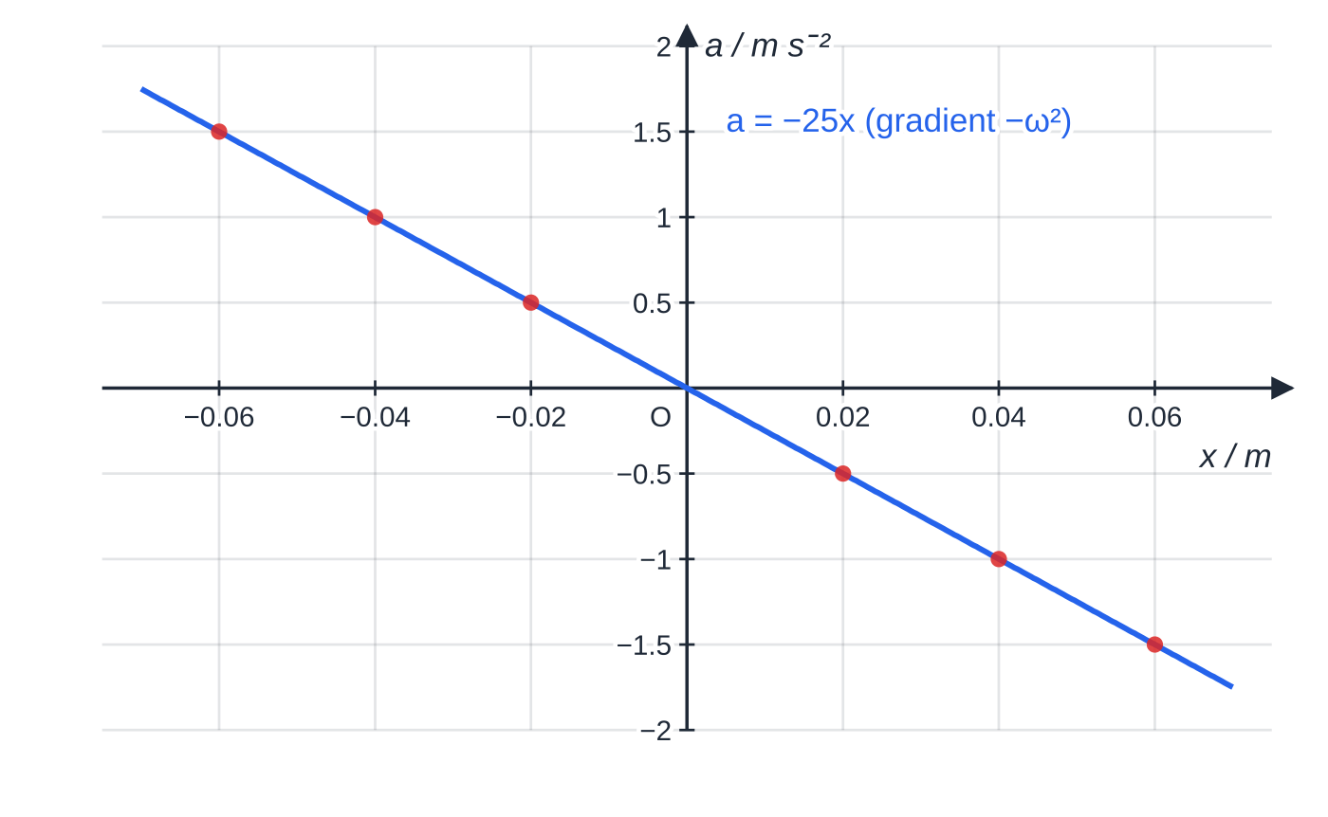
How can you tell whether a motion is simple harmonic?
Section 2 of 13
Check both parts of the condition: the acceleration (or resultant force) always points towards equilibrium, and its size is proportional to the displacement. On a graph of a against x, SHM gives a straight line through the origin with gradient -ω²; in a table, a/x is the same negative constant for every row.
The glider of Worked example 1: every point lies on a = −25x, a straight line through the origin, so the motion is SHM.
Notes:
How can you tell whether a motion is simple harmonic?. Full notes: https://examinerprep.com/notes/edexcel-ial-physics/simple-harmonic-motion/

Slide 7
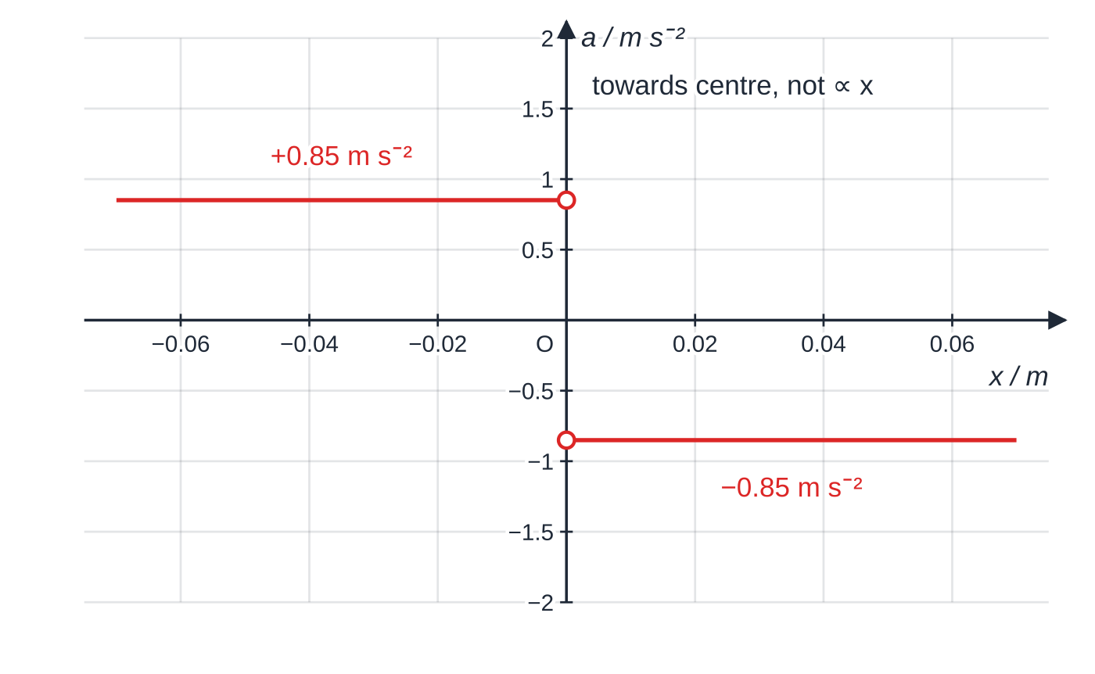
How can you tell whether a motion is simple harmonic? (continued)
Section 2 of 13
A block sliding on a smooth V-shaped track always accelerates back towards the centre, but at a constant 0.85 m s⁻², so it is not SHM.
Notes:
How can you tell whether a motion is simple harmonic?. Full notes: https://examinerprep.com/notes/edexcel-ial-physics/simple-harmonic-motion/

Slide 8
How can you tell whether a motion is simple harmonic? (continued)
Section 2 of 13 · Worked example 1 · Medium · Show that
WORKED EXAMPLE · QUESTION
A 0.40 kg glider on a level air track is held between two stretched springs. A data logger records:
x / m | −0.060 | −0.040 | −0.020 | +0.020 | +0.040 | +0.060
a / m s⁻² | +1.50 | +1.00 | +0.50 | −0.50 | −1.00 | −1.50
(a) Show that the glider moves with SHM. (b) Determine its period. (c) Calculate the resultant force when x = +0.040 m.
SOLUTION
(a) Every a has the opposite sign to x, so the acceleration is towards equilibrium. a/x = -1.00 ÷0.040 = -0.50 ÷0.020 = …= -25 s⁻² for every row, so a ∝-x: SHM. (Two rows are not enough for "show that": test several, or show the a–x graph is a straight line through the origin.)
(b) ω² = 25 s⁻², ω= 5.0 rad s⁻¹, T = 2π/ω: 1.26 s.
Notes:
How can you tell whether a motion is simple harmonic?: Worked example 1. Full notes: https://examinerprep.com/notes/edexcel-ial-physics/simple-harmonic-motion/

Slide 9
How can you tell whether a motion is simple harmonic? (continued)
Section 2 of 13 · Worked example 1 · Medium · Show that (continued)
(c) F = ma = 0.40 ×(-1.00): −0.40 N (0.40 N towards equilibrium).
Notes:
How can you tell whether a motion is simple harmonic?: Worked example 1. Full notes: https://examinerprep.com/notes/edexcel-ial-physics/simple-harmonic-motion/

Slide 10
How can you tell whether a motion is simple harmonic? (continued)
Section 2 of 13
System | SHM? | Reason
Mass on a spring (within the limit of proportionality) | yes | Hooke's law makes the resultant force proportional to displacement
Simple pendulum | only for small angles | the restoring force is mg sin θ, close to proportional to θ only below about 10°
Block sliding on a smooth V-shaped track | no | the restoring acceleration has a constant size, g sin α
Ball bouncing on a hard floor | no | between bounces the acceleration is g downwards whatever the height
Ball rolling in a shallow circular bowl | approximately, for small displacements | like a pendulum: the restoring force grows almost in proportion to the displacement
Notes:
How can you tell whether a motion is simple harmonic?. Full notes: https://examinerprep.com/notes/edexcel-ial-physics/simple-harmonic-motion/

Slide 11
How can you tell whether a motion is simple harmonic? (continued)
Section 2 of 13
Common error
Saying a motion is SHM "because there is a restoring force" or "because it repeats". Both are true of the bouncing ball, which is not SHM. The test is proportionality between acceleration and displacement.
Notes:
How can you tell whether a motion is simple harmonic?. Full notes: https://examinerprep.com/notes/edexcel-ial-physics/simple-harmonic-motion/

Slide 12
Which equations describe the motion?
Section 3 of 13
x = Acos ωt v = -Aωsin ωt a = -Aω²cos ωt
T = 1/f = 2π/ω ω= 2πf
All of these are in the formulae list. A is the amplitude and t the time since the object was at x = +A; ωt is an angle in radians. If timing starts as the object passes through equilibrium, use x = Asin ωt instead. Substituting x = Acos ωt into the acceleration gives a = -ω²(Acos ωt) = -ω²x, the defining condition, as it must be. Since sin and cos never exceed 1:
v_(max) = Aω (at x = 0) a_(max) = Aω² (at x = ±A)
Notes:
Which equations describe the motion?. Full notes: https://examinerprep.com/notes/edexcel-ial-physics/simple-harmonic-motion/

Slide 13
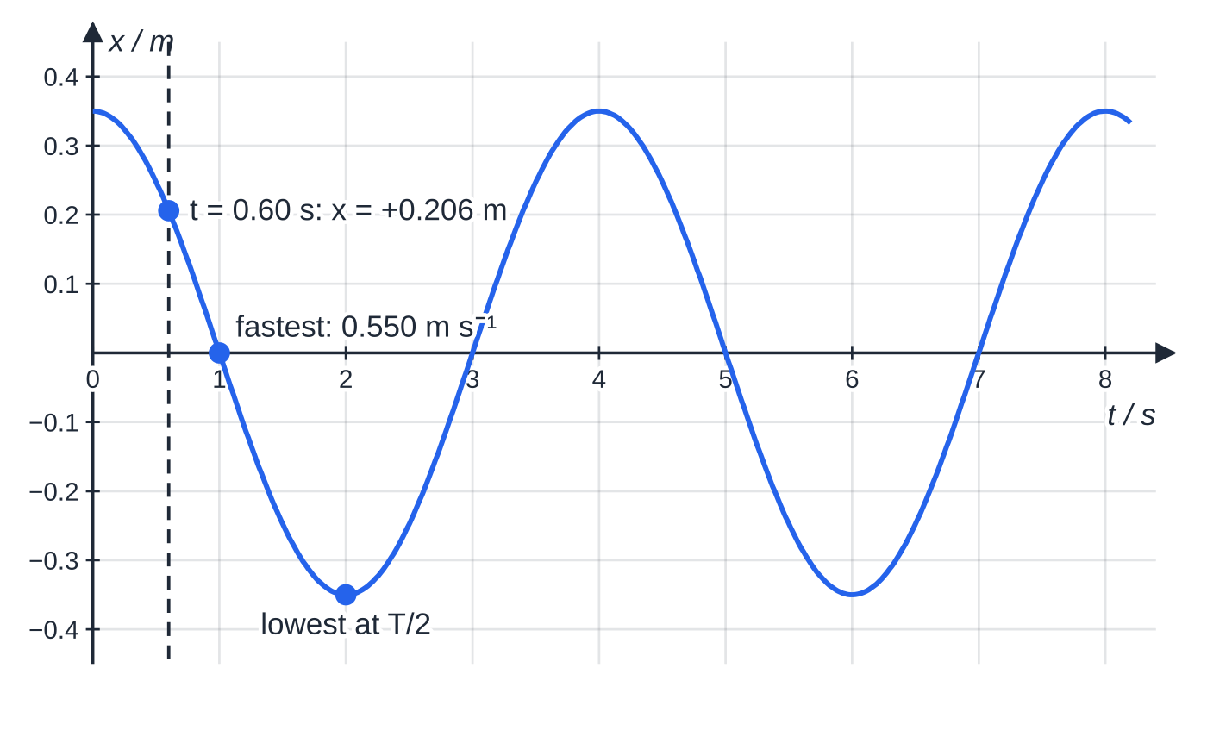
Which equations describe the motion? (continued)
Section 3 of 13
The buoy of Worked example 2 (A = 0.35 m, T = 4.0 s), released at its highest point; the dashed line marks t = 0.60 s.
Notes:
Which equations describe the motion?. Full notes: https://examinerprep.com/notes/edexcel-ial-physics/simple-harmonic-motion/

Slide 14
Which equations describe the motion? (continued)
Section 3 of 13 · Worked example 2 · Medium · Calculate
WORKED EXAMPLE · QUESTION
A buoy moves up and down with SHM of amplitude 0.35 m and period 4.0 s. Timing starts at its highest point; upwards is positive. Calculate (a) the angular frequency, (b) the maximum speed, and (c) the displacement, velocity and acceleration at t = 0.60 s.
SOLUTION
(a) ω= 2π÷4.0: 1.57 rad s⁻¹ (1.5708).
(b) v_(max) = Aω= 0.35 ×1.5708: 0.550 m s⁻¹.
(c) ωt = 1.5708 ×0.60 = 0.942 rad. x = 0.35cos 0.942 = 0.35 ×0.588: +0.206 m. v = -0.550 sin 0.942 = -0.550 ×0.809: −0.445 m s⁻¹ (moving down). a = -ω²x = -2.467 ×0.206: −0.508 m s⁻² (towards equilibrium). The buoy is above equilibrium but falling, and speeding up.
Notes:
Which equations describe the motion?: Worked example 2. Full notes: https://examinerprep.com/notes/edexcel-ial-physics/simple-harmonic-motion/

Slide 15
Which equations describe the motion? (continued)
Section 3 of 13
Common error
Leaving the calculator in degree mode. cos(0.942°) is almost exactly 1, which would leave the buoy at 0.350 m, still at the top after 0.60 s. If an answer says the object has barely moved, check the angle mode.
Notes:
Which equations describe the motion?. Full notes: https://examinerprep.com/notes/edexcel-ial-physics/simple-harmonic-motion/

Slide 16
How are the displacement, velocity and acceleration graphs linked?
Section 4 of 13
Gradient of the x–t graph = velocity: zero at the peaks and troughs (momentarily at rest at ±A), steepest where the graph crosses the time axis (maximum speed at equilibrium).
Gradient of the v–t graph = acceleration: steepest where v = 0, at the extremes, where the acceleration is largest.
For a curve, find the gradient at an instant by drawing a tangent and using a large triangle on it.
Position | Displacement | Speed | Acceleration
Equilibrium | 0 | maximum, Aω | 0
Positive extreme | +A | 0 | maximum, −Aω² (towards equilibrium)
Negative extreme | −A | 0 | maximum, +Aω² (towards equilibrium)
Notes:
How are the displacement, velocity and acceleration graphs linked?. Full notes: https://examinerprep.com/notes/edexcel-ial-physics/simple-harmonic-motion/

Slide 17
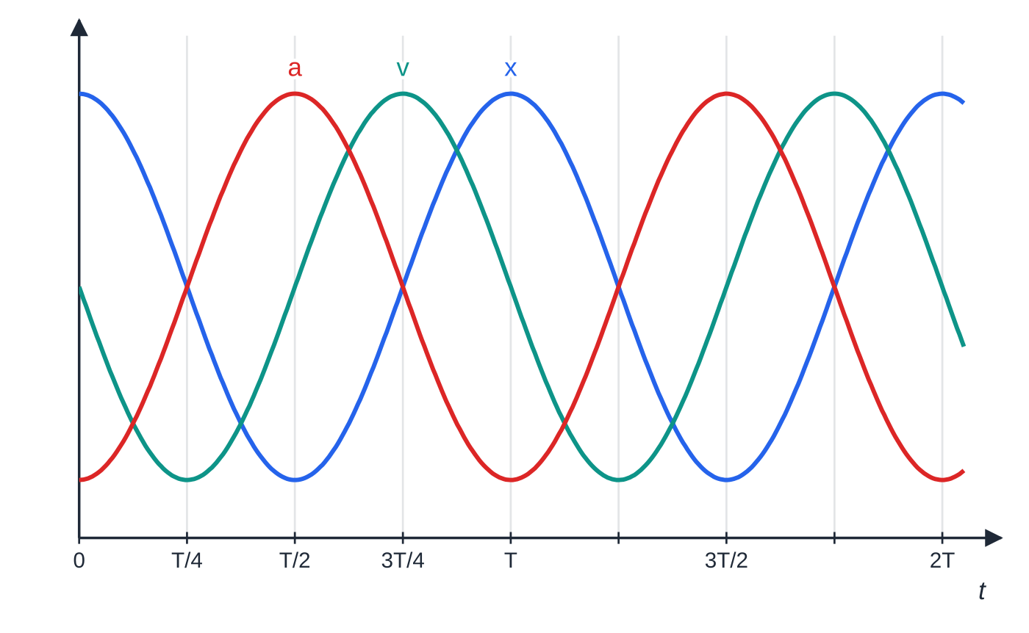
How are the displacement, velocity and acceleration graphs linked? (continued)
Section 4 of 13
Phase relationships
Velocity leads displacement by a quarter of a cycle (π/2 rad, 90°): each peak of the v–t graph comes T/4 before the next peak of the x–t graph. Acceleration is in antiphase with displacement (π rad, 180°): when x is most positive, a is most negative, the graphical form of a = -ω²x. So acceleration also leads velocity by a quarter of a cycle.
x = A cos ωt, v = −Aω sin ωt and a = −Aω² cos ωt, each scaled to the same height. Reading left to right, the peaks come in the order a, v, x, each a quarter period apart.
Notes:
How are the displacement, velocity and acceleration graphs linked?. Full notes: https://examinerprep.com/notes/edexcel-ial-physics/simple-harmonic-motion/

Slide 18
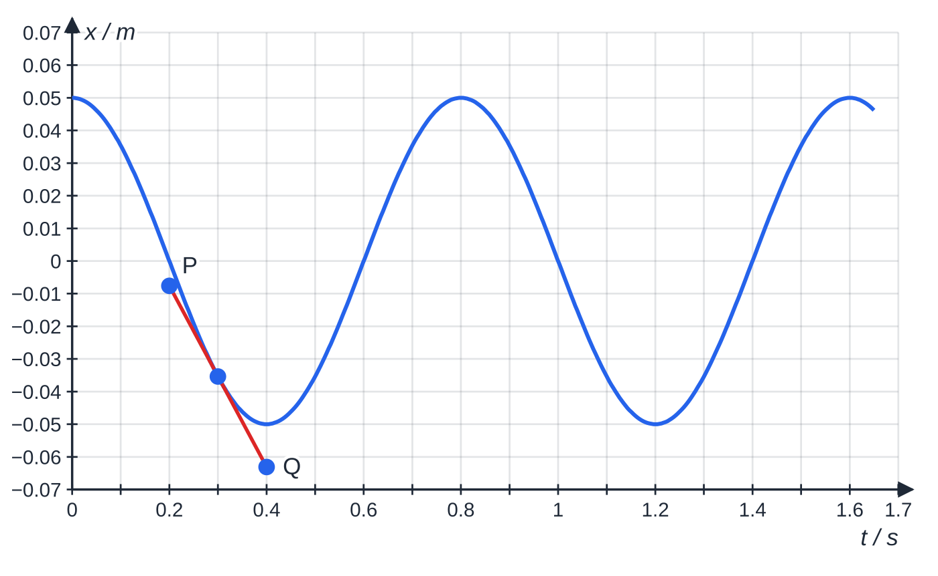
How are the displacement, velocity and acceleration graphs linked? (continued)
Section 4 of 13
A mass on a spring with A = 0.050 m and T = 0.80 s. The tangent at t = 0.30 s runs from P (0.20 s, −0.00759 m) to Q (0.40 s, −0.0631 m).
Notes:
How are the displacement, velocity and acceleration graphs linked?. Full notes: https://examinerprep.com/notes/edexcel-ial-physics/simple-harmonic-motion/

Slide 19
How are the displacement, velocity and acceleration graphs linked? (continued)
Section 4 of 13 · Worked example 3 · Medium · Determine
WORKED EXAMPLE · QUESTION
The graph above shows the displacement of a mass on a spring. (a) Use the tangent to determine the velocity at t = 0.30 s. (b) Check with v = -Aωsin ωt. (c) Calculate the maximum speed and state one time at which it occurs.
SOLUTION
(a) v = (-0.0631 - (-0.00759))/(0.40 - 0.20): −0.278 m s⁻¹.
(b) ω= 2π/0.80 = 7.854 rad s⁻¹, ωt = 2.356 rad: v = -0.050 ×7.854 ×sin 2.356 = -0.278 m s⁻¹ ✓. The minus sign matters: the mass is below equilibrium and still moving in the negative direction, towards the trough at 0.40 s.
(c) v_(max) = Aω= 0.050 ×7.854: 0.393 m s⁻¹, for example at t = 0.20 s.
Notes:
How are the displacement, velocity and acceleration graphs linked?: Worked example 3. Full notes: https://examinerprep.com/notes/edexcel-ial-physics/simple-harmonic-motion/

Slide 20
How are the displacement, velocity and acceleration graphs linked? (continued)
Section 4 of 13
Exam tip — sketch from gradients
To sketch v–t from x–t, mark the zero-gradient points first (where v = 0), then the steepest points (largest |v|), and keep the same period. Repeat to get a–t from v–t.
Notes:
How are the displacement, velocity and acceleration graphs linked?. Full notes: https://examinerprep.com/notes/edexcel-ial-physics/simple-harmonic-motion/

Slide 21
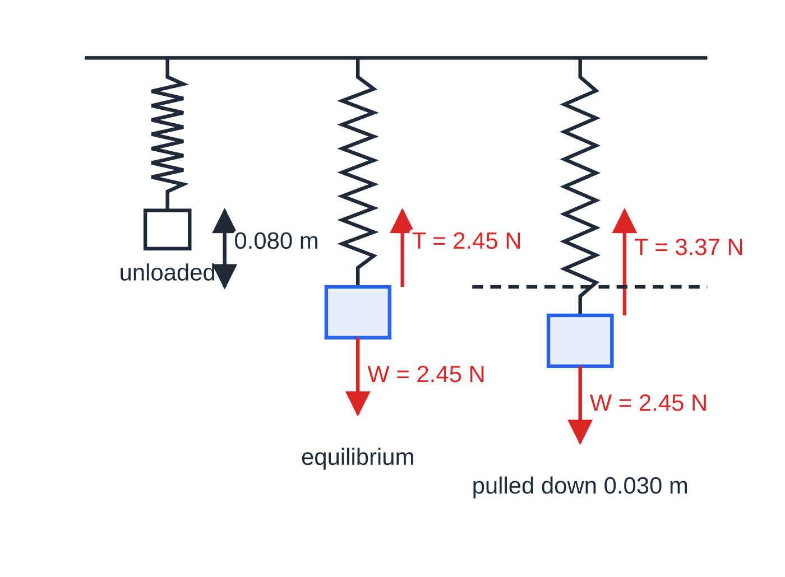
What sets the period of a mass on a spring?
Section 5 of 13
For a mass m on a spring of stiffness k, the resultant force for a displacement x from equilibrium is -kx, for a vertical spring too, because at equilibrium the weight is already balanced by the tension. So a = -(k/m)x: SHM with ω² = k/m, giving
T = 2π√(m/k)
In the formulae list (m in kg, k in N m⁻¹). It is independent of amplitude and of g: the same spring and mass have the same period on the Moon. Valid while the spring obeys Hooke's law and its own mass is small compared with m.
Drawn to scale. At equilibrium the forces balance; pulled down 0.030 m, the tension exceeds the weight by k × 0.030 = 0.92 N, a restoring force proportional to the extra displacement.
Notes:
What sets the period of a mass on a spring?. Full notes: https://examinerprep.com/notes/edexcel-ial-physics/simple-harmonic-motion/

Slide 22
What sets the period of a mass on a spring? (continued)
Section 5 of 13 · Worked example 4 · Medium · Calculate
WORKED EXAMPLE · QUESTION
A 0.250 kg mass hung on a light spring extends it by 0.080 m. It is pulled down a further 0.030 m and released; g = 9.81 N kg⁻¹. Calculate (a) the spring constant, (b) the period, (c) the maximum speed. (d) The mass is replaced by a 1.00 kg mass. State the new period.
SOLUTION
(a) At equilibrium tension = weight: k = mg/Δl = 0.250 ×9.81 ÷0.080: 30.7 N m⁻¹.
(b) T = 2π√(0.250 ÷30.66): 0.567 s. Check: m/k = Δl/g, so 2π√(0.080/9.81) gives the same 0.567 s.
(c) The amplitude is the 0.030 m pull, not the 0.080 m extension: ω= 2π÷0.567 = 11.07 rad s⁻¹, v_(max) = 0.030 ×11.07: 0.33 m s⁻¹.
(d) T ∝√m and the mass is 4 times larger: T = 2 ×0.567: 1.13 s.
Notes:
What sets the period of a mass on a spring?: Worked example 4. Full notes: https://examinerprep.com/notes/edexcel-ial-physics/simple-harmonic-motion/

Slide 23
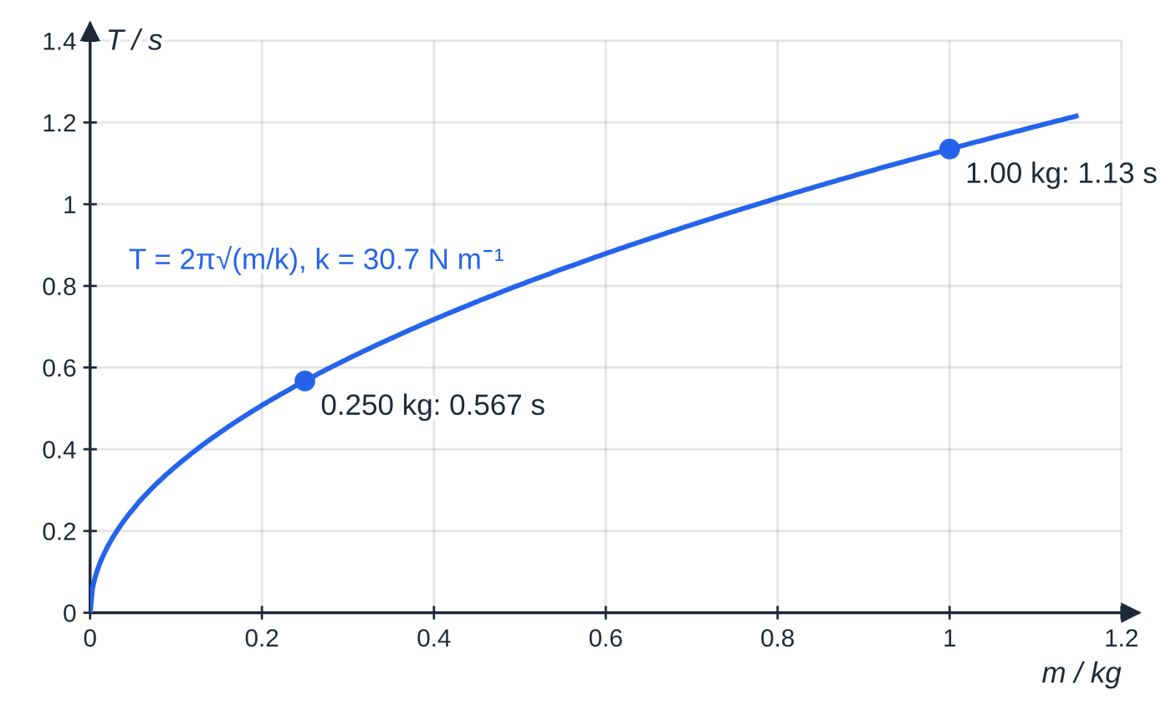
What sets the period of a mass on a spring? (continued)
Section 5 of 13
Common error
Using the static extension (0.080 m) as the amplitude. The amplitude is measured from the equilibrium position, so it is the extra distance the mass was pulled down, 0.030 m here.
Period against mass for the spring of Worked example 4: T ∝ √m, so four times the mass doubles the period.
Notes:
What sets the period of a mass on a spring?. Full notes: https://examinerprep.com/notes/edexcel-ial-physics/simple-harmonic-motion/

Slide 24
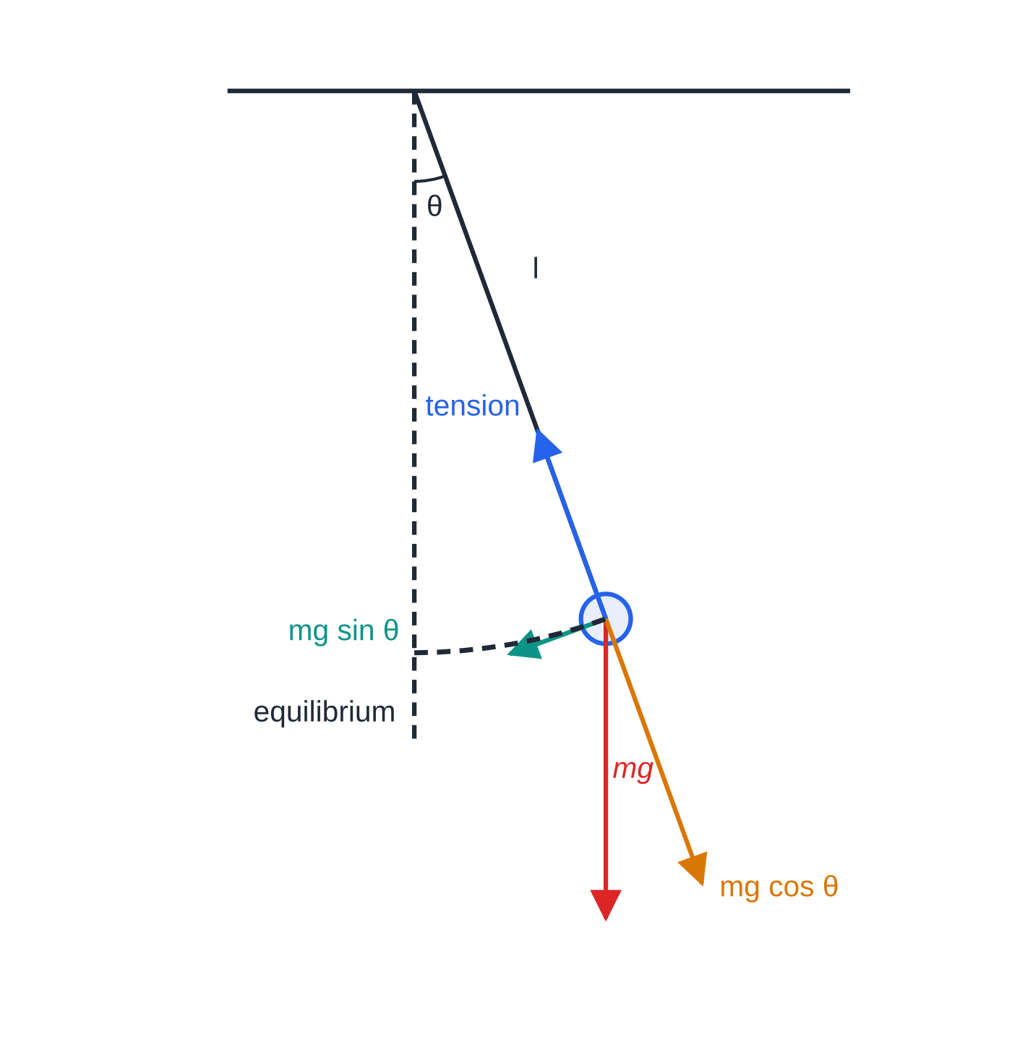
What sets the period of a simple pendulum?
Section 6 of 13
A simple pendulum is a small dense bob on a light, inextensible string of length l, measured from the point of suspension to the centre of the bob. Displaced by angle θ, the component of the weight along the arc, mgsin θ, pulls the bob back; the tension and mgcos θ act along the string and give no restoring effect.
For small θ in radians, sin θ≈θ= x/l. The restoring force becomes -(mg/l)x, proportional to x, so a = -(g/l)x: SHM with ω² = g/l. The mass cancels, because it appears in both the restoring force and the inertia.
T = 2π√(l/g)
The bob displaced by 20° (drawn at that angle). Only the component mg sin θ, at right angles to the string, acts back towards equilibrium.
In the formulae list (l in m, g in N kg⁻¹).
Notes:
What sets the period of a simple pendulum?. Full notes: https://examinerprep.com/notes/edexcel-ial-physics/simple-harmonic-motion/

Slide 25
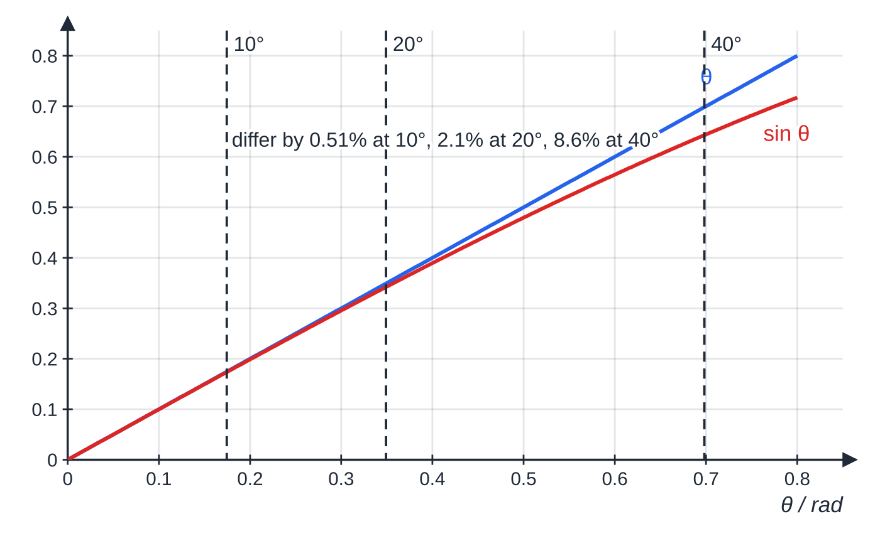
What sets the period of a simple pendulum? (continued)
Section 6 of 13
Valid only for small amplitudes (below about 10°); independent of the bob's mass and of the amplitude within that range.
How good is sin θ ≈ θ? At 10° they differ by 0.51%, at 20° by 2.1%, at 40° by 8.6%. Beyond small angles the restoring force is no longer proportional to x and the period grows.
Notes:
What sets the period of a simple pendulum?. Full notes: https://examinerprep.com/notes/edexcel-ial-physics/simple-harmonic-motion/

Slide 26
What sets the period of a simple pendulum? (continued)
Section 6 of 13 · Worked example 5 · Hard · Determine
WORKED EXAMPLE · QUESTION
A pendulum clock is designed to have a period of 2.00 s; g = 9.81 N kg⁻¹. (a) Calculate the length of the pendulum. (b) On a hot day the length increases by 0.50%. Determine how much time the clock loses in one day (86 400 s).
SOLUTION
(a) l = gT²/4π² = 9.81 ×2.00² ÷4π²: 0.994 m.
(b) T ∝√l, so T_new = 2.00 ×√1.005 = 2.00 ×1.00250, about 0.25% longer. The clock counts swings, so it shows only 1/1.00250 of the real time: lost = 86 400 ×(1 - 1/1.00250): 215 s (about 3.6 minutes) per day. A percentage change in l gives half that percentage change in T.
Notes:
What sets the period of a simple pendulum?: Worked example 5. Full notes: https://examinerprep.com/notes/edexcel-ial-physics/simple-harmonic-motion/

Slide 27
What sets the period of a simple pendulum? (continued)
Section 6 of 13
Exam tip — proportionality first
Write T ∝√m and T ∝1/√k for a spring, T ∝√l and T ∝1/√g for a pendulum; then 4× in the quantity gives 2× in the period. The same pendulum on the Moon (g = 1.62 N kg⁻¹) would have T = 2.00 ×√(9.81/1.62) = 4.92 s.
Notes:
What sets the period of a simple pendulum?. Full notes: https://examinerprep.com/notes/edexcel-ial-physics/simple-harmonic-motion/

Slide 28
How can an oscillation be used to measure g?
Section 7 of 13
Squaring T = 2π√(l/g) gives T² = (4π²/g) l: a graph of T² against l is a straight line through the origin with gradient 4π²/g.
Clamp the string between two small blocks so the pivot is fixed; measure l to the centre of the bob (metre rule plus half the bob diameter from vernier calipers).
Displace by under 10° and time 20 oscillations; repeat, average and divide by 20. Timing many oscillations makes reaction-time uncertainty a small fraction of the measured time.
Start and stop timing as the bob passes equilibrium, marked by a fiducial mark behind the string: the bob is fastest there, so the instant is sharpest.
Take six or more lengths over as wide a range as practical.
Notes:
How can an oscillation be used to measure g?. Full notes: https://examinerprep.com/notes/edexcel-ial-physics/simple-harmonic-motion/

Slide 29
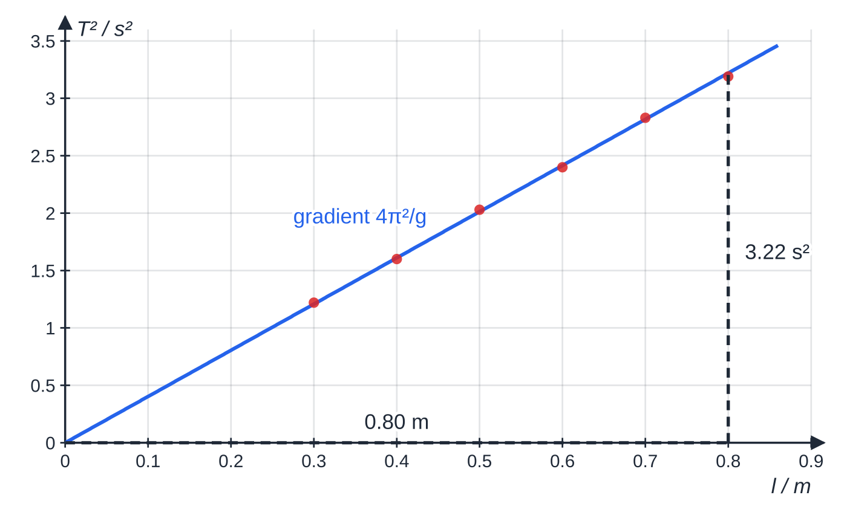
How can an oscillation be used to measure g? (continued)
Section 7 of 13
Specimen results for six lengths (20 oscillations timed for each). The best-fit line passes through the origin within the scatter; the triangle rises 3.22 s² over 0.80 m.
Notes:
How can an oscillation be used to measure g?. Full notes: https://examinerprep.com/notes/edexcel-ial-physics/simple-harmonic-motion/

Slide 30
How can an oscillation be used to measure g? (continued)
Section 7 of 13 · Worked example 6 · Hard · Evaluate
WORKED EXAMPLE · QUESTION
(a) Use the gradient triangle on the graph to determine g. (b) For the 0.800 m length, 20 oscillations took 35.7 s; length ± 0.002 m, time for 20 oscillations ± 0.2 s. Calculate g from this single reading and its percentage uncertainty, and comment on the result from (a).
SOLUTION
(a) Gradient = 3.22 ÷0.80 = 4.025 s² m⁻¹ = 4π²/g, so g = 4π² ÷4.025: 9.81 m s⁻².
(b) T = 35.7 ÷20 = 1.785 s; g = 4π²l/T² = 4π² ×0.800 ÷1.785²: 9.91 m s⁻². The time is squared, so its percentage counts twice: l 0.25%, T 0.56%, total 0.25 + 2 ×0.56 = 1.4%: g = 9.91 ± 0.14 m s⁻². The range 9.77 to 10.05 m s⁻² includes 9.81 m s⁻², so the two agree; the graph uses all six readings and reduces the effect of random error in any one, so its value is the better one.
Notes:
How can an oscillation be used to measure g?: Worked example 6. Full notes: https://examinerprep.com/notes/edexcel-ial-physics/simple-harmonic-motion/

Slide 31
How can an oscillation be used to measure g? (continued)
Section 7 of 13
Exam tip — graphs beat constant errors
If l is measured to the top of the bob, every length is too short by the same amount. The T²–l line shifts sideways and gains an intercept, but its gradient, and so g, is unchanged. A single calculation has no such protection.
Notes:
How can an oscillation be used to measure g?. Full notes: https://examinerprep.com/notes/edexcel-ial-physics/simple-harmonic-motion/

Slide 32
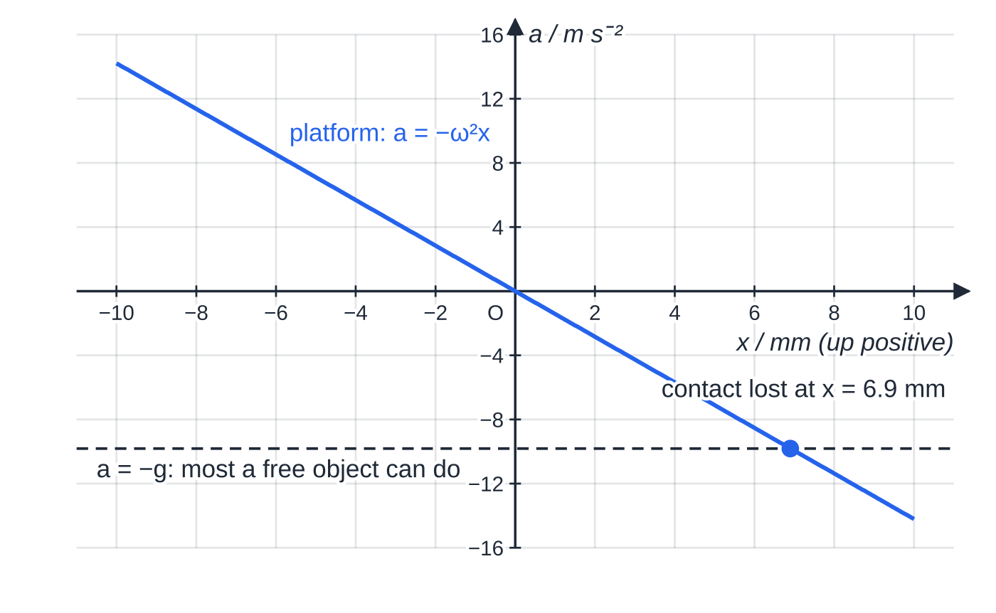
When does a resting object leave a vibrating surface?
Section 8 of 13
An object resting on (not fixed to) a surface moving with vertical SHM is pushed up by the contact force but can only be pulled down by its weight, so its largest possible downward acceleration is g. It stays in contact only while the surface's downward acceleration is no more than g. That acceleration is largest at the top of the motion, Aω², so contact is kept throughout if Aω² ≤g.
Platform acceleration against displacement at 6.0 Hz with A = 10 mm. Above x = 6.9 mm the platform accelerates downwards faster than g, so a resting object leaves it there.
Notes:
When does a resting object leave a vibrating surface?. Full notes: https://examinerprep.com/notes/edexcel-ial-physics/simple-harmonic-motion/

Slide 33
When does a resting object leave a vibrating surface? (continued)
Section 8 of 13 · Worked example 7 · Hard · Calculate
WORKED EXAMPLE · QUESTION
A sensor rests, unfixed, on a platform vibrating vertically with SHM at 6.0 Hz; g = 9.81 m s⁻². (a) Calculate the largest amplitude for which it stays in contact. (b) At 5.0 mm amplitude, calculate the maximum acceleration of the platform and the highest frequency at which the sensor still stays in contact. (c) At 10 mm amplitude, state where the sensor first loses contact.
SOLUTION
(a) ω= 2π×6.0 = 37.7 rad s⁻¹; A_(max) = g/ω² = 9.81 ÷37.7² = 6.90 ×10⁻³ m: 6.9 mm.
(b) a_(max) = Aω² = 0.0050 ×37.7²: 7.1 m s⁻², less than g, so contact is kept. Highest frequency: f = √(9.81 ÷0.0050) ÷2π: 7.0 Hz.
(c) ω²x = g at x = 6.9 mm above equilibrium, on the way up; the sensor leaves the platform there.
Notes:
When does a resting object leave a vibrating surface?: Worked example 7. Full notes: https://examinerprep.com/notes/edexcel-ial-physics/simple-harmonic-motion/

Slide 34
Exam tips for 5.5
Section 9 of 13
Exam tip 1 — define SHM in two parts
Acceleration proportional to displacement from equilibrium, and always directed towards equilibrium. Writing a = -ω²x and saying what each symbol means gives both.
Exam tip 2 — radians, always
Every ωt is in radians. Switch to radian mode before the first calculation, and back to degrees only for angles such as a pendulum's release angle.
Exam tip 3 — know which way you are timing
x = Acos ωt starts at an extreme; x = Asin ωt starts at equilibrium. Read where timing starts and keep the matching velocity equation.
Notes:
Exam tips for 5.5. Full notes: https://examinerprep.com/notes/edexcel-ial-physics/simple-harmonic-motion/

Slide 35
Exam tips for 5.5 (continued)
Section 9 of 13
Exam tip 4 — signs carry direction
State the positive direction. "−0.445 m s⁻¹, taking upwards as positive" means moving downwards at 0.445 m s⁻¹, not a mistake.
Exam tip 5 — linearise for a graph
Plot T² against l (gradient 4π²/g) or T² against m (gradient 4π²/k). When a quantity is squared, double its percentage uncertainty.
Notes:
Exam tips for 5.5. Full notes: https://examinerprep.com/notes/edexcel-ial-physics/simple-harmonic-motion/

Slide 36
Common misconceptions
Section 10 of 13
Misconception | Why it is wrong | Correct idea
Any oscillation with a restoring force is SHM. | The restoring force must also be proportional to displacement. | Test that a/x is a negative constant (or a–x is a straight line through the origin).
At the extremes the acceleration is zero because the object stops. | Velocity is momentarily zero, but displacement, and so restoring force, is greatest there. | Acceleration is maximum, Aω², at ±A; zero at equilibrium.
A bigger swing takes longer. | A bigger displacement brings a proportionally bigger restoring force, so the object moves faster. | The period of SHM is independent of amplitude (for a pendulum, only at small angles).
A heavier pendulum bob swings more slowly. | Mass appears in both the restoring force and the inertia, and cancels. | T = 2π√(l/g) has no mass in it.
A mass on a spring would have a different period on the Moon. | Gravity only shifts the equilibrium position. | T = 2π√(m/k) has no g in it.
Notes:
Common misconceptions. Full notes: https://examinerprep.com/notes/edexcel-ial-physics/simple-harmonic-motion/

Slide 37
Common misconceptions (continued)
Section 10 of 13
Misconception | Why it is wrong | Correct idea
Velocity and displacement are in antiphase. | Velocity is greatest when displacement is zero. | Velocity is a quarter cycle (π/2) ahead of displacement; acceleration is in antiphase (π).
Notes:
Common misconceptions. Full notes: https://examinerprep.com/notes/edexcel-ial-physics/simple-harmonic-motion/

Slide 38
How this topic connects
Section 11 of 13
Hooke's law (Unit 1) and circular motion (Unit 4)
F = kΔx for a spring is why a mass–spring system is SHM; the same k appears in T = 2π√(m/k). ω is in rad s⁻¹ because the shadow of an object moving in a circle at angular speed ω moves with SHM of angular frequency ω.
Waves (Unit 2)
Each particle of a medium carrying a sinusoidal wave oscillates with SHM; the phase difference between particles is the same idea as the phase difference between x, v and a here.
Energy, damping and resonance (next Oscillations page)
Kinetic and potential energy are exchanged during each cycle; real oscillators lose energy, and a driven oscillator responds most strongly near its natural frequency 1/T.
Notes:
How this topic connects. Full notes: https://examinerprep.com/notes/edexcel-ial-physics/simple-harmonic-motion/

Slide 39
Key equations
Section 12 of 13
Equation | Use | In the formulae list?
F = -kx | condition for SHM in terms of force | yes
a = -ω²x | condition for SHM; acceleration at any displacement | yes
x = Acos ωt | displacement at time t (timed from an extreme) | yes
v = -Aωsin ωt | velocity at time t | yes
a = -Aω²cos ωt | acceleration at time t | yes
T = 1/f = 2π/ω, ω= 2πf | linking period, frequency and angular frequency | yes
T = 2π√(m/k) | period of a mass on a spring | yes
T = 2π√(l/g) | period of a simple pendulum, small angles | yes
v_(max) = Aω, a_(max) = Aω² | maximum speed (at equilibrium) and acceleration (at the extremes) | no — derive it from the sin and cos equations
Notes:
Key equations. Full notes: https://examinerprep.com/notes/edexcel-ial-physics/simple-harmonic-motion/

Slide 40
Key equations (continued)
Section 12 of 13
Equation | Use | In the formulae list?
T² = (4π²/g) l | straight-line graph to find g | no — square the pendulum equation
Notes:
Key equations. Full notes: https://examinerprep.com/notes/edexcel-ial-physics/simple-harmonic-motion/

Slide 41
Check your understanding
Section 13 of 13
1. A ball bounces repeatedly on a hard floor, reaching the same height each time. Explain why its motion is not simple harmonic.
2. An oscillator has a frequency of 2.5 Hz. Calculate its period and angular frequency.
3. An object moves with SHM of amplitude 0.12 m and period 1.5 s. Calculate its maximum speed and maximum acceleration.
4. At an instant, an oscillator is at its maximum positive displacement. State its velocity and the direction of its acceleration.
5. A pendulum's length is increased from 0.40 m to 2.42 m. By what factor does its period change?
Notes:
Check your understanding: questions. Full notes: https://examinerprep.com/notes/edexcel-ial-physics/simple-harmonic-motion/

Slide 42
Check your understanding · answers
Section 13 of 13
1. Between bounces its acceleration is g downwards whatever its height, so the acceleration is not proportional to its displacement from any fixed point.
2. T = 1/2.5 = 0.40 s; ω= 2π×2.5 = 15.7 rad s⁻¹.
3. ω= 2π/1.5 = 4.19 rad s⁻¹; v_(max) = 0.12 ×4.19 = 0.50 m s⁻¹; a_(max) = 0.12 ×4.19² = 2.11 m s⁻².
4. Velocity zero; acceleration maximum and in the negative direction (towards equilibrium).
5. T ∝√l; the length increases by a factor of 6.05, so the period increases by √6.05 = 2.46 (about 2.5).
Notes:
Check your understanding: answers. Full notes: https://examinerprep.com/notes/edexcel-ial-physics/simple-harmonic-motion/

Slide 43
Practice questions
5 original exam-style questions. Answers at the end of the deck.

Slide 44
Question 1
1 mark
Which statement describes the acceleration of an object moving with simple harmonic motion?
A constant in size and always directed towards the equilibrium position
B proportional to the displacement from the equilibrium position and always directed towards it
C proportional to the displacement from the equilibrium position and always directed away from it
D proportional to the velocity and always in the opposite direction to the velocity
Notes:
Online with the full mark scheme: https://examinerprep.com/ial-physics-5-5-simple-harmonic-motion-questions#IALP-U5-5-A-01

Slide 45
Question 2
1 mark
The tip of a vibrating ruler moves with simple harmonic motion of amplitude 0.040 m and period 0.50 s.
What is the maximum speed of the tip?
A 0.080 m s⁻¹
B 0.50 m s⁻¹
C 1.0 m s⁻¹
D 6.3 m s⁻¹
Notes:
Online with the full mark scheme: https://examinerprep.com/ial-physics-5-5-simple-harmonic-motion-questions#IALP-U5-5-A-03

Slide 46
Question 3
1 mark
An object moves with simple harmonic motion. At one instant its displacement from the equilibrium position is zero.
Which row describes the object at this instant?
A speed maximum, acceleration zero
B speed zero, acceleration zero
C speed zero, acceleration maximum
D speed maximum, acceleration maximum
Notes:
Online with the full mark scheme: https://examinerprep.com/ial-physics-5-5-simple-harmonic-motion-questions#IALP-U5-5-A-04

Slide 47
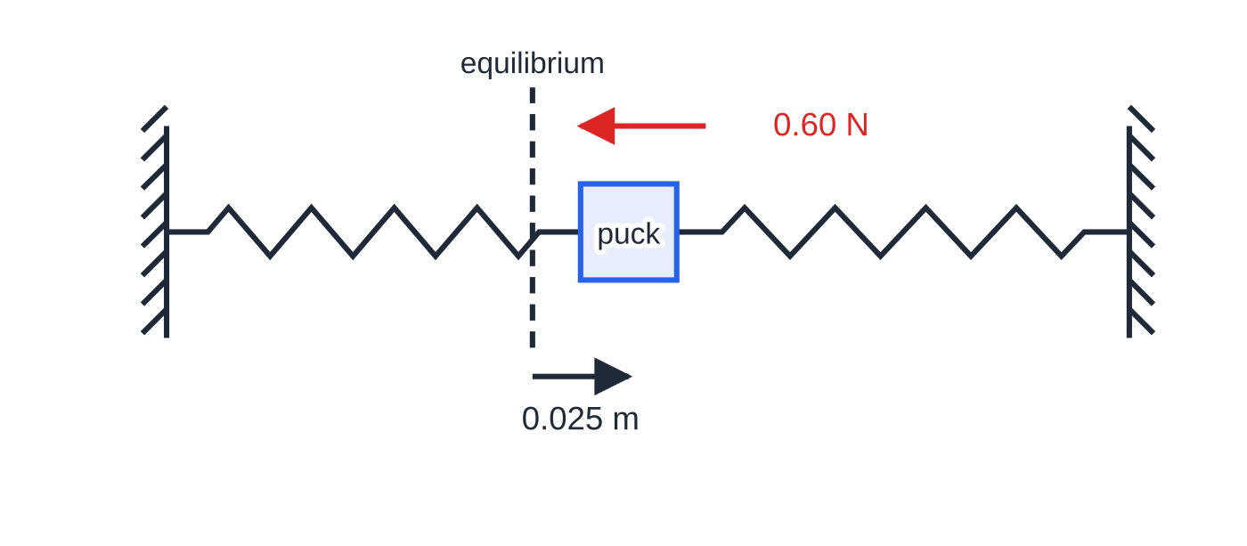
Question 4
4 marks
A puck on a level air table is attached between two stretched springs. When the puck is displaced 0.025 m from its equilibrium position, the resultant force on it is 0.60 N towards the equilibrium position.
Figure: puck displaced from equilibrium between two springs (not to scale)
(a) State the conditions for an object to move with simple harmonic motion. [2]
(b) The puck moves with simple harmonic motion. Calculate the constant k in F = −kx for this system. [1]
(c) Calculate the size of the resultant force on the puck when its displacement is 0.040 m. [1]
Notes:
Online with the full mark scheme: https://examinerprep.com/ial-physics-5-5-simple-harmonic-motion-questions#IALP-U5-5-B-01

Slide 48
Question 5
5 marks
The prong of a tuning fork vibrates with simple harmonic motion at 440 Hz. The amplitude of the tip of the prong is 0.80 mm.
(a) Calculate the angular frequency of the vibration. [1]
(b) Calculate the maximum speed of the tip of the prong. [2]
(c) Calculate the maximum acceleration of the tip of the prong. [2]
Notes:
Online with the full mark scheme: https://examinerprep.com/ial-physics-5-5-simple-harmonic-motion-questions#IALP-U5-5-B-02

Slide 49
Answers

Slide 50
Question 1 · answer
Answer B
SHM requires a = −ω²x: the acceleration is proportional to the displacement and directed towards the equilibrium position (the minus sign).
Notes:
Full mark scheme: https://examinerprep.com/ial-physics-5-5-simple-harmonic-motion-questions#IALP-U5-5-A-01

Slide 51
Question 2 · answer
Answer B
ω = 2π/T = 2π ÷ 0.50 = 12.6 rad s⁻¹. vₘₐₓ = Aω = 0.040 × 12.57 = 0.50 m s⁻¹.
Notes:
Full mark scheme: https://examinerprep.com/ial-physics-5-5-simple-harmonic-motion-questions#IALP-U5-5-A-03

Slide 52
Question 3 · answer
Answer A
At equilibrium x = 0, so a = −ω²x = 0. The speed is greatest there, Aω: speed maximum, acceleration zero.
Notes:
Full mark scheme: https://examinerprep.com/ial-physics-5-5-simple-harmonic-motion-questions#IALP-U5-5-A-04

Slide 53
Question 4 · answer
Mark scheme
acceleration (or resultant force) proportional to the displacement from the equilibrium position
and always directed towards the equilibrium position / opposite to the displacement
k = 0.60 ÷ 0.025 = 24 N m⁻¹
24 × 0.040 = 0.96 N (towards equilibrium)
Notes:
Full mark scheme: https://examinerprep.com/ial-physics-5-5-simple-harmonic-motion-questions#IALP-U5-5-B-01

Slide 54
Question 5 · answer
Mark scheme
ω = 2π × 440 = 2.76 × 10³ rad s⁻¹
vₘₐₓ = Aω = 0.80 × 10⁻³ × 2765
= 2.2 m s⁻¹ (2.21)
aₘₐₓ = Aω² = 0.80 × 10⁻³ × 2765²
= 6.1 × 10³ m s⁻²
Notes:
Full mark scheme: https://examinerprep.com/ial-physics-5-5-simple-harmonic-motion-questions#IALP-U5-5-B-02

Slide 55
Keep practising
Notes for this topic
Questions on this topic
Build a printable test
ExaminerPrep is an independent tutoring service. It has been developed independently from and is not endorsed by the International Baccalaureate Organization. "International Baccalaureate", "IB" and "IB Diploma Programme" are registered trademarks of the IBO, used here for descriptive purposes only.
Pearson Edexcel and Cambridge are trademarks of their owners; ExaminerPrep is not affiliated with any exam board.

