Slide 1
EP
EDEXCEL IAL PHYSICS
5.1 Specific heat capacity and specific latent heat
The full notes page in 12 sections · practice questions with answers · simulations
ExaminerPrep is an independent tutoring service. It has been developed independently from and is not endorsed by the International Baccalaureate Organization. "International Baccalaureate", "IB" and "IB Diploma Programme" are registered trademarks of the IBO, used here for descriptive purposes only.
Pearson Edexcel and Cambridge are trademarks of their owners; ExaminerPrep is not affiliated with any exam board.
Notes:
5.1 Specific heat capacity and specific latent heat. Notes for this topic: https://examinerprep.com/notes/edexcel-ial-physics/specific-heat-capacity-and-specific-latent-heat/

Slide 2
What this page covers
Overview
Specific heat capacity and ΔE = mcΔθ
Measuring a specific heat capacity with an electrical heater, E = VIt, and reducing heat losses
Specific latent heat of fusion and of vaporisation, and ΔE = LΔm
Heating and cooling curves: sloping and flat sections
Core Practical 13: measuring a specific latent heat (control funnel; boiling at two powers)
The method of mixtures
Core Practical 12: calibrating a thermistor in a potential divider as a thermostat
Notes:
What this page covers. Full notes: https://examinerprep.com/notes/edexcel-ial-physics/specific-heat-capacity-and-specific-latent-heat/

Slide 3
In one minute
Key points
1. Two equations do almost all the work here, ΔE = mcΔθ for a change of temperature and ΔE = LΔm for a change of state, and each experiment measures c or L by supplying a known energy E = VIt.
2. Specific heat capacity: energy to raise the temperature of 1 kg by 1 K.
3. Specific latent heat: energy to change the state of 1 kg with no change of temperature.
4. Heat losses make a measured c or L too large unless you correct for them.
5. On a heating curve, sloping sections have gradient P/mc; flat sections are changes of state, where energy raises the molecules' potential energy, not their kinetic energy.
6. A calibrated thermistor potential divider gives an output p.d. that marks a set temperature, which is how a thermostat works.
Notes:
In one minute. Full notes: https://examinerprep.com/notes/edexcel-ial-physics/specific-heat-capacity-and-specific-latent-heat/

Slide 4
What is specific heat capacity?
Section 1 of 12
Specific heat capacity c: the energy needed to raise the temperature of 1 kg of a substance by 1 K (or 1 °C). Unit: J kg⁻¹ K⁻¹.
Energy supplied to a material goes into its internal energy, the random kinetic and potential energies of its molecules (topic 5.2); a rise in temperature means a rise in their mean kinetic energy. Doubling the mass doubles the energy needed, and some substances need more energy per kilogram per kelvin than others. Together:
ΔE = mcΔθ
with ΔE in J, m in kg, c in J kg⁻¹ K⁻¹ and Δθ in K or °C. It is in the formulae list supplied in the exam, and is valid only with no change of state and over a range where c is constant.
Notes:
What is specific heat capacity?. Full notes: https://examinerprep.com/notes/edexcel-ial-physics/specific-heat-capacity-and-specific-latent-heat/

Slide 5
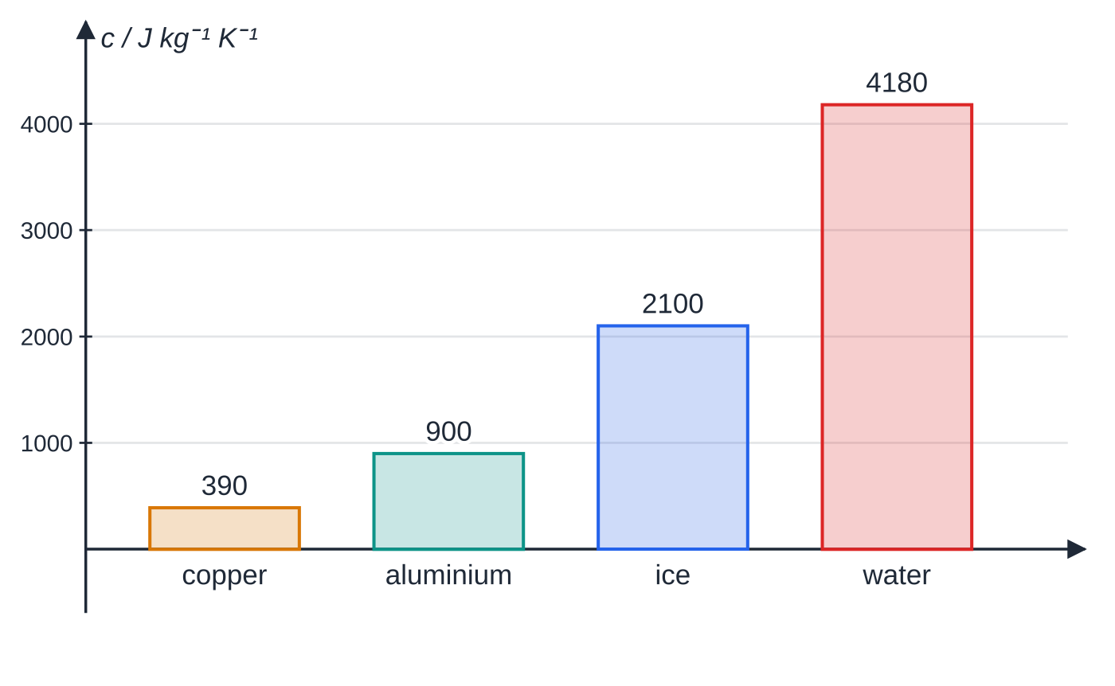
What is specific heat capacity? (continued)
Section 1 of 12
A temperature difference is the same in kelvin and in degrees Celsius (20 °C to 30 °C is a rise of 10 K); only absolute temperatures need the +273.
Water's value, 4180 J kg⁻¹ K⁻¹, is unusually large; aluminium is about 900 and copper about 390 J kg⁻¹ K⁻¹. A large c means a lot of energy for a small temperature change, which is why water is used in heating systems and car radiators, and why the sea warms slowly.
Specific heat capacities used on this page. The same energy warms a kilogram of copper about ten times as much as a kilogram of water.
Notes:
What is specific heat capacity?. Full notes: https://examinerprep.com/notes/edexcel-ial-physics/specific-heat-capacity-and-specific-latent-heat/

Slide 6
What is specific heat capacity? (continued)
Section 1 of 12 · Worked example 1 · Easy · Calculate
WORKED EXAMPLE · QUESTION
A tea urn contains 3.50 kg of water at 18.0 °C. Its heating element has a power of 2.40 kW; c of water = 4180 J kg⁻¹ K⁻¹. (a) Calculate the energy needed to heat the water to 95.0 °C. (b) Calculate the minimum time this takes. (c) Explain why the actual time is longer.
SOLUTION
(a) Δθ= 95.0 - 18.0 = 77.0 K, so ΔE = 3.50 ×4180 ×77.0 = 1 126 510 J: 1.13 ×10⁶ J.
(b) t = ΔE / P = 1 126 510 ÷2400: 469 s (about 7.8 minutes).
(c) Some of the element's energy heats the urn itself and some is transferred to the surroundings, and these losses grow as the water gets hotter.
Notes:
What is specific heat capacity?: Worked example 1. Full notes: https://examinerprep.com/notes/edexcel-ial-physics/specific-heat-capacity-and-specific-latent-heat/

Slide 7
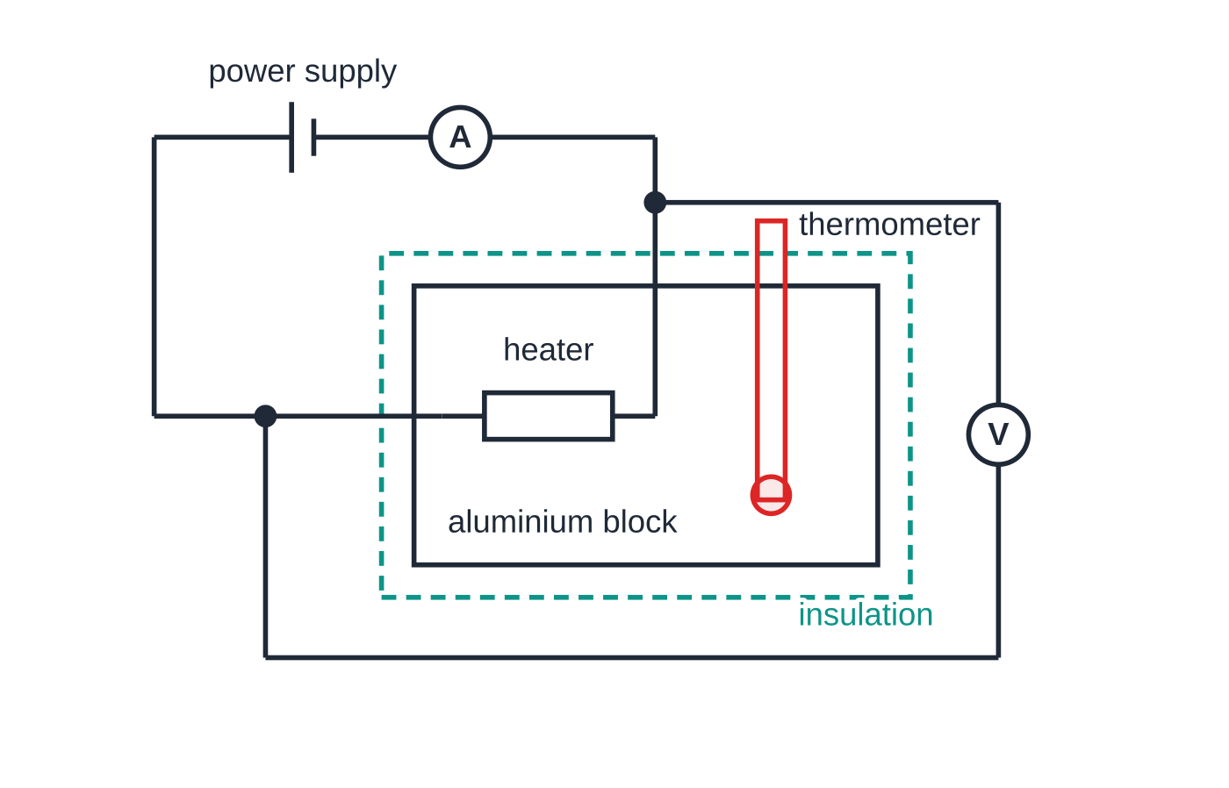
How do you measure a specific heat capacity electrically?
Section 2 of 12
Supply a measured electrical energy E = VIt to a known mass and measure the temperature rise. If no energy is lost, VIt = mcΔθ, so c = VIt/(mΔθ).
Apparatus: a metal block with an immersion heater in one hole and a thermometer (or temperature sensor) in the other; an ammeter in series with the heater and a voltmeter across it, so VI is the power delivered to the block; a stopwatch and a balance.
The electrical method: ammeter in series with the heater, voltmeter across the heater only, insulation round the block.
Notes:
How do you measure a specific heat capacity electrically?. Full notes: https://examinerprep.com/notes/edexcel-ial-physics/specific-heat-capacity-and-specific-latent-heat/

Slide 8
How do you measure a specific heat capacity electrically? (continued)
Section 2 of 12
Reducing losses: insulate the block; put a drop of oil or water in the thermometer hole for good thermal contact; keep the rise to about 10–30 K so the block never gets far above room temperature. Check V and I stay steady, record the temperature every 30 s or 60 s and plot θ against t. For a liquid, put the heater in a measured mass of liquid in an insulated container and stir before each reading.
Why use the gradient of a temperature–time graph?
Dividing VIt = mcΔθ by time gives
VI = mc Δθ/Δt ⇒ c = VI/(m ×gradient)
Not in the formulae list: derive it from E = VIt and ΔE = mcΔθ. Use the gradient of the straight early part of the graph. At first the block is at room temperature and loses almost nothing; later it loses energy faster, so the graph curves below its starting tangent.
Notes:
How do you measure a specific heat capacity electrically?. Full notes: https://examinerprep.com/notes/edexcel-ial-physics/specific-heat-capacity-and-specific-latent-heat/

Slide 9
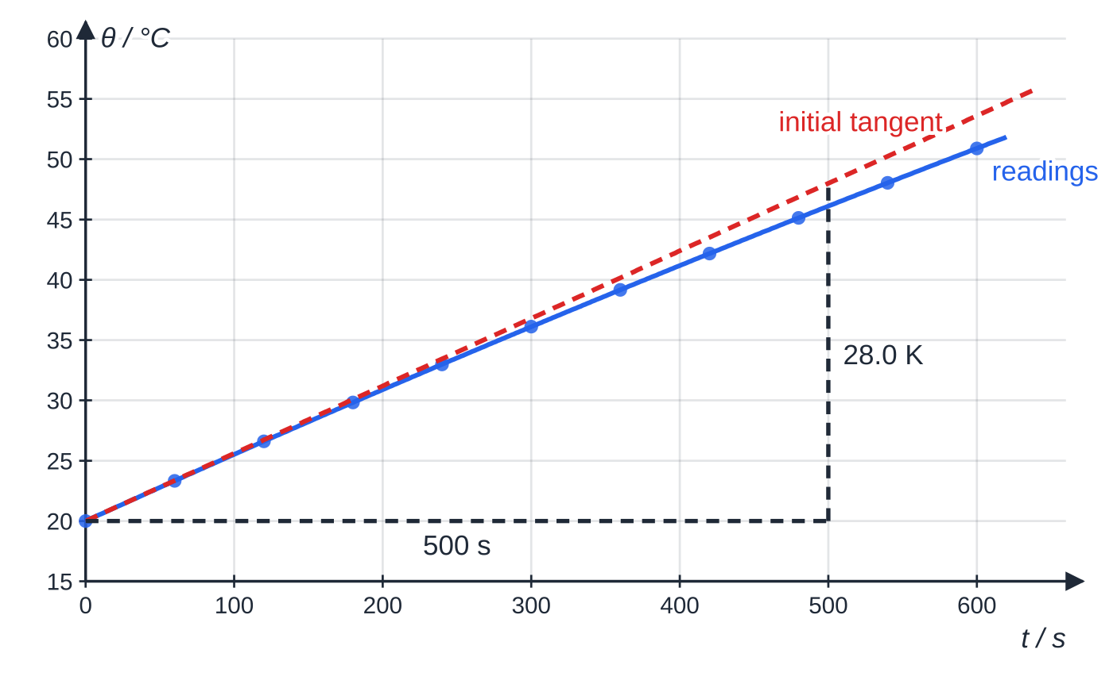
How do you measure a specific heat capacity electrically? (continued)
Section 2 of 12
A 1.00 kg aluminium block heated at 12.0 V and 4.20 A (50.4 W). The initial tangent rises 28.0 K in 500 s; later readings fall below it as losses grow.
Notes:
How do you measure a specific heat capacity electrically?. Full notes: https://examinerprep.com/notes/edexcel-ial-physics/specific-heat-capacity-and-specific-latent-heat/

Slide 10
How do you measure a specific heat capacity electrically? (continued)
Section 2 of 12 · Worked example 2 · Medium · Determine
WORKED EXAMPLE · QUESTION
Use the graph above (mass 1.00 kg, 12.0 V, 4.20 A). (a) Determine the specific heat capacity of aluminium from the initial gradient. (b) A student instead uses the first and last readings, 20.0 °C at 0 s and 50.9 °C at 600 s. Calculate the value this gives and explain why it is larger.
SOLUTION
(a) Gradient = 28.0 ÷500 = 0.0560 K s⁻¹, so c = (12.0 ×4.20)/(1.00 ×0.0560): c = 900 J kg⁻¹ K⁻¹.
(b) c = (50.4 ×600)/(1.00 ×30.9): 979 J kg⁻¹ K⁻¹, 8.7% larger. Over 600 s some energy is lost to the surroundings, so Δθ is smaller than without losses; dividing the full energy by too small a Δθ gives too large a c.
Notes:
How do you measure a specific heat capacity electrically?: Worked example 2. Full notes: https://examinerprep.com/notes/edexcel-ial-physics/specific-heat-capacity-and-specific-latent-heat/

Slide 11
How do you measure a specific heat capacity electrically? (continued)
Section 2 of 12
Common error
Saying heat losses make the measured c smaller. The energy supplied is measured correctly; the temperature rise is too small, and since c = E/(mΔθ), c comes out larger.
Notes:
How do you measure a specific heat capacity electrically?. Full notes: https://examinerprep.com/notes/edexcel-ial-physics/specific-heat-capacity-and-specific-latent-heat/

Slide 12
What is specific latent heat?
Section 3 of 12
Specific latent heat L: the energy needed to change the state of 1 kg of a substance without any change in temperature. Unit: J kg⁻¹.
ΔE = LΔm
Δm is the mass that changes state (kg). This is in the formulae list supplied in the exam. The same energy is released when the change is reversed (freezing, condensing).
Change of state | Name of L | Water (values used on this page)
solid ↔ liquid (melting, freezing) | specific latent heat of fusion | 3.34 × 10⁵ J kg⁻¹
liquid ↔ gas (boiling, condensing) | specific latent heat of vaporisation | 2.26 × 10⁶ J kg⁻¹
Notes:
What is specific latent heat?. Full notes: https://examinerprep.com/notes/edexcel-ial-physics/specific-heat-capacity-and-specific-latent-heat/

Slide 13
What is specific latent heat? (continued)
Section 3 of 12
Why does the temperature stay constant?
Temperature is linked to the mean kinetic energy of the molecules. During a change of state the energy does work against the attractive forces between molecules, separating them: it raises their potential energy. Their mean kinetic energy, and so the temperature, does not change even though energy is still being supplied.
Vaporisation needs about seven times more energy than fusion for water. Melting only loosens the arrangement; boiling separates the molecules completely and the expanding gas also pushes back the atmosphere.
Notes:
What is specific latent heat?. Full notes: https://examinerprep.com/notes/edexcel-ial-physics/specific-heat-capacity-and-specific-latent-heat/

Slide 14
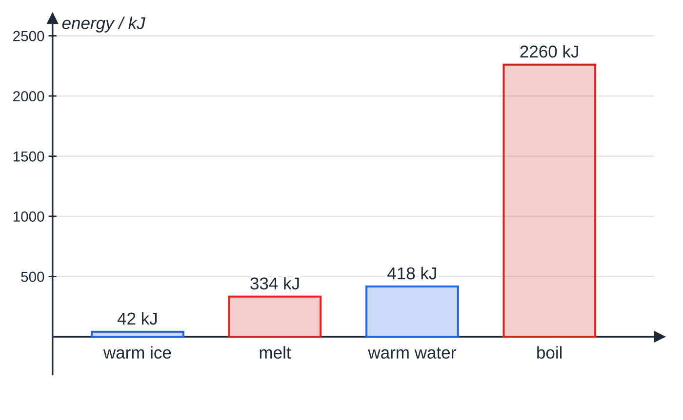
What is specific latent heat? (continued)
Section 3 of 12
Boiling is 2260 kJ of the 3054 kJ total. It is also why steam at 100 °C scalds far worse than water at 100 °C: each kilogram releases 2.26 × 10⁶ J as it condenses, before it even starts to cool.
Energy to take 1.00 kg of ice at −20 °C to steam at 100 °C (c of ice 2100, c of water 4180 J kg⁻¹ K⁻¹). Boiling needs more than the other three stages together.
Notes:
What is specific latent heat?. Full notes: https://examinerprep.com/notes/edexcel-ial-physics/specific-heat-capacity-and-specific-latent-heat/

Slide 15
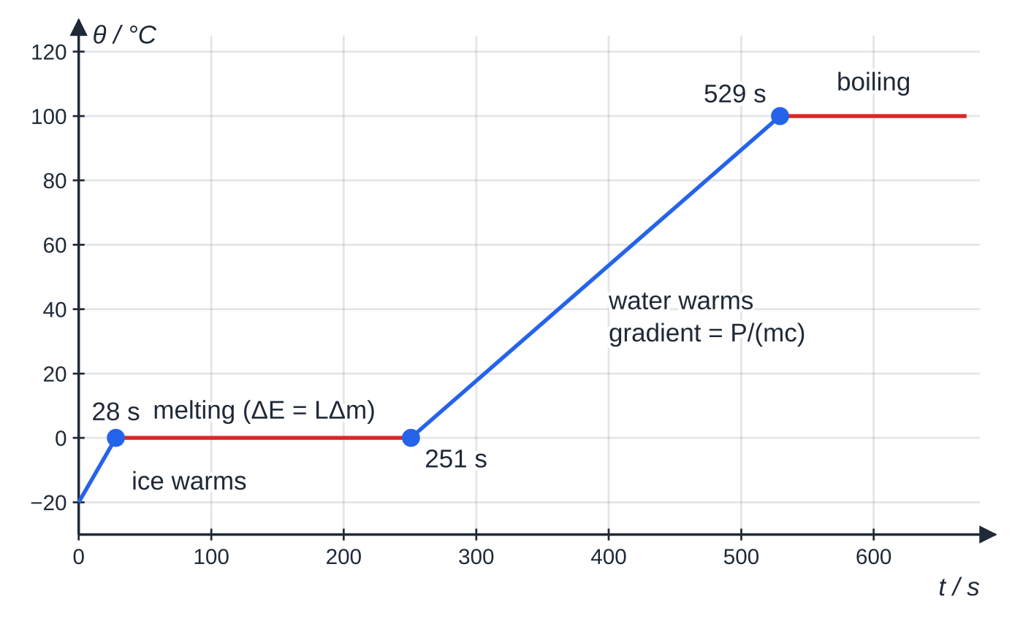
What do heating and cooling curves show?
Section 4 of 12
Heat a substance at a constant rate and plot temperature against time. Each sloping section is one state warming; each flat section is a change of state.
Sloping section: P = mc ×gradient, so the gradient is inversely proportional to c. Ice (2100 J kg⁻¹ K⁻¹) warms about twice as fast as the same mass of water.
Flat section: P ×(plateau length) = mL, so the plateau length is proportional to L.
0.200 kg of ice from −20 °C heated at 300 W, computed with no losses. The boiling plateau lasts until 2036 s, far off the graph.
Notes:
What do heating and cooling curves show?. Full notes: https://examinerprep.com/notes/edexcel-ial-physics/specific-heat-capacity-and-specific-latent-heat/

Slide 16
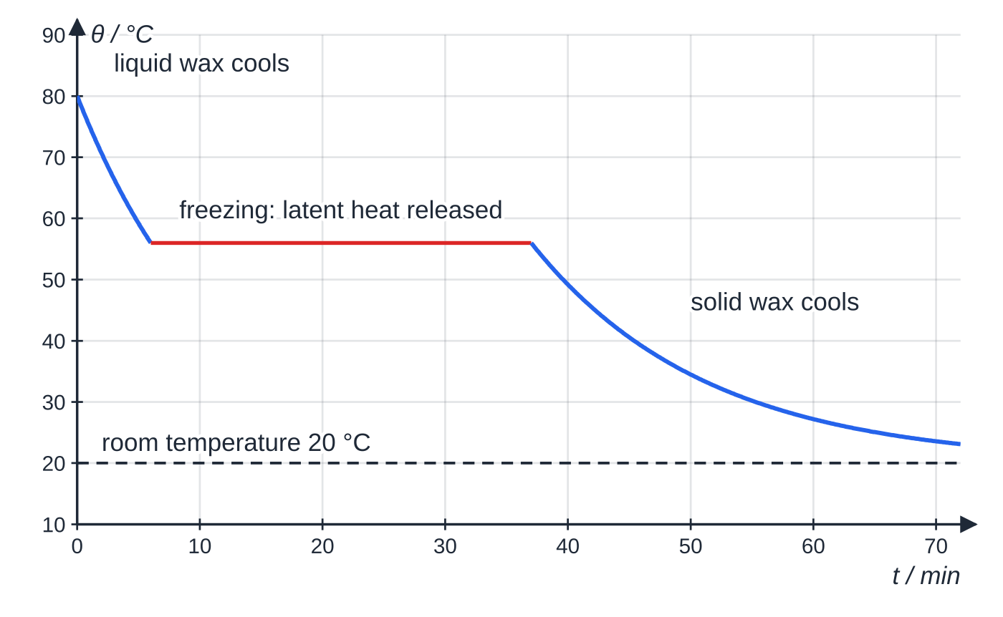
What do heating and cooling curves show? (continued)
Section 4 of 12
A cooling curve is the same story in reverse: the temperature levels off at the freezing point while latent heat is released, and falls again only once all the liquid is solid. The sloping parts are curved because the cooling rate depends on how much hotter the sample is than the room.
Molten wax cooling in a 20 °C room: it stays at 56 °C for about 31 minutes while latent heat is released.
Notes:
What do heating and cooling curves show?. Full notes: https://examinerprep.com/notes/edexcel-ial-physics/specific-heat-capacity-and-specific-latent-heat/

Slide 17
What do heating and cooling curves show? (continued)
Section 4 of 12 · Worked example 3 · Medium · Determine
WORKED EXAMPLE · QUESTION
The heating curve above is for 0.200 kg of ice heated at a steady 300 W, all absorbed by the sample; c of water = 4180 J kg⁻¹ K⁻¹. (a) Use the melting plateau to determine the specific latent heat of fusion. (b) Use the two sloping sections to determine the specific heat capacity of ice. (c) Calculate how long the water would take to boil away completely (L = 2.26 × 10⁶ J kg⁻¹).
SOLUTION
(a) Melting lasts from 28 s to 251 s: ΔE = 300 ×223 = 66 900 J, L = 66 900 ÷0.200 = 334 500 J kg⁻¹. Times read from a graph justify 2 s.f.: 3.3 ×10⁵ J kg⁻¹.
(b) Ice: 20 K in 28 s, 0.714 K s⁻¹. Water: 100 K from 251 s to 529 s, 100 ÷278 = 0.360 K s⁻¹. Same P and m, so c ∝1/gradient: c_ice = 4180 ×0.360 ÷0.714: 2100 J kg⁻¹ K⁻¹.
(c) t = mL/P = 0.200 ×2.26 ×10⁶ ÷300 = 1507 s: about 25 minutes, longer than all the earlier stages together.
Notes:
What do heating and cooling curves show?: Worked example 3. Full notes: https://examinerprep.com/notes/edexcel-ial-physics/specific-heat-capacity-and-specific-latent-heat/

Slide 18
What do heating and cooling curves show? (continued)
Section 4 of 12
Exam tip — compare stages by ratios
With the same heater and mass throughout, gradients give the inverse ratio of specific heat capacities and plateau lengths give the ratio of latent heats. No energy calculation is needed.
Notes:
What do heating and cooling curves show?. Full notes: https://examinerprep.com/notes/edexcel-ial-physics/specific-heat-capacity-and-specific-latent-heat/

Slide 19
Core Practical 13: how do you measure a specific latent heat?
Section 5 of 12
Fusion: melting ice with a heater and a control
Fill two identical funnels with crushed, already-melting ice (so at 0 °C), each draining into a beaker. A low-voltage heater goes in one; the other is the control.
When both drip steadily, empty the beakers and start the heater and stopwatch together. Record V and I.
After time t, switch off and weigh the water collected in each beaker.
Both funnels gain the same energy from the room, so subtracting the control's mass leaves the ice melted by the heater alone:
L = VIt/(m_heated - m_control)
Not in the formulae list: derive it from E = VIt and ΔE = LΔm.
Notes:
Core Practical 13: how do you measure a specific latent heat?. Full notes: https://examinerprep.com/notes/edexcel-ial-physics/specific-heat-capacity-and-specific-latent-heat/

Slide 20
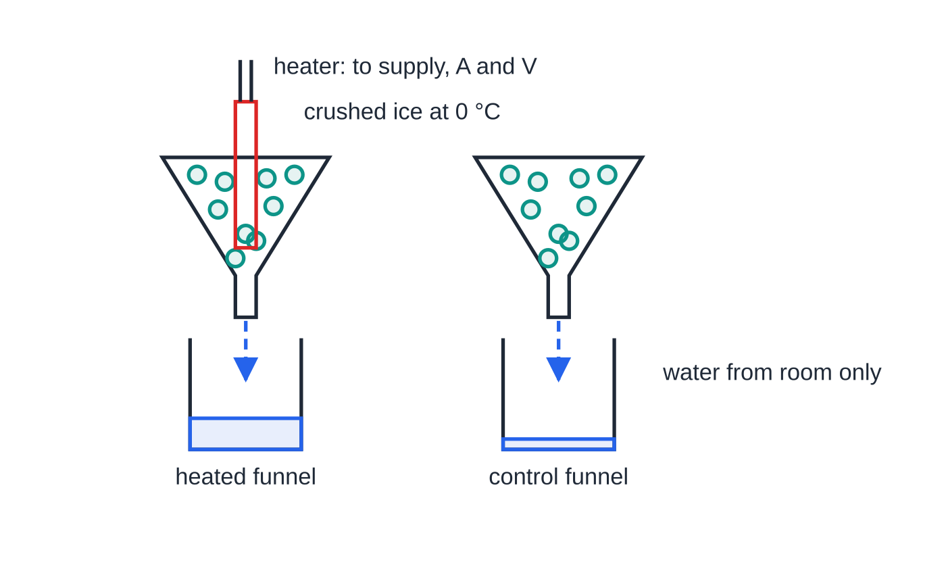
Core Practical 13: how do you measure a specific latent heat? (continued)
Section 5 of 12
The funnel method. The difference between the two masses of water is the ice melted by the heater alone.
Notes:
Core Practical 13: how do you measure a specific latent heat?. Full notes: https://examinerprep.com/notes/edexcel-ial-physics/specific-heat-capacity-and-specific-latent-heat/

Slide 21
Core Practical 13: how do you measure a specific latent heat? (continued)
Section 5 of 12 · Worked example 4 · Hard · Evaluate
WORKED EXAMPLE · QUESTION
The heater runs for 300 ± 1 s at 11.8 ± 0.1 V and 3.95 ± 0.05 A. The heated funnel collects 52.6 g of water and the control 9.8 g, each ± 0.1 g. (a) Calculate the specific latent heat of fusion of ice. (b) Calculate its percentage uncertainty. (c) The accepted value is 3.34 × 10⁵ J kg⁻¹. Comment on the result.
SOLUTION
(a) E = 11.8 ×3.95 ×300 = 13 983 J; Δm = 52.6 - 9.8 = 42.8 g; L = 13 983 ÷0.0428: 3.27 ×10⁵ J kg⁻¹.
(b) Percentage uncertainties add for a product and quotient; the difference Δm carries ± 0.2 g. V 0.85%, I 1.27%, t 0.33%, Δm 0.2 ÷42.8 = 0.47%: 2.9%, so L = (3.27 ±0.10) ×10⁵ J kg⁻¹.
(c) Difference (3.34 - 3.267) ÷3.34 = 2.2%, less than 2.9%: it agrees with the accepted value within its uncertainty.
Notes:
Core Practical 13: how do you measure a specific latent heat?: Worked example 4. Full notes: https://examinerprep.com/notes/edexcel-ial-physics/specific-heat-capacity-and-specific-latent-heat/

Slide 22
Core Practical 13: how do you measure a specific latent heat? (continued)
Section 5 of 12
Exam tip — systematic errors push L up
Ice colder than 0 °C (some energy warms the ice instead of melting it) and a heater not fully covered by ice (some energy heats the air) both mean less ice melts per joule, so L comes out too large.
Vaporisation: boiling water at two powers
Keep water boiling steadily in an insulated container on a balance and record the mass lost in a measured time; then repeat at a second power. Heat is lost at a rate h that depends on the container's temperature, the same in both runs because the water stays at 100 °C. So P₁ t = Lm₁ + ht and P₂ t = Lm₂ + ht, and subtracting removes h:
L = ((P₂ - P₁) t)/(m₂ - m₁)
Not in the formulae list: derive it from the two energy equations.
Notes:
Core Practical 13: how do you measure a specific latent heat?. Full notes: https://examinerprep.com/notes/edexcel-ial-physics/specific-heat-capacity-and-specific-latent-heat/

Slide 23
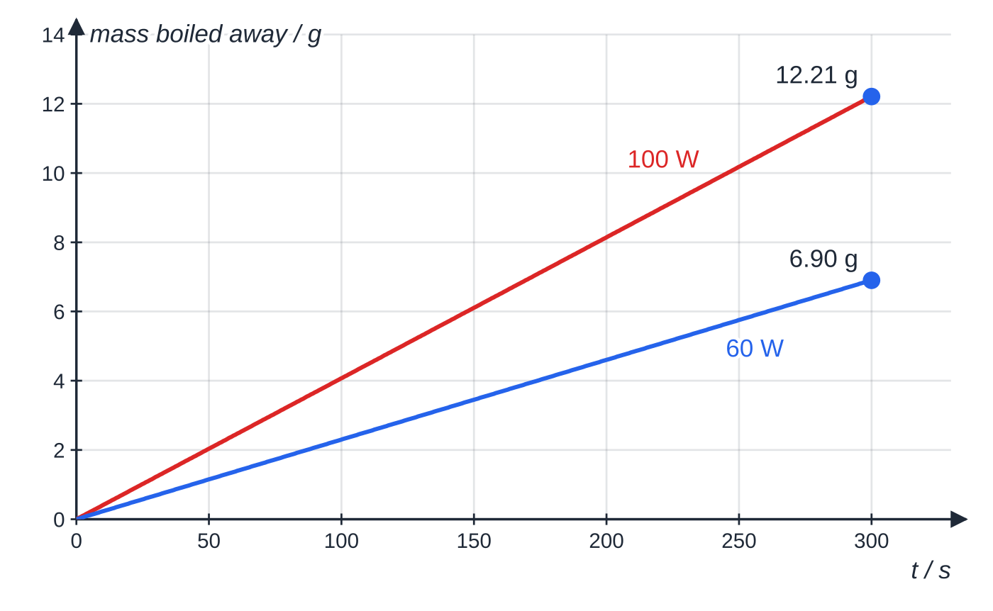
Core Practical 13: how do you measure a specific latent heat? (continued)
Section 5 of 12
Mass boiled away at 60 W and 100 W, computed with L = 2.26 × 10⁶ J kg⁻¹ and the same 8.0 W loss in both runs. Each gradient is (P − h)/L.
Notes:
Core Practical 13: how do you measure a specific latent heat?. Full notes: https://examinerprep.com/notes/edexcel-ial-physics/specific-heat-capacity-and-specific-latent-heat/

Slide 24
Core Practical 13: how do you measure a specific latent heat? (continued)
Section 5 of 12 · Worked example 5 · Medium · Calculate
WORKED EXAMPLE · QUESTION
In 300 s, 6.90 g of boiling water boils away at 60.0 W and 12.21 g at 100.0 W. (a) Calculate the specific latent heat of vaporisation. (b) Calculate the rate of heat loss. (c) Calculate the value obtained by ignoring heat loss and using only the 60.0 W run.
SOLUTION
(a) L = ((100.0 - 60.0) ×300)/((12.21 - 6.90) ×10⁻³) = 12 000/(5.31 ×10⁻³): 2.26 ×10⁶ J kg⁻¹.
(b) h = 60.0 - (2.26 ×10⁶ ×6.90 ×10⁻³)/300: 8.0 W.
(c) L = 60.0 ×300 ÷6.90 ×10⁻³: 2.61 ×10⁶ J kg⁻¹, about 15% too large.
Notes:
Core Practical 13: how do you measure a specific latent heat?: Worked example 5. Full notes: https://examinerprep.com/notes/edexcel-ial-physics/specific-heat-capacity-and-specific-latent-heat/

Slide 25
How does the method of mixtures work?
Section 6 of 12
Put a hot object and a cold one in contact in an insulated container and energy flows from hot to cold until they share a final temperature. If none is lost, energy lost by the hot part = energy gained by the cold part.
Write one term for every stage of every part: mcΔθ for each temperature change, LΔm for each change of state. Ice that melts and then warms needs two terms.
Each Δθ is (higher − lower temperature) for that part, so every term is positive.
It can find an unknown c, L, final temperature or mass, but is less accurate than the electrical method because energy is lost during the transfer and while the mixture settles.
Notes:
How does the method of mixtures work?. Full notes: https://examinerprep.com/notes/edexcel-ial-physics/specific-heat-capacity-and-specific-latent-heat/

Slide 26
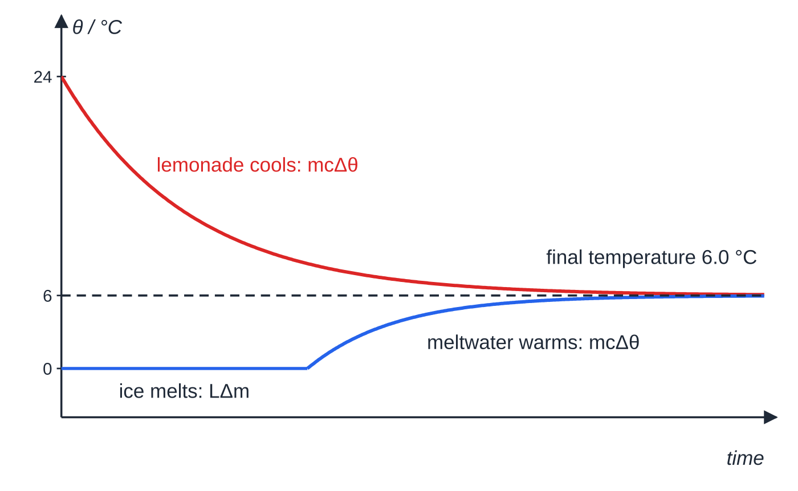
How does the method of mixtures work? (continued)
Section 6 of 12
Ice cooling a drink (sketch): the lemonade cools; the ice melts at 0 °C, then its meltwater warms. Both end at the same temperature.
Notes:
How does the method of mixtures work?. Full notes: https://examinerprep.com/notes/edexcel-ial-physics/specific-heat-capacity-and-specific-latent-heat/

Slide 27
How does the method of mixtures work? (continued)
Section 6 of 12 · Worked example 6 · Medium · Calculate
WORKED EXAMPLE · QUESTION
A glass holds 0.250 kg of lemonade at 24.0 °C. Ice at 0 °C is added until, when all has melted, the mixture is at 6.0 °C. Take c of lemonade and water as 4180 J kg⁻¹ K⁻¹ and L of fusion as 3.34 × 10⁵ J kg⁻¹; ignore the glass and surroundings. Calculate the mass of ice added.
SOLUTION
Lost by the lemonade: 0.250 ×4180 ×18.0 = 18 810 J. Gained per kilogram of ice (melt, then warm 0 → 6.0 °C): 3.34 ×10⁵ + 4180 ×6.0 = 359 080 J kg⁻¹. So m = 18 810 ÷359 080: 0.052 kg (52.4 g).
Forgetting that the meltwater warms gives 18 810 ÷3.34 ×10⁵ = 0.056 kg, too much ice.
Notes:
How does the method of mixtures work?: Worked example 6. Full notes: https://examinerprep.com/notes/edexcel-ial-physics/specific-heat-capacity-and-specific-latent-heat/

Slide 28
How does the method of mixtures work? (continued)
Section 6 of 12
Common error
Using one Δθ for both parts, or the final temperature as if it were the change. Each part has its own temperature change; they share only the final temperature.
Notes:
How does the method of mixtures work?. Full notes: https://examinerprep.com/notes/edexcel-ial-physics/specific-heat-capacity-and-specific-latent-heat/

Slide 29
Core Practical 12: how do you calibrate a thermistor as a thermostat?
Section 7 of 12
An NTC thermistor in series with a variable resistor across a fixed supply forms a potential divider; a voltmeter (or data logger) measures the output across the resistor. As the temperature rises the thermistor's resistance falls, so its share of the supply p.d. falls and the output rises (resistance–temperature behaviour is covered in Unit 2). The same current flows through both, so
Vₒᵤₜ = Vᵢₙ ×R/(R + Rₜₕ)
Not in the formulae list: derive it from V = IR.
Notes:
Core Practical 12: how do you calibrate a thermistor as a thermostat?. Full notes: https://examinerprep.com/notes/edexcel-ial-physics/specific-heat-capacity-and-specific-latent-heat/

Slide 30
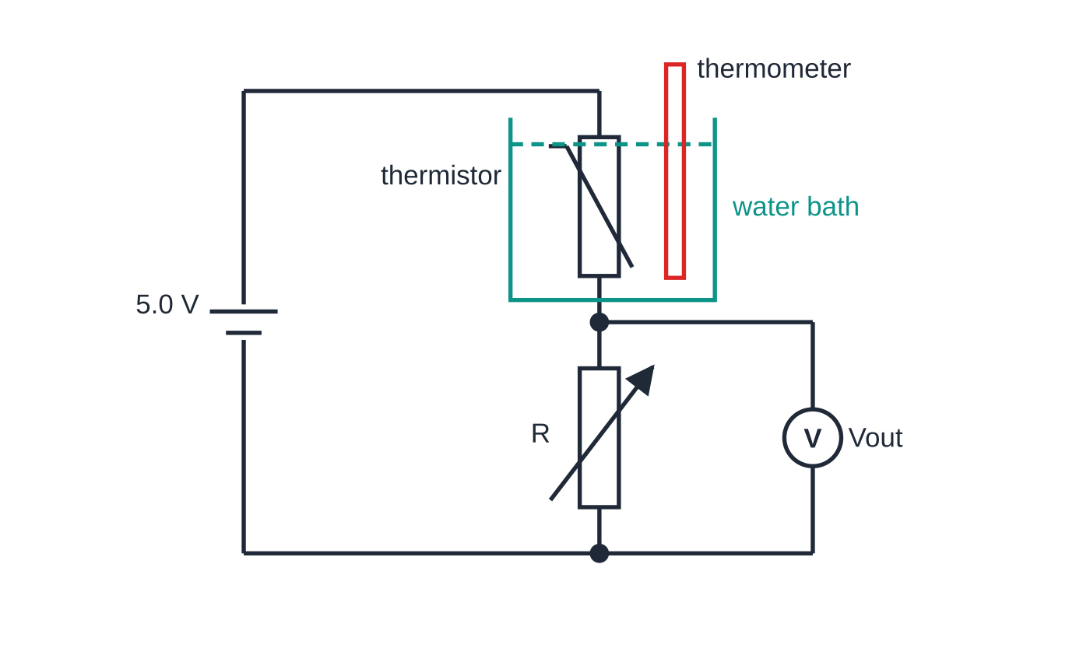
Core Practical 12: how do you calibrate a thermistor as a thermostat? (continued)
Section 7 of 12
Calibrating: put the thermistor in a water bath beside a thermometer, start with iced water and heat gently in steps of about 10 °C to near 100 °C. Stir, wait for steady readings, record θ and Vₒᵤₜ; repeat while cooling and average. The graph of Vₒᵤₜ against θ is the calibration curve that converts later readings into temperatures.
As a thermostat: a switching circuit turns a heater off when Vₒᵤₜ rises above a set value and on again when it falls below; the variable resistor sets that temperature.
Calibration circuit. Thermistor and thermometer sit close together in the stirred bath so they are at the same temperature; the output is taken across R.
Notes:
Core Practical 12: how do you calibrate a thermistor as a thermostat?. Full notes: https://examinerprep.com/notes/edexcel-ial-physics/specific-heat-capacity-and-specific-latent-heat/

Slide 31
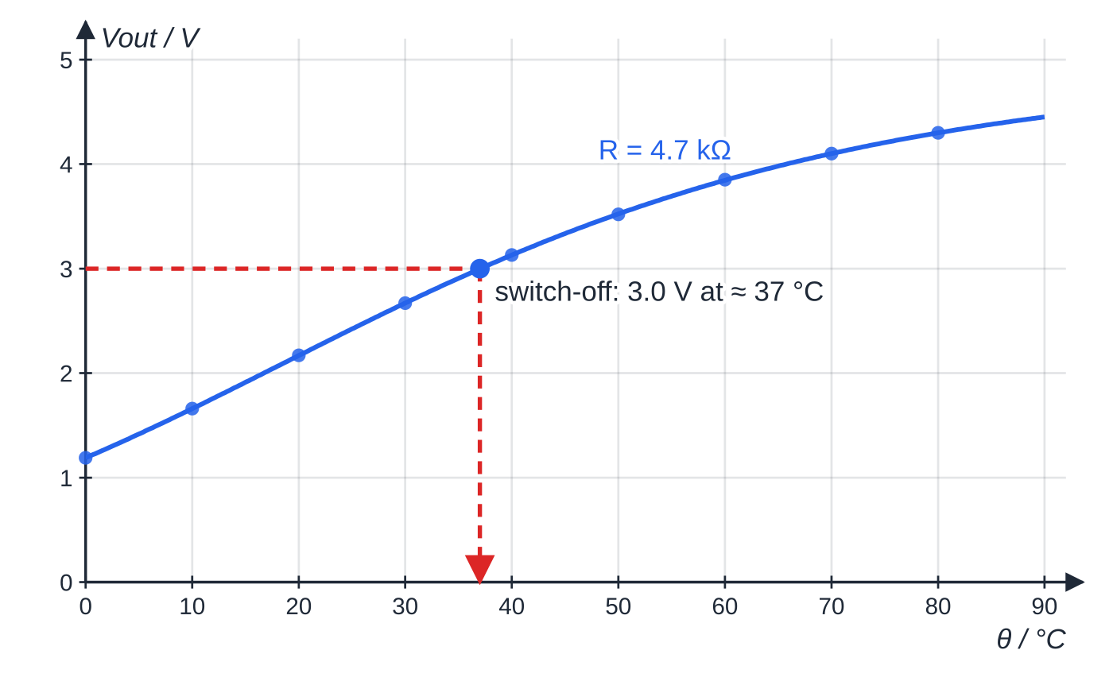
Core Practical 12: how do you calibrate a thermistor as a thermostat? (continued)
Section 7 of 12
Keep the supply and the resistor setting fixed after calibrating, since changing either moves the whole curve. Safety: low-voltage supply, connections out of the water (or the thermistor sealed in a thin tube), care with hot water.
Thermistor of 5.0 kΩ at 25 °C, R = 4.7 kΩ, 5.0 V supply. Output rises from 1.19 V at 0 °C to 4.30 V at 80 °C, steepest (most sensitive) where the thermistor's resistance is close to R.
Notes:
Core Practical 12: how do you calibrate a thermistor as a thermostat?. Full notes: https://examinerprep.com/notes/edexcel-ial-physics/specific-heat-capacity-and-specific-latent-heat/

Slide 32
Core Practical 12: how do you calibrate a thermistor as a thermostat? (continued)
Section 7 of 12 · Worked example 7 · Hard · Calculate and explain
WORKED EXAMPLE · QUESTION
The circuit above (R = 4.7 kΩ) switches a heater off when Vₒᵤₜ reaches 3.0 V. The thermistor is 5.0 kΩ at 25 °C. (a) Use the curve to find the switch-off temperature and calculate the thermistor's resistance then. (b) For an aquarium the switch-off must be at 25 °C. Calculate the new setting of R. (c) Explain why the circuit must be recalibrated.
SOLUTION
(a) Reading across from 3.0 V: θ≈37 °C. Then 2.0 V is across the thermistor and the current is the same in both, so Rₜₕ = 4.7 ×2.0 ÷3.0: 3.13 kΩ.
(b) At 25 °C the thermistor (5.0 kΩ) must take 2.0 V while R takes 3.0 V: R = 5.0 ×3.0 ÷2.0: 7.5 kΩ.
(c) A larger R gives a larger output at every temperature, so the old curve no longer converts Vₒᵤₜ into θ; a new curve is needed to check the switching temperature and read other temperatures.
Notes:
Core Practical 12: how do you calibrate a thermistor as a thermostat?: Worked example 7. Full notes: https://examinerprep.com/notes/edexcel-ial-physics/specific-heat-capacity-and-specific-latent-heat/

Slide 33
Core Practical 12: how do you calibrate a thermistor as a thermostat? (continued)
Section 7 of 12
Exam tip — reason with shares
Hotter → thermistor resistance falls → its share of the p.d. falls → the p.d. across the resistor rises. With the output across the thermistor instead, it falls as temperature rises.
Notes:
Core Practical 12: how do you calibrate a thermistor as a thermostat?. Full notes: https://examinerprep.com/notes/edexcel-ial-physics/specific-heat-capacity-and-specific-latent-heat/

Slide 34
Exam tips for 5.1
Section 8 of 12
Exam tip 1 — kelvin or Celsius?
For Δθ either scale gives the same number. Use kelvin only for absolute temperatures (gas laws, 5.2). Write the unit of c as J kg⁻¹ K⁻¹.
Exam tip 2 — convert grams to kilograms
Masses are often given in grams. Convert before using ΔE = mcΔθ or ΔE = LΔm; an answer 1000 times too big is the usual sign.
Exam tip 3 — say which way losses push the answer
"Energy is lost to the surroundings" is not enough. Finish the chain: less energy reaches the sample → smaller Δθ (or less mass changes state) → calculated c (or L) too large.
Notes:
Exam tips for 5.1. Full notes: https://examinerprep.com/notes/edexcel-ial-physics/specific-heat-capacity-and-specific-latent-heat/

Slide 35
Exam tips for 5.1 (continued)
Section 8 of 12
Exam tip 4 — one term per stage
List every stage before writing numbers: warm the solid, melt, warm the liquid, boil. Each is a separate mcΔθ or LΔm term.
Exam tip 5 — explain the flat section with energy, not "heat"
Say the energy increases the potential energy of the molecules (weakening or breaking the bonds between them) while their mean kinetic energy, and so the temperature, stays constant.
Notes:
Exam tips for 5.1. Full notes: https://examinerprep.com/notes/edexcel-ial-physics/specific-heat-capacity-and-specific-latent-heat/

Slide 36
Common misconceptions
Section 9 of 12
Misconception | Why it is wrong | Correct idea
When the temperature stops rising, no more energy is going in. | The heater is still on; the energy is changing the state. | During a change of state, energy raises the molecules' potential energy at constant temperature.
Heat losses make the measured c too small. | The energy is measured correctly; the temperature rise is too small. | c = E/(mΔθ) with Δθ too small, so c is too large.
A temperature change must be converted to kelvin by adding 273. | The 273 cancels in the difference. | Δθ has the same value in K and in °C.
Steam and water at 100 °C carry the same energy. | Steam also holds the latent heat of vaporisation. | Each kilogram of steam releases 2.26 × 10⁶ J more as it condenses, so steam scalds badly.
The control funnel checks that the heater works. | It measures melting caused by the room. | Its mass is subtracted so only the heater's melting is used.
Notes:
Common misconceptions. Full notes: https://examinerprep.com/notes/edexcel-ial-physics/specific-heat-capacity-and-specific-latent-heat/

Slide 37
Common misconceptions (continued)
Section 9 of 12
Misconception | Why it is wrong | Correct idea
A thermistor circuit gives the temperature directly. | The output depends on the supply, the resistor and the thermistor. | It must be calibrated against a thermometer, for that supply and resistor only.
Notes:
Common misconceptions. Full notes: https://examinerprep.com/notes/edexcel-ial-physics/specific-heat-capacity-and-specific-latent-heat/

Slide 38
How this topic connects
Section 10 of 12
2 Internal energy and the ideal gas
The energy in ΔE = mcΔθ and ΔE = LΔm goes into internal energy, which 5.2 splits into random kinetic and potential energies and links to absolute temperature.
Electrical power, thermistors and potential dividers (Unit 2)
E = VIt and P = VI supply the energy in every method here, with the usual meter placement. Why an NTC thermistor's resistance falls with temperature, and how a potential divider shares p.d., come from Unit 2; Core Practical 12 puts them to work.
Practical skills and uncertainties (Unit 6)
Combining percentage uncertainties, comparing a percentage difference with an uncertainty, and removing a systematic error by subtraction (control funnel, two powers) all reappear in the practical paper.
Notes:
How this topic connects. Full notes: https://examinerprep.com/notes/edexcel-ial-physics/specific-heat-capacity-and-specific-latent-heat/

Slide 39
Key equations
Section 11 of 12
Equation | Use | In the formulae list?
ΔE = mcΔθ | energy for a temperature change, no change of state (c in J kg⁻¹ K⁻¹) | yes
ΔE = LΔm | energy for a change of state at constant temperature (L in J kg⁻¹) | yes
E = VIt, P = VI | energy and power from an electrical heater | yes
c = VI/(m ×gradient of θ–t) | specific heat capacity from a heating graph | no — derive it from VIt = mcΔθ
L = VIt/(m_heated - m_control) | funnel method for the latent heat of fusion | no — derive it
L = ((P₂ - P₁)t)/(m₂ - m₁) | two-power method, heat loss cancels | no — derive it
energy lost by hot part = energy gained by cold part | method of mixtures | no — a statement of energy conservation, learn it
Vₒᵤₜ = Vᵢₙ ×R/(R + Rₜₕ) | output of the thermistor potential divider | no — derive it from V = IR
Notes:
Key equations. Full notes: https://examinerprep.com/notes/edexcel-ial-physics/specific-heat-capacity-and-specific-latent-heat/

Slide 40
Check your understanding
Section 12 of 12
1. Calculate the energy needed to warm a 0.40 kg copper pan from 20 °C to 70 °C (c = 385 J kg⁻¹ K⁻¹).
2. Explain why boiling water stays at 100 °C while the kettle element is still on.
3. A 0.150 kg steel bolt (c = 490 J kg⁻¹ K⁻¹) at 95.0 °C is dropped into 0.300 kg of water at 18.0 °C. Find the final temperature, ignoring losses.
4. A 2.2 kW kettle is left on after the water boils. How long does it take to boil away 0.10 kg of water? (L = 2.26 × 10⁶ J kg⁻¹)
5. In Core Practical 12, why must the thermistor and thermometer be close together and the water stirred before each reading?
6. On a heating curve with one heater and one sample, the liquid section has half the gradient of the solid section. Find c_liquid/c_solid.
Notes:
Check your understanding: questions. Full notes: https://examinerprep.com/notes/edexcel-ial-physics/specific-heat-capacity-and-specific-latent-heat/

Slide 41
Check your understanding · answers
Section 12 of 12
1. ΔE = 0.40 ×385 ×50 = 7700 J (7.7 kJ).
2. The energy increases the potential energy of the molecules as they separate to form steam. Their mean kinetic energy does not increase, so the temperature stays constant until all the water has boiled.
3. 0.150 ×490 ×(95.0 - θ) = 0.300 ×4180 ×(θ- 18.0) gives θ= 22.3 °C. The water's much larger mc keeps it close to its starting temperature.
4. t = 0.10 ×2.26 ×10⁶ ÷2200 = 103 s, assuming all the energy goes into the water.
5. So the thermistor is at the temperature the thermometer shows. Without stirring, water near the heat source is hotter, and each output p.d. would be paired with the wrong temperature.
6. Same P and m, so c ∝1/gradient: the ratio is 2, as for water and ice (4180 ÷ 2100 ≈ 2.0).
Notes:
Check your understanding: answers. Full notes: https://examinerprep.com/notes/edexcel-ial-physics/specific-heat-capacity-and-specific-latent-heat/

Slide 42
Practice questions
5 original exam-style questions. Answers at the end of the deck.

Slide 43
Question 1
1 mark
0.050 kg of ice at 0 °C is added to 0.400 kg of water at 30.0 °C in an insulated container. All the ice melts. Specific heat capacity of water = 4180 J kg⁻¹ K⁻¹. Specific latent heat of fusion of ice = 3.34 × 10⁵ J kg⁻¹.
What is the final temperature of the water?
A 18 °C
B 20 °C
C 21 °C
D 27 °C
Notes:
Online with the full mark scheme: https://examinerprep.com/ial-physics-5-1-specific-heat-capacity-and-specific-latent-heat-questions#IALP-U5-1-A-09

Slide 44
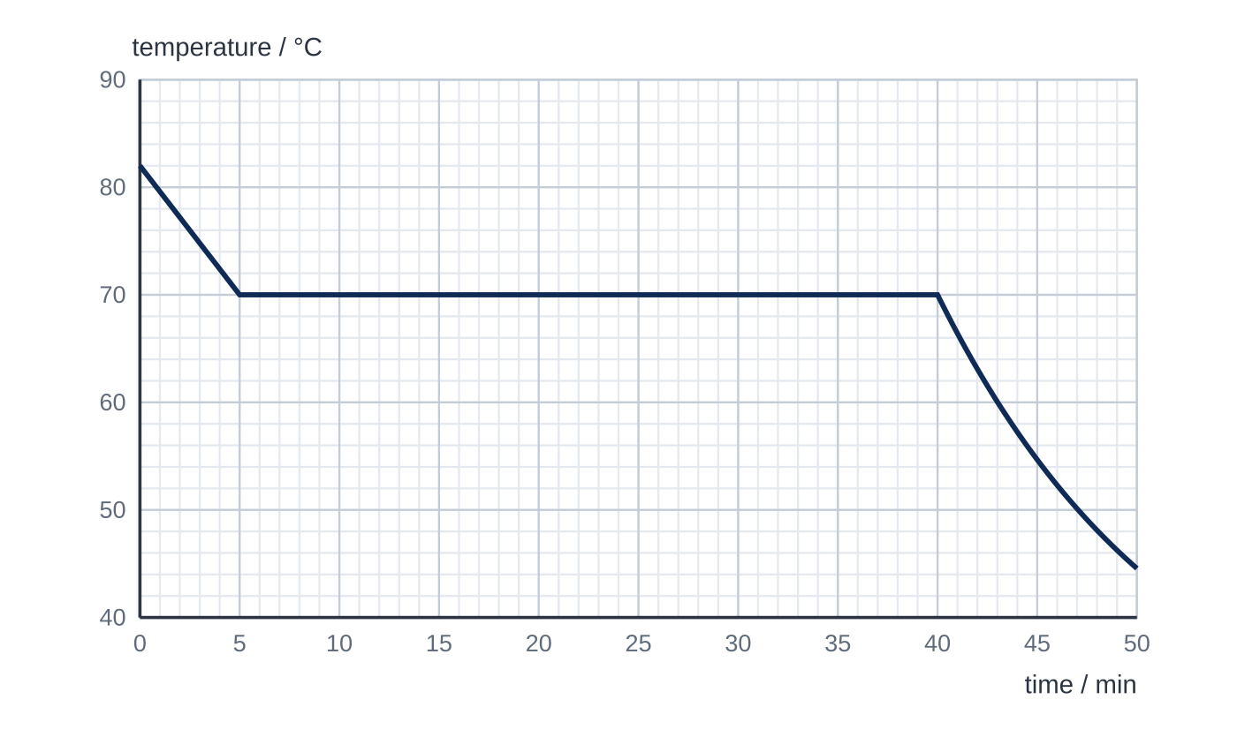
Question 2
1 mark
A tube of a molten compound cools in the air. The graph is its cooling curve; just before it begins to solidify, the liquid cools at a steady rate. The specific heat capacity of the liquid compound is 2300 J kg⁻¹ K⁻¹. Assume that the rate of energy loss to the surroundings is the same just before and during solidification.
What is the specific latent heat of fusion of the compound?
A 3.2 × 10³ J kg⁻¹
B 1.9 × 10⁵ J kg⁻¹
C 2.2 × 10⁵ J kg⁻¹
D 1.2 × 10⁷ J kg⁻¹
Notes:
Online with the full mark scheme: https://examinerprep.com/ial-physics-5-1-specific-heat-capacity-and-specific-latent-heat-questions#IALP-U5-1-FA-09

Slide 45
Question 3
1 mark
Which is the SI unit of specific latent heat?
A J
B J K⁻¹
C J kg⁻¹
D J kg⁻¹ K⁻¹
Notes:
Online with the full mark scheme: https://examinerprep.com/ial-physics-5-1-specific-heat-capacity-and-specific-latent-heat-questions#IALP-U5-1-A-01

Slide 46
Question 4
8 marks
A coffee machine heats milk by passing steam at 100 °C into it. The steam condenses in the milk. A jug contains 0.180 kg of milk at 5.0 °C, which is to be heated to 65.0 °C. Specific heat capacity of milk = 3900 J kg⁻¹ K⁻¹. Specific heat capacity of water = 4180 J kg⁻¹ K⁻¹. Specific latent heat of vaporisation of water = 2.26 × 10⁶ J kg⁻¹.
(a) Calculate the energy gained by the milk. [2]
(b) Calculate the mass of steam that must condense in the milk. [3]
(c) Explain why steam heats the milk far more effectively than the same mass of water at 100 °C would. [2]
(d) State one assumption you made in your calculation. [1]
Notes:
Online with the full mark scheme: https://examinerprep.com/ial-physics-5-1-specific-heat-capacity-and-specific-latent-heat-questions#IALP-U5-1-B-05

Slide 47
Question 5
5 marks
A travel kettle has a heating element of power 2.00 kW. It contains 0.750 kg of water at 20.0 °C. Specific heat capacity of water = 4180 J kg⁻¹ K⁻¹.
(a) State what is meant by the specific heat capacity of a substance. [1]
(b) Calculate the energy needed to bring the water to 100 °C. [2]
(c) Calculate the minimum time this takes. [1]
(d) Give one reason why the actual time is longer. [1]
Notes:
Online with the full mark scheme: https://examinerprep.com/ial-physics-5-1-specific-heat-capacity-and-specific-latent-heat-questions#IALP-U5-1-B-01

Slide 48
Answers

Slide 49
Question 1 · answer
Answer A
Energy lost by the warm water = energy to melt the ice + energy to warm the meltwater: 0.400 × 4180 × (30.0 − θ) = 0.050 × 3.34 × 10⁵ + 0.050 × 4180 × θ. So 50 160 − 1672θ = 16 700 + 209θ, giving θ = 18 °C (17.8 °C).
Notes:
Full mark scheme: https://examinerprep.com/ial-physics-5-1-specific-heat-capacity-and-specific-latent-heat-questions#IALP-U5-1-A-09

Slide 50
Question 2 · answer
Answer B
Liquid cooling rate = (82 − 70) ÷ 300 s = 0.040 K s⁻¹, so the rate of energy loss is m × 2300 × 0.040. Solidification lasts 40 − 5 = 35 min = 2100 s, so mL = m × 2300 × 0.040 × 2100 and L = 1.9 × 10⁵ J kg⁻¹ (1.93 × 10⁵). The mass cancels.
Notes:
Full mark scheme: https://examinerprep.com/ial-physics-5-1-specific-heat-capacity-and-specific-latent-heat-questions#IALP-U5-1-FA-09

Slide 51
Question 3 · answer
Answer C
From ΔE = LΔm, L = ΔE/Δm, so its unit is J kg⁻¹. There is no kelvin in it because the temperature does not change during a change of state.
Notes:
Full mark scheme: https://examinerprep.com/ial-physics-5-1-specific-heat-capacity-and-specific-latent-heat-questions#IALP-U5-1-A-01

Slide 52
Question 4 · answer
Mark scheme
ΔE = 0.180 × 3900 × (65.0 − 5.0)
= 4.21 × 10⁴ J (42 120 J)
each kg of steam releases L on condensing and then 4180 × (100 − 65.0) as the condensed water cools
energy per kg = 2.26 × 10⁶ + 146 300 = 2.41 × 10⁶ J
m = 42 120 ÷ 2.406 × 10⁶ = 0.0175 kg (17.5 g) (allow error carried forward)
the steam releases its latent heat of vaporisation as it condenses
this is about 2.26 × 10⁶ J per kg, much more than the water releases in cooling from 100 °C to 65.0 °C (1.46 × 10⁵ J per kg)
no energy is transferred to the jug or the surroundings / the condensed water mixes with the milk and ends at 65.0 °C
Notes:
Full mark scheme: https://examinerprep.com/ial-physics-5-1-specific-heat-capacity-and-specific-latent-heat-questions#IALP-U5-1-B-05

Slide 53
Question 5 · answer
Mark scheme
the energy needed to raise the temperature of 1 kg of the substance by 1 K
Δθ = 80.0 K; ΔE = 0.750 × 4180 × 80.0
= 2.51 × 10⁵ J (250 800 J)
t = 250 800 ÷ 2000 = 125.4 s, so 126 s (rounded up: 125 s is too short) (allow error carried forward)
energy is also used to heat the kettle itself / energy is transferred to the surroundings
Notes:
Full mark scheme: https://examinerprep.com/ial-physics-5-1-specific-heat-capacity-and-specific-latent-heat-questions#IALP-U5-1-B-01

Slide 54
Keep practising
Notes for this topic
Questions on this topic
Build a printable test
ExaminerPrep is an independent tutoring service. It has been developed independently from and is not endorsed by the International Baccalaureate Organization. "International Baccalaureate", "IB" and "IB Diploma Programme" are registered trademarks of the IBO, used here for descriptive purposes only.
Pearson Edexcel and Cambridge are trademarks of their owners; ExaminerPrep is not affiliated with any exam board.

