Slide 1
EP
EDEXCEL IAL PHYSICS
5.8 Stars: radiation, distances and the HR diagram
The full notes page in 13 sections · practice questions with answers · simulations
ExaminerPrep is an independent tutoring service. It has been developed independently from and is not endorsed by the International Baccalaureate Organization. "International Baccalaureate", "IB" and "IB Diploma Programme" are registered trademarks of the IBO, used here for descriptive purposes only.
Pearson Edexcel and Cambridge are trademarks of their owners; ExaminerPrep is not affiliated with any exam board.
Notes:
5.8 Stars: radiation, distances and the HR diagram. Notes for this topic: https://examinerprep.com/notes/edexcel-ial-physics/stars-radiation-distances-and-the-hr-diagram/

Slide 2
What this page covers
Overview
Black-body radiators and how to read a black-body radiation curve
Wien's displacement law, λ_(max)T=2.898×10⁻³ m K, to find surface temperatures
The Stefan–Boltzmann law, L=σAT⁴, for the luminosity (power output) of a star
Intensity and the inverse-square law, I=L/4πd²
Distances: trigonometric parallax, the parsec and the light-year, and standard candles
The Hertzsprung–Russell (HR) diagram and how it shows the life cycle of stars of different masses
Notes:
What this page covers. Full notes: https://examinerprep.com/notes/edexcel-ial-physics/stars-radiation-distances-and-the-hr-diagram/

Slide 3
In one minute
Key points
1. A black body absorbs all radiation falling on it and emits a continuous spectrum whose shape depends only on its temperature, and stars are close to black bodies.
2. Wien: λ_(max)T=2.898×10⁻³ m K; hotter stars peak at shorter wavelengths (bluer). T is in kelvin.
3. Stefan–Boltzmann: L=σAT⁴ with A=4πr²; doubling the temperature multiplies the power by 16.
4. Inverse-square law: I=L/4πd². Measure I; know d and you find L; know L (a standard candle) and you find d.
5. Parallax: a nearby star shifts against distant stars as the Earth orbits; d=r/tan p. A star at 1 parsec has p = 1 arcsecond.
6. HR diagram: luminosity against temperature (hot on the left). Main sequence, red giants, supergiants and white dwarfs sit in distinct regions; a star's mass decides its path and its end.
Notes:
In one minute. Full notes: https://examinerprep.com/notes/edexcel-ial-physics/stars-radiation-distances-and-the-hr-diagram/

Slide 4
What is a black body, and what does its radiation curve show?
Section 1 of 13
Three equations and two diagrams unlock almost everything we know about stars. The colour of a star gives its temperature (Wien), temperature and size give its power output (Stefan–Boltzmann), and power and distance give how bright it looks from Earth (inverse-square law). All three rest on one idealisation.
A black body is an idealised object that absorbs all the electromagnetic radiation falling on it, and emits radiation with a spectrum that depends only on its temperature.
Every object above absolute zero emits electromagnetic radiation. A black body is the perfect emitter as well as the perfect absorber: no object at the same temperature emits more at any wavelength.
Notes:
What is a black body, and what does its radiation curve show?. Full notes: https://examinerprep.com/notes/edexcel-ial-physics/stars-radiation-distances-and-the-hr-diagram/

Slide 5
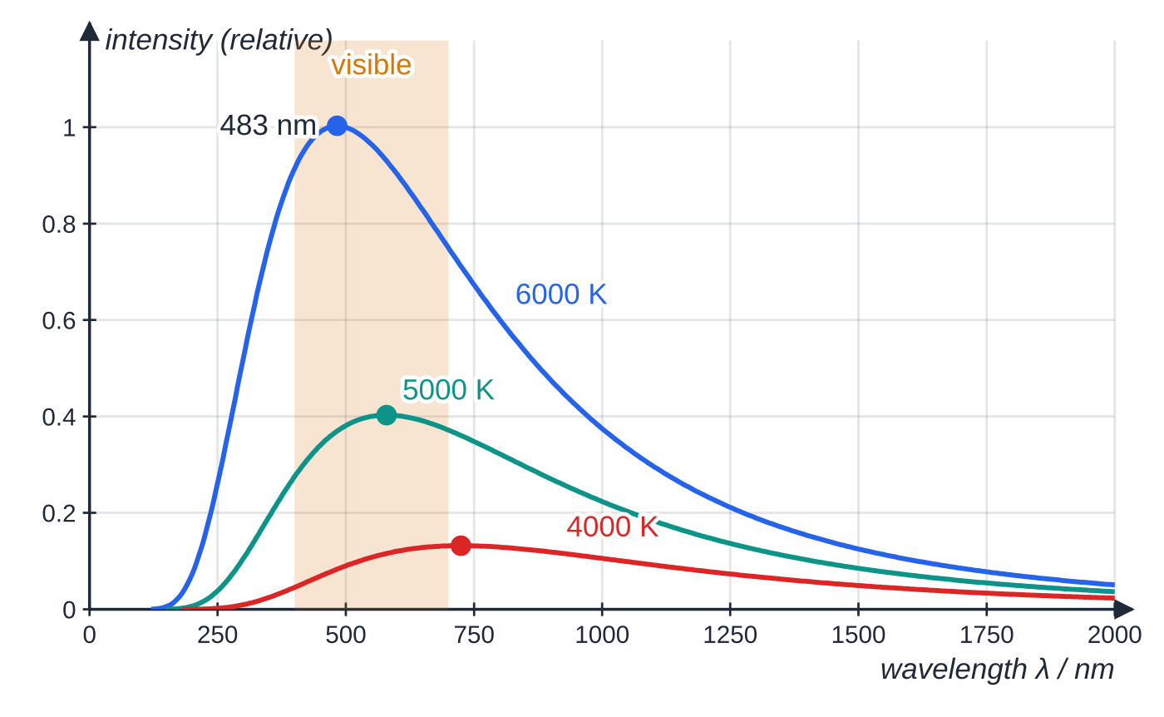
What is a black body, and what does its radiation curve show? (continued)
Section 1 of 13
The spectrum is continuous (all wavelengths are present), but the power is not spread evenly: the curve of intensity against wavelength rises steeply to a peak at λ_(max) and falls away more gradually at long wavelengths.
Stars are a good approximation to black bodies, so their continuous spectra can be used to find their surface temperatures.
Reading a black-body curve
Hotter → curve higher at every wavelength. A hotter body emits more at every wavelength, so the curves never cross.
Black-body radiation curves for 6000 K, 5000 K and 4000 K, plotted from the black-body (Planck) law. The peak wavelengths (483, 580 and 725 nm) follow Wien's law; the area under the 6000 K curve is (6000/4000)⁴ ≈ 5.1 times the area under the 4000 K curve, as the Stefan–Boltzmann law predicts.
Notes:
What is a black body, and what does its radiation curve show?. Full notes: https://examinerprep.com/notes/edexcel-ial-physics/stars-radiation-distances-and-the-hr-diagram/

Slide 6
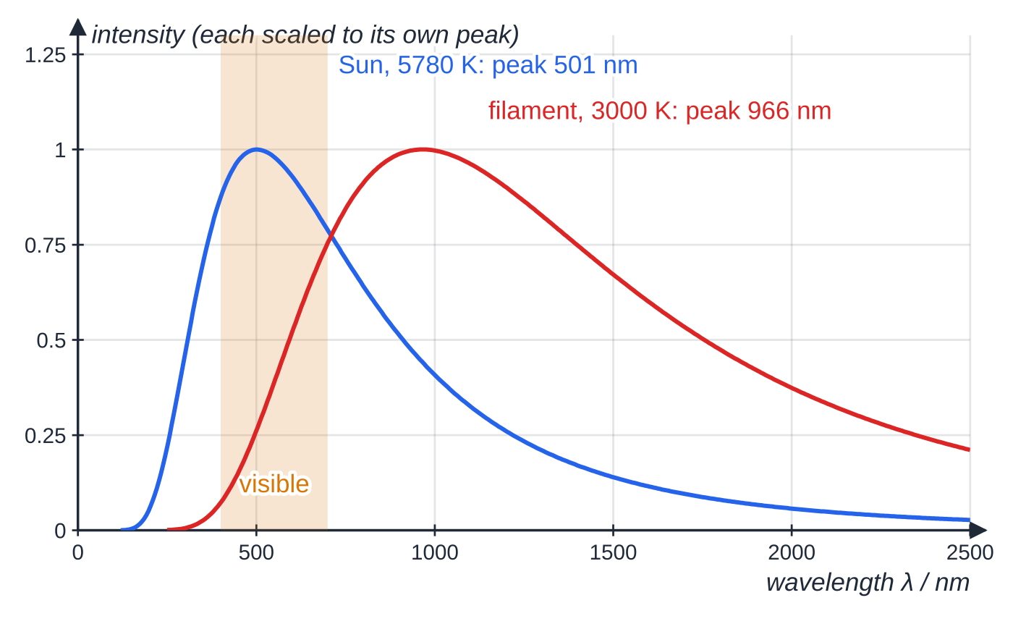
What is a black body, and what does its radiation curve show? (continued)
Section 1 of 13
Hotter → peak at a shorter wavelength. The peak moves from the infrared (cool stars) through the visible to the ultraviolet (very hot stars). This is why cool stars look red and hot stars look blue-white.
Area under the curve = total power emitted per unit area, which is proportional to T⁴.
The Sun's peak, near 501 nm, lies in the visible region; a filament lamp at about 3000 K peaks in the infrared, so most of its output is heat, not light.
Each curve is scaled to its own peak so the shapes can be compared. The Sun's peak lies inside the visible band; the filament's peak is well into the infrared, and only the short-wavelength tail of its curve is visible light.
Notes:
What is a black body, and what does its radiation curve show?. Full notes: https://examinerprep.com/notes/edexcel-ial-physics/stars-radiation-distances-and-the-hr-diagram/

Slide 7
How do you find the temperature of a star from its spectrum?
Section 2 of 13
λ_(max)T=2.898×10⁻³ m K
λ_(max) is the wavelength at which the intensity is greatest (m) and T the surface temperature (K). Wien's law is in the formulae list. Since λ_(max)∝1/T, doubling the temperature halves the peak wavelength. The temperature must be in kelvin (T/K=θ/°C+273).
Measure the spectrum of the star, find the wavelength at the peak, and divide 2.898×10⁻³ m K by it.
This gives the surface temperature: the temperature of the layer the light escapes from, not the much hotter core.
Notes:
How do you find the temperature of a star from its spectrum?. Full notes: https://examinerprep.com/notes/edexcel-ial-physics/stars-radiation-distances-and-the-hr-diagram/

Slide 8
How do you find the temperature of a star from its spectrum? (continued)
Section 2 of 13 · Worked example 1 · Easy · Calculate, state
WORKED EXAMPLE · QUESTION
(a) The spectrum of a blue-white star has its peak intensity at a wavelength of 380 nm. Calculate the surface temperature of the star. (b) A red dwarf star has a surface temperature of 3200 K. Calculate the wavelength at which its emission peaks and state the region of the electromagnetic spectrum it lies in.
SOLUTION
(a) Rearrange Wien's law, with the wavelength in metres: T=2.898×10⁻³÷380×10⁻⁹= 7.63 × 10³ K
(b) λ_(max)=2.898×10⁻³÷3200=9.06×10⁻⁷ m (906 nm). This is longer than 700 nm (the visible range is about 400–700 nm), so the peak is in the infrared. The star still emits visible light, mostly at the red end, so it looks red.
Notes:
How do you find the temperature of a star from its spectrum?: Worked example 1. Full notes: https://examinerprep.com/notes/edexcel-ial-physics/stars-radiation-distances-and-the-hr-diagram/

Slide 9
How do you find the temperature of a star from its spectrum? (continued)
Section 2 of 13
Common error — wrong units in Wien and Stefan–Boltzmann
Using a temperature in degrees Celsius in Wien's law or the Stefan–Boltzmann law: both need the absolute temperature in kelvin. A second slip is leaving the wavelength in nm, which makes the temperature 10⁹ times too small.
Notes:
How do you find the temperature of a star from its spectrum?. Full notes: https://examinerprep.com/notes/edexcel-ial-physics/stars-radiation-distances-and-the-hr-diagram/

Slide 10
How much power does a star radiate?
Section 3 of 13
The luminosity L of a star is its total power output: the energy it radiates per second, in all directions, at all wavelengths.
L=σAT⁴
L is the luminosity (W), σ the Stefan–Boltzmann constant =5.67×10⁻⁸ W m⁻² K⁻⁴, A the surface area (m²) and T the surface temperature (K). The Stefan–Boltzmann law is in the formulae list. For a spherical star of radius r, A=4πr², so L=4πr²σT⁴; the area formula is not in the list (No — learn it).
L∝r² and L∝T⁴. Temperature has the stronger effect: doubling T multiplies L by 2⁴=16; doubling r multiplies it by 4.
A cool star can still be very luminous if it is very large (a red giant); a hot star can be dim if it is very small (a white dwarf).
Notes:
How much power does a star radiate?. Full notes: https://examinerprep.com/notes/edexcel-ial-physics/stars-radiation-distances-and-the-hr-diagram/

Slide 11
How much power does a star radiate? (continued)
Section 3 of 13
Astronomers often quote luminosity in units of the Sun's luminosity, L_⊙=3.83×10²⁶ W (radius R_⊙=6.96×10⁸ m, surface temperature ≈ 5780 K). These are not on the data list: a question will give them.
Notes:
How much power does a star radiate?. Full notes: https://examinerprep.com/notes/edexcel-ial-physics/stars-radiation-distances-and-the-hr-diagram/

Slide 12
How much power does a star radiate? (continued)
Section 3 of 13 · Worked example 2 · Easy · Calculate
WORKED EXAMPLE · QUESTION
A star has a radius of 1.7 × 10⁹ m and a surface temperature of 8500 K. Calculate its luminosity and express it as a multiple of the Sun's luminosity, 3.83 × 10²⁶ W.
SOLUTION
A=4π(1.7×10⁹)²=3.63×10¹⁹ m²
L=σAT⁴=5.67×10⁻⁸×3.63×10¹⁹×8500⁴=1.07×10²⁸ W≈ 1.1 × 10²⁸ W
1.07×10²⁸÷3.83×10²⁶= 28 L☉. The radius is given to 2 s.f., so the luminosity is given to 2 s.f.
Notes:
How much power does a star radiate?: Worked example 2. Full notes: https://examinerprep.com/notes/edexcel-ial-physics/stars-radiation-distances-and-the-hr-diagram/

Slide 13
How much power does a star radiate? (continued)
Section 3 of 13 · Worked example 3 · Medium · Show that, explain
WORKED EXAMPLE · QUESTION
A red giant with a surface temperature of 3600 K and a white dwarf with a surface temperature of 18 000 K have the same luminosity. Show that the radius of the red giant is 25 times the radius of the white dwarf, and explain why equal luminosity does not mean that the two stars look equally bright from Earth.
SOLUTION
Equal luminosity, so 4πr₁²σT₁⁴=4πr₂²σT₂⁴; cancel 4πσ: r₁/r₂=(T₂/T₁)²=(18 000/3600)²=5²= 25
How bright a star looks depends on the intensity at Earth, I=L/4πd², so equal luminosities look equally bright only if the stars are at the same distance.
Ratio methods are quick and avoid big powers of ten: write the equation for both stars and divide.
Notes:
How much power does a star radiate?: Worked example 3. Full notes: https://examinerprep.com/notes/edexcel-ial-physics/stars-radiation-distances-and-the-hr-diagram/

Slide 14
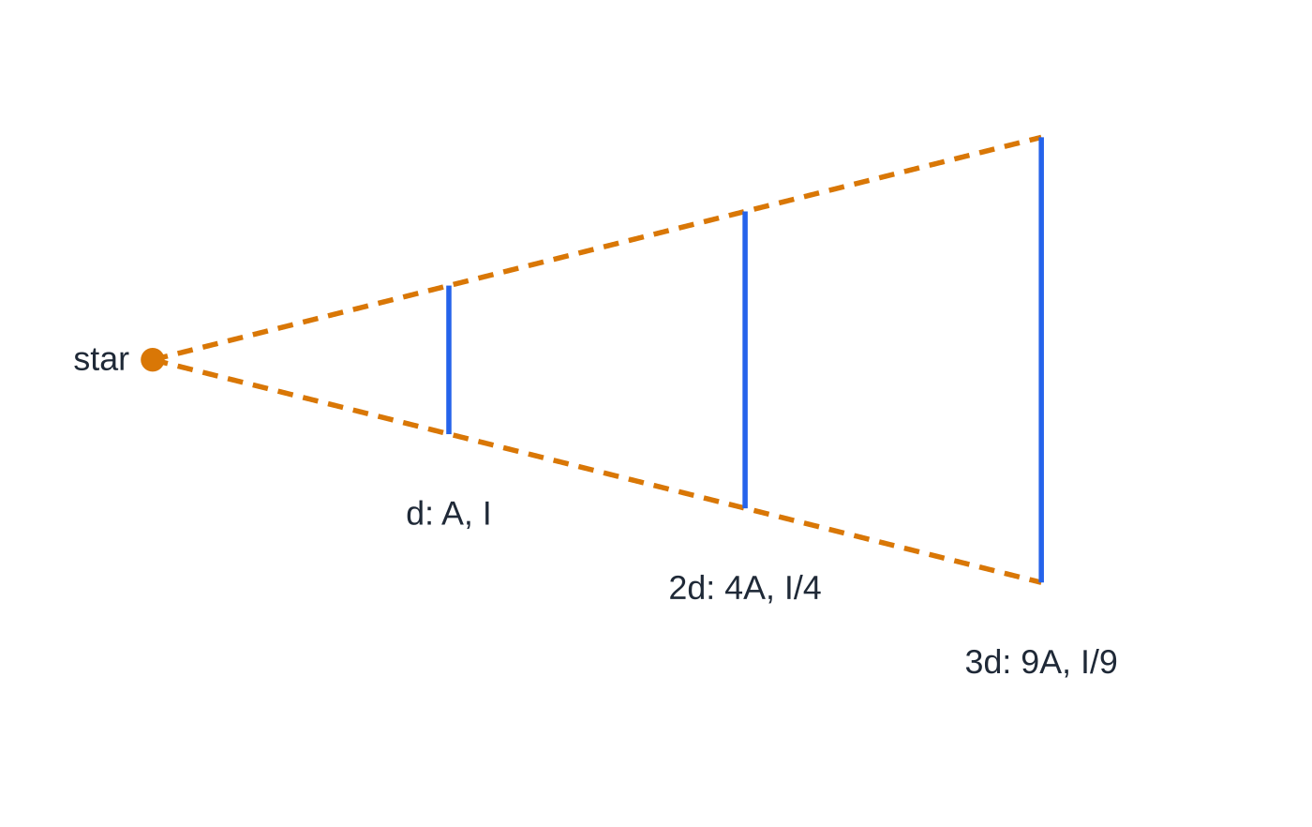
How bright does a star appear from Earth?
Section 4 of 13
Intensity I is the power per unit area incident on a surface at right angles to the direction of the radiation. At distance d from a star, I=L/4πd², with I in W m⁻², L in W and d in m. This is in the formulae list.
The star's power spreads out over the surface of a sphere of radius d, area 4πd². The equation assumes nothing absorbs the radiation on the way (no dust or gas in between).
The inverse-square law, seen edge-on. The same power passes through each square, but the squares' sides grow in proportion to the distance, so their areas grow as d²: at 2d the intensity is a quarter, at 3d a ninth.
Notes:
How bright does a star appear from Earth?. Full notes: https://examinerprep.com/notes/edexcel-ial-physics/stars-radiation-distances-and-the-hr-diagram/

Slide 15
How bright does a star appear from Earth? (continued)
Section 4 of 13
Measured on Earth: the intensity I (with a detector of known area) and the spectrum (so λ_(max) and T).
Then: if d is known, L=4πd²I; and with T from Wien, the radius follows from L=4πr²σT⁴.
Example: the Sun's luminosity spread over a sphere of radius 1 AU = 1.50 × 10¹¹ m gives about 1.35 × 10³ W m⁻² above the Earth's atmosphere.
Notes:
How bright does a star appear from Earth?. Full notes: https://examinerprep.com/notes/edexcel-ial-physics/stars-radiation-distances-and-the-hr-diagram/

Slide 16
How bright does a star appear from Earth? (continued)
Section 4 of 13 · Worked example 4 · Hard · Calculate, suggest
WORKED EXAMPLE · QUESTION
A star is 2.6 × 10¹⁷ m from Earth. The intensity of its radiation at the Earth is 2.2 × 10⁻⁹ W m⁻², and its spectrum peaks at 420 nm. Calculate (a) its luminosity, (b) its surface temperature and (c) its radius. (d) The Sun's radius is 6.96 × 10⁸ m. Suggest which type of star this is.
SOLUTION
(a) L=4πd²I=4π×(2.6×10¹⁷)²×2.2×10⁻⁹=1.87×10²⁷ W≈ 1.9 × 10²⁷ W
(b) T=2.898×10⁻³÷420×10⁻⁹= 6900 K
(c) r=√(L/4πσT⁴)=√((1.87×10²⁷)/(4π×5.67×10⁻⁸×6900⁴))=1.08×10⁹ m≈ 1.1 × 10⁹ m
(d) About 1.5 times the Sun's radius, about 4.9 times its luminosity and a little hotter: a main sequence star somewhat more massive than the Sun.
Keep the unrounded luminosity in your calculator for (c); the square root halves the effect of any rounding, but the fourth power of T magnifies slips in T.
Notes:
How bright does a star appear from Earth?: Worked example 4. Full notes: https://examinerprep.com/notes/edexcel-ial-physics/stars-radiation-distances-and-the-hr-diagram/

Slide 17
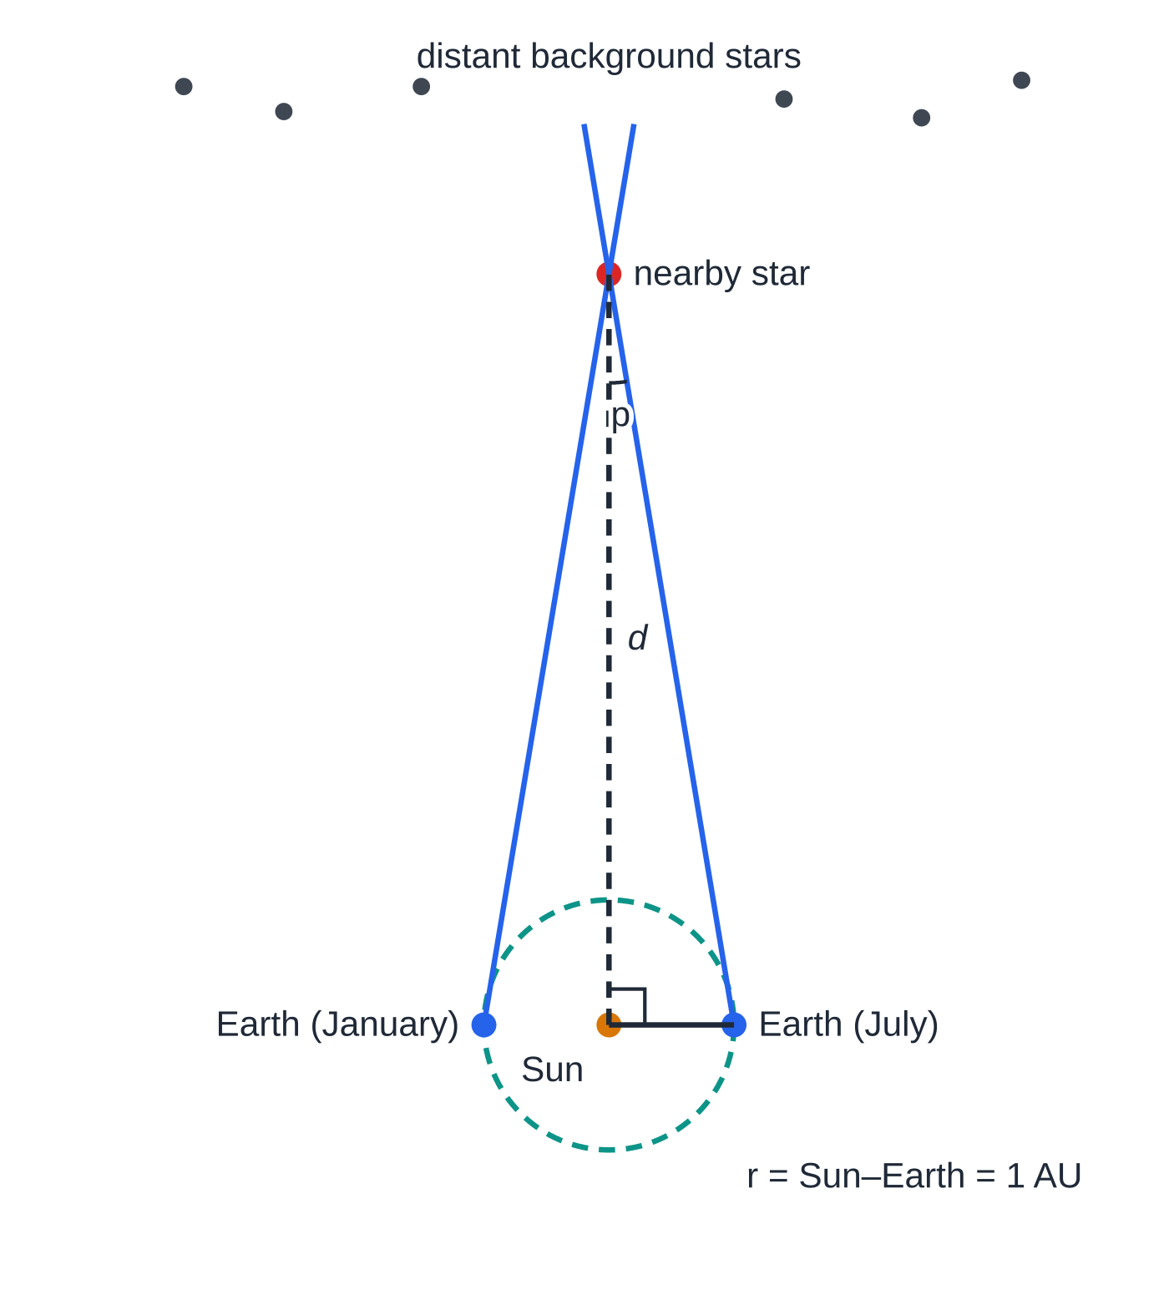
How is the distance to a nearby star measured?
Section 5 of 13
Hold a finger at arm's length and close each eye in turn: the finger jumps against the background. Trigonometric parallax is the same effect with the Earth's orbit as the baseline. As the Earth moves round its orbit, a nearby star appears to shift its position against the background of much more distant stars (which barely move).
Measure the star's angular position, then again six months later, when the Earth is on the other side of the Sun, 2 AU away. Half the total angular shift is the parallax angle p.
The parallax angle is the angle at the star subtended by the radius of the Earth's orbit, r = 1 AU, so tan p=r/d.
Trigonometric parallax. Sight lines to the nearby star from opposite ends of the Earth's orbit, six months apart, point at different background stars. The right angle is at the Sun, so tan p = r/d. The angle is drawn hugely enlarged.
d=r/tan p≈r/p (p in radians)
Notes:
How is the distance to a nearby star measured?. Full notes: https://examinerprep.com/notes/edexcel-ial-physics/stars-radiation-distances-and-the-hr-diagram/

Slide 18
How is the distance to a nearby star measured? (continued)
Section 5 of 13
d is the distance to the star (m), r the radius of the Earth's orbit = 1 AU = 1.50 × 10¹¹ m and p the parallax angle. This is not in the formulae list (No — learn it (trigonometry)). Parallax angles are tiny, always less than 1 arcsecond (1 arcsecond = 1/3600 of a degree), so tan p≈p in radians.
Unit | Definition | Value
astronomical unit (AU) | the mean distance from the Earth to the Sun | 1.50 × 10¹¹ m
light-year (ly) | the distance travelled by light in a vacuum in one year | 9.46 × 10¹⁵ m
parsec (pc) | the distance at which 1 AU subtends an angle of 1 arcsecond (the distance of a star with a parallax angle of 1 arcsecond) | 3.09 × 10¹⁶ m ≈ 3.26 ly
Because d∝1/p: d in parsecs = 1 ÷ (p in arcseconds). A parallax of 0.5 arcseconds means 2 pc.
Limit: for distant stars the angle is too small to measure reliably against the uncertainty, so parallax works only for relatively nearby stars (in our part of the galaxy).
Notes:
How is the distance to a nearby star measured?. Full notes: https://examinerprep.com/notes/edexcel-ial-physics/stars-radiation-distances-and-the-hr-diagram/

Slide 19
How is the distance to a nearby star measured? (continued)
Section 5 of 13
Telescopes in space, above the blurring atmosphere, extend the range.
Notes:
How is the distance to a nearby star measured?. Full notes: https://examinerprep.com/notes/edexcel-ial-physics/stars-radiation-distances-and-the-hr-diagram/

Slide 20
How is the distance to a nearby star measured? (continued)
Section 5 of 13 · Worked example 5 · Medium · Calculate
WORKED EXAMPLE · QUESTION
The parallax angle of a star is measured as 0.29 arcseconds. 1 AU = 1.50 × 10¹¹ m and 1 light-year = 9.46 × 10¹⁵ m. Calculate the distance to the star (a) in parsecs, (b) in metres, (c) in light-years.
SOLUTION
(a) d=1÷0.29= 3.4 pc
(b) Convert the angle: p=0.29÷3600=8.06×10⁻⁵ degrees =1.41×10⁻⁶ rad. Then d=1.50×10¹¹÷tan(1.41×10⁻⁶)=1.07×10¹⁷ m≈ 1.1 × 10¹⁷ m
(c) 1.07×10¹⁷÷9.46×10¹⁵= 11 ly
Check: 3.45 pc×3.09×10¹⁶ m=1.07×10¹⁷ m, the same as (b).
Notes:
How is the distance to a nearby star measured?: Worked example 5. Full notes: https://examinerprep.com/notes/edexcel-ial-physics/stars-radiation-distances-and-the-hr-diagram/

Slide 21
How do standard candles measure greater distances?
Section 6 of 13
A standard candle is an astronomical object whose luminosity is known, so that its distance can be found from the intensity received.
Measure the intensity I at Earth; with L known, rearrange the inverse-square law: d=√(L/4πI).
Cepheid variable stars pulsate, and their luminosity is linked to their period of pulsation: measure the period, deduce L. The link was calibrated using Cepheids whose distance was known by parallax. They work out to other nearby galaxies.
Type Ia supernovae (exploding white dwarfs) all reach about the same peak luminosity, billions of times the Sun's. They are visible across billions of light-years.
Each method is calibrated by the one before it (parallax → Cepheids → supernovae), so uncertainties build up as distances grow.
Notes:
How do standard candles measure greater distances?. Full notes: https://examinerprep.com/notes/edexcel-ial-physics/stars-radiation-distances-and-the-hr-diagram/

Slide 22
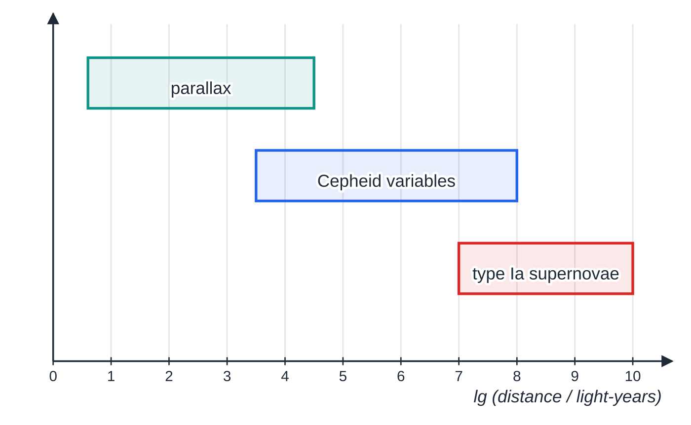
How do standard candles measure greater distances? (continued)
Section 6 of 13
The distance ladder (approximate ranges, logarithmic scale). Each rung overlaps the one above it, and that overlap is where the brighter standard candle is calibrated, so uncertainties build up towards the top.
Notes:
How do standard candles measure greater distances?. Full notes: https://examinerprep.com/notes/edexcel-ial-physics/stars-radiation-distances-and-the-hr-diagram/

Slide 23
How do standard candles measure greater distances? (continued)
Section 6 of 13 · Worked example 6 · Medium · Calculate, explain
WORKED EXAMPLE · QUESTION
A type Ia supernova in a distant galaxy is observed. At its brightest it has a luminosity of 2.0 × 10³⁶ W, and the peak intensity measured at Earth is 7.4 × 10⁻¹⁶ W m⁻². (a) Calculate the distance to the galaxy in metres and in light-years (1 ly = 9.46 × 10¹⁵ m). (b) Explain why parallax could not be used for this galaxy.
SOLUTION
(a) d=√((2.0×10³⁶)/(4π×7.4×10⁻¹⁶))=1.47×10²⁵ m≈ 1.5 × 10²⁵ m; 1.47×10²⁵÷9.46×10¹⁵= 1.6 × 10⁹ ly
(b) At this distance the parallax angle (about 2 × 10⁻⁹ arcseconds) would be far too small to measure.
Notes:
How do standard candles measure greater distances?: Worked example 6. Full notes: https://examinerprep.com/notes/edexcel-ial-physics/stars-radiation-distances-and-the-hr-diagram/

Slide 24
How do standard candles measure greater distances? (continued)
Section 6 of 13
Common error — forgetting the square root
Forgetting the square root when finding d from I=L/4πd², or using 4πd instead of 4πd². A sanity check: a quarter of the intensity means twice the distance.
Notes:
How do standard candles measure greater distances?. Full notes: https://examinerprep.com/notes/edexcel-ial-physics/stars-radiation-distances-and-the-hr-diagram/

Slide 25
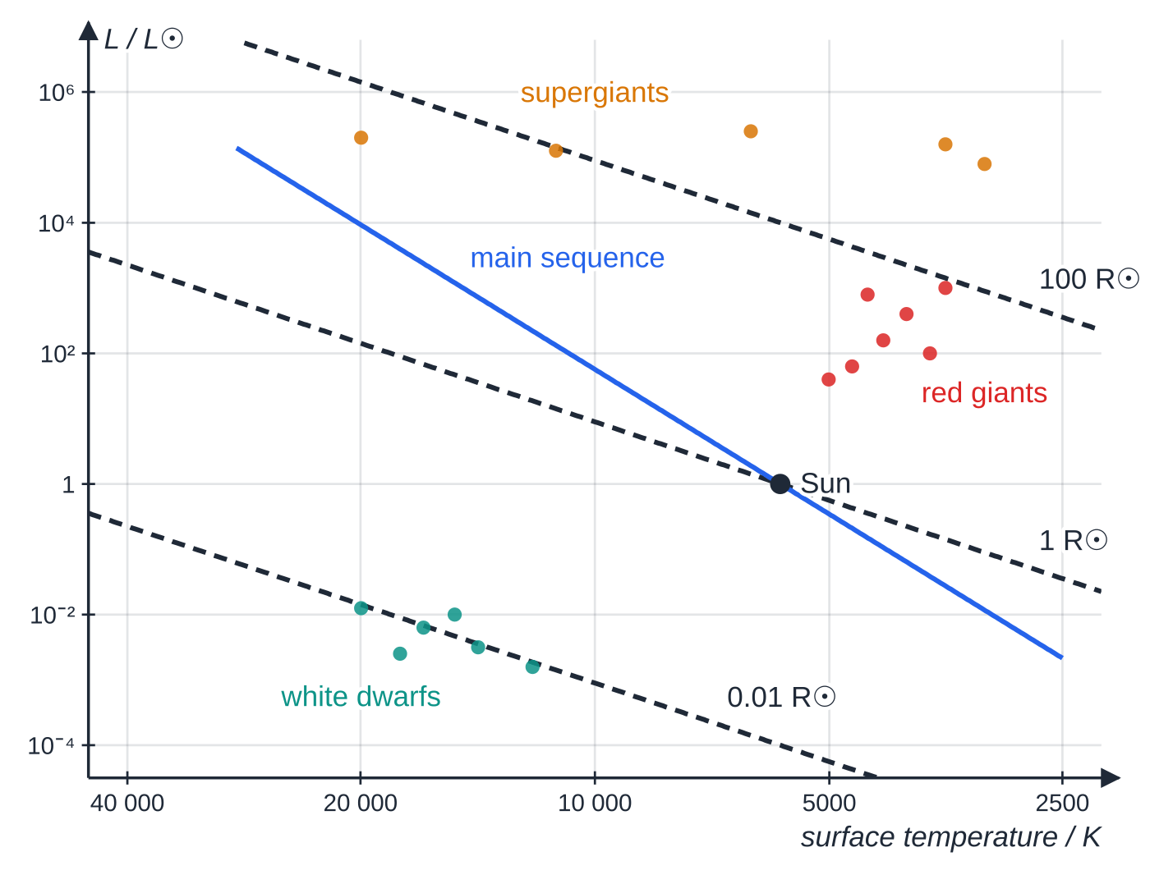
What is the Hertzsprung–Russell diagram?
Section 7 of 13
A Hertzsprung–Russell (HR) diagram is a plot of luminosity (vertical, logarithmic scale, often in units of L_⊙) against surface temperature (horizontal, logarithmic, with temperature decreasing from left to right). Stars do not fall randomly: most lie on a diagonal band, the main sequence, and the rest gather in a few distinct groups. Because L=4πr²σT⁴, every point on the diagram also has a radius: lines of constant radius run diagonally, and stars get bigger towards the top right.
A simple HR diagram. The main sequence is drawn from the approximate relations L ∝ M³·⁵ and r ∝ M⁰·⁸, with the temperature from L = 4πr²σT⁴; the dashed lines are lines of constant radius from the same law. Note the temperature scale: hottest on the left.
Notes:
What is the Hertzsprung–Russell diagram?. Full notes: https://examinerprep.com/notes/edexcel-ial-physics/stars-radiation-distances-and-the-hr-diagram/

Slide 26
What is the Hertzsprung–Russell diagram? (continued)
Section 7 of 13
Region | Where on the diagram | What the stars are like
Main sequence | diagonal band, top left to bottom right | fusing hydrogen into helium in the core; the most massive are hot, blue and very luminous, the least massive cool, red and dim. About 90% of stars are here
Red giants | above the main sequence, on the right | cool (about 3000–5000 K) but luminous, so they must be large: tens to hundreds of times the Sun's radius
Supergiants | across the top | the most luminous stars, up to about 10⁶ L☉; red supergiants are the largest stars of all
White dwarfs | bottom left | hot (often over 10 000 K) but dim, so they must be tiny, about the size of the Earth
Notes:
What is the Hertzsprung–Russell diagram?. Full notes: https://examinerprep.com/notes/edexcel-ial-physics/stars-radiation-distances-and-the-hr-diagram/

Slide 27
What is the Hertzsprung–Russell diagram? (continued)
Section 7 of 13
Exam tip — sketching an HR diagram
Label both axes with quantities and units (or L/L_⊙), put the hottest temperature on the left, and mark at least the main sequence, red giants and white dwarfs. Adding the Sun at about 5780 K, 1 L☉ is a quick way to show you know the scale.
Notes:
What is the Hertzsprung–Russell diagram?. Full notes: https://examinerprep.com/notes/edexcel-ial-physics/stars-radiation-distances-and-the-hr-diagram/

Slide 28
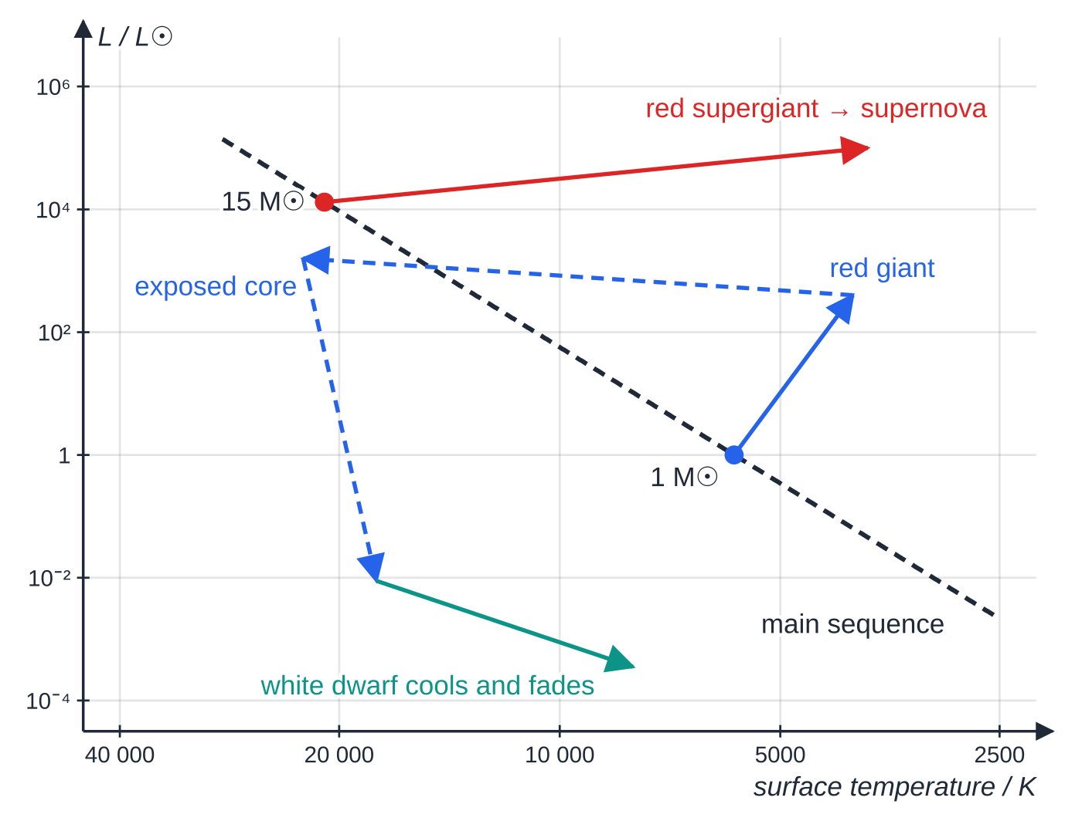
How does the HR diagram show the life cycle of a star?
Section 8 of 13
A star forms when a cloud of gas and dust (a nebula) collapses under gravity. The protostar heats up until hydrogen fusion begins in its core and it joins the main sequence. Where it joins depends on its mass.
On the main sequence the outward pressure from the hot core balances the inward pull of gravity, and the star stays in nearly the same place on the diagram for most of its life. More massive stars use their fuel much faster, so they have shorter lives.
When the hydrogen in the core runs out, the core contracts and heats, the outer layers expand and cool, and the star moves up and to the right on the diagram.
Schematic paths on the HR diagram. The 15 M☉ star starts on the main sequence at about 21 000 K and 13 000 L☉ (from the same mass relations as the previous figure). The Sun-like star becomes a red giant, briefly shows its hot exposed core at the top left, then ends as a white dwarf that slides down a line of almost constant radius.
Notes:
How does the HR diagram show the life cycle of a star?. Full notes: https://examinerprep.com/notes/edexcel-ial-physics/stars-radiation-distances-and-the-hr-diagram/

Slide 29
How does the HR diagram show the life cycle of a star? (continued)
Section 8 of 13
Low-mass stars (up to about 8 solar masses, including the Sun)
Main sequence → red giant (helium fusion begins in the core; the outer layers swell to perhaps a hundred times their former radius).
The outer layers drift away as a planetary nebula, exposing the hot core, which is seen briefly at the top left of the diagram.
The core becomes a white dwarf: no fusion, very dense, about Earth-sized. It cools and fades, moving down and to the right along a line of almost constant radius.
High-mass stars (more than about 8 solar masses)
Main sequence (high and to the left) → red supergiant, fusing heavier and heavier elements in shells around the core, up to iron.
When the core can release no more energy by fusion it collapses in a fraction of a second and the star explodes as a supernova, briefly outshining a whole galaxy.
Notes:
How does the HR diagram show the life cycle of a star?. Full notes: https://examinerprep.com/notes/edexcel-ial-physics/stars-radiation-distances-and-the-hr-diagram/

Slide 30
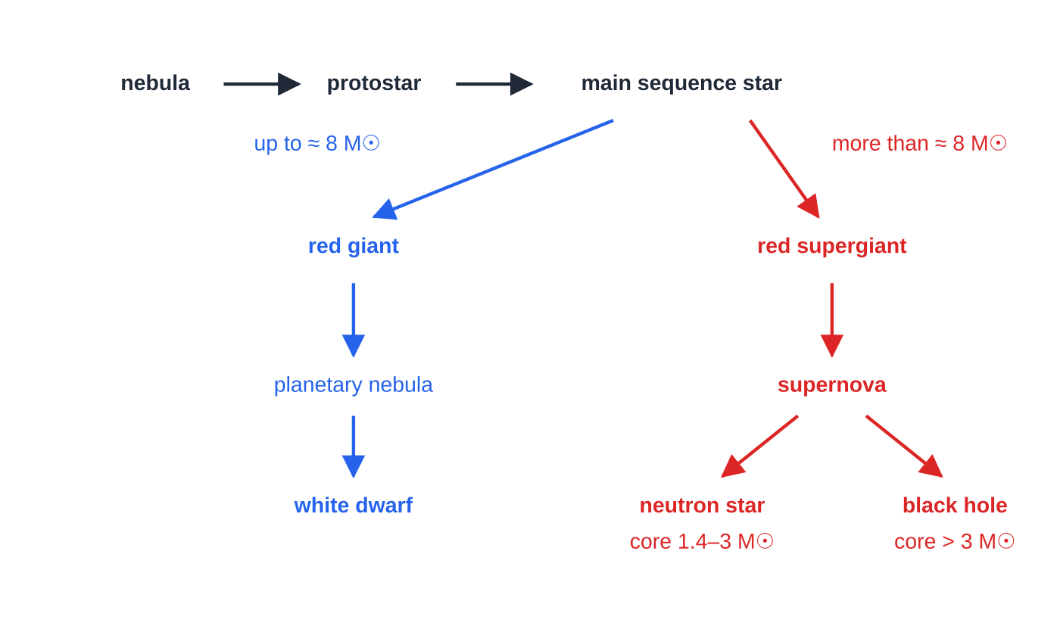
How does the HR diagram show the life cycle of a star? (continued)
Section 8 of 13
The remnant core becomes a neutron star (core about 1.4 to 3 solar masses: incredibly dense, made almost entirely of neutrons) or, if more than about 3 solar masses, a black hole, whose gravity is so strong that not even light can escape.
Life cycles of stars by mass. The boundary masses are approximate.
Notes:
How does the HR diagram show the life cycle of a star?. Full notes: https://examinerprep.com/notes/edexcel-ial-physics/stars-radiation-distances-and-the-hr-diagram/

Slide 31
How does the HR diagram show the life cycle of a star? (continued)
Section 8 of 13 · Worked example 7 · Hard · Describe, compare
WORKED EXAMPLE · QUESTION
A star of 20 solar masses and a star of 1 solar mass form from the same nebula. Describe and compare how the two stars will change during their lives, referring to their positions on a Hertzsprung–Russell diagram.
SOLUTION
A full answer makes these points, linking each stage to the diagram:
Both stars join the main sequence when hydrogen fusion starts in the core; the 20 solar mass star joins at the top left (hotter, far more luminous), the 1 solar mass star lower down, near the middle.
The more massive star uses its hydrogen much faster, so it leaves the main sequence first (after millions rather than billions of years).
When core hydrogen runs out, both stars expand and their surfaces cool: they move to the right. The Sun-like star becomes a red giant, the massive star a red supergiant near the top right.
Notes:
How does the HR diagram show the life cycle of a star?: Worked example 7. Full notes: https://examinerprep.com/notes/edexcel-ial-physics/stars-radiation-distances-and-the-hr-diagram/

Slide 32
How does the HR diagram show the life cycle of a star? (continued)
Section 8 of 13 · Worked example 7 · Hard · Describe, compare (continued)
The 1 solar mass star sheds its outer layers as a planetary nebula; its core becomes a white dwarf at the bottom left, which cools and fades.
The 20 solar mass star fuses heavier elements until its core collapses, and it explodes as a supernova.
Its remnant core becomes a neutron star or, if the core mass is more than about 3 solar masses, a black hole; neither appears on the HR diagram.
Notes:
How does the HR diagram show the life cycle of a star?: Worked example 7. Full notes: https://examinerprep.com/notes/edexcel-ial-physics/stars-radiation-distances-and-the-hr-diagram/

Slide 33
How does the HR diagram show the life cycle of a star? (continued)
Section 8 of 13
Common error — "travelling along the main sequence"
Describing the main sequence as a path that stars travel along as they age. A star stays at almost the same point on the main sequence for most of its life; its position there is set by its mass. It is when it leaves the main sequence that it moves across the diagram.
Notes:
How does the HR diagram show the life cycle of a star?. Full notes: https://examinerprep.com/notes/edexcel-ial-physics/stars-radiation-distances-and-the-hr-diagram/

Slide 34
Exam tips for 5.8
Section 9 of 13
Exam tip 1 — convert first
Kelvin, metres and watts before anything else: nm × 10⁻⁹, °C + 273, and solar units × the value given in the question. Write the conversions as separate lines.
Exam tip 2 — the chain of three equations
Most multi-step star questions follow the same chain: λ_(max)→T (Wien); I and d→L (inverse square); L and T→r (Stefan–Boltzmann). Identify which two quantities you are given and which equation links them.
Exam tip 3 — use ratios
For "how many times larger" questions, write L=4πr²σT⁴ for both stars and divide: the constants cancel and the arithmetic is short. Remember the powers: r squared, T to the fourth.
Notes:
Exam tips for 5.8. Full notes: https://examinerprep.com/notes/edexcel-ial-physics/stars-radiation-distances-and-the-hr-diagram/

Slide 35
Exam tips for 5.8 (continued)
Section 9 of 13
Exam tip 4 — the power of 4 in uncertainties
If T has a percentage uncertainty of 2%, T⁴ (and so L for a given radius) has 4 × 2% = 8%. When finding r=√(L/4πσT⁴), the percentage uncertainty is ½ × (% in L) + 2 × (% in T). And use the right word: luminosity for the power a star emits, intensity (or apparent brightness) for what arrives per square metre at Earth.
Notes:
Exam tips for 5.8. Full notes: https://examinerprep.com/notes/edexcel-ial-physics/stars-radiation-distances-and-the-hr-diagram/

Slide 36
Common misconceptions
Section 10 of 13
Misconception | Why it is wrong | Correct idea
The brightest stars in the sky are the most luminous. | Apparent brightness depends on distance as well as on power output. | Intensity at Earth is I=L/4πd²: a nearby dim star can look brighter than a distant luminous one.
A red star emits only red light. | A black-body spectrum is continuous. | A red star emits all wavelengths; its peak is in the red or infrared, so red dominates what we see.
Red giants are dim because they are cool. | Luminosity depends on area as well as temperature. | Red giants are cool but enormous, so their luminosity is high (L∝r²T⁴).
Stars move along the main sequence as they age. | A star's position on the main sequence is set by its mass. | A star stays almost fixed on the main sequence while it fuses hydrogen, then moves off it.
A parsec is a unit of time. | The name sounds like "second", but it is defined from an angle (an arcsecond). | A parsec is a distance: 3.09 × 10¹⁶ m, about 3.26 light-years.
Notes:
Common misconceptions. Full notes: https://examinerprep.com/notes/edexcel-ial-physics/stars-radiation-distances-and-the-hr-diagram/

Slide 37
Common misconceptions (continued)
Section 10 of 13
Misconception | Why it is wrong | Correct idea
Every star ends as a black hole or a supernova. | Most stars are low-mass. | Stars up to about 8 solar masses, including the Sun, end as white dwarfs; only massive stars end in a core-collapse supernova.
Notes:
Common misconceptions. Full notes: https://examinerprep.com/notes/edexcel-ial-physics/stars-radiation-distances-and-the-hr-diagram/

Slide 38
How this topic connects
Section 11 of 13
Photons and line spectra (Unit 2)
The dark absorption lines on a star's continuous spectrum identify the elements in its outer layers; Wien's law uses the continuous spectrum underneath them. Intensity as power per unit area was first met with waves.
Thermal physics and 5.3 Nuclear fusion
Wien's law and the Stefan–Boltzmann law need absolute temperatures in kelvin, the same scale used for the ideal gas. The energy a star radiates as luminosity comes from fusion in its core; the mass of the star decides how fast it is used up.
7 Gravitation and 5.9 Cosmology
Gravity drives the collapse that forms a star and ends its life; standard candles give the distances that, with redshift, reveal the expanding universe.
Notes:
How this topic connects. Full notes: https://examinerprep.com/notes/edexcel-ial-physics/stars-radiation-distances-and-the-hr-diagram/

Slide 39
Key equations
Section 12 of 13
Equation | Use | In the formulae list?
λ_(max)T=2.898×10⁻³ m K | surface temperature from the peak wavelength (Wien's law) | yes
L=σAT⁴ | luminosity from surface area and temperature (Stefan–Boltzmann law); σ=5.67×10⁻⁸ W m⁻² K⁻⁴ | yes
A=4πr² | surface area of a spherical star | no — learn it
I=L/4πd² | intensity at distance d; luminosity from distance; distance from a standard candle | yes
d=r/tan p≈r/p | distance by trigonometric parallax (r = 1 AU, p in radians for the approximation) | no — learn it (trigonometry)
d/pc=1÷(p/arcsecond) | parallax distance in parsecs | no — learn it
r₁/r₂=√(L₁/L₂)×(T₂/T₁)² | comparing the radii of two stars | no — derive it from L=4πr²σT⁴
Notes:
Key equations. Full notes: https://examinerprep.com/notes/edexcel-ial-physics/stars-radiation-distances-and-the-hr-diagram/

Slide 40
Check your understanding
Section 13 of 13
1. What is meant by a black body?
2. A star has a surface temperature of 10 000 K. At what wavelength does its emission peak?
3. Star X has twice the radius and twice the surface temperature of star Y. How many times more luminous is X?
4. A star has a parallax angle of 0.05 arcseconds. How far away is it in parsecs, and why would this measurement be harder than for a star at 2 pc?
5. Where on an HR diagram are white dwarfs, and what does their position tell you about their size?
Notes:
Check your understanding: questions. Full notes: https://examinerprep.com/notes/edexcel-ial-physics/stars-radiation-distances-and-the-hr-diagram/

Slide 41
Check your understanding · answers
Section 13 of 13
1. An idealised object that absorbs all the electromagnetic radiation falling on it; its emitted spectrum depends only on its temperature.
2. λ_(max)=2.898×10⁻³÷10 000= 2.90 × 10⁻⁷ m (290 nm), in the ultraviolet.
3. L∝r²T⁴=2²×2⁴= 64 times.
4. d=1÷0.05= 20 pc. The angle is ten times smaller than for a star at 2 pc, so the same angular uncertainty is a much larger percentage of it.
5. Bottom left: hot but dim. For a high temperature to give a low luminosity in L=4πr²σT⁴, the radius must be very small, about the size of the Earth.
Notes:
Check your understanding: answers. Full notes: https://examinerprep.com/notes/edexcel-ial-physics/stars-radiation-distances-and-the-hr-diagram/

Slide 42
Practice questions
5 original exam-style questions. Answers at the end of the deck.

Slide 43
Question 1
1 mark
Two Cepheid variable stars X and Y have the same period of pulsation and therefore the same mean luminosity. The mean intensity of the radiation from X measured at the Earth is ¹/₉ of that from Y.
What is the ratio ^(distance to X)/_(distance to Y)?
A 1/9
B 1/3
C 3
D 9
Notes:
Online with the full mark scheme: https://examinerprep.com/ial-physics-5-8-stars-radiation-distances-and-the-hr-diagram-questions#IALP-U5-8-A-07

Slide 44
Question 2
1 mark
Where on a Hertzsprung–Russell diagram are white dwarf stars found?
A high surface temperature and high luminosity
B high surface temperature and low luminosity
C low surface temperature and high luminosity
D low surface temperature and low luminosity
Notes:
Online with the full mark scheme: https://examinerprep.com/ial-physics-5-8-stars-radiation-distances-and-the-hr-diagram-questions#IALP-U5-8-A-08

Slide 45
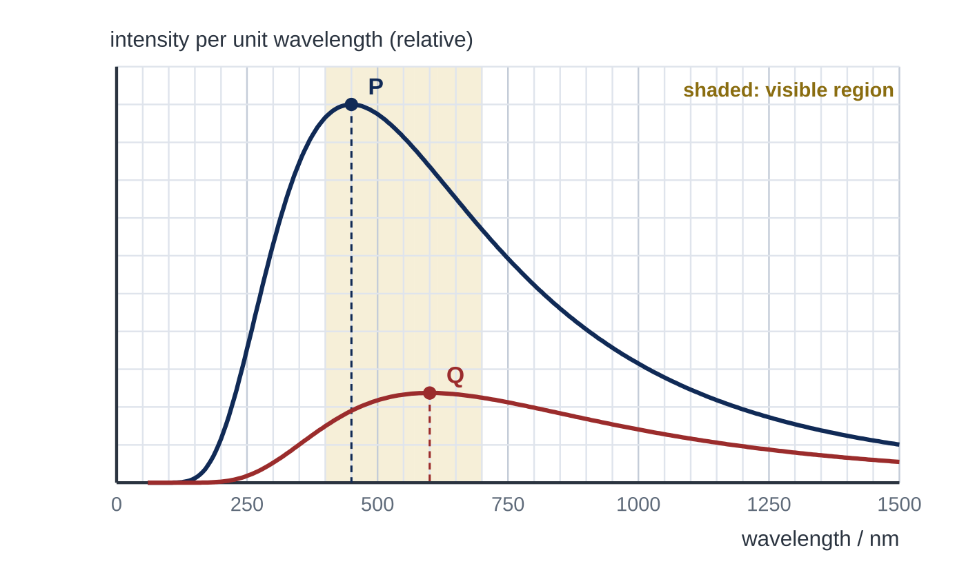
Question 3
1 mark
The graph shows the black-body radiation curves for two stars, P and Q, drawn to the same scale.
What is the ratio ᵖᵒʷᵉʳᵉᵐⁱᵗᵗᵉᵈᵖᵉʳᵘⁿⁱᵗˢᵘʳᶠᵃᶜᵉᵃʳᵉᵃᵒᶠᴾ/_(power emitted per unit surface area of Q)?
A 0.32
B 1.3
C 1.8
D 3.2
Notes:
Online with the full mark scheme: https://examinerprep.com/ial-physics-5-8-stars-radiation-distances-and-the-hr-diagram-questions#IALP-U5-8-FA-01

Slide 46
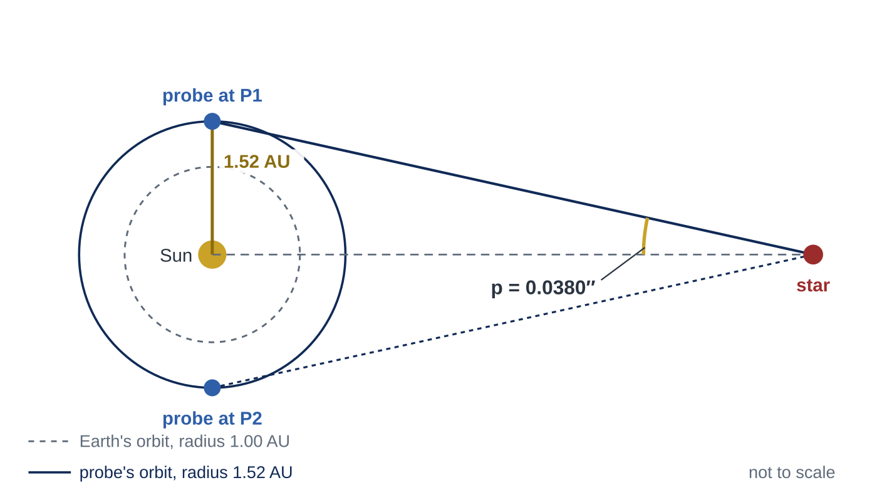
Question 4
8 marks
A space probe orbits the Sun in a circular orbit of radius 1.52 AU. It observes a star from positions P1 and P2 on opposite sides of its orbit and measures the parallax angle p shown in the diagram. 1 AU = 1.50 × 10¹¹ m; 1 parsec = 3.09 × 10¹⁶ m.
(a) Explain why the probe can measure the distances to stars further away than a telescope on the Earth with the same angular precision can. [1]
(b) Calculate the distance to the star in metres. [3]
(c) Show that this distance is about 40 pc. [1]
(d) The intensity of the star's radiation at the Earth is 2.6 × 10⁻¹⁰ W m⁻². Calculate the luminosity of the star. [2]
(e) The luminosity of the Sun is 3.83 × 10²⁶ W. Calculate the luminosity of the star as a multiple of the Sun's luminosity. [1]
Notes:
Online with the full mark scheme: https://examinerprep.com/ial-physics-5-8-stars-radiation-distances-and-the-hr-diagram-questions#IALP-U5-8-FB-04

Slide 47
Question 5
5 marks
The radiation emitted by stars can be modelled as black-body radiation. Star A has a surface temperature of 8000 K and star B has a surface temperature of 4000 K.
(a) State what is meant by a black body. [1]
(b) Describe two ways in which the black-body radiation curve (intensity against wavelength) of star B differs from that of star A. [2]
(c) Calculate the wavelength at which the radiation from star A has its maximum intensity. [1]
(d) State the region of the electromagnetic spectrum in which this wavelength lies. [1]
Notes:
Online with the full mark scheme: https://examinerprep.com/ial-physics-5-8-stars-radiation-distances-and-the-hr-diagram-questions#IALP-U5-8-B-01

Slide 48
Answers

Slide 49
Question 1 · answer
Answer C
I = L/4πd² with L the same, so d ∝ 1/√I. d_X/d_Y = √9 = 3.
Notes:
Full mark scheme: https://examinerprep.com/ial-physics-5-8-stars-radiation-distances-and-the-hr-diagram-questions#IALP-U5-8-A-07

Slide 50
Question 2 · answer
Answer B
White dwarfs are at the bottom left of the diagram: hot but dim, because they are very small.
Notes:
Full mark scheme: https://examinerprep.com/ial-physics-5-8-stars-radiation-distances-and-the-hr-diagram-questions#IALP-U5-8-A-08

Slide 51
Question 3 · answer
Answer D
From the graph the peaks are at 450 nm (P) and 600 nm (Q). Wien's law gives T ∝ 1/λₘₐₓ, so T_P/T_Q = 600/450 = 1.33. Power per unit area = σT⁴, so the ratio = 1.33⁴ = 3.2.
Notes:
Full mark scheme: https://examinerprep.com/ial-physics-5-8-stars-radiation-distances-and-the-hr-diagram-questions#IALP-U5-8-FA-01

Slide 52
Question 4 · answer
Mark scheme
its baseline (orbit radius) is larger, so a star at a given distance gives a larger parallax angle, and the smallest measurable angle is reached at a greater distance
radius of the probe's orbit = 1.52 × 1.50 × 10¹¹ = 2.28 × 10¹¹ m
p = 0.0380/3600 degree = 1.84 × 10⁻⁷ rad
d = 2.28 × 10¹¹ ÷ tan p = 1.24 × 10¹⁸ m
1.24 × 10¹⁸ ÷ 3.09 × 10¹⁶ = 40.1 pc ≈ 40 pc
L = 4πd²I = 4π × (1.24 × 10¹⁸)² × 2.6 × 10⁻¹⁰
= 5.0 × 10²⁷ W
5.0 × 10²⁷ ÷ 3.83 × 10²⁶ = 13
Notes:
Full mark scheme: https://examinerprep.com/ial-physics-5-8-stars-radiation-distances-and-the-hr-diagram-questions#IALP-U5-8-FB-04

Slide 53
Question 5 · answer
Mark scheme
an (idealised) object that absorbs all the electromagnetic radiation falling on it
the peak of B is at a longer wavelength (twice that of A)
B's curve is lower at every wavelength / the area under it is smaller (1/16 of A's per unit area)
λₘₐₓ = 2.898 × 10⁻³ ÷ 8000 = 3.62 × 10⁻⁷ m
ultraviolet (362 nm is shorter than about 400 nm)
Notes:
Full mark scheme: https://examinerprep.com/ial-physics-5-8-stars-radiation-distances-and-the-hr-diagram-questions#IALP-U5-8-B-01

Slide 54
Keep practising
Notes for this topic
Questions on this topic
Build a printable test
ExaminerPrep is an independent tutoring service. It has been developed independently from and is not endorsed by the International Baccalaureate Organization. "International Baccalaureate", "IB" and "IB Diploma Programme" are registered trademarks of the IBO, used here for descriptive purposes only.
Pearson Edexcel and Cambridge are trademarks of their owners; ExaminerPrep is not affiliated with any exam board.

