Slide 1
EP
EDEXCEL IAL PHYSICS
1.9 Stress, strain and the Young modulus
The full notes page in 11 sections · practice questions with answers · simulations
ExaminerPrep is an independent tutoring service. It has been developed independently from and is not endorsed by the International Baccalaureate Organization. "International Baccalaureate", "IB" and "IB Diploma Programme" are registered trademarks of the IBO, used here for descriptive purposes only.
Pearson Edexcel and Cambridge are trademarks of their owners; ExaminerPrep is not affiliated with any exam board.
Notes:
1.9 Stress, strain and the Young modulus. Notes for this topic: https://examinerprep.com/notes/edexcel-ial-physics/stress-strain-and-the-young-modulus/

Slide 2
What this page covers
Overview
Tensile and compressive stress, σ= F/A, including the area of a wire from its diameter
Tensile and compressive strain, ε= Δx/x
The Young modulus, E = σ/ε, and using it to predict extensions
Stress–strain graphs for a ductile metal; breaking stress (ultimate tensile stress)
Describing materials as stiff, strong, brittle, ductile, malleable, hard or tough, using graphs as evidence
Core Practical 3: determining the Young modulus of a material in the form of a wire
Notes:
What this page covers. Full notes: https://examinerprep.com/notes/edexcel-ial-physics/stress-strain-and-the-young-modulus/

Slide 3
In one minute
Key points
1. Dividing force by area and extension by original length turns a force–extension graph for one sample into a stress–strain graph for the material, whose gradient is the Young modulus.
2. Stress σ= F/A (unit Pa = N m⁻²); strain ε= Δx/x (no unit). Both can be tensile (stretching) or compressive (squashing).
3. Young modulus E = σ/ε= Fx/(AΔx), unit Pa. A thicker or longer wire of the same metal has the same E.
4. On a stress–strain graph the gradient of the straight section is E; the highest point is the breaking stress (ultimate tensile stress).
5. Stiff = large E; strong = large breaking stress; brittle = breaks with little or no plastic deformation; ductile = large plastic deformation in tension; tough = absorbs a lot of energy before breaking.
6. Core Practical 3 uses a long thin wire, a micrometer for the diameter at several places, a fixed scale for the extension, and the gradient of a stress–strain graph.
Notes:
In one minute. Full notes: https://examinerprep.com/notes/edexcel-ial-physics/stress-strain-and-the-young-modulus/

Slide 4
What are tensile and compressive stress?
Section 1 of 11
A force–extension graph describes one particular wire. Hang the same load on a wire twice as thick and it stretches a quarter as much; use a wire twice as long and it stretches twice as much. To compare materials rather than objects, we need quantities that take out the size of the sample. Stress does that for the force.
Stress
is the force acting per unit cross-sectional area:
σ= F/A
σ = stress (Pa, i.e. N m⁻²), F = force (N), A = cross-sectional area (m²). For a wire of diameter d: A = πd²/4 = πr².
Tensile stress: the forces pull outwards and tend to stretch the sample (a cable, a rope, a guitar string).
Notes:
What are tensile and compressive stress?. Full notes: https://examinerprep.com/notes/edexcel-ial-physics/stress-strain-and-the-young-modulus/

Slide 5
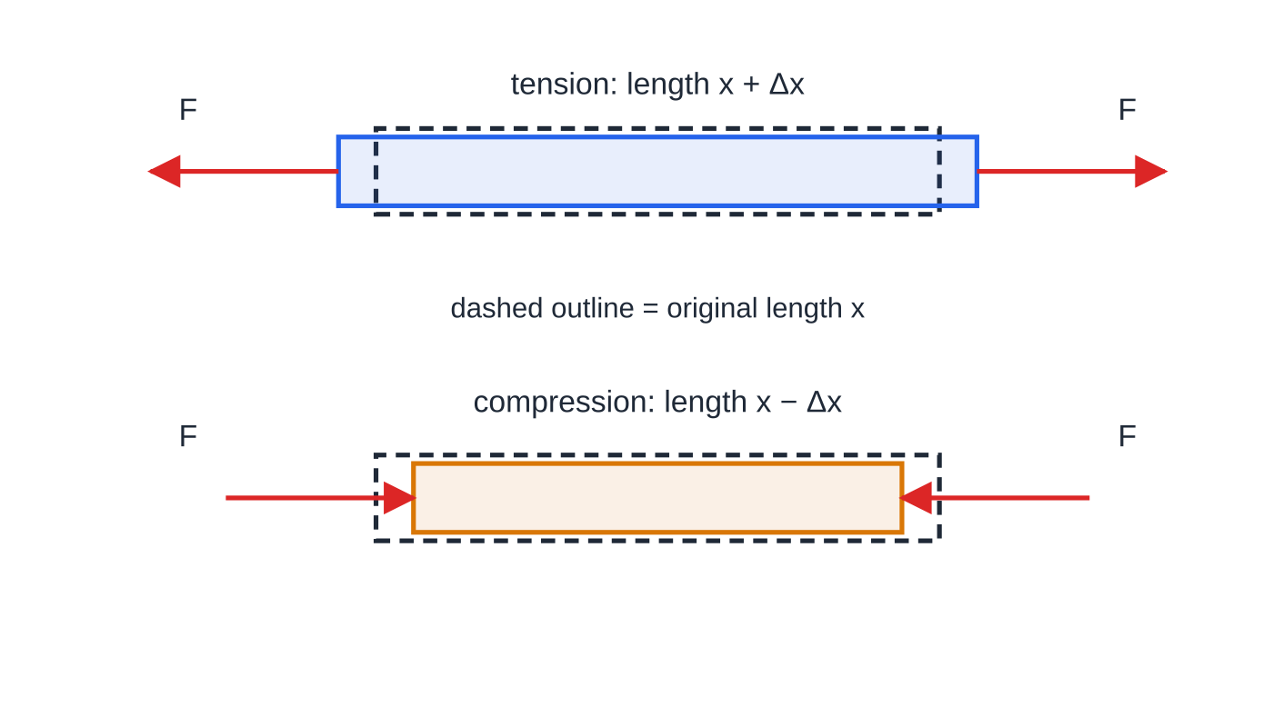
What are tensile and compressive stress? (continued)
Section 1 of 11
Compressive stress: the forces push inwards and tend to squash it (a column, a table leg, the sole of a shoe).
The area A is the cross-section at right angles to the force.
Stresses in materials are large numbers: 1 MPa = 10⁶ Pa, 1 GPa = 10⁹ Pa. Areas of wires are tiny: 1 mm² = 10⁻⁶ m².
The same rod in tension (top) and in compression (bottom). Equal and opposite forces F act at the ends; the change in length Δx is measured from the original length x.
Notes:
What are tensile and compressive stress?. Full notes: https://examinerprep.com/notes/edexcel-ial-physics/stress-strain-and-the-young-modulus/

Slide 6
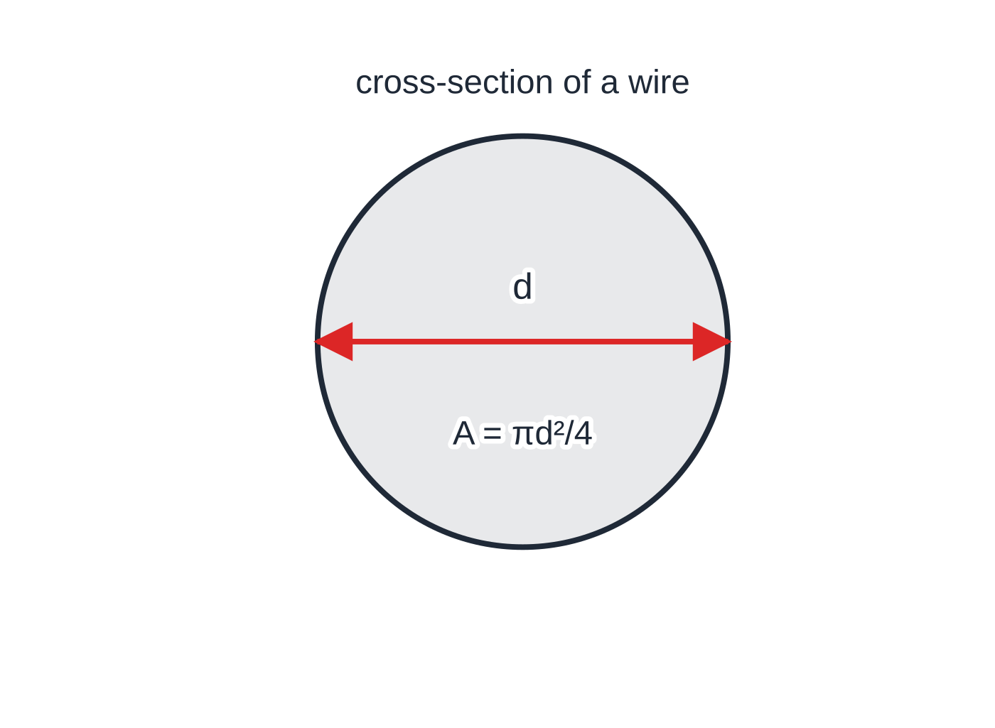
What are tensile and compressive stress? (continued)
Section 1 of 11
The cross-sectional area of a wire comes from its measured diameter: A = πd²/4. Halve the diameter before using πr², and convert mm to m before squaring.
Notes:
What are tensile and compressive stress?. Full notes: https://examinerprep.com/notes/edexcel-ial-physics/stress-strain-and-the-young-modulus/

Slide 7
What are tensile and compressive stress? (continued)
Section 1 of 11 · Worked example 1 · Easy · Calculate
WORKED EXAMPLE · QUESTION
A lamp of mass 42 kg hangs at rest from a single steel wire of diameter 2.4 mm. Calculate the tensile stress in the wire.
SOLUTION
The tension equals the weight: F = mg = 42×9.81 = 412 N.
Area from the diameter, in metres: A = π×(2.4×10⁻³)²÷4 = 4.52×10⁻⁶ m².
σ= 412÷4.52×10⁻⁶ → σ = 9.1 × 10⁷ Pa (91 MPa).
Notes:
What are tensile and compressive stress?: Worked example 1. Full notes: https://examinerprep.com/notes/edexcel-ial-physics/stress-strain-and-the-young-modulus/

Slide 8
What are tensile and compressive stress? (continued)
Section 1 of 11
Common error
Putting the diameter into πr². This makes the area four times too big and the stress four times too small. Halve the diameter first, or use πd²/4, and convert millimetres to metres before squaring.
Notes:
What are tensile and compressive stress?. Full notes: https://examinerprep.com/notes/edexcel-ial-physics/stress-strain-and-the-young-modulus/

Slide 9
What is strain?
Section 2 of 11
Strain
is the change in length divided by the original length:
ε= Δx/x
ε = strain (no unit), Δx = extension or compression (m), x = original length (m).
Strain is a ratio of two lengths, so it has no unit. It may be given as a decimal or as a percentage: a strain of 0.002 is 0.2%. Tensile strain is an extension; compressive strain is a reduction in length.
Strain compares the change with the size of the sample, so a 1 mm stretch is a big strain for a 10 cm wire but a tiny one for a 10 m cable.
Metals in their elastic region usually show strains well below 0.01 (1%). This is why the Young modulus practical needs a long wire.
Use the original length, not the stretched length.
Notes:
What is strain?. Full notes: https://examinerprep.com/notes/edexcel-ial-physics/stress-strain-and-the-young-modulus/

Slide 10
What is the Young modulus?
Section 3 of 11
The Young modulus
of a material is the ratio of stress to strain, for stresses within the limit of proportionality:
E = σ/ε so E = Fx/A Δx
E = Young modulus (Pa). Strain has no unit, so E has the unit of stress. Valid where stress is proportional to strain: the straight part of a stress–strain graph, where the material obeys Hooke's law.
E measures the stiffness of a material: a large E means a large stress is needed for a small strain.
It does not depend on the shape or size of the sample. Compare the stiffness of an object (1.8): k = F/Δx = EA/x, which does depend on A and x.
Notes:
What is the Young modulus?. Full notes: https://examinerprep.com/notes/edexcel-ial-physics/stress-strain-and-the-young-modulus/

Slide 11
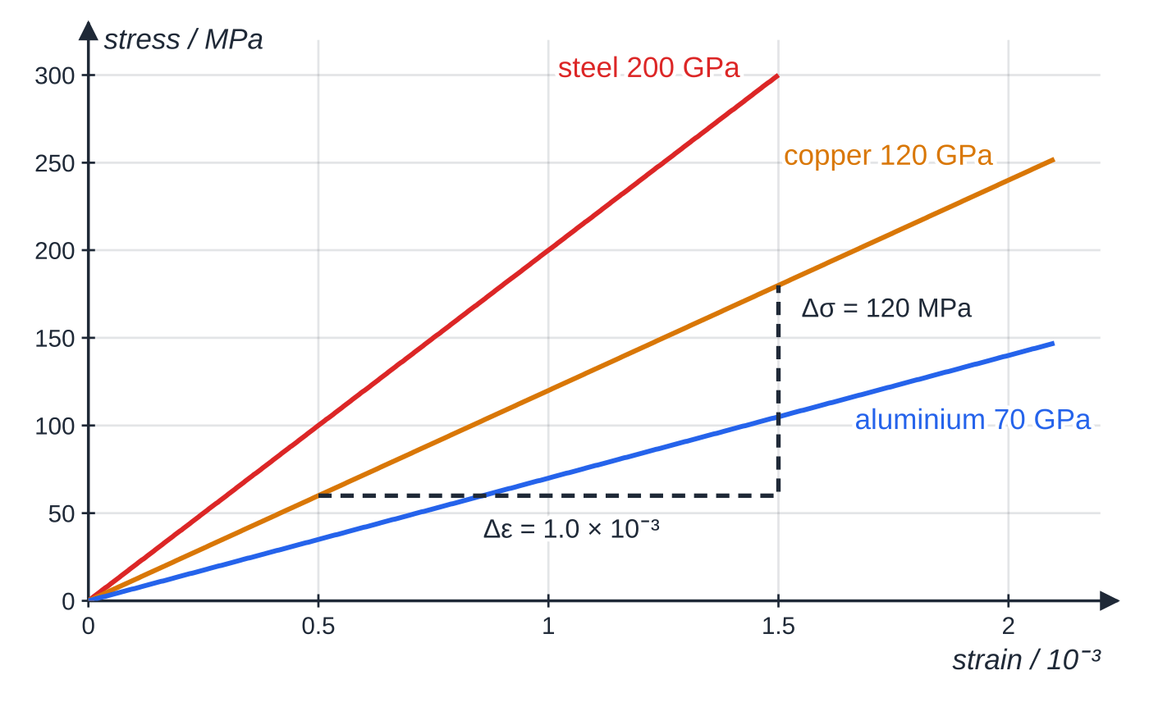
What is the Young modulus? (continued)
Section 3 of 11
Typical values: steel about 200 GPa, copper about 120 GPa, aluminium about 70 GPa, rubber only a few MPa.
The straight-line regions of three metals, drawn from E = σ/ε. The steeper the line, the stiffer the material. The triangle on the copper line gives 120 MPa ÷ 1.0 × 10⁻³ = 1.2 × 10¹¹ Pa.
Notes:
What is the Young modulus?. Full notes: https://examinerprep.com/notes/edexcel-ial-physics/stress-strain-and-the-young-modulus/

Slide 12
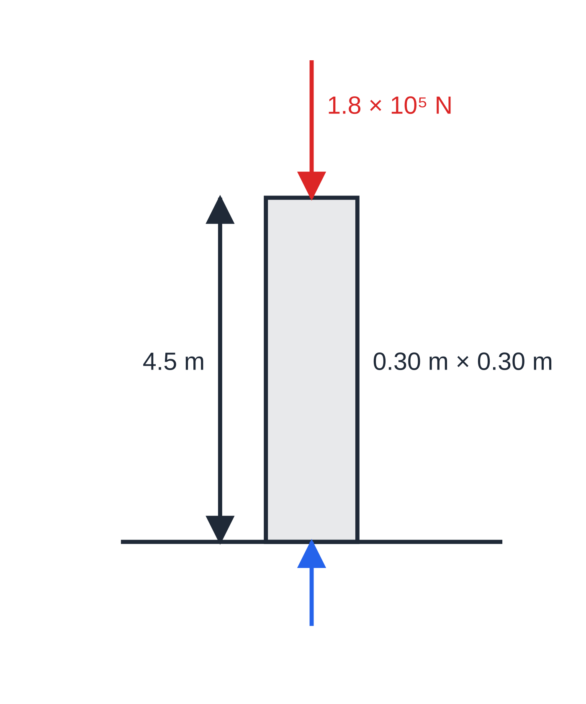
What is the Young modulus? (continued)
Section 3 of 11
The granite column of worked example 2 (not to scale), squeezed between the load and the ground: a compressive stress.
Notes:
What is the Young modulus?. Full notes: https://examinerprep.com/notes/edexcel-ial-physics/stress-strain-and-the-young-modulus/

Slide 13
What is the Young modulus? (continued)
Section 3 of 11 · Worked example 2 · Medium · Calculate
WORKED EXAMPLE · QUESTION
A granite column of square cross-section, 0.30 m × 0.30 m, supports a compressive load of 1.8 × 10⁵ N. The column is 4.5 m tall and the load shortens it by 0.21 mm. Calculate (a) the compressive stress, (b) the compressive strain and (c) the Young modulus of the granite.
SOLUTION
(a) σ= 1.8×10⁵÷(0.30×0.30) = 1.8×10⁵÷0.090 → σ = 2.0 × 10⁶ Pa.
(b) Both lengths in metres: ε= 2.1×10⁻⁴÷4.5 → ε = 4.67 × 10⁻⁵ (no unit).
(c) E = 2.0×10⁶÷4.67×10⁻⁵ → E = 4.3 × 10¹⁰ Pa (43 GPa).
Notes:
What is the Young modulus?: Worked example 2. Full notes: https://examinerprep.com/notes/edexcel-ial-physics/stress-strain-and-the-young-modulus/

Slide 14
What is the Young modulus? (continued)
Section 3 of 11 · Worked example 3 · Medium · Calculate, state
WORKED EXAMPLE · QUESTION
A copper wire is 1.6 m long and 0.50 mm in diameter. A load of 25 N is hung from it. The Young modulus of copper is 1.2 × 10¹¹ Pa; assume the wire obeys Hooke's law. (a) Calculate the extension. (b) A second wire of the same copper has the same length but twice the diameter. State its extension under the same load.
SOLUTION
(a) A = π×(0.50×10⁻³)²÷4 = 1.96×10⁻⁷ m², so σ= 25÷1.96×10⁻⁷ = 1.27×10⁸ Pa.
ε= σ/E = 1.27×10⁸÷1.2×10¹¹ = 1.06×10⁻³, so Δx = εx = 1.06×10⁻³×1.6 → Δx = 1.7 mm.
(b) Doubling d multiplies A by 4, so the stress and the strain are quartered: 1.70÷4 → 0.42 mm. The Young modulus is unchanged because it is the same material; only the object's stiffness changes.
Notes:
What is the Young modulus?: Worked example 3. Full notes: https://examinerprep.com/notes/edexcel-ial-physics/stress-strain-and-the-young-modulus/

Slide 15
What does a stress–strain graph show?
Section 4 of 11
A stress–strain graph has the same shape as the force–extension graph of the same sample, but it describes the material: any sample of it gives the same curve. The points on it are the ones you met in 1.8.
Gradient of the straight section = Young modulus E.
P, limit of proportionality: the end of the straight line.
E, elastic limit: beyond this the sample does not return to its original length when the load is removed.
Y, yield point: the material starts to deform plastically with little or no increase in stress.
Breaking stress (ultimate tensile stress, UTS): the greatest stress the material can withstand, the highest point of the curve.
For a ductile metal, beyond the UTS the wire forms a narrow "neck"; the force it can support falls and it breaks soon after.
Notes:
What does a stress–strain graph show?. Full notes: https://examinerprep.com/notes/edexcel-ial-physics/stress-strain-and-the-young-modulus/

Slide 16
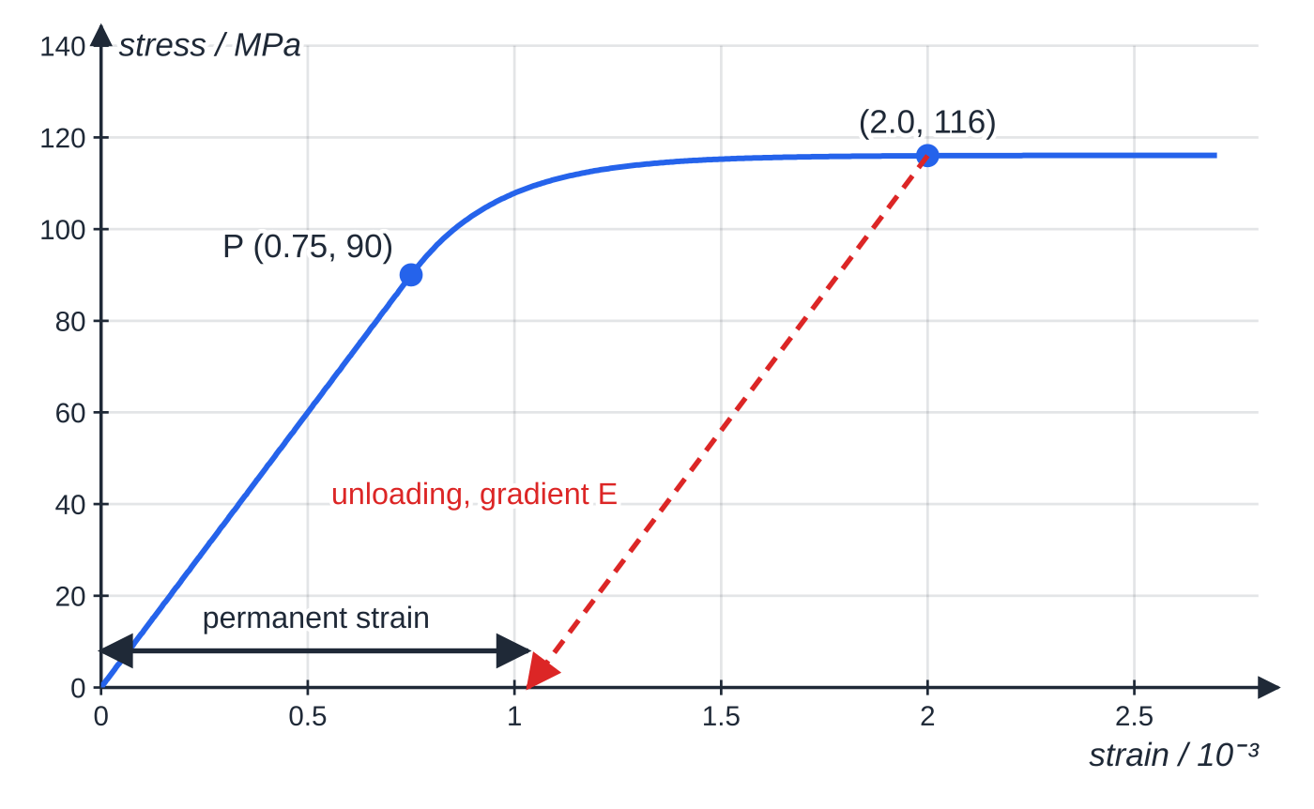
What does a stress–strain graph show? (continued)
Section 4 of 11
Graph A: the start of the curve for one ductile metal (a model). It is straight to P at 90 MPa, so E = 90 MPa ÷ 0.75 × 10⁻³ = 1.2 × 10¹¹ Pa. Unloading from a strain of 2.0 × 10⁻³ follows a line parallel to the first and leaves a permanent strain of about 1.0 × 10⁻³.
Notes:
What does a stress–strain graph show?. Full notes: https://examinerprep.com/notes/edexcel-ial-physics/stress-strain-and-the-young-modulus/

Slide 17
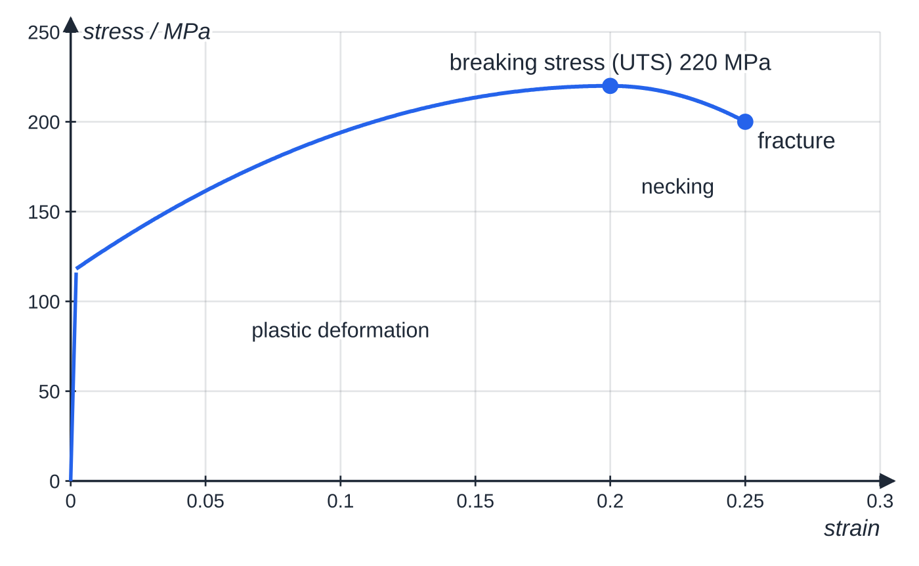
What does a stress–strain graph show? (continued)
Section 4 of 11
Graph B: the whole curve for the same metal. On this scale the elastic part is an almost vertical line at the start: plastic strain is hundreds of times larger than elastic strain. The breaking stress is the maximum, not the end point.
Notes:
What does a stress–strain graph show?. Full notes: https://examinerprep.com/notes/edexcel-ial-physics/stress-strain-and-the-young-modulus/

Slide 18
What does a stress–strain graph show? (continued)
Section 4 of 11 · Worked example 4 · Hard · Determine, estimate
WORKED EXAMPLE · QUESTION
Use graphs A and B for this metal. (a) Determine the Young modulus. (b) A wire of this metal has diameter 0.80 mm. Calculate the greatest load it can support. (c) A 1.2 m length of the wire is stretched to a strain of 2.0 × 10⁻³ and the load is removed. Estimate its permanent extension.
SOLUTION
(a) Gradient from the origin to P: E = 90×10⁶÷0.75×10⁻³ → E = 1.2 × 10¹¹ Pa.
(b) Greatest load = breaking stress × area: A = π×(0.80×10⁻³)²÷4 = 5.03×10⁻⁷ m², F = 220×10⁶×5.03×10⁻⁷ = 111 N → 1.1 × 10² N.
(c) At ε= 2.0×10⁻³ the stress is about 116 MPa. On unloading the elastic part is recovered along a line of gradient E: elastic strain = 116×10⁶÷1.2×10¹¹ = 9.7×10⁻⁴. Permanent strain ≈2.0×10⁻³ - 0.97×10⁻³ = 1.0×10⁻³, so permanent extension ≈1.0×10⁻³×1.2 → ≈ 1.2 mm.
Notes:
What does a stress–strain graph show?: Worked example 4. Full notes: https://examinerprep.com/notes/edexcel-ial-physics/stress-strain-and-the-young-modulus/

Slide 19
What does a stress–strain graph show? (continued)
Section 4 of 11
Exam tip
"Breaking stress" means the maximum stress on the curve, not the stress at the point where the line stops. For a ductile metal the line ends lower than the maximum because the wire has necked.
Notes:
What does a stress–strain graph show?. Full notes: https://examinerprep.com/notes/edexcel-ial-physics/stress-strain-and-the-young-modulus/

Slide 20
What does a stress–strain graph show? (continued)
Section 4 of 11 · Worked example 5 · Hard · Calculate
WORKED EXAMPLE · QUESTION
A hoist must hold a load of mass 2500 kg on a single steel cable. The breaking stress of the steel is 1.6 × 10⁹ Pa and, for safety, the stress in the cable must not exceed one fifth of this. The Young modulus of the steel is 2.0 × 10¹¹ Pa. (a) Calculate the minimum diameter of the cable. (b) Calculate the extension of a 32 m length of this cable when it carries the load.
SOLUTION
Greatest allowed stress σ= 1.6×10⁹÷5 = 3.2×10⁸ Pa; load F = 2500×9.81 = 2.45×10⁴ N.
(a) A = F/σ= 2.45×10⁴÷3.2×10⁸ = 7.66×10⁻⁵ m², so d = √(4A/π) → d = 9.9 mm.
(b) ε= σ/E = 3.2×10⁸÷2.0×10¹¹ = 1.6×10⁻³, so Δx = 1.6×10⁻³×32 → Δx = 51 mm.
The cable diameter must be rounded up to a size that is available, so the real stress is a little lower.
Notes:
What does a stress–strain graph show?: Worked example 5. Full notes: https://examinerprep.com/notes/edexcel-ial-physics/stress-strain-and-the-young-modulus/

Slide 21
How do you describe a material from its stress–strain graph?
Section 5 of 11
Everyday words like "strong" and "tough" have precise meanings in physics, and each one is linked to a different feature of the stress–strain graph.
Property | Meaning | Evidence on a stress–strain graph
Stiff | large stress needed for a small strain | steep straight section (large E)
Strong | large stress needed to break it | high maximum (large breaking stress)
Brittle | breaks with little or no plastic deformation | line ends at or just after the straight section
Ductile | can be drawn out into a wire; large plastic deformation under tension | long plastic region before breaking
Malleable | can be hammered or pressed permanently into a new shape | large plastic deformation (shown on a compressive graph)
Hard | resists scratching and denting of its surface | not read from the graph; hard materials usually yield at high stress
Notes:
How do you describe a material from its stress–strain graph?. Full notes: https://examinerprep.com/notes/edexcel-ial-physics/stress-strain-and-the-young-modulus/

Slide 22
How do you describe a material from its stress–strain graph? (continued)
Section 5 of 11
Property | Meaning | Evidence on a stress–strain graph
Tough | absorbs a lot of energy before breaking; resists cracks | large area under the curve up to breaking
The properties are independent: glass is stiff and strong but brittle; copper is ductile but not very strong; a material can be strong without being tough. The opposite of brittle is tough or ductile, not "strong"; the opposite of stiff is flexible, not "weak".
Notes:
How do you describe a material from its stress–strain graph?. Full notes: https://examinerprep.com/notes/edexcel-ial-physics/stress-strain-and-the-young-modulus/

Slide 23
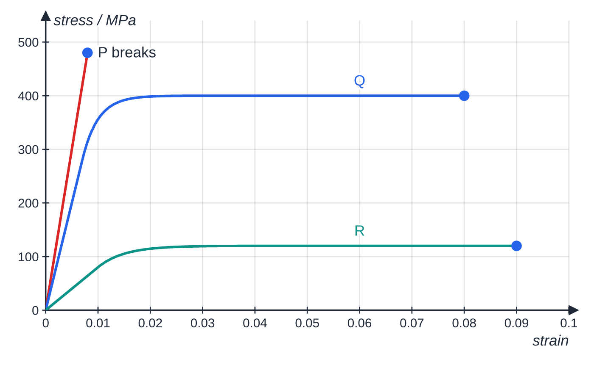
How do you describe a material from its stress–strain graph? (continued)
Section 5 of 11
Three model materials. P: stiffest and strongest, but brittle. Q: stiff, strong and ductile, with the largest area under its curve, so the toughest. R: low stiffness and low strength, but the most ductile.
Notes:
How do you describe a material from its stress–strain graph?. Full notes: https://examinerprep.com/notes/edexcel-ial-physics/stress-strain-and-the-young-modulus/

Slide 24
How do you describe a material from its stress–strain graph? (continued)
Section 5 of 11 · Worked example 6 · Medium · Identify
WORKED EXAMPLE · QUESTION
Use the graph of materials P, Q and R. Identify, with a reason from the graph, the material that is (a) the stiffest, (b) the strongest, (c) brittle, (d) the most ductile and (e) the toughest.
SOLUTION
(a) Gradients of the straight sections: P: 480 MPa ÷ 0.008 = 6.0 × 10¹⁰ Pa; Q: 280 MPa ÷ 0.007 = 4.0 × 10¹⁰ Pa; R: 80 MPa ÷ 0.010 = 8.0 × 10⁹ Pa → P is the stiffest.
(b), (c) P reaches 480 MPa, above Q (400 MPa) and R (120 MPa) → P is the strongest; its line ends where it stops being straight → P is brittle.
(d) R breaks at a strain of 0.090, Q at 0.080, P at 0.008 → R is the most ductile.
(e) Area under P = ½×480×10⁶×0.008 ≈1.9×10⁶ J m⁻³; Q's area is about 15 times this and R's about 5 times → Q is the toughest. P is the strongest material but the least tough: strength and toughness are different properties.
Notes:
How do you describe a material from its stress–strain graph?: Worked example 6. Full notes: https://examinerprep.com/notes/edexcel-ial-physics/stress-strain-and-the-young-modulus/

Slide 25
How do you describe a material from its stress–strain graph? (continued)
Section 5 of 11
Common error
Using "strong" for everything. If a question asks which material is stiffer, the answer must be about the gradient; if it asks which is tougher, it must be about the area. Name the feature of the graph each time.
Notes:
How do you describe a material from its stress–strain graph?. Full notes: https://examinerprep.com/notes/edexcel-ial-physics/stress-strain-and-the-young-modulus/

Slide 26
How do you determine the Young modulus of a wire (Core Practical 3)?
Section 6 of 11
Idea: load a wire, measure its extension, and plot stress against strain; the gradient of the straight section is E.
Why long and thin: metal strains are tiny. A long wire (2–3 m) gives a larger extension for the same strain; a thin wire gives a large stress for a modest load. Both make the extension big enough to measure with a small percentage uncertainty.
Set-up: clamp one end firmly; run the wire along the bench over a pulley; attach a small pointer (a tape flag) near the pulley, against a fixed scale; start with a small load to straighten the wire.
Original length x: from the clamp to the pointer, with a metre rule or tape measure.
Diameter d: a micrometer at several points along the wire and in two directions at right angles at each point; take the mean. This finds the average size and allows for a wire that is not perfectly round.
Notes:
How do you determine the Young modulus of a wire (Core Practical 3)?. Full notes: https://examinerprep.com/notes/edexcel-ial-physics/stress-strain-and-the-young-modulus/

Slide 27
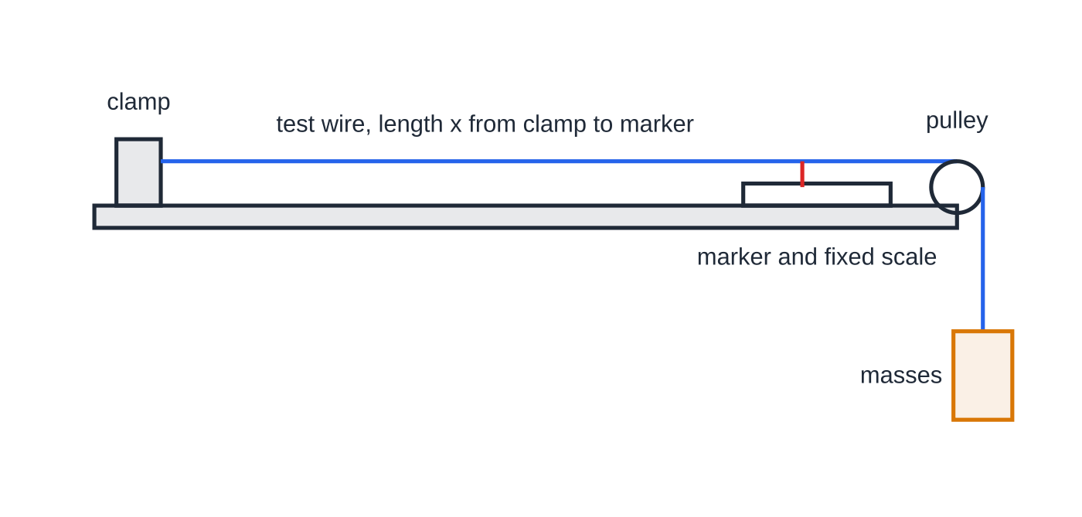
How do you determine the Young modulus of a wire (Core Practical 3)? (continued)
Section 6 of 11
Extension: add masses in equal steps; record the pointer position each time and subtract the starting reading. A vernier scale (or a travelling microscope) gives a finer reading than a millimetre scale.
Check: remove the masses one at a time and read again; returning readings show the wire stayed elastic.
Safety: eye protection in case the wire snaps; a box of padding under the masses; keep feet clear.
One arrangement for Core Practical 3. The marker moves along the fixed scale as the wire extends; the extension is the change in the marker reading.
Notes:
How do you determine the Young modulus of a wire (Core Practical 3)?. Full notes: https://examinerprep.com/notes/edexcel-ial-physics/stress-strain-and-the-young-modulus/

Slide 28
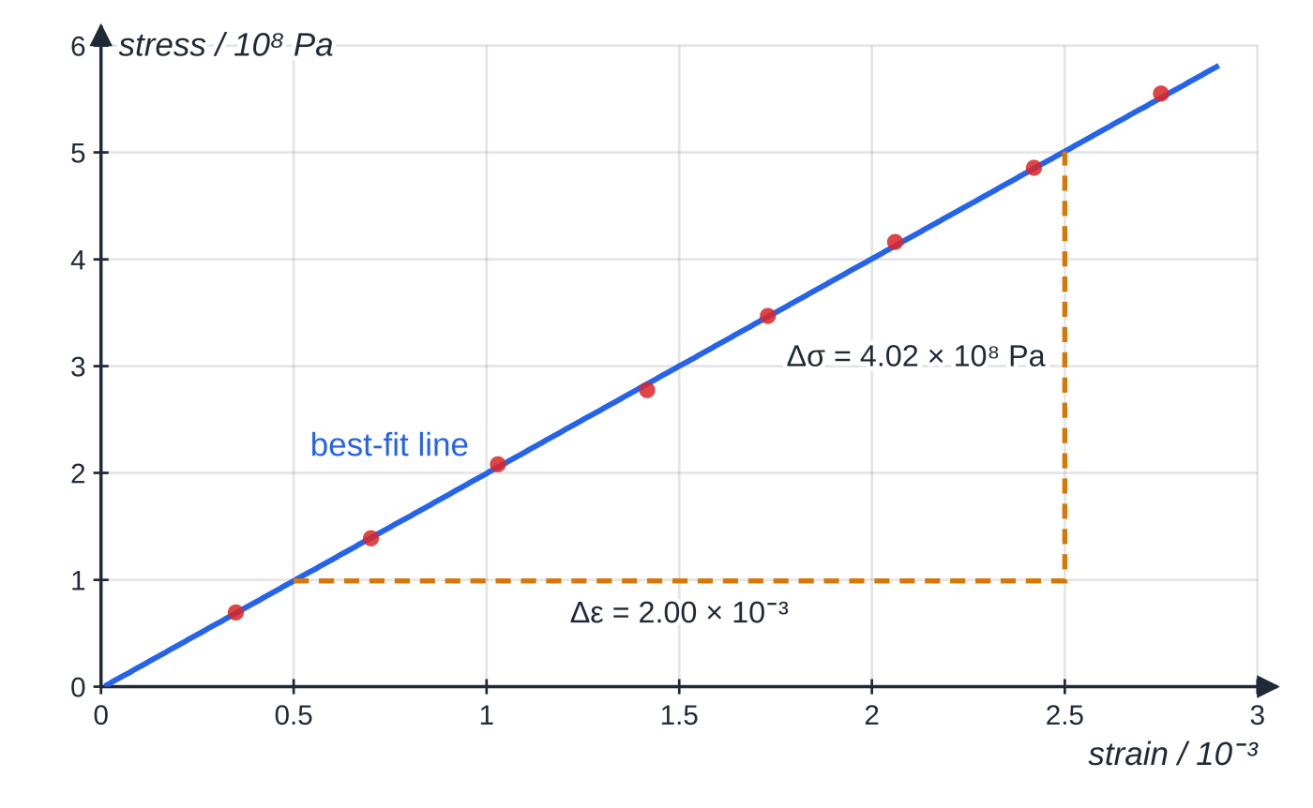
How do you determine the Young modulus of a wire (Core Practical 3)? (continued)
Section 6 of 11
Specimen results for a steel wire (2.40 m long, mean diameter 0.300 mm), loads from 0.5 kg to 4.0 kg. The best-fit line passes very close to the origin; its gradient is about 2.0 × 10¹¹ Pa.
Notes:
How do you determine the Young modulus of a wire (Core Practical 3)?. Full notes: https://examinerprep.com/notes/edexcel-ial-physics/stress-strain-and-the-young-modulus/

Slide 29
How do you determine the Young modulus of a wire (Core Practical 3)? (continued)
Section 6 of 11 · Worked example 7 · Hard · Calculate, determine
WORKED EXAMPLE · QUESTION
The micrometer readings of the wire's diameter were 0.30, 0.29, 0.31, 0.30 and 0.30 mm. The original length was 2.40 m. (a) Calculate the mean diameter and its percentage uncertainty. (b) Show how the point for a 2.0 kg load was calculated: its extension was 3.4 mm. (c) Use the graph to determine the Young modulus of the steel.
SOLUTION
(a) Mean, with half the range as the uncertainty: d = 0.300 mm ± 0.01 mm, percentage uncertainty = 0.01÷0.30×100 → 3.3%.
(b) A = π×(0.300×10⁻³)²÷4 = 7.07×10⁻⁸ m²; σ= 19.62÷7.07×10⁻⁸ = 2.78×10⁸ Pa; ε= 3.4×10⁻³ m÷2.40 = 1.42×10⁻³.
(c) Large triangle on the best-fit line, from (0.50×10⁻³, 0.99×10⁸ Pa) to (2.50×10⁻³, 5.01×10⁸ Pa): E = 4.02×10⁸÷2.0×10⁻³ = 2.01×10¹¹ Pa → E = 2.0 × 10¹¹ Pa.
Notes:
How do you determine the Young modulus of a wire (Core Practical 3)?: Worked example 7. Full notes: https://examinerprep.com/notes/edexcel-ial-physics/stress-strain-and-the-young-modulus/

Slide 30
How do you determine the Young modulus of a wire (Core Practical 3)? (continued)
Section 6 of 11 · Worked example 7 · Hard · Calculate, determine (continued)
For comparison: the largest extension, 6.6 mm, read to ± 0.05 mm, has a percentage uncertainty of 0.76%, and the length (2.40 m ± 0.5 mm) only 0.02%. The diameter dominates, and it is squared in the area, so measure it with the most care.
Notes:
How do you determine the Young modulus of a wire (Core Practical 3)?: Worked example 7. Full notes: https://examinerprep.com/notes/edexcel-ial-physics/stress-strain-and-the-young-modulus/

Slide 31
How do you determine the Young modulus of a wire (Core Practical 3)? (continued)
Section 6 of 11
Exam tip
When asked to improve this experiment, aim at the largest percentage uncertainty: take more diameter readings along the wire, or use a longer wire to increase the extension. Repeating extension readings while unloading also shows whether the elastic limit was passed.
Notes:
How do you determine the Young modulus of a wire (Core Practical 3)?. Full notes: https://examinerprep.com/notes/edexcel-ial-physics/stress-strain-and-the-young-modulus/

Slide 32
Exam tips for 1.9
Section 7 of 11
Exam tip 1 — convert before you square
Change millimetres to metres before calculating an area: 0.50 mm = 0.50 × 10⁻³ m, and (0.50 × 10⁻³)² = 2.5 × 10⁻⁷ m². An area left in mm² gives a stress a million times too large.
Exam tip 2 — read the axis prefix
Stress axes are often labelled in MPa or 10⁸ Pa and strain axes in 10⁻³ or %. Write the powers of ten into the gradient calculation; a Young modulus for a metal should come out at around 10¹⁰–10¹¹ Pa.
Exam tip 3 — material or object?
The Young modulus, breaking stress and properties such as "ductile" belong to the material. Stiffness k, extension and breaking force belong to a particular sample and change with its length and area.
Notes:
Exam tips for 1.9. Full notes: https://examinerprep.com/notes/edexcel-ial-physics/stress-strain-and-the-young-modulus/

Slide 33
Exam tips for 1.9 (continued)
Section 7 of 11
Exam tip 4 — quote the graph
When you describe a material, back each word with a feature: "stiff: the straight section is steep", "brittle: it breaks at the end of the straight section with no plastic region", "tough: large area under the curve".
Exam tip 5 — describe the practical in measurable steps
For each quantity give the instrument and how it is used: micrometer on the diameter at several places, metre rule for the original length from the clamp to the pointer, fixed scale or vernier for the extension, equal load steps, then a graph of stress against strain.
Notes:
Exam tips for 1.9. Full notes: https://examinerprep.com/notes/edexcel-ial-physics/stress-strain-and-the-young-modulus/

Slide 34
Common misconceptions
Section 8 of 11
Misconception | Why it is wrong | Correct idea
A thicker wire of the same metal has a larger Young modulus. | A larger area reduces the stress and the strain in the same proportion. | E is a property of the material; thickness changes the object's stiffness k.
Strain is measured in metres. | It is a length divided by a length. | Strain has no unit; it may be written as a percentage.
Strong and stiff mean the same thing. | Stiffness is about strain under a stress; strength is about the stress at breaking. | Stiff = steep gradient; strong = high breaking stress.
Brittle materials are weak. | Brittleness is about how a material breaks, not the stress needed. | Glass and ceramics can be very strong but still brittle.
The breaking stress is where the graph ends. | A ductile wire necks after the maximum, so the line ends lower. | Breaking stress (UTS) is the highest stress on the curve.
Notes:
Common misconceptions. Full notes: https://examinerprep.com/notes/edexcel-ial-physics/stress-strain-and-the-young-modulus/

Slide 35
Common misconceptions (continued)
Section 8 of 11
Misconception | Why it is wrong | Correct idea
Hard means tough. | Hardness concerns the surface; toughness concerns energy absorbed before breaking. | A hard material such as glass can be brittle and not tough.
Notes:
Common misconceptions. Full notes: https://examinerprep.com/notes/edexcel-ial-physics/stress-strain-and-the-young-modulus/

Slide 36
How this topic connects
Section 9 of 11
8 Hooke's law and elastic strain energy
The force–extension graph of a sample becomes a stress–strain graph when you divide by A and x; the object's stiffness is k = EA/x, and the area under the force–extension graph is the elastic strain energy.
2 Forces and Newton's laws
The force in stress = F/A is usually a tension or a weight found from equilibrium: the same free-body diagrams as for ropes and hanging loads.
8 Resistivity and 3.3 The AS core practicals
Finding the resistivity of a wire uses the same micrometer readings and the same area πd²/4; both experiments are most sensitive to the diameter. Mean and half-range uncertainties and gradients from a large triangle are practised here too.
Notes:
How this topic connects. Full notes: https://examinerprep.com/notes/edexcel-ial-physics/stress-strain-and-the-young-modulus/

Slide 37
Key equations
Section 10 of 11
Equation | Use | In the formulae list?
σ= F/A | tensile or compressive stress (Pa) | yes
ε= Δx/x | tensile or compressive strain (no unit) | yes
E = σ/ε | Young modulus (Pa) | yes
A = πd²/4 | area of a wire from its diameter | no — learn it
E = Fx/(AΔx) | Young modulus from raw measurements | no — derive it from the three above
Δx = Fx/(EA) | predicting an extension | no — derive it
k = EA/x | stiffness of a wire or rod (link to 1.8) | no — derive it
Notes:
Key equations. Full notes: https://examinerprep.com/notes/edexcel-ial-physics/stress-strain-and-the-young-modulus/

Slide 38
Check your understanding
Section 11 of 11
1. Express the pascal in SI base units.
2. A nylon cord 2.50 m long stretches by 45 mm. Calculate the strain.
3. Wire B is made of the same metal as wire A but is twice as long and has twice the diameter. Both carry the same load. Compare their extensions.
4. Explain the difference between a ductile and a malleable material.
5. Explain why a long wire is used in the Young modulus core practical.
6. A steel wire (E = 2.0 × 10¹¹ Pa) of length 3.0 m and cross-sectional area 1.5 × 10⁻⁷ m² carries 30 N. Calculate its extension.
Notes:
Check your understanding: questions. Full notes: https://examinerprep.com/notes/edexcel-ial-physics/stress-strain-and-the-young-modulus/

Slide 39
Check your understanding · answers
Section 11 of 11
1. 1 Pa = 1 N m⁻² = 1 kg m s⁻² ÷ m² = 1 kg m⁻¹ s⁻².
2. ε= 0.045÷2.50 = 0.018 (1.8%), with no unit.
3. Δx = Fx/(EA). Doubling x doubles Δx; doubling d quadruples A. B's extension is 2÷4 = 0.5 times A's.
4. Both undergo large plastic deformation without breaking. Ductile describes this under tension (the material can be drawn into a wire); malleable describes it under compression (it can be hammered or rolled into sheets).
5. For a given stress the strain is fixed, so the extension is proportional to the original length. A long wire gives a larger extension, which reduces its percentage uncertainty.
6. Δx = Fx/(EA) = 30×3.0÷(2.0×10¹¹×1.5×10⁻⁷) = 3.0×10⁻³ m = 3.0 mm.
Notes:
Check your understanding: answers. Full notes: https://examinerprep.com/notes/edexcel-ial-physics/stress-strain-and-the-young-modulus/

Slide 40
Practice questions
5 original exam-style questions. Answers at the end of the deck.

Slide 41
Question 1
1 mark
Which row gives correct units for stress, strain and the Young modulus?
A stress: N m⁻² · strain: m · Young modulus: N m⁻³
B stress: N m⁻² · strain: no unit · Young modulus: N m⁻²
C stress: N m² · strain: no unit · Young modulus: N m²
D stress: N m⁻¹ · strain: m · Young modulus: N m⁻²
Notes:
Online with the full mark scheme: https://examinerprep.com/ial-physics-1-9-stress-strain-and-the-young-modulus-questions#IALP-U1-9-A-01

Slide 42
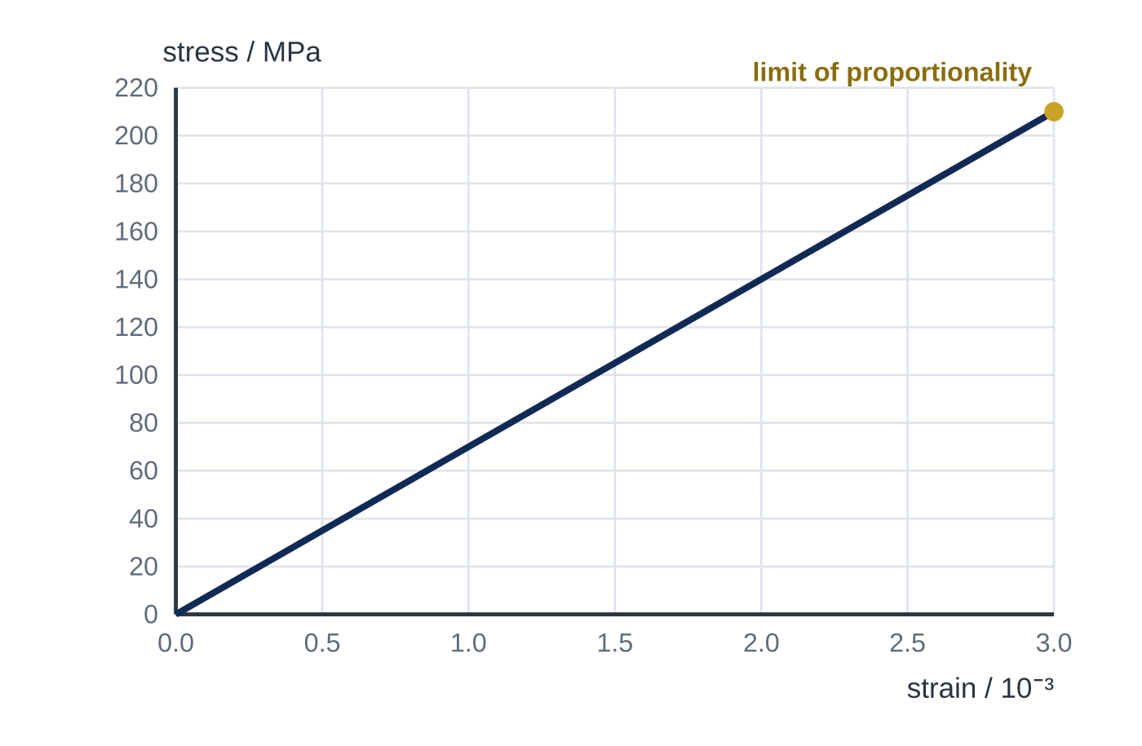
Question 2
1 mark
The graph shows the stress–strain graph for a sample of an aluminium alloy, up to its limit of proportionality.
What is the Young modulus of the alloy?
A 7.0 × 10⁴ Pa
B 7.0 × 10⁷ Pa
C 7.0 × 10¹⁰ Pa
D 7.0 × 10¹³ Pa
Notes:
Online with the full mark scheme: https://examinerprep.com/ial-physics-1-9-stress-strain-and-the-young-modulus-questions#IALP-U1-9-FA-01

Slide 43
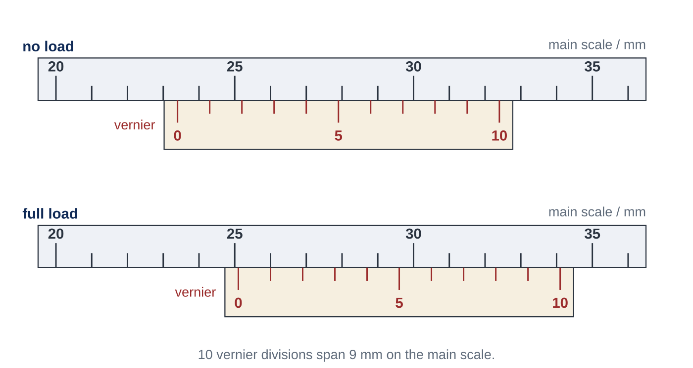
Question 3
1 mark
In an experiment to find the Young modulus of a metal, a vernier scale reads the position of a pointer fixed to a test wire of original length 2.00 m. Figure 1 shows the vernier readings with no load and with the full load.
What is the strain in the wire with the full load?
A 8.5 × 10⁻⁴
B 1.0 × 10⁻³
C 1.3 × 10⁻²
D 8.5 × 10⁻¹
Notes:
Online with the full mark scheme: https://examinerprep.com/ial-physics-1-9-stress-strain-and-the-young-modulus-questions#IALP-U1-9-FA-10

Slide 44
Question 4
4 marks
A steel guy wire helps to hold a radio mast upright. The wire has a diameter of 6.0 mm and the tension in it is 3.2 kN. The Young modulus of the steel is 2.1 × 10¹¹ Pa.
(a) State what is meant by tensile stress. [1]
(b) Calculate the cross-sectional area of the wire. [1]
(c) Calculate the tensile stress in the wire. [1]
(d) Calculate the strain in the wire. [1]
Notes:
Online with the full mark scheme: https://examinerprep.com/ial-physics-1-9-stress-strain-and-the-young-modulus-questions#IALP-U1-9-B-01

Slide 45
Question 5
4 marks
When a person stands on one leg, the shaft of the thigh bone (femur) carries a compressive force of about 1.4 kN. The shaft is 0.45 m long and its bone has a cross-sectional area of 3.5 × 10⁻⁴ m². The Young modulus of bone is 1.7 × 10¹⁰ Pa.
(a) State what is meant by compressive strain. [1]
(b) Calculate the compressive stress in the bone. [1]
(c) Calculate the amount by which the shaft shortens. [2]
Notes:
Online with the full mark scheme: https://examinerprep.com/ial-physics-1-9-stress-strain-and-the-young-modulus-questions#IALP-U1-9-B-02

Slide 46
Answers

Slide 47
Question 1 · answer
Answer B
Stress = force ÷ area, so N m⁻² (Pa). Strain = length ÷ length, so it has no unit. The Young modulus = stress ÷ strain, so it has the unit of stress, N m⁻².
Notes:
Full mark scheme: https://examinerprep.com/ial-physics-1-9-stress-strain-and-the-young-modulus-questions#IALP-U1-9-A-01

Slide 48
Question 2 · answer
Answer C
The line passes through the gridline intersection (2.0 × 10⁻³, 140 MPa). E = gradient = 140 × 10⁶ ÷ 2.0 × 10⁻³ = 7.0 × 10¹⁰ Pa.
Notes:
Full mark scheme: https://examinerprep.com/ial-physics-1-9-stress-strain-and-the-young-modulus-questions#IALP-U1-9-FA-01

Slide 49
Question 3 · answer
Answer A
No load: 23 mm + 4 × 0.1 mm = 23.4 mm. Full load: 25 mm + 1 × 0.1 mm = 25.1 mm. Extension = 1.7 mm = 1.7 × 10⁻³ m. ε = 1.7 × 10⁻³ ÷ 2.00 = 8.5 × 10⁻⁴.
Notes:
Full mark scheme: https://examinerprep.com/ial-physics-1-9-stress-strain-and-the-young-modulus-questions#IALP-U1-9-FA-10

Slide 50
Question 4 · answer
Mark scheme
the stretching force acting per unit cross-sectional area / F/A for forces pulling outwards
π × (6.0 × 10⁻³)² ÷ 4 = 2.8 × 10⁻⁵ m² (2.83 × 10⁻⁵ m²)
3200 ÷ 2.83 × 10⁻⁵ = 1.1 × 10⁸ Pa (allow error carried forward)
ε = σ/E = 1.13 × 10⁸ ÷ 2.1 × 10¹¹ = 5.4 × 10⁻⁴ (allow error carried forward)
Notes:
Full mark scheme: https://examinerprep.com/ial-physics-1-9-stress-strain-and-the-young-modulus-questions#IALP-U1-9-B-01

Slide 51
Question 5 · answer
Mark scheme
the reduction in length divided by the original length
1400 ÷ 3.5 × 10⁻⁴ = 4.0 × 10⁶ Pa
ε = σ/E = 4.0 × 10⁶ ÷ 1.7 × 10¹⁰ = 2.35 × 10⁻⁴
Δx = εx = 2.35 × 10⁻⁴ × 0.45 = 1.1 × 10⁻⁴ m (0.11 mm) (allow error carried forward)
Notes:
Full mark scheme: https://examinerprep.com/ial-physics-1-9-stress-strain-and-the-young-modulus-questions#IALP-U1-9-B-02

Slide 52
Keep practising
Notes for this topic
Questions on this topic
Build a printable test
ExaminerPrep is an independent tutoring service. It has been developed independently from and is not endorsed by the International Baccalaureate Organization. "International Baccalaureate", "IB" and "IB Diploma Programme" are registered trademarks of the IBO, used here for descriptive purposes only.
Pearson Edexcel and Cambridge are trademarks of their owners; ExaminerPrep is not affiliated with any exam board.

