Slide 1
EP
EDEXCEL IAL PHYSICS
2.2 Superposition and stationary waves
The full notes page in 12 sections · practice questions with answers · simulations
ExaminerPrep is an independent tutoring service. It has been developed independently from and is not endorsed by the International Baccalaureate Organization. "International Baccalaureate", "IB" and "IB Diploma Programme" are registered trademarks of the IBO, used here for descriptive purposes only.
Pearson Edexcel and Cambridge are trademarks of their owners; ExaminerPrep is not affiliated with any exam board.
Notes:
2.2 Superposition and stationary waves. Notes for this topic: https://examinerprep.com/notes/edexcel-ial-physics/superposition-and-stationary-waves/

Slide 2
What this page covers
Overview
Wavefronts, the principle of superposition, phase and phase difference
Coherent sources, path difference and two-source interference
Turning a path difference into a phase difference, and deciding between a maximum and a minimum
How a stationary wave forms; nodes, antinodes and displacement–distance graphs at different instants
Harmonics on a string fixed at both ends
Harmonics in pipes closed at one end and open at both ends
The speed of a transverse wave on a string, v = √(T/μ)
Core Practical 5: how length, tension and mass per unit length affect the frequency of a vibrating string
Notes:
What this page covers. Full notes: https://examinerprep.com/notes/edexcel-ial-physics/superposition-and-stationary-waves/

Slide 3
In one minute
Key points
1. When two or more waves meet at a point, the resultant displacement is the vector sum of the individual displacements, and this single rule (superposition) explains interference, stationary waves and the harmonics of strings and pipes.
2. Coherent sources have a constant phase difference, so they have the same frequency. Only coherent waves give a steady interference pattern.
3. For sources in phase: path difference = nλ gives a maximum; path difference = (n + ½)λ gives a minimum.
4. Phase difference = 2π× (path difference)/λ, in radians.
5. A stationary wave forms when two waves of the same frequency travel in opposite directions and superpose. Adjacent nodes are λ/2 apart; antinodes lie midway between them.
6. String fixed at both ends: L = nλ/2, all harmonics. Pipe closed at one end: L = λ/4, 3λ/4, …, odd harmonics only. Pipe open at both ends: L = nλ/2, all harmonics.
Notes:
In one minute. Full notes: https://examinerprep.com/notes/edexcel-ial-physics/superposition-and-stationary-waves/

Slide 4
In one minute (continued)
Key points
7. Speed of a transverse wave on a string: v = √(T/μ), so the fundamental frequency is f = 1/2L√(T/μ).
Notes:
In one minute. Full notes: https://examinerprep.com/notes/edexcel-ial-physics/superposition-and-stationary-waves/

Slide 5
What happens when two waves meet?
Section 1 of 12
Where two sets of ripples cross, the water does something neither set would do alone, yet afterwards each set carries on unchanged. One simple rule describes the overlap.
Principle of superposition: when two or more waves meet at a point, the resultant displacement is the vector sum of the individual displacements.
"Vector sum" here means that displacements carry a sign. A displacement of +3.0 mm from one wave and −2.0 mm from another add to give +1.0 mm. The waves themselves pass through each other unchanged; superposition only describes what the medium does while they overlap.
Constructive superposition: the waves arrive in phase, crest on crest, and the resultant amplitude is the sum of the amplitudes.
Destructive superposition: the waves arrive in antiphase, crest on trough, and the resultant amplitude is the difference of the amplitudes. It is zero only if the two amplitudes are equal.
Notes:
What happens when two waves meet?. Full notes: https://examinerprep.com/notes/edexcel-ial-physics/superposition-and-stationary-waves/

Slide 6
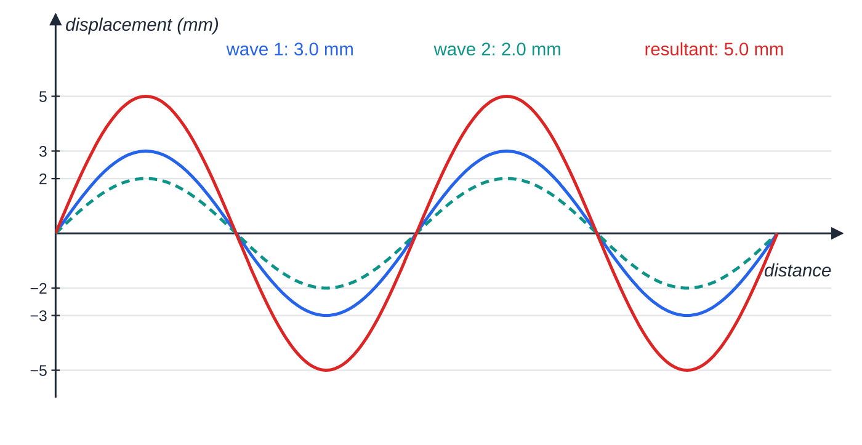
What happens when two waves meet? (continued)
Section 1 of 12
In phase: two waves of the same wavelength with amplitudes 3.0 mm and 2.0 mm add point by point to give a resultant of amplitude 5.0 mm.
Notes:
What happens when two waves meet?. Full notes: https://examinerprep.com/notes/edexcel-ial-physics/superposition-and-stationary-waves/

Slide 7
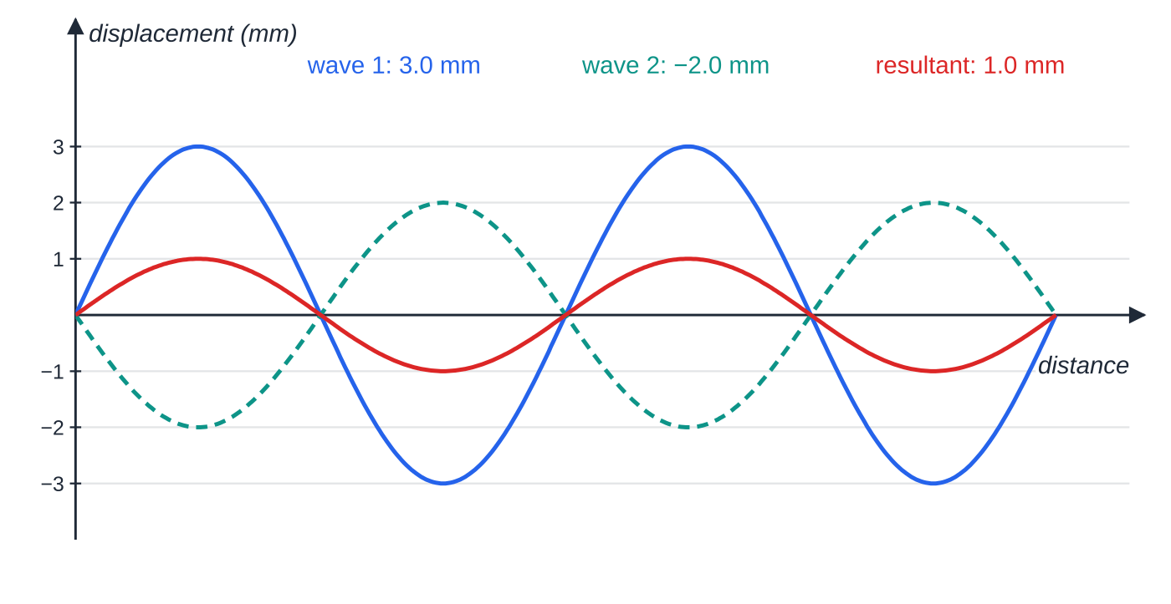
What happens when two waves meet? (continued)
Section 1 of 12
Phase, phase difference and wavefronts
Phase describes where a point is in its cycle of oscillation; one whole cycle is 2π rad (360°). Phase difference is how far one oscillation is ahead of or behind another, as a fraction of a cycle, in radians or degrees.
In phase: phase difference 0, 2π, 4π, … The oscillations reach their peaks together.
In antiphase: the same two waves now partly cancel. The resultant amplitude is 3.0 − 2.0 = 1.0 mm, not zero, because the amplitudes are unequal.
Notes:
What happens when two waves meet?. Full notes: https://examinerprep.com/notes/edexcel-ial-physics/superposition-and-stationary-waves/

Slide 8
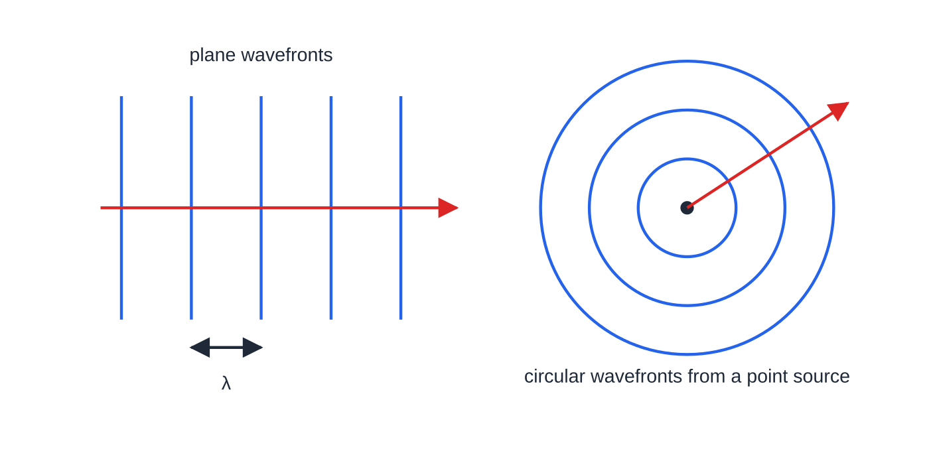
What happens when two waves meet? (continued)
Section 1 of 12
Antiphase: phase difference π, 3π, 5π, … One is at a peak when the other is at a trough.
A wavefront is a line or surface joining neighbouring points that are in phase, such as a line drawn along one crest. The direction of travel is at right angles to the wavefronts, and adjacent wavefronts drawn crest to crest are one wavelength apart. Plane waves have straight, parallel wavefronts; a small source gives circular wavefronts spreading out from it.
Wavefronts join points in phase (here, crests). Travel is always at right angles to the wavefronts, and neighbouring crest wavefronts are one wavelength apart.
Notes:
What happens when two waves meet?. Full notes: https://examinerprep.com/notes/edexcel-ial-physics/superposition-and-stationary-waves/

Slide 9
How do path difference and phase difference decide what you detect?
Section 2 of 12
If the phase difference between two overlapping waves keeps changing, maxima and minima move about too quickly to be seen or heard. A steady pattern needs sources that stay in step.
Coherent sources emit waves with a constant phase difference between them (so they must have the same frequency). Interference is the superposition of waves from coherent sources, giving a steady pattern of maxima and minima.
Two loudspeakers driven by one signal generator, or two dippers on one vibrating bar in a ripple tank, are coherent. Two separate lamps are not.
What you detect at a point depends on the path difference: the difference between the distances from the two sources to the point. Each extra wavelength of path puts one wave a whole cycle behind, back in step; an extra half wavelength puts crest on trough.
Notes:
How do path difference and phase difference decide what you detect?. Full notes: https://examinerprep.com/notes/edexcel-ial-physics/superposition-and-stationary-waves/

Slide 10
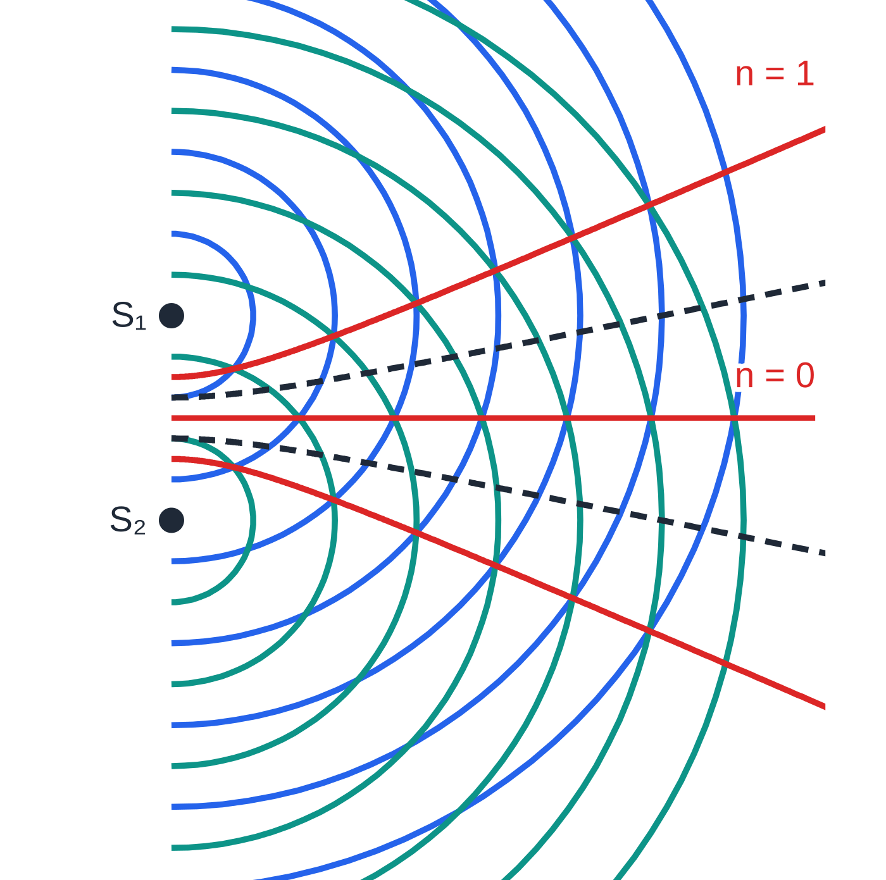
How do path difference and phase difference decide what you detect? (continued)
Section 2 of 12
From path difference to phase difference
Because one wavelength of path is one whole cycle, 2π rad, the conversion is a simple proportion:
phase difference = (2π×path difference)/λ
The phase difference is in radians, and the path difference and wavelength must be in the same unit. This relationship is not in the formulae list, so learn it. For two sources that are in phase:
path difference = nλ → phase difference 2nπ → maximum (constructive);
Crests from two in-phase sources S₁ and S₂ (λ = 0.8 units, sources 2.0 units apart). Solid red lines join maxima (path difference 0 and λ); dashed lines join minima (path difference λ/2).
Notes:
How do path difference and phase difference decide what you detect?. Full notes: https://examinerprep.com/notes/edexcel-ial-physics/superposition-and-stationary-waves/

Slide 11
How do path difference and phase difference decide what you detect? (continued)
Section 2 of 12
path difference = (n + ½)λ → phase difference (2n + 1)π → minimum (destructive), where n = 0, 1, 2, …
If the two sources are themselves in antiphase, the conditions swap: whole wavelengths of path difference give minima and half wavelengths give maxima. So always check how the sources are driven before naming a maximum or a minimum.
Notes:
How do path difference and phase difference decide what you detect?. Full notes: https://examinerprep.com/notes/edexcel-ial-physics/superposition-and-stationary-waves/

Slide 12
How do path difference and phase difference decide what you detect? (continued)
Section 2 of 12 · Worked example 1 · Medium · Determine
WORKED EXAMPLE · QUESTION
Two dippers fixed to the same vibrating bar touch the water in a ripple tank. The bar vibrates at 12 Hz and the ripples travel at 0.30 m s⁻¹. Point P is 16.0 cm from one dipper and 9.75 cm from the other. Point Q is 13.5 cm from one dipper and 21.0 cm from the other. Determine whether the water at P and at Q oscillates with a large or a small amplitude.
SOLUTION
Wavelength: λ= v/f = 0.30 ÷12 = 0.025 m = 2.5 cm.
Path differences: P: 16.0 - 9.75 = 6.25 cm = 2.5λ. Q: 21.0 - 13.5 = 7.5 cm = 3.0λ.
Phase differences: the dippers move together, so they are in phase. P: 2π×2.5 = 5π rad (antiphase). Q: 2π×3.0 = 6π rad (in phase).
P is a minimum (small amplitude);
Notes:
How do path difference and phase difference decide what you detect?: Worked example 1. Full notes: https://examinerprep.com/notes/edexcel-ial-physics/superposition-and-stationary-waves/

Slide 13
How do path difference and phase difference decide what you detect? (continued)
Section 2 of 12 · Worked example 1 · Medium · Determine (continued)
Q is a maximum (large amplitude). The amplitude at P is small rather than exactly zero, because the ripple from the nearer dipper has spread out less and so has the larger amplitude.
Notes:
How do path difference and phase difference decide what you detect?: Worked example 1. Full notes: https://examinerprep.com/notes/edexcel-ial-physics/superposition-and-stationary-waves/

Slide 14
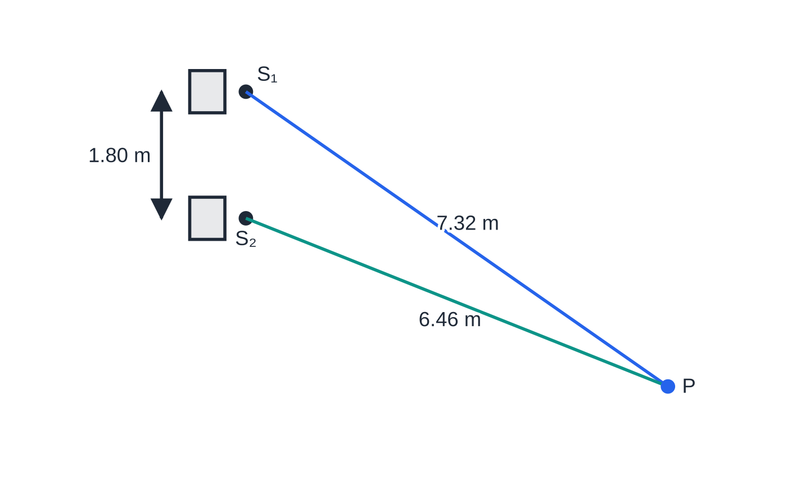
How do path difference and phase difference decide what you detect? (continued)
Section 2 of 12 · Worked example 2 · Hard · Calculate
WORKED EXAMPLE · QUESTION
Two loudspeakers S₁ and S₂, 1.80 m apart, are connected to the same signal generator set to 590 Hz. A listener stands at P, 7.32 m from S₁ and 6.46 m from S₂. The speed of sound is 340 m s⁻¹. (a) Calculate the phase difference between the two waves at P and describe what the listener hears. (b) Calculate the lowest frequency at which the listener would hear a maximum at P.
SOLUTION
Wavelength: λ= 340 ÷590 = 0.576 m.
Plan view to scale. Both loudspeakers are driven by the same signal generator, so they are coherent and in phase. The path difference at P is 7.32 − 6.46 = 0.86 m.
Notes:
How do path difference and phase difference decide what you detect?: Worked example 2. Full notes: https://examinerprep.com/notes/edexcel-ial-physics/superposition-and-stationary-waves/

Slide 15
How do path difference and phase difference decide what you detect? (continued)
Section 2 of 12 · Worked example 2 · Hard · Calculate (continued)
(a) Path difference = 7.32 - 6.46 = 0.86 m, which is 0.86 ÷0.576 = 1.49 wavelengths. Phase difference = 2π×0.86 ÷0.576 = 9.38 rad. Removing one whole cycle: 9.38 - 2π= 3.09 rad ≈π. The waves are in antiphase at P, so the listener is in a quiet region (a minimum).
(b) A path difference of zero is not possible at P, so the lowest frequency for a maximum makes the path difference exactly one wavelength: λ= 0.86 m, f = 340 ÷0.86 = 395 Hz.
Notes:
How do path difference and phase difference decide what you detect?: Worked example 2. Full notes: https://examinerprep.com/notes/edexcel-ial-physics/superposition-and-stationary-waves/

Slide 16
How does a stationary wave form, and what do its graphs show?
Section 3 of 12
Send a continuous wave along a rope tied to a wall: it reflects, so the rope carries two waves of the same frequency moving in opposite directions, and their sum no longer travels.
A stationary (standing) wave forms when two progressive waves of the same frequency (and similar amplitude) travel in opposite directions through the same region and superpose.
At some points the two waves always arrive in antiphase and cancel. These are nodes, points of zero amplitude.
Midway between nodes the waves arrive in phase and the amplitude is greatest. These are antinodes.
Adjacent nodes are λ/2 apart, and so are adjacent antinodes. A node and the next antinode are λ/4 apart.
Notes:
How does a stationary wave form, and what do its graphs show?. Full notes: https://examinerprep.com/notes/edexcel-ial-physics/superposition-and-stationary-waves/

Slide 17
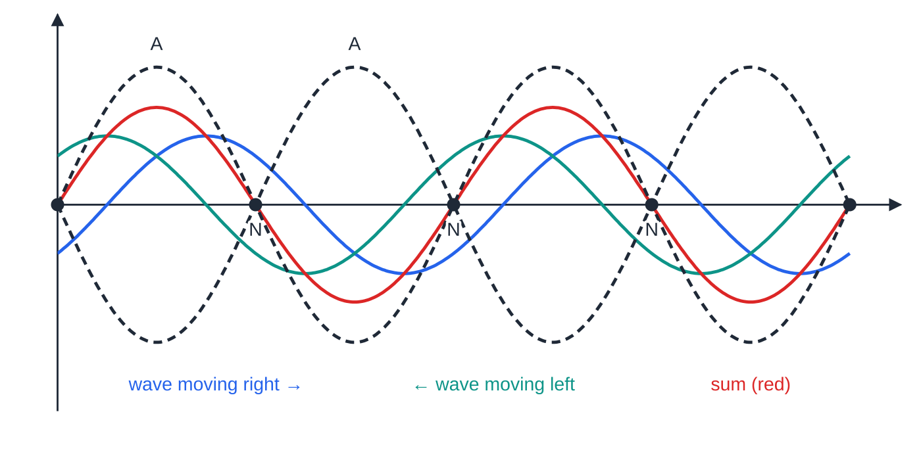
How does a stationary wave form, and what do its graphs show? (continued)
Section 3 of 12
Here λ is the wavelength of the two travelling waves, so a measured node spacing must be doubled to give it.
Displacement–distance graphs of a stationary wave
A displacement–distance graph is a snapshot. For a stationary wave, every snapshot has the same nodes and fits inside the same envelope; only the size and sign of each loop change.
Two identical waves travelling in opposite directions, and their sum one-eighth of a period after their crests coincided. The sum does not travel: its zeros stay at the nodes N, λ/2 apart, and it grows and shrinks inside the dashed envelope. A labels the antinodes.
Notes:
How does a stationary wave form, and what do its graphs show?. Full notes: https://examinerprep.com/notes/edexcel-ial-physics/superposition-and-stationary-waves/

Slide 18
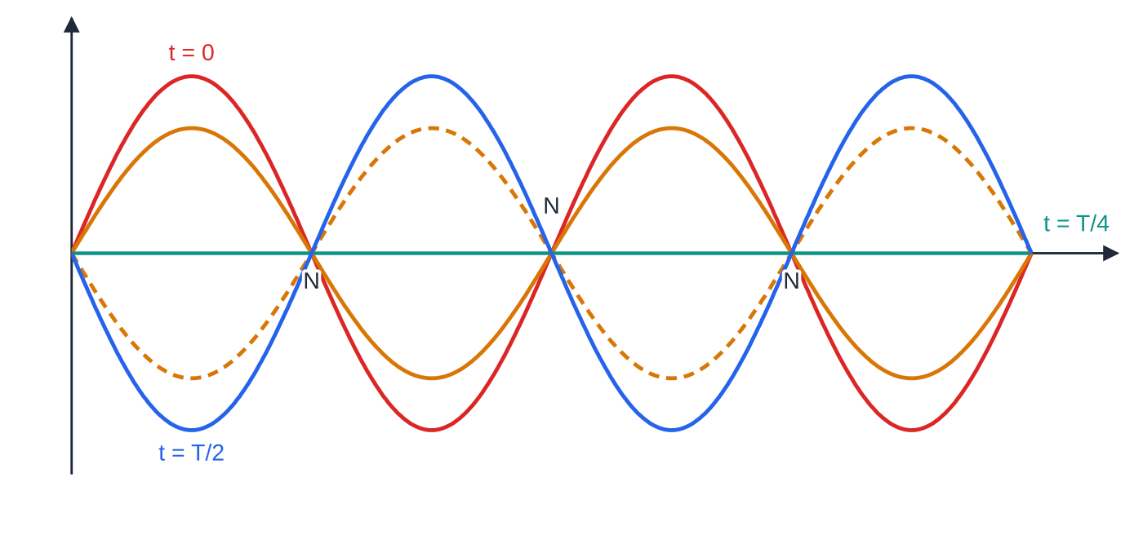
How does a stationary wave form, and what do its graphs show? (continued)
Section 3 of 12
Twice in every period the whole string is momentarily straight (zero displacement everywhere). The energy is then all kinetic.
All points between two adjacent nodes oscillate in phase but with different amplitudes. Points in adjacent loops are in antiphase.
So on a stationary wave the phase difference between two points is either 0 or π, unlike a progressive wave, where it changes steadily with distance.
Snapshots of one stationary wave at five instants during half a period (t = 0, T/8, T/4, 3T/8, T/2). The nodes never move. Every point in a loop moves up and down together; neighbouring loops move in opposite directions.
Notes:
How does a stationary wave form, and what do its graphs show?. Full notes: https://examinerprep.com/notes/edexcel-ial-physics/superposition-and-stationary-waves/

Slide 19
How does a stationary wave form, and what do its graphs show? (continued)
Section 3 of 12
Feature | Progressive wave | Stationary wave
Energy | transferred in the direction of travel | no net transfer of energy along the wave
Amplitude | the same at every point (if no energy is lost) | varies from zero at nodes to a maximum at antinodes
Phase | changes steadily along the wave, 2π per wavelength | all points in one loop in phase; adjacent loops in antiphase
Wavelength | distance between neighbouring points in phase | twice the distance between adjacent nodes
Common error
Using the progressive-wave rule "phase difference = 2π× distance/λ" for two points on a stationary wave. On a stationary wave, two points in the same loop are in phase however far apart they are, and points in neighbouring loops are in antiphase.
Notes:
How does a stationary wave form, and what do its graphs show?. Full notes: https://examinerprep.com/notes/edexcel-ial-physics/superposition-and-stationary-waves/

Slide 20
Which frequencies can a stretched string vibrate at?
Section 4 of 12
A string clamped at both ends has a node at each end, so a whole number of loops, each λ/2 long, must span the length L:
L = nλ/2 ⇒ λₙ = 2L/n, fₙ = nv/2L = nf₁, n = 1, 2, 3, …
The lowest frequency, with one loop, is the fundamental or first harmonic. Every whole-number multiple of it is possible; these are the harmonics. Here v is the wave speed on the string in m s⁻¹, which does not change when you change the frequency. These results are not in the formulae list: derive them from "a whole number of λ/2 fits in L" together with v = fλ, which is in the list.
At any other frequency the reflected waves arrive out of step and do not reinforce, so only a small, irregular motion appears; at a harmonic, each reflection adds to the motion and a large steady amplitude builds up.
Notes:
Which frequencies can a stretched string vibrate at?. Full notes: https://examinerprep.com/notes/edexcel-ial-physics/superposition-and-stationary-waves/

Slide 21
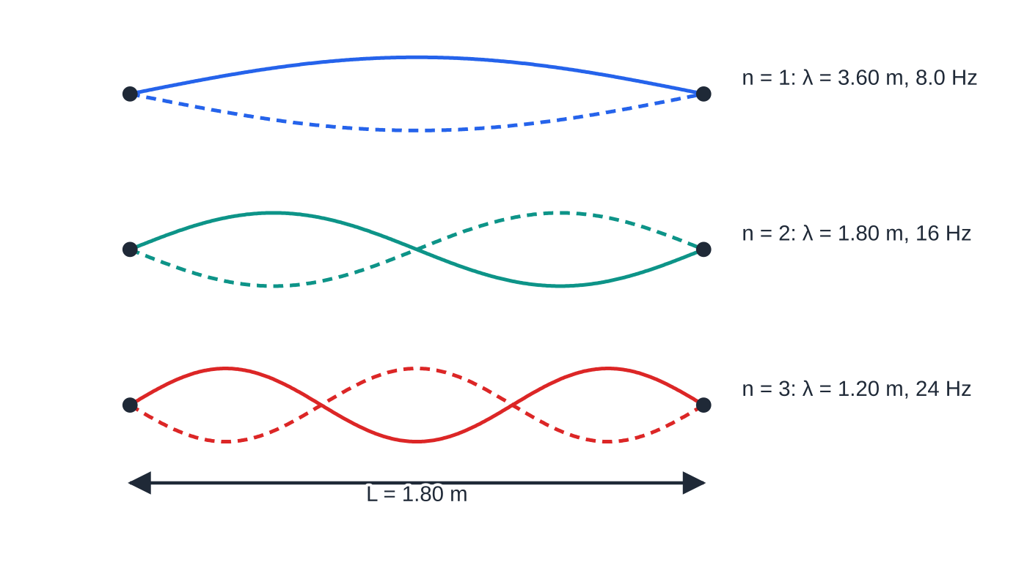
Which frequencies can a stretched string vibrate at? (continued)
Section 4 of 12
The cord of worked example 3. Each pattern fits a whole number of half wavelengths into 1.80 m, so the frequencies are 8.0 Hz, 16 Hz and 24 Hz, whole-number multiples of the fundamental.
Notes:
Which frequencies can a stretched string vibrate at?. Full notes: https://examinerprep.com/notes/edexcel-ial-physics/superposition-and-stationary-waves/

Slide 22
Which frequencies can a stretched string vibrate at? (continued)
Section 4 of 12 · Worked example 3 · Easy · Calculate
WORKED EXAMPLE · QUESTION
A rubber cord is stretched between two fixed points 1.80 m apart and driven near one end. At 24 Hz a steady stationary wave with three loops appears. (a) Calculate the wavelength and the speed of the waves on the cord. (b) Calculate the fundamental frequency and the frequency at which four loops would appear.
SOLUTION
(a) Three loops are three half wavelengths: λ= 2 ×1.80 ÷3 = 1.20 m. Then v = fλ= 24 ×1.20 = λ = 1.20 m, v = 28.8 m s⁻¹.
(b) The wave speed is unchanged. The fundamental has one loop, so λ= 2L = 3.60 m and f₁ = 28.8 ÷3.60 = 8.0 Hz. Four loops: 4 ×8.0 = 32 Hz. f₁ = 8.0 Hz; four loops at 32 Hz.
Quick check: 24 Hz is the third harmonic, so the fundamental must be 24 ÷3 = 8.0 Hz.
Notes:
Which frequencies can a stretched string vibrate at?: Worked example 3. Full notes: https://examinerprep.com/notes/edexcel-ial-physics/superposition-and-stationary-waves/

Slide 23
Which frequencies resonate in a pipe?
Section 5 of 12
Sound reflects at both ends of a pipe, so a stationary wave forms in the air column. Sound is longitudinal, so this is a pattern of air displacement along the pipe. Diagrams draw the envelope sideways to show the size of the motion.
At a closed end the air cannot move: a displacement node.
At an open end the air moves freely: a displacement antinode. In reality it sits just beyond the end; ignore this end correction unless told otherwise.
Closed at one end: the shortest pattern is node to antinode, a quarter wavelength. Adding half a wavelength at a time gives L = λ/4, 3λ/4, 5λ/4, … Only odd harmonics are possible: f₁, 3f₁, 5f₁, … with f₁ = v/4L.
Open at both ends: antinode to antinode, so L = λ/2, λ, 3λ/2, … All harmonics are possible: f₁, 2f₁, 3f₁, … with f₁ = v/2L, the same rule as a string.
Notes:
Which frequencies resonate in a pipe?. Full notes: https://examinerprep.com/notes/edexcel-ial-physics/superposition-and-stationary-waves/

Slide 24
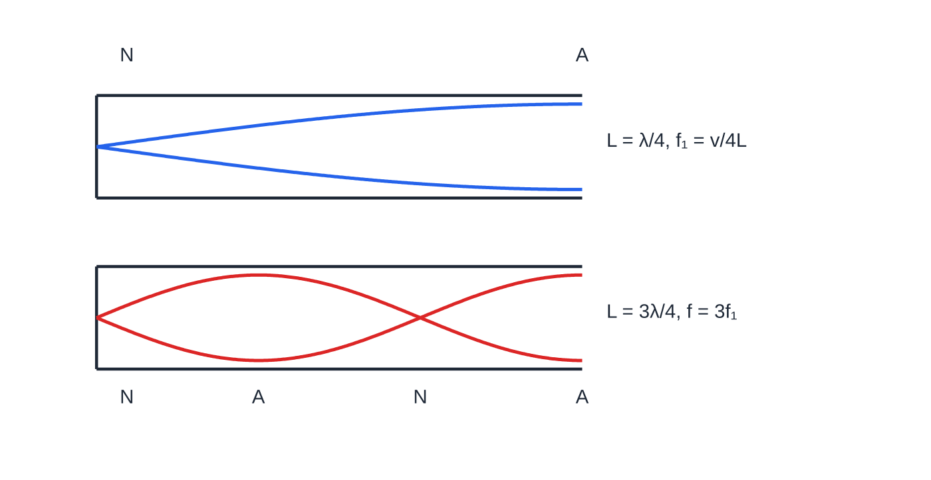
Which frequencies resonate in a pipe? (continued)
Section 5 of 12
Pipe closed at the left end: a node at the closed end, an antinode at the open end. The two lowest modes are the fundamental (L = λ/4) and the third harmonic (L = 3λ/4); the second harmonic cannot fit.
Notes:
Which frequencies resonate in a pipe?. Full notes: https://examinerprep.com/notes/edexcel-ial-physics/superposition-and-stationary-waves/

Slide 25
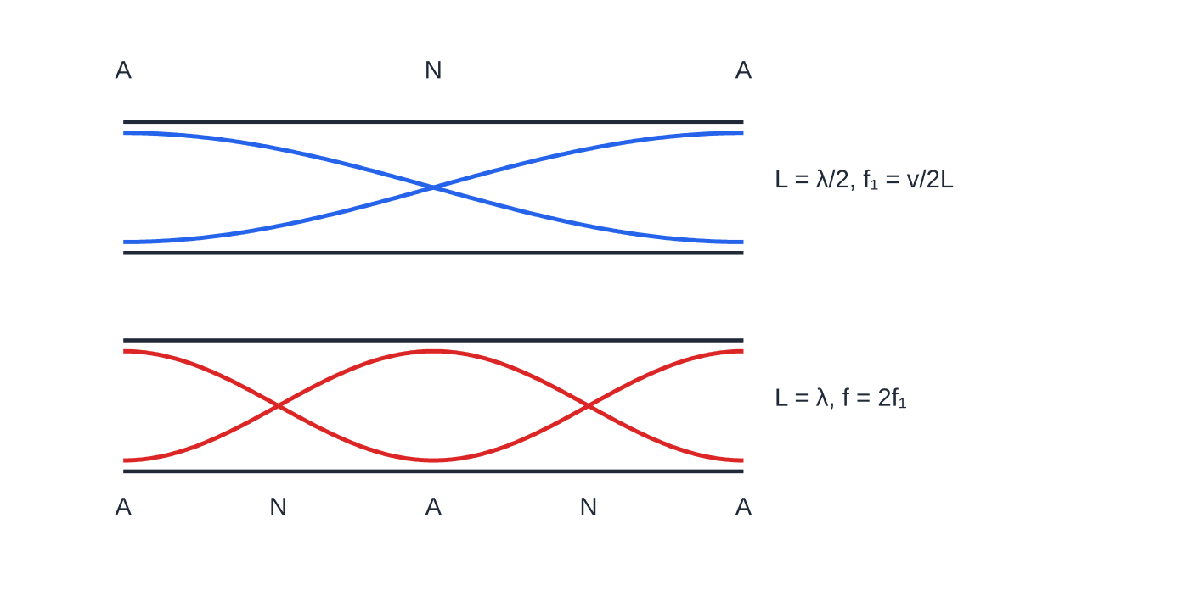
Which frequencies resonate in a pipe? (continued)
Section 5 of 12
Pipe open at both ends: antinodes at both ends. The fundamental has L = λ/2 and every whole-number harmonic is possible, so the next mode is 2f₁.
Notes:
Which frequencies resonate in a pipe?. Full notes: https://examinerprep.com/notes/edexcel-ial-physics/superposition-and-stationary-waves/

Slide 26
Which frequencies resonate in a pipe? (continued)
Section 5 of 12 · Worked example 4 · Medium · Calculate
WORKED EXAMPLE · QUESTION
A plastic tube has length 0.320 m. The speed of sound in the air inside is 340 m s⁻¹. Ignore end corrections. (a) One end is closed with a cap. Calculate the fundamental frequency and the next two frequencies at which the tube resonates. (b) The cap is removed. Calculate the new fundamental frequency.
SOLUTION
(a) Closed at one end, the fundamental has L = λ/4: λ= 4 ×0.320 = 1.28 m, so f₁ = 340 ÷1.28 = 266 Hz (265.6 Hz). Only odd harmonics are possible: 3f₁ = 797 Hz and 5f₁ = 1330 Hz. 266 Hz, 797 Hz, 1330 Hz
(b) Open at both ends, the fundamental has L = λ/2: λ= 2 ×0.320 = 0.64 m, so f₁ = 340 ÷0.64 = 531 Hz.
Closing one end halves the fundamental and removes the even harmonics; the open tube has 531 Hz, 1060 Hz, 1590 Hz …
Notes:
Which frequencies resonate in a pipe?: Worked example 4. Full notes: https://examinerprep.com/notes/edexcel-ial-physics/superposition-and-stationary-waves/

Slide 27
What sets the speed of a wave on a string?
Section 6 of 12
The speed of waves on a string is set by the tension and the mass per unit length.
v = √(T/μ)
Here v is the wave speed (m s⁻¹), T the tension (N) and μ the mass per unit length (kg m⁻¹). This equation is in the formulae list supplied in the exam. The mass per unit length is μ= mass ÷ length. For a wire of density ρ and cross-sectional area A, μ= ρA; learn this step, because it is not given.
A tighter string pulls each displaced section back more strongly, so the disturbance passes on faster: v ∝√T.
A heavier string responds more slowly to the same tension: v ∝1/√μ.
Notes:
What sets the speed of a wave on a string?. Full notes: https://examinerprep.com/notes/edexcel-ial-physics/superposition-and-stationary-waves/

Slide 28
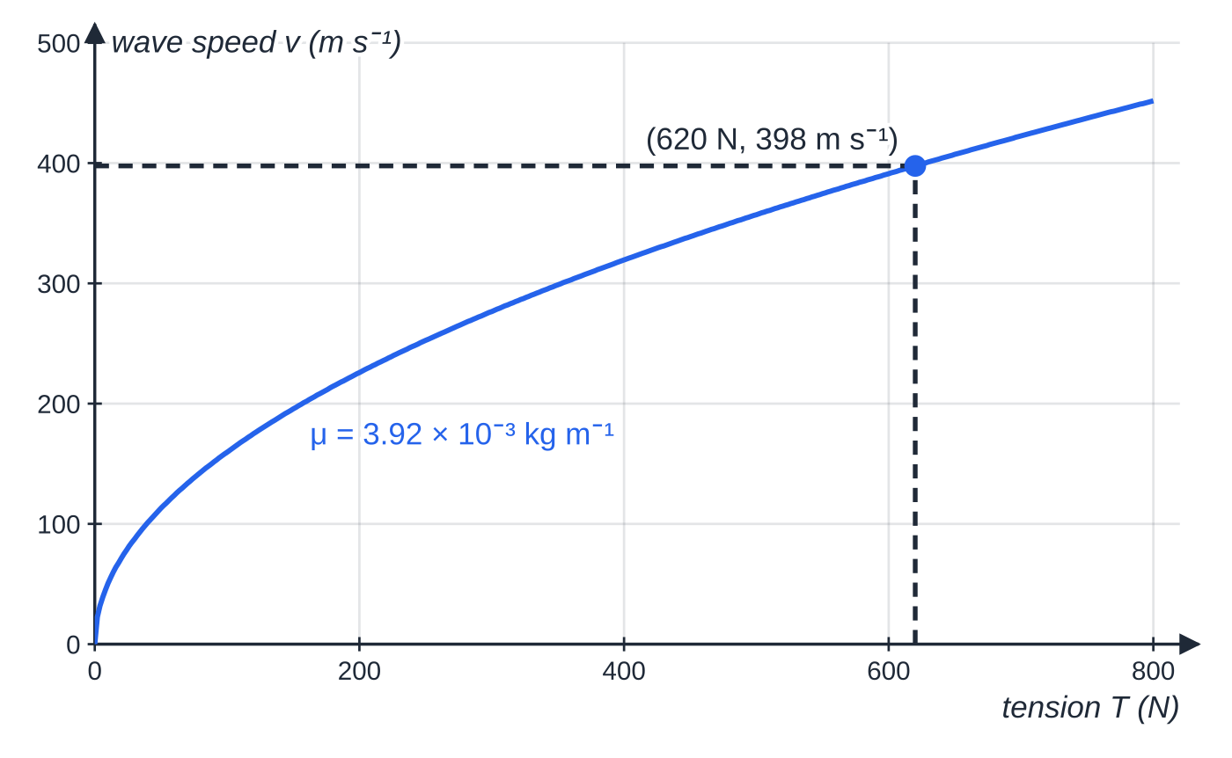
What sets the speed of a wave on a string? (continued)
Section 6 of 12
Combining v = √(T/μ) with the fundamental of a string (λ= 2L) and v = fλ gives the fundamental frequency of a stretched string:
f = 1/2L√(T/μ)
This is not in the formulae list: derive it from v = fλ, λ= 2L and v = √(T/μ). It shows three proportionalities that the core practical tests: f ∝1/L at constant T and μ; f ∝√T at constant L and μ; f ∝1/√μ at constant L and T.
Wave speed on the piano wire of worked example 5 as the tension changes. The curve rises ever more slowly because v ∝ √T: quadrupling the tension only doubles the speed.
Notes:
What sets the speed of a wave on a string?. Full notes: https://examinerprep.com/notes/edexcel-ial-physics/superposition-and-stationary-waves/

Slide 29
What sets the speed of a wave on a string? (continued)
Section 6 of 12 · Worked example 5 · Hard · Calculate
WORKED EXAMPLE · QUESTION
A steel piano wire has diameter 0.80 mm and a vibrating length of 0.95 m. The density of steel is 7800 kg m⁻³. The tension in the wire is 620 N. (a) Calculate the fundamental frequency of the wire. (b) Calculate the tension needed to raise the fundamental frequency to 220 Hz.
SOLUTION
Mass per unit length: radius = 0.40 ×10⁻³ m, so A = π(0.40 ×10⁻³)² = 5.03 ×10⁻⁷ m² and μ= ρA = 7800 ×5.03 ×10⁻⁷ = 3.92 ×10⁻³ kg m⁻¹.
Wave speed: v = √(620 ÷3.921 ×10⁻³) = 398 m s⁻¹.
(a) Fundamental, λ= 2L: f = 398 ÷(2 ×0.95) = 209 Hz.
(b) With L and μ fixed, f ∝√T, so T ∝f²: T = 620 ×(220 ÷209.3)² = 685 N.
Notes:
What sets the speed of a wave on a string?: Worked example 5. Full notes: https://examinerprep.com/notes/edexcel-ial-physics/superposition-and-stationary-waves/

Slide 30
What sets the speed of a wave on a string? (continued)
Section 6 of 12
Common error
Using the diameter as the radius, or leaving it in millimetres. Halve the diameter and convert to metres before finding the area. The area scales as the square, so a slip here changes μ by a factor of 4 or of a million.
Notes:
What sets the speed of a wave on a string?. Full notes: https://examinerprep.com/notes/edexcel-ial-physics/superposition-and-stationary-waves/

Slide 31
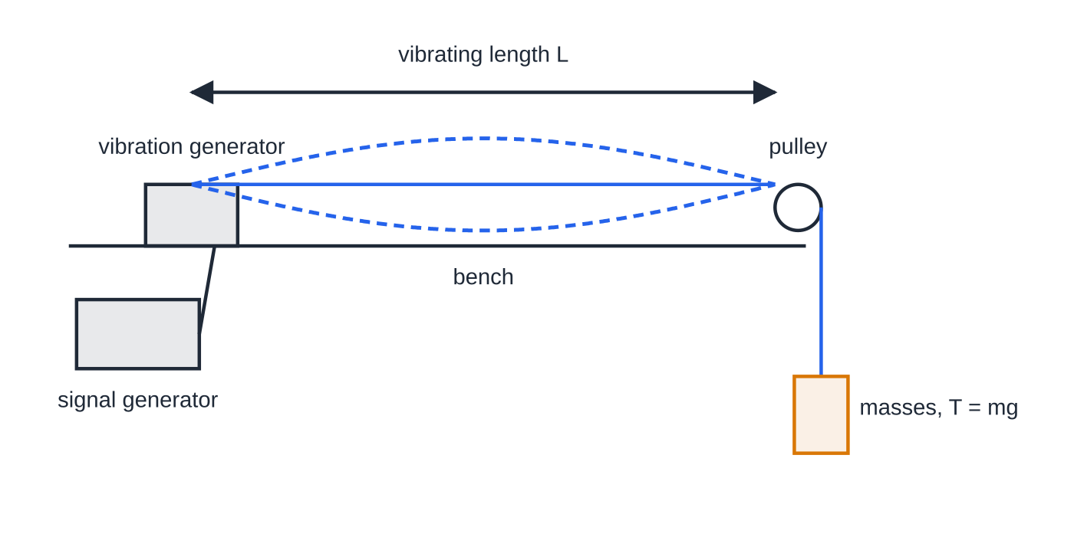
How do you investigate the frequency of a vibrating string?
Section 7 of 12
Core Practical 5 tests the relationship f = 1/2L√(T/μ) by changing one variable at a time and finding the fundamental frequency each time.
Set-up: as in the figure; slotted masses on a hanger give T = mg.
Finding resonance: raise the frequency slowly until one loop has the largest amplitude; approach from above too and take the midpoint. Read f from the signal generator.
Core Practical 5 set-up. The string runs from a vibration generator, driven by a signal generator, over a pulley to hanging masses that set the tension T = mg. Shown vibrating in its fundamental, one loop between the generator and the pulley.
Notes:
How do you investigate the frequency of a vibrating string?. Full notes: https://examinerprep.com/notes/edexcel-ial-physics/superposition-and-stationary-waves/

Slide 32
How do you investigate the frequency of a vibrating string? (continued)
Section 7 of 12
Length: keep T and the string fixed; move the vibration generator to change L (metre rule). Use at least five lengths.
Tension: keep L and the string fixed and change the hanging mass.
Mass per unit length: keep L and T fixed and use strings of different μ (weigh a measured length of each).
Graphs: f against 1/L, f against √T (or f² against T), and f against 1/√μ should each be a straight line through the origin.
Safety: keep feet clear of the masses (padding underneath) and wear eye protection in case the string snaps.
Notes:
How do you investigate the frequency of a vibrating string?. Full notes: https://examinerprep.com/notes/edexcel-ial-physics/superposition-and-stationary-waves/

Slide 33
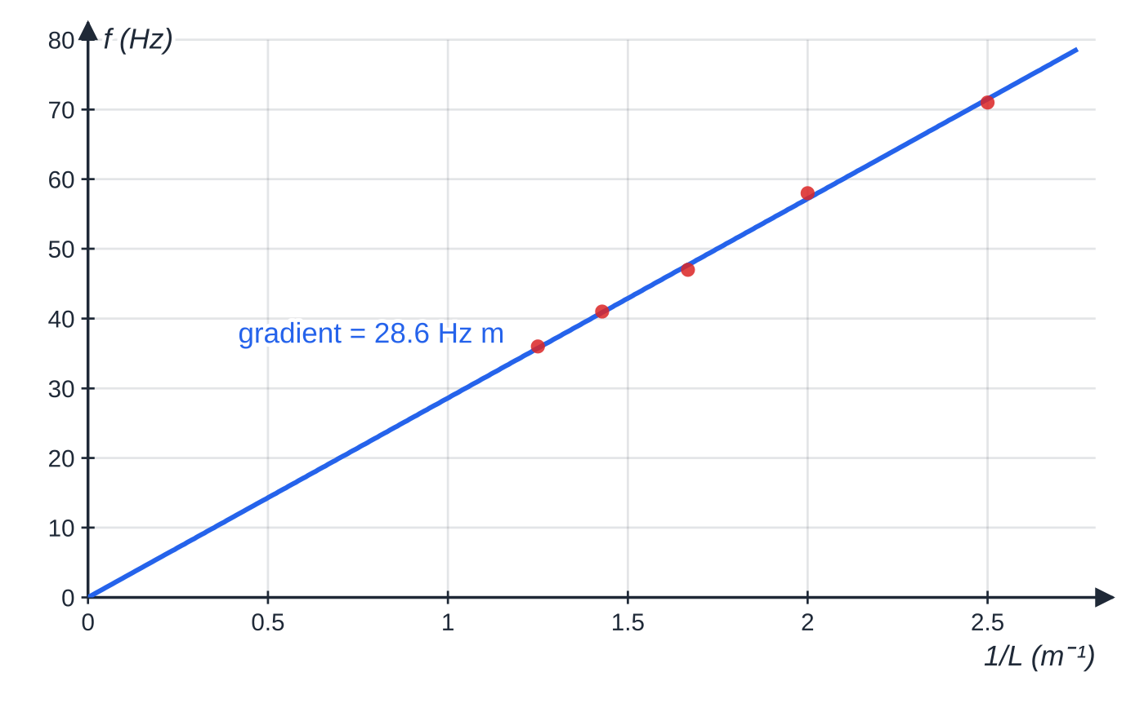
How do you investigate the frequency of a vibrating string? (continued)
Section 7 of 12
The data of worked example 6: fundamental frequency against 1/L. The points lie close to a straight line through the origin, as f = ½√(T/μ) × (1/L) predicts.
Notes:
How do you investigate the frequency of a vibrating string?. Full notes: https://examinerprep.com/notes/edexcel-ial-physics/superposition-and-stationary-waves/

Slide 34
How do you investigate the frequency of a vibrating string? (continued)
Section 7 of 12 · Worked example 6 · Hard · Determine
WORKED EXAMPLE · QUESTION
A student keeps the hanging mass at 0.400 kg and measures the fundamental frequency f for five lengths. Her results: L = 0.400 m, 71 Hz; 0.500 m, 58 Hz; 0.600 m, 47 Hz; 0.700 m, 41 Hz; 0.800 m, 36 Hz. The signal generator displays the frequency to the nearest 1 Hz. g = 9.81 N kg⁻¹. (a) Explain why a graph of f against 1/L should be a straight line through the origin. (b) Use the gradient of her graph to determine the mass per unit length of the string. (c) Calculate the percentage uncertainty in the frequency reading of 36 Hz.
SOLUTION
(a) Rearranging, f = ½√(T/μ) ×(1/L). With T and μ constant this has the form y = mx, so f against 1/L is a straight line through the origin with gradient ½√(T/μ).
(b) The 1/L values are 2.50, 2.00, 1.67, 1.43 and 1.25 m⁻¹. Tension T = 0.400 ×9.81 = 3.92 N. Gradient of the best-fit line = 28.6 Hz m. From gradient = ½√(T/μ): μ= T ÷(4 ×gradient²) = 3.924 ÷(4 ×28.6²) = 1.20 × 10⁻³ kg m⁻¹.
Notes:
How do you investigate the frequency of a vibrating string?: Worked example 6. Full notes: https://examinerprep.com/notes/edexcel-ial-physics/superposition-and-stationary-waves/

Slide 35
How do you investigate the frequency of a vibrating string? (continued)
Section 7 of 12 · Worked example 6 · Hard · Determine (continued)
(c) Uncertainty = half the resolution of the display, ±0.5 Hz: 0.5 ÷36 ×100 = 1.4%.
Judging the frequency of largest amplitude is usually a bigger uncertainty than the display; repeat readings from both sides and average.
Notes:
How do you investigate the frequency of a vibrating string?: Worked example 6. Full notes: https://examinerprep.com/notes/edexcel-ial-physics/superposition-and-stationary-waves/

Slide 36
Exam tips for 2.2
Section 8 of 12
Exam tip 1 — count wavelengths, then decide
Divide the path difference by the wavelength. 0, 1, 2 … means in phase; 0.5, 1.5, 2.5 … means antiphase. State whether the sources are in phase, then name the maximum or minimum.
Exam tip 2 — nodes are half a wavelength apart
Node to node and antinode to antinode are both λ/2; node to the nearest antinode is λ/4. A measured node spacing must be doubled to give λ.
Exam tip 3 — sketch the pipe first
Draw the pipe, put N at every closed end and A at every open end, then fit the simplest pattern between them. Count the quarter wavelengths that fit in L before you write any equation.
Notes:
Exam tips for 2.2. Full notes: https://examinerprep.com/notes/edexcel-ial-physics/superposition-and-stationary-waves/

Slide 37
Exam tips for 2.2 (continued)
Section 8 of 12
Exam tip 4 — describe the formation in three steps
To explain how a stationary wave forms: (1) a wave reflects at the end; (2) the incident and reflected waves have the same frequency and travel in opposite directions; (3) they superpose, cancelling at nodes and reinforcing at antinodes.
Exam tip 5 — the frequency never changes on reflection or between media
A string vibrating at 220 Hz makes a sound wave of 220 Hz in the air. The speed and wavelength differ between string and air; the frequency is the same.
Notes:
Exam tips for 2.2. Full notes: https://examinerprep.com/notes/edexcel-ial-physics/superposition-and-stationary-waves/

Slide 38
Common misconceptions
Section 9 of 12
Misconception | Why it is wrong | Correct idea
Destructive interference always produces silence or darkness. | Unequal amplitudes only partly cancel. | The resultant amplitude is the difference of the amplitudes; zero only if they are equal.
Waves of the same frequency are automatically coherent. | Two separate sources at the same nominal frequency drift in phase. | Coherent means a constant phase difference, normally from one shared source or driver.
The distance between adjacent nodes is one wavelength. | Each loop is only half a cycle of the pattern. | Adjacent nodes are λ/2 apart.
A stationary wave carries energy along the string like a progressive wave. | Equal waves travel both ways, so their energy flows cancel. | There is no net energy transfer along a stationary wave; energy stays between the nodes.
Notes:
Common misconceptions. Full notes: https://examinerprep.com/notes/edexcel-ial-physics/superposition-and-stationary-waves/

Slide 39
Common misconceptions (continued)
Section 9 of 12
Misconception | Why it is wrong | Correct idea
All points on a stationary wave have the same amplitude, as on a progressive wave. | Nodes never move. | Amplitude varies from zero at a node to a maximum at an antinode.
A pipe closed at one end has all harmonics, like a string. | A closed end must be a node and an open end an antinode. | Only odd harmonics: f₁, 3f₁, 5f₁, …
Notes:
Common misconceptions. Full notes: https://examinerprep.com/notes/edexcel-ial-physics/superposition-and-stationary-waves/

Slide 40
How this topic connects
Section 10 of 12
1 Progressive waves
Every calculation here starts from v = fλ, and the phase difference along a progressive wave (2π per wavelength) is the idea that path difference builds on.
4 Diffraction and the wave nature of electrons
A diffraction grating is many coherent sources at once. The condition for a bright line, nλ= dsin θ, is the "path difference = whole number of wavelengths" rule from this page.
Unit 1 forces and materials, and Unit 5 oscillations
The tension in the practical comes from a hanging weight, T = mg, and the mass per unit length of a wire from its density and area, μ= ρA. A string or pipe driven at one of its harmonic frequencies is an example of resonance (Unit 5): a driving frequency that matches a natural frequency gives a large amplitude.
Notes:
How this topic connects. Full notes: https://examinerprep.com/notes/edexcel-ial-physics/superposition-and-stationary-waves/

Slide 41
Key equations
Section 11 of 12
Equation | Use | In the formulae list?
v = fλ | wavelength from frequency and speed (page 2.1); v in m s⁻¹, f in Hz, λ in m | Yes
v = √(T/μ) | speed of a transverse wave on a string; T in N, μ in kg m⁻¹ | Yes
phase difference = 2π× path difference/λ | converting path difference to phase difference (radians) | No — learn it
path difference = nλ / (n + ½)λ | maximum / minimum for sources in phase | No — learn it
node spacing = λ/2 | wavelength from a stationary wave | No — learn it
L = nλ/2, fₙ = nf₁ | string fixed at both ends; pipe open at both ends | No — derive it from the end conditions
Notes:
Key equations. Full notes: https://examinerprep.com/notes/edexcel-ial-physics/superposition-and-stationary-waves/

Slide 42
Key equations (continued)
Section 11 of 12
Equation | Use | In the formulae list?
L = λ/4, 3λ/4, …; f₁ = v/4L | pipe closed at one end (odd harmonics only) | No — derive it from the end conditions
f = 1/2L√(T/μ) | fundamental of a stretched string | No — derive it from v = fλ and λ = 2L
μ= ρA | mass per unit length of a wire; ρ in kg m⁻³, A in m² | No — learn it
Notes:
Key equations. Full notes: https://examinerprep.com/notes/edexcel-ial-physics/superposition-and-stationary-waves/

Slide 43
Check your understanding
Section 12 of 12
1. What is meant by two sources being coherent?
2. Two in-phase sources emit waves of wavelength 0.30 m. At a point the path difference is 1.05 m. Is the point a maximum or a minimum?
3. Adjacent nodes on a stationary wave are 18 cm apart and the frequency is 250 Hz. Calculate the wave speed.
4. A pipe closed at one end has a fundamental frequency of 125 Hz. State the next two resonant frequencies.
5. The tension in a string is made four times larger, with the length and string unchanged. What happens to the fundamental frequency?
6. Two points on a stationary wave are 0.10 m and 0.30 m from a node at one end. The wavelength is 0.80 m. State the phase difference between them.
Notes:
Check your understanding: questions. Full notes: https://examinerprep.com/notes/edexcel-ial-physics/superposition-and-stationary-waves/

Slide 44
Check your understanding · answers
Section 12 of 12
1. They emit waves with a constant phase difference between them, which means they must also have the same frequency.
2. 1.05 ÷0.30 = 3.5 wavelengths, a whole number plus a half, so the waves arrive in antiphase: a minimum.
3. λ= 2 ×0.18 = 0.36 m; v = fλ= 250 ×0.36 = 90 m s⁻¹.
4. Only odd harmonics are possible: 3 ×125 = 375 Hz and 5 ×125 = 625 Hz.
5. f ∝√T, so the frequency is multiplied by √4 = 2: it doubles.
6. Nodes are λ/2 = 0.40 m apart, at 0, 0.40 m, 0.80 m … Both points lie between the nodes at 0 and 0.40 m, so they are in the same loop and oscillate in phase: phase difference 0 (not 2π×0.20/0.80 = π/2, which is the progressive-wave rule).
Notes:
Check your understanding: answers. Full notes: https://examinerprep.com/notes/edexcel-ial-physics/superposition-and-stationary-waves/

Slide 45
Practice questions
5 original exam-style questions. Answers at the end of the deck.

Slide 46
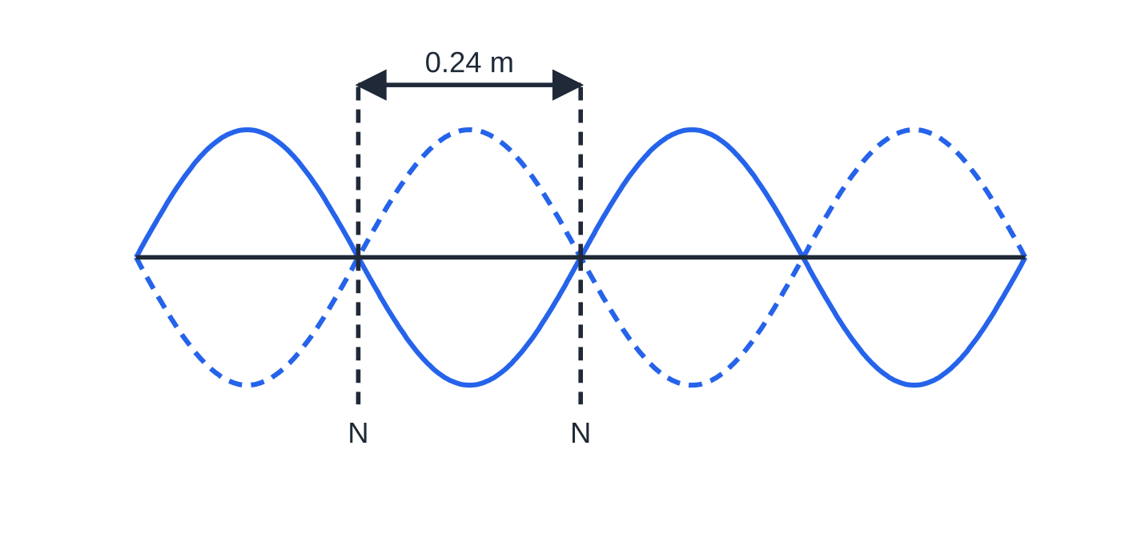
Question 1
1 mark
A stationary wave is set up on a stretched rope by a motor vibrating at 150 Hz. Adjacent nodes are 0.24 m apart.
What is the speed of the waves on the rope?
Figure: stationary wave on the rope; N = node (not to scale)
A 18 m s⁻¹
B 36 m s⁻¹
C 72 m s⁻¹
D 144 m s⁻¹
Notes:
Online with the full mark scheme: https://examinerprep.com/ial-physics-2-2-superposition-and-stationary-waves-questions#IALP-U2-2-A-03

Slide 47
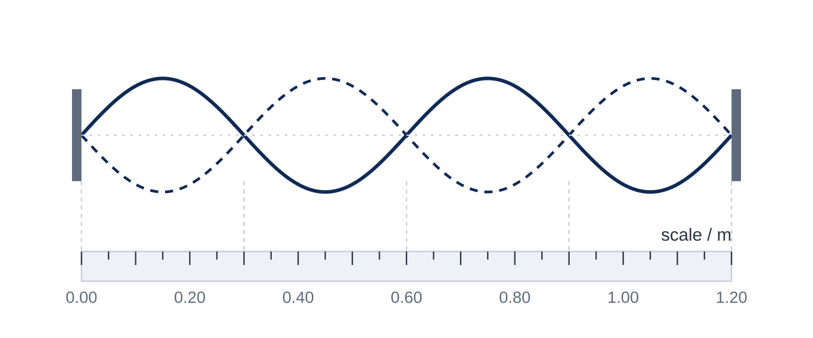
Question 2
1 mark
The diagram shows a stationary wave on a string fixed at both ends, with a scale beneath it.
What is the wavelength of the progressive waves that form the stationary wave?
A 0.30 m
B 0.60 m
C 1.20 m
D 2.40 m
Notes:
Online with the full mark scheme: https://examinerprep.com/ial-physics-2-2-superposition-and-stationary-waves-questions#IALP-U2-2-FA-04

Slide 48
Question 3
1 mark
Two sources of waves are described as coherent.
Which statement must be true?
A There is a constant phase difference between the waves from the sources.
B The sources emit waves that travel at the same speed.
C The sources emit waves of the same amplitude.
D The waves from the sources always superpose constructively.
Notes:
Online with the full mark scheme: https://examinerprep.com/ial-physics-2-2-superposition-and-stationary-waves-questions#IALP-U2-2-A-01

Slide 49
Question 4
6 marks
A heavy rope of length 1.50 m is fixed at both ends and driven by a motor. At a frequency of 84 Hz a stationary wave with three loops is formed. Point X is 0.25 m from one end of the rope and point Y is 0.75 m from the same end.
(a) Calculate the wavelength of the waves on the rope. [1]
(b) Calculate the speed of the waves on the rope. [1]
(c) Calculate the fundamental frequency of the rope. [1]
(d) Compare the amplitudes and the phases of the oscillations of X and Y, and state the displacement of Y at the instant X has its maximum positive displacement. [3]
Notes:
Online with the full mark scheme: https://examinerprep.com/ial-physics-2-2-superposition-and-stationary-waves-questions#IALP-U2-2-B-04

Slide 50
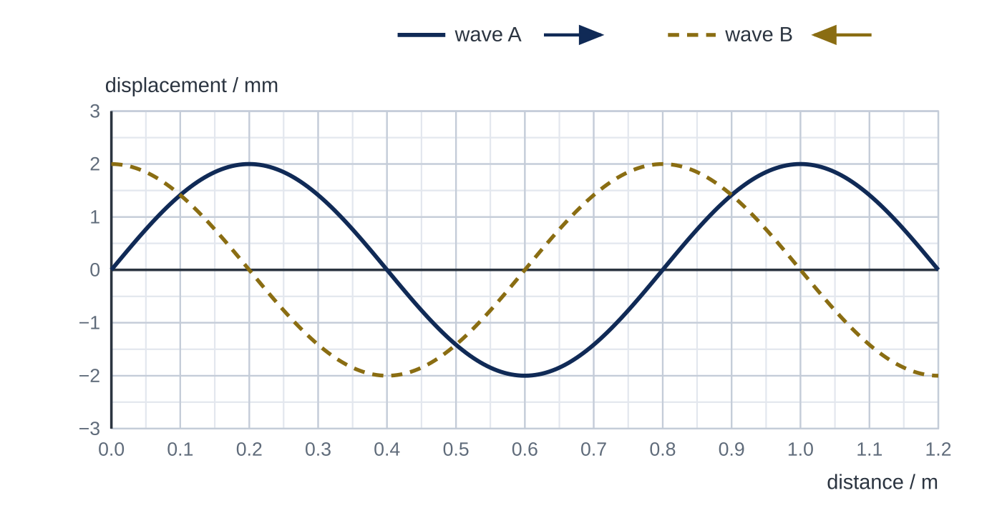
Question 5
6 marks
Two progressive waves of the same amplitude and frequency travel in opposite directions along a stretched cord and superpose to form a stationary wave. Figure 1 shows the displacement caused by each wave at time t = 0: wave A travels to the right and wave B travels to the left.
(a) Use Figure 1 to determine the resultant displacement of the cord at t = 0 at (i) x = 0.20 m and (ii) x = 0.30 m. [2]
(b) The point at x = 0.30 m is a node. Explain why, and state the position of the next node along the cord. [2]
(c) Determine the amplitude of oscillation of the cord at x = 0.10 m. [2]
Notes:
Online with the full mark scheme: https://examinerprep.com/ial-physics-2-2-superposition-and-stationary-waves-questions#IALP-U2-2-FB-07

Slide 51
Answers

Slide 52
Question 1 · answer
Answer C
Adjacent nodes are λ/2 apart, so λ = 2 × 0.24 = 0.48 m. v = fλ = 150 × 0.48 = 72 m s⁻¹.
Notes:
Full mark scheme: https://examinerprep.com/ial-physics-2-2-superposition-and-stationary-waves-questions#IALP-U2-2-A-03

Slide 53
Question 2 · answer
Answer B
There are four loops in 1.20 m, so each loop (node to node) is 0.30 m. One loop is half a wavelength, so λ = 2 × 0.30 = 0.60 m.
Notes:
Full mark scheme: https://examinerprep.com/ial-physics-2-2-superposition-and-stationary-waves-questions#IALP-U2-2-FA-04

Slide 54
Question 3 · answer
Answer A
Coherent sources have a constant phase difference, which also means they have the same frequency. Their amplitudes need not be equal, and whether they superpose constructively depends on the path difference to each point.
Notes:
Full mark scheme: https://examinerprep.com/ial-physics-2-2-superposition-and-stationary-waves-questions#IALP-U2-2-A-01

Slide 55
Question 4 · answer
Mark scheme
three loops = 3λ/2 = 1.50 m, so λ = 1.00 m
v = fλ = 84 × 1.00 = 84 m s⁻¹
84 ÷ 3 = 28 Hz
X and Y are both at antinodes (0.25 m and 0.75 m are midway between nodes at 0, 0.50 m and 1.00 m), so they have the same (maximum) amplitude
they are in adjacent loops, so they oscillate in antiphase / phase difference π rad
Y has its maximum negative displacement (equal in size to that of X)
Notes:
Full mark scheme: https://examinerprep.com/ial-physics-2-2-superposition-and-stationary-waves-questions#IALP-U2-2-B-04

Slide 56
Question 5 · answer
Mark scheme
(i) 2.0 + 0 = 2.0 mm
(ii) about +1.4 + (−1.4) = 0
at x = 0.30 m the oscillations caused by the two waves are always in antiphase with equal amplitudes, so they cancel at every instant
nodes are λ/2 = 0.40 m apart, so the next node is at 0.70 m
x = 0.10 m is λ/4 = 0.20 m from the node at 0.30 m, so it is an antinode, where the two waves are always in phase
amplitude = 2.0 + 2.0 = 4.0 mm
Notes:
Full mark scheme: https://examinerprep.com/ial-physics-2-2-superposition-and-stationary-waves-questions#IALP-U2-2-FB-07

Slide 57
Keep practising
Notes for this topic
Questions on this topic
Build a printable test
ExaminerPrep is an independent tutoring service. It has been developed independently from and is not endorsed by the International Baccalaureate Organization. "International Baccalaureate", "IB" and "IB Diploma Programme" are registered trademarks of the IBO, used here for descriptive purposes only.
Pearson Edexcel and Cambridge are trademarks of their owners; ExaminerPrep is not affiliated with any exam board.

