Slide 1
EP
EDEXCEL IAL PHYSICS
6.3 The A2 core practicals
The full notes page in 13 sections · practice questions with answers · simulations
ExaminerPrep is an independent tutoring service. It has been developed independently from and is not endorsed by the International Baccalaureate Organization. "International Baccalaureate", "IB" and "IB Diploma Programme" are registered trademarks of the IBO, used here for descriptive purposes only.
Pearson Edexcel and Cambridge are trademarks of their owners; ExaminerPrep is not affiliated with any exam board.
Notes:
6.3 The A2 core practicals. Notes for this topic: https://examinerprep.com/notes/edexcel-ial-physics/the-a2-core-practicals/

Slide 2
What this page covers
Overview
A common framework for any core practical, with the A2 rules for combining uncertainties
CP9 force and change of momentum; CP10 video analysis of collisions between small spheres
CP11 a capacitor charging and discharging on a data logger or oscilloscope
CP12 calibrating a thermistor in a potential divider as a thermostat
CP13 the specific latent heat of a phase change
CP14 pressure and volume of a gas at constant temperature
CP15 absorption of gamma radiation by lead
CP16 an unknown mass from resonant frequencies of known masses
Notes:
What this page covers. Full notes: https://examinerprep.com/notes/edexcel-ial-physics/the-a2-core-practicals/

Slide 3
In one minute
Key points
1. Every A2 core practical turns a physics equation into a straight-line graph, and exponential laws need a ln graph.
2. CP9 area under F–t = Δp · CP11 ln V against t (gradient −1/RC) · CP14 p against 1/V (gradient NkT) · CP15 ln C against x (gradient −μ) · CP16 1/f² against m (gradient 4π²/k).
3. CP10 checks momentum in two perpendicular directions from positions measured frame by frame; CP12 is a calibration curve, not a straight line.
4. CP13 uses a control (an unheated funnel of ice) to remove the energy gained from the room.
5. Percentage uncertainties add for products and quotients; compare the total with the percentage difference from the expected value.
6. Radioactive sources: tongs, distance, short exposure, back in the lead box, and subtract the background count.
Notes:
In one minute. Full notes: https://examinerprep.com/notes/edexcel-ial-physics/the-a2-core-practicals/

Slide 4
How should you revise the A2 core practicals?
Section 1 of 13
The A2 practical paper changes something in these experiments (a different source, gas or sensor) and asks you to plan, analyse and evaluate. Learn each as a pattern: equation, straight-line graph (often a log graph), limiting measurement. Use the seven AS headings: aim; apparatus with resolutions; method (varied, measured, controlled, range); graph and its gradient or intercept; uncertainties as one percentage; specific safety; an improvement with its reason.
Uncertainty rules at A2. % in ab or a/b = % in a + % in b; % in aⁿ = n × % in a. Sums and differences: add absolute uncertainties (for example a mass found by subtracting two readings). Gradient: compare the best-fit line with the steepest and shallowest lines through the error bars. A result agrees with an accepted value if the percentage difference is smaller than the percentage uncertainty. Full treatment on 6.2; AS versions on 3.2.
Notes:
How should you revise the A2 core practicals?. Full notes: https://examinerprep.com/notes/edexcel-ial-physics/the-a2-core-practicals/

Slide 5
CP9 and CP10: how do you test force, momentum and collisions?
Section 2 of 13
CP9: force and change of momentum
Aim: show that the resultant force equals the rate of change of momentum, F = Δp/Δt, or that the impulse FΔt equals Δp.
Method A (constant force). A trolley on a runway tilted just enough to cancel friction (it rolls at constant speed when pushed) is pulled by a string over a pulley to a hanging mass. A card on the trolley passes through two light gates; the logger gives the speed at each and the time between. The hanging weight accelerates the trolley and the hanging mass, so use their total mass in Δp. Move masses from trolley to hanger to change the force at constant total mass. Graph: F against Δp/Δt is a straight line through the origin, gradient 1.
Notes:
CP9 and CP10: how do you test force, momentum and collisions?. Full notes: https://examinerprep.com/notes/edexcel-ial-physics/the-a2-core-practicals/

Slide 6
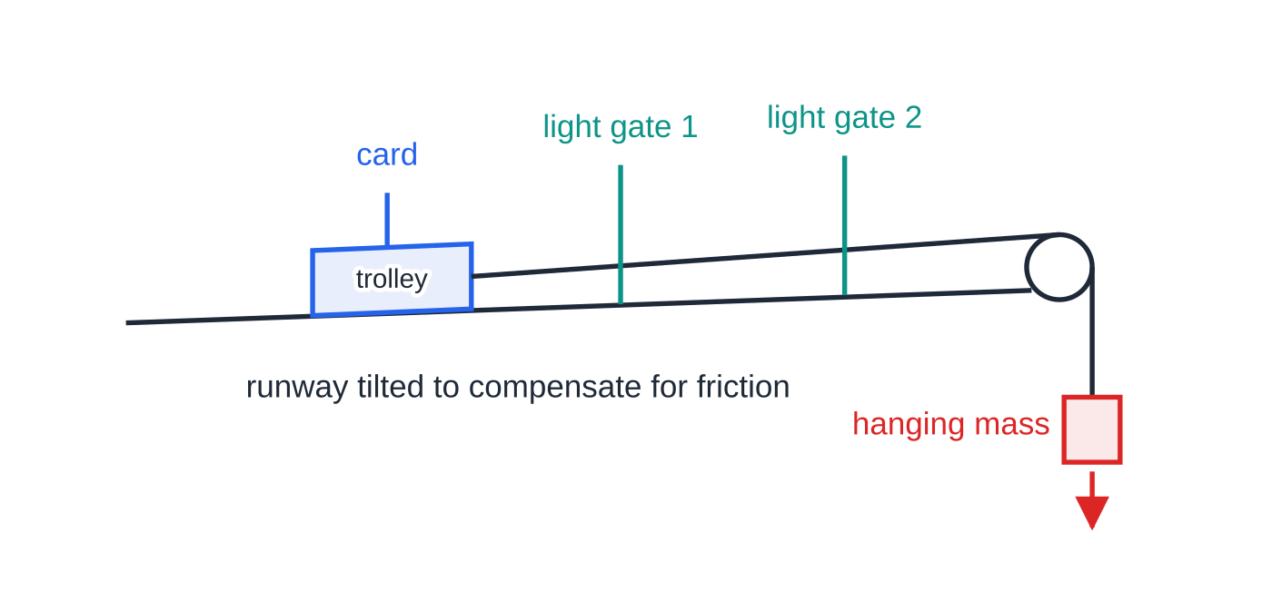
CP9 and CP10: how do you test force, momentum and collisions? (continued)
Section 2 of 13
Method B (force sensor). The trolley runs into a sprung buffer on a force sensor connected to a logger; light gates give the speed just before and after impact. The area under the force–time graph is the impulse; compare it with m(v − u), minding the sign of the rebound velocity.
Uncertainties: friction compensation; card length; slow sampling misses a short impact's peak.
Safety: an end stop; padding under the hanging masses.
Method A: the light gates time the card at two points.
Notes:
CP9 and CP10: how do you test force, momentum and collisions?. Full notes: https://examinerprep.com/notes/edexcel-ial-physics/the-a2-core-practicals/

Slide 7
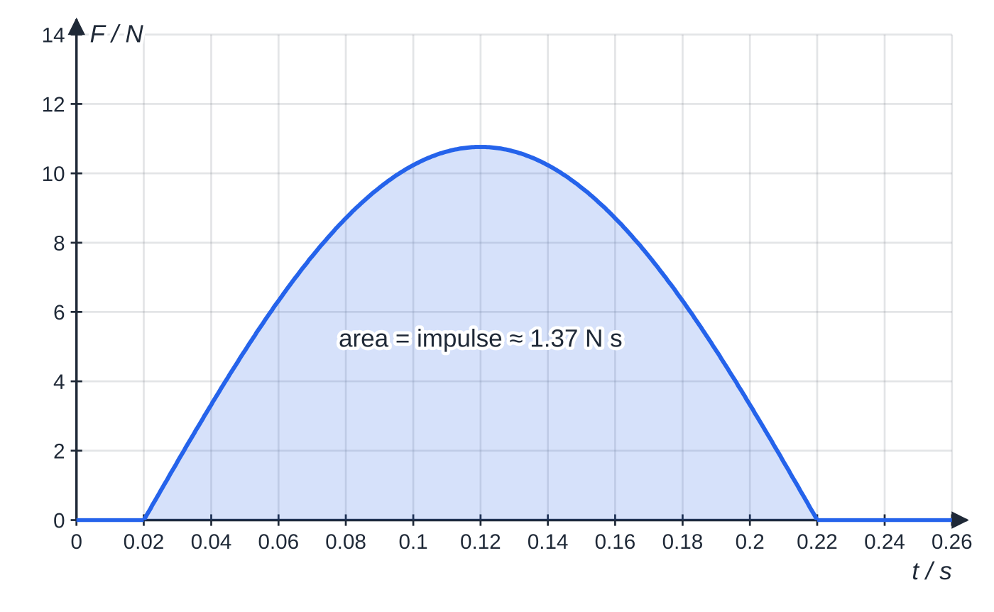
CP9 and CP10: how do you test force, momentum and collisions? (continued)
Section 2 of 13
Improvements: longer card or slower trolley; repeat and average; a softer buffer lengthens the impact so more points are logged.
Force sensor data for a 0.850 kg trolley rebounding from a sprung buffer. The trapezium rule over the logger samples gives an impulse of 1.37 N s.
Notes:
CP9 and CP10: how do you test force, momentum and collisions?. Full notes: https://examinerprep.com/notes/edexcel-ial-physics/the-a2-core-practicals/

Slide 8
CP9 and CP10: how do you test force, momentum and collisions? (continued)
Section 2 of 13 · Worked example 1 · Medium · Calculate, compare
WORKED EXAMPLE · QUESTION
In this run a 0.100 m card blocks the light gate for 0.105 s on the way in and 0.149 s on the way out. Calculate the change of momentum and compare it with the impulse of 1.37 N s.
SOLUTION
u = 0.100 ÷ 0.105 = 0.952 m s⁻¹ towards the sensor; v = 0.100 ÷ 0.149 = 0.671 m s⁻¹ away. Rebound direction positive: Δp = 0.850 × (0.671 − (−0.952)) = 1.38 N s. Percentage difference from the impulse = 0.6%: they agree well.
Notes:
CP9 and CP10: how do you test force, momentum and collisions?: Worked example 1. Full notes: https://examinerprep.com/notes/edexcel-ial-physics/the-a2-core-practicals/

Slide 9
CP9 and CP10: how do you test force, momentum and collisions? (continued)
Section 2 of 13
Common error
Subtracting the speeds when the trolley bounces back. The velocity reverses, so the speeds add. Using 0.671 − 0.952 gives a momentum change about six times too small.
CP10: a collision analysed from a video
Aim: use a video camera and analysis software to test conservation of momentum in a collision between two small spheres, and decide whether kinetic energy is conserved. Apparatus: two weighed spheres on a smooth, level surface; a camera looking straight down; a ruler in the spheres' plane as a scale; good lighting. Method: roll A into stationary B off-centre (a glancing collision). Step through the video frame by frame, recording each sphere's centre. Calibrate distances from the scale and times from the frame rate (time between frames = 1 ÷ frames per second). Analysis: x-axis along A's original path; velocity components over several frames; check total momentum in x and in y separately; compare kinetic energy.
Notes:
CP9 and CP10: how do you test force, momentum and collisions?. Full notes: https://examinerprep.com/notes/edexcel-ial-physics/the-a2-core-practicals/

Slide 10
CP9 and CP10: how do you test force, momentum and collisions? (continued)
Section 2 of 13
Uncertainties: blurred centres; perspective (a scale out of the spheres' plane); friction, so velocities measured far from the collision are too small.
Safety: stop spheres reaching the floor (slipping hazard); hot lamps away from cables.
Improvements: higher frame rate, short exposure; frames just either side of impact; a line fitted to position against time.
Notes:
CP9 and CP10: how do you test force, momentum and collisions?. Full notes: https://examinerprep.com/notes/edexcel-ial-physics/the-a2-core-practicals/

Slide 11
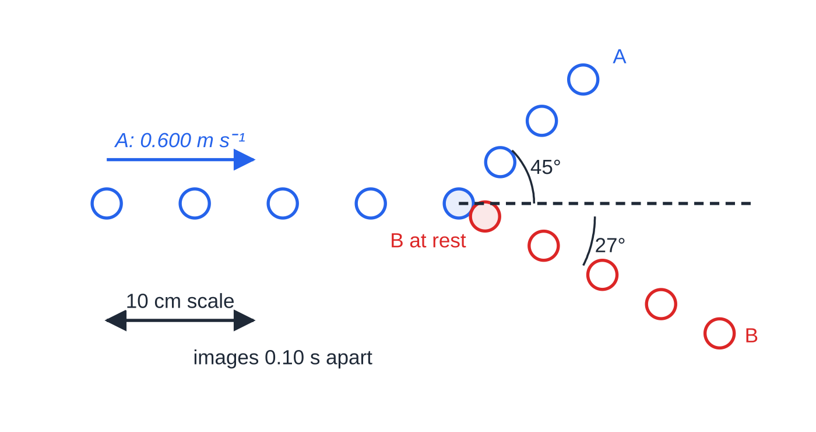
CP9 and CP10: how do you test force, momentum and collisions? (continued)
Section 2 of 13 · Worked example 2 · Hard · Show that, determine
WORKED EXAMPLE · QUESTION
Two identical spheres, each 35.0 g, collide as shown. Over four image intervals before the collision A moves 24.0 cm along x. Over four intervals after, A moves 8.0 cm in x and 8.0 cm in y; B moves 16.0 cm in x and −8.0 cm in y. (a) Calculate the velocity components. (b) Show that momentum is conserved in both directions. (c) Determine whether the collision is elastic.
Every fifth frame at 50 frames per second, to scale. Equal spacing means constant velocity.
Notes:
CP9 and CP10: how do you test force, momentum and collisions?: Worked example 2. Full notes: https://examinerprep.com/notes/edexcel-ial-physics/the-a2-core-practicals/

Slide 12
CP9 and CP10: how do you test force, momentum and collisions? (continued)
Section 2 of 13 · Worked example 2 · Hard · Show that, determine (continued)
SOLUTION
(a) Four intervals = 4 × 5 ÷ 50 = 0.40 s. Before: u_A = 0.240 ÷ 0.40 = 0.600 m s⁻¹. After: A (0.200, 0.200) m s⁻¹, B (0.400, −0.200) m s⁻¹.
(b) Equal masses, so compare sums of components. x: 0.200 + 0.400 = 0.600 = u_A; y: 0.200 + (−0.200) = 0. Momentum is conserved in both directions.
(c) v_A = 0.283 m s⁻¹, v_B = 0.447 m s⁻¹. Eₖ before = ½ × 0.0350 × 0.600² = 6.30 mJ; after = 4.90 mJ, only 78%: inelastic. Displacements are ± 0.2 cm (2.5% of 8.0 cm), so Eₖ (∝ v²) is ± 5%; the 22% loss is real.
Notes:
CP9 and CP10: how do you test force, momentum and collisions?: Worked example 2. Full notes: https://examinerprep.com/notes/edexcel-ial-physics/the-a2-core-practicals/

Slide 13
CP11: how do you display a capacitor charging and discharging?
Section 3 of 13
Aim: record the p.d. across a capacitor as it charges and discharges through a resistor, with a data logger or oscilloscope, and find RC. Apparatus: d.c. supply, capacitor, resistor, two-way switch, logger with a voltage sensor across the capacitor (or an oscilloscope with a square-wave signal generator).
Logger method: one switch position charges the capacitor through the resistor, the other discharges it through the resistor. Record V against t for at least five time constants, with RC of several seconds or more. Oscilloscope method: a square wave charges and discharges the capacitor repeatedly, giving a steady trace; each half-period must be at least about five time constants. Graph: discharging, V = V₀e^(-t/RC), so ln V = ln V₀ - t/RC: ln V against t is a straight line of gradient −1/RC. Charging, V = V₀(1 - e^(-t/RC)); the time to reach 0.63V₀ is RC.
Uncertainties: wide capacitor tolerances (often ±10% or ±20%); a sensor resistance not much larger than R adds a second discharge path; reading a fast trace.
Safety: connect an electrolytic capacitor the right way round and below its rated voltage, or it can overheat and burst; discharge large capacitors before handling.
Notes:
CP11: how do you display a capacitor charging and discharging?. Full notes: https://examinerprep.com/notes/edexcel-ial-physics/the-a2-core-practicals/

Slide 14
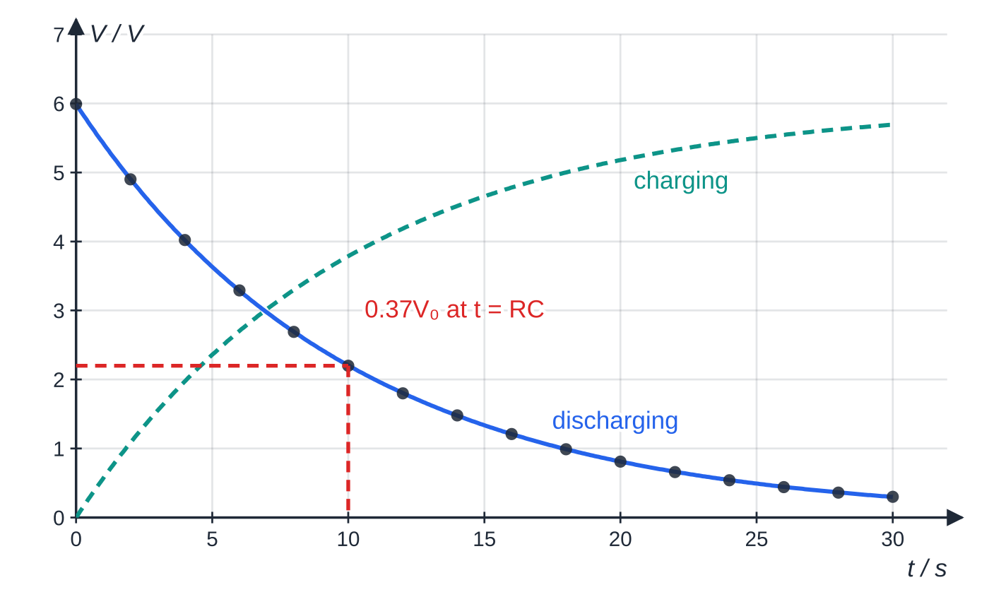
CP11: how do you display a capacitor charging and discharging? (continued)
Section 3 of 13
Improvements: use the ln-graph gradient, not one time-to-halve reading; repeat with several resistors and plot RC against R: the gradient is C.
Specimen logger readings for discharge through 22.0 kΩ (points), with the charging curve. At t = RC: 0.37V₀ discharging, 0.63V₀ charging.
Notes:
CP11: how do you display a capacitor charging and discharging?. Full notes: https://examinerprep.com/notes/edexcel-ial-physics/the-a2-core-practicals/

Slide 15
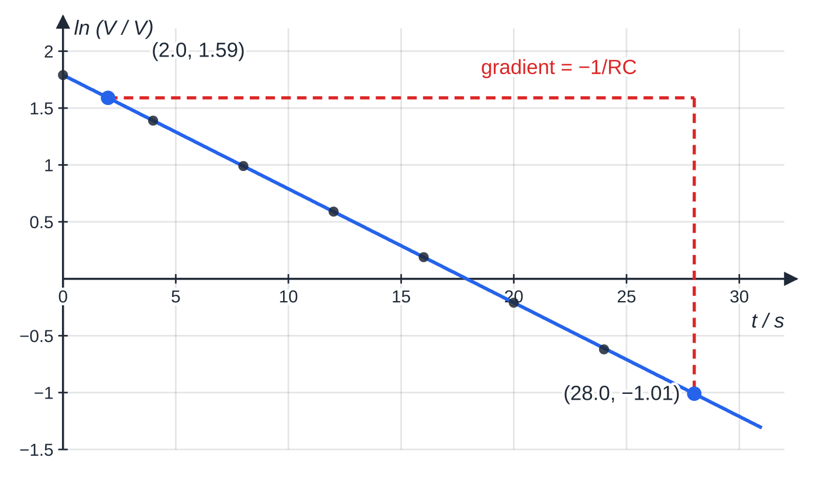
CP11: how do you display a capacitor charging and discharging? (continued)
Section 3 of 13
The same readings as ln V: a straight line. The triangle uses two points on the best-fit line.
Notes:
CP11: how do you display a capacitor charging and discharging?. Full notes: https://examinerprep.com/notes/edexcel-ial-physics/the-a2-core-practicals/

Slide 16
CP11: how do you display a capacitor charging and discharging? (continued)
Section 3 of 13 · Worked example 3 · Medium · Determine
WORKED EXAMPLE · QUESTION
The capacitor is labelled 470 μF ± 10%; the resistor is 22.0 kΩ ± 1%. The best-fit ln V line passes through (2.0 s, 1.59) and (28.0 s, −1.01); steepest and shallowest lines give ± 3% in the gradient. (a) Determine RC. (b) Calculate C and its uncertainty. (c) Comment on the label.
SOLUTION
(a) gradient = (−1.01 − 1.59) ÷ (28.0 − 2.0) = −0.100 s⁻¹ = −1/RC, so RC = 10.0 s.
(b) C = 10.0 ÷ 22 000 = 455 μF; 3% + 1% = 4%, so C = 455 ± 18 μF.
(c) Percentage difference 3.3% < 10% tolerance: consistent with 470 μF. Check: time to halve = RC ln 2 = 6.93 s; intercept 1.79 gives V₀ = e^(1.79) = 5.99 V.
Notes:
CP11: how do you display a capacitor charging and discharging?: Worked example 3. Full notes: https://examinerprep.com/notes/edexcel-ial-physics/the-a2-core-practicals/

Slide 17
CP12: how do you calibrate a thermistor as a thermostat?
Section 4 of 13
Aim: a calibration curve of output p.d. against temperature for a potential divider containing an NTC thermistor, so it can sense and control temperature. Apparatus: sealed thermistor, fixed resistor, low-voltage supply, voltmeter (or logger), water on a hot plate, stirrer, thermometer, ice.
Method. Thermistor and fixed resistor in series across the supply, voltmeter across the fixed resistor, thermistor beside the thermometer bulb in the water. Start with ice and water at 0 °C; heat slowly, stirring, recording Vₒᵤₜ every 5 °C or 10 °C up to about 90 °C. Repeat while cooling and average. Graph: Vₒᵤₜ against θ is a smooth curve, not a straight line; read the temperature that matches a measured Vₒᵤₜ. As a thermostat the output feeds a switching circuit that turns a heater off at a set Vₒᵤₜ. Choose the fixed resistor equal to the thermistor's resistance at the set temperature, so the output is half the supply there, near the steepest, most sensitive part of the curve.
Uncertainties: thermistor and thermometer at different temperatures (heat slowly, stir, wait); self-heating; thermometer resolution.
Notes:
CP12: how do you calibrate a thermistor as a thermostat?. Full notes: https://examinerprep.com/notes/edexcel-ial-physics/the-a2-core-practicals/

Slide 18
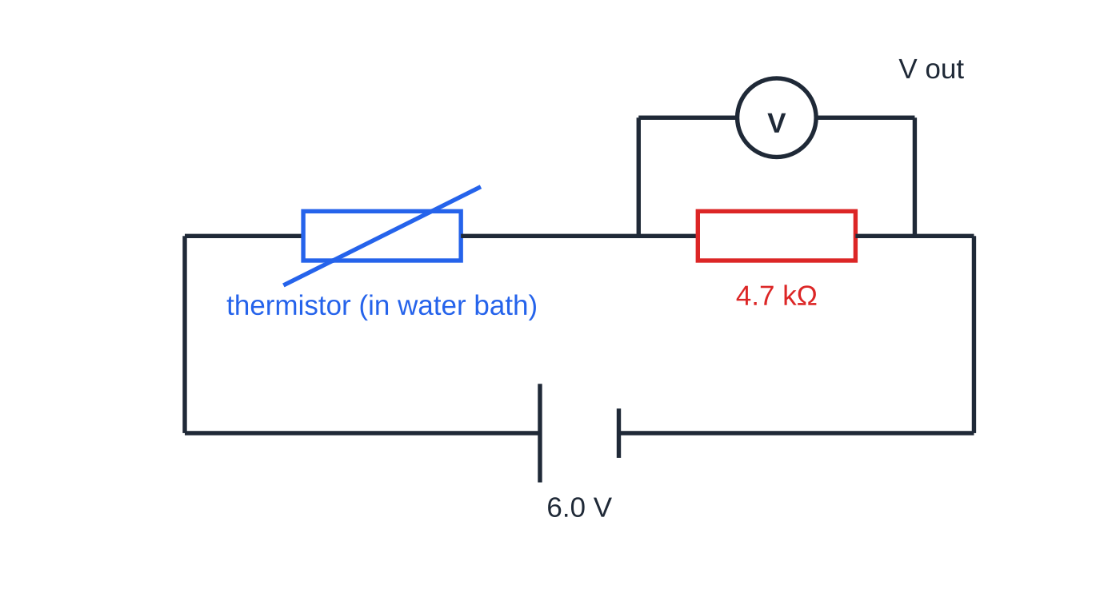
CP12: how do you calibrate a thermistor as a thermostat? (continued)
Section 4 of 13
Safety: scalds: heat-proof mat, do not move the hot beaker; connections out of the water; low voltage.
Improvements: a logger with temperature probe reads Vₒᵤₜ and θ together; a small supply p.d. limits self-heating.
The CP12 potential divider, with the voltmeter across the 4.7 kΩ fixed resistor.
Notes:
CP12: how do you calibrate a thermistor as a thermostat?. Full notes: https://examinerprep.com/notes/edexcel-ial-physics/the-a2-core-practicals/

Slide 19
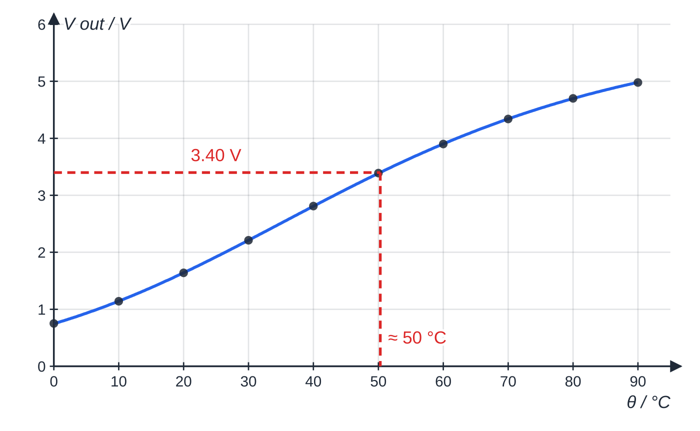
CP12: how do you calibrate a thermistor as a thermostat? (continued)
Section 4 of 13
Specimen calibration curve: Vₒᵤₜ rises from 0.75 V at 0 °C to 4.98 V at 90 °C as the thermistor's resistance falls.
Notes:
CP12: how do you calibrate a thermistor as a thermostat?. Full notes: https://examinerprep.com/notes/edexcel-ial-physics/the-a2-core-practicals/

Slide 20
CP12: how do you calibrate a thermistor as a thermostat? (continued)
Section 4 of 13 · Worked example 4 · Medium · Calculate, suggest
WORKED EXAMPLE · QUESTION
Supply 6.00 V, fixed resistor 4.70 kΩ. (a) At 25 °C, Vₒᵤₜ = 1.92 V. Calculate the thermistor's resistance. (b) Find the temperature when Vₒᵤₜ = 3.40 V. (c) A thermostat switches a heater off when its input reaches 3.0 V; the thermistor's resistance at 60 °C is 2.53 kΩ. Suggest a fixed resistor to keep the water at 60 °C.
SOLUTION
(a) Same current in both; the thermistor has 6.00 − 1.92 = 4.08 V, so Rₜₕ = 4.70 kΩ × 4.08 ÷ 1.92 = 9.99 kΩ.
(b) Across from 3.40 V to the curve, then down: θ ≈ 50 °C.
(c) 3.0 V is half of 6.0 V, so the resistances must be equal at 60 °C: ≈ 2.5 kΩ (check: 6.00 × 2.5 ÷ (2.5 + 2.53) = 2.98 V).
Sensitivity: about 59 mV per °C from 35 °C to 45 °C, only 28 mV per °C from 80 °C to 90 °C.
Notes:
CP12: how do you calibrate a thermistor as a thermostat?: Worked example 4. Full notes: https://examinerprep.com/notes/edexcel-ial-physics/the-a2-core-practicals/

Slide 21
CP12: how do you calibrate a thermistor as a thermostat? (continued)
Section 4 of 13
Exam tip
Say which way the output goes and why: as temperature rises the thermistor's resistance falls, it takes a smaller share of the supply p.d., and the p.d. across the fixed resistor rises. With the voltmeter across the thermistor, the output falls.
Notes:
CP12: how do you calibrate a thermistor as a thermostat?. Full notes: https://examinerprep.com/notes/edexcel-ial-physics/the-a2-core-practicals/

Slide 22
CP13: how do you measure a specific latent heat?
Section 5 of 13
Aim: the specific latent heat of a phase change, for example fusion of ice, using ΔE = LΔm. Apparatus: two filter funnels of crushed ice over two beakers, a low-voltage immersion heater in one funnel only, joulemeter or ammeter, voltmeter and stopclock, balance.
Method. Pack melting crushed ice round the heater. When both funnels drip steadily, empty both beakers. Switch on and start the clock; after several minutes switch off and weigh the water in each beaker. The second funnel is the control: it shows how much ice the room melts in the same time. The heater's energy VIt melts only the extra mass, so L = VIt/(mₕₑₐₜₑᵣ - m_control). Vaporisation variant: a heater keeps water boiling on a balance; record mass lost per second at two powers. Losses to the room are the same in both, so L = (P₁ − P₂)/(rate₁ − rate₂).
Notes:
CP13: how do you measure a specific latent heat?. Full notes: https://examinerprep.com/notes/edexcel-ial-physics/the-a2-core-practicals/

Slide 23
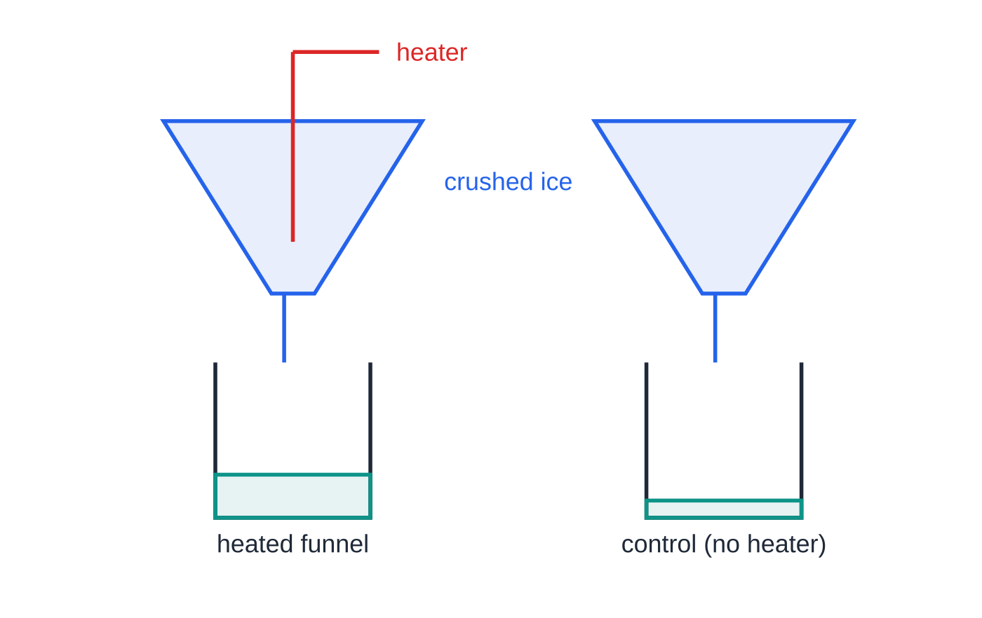
CP13: how do you measure a specific latent heat? (continued)
Section 5 of 13
Uncertainties: ice below 0 °C (use melting, wet ice); meltwater clinging to ice and funnel; heater energy lost to the air or funnel.
Safety: never switch on an uncovered heater (it overheats); keep mains supply and meters away from water; mop spills.
Improvements: run longer; finer ice for better contact; insulate the funnel.
The control collects water melted by the room; the heated funnel collects that plus the heater's share.
Notes:
CP13: how do you measure a specific latent heat?. Full notes: https://examinerprep.com/notes/edexcel-ial-physics/the-a2-core-practicals/

Slide 24
CP13: how do you measure a specific latent heat? (continued)
Section 5 of 13 · Worked example 5 · Medium · Determine
WORKED EXAMPLE · QUESTION
Use the results to determine the specific latent heat of fusion of ice, with its uncertainty, and compare it with the accepted 3.34 × 10⁵ J kg⁻¹.
Quantity | Reading | Uncertainty | Percentage
p.d. V | 12.0 V | ±0.1 V | 0.83%
current I | 3.50 A | ±0.01 A | 0.29%
time t | 240 s | ±0.5 s | 0.21%
mass melted Δm = 37.6 g − 7.4 g | 30.2 g | ±0.1 g + ±0.1 g = ±0.2 g | 0.66%
SOLUTION
Step 1 E = VIt = 12.0 × 3.50 × 240 = 10 080 J.
Step 2 Δm = 37.6 − 7.4 = 30.2 g, so L = 10 080 ÷ 0.0302 = 3.34 × 10⁵ J kg⁻¹.
Notes:
CP13: how do you measure a specific latent heat?: Worked example 5. Full notes: https://examinerprep.com/notes/edexcel-ial-physics/the-a2-core-practicals/

Slide 25
CP13: how do you measure a specific latent heat? (continued)
Section 5 of 13 · Worked example 5 · Medium · Determine (continued)
Step 3 0.83 + 0.29 + 0.21 + 0.66 = 2.0%, so L = (3.34 ± 0.07) × 10⁵ J kg⁻¹. The accepted value is well inside this range. The p.d. contributes most, so a finer voltmeter would help.
Notes:
CP13: how do you measure a specific latent heat?: Worked example 5. Full notes: https://examinerprep.com/notes/edexcel-ial-physics/the-a2-core-practicals/

Slide 26
CP13: how do you measure a specific latent heat? (continued)
Section 5 of 13
Common error
Leaving out the control and using the whole 37.6 g. Ice melted by the room is then credited to the heater, giving L ≈ 2.68 × 10⁵ J kg⁻¹, about 20% too small.
Notes:
CP13: how do you measure a specific latent heat?. Full notes: https://examinerprep.com/notes/edexcel-ial-physics/the-a2-core-practicals/

Slide 27
CP14: how are the pressure and volume of a gas related?
Section 6 of 13
Aim: how the pressure of a fixed mass of gas depends on its volume at constant temperature. Apparatus: dry air trapped above oil in a vertical, uniform glass tube with a scale; a Bourdon gauge on the oil reservoir; a foot pump (or a gas syringe with a pressure sensor and logger).
Method. Pump oil up to compress the air, close the valve, wait about a minute, then read the pressure and the air-column length (eye level, bottom of meniscus). Release pressure in steps and repeat. The bore is uniform, so volume = length × area and length can stand in for volume. Why wait: compressing a gas does work on it and warms it; waiting lets it return to room temperature. Graph: pV = NkT, so p against 1/V is a straight line through the origin of gradient NkT; a p–V curve is hard to test by eye.
Uncertainties: parallax at the meniscus; gauge resolution; a gauge reading above atmospheric rather than absolute pressure gives a line missing the origin.
Safety: goggles, as the glass tube is under pressure; never exceed the stated maximum pressure.
Improvements: sensor and logger; a wider range; check pV for every pair.
Notes:
CP14: how are the pressure and volume of a gas related?. Full notes: https://examinerprep.com/notes/edexcel-ial-physics/the-a2-core-practicals/

Slide 28
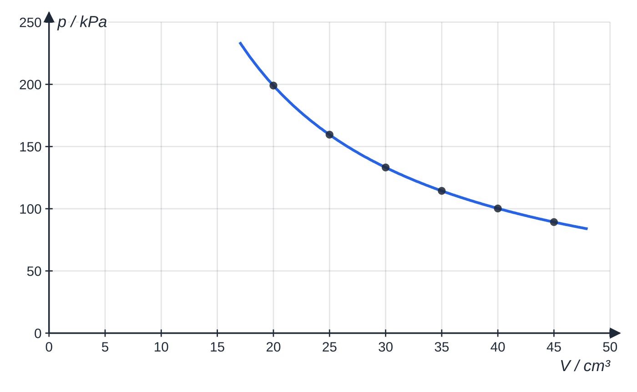
CP14: how are the pressure and volume of a gas related? (continued)
Section 6 of 13
Specimen results for trapped air at 293 K: p against V is a curve.
Notes:
CP14: how are the pressure and volume of a gas related?. Full notes: https://examinerprep.com/notes/edexcel-ial-physics/the-a2-core-practicals/

Slide 29
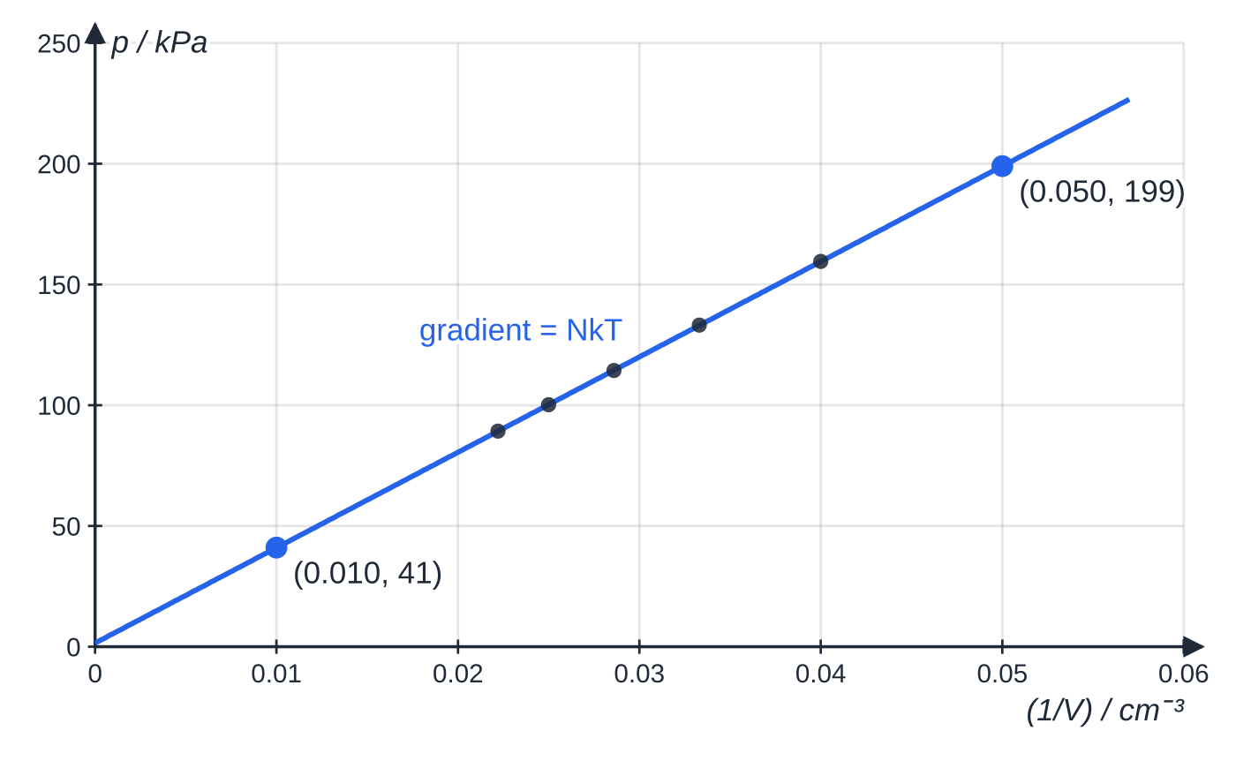
CP14: how are the pressure and volume of a gas related? (continued)
Section 6 of 13
p against 1/V is a straight line through (very nearly) the origin; every pV lies between 3.98 J and 4.02 J.
Notes:
CP14: how are the pressure and volume of a gas related?. Full notes: https://examinerprep.com/notes/edexcel-ial-physics/the-a2-core-practicals/

Slide 30
CP14: how are the pressure and volume of a gas related? (continued)
Section 6 of 13 · Worked example 6 · Medium · Determine
WORKED EXAMPLE · QUESTION
The best-fit line passes through (0.010 cm⁻³, 41 kPa) and (0.050 cm⁻³, 199 kPa). The air is at 293 K. Determine the number of molecules of trapped air.
SOLUTION
Gradient = (199 − 41) ÷ (0.050 − 0.010) = 3950 kPa cm³. Since 1 kPa cm³ = 10³ Pa × 10⁻⁶ m³ = 10⁻³ J, NkT = 3.95 J. N = 3.95 ÷ (1.38 × 10⁻²³ × 293) = 9.77 × 10²⁰.
Notes:
CP14: how are the pressure and volume of a gas related?: Worked example 6. Full notes: https://examinerprep.com/notes/edexcel-ial-physics/the-a2-core-practicals/

Slide 31
CP15: how does lead absorb gamma radiation?
Section 7 of 13
Aim: how gamma intensity falls through increasing thicknesses of lead. Apparatus: sealed gamma source (for example cobalt-60) in a holder, GM tube and counter, lead sheets, micrometer, stopclock, tongs, thin aluminium sheet.
Method. With the source in its lead box, count for several minutes for the background rate. Fix source and GM tube a set distance apart; a thin aluminium sheet over the source absorbs any beta particles. Measure each sheet with the micrometer, place sheets between source and tube, and count for a fixed time; repeat and average. Graph: subtract the background from every rate. The corrected rate falls exponentially, C = C₀e^(-μx), so ln C against x is a straight line of gradient −μ. The half-value thickness is ln 2/μ.
Notes:
CP15: how does lead absorb gamma radiation?. Full notes: https://examinerprep.com/notes/edexcel-ial-physics/the-a2-core-practicals/

Slide 32
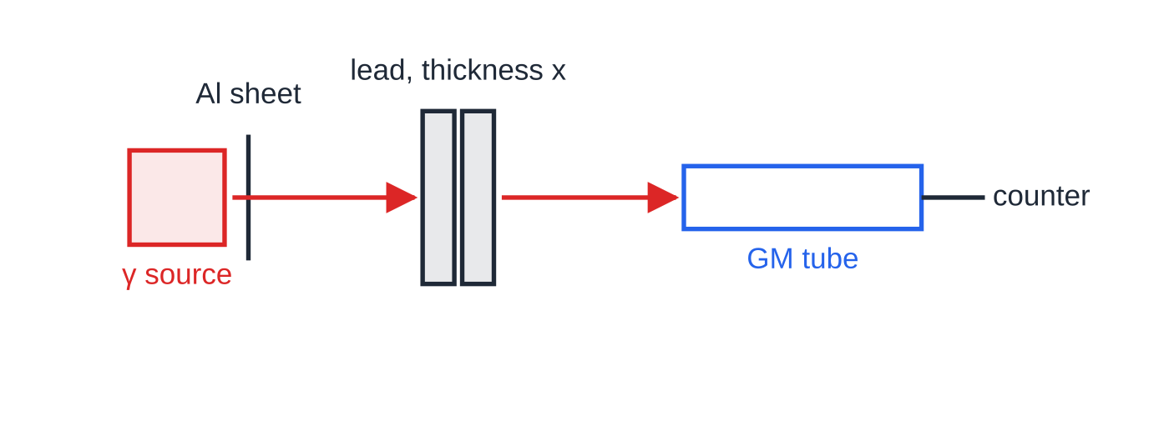
CP15: how does lead absorb gamma radiation? (continued)
Section 7 of 13
Uncertainties: random decay, so record hundreds or thousands of counts; background matters most at large thicknesses; distance must stay fixed.
Safety: tongs at arm's length, never pointed at anyone; short exposure; back in the lead box promptly; lead is toxic, so gloves or hand-washing.
Improvements: longer counts; more thicknesses; a clamp to fix the geometry.
Fixed geometry: only the lead thickness x changes; the aluminium sheet removes beta particles.
Notes:
CP15: how does lead absorb gamma radiation?. Full notes: https://examinerprep.com/notes/edexcel-ial-physics/the-a2-core-practicals/

Slide 33
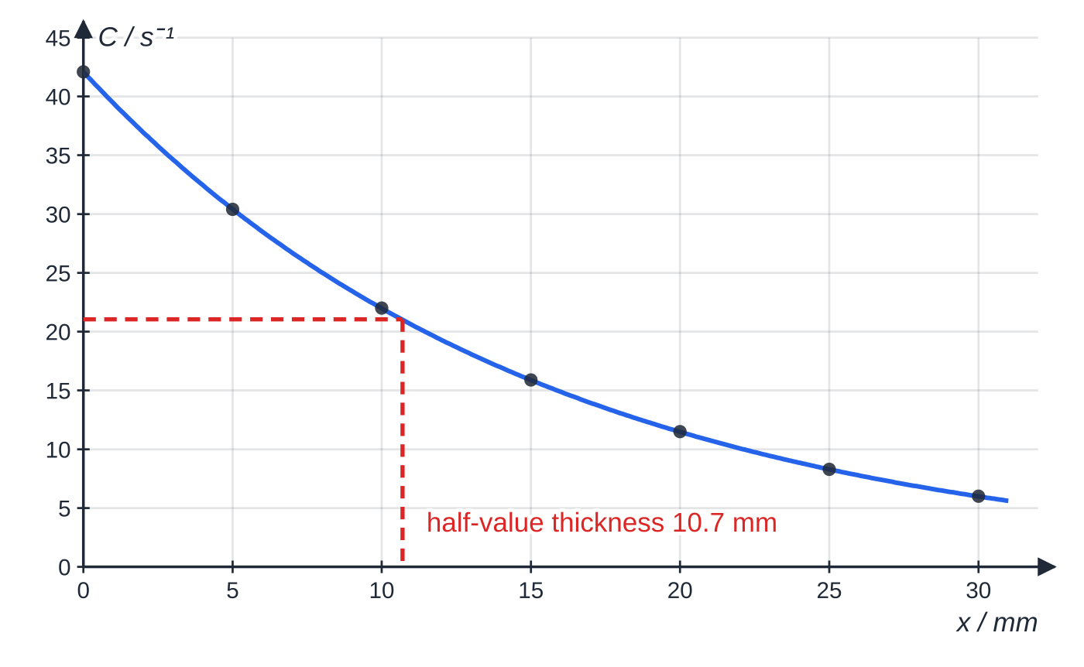
CP15: how does lead absorb gamma radiation? (continued)
Section 7 of 13
Specimen corrected count rates (background 0.40 s⁻¹ subtracted): the rate halves every 10.7 mm.
Notes:
CP15: how does lead absorb gamma radiation?. Full notes: https://examinerprep.com/notes/edexcel-ial-physics/the-a2-core-practicals/

Slide 34
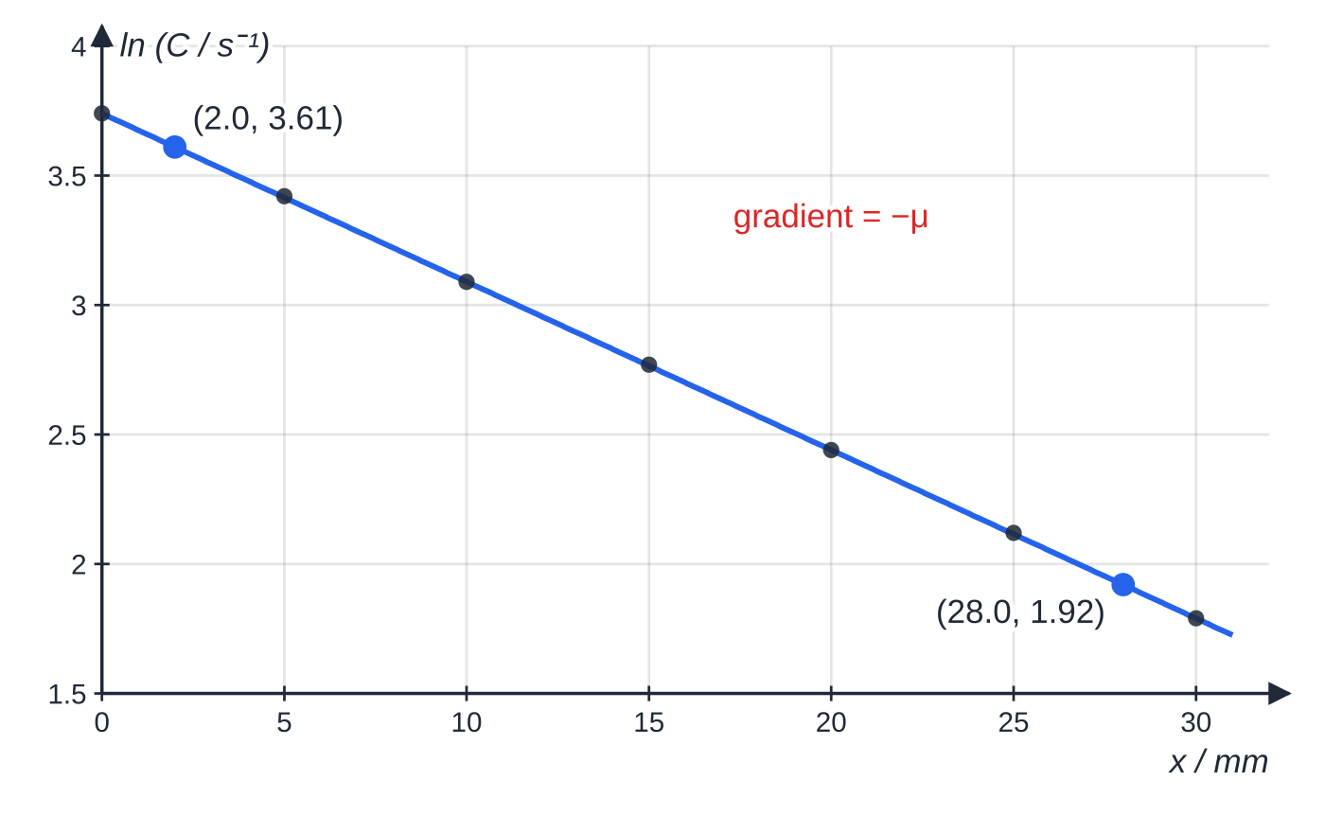
CP15: how does lead absorb gamma radiation? (continued)
Section 7 of 13
ln C against x is a straight line, confirming exponential absorption.
Notes:
CP15: how does lead absorb gamma radiation?. Full notes: https://examinerprep.com/notes/edexcel-ial-physics/the-a2-core-practicals/

Slide 35
CP15: how does lead absorb gamma radiation? (continued)
Section 7 of 13 · Worked example 7 · Medium · Calculate, determine
WORKED EXAMPLE · QUESTION
Background: 240 counts in 600 s. With 10 mm of lead, 2240 counts in 100 s. The best-fit ln line passes through (2.0 mm, 3.61) and (28.0 mm, 1.92). (a) Calculate the corrected count rate and its natural log for 10 mm. (b) Determine μ. (c) Calculate the half-value thickness.
SOLUTION
(a) Background = 240 ÷ 600 = 0.40 s⁻¹; C = 2240 ÷ 100 − 0.40 = 22.0 s⁻¹, ln C = 3.09.
(b) Gradient = (1.92 − 3.61) ÷ (28.0 − 2.0) = −0.0650 mm⁻¹ = −μ: μ = 0.0650 mm⁻¹ (65 m⁻¹).
(c) x_½ = ln 2 ÷ 0.0650 = 10.7 mm, matching the C–x graph. At 30 mm the background is 7% of the corrected rate; not subtracting it would bend the ln graph upwards at large thicknesses.
Notes:
CP15: how does lead absorb gamma radiation?: Worked example 7. Full notes: https://examinerprep.com/notes/edexcel-ial-physics/the-a2-core-practicals/

Slide 36
CP15: how does lead absorb gamma radiation? (continued)
Section 7 of 13
Exam tip
A log has no unit, so label the axis "ln (C / s⁻¹)". The gradient of ln C against x has the unit of 1/x, here mm⁻¹.
Notes:
CP15: how does lead absorb gamma radiation?. Full notes: https://examinerprep.com/notes/edexcel-ial-physics/the-a2-core-practicals/

Slide 37
CP16: how do you find an unknown mass from resonance?
Section 8 of 13
Aim: an unknown mass from the resonant frequencies of a mass–spring system loaded with known masses. Apparatus: spring on a vibration generator driven by a signal generator, slotted masses, the unknown mass, clamped stand, oscilloscope to check frequency.
Method. For each known mass, raise the driving frequency slowly to find where the mass's amplitude is largest: the resonant frequency, equal to the natural frequency. Approach from above and below and average. Then do the same for the unknown mass. Graph: T = 2π√(m/k) and f = 1/T give 1/f² = 4π² m/k: 1/f² against m is a straight line of gradient 4π²/k. The spring's own mass adds a little to every load, giving a small positive intercept. Read the unknown mass from the line. Variant: time 10 free oscillations of each mass from a reference mark at the equilibrium position and plot T² against m.
Notes:
CP16: how do you find an unknown mass from resonance?. Full notes: https://examinerprep.com/notes/edexcel-ial-physics/the-a2-core-practicals/

Slide 38
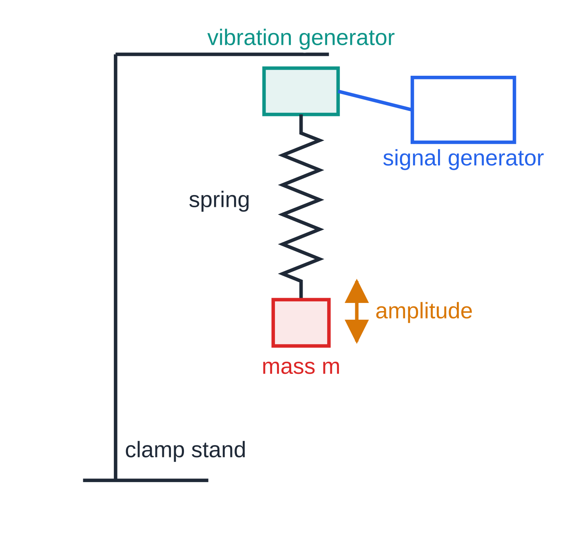
CP16: how do you find an unknown mass from resonance? (continued)
Section 8 of 13
Uncertainties: damping broadens the peak; the frequency dial; large amplitudes beyond the limit of proportionality.
Safety: small amplitudes so masses stay on; clamp the stand; goggles in case the spring breaks.
Improvements: oscilloscope frequency; wider mass range; repeats.
CP16: raise the driving frequency slowly until the mass's amplitude is largest.
Notes:
CP16: how do you find an unknown mass from resonance?. Full notes: https://examinerprep.com/notes/edexcel-ial-physics/the-a2-core-practicals/

Slide 39
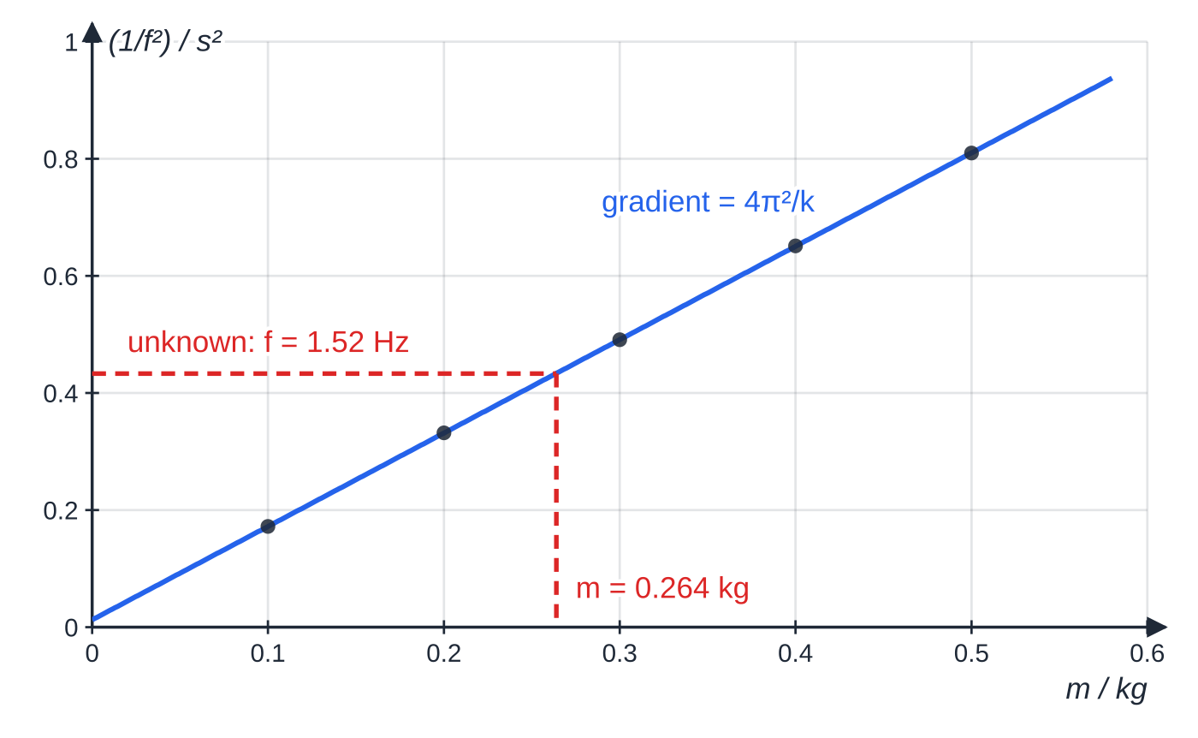
CP16: how do you find an unknown mass from resonance? (continued)
Section 8 of 13
Across at 1/f² = 0.433 s² and down gives 0.264 kg.
Notes:
CP16: how do you find an unknown mass from resonance?. Full notes: https://examinerprep.com/notes/edexcel-ial-physics/the-a2-core-practicals/

Slide 40
CP16: how do you find an unknown mass from resonance? (continued)
Section 8 of 13 · Worked example 8 · Hard · Determine, explain
WORKED EXAMPLE · QUESTION
The best-fit line passes through (0.100 kg, 0.172 s²) and (0.500 kg, 0.810 s²). The unknown mass resonates at 1.52 Hz. (a) Determine the spring constant. (b) Determine the unknown mass. (c) Explain why the line misses the origin.
SOLUTION
(a) gradient = (0.810 − 0.172) ÷ 0.400 = 1.595 s² kg⁻¹ = 4π²/k, so k = 4π² ÷ 1.595 = 24.8 N m⁻¹.
(b) 1 ÷ 1.52² = 0.4328 s²; intercept = 0.172 − 1.595 × 0.100 = 0.0125 s²; m = (0.4328 − 0.0125) ÷ 1.595 = 0.264 kg.
(c) The spring itself moves, adding an effective mass of about 8 g to every load: a systematic effect the graph method handles automatically.
Notes:
CP16: how do you find an unknown mass from resonance?: Worked example 8. Full notes: https://examinerprep.com/notes/edexcel-ial-physics/the-a2-core-practicals/

Slide 41
Exam tips for 6.3
Section 9 of 13
Exam tip 1 — lead with the equation
For any variation, write the physics equation and rearrange it into y = mx + c; for an exponential take ln first: y = Ae⁻ᵏˣ becomes ln y = ln A − kx.
Exam tip 2 — combine uncertainties the right way
Add absolute uncertainties for subtracted quantities (a mass from two weighings), percentages for products and quotients, and multiply by the power for squares and cubes. Quote the final uncertainty to 1 or 2 s.f.
Exam tip 3 — judge agreement with numbers
"Close to the accepted value" is too vague: compare percentage difference with percentage uncertainty; if smaller, the result agrees.
Notes:
Exam tips for 6.3. Full notes: https://examinerprep.com/notes/edexcel-ial-physics/the-a2-core-practicals/

Slide 42
Exam tips for 6.3 (continued)
Section 9 of 13
Exam tip 4 — specific safety
Give hazard and precaution together: "handle the source with tongs to keep it away from the body"; "wear goggles because the pressurised glass tube may shatter".
Exam tip 5 — controls and corrections
Subtract the background (CP15) and the control (CP13), let the gas return to room temperature (CP14), include the hanging mass in the moving mass (CP9), and mention the correction in any method.
Notes:
Exam tips for 6.3. Full notes: https://examinerprep.com/notes/edexcel-ial-physics/the-a2-core-practicals/

Slide 43
Common misconceptions
Section 10 of 13
Misconception | Why it is wrong | Correct idea
For a rebound, Δp = m(v − u) with both speeds positive. | The velocity has reversed. | Give the rebound the opposite sign: the speeds add.
In a glancing collision momentum is conserved only along the original direction. | Momentum is a vector, conserved in every direction. | Check two perpendicular directions separately.
A graph of V against t is enough to find RC accurately. | A curve is hard to read precisely and hides anomalies. | Plot ln V against t; the gradient is −1/RC.
A thermistor calibration graph should be a straight line. | Resistance changes non-linearly with temperature. | Draw a smooth curve; it is steepest (most sensitive) in the middle.
The background count is too small to matter. | At large thicknesses the source count is small too. | Subtract it from every reading before taking logs.
The gas temperature stays constant automatically. | Quick compression does work on the gas and warms it. | Wait after each change before reading p and V.
Notes:
Common misconceptions. Full notes: https://examinerprep.com/notes/edexcel-ial-physics/the-a2-core-practicals/

Slide 44
How this topic connects
Section 11 of 13
Theory pages in Units 4 and 5
Impulse and collisions (4.1), capacitors (4.4), specific latent heat (5.1), the ideal gas (5.2), radioactive decay and absorption (5.4), SHM and resonance (5.5, 5.6). CP12 builds on the Unit 2 potential divider.
1 Planning and 6.2 Uncertainties and logarithmic graphs
Choosing a logger, a camera or a control is the planning skill of 6.1; ln graphs and combined uncertainties are in full on 6.2. The seven headings match the AS practicals (3.3).
Notes:
How this topic connects. Full notes: https://examinerprep.com/notes/edexcel-ial-physics/the-a2-core-practicals/

Slide 45
Key equations
Section 12 of 13
Equation | Use | In the formulae list?
FΔt = Δp, p = mv | CP9, impulse and momentum (N s) | yes
F = Δp/Δt | CP9, force and rate of change of momentum | no — rearrange FΔt = Δp
impulse = area under F–t graph | CP9, force sensor | no — learn it
Eₖ = ½mv² = p²/2m | CP10, elastic or inelastic | yes
V = V₀e^(−t/RC), ln V = ln V₀ − t/RC | CP11, discharge (RC in s) | yes
t_½ = RC ln 2 | CP11, time to halve | no — derive it
Vₒᵤₜ = VᵢₙR₂/(R₁ + R₂) | CP12, potential divider | no — derive it from V = IR
ΔE = LΔm, W = VIt | CP13 (L in J kg⁻¹) | yes
pV = NkT | CP14 (k = 1.38 × 10⁻²³ J K⁻¹) | yes
Notes:
Key equations. Full notes: https://examinerprep.com/notes/edexcel-ial-physics/the-a2-core-practicals/

Slide 46
Key equations (continued)
Section 12 of 13
Equation | Use | In the formulae list?
C = C₀e^(−μx), x_½ = ln 2/μ | CP15, absorption by lead | no — given in the question when needed
T = 2π√(m/k), f = 1/T | CP16 (k in N m⁻¹) | yes
1/f² = 4π²m/k | CP16, straight-line form | no — derive it
% uncertainty of a product or quotient = sum of the % uncertainties | every practical | no — learn it
Notes:
Key equations. Full notes: https://examinerprep.com/notes/edexcel-ial-physics/the-a2-core-practicals/

Slide 47
Check your understanding
Section 13 of 13
1. In CP9 with a hanging mass, why move masses from the trolley to the hanger rather than simply add them to the hanger?
2. A 100 μF capacitor discharges through a 47 kΩ resistor. How long does the p.d. take to halve?
3. In CP13, why is the control funnel left for the same time as the heated funnel?
4. A ln C against x graph for gamma rays in a metal has gradient −0.0580 mm⁻¹. Calculate the half-value thickness.
5. In CP16, why does a 1/f² against m graph give a more reliable unknown mass than one calculation with k and one frequency?
Notes:
Check your understanding: questions. Full notes: https://examinerprep.com/notes/edexcel-ial-physics/the-a2-core-practicals/

Slide 48
Check your understanding · answers
Section 13 of 13
1. The hanging weight accelerates both, so moving masses keeps the total moving mass constant and only the force changes.
2. t_½ = RC ln 2 = 47 × 10³ × 100 × 10⁻⁶ × 0.693 = 3.3 s.
3. The room melts ice at the same rate in both, so subtracting the control mass leaves the mass melted by the heater alone.
4. μ = 0.0580 mm⁻¹; x_½ = ln 2 ÷ 0.0580 = 12.0 mm.
5. The line uses every mass, so random errors average out and anomalies show; the spring's mass appears as the intercept and is allowed for.
Notes:
Check your understanding: answers. Full notes: https://examinerprep.com/notes/edexcel-ial-physics/the-a2-core-practicals/

Slide 49
Practice questions
2 original exam-style questions. Answers at the end of the deck.

Slide 50
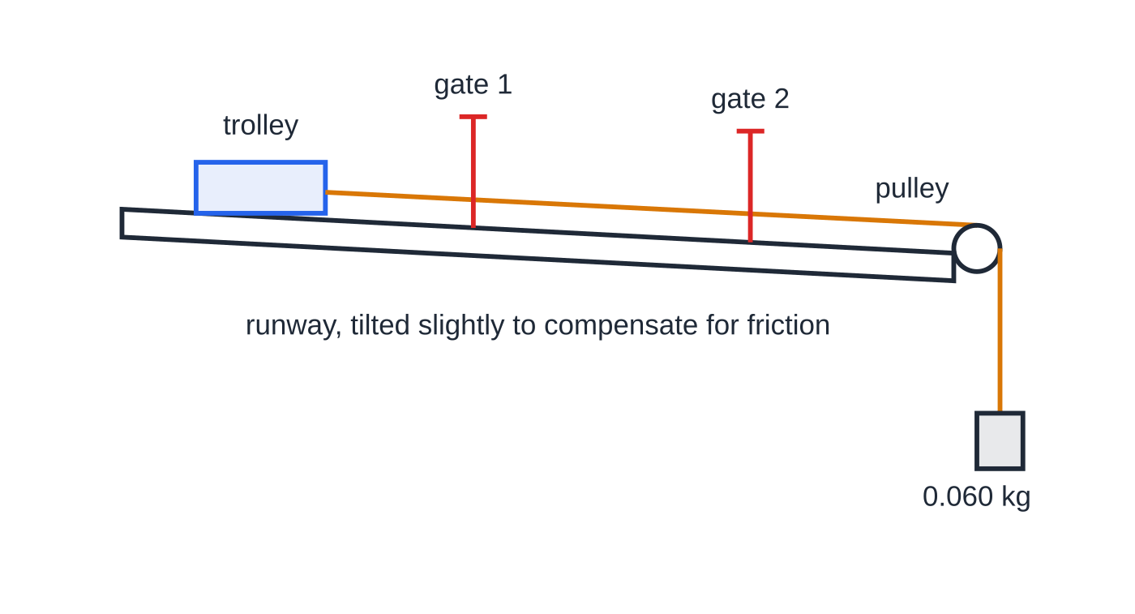
Question 1
6 marks
A student tests the relationship between force and change of momentum. A trolley on a friction-compensated runway is pulled by a string that passes over a pulley to a hanging mass of 0.060 kg. The total mass of the trolley and the hanging mass is 0.800 kg. Two light gates record the speed of the trolley as 0.215 m s⁻¹ at the first gate and 0.580 m s⁻¹ at the second, and the time taken between the gates as 0.500 s.
Figure: trolley, light gates, pulley and hanging mass; not to scale
(a) Calculate the accelerating force provided by the hanging mass. [1]
(b) Calculate the rate of change of momentum of the moving system. [2]
(c) Calculate the percentage difference between your answers to (a) and (b), using (a) as the reference. [1]
(d) Explain why the runway is tilted slightly before the experiment starts. [1]
(e) To change the force, the student moves slotted masses from the trolley to the hanger. Explain why. [1]
Notes:
Online with the full mark scheme: https://examinerprep.com/ial-physics-6-3-the-a2-core-practicals-questions#IALP-U6-3-B-01

Slide 51
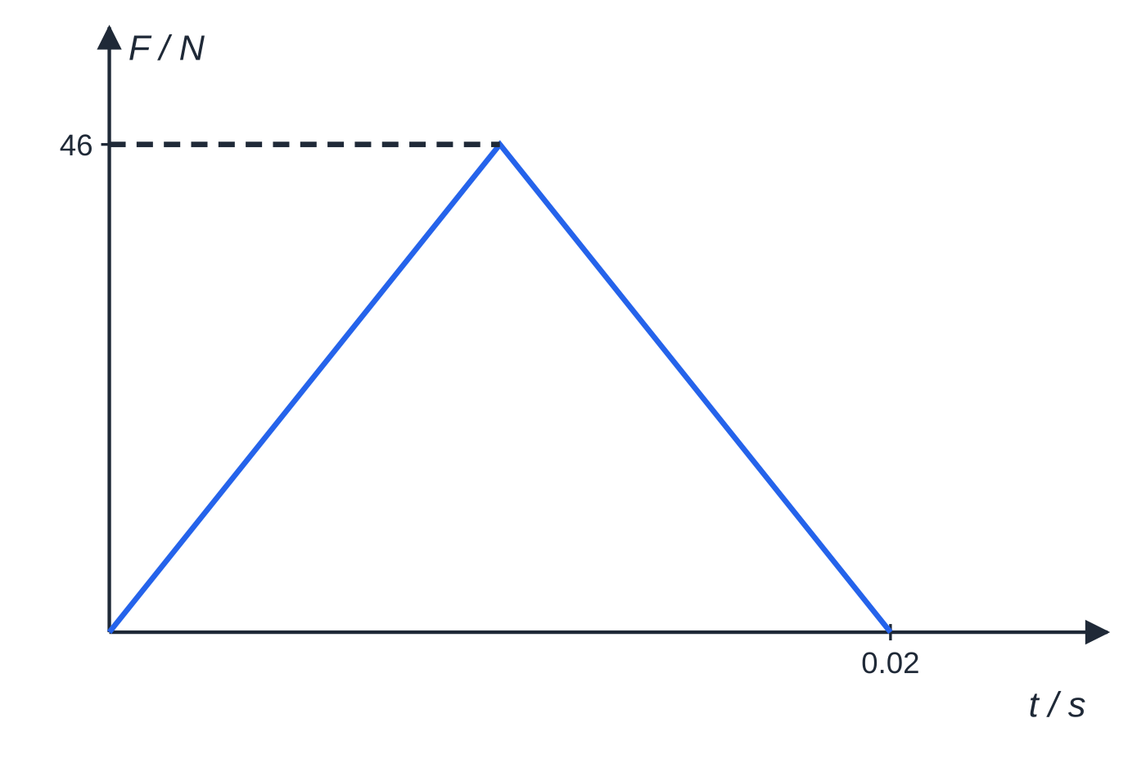
Question 2
8 marks
A tennis ball of mass 0.057 kg is dropped from rest from a height of 1.08 m onto a force plate connected to a data logger. The force–time graph for the impact is approximately a triangle with a peak force of 46 N and a total contact time of 0.020 s. Air resistance is negligible.
Figure: approximate force–time graph for the impact; not to scale
(a) Calculate the speed of the ball just before it hits the plate. [2]
(b) Use the graph to determine the impulse exerted by the plate on the ball. [2]
(c) Taking the impulse to be equal to the change of momentum of the ball, calculate the speed at which it rebounds. [2]
(d) The weight of the ball acts throughout the contact. Show that ignoring it makes the rebound speed in (c) about 0.2 m s⁻¹ too large. [2]
Notes:
Online with the full mark scheme: https://examinerprep.com/ial-physics-6-3-the-a2-core-practicals-questions#IALP-U6-3-B-02

Slide 52
Answers

Slide 53
Question 1 · answer
Mark scheme
F = 0.060 × 9.81 = 0.589 N
Δp = 0.800 × (0.580 − 0.215) = 0.292 kg m s⁻¹
Δp/Δt = 0.292 ÷ 0.500 = 0.584 N
(0.589 − 0.584) ÷ 0.589 × 100 = 0.8%
a component of the trolley's weight down the slope balances friction, so the resultant force is the pull of the hanging mass alone
the force accelerates the trolley and the hanging masses together, so moving masses keeps the total mass constant and only the force changes
Notes:
Full mark scheme: https://examinerprep.com/ial-physics-6-3-the-a2-core-practicals-questions#IALP-U6-3-B-01

Slide 54
Question 2 · answer
Mark scheme
v² = 2gh = 2 × 9.81 × 1.08
v = 4.60 m s⁻¹
impulse = area under the force–time graph = ½ × 46 × 0.020
= 0.46 N s
velocity reverses, so 0.46 = 0.057(v + 4.60)
v = 8.07 − 4.60 = 3.47 m s⁻¹
impulse of the weight = 0.057 × 9.81 × 0.020 = 0.011 N s, which acts against the plate's push
resultant impulse 0.449 N s gives v = 0.449 ÷ 0.057 − 4.60 = 3.27 m s⁻¹, about 0.2 m s⁻¹ smaller
Notes:
Full mark scheme: https://examinerprep.com/ial-physics-6-3-the-a2-core-practicals-questions#IALP-U6-3-B-02

Slide 55
Keep practising
Notes for this topic
Questions on this topic
Build a printable test
ExaminerPrep is an independent tutoring service. It has been developed independently from and is not endorsed by the International Baccalaureate Organization. "International Baccalaureate", "IB" and "IB Diploma Programme" are registered trademarks of the IBO, used here for descriptive purposes only.
Pearson Edexcel and Cambridge are trademarks of their owners; ExaminerPrep is not affiliated with any exam board.

