Slide 1
EP
EDEXCEL IAL PHYSICS
3.3 The AS core practicals
The full notes page in 14 sections · practice questions with answers · simulations
ExaminerPrep is an independent tutoring service. It has been developed independently from and is not endorsed by the International Baccalaureate Organization. "International Baccalaureate", "IB" and "IB Diploma Programme" are registered trademarks of the IBO, used here for descriptive purposes only.
Pearson Edexcel and Cambridge are trademarks of their owners; ExaminerPrep is not affiliated with any exam board.
Notes:
3.3 The AS core practicals. Notes for this topic: https://examinerprep.com/notes/edexcel-ial-physics/the-as-core-practicals/

Slide 2
What this page covers
Overview
A common framework for any core practical: aim, apparatus, method, graph, uncertainties, safety, improvements
CP1 acceleration of free fall
CP2 viscosity by the falling-ball method
CP3 the Young modulus of a wire
CP4 speed of sound with a two-beam oscilloscope
CP5 the vibrating string (length, tension, mass per unit length)
CP6 wavelength of light with a diffraction grating
CP7 resistivity of a wire and CP8 e.m.f. and internal resistance
Notes:
What this page covers. Full notes: https://examinerprep.com/notes/edexcel-ial-physics/the-as-core-practicals/

Slide 3
In one minute
Key points
1. Every AS core practical turns a physics equation into a straight-line graph, and the quantity you want is in the gradient (or the intercept).
2. CP1 h against t² (gradient g/2) · CP3 stress against strain (gradient E) · CP5 f against 1/l · CP6 sin θ against n · CP7 R against l (gradient ρ/A) · CP8 V against I (intercept ε, gradient −r).
3. CP2 uses the force balance at terminal velocity, W = U + F; CP4 finds λ by moving a microphone until two traces are back in phase.
4. The smallest measured quantity (a wire diameter, an extension, a ball radius) usually carries the largest percentage uncertainty.
5. A safety answer names the hazard and the precaution: goggles because a loaded wire may snap; never look along a laser beam.
Notes:
In one minute. Full notes: https://examinerprep.com/notes/edexcel-ial-physics/the-as-core-practicals/

Slide 4
How should you revise a core practical?
Section 1 of 14
The practical paper rarely asks you to repeat a method word for word. It changes the object, the liquid, the wire or the source and expects you to adapt. So learn each practical as a pattern under the same seven headings:
Aim: the quantity to be found, in one line.
Apparatus: each instrument with its resolution (metre rule 1 mm, vernier calipers 0.1 mm, micrometer 0.01 mm).
Method: what is varied, what is measured, what is kept constant, how many readings and repeats.
Graph: the axes that give a straight line, and what the gradient or intercept means.
Uncertainties: which measurement limits the result, and whether the error is random or systematic.
Safety: a specific hazard and a specific precaution.
Improvements: a change that reduces the main uncertainty, with the reason.
Notes:
How should you revise a core practical?. Full notes: https://examinerprep.com/notes/edexcel-ial-physics/the-as-core-practicals/

Slide 5
How should you revise a core practical? (continued)
Section 1 of 14
Practical | Measure | Plot | Gradient or intercept gives
CP1 free fall | fall height h, time t | h against t² | gradient = g/2
CP2 viscosity | ball diameter, time between bands | v against r² (several ball sizes) or one calculation | gradient = 2g(ρₛ - ρ_f)/9η
CP3 Young modulus | load F, extension Δx, length, diameter | stress against strain | gradient = E
CP4 speed of sound | microphone separation, frequency | distance moved against number of wavelengths | gradient = λ; then v = fλ
CP5 vibrating string | f of the first harmonic for different l, T or μ | f against 1/l (or f² against T) | gradient = ½√(T/μ)
CP6 grating | spot separation, grating-to-screen distance | sin θ against order n | gradient = λ/d
Notes:
How should you revise a core practical?. Full notes: https://examinerprep.com/notes/edexcel-ial-physics/the-as-core-practicals/

Slide 6
How should you revise a core practical? (continued)
Section 1 of 14
Practical | Measure | Plot | Gradient or intercept gives
CP7 resistivity | V and I for different lengths, diameter | R against l | gradient = ρ/A
CP8 e.m.f. and r | terminal p.d. V and current I | V against I | intercept = ε; gradient = −r
The AS uncertainty rules (page 3.2) apply throughout: a single reading has an uncertainty of half the resolution, repeats have half the range, and percentage uncertainty = uncertainty ÷ measured value × 100%. At AS you find the percentage uncertainty of a single quantity and say which measurement dominates; combining uncertainties belongs to Unit 6.
Notes:
How should you revise a core practical?. Full notes: https://examinerprep.com/notes/edexcel-ial-physics/the-as-core-practicals/

Slide 7
CP1: how do you measure the acceleration of free fall?
Section 2 of 14
Aim: determine g by timing a body falling from rest.
Apparatus: small steel ball, electromagnet, trapdoor switch (or a light gate), electronic timer, metre rule, set square.
Method: switching off the magnet releases the ball and starts the timer; the ball opens the trapdoor and stops it. Measure h from the bottom of the ball to the trapdoor, using the set square to keep the rule vertical. Use five or six heights over the widest range possible (for example 0.20 m to 1.20 m) and repeat each three times.
Graph: from rest, h = ½ g t², so h against t² is a straight line through the origin with gradient g/2. A gradient of 4.87 m s⁻² gives g = 2 × 4.87 = 9.74 m s⁻², 0.71% below 9.81 m s⁻².
Variant: a light gate measures the speed v = (ball diameter) ÷ (time the beam is blocked) after a fall h; then v² = 2gh and the gradient of v² against h is 2g.
Notes:
CP1: how do you measure the acceleration of free fall?. Full notes: https://examinerprep.com/notes/edexcel-ial-physics/the-as-core-practicals/

Slide 8
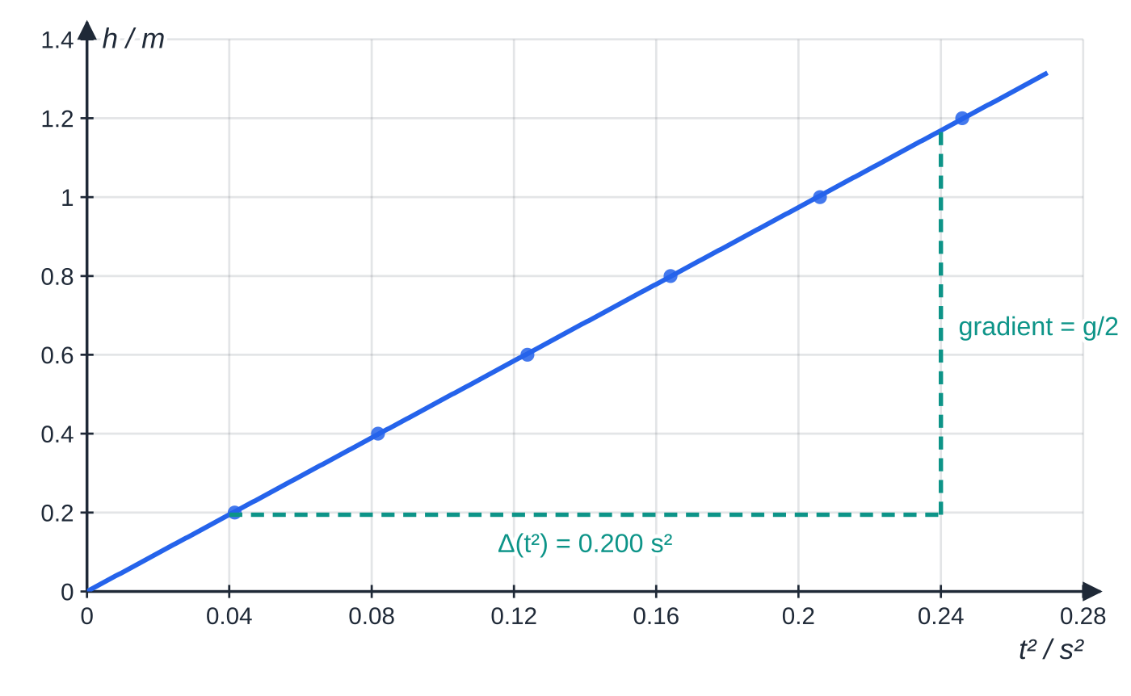
CP1: how do you measure the acceleration of free fall? (continued)
Section 2 of 14
Uncertainties: the magnet holds the ball for a moment after switch-off (residual magnetism), making every time slightly too long, a systematic error; reading h to ±0.5 mm and parallax at the scale.
Safety: catch the falling steel ball in a box of sand or cloth; the magnet coil can get warm, so switch it off between drops.
Improvements: use the smallest magnet current that holds the ball; use larger heights so the times are longer and their percentage uncertainty smaller; replace the trapdoor by two light gates.
CP1: h against t² for a ball falling from rest is a straight line through the origin. The gradient here is 4.87 m s⁻², so g = 9.74 m s⁻².
Notes:
CP1: how do you measure the acceleration of free fall?. Full notes: https://examinerprep.com/notes/edexcel-ial-physics/the-as-core-practicals/

Slide 9
CP1: how do you measure the acceleration of free fall? (continued)
Section 2 of 14
Common error — plotting h against t
h is proportional to t², not t, so a graph of h against t curves. Square the times first. The theory is on page 1.1 (Motion, vectors and projectiles).
Notes:
CP1: how do you measure the acceleration of free fall?. Full notes: https://examinerprep.com/notes/edexcel-ial-physics/the-as-core-practicals/

Slide 10
CP2: how do you find the viscosity of a liquid?
Section 3 of 14
Aim: find the viscosity η of a liquid such as glycerol from the terminal velocity of a small sphere.
Apparatus: tall, wide tube of the liquid, small steel balls, micrometer, three rubber bands round the tube, metre rule, stopwatch, thermometer, balance and measuring cylinder (for the densities), a magnet on a string to retrieve the balls.
Method: measure each ball's diameter with the micrometer in several directions. Place the first band well below the surface so the ball has reached terminal velocity before timing starts. Release the ball gently on the axis of the tube and time it from A to B and from B to C: equal times confirm a constant (terminal) velocity. Repeat, and record the temperature.
Analysis: at terminal velocity the forces balance, W = U + F, with F = 6πηrv (Stokes' law).
Graph: with balls of several sizes, v against r² is a straight line through the origin of gradient 2g(ρₛ - ρ_f)/9η.
Notes:
CP2: how do you find the viscosity of a liquid?. Full notes: https://examinerprep.com/notes/edexcel-ial-physics/the-as-core-practicals/

Slide 11
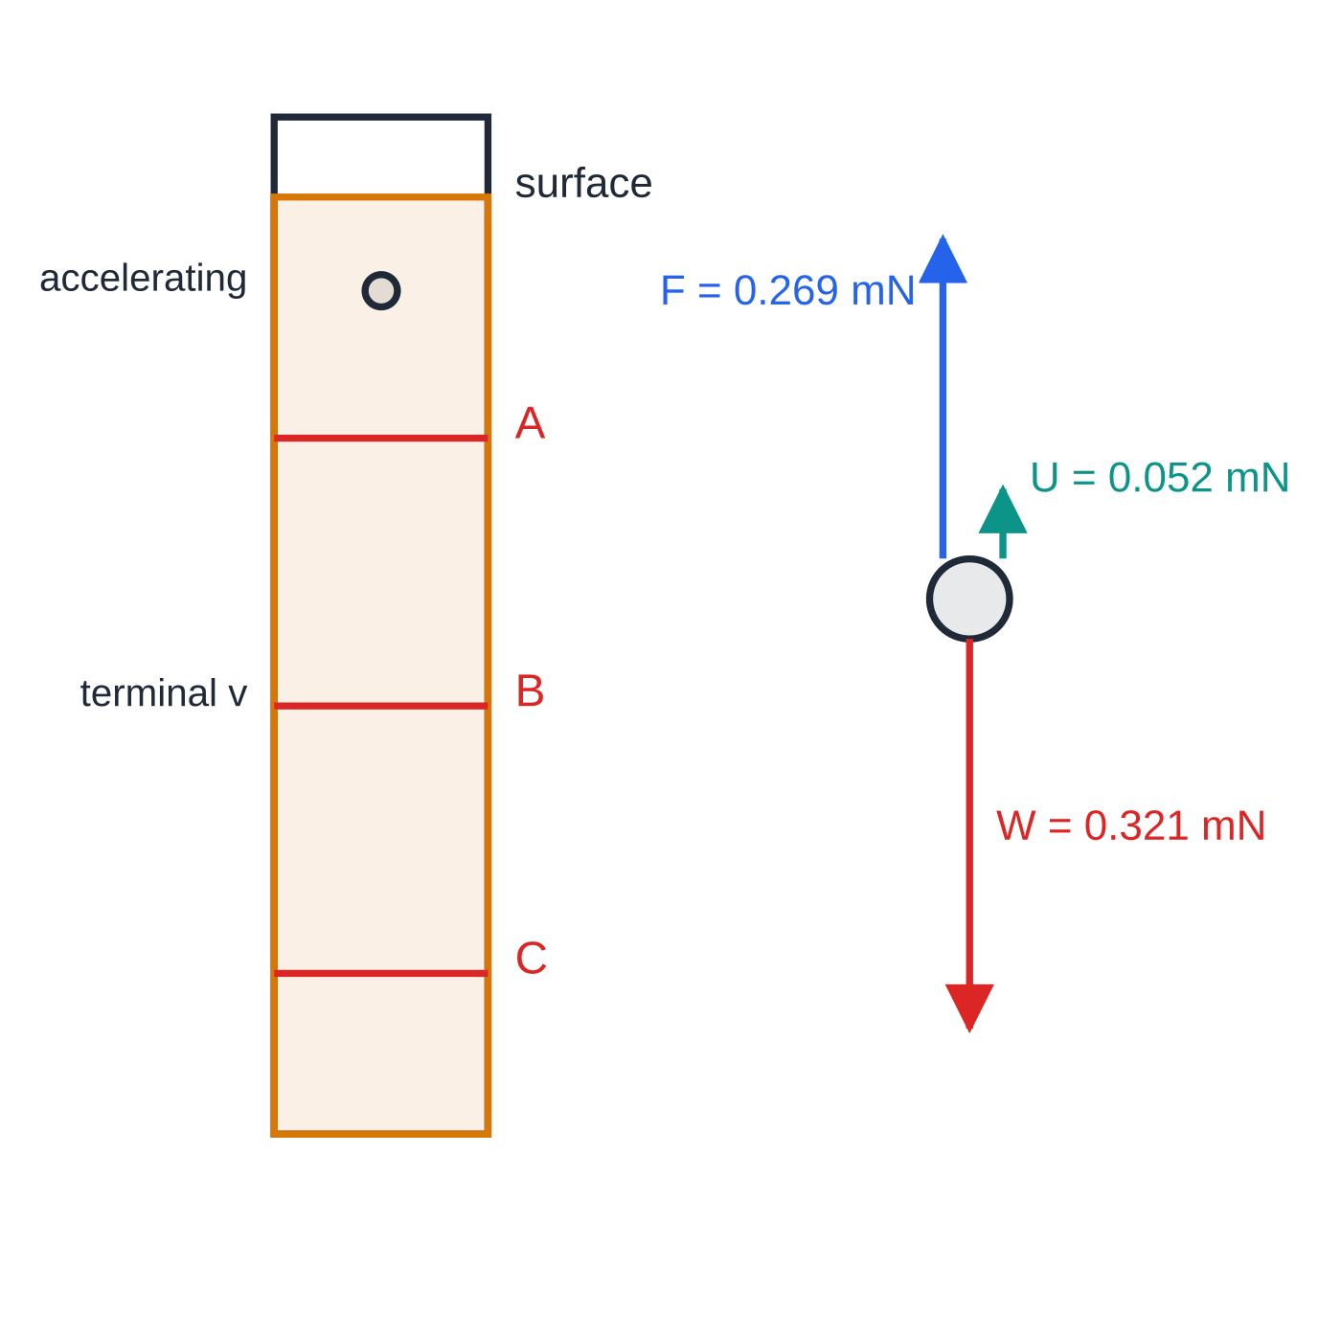
CP2: how do you find the viscosity of a liquid? (continued)
Section 3 of 14
Uncertainties: starting and stopping the stopwatch by eye (reaction time, parallax at the bands); the small radius, which is squared; the temperature, because viscosity falls steeply as the liquid warms.
Safety: wipe up spills at once, as glycerol and oils make the floor slippery; clamp the tall tube so it cannot topple.
Improvements: view the bands at eye level, or film the fall next to a scale and step through the frames; use a longer distance between bands; use a wide tube so the walls do not slow the ball; keep the liquid in a water bath at a known temperature.
Writing the weight and upthrust in terms of the ball's volume and the two densities, then solving for η:
CP2. Left: timing starts at band A, once the ball has stopped accelerating; equal times for A–B and B–C confirm terminal velocity. Right: forces on a 2.00 mm steel ball in glycerol at terminal velocity, drawn to scale: U + F = W.
Notes:
CP2: how do you find the viscosity of a liquid?. Full notes: https://examinerprep.com/notes/edexcel-ial-physics/the-as-core-practicals/

Slide 12
CP2: how do you find the viscosity of a liquid? (continued)
Section 3 of 14
(4/3)πr³ρₛ g = (4/3)πr³ρ_f g + 6πηr v ⟹ η= (2r² g(ρₛ - ρ_f))/9v
F = 6πηrv is in the formulae list; the expression for η is not, so derive it. Stokes' law holds only for a small sphere moving slowly through the liquid in laminar flow.
Notes:
CP2: how do you find the viscosity of a liquid?. Full notes: https://examinerprep.com/notes/edexcel-ial-physics/the-as-core-practicals/

Slide 13
CP2: how do you find the viscosity of a liquid? (continued)
Section 3 of 14 · Worked example 1 · Medium · Calculate, determine
WORKED EXAMPLE · QUESTION
A steel ball of diameter 2.00 mm (density 7800 kg m⁻³) falls through glycerol (density 1260 kg m⁻³). Its times to fall the 0.200 m between bands A and B are 19.4 s, 19.9 s and 19.6 s. (a) Calculate the mean time and its uncertainty. (b) Calculate the terminal velocity. (c) Determine the viscosity of the glycerol.
SOLUTION
(a) Mean = 19.63 s; half the range = (19.9 − 19.4) ÷ 2 = 0.25 s. t = 19.6 s ± 0.25 s (1.3%)
(b) Constant speed between the bands: v = (0.200/19.63) = 1.02 ×10⁻² m s⁻¹
(c) With r = 1.00 × 10⁻³ m: η= (2 ×(1.00×10⁻³)² ×9.81 ×(7800 - 1260))/(9 ×0.01019) = 1.40 Pa s
The micrometer reads the diameter to ±0.005 mm, only 0.25% here, so the timing (1.3%) dominates.
Notes:
CP2: how do you find the viscosity of a liquid?: Worked example 1. Full notes: https://examinerprep.com/notes/edexcel-ial-physics/the-as-core-practicals/

Slide 14
CP3: how do you find the Young modulus of a wire?
Section 4 of 14
Aim: determine the Young modulus E of a metal in the form of a long wire.
Apparatus: a wire 2–3 m long clamped at one end and passing over a pulley at the edge of the bench; mass hanger and slotted masses; a small flag of tape on the wire next to a fixed metre rule (or a vernier scale); micrometer; tape measure; safety goggles.
Method: hang a small load first to straighten the wire and take its reading as zero. Measure the original length l from the clamp to the flag. Measure the diameter at several points and in two directions at right angles; average. Add equal loads, recording the flag position each time; then remove them to check the wire returns (it stayed elastic).
Graph: stress = F/A against strain = Δx/l; the gradient of the straight section is E. Points that curve away at the top show the limit of proportionality has been passed, so leave them out of the gradient.
Notes:
CP3: how do you find the Young modulus of a wire?. Full notes: https://examinerprep.com/notes/edexcel-ial-physics/the-as-core-practicals/

Slide 15
CP3: how do you find the Young modulus of a wire? (continued)
Section 4 of 14
Uncertainties: the extensions are only a few millimetres, so their percentage uncertainty is large; the diameter of about 0.4 mm read to 0.01 mm is also a few per cent; temperature changes and the wire settling in the clamp.
Safety: goggles, because a loaded wire may snap and whip back; a box of sand or foam under the masses; keep feet clear.
Improvements: a longer wire gives a larger extension for the same strain; a vernier scale reads extensions to 0.1 mm; a second, unloaded reference wire hung alongside (Searle's arrangement) cancels sag and temperature effects.
Notes:
CP3: how do you find the Young modulus of a wire?. Full notes: https://examinerprep.com/notes/edexcel-ial-physics/the-as-core-practicals/

Slide 16
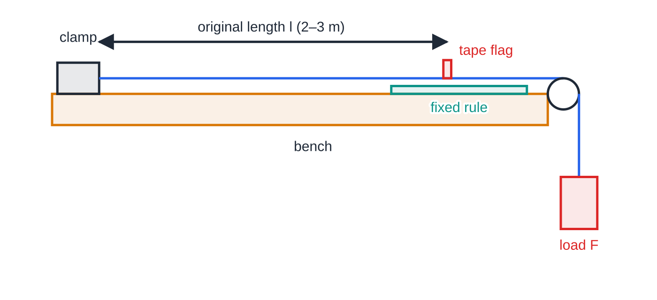
CP3: how do you find the Young modulus of a wire? (continued)
Section 4 of 14
CP3 apparatus. The wire is clamped at one end and loaded over a pulley; the extension is the distance the tape flag moves along the fixed rule. Goggles, and a box under the load, in case the wire snaps.
Notes:
CP3: how do you find the Young modulus of a wire?. Full notes: https://examinerprep.com/notes/edexcel-ial-physics/the-as-core-practicals/

Slide 17
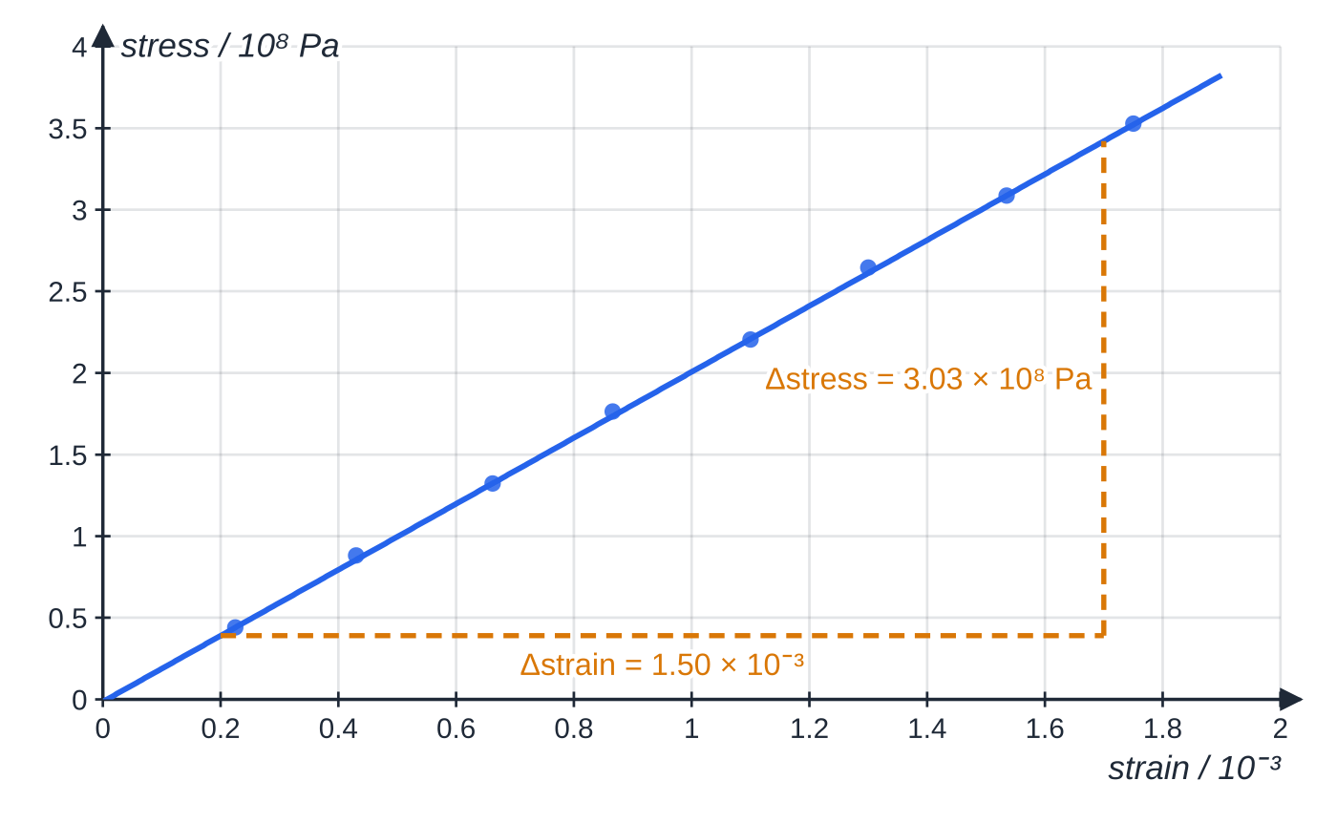
CP3: how do you find the Young modulus of a wire? (continued)
Section 4 of 14
CP3 specimen results for a steel wire 2.400 m long and 0.38 mm in diameter. The triangle spans most of the best-fit line; its gradient is the Young modulus.
Notes:
CP3: how do you find the Young modulus of a wire?. Full notes: https://examinerprep.com/notes/edexcel-ial-physics/the-as-core-practicals/

Slide 18
CP3: how do you find the Young modulus of a wire? (continued)
Section 4 of 14 · Worked example 2 · Medium · Calculate, determine
WORKED EXAMPLE · QUESTION
The wire in the graph above has six diameter readings between 0.37 mm and 0.39 mm, mean 0.38 mm. Its largest load, 40.0 N, gives an extension of 4.2 mm. (a) Calculate the cross-sectional area. (b) Calculate the stress and strain for the 40.0 N load. (c) Use the graph to determine E. (d) Calculate the percentage uncertainty in the diameter.
SOLUTION
(a) A = πd²/4 = (π×(0.38×10⁻³)²)/4 = 1.13 ×10⁻⁷ m²
(b) Stress = 40.0/(1.134×10⁻⁷) = 3.53×10⁸ Pa; strain = (4.2×10⁻³)/2.400 = 1.75×10⁻³. 3.53 × 10⁸ Pa and 1.75 × 10⁻³
(c) Triangle read from the line: E = ((3.42 - 0.39)×10⁸)/((1.70 - 0.20)×10⁻³) = 2.02 ×10¹¹ Pa
(d) Half the range of the diameters is ±0.01 mm: (0.01/0.38)×100% = 2.6%
Compare the extension: ±0.05 mm on 4.2 mm is only 1.2%.
Notes:
CP3: how do you find the Young modulus of a wire?: Worked example 2. Full notes: https://examinerprep.com/notes/edexcel-ial-physics/the-as-core-practicals/

Slide 19
CP3: how do you find the Young modulus of a wire? (continued)
Section 4 of 14 · Worked example 2 · Medium · Calculate, determine (continued)
With a vernier scale, the diameter becomes the limiting measurement.
Notes:
CP3: how do you find the Young modulus of a wire?: Worked example 2. Full notes: https://examinerprep.com/notes/edexcel-ial-physics/the-as-core-practicals/

Slide 20
CP3: how do you find the Young modulus of a wire? (continued)
Section 4 of 14
Exam tip — units in CP3
Strain has no unit, so the Young modulus has the unit of stress, Pa (N m⁻²). Convert millimetres to metres for both the diameter and the extension before substituting: a factor of 10⁶ hides in d².
Notes:
CP3: how do you find the Young modulus of a wire?. Full notes: https://examinerprep.com/notes/edexcel-ial-physics/the-as-core-practicals/

Slide 21
CP4: how do you measure the speed of sound with an oscilloscope?
Section 5 of 14
Aim: measure the speed of sound in air using v = fλ.
Apparatus: signal generator, loudspeaker, two microphones, two-beam (dual-trace) oscilloscope, metre rule.
Method: drive the loudspeaker at a few kilohertz. Connect one microphone to channel 1 and the other to channel 2, both in line with the speaker. Start with the microphones side by side so the traces are in phase. Slide microphone 2 away along the rule: the traces drift out of phase and come back into phase each time the separation grows by one wavelength. Record the position after each of n = 1, 2, 3 … wavelengths.
Graph: distance moved against n is a straight line of gradient λ. Read the period from the screen (divisions × timebase) to find f, then v = fλ. Alternatively, change f and plot λ against 1/f: the gradient is v.
Uncertainties: judging exactly where the traces are in phase; sound reflected from the bench and walls distorting the traces; the frequency dial of the generator.
Notes:
CP4: how do you measure the speed of sound with an oscilloscope?. Full notes: https://examinerprep.com/notes/edexcel-ial-physics/the-as-core-practicals/

Slide 22
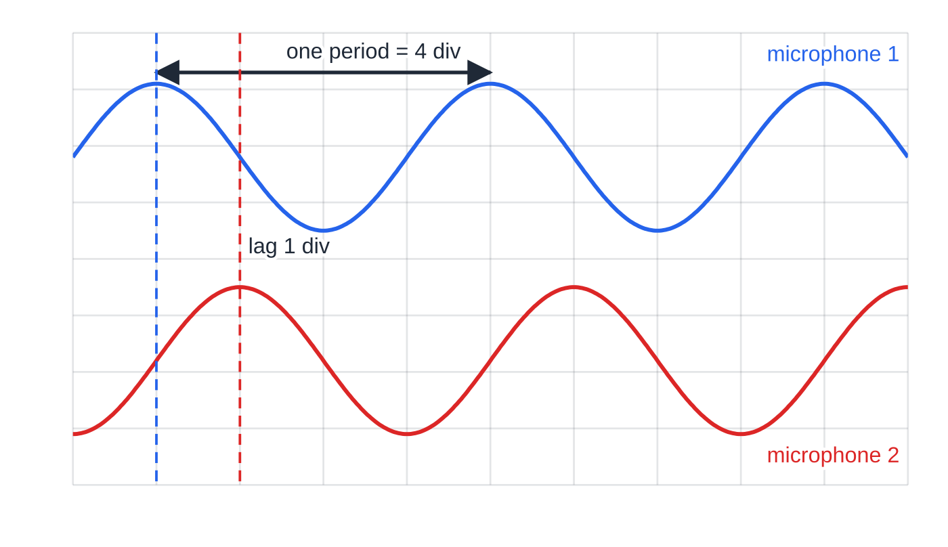
CP4: how do you measure the speed of sound with an oscilloscope? (continued)
Section 5 of 14
Safety: keep the sound level low and the session short to protect hearing.
Improvements: move through many wavelengths and divide; measure f from the oscilloscope rather than the dial; use the X–Y mode, where in-phase signals give a sloping straight line that is easier to judge; work away from hard surfaces.
CP4: the two-beam oscilloscope at 0.1 ms per division. Microphone 2 is a quarter of a wavelength further from the speaker, so its trace lags by a quarter of a period: one division, 0.1 ms.
Notes:
CP4: how do you measure the speed of sound with an oscilloscope?. Full notes: https://examinerprep.com/notes/edexcel-ial-physics/the-as-core-practicals/

Slide 23
CP4: how do you measure the speed of sound with an oscilloscope? (continued)
Section 5 of 14 · Worked example 3 · Medium · Determine, calculate
WORKED EXAMPLE · QUESTION
The screen above uses a timebase of 0.1 ms per division. Starting from the in-phase position, microphone 2 is moved 1.10 m, during which the traces come back into phase 8 times. (a) Determine the frequency. (b) Calculate the speed of sound. (c) Check your answer using the lag shown on the screen.
SOLUTION
(a) One period covers 4 divisions: T = 4 × 0.1 ms = 0.40 ms, so f = 1/(0.40×10⁻³) = 2500 Hz
(b) 8 wavelengths in 1.10 m: λ = 1.10 ÷ 8 = 0.1375 m, so v = 2500 × 0.1375 = 344 m s⁻¹
(c) A lag of 1 division (0.1 ms) is a quarter of a period, so the extra path is λ/4 = 0.0344 m: v = 0.0344/(1.0×10⁻⁴) = 344 m s⁻¹; the two methods agree
Notes:
CP4: how do you measure the speed of sound with an oscilloscope?: Worked example 3. Full notes: https://examinerprep.com/notes/edexcel-ial-physics/the-as-core-practicals/

Slide 24
CP5: what sets the frequency of a vibrating string?
Section 6 of 14
Aim: investigate how the frequency of the first harmonic depends on the length l, tension T and mass per unit length μ of a string.
Apparatus: string or wire passing over a pulley to a mass hanger (T = mg), two bridges, a vibration generator driven by a signal generator, metre rule, balance.
Method: fix the vibrating length between the bridges. Raise the frequency slowly until the string vibrates in one loop with the largest amplitude (the first harmonic) and read f. Change one variable at a time: move a bridge to change l; add masses to change T; change the string to change μ, finding each μ by weighing a long measured length.
Graph: for the first harmonic λ = 2l, so f = 1/2l√(T/μ). Plot f against 1/l (gradient ½√(T/μ)), f² against T (gradient 1/4l²μ), or f against 1/√μ.
Uncertainties: deciding where the amplitude is largest, because resonance covers a range of frequencies; measuring l between the contact points of the bridges; the calibration of the generator.
Notes:
CP5: what sets the frequency of a vibrating string?. Full notes: https://examinerprep.com/notes/edexcel-ial-physics/the-as-core-practicals/

Slide 25
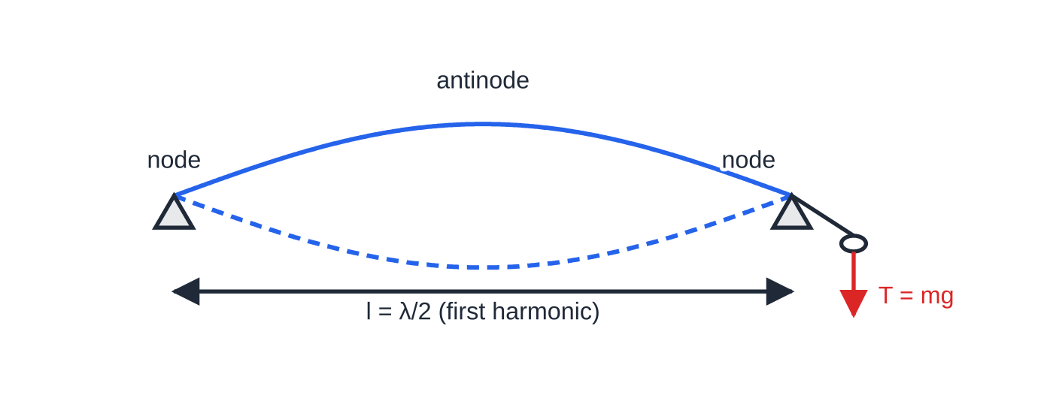
CP5: what sets the frequency of a vibrating string? (continued)
Section 6 of 14
Safety: the masses fall if the string breaks, so keep feet clear and use a box underneath; wear goggles with a wire under high tension.
Improvements: approach resonance from above and from below and average the two readings; check the frequency on an oscilloscope; use a wider range of lengths.
CP5: the first harmonic, one loop between the bridges. The vibrating length l is half a wavelength, so f = v/2l = (1/2l)√(T/μ).
Notes:
CP5: what sets the frequency of a vibrating string?. Full notes: https://examinerprep.com/notes/edexcel-ial-physics/the-as-core-practicals/

Slide 26
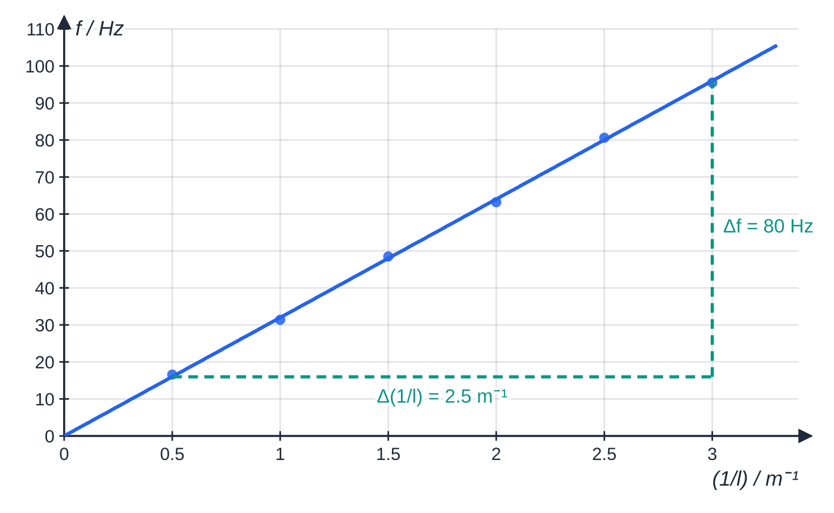
CP5: what sets the frequency of a vibrating string? (continued)
Section 6 of 14
CP5 specimen results with a 0.500 kg mass on the hanger: f against 1/l is a straight line through the origin, gradient 32.0 m s⁻¹.
Notes:
CP5: what sets the frequency of a vibrating string?. Full notes: https://examinerprep.com/notes/edexcel-ial-physics/the-as-core-practicals/

Slide 27
CP5: what sets the frequency of a vibrating string? (continued)
Section 6 of 14 · Worked example 4 · Hard · Determine
WORKED EXAMPLE · QUESTION
The tension in the string above is provided by a 0.500 kg mass. Use the graph to determine the speed of the waves on the string and its mass per unit length.
SOLUTION
Gradient from the triangle: (96 - 16)/(3.0 - 0.5) = 32.0 m s⁻¹ (Hz ÷ m⁻¹ = m s⁻¹).
f = v/2l, so gradient = v/2 and v = 2 × 32.0 = 64.0 m s⁻¹
v = √(T/μ) with T = 0.500 × 9.81 = 4.91 N, so μ= T/v² = 4.905/64.0² = 1.20 ×10⁻³ kg m⁻¹
Notes:
CP5: what sets the frequency of a vibrating string?: Worked example 4. Full notes: https://examinerprep.com/notes/edexcel-ial-physics/the-as-core-practicals/

Slide 28
CP6: how do you measure a wavelength with a diffraction grating?
Section 7 of 14
Aim: determine the wavelength of laser light using a grating with a known number of lines per millimetre.
Apparatus: laser, diffraction grating, screen, metre rule and tape measure.
Method: set the grating at right angles to the beam and the screen parallel to the grating, a distance D of 1–2 m away. Measure the distance between the two first-order spots (2x₁), then between the two second-order spots, and so on. Halve each distance; tan θ = x/D; then nλ = d sin θ with d = 1/(lines per metre).
Graph: sin θ against n is a straight line through the origin with gradient λ/d.
Uncertainties: locating the centre of each spot; measuring D; the grating not being exactly perpendicular to the beam.
Safety: never look along the beam or at its reflections; remove watches and rings and keep shiny surfaces out of the beam path; use a low-power laser and a warning sign.
Notes:
CP6: how do you measure a wavelength with a diffraction grating?. Full notes: https://examinerprep.com/notes/edexcel-ial-physics/the-as-core-practicals/

Slide 29
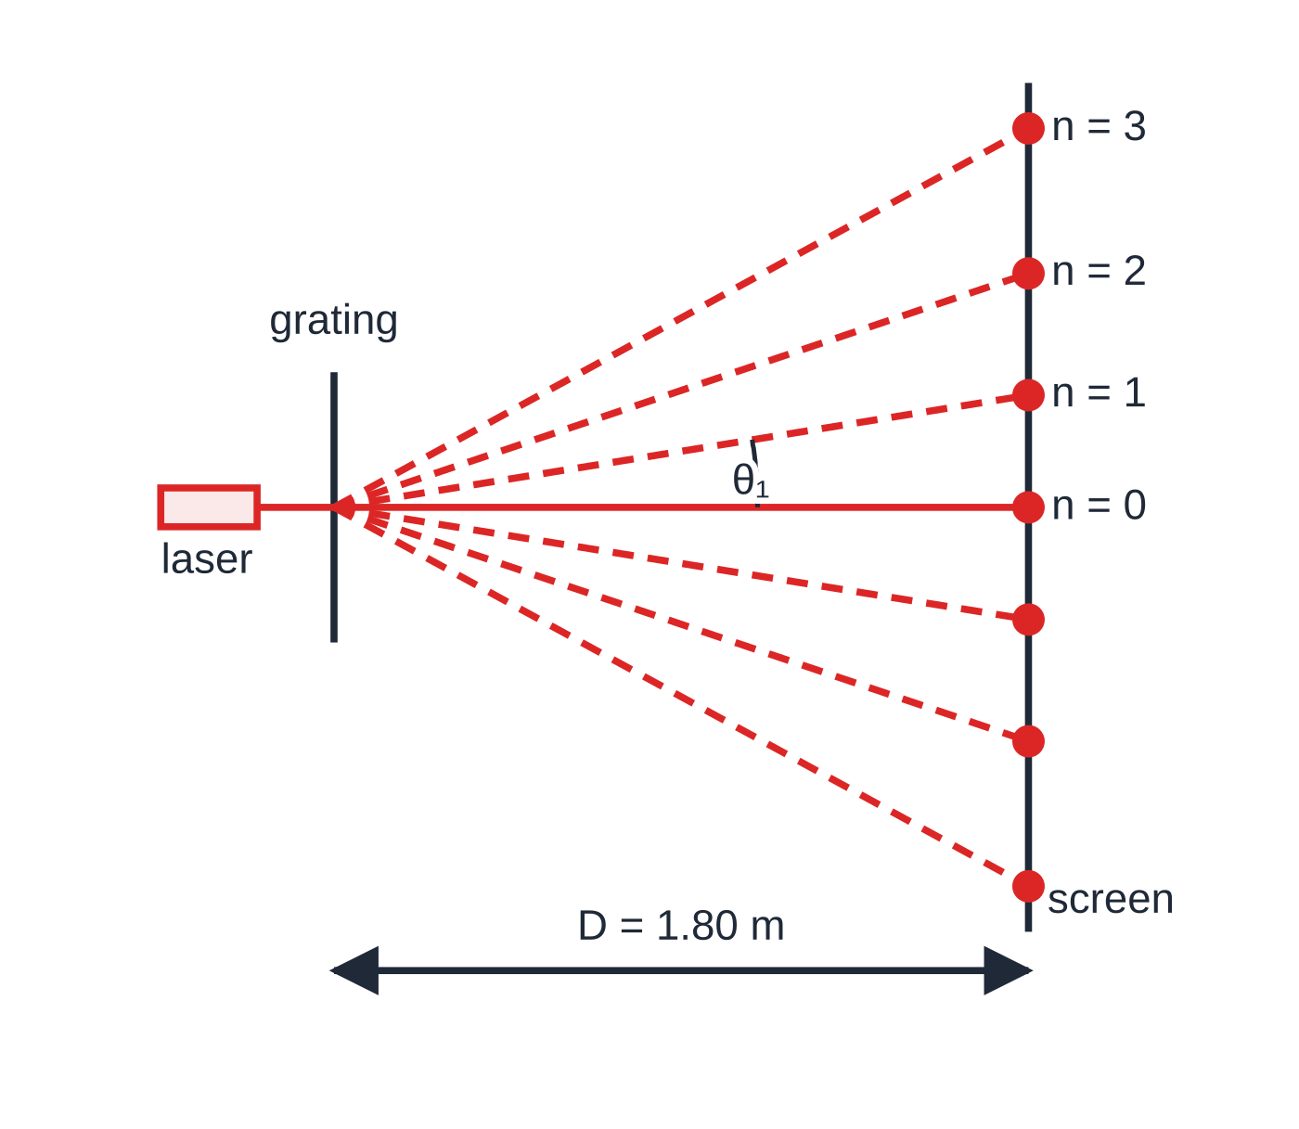
CP6: how do you measure a wavelength with a diffraction grating? (continued)
Section 7 of 14
Improvements: measure across opposite orders rather than from the centre; use a larger D so the spots are further apart; use higher orders; darken the room so the spot centres are easier to see.
CP6, drawn to scale for a 532 nm laser and a grating of 300 lines mm⁻¹ placed 1.80 m from the screen. Each order leaves the grating at the angle given by nλ = d sin θ; the angles are far too large for small-angle shortcuts.
Notes:
CP6: how do you measure a wavelength with a diffraction grating?. Full notes: https://examinerprep.com/notes/edexcel-ial-physics/the-as-core-practicals/

Slide 30
CP6: how do you measure a wavelength with a diffraction grating? (continued)
Section 7 of 14 · Worked example 5 · Medium · Calculate, determine
WORKED EXAMPLE · QUESTION
A grating with 300 lines per mm is 1.80 m from a screen. The distance between the two first-order spots is 0.582 m; between the two second-order spots it is 1.213 m. (a) Calculate the grating spacing. (b) Determine the wavelength using each order and find the mean. (c) Calculate the highest order that can be seen.
SOLUTION
(a) d = 1/(300×10³ m⁻¹) = 3.33 ×10⁻⁶ m
(b) First order: θ= tan⁻¹(0.291/1.80) = 9.18°, λ= 3.333×10⁻⁶ ×sin 9.18° = 532 nm. Second order: θ= tan⁻¹(0.6065/1.80) = 18.6°, λ= 3.333×10⁻⁶ ×sin 18.6° ÷2 = 532 nm. Mean λ = 532 nm
(c) sin θ cannot exceed 1, so n ≤ d/λ = 6.26: highest order 6
Notes:
CP6: how do you measure a wavelength with a diffraction grating?: Worked example 5. Full notes: https://examinerprep.com/notes/edexcel-ial-physics/the-as-core-practicals/

Slide 31
CP6: how do you measure a wavelength with a diffraction grating? (continued)
Section 7 of 14
Exam tip — no small-angle shortcut
Shortcuts such as sin θ ≈ x/D fail for gratings because the angles are large. Find θ from tan θ = x/D first, then take its sine.
Notes:
CP6: how do you measure a wavelength with a diffraction grating?. Full notes: https://examinerprep.com/notes/edexcel-ial-physics/the-as-core-practicals/

Slide 32
CP7: how do you find the resistivity of a wire?
Section 8 of 14
Aim: determine the resistivity ρ of the metal of a wire.
Apparatus: about 1 m of thin wire taped along a metre rule, a sliding clip (crocodile clip or jockey), cell, switch, ammeter, voltmeter, micrometer.
Method: measure the diameter at several points and in two directions; average and find A. Connect the wire in series with the cell, switch and ammeter, with the voltmeter across the length l between the fixed end and the clip. For lengths from about 0.20 m to 0.90 m, close the switch briefly, read V and I, open it again; R = V/I.
Graph: R = ρl/A, so R against l is a straight line of gradient ρ/A; ρ = gradient × A.
Uncertainties: the diameter, which is squared in A; contact resistance at the clip and the leads (a systematic error that gives an intercept); the wire warming, which raises its resistance.
Safety: a thin wire carrying a large current gets hot, so keep the current small and switch off between readings.
Notes:
CP7: how do you find the resistivity of a wire?. Full notes: https://examinerprep.com/notes/edexcel-ial-physics/the-as-core-practicals/

Slide 33
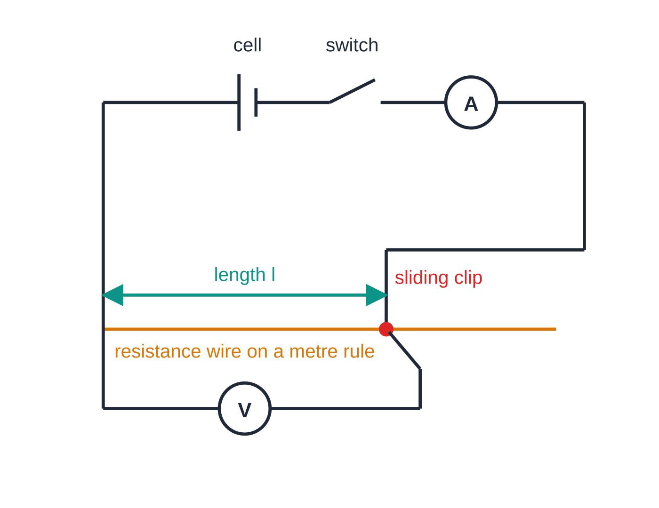
CP7: how do you find the resistivity of a wire? (continued)
Section 8 of 14
Improvements: use a small p.d. so the temperature stays constant; clean the wire where the clip touches it; use the gradient, not a single reading, so a constant contact resistance does not matter.
CP7 circuit. The ammeter measures the current through the wire and the voltmeter the p.d. across the length l between the fixed end and the sliding clip; R = V/I.
Notes:
CP7: how do you find the resistivity of a wire?. Full notes: https://examinerprep.com/notes/edexcel-ial-physics/the-as-core-practicals/

Slide 34
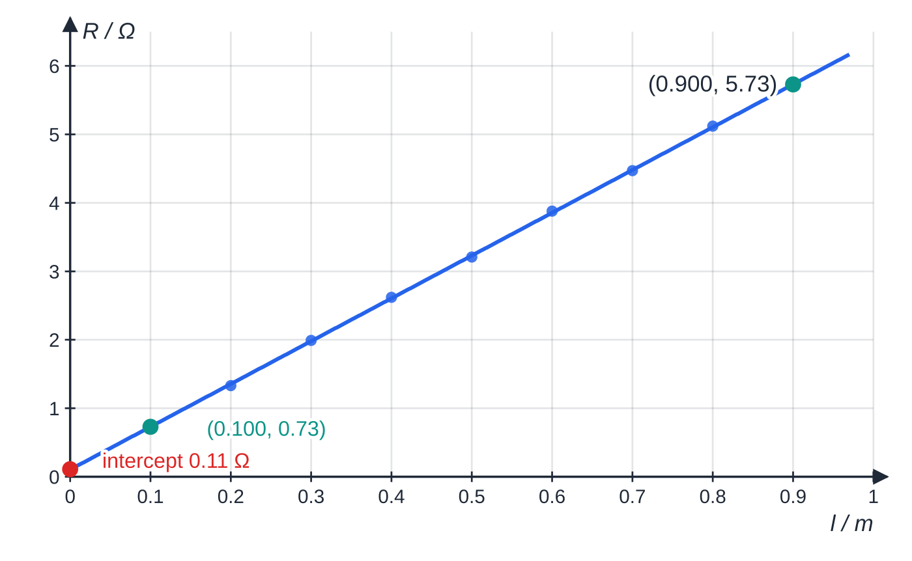
CP7: how do you find the resistivity of a wire? (continued)
Section 8 of 14
CP7 specimen results for a constantan wire. The intercept of 0.11 Ω is contact resistance; the gradient is 6.25 Ω m⁻¹.
Notes:
CP7: how do you find the resistivity of a wire?. Full notes: https://examinerprep.com/notes/edexcel-ial-physics/the-as-core-practicals/

Slide 35
CP7: how do you find the resistivity of a wire? (continued)
Section 8 of 14 · Worked example 6 · Medium · Calculate, explain
WORKED EXAMPLE · QUESTION
Five micrometer readings of the wire's diameter are 0.31, 0.32, 0.31, 0.32 and 0.31 mm. The best-fit line on the graph above passes through (0.100 m, 0.73 Ω) and (0.900 m, 5.73 Ω). (a) Calculate the cross-sectional area. (b) Determine the resistivity. (c) Explain why the intercept does not affect your answer.
SOLUTION
(a) Mean diameter 0.314 mm: A = (π×(0.314×10⁻³)²)/4 = 7.74 ×10⁻⁸ m²
(b) Gradient = (5.73 - 0.73)/(0.900 - 0.100) = 6.25 Ω m⁻¹, so ρ= 6.25 ×7.74×10⁻⁸ = 4.84 ×10⁻⁷ Ω m
(c) Contact resistance adds the same amount to every R. It shifts the line up but leaves the gradient unchanged.
Notes:
CP7: how do you find the resistivity of a wire?: Worked example 6. Full notes: https://examinerprep.com/notes/edexcel-ial-physics/the-as-core-practicals/

Slide 36
CP8: how do you find the e.m.f. and internal resistance of a cell?
Section 9 of 14
Aim: determine the e.m.f. ε and internal resistance r of a cell.
Apparatus: the cell, variable resistor, ammeter, voltmeter, switch (a fixed protective resistor in series is useful).
Method: connect the cell in series with the variable resistor, ammeter and switch, with the voltmeter directly across the cell terminals. Close the switch, read V and I, open it; repeat for at least six settings covering the widest range of current.
Graph: ε = I(R + r) gives V = ε − Ir, so V against I is a straight line: intercept on the V-axis = ε, gradient = −r.
Uncertainties: the cell warms, so its internal resistance and e.m.f. drift while current flows; the resolution of the meters at small currents.
Safety: never short-circuit the cell; avoid rechargeable cells with very small r, which can deliver large currents and become hot.
Notes:
CP8: how do you find the e.m.f. and internal resistance of a cell?. Full notes: https://examinerprep.com/notes/edexcel-ial-physics/the-as-core-practicals/

Slide 37
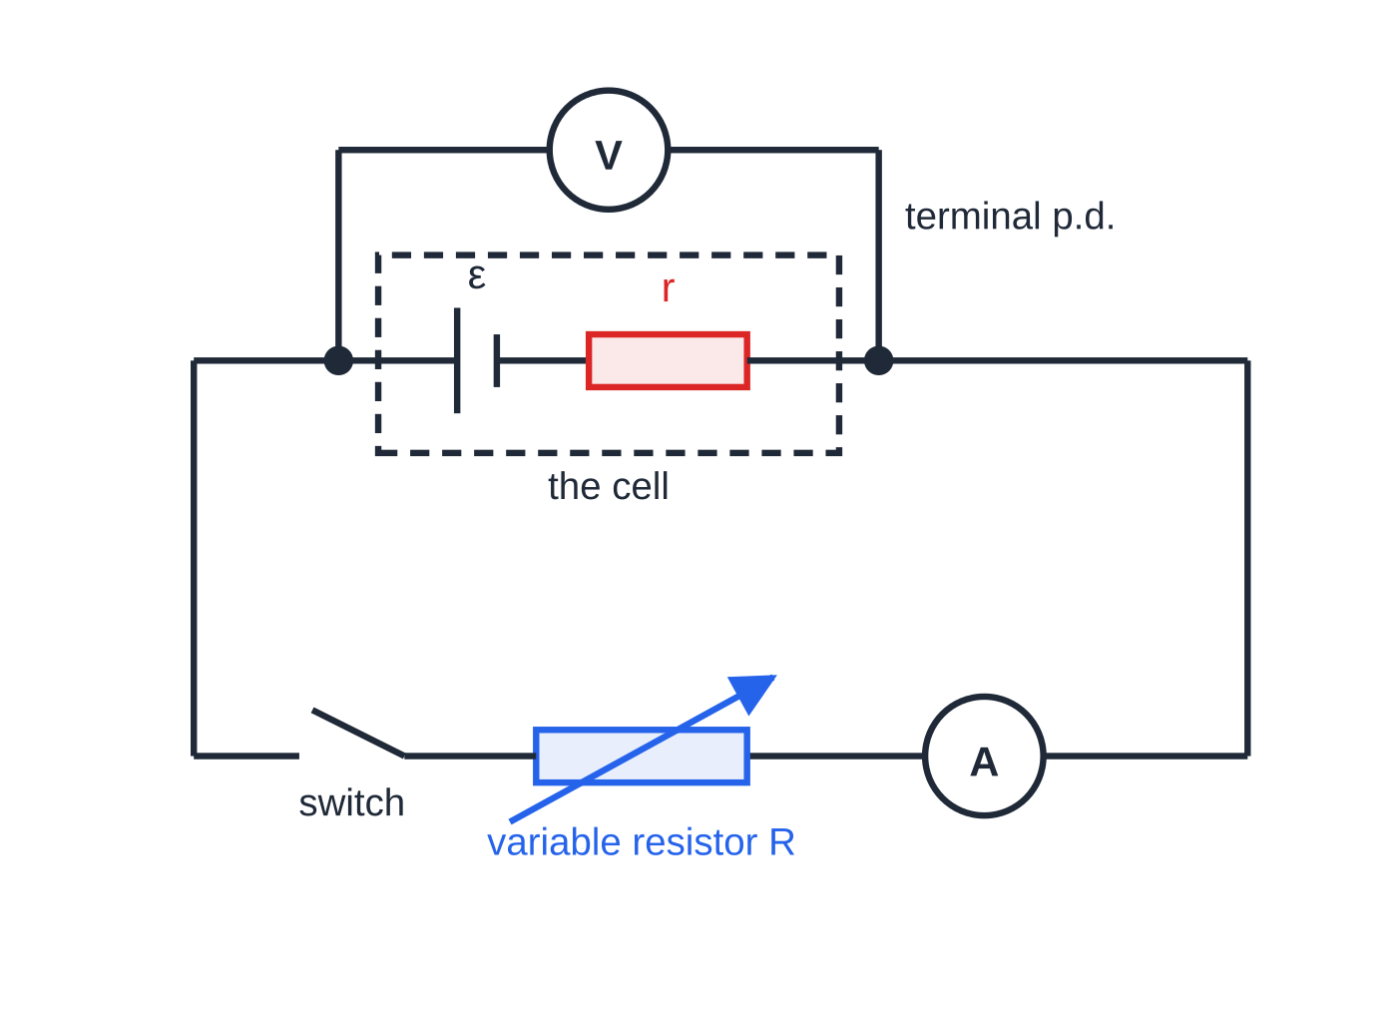
CP8: how do you find the e.m.f. and internal resistance of a cell? (continued)
Section 9 of 14
Improvements: switch off between readings so the cell does not heat; take readings quickly; repeat with the readings in reverse order and average.
CP8 circuit. The internal resistance r is drawn inside the dashed box with the cell; the voltmeter across the terminals reads the terminal p.d. V, not the e.m.f.
Notes:
CP8: how do you find the e.m.f. and internal resistance of a cell?. Full notes: https://examinerprep.com/notes/edexcel-ial-physics/the-as-core-practicals/

Slide 38
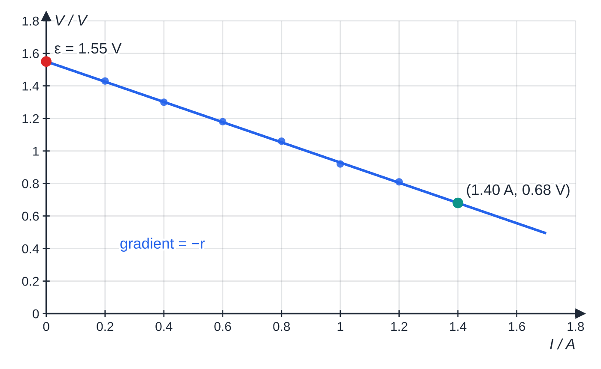
CP8: how do you find the e.m.f. and internal resistance of a cell? (continued)
Section 9 of 14
CP8 specimen results: the terminal p.d. falls as the current rises because more p.d. is lost across r. The intercept on the V-axis is ε; the gradient is −r.
Notes:
CP8: how do you find the e.m.f. and internal resistance of a cell?. Full notes: https://examinerprep.com/notes/edexcel-ial-physics/the-as-core-practicals/

Slide 39
CP8: how do you find the e.m.f. and internal resistance of a cell? (continued)
Section 9 of 14 · Worked example 7 · Hard · State, determine, calculate
WORKED EXAMPLE · QUESTION
The best-fit line on the graph above meets the V-axis at 1.55 V and passes through (1.40 A, 0.68 V). (a) State the e.m.f. (b) Determine the internal resistance. (c) The variable resistor is set to 2.0 Ω. Calculate the current and the terminal p.d.
SOLUTION
(a) At I = 0 there are no lost volts: ε = 1.55 V
(b) Gradient = (0.68 - 1.55)/1.40 = -0.621 Ω, and r = −gradient: r = 0.62 Ω
(c) ε = I(R + r): I = 1.55/(2.0 + 0.621) = 0.59 A, and V = IR = 0.591 × 2.0: I = 0.59 A, V = 1.18 V
The largest possible current, with R = 0, would be ε/r ≈ 2.5 A: the reason never to short-circuit the cell.
Notes:
CP8: how do you find the e.m.f. and internal resistance of a cell?: Worked example 7. Full notes: https://examinerprep.com/notes/edexcel-ial-physics/the-as-core-practicals/

Slide 40
CP8: how do you find the e.m.f. and internal resistance of a cell? (continued)
Section 9 of 14
Common error — calling the terminal p.d. the e.m.f.
Only at zero current does the terminal p.d. equal ε. At every other point it is less by Ir, which is why the graph is extrapolated to I = 0.
Notes:
CP8: how do you find the e.m.f. and internal resistance of a cell?. Full notes: https://examinerprep.com/notes/edexcel-ial-physics/the-as-core-practicals/

Slide 41
Exam tips for 3.3
Section 10 of 14
Exam tip 1 — lead with the equation
For any variation of a core practical, write the physics equation first, then rearrange it into y = mx + c. The axes, the expected shape and the meaning of the gradient all follow from that one line.
Exam tip 2 — a method is a sequence of measurements
In a "describe" question, name each instrument with what it measures, say what is varied and what is kept constant, give the number of readings and repeats, and finish with the graph and how the result comes from it. Numbered steps make this easy to follow.
Notes:
Exam tips for 3.3. Full notes: https://examinerprep.com/notes/edexcel-ial-physics/the-as-core-practicals/

Slide 42
Exam tips for 3.3 (continued)
Section 10 of 14
Exam tip 3 — AS uncertainties
Use half the resolution for a single reading and half the range for repeats, then divide by the value for a percentage. When asked which measurement matters most, compare percentages, not absolute uncertainties.
Exam tip 4 — specific safety
"Be careful" earns nothing. State the hazard and the precaution together: "wear goggles because the wire may snap under load"; "switch off between readings so the wire does not overheat".
Exam tip 5 — improvements with a reason
Target the largest uncertainty and say why the change helps: "use a longer wire, so the extension is larger and its percentage uncertainty smaller". "Repeat the experiment" only reduces random error.
Notes:
Exam tips for 3.3. Full notes: https://examinerprep.com/notes/edexcel-ial-physics/the-as-core-practicals/

Slide 43
Common misconceptions
Section 11 of 14
Misconception | Why it is wrong | Correct idea
Repeating readings removes every error. | Averaging only reduces random error; a systematic error is the same in every repeat. | Remove systematic errors by method (zero checks, gradients), not by repeating.
Timing in CP2 should start when the ball enters the liquid. | The ball is still accelerating near the surface. | Start timing below the surface, once equal times for equal distances show terminal velocity.
Bigger loads always give a better Young modulus. | Beyond the limit of proportionality stress is no longer proportional to strain. | Use only the straight section of the stress–strain graph.
In CP4, in-phase traces mean the microphones are the same distance from the speaker. | The traces repeat every period. | In phase means the separation is a whole number of wavelengths.
An intercept on the R–l graph means the experiment failed. | A constant contact resistance adds the same amount to every reading. | Use the gradient; the intercept does not affect ρ.
Notes:
Common misconceptions. Full notes: https://examinerprep.com/notes/edexcel-ial-physics/the-as-core-practicals/

Slide 44
Common misconceptions (continued)
Section 11 of 14
Misconception | Why it is wrong | Correct idea
The gradient of the V–I graph is the internal resistance. | The line slopes downwards, so its gradient is negative. | Gradient = −r; the intercept on the V-axis is ε.
Notes:
Common misconceptions. Full notes: https://examinerprep.com/notes/edexcel-ial-physics/the-as-core-practicals/

Slide 45
How this topic connects
Section 12 of 14
The theory pages in Units 1 and 2
Each practical belongs to a topic page: free fall (1.1), viscosity (1.7), the Young modulus (1.9), progressive and stationary waves (2.1, 2.2), diffraction gratings (2.4), resistivity (2.8) and e.m.f. (2.9).
1 Planning and 3.2 Uncertainties and graphs
Choosing the micrometer for a wire diameter or a set square for a vertical rule is the same skill in every practical here; gradients from large triangles, half-range uncertainties and percentage uncertainty turn the results into numbers.
The A2 core practicals (Unit 6)
The same seven-heading approach carries on to Core Practicals 9–16, where uncertainties are combined and logarithmic graphs are used.
Notes:
How this topic connects. Full notes: https://examinerprep.com/notes/edexcel-ial-physics/the-as-core-practicals/

Slide 46
Key equations
Section 13 of 14
Equation | Use | In the formulae list?
h = ½ g t² | CP1, fall from rest | No — derive it from s = ut + ½ at²
F = 6πηr v | CP2, Stokes' law | Yes
η= 2r² g(ρₛ - ρ_f)/9v | CP2, viscosity from terminal velocity | No — derive it from W = U + F
stress = F/A, strain = Δx/x, E = stress/strain | CP3 | Yes
v = fλ | CP4 | Yes
v = √(T/μ) | CP5, wave speed on a string | Yes
f = 1/2l√(T/μ) | CP5, first harmonic | No — derive it with λ = 2l
nλ = d sin θ | CP6 | Yes
R = ρl/A, R = V/I | CP7 | Yes
Notes:
Key equations. Full notes: https://examinerprep.com/notes/edexcel-ial-physics/the-as-core-practicals/

Slide 47
Key equations (continued)
Section 13 of 14
Equation | Use | In the formulae list?
ε = I(R + r) | CP8 | Yes
V = ε − Ir | CP8, straight-line form | No — derive it
percentage uncertainty = (uncertainty ÷ value) × 100% | every practical | No — learn it
Notes:
Key equations. Full notes: https://examinerprep.com/notes/edexcel-ial-physics/the-as-core-practicals/

Slide 48
Check your understanding
Section 14 of 14
1. Why is a graph of h against t² used in CP1, and how is g found from it?
2. In CP2, how can you show that the ball has reached terminal velocity before it passes the first timing band?
3. Why is the wire in CP3 long and thin?
4. A grating with 600 lines per mm gives a first-order maximum at 22.3°. Calculate the wavelength.
5. A V–I graph for a battery meets the V-axis at 4.5 V and has a gradient of −1.5 V A⁻¹. State the e.m.f. and the internal resistance.
Notes:
Check your understanding: questions. Full notes: https://examinerprep.com/notes/edexcel-ial-physics/the-as-core-practicals/

Slide 49
Check your understanding · answers
Section 14 of 14
1. h = ½ g t² for a fall from rest, so h is proportional to t²: a straight line through the origin with gradient g/2. g = 2 × gradient.
2. Time it over two equal distances one after the other (bands A–B and B–C). If the times are equal within their uncertainty, the velocity is constant.
3. A long wire gives a larger extension for the same strain, and a thin wire gives a larger stress for the same load. Both make the extension bigger, so its percentage uncertainty is smaller.
4. d = 1/(600×10³) = 1.67×10⁻⁶ m; λ= dsin 22.3° = 632 nm.
5. ε = 4.5 V (the intercept); r = 1.5 Ω (minus the gradient).
Notes:
Check your understanding: answers. Full notes: https://examinerprep.com/notes/edexcel-ial-physics/the-as-core-practicals/

Slide 50
Practice questions
2 original exam-style questions. Answers at the end of the deck.

Slide 51
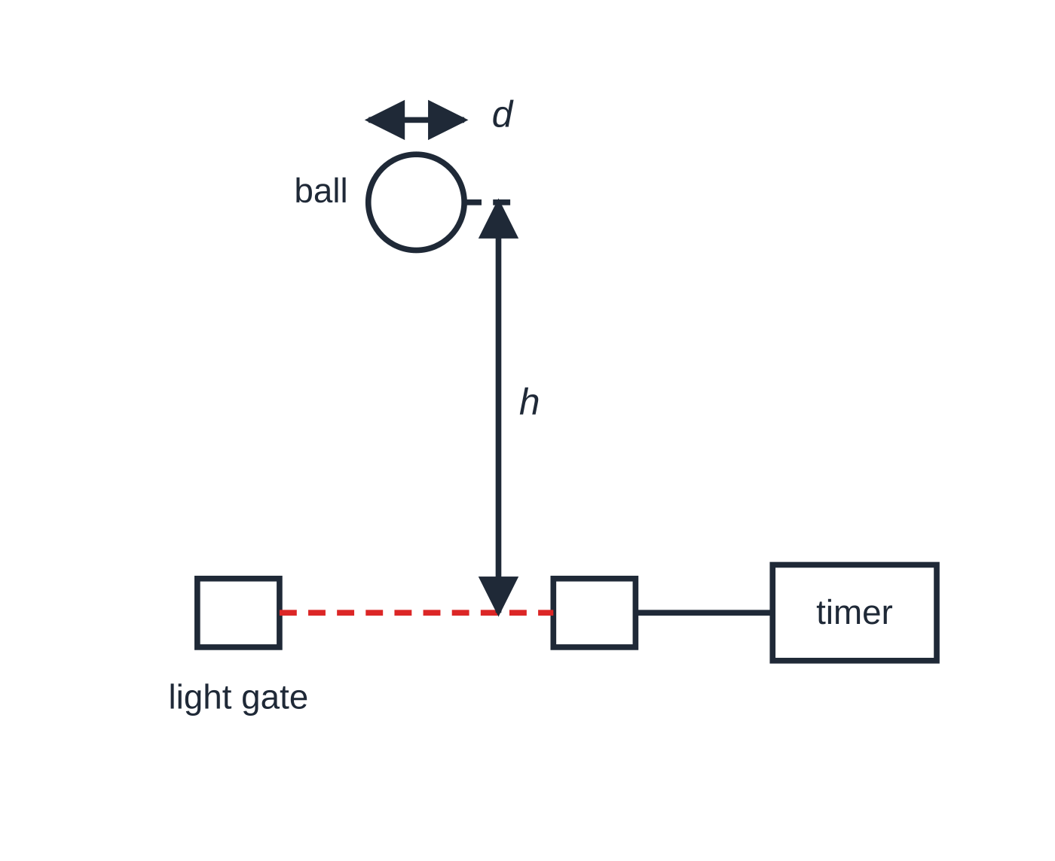
Question 1
7 marks
A student uses a single light gate to determine the acceleration of free fall. A steel ball is released from rest a height h above the light beam. The ball's diameter d is measured as 19.0 mm with vernier calipers. A timer records the time Δt for which the ball blocks the beam, and the speed of the ball is taken as v = d/Δt. The student repeats this for several values of h.
Figure: the ball is released from rest a height h above the light beam; not to scale
(a) The calipers have a resolution of 0.1 mm. Taking the uncertainty as half the resolution, state the uncertainty in d and calculate its percentage uncertainty. [2]
(b) For h = 0.600 m, Δt = 5.56 ms. Calculate v. [1]
(c) Explain why a graph of v² against h is expected to be a straight line through the origin, and state how g is found from it. [2]
(d) The gradient of the student's line is 19.4 m s⁻². Calculate g. [1]
(e) Suggest why the light gate must be lined up so that the beam passes through the centre of the ball. [1]
Notes:
Online with the full mark scheme: https://examinerprep.com/ial-physics-3-3-the-as-core-practicals-questions#IALP-U3-3-B-01

Slide 52
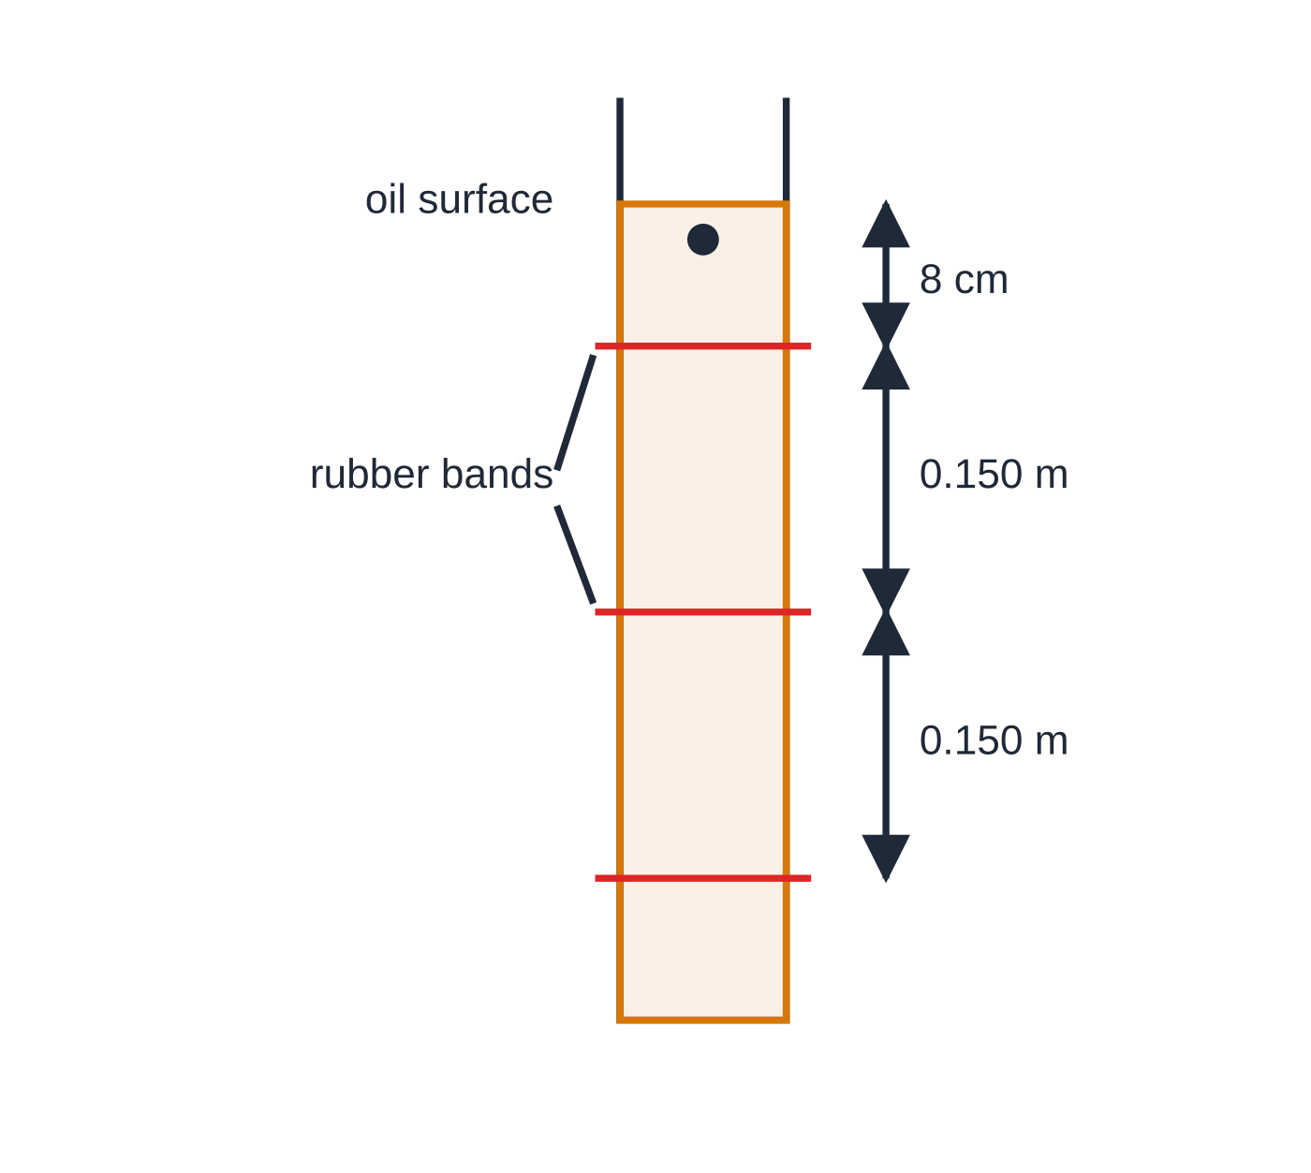
Question 2
6 marks
A student finds the terminal velocity of a small steel ball falling through engine oil in a tall measuring cylinder. Three rubber bands are placed round the cylinder: the first is 8 cm below the surface of the oil and the other two are each 0.150 m below the one above.
Figure: positions of the three bands on the measuring cylinder; not to scale
(a) Explain why the first band is placed well below the surface of the oil. [1]
(b) Describe how the student can use the three bands to check that the ball is moving at terminal velocity. [2]
(c) The times for the ball to fall between the first and second bands in three trials are 4.21 s, 4.35 s and 4.28 s. Calculate the mean time and its uncertainty. [2]
(d) Calculate the terminal velocity of the ball. [1]
Notes:
Online with the full mark scheme: https://examinerprep.com/ial-physics-3-3-the-as-core-practicals-questions#IALP-U3-3-B-02

Slide 53
Answers

Slide 54
Question 1 · answer
Mark scheme
half the resolution of the calipers = ±0.05 mm
0.05 ÷ 19.0 × 100 = 0.26%
19.0 × 10⁻³ ÷ 5.56 × 10⁻³ = 3.42 m s⁻¹
from rest, v² = u² + 2as gives v² = 2gh, so v² ∝ h
g = gradient ÷ 2
19.4 ÷ 2 = 9.70 m s⁻²
off-centre, the ball blocks the beam along a chord shorter than d, so Δt is shorter and the calculated v too large
Notes:
Full mark scheme: https://examinerprep.com/ial-physics-3-3-the-as-core-practicals-questions#IALP-U3-3-B-01

Slide 55
Question 2 · answer
Mark scheme
the ball is still accelerating near the surface, so timing starts only once it has reached terminal velocity
time the ball between the first and second bands and between the second and third bands
the two times are equal (within their uncertainty) if the velocity is constant
mean = 4.28 s
uncertainty = half the range = (4.35 − 4.21) ÷ 2 = ±0.07 s
0.150 ÷ 4.28 = 0.0350 m s⁻¹
Notes:
Full mark scheme: https://examinerprep.com/ial-physics-3-3-the-as-core-practicals-questions#IALP-U3-3-B-02

Slide 56
Keep practising
Notes for this topic
Questions on this topic
Build a printable test
ExaminerPrep is an independent tutoring service. It has been developed independently from and is not endorsed by the International Baccalaureate Organization. "International Baccalaureate", "IB" and "IB Diploma Programme" are registered trademarks of the IBO, used here for descriptive purposes only.
Pearson Edexcel and Cambridge are trademarks of their owners; ExaminerPrep is not affiliated with any exam board.

