Slide 1
EP
EDEXCEL IAL PHYSICS
4.8 The standard model and particle interactions
The full notes page in 11 sections · practice questions with answers · simulations
ExaminerPrep is an independent tutoring service. It has been developed independently from and is not endorsed by the International Baccalaureate Organization. "International Baccalaureate", "IB" and "IB Diploma Programme" are registered trademarks of the IBO, used here for descriptive purposes only.
Pearson Edexcel and Cambridge are trademarks of their owners; ExaminerPrep is not affiliated with any exam board.
Notes:
4.8 The standard model and particle interactions. Notes for this topic: https://examinerprep.com/notes/edexcel-ial-physics/the-standard-model-and-particle-interactions/

Slide 2
What this page covers
Overview
ΔE = c²Δm applied to the creation and annihilation of matter and antimatter
The units MeV, GeV, MeV/c² and GeV/c², and converting them to joules and kilograms
Particles and antiparticles; annihilation and pair production
The standard model: quarks, baryons (three quarks), mesons (quark–antiquark), leptons and the photon
How the pattern of the standard model predicted the top quark
Conservation of charge, baryon number and lepton number, and writing and interpreting particle equations
Why the longer lifetime of fast-moving unstable particles matters (muons reaching the ground), in words only
Notes:
What this page covers. Full notes: https://examinerprep.com/notes/edexcel-ial-physics/the-standard-model-and-particle-interactions/

Slide 3
In one minute
Key points
1. Mass and energy are equivalent, ΔE = c²Δm, so particles can be created from energy and destroyed into it, but only in reactions that conserve charge, baryon number, lepton number, energy and momentum.
2. An electron's rest energy is about 0.51 MeV; a proton's is about 940 MeV. Particle masses are quoted in MeV/c² or GeV/c².
3. Every particle has an antiparticle with the same mass and opposite charge. A particle and its antiparticle can annihilate into photons; a photon with enough energy can create a particle–antiparticle pair.
4. Hadrons are made of quarks: baryons have three quarks (proton uud, neutron udd), mesons a quark and an antiquark. Leptons (electron, muon, tau and their neutrinos) are fundamental.
5. If any one of charge, baryon number or lepton number is different before and after, the reaction cannot happen.
Notes:
In one minute. Full notes: https://examinerprep.com/notes/edexcel-ial-physics/the-standard-model-and-particle-interactions/

Slide 4
In one minute (continued)
Key points
6. Fast unstable particles survive much longer, as measured by us, than they do at rest: that is why so many muons made high in the atmosphere reach the ground.
Notes:
In one minute. Full notes: https://examinerprep.com/notes/edexcel-ial-physics/the-standard-model-and-particle-interactions/

Slide 5
How are mass and energy related?
Section 1 of 11
Einstein showed that mass is a form of energy. Whenever the energy of a system changes, its mass changes too, and in particle physics the conversion happens in full: mass can disappear and reappear as photons, and photon energy can turn into new particles.
Mass–energy equivalence
ΔE = c²Δm ΔE energy change (J), Δm mass change (kg), c speed of light = 3.00 × 10⁸ m s⁻¹. In the formulae list. The
rest energy of a particle is the energy equivalent of its mass when it is not moving, mc² (No — learn it).
c² = 9.00 × 10¹⁶ m² s⁻² is enormous, so a tiny mass corresponds to a large energy. The total energy of a moving particle is its rest energy plus its kinetic energy. When particles are created, the energy supplied must cover their rest energies, and anything left over becomes kinetic energy.
Notes:
How are mass and energy related?. Full notes: https://examinerprep.com/notes/edexcel-ial-physics/the-standard-model-and-particle-interactions/

Slide 6
How are mass and energy related? (continued)
Section 1 of 11
Energy and momentum are both conserved in every interaction, so mass can be traded for energy but nothing is created from nothing.
Notes:
How are mass and energy related?. Full notes: https://examinerprep.com/notes/edexcel-ial-physics/the-standard-model-and-particle-interactions/

Slide 7
How are mass and energy related? (continued)
Section 1 of 11 · Worked example 1 · Medium · Calculate
WORKED EXAMPLE · QUESTION
(a) Calculate the rest energy of an electron in joules. (b) Express it in MeV (1 MeV = 1.60 × 10⁻¹³ J). (c) A gamma photon has an energy of 1.33 MeV. Calculate the mass equivalent of this energy, and compare it with the mass of an electron.
SOLUTION
(a) ΔE = c²Δm with Δm = the electron's mass: E = 9.11×10⁻³¹ ×(3.00×10⁸)² = 8.20 × 10⁻¹⁴ J
(b) 8.20×10⁻¹⁴ ÷1.60×10⁻¹³ = 0.512 MeV
(c) Convert MeV to joules, then divide by c²: Δm = 1.33 ×1.60×10⁻¹³ ÷(3.00×10⁸)² = 2.13×10⁻¹³ ÷9.00×10¹⁶ = 2.36 × 10⁻³⁰ kg; ÷ 9.11 × 10⁻³¹ = 2.6 electron masses
The accepted rest energy of the electron is 0.511 MeV; data-sheet values rounded to 3 s.f. give 0.512 MeV. Either is fine if your working is shown. Because 1.33 MeV is more than twice the electron's rest energy, this photon has enough energy to create an electron–positron pair.
Notes:
How are mass and energy related?: Worked example 1. Full notes: https://examinerprep.com/notes/edexcel-ial-physics/the-standard-model-and-particle-interactions/

Slide 8
Which units do particle physicists use for energy and mass?
Section 2 of 11
Joules and kilograms are inconveniently large for single particles. Particle energies are given in electronvolts and their multiples, and masses are given as rest energy divided by c².
Unit | Meaning | In SI units
1 eV | energy transferred to an electron moved through a p.d. of 1 V | 1.60 × 10⁻¹⁹ J
1 MeV | 10⁶ eV | 1.60 × 10⁻¹³ J
1 GeV | 10⁹ eV | 1.60 × 10⁻¹⁰ J
1 MeV/c² | the mass whose rest energy is 1 MeV | 1.60 × 10⁻¹³ ÷ 9.00 × 10¹⁶ = 1.78 × 10⁻³⁰ kg
1 GeV/c² | the mass whose rest energy is 1 GeV | 1.78 × 10⁻²⁷ kg, close to the mass of a proton
Energy in MeV → J: multiply by 1.60 × 10⁻¹³. Mass in MeV/c² → kg: multiply by 1.60 × 10⁻¹³, then divide by c². "MeV/c²" is read literally: an energy in MeV divided by c². Saying "the proton has a mass of 938 MeV/c²" is the same as saying "its rest energy is 938 MeV".
Notes:
Which units do particle physicists use for energy and mass?. Full notes: https://examinerprep.com/notes/edexcel-ial-physics/the-standard-model-and-particle-interactions/

Slide 9
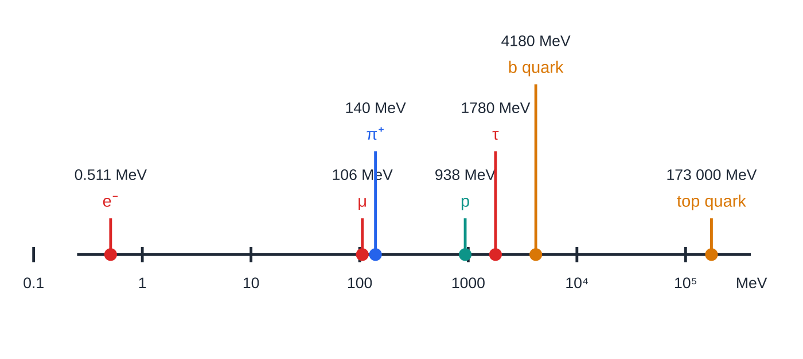
Which units do particle physicists use for energy and mass? (continued)
Section 2 of 11
The range of masses is huge, so a logarithmic scale is the only way to show them on one diagram.
Measured rest energies (3 s.f.) placed on a logarithmic scale, where each division is ten times the previous one. The top quark is about 340 000 times heavier than the electron. The quark values are estimates, because quarks are never found on their own.
Notes:
Which units do particle physicists use for energy and mass?. Full notes: https://examinerprep.com/notes/edexcel-ial-physics/the-standard-model-and-particle-interactions/

Slide 10
Which units do particle physicists use for energy and mass? (continued)
Section 2 of 11 · Worked example 2 · Medium · Show that
WORKED EXAMPLE · QUESTION
(a) Use the data-sheet mass of the proton to show that its mass is about 940 MeV/c². (b) A meson has a mass of 5.28 GeV/c². Calculate its mass in kg and compare it with the mass of the proton.
SOLUTION
(a) Rest energy in joules, then in MeV: 1.67×10⁻²⁷ ×9.00×10¹⁶ = 1.50×10⁻¹⁰ J; ÷ 1.60 × 10⁻¹³ = 939 MeV, so ≈ 940 MeV/c²
(b) GeV → J, then divide by c²: m = 5.28×10⁹ ×1.60×10⁻¹⁹ ÷9.00×10¹⁶ = 9.39 × 10⁻²⁷ kg; ÷ 1.67 × 10⁻²⁷ = 5.62 times the proton's mass
A meson is not "lighter than a baryon" by definition: the names describe the quark content, not the mass.
Notes:
Which units do particle physicists use for energy and mass?: Worked example 2. Full notes: https://examinerprep.com/notes/edexcel-ial-physics/the-standard-model-and-particle-interactions/

Slide 11
Which units do particle physicists use for energy and mass? (continued)
Section 2 of 11
Common error — Half a conversion
Converting GeV/c² to kg by multiplying by 1.60 × 10⁻¹⁹ only, or dividing by c instead of c². Do it in two visible steps: energy in joules first, then ÷ c². Sanity check: anything near 1 GeV/c² should come out near 10⁻²⁷ kg.
Notes:
Which units do particle physicists use for energy and mass?. Full notes: https://examinerprep.com/notes/edexcel-ial-physics/the-standard-model-and-particle-interactions/

Slide 12
What happens when matter meets antimatter?
Section 3 of 11
An antiparticle is a particle with the same mass as its partner but the opposite charge (and opposite baryon and lepton numbers).
Particle | Antiparticle | Charge of antiparticle / e
electron e⁻ | positron e⁺ | +1
proton p | antiproton p̄ | −1
neutron n | antineutron n̄ | 0 (but baryon number −1)
neutrino ν | antineutrino ν̄ | 0 (but lepton number −1)
up quark u | anti-up ū | −2/3
A neutral particle can still have a distinct antiparticle: the antineutron and the antineutrino are told apart by their baryon or lepton number. A photon is its own antiparticle.
Notes:
What happens when matter meets antimatter?. Full notes: https://examinerprep.com/notes/edexcel-ial-physics/the-standard-model-and-particle-interactions/

Slide 13
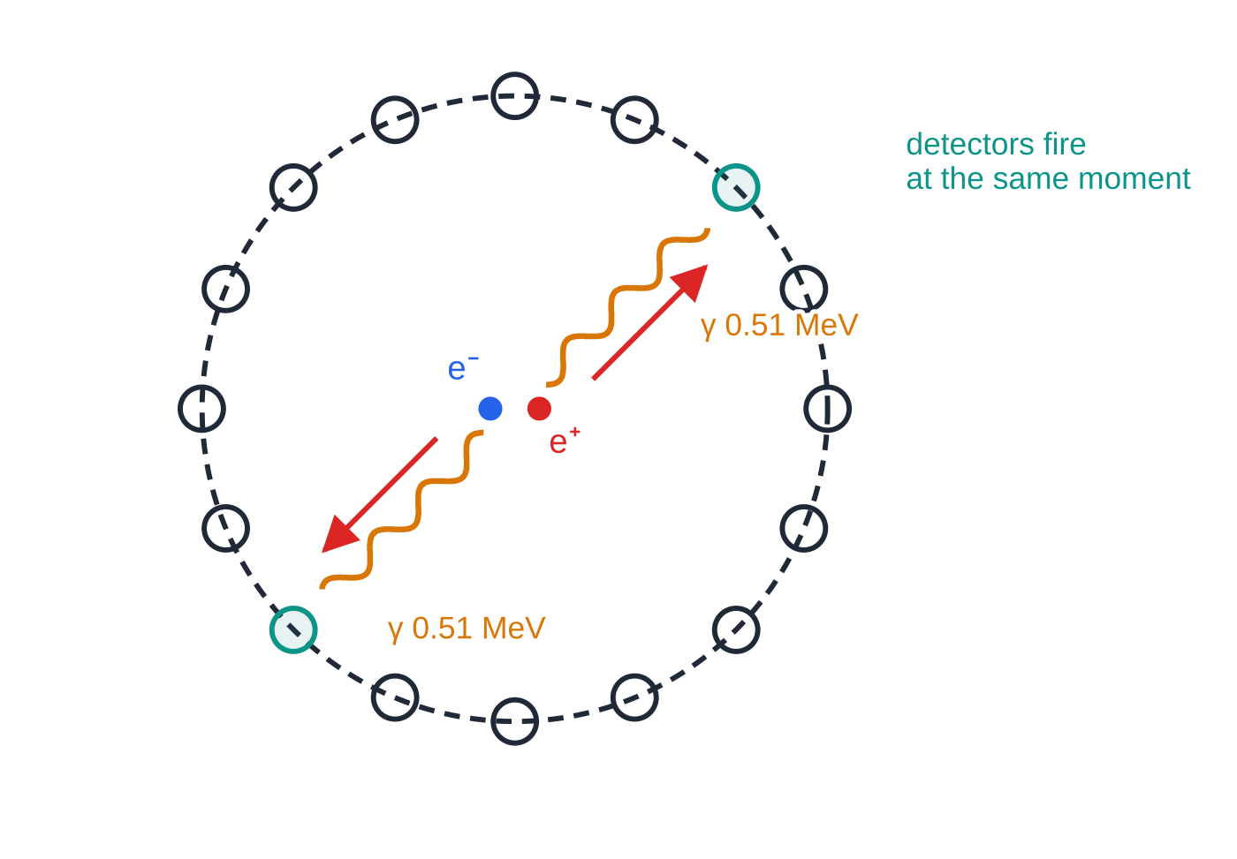
What happens when matter meets antimatter? (continued)
Section 3 of 11
Antimatter is made in collisions in accelerators, in cosmic-ray showers and in some radioactive decays (a positron is emitted in β⁺ decay).
Annihilation
When a particle meets its antiparticle they annihilate: their total mass is converted into energy, usually as two gamma photons. If the pair is almost at rest, the total momentum is zero. A single photon always carries momentum, so momentum could not be conserved; two photons moving in opposite directions with equal energies keep the total at zero. For energy, 2mc² (plus any kinetic energy) = total photon energy, so each photon from an electron–positron pair at rest has E = mₑ c² ≈0.51 MeV.
Annihilation of an electron and a positron almost at rest. The photons' momentum arrows (p = E/c) are equal in length and opposite in direction, so momentum is conserved. A PET scanner uses exactly this: detectors on opposite sides of the ring record the two 0.51 MeV photons at the same moment.
Notes:
What happens when matter meets antimatter?. Full notes: https://examinerprep.com/notes/edexcel-ial-physics/the-standard-model-and-particle-interactions/

Slide 14
What happens when matter meets antimatter? (continued)
Section 3 of 11 · Worked example 3 · Medium · Explain
WORKED EXAMPLE · QUESTION
A positron and an electron, both almost at rest, annihilate. (a) Explain why two photons are produced rather than one. (b) Calculate the energy, the frequency and the wavelength of each photon.
SOLUTION
(a) Total momentum before ≈ 0. One photon would carry momentum, so two photons are emitted in opposite directions with equal momenta: total momentum stays zero
(b) Each photon carries the rest energy of one of the particles: E = mₑ c² = 8.20 × 10⁻¹⁴ J (0.512 MeV). From E = hf: f = 8.20×10⁻¹⁴ ÷6.63×10⁻³⁴ = 1.24 × 10²⁰ Hz. From c = fλ: λ= 3.00×10⁸ ÷1.237×10²⁰ = 2.43 × 10⁻¹² m
This wavelength is far shorter than that of X-rays used in medicine: these are gamma photons.
Notes:
What happens when matter meets antimatter?: Worked example 3. Full notes: https://examinerprep.com/notes/edexcel-ial-physics/the-standard-model-and-particle-interactions/

Slide 15
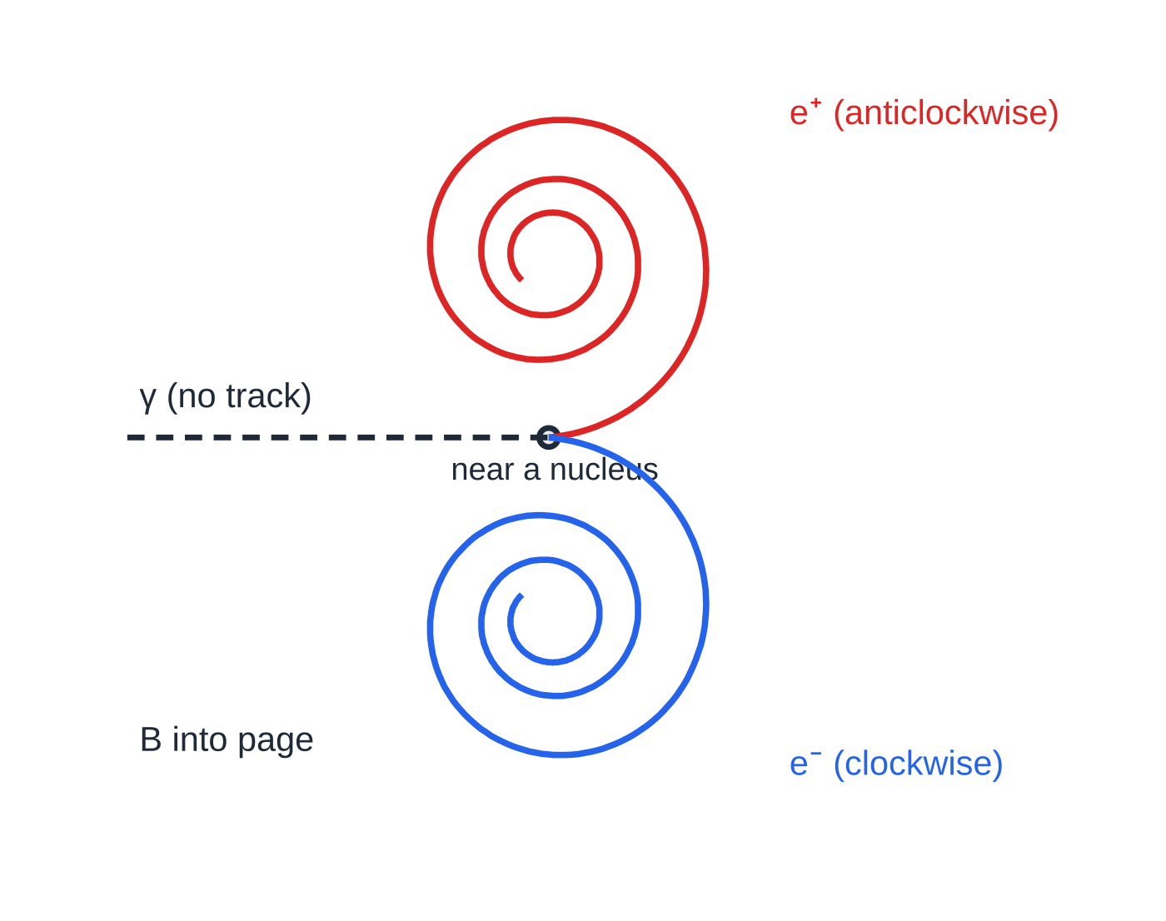
What happens when matter meets antimatter? (continued)
Section 3 of 11
Pair production
A high-energy photon can turn into a particle–antiparticle pair, for example γ→e⁻ + e⁺. The photon must supply at least the rest energy of both particles: E_(min) = 2mc². For an electron–positron pair this is about 1.02 MeV, and any extra energy becomes the kinetic energy of the pair.
Pair production happens close to a nucleus. The nucleus takes up some momentum, which lets both energy and momentum be conserved; its share of the energy is tiny and is usually ignored. Charge is conserved (0 → −1 + 1), and lepton number too (0 → +1 − 1). That is why the products must be a particle and its antiparticle.
Sketch of pair production in a detector with a magnetic field into the page. The photon leaves no track because it is uncharged. The electron and positron curve in opposite directions (opposite charges), and each spirals inwards as it loses momentum ionising the medium (r = p/BQ, see 4.7).
Notes:
What happens when matter meets antimatter?. Full notes: https://examinerprep.com/notes/edexcel-ial-physics/the-standard-model-and-particle-interactions/

Slide 16
What happens when matter meets antimatter? (continued)
Section 3 of 11 · Worked example 4 · Hard · Calculate
WORKED EXAMPLE · QUESTION
(a) Calculate the minimum energy, in GeV, a photon needs to create a proton–antiproton pair. (b) Calculate the minimum frequency of the photon. (c) A photon of energy 2.40 GeV creates a proton–antiproton pair. Calculate the total kinetic energy of the pair.
SOLUTION
(a) Energy for two proton rest masses: E_(min) = 2mₚ c² = 2 ×1.67×10⁻²⁷ ×9.00×10¹⁶ = 3.01×10⁻¹⁰ J; ÷ 1.60 × 10⁻¹⁰ = 1.88 GeV
(b) f_(min) = 3.01×10⁻¹⁰ ÷6.63×10⁻³⁴ = 4.53 × 10²³ Hz
(c) Energy left after paying for the rest energies: Eₖ = 2.40 - 1.88 = 0.52 GeV
The same photon could not make just one proton: charge and baryon number would not be conserved.
Notes:
What happens when matter meets antimatter?: Worked example 4. Full notes: https://examinerprep.com/notes/edexcel-ial-physics/the-standard-model-and-particle-interactions/

Slide 17
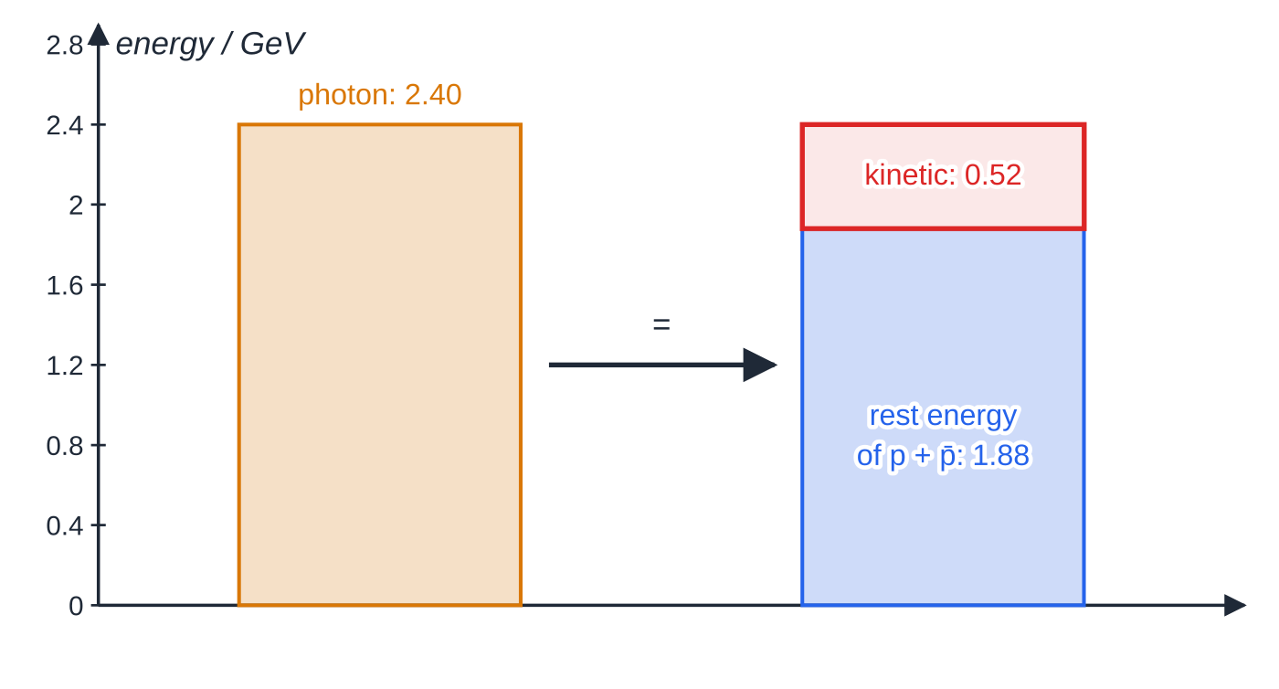
What happens when matter meets antimatter? (continued)
Section 3 of 11
Energy budget for Worked example 4: the 2.40 GeV photon pays 1.88 GeV for the rest energies of the proton and antiproton, and the remaining 0.52 GeV becomes their kinetic energy.
Notes:
What happens when matter meets antimatter?. Full notes: https://examinerprep.com/notes/edexcel-ial-physics/the-standard-model-and-particle-interactions/

Slide 18
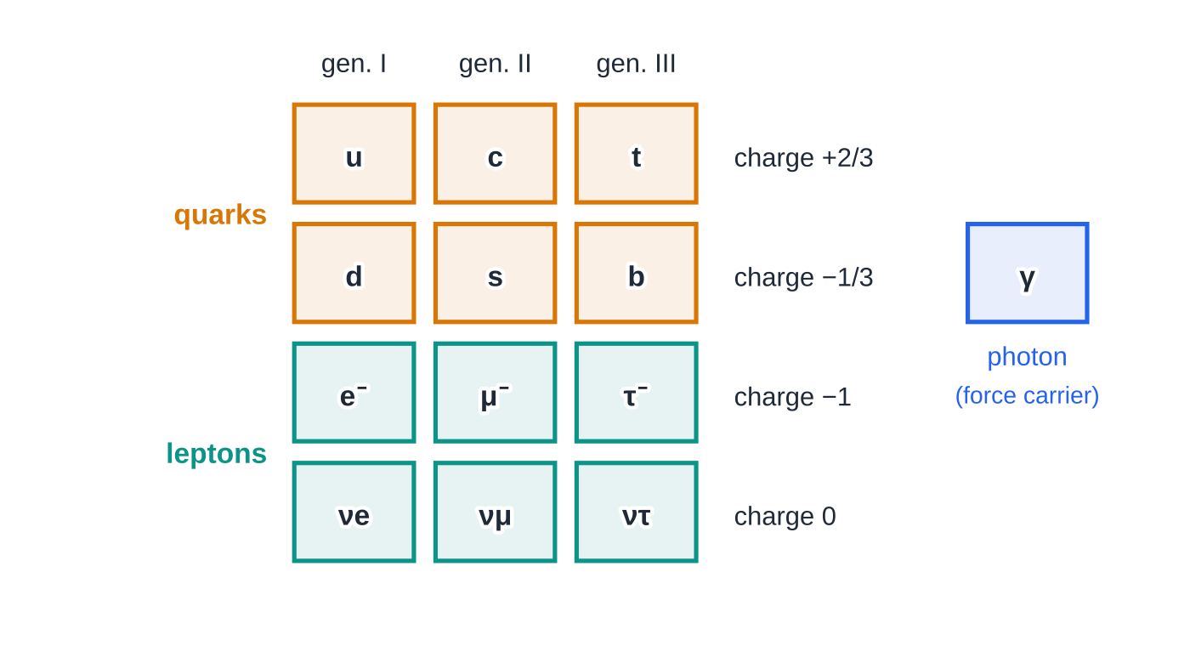
How are particles classified in the standard model?
Section 4 of 11
The standard model describes all known matter with a small set of fundamental particles: six quarks, six leptons and the force-carrying particles, of which you need the photon. Each has an antiparticle.
The fundamental particles of the standard model, in three generations. Ordinary matter needs only the first generation (u, d, e⁻, νe). The other force carriers (for the strong and weak interactions) are not required here.
Notes:
How are particles classified in the standard model?. Full notes: https://examinerprep.com/notes/edexcel-ial-physics/the-standard-model-and-particle-interactions/

Slide 19
How are particles classified in the standard model? (continued)
Section 4 of 11
Group | Made of | Examples | Baryon number | Lepton number
Baryons (hadrons) | three quarks | proton uud, neutron udd | +1 (antibaryons −1) | 0
Mesons (hadrons) | a quark and an antiquark | π⁺ ud̄, π⁻ dū, π⁰ uū or dd̄ | 0 | 0
Leptons | fundamental, no smaller parts | e⁻, μ⁻, τ⁻, νe, νμ, ντ | 0 | +1 (antileptons −1)
Photon | fundamental | γ | 0 | 0
Notes:
How are particles classified in the standard model?. Full notes: https://examinerprep.com/notes/edexcel-ial-physics/the-standard-model-and-particle-interactions/

Slide 20
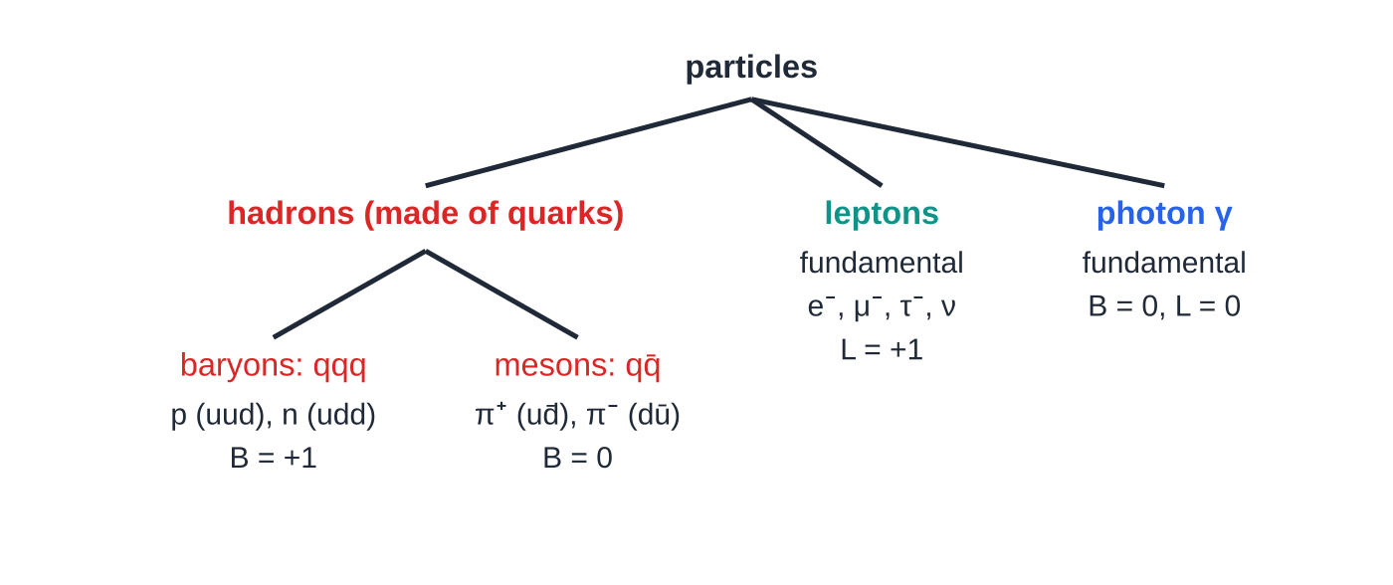
How are particles classified in the standard model? (continued)
Section 4 of 11
Hadrons are particles made of quarks (baryons and mesons), and quarks are never seen on their own. Quark charges are u = +2/3, d = −1/3 and s = −1/3 (in units of e), and each quark has baryon number +1/3. Antiquarks have the opposite charge and baryon number −1/3. The charge of a hadron is the sum of its quark charges, and is always a whole number. The neutrino is a lepton with no charge and a very small mass; it hardly interacts with matter, which is why it was first proposed to explain the "missing" energy in beta decay.
Classifying particles: the first question is always "is it made of quarks?". Hadrons are; leptons and the photon are fundamental.
Notes:
How are particles classified in the standard model?. Full notes: https://examinerprep.com/notes/edexcel-ial-physics/the-standard-model-and-particle-interactions/

Slide 21
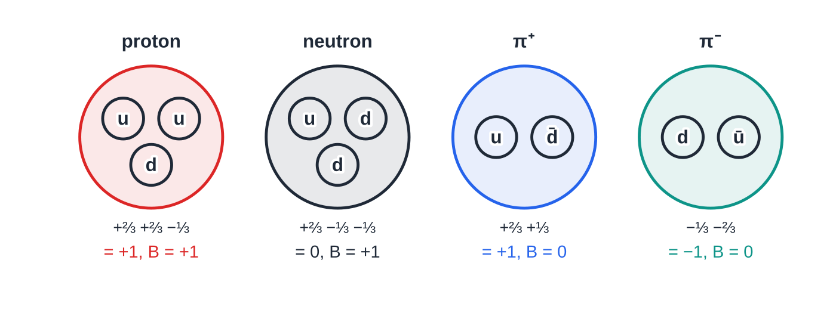
How are particles classified in the standard model? (continued)
Section 4 of 11
How the pattern predicted the top quark
Leptons come in three pairs: (e, νe), (μ, νμ), (τ, ντ). The quarks were expected to follow the same symmetry: three pairs (u, d), (c, s), (t, b). When the bottom quark was discovered in 1977, the model required a partner with charge +2/3 to complete the third pair. Physicists searched for it at ever higher energies, and the top quark was found in 1995 with a mass of about 173 GeV/c², which is why it took so long.
Quark content of two baryons and two mesons, with the quark charges added exactly. Three quarks give baryon number 3 × 1/3 = +1; a quark and an antiquark give 1/3 − 1/3 = 0.
Notes:
How are particles classified in the standard model?. Full notes: https://examinerprep.com/notes/edexcel-ial-physics/the-standard-model-and-particle-interactions/

Slide 22
How are particles classified in the standard model? (continued)
Section 4 of 11
This is a good example of a scientific model making a successful prediction that was later confirmed by experiment.
Common error — Is it made of quarks?
Calling the electron or the muon a hadron, or a meson a lepton. The test is simple: is it made of quarks? Baryons and mesons are; leptons and the photon are not. The muon is a heavy cousin of the electron, not a meson.
Notes:
How are particles classified in the standard model?. Full notes: https://examinerprep.com/notes/edexcel-ial-physics/the-standard-model-and-particle-interactions/

Slide 23
How do you decide whether a particle interaction is possible?
Section 5 of 11
Write the equation with each particle as a symbol, then add up three numbers on each side. If any one of them is different before and after, the interaction cannot happen.
Conserved quantity | Values to use
Charge Q | in units of e: p +1, n 0, e⁻ −1, e⁺ +1, π± ±1, ν 0, γ 0
Baryon number B | baryons +1, antibaryons −1, quarks +1/3, antiquarks −1/3, everything else 0
Lepton number L | leptons (e⁻, μ⁻, ν) +1, antileptons (e⁺, μ⁺, ν̄) −1, everything else 0
Energy (including rest energy) and momentum must also be conserved. A particle can only decay into particles whose total rest mass is less than its own; collisions can make heavier particles if there is enough kinetic energy.
Beta-minus decay as a particle equation is n →p + e⁻ + ν̄. Check: Q 0 → 1 − 1 + 0 = 0; B 1 → 1; L 0 → 0 + 1 − 1 = 0. The antineutrino is what makes the lepton number balance.
Notes:
How do you decide whether a particle interaction is possible?. Full notes: https://examinerprep.com/notes/edexcel-ial-physics/the-standard-model-and-particle-interactions/

Slide 24
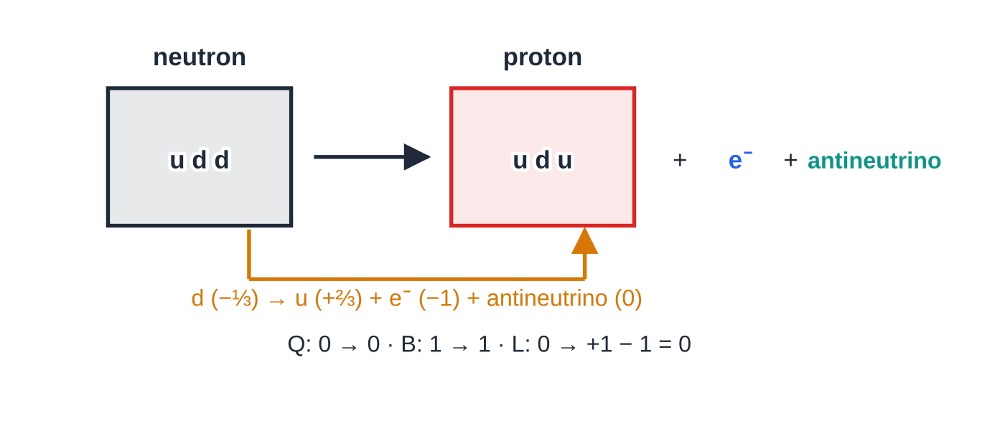
How do you decide whether a particle interaction is possible? (continued)
Section 5 of 11
At quark level the same decay is d →u + e⁻ + ν̄: one down quark (−1/3) becomes an up quark (+2/3), and the charge difference of +1 is balanced by the electron.
Beta-minus decay at quark level: one d quark in the neutron becomes a u quark, so udd becomes uud, and an electron and an antineutrino are emitted. Charge, baryon number and lepton number all balance.
Notes:
How do you decide whether a particle interaction is possible?. Full notes: https://examinerprep.com/notes/edexcel-ial-physics/the-standard-model-and-particle-interactions/

Slide 25
How do you decide whether a particle interaction is possible? (continued)
Section 5 of 11 · Worked example 5 · Hard · Deduce
WORKED EXAMPLE · QUESTION
(a) A baryon has a charge of +1 and contains one s quark. Deduce its other two quarks. (b) Use conservation laws to decide which of these interactions are possible.
SOLUTION
(a) Charges must add to +1. s = −1/3, so the other two must total +4/3: u u (+2/3 + 2/3). The baryon is uus.
(b) Tabulate Q, B, L for each side:
Interaction | Q | B | L | Possible?
p + p̄ →π⁺ + π⁻ + π⁰ | 0 → 0 ✓ | 0 → 0 ✓ | 0 → 0 ✓ | yes
p →π⁰ + e⁺ | +1 → +1 ✓ | +1 → 0 ✗ | 0 → −1 ✗ | no
π⁺ →μ⁺ + ν̄ | +1 → +1 ✓ | 0 → 0 ✓ | 0 → −2 ✗ | no
Notes:
How do you decide whether a particle interaction is possible?: Worked example 5. Full notes: https://examinerprep.com/notes/edexcel-ial-physics/the-standard-model-and-particle-interactions/

Slide 26
How do you decide whether a particle interaction is possible? (continued)
Section 5 of 11 · Worked example 5 · Hard · Deduce (continued)
Interaction | Q | B | L | Possible?
p + e⁻ →n + ν | 0 → 0 ✓ | +1 → +1 ✓ | +1 → +1 ✓ | yes
One failure is enough to rule an interaction out. The pion's real decay is π⁺ →μ⁺ + ν, with a neutrino (L = +1), not an antineutrino. The second line shows why the proton is stable: there is no lighter baryon for it to decay into.
Notes:
How do you decide whether a particle interaction is possible?: Worked example 5. Full notes: https://examinerprep.com/notes/edexcel-ial-physics/the-standard-model-and-particle-interactions/

Slide 27
How do you decide whether a particle interaction is possible? (continued)
Section 5 of 11
Exam tip — Lay out the check
Set the check out as a small table, one row per conserved quantity, with the totals before and after. When asked "which law is violated?", name the quantity and give the two totals, for example "lepton number: 0 before, −2 after".
Notes:
How do you decide whether a particle interaction is possible?. Full notes: https://examinerprep.com/notes/edexcel-ial-physics/the-standard-model-and-particle-interactions/

Slide 28
Why do so many muons reach the ground?
Section 6 of 11
Cosmic rays (mostly protons) hit nuclei high in the atmosphere, about 10–15 km up, and produce pions, which quickly decay into muons. A muon at rest has a mean lifetime of about 2.2 µs. Even at almost the speed of light, it would travel only about 660 m in that time, so almost none should reach sea level.
In fact, large numbers are detected at the ground. For particles moving at speeds close to c, the lifetime measured by an observer they are moving past is much longer than the lifetime at rest; at 0.995c it is about ten times longer. This relativistic increase in lifetime is only significant at speeds that are a large fraction of c. It also matters in accelerators: fast unstable particles travel much further before decaying, which is how their tracks can be recorded.
Notes:
Why do so many muons reach the ground?. Full notes: https://examinerprep.com/notes/edexcel-ial-physics/the-standard-model-and-particle-interactions/

Slide 29
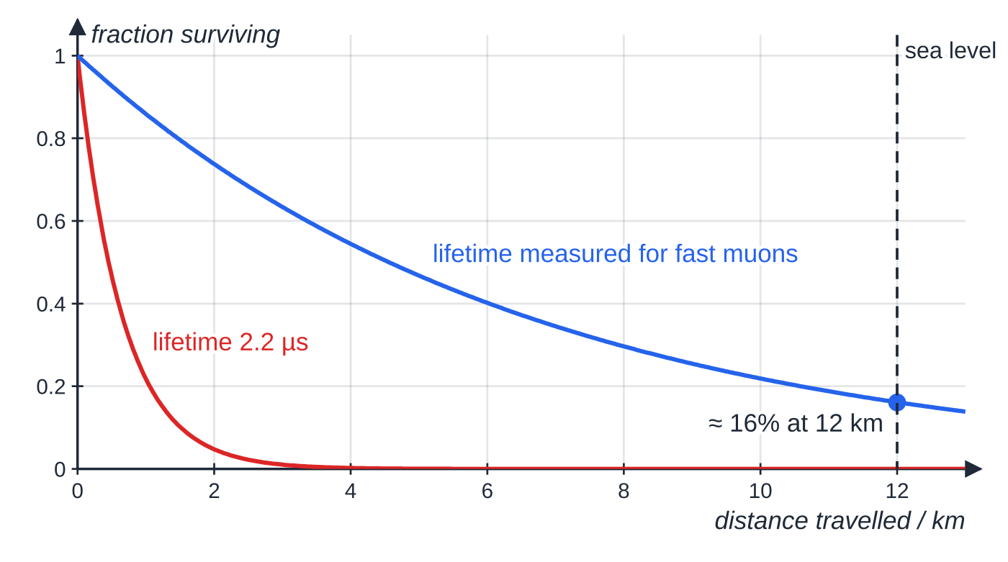
Why do so many muons reach the ground? (continued)
Section 6 of 11
Fraction of muons still undecayed against distance travelled at 0.995c (curves from exponential decay with a mean lifetime). With a 2.2 µs lifetime almost none would survive the first few kilometres; with the longer lifetime measured for fast muons, about 16% survive 12 km. No relativistic equations are needed in this course, only the idea.
Notes:
Why do so many muons reach the ground?. Full notes: https://examinerprep.com/notes/edexcel-ial-physics/the-standard-model-and-particle-interactions/

Slide 30
Why do so many muons reach the ground? (continued)
Section 6 of 11 · Worked example 6 · Hard · Explain
WORKED EXAMPLE · QUESTION
Muons are produced about 12 km above the ground and travel downwards at 0.995c. Their mean lifetime at rest is 2.2 µs. Explain why muons detected at sea level are evidence that the lifetime of a fast-moving particle is increased. Include a calculation in your answer.
SOLUTION
Speed = 0.995 × 3.00 × 10⁸ = 2.985 × 10⁸ m s⁻¹; in one lifetime at rest a muon travels 2.985 × 10⁸ × 2.2 × 10⁻⁶ ≈ 660 m.
The journey of 12 km takes 12 × 10³ ÷ 2.985 × 10⁸ ≈ 40 µs, about 18 lifetimes. If the lifetime were 2.2 µs, only a minute fraction of the muons would still exist at sea level, far too few to detect in large numbers.
Many muons are in fact detected at sea level, so they must survive much longer than 2.2 µs as measured in the Earth's frame.
Notes:
Why do so many muons reach the ground?: Worked example 6. Full notes: https://examinerprep.com/notes/edexcel-ial-physics/the-standard-model-and-particle-interactions/

Slide 31
Why do so many muons reach the ground? (continued)
Section 6 of 11 · Worked example 6 · Hard · Explain (continued)
This is the relativistic increase in lifetime: it is significant because the muons travel at a speed very close to c. At everyday speeds the effect is far too small to notice.
Notes:
Why do so many muons reach the ground?: Worked example 6. Full notes: https://examinerprep.com/notes/edexcel-ial-physics/the-standard-model-and-particle-interactions/

Slide 32
Why do so many muons reach the ground? (continued)
Section 6 of 11
Common error — "Faster than light"
Saying the muons "move faster than light" or "stop decaying". They still decay at random; what changes is that, measured from the ground, their mean lifetime is much longer, so they cover a greater distance before decaying.
Notes:
Why do so many muons reach the ground?. Full notes: https://examinerprep.com/notes/edexcel-ial-physics/the-standard-model-and-particle-interactions/

Slide 33
Exam tips for 4.8
Section 7 of 11
Exam tip 1 — Convert in two steps
For masses in MeV/c² or GeV/c²: first turn the energy into joules (× 1.60 × 10⁻¹³ or × 1.60 × 10⁻¹⁰), then divide by c². Write each step on its own line.
Exam tip 2 — Two photons, two rest energies
In annihilation the total energy is shared between two photons, so each photon from a pair at rest has mc², not 2mc². In pair production one photon must supply 2mc².
Exam tip 3 — Three checks, in order
Charge, baryon number, lepton number: check all three for every interaction and show the totals. If a reaction is impossible even though all three balance, look at energy: is the total rest mass of the products bigger than the parent's?
Notes:
Exam tips for 4.8. Full notes: https://examinerprep.com/notes/edexcel-ial-physics/the-standard-model-and-particle-interactions/

Slide 34
Exam tips for 4.8 (continued)
Section 7 of 11
Exam tip 4 — Quark arithmetic
Write each quark's charge under its symbol and add, as fractions. An antiquark flips the sign: d̄ is +1/3, ū is −2/3. A total that is not a whole number means the combination is wrong.
Exam tip 5 — Muons in words
Give one number (the distance travelled in 2.2 µs, a few hundred metres) and compare it with the height of production. Then say "the lifetime measured in the Earth's frame is increased because the muons travel close to c".
Notes:
Exam tips for 4.8. Full notes: https://examinerprep.com/notes/edexcel-ial-physics/the-standard-model-and-particle-interactions/

Slide 35
Common misconceptions
Section 8 of 11
Misconception | Why it is wrong | Correct idea
An antiparticle has negative mass. | Annihilation releases 2mc², which needs both masses to be positive. | Same mass, opposite charge, baryon number and lepton number.
Annihilation of a pair at rest produces one photon. | One photon always has momentum; the total before was zero. | Two photons, equal energies, opposite directions.
A 1.02 MeV photon can create a pair anywhere. | In empty space energy and momentum cannot both be conserved. | Pair production happens near a nucleus, which takes up momentum.
Mesons are mid-weight particles and leptons are light ones. | The names began as mass labels but the tau lepton is heavier than a proton. | Classify by content: baryons qqq, mesons qq̄, leptons fundamental.
If charge balances, the reaction is possible. | Baryon and lepton number must balance too, and energy must be available. | Check Q, B, L (and energy): one failure rules it out.
Notes:
Common misconceptions. Full notes: https://examinerprep.com/notes/edexcel-ial-physics/the-standard-model-and-particle-interactions/

Slide 36
Common misconceptions (continued)
Section 8 of 11
Misconception | Why it is wrong | Correct idea
Neutral particles are their own antiparticles. | The neutron and neutrino are neutral but have baryon or lepton number. | Only particles with every quantum number zero, like the photon, are their own antiparticles.
Notes:
Common misconceptions. Full notes: https://examinerprep.com/notes/edexcel-ial-physics/the-standard-model-and-particle-interactions/

Slide 37
How this topic connects
Section 9 of 11
7 Atomic structure and particle accelerators
Particles are given the energy for pair creation in linacs and cyclotrons, and the curved tracks of pair production are interpreted with r = p/BQ.
Photons (Unit 2) and momentum (4.1)
E = hf, c = fλ and the electronvolt are used for every annihilation and pair-production photon. Conservation of momentum explains why annihilation gives two photons and why pair production needs a nucleus nearby.
Nuclear decay and binding energy (Unit 5)
ΔE = c²Δm gives the energy released in fission and fusion, and β± decay equations use the same conservation checks as this page.
Notes:
How this topic connects. Full notes: https://examinerprep.com/notes/edexcel-ial-physics/the-standard-model-and-particle-interactions/

Slide 38
Key equations
Section 10 of 11
Equation | Use | In the formulae list?
ΔE = c²Δm | energy equivalent of a change in mass, and vice versa | Yes
E₀ = mc² | rest energy of one particle | No — learn it (special case of the line above)
1 MeV = 1.60 × 10⁻¹³ J; 1 GeV = 1.60 × 10⁻¹⁰ J | converting particle energies to SI | No — learn it (from 1 eV = 1.60 × 10⁻¹⁹ J)
m (kg) = E (J) ÷ c² | converting MeV/c² and GeV/c² to kg | No — derive it
Eᵧ = mc² (each photon) | annihilation of a particle–antiparticle pair at rest | No — derive it
E_(min) = 2mc² | minimum photon energy for pair production | No — derive it
E = hf, c = fλ | frequency and wavelength of the photons | Yes
Notes:
Key equations. Full notes: https://examinerprep.com/notes/edexcel-ial-physics/the-standard-model-and-particle-interactions/

Slide 39
Check your understanding
Section 11 of 11
1. State the quark composition of a proton and of a neutron, and show that their charges are correct.
2. A muon has a mass of 106 MeV/c². What is its mass in kg?
3. What is the minimum photon energy needed to make a muon–antimuon pair?
4. Is n → p + e⁻ possible? Give a reason.
5. Why is the π⁺ classed as a meson and not a baryon?
6. An electron and a positron, each with negligible kinetic energy, annihilate. State the total energy released in MeV and explain why it is shared equally between two photons.
Notes:
Check your understanding: questions. Full notes: https://examinerprep.com/notes/edexcel-ial-physics/the-standard-model-and-particle-interactions/

Slide 40
Check your understanding · answers
Section 11 of 11
1. Proton uud: +2/3 + 2/3 − 1/3 = +1. Neutron udd: +2/3 − 1/3 − 1/3 = 0.
2. 106 × 1.60 × 10⁻¹³ = 1.70 × 10⁻¹¹ J; ÷ 9.00 × 10¹⁶ = 1.88 × 10⁻²⁸ kg.
3. Twice the rest energy: 2 × 106 MeV = 212 MeV (0.212 GeV).
4. No. Charge (0 → 0) and baryon number (1 → 1) balance, but lepton number does not: 0 before, +1 after. An antineutrino must also be emitted.
5. It is made of a quark and an antiquark (ud̄), so its baryon number is 1/3 − 1/3 = 0. Baryons have three quarks and baryon number +1.
6. Total energy = 2mₑc² ≈ 2 × 0.51 = 1.02 MeV. The total momentum before is zero, so the two photons must have equal and opposite momenta; since p = E/c for a photon, equal momenta mean equal energies, 0.51 MeV each.
Notes:
Check your understanding: answers. Full notes: https://examinerprep.com/notes/edexcel-ial-physics/the-standard-model-and-particle-interactions/

Slide 41
Practice questions
5 original exam-style questions. Answers at the end of the deck.

Slide 42
Question 1
1 mark
Which quantity is not always conserved in particle interactions?
A baryon number
B charge
C lepton number
D number of hadrons
Notes:
Online with the full mark scheme: https://examinerprep.com/ial-physics-4-8-the-standard-model-and-particle-interactions-questions#IALP-U4-8-A-05

Slide 43
Question 2
1 mark
Which particle is a lepton?
A neutron
B muon
C pion
D proton
Notes:
Online with the full mark scheme: https://examinerprep.com/ial-physics-4-8-the-standard-model-and-particle-interactions-questions#IALP-U4-8-A-01

Slide 44
Question 3
1 mark
A particle has a mass of 1.00 GeV/c².
What is this mass in kilograms?
A 1.78 × 10⁻²⁷ kg
B 5.33 × 10⁻¹⁹ kg
C 1.60 × 10⁻¹⁰ kg
D 1.44 × 10⁷ kg
Notes:
Online with the full mark scheme: https://examinerprep.com/ial-physics-4-8-the-standard-model-and-particle-interactions-questions#IALP-U4-8-A-02

Slide 45
Question 4
5 marks
Particles in the standard model can be grouped as baryons, mesons, leptons and photons. The charges of the up and down quarks are +2/3 e and −1/3 e.
(a) State the difference in quark structure between a baryon and a meson. [2]
(b) State the quark composition of the proton and show that it gives the correct charge. [2]
(c) The antiproton has the same mass as the proton. State its charge and its quark composition. [1]
Notes:
Online with the full mark scheme: https://examinerprep.com/ial-physics-4-8-the-standard-model-and-particle-interactions-questions#IALP-U4-8-B-02

Slide 46
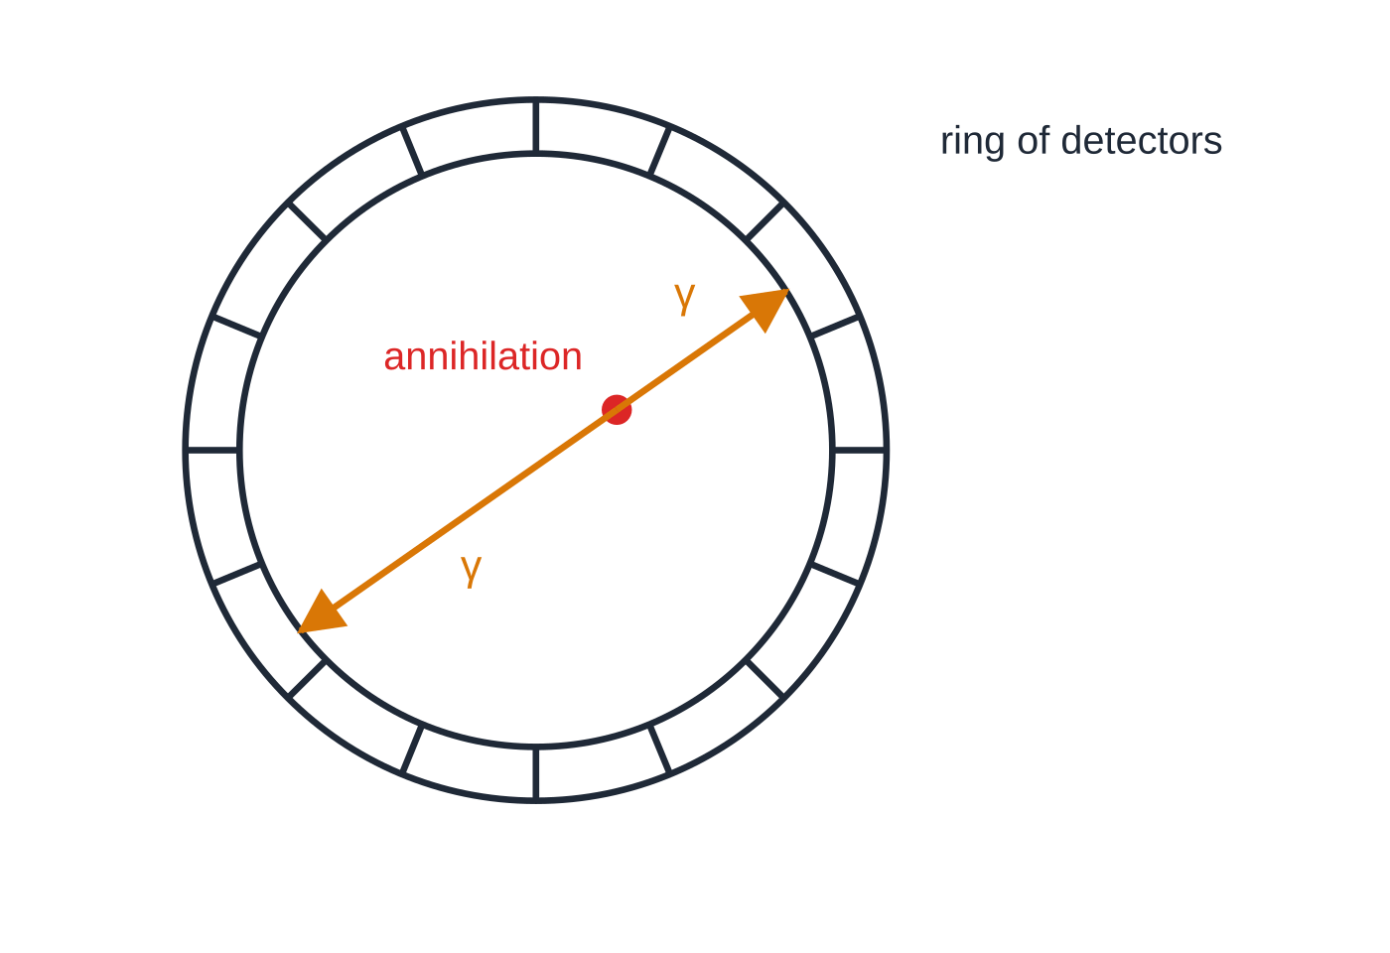
Question 5
7 marks
In a hospital scanner, a radioactive tracer emits positrons inside the patient's body. Each positron slows down and then annihilates with an electron. Assume both particles are at rest when they annihilate. Mass of electron = 9.11 × 10⁻³¹ kg.
Figure: two photons from one annihilation reaching opposite detectors (not to scale)
(a) State what is meant by the antiparticle of a particle. [1]
(b) Explain why the annihilation produces two photons travelling in opposite directions. [2]
(c) Calculate the energy of each photon in joules and its wavelength. [3]
(d) Detectors surround the patient. Suggest how recording two photons at the same moment, on opposite sides, helps to locate where the annihilation took place. [1]
Notes:
Online with the full mark scheme: https://examinerprep.com/ial-physics-4-8-the-standard-model-and-particle-interactions-questions#IALP-U4-8-B-03

Slide 47
Answers

Slide 48
Question 1 · answer
Answer D
Charge, baryon number and lepton number are conserved in every interaction. The number of hadrons can change: for example a proton and an antiproton (two hadrons) can annihilate into three pions.
Notes:
Full mark scheme: https://examinerprep.com/ial-physics-4-8-the-standard-model-and-particle-interactions-questions#IALP-U4-8-A-05

Slide 49
Question 2 · answer
Answer B
Leptons are fundamental particles that are not made of quarks: the electron, muon, tau and the three neutrinos. The neutron and proton are baryons (three quarks) and the pion is a meson (quark and antiquark), so the answer is the muon.
Notes:
Full mark scheme: https://examinerprep.com/ial-physics-4-8-the-standard-model-and-particle-interactions-questions#IALP-U4-8-A-01

Slide 50
Question 3 · answer
Answer A
Rest energy = 1.00 × 10⁹ × 1.60 × 10⁻¹⁹ = 1.60 × 10⁻¹⁰ J. m = E/c² = 1.60 × 10⁻¹⁰ ÷ 9.00 × 10¹⁶ = 1.78 × 10⁻²⁷ kg.
Notes:
Full mark scheme: https://examinerprep.com/ial-physics-4-8-the-standard-model-and-particle-interactions-questions#IALP-U4-8-A-02

Slide 51
Question 4 · answer
Mark scheme
a baryon consists of three quarks
a meson consists of a quark and an antiquark
u u d
+2/3 + 2/3 − 1/3 = +1 (e)
charge −1 (e) and u u d
Notes:
Full mark scheme: https://examinerprep.com/ial-physics-4-8-the-standard-model-and-particle-interactions-questions#IALP-U4-8-B-02

Slide 52
Question 5 · answer
Mark scheme
a particle with the same mass but opposite charge (and opposite baryon/lepton number)
the total momentum before annihilation is (approximately) zero
a single photon would carry momentum, so two photons with equal and opposite momenta are needed to conserve momentum
E = mₑc² = 9.11 × 10⁻³¹ × 9.00 × 10¹⁶ = 8.20 × 10⁻¹⁴ J
λ = hc/E = 6.63 × 10⁻³⁴ × 3.00 × 10⁸ ÷ 8.20 × 10⁻¹⁴
= 2.43 × 10⁻¹² m
the annihilation must have happened somewhere on the straight line joining the two detectors (many such lines cross at the tracer's location)
Notes:
Full mark scheme: https://examinerprep.com/ial-physics-4-8-the-standard-model-and-particle-interactions-questions#IALP-U4-8-B-03

Slide 53
Keep practising
Notes for this topic
Questions on this topic
Build a printable test
ExaminerPrep is an independent tutoring service. It has been developed independently from and is not endorsed by the International Baccalaureate Organization. "International Baccalaureate", "IB" and "IB Diploma Programme" are registered trademarks of the IBO, used here for descriptive purposes only.
Pearson Edexcel and Cambridge are trademarks of their owners; ExaminerPrep is not affiliated with any exam board.

