Slide 1
EP
EDEXCEL IAL PHYSICS
6.2 Uncertainties and logarithmic graphs (A2)
The full notes page in 12 sections · practice questions with answers · simulations
ExaminerPrep is an independent tutoring service. It has been developed independently from and is not endorsed by the International Baccalaureate Organization. "International Baccalaureate", "IB" and "IB Diploma Programme" are registered trademarks of the IBO, used here for descriptive purposes only.
Pearson Edexcel and Cambridge are trademarks of their owners; ExaminerPrep is not affiliated with any exam board.
Notes:
6.2 Uncertainties and logarithmic graphs (A2). Notes for this topic: https://examinerprep.com/notes/edexcel-ial-physics/uncertainties-and-logarithmic-graphs-a2/

Slide 2
What this page covers
Overview
Combining uncertainties: absolute uncertainties for sums and differences
Percentage uncertainties for products and quotients, and multiplying by the power
Percentage difference from an accepted value, compared with the percentage uncertainty, to judge agreement
Error bars, steepest and shallowest gradient lines, and the uncertainty in a gradient and an intercept
Natural and base-10 logarithms, the rules you need, and significant figures in logs
Plotting ln y against x to test y = Aeᵏˣ (capacitor discharge, radioactive decay, absorption)
Plotting log y against log x to test y = kxⁿ and find n and k
Units and significant figures for log columns, axes, gradients and intercepts
Notes:
What this page covers. Full notes: https://examinerprep.com/notes/edexcel-ial-physics/uncertainties-and-logarithmic-graphs-a2/

Slide 3
In one minute
Key points
1. At A2 you carry uncertainties all the way into the final answer: add absolute uncertainties for sums and differences, add percentage uncertainties for products and quotients, and use the result to judge whether the answer agrees with an accepted value.
2. A quantity raised to a power n contributes n times its percentage uncertainty (a square root is the power ½). A small difference between two large readings can have a large percentage uncertainty.
3. Percentage difference = |experimental − accepted| ÷ accepted × 100%. If it is smaller than the percentage uncertainty, the result agrees with the accepted value within its uncertainty.
4. Draw error bars, then the steepest and shallowest lines that still pass through them. Uncertainty in the gradient ≈ (steepest − shallowest) ÷ 2.
5. y = Aeᵏˣ → plot ln y against x: gradient k, intercept ln A. y = kxⁿ → plot log y against log x: gradient n, intercept log k.
6. A log has no unit: label axes ln (V / V).
Notes:
In one minute. Full notes: https://examinerprep.com/notes/edexcel-ial-physics/uncertainties-and-logarithmic-graphs-a2/

Slide 4
In one minute (continued)
Key points
Give a log to as many decimal places as the number has significant figures.
Notes:
In one minute. Full notes: https://examinerprep.com/notes/edexcel-ial-physics/uncertainties-and-logarithmic-graphs-a2/

Slide 5
How do you combine uncertainties when quantities are added or subtracted?
Section 1 of 12
At AS you found the uncertainty of one reading at a time. At A2 most results are calculated from several readings, so you need rules for combining uncertainties. These rules give a cautious, worst-case estimate. Start with a result that is a sum or a difference of two measured values. Each reading could be out by its full uncertainty, and the two errors could happen to push the result the same way. That is true even for a subtraction: if the first reading is slightly too high and the second slightly too low, the difference is too large by both amounts together. So the absolute uncertainties add.
Sums and differences. If y = a + b or y = a - b, then Δy = Δa + Δb, where Δa and Δb are absolute uncertainties in the same unit as a and b. This is a practical-skills rule, not a formula on the data sheet.
Typical cases: a temperature rise, an extension from two scale readings, and a count rate corrected for background. Work out the absolute uncertainty first; turn it into a percentage only if the result goes on into a product or quotient.
Notes:
How do you combine uncertainties when quantities are added or subtracted?. Full notes: https://examinerprep.com/notes/edexcel-ial-physics/uncertainties-and-logarithmic-graphs-a2/

Slide 6
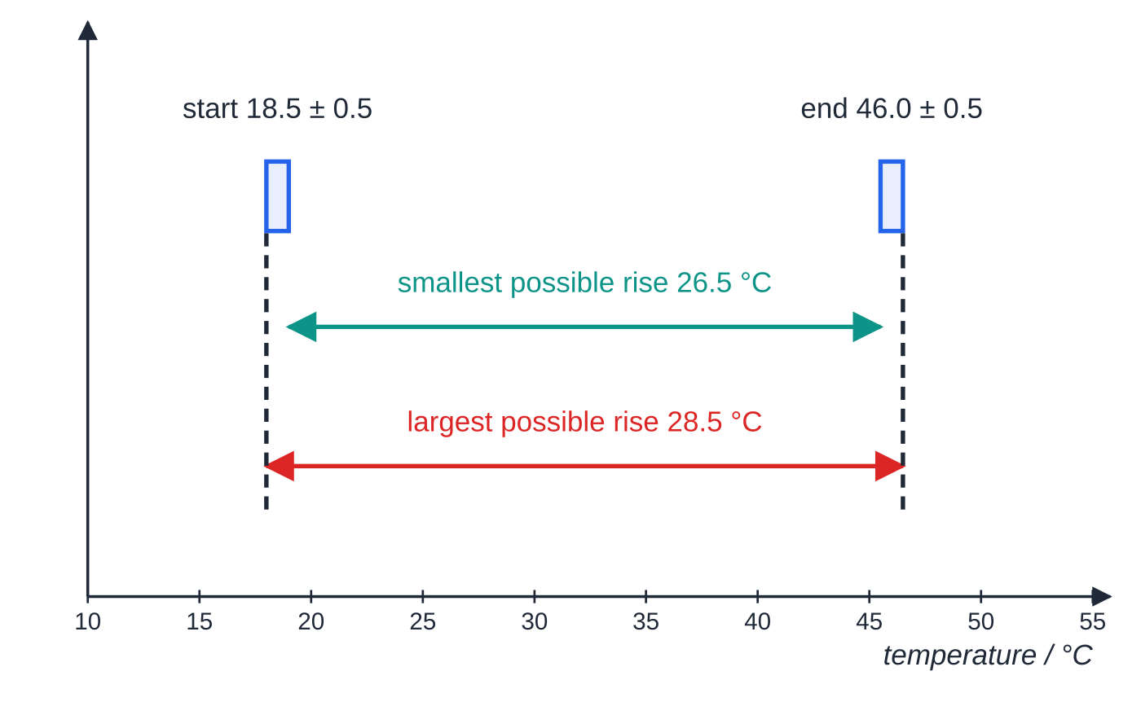
How do you combine uncertainties when quantities are added or subtracted? (continued)
Section 1 of 12
The danger is a small difference between two large readings: the absolute uncertainty stays the same size but becomes a much larger fraction of the result. Design the experiment so the difference is as large as practical.
The rise can be anywhere from 26.5 °C to 28.5 °C, so it is 27.5 °C ± 1.0 °C: absolute uncertainties add even though the readings are subtracted.
Notes:
How do you combine uncertainties when quantities are added or subtracted?. Full notes: https://examinerprep.com/notes/edexcel-ial-physics/uncertainties-and-logarithmic-graphs-a2/

Slide 7
How do you combine uncertainties when quantities are added or subtracted? (continued)
Section 1 of 12 · Worked example 1 · Easy · Calculate
WORKED EXAMPLE · QUESTION
A block is heated electrically. A thermometer with 1 °C divisions reads 18.5 °C at the start and 46.0 °C at the end; each reading is ± 0.5 °C. Calculate the temperature rise, its absolute uncertainty and its percentage uncertainty, and compare the last with the percentage uncertainty of the final reading alone.
SOLUTION
Step 1 The rise is a difference: Δθ = 46.0 − 18.5 = 27.5 °C.
Step 2 Add the absolute uncertainties: 0.5 + 0.5 = ± 1.0 °C.
Step 3 Percentage uncertainty: 1.0 ÷ 27.5 × 100 = 3.6%. The 46.0 °C reading alone is only 0.5 ÷ 46.0 × 100 = 1.1%.
Δθ = 27.5 °C ± 1.0 °C (3.6%), over three times the 1.1% of one reading. Heating for longer would cut the percentage, because the ± 1.0 °C stays the same.
Notes:
How do you combine uncertainties when quantities are added or subtracted?: Worked example 1. Full notes: https://examinerprep.com/notes/edexcel-ial-physics/uncertainties-and-logarithmic-graphs-a2/

Slide 8
How do you combine uncertainties for products, quotients and powers?
Section 2 of 12
For products and quotients the percentage uncertainties combine. If a is 2% too big and b is 3% too big, ab is about 5% too big. If b is 3% too small and on the bottom of a fraction, a/b is again about 5% too big: uncertainties never cancel.
Products, quotients and powers.
If y = (aᵖ b^q)/cʳ, then
%y = p(%a) + q(%b) + r(%c)
with each power used as a positive number. Then turn the total back into an absolute uncertainty: Δy = y ×%y ÷100. This is a practical-skills rule to learn.
Powers. A square doubles the percentage uncertainty, a cube triples it and a square root halves it. For small uncertainties (1+p)² ≈1 + 2p, which is where the factor comes from.
Exact numbers (2, π, ½, a count of 20 oscillations) have no uncertainty and contribute nothing.
Notes:
How do you combine uncertainties for products, quotients and powers?. Full notes: https://examinerprep.com/notes/edexcel-ial-physics/uncertainties-and-logarithmic-graphs-a2/

Slide 9
How do you combine uncertainties for products, quotients and powers? (continued)
Section 2 of 12
A constant multiplier changes the value but not the percentage uncertainty: T = (time for 20 swings) ÷ 20 has the same percentage uncertainty as the time.
Mixed calculations such as c = E ÷mΔθ: absolute uncertainty of the difference first, then its percentage, then add percentages.
Rounding. Give the final absolute uncertainty to 1 (or 2) significant figures and the value to the same decimal place.
The quantity with the highest power usually dominates the total, so it deserves the most precise instrument: for a wire, measure the diameter with a micrometer at several places and average.
Notes:
How do you combine uncertainties for products, quotients and powers?. Full notes: https://examinerprep.com/notes/edexcel-ial-physics/uncertainties-and-logarithmic-graphs-a2/

Slide 10
How do you combine uncertainties for products, quotients and powers? (continued)
Section 2 of 12 · Worked example 2 · Medium · Calculate
WORKED EXAMPLE · QUESTION
For a wire, R = 6.4 Ω ± 0.1 Ω, diameter d = 0.28 mm ± 0.01 mm and length l = 0.850 m ± 0.002 m. Calculate the resistivity ρ = RA/l, where A = πd²/4, and its absolute uncertainty.
SOLUTION
Step 1 The value: A = π(0.28 × 10⁻³)² ÷ 4 = 6.16 × 10⁻⁸ m², so ρ = 6.4 × 6.16 × 10⁻⁸ ÷ 0.850 = 4.64 × 10⁻⁷ Ω m.
Step 2 Percentage uncertainty of each measurement: %R = 0.1 ÷ 6.4 × 100 = 1.6%; %d = 0.01 ÷ 0.28 × 100 = 3.6%; %l = 0.002 ÷ 0.850 × 100 = 0.24%.
Step 3 d is squared, so its percentage counts twice; add everything: %ρ = 1.6 + 2 × 3.6 + 0.24 = 8.9%.
Step 4 Back to an absolute uncertainty: Δρ = 8.9% × 4.64 × 10⁻⁷ = 0.41 × 10⁻⁷ Ω m.
ρ = (4.6 ± 0.4) × 10⁻⁷ Ω m. The uncertainty is quoted to 1 s.f., so the value is rounded to the same decimal place (4.6, not 4.64).
Notes:
How do you combine uncertainties for products, quotients and powers?: Worked example 2. Full notes: https://examinerprep.com/notes/edexcel-ial-physics/uncertainties-and-logarithmic-graphs-a2/

Slide 11
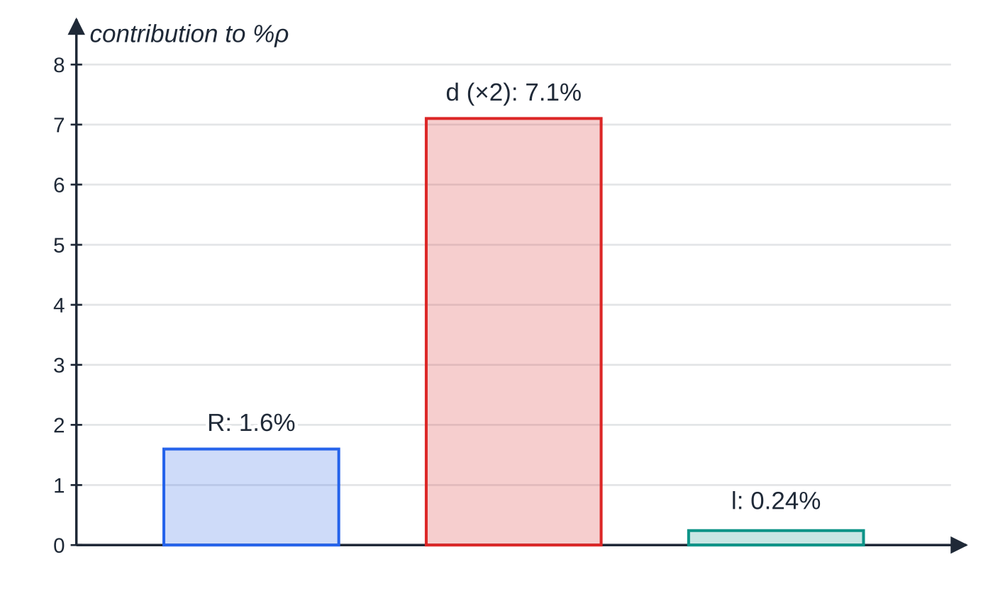
How do you combine uncertainties for products, quotients and powers? (continued)
Section 2 of 12
Common error
Subtracting the percentage uncertainty of a quantity on the bottom of a fraction. Multiplying or dividing, its percentage (times its power) is added.
Worked example 2: the diameter is the least precise measurement and is squared, so it supplies 7.1 of the 8.9 percentage points. Improving the length measurement would make almost no difference.
Notes:
How do you combine uncertainties for products, quotients and powers?. Full notes: https://examinerprep.com/notes/edexcel-ial-physics/uncertainties-and-logarithmic-graphs-a2/

Slide 12
How do you decide whether a result agrees with an accepted value?
Section 3 of 12
Once a result has an uncertainty, you can ask whether it is any good. Two different percentages answer two different questions.
Percentage difference = (|experimental value - accepted value|)/(accepted value) ×100%. It measures how accurate the result is (how close to the accepted value). The percentage uncertainty measures how precise it is (how wide its range). Learn this; it is not on the data sheet.
Percentage difference < percentage uncertainty: the accepted value lies inside the range of your result, so the result agrees with (is consistent with) it within the experimental uncertainty.
Percentage difference > percentage uncertainty: the accepted value lies outside your range. The uncertainties you estimated cannot explain the gap, so there is probably a systematic error, or an uncertainty you have not allowed for. Say what it might be and which way it pushes the result.
Equivalent check: does the accepted value fall inside value ± uncertainty?
Notes:
How do you decide whether a result agrees with an accepted value?. Full notes: https://examinerprep.com/notes/edexcel-ial-physics/uncertainties-and-logarithmic-graphs-a2/

Slide 13
How do you decide whether a result agrees with an accepted value? (continued)
Section 3 of 12
With no accepted value (two methods, or a tolerance such as "470 μF ± 10%"), compare the two ranges: if they overlap, the values are consistent.
Notes:
How do you decide whether a result agrees with an accepted value?. Full notes: https://examinerprep.com/notes/edexcel-ial-physics/uncertainties-and-logarithmic-graphs-a2/

Slide 14
How do you decide whether a result agrees with an accepted value? (continued)
Section 3 of 12 · Worked example 3 · Medium · Calculate, deduce
WORKED EXAMPLE · QUESTION
A student finds the p.d. at which a red LED just starts to conduct, V = 1.74 V ± 0.05 V. The LED's wavelength is given as 630 nm ± 10 nm. She uses h = eVλ/c. (a) Calculate h and its percentage uncertainty. (b) Decide whether her value agrees with the accepted value, 6.63 × 10⁻³⁴ J s, and comment.
SOLUTION
(a) e and c are constants with no uncertainty: h = 1.60 × 10⁻¹⁹ × 1.74 × 630 × 10⁻⁹ ÷ 3.00 × 10⁸ = 5.85 × 10⁻³⁴ J s. Add the percentage uncertainties: 0.05 ÷ 1.74 × 100 + 10 ÷ 630 × 100 = 2.9% + 1.6% = 4.5%.
(b) Percentage difference: (6.63 − 5.85) ÷ 6.63 × 100 = 12%, more than twice the 4.5% uncertainty. The value does not agree: (5.85 ± 0.26) × 10⁻³⁴ J s reaches only 6.11. A systematic error is likely. Judging the "switch-on" p.d. by eye gives a value that is too low, which makes h too low.
Notes:
How do you decide whether a result agrees with an accepted value?: Worked example 3. Full notes: https://examinerprep.com/notes/edexcel-ial-physics/uncertainties-and-logarithmic-graphs-a2/

Slide 15
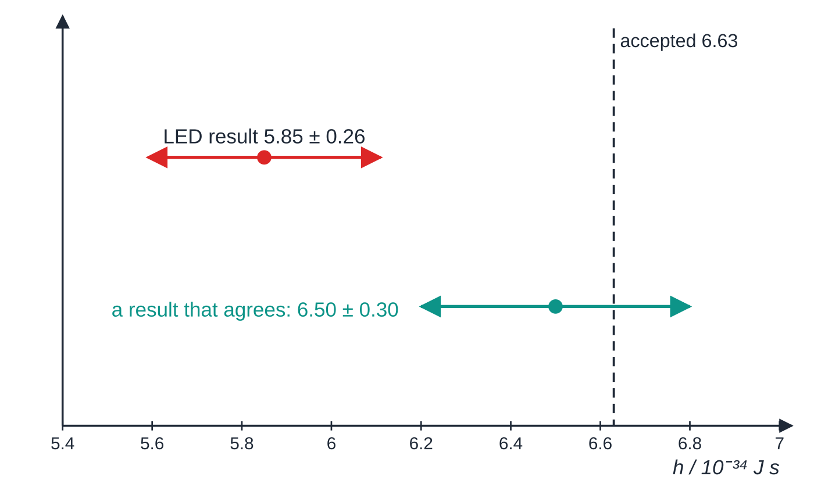
How do you decide whether a result agrees with an accepted value? (continued)
Section 3 of 12
Worked example 3 as a number line. The LED range stops short of 6.63; a range that includes the accepted value (teal) agrees with it.
Notes:
How do you decide whether a result agrees with an accepted value?. Full notes: https://examinerprep.com/notes/edexcel-ial-physics/uncertainties-and-logarithmic-graphs-a2/

Slide 16
How do you find the uncertainty in a gradient and an intercept?
Section 4 of 12
Most Unit 6 results come from the gradient or intercept of a straight-line graph, so the uncertainty is found from the graph itself.
Error bars. A vertical bar through each point, ± the uncertainty in y (horizontal too if x is uncertain), from the resolution or half-range of repeats.
Best-fit line. As at AS, with points scattered evenly about it; it should pass through (almost) all the error bars.
Steepest and shallowest lines. The steepest and least steep straight lines that still pass through all the error bars. In practice they usually join the bottom of the first bar to the top of the last bar, and the top of the first to the bottom of the last.
Uncertainty in the gradient ≈ (steepest − shallowest) ÷ 2. Another common method uses |best − worst|, with whichever extreme line differs more from the best fit; either way, show the gradients you used.
Notes:
How do you find the uncertainty in a gradient and an intercept?. Full notes: https://examinerprep.com/notes/edexcel-ial-physics/uncertainties-and-logarithmic-graphs-a2/

Slide 17
How do you find the uncertainty in a gradient and an intercept? (continued)
Section 4 of 12
Uncertainty in the intercept: half the difference between the intercepts of the steepest and shallowest lines. A long extrapolation makes it far less certain than the gradient.
Percentage uncertainty in the gradient = uncertainty ÷ best gradient × 100%; it feeds into anything calculated from the gradient.
Notes:
How do you find the uncertainty in a gradient and an intercept?. Full notes: https://examinerprep.com/notes/edexcel-ial-physics/uncertainties-and-logarithmic-graphs-a2/

Slide 18
How do you find the uncertainty in a gradient and an intercept? (continued)
Section 4 of 12 · Worked example 4 · Hard · Determine
WORKED EXAMPLE · QUESTION
Air is sealed in a flask of fixed volume and heated in a water bath. Pressure p is read from a gauge with an uncertainty of ± 1.0 kPa.
θ / °C | 20 | 30 | 40 | 50 | 60 | 70 | 80 | 90
p / kPa | 107.4 | 110.8 | 114.7 | 118.1 | 122.0 | 125.4 | 129.1 | 133.0
The best-fit line passes through (20 °C, 107.3 kPa) and (90 °C, 132.8 kPa). (a) Calculate its gradient and the temperature at which it predicts p = 0. (b) Use the steepest and shallowest lines to find the uncertainties. (c) Compare the result with −273 °C.
Notes:
How do you find the uncertainty in a gradient and an intercept?: Worked example 4. Full notes: https://examinerprep.com/notes/edexcel-ial-physics/uncertainties-and-logarithmic-graphs-a2/

Slide 19
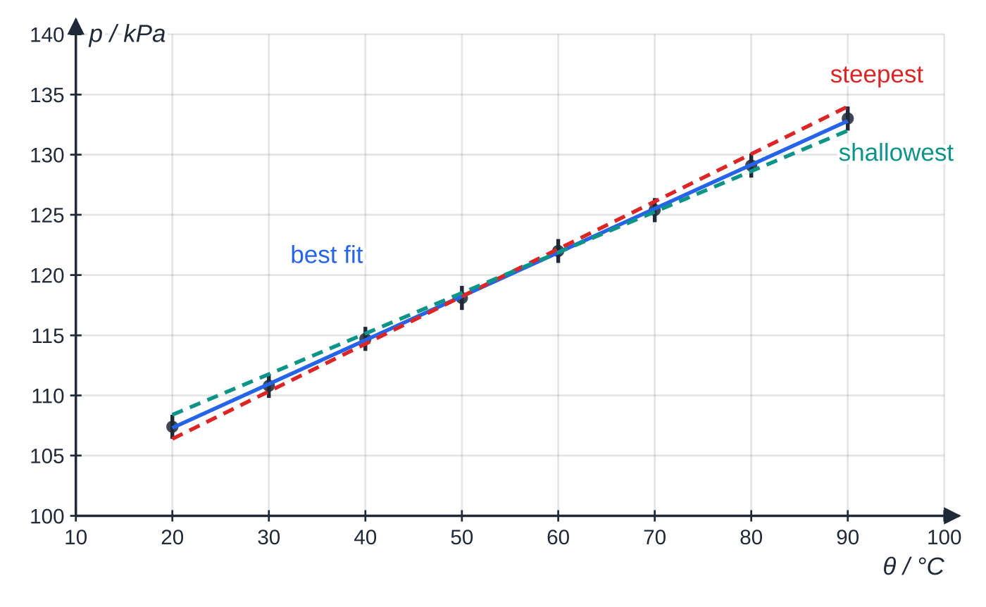
How do you find the uncertainty in a gradient and an intercept? (continued)
Section 4 of 12 · Worked example 4 · Hard · Determine (continued)
SOLUTION
(a) gradient = (132.8 − 107.3) ÷ 70 = 0.364 kPa °C⁻¹. p = 0 when θ = 20 − 107.3 ÷ 0.364 = −275 °C.
(b) Steepest: (134.0 − 106.4) ÷ 70 = 0.394; shallowest: (132.0 − 108.4) ÷ 70 = 0.337. Uncertainty = (0.394 − 0.337) ÷ 2 = ± 0.029 kPa °C⁻¹ (7.8%). Extrapolate each line to p = 0: steepest 20 − 106.4 ÷ 0.394 = −250 °C; shallowest 20 − 108.4 ÷ 0.337 = −302 °C, so the intercept is uncertain by ± 26 °C.
(c) Result (−275 ± 26) °C.
The steepest line joins (20 °C, 106.4 kPa) to (90 °C, 134.0 kPa); the shallowest joins (20 °C, 108.4 kPa) to (90 °C, 132.0 kPa). Both still pass through every ± 1.0 kPa error bar.
Notes:
How do you find the uncertainty in a gradient and an intercept?: Worked example 4. Full notes: https://examinerprep.com/notes/edexcel-ial-physics/uncertainties-and-logarithmic-graphs-a2/

Slide 20
How do you find the uncertainty in a gradient and an intercept? (continued)
Section 4 of 12 · Worked example 4 · Hard · Determine (continued)
Percentage difference from −273 °C = 0.7%, far inside the ± 9% range: the data agree with −273 °C.
Notes:
How do you find the uncertainty in a gradient and an intercept?: Worked example 4. Full notes: https://examinerprep.com/notes/edexcel-ial-physics/uncertainties-and-logarithmic-graphs-a2/

Slide 21
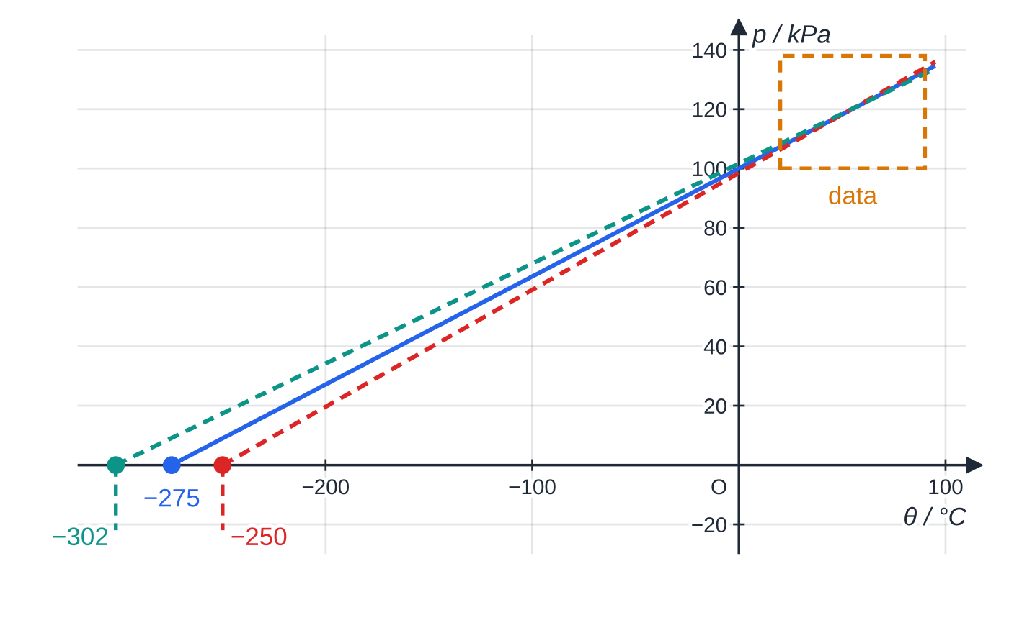
How do you find the uncertainty in a gradient and an intercept? (continued)
Section 4 of 12
The same three lines extended to p = 0. The gradients differ by only 0.057 kPa °C⁻¹, but more than 290 °C beyond the data their intercepts are 52 °C apart: long extrapolation magnifies small gradient differences.
Notes:
How do you find the uncertainty in a gradient and an intercept?. Full notes: https://examinerprep.com/notes/edexcel-ial-physics/uncertainties-and-logarithmic-graphs-a2/

Slide 22
What do you need to know about logarithms?
Section 5 of 12
Exponential and power-law relationships give curves, which are hard to judge by eye. Taking logs turns both into straight lines whose gradient and intercept give the constants. First, the log skills themselves.
Two bases. ln uses base e (≈ 2.718): ln eˣ = x. log (or lg) uses base 10: log 10ˣ = x. Use the one the question uses, and stay with it.
The three rules (true for either base): log(ab) = log a + log b, log(a/b) = log a - log b, log(aⁿ) = nlog a.
Units. Only a pure number has a log, so divide by the unit first: ln (V / V), log (T / s). Logs have no unit.
Significant figures. Give a log to the same number of decimal places as the number has significant figures. 5.83 V (3 s.f.) → ln 5.83 = 1.763; 0.64 V (2 s.f.) → ln 0.64 = −0.45. The digits before the decimal point only say where the decimal point was.
Error bars on a log graph. Δ(ln y) ≈Δy ÷y, the fractional uncertainty. For 2.38 V ± 0.05 V: ln 2.43 = 0.888 and ln 2.33 = 0.846 either side of ln 2.38 = 0.867, about ± 0.021.
Notes:
What do you need to know about logarithms?. Full notes: https://examinerprep.com/notes/edexcel-ial-physics/uncertainties-and-logarithmic-graphs-a2/

Slide 23
What do you need to know about logarithms? (continued)
Section 5 of 12
The bars grow as y gets smaller.
Changing base. log y = 0.434ln y. So if you plot log y for an exponential, the gradient is 0.434k, not k: another reason to use ln for exponentials.
Relationship | Plot y | against x | Gradient | Intercept
y = Aeᵏˣ (exponential) | ln y | x | k (unit: 1 / unit of x) | ln A
y = kxⁿ (power law) | log y (or ln y) | log x (or ln x) | n (no unit) | log k (or ln k)
V = V₀e^(−t/RC) | ln V | t | −1/RC | ln V₀
N = N₀e^(−λt) (or activity, count rate) | ln N | t | −λ | ln N₀
T = 2π√(l/g) | log T | log l | 0.5 | log (2π/√g)
Notes:
What do you need to know about logarithms?. Full notes: https://examinerprep.com/notes/edexcel-ial-physics/uncertainties-and-logarithmic-graphs-a2/

Slide 24
What do you need to know about logarithms? (continued)
Section 5 of 12
Exam tip
Before plotting, take logs of both sides of the equation in writing and line the result up under y = mx + c. That one line tells you what to plot, what the gradient means and what the intercept means, and it is often asked for on its own.
Notes:
What do you need to know about logarithms?. Full notes: https://examinerprep.com/notes/edexcel-ial-physics/uncertainties-and-logarithmic-graphs-a2/

Slide 25
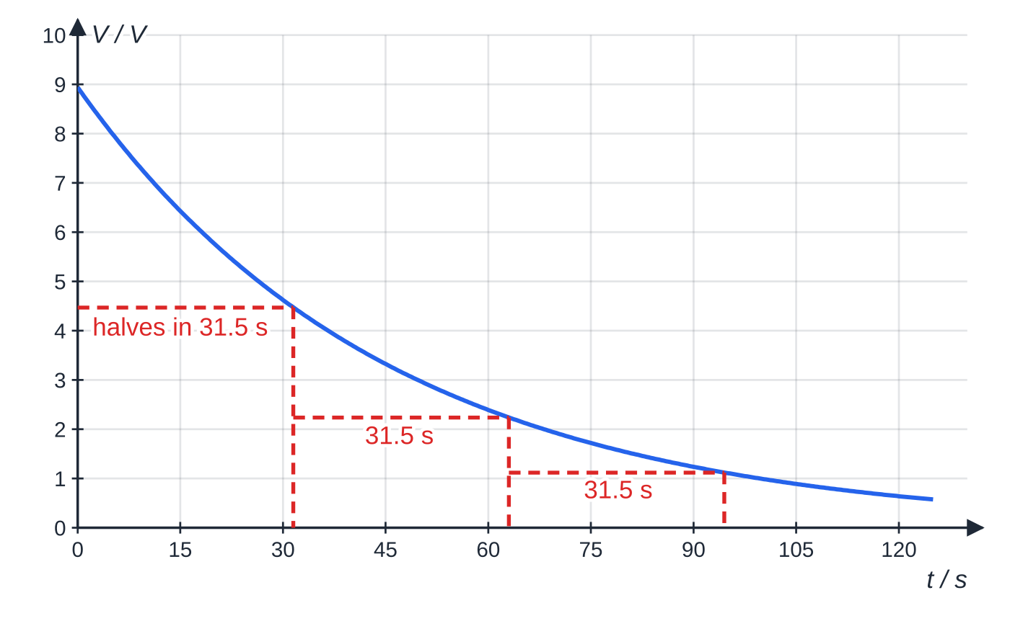
How do you test an exponential relationship with a log graph?
Section 6 of 12
An exponential change has a constant ratio in equal intervals of x: the same fraction is lost every 15 s, every half-life, every millimetre of absorber. A falling curve could be many things, so the curve alone is never convincing.
Take natural logs of y = Aeᵏˣ:
ln y = ln A + kx
This matches y = mx + c with ln y against x.
The constant-ratio property: the p.d. halves every 31.5 s (= ln 2 × RC) whatever the starting value. Equal times, equal fractions lost.
Notes:
How do you test an exponential relationship with a log graph?. Full notes: https://examinerprep.com/notes/edexcel-ial-physics/uncertainties-and-logarithmic-graphs-a2/

Slide 26
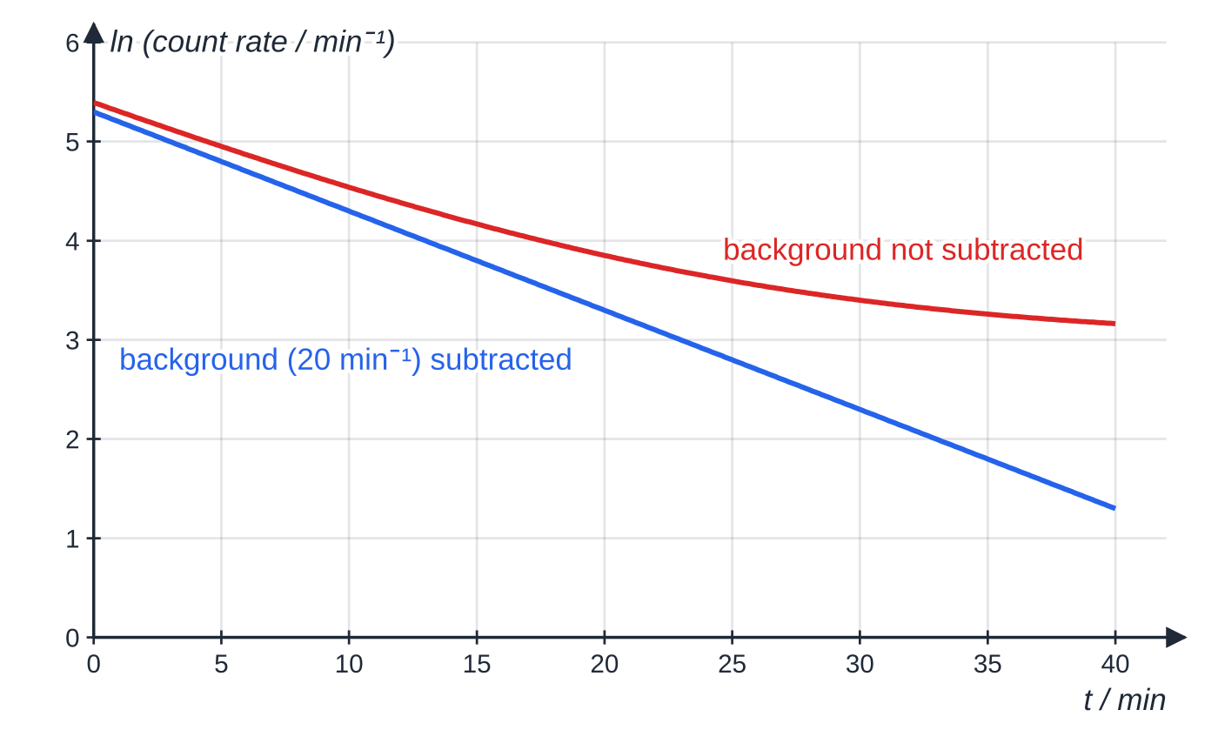
How do you test an exponential relationship with a log graph? (continued)
Section 6 of 12
A straight line means the relationship is exponential; the gradient is k and the intercept ln A, so A = eⁱⁿᵗᵉʳᶜᵉᵖᵗ, with the unit of y.
For a decay k is negative: the gradient gives the decay constant (−λ) or −1/RC.
Half-life (time to halve) = ln 2 ÷ |gradient|.
Correct the data first if the physics needs it: subtract the background count from a count rate, or the room temperature from a cooling temperature, before taking logs. Uncorrected data give a curve on the log graph.
A source with a background of 20 counts per minute. Uncorrected, the ln graph curves towards ln 20; corrected, it is straight with gradient −0.1 min⁻¹ = −λ.
Notes:
How do you test an exponential relationship with a log graph?. Full notes: https://examinerprep.com/notes/edexcel-ial-physics/uncertainties-and-logarithmic-graphs-a2/

Slide 27
How do you test an exponential relationship with a log graph? (continued)
Section 6 of 12 · Worked example 5 · Hard · Show that, determine
WORKED EXAMPLE · QUESTION
A capacitor discharges through a 100 kΩ resistor; a data logger records the p.d. V across it. The capacitor is labelled 470 μF ± 10%.
t / s | V / V | ln (V / V)
0 | 8.95 | 2.192
15 | 6.43 | 1.861
30 | 4.61 | 1.528
45 | 3.32 | 1.200
60 | 2.38 | 0.867
75 | 1.71 | 0.536
90 | 1.23 | 0.207
Notes:
How do you test an exponential relationship with a log graph?: Worked example 5. Full notes: https://examinerprep.com/notes/edexcel-ial-physics/uncertainties-and-logarithmic-graphs-a2/

Slide 28
How do you test an exponential relationship with a log graph? (continued)
Section 6 of 12 · Worked example 5 · Hard · Show that, determine (continued)
t / s | V / V | ln (V / V)
105 | 0.88 | −0.13
120 | 0.64 | −0.45
(a) Show that a graph of ln V against t should be a straight line. (b) Use the graph to determine the capacitance. (c) Decide whether the result is consistent with the label.
Notes:
How do you test an exponential relationship with a log graph?: Worked example 5. Full notes: https://examinerprep.com/notes/edexcel-ial-physics/uncertainties-and-logarithmic-graphs-a2/

Slide 29
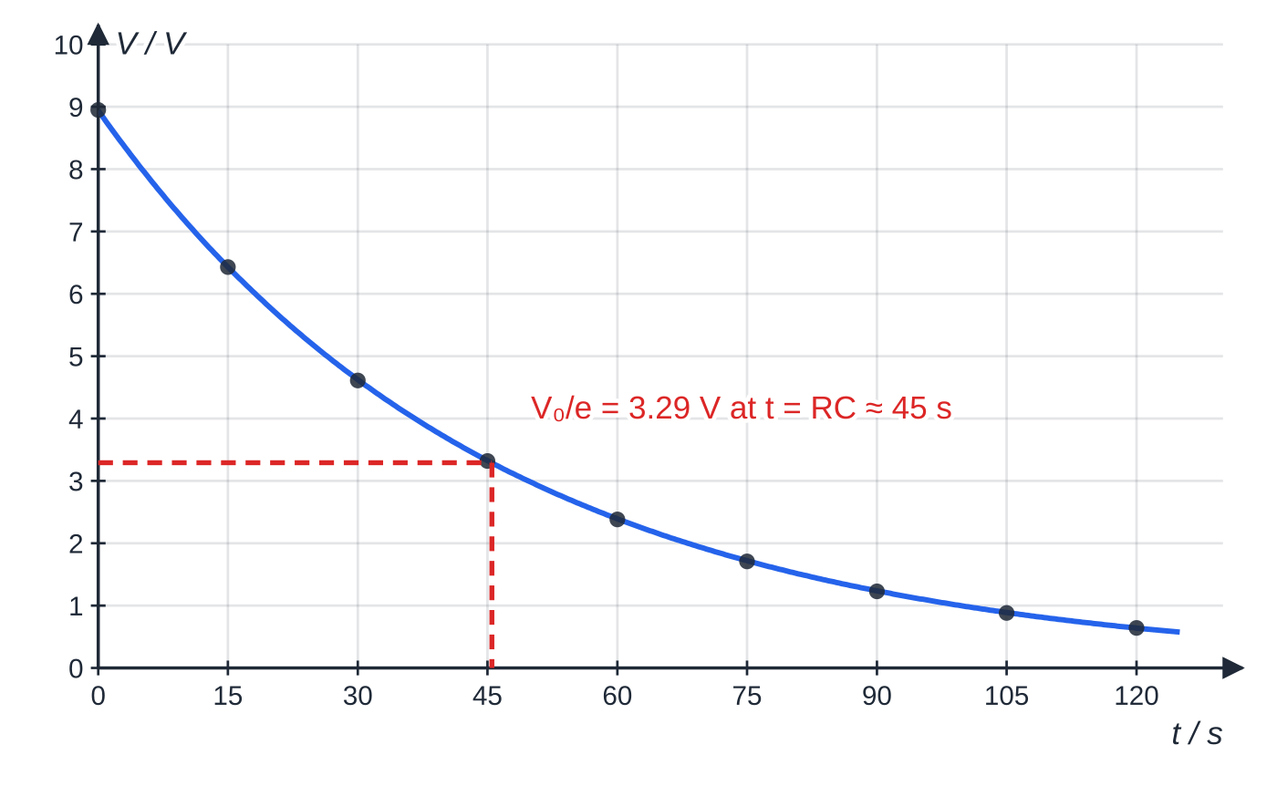
How do you test an exponential relationship with a log graph? (continued)
Section 6 of 12 · Worked example 5 · Hard · Show that, determine (continued)
The discharge data on ordinary axes: exponential, or some other falling curve? The log graph settles it. After one time constant (about 45 s) V has fallen to 3.29 V, 1/e of 8.94 V.
Notes:
How do you test an exponential relationship with a log graph?: Worked example 5. Full notes: https://examinerprep.com/notes/edexcel-ial-physics/uncertainties-and-logarithmic-graphs-a2/

Slide 30
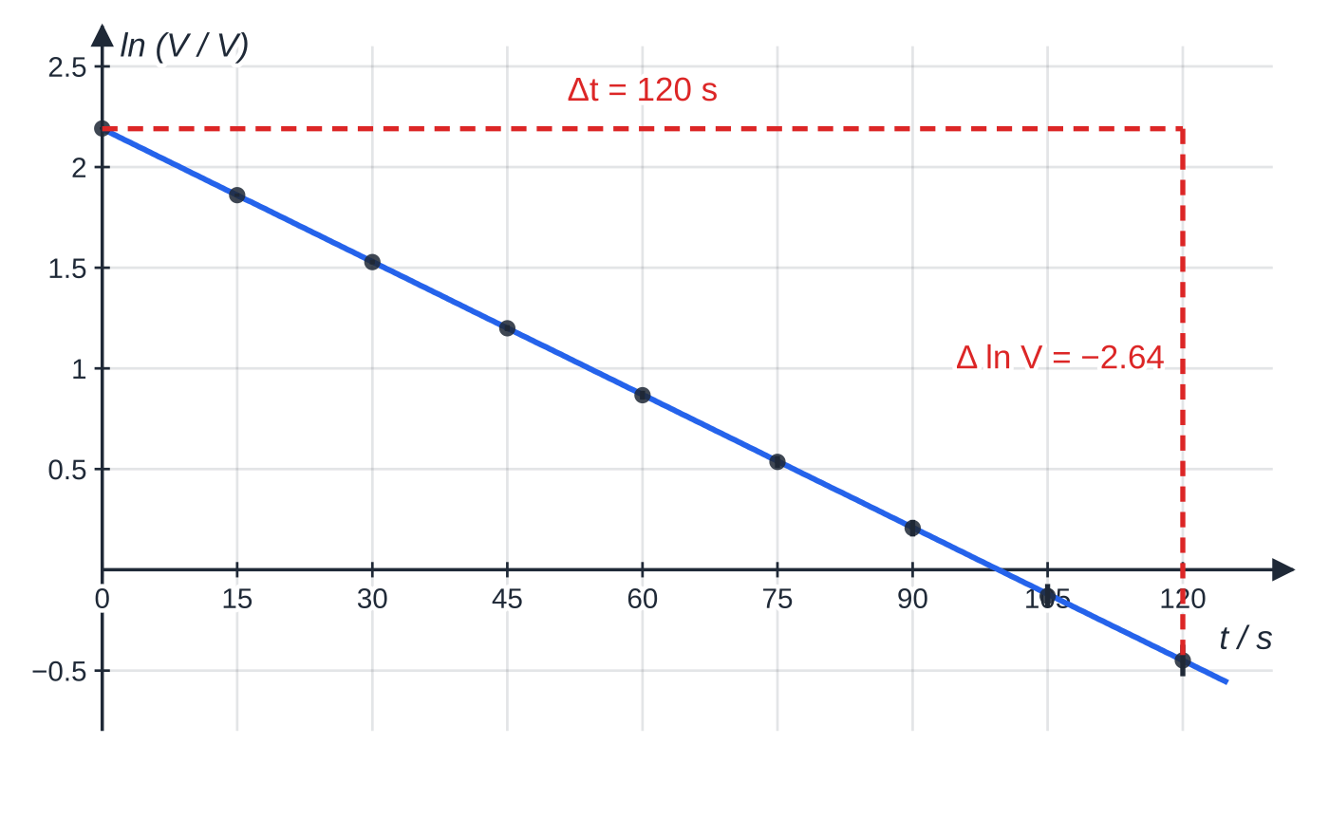
How do you test an exponential relationship with a log graph? (continued)
Section 6 of 12 · Worked example 5 · Hard · Show that, determine (continued)
SOLUTION
(a) Take natural logs of V = V₀ e^(-t/RC): ln V = ln V₀ - 1/RCt, which matches y = c + mx. A straight line of gradient −1/RC and intercept ln V₀.
(b) Gradient from the triangle, values read from the line: (−0.45 − 2.19) ÷ (120 − 0) = −0.0220 s⁻¹. RC = 1 ÷ 0.0220 = 45.5 s, so C = 45.5 ÷ (100 × 10³) = 455 μF (4.55 × 10⁻⁴ F).
(c) Percentage difference from the label: (470 − 455) ÷ 470 × 100 = 3.2% < 10%: consistent with the label.
The same data as ln (V / V) against t: a straight line, so the discharge is exponential. The triangle spans the whole line, from 2.19 at 0 s to −0.45 at 120 s. Error bars of ± 0.05 V become ± 0.05/V in ln V, so they grow as V falls.
Notes:
How do you test an exponential relationship with a log graph?: Worked example 5. Full notes: https://examinerprep.com/notes/edexcel-ial-physics/uncertainties-and-logarithmic-graphs-a2/

Slide 31
How do you test an exponential relationship with a log graph? (continued)
Section 6 of 12 · Worked example 5 · Hard · Show that, determine (continued)
The intercept, 2.19, gives V₀ = e^(2.19) = 8.94 V, matching the first reading. The time for the p.d. to halve is ln 2 × RC = 31.5 s.
Notes:
How do you test an exponential relationship with a log graph?: Worked example 5. Full notes: https://examinerprep.com/notes/edexcel-ial-physics/uncertainties-and-logarithmic-graphs-a2/

Slide 32
How do you test a power law with a log–log graph?
Section 7 of 12
For y = kxⁿ with n unknown, y against x is a curve you cannot read n from. Take logs of both sides:
log y = nlog x + log k
Plot log y against log x; a straight line confirms a power law.
The gradient is the power n and has no unit. Either base works and gives the same n; just use the same base on both axes.
The intercept is log k, but only where log x = 0. The log x axis rarely starts at 0, so calculate it: log k = log y − n log x using a point on the line, then k = 10^(log k).
If theory predicts the power (0.5 for a pendulum, −2 for an inverse-square law), compare your n with it using its uncertainty from the extreme lines.
If you already know n, a direct linear graph (T² against l) is simpler; use log–log when n itself is the question.
Notes:
How do you test a power law with a log–log graph?. Full notes: https://examinerprep.com/notes/edexcel-ial-physics/uncertainties-and-logarithmic-graphs-a2/

Slide 33
How do you test a power law with a log–log graph? (continued)
Section 7 of 12 · Worked example 6 · Hard · Determine
WORKED EXAMPLE · QUESTION
Astronomers measure the orbital radius r and period T of five moons of a distant planet. They expect T = krⁿ.
r / 10⁸ m | T / 10⁴ s | log (r / m) | log (T / s)
1.20 | 3.53 | 8.079 | 4.548
1.95 | 7.32 | 8.290 | 4.865
3.10 | 14.7 | 8.491 | 5.167
4.85 | 28.7 | 8.686 | 5.458
7.40 | 54.1 | 8.869 | 5.733
(a) Use the graph to determine n. (b) For circular orbits, T = (2π/√(GM)) r^(1.5). Determine the mass M of the planet.
Notes:
How do you test a power law with a log–log graph?: Worked example 6. Full notes: https://examinerprep.com/notes/edexcel-ial-physics/uncertainties-and-logarithmic-graphs-a2/

Slide 34
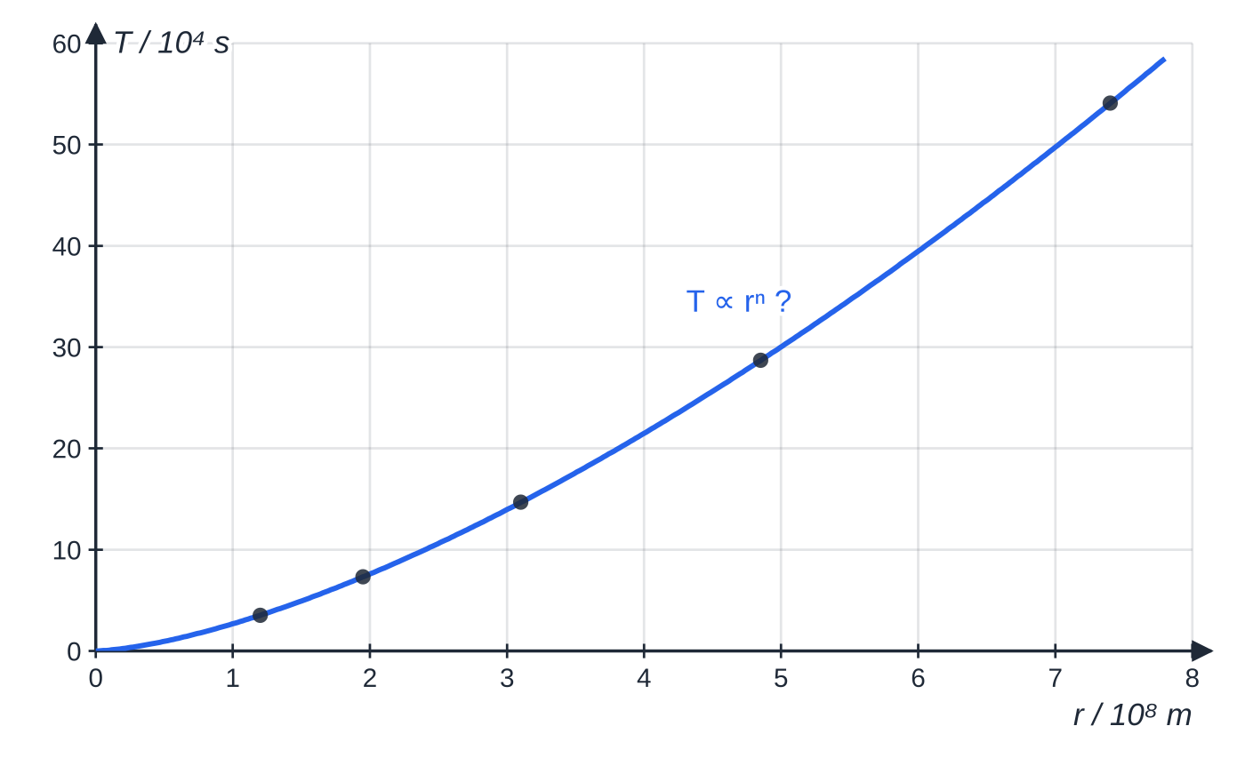
How do you test a power law with a log–log graph? (continued)
Section 7 of 12 · Worked example 6 · Hard · Determine (continued)
On ordinary axes the moon data curve upwards. From this graph alone you cannot tell whether the power is 1.5, 1.4 or 2.
Notes:
How do you test a power law with a log–log graph?: Worked example 6. Full notes: https://examinerprep.com/notes/edexcel-ial-physics/uncertainties-and-logarithmic-graphs-a2/

Slide 35
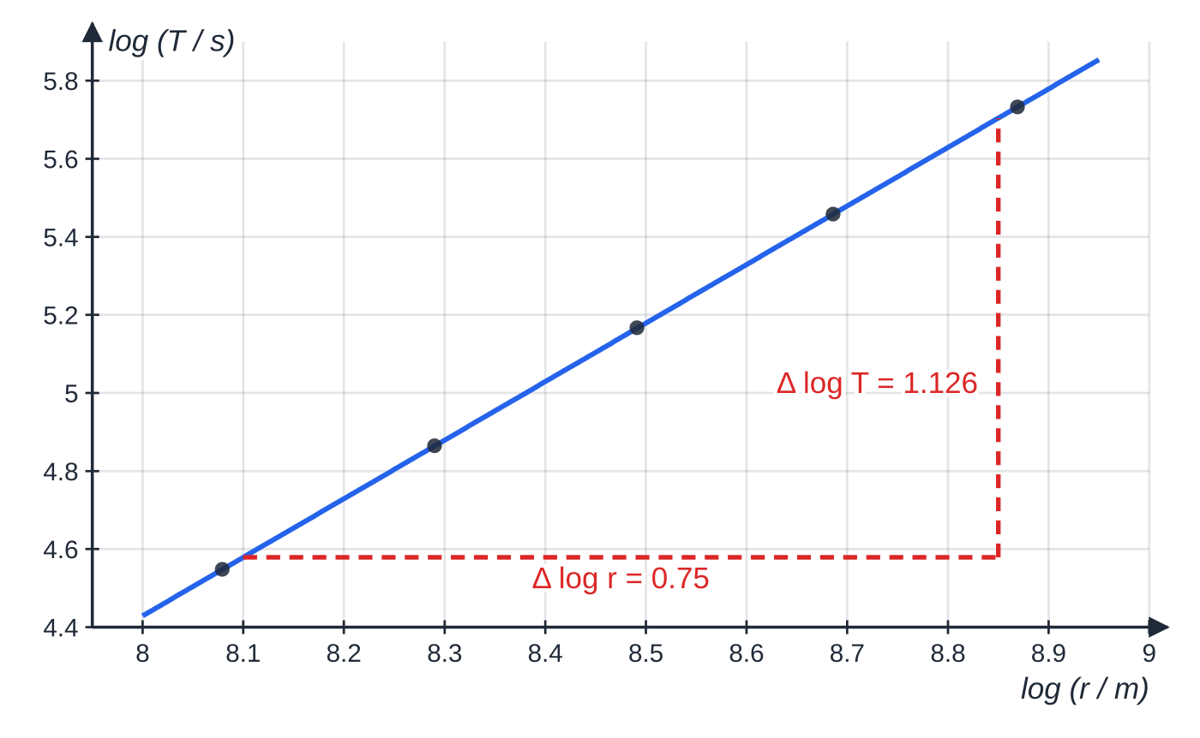
How do you test a power law with a log–log graph? (continued)
Section 7 of 12 · Worked example 6 · Hard · Determine (continued)
SOLUTION
(a) Gradient from the triangle: n = (5.705 − 4.579) ÷ (8.85 − 8.10) = 1.126 ÷ 0.75 = 1.50.
(b) log k from a point on the line, with n = 1.50: log k = 4.579 − 1.50 × 8.10 = −7.571, so k = 10^(−7.571) = 2.69 × 10⁻⁸ s m^(−1.5). Match k to 2π/√(GM) and rearrange: M = 4π² ÷ (Gk²) = 4π² ÷ (6.67 × 10⁻¹¹ × (2.69 × 10⁻⁸)²) = 8.2 × 10²⁶ kg.
M ∝ 1/k² = 10⁻²ˡᵒᵍᵏ, so an error of 0.01 in log k changes M by about 5%: keep three decimal places in logs.
log (T / s) against log (r / m) is a straight line of gradient 1.50, so T ∝ r^(1.5). The triangle uses points read from the line, not data points.
Notes:
How do you test a power law with a log–log graph?: Worked example 6. Full notes: https://examinerprep.com/notes/edexcel-ial-physics/uncertainties-and-logarithmic-graphs-a2/

Slide 36
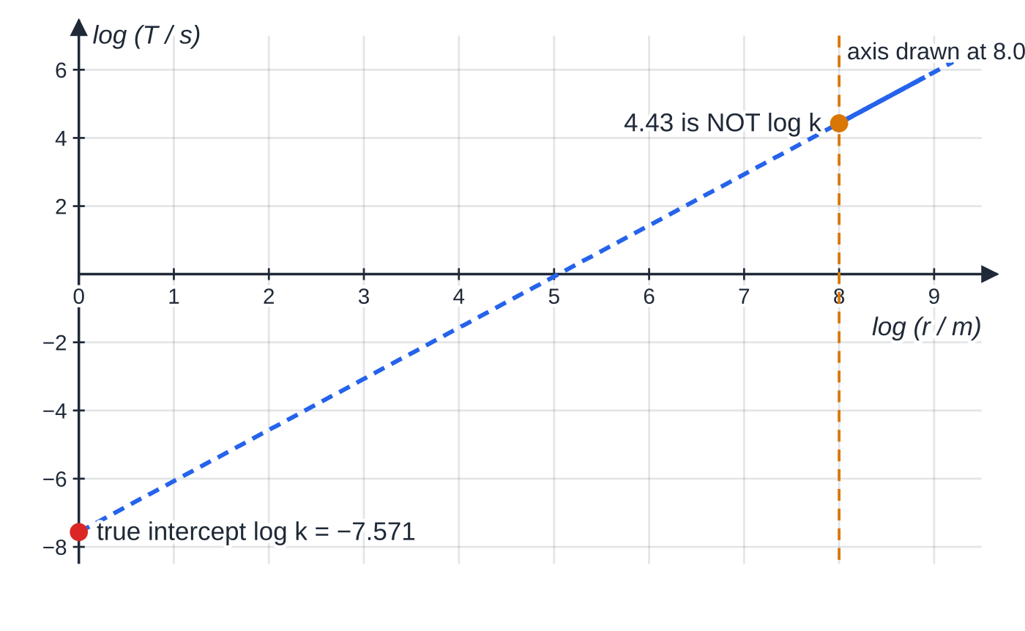
How do you test a power law with a log–log graph? (continued)
Section 7 of 12
Common error
Reading the "intercept" of a log–log graph where the line meets the vertical axis drawn at log x = 8.0. That is not log k; log k is the value at log x = 0. Calculate it from c = y − mx.
The data occupy only the solid part, log r ≈ 8 to 9. The intercept you need is at log r = 0, far off the usual graph, so calculate it from c = y − mx.
Notes:
How do you test a power law with a log–log graph?. Full notes: https://examinerprep.com/notes/edexcel-ial-physics/uncertainties-and-logarithmic-graphs-a2/

Slide 37
Exam tips for 6.2
Section 8 of 12
Exam tip 1 — say which rule you are using
Write "percentage uncertainties add for a product" or "absolute uncertainties add for a difference", then show the numbers. Remember to multiply by the power: a squared diameter counts twice.
Exam tip 2 — finish the comparison
When comparing with an accepted value, calculate both percentages, compare them in one sentence ("4.5% is less than 12%"), and give a conclusion: agrees within uncertainty, or does not, with a likely systematic error and its direction.
Exam tip 3 — steepest and shallowest lines
Make both lines pass through every error bar, label them, and show the two gradients you read. Half their difference is the uncertainty; quote it to 1 or 2 significant figures.
Notes:
Exam tips for 6.2. Full notes: https://examinerprep.com/notes/edexcel-ial-physics/uncertainties-and-logarithmic-graphs-a2/

Slide 38
Exam tips for 6.2 (continued)
Section 8 of 12
Exam tip 4 — log columns
Head the column ln (V / V), give each value to as many decimal places as the reading has significant figures, and keep the minus sign for values below 1.
Exam tip 5 — units of gradients on log graphs
For ln y against t, the gradient has the unit s⁻¹ (1 / unit of x). For log y against log x, the gradient has no unit. The intercept ln A has no unit, but A does.
Notes:
Exam tips for 6.2. Full notes: https://examinerprep.com/notes/edexcel-ial-physics/uncertainties-and-logarithmic-graphs-a2/

Slide 39
Common misconceptions
Section 9 of 12
Misconception | Why it is wrong | Correct idea
For a difference, the uncertainties subtract. | Each reading could be out in the opposite direction, which widens the range of the difference. | Absolute uncertainties always add for sums and differences.
A quantity on the bottom of a fraction reduces the overall uncertainty. | Dividing by an uncertain number makes the result more uncertain, not less. | Add the percentage uncertainties for products and quotients alike.
Squaring a quantity squares its percentage uncertainty. | For small uncertainties, (1 + p)² ≈ 1 + 2p. | Multiply the percentage uncertainty by the power.
A small percentage difference means the result is precise. | Percentage difference measures closeness to the accepted value (accuracy), not spread. | Compare percentage difference (accuracy) with percentage uncertainty (precision).
A log graph only "makes the line straight". | Its gradient and intercept are the constants of the relationship. | Match the log equation to y = mx + c to read k, n or A.
Notes:
Common misconceptions. Full notes: https://examinerprep.com/notes/edexcel-ial-physics/uncertainties-and-logarithmic-graphs-a2/

Slide 40
Common misconceptions (continued)
Section 9 of 12
Misconception | Why it is wrong | Correct idea
Logs should be given to the same number of significant figures as the data. | The figures before the decimal point of a log only fix the power of ten. | Give the log the same number of decimal places as the data has significant figures.
Notes:
Common misconceptions. Full notes: https://examinerprep.com/notes/edexcel-ial-physics/uncertainties-and-logarithmic-graphs-a2/

Slide 41
How this topic connects
Section 10 of 12
1 Measurements, uncertainties and graphs (AS, Unit 3)
Half the resolution, half the range, single percentage uncertainties and linearising to y = mx + c are the starting point for everything on this page.
Capacitors (Unit 4) and nuclear decay, oscillations and gravitation (Unit 5)
Capacitor discharge, Q = Q₀e^(−t/RC), is the classic ln graph. ln (count rate) against t gives the decay constant; log–log graphs test T ∝ l^(0.5) and T ∝ r^(1.5); error bars and extreme lines judge absolute zero.
3 The A2 core practicals
Capacitor discharge, gas pressure, gamma absorption by lead and resonance all finish with the analysis practised here. Planning, precision and accuracy are on 6.1.
Notes:
How this topic connects. Full notes: https://examinerprep.com/notes/edexcel-ial-physics/uncertainties-and-logarithmic-graphs-a2/

Slide 42
Key equations
Section 11 of 12
Equation | Use | In the formulae list?
Δy = Δa + Δb for y = a ± b | uncertainty of a sum or difference (absolute uncertainties, same unit as y) | no — learn it
%y = p(%a) + q(%b) for y = aᵖb^q (or aᵖ/b^q) | uncertainty of a product, quotient or power | no — learn it
percentage difference = |exp − accepted| ÷ accepted × 100% | judging accuracy and agreement | no — learn it
Δ(gradient) ≈ (steepest − shallowest) ÷ 2 | uncertainty in a gradient (or intercept) | no — learn it
ln y = ln A + kx | testing y = Aeᵏˣ; gradient k in 1 / unit of x | no — derive it by taking logs
log y = n log x + log k | testing y = kxⁿ; gradient n has no unit | no — derive it by taking logs
Notes:
Key equations. Full notes: https://examinerprep.com/notes/edexcel-ial-physics/uncertainties-and-logarithmic-graphs-a2/

Slide 43
Key equations (continued)
Section 11 of 12
Equation | Use | In the formulae list?
Q = Q₀e^(−t/RC); N = N₀e^(−λt) | the exponential relationships most often linearised (RC in s, λ in s⁻¹) | yes
Notes:
Key equations. Full notes: https://examinerprep.com/notes/edexcel-ial-physics/uncertainties-and-logarithmic-graphs-a2/

Slide 44
Check your understanding
Section 12 of 12
1. a = 2.0 ± 0.1 and b = 5.0 ± 0.2. What is the percentage uncertainty in ab, and in a/b?
2. A length has a percentage uncertainty of 2%. What is the percentage uncertainty in its cube, and in its square root?
3. Two lengths are 25.3 cm ± 0.1 cm and 24.1 cm ± 0.1 cm. Find their difference and its percentage uncertainty. What does this suggest?
4. You suspect y = kxⁿ with unknown n. What do you plot, and how do you find n and k?
5. A reading is 3.40 V. Write ln (V / V) to the correct precision.
6. A result is (−275 ± 26) °C and the accepted value is −273 °C. Does it agree? Would it still agree if the uncertainty were ± 1 °C?
Notes:
Check your understanding: questions. Full notes: https://examinerprep.com/notes/edexcel-ial-physics/uncertainties-and-logarithmic-graphs-a2/

Slide 45
Check your understanding · answers
Section 12 of 12
1. %a = 0.1 ÷ 2.0 × 100 = 5% and %b = 0.2 ÷ 5.0 × 100 = 4%. So 5% + 4% = 9% for both: percentage uncertainties add for products and for quotients.
2. 3 × 2% = 6% for the cube; ½ × 2% = 1% for the square root.
3. 1.2 cm ± 0.2 cm, which is 0.2 ÷ 1.2 × 100 = 17%. Small differences between large readings are very uncertain; measure the difference directly or make it larger.
4. log y against log x. A straight line confirms the power law; its gradient is n; log k = log y − n log x for any point on the line, so k = 10ˡᵒᵍᵏ.
5. 3.40 has 3 significant figures, so the log gets 3 decimal places: ln 3.40 = 1.224.
6. Percentage difference = 2 ÷ 273 × 100 = 0.7% < 26 ÷ 275 × 100 = 9.5%, so it agrees. With ± 1 °C the range −276 °C to −274 °C excludes −273 °C, so it would not agree.
Notes:
Check your understanding: answers. Full notes: https://examinerprep.com/notes/edexcel-ial-physics/uncertainties-and-logarithmic-graphs-a2/

Slide 46
Practice questions
2 original exam-style questions. Answers at the end of the deck.

Slide 47
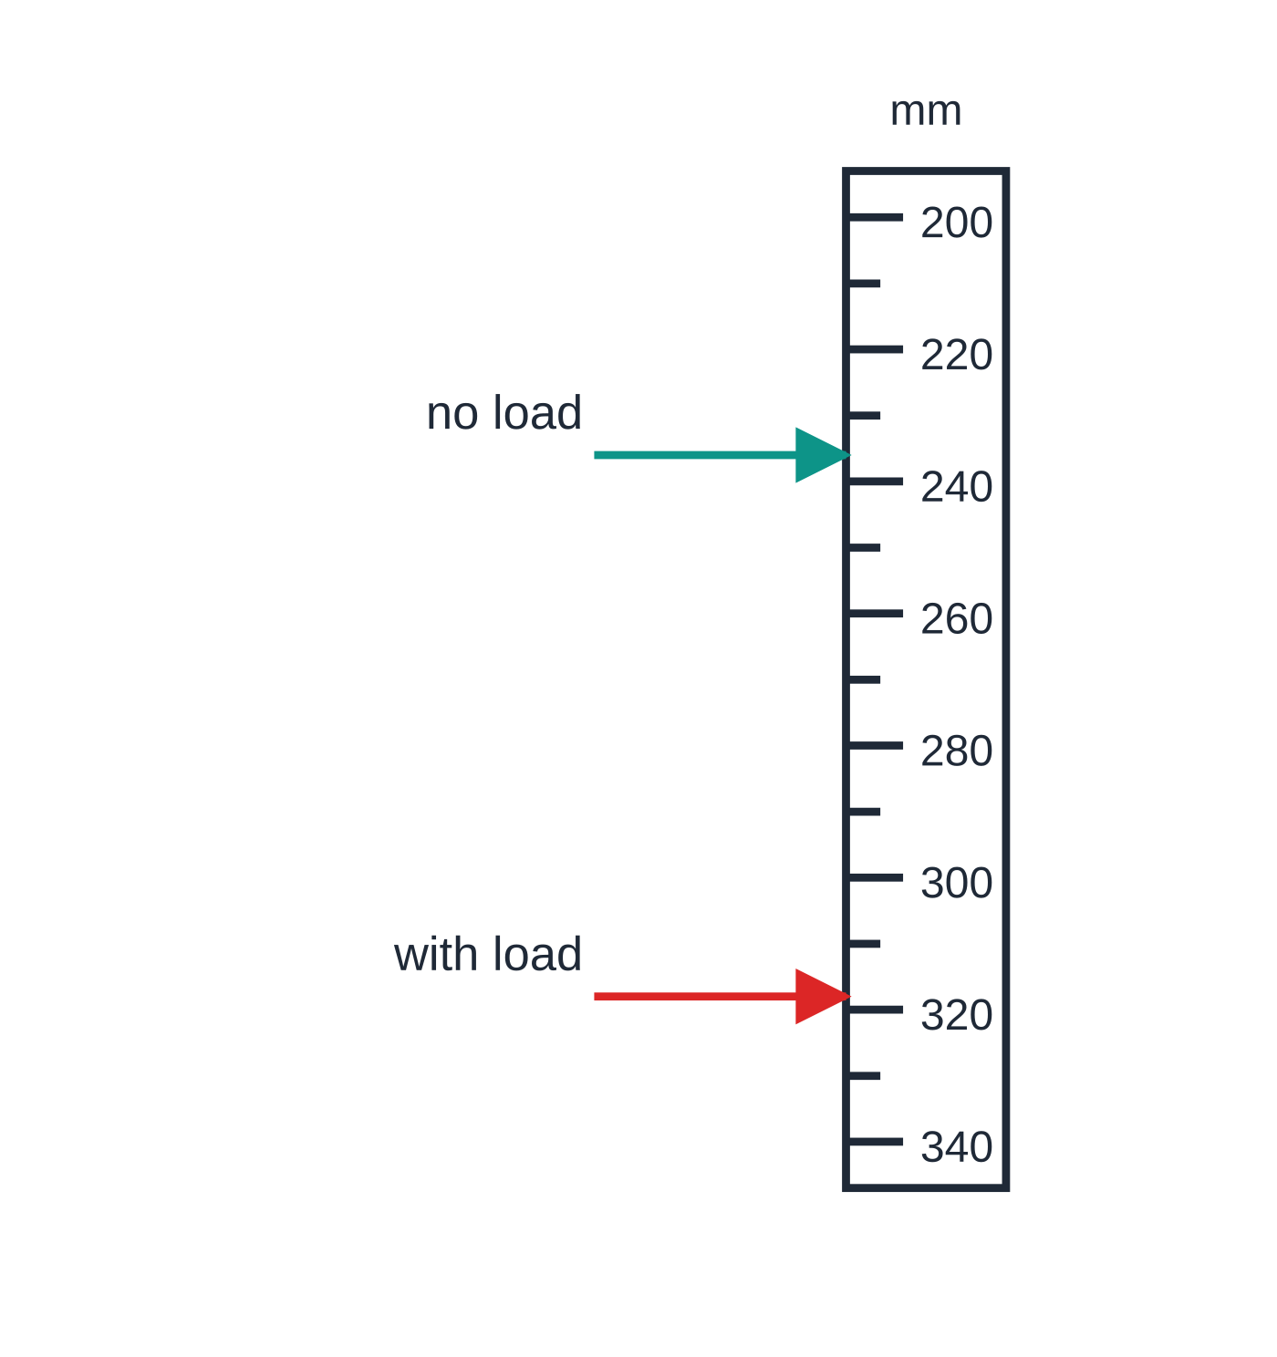
Question 1
4 marks
A pointer is fixed to the bottom of a spring hanging beside a vertical metre rule. Before a load is added the pointer is at 236 mm; with the load it is at 318 mm. Each reading has an uncertainty of ± 1 mm.
Figure: pointer positions against the vertical metre rule (readings 236 mm and 318 mm)
(a) Calculate the extension of the spring. [1]
(b) State the absolute uncertainty in the extension. [1]
(c) Calculate the percentage uncertainty in the extension. [1]
(d) Explain why this is much larger than the percentage uncertainty in the reading of 318 mm. [1]
Notes:
Online with the full mark scheme: https://examinerprep.com/ial-physics-6-2-uncertainties-and-logarithmic-graphs-a2-questions#IALP-U6-2-B-01

Slide 48
Question 2
4 marks
A trolley of mass 0.750 kg ± 0.005 kg passes through a light gate. Its speed is found to be 1.24 m s⁻¹ ± 0.03 m s⁻¹.
(a) Calculate the kinetic energy of the trolley. [1]
(b) Calculate the percentage uncertainty in the kinetic energy. [2]
(c) Write the kinetic energy with its absolute uncertainty. [1]
Notes:
Online with the full mark scheme: https://examinerprep.com/ial-physics-6-2-uncertainties-and-logarithmic-graphs-a2-questions#IALP-U6-2-B-02

Slide 49
Answers

Slide 50
Question 1 · answer
Mark scheme
318 − 236 = 82 mm
the absolute uncertainties add for a difference: 1 + 1 = ± 2 mm
2 ÷ 82 × 100 = 2.4%
the extension is a small difference between two larger readings: the uncertainty (doubled) is compared with 82 mm rather than 318 mm, which alone gives only 0.31%
Notes:
Full mark scheme: https://examinerprep.com/ial-physics-6-2-uncertainties-and-logarithmic-graphs-a2-questions#IALP-U6-2-B-01

Slide 51
Question 2 · answer
Mark scheme
½ × 0.750 × 1.24² = 0.577 J (0.5766 J)
mass: 0.005 ÷ 0.750 × 100 = 0.67%; speed: 0.03 ÷ 1.24 × 100 = 2.4%, doubled because v is squared
0.67 + 2 × 2.4 = 5.5%
5.5% of 0.577 J = 0.032 J, so (0.58 ± 0.03) J
Notes:
Full mark scheme: https://examinerprep.com/ial-physics-6-2-uncertainties-and-logarithmic-graphs-a2-questions#IALP-U6-2-B-02

Slide 52
Keep practising
Notes for this topic
Questions on this topic
Build a printable test
ExaminerPrep is an independent tutoring service. It has been developed independently from and is not endorsed by the International Baccalaureate Organization. "International Baccalaureate", "IB" and "IB Diploma Programme" are registered trademarks of the IBO, used here for descriptive purposes only.
Pearson Edexcel and Cambridge are trademarks of their owners; ExaminerPrep is not affiliated with any exam board.

