Slide 1
EP
EDEXCEL IAL PHYSICS
1.5 Work and energy
The full notes page in 12 sections · practice questions with answers · simulations
ExaminerPrep is an independent tutoring service. It has been developed independently from and is not endorsed by the International Baccalaureate Organization. "International Baccalaureate", "IB" and "IB Diploma Programme" are registered trademarks of the IBO, used here for descriptive purposes only.
Pearson Edexcel and Cambridge are trademarks of their owners; ExaminerPrep is not affiliated with any exam board.
Notes:
1.5 Work and energy. Notes for this topic: https://examinerprep.com/notes/edexcel-ial-physics/work-and-energy/

Slide 2
What this page covers
Overview
Work done by a force, and the joule
Work done by a force at an angle to the displacement
Work done from the area under a force–displacement graph
Kinetic energy, and braking distances from work done = change in kinetic energy
Changes in gravitational potential energy near the Earth's surface
The principle of conservation of energy, with and without resistive forces: ramps, roller coasters and pendulums
Using energy to find the speed of a projectile
Notes:
What this page covers. Full notes: https://examinerprep.com/notes/edexcel-ial-physics/work-and-energy/

Slide 3
In one minute
Key points
1. Energy gives a second way into mechanics: instead of following forces moment by moment, you compare energy stores at the start and the end, and this still works when the path curves.
2. Work done = force × distance moved in the direction of the force: ΔW = FΔs. Work done = energy transferred. Unit: joule, 1 J = 1 N m.
3. A force at angle θ to the displacement does work FΔscos θ. A force at 90° to the motion does no work. Work done = area under a force–displacement graph.
4. Eₖ = ½ mv²: double the speed, four times the kinetic energy — and four times the braking distance.
5. ΔE_grav = mgΔh, where Δh is the vertical height change. The path does not matter.
6. Energy is never created or destroyed. With resistive forces: loss of E_grav = gain in Eₖ + work done against resistive forces.
Notes:
In one minute. Full notes: https://examinerprep.com/notes/edexcel-ial-physics/work-and-energy/

Slide 4
What is work done?
Section 1 of 12
In physics "work" has a precise meaning: a force does work when its point of application moves in the direction of the force. Work is how energy is transferred mechanically, so counting work is counting energy.
Work done by a force:
the force multiplied by the distance moved in the direction of the force.
ΔW = FΔs
ΔW = work done (J) · F = force (N) · Δs = displacement in the direction of the force (m). Supplied in the formulae list. For a constant force acting along the line of motion; for a varying force, use the area under the force–displacement graph.
Work done = energy transferred. When a force does 500 J of work, 500 J of energy is transferred from one store to another.
Notes:
What is work done?. Full notes: https://examinerprep.com/notes/edexcel-ial-physics/work-and-energy/

Slide 5
What is work done? (continued)
Section 1 of 12
The joule: 1 J is the work done when a force of 1 N moves its point of application 1 m in the direction of the force, so 1 J = 1 N m = 1 kg m² s⁻².
Work is a scalar, even though force and displacement are vectors.
No displacement, no work: holding a heavy bag still, or pushing against a wall that does not move, does no work on the object.
Notes:
What is work done?. Full notes: https://examinerprep.com/notes/edexcel-ial-physics/work-and-energy/

Slide 6
What is work done? (continued)
Section 1 of 12 · Worked example 1 · Easy · Calculate
WORKED EXAMPLE · QUESTION
A cleaner pushes a floor-polishing machine 25 m along a straight corridor with a constant horizontal force of 64 N. Calculate the work done by the cleaner on the machine.
SOLUTION
The force acts along the direction of motion, so use ΔW = FΔs directly: ΔW = 64 ×25 = 1.6 × 10³ J (1600 J)
The weight of the machine acts vertically and the motion is horizontal, so the weight does no work here.
Notes:
What is work done?: Worked example 1. Full notes: https://examinerprep.com/notes/edexcel-ial-physics/work-and-energy/

Slide 7
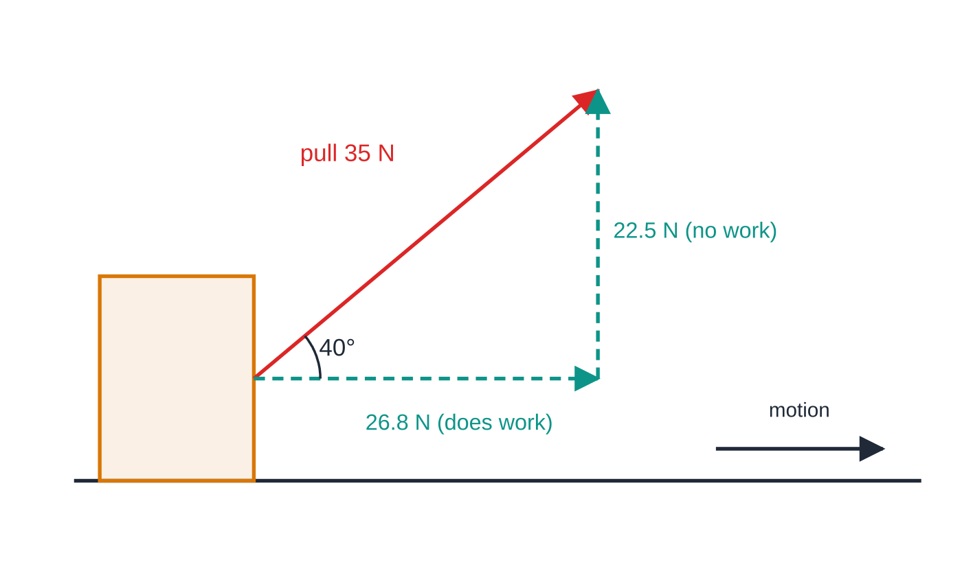
What if the force is at an angle to the motion?
Section 2 of 12
Only the component of the force along the displacement does work. For a force F at angle θ to the displacement, the component along the motion is Fcos θ, so
ΔW = Fcos θ×Δs
The perpendicular component Fsin θ does no work: there is no displacement in its direction.
Only the 26.8 N component along the floor does work as the suitcase moves. The 22.5 N component pulls upwards on the case, but the case does not move upwards, so it does no work. Force arrows are drawn to scale.
Notes:
What if the force is at an angle to the motion?. Full notes: https://examinerprep.com/notes/edexcel-ial-physics/work-and-energy/

Slide 8
What if the force is at an angle to the motion? (continued)
Section 2 of 12
Angle between force and displacement | Work done | Example
0° | FΔs (the most possible) | a horizontal push along a level floor
between 0° and 90° | FΔscos θ, positive | pulling a suitcase by its handle
90° | zero | weight and normal contact force on a body moving along level ground
180° | negative: the force removes energy from the body | friction and air resistance, braking forces
Notes:
What if the force is at an angle to the motion?. Full notes: https://examinerprep.com/notes/edexcel-ial-physics/work-and-energy/

Slide 9
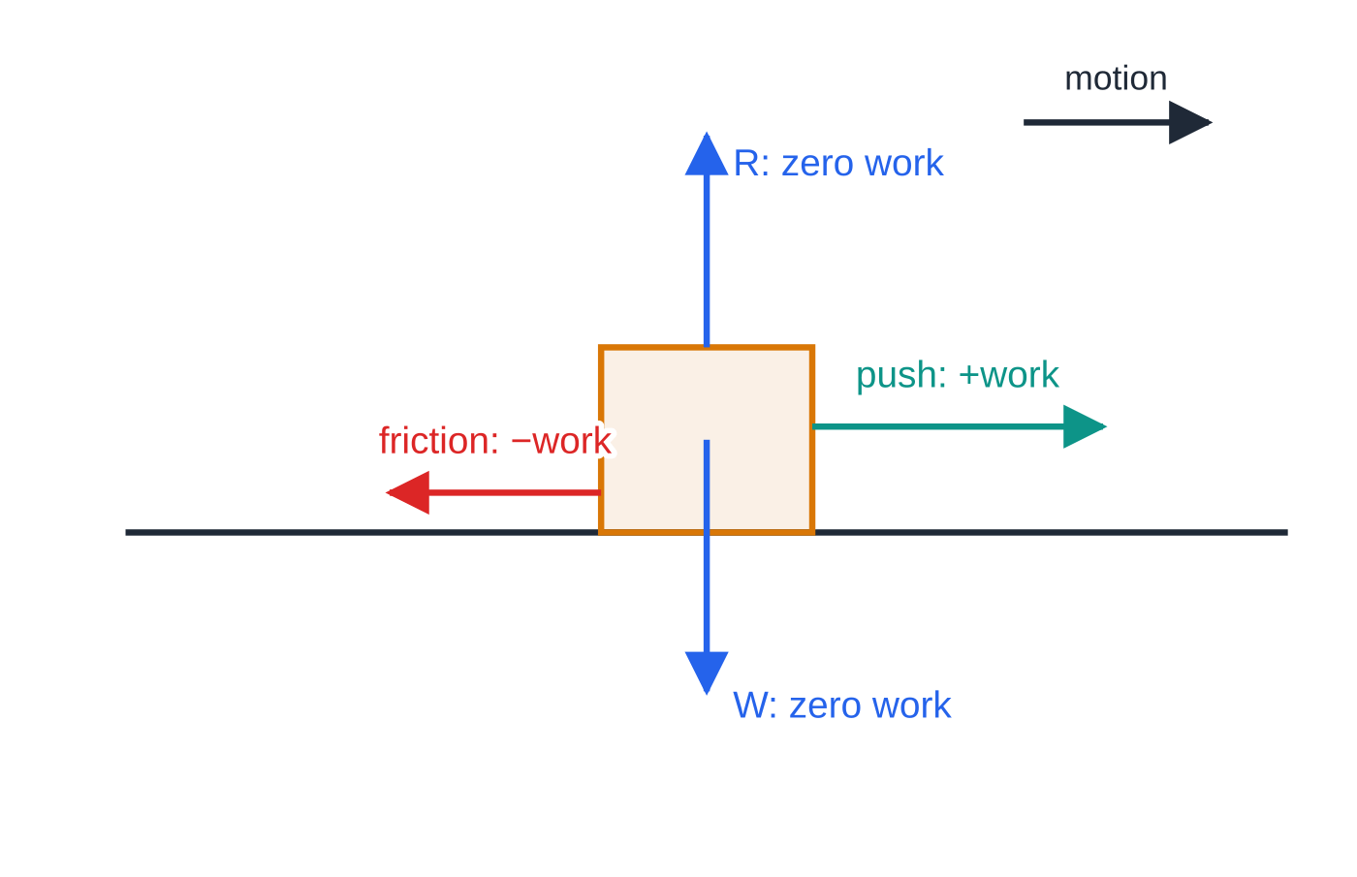
What if the force is at an angle to the motion? (continued)
Section 2 of 12
A box pushed along a level floor. The push (0°) does positive work, friction (180°) does negative work, and the weight and normal contact force (90°) do none.
Notes:
What if the force is at an angle to the motion?. Full notes: https://examinerprep.com/notes/edexcel-ial-physics/work-and-energy/

Slide 10
What if the force is at an angle to the motion? (continued)
Section 2 of 12 · Worked example 2 · Medium · Determine
WORKED EXAMPLE · QUESTION
A traveller pulls a wheeled suitcase 120 m along a level airport floor. The handle makes an angle of 40° with the horizontal and the pull along the handle is 35 N. The suitcase moves at constant velocity. (a) Calculate the work done by the pull. (b) State the work done on the suitcase by its weight. (c) Determine the work done against resistive forces.
SOLUTION
(a) Component of the pull along the displacement: Fcos θ= 35cos 40° = 26.8 N. Work done = 26.81 ×120 = 3217 J ≈ 3.2 × 10³ J
(b) The weight is perpendicular to the horizontal displacement: work done by the weight = 0
(c) Constant velocity, so the resultant horizontal force is zero and the resistive forces total 26.8 N backwards: work done against resistive forces = 3.2 × 10³ J — the same energy, transferred to the surroundings as thermal energy.
Notes:
What if the force is at an angle to the motion?: Worked example 2. Full notes: https://examinerprep.com/notes/edexcel-ial-physics/work-and-energy/

Slide 11
What if the force is at an angle to the motion? (continued)
Section 2 of 12
Common error
Using sin instead of cos, or multiplying the whole pull by the distance. Draw the angle between the force and the direction of motion; the component next to that angle (Fcos θ) is the one that does work.
Notes:
What if the force is at an angle to the motion?. Full notes: https://examinerprep.com/notes/edexcel-ial-physics/work-and-energy/

Slide 12
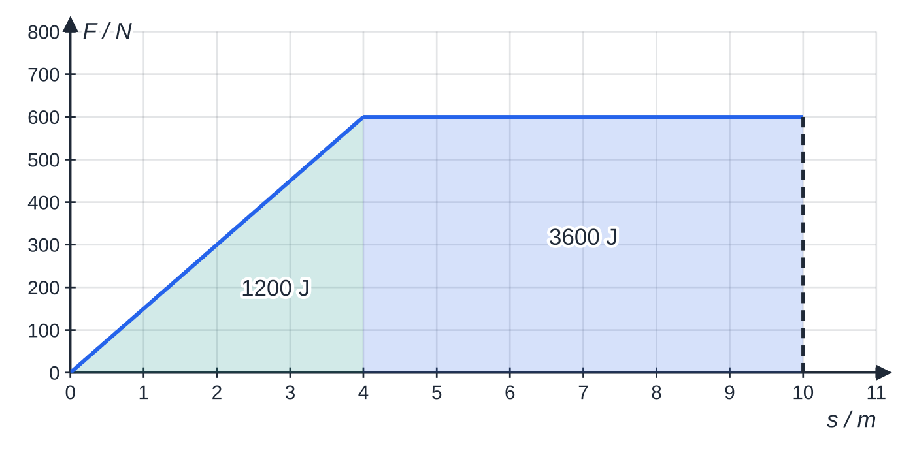
How do you find work from a force–displacement graph?
Section 3 of 12
For a constant force, ΔW = FΔs is the area of a rectangle under a horizontal line on a graph of F against s. The same is true for any force: work done = area under the force–displacement graph.
Straight-line sections: split the area into rectangles and triangles.
Curved graphs: count squares (or estimate with thin strips), and multiply by the work represented by one square.
The force plotted must be the component along the displacement.
Force exerted by a winch cable on a boat being hauled up a slipway. The force rises steadily as the cable tightens, then stays constant. Total area = 1200 J + 3600 J = 4800 J.
Notes:
How do you find work from a force–displacement graph?. Full notes: https://examinerprep.com/notes/edexcel-ial-physics/work-and-energy/

Slide 13
How do you find work from a force–displacement graph? (continued)
Section 3 of 12 · Worked example 3 · Easy · Determine
WORKED EXAMPLE · QUESTION
The graph above shows how the force of a winch cable on a small boat varies with the distance the boat moves up a slipway. The cable is parallel to the slipway. Determine the total work done by the cable over the first 10.0 m.
SOLUTION
Step 1 Triangle, 0 to 4.0 m: ½ ×4.0 ×600 = 1200 J
Step 2 Rectangle, 4.0 m to 10.0 m: 6.0 ×600 = 3600 J
Step 3 Add: ΔW = 1200 + 3600 = 4.8 × 10³ J. Check the units of the area: N × m = J.
Notes:
How do you find work from a force–displacement graph?: Worked example 3. Full notes: https://examinerprep.com/notes/edexcel-ial-physics/work-and-energy/

Slide 14
How do you find work from a force–displacement graph? (continued)
Section 3 of 12
Exam tip
Before you use an area, check the axis units. If the displacement is in cm or the force in kN, convert first — or convert the area at the end — or the answer will be out by a power of ten.
Notes:
How do you find work from a force–displacement graph?. Full notes: https://examinerprep.com/notes/edexcel-ial-physics/work-and-energy/

Slide 15
What is kinetic energy?
Section 4 of 12
Kinetic energy:
the energy a body has because of its motion.
Eₖ = ½ mv²
Eₖ = kinetic energy (J) · m = mass (kg) · v = speed (m s⁻¹). Supplied in the formulae list. Kinetic energy is a scalar and is never negative; the direction of motion does not matter.
Where does ½mv² come from?
Let a constant resultant force F accelerate a mass m from rest through a distance s. The work done is W = Fs = mas. From v² = u² + 2as with u = 0, as = ½ v². So W = ½ mv²: all the work done by the resultant force becomes kinetic energy. This is the work–energy idea: the work done by the resultant force on a body equals its change in kinetic energy.
Eₖ ∝v²: doubling the speed multiplies the kinetic energy by four.
Notes:
What is kinetic energy?. Full notes: https://examinerprep.com/notes/edexcel-ial-physics/work-and-energy/

Slide 16
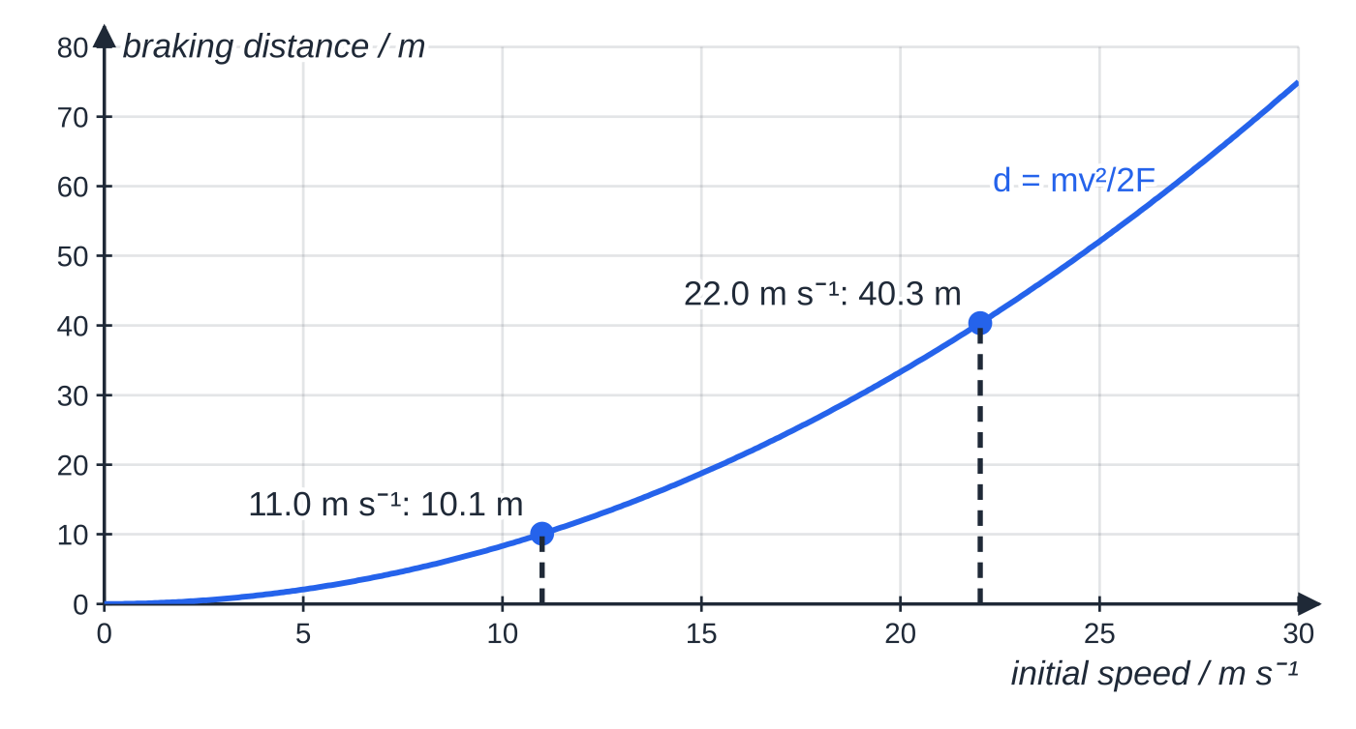
What is kinetic energy? (continued)
Section 4 of 12
Braking: a constant braking force F does negative work over the braking distance d until all the kinetic energy has gone: Fd = ½ mv², so d = mv²/2F — the braking distance is proportional to v².
Braking distance against initial speed for the car of worked example 4 (mass 1350 kg, constant braking force 8.10 kN). The curve is d = mv²/2F: doubling the speed from 11.0 to 22.0 m s⁻¹ quadruples the distance.
Notes:
What is kinetic energy?. Full notes: https://examinerprep.com/notes/edexcel-ial-physics/work-and-energy/

Slide 17
What is kinetic energy? (continued)
Section 4 of 12 · Worked example 4 · Medium · Deduce
WORKED EXAMPLE · QUESTION
A car of mass 1350 kg travels at 22.0 m s⁻¹ on a level road. The driver brakes and the car stops in a straight line. The braking force is constant at 8.10 kN. (a) Calculate the kinetic energy of the car before braking. (b) Calculate the braking distance. (c) Without further use of the formula for kinetic energy, deduce the braking distance from 11.0 m s⁻¹ with the same braking force.
SOLUTION
(a) Eₖ = ½ ×1350 ×22.0² = 3.27 × 10⁵ J
(b) Work done by the brakes = kinetic energy removed: Fd = Eₖ, so d = 3.267 ×10⁵ ÷8100 = 40.3 m
(c) Half the speed → one quarter of the kinetic energy → one quarter of the distance: d = 40.33 ÷4 = 10.1 m
Notes:
What is kinetic energy?: Worked example 4. Full notes: https://examinerprep.com/notes/edexcel-ial-physics/work-and-energy/

Slide 18
What is kinetic energy? (continued)
Section 4 of 12
Common error
Squaring the mass or forgetting to square the speed. Write ½ ×m ×v² with the numbers in that order, and square the speed before you multiply.
Notes:
What is kinetic energy?. Full notes: https://examinerprep.com/notes/edexcel-ial-physics/work-and-energy/

Slide 19
What is gravitational potential energy?
Section 5 of 12
Gravitational potential energy:
the energy a body has because of its position in a gravitational field.
ΔE_grav = mgΔh
m = mass (kg) · g = 9.81 N kg⁻¹ · Δh = change in vertical height (m). Supplied in the formulae list. Valid near the Earth's surface, where g is constant over the height change.
It comes from work done against the weight: lifting a body steadily through Δh needs a force mg over a distance Δh.
Only changes in E_grav matter; you may choose any convenient zero level (the ground, the bottom of the slope).
The path does not matter: up a ramp, up stairs or straight up, the gain is the same for the same Δh.
Notes:
What is gravitational potential energy?. Full notes: https://examinerprep.com/notes/edexcel-ial-physics/work-and-energy/

Slide 20
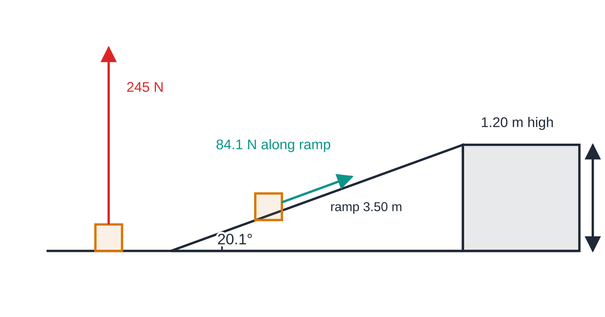
What is gravitational potential energy? (continued)
Section 5 of 12
Two routes to the same platform. The ramp (20.1° to the horizontal) needs a smaller force, 84.1 N instead of 245 N, applied over a longer distance — the work done is the same 294 J.
Notes:
What is gravitational potential energy?. Full notes: https://examinerprep.com/notes/edexcel-ial-physics/work-and-energy/

Slide 21
What is gravitational potential energy? (continued)
Section 5 of 12 · Worked example 5 · Easy · Calculate
WORKED EXAMPLE · QUESTION
A crate of mass 25 kg is moved onto a platform 1.20 m high, either by lifting it straight up or by pushing it up a ramp 3.50 m long. Resistive forces are negligible. (a) Calculate the gain in gravitational potential energy of the crate. (b) Calculate the smallest force, parallel to the ramp, that will push the crate up the ramp.
SOLUTION
(a) Use the vertical height only: ΔE_grav = 25 ×9.81 ×1.20 = 294 J
(b) Work done along the ramp = gain in E_grav: F ×3.50 = 294.3, so F = 84.1 N
Lifting straight up needs at least mg = 245 N. The ramp reduces the force, not the energy.
Notes:
What is gravitational potential energy?: Worked example 5. Full notes: https://examinerprep.com/notes/edexcel-ial-physics/work-and-energy/

Slide 22
What is gravitational potential energy? (continued)
Section 5 of 12
Common error
Using the length along a slope as Δh. In mgΔh the height is always vertical: for a slope of length L at angle θ to the horizontal, Δh = Lsin θ.
Notes:
What is gravitational potential energy?. Full notes: https://examinerprep.com/notes/edexcel-ial-physics/work-and-energy/

Slide 23
How do you use the principle of conservation of energy?
Section 6 of 12
Principle of conservation of energy: energy cannot be created or destroyed; it can only be transferred from one store to another, so the total energy of a closed system stays constant.
No resistive forces
Loss of gravitational potential energy = gain in kinetic energy: mgΔh = ½ mv² - ½ mu². The mass cancels, giving v² = u² + 2gΔh, whatever the shape of the path.
With resistive forces
Friction and air resistance do negative work on the body. The energy is not destroyed — it is transferred to the surroundings, mostly as thermal energy (and some sound).
loss of E_grav = gain in Eₖ + work done against resistive forces
work done against resistive forces = average resistive force × distance moved along the path
Notes:
How do you use the principle of conservation of energy?. Full notes: https://examinerprep.com/notes/edexcel-ial-physics/work-and-energy/

Slide 24
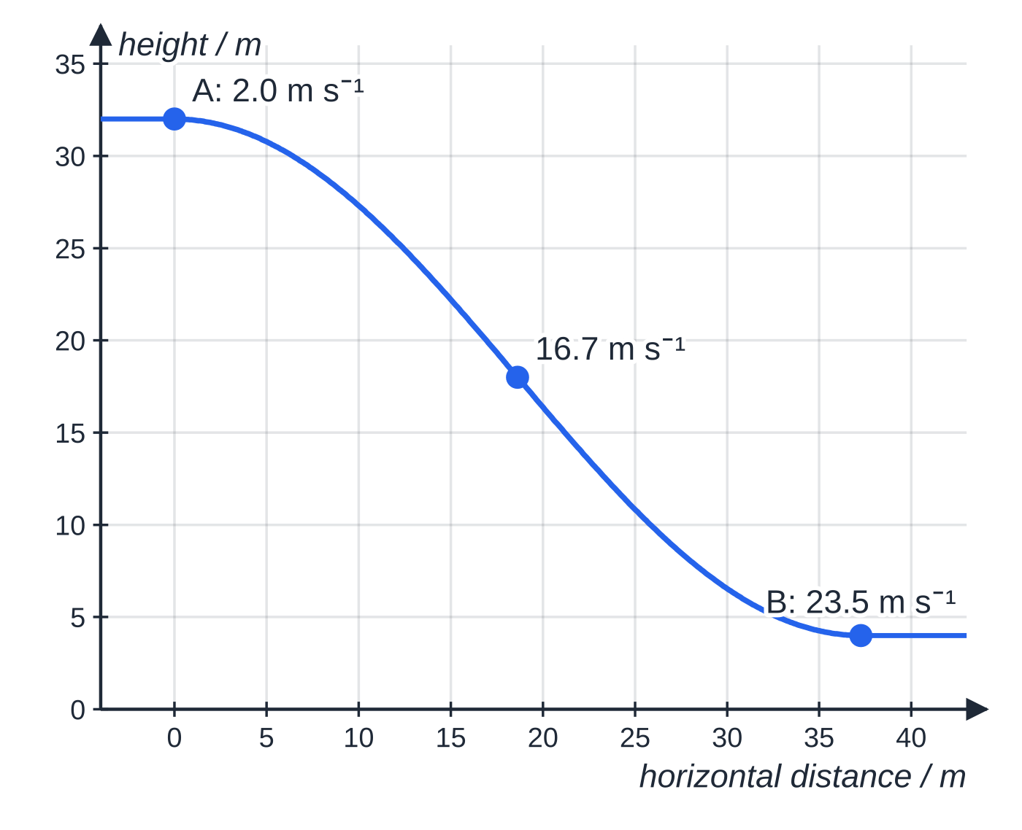
How do you use the principle of conservation of energy? (continued)
Section 6 of 12
This balance is not in the formulae list — derive it from the three equations that are.
A reliable method
1. Mark the start and end points and choose the zero of height.
2. Write the energy balance in words first ("loss of GPE = gain in KE + energy transferred to the surroundings").
3. Substitute the stores at the start and the end; solve for the unknown.
Side profile of a roller coaster, drawn to scale. The speeds shown assume no resistive forces: v² = 2.0² + 2 × 9.81 × (32.0 − h). The track from A to B, measured along this profile, is 48 m long.
Notes:
How do you use the principle of conservation of energy?. Full notes: https://examinerprep.com/notes/edexcel-ial-physics/work-and-energy/

Slide 25
How do you use the principle of conservation of energy? (continued)
Section 6 of 12 · Worked example 6 · Hard · Calculate
WORKED EXAMPLE · QUESTION
A roller-coaster car and its riders have a total mass of 650 kg. The car passes point A, 32.0 m above the ground, at 2.0 m s⁻¹, then runs down to point B, 4.0 m above the ground. The track from A to B is 48 m long. (a) Calculate the speed at B if resistive forces are negligible. (b) The speed measured at B is 22.0 m s⁻¹. Calculate the energy transferred to the surroundings between A and B, and the average resistive force.
SOLUTION
(a) Loss of GPE = gain in KE; the mass cancels: v² = 2.0² + 2 ×9.81 ×(32.0 - 4.0) = 553.4, so v = 23.5 m s⁻¹
(b) Loss of GPE from A to B: 650 ×9.81 ×28.0 = 178 542 J. Gain in KE: ½ ×650 ×(22.0² - 2.0²) = 156 000 J. The difference has gone to the surroundings: 178 542 - 156 000 = 22 542 J ≈ 2.25 × 10⁴ J
Work done against resistive forces = average force × distance along the track: F = 22 542 ÷48 = 469.6 N ≈ 470 N
Notes:
How do you use the principle of conservation of energy?: Worked example 6. Full notes: https://examinerprep.com/notes/edexcel-ial-physics/work-and-energy/

Slide 26
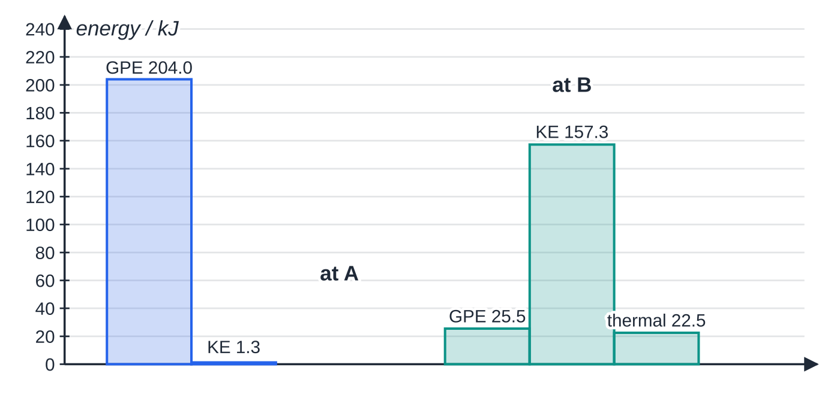
How do you use the principle of conservation of energy? (continued)
Section 6 of 12
Pendulums
A pendulum bob swings on an arc; the string pulls at 90° to the motion, so the tension does no work.
Only the vertical drop matters: released at angle θ on a string of length L, the bob falls h = L(1 - cos θ) to its lowest point.
At the lowest point Eₖ is greatest; at the ends of the swing Eₖ = 0 and E_grav is greatest.
Energy stores of the roller-coaster car (ground as zero of GPE). At A: 204.0 + 1.3 = 205.3 kJ. At B: 25.5 + 157.3 + 22.5 = 205.3 kJ. The total is conserved; 22.5 kJ has been transferred to the surroundings.
Notes:
How do you use the principle of conservation of energy?. Full notes: https://examinerprep.com/notes/edexcel-ial-physics/work-and-energy/

Slide 27
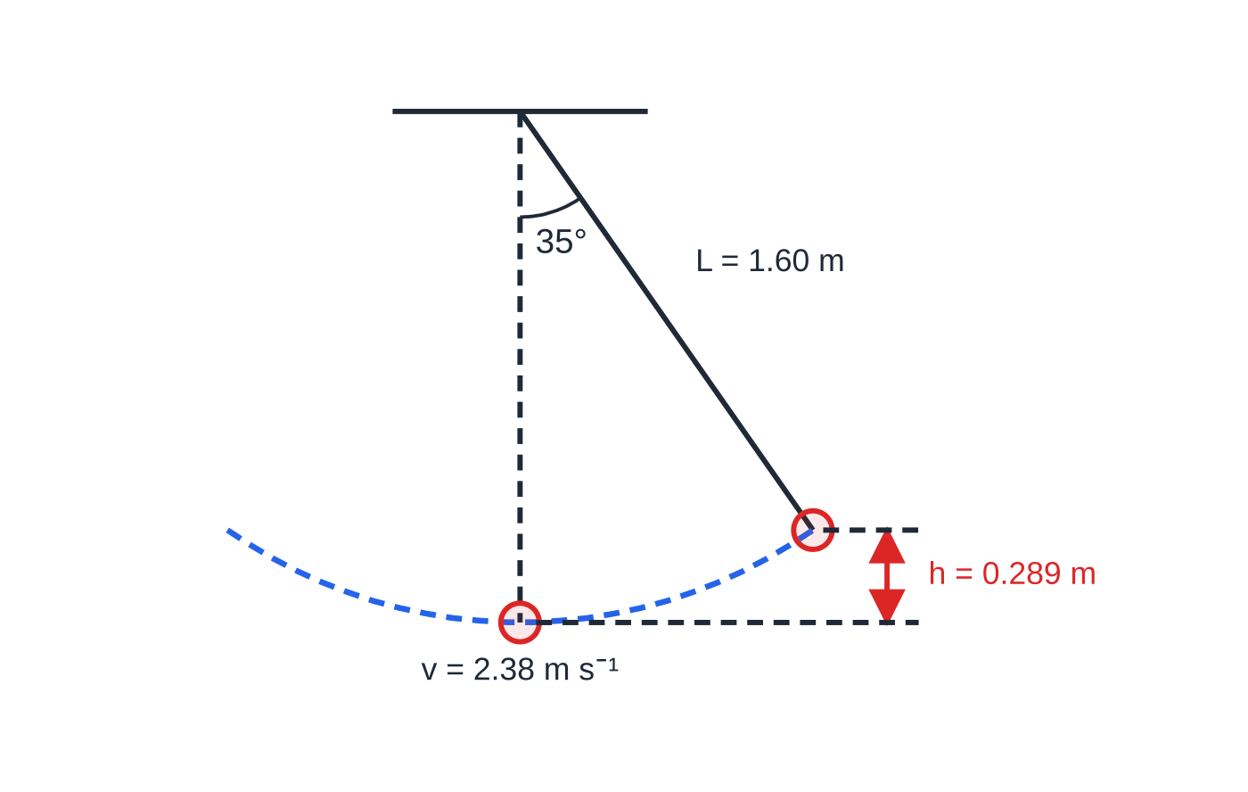
How do you use the principle of conservation of energy? (continued)
Section 6 of 12
In a real pendulum the swings die away as energy is transferred to the surroundings by air resistance.
A 1.60 m pendulum released from 35°, drawn to scale. It falls 1.60(1 − cos 35°) = 0.289 m, so at the lowest point v = √(2 × 9.81 × 0.2894) = 2.38 m s⁻¹, whatever the mass of the bob.
Notes:
How do you use the principle of conservation of energy?. Full notes: https://examinerprep.com/notes/edexcel-ial-physics/work-and-energy/

Slide 28
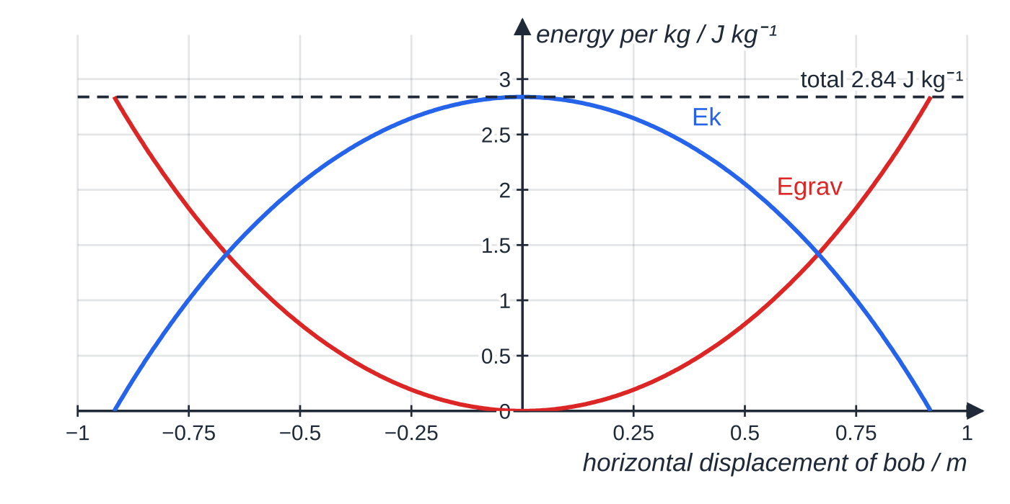
How do you use the principle of conservation of energy? (continued)
Section 6 of 12
Exam tip
For a speed with no resistive forces you do not need the mass — it cancels. For the energy transferred to the surroundings, or a resistive force, you do. If a question gives you a mass, check which kind of question it is.
Energy of the same pendulum (per kilogram of bob) across one swing, with no air resistance. Egrav and Ek trade places, and their sum stays at 9.81 × 0.289 = 2.84 J kg⁻¹.
Notes:
How do you use the principle of conservation of energy?. Full notes: https://examinerprep.com/notes/edexcel-ial-physics/work-and-energy/

Slide 29
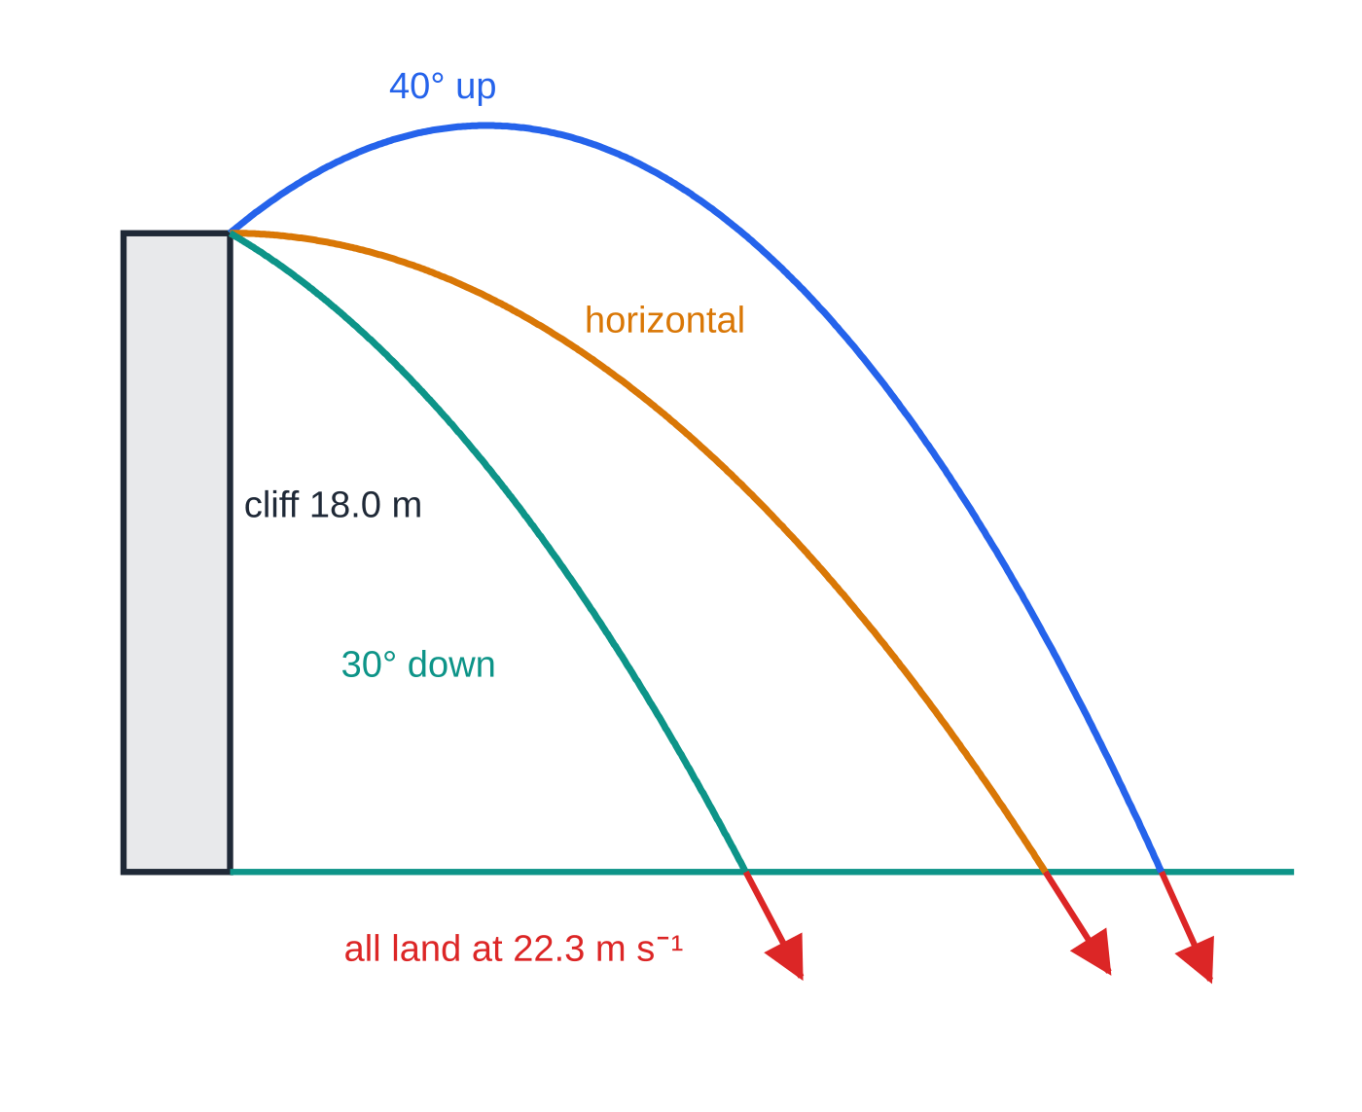
How does energy give the speed of a projectile?
Section 7 of 12
With no air resistance, a projectile's speed at any height follows from energy alone: v² = u² + 2gΔh, where Δh is the vertical drop. The launch angle does not matter for the speed: kinetic energy is a scalar and the loss of E_grav depends only on the drop. Energy gives the speed but not the direction or the time. For those, use the component method from 1.1.
Three stones thrown at 12.0 m s⁻¹ from an 18.0 m cliff at different angles, paths computed and drawn to scale. They land at different places and times, but the red arrows (drawn to scale) show the same landing speed, 22.3 m s⁻¹, in different directions.
Notes:
How does energy give the speed of a projectile?. Full notes: https://examinerprep.com/notes/edexcel-ial-physics/work-and-energy/

Slide 30
How does energy give the speed of a projectile? (continued)
Section 7 of 12 · Worked example 7 · Medium · Show that
WORKED EXAMPLE · QUESTION
A stone is thrown from the top of a cliff 18.0 m above the sea with a speed of 12.0 m s⁻¹. Air resistance is negligible. (a) Calculate the speed at which the stone hits the sea. (b) Show that a launch at 40° above the horizontal gives the same answer using velocity components.
SOLUTION
(a) Loss of GPE = gain in KE: v² = 12.0² + 2 ×9.81 ×18.0 = 144 + 353.2 = 497.2, so v = 22.3 m s⁻¹
(b) Components at launch: u_H = 12.0cos 40° = 9.19 m s⁻¹, u_V = 12.0sin 40° = 7.71 m s⁻¹. Vertical speed at the sea (18.0 m below), horizontal speed unchanged: v_V² = 7.71² + 2 ×9.81 ×18.0, so v_V = 20.3 m s⁻¹. Then v = √(9.19² + 20.31²) = 22.30 m s⁻¹ — the same speed
Notes:
How does energy give the speed of a projectile?: Worked example 7. Full notes: https://examinerprep.com/notes/edexcel-ial-physics/work-and-energy/

Slide 31
Exam tips for 1.5
Section 8 of 12
Exam tip 1 — use the component along the motion
For work done, sketch the force and the displacement and mark the angle between them. Work done = (component of force along the displacement) × displacement. Forces at 90° to the motion, such as the normal contact force on level ground, contribute nothing.
Exam tip 2 — vertical height only
In mgΔh, Δh is the vertical change in height. For a slope, Δh = Lsin θ; for a pendulum, Δh = L(1 - cos θ). The distance along the path goes into the work done against resistive forces instead.
Exam tip 3 — write the energy balance in words first
"Loss of GPE = gain in KE + work done against friction" makes clear which store is which, and means a slip in one term need not cost the method. Then substitute.
Notes:
Exam tips for 1.5. Full notes: https://examinerprep.com/notes/edexcel-ial-physics/work-and-energy/

Slide 32
Exam tips for 1.5 (continued)
Section 8 of 12
Exam tip 4 — SI units before you substitute
Masses in kg (not g), speeds in m s⁻¹ (convert km h⁻¹ by dividing by 3.6), forces in N (not kN). Kinetic energy depends on v², so a unit slip in the speed is squared too.
Exam tip 5 — "show that" and "explain"
In a "show that", give your result to one more significant figure than the value quoted. In an "explain" about energy, name the stores and the transfer: "gravitational potential energy is transferred to kinetic energy, and some is transferred to the surroundings as thermal energy by work done against air resistance".
Notes:
Exam tips for 1.5. Full notes: https://examinerprep.com/notes/edexcel-ial-physics/work-and-energy/

Slide 33
Common misconceptions
Section 9 of 12
Misconception | Why it is wrong | Correct idea
Every force on a moving body does work on it. | A force at 90° to the displacement has no component along it. | Only the component along the displacement does work: ΔW = FΔscos θ.
Holding a heavy box still is hard work, so work is done on the box. | The box does not move, so Δs = 0. | No work is done on the box; the energy your muscles use stays in your body as thermal energy.
Doubling the speed doubles the kinetic energy. | Eₖ depends on v². | Double the speed gives four times the kinetic energy and four times the braking distance.
A longer, gentler ramp gives the load more potential energy. | ΔE_grav depends only on the vertical height change. | Same Δh, same ΔE_grav; the ramp only reduces the force needed.
Friction destroys energy. | Energy is conserved. | Friction transfers energy to the surroundings, mostly as thermal energy.
Notes:
Common misconceptions. Full notes: https://examinerprep.com/notes/edexcel-ial-physics/work-and-energy/

Slide 34
Common misconceptions (continued)
Section 9 of 12
Misconception | Why it is wrong | Correct idea
A heavier object reaches the bottom of a smooth slope faster. | Both mgΔh and ½ mv² are proportional to m. | With no resistive forces the mass cancels: v = √(2gΔh) from rest.
Notes:
Common misconceptions. Full notes: https://examinerprep.com/notes/edexcel-ial-physics/work-and-energy/

Slide 35
How this topic connects
Section 10 of 12
1 Motion, vectors and projectiles
v² = u² + 2as multiplied by ½ m is the work–energy statement: Fs = ½ mv² - ½ mu². Energy gives a projectile's speed; components give its direction and time.
Power and efficiency (next page) and Materials (Unit 1)
Power is the rate of doing work, and efficiency compares the useful work done with the total energy supplied — both build directly on the work done calculated here. The area under a force–extension graph is the work done in stretching a material — the same "area under force against distance" idea.
Momentum and collisions (1.3 and Unit 4)
Momentum is conserved in every collision, but kinetic energy is conserved only in an elastic one; in the others some is transferred to the surroundings.
Notes:
How this topic connects. Full notes: https://examinerprep.com/notes/edexcel-ial-physics/work-and-energy/

Slide 36
Key equations
Section 11 of 12
Equation | Use | In the formulae list?
ΔW = FΔs | work done by a force along the displacement | Yes
ΔW = FΔscos θ | force at angle θ to the displacement | No — learn it (resolve the force)
work done = area under F–s graph | varying force | No — learn it
Eₖ = ½ mv² | kinetic energy | Yes
ΔE_grav = mgΔh | change in gravitational potential energy near the Earth's surface | Yes
v² = u² + 2gΔh | speed after a vertical drop Δh, no resistive forces, any path | No — derive it from mgΔh = Δ(½ mv²)
mgΔh = ΔEₖ + Fᵣd | energy balance with an average resistive force Fᵣ over a path length d | No — derive it
Notes:
Key equations. Full notes: https://examinerprep.com/notes/edexcel-ial-physics/work-and-energy/

Slide 37
Key equations (continued)
Section 11 of 12
Equation | Use | In the formulae list?
h = L(1 - cos θ) | vertical drop of a pendulum bob | No — derive it (trigonometry)
Notes:
Key equations. Full notes: https://examinerprep.com/notes/edexcel-ial-physics/work-and-energy/

Slide 38
Check your understanding
Section 12 of 12
1. Define work done and give its SI unit in base units.
2. A 2.0 kg bag of shopping is lifted 1.5 m onto a table. Calculate its gain in gravitational potential energy.
3. Calculate the kinetic energy of a 0.16 kg cricket ball moving at 30 m s⁻¹.
4. A waiter carries a tray across a level room at constant speed and constant height. How much work does the waiter's upward force do on the tray?
5. A 12 kg sledge slides from rest down a snowy slope with a vertical drop of 6.0 m and reaches 9.0 m s⁻¹. How much energy is transferred to the surroundings?
Notes:
Check your understanding: questions. Full notes: https://examinerprep.com/notes/edexcel-ial-physics/work-and-energy/

Slide 39
Check your understanding · answers
Section 12 of 12
1. Work done is the force multiplied by the distance moved in the direction of the force. Unit: J = N m = kg m² s⁻².
2. ΔE_grav = 2.0 ×9.81 ×1.5 = 29 J.
3. Eₖ = ½ ×0.16 ×30² = 72 J.
4. None. The upward force is at 90° to the horizontal displacement, so it has no component along the motion.
5. Loss of GPE = 12 ×9.81 ×6.0 = 706 J; gain in KE = ½ ×12 ×9.0² = 486 J; energy transferred = 706 - 486 = 220 J.
Notes:
Check your understanding: answers. Full notes: https://examinerprep.com/notes/edexcel-ial-physics/work-and-energy/

Slide 40
Practice questions
5 original exam-style questions. Answers at the end of the deck.

Slide 41
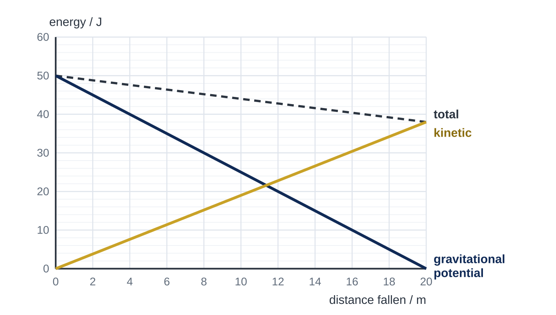
Question 1
1 mark
A pine cone falls from rest from a branch 20 m above the ground. The graph shows how its gravitational potential energy, its kinetic energy and its total energy change with the distance it has fallen.
How much work is done against air resistance during the whole fall?
A 12 J
B 38 J
C 50 J
D 88 J
Notes:
Online with the full mark scheme: https://examinerprep.com/ial-physics-1-5-work-and-energy-questions#IALP-U1-5-FA-05

Slide 42
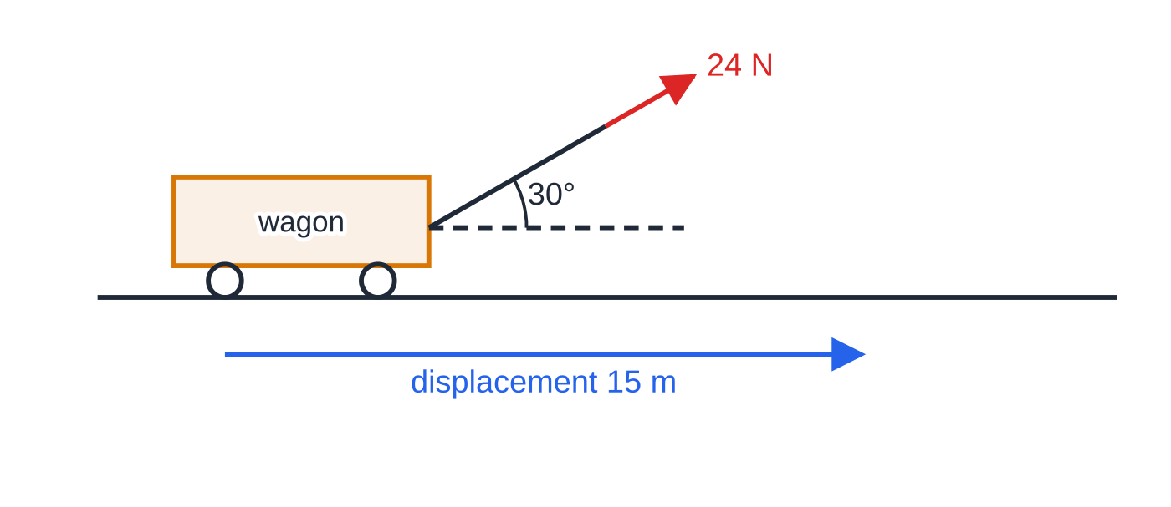
Question 2
1 mark
A child pulls a toy wagon 15 m along level ground. The handle makes an angle of 30° with the horizontal and the pull along the handle is 24 N.
How much work does the pull do on the wagon?
Figure: the pull on the wagon handle at 30° to the horizontal (not to scale)
A 180 J
B 310 J
C 360 J
D 420 J
Notes:
Online with the full mark scheme: https://examinerprep.com/ial-physics-1-5-work-and-energy-questions#IALP-U1-5-A-02

Slide 43
Question 3
1 mark
A sprinter of mass 68 kg runs at 9.5 m s⁻¹.
What is her kinetic energy?
A 0.32 kJ
B 0.65 kJ
C 3.1 kJ
D 6.1 kJ
Notes:
Online with the full mark scheme: https://examinerprep.com/ial-physics-1-5-work-and-energy-questions#IALP-U1-5-A-03

Slide 44
Question 4
4 marks
A hospital porter pushes a patient's bed 35 m along a level corridor. The porter's push is horizontal and constant at 140 N, and the bed moves at constant velocity.
(a) Calculate the work done by the porter on the bed. [2]
(b) Explain why the weight of the bed does no work on it. [1]
(c) State the work done against resistive forces. Give a reason for your answer. [1]
Notes:
Online with the full mark scheme: https://examinerprep.com/ial-physics-1-5-work-and-energy-questions#IALP-U1-5-B-01

Slide 45
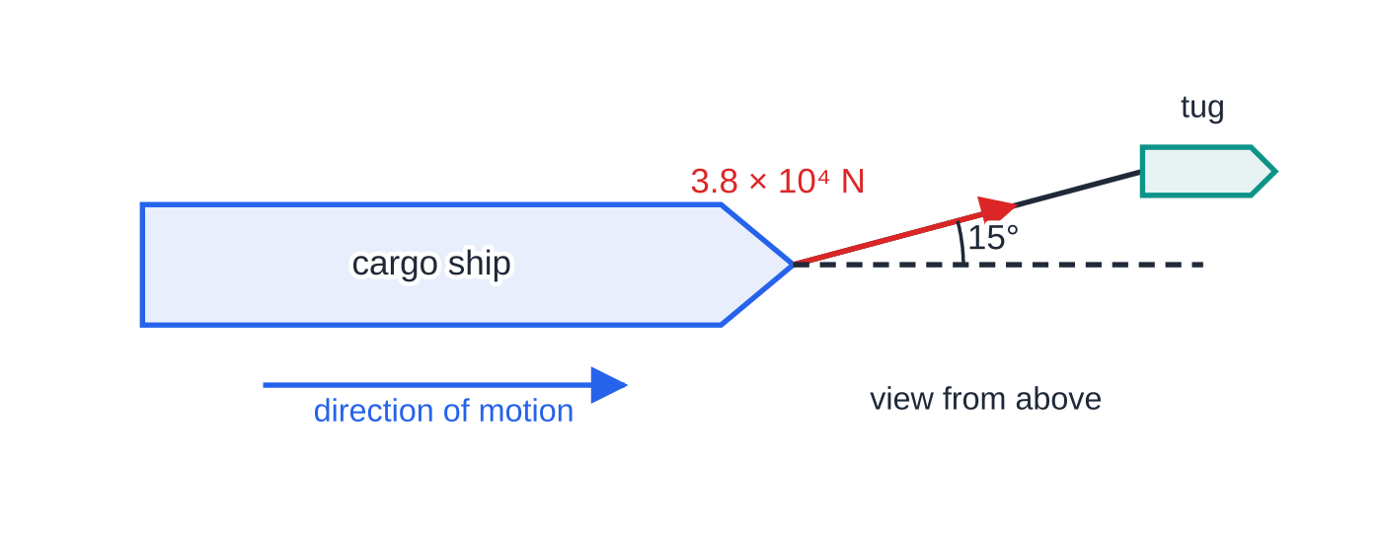
Question 5
5 marks
A tug tows a cargo ship 250 m into a harbour at constant velocity. The towing cable makes an angle of 15° with the ship's direction of motion. The tension in the cable is 3.8 × 10⁴ N.
Figure: the tug tows the ship with the cable at 15° to the direction of motion (not to scale)
(a) Calculate the component of the tension along the ship's direction of motion. [1]
(b) Calculate the work done by the tension as the ship moves 250 m. [2]
(c) State the total work done on the ship by all the forces acting on it. Explain your answer. [2]
Notes:
Online with the full mark scheme: https://examinerprep.com/ial-physics-1-5-work-and-energy-questions#IALP-U1-5-B-02

Slide 46
Answers

Slide 47
Question 1 · answer
Answer A
At the start the total energy is 50 J (all gravitational potential). At the ground it is 38 J (all kinetic). The energy transferred by work against air resistance is 50 − 38 = 12 J, the fall in the total-energy line.
Notes:
Full mark scheme: https://examinerprep.com/ial-physics-1-5-work-and-energy-questions#IALP-U1-5-FA-05

Slide 48
Question 2 · answer
Answer B
Only the component along the displacement does work: 24 cos 30° × 15 = 310 J (312 J).
Notes:
Full mark scheme: https://examinerprep.com/ial-physics-1-5-work-and-energy-questions#IALP-U1-5-A-02

Slide 49
Question 3 · answer
Answer C
Eₖ = ½mv² = ½ × 68 × 9.5² = 3070 J = 3.1 kJ.
Notes:
Full mark scheme: https://examinerprep.com/ial-physics-1-5-work-and-energy-questions#IALP-U1-5-A-03

Slide 50
Question 4 · answer
Mark scheme
ΔW = FΔs = 140 × 35
= 4.9 × 10³ J (4900 J)
the weight acts vertically and the bed moves horizontally / there is no displacement in the direction of the weight
4.9 × 10³ J, because the velocity is constant so the kinetic energy does not change / the resistive force equals the push
Notes:
Full mark scheme: https://examinerprep.com/ial-physics-1-5-work-and-energy-questions#IALP-U1-5-B-01

Slide 51
Question 5 · answer
Mark scheme
3.8 × 10⁴ × cos 15° = 3.7 × 10⁴ N (3.67 × 10⁴ N)
ΔW = 3.67 × 10⁴ × 250
= 9.2 × 10⁶ J — allow error carried forward from (a)
zero
the velocity is constant, so the kinetic energy does not change / the resultant force is zero
Notes:
Full mark scheme: https://examinerprep.com/ial-physics-1-5-work-and-energy-questions#IALP-U1-5-B-02

Slide 52
Keep practising
Notes for this topic
Questions on this topic
Build a printable test
ExaminerPrep is an independent tutoring service. It has been developed independently from and is not endorsed by the International Baccalaureate Organization. "International Baccalaureate", "IB" and "IB Diploma Programme" are registered trademarks of the IBO, used here for descriptive purposes only.
Pearson Edexcel and Cambridge are trademarks of their owners; ExaminerPrep is not affiliated with any exam board.

